Slide 1
25th COSMO General Meeting
11-15 September 2023
Opening
Panagiotis Skrimizeas
Chairman of COSMO Steering Committee (STC)
Notes:
Good morning, everyone.
Dear Prof. Mietus,
Thank you for your warm welcome and we are grateful for your hospitality

Slide 2
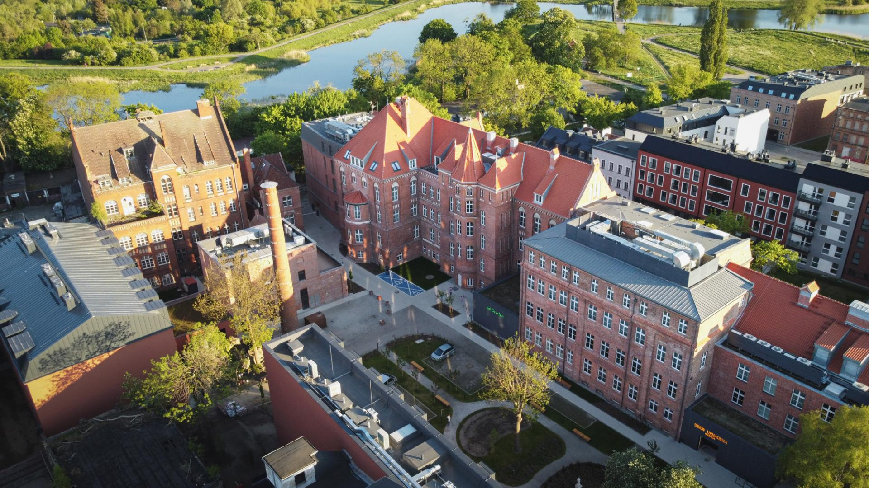
25th COSMO General Meeting
11-15 September 2023, Gdansk
Notes:
Dear colleagues,
Welcome to the inaugural session of the 25th COSMO General Meeting. On behalf of the STC, it is a great honour for us to be with you today. Over these days, we will delve with you into the exciting world of the latest developments in numerical weather prediction.
Weather affects our lives in countless ways, from daily routines to major economic decisions and disaster preparedness. Understanding and predicting the weather accurately is a scientific endeavor and a critical service to society. It is a domain where science, technology and policy making come together to make our world safer.

Slide 3
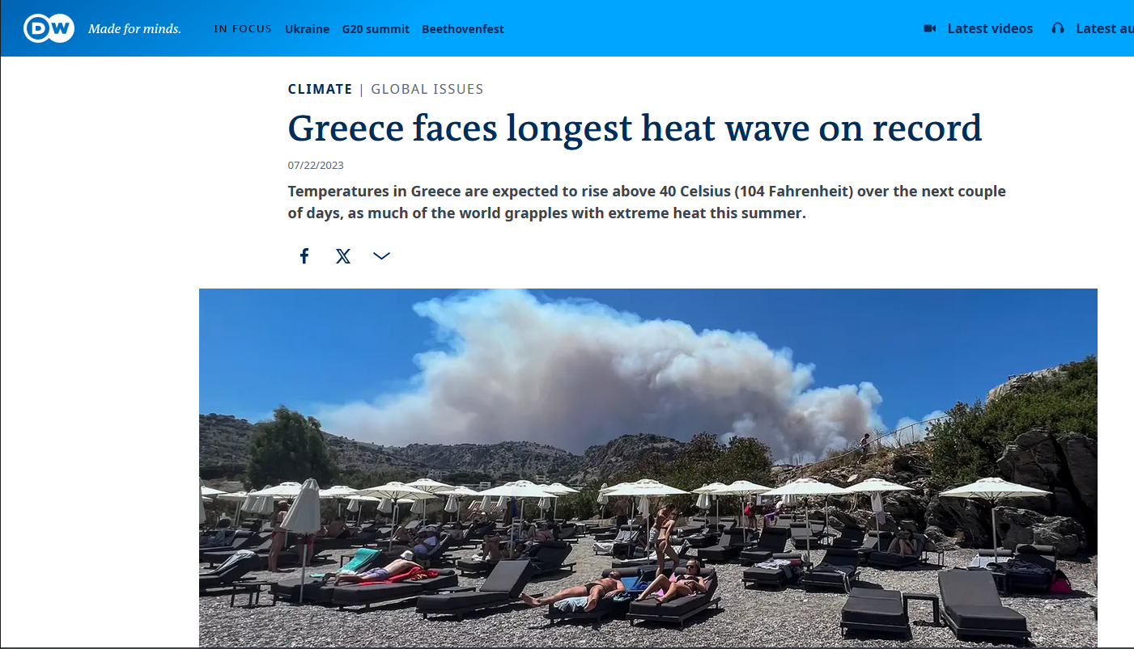
Notes:
This summer, Greece experienced particularly extreme events. Long lasting high temperatures;

Slide 4
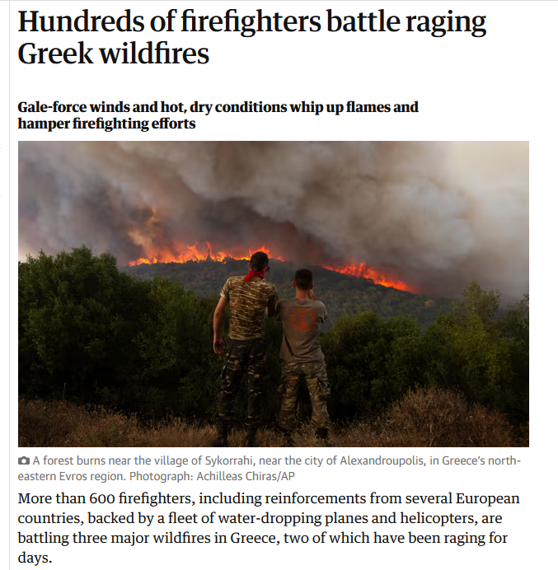
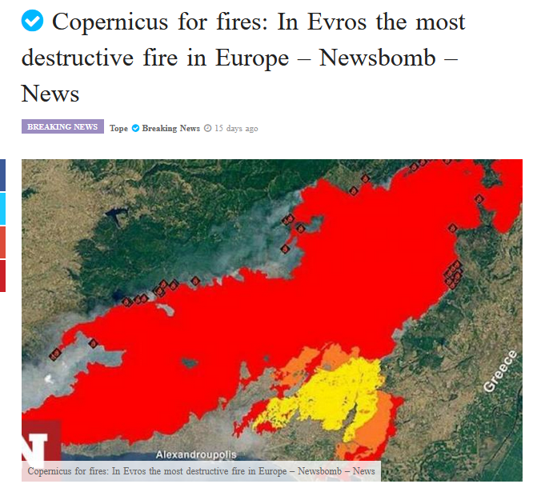
Notes:
Devastating fires in the island of Rhodes, in Attica region close to Athens, and especially in Evros. In Evros, the mega fire caused the total destruction of the Dadia forest and national park.

Slide 5
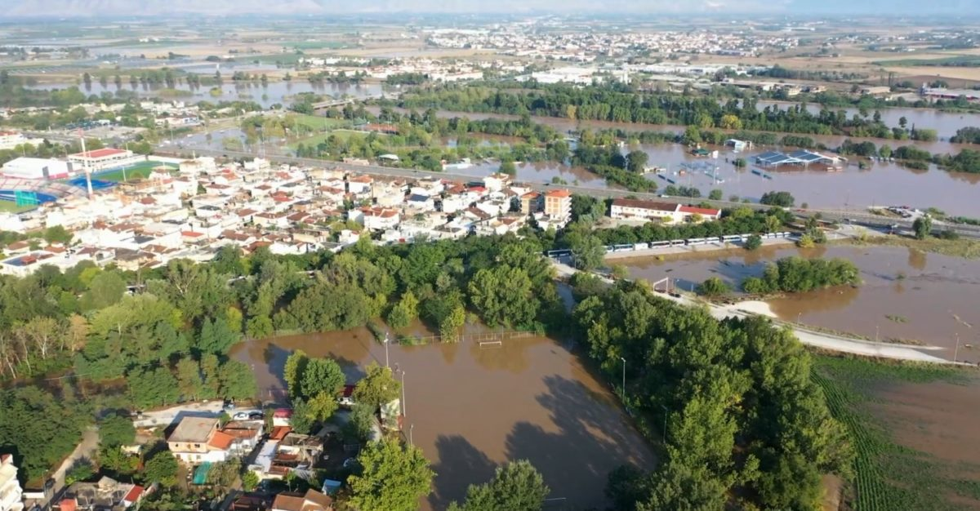
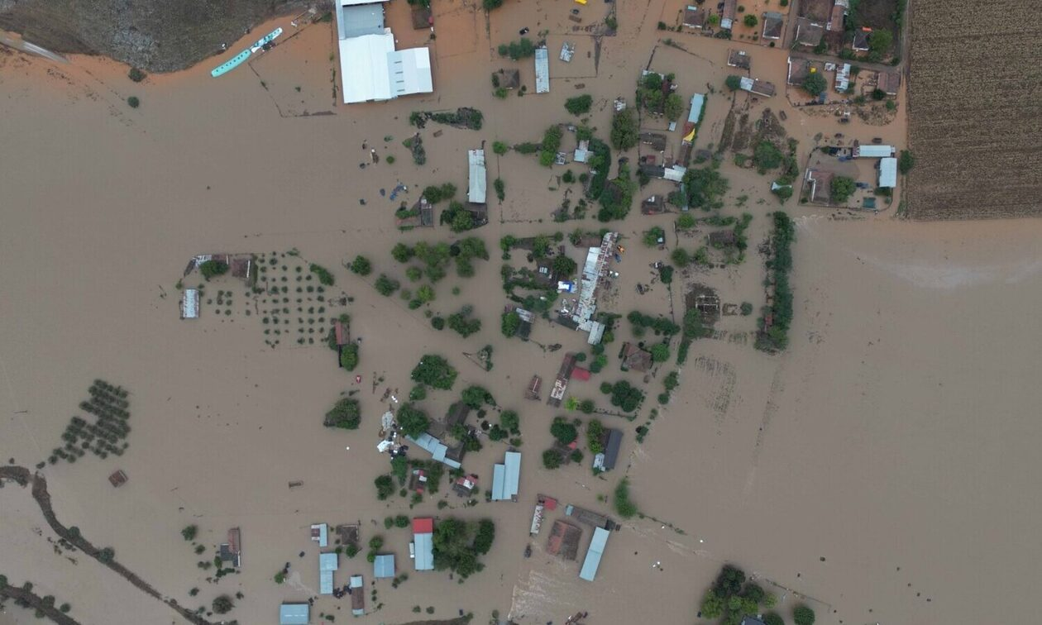
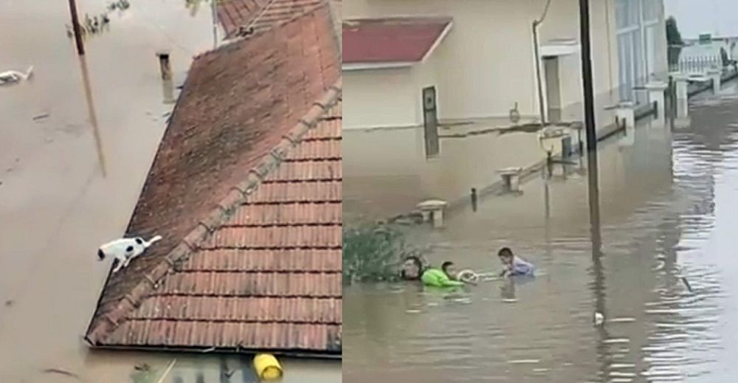
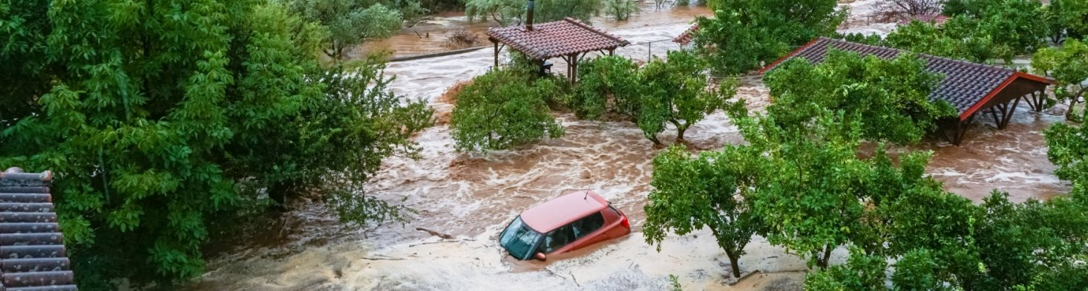
Notes:
Finally, during the weather system named 'Daniel', extreme rainfall and widespread flooding mean that entire villages in Central Greece are now underwater.

Slide 6
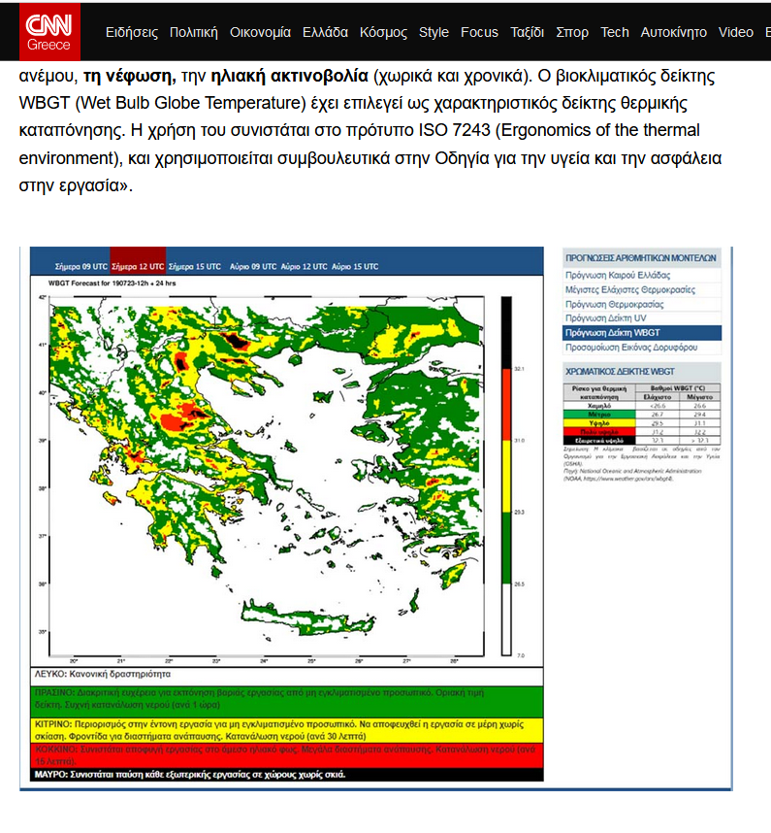
During the heatwave, we produced ICON-based 'heat stress index' forecasts that assisted the Greek Ministry of Labor and Social Affairs in the decision-making processes to protect outdoor workers from high temperatures.
Notes:
The Hellenic Meteorological Service has always been there, using numerical weather prediction models as a key tool to provide forecasting guidance.
During the heatwave, we produced ICON-based 'heat stress index' forecasts that assisted the Greek Ministry of Labor and Social Affairs in the decision-making processes to protect outdoor workers from high temperatures.

Slide 7
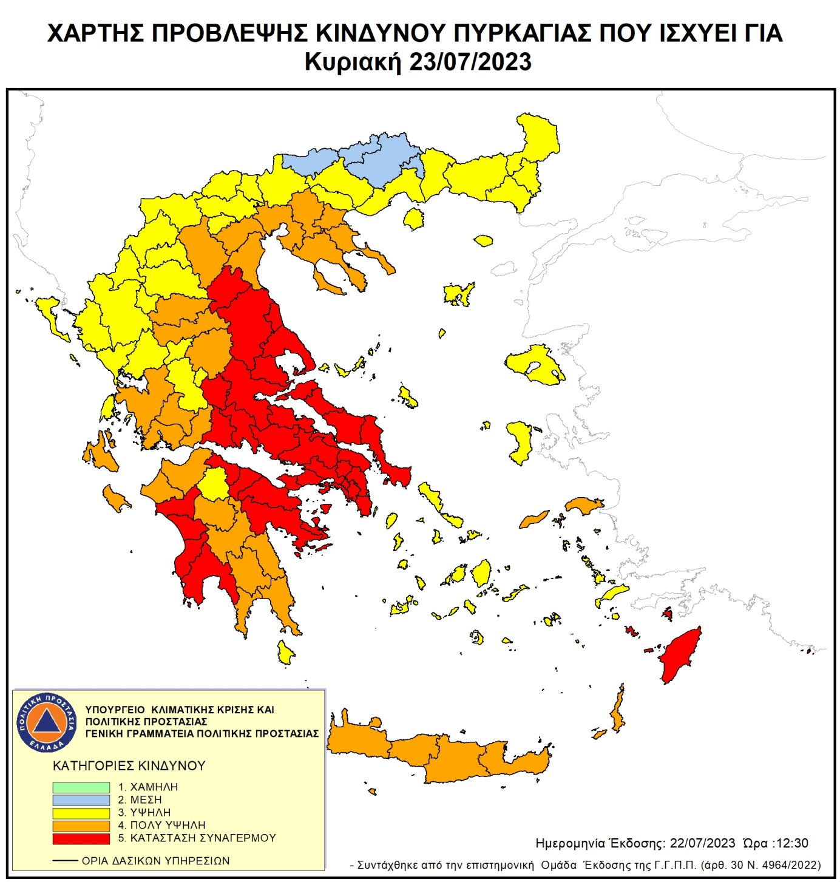
We provide on a regular basis ICON results to the National Civil Protection for the daily predictive assessment of the fire risk index.
Notes:
In addition, we provide on a regular basis ICON results to the National Civil Protection for the daily predictive assessment of the fire risk index.

Slide 8
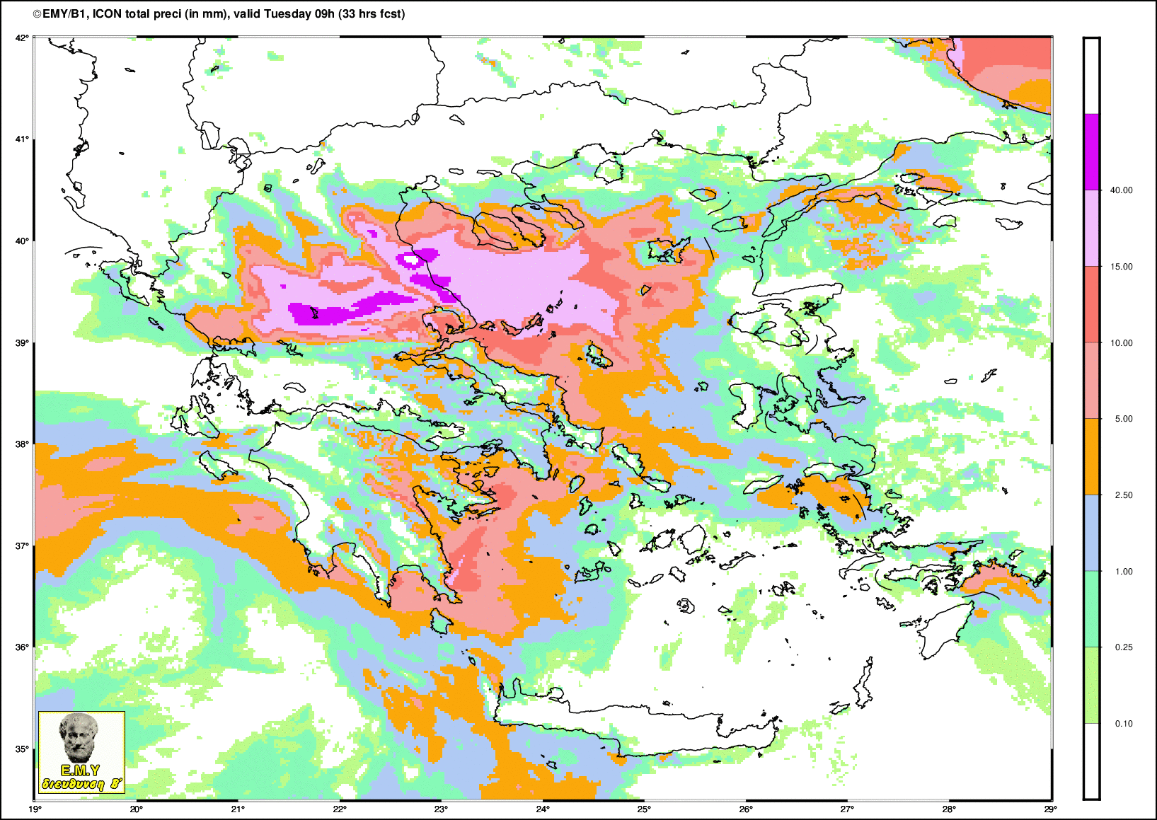
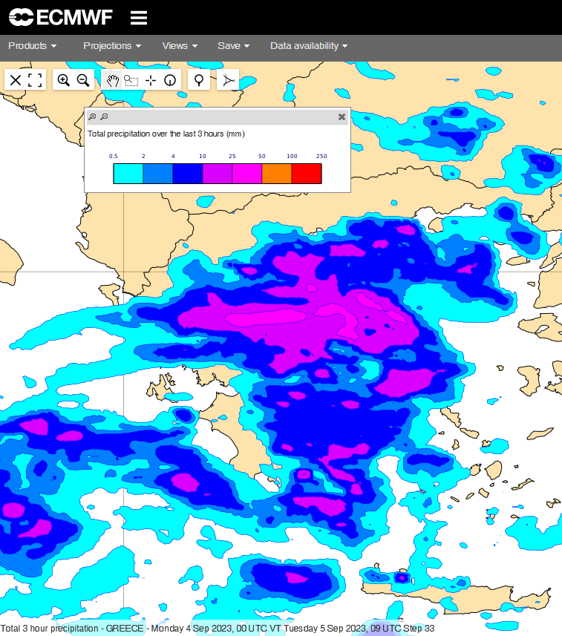
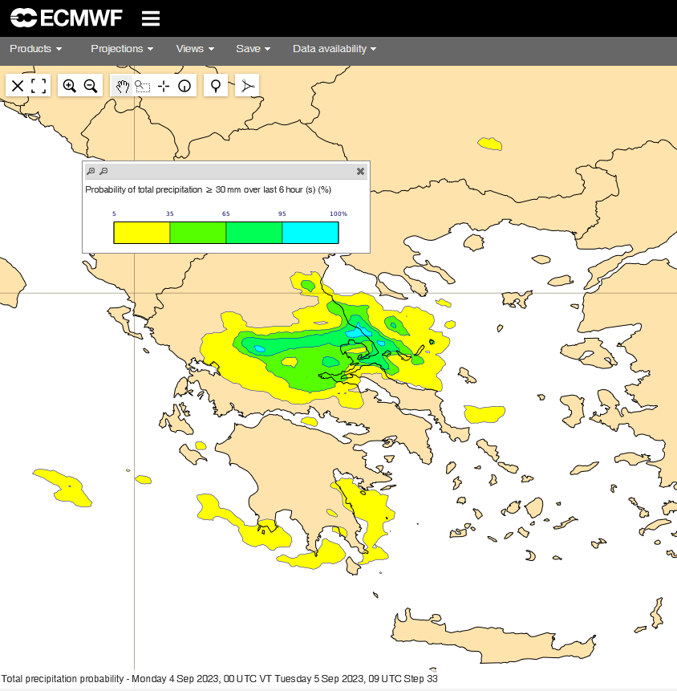
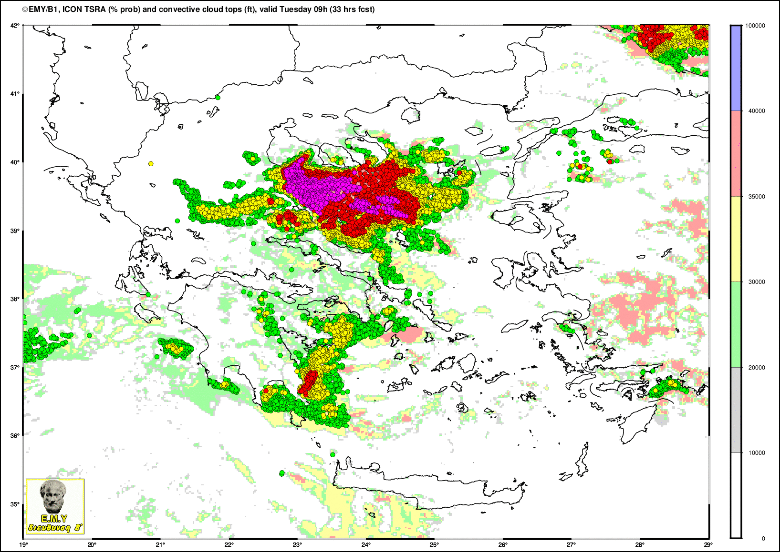
Using the predictive guidance provided by the numerical weather prediction, we informed the public and the state about the recent adverse weather system “Daniel” on time and with high temporal and spatial accuracy.
Notes:
Finally, using the predictive guidance provided by the numerical weather prediction models, we informed the public and the state about the recent adverse weather system “Daniel” on time and with high temporal and spatial accuracy.

Slide 9
25th COSMO General Meeting
11-15 September 2023, Gdansk
Notes:
Dear colleagues,
Over these days, this meeting will be a forum for knowledge exchange and cooperation. Together, we will explore the latest developments, innovations, and challenges shaping the field of numerical weather prediction. We need to improve our ability to simulate the complex behavior of the atmosphere through a deeper understanding of atmospheric processes, especially at small scales, dealing with uncertainties, and through better integration of data from different sources. These improvements will allow us to provide highly accurate in space and time forecasts and warnings. In this way, we, as Meteorological and Hydrological Sservices, can better respond to our role and obligation to society in the face of climate change.
In conclusion, I would like to express again my gratitude to our colleagues at IMGW for the organization of the meeting and for their hospitality.
Thank you also to all of you for being here with your different contributions. I am sure we will have a fruitful and inspiring meeting.

Slide 10
25th COSMO General Meeting
Thank you for your attention

