Slide 1
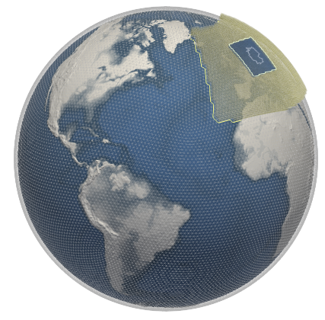
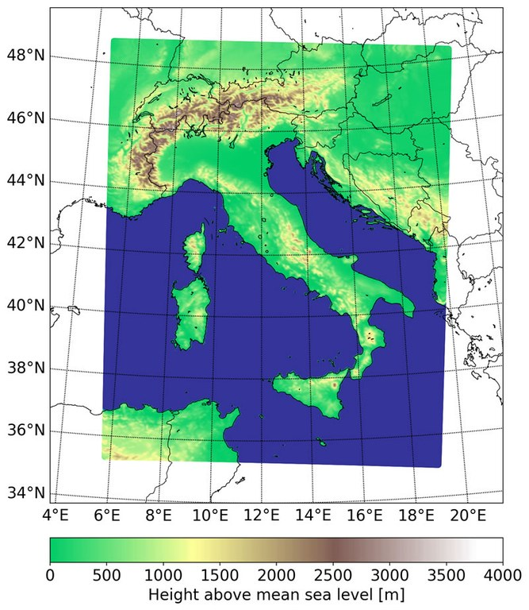
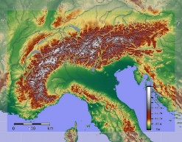
The GLORI project
Chiara Marsigli
Deutscher Wetterdienst
Arpae Emilia-Romagna

Slide 2

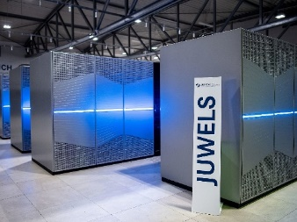
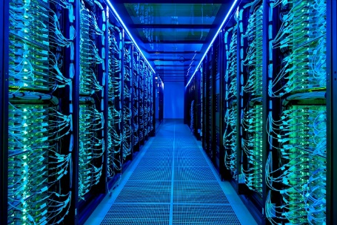


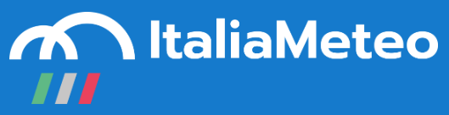




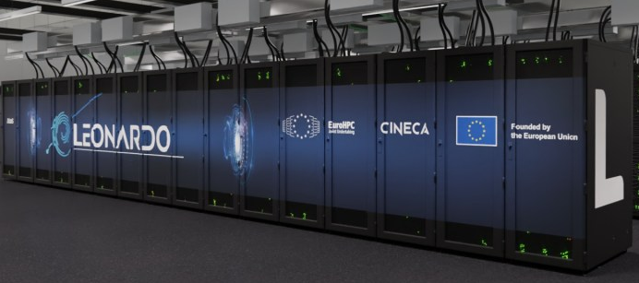


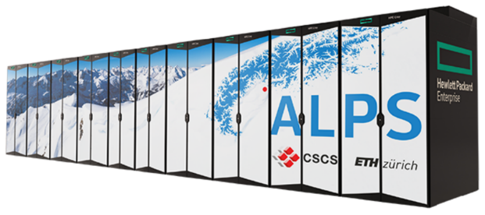

GLORI Partners and HPC system
IDEA-S4S

Slide 3
Italia – Deutschland
science-4-services network in weather and climate
IDEA-S4S
Education
Science for Services
Networking
Integrated IDEA-S4S network
Claudia Volosciuk, DWD
2023

Slide 4
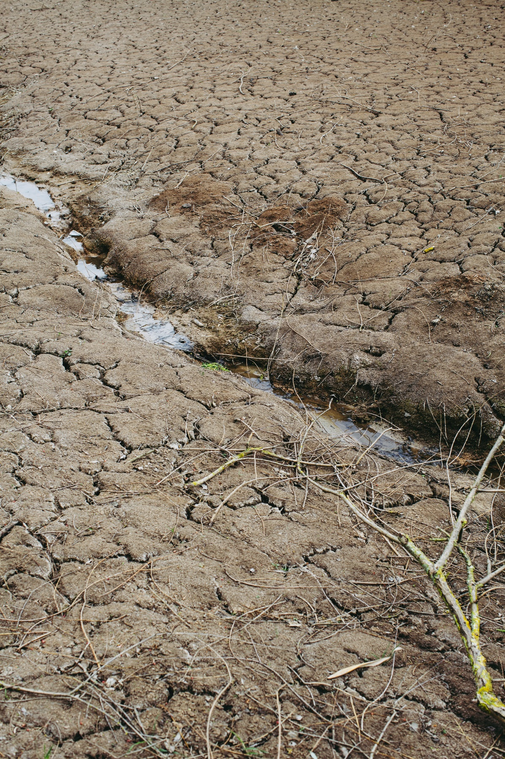
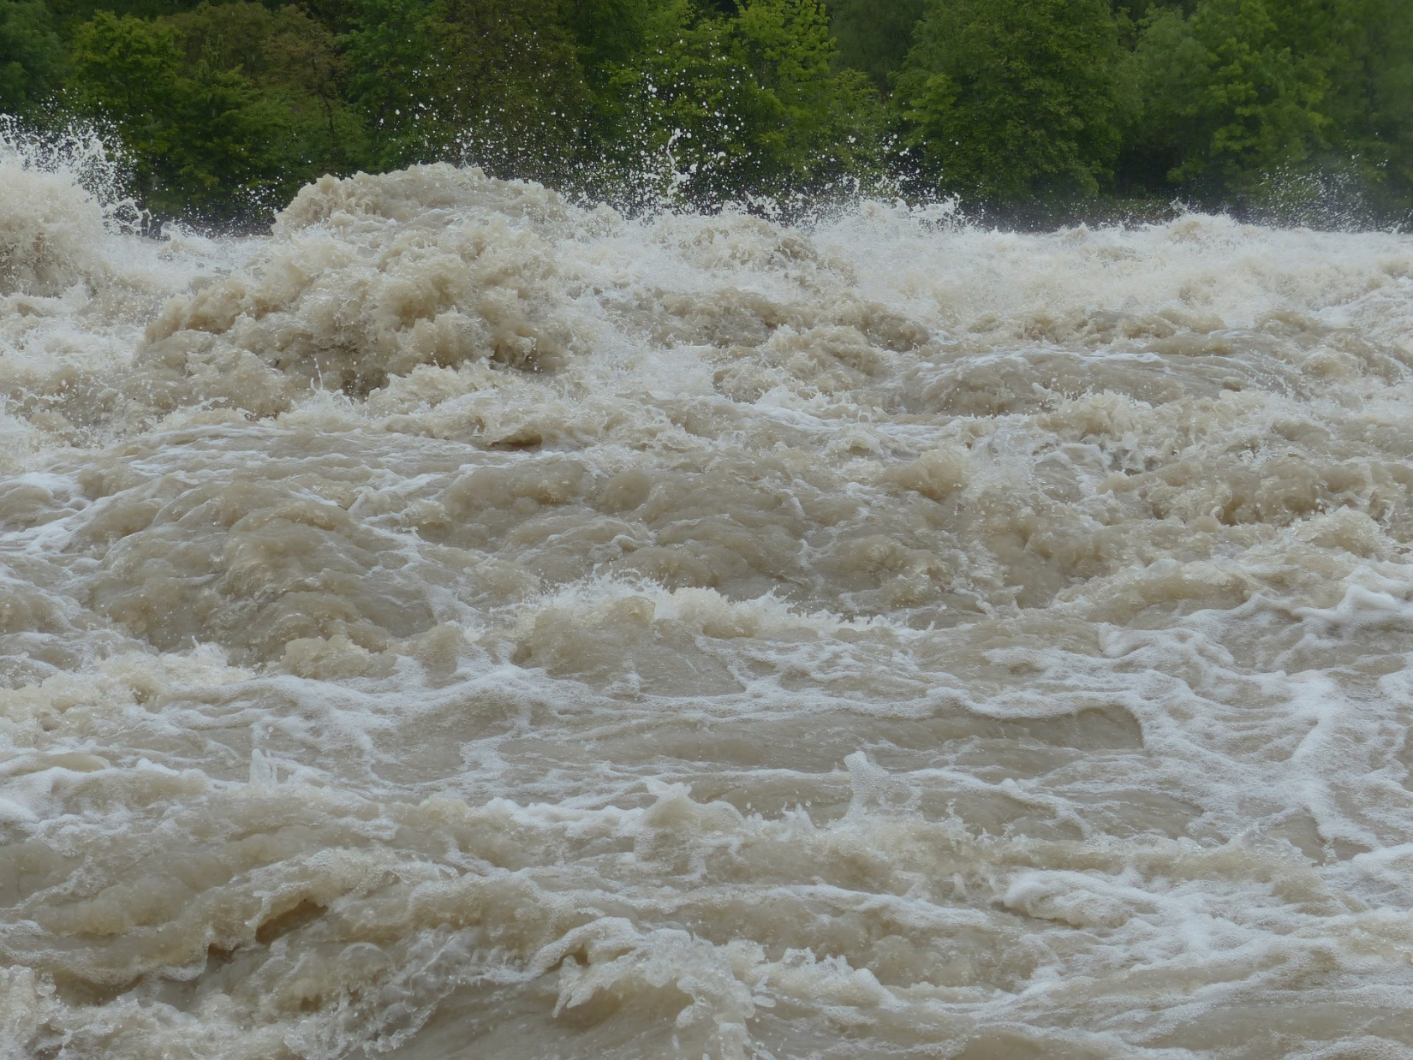
Overarching research topic for first phase
Coupled processes in the Earth system
to improve seamless weather & climate predictions,
in particular for flooding and drought events
Notes:
Traditional reductionist model insufficient
Stresses from the world have pushed scientist to consider messy, multidimensional problems.
Emergence of new technologies that have the potential to empower many different fields
Pressure against traditional disciplinary barriers is increasing

Slide 5
Science 4 services: Junior Research Groups
1 early career group lead and 2 PhD students
The following 2 Junior Research Groups will be funded:
EXPATS: Exploiting spatiotemporal cloud patterns to advance severe storms process understanding and detection (University of Cologne);
Italian partners: CNR-ISAC, ARPAE, University of Bologna
INVACODA: Increasing the value of campaign observations through data assimilation to advance convective predictability (Karlsruhe Institute of Technology KIT); Italian partners: CNR-ISAC, University of Bologna
Claudia Volosciuk, DWD
2023

Slide 6
Science 4 services: PhD projects
1 PhD student is funded per project
The following 4 PhD projects will be funded:
PolarFlood: Optimal exploitation of polarimetry and observation error covariances for precipitation-induced flood forecast (University of Bonn);
Italian partner: ARPAE
T-POL: Towards the assimilation of dual-polarization radar data (KU Eichstätt-Ingolstadt);
Italian partner: University of Bologna
FS-SF: Frozen Soil conditions in Seasonal Forecasting with ICON-Seamless (Goethe Universität Frankfurt);
Italian partner: CMCC
SESTO: Seamless short-term forecasting: from satellite nowcasting to ensemble NWP using physics-enhanced artificial intelligence (DLR);
Italian partner: ARPAE
Claudia Volosciuk, DWD
2023
Notes:
ff

Slide 7

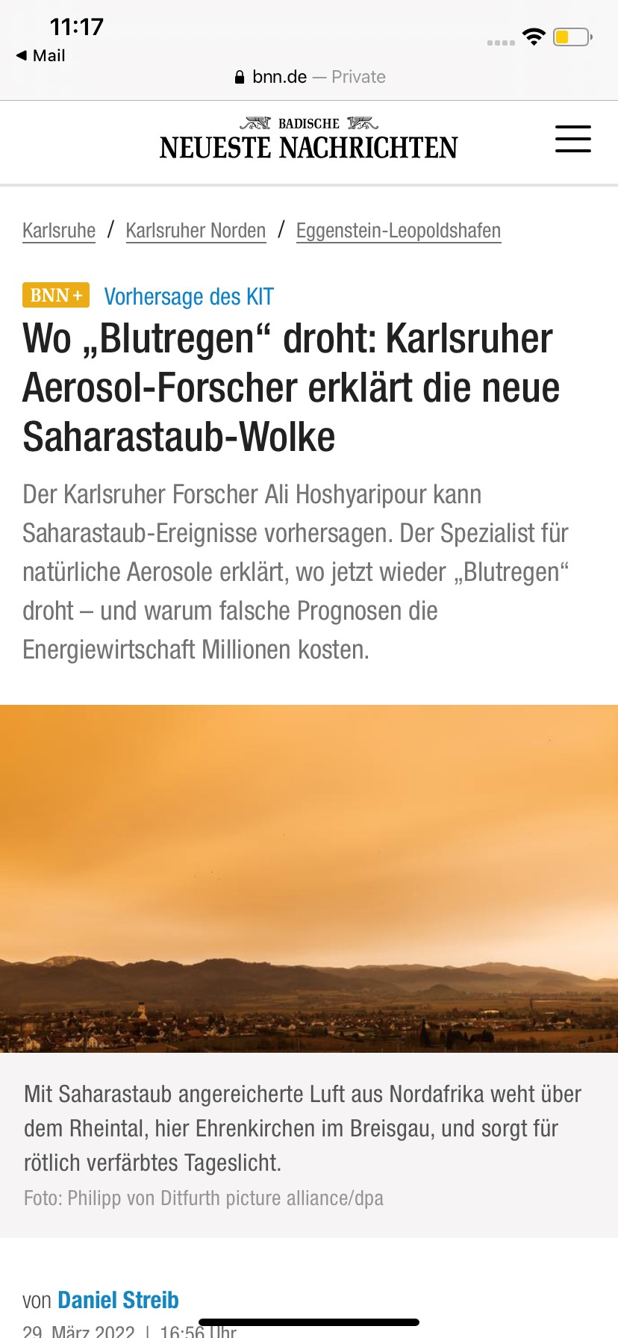
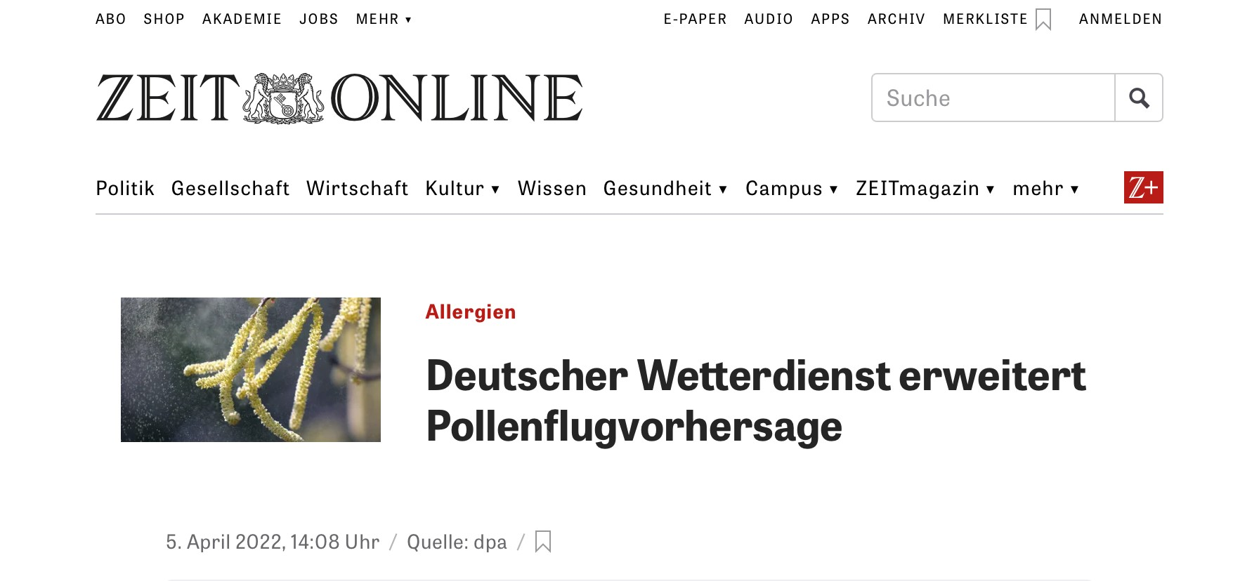

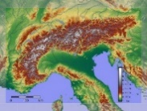
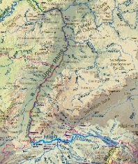
GLORI
uncertainty estimation with ensembles
development
applications
energy
high-res DA
physics at high-res
health
Interoperability and compatibility between GLORI and DestinE DT on Leonardo (CINECA)
GPU porting
catchments
land and urban
data lake
aerosol
HPC accelerators

Slide 8

Milestones
  M1 (end of 2023): GLORI-Alps Basic-Version technically working (13-6.5-1 km resolution), 40 members DA-Cycle as baseline, initial higher resolution technically working
  M2 (end of 2024): Higher-resolution and On-Demand GLORI-Alps and GLORI-Med working technically, selected cases of improved quality for selected scores and quantities
  M3 (end of 2025): Higher-resolution cases working in case studies with improved quality on selected scores and quantities
  M4 (end of 2026): Well-documented On-Demand Global-to-regional Digital Twin with high-resolution global (<= 3.25 km det) and regional (500 m) usable with clearly improved quality vs the baseline

Slide 9
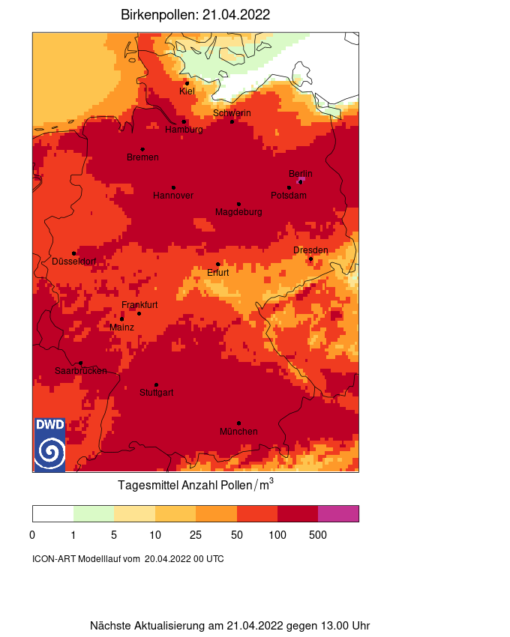
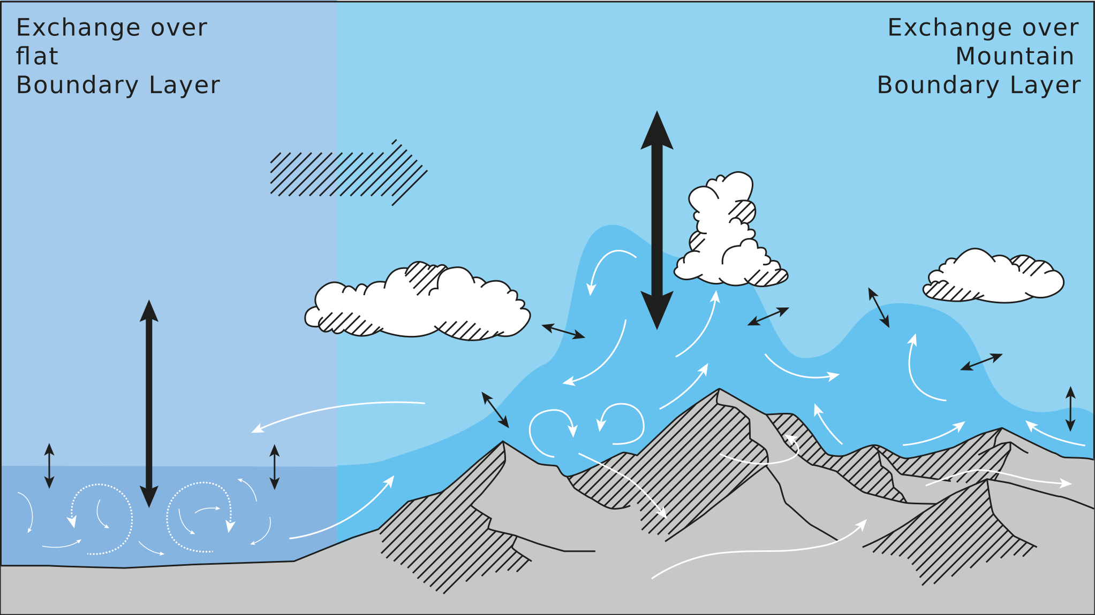
GLORI use cases
  TEAMx: Alpine Twin configuration to provide forecasts for the mission planning of TEAMx
  Floods -> on selected catchments, hydrological models where available at the partners
  Pollen (health) -> thunderstorm asthma (KIT)
  Mineral dust (energy) (KIT)
  Urban Heat Island -> COSMO Priority Project CITTA´
  Urban flooding (CMCC)
  Research (e.g. demonstrate the improved physics)

Slide 10
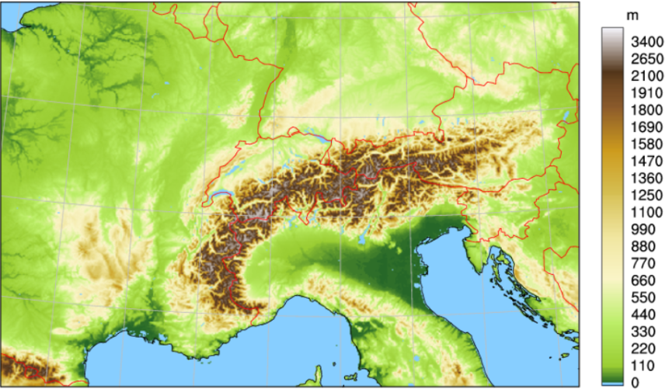
Alpine Twin Setup
ICON-Alpine2
ICON-Alpine1
1 km
2 km
Geometric height of the earth surface above msl [m] © MeteoSwiss
Daniela Littmann, DWD
10

Slide 11
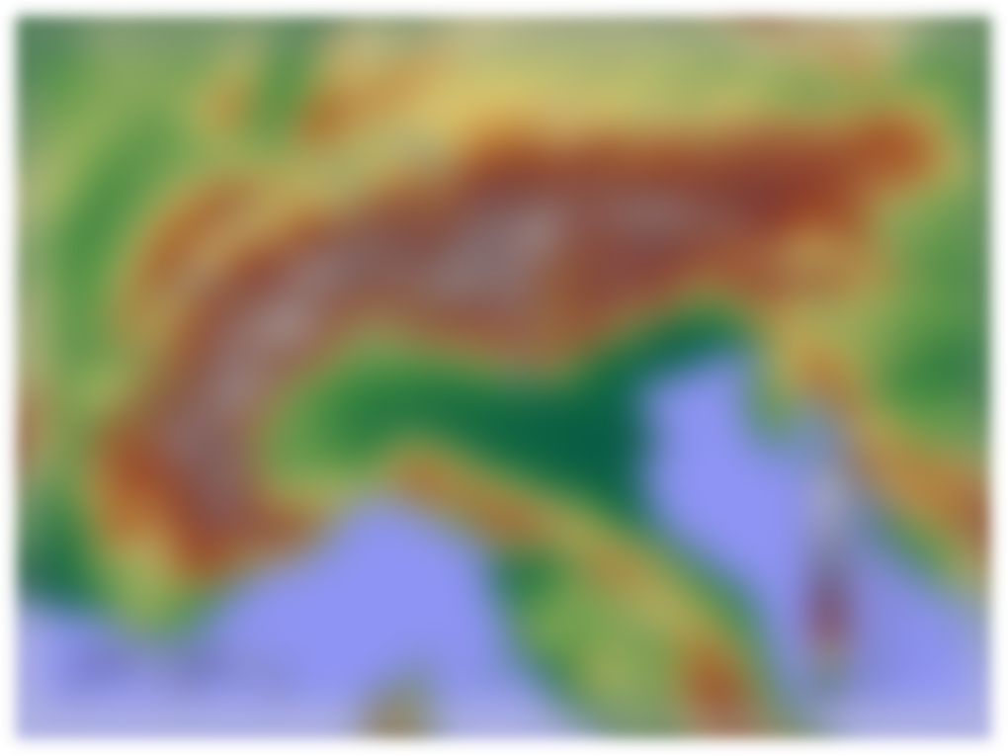
Alpine Twin Setup
(GLORI global ->) ICON-EU GLORI
BCs
IC
ICON 2 km Alpine
KENDA analysis
ICON 2 km Alpine
ICON 1 km Alpine (nest 1, 2-way)
ICON 500 m Alpine (nest 2, 2-way)
GLORI setup

Slide 12

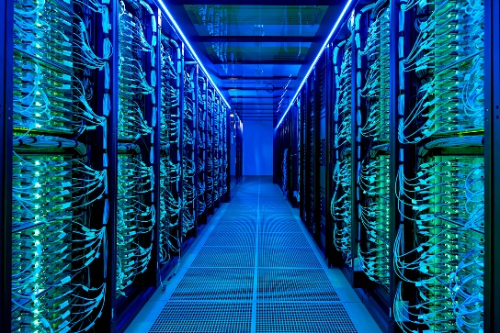
GLORI-Alps on
HoreKa is a hybrid CPU-GPU cluster managed by SCC at KIT
Target machine for global DT and GLORI-Alps
Infrastructure
Integration will strengthen KIT‘s contribution to ICON consortium
  Buildbot implementation providing ART and GPU tests
  Computing resources for GLORI-DT
Contributes to sustainable software development
GPU port of ICON-ART
ICON GPU port does not fully cover GLORI application yet
  Health application: pollen (port recently completed)
  Energy application: mineral dust (to be ported within GLORI)
GPU port is also relevant for GLORI-Med on Leonardo (CPU+GPU) and other heterogeneous target clusters in the future
https://www.scc.kit.edu/dienste/horeka.php
Michael Krayer, DWD, KIT

Slide 13
Implementation on HoreKa
Global-to-Regional ICON – Implementing the Alpine Digital Twin on HoreKa
DWD global operational configuration
Test global high resolution
LAM: Alpine Domain CH2, nest CH1
A
13.6 mill CPUh
50000 GPUh
Operational 1-month ICON ASS & MAIN
3-day high resolution ICON-nwp test
3-day ICON-LAM D2 ASS
3-day ICON-LAM CH2 ASS
Xu Xu, DWD
13

Slide 14
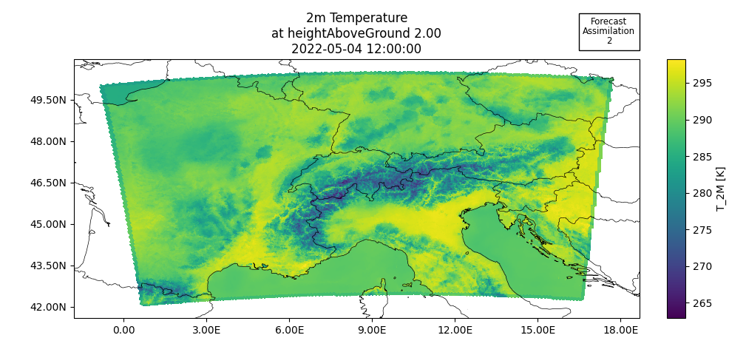
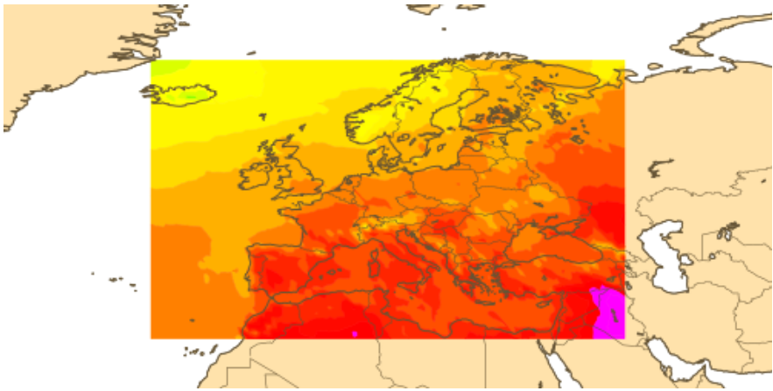
Alpine Domain CH2
Implementation on HoreKa
EU
6.5 km
74 levels
CH2 (1000)
2km / 1km
65 levels
Xu Xu, DWD
14

Slide 15
Test Case 1
Implementation on HoreKa
Test Case 2
05.05.2022
Thunderstorm and strong precipitiation at edge of the Alps
21.06.2022
Thunderstorm in the South of Germany
Xu Xu, DWD
15

Slide 16
Ensemble forecasts with model perturbations
High resolution modelling over Alpine region with the focus on land-surface and atmosphere interaction
Developement of model perturbations
  Perturbation of surface parameters
  SPP
Improvement of hydrology (sub)processes:
  ParFlow (offline, and/or coupled)
Test the coupling of TERRA and ParFlow
Zahra Parsakhoo, DWD

Slide 17
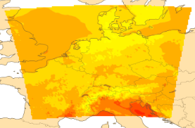
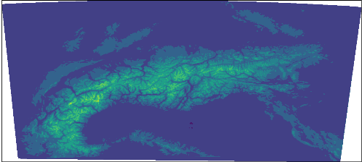
Experiments setup
GLORI-Alpine domains
BACY ensemble forecast run with nesting:
  2 model domains:
    Outer domain: 2km ICON-D2 (operational)
    Inner domain: 1km nested domain generated by G. Zängl for TEAMx project over Alpine area
  2 case studies: 05.05.2022 and 21.06.22
  24h forecast with 20 ensemble members
Zahra Parsakhoo, DWD

Slide 18
Experiments setup
ICON-D2 with nest:
Test 1: Different parameterisation for shallow convection:
  Shallowconv_only | grayzone_deepconv | Two-moment microphysics
Test 2: Perturbation OFF for all surface parameters
Test 3: Perturbation ON for one or some parameters
ParFlow
Offline run over Germany forced by ICON-D2 atmospheric data
Zahra Parsakhoo, DWD

Slide 19
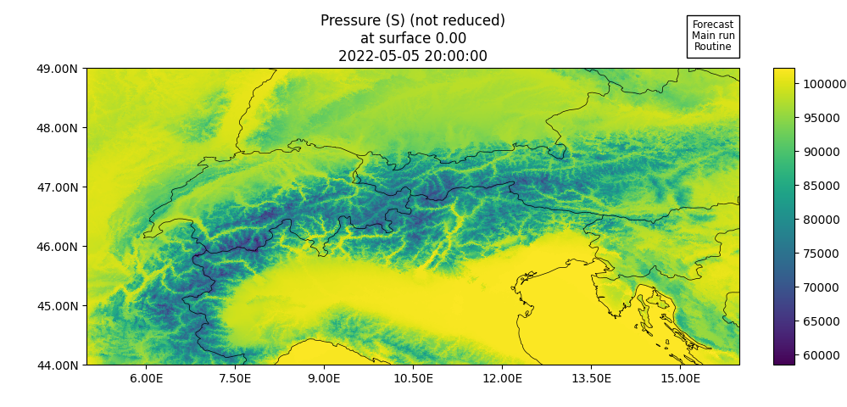
Model physics experiments - Hindcast
Surface pressure on 5.5.2022, 20h
Model top | 22 km
Vertical level | 65 full (66 half)
Hor. grid scale | 2 km, 1 km
LATBC | Analysis (ICON-EU)
2-way-Nesting
Model version 2.6.6 (currently)
SGS orographic drag | Lott and Miller scheme (COSMO)
Microphysics | 2-momentum
Turbulence | TURBDIFF
Surface Transfer | TURBTRAN
Land | TERRA
ICON-CH1 test domain from TeamX with 1 km horizontal grid scale nested into ICON-D2 (2 km).
Daniela Littmann, DWD
19

Slide 20







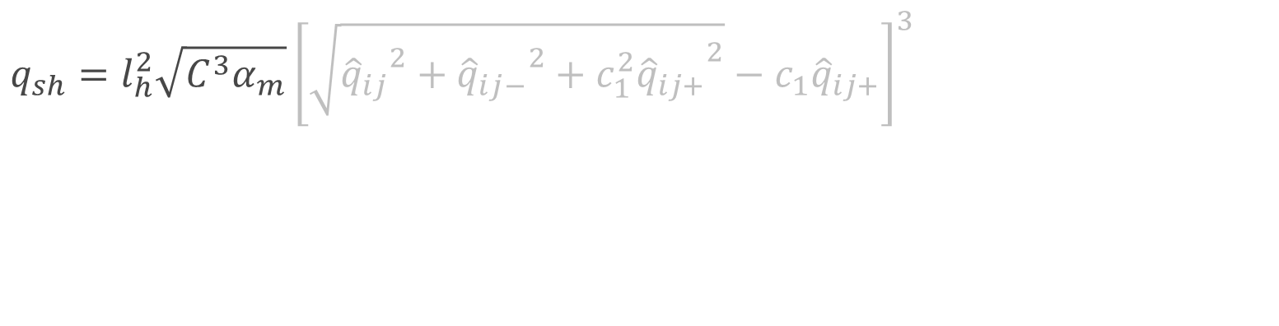
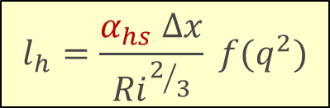
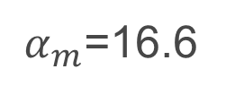


Horizontal shear experiment
Horizontal shear term (TKE source term):
$${\hat{q}}_{ij }=\left(∂_{j}{\hat{u}}_{i}+∂_{i}{\hat{u}}_{j}\right) \\ {\hat{q}}_{ij−}=\left(∂_{i}{\hat{u}}_{i}−∂_{j}{\hat{u}}_{j}\right)$$
$${\hat{q}}_{ij+}=\left(∂_{i}{\hat{u}}_{i}+∂_{j}{\hat{u}}_{j}\right)$$
$$q_{sh}=l_{h}^{2}\sqrt{C^{3}α_{m}}{\left[\sqrt{{{\hat{q}}_{ij}}^{2}+{{\hat{q}}_{ij−}}^{2}+{{c_{1}^{2}\hat{q}}_{ij+}}^{2}}−{c_{1}\hat{q}}_{ij+}\right]}^{3}$$
$$C=0.5$$
${ α}_{m}$=16.6
Symbols:
Stability factor
Momentum variance factor
Length scale factor for hori. shear
Effective horizontal length scale
Horizontal grid spacing
Gradient Richardson number
TKE correction function
$$l_{h}=\frac{α_{hs} ∆x}{{Ri}^{2/3}} f(q^{2})$$
Daniela Littmann, DWD
20

Slide 21
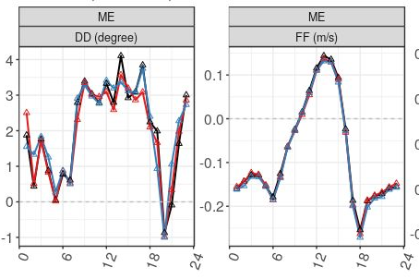
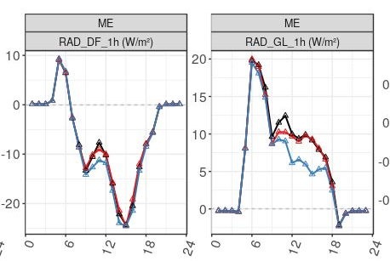
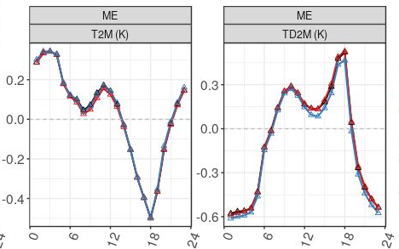

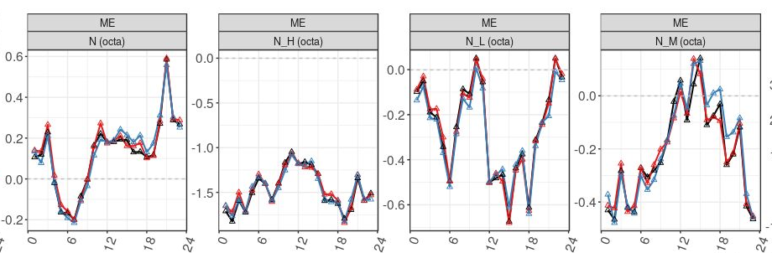
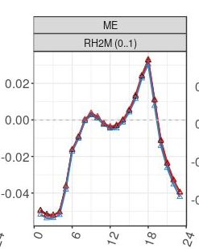
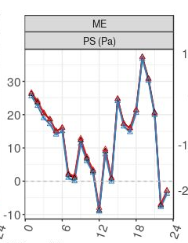
Horizontal shear experiment: verification
May 2022 – ICON-CH1
Score Value
Time
Daniela Littmann, DWD
21

Slide 22
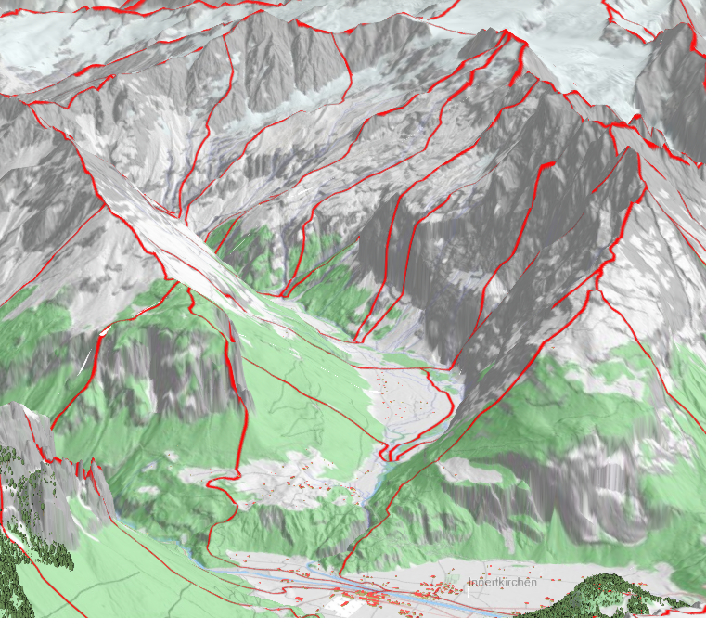
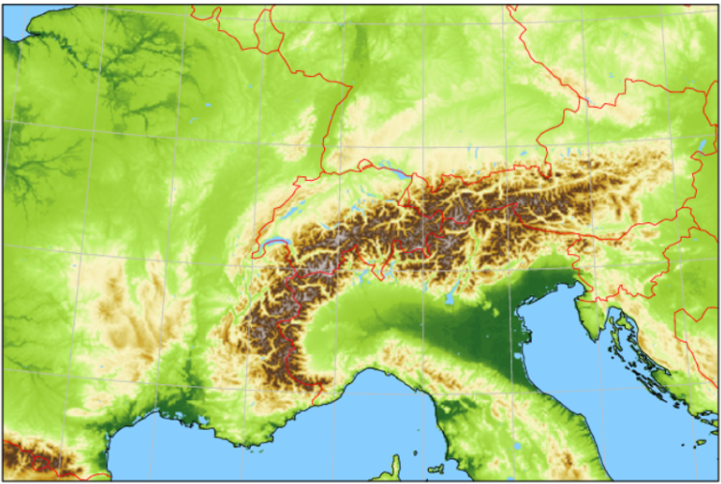
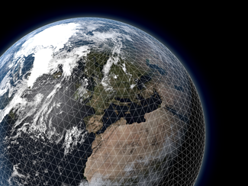



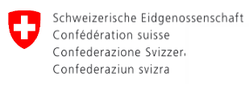





Global to Regional ICON Alpine Twin
End-to-end pilot applications
Flood forecasting (e.g., BAFU)
TEAMx
Ürbachtal (SwissTopo)
2 km² catchments (red contours)
ICON-CH1-EPS: Δz=925m
SwissTopo terrain: Δz=1900 m

Slide 23
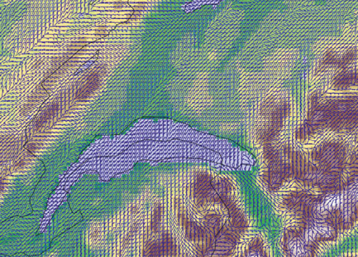
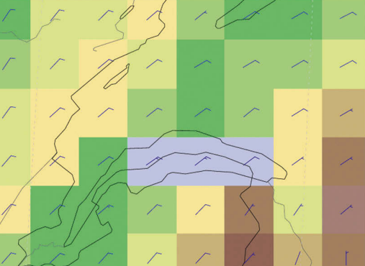
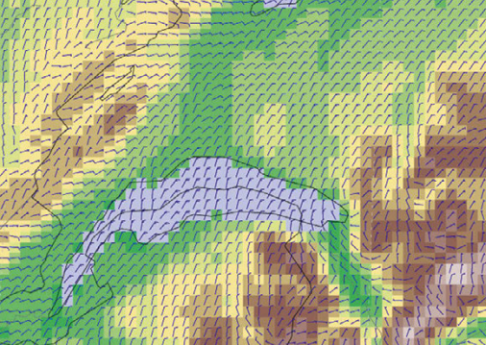
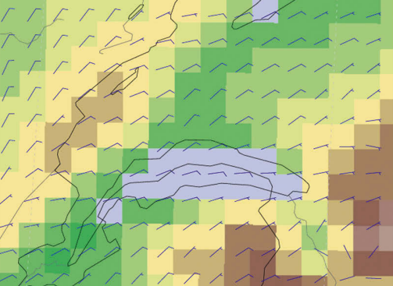
GLORI-A Timeline
Project Start
Technical demonstration
First prototype
Δx = 0.5 km
Technology Integration
Demonstration with
external application
2022
2023
2024
2025
2026
GPU Porting
Setup on Balfrin (A100)
Model ready
Improved quality
Δx = 500 m
TEAMx
End-to-end workflow
for one external user
GPU porting done
COSMO GM, September 2023, Gdansk

Slide 24
News
June 2023: GLORI-A Phase II approved by the Swiss Federal Council: Funding secured for 2024-2026
Ongoing work includes
Finalization of GPU version with OpenAcc; Consolidation and optimization of the Python Dycore for better performance
Scoping of
  On-demand system
  Use cases: Agile & user-guided development of the DT
    TEAMx field campaign: First user interview took place
    Stakeholder analysis for DT data to develop another use case (Flood forecasting / Energy generation / Agricultural applications etc)
COSMO GM, September 2023, Gdansk

Slide 25
ICON Performance Improvements
ICON-CH1-EPS on ALPS, +33h with 8 GPUs
G2G
Fix first performance bugs
NVIDIA optimization
Mixed precision
Inlining
Network update
Synchronous IO
Asynchronous IO with 2-sided communication
Additional optimizations
Port of interpolation
CUDA-GRAPHS
Goal
1 year of work in collaboration with CSCS & NVIDIA: Factor 3x speedup!

Slide 26
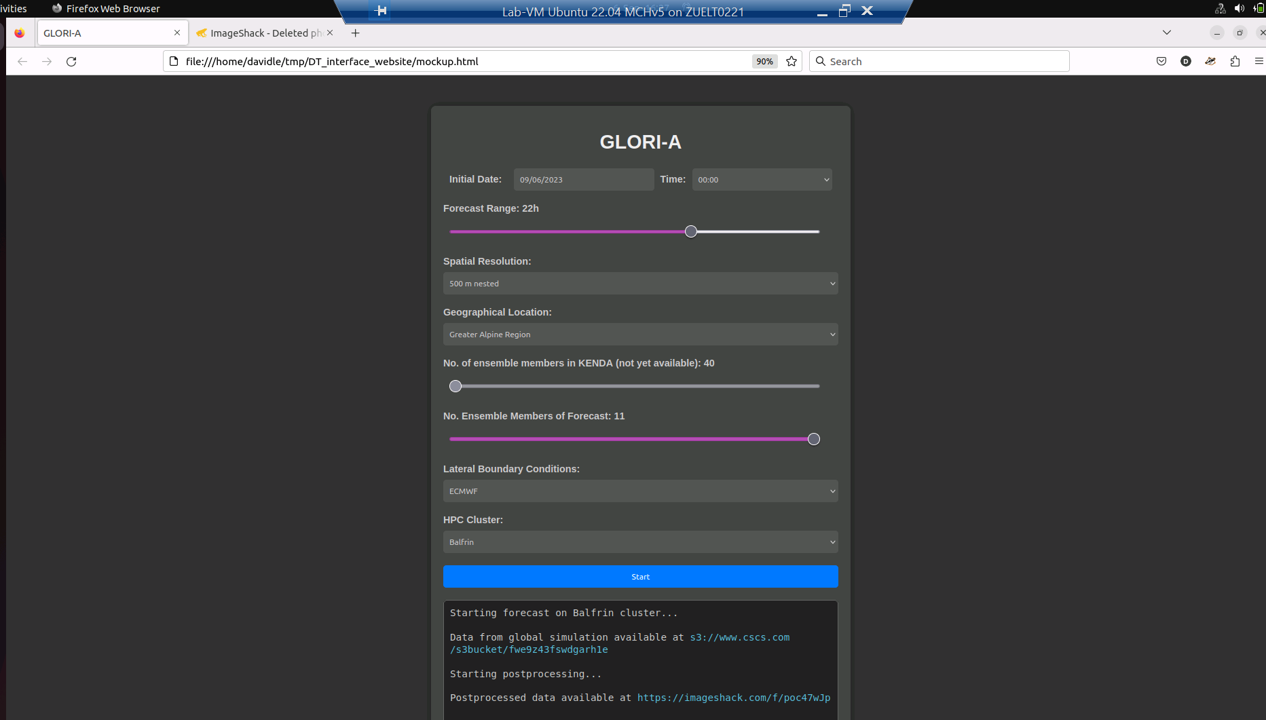
Work in progress: On-demand interface and workflow

Slide 27
GLORI in Italy
Waiting for the signature of the agreement
In the meantime:
  Participation to GLORI meetings
  Collaboration in the IDEA framework (Junior Research Groups, PhD projects)
  Data availability and data collection
    radar reflectivity volumes (Arpae)
  Cooperation within COSMO (data assimilation, model improvement)
  Implementation of GLORI on Leonardo will start soon (DestinE and CINECA):
    Definition of GLORI Med
    Regional coupled model setup at CMCC

Slide 28
Working Groups
WG1 system implementation and configuration
WG2 data assimilation
WG3 infrastructure and data flow
WG4 GPU porting
WG5 model improvement
  ICON towards the hectometric scale, establish a “working group” with PP CITTA`
WG6 verification, impact, communication

Slide 29
Thank you for your attention!

Slide 30
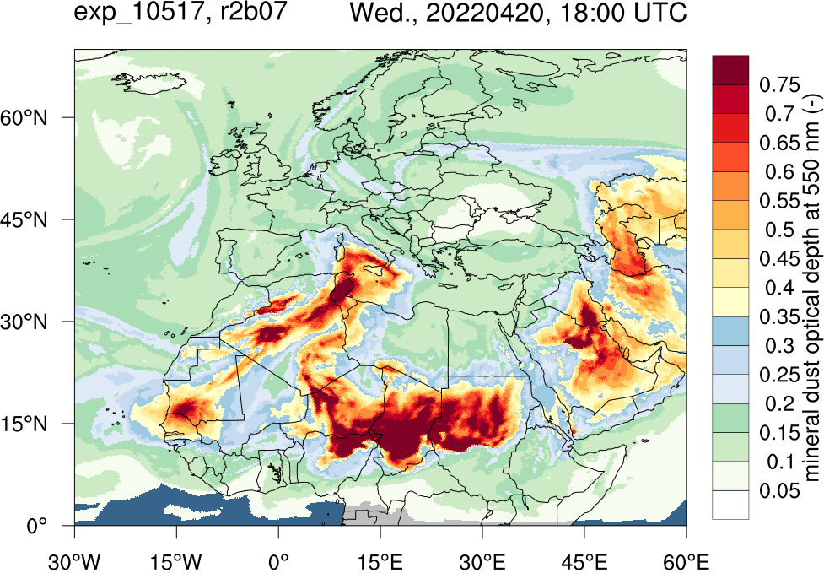
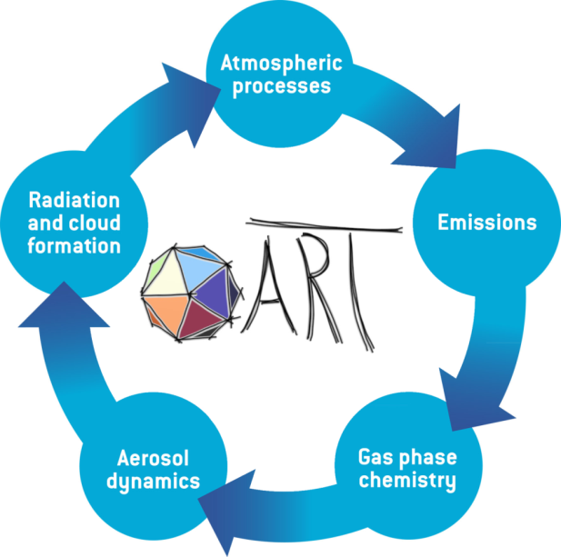

Dust and pollen forecast for energy and health
ICON-ART
Ali Hoshyaripour
Notes:
Data from operational applications of ICON-ART at DWD.
Left: Dust forecast; right: pollen forecast

Slide 31
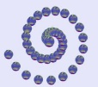


Augmenting the hydrometeorological value chain through co-design
Collaboration of DWD with regional flood forecasting centres (HVZ)
User-specific meteorological evaluation / verification
Obs / Pegel
ICON
DWD
HVZ
Evaluation / verification by hydrologists
Flood forecasting models
GLORI-DT
HVZ
Radar / Obs
User-oriented product development of warning information
Flood predictions
climatologies
Communication of
Weather and climate services
IDEA-S4S
Decision maker, civil protection, emergency management
V. Fundel, C. Volosciuk, J. Keller, DWD
Notes:
3 IDEA Positions in Germany: 2 at DWD, one based at a regional flood forecasting centre and one position co-funded by DWD and HVZ Rheinland-Pfalz on communiation aspects

