Slide 1
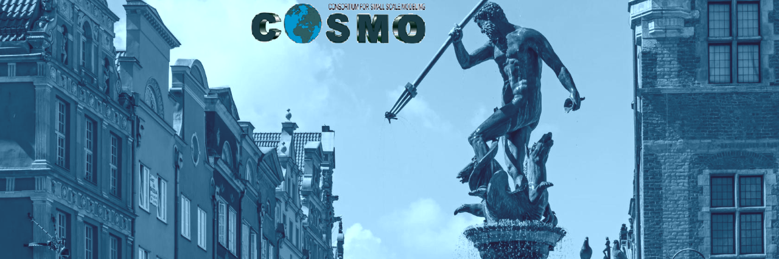
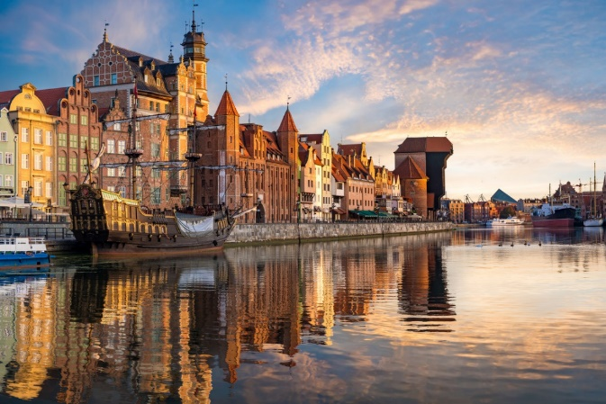

COSMO
General Meeting
2023
Opening / general information
Andrzej Wyszogrodzki

Slide 2
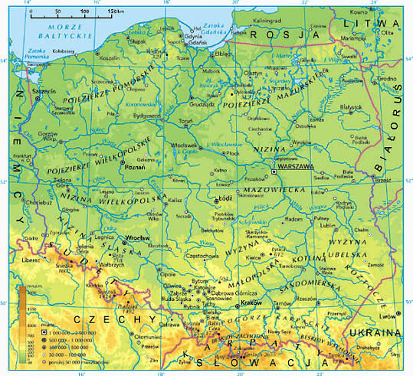
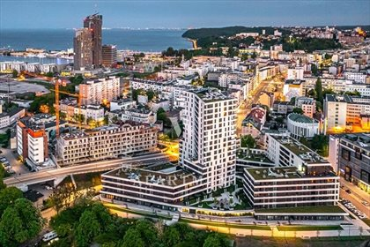
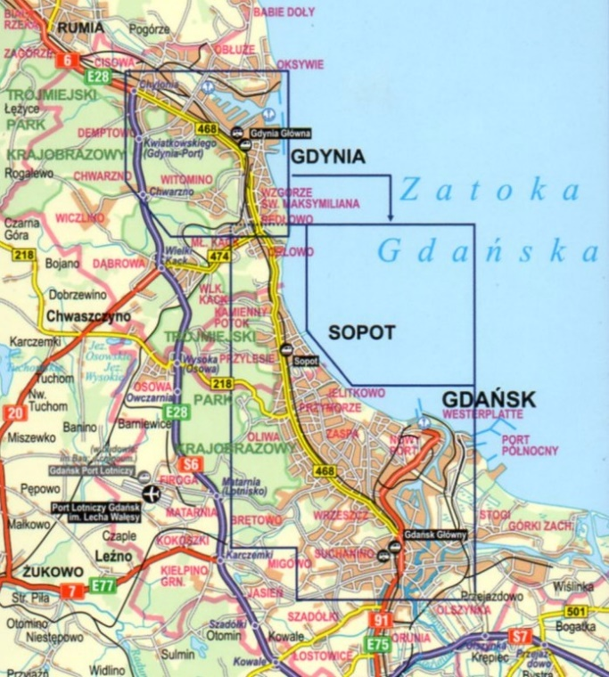
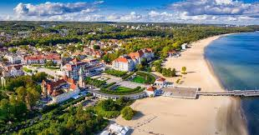
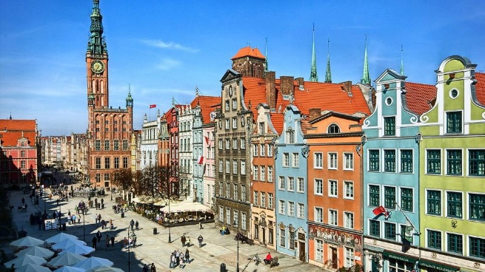
COSMO General Meeting 2023
Meeting dates: 11-15.09.2023
Gdynia (1209,1926), ~244K
Sopot (VIII-X/1283,1901), ~32K
Gdańsk(VI/999,1312-1457), ~486 K

Slide 3
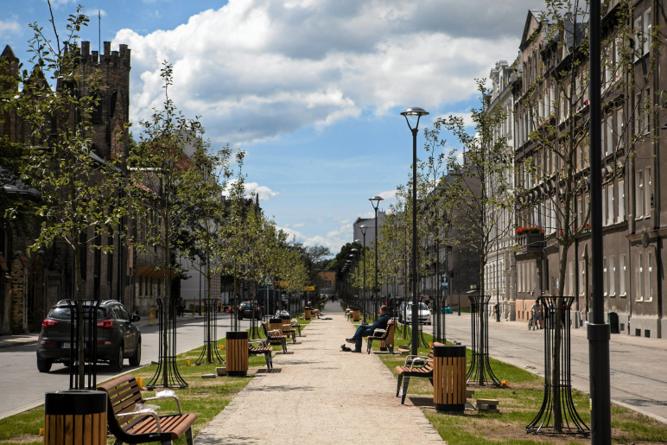
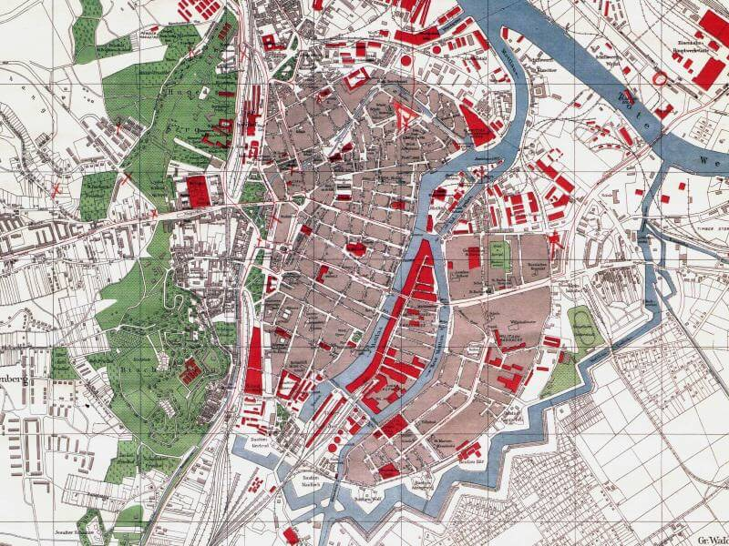
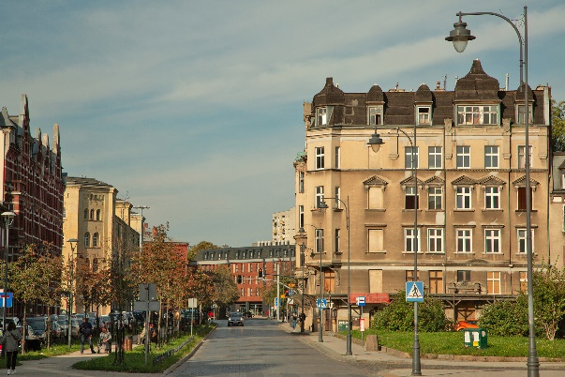
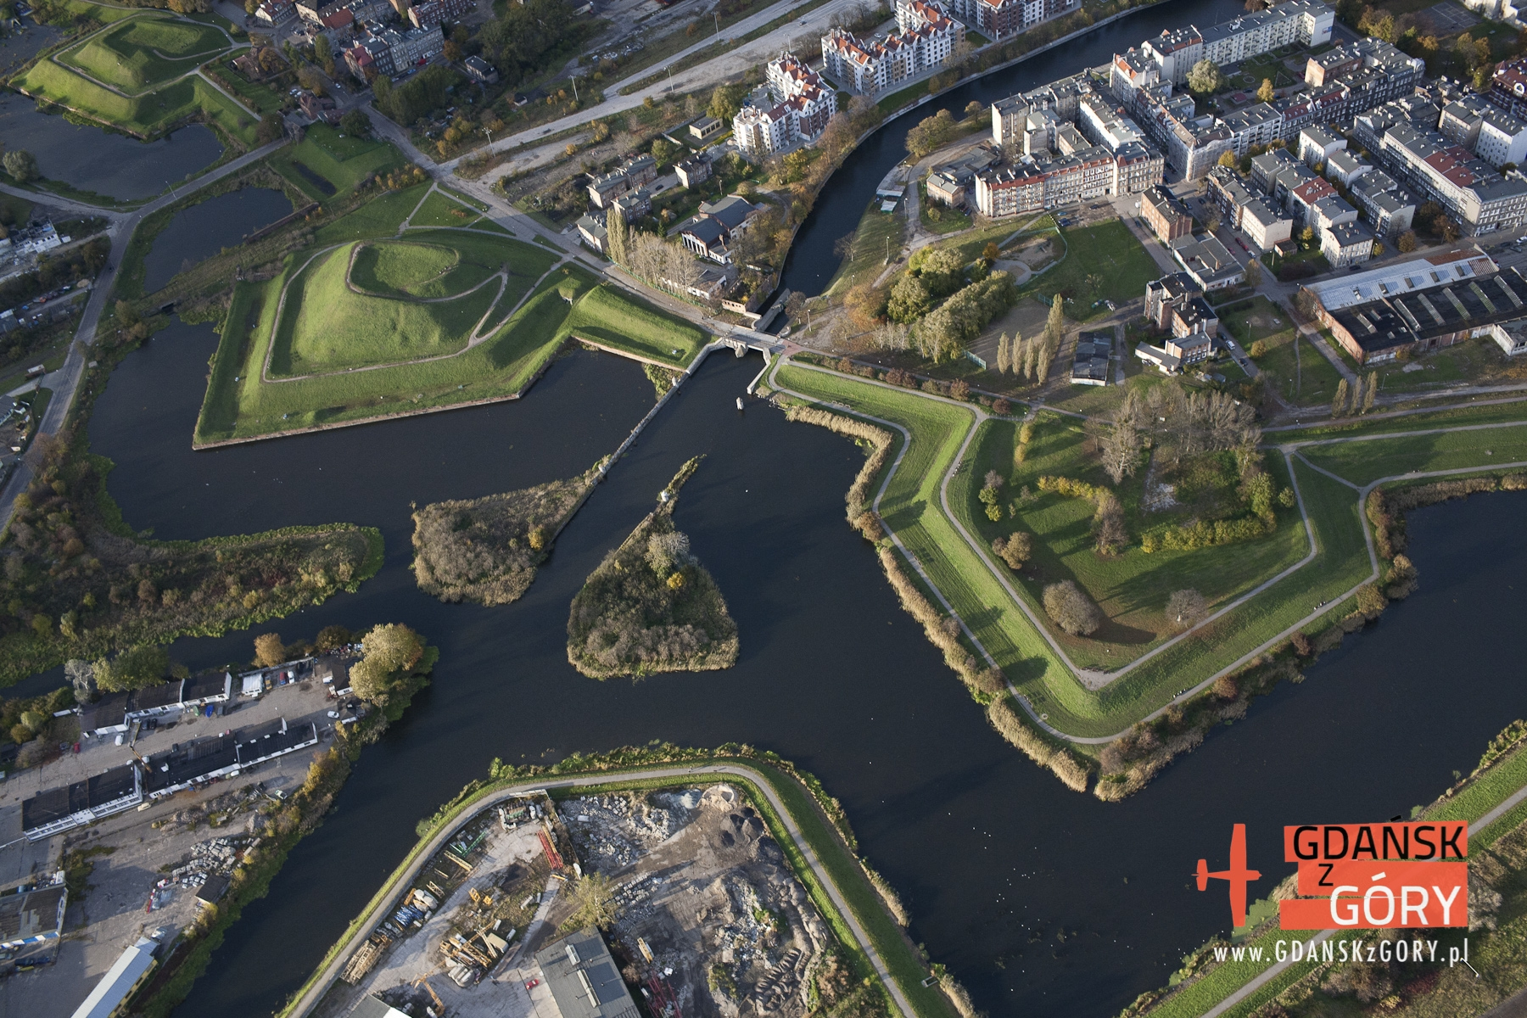
Hotel Dwór Uphagena Arche
Dolne Miasto (Lower City),
~1km form the centre of Gdańsk old town
New Motława River, city fortifications from 1638 r.

Slide 4
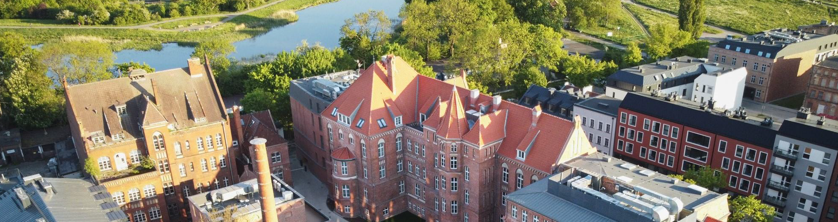
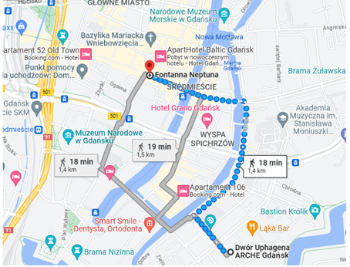
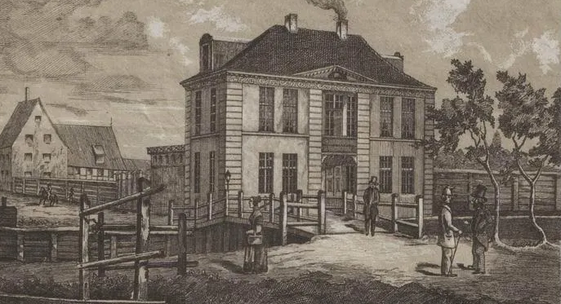
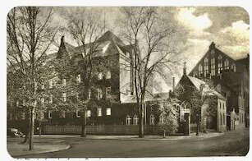
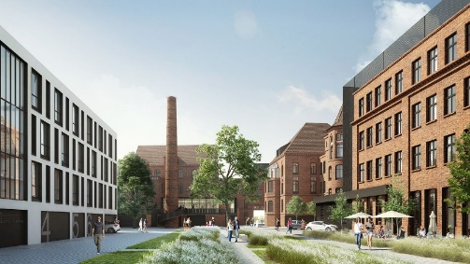
Dwór Uphagena Arche, Gdańsk
Buildings of Uphanen family from 1800-
Catholic hospotal 1853-1945
City hospital
1945-2001
ARCHE Dwór Uphagena 2021+
~1km (18 min walk) form the Neptune Fountain

Slide 5
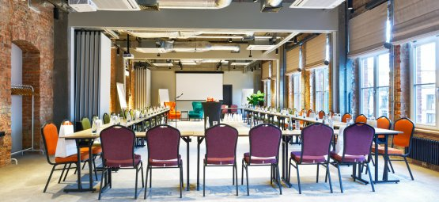
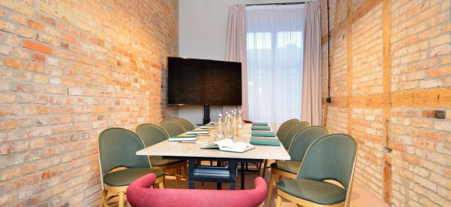
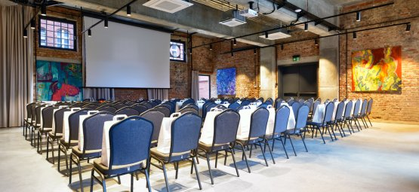
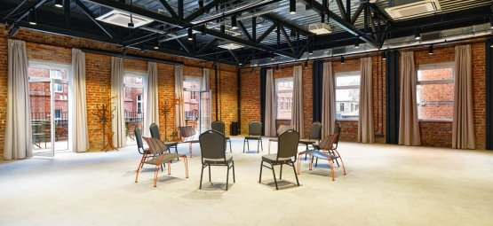
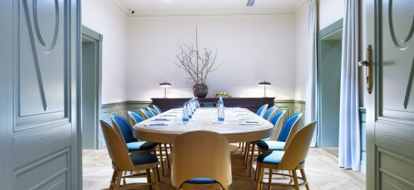
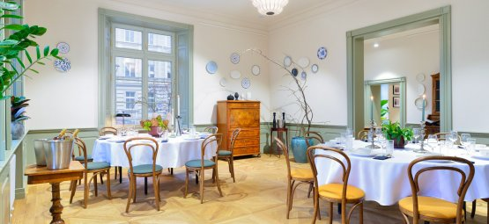
Hotel Dwór Uphagena Arche
https://www.archedworuphagena.pl/
Conference rooms
BASTION MIŚ (130m²) main building of Dwór Uphagena (plenary)
switchabe to 3 smaller rooms:
BASTION MIŚ A (36m2)
BASTION MIŚ B (39m2)
BASTION MIŚ C (36m2)
BASTION WILK (117m²) with foyer, ground level
BASTION ŻUBR (117m²) with terrace 1st floor
BASTION KRÓLIK (15m²) main building
U PROFESORA /Oranżeria (48m²) old building
BOARDROOM (38m²) old building
MIŚ
KRÓLIK
WILK
BOARDROOM
U PROFESORA /Oragneria
ŻUBR

Slide 6
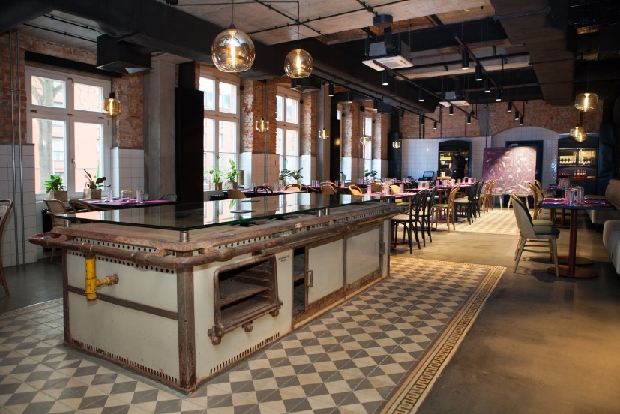
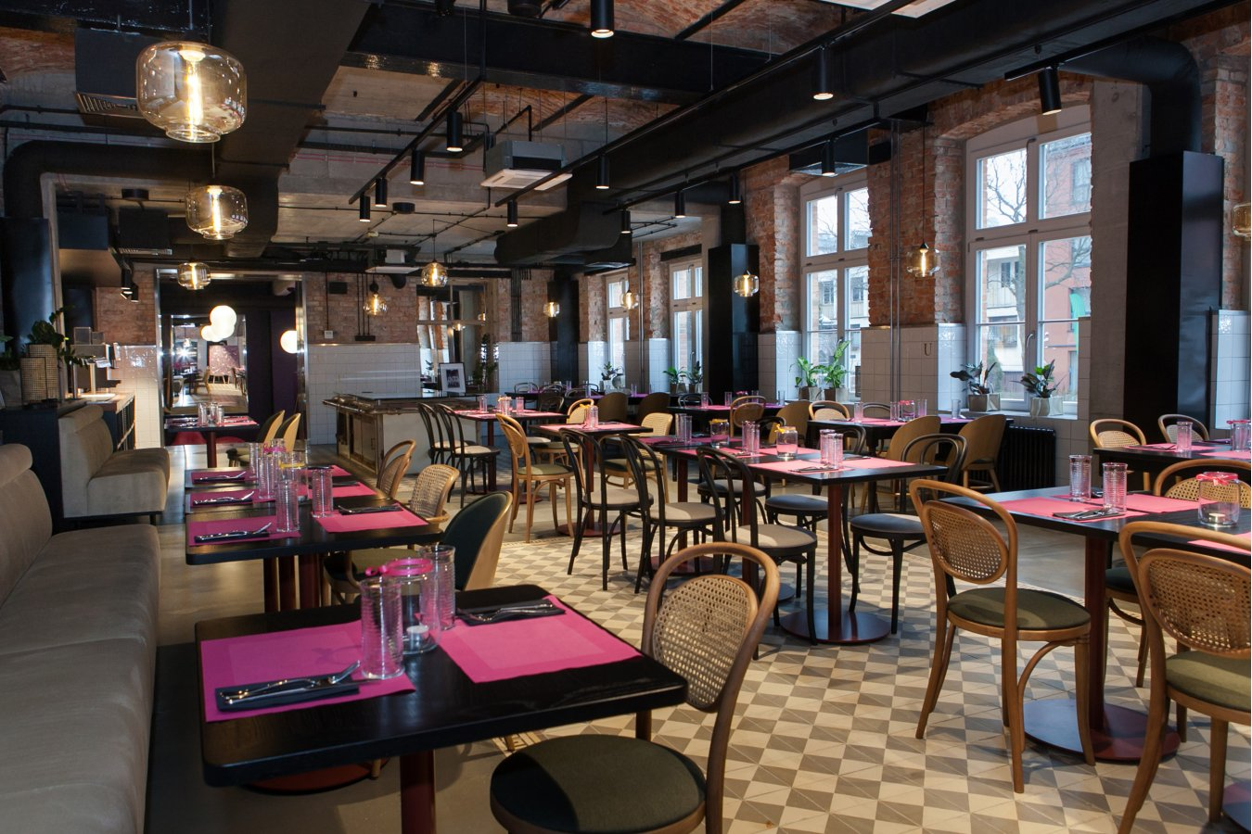
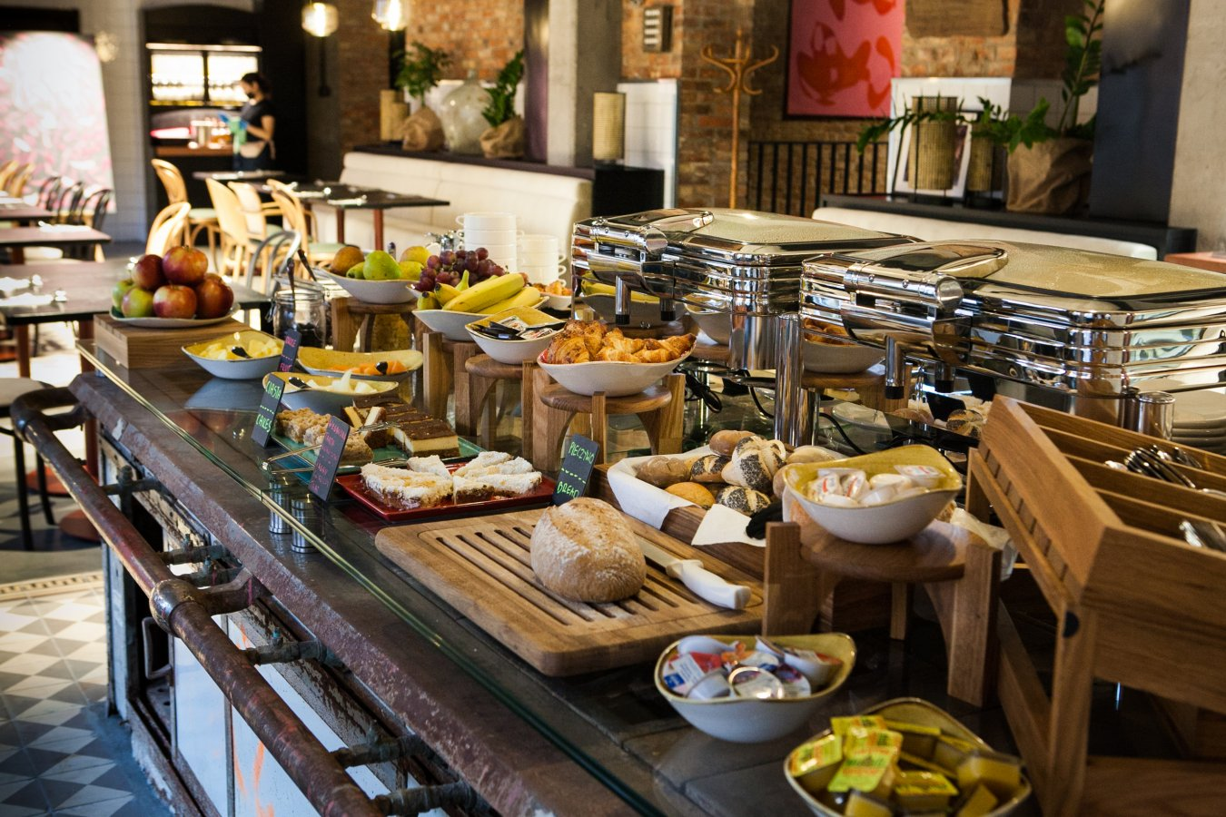
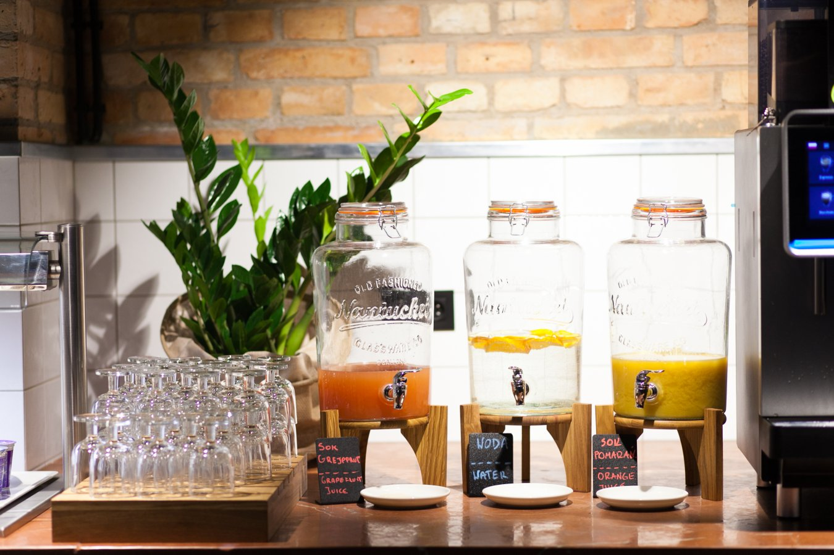
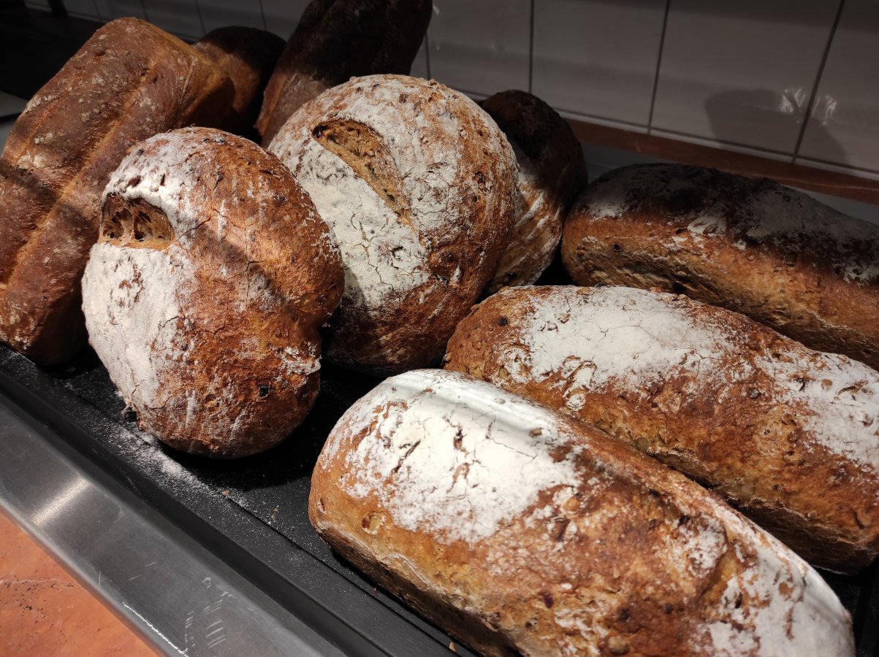
Hotel Dwór Uphagena Arche
https://www.archedworuphagena.pl/
Restauracja Stara Kuchnia (restaurant „old kitchen”)
M-Th: 13:00 - 21:00
F-Sa: 13:00 - 23:00

Slide 7
Hotel Dwór Uphagena Arche
https://www.archedworuphagena.pl/
Restauracja Stara Kuchnia (restaurant „old kitchen”)
M-Th: 13:00 - 21:00
F-Sa: 13:00 - 23:00
Tuesday:
Mixed salads with grilled halumi cheese, baked cherry tomatoes, pumpkin seeds Chicken or vegetable curry, jasmine rice, fennel (dill)
Wednesday:
Spicy pumpkin cream soup
Spaghetti aglio e olio
Spaghetti with arabiata sauce and bacon
Thursday:
Tomatoes cream soup with mozzarella and lovage oil (lubczyk) Arancini with vegetables and herbal sauce
Poultry meatballs with buckweet (kaszotto)
Friday:
Tartare from marinated Baltic herring
Hake in panko breadcrumbs, french fries, sauerkraut Risotto with poricini mushooms (borowiki)

Slide 8
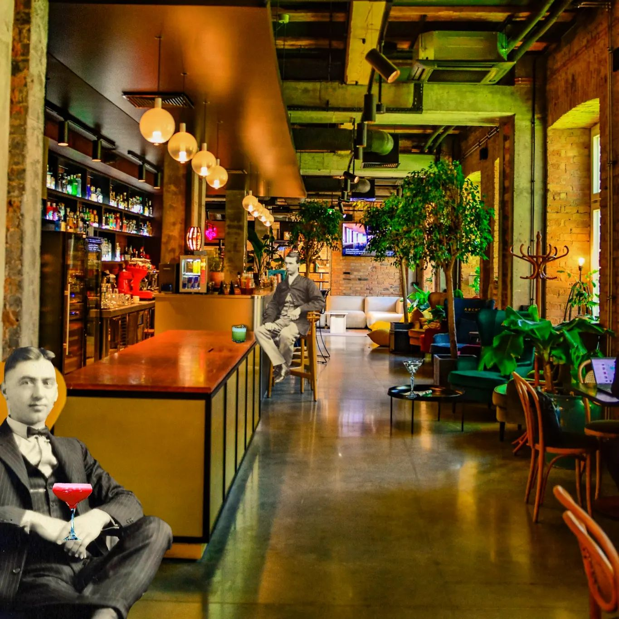
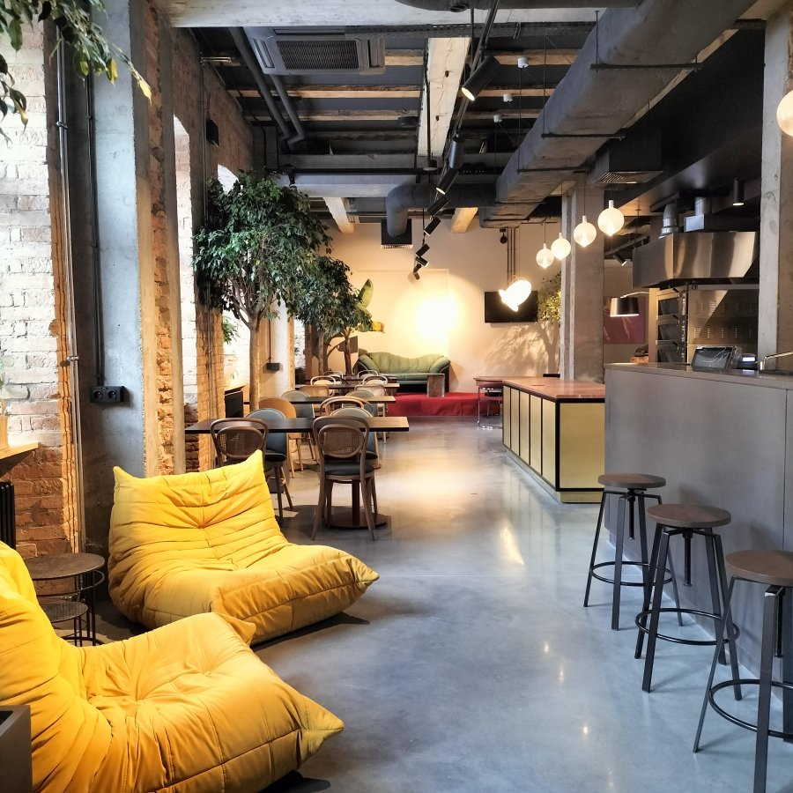
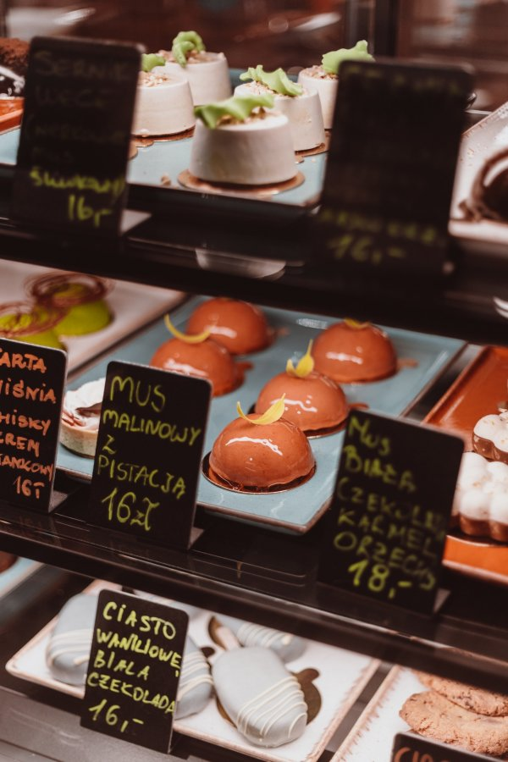
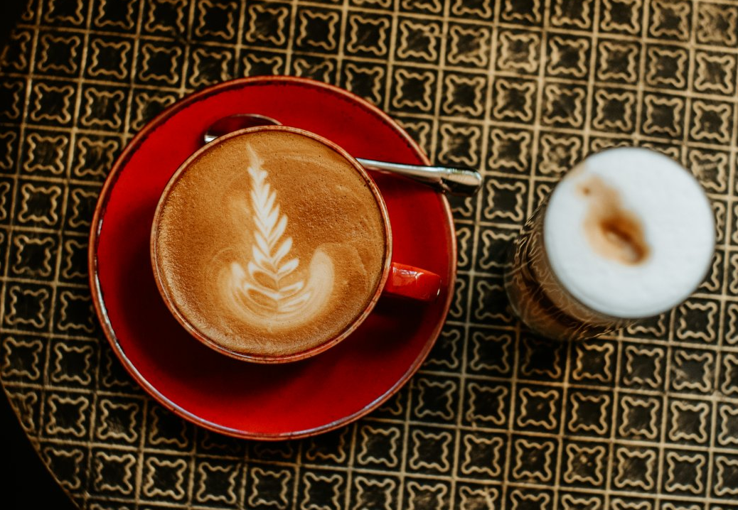
Hotel Dwór Uphagena Arche
https://www.archedworuphagena.pl/
Kawiarnia & Bar Maglownia
(coffee & drink bar)
S-Th: 11:00 - 23:00
F-Sa: 11:00 - 01:00

Slide 9
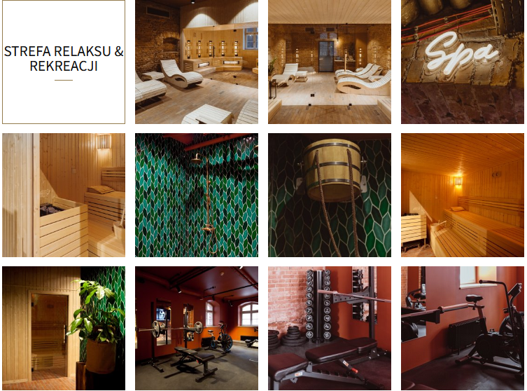
Hotel Dwór Uphagena Arche
https://www.archedworuphagena.pl/

Slide 10
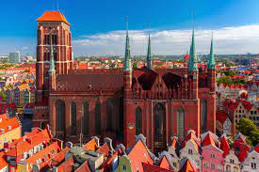
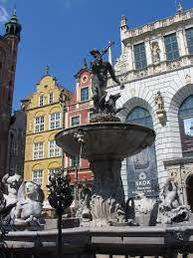
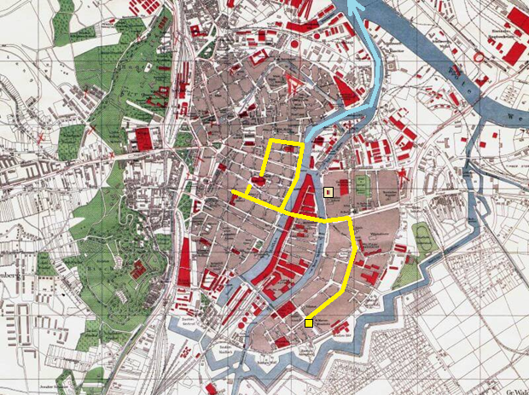
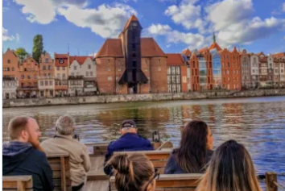
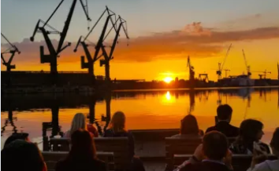
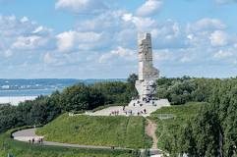
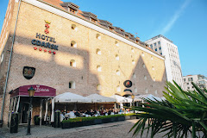
Excurion day – Wednesday 13-09-2023
14:00 – guiding tour start @Uphagen Arche, split for 2 groups, audio equipment
17:00 – boat tour: Fishmarkt (Targ Rybny) – Motława, ShipYard - Westerplatte
18:30 – dinner in Brovarnia @Hotel Gdańsk
22:00 – End / comeback to Uphagen Arche

Slide 11
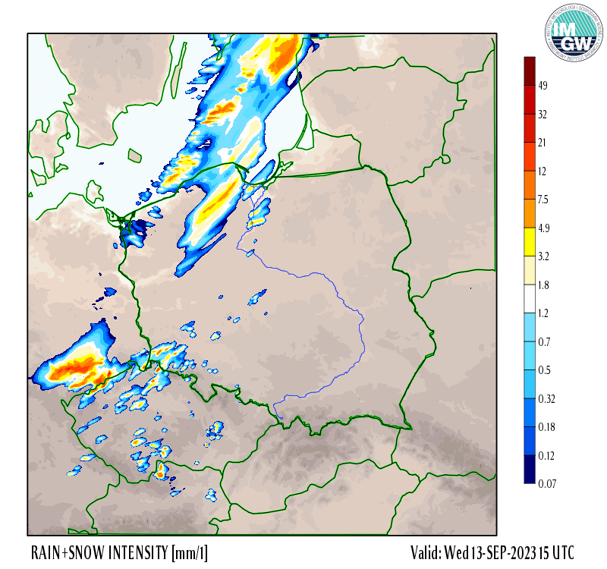
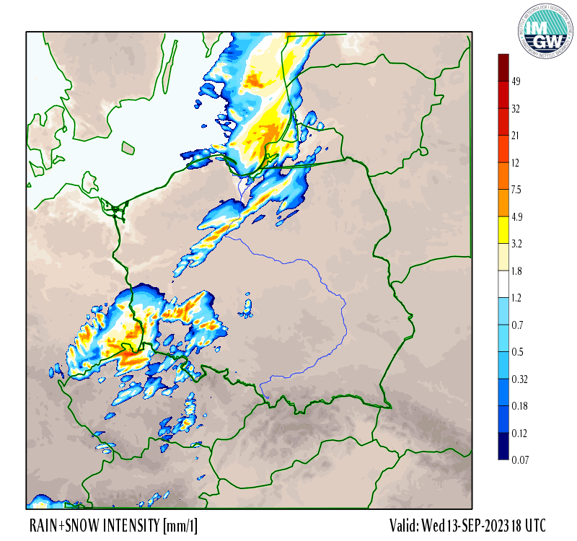
Excurion day – Wednesday 13-09-2023
Weather forecast
Rain: 15-18 UTC (17-20 local time)

Slide 12
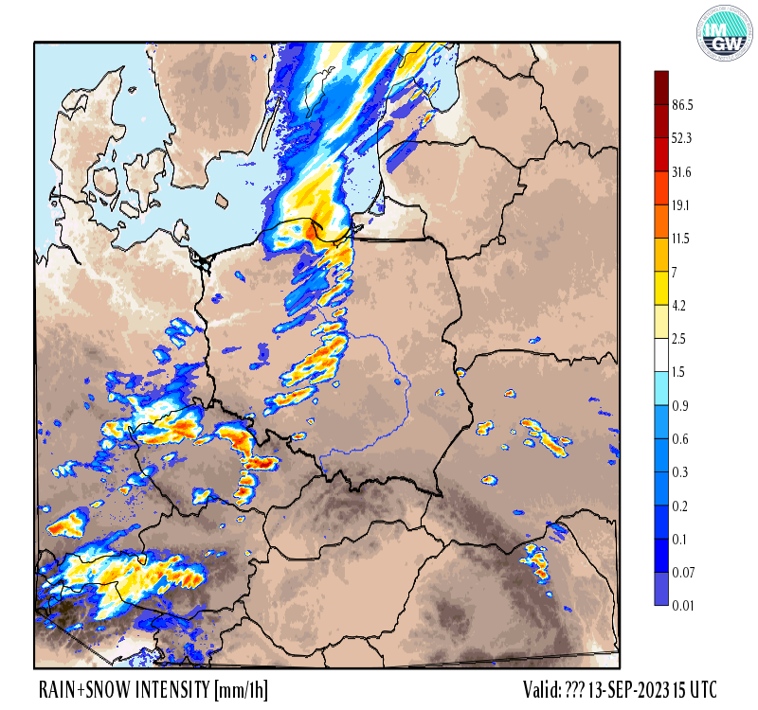
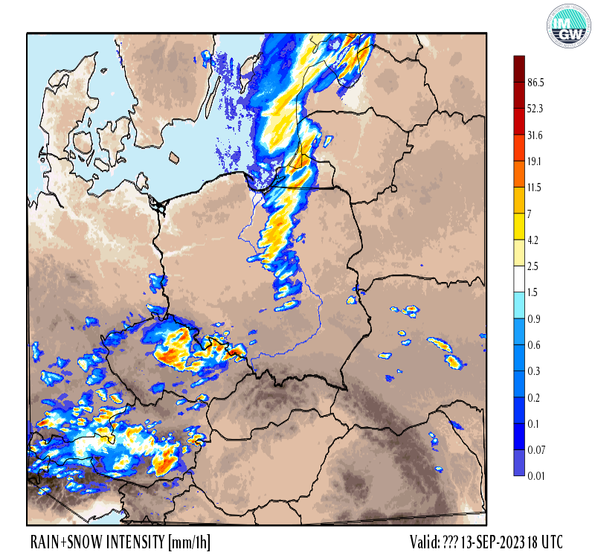
Excurion day – Wednesday 13-09-2023
ICON-LAM Weather forecast
Rain: 14-17 UTC (16-19 local time)

Slide 13
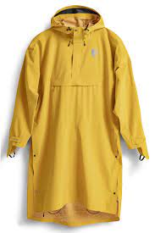

Excurion day – Wednesday 13-09-2023
ICON-LAM Weather forecast
Rain: 14-17 UTC (16-19 local time)

Slide 14
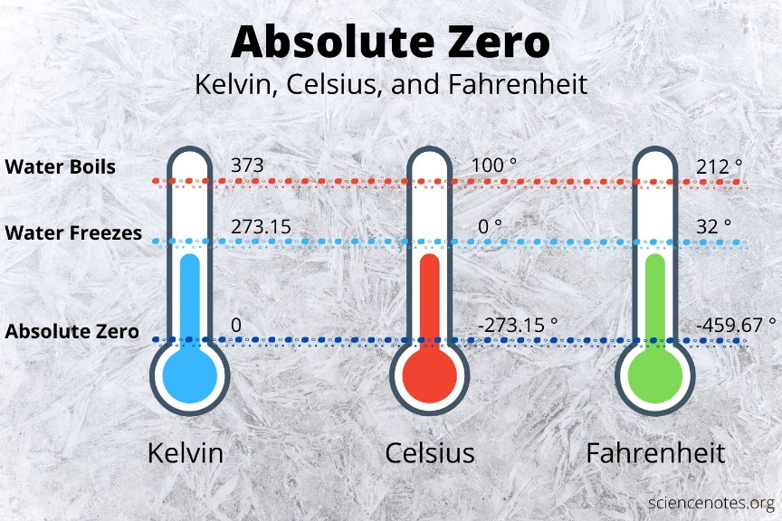
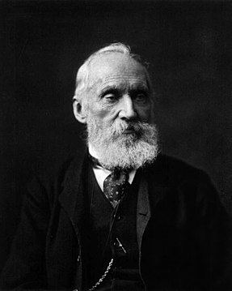
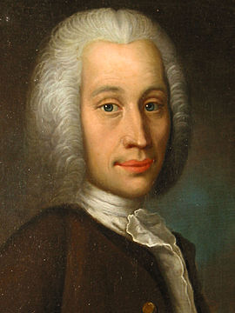
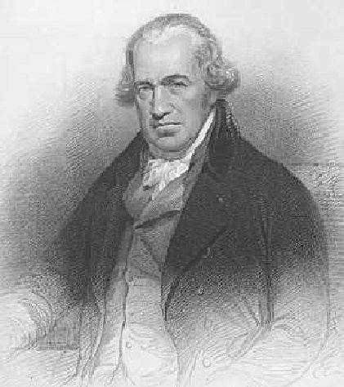
Weather trivia
Which scale is most importatnt?
William Thomson, 1. lord Kelvin (1824-1907)
Anders Celsjusz (1701-1744)
Daniel Gabriel Fahrenheit (1686-1736)

Slide 15
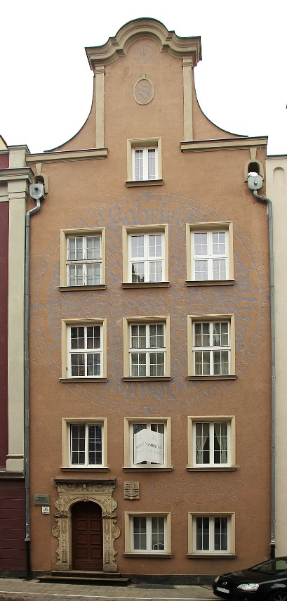
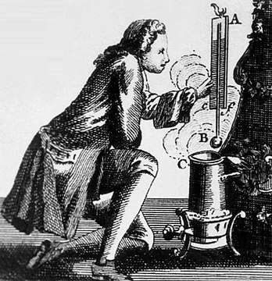




Ogarna Street 95
In Gdańsk - Fahrenheit scale!
Fahrenheit termometer
at Długi Targ (Long Market Street)
Daniel Gabriel Fahrenheit (1686-1736)
Born in Gdańsk
Fahrenheit Union of Universities (FarU)
Medical University of Gdańsk,
Gdańsk University of Technology
University of Gdańsk
Fahrenheit Science Picnic – Fahrenheit's Day 28/05/2023

