Slide 1
Tests with ICON ensemble (including SPPT) at IMS
Pavel Khain¹, Sascha Bellaire^{2,3} and Alon Shtivelman¹
¹Israel Meteorological Service, Bet-Dagan, Israel
²Center for Climate System Modeling (C2SM), Zurich, Switzerland
³Federal Office of Meteorology and Climatology MeteoSwiss, Zurich, Switzerland
WG7, GM 2023, Gdansk

Slide 2
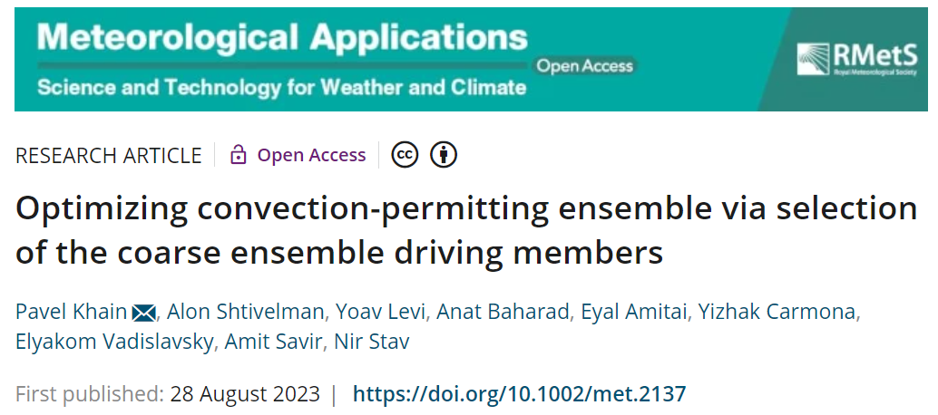

Slide 3
Verification
ICON 20-members (2.5km resolution) driven by randomly selected ECMWF ensemble (EC-ENS) members over the Eastern Mediterranean using different perturbation methods.
EC_ENS_51 - full ECMWF ensemble (EC-ENS)
COSMO_SPPT_20 - Stochastic Perturbation of Physics Tendencies (SPPT)
New:
ICON_20 - unperturbed
ICON_PP_20 - Parameter Perturbation (PP)
ICON_SPPT_20 - Stochastic Perturbation of Physics Tendencies (SPPT)
ICON_SPPT4_20 – as previous but after precipitation calibration

Slide 4
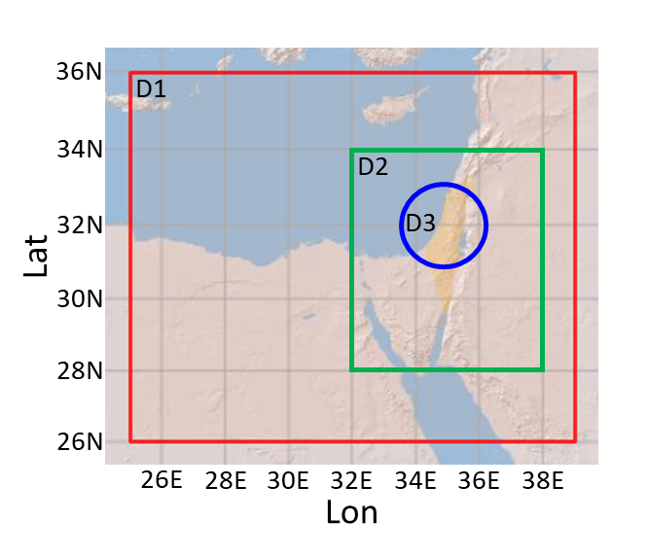
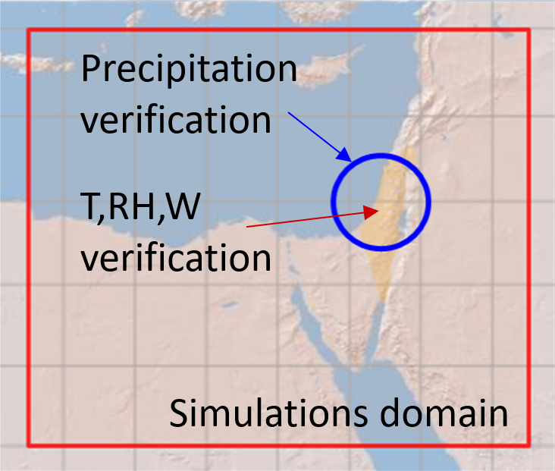
Verification period: 12/12/2021-12/2/2022

Slide 5
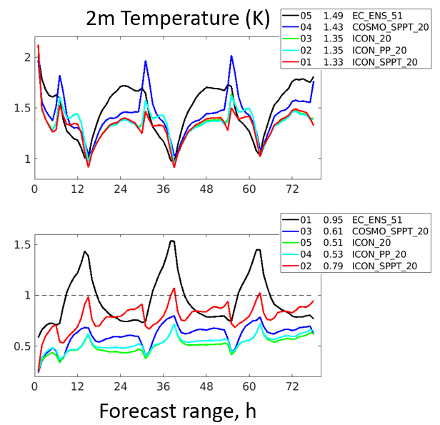
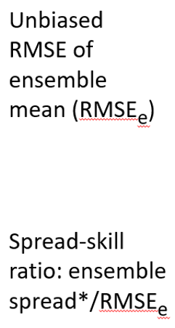
Spread Skill verification
reminder

Slide 6
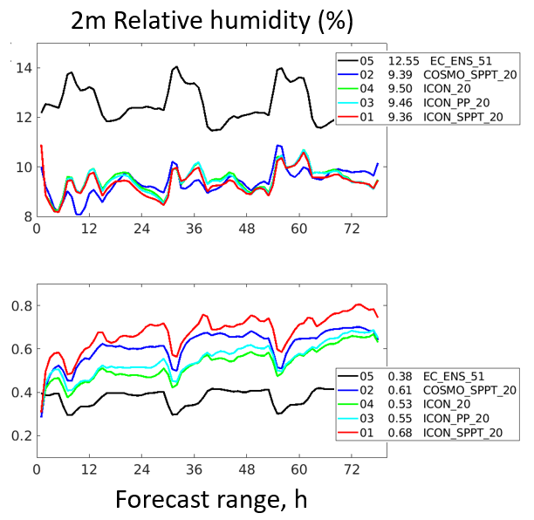
Spread Skill verification
reminder

Slide 7
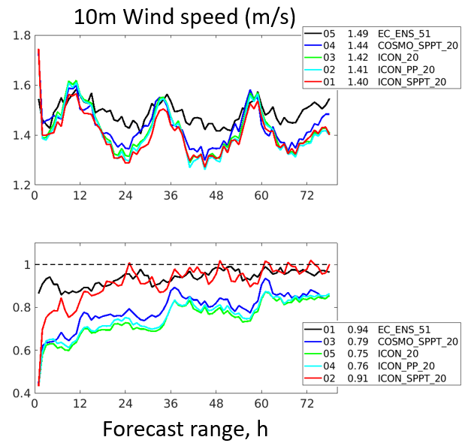
Spread Skill verification
reminder

Slide 8
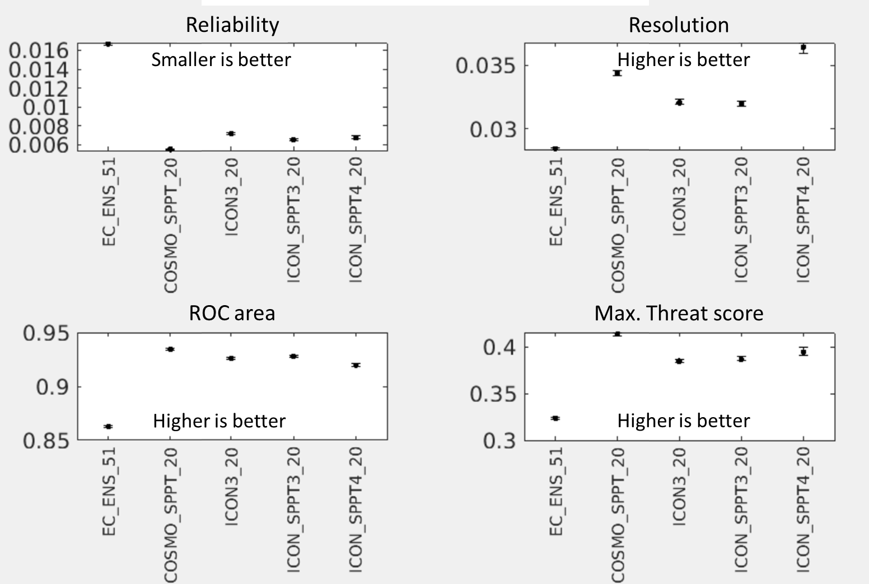
Precipitation verification

Slide 9
What is ICON_SPPT4 ?

Slide 10
Tackling strong precipitation overestimation in ICON
during unstable events with weak dynamic forcing
Tomorrow afternoon
Pavel Khain, IMS
WG3a meeting, GM2023, Gdansk
mm/6h
Radar
ICON

Slide 11
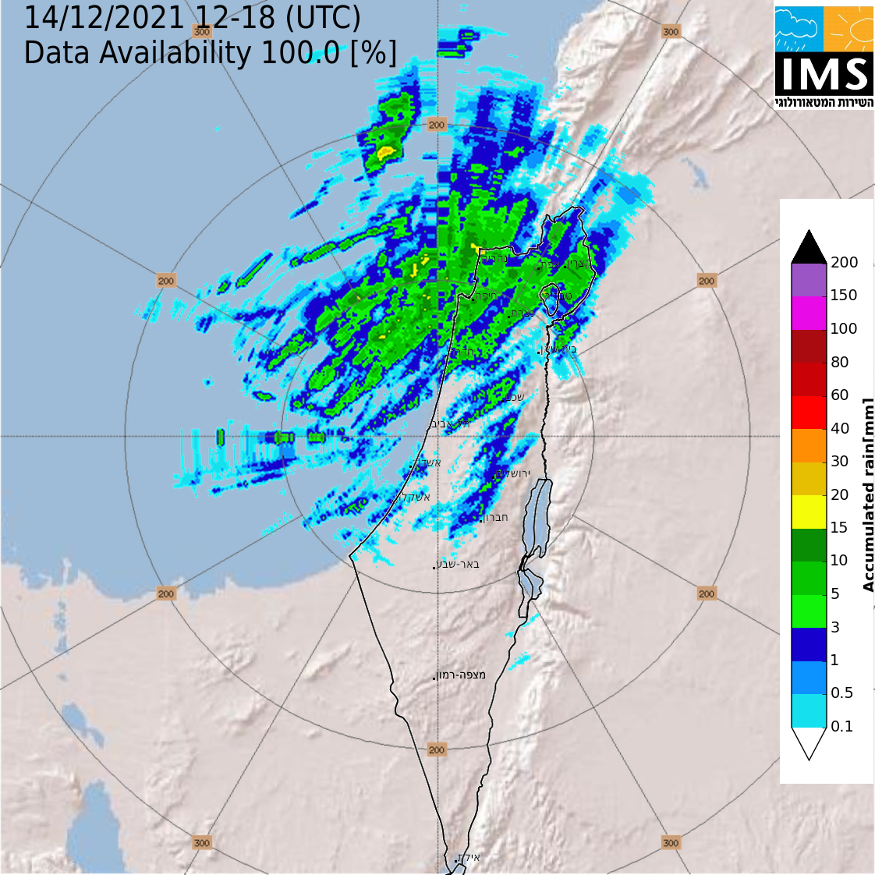
Example:

Slide 12
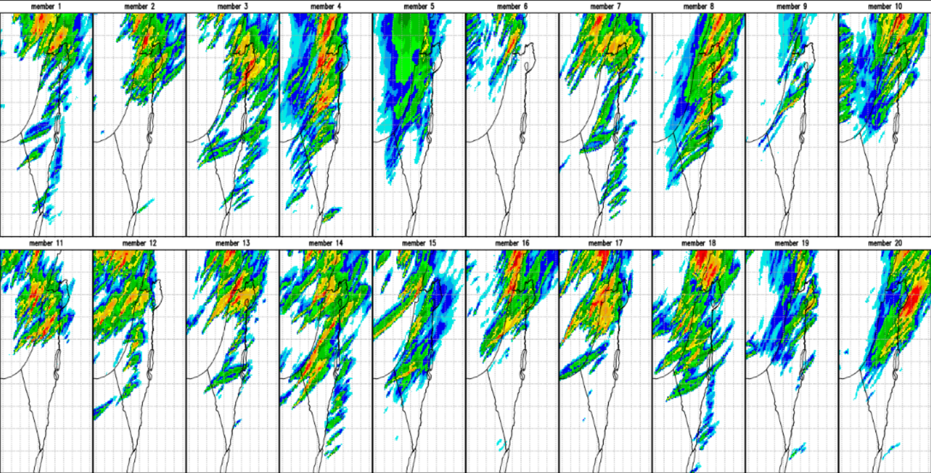
Example: ICON SPPT

Slide 13
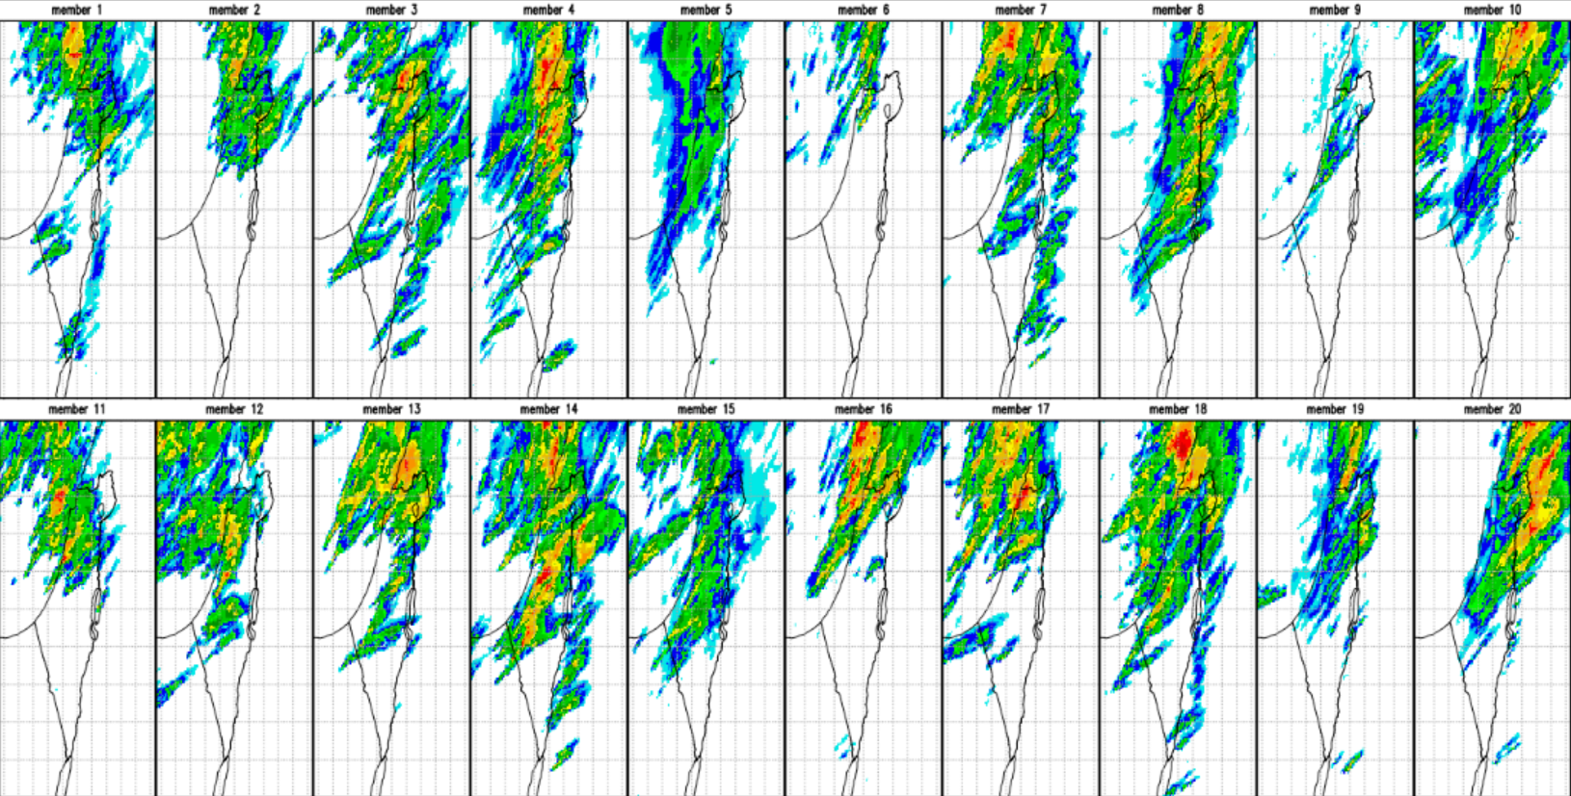
Example: ICON SPPT4

Slide 14
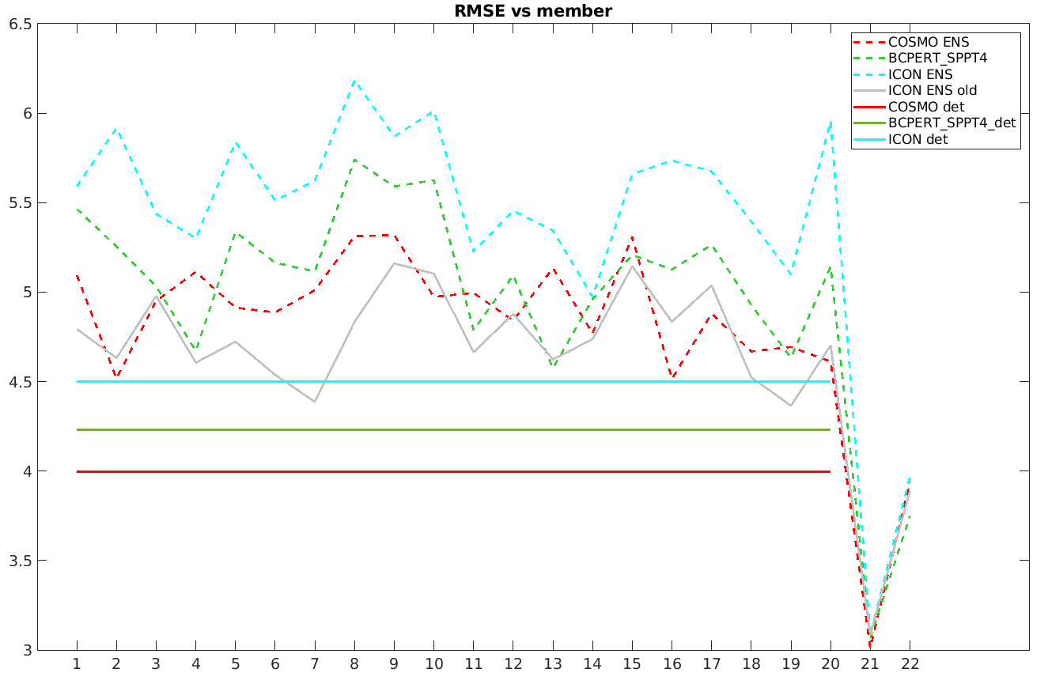
COSMO_SPPT_20
ICON_SPPT4_20
ICON_SPPT_20
ICON_20
COSMO_SPPT_20_det
ICON_SPPT4_20_det
ICON_SPPT_20_det
RMSE(mm/6h) vs stations
75% percentile
50% percentile

Slide 15
Conclusions
SPPT has benefit at T2m, RH2m, WS10m
Precipitation: COSOMO-SPPT is still better
Plan
1. Verify precipitation in more details
2. Rerun recent SPPT version
3. Other ideas?

