Slide 1


Task 2.1. Development and testing automatic QC methods based on the RainGaugeQC algorithms developed at IMGW
Anna Jurczyk, Katarzyna Ośródka, Jan Szturc (IMGW-PIB, Poland)
Gdańsk, 11-15 September 2023
Notes:
In this presentation I would like to present works carried out at the Department of Nowcasting in IMGW in Poland in the frame of the task 2.1: “…”

Slide 2
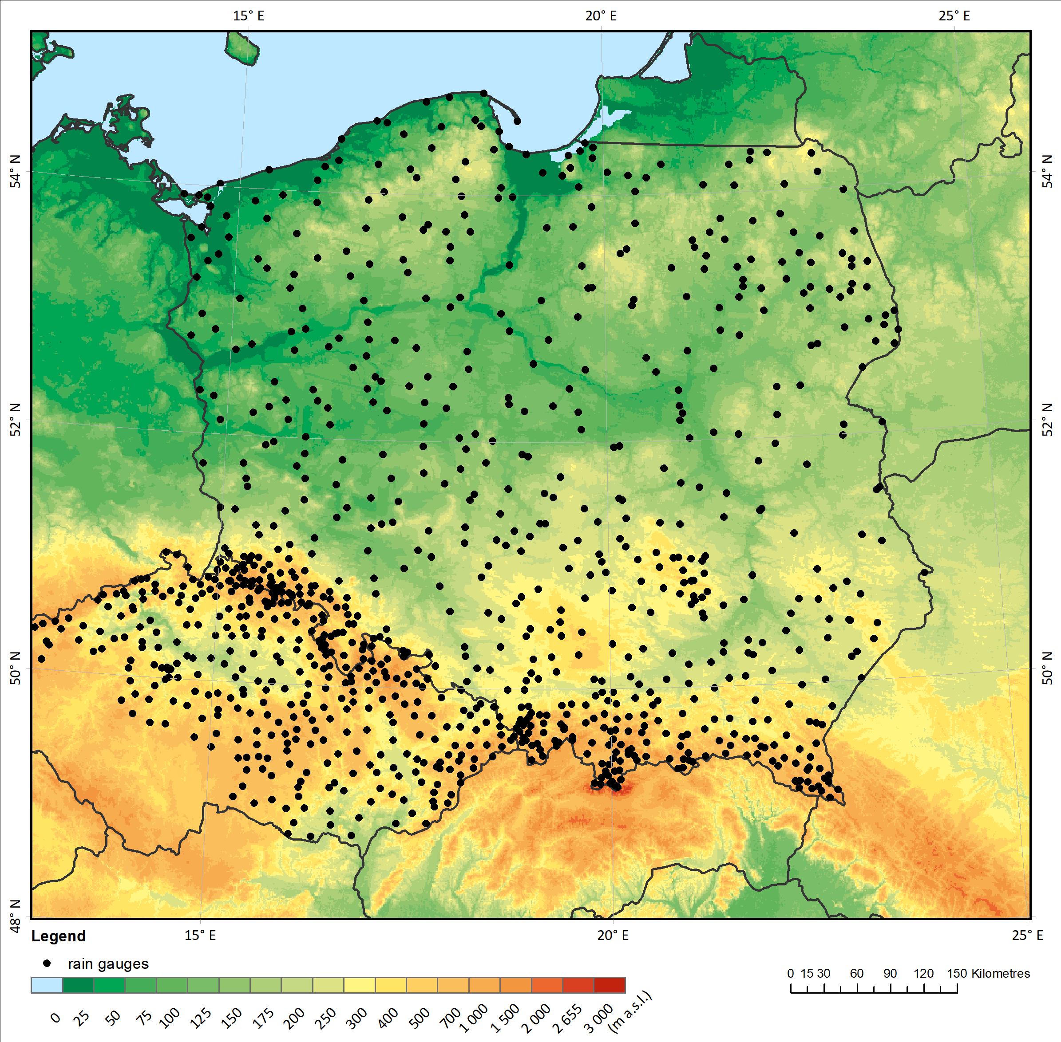
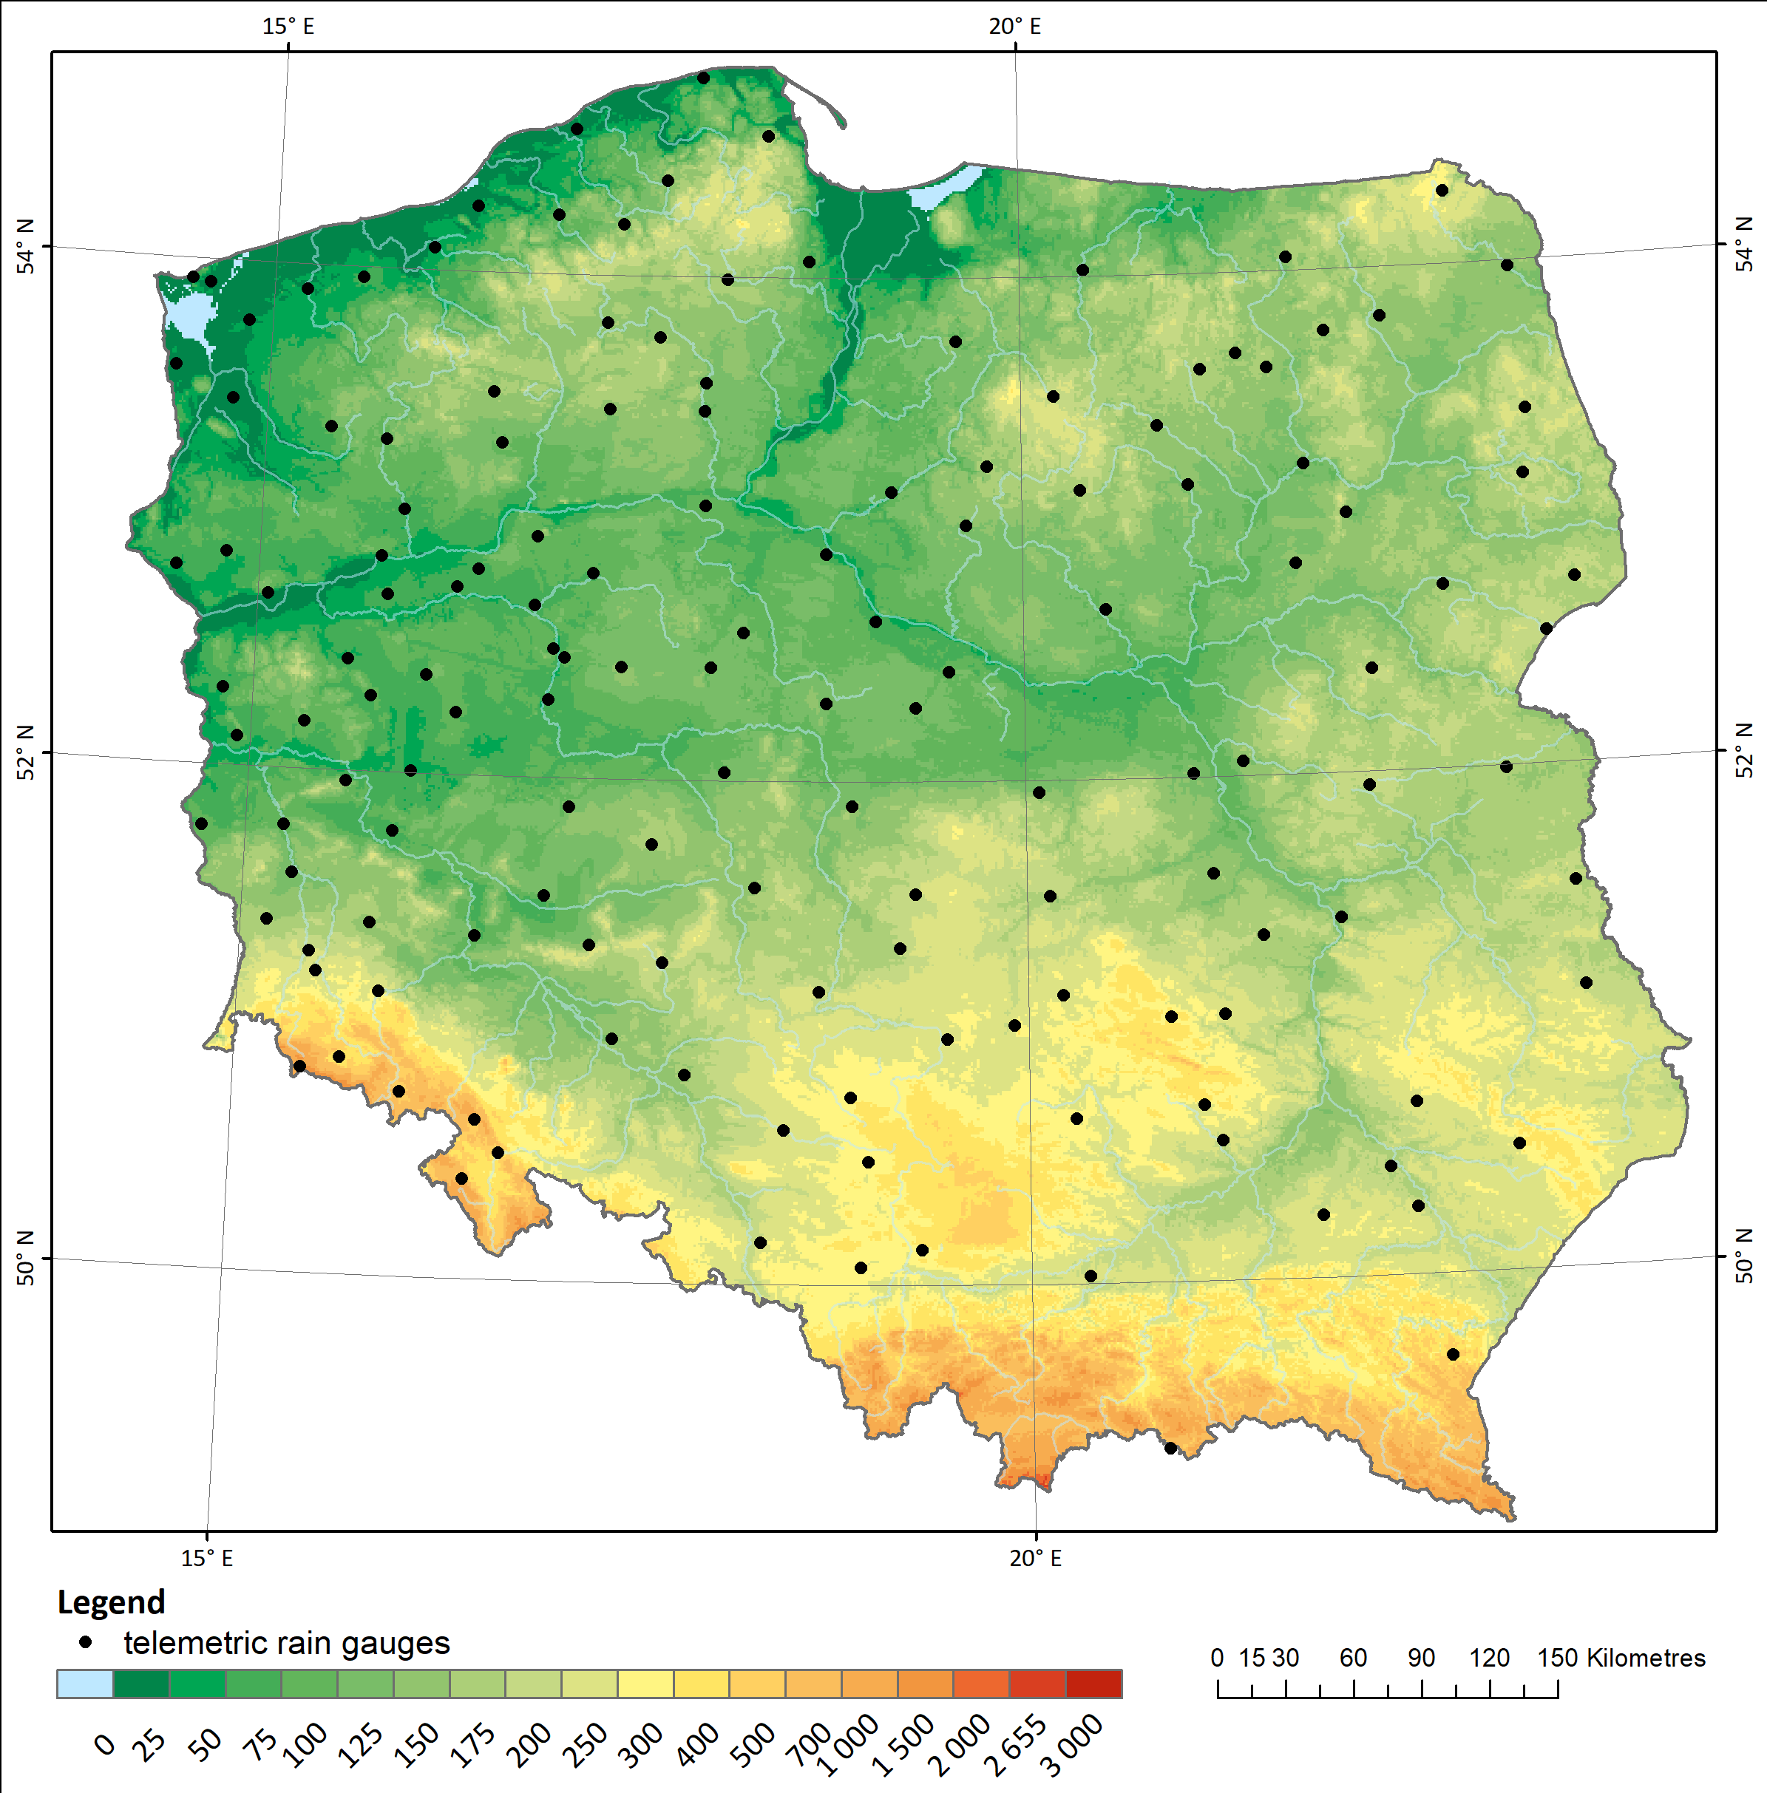
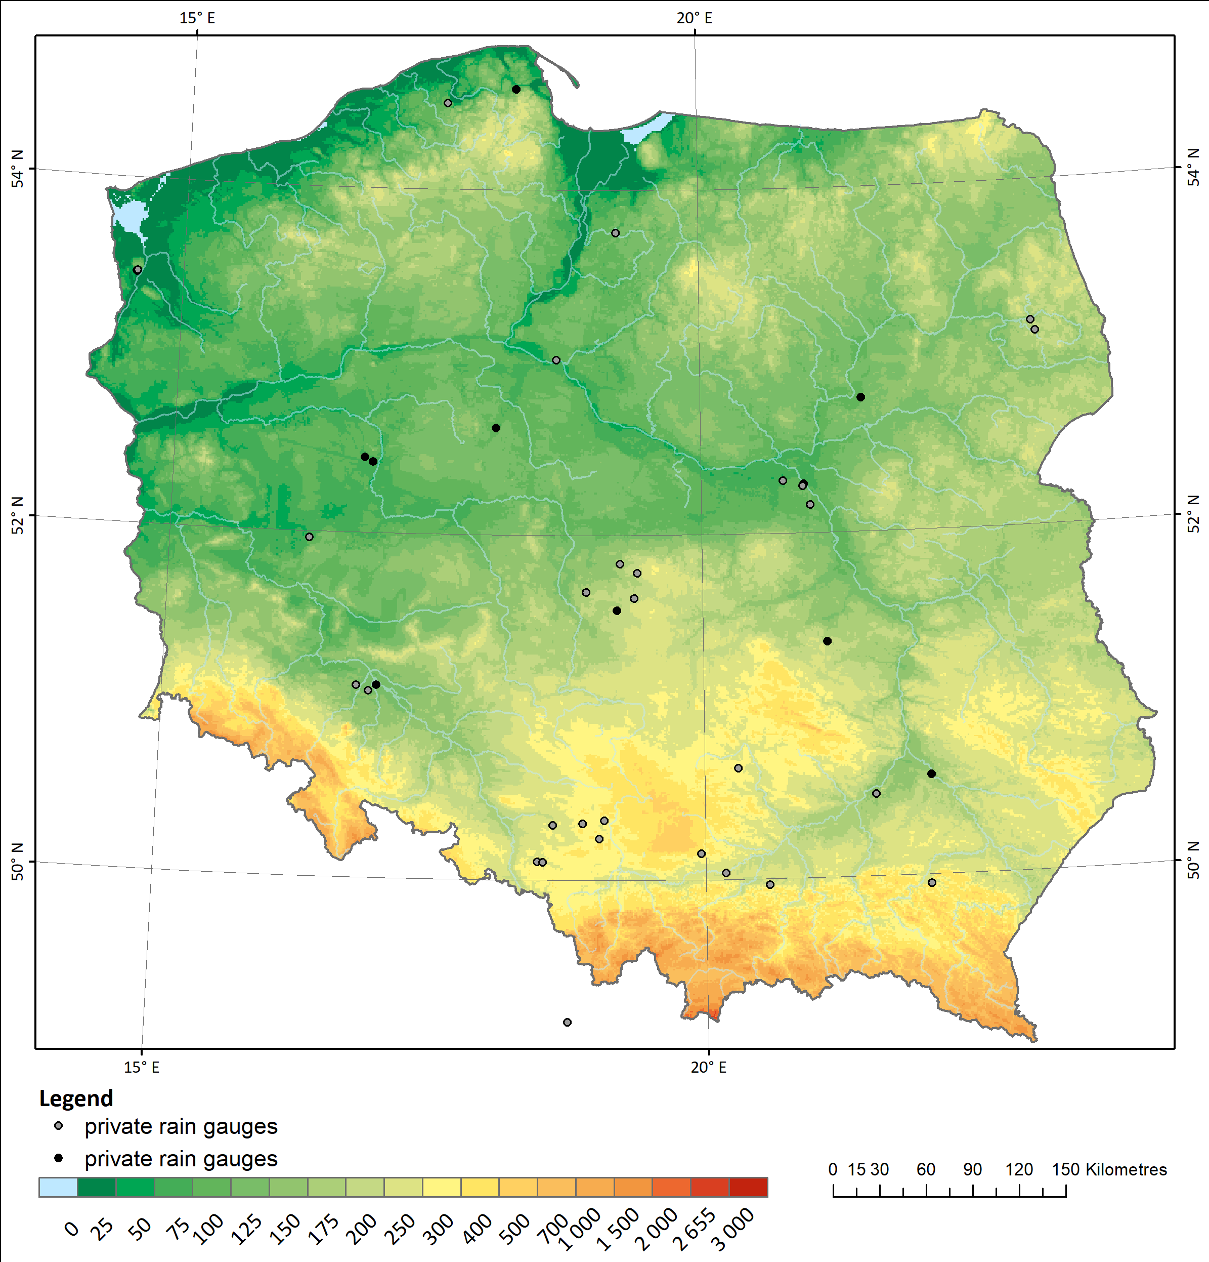
2.1. Development and testing automatic QC methods based on the RainGaugeQC algorithms
Data available from rain gauge networks
Professional NMS networks: Unprofessional networks:
Tytuł prezentacji z tutaj
IMGW (PL)
DWD (GE) – planned
CHMU (CZ)
SHMU (SK) – planned
Board of the State Forests
– state network
Private stations (PWSs) supported by the IMGW
Notes:
The basic precipitation data in the quantitative precipitation estimation, are data from telemetric rain gauges.
Here you can see maps of locations of rain gauges from networks which can be divided into two groups:
professional networks of national meteorological services, like IMGW network, and from neighbouring countries. Up to now we only have operational data from Czech Republic, and we expect to exchange data with Slovakia and Germany in a few months,
the second group we named as “unprofessional networks”, which means networks operated by institutions which are not meteorological services, like the Board of the State Forests, and networks of private rain gauges.
This is the current state of the PWS network in Poland supported by our Institute. The network has not been made public yet, as it is in the state of organisation and technical connection, so it is not very numerous – it has 41 stations. But we hope to reach at least several hundred stations once it is made public.
You can see that spatial distribution of gauges strongly depends on kind of network. Professional networks, i.e. those from NMSs, are characterised by most evenly distributed gauges, but they are denser in the mountains. In unprofessional state networks the gauge distribution depends on their specific applications, while the density of private networks depends on the population density.

Slide 3
2.1. Development and testing automatic QC methods based on the RainGaugeQC algorithms
Design and implementation of version of the RainGaugeQC software for QC of unprofessional gauges
(standard RainGaugeQC: Ośródka et al., AMT 2022)
Abbr. | Algorithm | Sub-algorithms | Standard RainGaugeQC | Version for unprofess. gauges
GEC | Gross Error Check |  | x | x
RC | Range Check |  | x | x
RCC | Radar Conformity Check | 1) Detection of incorrect „no precipitation” data | x | x
 |  | 2) Detection of false precipitation reports | x | x
TCC | Temporal Consistency Check | 1) Detection of blocked sensors | x | x
 |  | 2) Comparison of two sensors | x
 |  | 3) Time series comparison with weather radar |  | x
 |  | 4) Bias correction with adjusted radar data |  | x
SCC | Spatial Consistency Check | 1) Detection of outliers from the local vicinity | x | x
 |  | 2) Advanced detection of outliers taking into account additional percentiles | x | x
Tytuł prezentacji z tutaj
Notes:
Rain gauge observations need to be quality controlled by dedicated software because of various errors. RainGaugeQC scheme was developed at IMGW for real-time quality control of rain gauge data.
The original version (in blue) was designed for telemetric measurement network operated in our Institute with stations equipped with two sensors: heated and unheated one. The scheme consists of several checks:
detection of exceedance of the natural limit, and, climate-based thresholds,
checking of the conformity of rain gauge and radar observations,
the consistency of time series from heated and unheated sensors,
and the spatial consistency of neighbouring gauges.
The proposed approach is focused on assessing the reliability of individual rain gauge observations. A quantitative indicator of reliability, called the quality index (QI), describes the quality of each measurement as a number in the range from 0.0 (for completely unreliable measurement) to 1.0 (for perfect measurement).
When it comes to quality control of unprofessional rain gauge stations, there is a need to rebuild temporal quality control. Instead of algorithm comparing two sensors, new algorithms (in yellow) are focused on comparison with time series of radar data and then bias correction (not only quality assessment, but also correction):

Slide 4

2.1. Development and testing automatic QC methods based on the RainGaugeQC algorithms
Design and implementation of version of the RainGaugeQC software for QC of unprofessional gauges
The following sub-algorithms have been designed and are in the process of verification:
TCC/3: Comparison of the agreement of time series of rain gauge data with radar observations.
  The reduction in the quality index (QI) of data from a given rain gauge depends on the correlation coefficient of the time series (of the last 5 or 10 days) from that rain gauge with the radar time series at that pixel.
TCC/4: Unbiasing by comparison with radar data (from the last 10 days).
Tytuł prezentacji z tutaj
$$bias=\frac{\sum_{10 days}{\left(R\right)}}{\sum_{10 days}{\left(G^{unprof}\right)}}$$
Notes:
The first algorithm TCC/3 is based on long-term correlation with radar data taking account of some thresholds for the precipitation sum and the number of non-rainy time-steps. The time series are from the last 5 or 10 days.
The reduction in the quality index of data from a given rain gauge, depends on the correlation coefficient of the time series from rain gauge and radar at a given pixel.
The second algorithm TCC/4 is applied only to unprofessional rain gauge data and it aims at unbiasing the data through comparison of long-term accumulations from rain gauge and radar data.
The performance of this scheme has been evaluated by analysing the spatial distribution of the precipitation field and comparing it with precipitation observations and estimates provided by other techniques, mainly manual rain gauges and multi-source estimates. The results of verification will be shown in our presentation dedicated to Task 3.1.

Slide 5
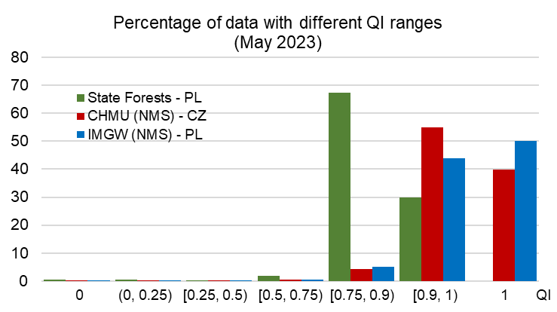
2.1. Development and testing automatic QC methods based on the RainGaugeQC algorithms
Analysis of quality controlled data
Tytuł prezentacji z tutaj
Notes:
Here you can see preliminary results of the QC algorithms verification, conducted on data from professional data from PL and CZ networks, and unprofessional State Forests network. The main observation is that professional data have bigger percentages for higher quality indices: mainly between 0.90 and 1, whereas for unprofessional State Forest network, data with lower quality indices: from 0.75 to 0.9, are more numerous.

Slide 6
Task 3.1. Processing different rainfall data sources (PWSs, CMLs, sewer/water service stations, etc.)
Anna Jurczyk, Katarzyna Ośródka, Jan Szturc (IMGW-PIB, Poland)
Gdańsk, 11-15 September 2023
Notes:
In this presentation I would like to present works carried out at the Department of Nowcasting in IMGW in Poland in the frame of the task 3.1: “…”.
Especially, we deal with a combination of unprofessional rain gauges with other standard data (telemetry, radar, satellite) into new enhanced rainfall estimates RainGRS+.

Slide 7
3.1. Multi-source precipitation (RainGRS+)
RainGRS+ model:
Quality-based combination of rain gauge, radar and satellite data (QPE)
Input data:
Data | Spatial resolution | Temporal resolution | Delay | From the software
IMGW rain gauge network | point | 10 min | 6 min | RainGaugeQC
Unprofessional networks (PWS) | point | 10 min | 12 min | RainGaugeQC
IMGW POLRAD radar network + neighbouring countries radars | 1 km | 10 min | 7 min | RadComposite
EUMETNET OPERA radar precipitation | 1.9 km x 2.2 km | 15 min | 13-23 min | EUMETNET OPERA
Meteosat (NWC-SAF) based precipitation estimates (algorithm, see: Jurczyk et al., 2020, Remote Sensing) | 1 km | 10 min | 3 min | sat_qc_int
CML (microwave commercial links) | point | 15 min | ? | COST OPENSENSE
Notes:
Our operational RainGRS product is a multi-source combination. The input data are:
data from telemetric rain gauge network,
weather radar data: from Polish network POLRAD and from radars of neighbouring countries,
satellite data – precipitation estimates based on Meteosat products.
Domain of this operational product is 800 km x 900 km and covers the whole Poland.
For the need of the COSMO model this domain has to be extended and data from other sources have to be included. So, this new product, called RainGRS plus, additionally is to employ the following data coloured in the table:
data from unprofessional weather stations including private ones,
radar precipitation product from EUMETNET OPERA,
and estimates based on attenuation derived from commercial microwave links.

Slide 8
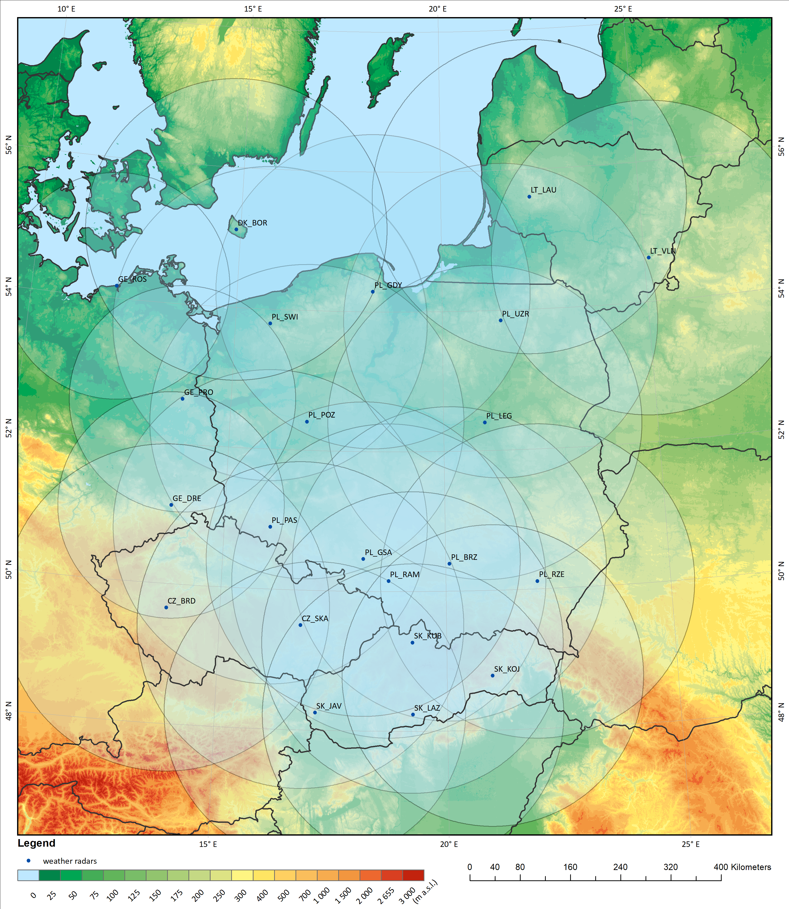
3.1. Multi-source precipitation (RainGRS+):
weather radar data
Weather radars in RainGRS+ system
(COSMO 2.8 domain)
PL: BRZ, GDA, GSA, LEG, PAS, POZ, RAM, RZE, SWI, UZR
GE: DRS, PRO, ROS
CZ: BRD, SKA
SK: JAV, KOJ, KUB, LAZ
LT: LAU, VLN
DK: BOR
+ OPERA composite
Notes:
The main precipitation data in multi-source estimation are weather radar data. Polish radar network POLRAD consists of 10 radars, and we also ingest data from neighbouring countries: …
Because RainGRS+ domain is larger (lardżer), so OPERA composites are also included in places not covered by the available radars.

Slide 9
3.1. Multi-source precipitation (RainGRS+)
satellite data
Various satellite-based precipitation field estimates are available. The best for our region are the NASA IMERG-final estimates, but these are reanalyses only available after several months.
The estimate designed for RainGRS based on Meteosat data processed with NWC-SAF software was found the best available in real-time.
PCPh = Precipitating Clouds from Cloud Physical Properties,
CRPh = Convective Rainfall Rate from Cloud Physical Properties,
CRR = Convective Rainfall Rate,
PC = Precipitating Clouds.
Notes:
Satellite estimates are useful especially in places where there is neither rain gauge nor radar data.
…
The following NWC-SAF products are applied in this estimate: Precipitating Clouds from Cloud Physical Properties,
Convective Rainfall Rate from Cloud Physical Properties, Convective Rainfall Rate, and Precipitating Clouds.

Slide 10
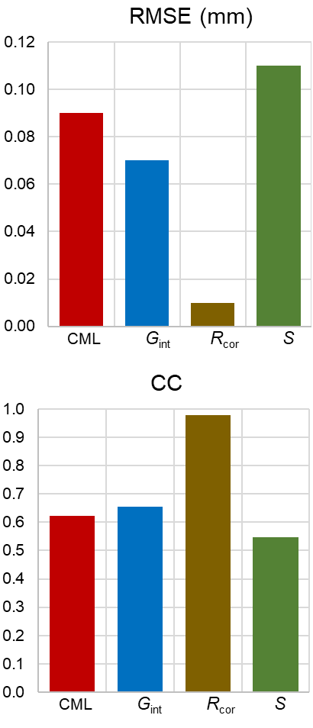
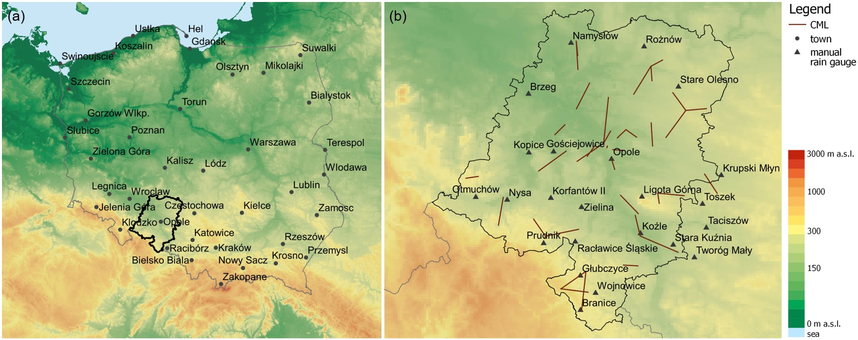
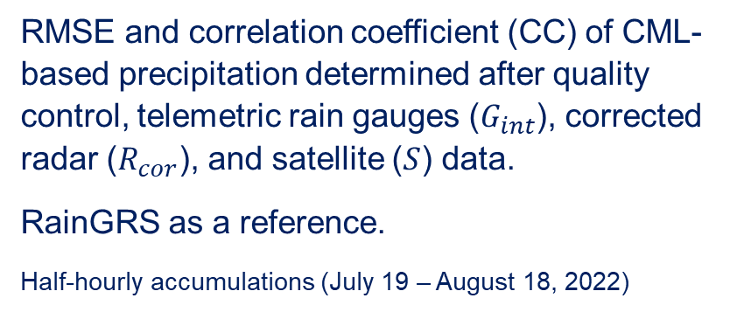
3.1. Multi-source precipitation (RainGRS+)
CML-based data
CMLs (commercial microwave links) provide precipitation estimates based on attenuation on the links.
RMSE and correlation coefficient (CC) of CML-based precipitation determined after quality control, telemetric rain gauges ($G_{int}$), corrected radar ($R_{cor}$), and satellite ($S$) data.
RainGRS as a reference.
Half-hourly accumulations (July 19 – August 18, 2022)
Notes:
Another source of precipitation data can be estimates based on attenuation on the commercial microwave links (CMLs). We have tested usefulness of the estimates on data from one month for the Opole region. CML-based precipitation was estimated and statistics of their reliability were determined.
Compared with other precipitation estimates, it was found that the CML-based precipitation fields are much worse than radar-derived estimates. They have slightly poorer reliability than spatially interpolated telemetric rain gauge data and significantly higher reliability than satellite estimates.
From the point of view of operational usage, the estimation of CML-based precipitation may bring some potential to the issue of improving precipitation field estimation with a high temporal and spatial resolution. However, the use of these estimates requires further work.
Our works are preliminary and operational use of the data depends on formal agreement with the CML data provider.

Slide 11
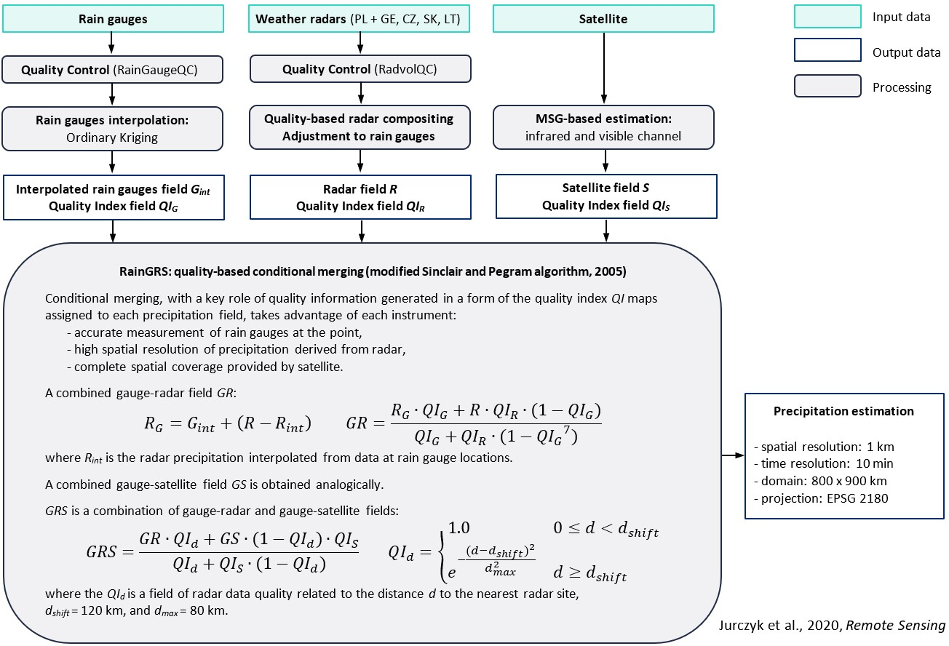
3.1. Multi-source precipitation (RainGRS+):
combination
Tytuł prezentacji z tutaj
Notes:
Here you can see a scheme of algorithms for multi-source precipitation combination.
In the current operational version, there are three data sources: telemetric rain gauges, radar and a meteorological satellite. Each of these inputs requires a dedicated data QC system, in particular: RaingaugeQC and RadvolQC, which also generates quality index fields. All the input data are pre-processed: the rain gauge data is spatially interpolated, the radar data is adjusted to the rain gauge data, and the satellite products from Meteosat are converted into a precipitation field.
Then a combination of these three types of data is carried out. The algorithm is based on conditional merging technique, proposed by Sinclair and Pegram, enhanced by involving detailed quality information that is assigned to individual input data, in order to take into account their advantages and disadvantages. This is carried out according to the formulas shown in this slide, combining first the gauge data with radar, then in the same way gauge with satellite, and finally combining the two fields into a combined GRS field.

Slide 12
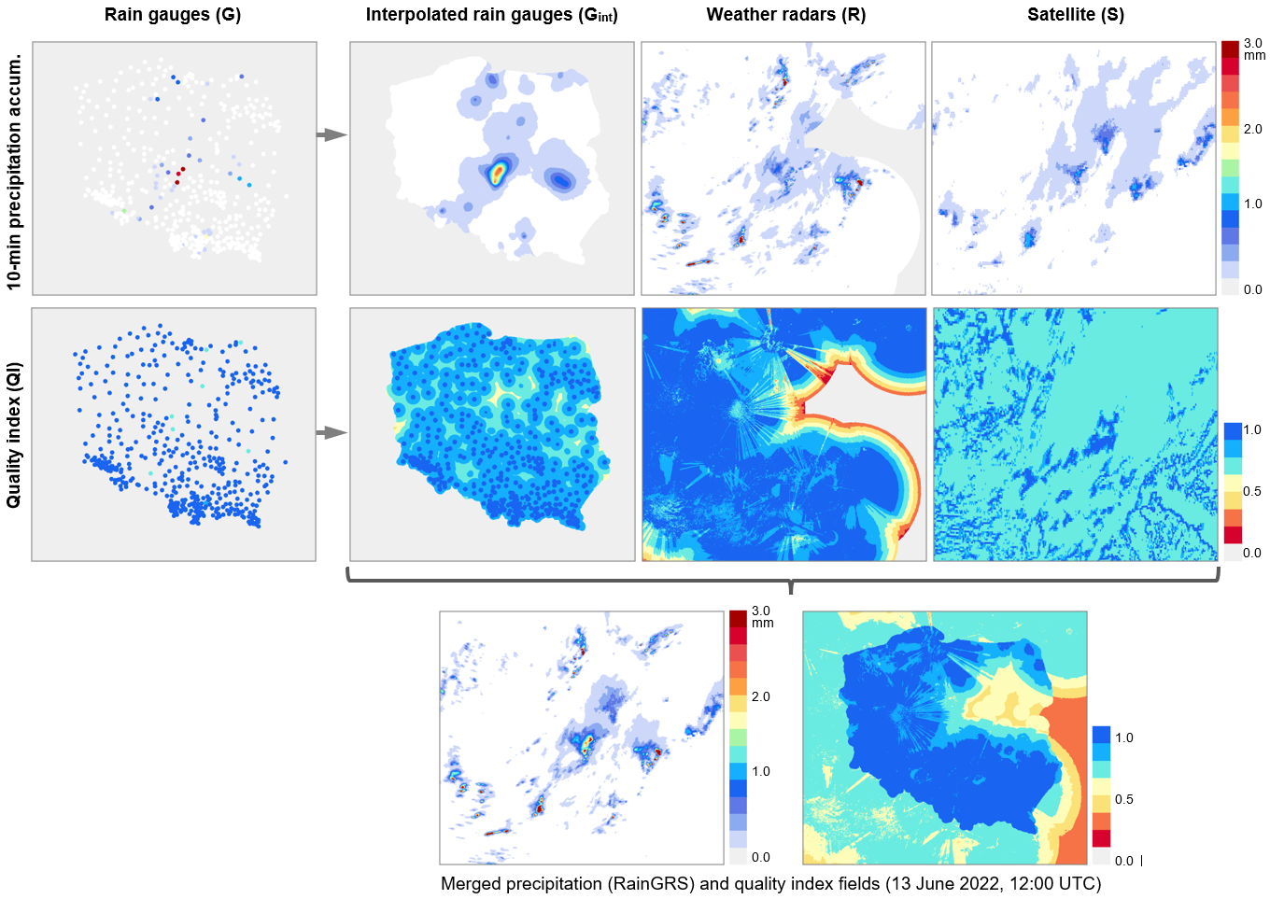
3.1. Multi-source precipitation (RainGRS+): combination
Tytuł prezentacji z tutaj
Notes:
This is an example of the RainGRS running.
In the top row we have the individual input fields: point and interpolated rain gauges, and from radar and satellite. In the next row we have the relevant dynamic quality fields. Their pattern depends on the specificity of the techniques: on the quality of the particular rain gauges, on the availability of data from the particular radars, and on the characteristics of the rainfall observed by the satellite (e.g. whether it is convective).
Here is the result of the algorithm: combined field of precipitation along with a field of its quality.

Slide 13
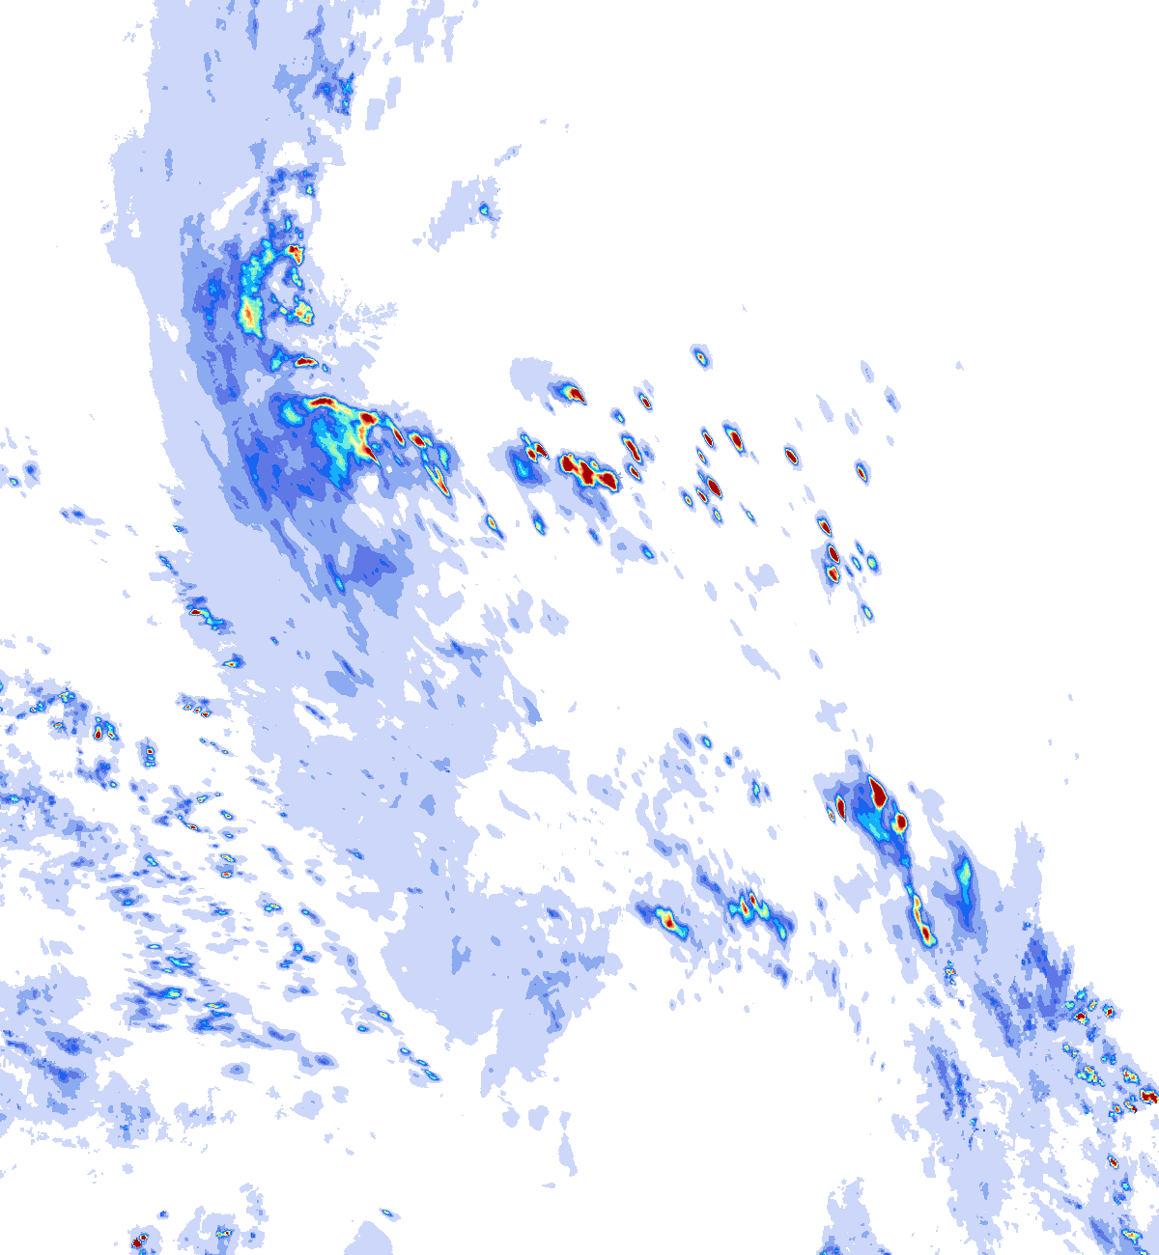
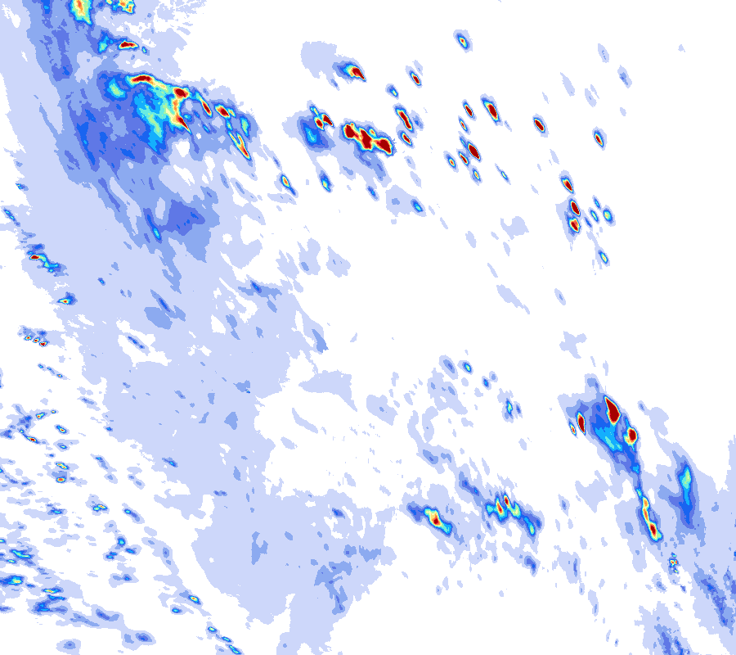
3.1. Multi-source precipitation (RainGRS+)
Determination of QPE (quantitative precipitation estimation) for COSMO 2.8 km domain (1200 km x 1300 km) with extended RainGRS+ system
RainGRS (PL) domain
Precipitation (mm / 10 min)
2023-08-06, 15:30 UTC
RainGRS+ (COSMO 2.8) domain
Notes:
Here, on the left you can see an example of operational RainGRS product, and on the right RainGRS+ for COSMO domain. The domain for COSMO is much larger (lardżer) and we have to remember that quality of the product may be worse outside the Poland domain.

Slide 14
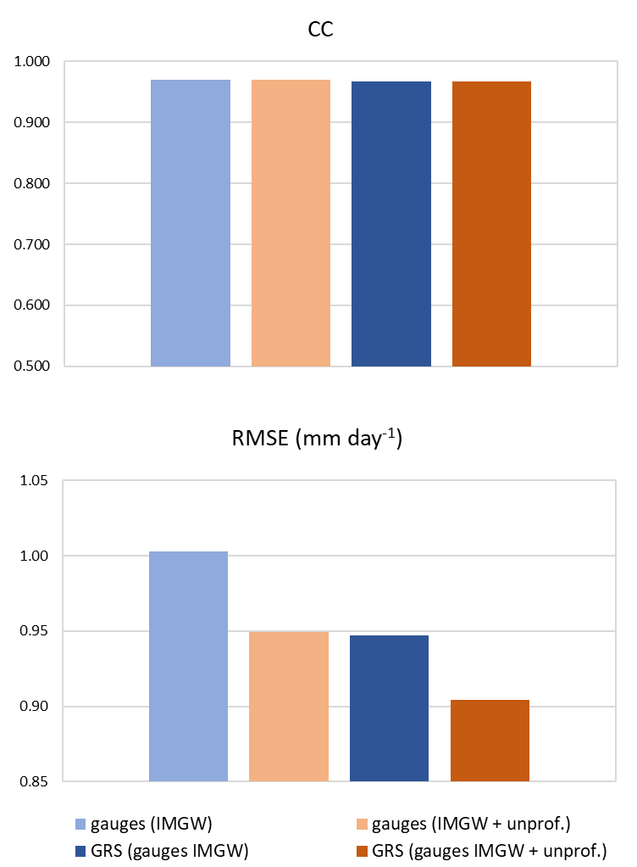
2.1. Development and testing automatic QC methods based on the RainGaugeQC algorithms
Reliability statistics of rainfall fields:
spatially interpolated from rain gauges from IMGW,
spatially interpolated from IMGW + unprof.,
RainGRS fields based on data from IMGW,
RainGRS fields based on data from IMGW + unprof.
Reference: data from manual rain gauges.
May 2023.
Notes:
In this diagram we can see reliability statistics for four precipitation fields: (a) only from professional rain gauges, (b) the same plus data from unprofessional network, (c) RainGRS estimate without, and (d) with data from unprofessional rain gauges. Data from manual rain gauges are used as reference – daily accumulations from May this year.
It can be noticed, that correlation coefficient is high and nearly the same for all presented fields. However, for both interpolated rain gauge fields and RainGRS estimates, RMSE is significantly lower after adding data from unprofessional network.

Slide 15

Thank you!

