Slide 1
Fuzzy verification on Common Areas
Naima Vela
September the 11th 2023 - 25th COSMO General Meeting - Gdańsk

Slide 2
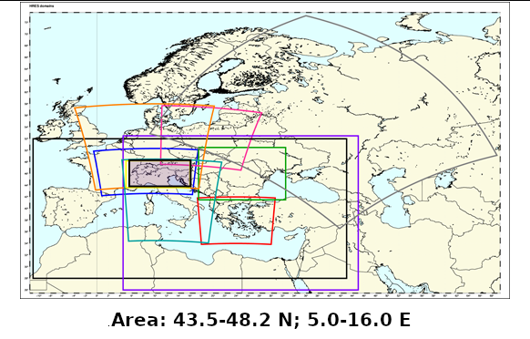
WHAT IS COMMON AREA 2
MODELS: ICON D2, COSMO 1E, ICON 1E, ICON GR, COSMO 2I, COSMO IT, ICON IT, ICON IL
September the 11th 2023

Slide 3
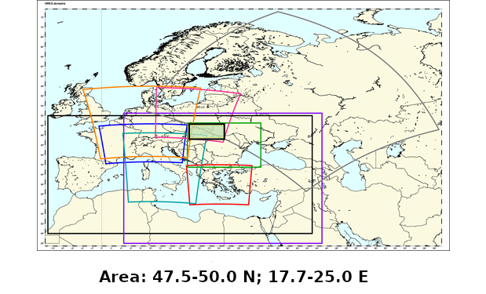
WHAT IS COMMON AREA 3
MODELS: ICON GR, ICON PL, COSMO CE PL, ICON IL
September the 11th 2023

Slide 4
DESCRIPTION OF THE VERIFICATION
Models:
Common Area 2:
ICON D2, COSMO 1E, ICON 1E, ICON GR, COSMO 2I, COSMO IT, ICON IT, ICON IL
Common Area 3:
ICON GR, ICON PL, COSMO CE PL, ICON IL
Observation: OPERA database by EUMETNET
Resolution (forecast and observation): 0.025°, lat-lon
Period: JJA 2022, SON 2022, DJF 2023, MAM 2023
Scores: FSS, FBI, ETS
Methods: 1 timestep
Cumulation: 3h
September the 11th 2023

Slide 5
Plot explanation
O: Period
O: Score
O: Day and timesteps
O: Thresholds
O: Models
O: Spatial scales

Slide 6
JJA 2022

Slide 7
FSS – D0 - 1T
COMMON AREA 2
0.2 mm: COSMO 1E and ICON D2 have the best performances followed by ICON 1E. Bad performance for COSMO 2I and IT and ICON IT. ICON GR has a very good FSS, but does not cover the entire period.
5.0 mm: more spread for this threshold. Very good FSS for ICON 1E followed by ICON D2, COSMO 1E. COSMO IT better than ICON IT and COSMO 2I, last ICON GR.
* ICON GR: incomplete
**ICON IL: no data

Slide 8
FBI and ETS – D0 - 1T
COMMON AREA 2
General underestimation with the exception of ICON and COSMO 1E at 5 mm/3h.
Best results for ICON D2 followed by COSMO and ICON 1E. Mixed results for ICON GR: good at 0.2 mm/3h, bad for 5 mm/3h.

Slide 9
FSS – D0 - 1T
COMMON AREA 3
0.2 mm: Better performance for ICON GR, followed by ICON PL. Worst performance for COSMO CE PL.
5.0 mm: ICON PL has the best performance at the large scales. COSMO CE PL always worst, but close to ICON GR at the largest scale.
* ICON GR: incomplete
**ICON IL and ICON NM: no data

Slide 10
FBI and ETS – D0 - 1T
COMMON AREA 3
General underestimation with the exception of ICON PL at 5 mm/3h.
Best results for ICON GR at smaller scales for 0.2 mm/3h, but worsening at larger scales. Good results for ICON PL.

Slide 11
Conclusions - JJA 2022
Very good results for COSMO and ICON 1E for all the scores (Area 2).
COSMO 1E has generally higher performances if compared to the other COSMO models. It’s comparable to the ICON models (Area 2).
ICON D2 has very good performances for FSS and ETS, but some underestimation (Area 2).
COSMO CE PL has generally lower performances if compared to ICON PL (Area 3).

Slide 12
SON 2022

Slide 13
FSS – D0 - 1T
COMMON AREA 2
0.2 mm: ICON D2, ICON GR and ICON 1E have the best results, followed by COSMO 1E. ICON IT better than COSMO 2I and COSMO IT.
5.0 mm: Best results for ICON 1E and ICON D2. COSMO 1E and ICON GR are close. Intermediate results for COSMO and ICON IT. Worst results for COSMO 2I.
* ICON GR: incomplete
**ICON IL: no data

Slide 14
FBI and ETS – D0 - 1T
COMMON AREA 2
Small underestimation for all models at 0.2 mm/3h. Large overestimation for small scales at 5 mm/3h.
Best results for ICON D2 followed by COSMO and ICON 1E at 0.2 mm/3h.Models are very close to each other at 5 mm/3h.

Slide 15
FSS – D0 - 1T
COMMON AREA 3
0.2 mm: Better performance for ICON GR and ICON PL. Worst performance for COSMO CE PL.
5.0 mm: ICON PL has the best performances. ICON GR is the worst, but close to COSMO CE PL at the small and medium scales.
* ICON GR: incomplete
**ICON IL and ICON NM: no data

Slide 16
FBI and ETS – D0 - 1T
COMMON AREA 3
Small underestimation at 0.2 mm/3h. Large overestimation at 5 mm/3h for small scales.
At larger scales the performances at 5 mm/3h get better than those at 0.2 mm/3h.

Slide 17
Conclusions - SON 2022
Very good performance for ICON D2 for all scores (Area 2).
Small underestimation at 0.2 mm/3h for all models (Area2 and Area 3)
Very large overestimation for all models at the small/medium scales for 5 mm/3h (Area2 and Area 3).
ETS values at 5 mm/3h get very close (Area 2) or better (Area 3) than those at 0.2 mm/3h

Slide 18
DJF 2023

Slide 19
FSS – D0 - 1T
COMMON AREA 2
0.2 mm: ICON D2 has the best results, followed by the other models which are very close to each other. ICON GR very good and ICON IL quite bad, but they are incomplete.
5.0 mm: good results for all the models with the exception of ICON IT, slightly worse. Very good ICON GR and quite bad ICON IL, but they are incomplete.
* ICON GR: only 12 2022
** ICON IL: only 02 2023
***ICON 1°: no data

Slide 20
FBI and ETS – D0 - 1T
COMMON AREA 2
Good FBI for all the models at 0.2 mm/3h. Great overestimation for all models at 5 mm/3h (ICON IL worst).
Best results for ICON D2 followed by ICON IT and COSMO 2I at 0.2 mm/3h. At 5 mm/3h and large scales models have close or better results than 0.2 mm. Poor results for ICON IL.

Slide 21
FSS – D0 - 1T
COMMON AREA 3
0.2 mm: Models are very close to each other at 0.2 mm/3h.
5.0 mm: ICON PL is better than COSMO CE PL. Quite good results for ICON IL and ICON GR.
* ICON GR: only 12 2022
** ICON IL: only 02 2023
***ICON NM: no data

Slide 22
FBI and ETS – D0 - 1T
COMMON AREA 3
Small underestimation at 0.2 mm/3h at large scales. Large overestimation at 5 mm/3h for small scales.
At larger scales the performances at 5 mm/3h get better than those at 0.2 mm/3h.

Slide 23
Conclusions - DJF 2023
Good performance for all scores for ICON D2. (Area 2)
COSMO 1E is always very close to (and sometimes even better than) the ICON models. (Area 2).
ICON PL always performs better than COSMO CE PL for all scores and all thresholds. (Area 3)
Great overestimation at 5 mm/3h for all the models at smaller scales. The highest among all the seasons (Area 2 and 3)
ICON GR general performance is very good and that of ICON IL is quite poor, but they are too incomplete to be compared to each other or the other models.

Slide 24
MAM 2023

Slide 25
FSS – D0 - 1T
COMMON AREA 2
0.2 mm: ICON D2 and ICON GR have the best results, followed by COSMO 1E. COSMO 2I follows together with ICON IT. COSMO IT is the worst.
5.0 mm: very good performance for ICON IL, worst for COSMO IT and 2I. The other models are in the middle, very close to each other.
* ICON 1E: no data

Slide 26
FBI and ETS – D0 - 1T
COMMON AREA 2
Good FBI for all the models at 0.2 mm/3h (little underestimation for ICON IL). Great overestimation for all models at 5 mm/. ICON GR overestimates less.
Best results for ICON D2 followed by ICON GR, ICON IT and COSMO 1E at 0.2 mm/3h. At 5 mm/3h and large scales models have close or better results than 0.2 mm.

Slide 27
FSS – D0 - 1T
COMMON AREA 3
0.2 mm: ICON GR has the best performances, ICON IL and PL are very close to each other, COSMO CE PL has the lowest FSS.
5.0 mm: ICON IL has the best results, followed by ICON GR and ICON PL. COSMO CE PL is the worst.
*ICON NM: no data

Slide 28
FBI and ETS – D0 - 1T
COMMON AREA 3
Small underestimation at 0.2 mm/3h at large scales. Large overestimation at 5 mm/3h for small scales for all models except ICON GR.
At larger scales the performances at 5 mm/3h get better than those at 0.2 mm/3h. Good performance for ICON GR at 0.2 mm/3h and ICON IL and PL at 5 mm/3h.

Slide 29
Conclusions - MAM 2023
Very good performance for ICON GR (better at 0.2 mm/3h) both for Common Area 2 and 3. ICON GR often has the best FBI.
All the models have very high FBI at 5 mm/3h threshold for the smaller scales (with the exception of ICON GR) both in Common Area 2 and 3.
Very good FSS for ICON IL for both areas, but with big overestimation at the smaller scales at 5 mm/3h.

Slide 30
General conclusions
The ICON models seem to have an overall better performance than the COSMO ones.
Among the COSMO models, COSMO 1E seems to generally have better performances. It is almost always comparable to ICON 1E.
COSMO CE PL always has poorer scores if compared to ICON PL.
ICON GR usually has very good FSS at 0.2 mm/3h and not so much at 5 mm/3h.
COSMO IT and 2I (Italian models) usually (but not always) have poorer performances if compared to ICON IT. ICON IT has poorer performances when compared to the other ICON models.
There is a great overestimation for the 5 mm/3h threshold at smaller scales (not in JJA 2022).
ETS values at larger scales at 5 mm/3h always get comparable or higher than those at 0.2 mm/3h (Common Area 2 and 3).
It is very hard to identify a season with the best performances.
September the 11th 2023

Slide 31
THANK YOU FOR YOUR ATTENTION!
Please send all your comments and questions to:
naima.vela@arpa.piemonte.it

