Slide 1
ICON ocean coupling
Martin Köhler and ICON-seamless and ESM-W

Slide 2
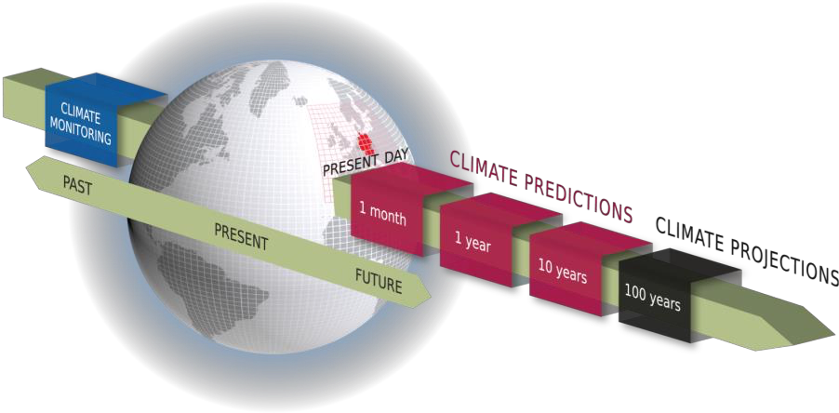
Seamless ICON forecasting system
MPI
Stephan Lorenz, Peter Korn, Wolfgang Müller, Rene Redler, Nils Brüggemann, Rainer Schnur
KU, DWD
Trang Van Pham, Gergely Bölöni, Holger Pohlmann, Christine Sgoff, Susanne Brienen, Kristina Fröhlich, Christian Steger, Barbara Früh
FE, DWD
Martin Köhler, Roland Wirth, Jürgen Helmert, Mikhail Dobrynin, Linda Schlemmer, Jan-Peter Schulz, Günther Zängl, Roland Potthast and more.
Hereon
Ha and Stefan Hagemann

Slide 3
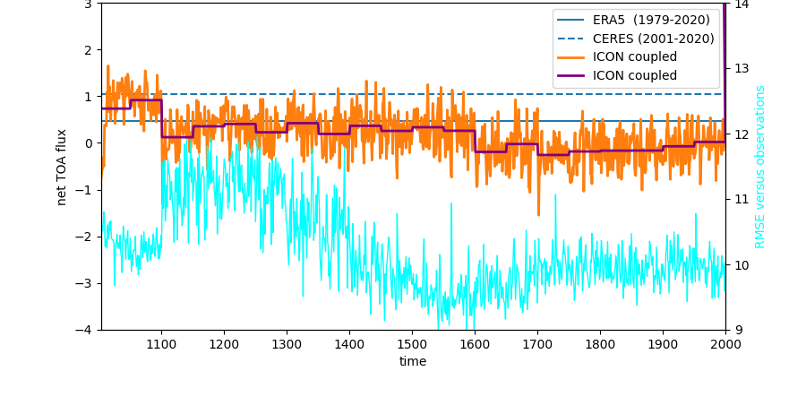
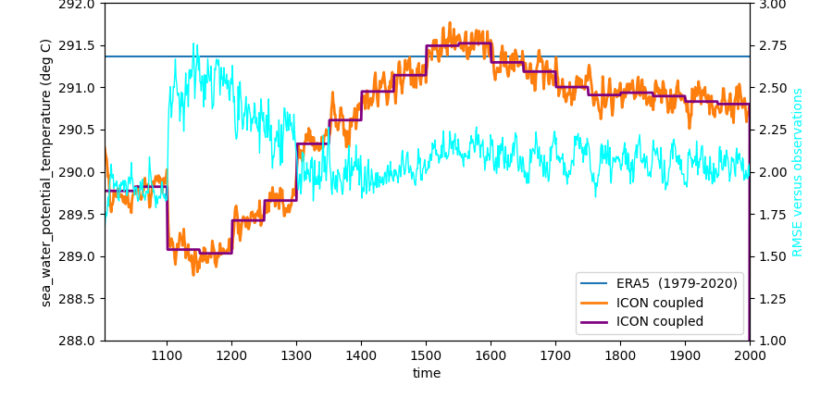
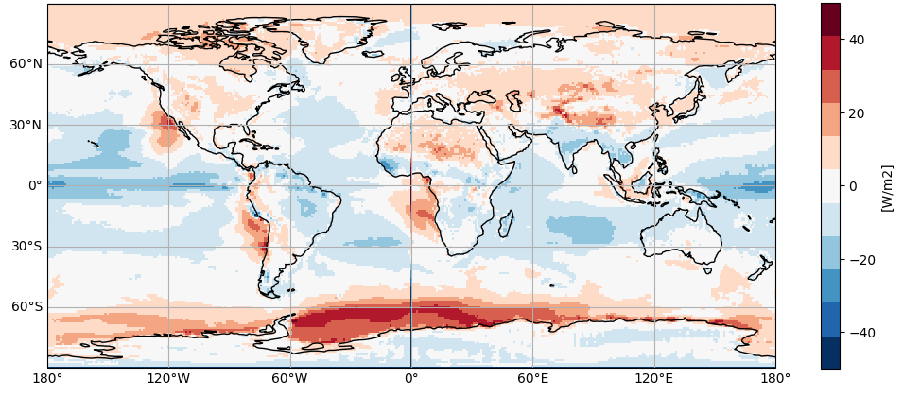
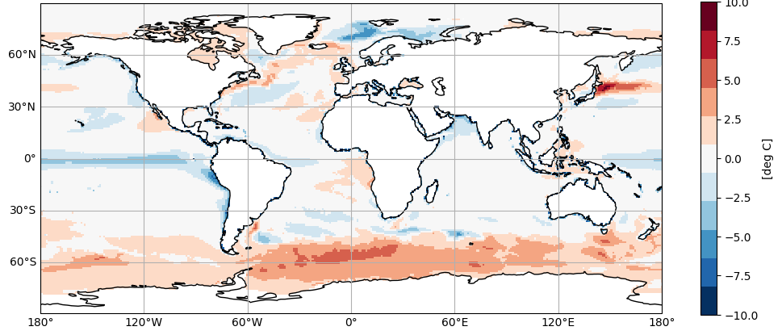
1000 years pre-industrial (a80km, o40km, L64)
TOA net flux
sea surface temperature
ERA5
CERES
-0.6K
below ERA5
0.02W/m2
1.
2.
3.
4.
5.
6.
7.
1.
tuning parameters:
EIS > 5.0K
ice fall speed = 0.6
box_liq_asy = 3.0
EIS > 7.0K
tau decay = 1000
box_liq = 0.06
tau decay = 1500
exp050

Slide 4
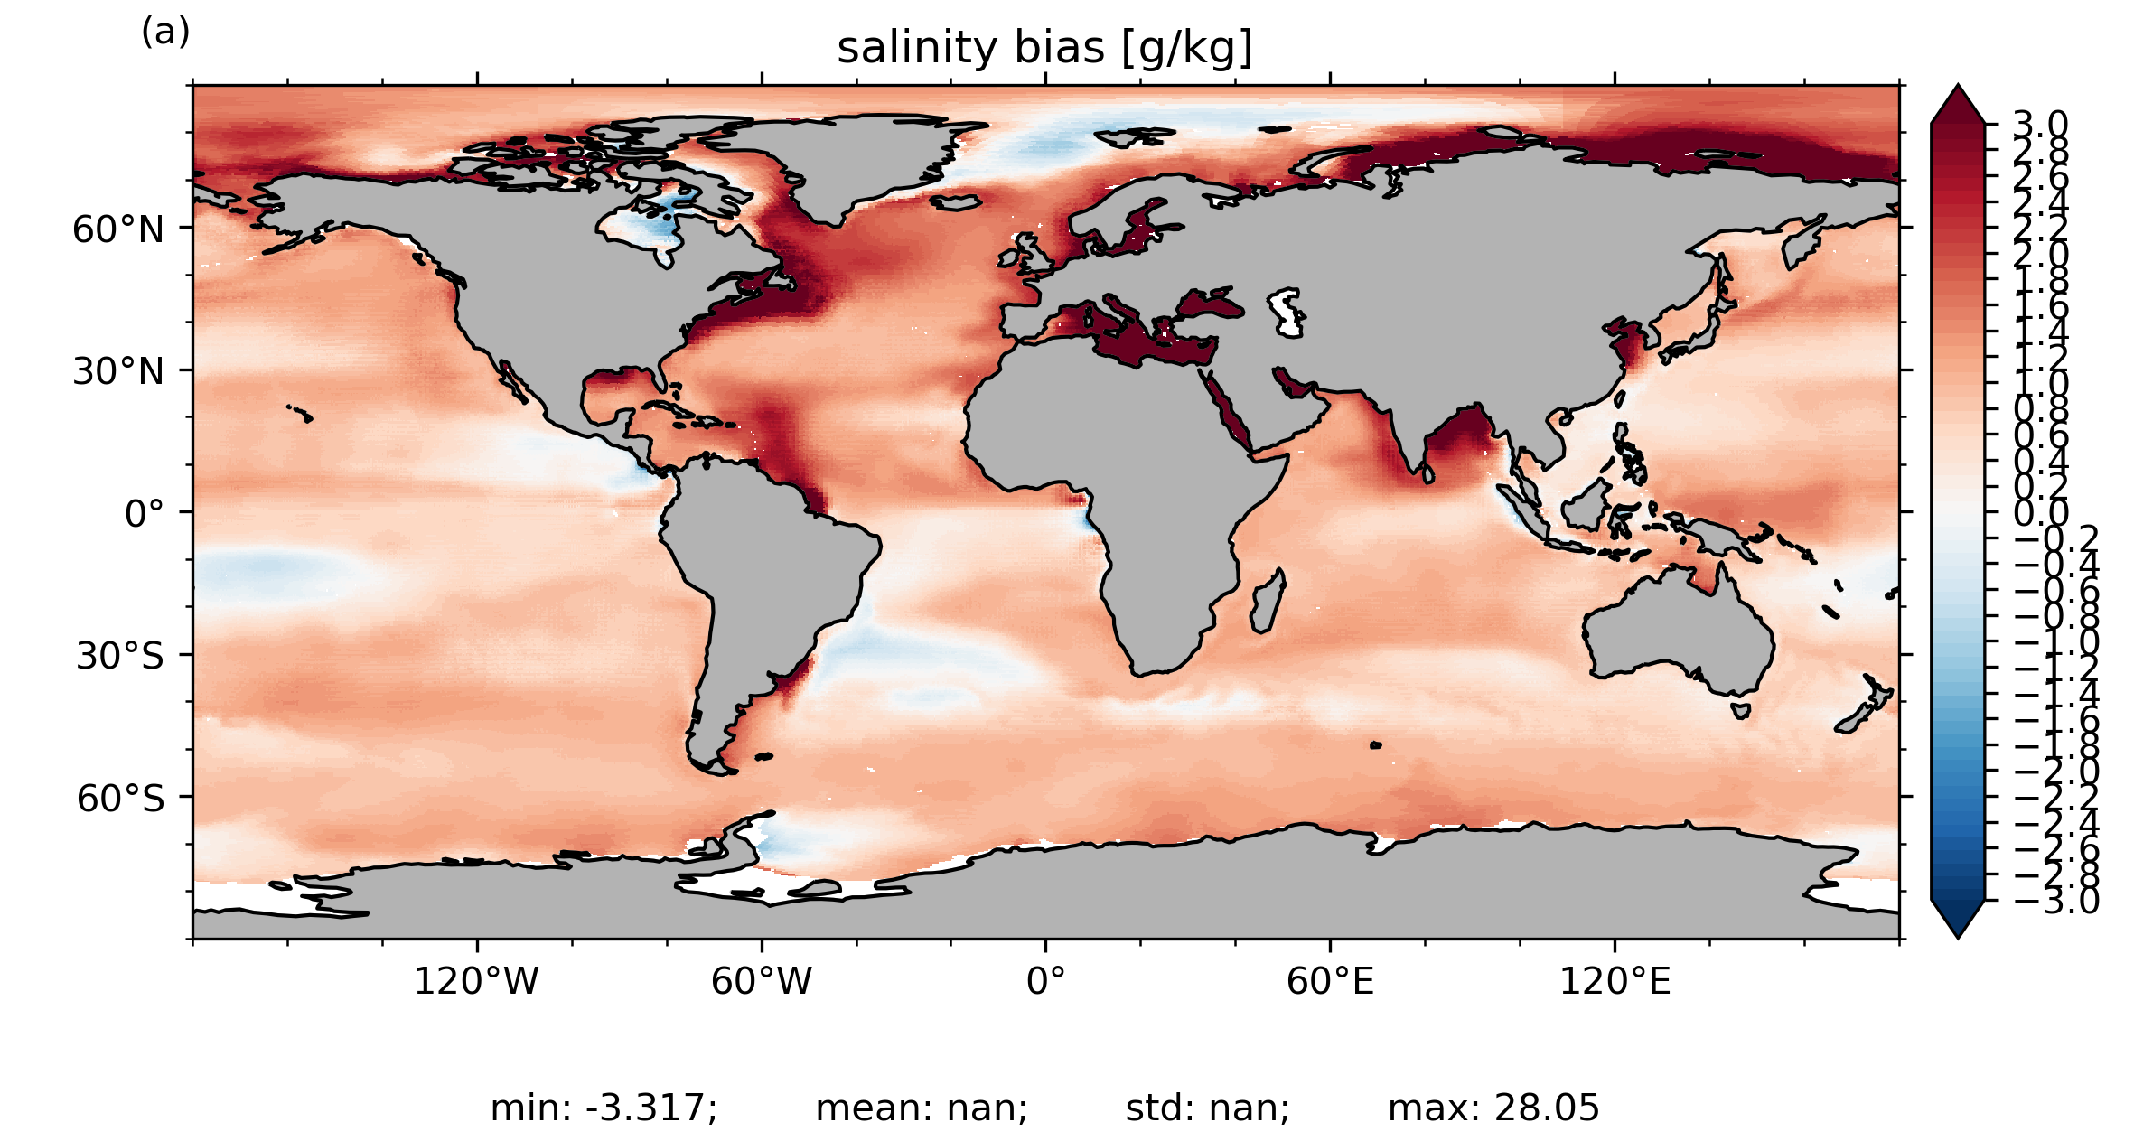
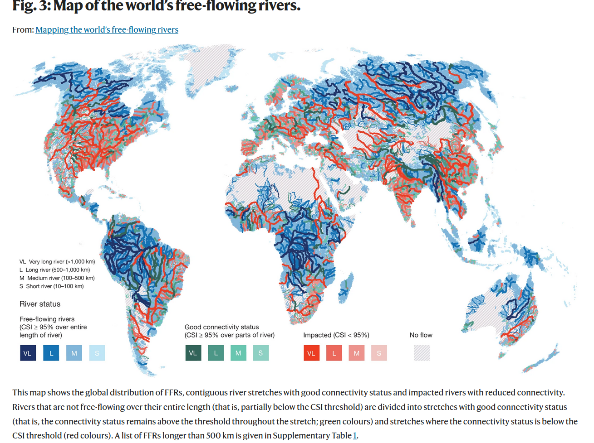
2000-2020 with ICON atmo. 80km, ocean 40km, L72
Salinity bias
free-flowing rivers
Grill, G., Lehner, B., Thieme, M. et al. Mapping the world’s free-flowing rivers. Nature 569, 215–221 (2019). https://doi.org/10.1038/s41586-019-1111-9
River discharge into oceans still missing. Will be implemented soon.
exp056

Slide 5
Coupling ICON-Seemless & Hydrological Discharge model (HD)
Coupling interfaces between HD (Hagemann, 2021) with ICON-NWP and ICON-O are in principal done.
Coupling interface with ICON-NWP inside HD was also prepared.
HD is linked with ICON as a submodule
An autobuild tool for compiling HD together with ICON was written
Tests in coupled mode with HD will be done next!
ICON-NWP
YAC
surface runoff
ground runoff
HD
YAC
river discharge
ICON-O

Slide 6
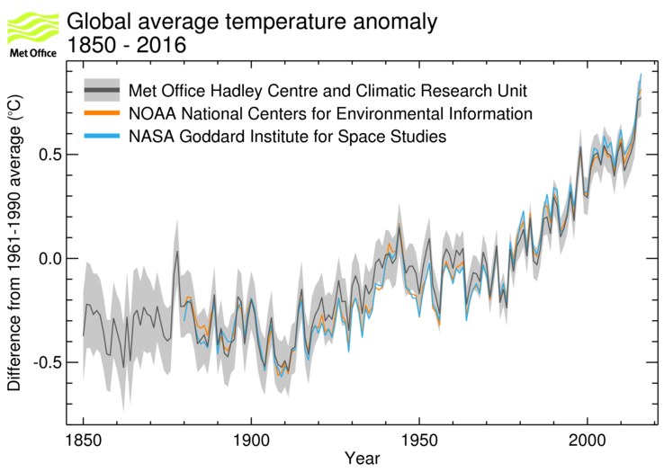
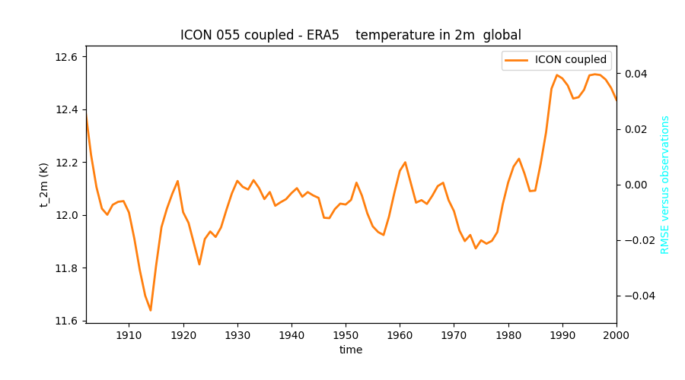
1900-2000 with ICON atmo. 80km, ocean 40km, L72
exp055

Slide 7
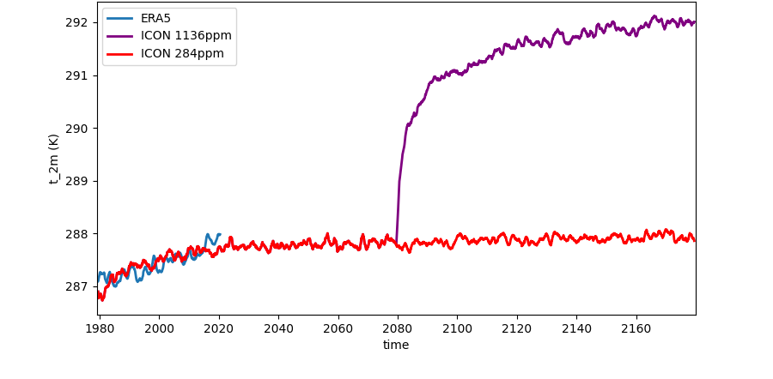
pre-industrial control (1850) and 4x CO₂
pre-industrial 1850 coupled climate
Kinne background aerosols
CO₂ and gases pre-industrial
4x CO₂
ICON R2B4 / R2B4 initialized from
Levitus ocean observations
and ERA5 atmosphere
ERA5 curve represents
period 1980-2020
4.1 K
100 years
200 years
global, annual mean

Slide 8

ICON ESM-W
Daniel Krüger, Nora Schenk, Richard Williams, Yunchang He,
Avetik Hayrapetyan, Alija Bevrnja, Martin Sprengel, Roland Potthast,
Stefanie Hollborn, Linda Schlemmer, Jan Keller, Günther Zängl

Slide 9
ICON ESM-W (0-7 Days)
2023 Coupling A+O YAC on NEC
Experimental Data Assimilation,
ICON-O-LAM technical
2024 Coupling A+O in BACY
Verification available
Data Assimilation in DACE technical
ICON-O-ZOOM technical
2025 Near-Realtime Tests with BACY, Data Bases, NUMEX Prep,
ICON-O-LAM Data Ass. technical
2026 Implementation in NUMEX
Deterministic Cycle with Data Assimilation preoperational
ICON-NWP
DACE-A
Atmospheric Data Assimilation
YAC
ICON-O
DACE-O
Ocean Data Assimilation
PDAF
Climate Ocean Data Assimilation
2027 LETKF implementation and testing
2028 hybrid EnVAR + LETKF implementation and testing
2029 NUMEX for hybrid system, Testing
2030 Ensemble-Variational ESM ready for operational forecasting

Slide 10
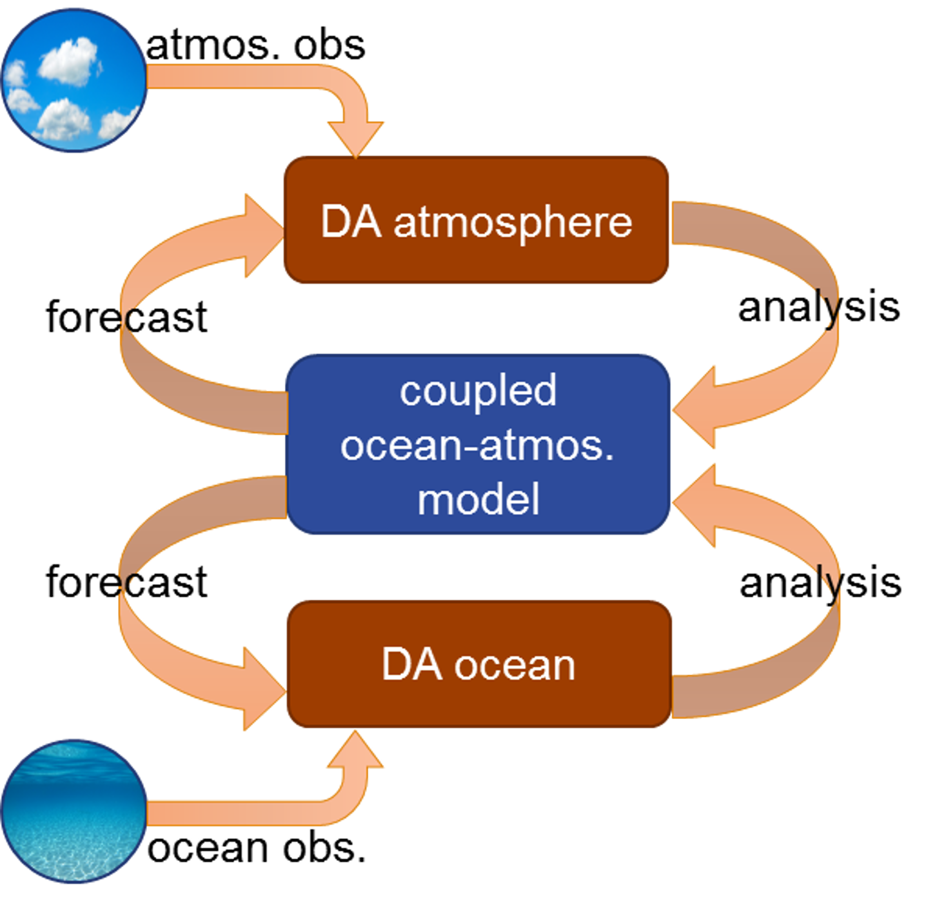
Coupled Data Assimilation

Slide 11
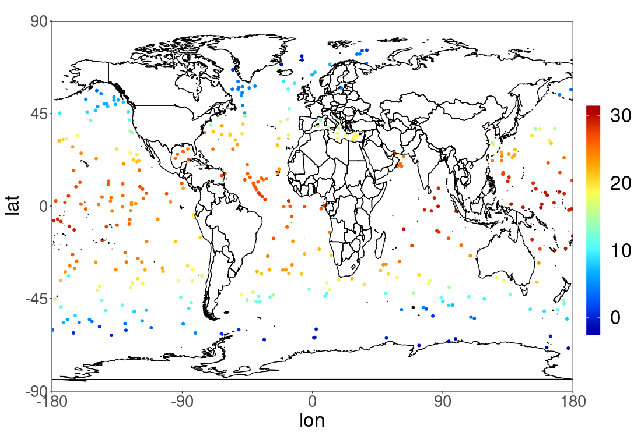
Ocean 3D-VAR – Read and Distribute Observations
Start Ocean DA with profiles from ARGO floats (~4000)
Variables: Temperature, Salinity
Other sources for profiles also possible (e.g. AniBOS, SOT/SOOP-XBT, OSTIA)
Temperature [°C]

Slide 12
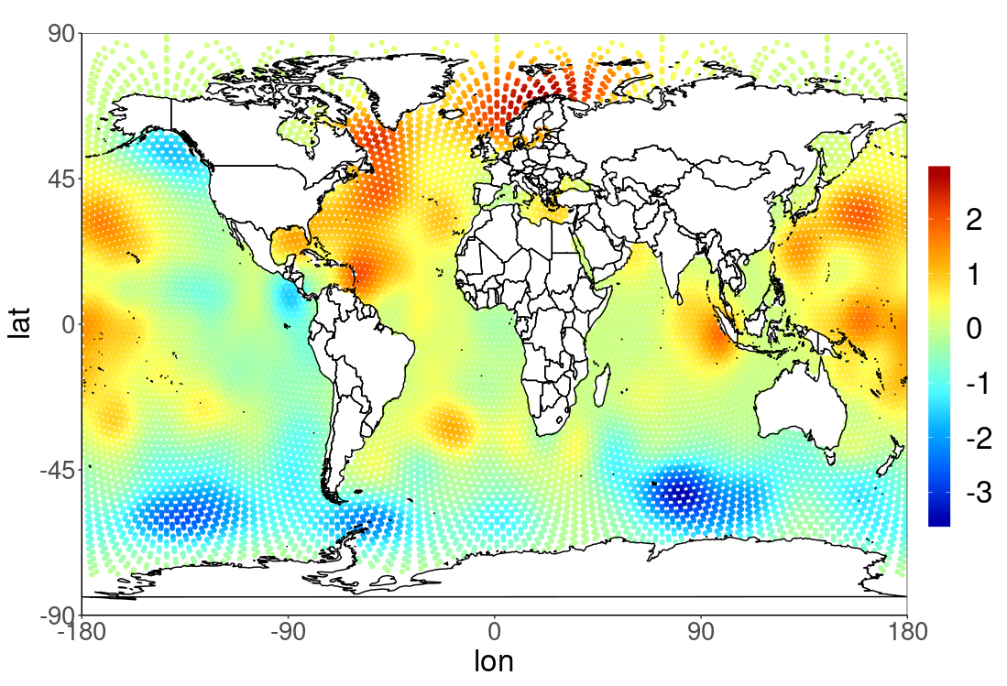
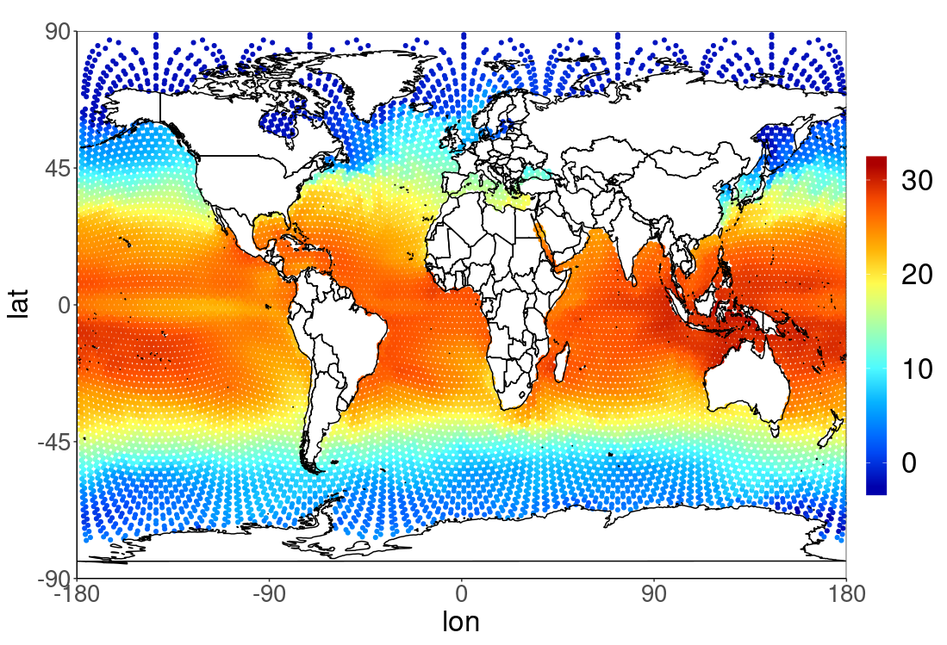


Ocean 3D-VAR – Generate Analysis
$$x_{inc}^{(a)}=BH^{T}{\left(R+HBH^{T}\right)}^{−1}(y−H\left(x^{\left(b\right)}\right))$$
  $$x^{(a)}=x^{(b)}+x_{inc}^{(a)}$$
Temperature [°C]
Temperature [°C]

Slide 13
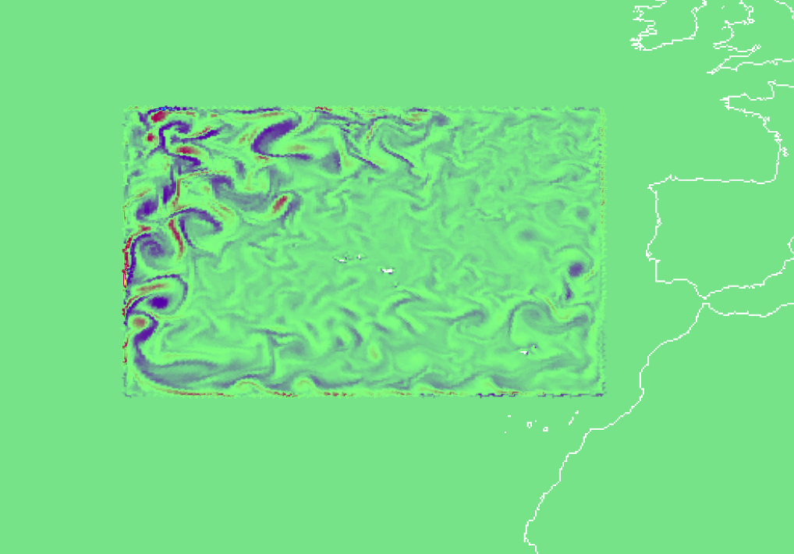
Local simulation
Current:
  experiment driven by initial
  conditions; wall BCs
Next:
  Disable time updates for
  outermost cells (implement
  constant value/flux BCs)
  Detect all intervention points in code
  for the driving variables
  Introduce constant BC reading
  Introduce time dependent
  BC reading

Slide 14
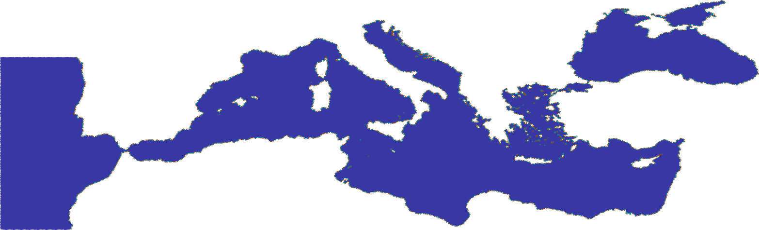
Upcoming: more complexity

Slide 15
Optimization for Aurora Tsubasa SX-9
ICON-O primarily developed for standard architectures (SIMD)
DMRZ uses vector machines => adaptions necessary for optimal usage
Threads (atm / oce) | Old Runtime (yr/d) | New Runtime (yr/d)
16/112 | 4.56 | 5.78
48/80 | 3.75 | 12.16
64/64 | 3.13 | 13.52
80/48 | 2.47 | 14.13
88/40 | 2.26 | 16.07
96/32 | 2.11 | 16.82
128 Threads, no output, 80/40km resolution

Slide 16
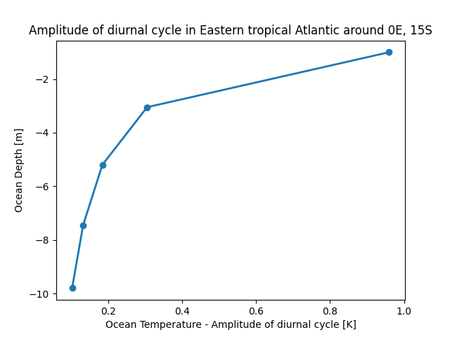
ocean diurnal cycle at L128
1.00m
3.05m
5.20m
7.45m
9.80m
ocean: L128smt, R2B6
atmosphere: L90, R2B5
mean February 1979
after 1 mon spin-up
mean amplitude (max-min) of diurnal cycle [K]

Slide 17
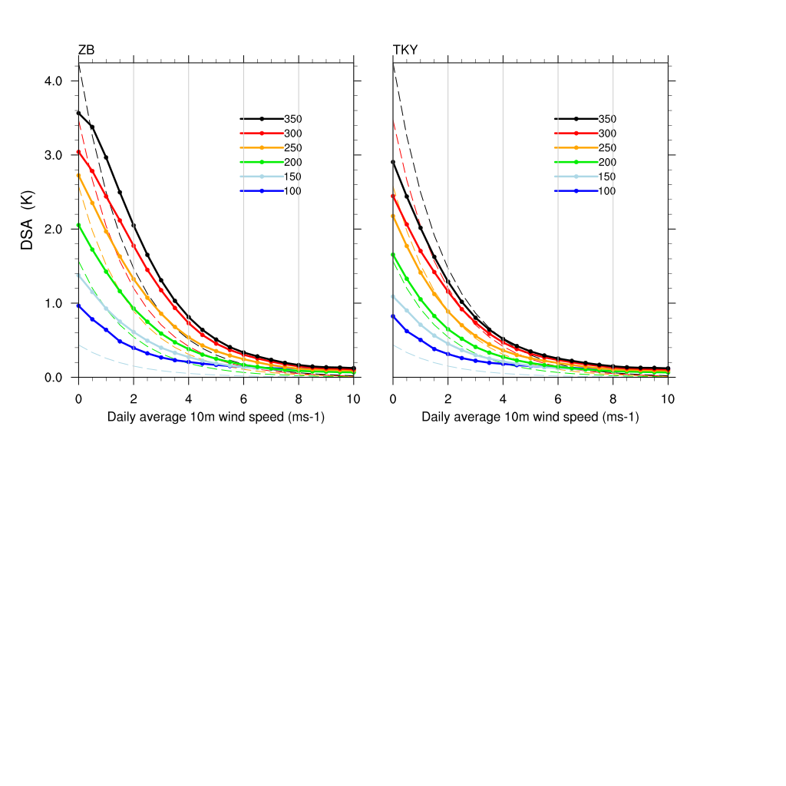
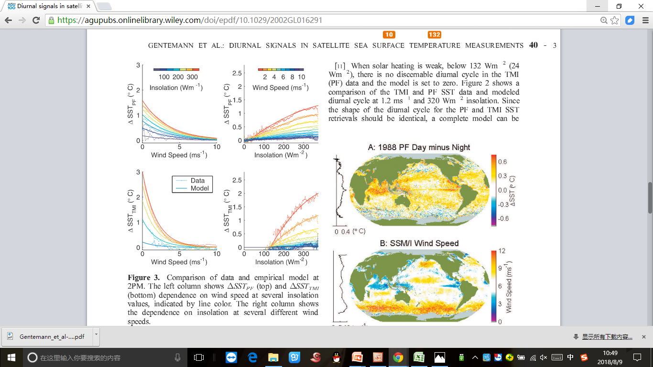
Diurnal SST amplitude in MetOffice and ICON
While et al (2017):
diurnal cycle in Met Office Model
Zeng, Beljaars (2005),
ICON
Takaya et al (2010),
ICON
Insolation(Wm-2)
Insolation(Wm-2)
Observations: thin
Observations: dashed
Reference: An empirical model of diurnal warming using non-linear least-squares regression based on TMI (microwave imager) observations (Chelle L. et al, 2003)
Region: 40S-40N oceans
Mengjuan Julia Liu and Martin Köhler (2018)

Slide 18
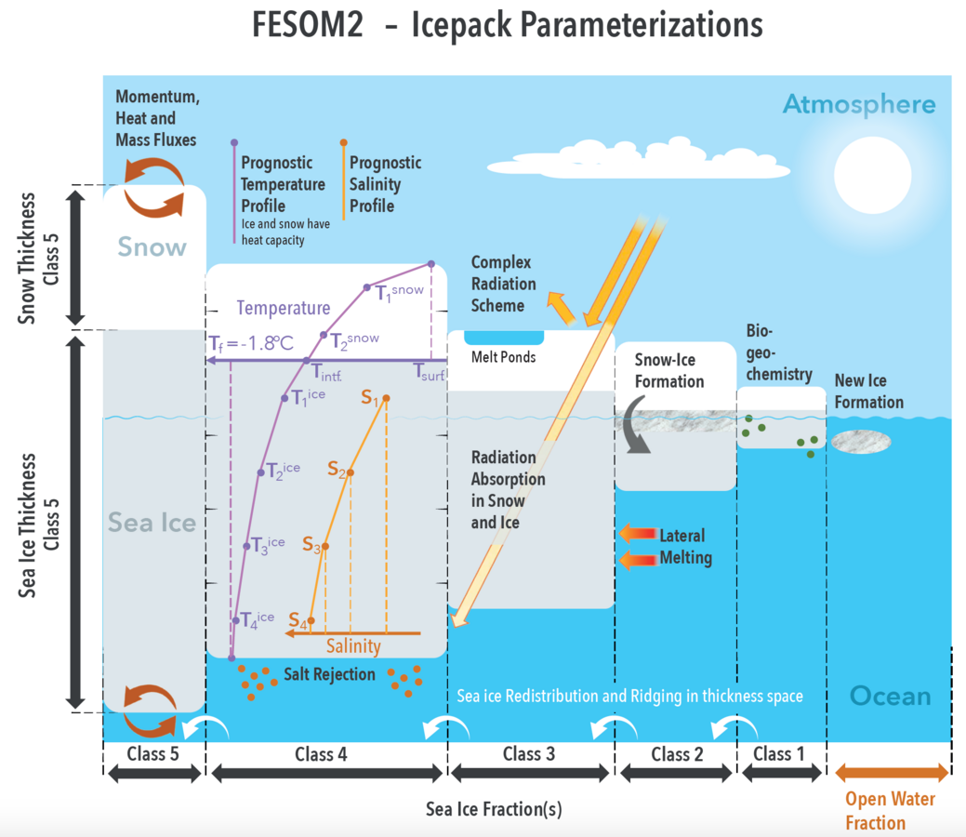
ICON coupled upgrades coming soon
land/turbulence parameterization package from ECHAM (JSBACH / VDIFF)
river routing and hydrological discharge mode (coupled with YAC)
define ideal vertical grid for NWP to seasonal to climate prediction
  thin top layer (1-2m thickness)
  good resolution at 500-1000m depth for improved ocean thermohaline circulation
  about 70-80 layers for performance
sea-ice dynamics based on ICON grid (Mehlmann and Korn, 2021)
  sea-ice bottom flux consistency with ocean
  (Dmitrii Mironov, Dirk Notz Uni. Hamburg, Stephan Lorenz)
options for sea-ice models:
  Dirk Notz single category, which we are using. Soon with Mehlmann/Korn (2022) ICON dynamics
  Einar Örn Ólason (who worked before at MPI, now in Norway): entirely new rheology (Maxwell elasto brittle), very promising, called NeXtSIM.
  Zapieri et al 2021: multi-category ice-pack in FESOM2
  LIM3 from NEMO
Zampieri, L., et al (2021)

