Slide 1
PP CITTA Applications in NMA
S. Dinicilă, R.C. Dumitrache, B. Maco, S. Gabrian
stefan.dinicila@meteoromania.ro, claudia.dumitrache@meteoromania.ro, bogdan.maco@meteoromania.ro, stefan.gabrian@meteoromania.ro,
National Meteorological Administration
PP CITTA General Meeting –11-15 September 2023

Slide 2
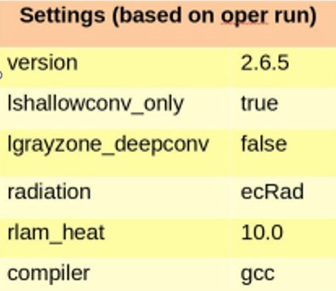
Model Set-Up
Initial conditions and LBC data from ICON global
00 UTC run / 48 forecast hours
Model output on regular latitude/longitude grid.

Slide 3
Experiment Set-Up
EISA | Experiment | lterra_urb | lurbalb | lurbahl
EISA2/EISA3 | UAA | T | T | T
 | UAH | T | F | T
 | UAL | T | T | F
 | URB | T | F | F
The models where run for the periods January 2023 and July 2023.
itype_eisa=2 : Set infiltration and bare soil evaporation over impervious surface areas to zero. All precipitation goes into surface runoff.
itype_eisa=3 : Same as itype_eisa=2, plus formation of puddles on impervious surface areas.

Slide 4
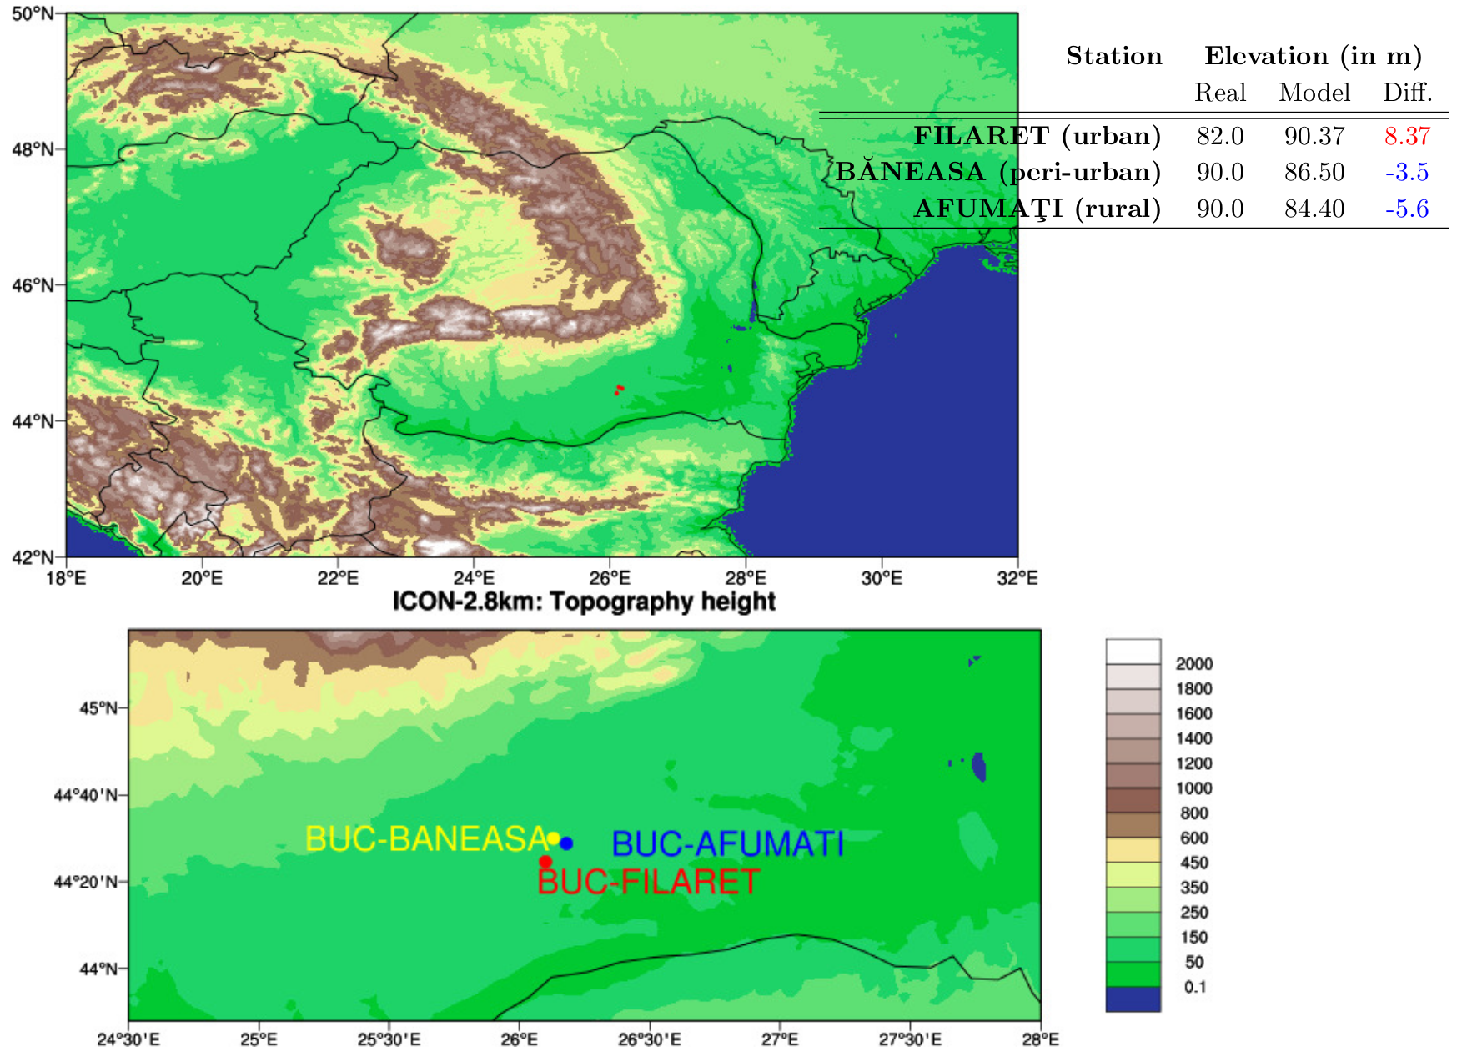

Slide 5
Results
T2m - hourly mean error for each experiment – 48 hours anticipation January and July 2023
Bucharest Filaret - urban station
Bucharest Baneasa – periurban station
Bucharest Afumati – rural station
Graphical representation of observations and the model forecast for T2m for each station mentioned before
Graphical representation of the T2m differences:
Observations : Bucharest Filaret - Bucharest Baneasa
Observations : Bucharest Filaret - Bucharest Afumati
Forecast for each experiment: Bucharest Filaret - Bucharest Baneasa
Forecast for each experiment: Bucharest Filaret - Bucharest Afumati
Verification scores obtained using MEC/FFV2

Slide 6
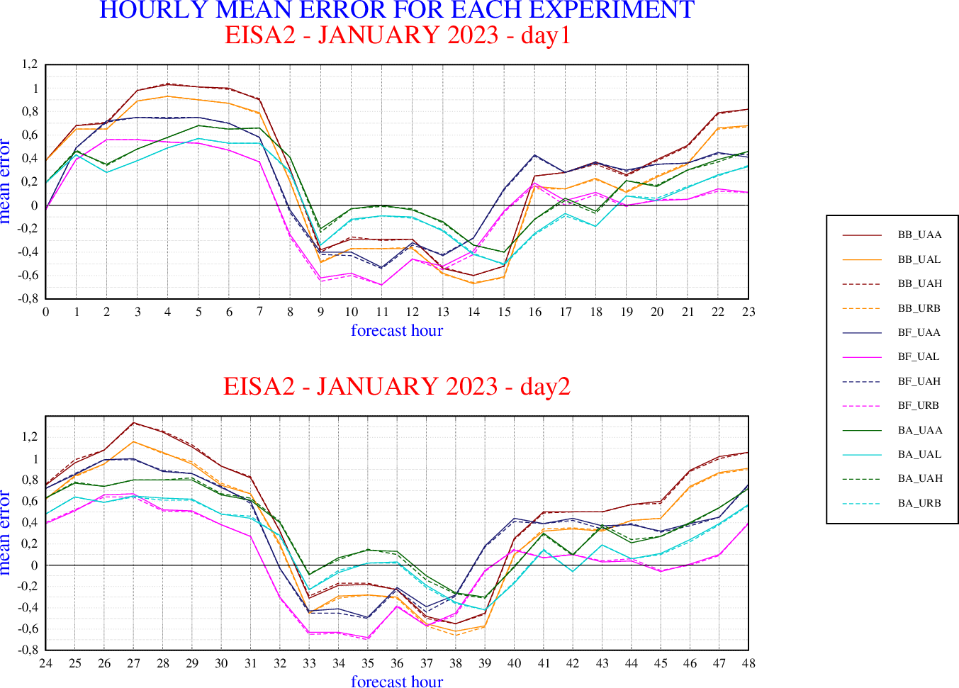
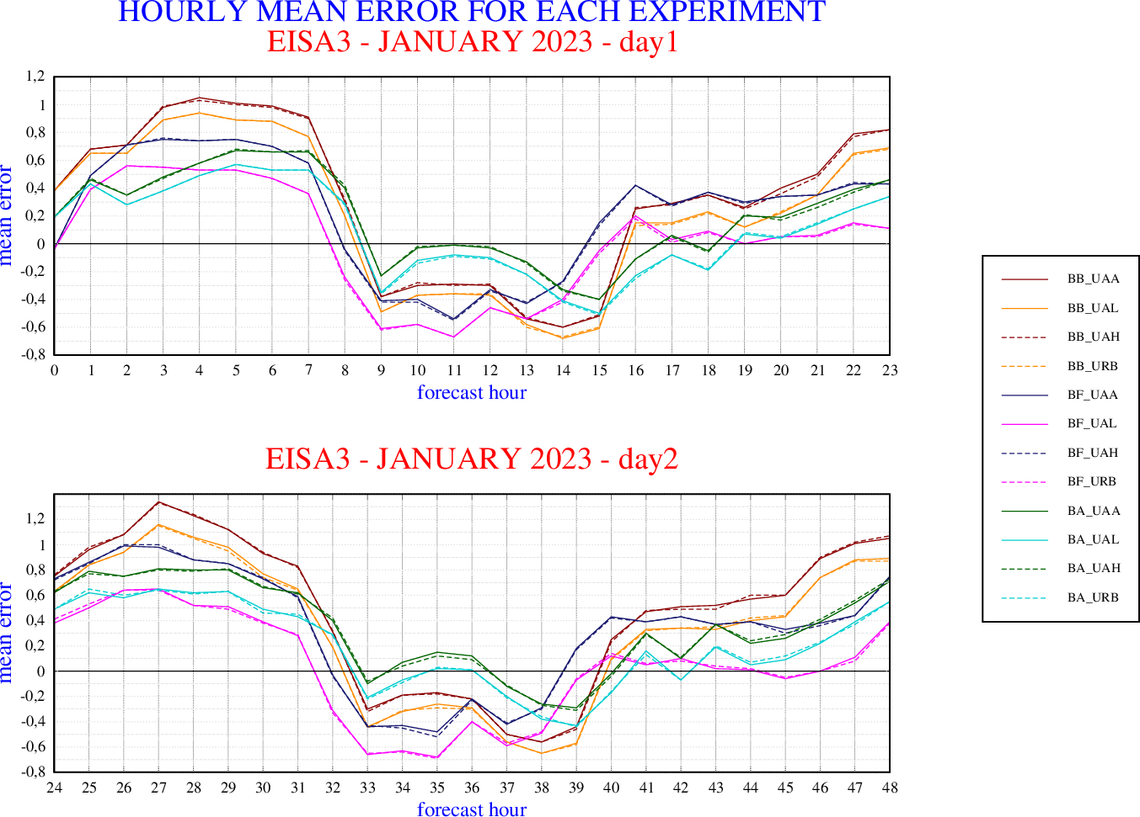
Hourly mean error for January 2023
using itype_eisa3
Hourly mean error for the January 2023
using itype_eisa2

Slide 7
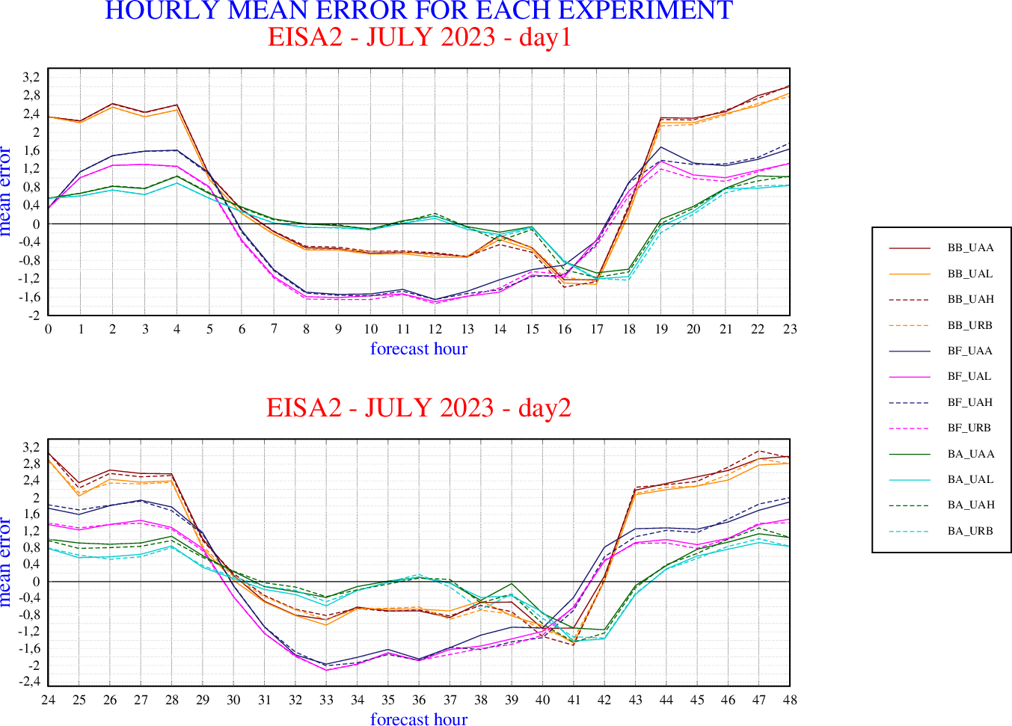
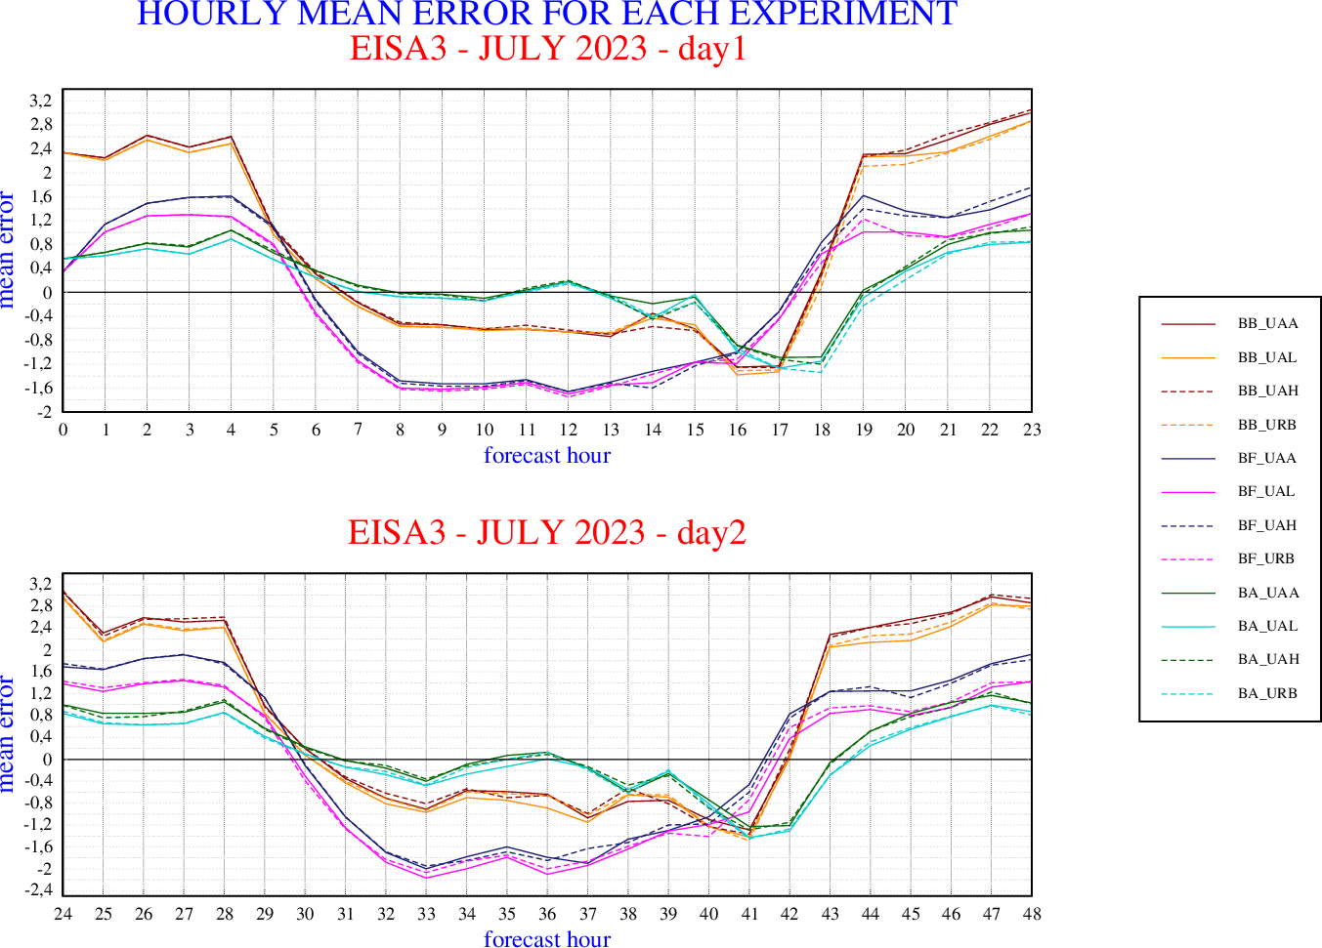
Hourly mean error for January 2023
using itype_eisa3
Hourly mean error for the January 2023
using itype_eisa2

Slide 8
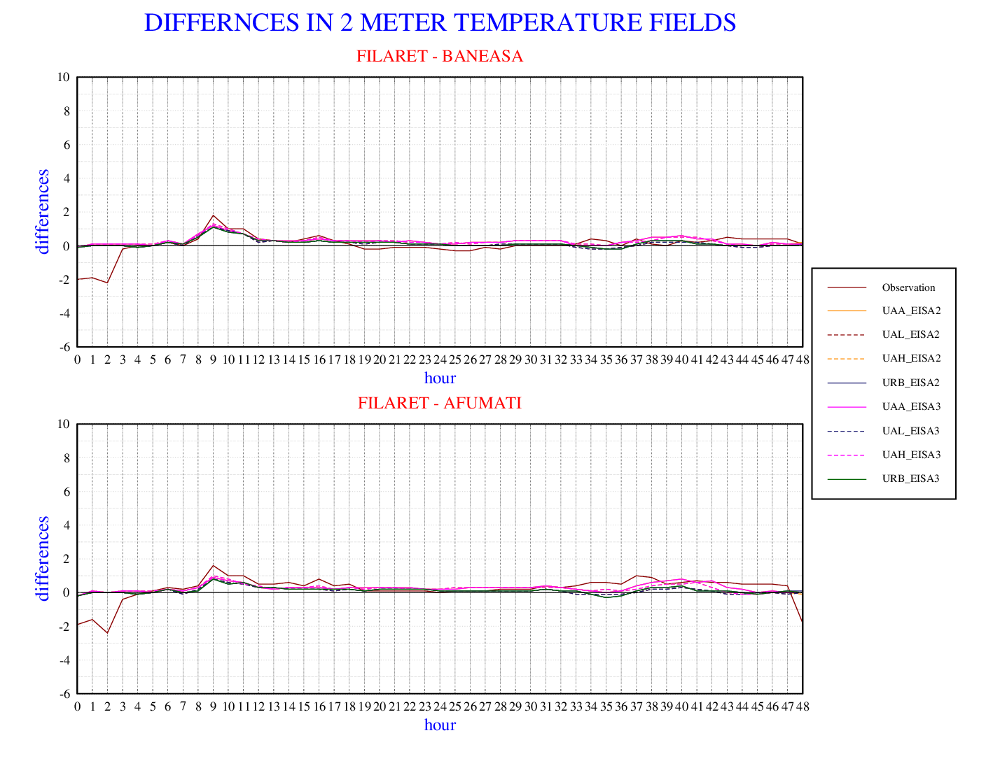
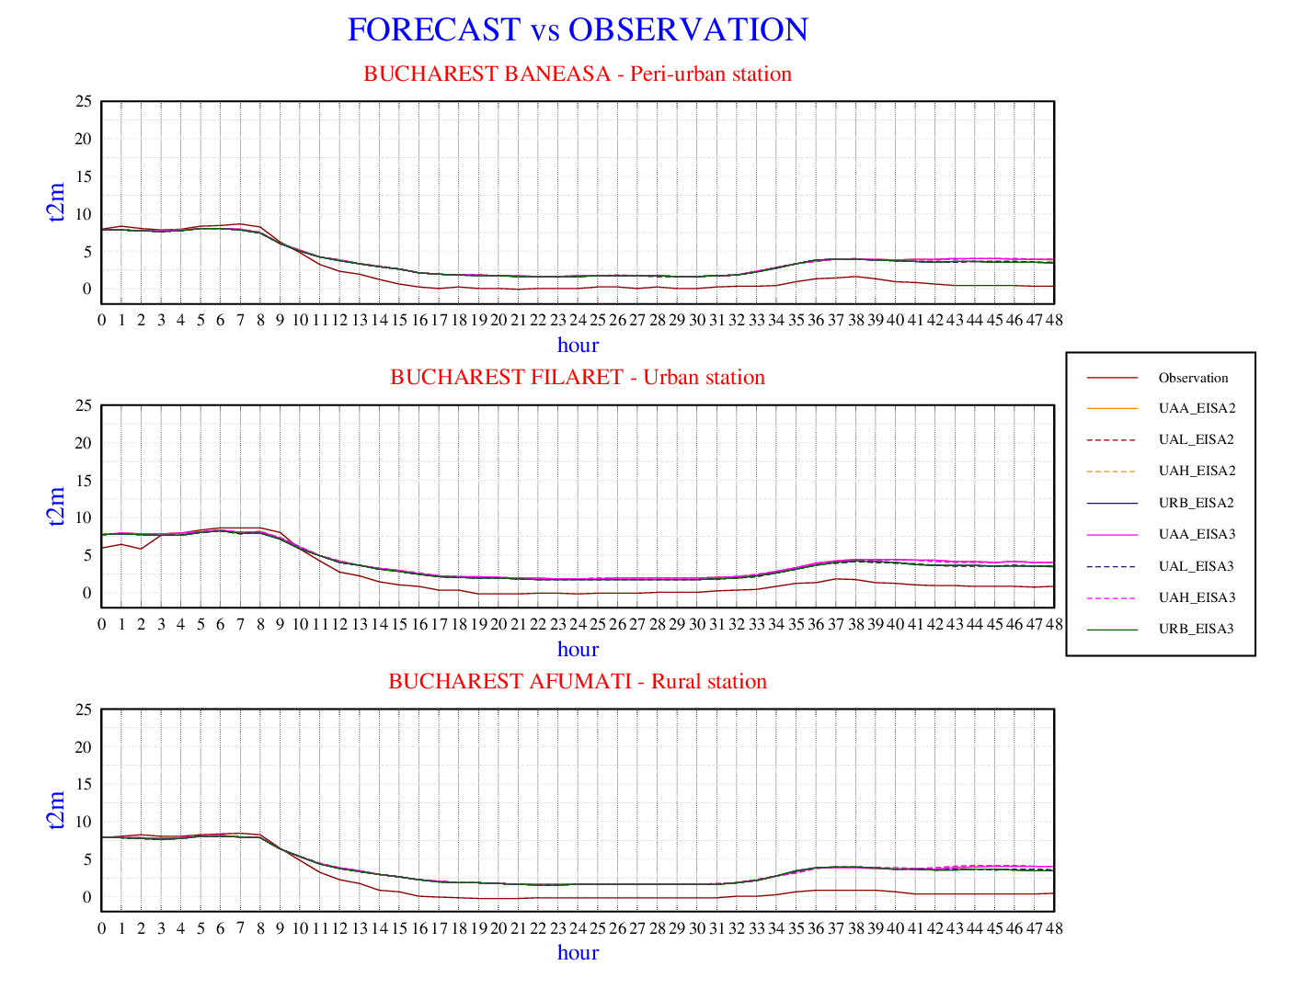
11th January 2023
T2m - Observations vs. model forecast for each station
11th January 2023.
urban-periurban & urban – rural
Obs: Bucharest Filaret - Bucharest Baneasa
Obs: Bucharest Filaret - Bucharest Afumati
Forecast: Bucharest Filaret - Bucharest Baneasa
Forecast: Bucharest Filaret - Bucharest Afumati

Slide 9
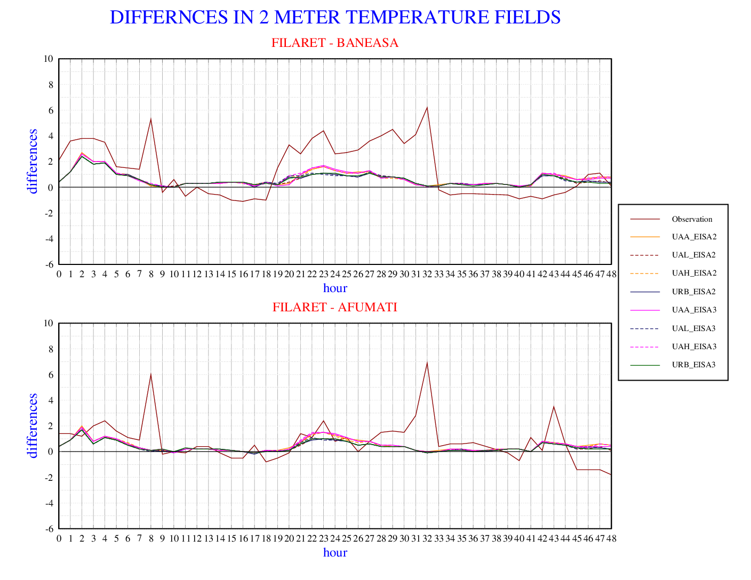
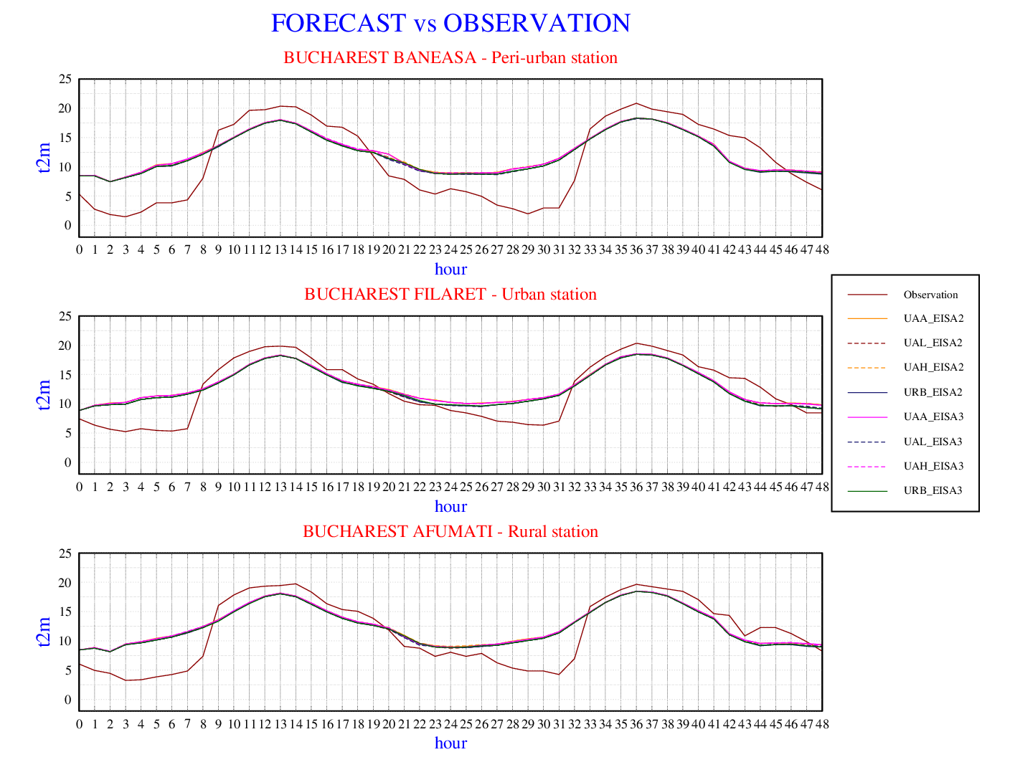
18th January 2023
T2m - Observations vs. model forecast for each station
18th January 2023.
urban-periurban & urban – rural
Obs: Bucharest Filaret - Bucharest Baneasa
Obs: Bucharest Filaret - Bucharest Afumati
Forecast: Bucharest Filaret - Bucharest Baneasa
Forecast: Bucharest Filaret - Bucharest Afumati

Slide 10
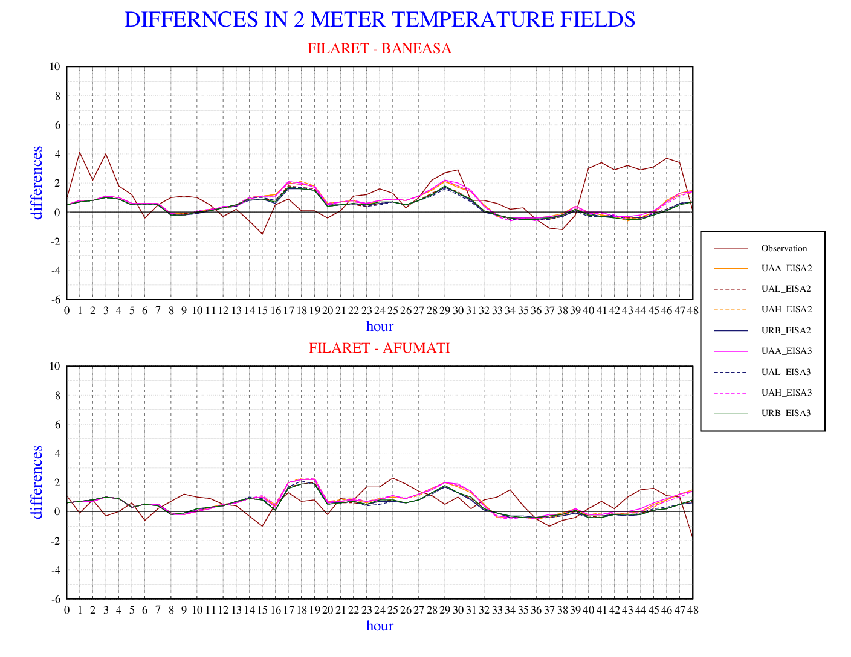
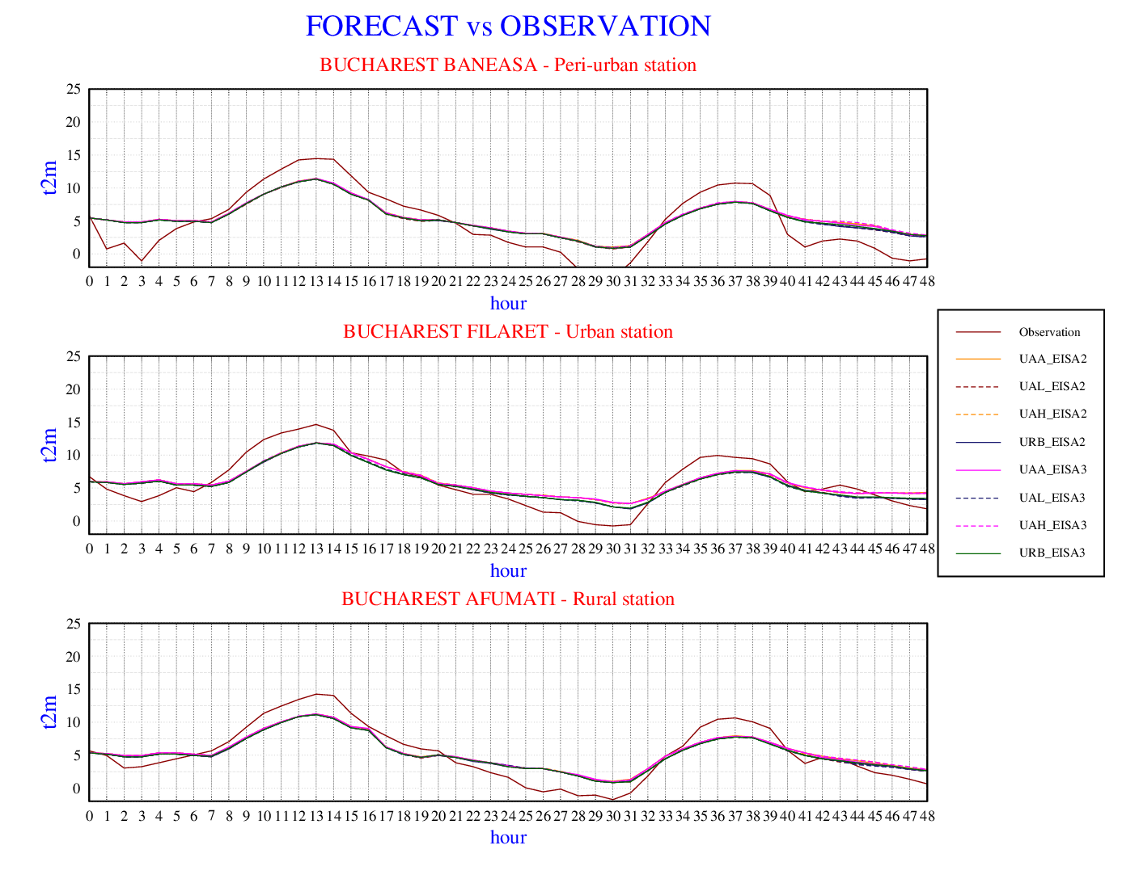
6th January 2023
T2m - Observations vs. model forecast for each station
6th January 2023.
urban-periurban & urban – rural
Obs: Bucharest Filaret - Bucharest Baneasa
Obs: Bucharest Filaret - Bucharest Afumati
Forecast: Bucharest Filaret - Bucharest Baneasa
Forecast: Bucharest Filaret - Bucharest Afumati

Slide 11
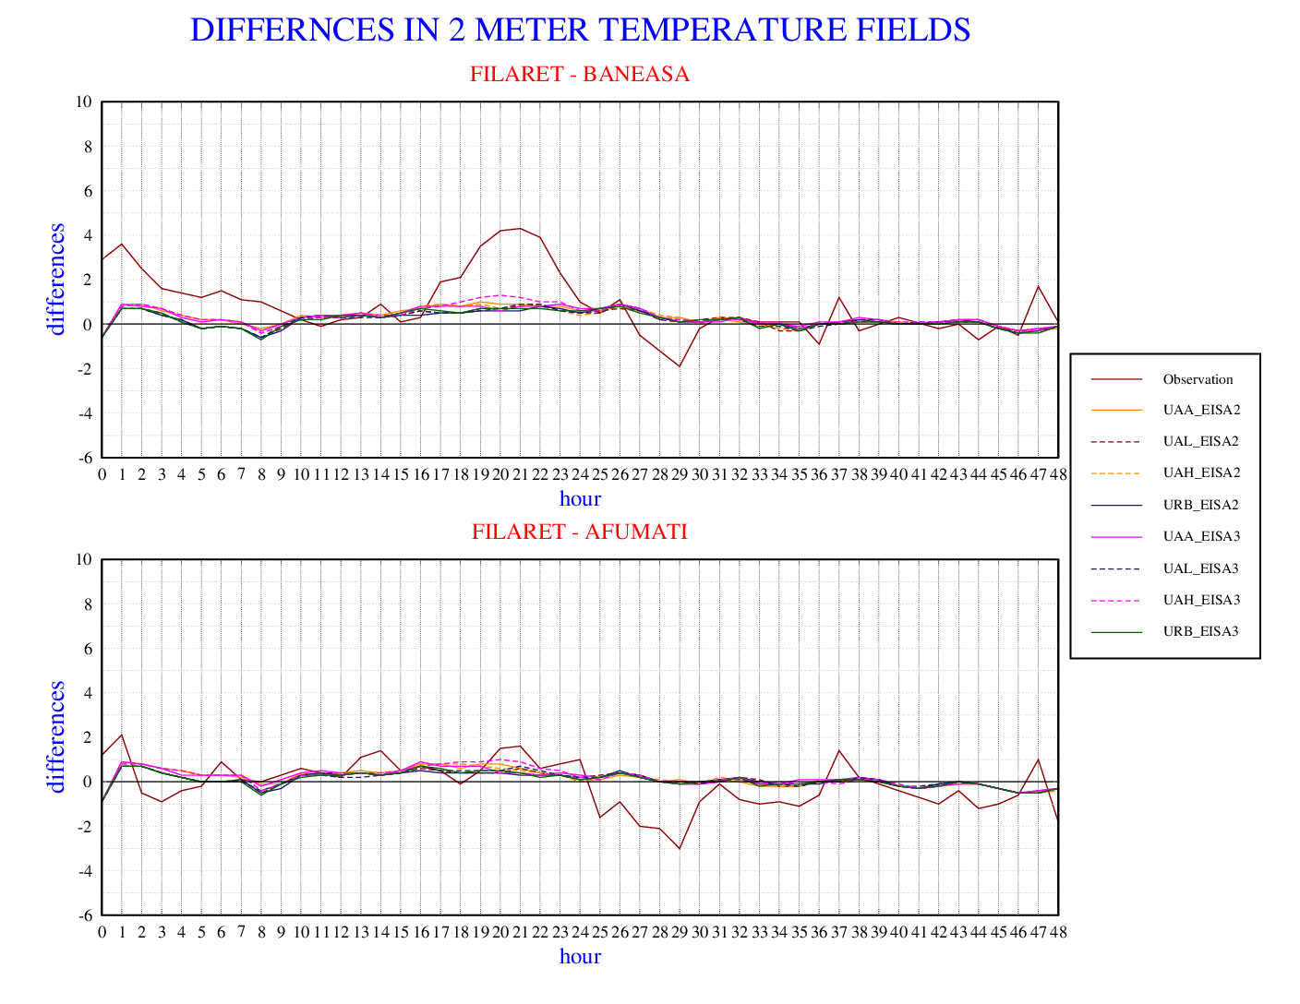
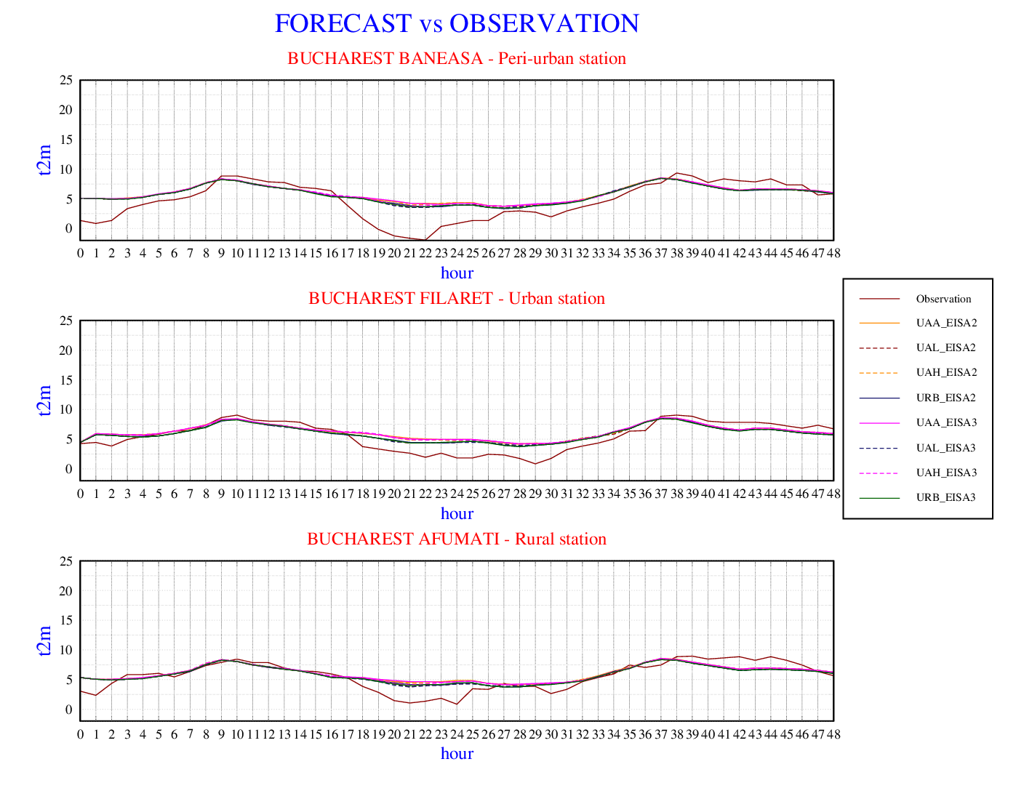
4th January 2023
T2m - Observations vs. model forecast for each station
4th January 2023.
urban-periurban & urban – rural
Obs: Bucharest Filaret - Bucharest Baneasa
Obs: Bucharest Filaret - Bucharest Afumati
Forecast: Bucharest Filaret - Bucharest Baneasa
Forecast: Bucharest Filaret - Bucharest Afumati

Slide 12
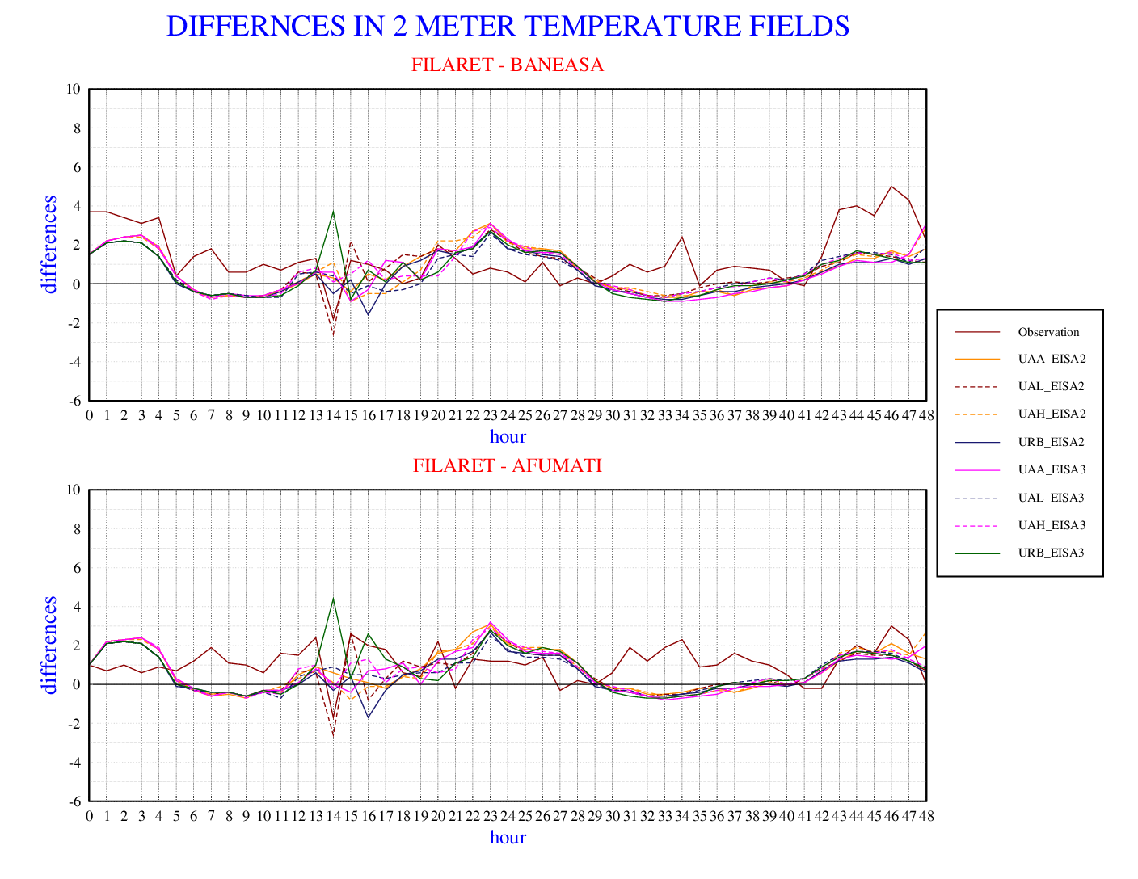
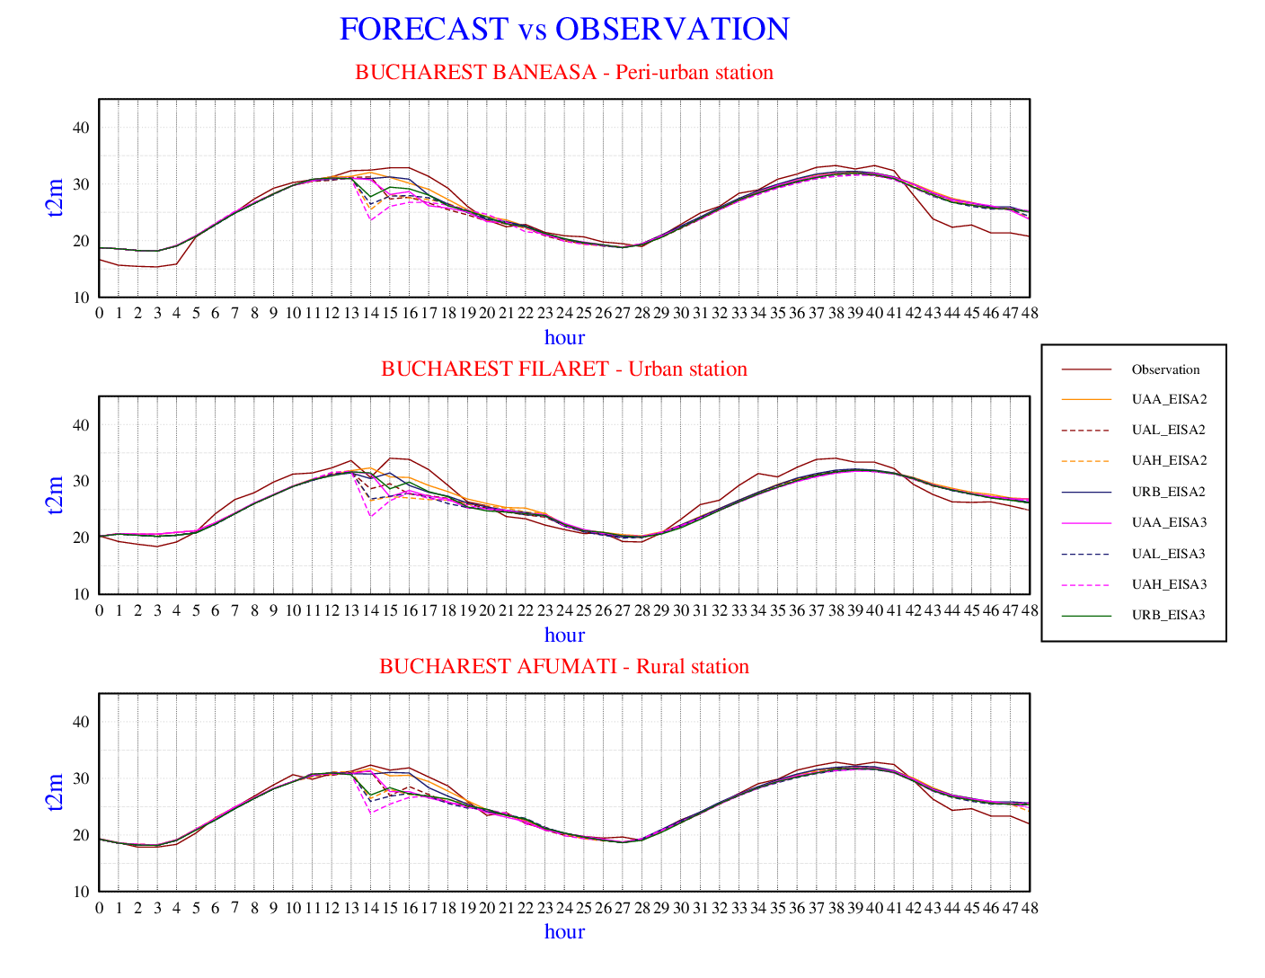
11th July 2023
T2m - Observations vs. model forecast for each station
11th July 2023.
urban-periurban & urban – rural
Obs: Bucharest Filaret - Bucharest Baneasa
Obs: Bucharest Filaret - Bucharest Afumati
Forecast: Bucharest Filaret - Bucharest Baneasa
Forecast: Bucharest Filaret - Bucharest Afumati

Slide 13
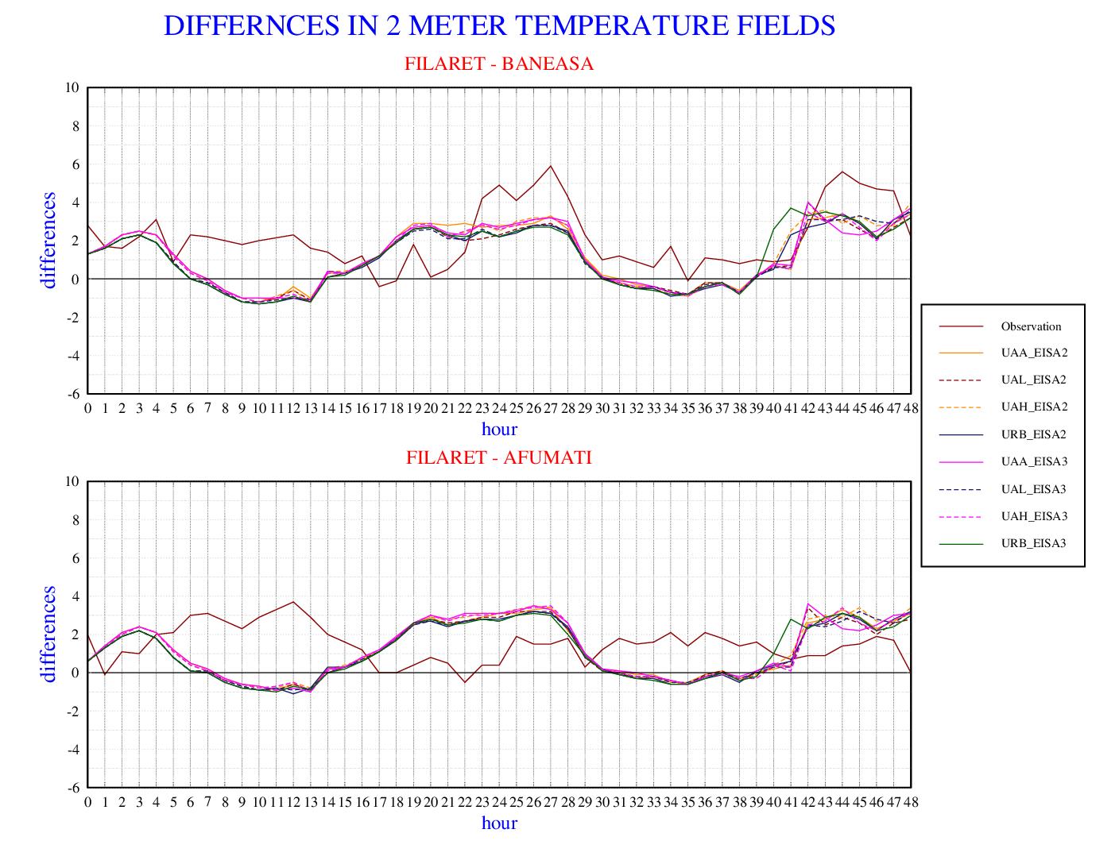
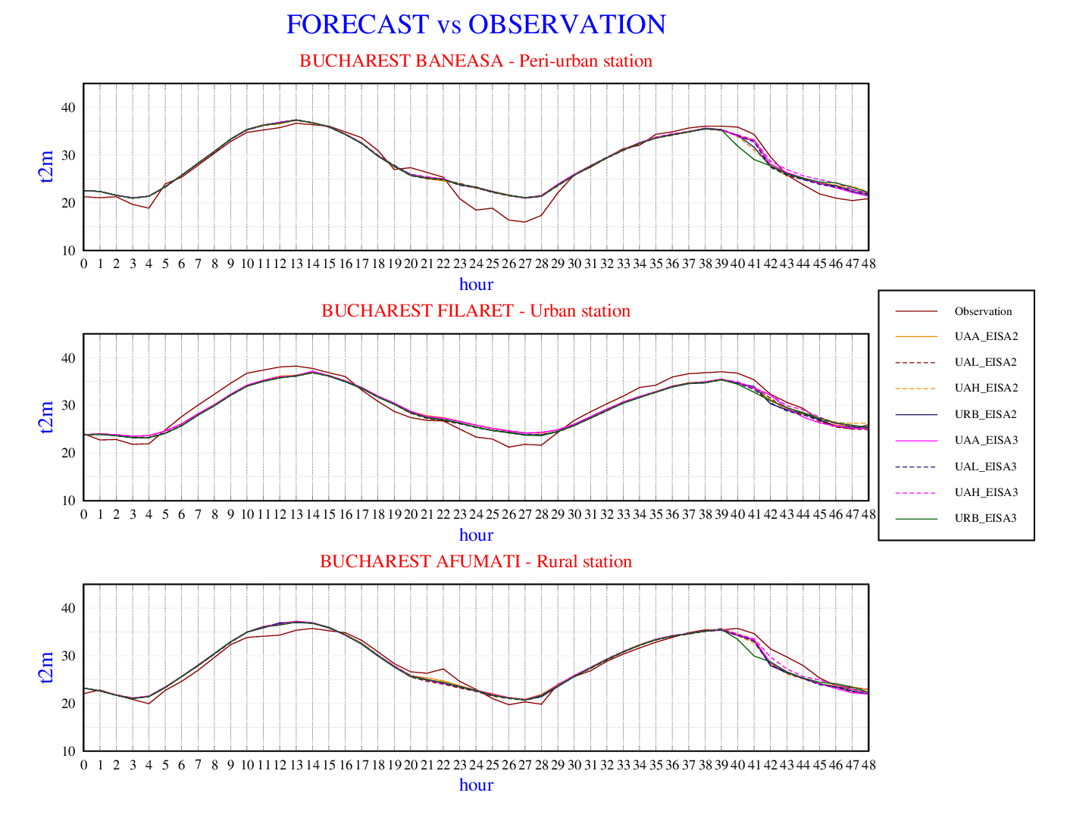
18th July 2023
T2m - Observations vs. model forecast for each station
18th July 2023.
urban-periurban & urban – rural
Obs: Bucharest Filaret - Bucharest Baneasa
Obs: Bucharest Filaret - Bucharest Afumati
Forecast: Bucharest Filaret - Bucharest Baneasa
Forecast: Bucharest Filaret - Bucharest Afumati

Slide 14
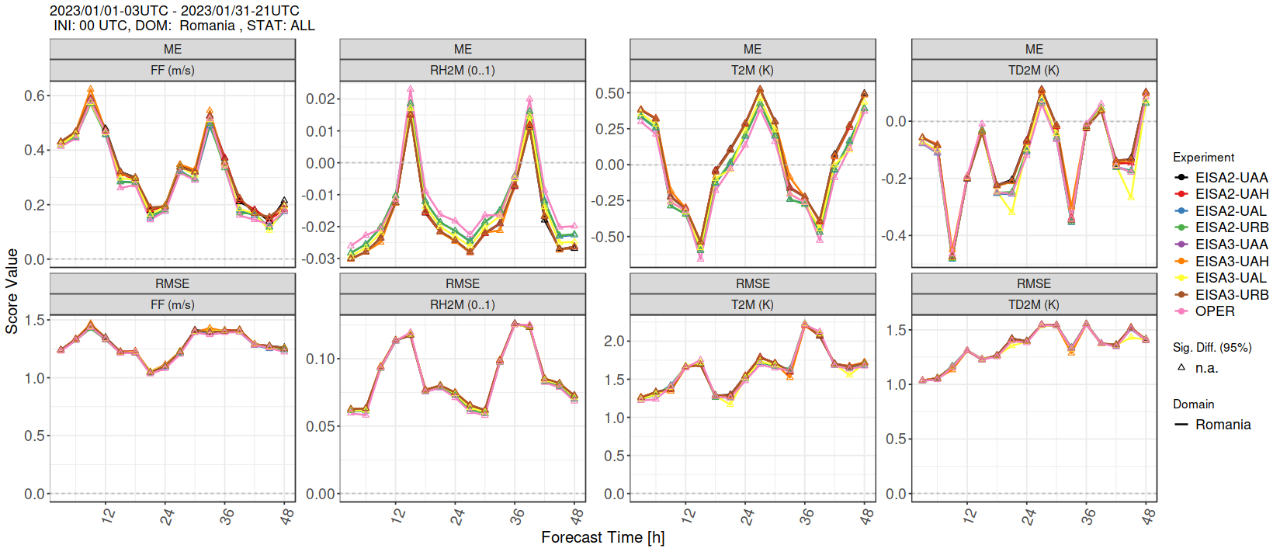
Verification results - January 2023
All experiments and ICON-RO

Slide 15
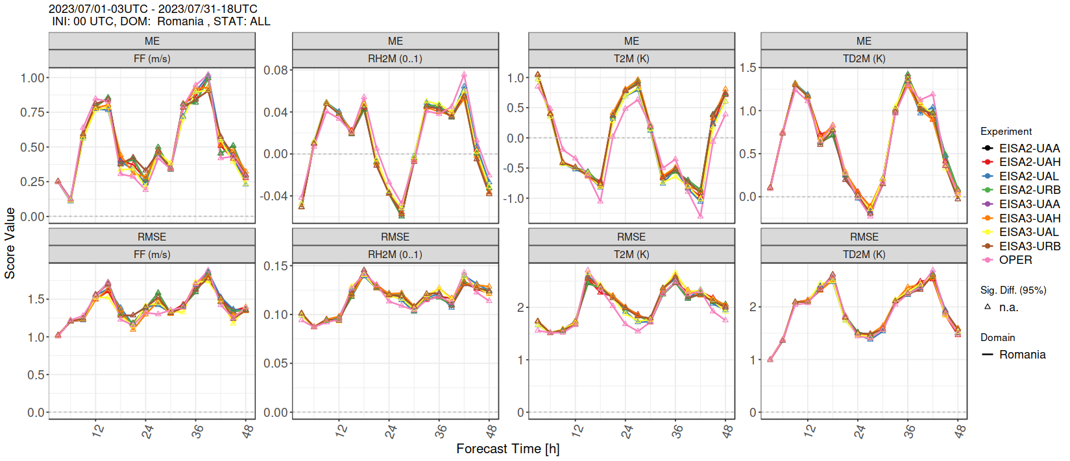
Verification results - July 2023
All experiments and ICON-RO

Slide 16
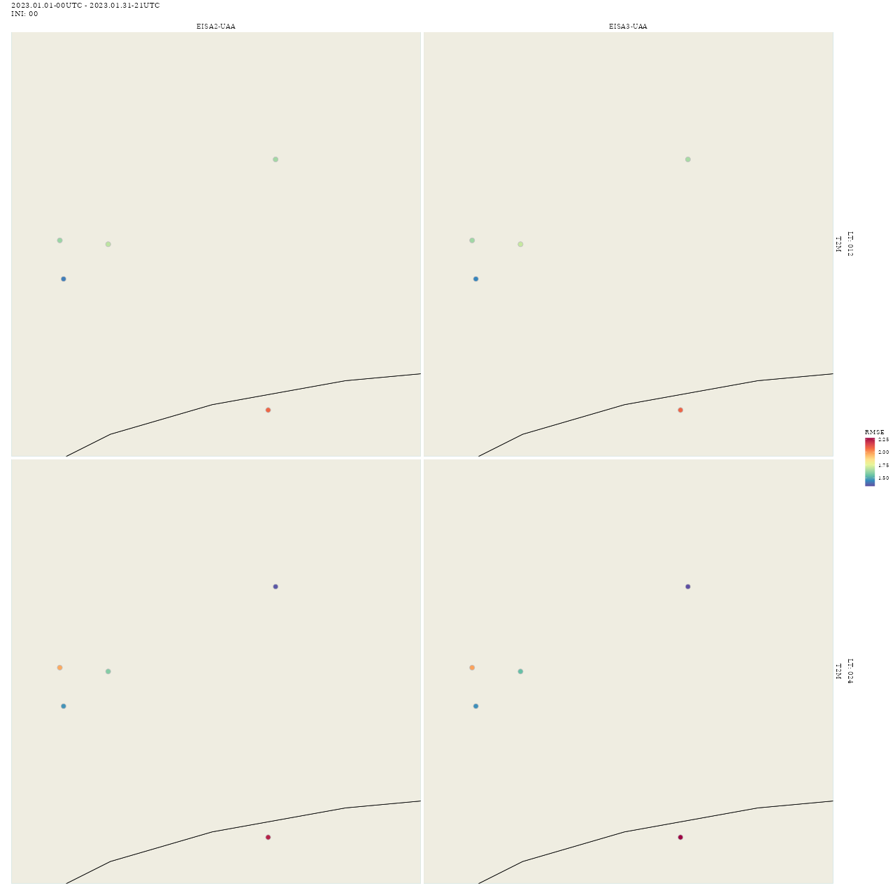
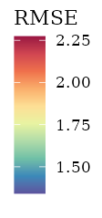
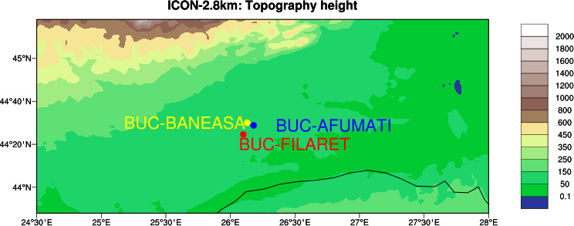
By station verification with MEC/FFV2 January
Verification for the synoptic meteorological stations.

Slide 17
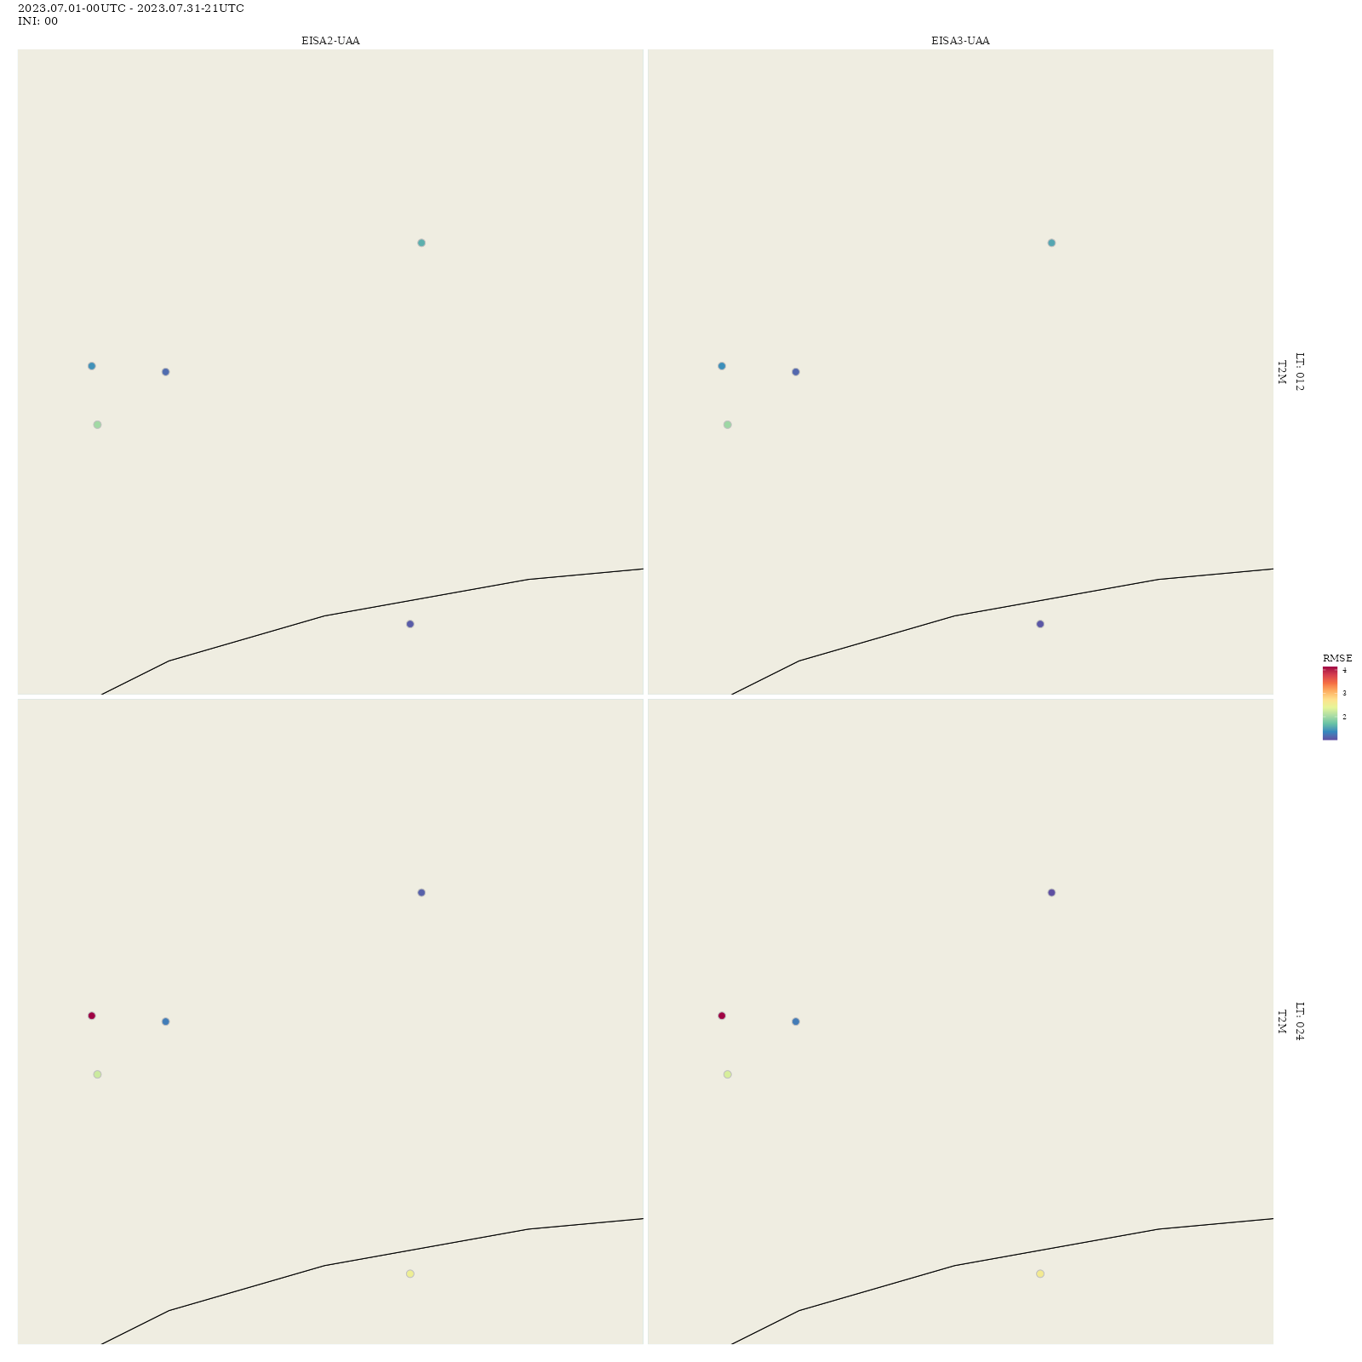
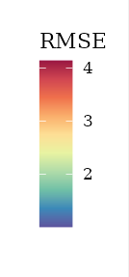
By station verification with MEC/FFV2 July
Verification for the synoptic meteorological stations.

Slide 18
Conclusion
For this presentation, the ICON Model has been ran 8 times with different urban parametrizations to evaluate them for the proposed domain of interest in the subtask 3.4 of the priority project CITTA.
The experiments were performed for the months of January and July for better representations.
Selective cases of urban heat island episodes were identified from the differences of the observations from the 3 meteorological stations in Bucharest. For these cases, the model's performance was exemplified in this presentation but for each run of the ICON model internal discussions were had about the efficacity of the parametrizations.
Along with these plots another verification was performed using the COSMO verification system MEC/FFV2 which delivered a full verification of all the continuous and categorical parameters forecasted by the TERRA_URB experiments and for the operational ICON v2.6.6. .This allowed the comparisons between the experiments and between the experiments and the operational model ICON-RO.

Slide 19
Next Steps
Study thunderstorm cases
Extract conclusions and apply the knowledge gained to improve the operational run of the ICON-RO model
Study some cases for the resolution of 1km

