Slide 1
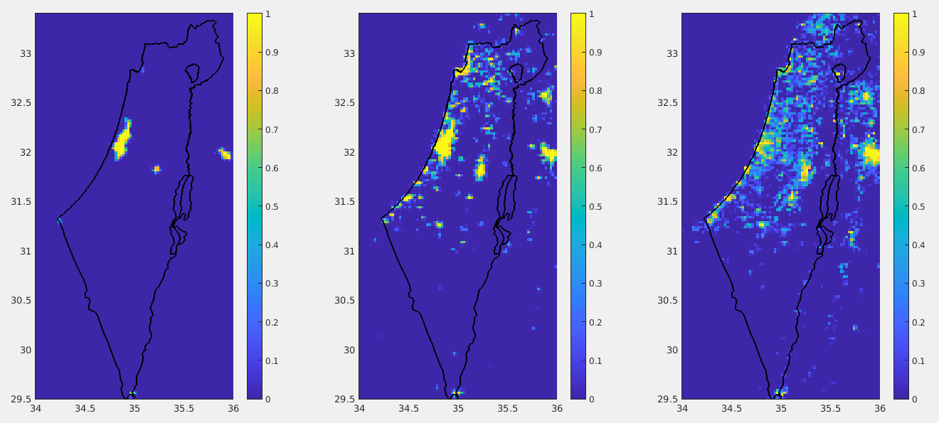
PP CITTA: status at IMS
Pavel Khain, Ron Drori
WG3b, GM 2023, Gdansk

Slide 2
This time lets start from the results …

Slide 3
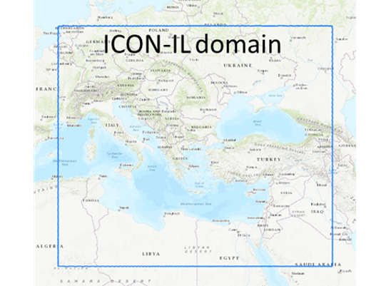
ICON-IL2.5
Platform: Time Critical Suite on the ECMWF HPC
Model setup: Domain: 4-45.5E/25.5-53N
Resolution: ~2.5km horizontal, 65 levels vertical
Range: 90h, IC/BC: det. IFS
Oper. runs: 2 runs/day (00, 12 UTC)
Data assimilation: LHN (IMS radar + OPERA)
When CAMS model predicts heavy haze, ICON uses CAMS forecasted aerosols
During cyclones ICON uses forecasted SST from IFS
Lakes temperature is corrected (important at cold starts)
old

Slide 4
ICON-IL2.5
Platform: Time Critical Suite on the ECMWF HPC
Model setup: Domain: 4-45.5E/25.5-53N
Resolution: ~2.5km horizontal, 65 levels vertical
Range: 90h, IC/BC: det. IFS
Oper. runs: 2 runs/day (00, 12 UTC)
Data assimilation: LHN (IMS radar + OPERA)
When CAMS model predicts heavy haze, ICON uses CAMS forecasted aerosols
During cyclones ICON uses forecasted SST from IFS
Lakes temperature is corrected (important at cold starts)
CAMS aerosol climatology
URBAN scheme is on, uses ESA land use mapped to GlobCover
Since 30/7/2023
Thanks Jan-Peter!

Slide 5
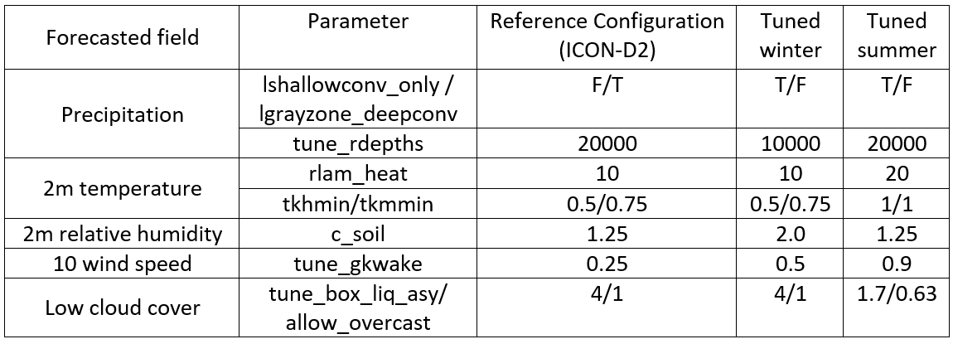
Configuration of ICON-IL2.5
from October to April (Tuned winter) and from May to September (Tuned summer)
Precipitation
rain_n0_factor
0.1
0.1
Year ago

Slide 6
Configuration of ICON-IL2.5
from October to April (Tuned winter) and from May to September (Tuned summer)
10
0.3/0.3
0.5/0.5
0.8
0.1
0.5
Precipitation
rain_n0_factor
0.1
0.1 or 64
rainparam1/rainparam2
200/1
200/1
Reduced: no need to artificially heat the nights everywhere just because they are too cold at the cities
Since 30/7/2023
Reduced: no need to artificially block the wind everywhere just because it is too strong at the cities

Slide 7
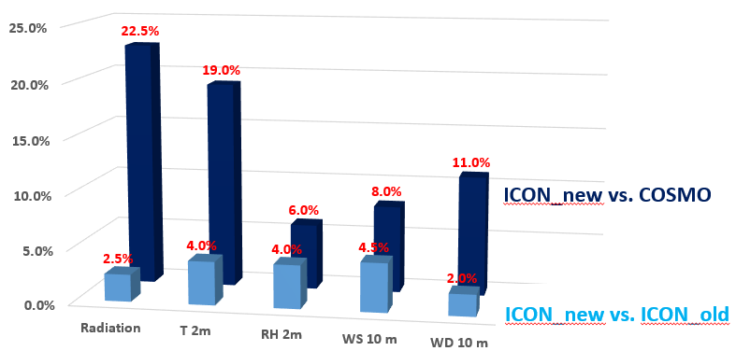
Expected % of improvement in RMSE (based on test periods)
Summer period (May to September):
Gl. Rad: error (typical RMSE) 51.4 W/m2, similar to the previous ver. 24% better than COSMO.
T2m: error 1.12ºC, 3% better than previous ver (7% at night). 19% better than COSMO.
RH2m: error 7.3%, similar to the previous ver. 9% better than COSMO. During nights: too high near coast, too low in dessert.
WS10m: error 1.12 m/s, 4% better than previous ver. 5% better than COSMO.
WD10m: error 44.7 degrees, 5% better than previous ver. 15% better than COSMO.
Winter period (October to April):
Gl. Rad: error 75.9 W/m2, 5% better than previous ver. 21% better than COSMO.
T2m: error 1.49ºC, 5% better than previous ver. (8% better at night, but 0.7ºC underest. at noon). 19% better than COSMO.
RH2m: error 9.55%, 9% better than previous ver. 3% better than COSMO.
WS10m: error 1.24 m/s, 5% better than previous ver. 11% better than COSMO.
WD10m: error 57.1 degrees, similar to the previous version, 7% better than COSMO.
Precipitation: improvement is expected during (previously) too high rain intensities in Oct-Dec in situations of weak synoptics.

Slide 8
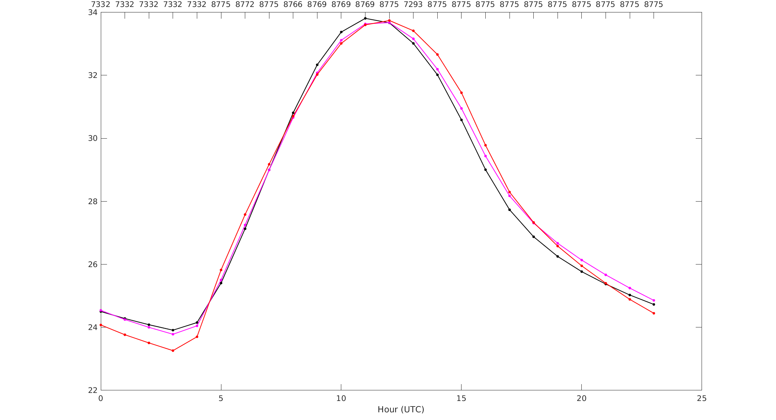
30/7/22-6/9/22
Temperature verification: all stations
Year ago
 | BIAS | RMSE
COSMO | -0.07 | 1.303
ICON | 0.04 | 1.134
OBS
Temperature (ºC)
Hour (UTC)

Slide 9
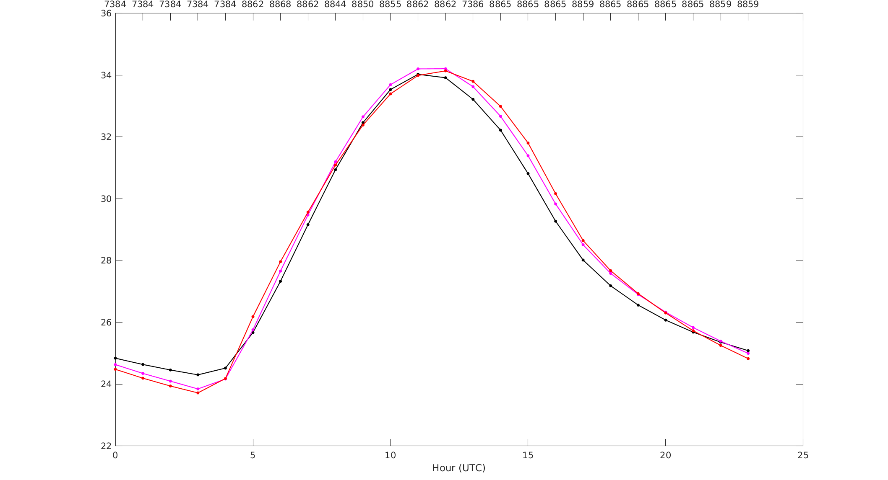
30/7/23-6/9/23
Temperature verification: all stations
Since upgrade
 | BIAS | RMSE
COSMO | -0.19 | 1.348
ICON | -0.02 | 1.083
OBS
Temperature (ºC)
No need now to artificially heat the nights everywhere just because they are too cold at the cities. Most of the stations are rural, therefore ICON nighttime T is reduced
Hour (UTC)

Slide 10
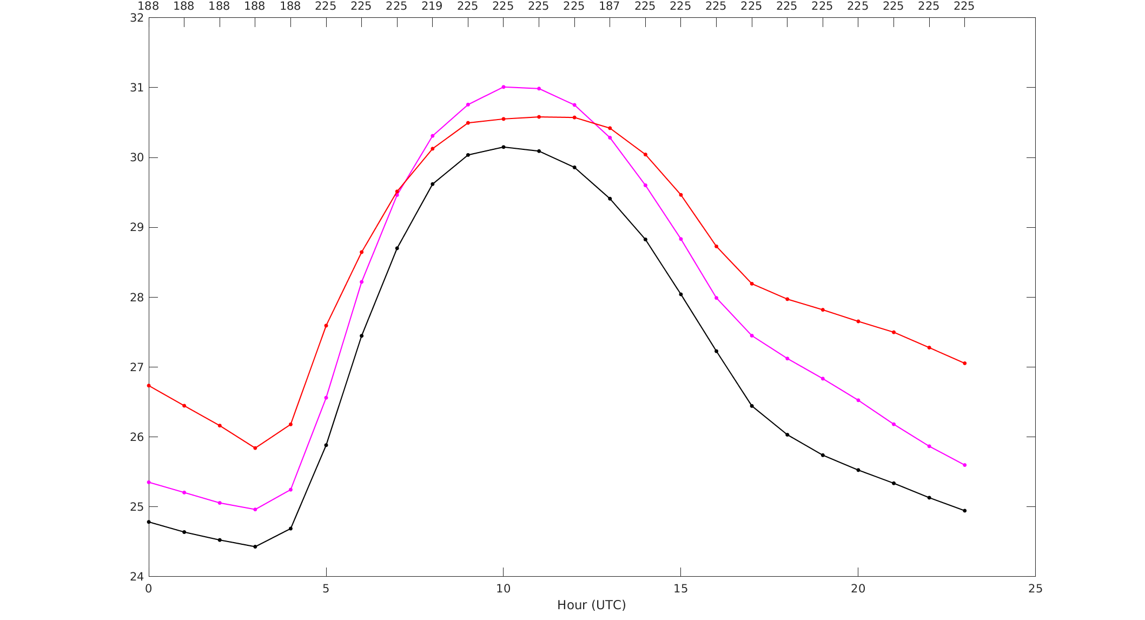
30/7/22-6/9/22
Temperature verification: Tel Aviv (Ha Kfar Ha Yarok)
Year ago
 | BIAS | RMSE
COSMO | -1.41 | 1.658
ICON | -0.63 | 1.071
OBS
Temperature (ºC)
Hour (UTC)

Slide 11
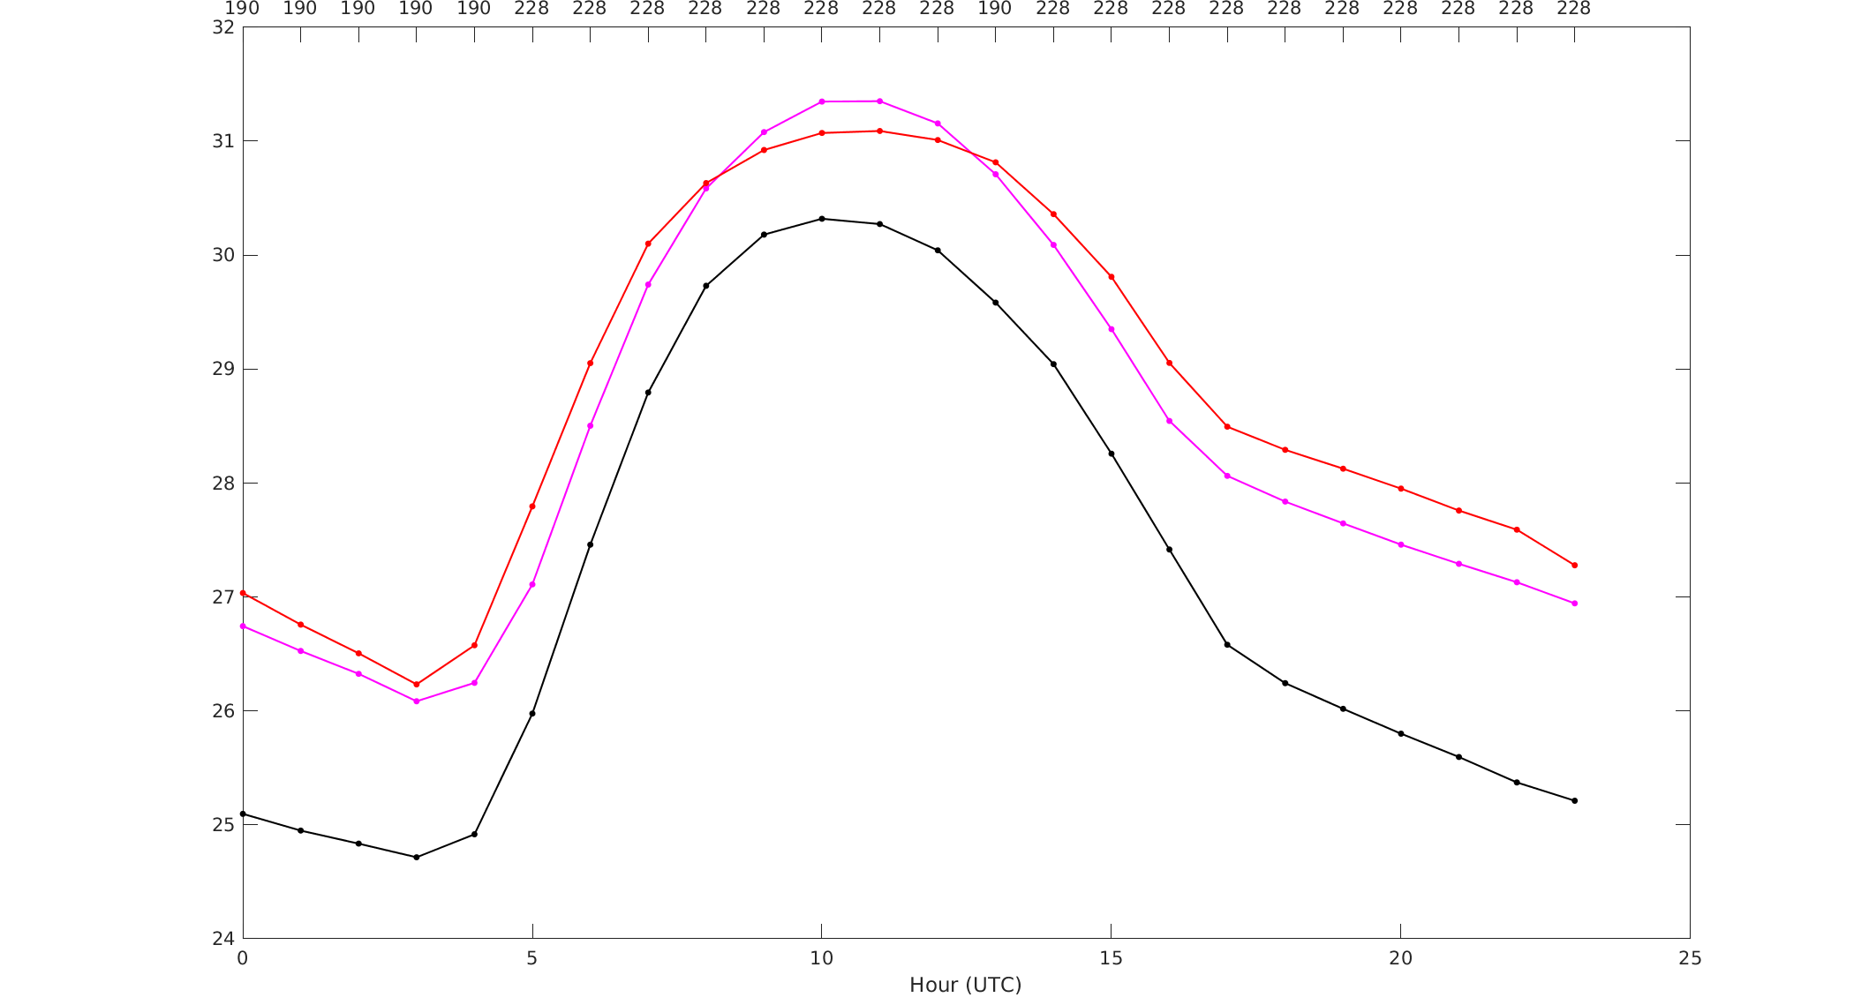
30/7/23-6/9/23
Temperature verification: Tel Aviv (Ha Kfar Ha Yarok)
Since upgrade
 | BIAS | RMSE
COSMO | -1.58 | 1.777
ICON | -0.27 | 0.726
OBS
Temperature (ºC)
Great simulation of the city heat island
Great simulation of the city heat island
Hour (UTC)

Slide 12
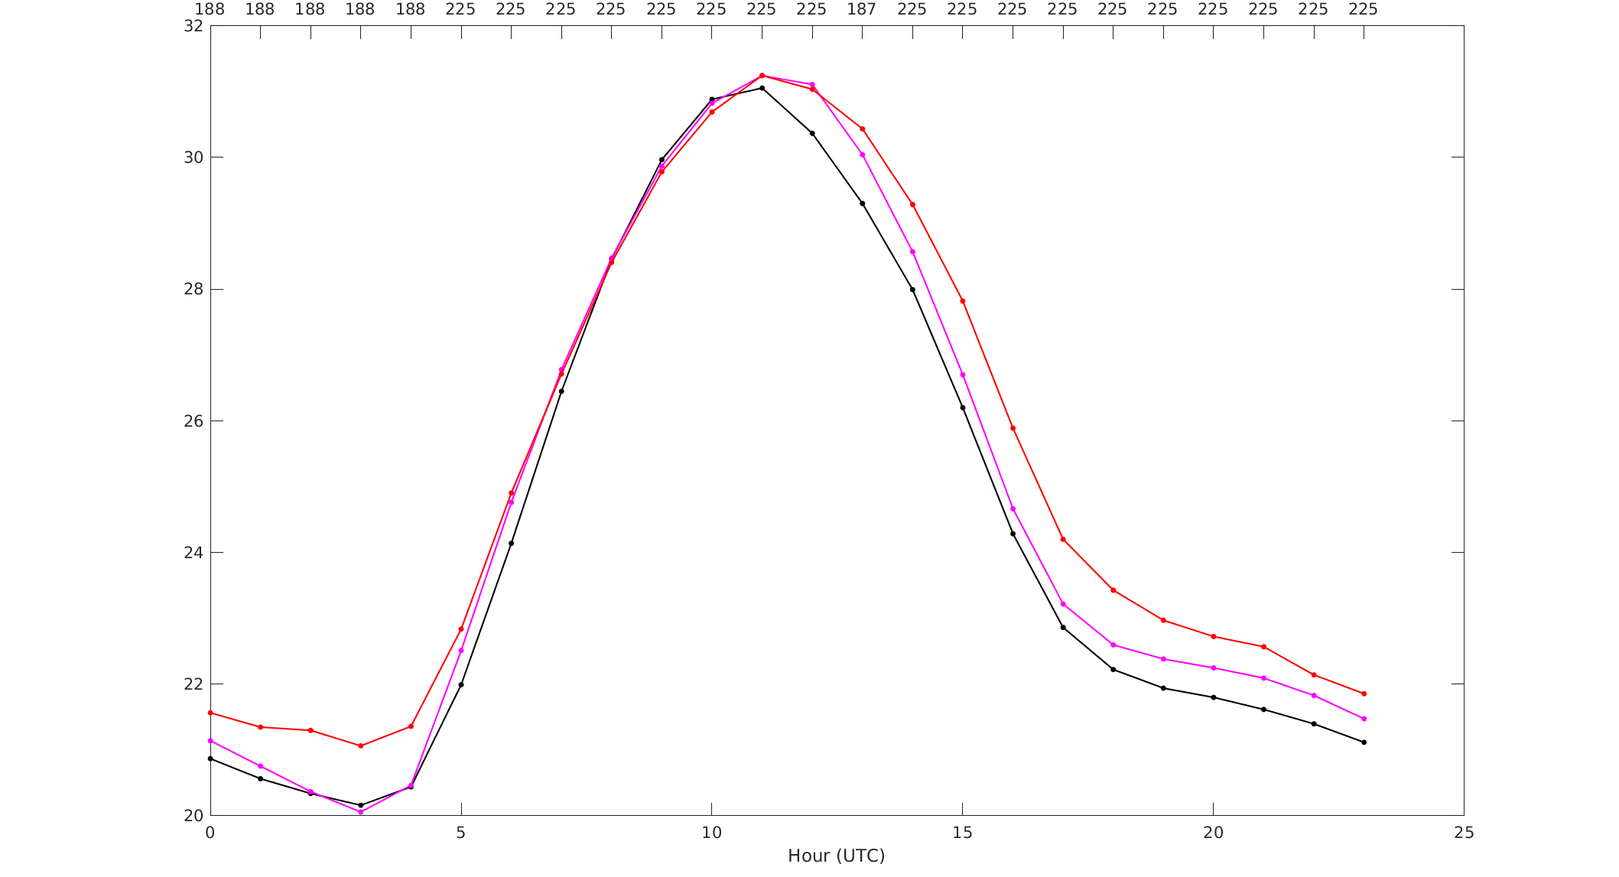
30/7/22-6/9/22
Temperature verification: Jerusalem (Jerusalem Centre)
Year ago
 | BIAS | RMSE
COSMO | -0.79 | 1.448
ICON | -0.46 | 1.271
OBS
Temperature (ºC)
Hour (UTC)

Slide 13
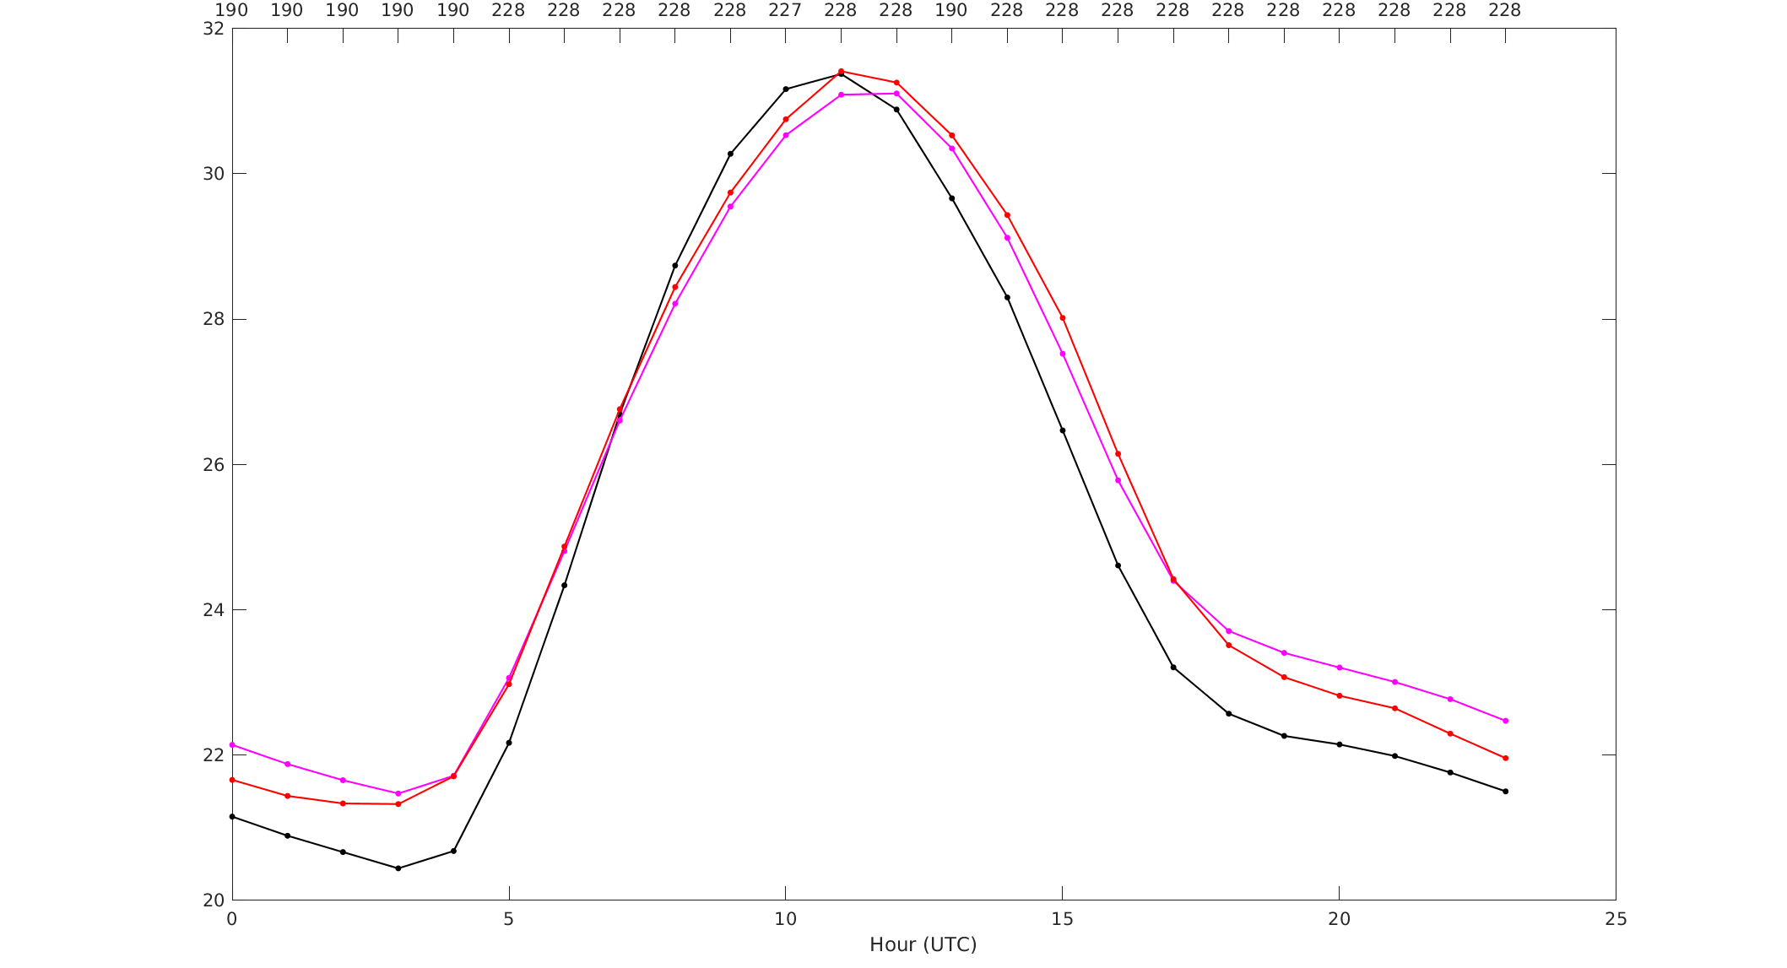
30/7/23-6/9/23
Temperature verification: Jerusalem (Jerusalem Centre)
Since upgrade
 | BIAS | RMSE
COSMO | -0.60 | 1.309
ICON | 0.04 | 0.974
OBS
Temperature (ºC)
Great simulation of the city heat island
Great simulation of the city heat island
Hour (UTC)

Slide 14
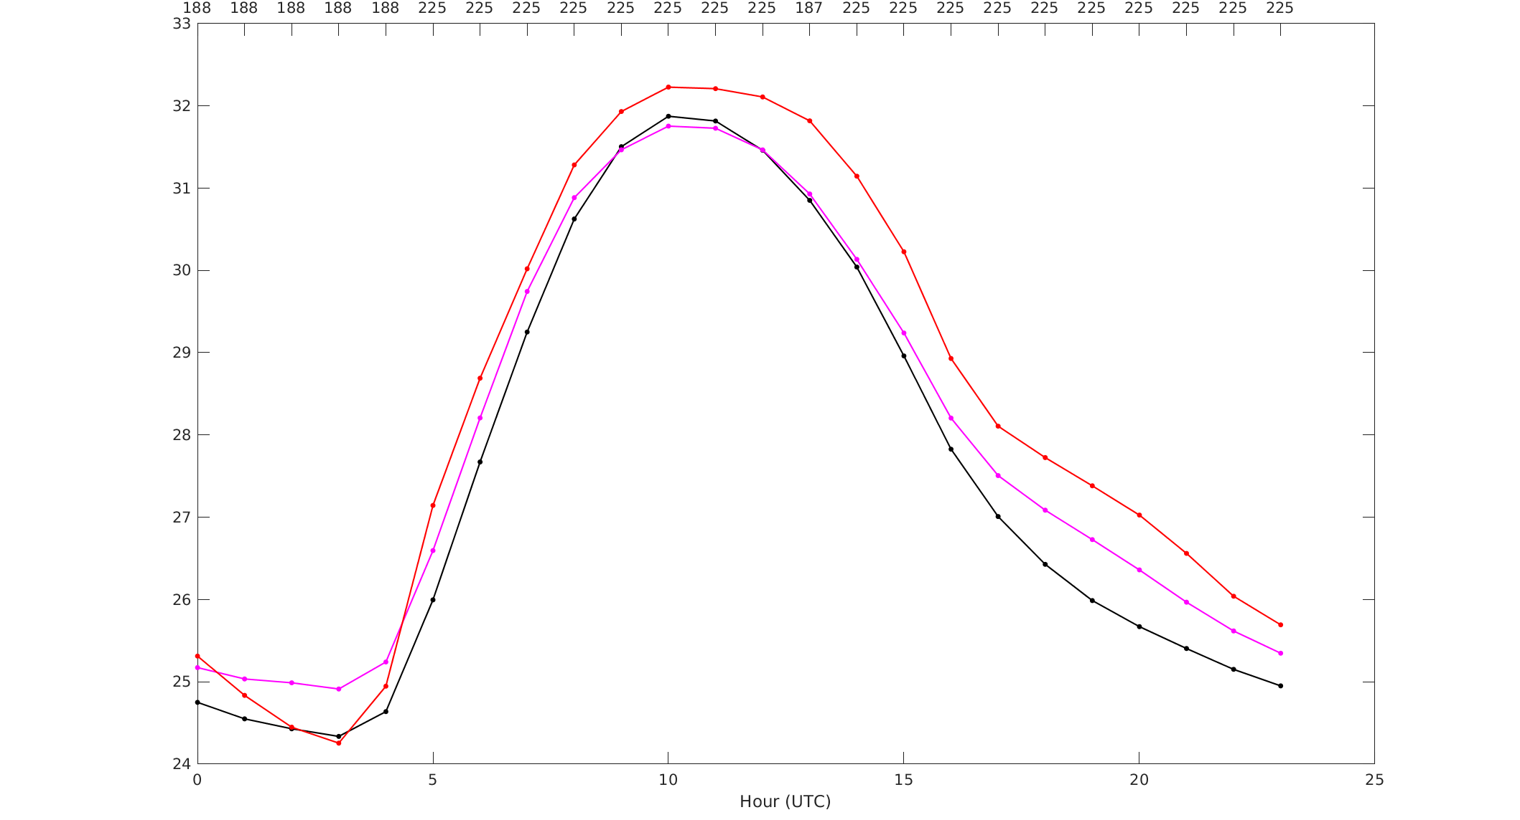
30/7/22-6/9/22
Temperature verification: Bet Dagan (“half” urban)
Year ago
 | BIAS | RMSE
COSMO | -0.81 | 1.200
ICON | -0.43 | 0.925
OBS
Temperature (ºC)
Hour (UTC)

Slide 15
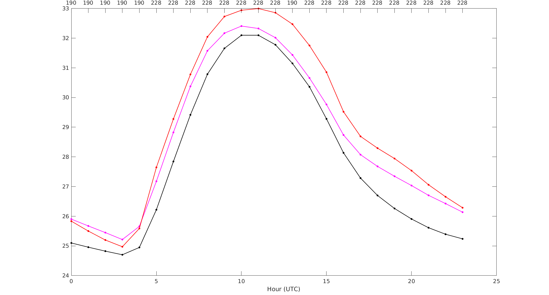
30/7/23-6/9/23
Temperature verification: Bet Dagan (“half” urban)
Since upgrade
 | BIAS | RMSE
COSMO | -1.18 | 1.516
ICON | -0.46 | 1.002
OBS
Temperature (ºC)
Hour (UTC)

Slide 16
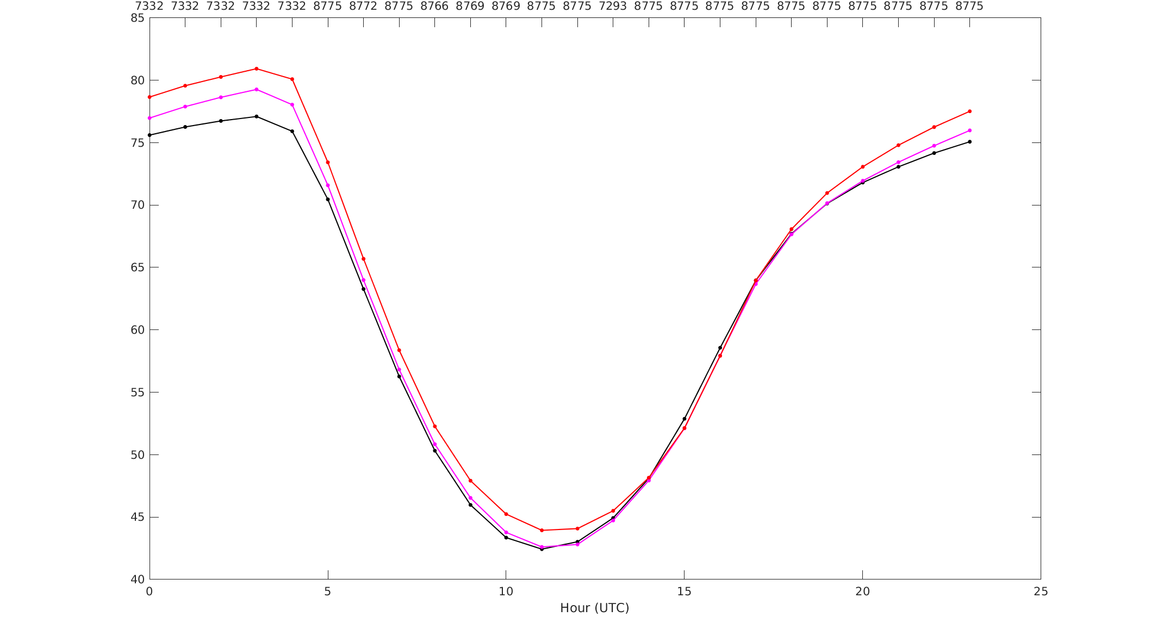
30/7/22-6/9/22
Relative humidity verification: all stations
Year ago
 | BIAS | RMSE
COSMO | -1.68 | 8.06
ICON | -1.18 | 7.24
OBS
Relative humidity (%)
Hour (UTC)

Slide 17
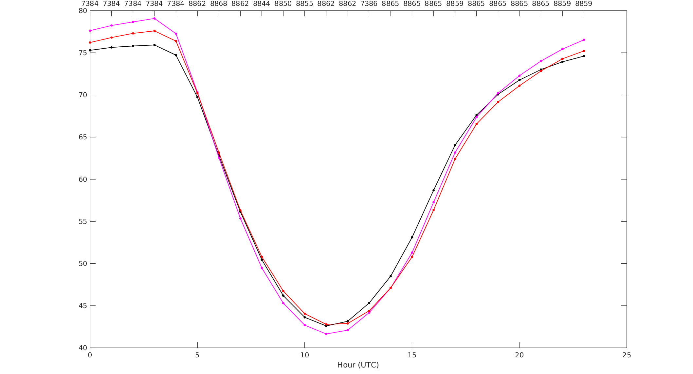
30/7/23-6/9/23
Relative humidity verification: all stations
Since upgrade
Too high forecasted humidity at nights…
 | BIAS | RMSE
COSMO | 0.10 | 7.88
ICON | 0.29 | 6.87
OBS
Set the new parameter which removes night evaporation in urban area
Itype_isa=2
Relative humidity (%)
Hour (UTC)

Slide 18
Wind speed verification
All stations
South stations
(far away from urban influence)
m/s | BIAS | RMSE
COSMO | -0.12 | 1.278
ICON | -0.18 | 1.197
m/s | BIAS | RMSE
COSMO | -0.46 | 1.333
ICON | -0.40 | 1.304
Old
30/7/22-6/9/22
m/s | BIAS | RMSE
COSMO | -0.14 | 1.266
ICON | -0.22 | 1.167
m/s | BIAS | RMSE
COSMO | -0.47 | 1.323
ICON | -0.27 | 1.278
Since upgrade
30/7/23-6/9/23
Previously the wind near the cities was too strong → we set large SSO friction → underestimation far away from cities
Now, the wind near the cities is better represented → we reduced SSO friction → increased wind far away from cities
However, the improvement is too small!

Slide 19
Details on URBAN implementation at IMS
(presented on July 2023)
Jump to conclusions

Slide 20
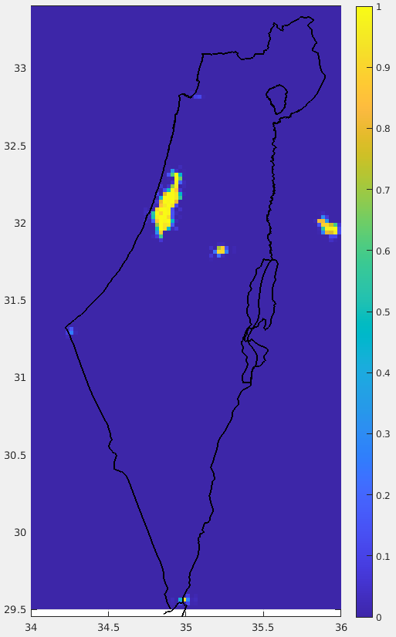
ICON-IL domain (2.5km) driven by IFS
FR_PAVED GlobCover
sea
land
Tel Aviv
Jerusalem
Strong underestimation

Slide 21
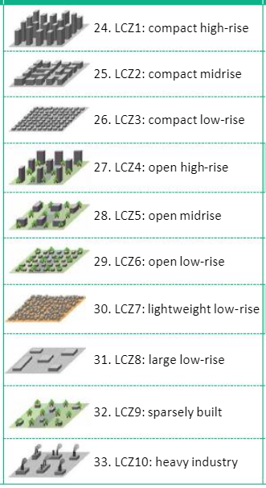
FR_PAVED NEW1
Carmela Apreda (CMCC)
sea
ECOCLIMAP-SG (300m resolution)
Roni Drori (IMS)
Urban classes 24-33
↓
GlobCover class 19
on triangular grid
Classes 27, 28, 29, 32 are partially urban. Taking them as 1 leads to overestimation in Urban fraction

Slide 22
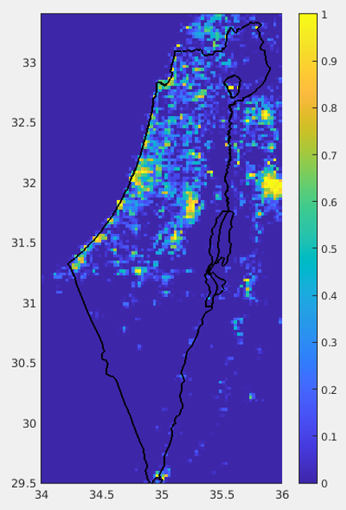
FR_PAVED NEW2
The European Space Agency (ESA) WorldCover 10 m 2021 product https://esa-worldcover.org/en
sea
Roni Drori (IMS)
10 land use classes
GlobCover classes 3,7,11,18,19, 20,21,22,23
on triangular grid
No overestimation in Urban fraction

Slide 24
FR_PAVED GlobCover
FR_PAVED NEW1
FR_PAVED NEW2

Slide 25
6 days experiment: 27/2/2023-4/3/2023 00 UTC + 78h on ATOS@ECMWF
Experiment | lterra_urb | lurbalb | lurbahf | fr_paved
ref | False | False | False | GlobCover
urb_car | True | True | True | NEW1
ref_esa | False | False | False | NEW2
urb_esa | True | True | True | NEW2
use urban albedo and emissivity
use urban anthropogenic heat flux
lterra_urb ! activate urban model TERRA_URB (modified heat capacity and thermal conductivity)
lurbalb ! use urban albedo and emissivity
lurbahf ! use urban anthropogenic heat flux
itype_kbmo=2 ! type of bluff-body thermal roughness length parameterization (2: Brutsaert Kanda)
itype_eisa=3 ! type of evaporation from impervious surface area. Commented in the code.

Slide 26
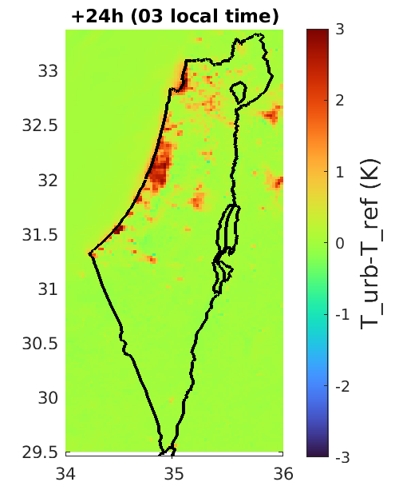
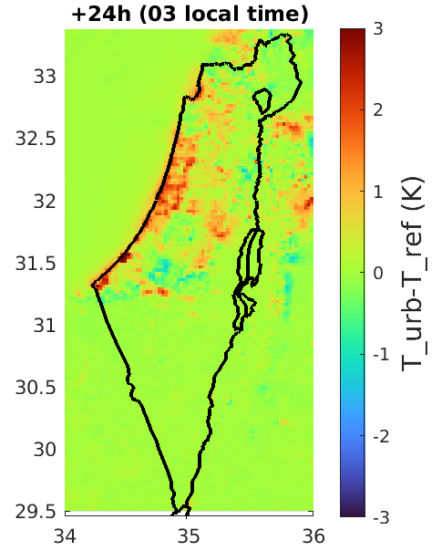
Night: heat island. The heat capacity of the cities keeps the daytime heat during the night
sea
sea
land
land
land
land
urb_car-ref
urb_esa-ref

Slide 27
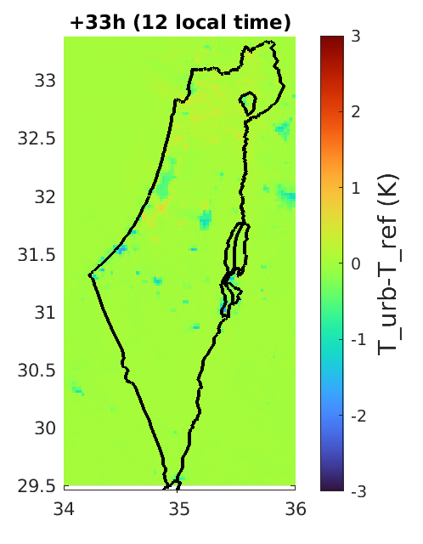
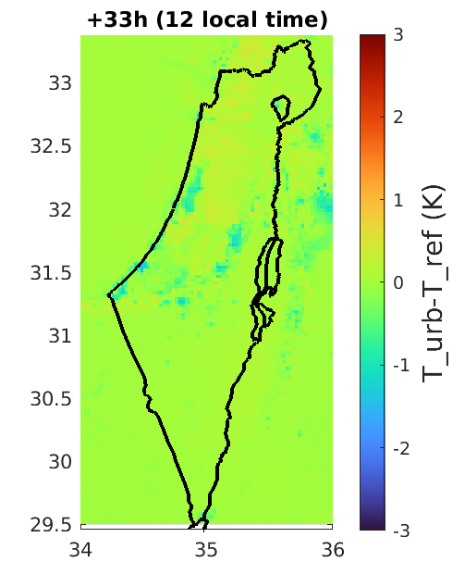
Before noon. The heat capacity of the cities keeps the nighttime cool air during the day
sea
sea
land
land
land
land
urb_car-ref
urb_esa-ref

Slide 28
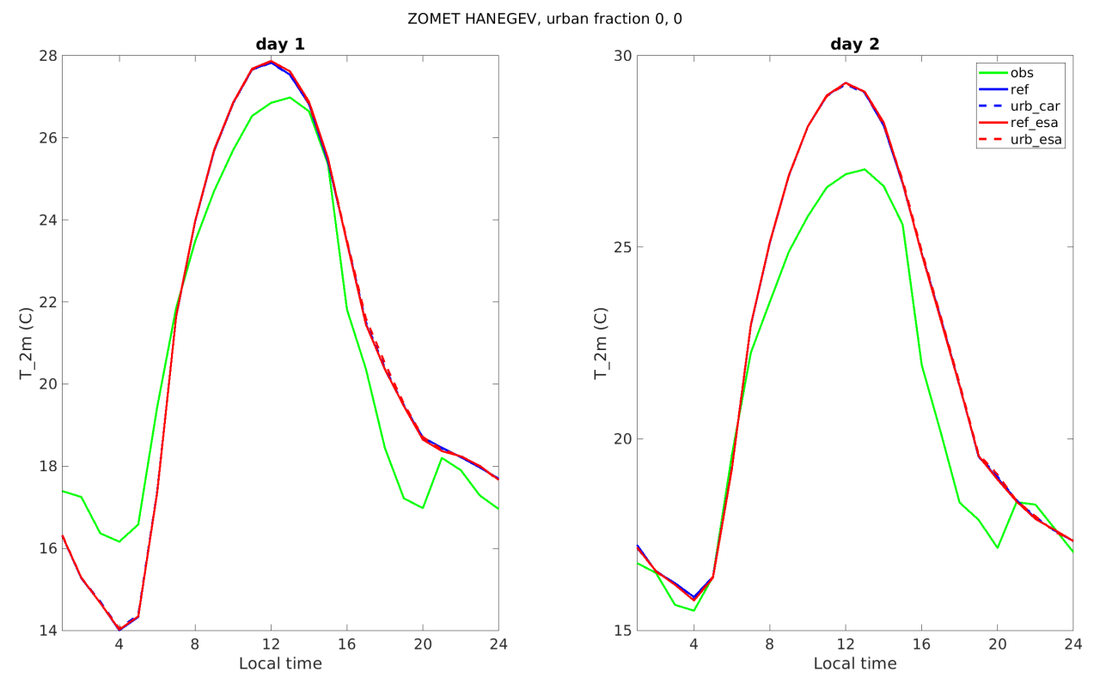
FR_PAVED NEW2
FR_PAVED NEW1
No effect in rural area. Good!

Slide 29
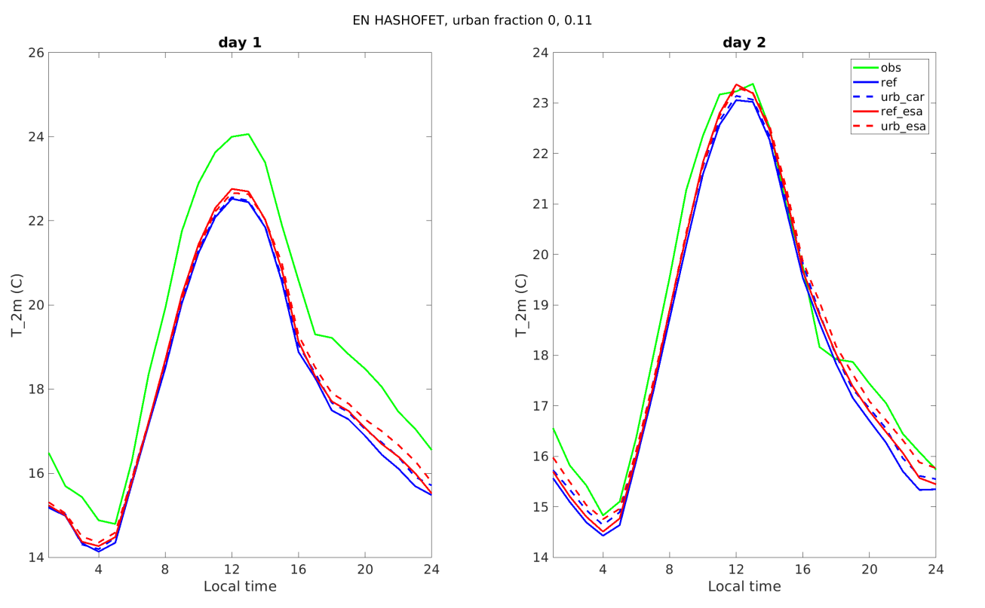
FR_PAVED NEW2
FR_PAVED NEW1
Small effect in weakly urban area. Good!

Slide 30
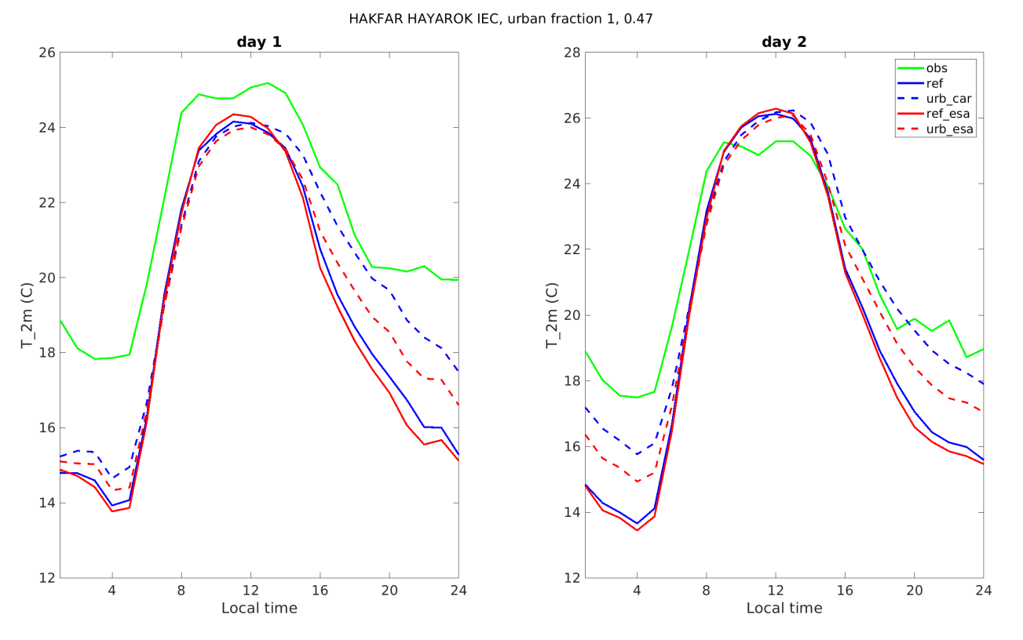
FR_PAVED NEW2
FR_PAVED NEW1
Big effect in urban area. Good!

Slide 31
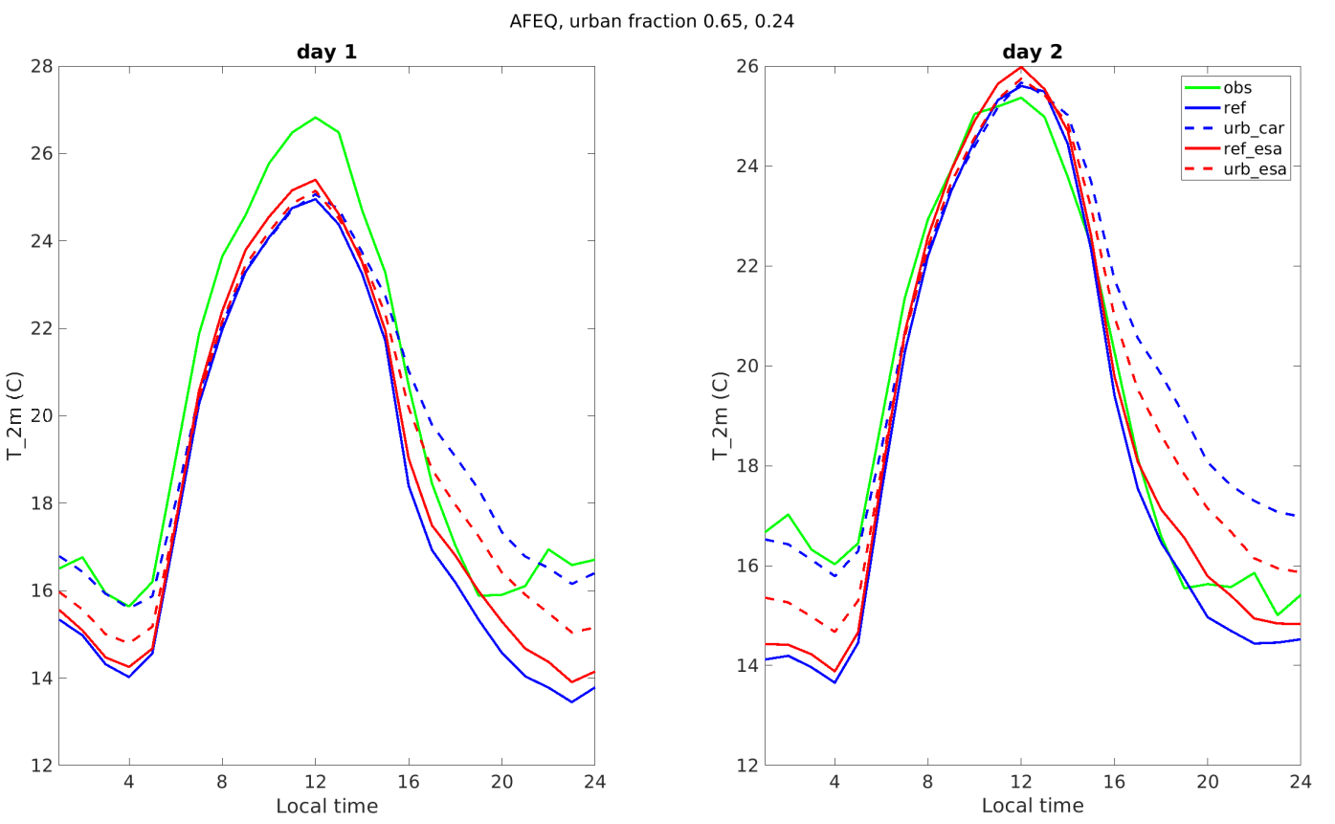
FR_PAVED NEW2
FR_PAVED NEW1
Big effect in urban area. Good!

Slide 32
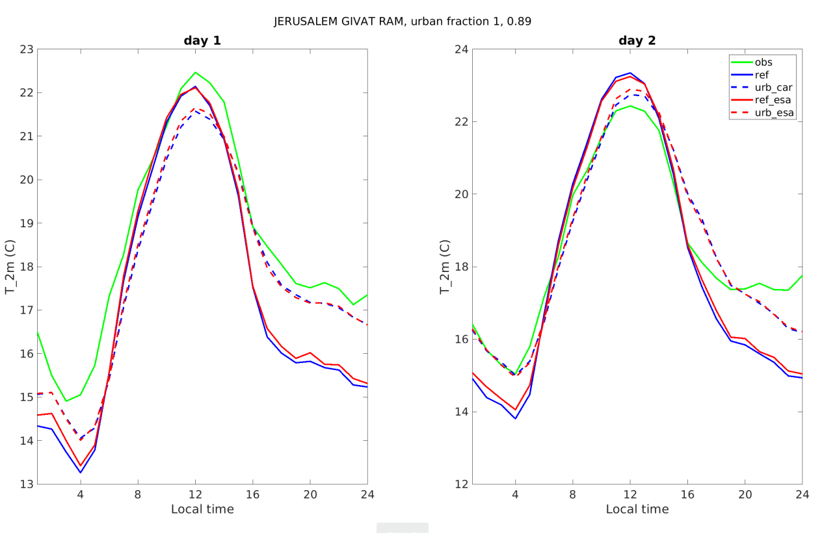
FR_PAVED NEW2
FR_PAVED NEW1
Great improvement in urban area. Good!

Slide 33
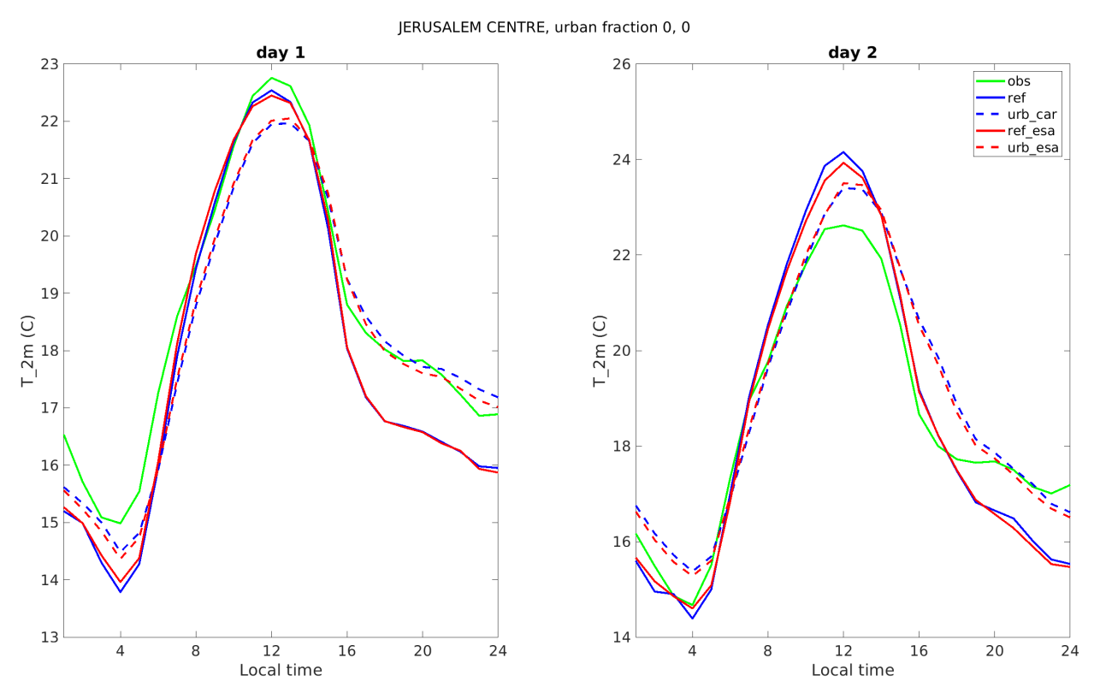
Great improvement in urban area. Good!

Slide 34
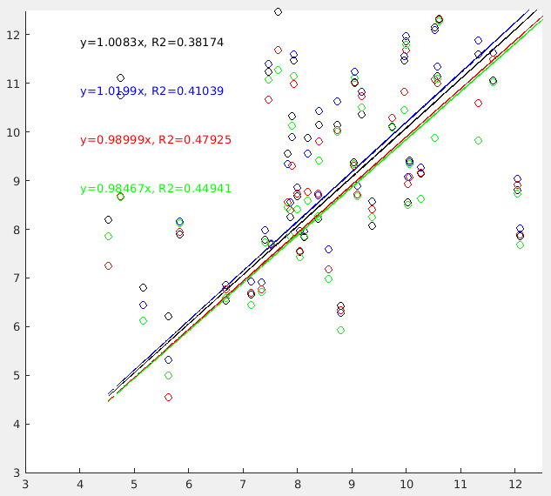
Mean diurnal amplitude ∆T during 8 days experiment: simulated vs observed
Each circle represents one station
As expected ∆T is lower when the urban effect is taken into account
∆T in model and observations approaches 1:1 line
urb_esa is the best
Simulated ∆T (ºC)
ref
ref_esa
urb_esa
urb_car
Observed ∆T (ºC)

Slide 35
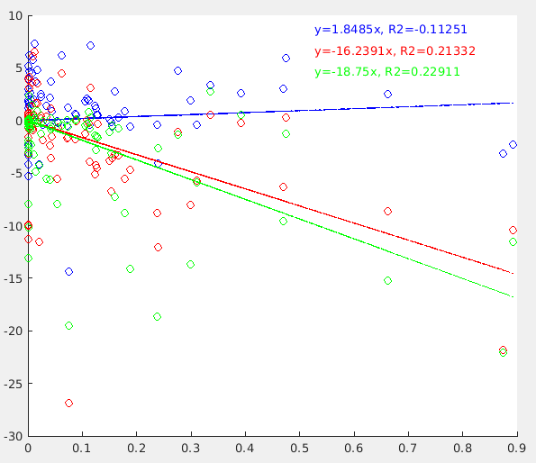
Mean diurnal amplitude ∆T during 8 days experiment: simulated effect vs urban fraction
Each circle represents one station
The simulated effect is estimated in percent (%) by:
ref_esa – no effect, as expected
urb_esa - ∆T is reduced by ~16%
urb_car - ∆T is reduced by ~19%
$100\frac{\text{∆}\text{T}\text{(}\text{urb}\text{)−}\text{∆}\text{T}\text{(}\text{ref}\text{)}}{\text{∆}\text{T}\text{(}\text{ref}\text{)}}$ (%)
$$100\frac{\text{∆}\text{T}\text{(}\text{urb}\text{)−}\text{∆}\text{T}\text{(}\text{ref}\text{)}}{\text{∆}\text{T}\text{(}\text{ref}\text{)}}$$
$$100\frac{\text{∆}\text{T}\text{(}\text{ref}\text{_}\text{esa}\text{)−}\text{∆}\text{T}\text{(}\text{ref}\text{)}}{\text{∆}\text{T}\text{(}\text{ref}\text{)}}$$
$$100\frac{\text{∆}\text{T}\text{(}\text{urb}\text{_}\text{esa}\text{)−}\text{∆}\text{T}\text{(}\text{ref}\text{)}}{\text{∆}\text{T}\text{(}\text{ref}\text{)}}$$
$$100\frac{\text{∆}\text{T}\text{(}\text{urb}\text{_}\text{car}\text{)−}\text{∆}\text{T}\text{(}\text{ref}\text{)}}{\text{∆}\text{T}\text{(}\text{ref}\text{)}}$$
Urban fraction [0-1]

Slide 36
Conclusions
By transferring classes 24-33 of ECOCLIMAP-SG to GlobCover class 19, the urban cover is improved significantly, but is overestimated. With the use of ESA there is no overestimation.
The urban scheme with ESA land use mapping showed good results
Therefore the model was retuned and the operational version was updated on 30/7/2023 !
Plans: analyze the effect of the scheme on (following PP CITTA plan):
Temperature and wind profiles over Tel Aviv and Jerusalem
Snow depth in Jerusalem during snow events
Thanks Jan-Peter!
Thanks everybody!

Slide 37
More slides

Slide 38
Verification since the upgrade:
Verification method
RMSE verification (left panels):
For each forecasted field, verification was performed separately for 4 groups. The groups were 54 inland and 27 coastal automatic weather stations over Israel, each verified separately for the night (00 UTC) and day (12 UTC) times during the first 72h of the forecast. The final RMSE score was obtained by averaging the RMSE scores of the 4 groups. The exception is the 10m wind direction verification. Here, the model and observation wind vectors were used to calculate the RMSE of the vector of difference (RMSE_{wv}), minus RMSE of the wind speed (RMSE_{ws}), resulting in score in units of m/s.
Hits verification (right panels):
Similar analysis was performed to obtain the percentage of hits. A forecast was accounted as hit in case its absolute error was below a predefined threshold. The thresholds for T2, RH2, WS10 and WD10 were defined as 2K, 13%, 2m/s and 30º, respectively.

Slide 39
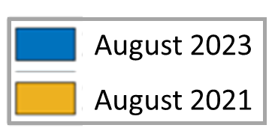
Verification since the upgrade:
2m Temperature
IFS CO-IL IC-IL IC-GL
IFS CO-IL IC-IL IC-GL

Slide 40
Verification since the upgrade:
2m Relative humidity
IFS CO-IL IC-IL IC-GL
IFS CO-IL IC-IL IC-GL

Slide 41
Verification since the upgrade:
10m Wind speed
IFS CO-IL IC-IL IC-GL
IFS CO-IL IC-IL IC-GL

Slide 42
Verification since the upgrade:
10m Wind direction
IFS CO-IL IC-IL IC-GL
IFS CO-IL IC-IL IC-GL

Slide 43
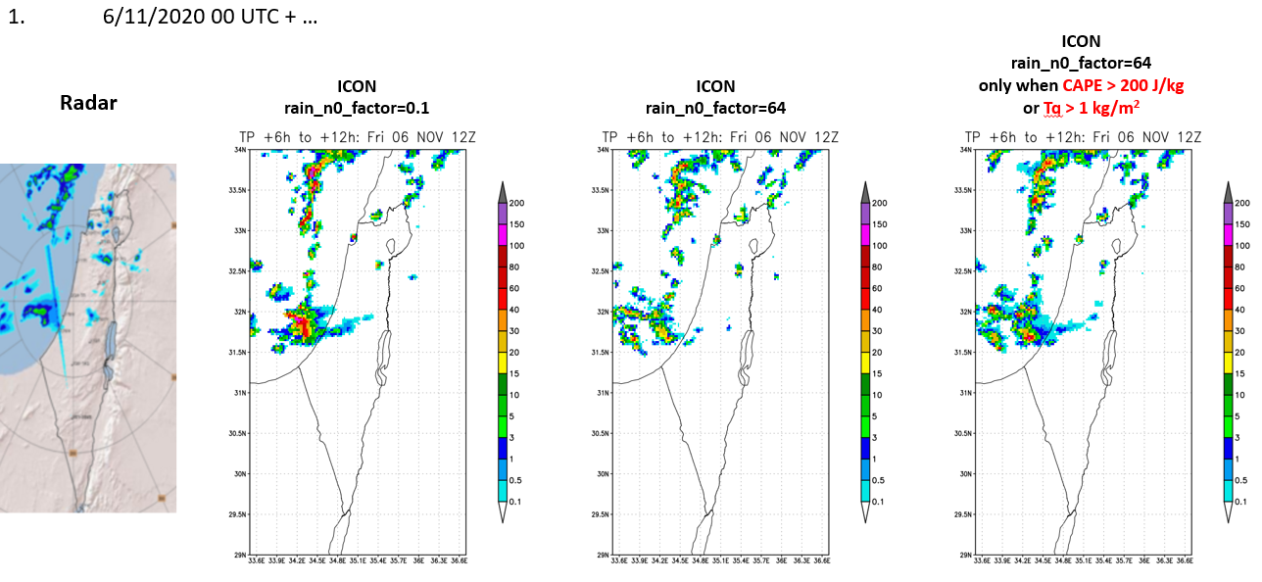
Expected precipitation improvement (test cases)
Visit:
12/9 WG3a

Slide 44
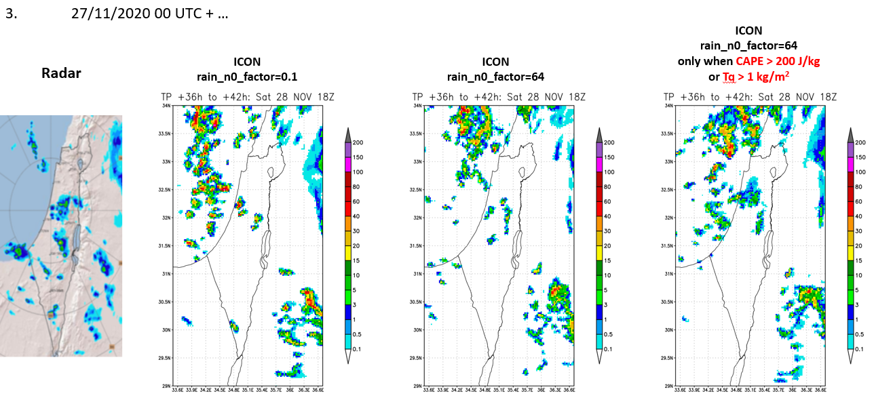
Expected precipitation improvement (test cases)
Visit:
12/9 WG3a

Slide 45
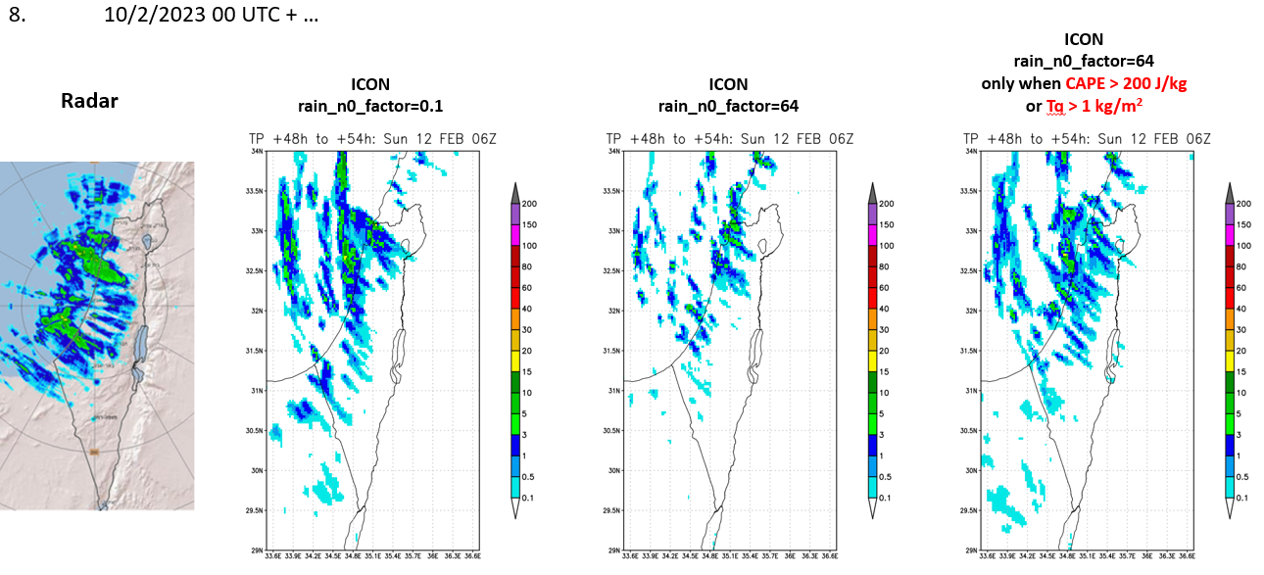
Expected precipitation improvement (test cases)
Visit:
12/9 WG3a

