Slide 1




Update on the latest TERRA_URB implementations by analyzing ICON-LAM and CCLM simulations
A. Campanale, M. Adinolfi, M. Raffa, P. Mercogliano, J.-P. Schulz
25th COSMO Meeting, 11-15 September 2023, Gdansk Poland

Slide 2
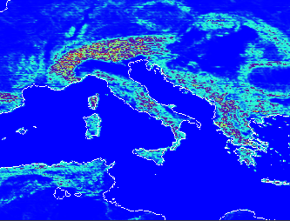
WG1: Porting of TERRA_URB in ICON
Urban Hydrology: model setup
Model: ICON-nwp
Resolution: 2km (0.018°) over Italy-LAM domain
Period: 01 August 2017 (00 UTC) to 05 August 2017 (24 UTC) 5 Days simulation
(very hot August in Italy, +2.53°C anomaly in respect to period 1971/2000)
Forcing data: ECMWF IFS analyses at 6hr
Main namelist switch: itype_eisa=3 water puddles (eisa 3)
itype_eisa=2 infiltration and bare soil evaporation over impervious areas set to 0 (eisa 2)
itype_eisa=1 no urban hydrology (eisa 1)
lterra_urb=off no TERRA_URB (ctrl run)
Downscaling from 8,5km to ~2km
IFS grid
ICON grid

Slide 3
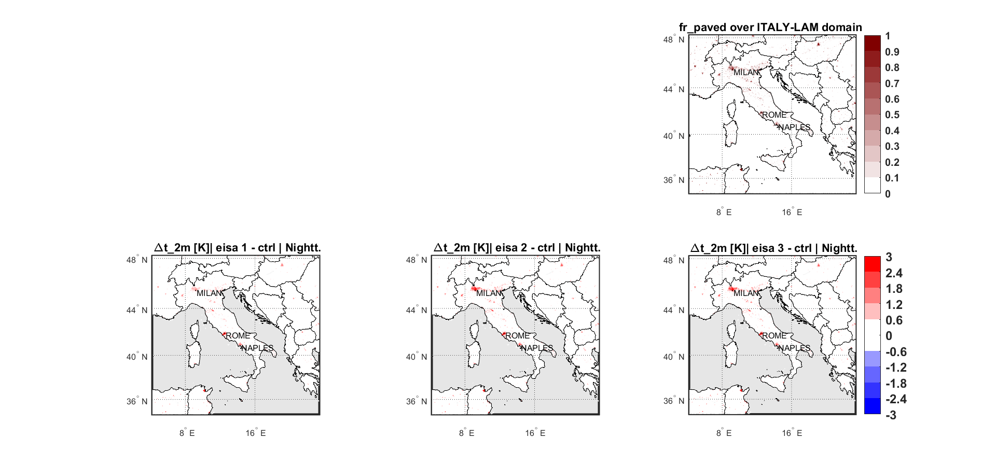
WG1: Porting of TERRA_URB in ICON
Resolution: 2km (0.018°) over Italy domain
Period: 01 August 2017 to 05 August 2017
Itype_eisa = 3 (eisa 3)
Itype_eisa = 2 (eisa 2)
Itype_eisa = 1 (eisa 1)
lterra_urb = off (ctrl)
Fr_paved maps vs t_2m differences maps
Strong differences between eisa 1 and 2 in the north of Italy (e.g. MILAN)
Almost no differences between eisa 2 and 3
Satisfactory matching between impervious area and temperature patterns
vs
vs

Slide 4
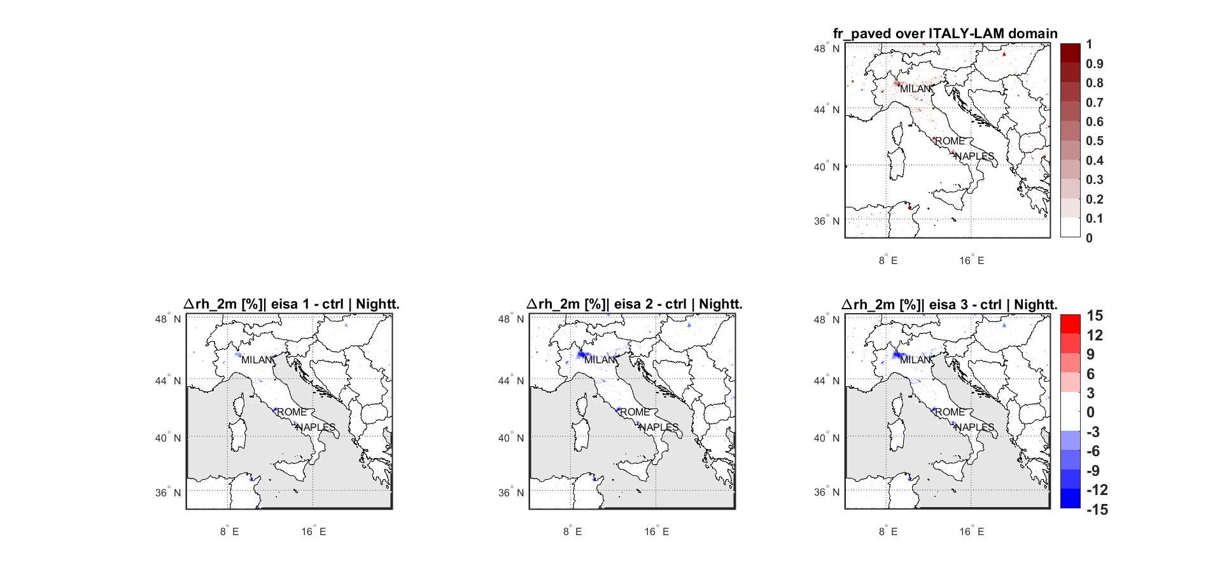
WG1: Porting of TERRA_URB in ICON
Resolution: 2km (0.018°) over Italy domain
Period: 01 August 2017 to 05 August 2017
Itype_eisa = 3 (eisa 3)
Itype_eisa = 2 (eisa 2)
Itype_eisa = 1 (eisa 1)
lterra_urb = off (ctrl)
Fr_paved maps vs rh_2m differences maps
Strong differences between eisa 1 and 2 in the north of Italy (e.g. MILAN)
Almost no differences between eisa 2 and 3
Satisfactory matching between impervious area and relative humidity patterns
vs
vs

Slide 5
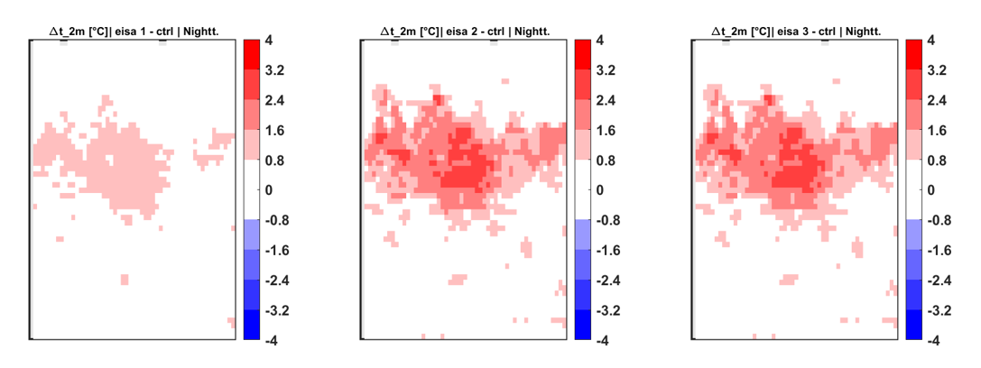
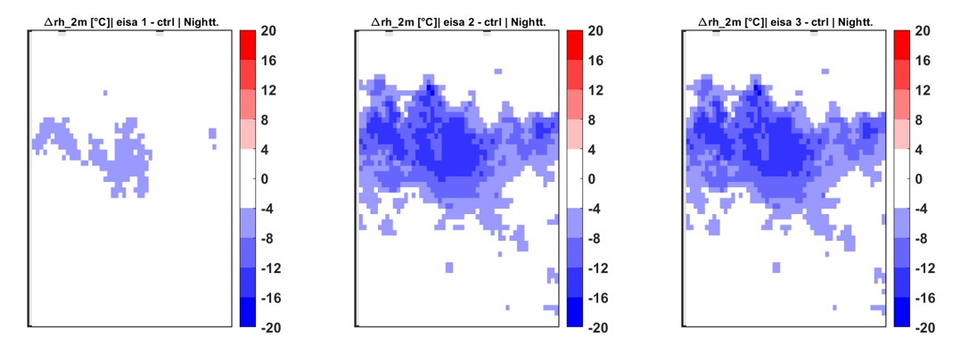
WG1: Porting of TERRA_URB in ICON
Resolution: 2km (0.018°) over Italy domain
Period: 01 August 2017 to 05 August 2017
Itype_eisa = 3 (eisa 3)
Itype_eisa = 2 (eisa 2)
Itype_eisa = 1 (eisa 1)
lterra_urb = off (ctrl)
t_2m and rh_2m differences over MILAN
Big differences in eisa 2 vs eisa 1
No differences in eisa 3 vs eisa 2
vs
vs
vs
vs

Slide 6
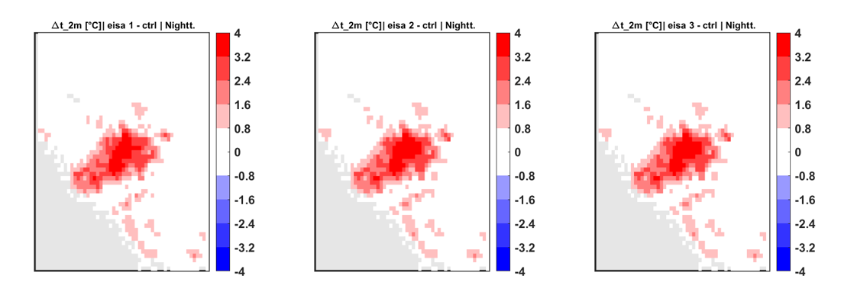
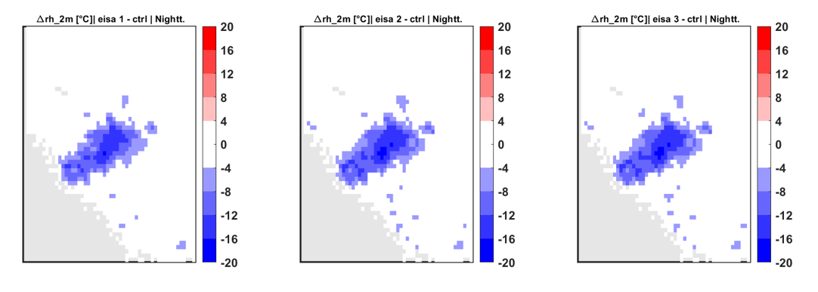
WG1: Porting of TERRA_URB in ICON
Resolution: 2km (0.018°) over Italy domain
Period: 01 August 2017 to 05 August 2017
Itype_eisa = 3 (eisa 3)
Itype_eisa = 2 (eisa 2)
Itype_eisa = 1 (eisa 1)
lterra_urb = off (ctrl)
t_2m and rh_2m differences over ROME
No differences in eisa 2 vs eisa 1
No differences in eisa 3 vs eisa 2
vs
vs
vs
vs

Slide 7
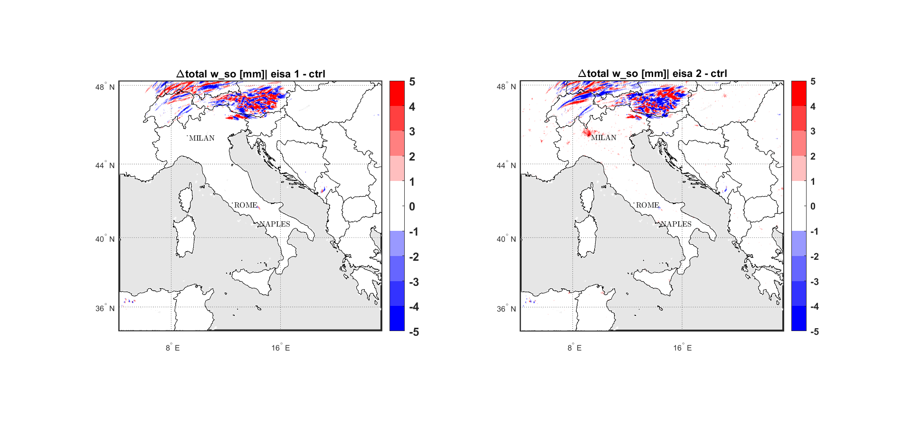
WG1: Porting of TERRA_URB in ICON
Resolution: 2km (0.018°) over Italy domain
Period: 01 August 2017 to 05 August 2017
Itype_eisa = 3 (eisa 3)
Itype_eisa = 2 (eisa 2)
Itype_eisa = 1 (eisa 1)
lterra_urb = off (ctrl)
Total soil moisture content
Strong differences in water content between eisa 1 and 2 in the north of Italy (e.g. MILAN): soil water cannot evaporate from paved areas!
vs
Eisa 2 implementations has strong effects on soils rich of water!

Slide 8


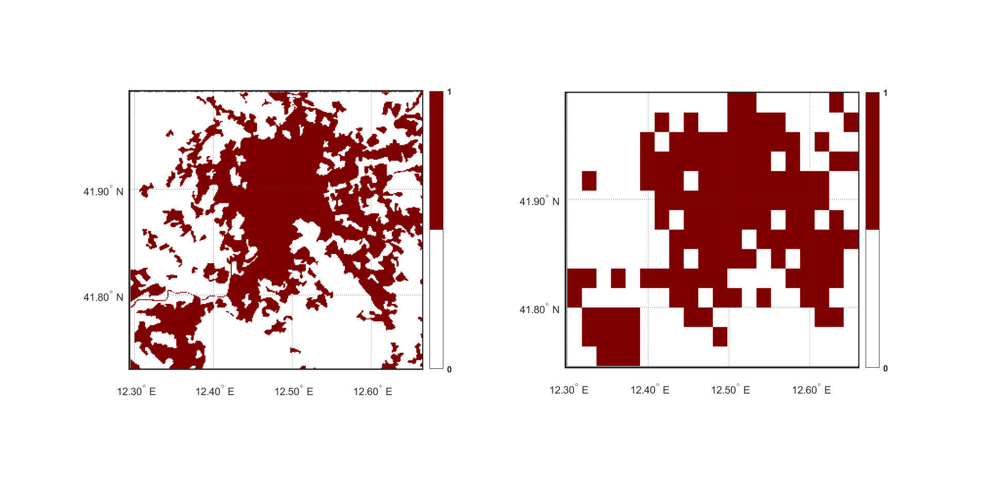
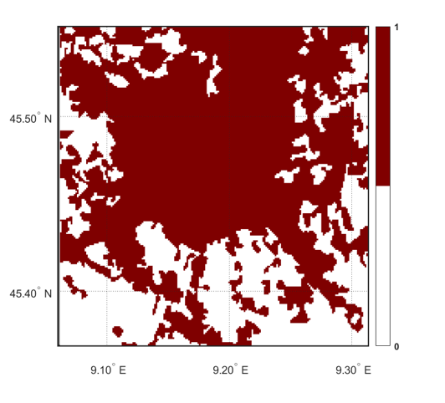
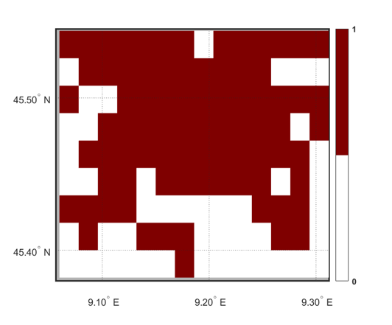
WG1: Porting of TERRA_URB in ICON
Validation with UrbClim reanalysis dataset
Dataset main Features
Domain: 100 European cities
Spatial Resolution: 100m x 100m
Temporal Coverage: 2008-2017
Temporal Resolution: 1 hour
Data Type: Gridded
Variables: t_2m (K), Wind Speed (m/s), Relative
humidity (%), Specific humidity (kg/kg),
urban-rural mask, land-sea mask
DOI: 10.24381/cds.c6459d3a
For the UrbClim dataset, the ERA5 reanalysis large-scale weather conditions are downscaled to urban agglomeration-scale.
The dataset was produced by VITO
(Flemish Institute of Technological Research) on behalf of the Copernicus Climate Change Service.
Urban Rural Mask used for UHI calculation
ROME UrbClim (100m res)
MILAN UrbClim (100m res)
ROME ICON exp. (2km res)
MILAN ICON exp. (2km res)
Remap
Remap

Slide 9
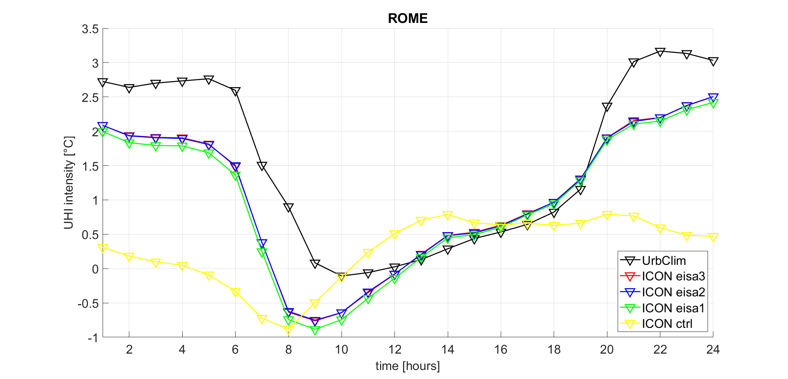
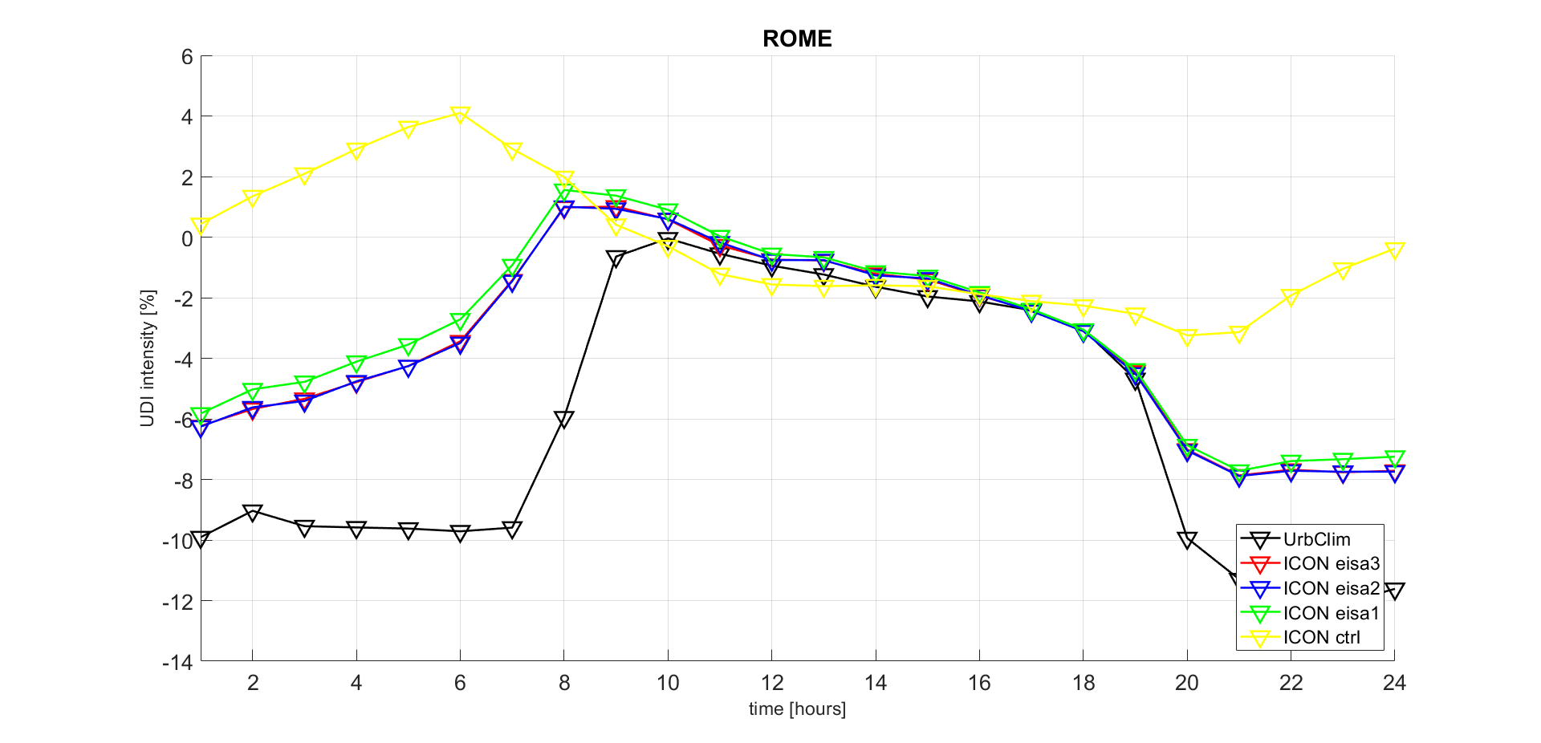
WG1: Porting of TERRA_URB in ICON
Resolution: 2km (0.018°) over Italy domain
Period: 01 August 2017 to 05 August 2017
Itype_eisa = 3 (eisa 3)
Itype_eisa = 2 (eisa 2)
Itype_eisa = 1 (eisa 1)
lterra_urb = off (ctrl)
ICON + TERRA-URB UDI vs UrbClim UHI and UDI:
Effect of urban hydrology over ROME

Slide 10
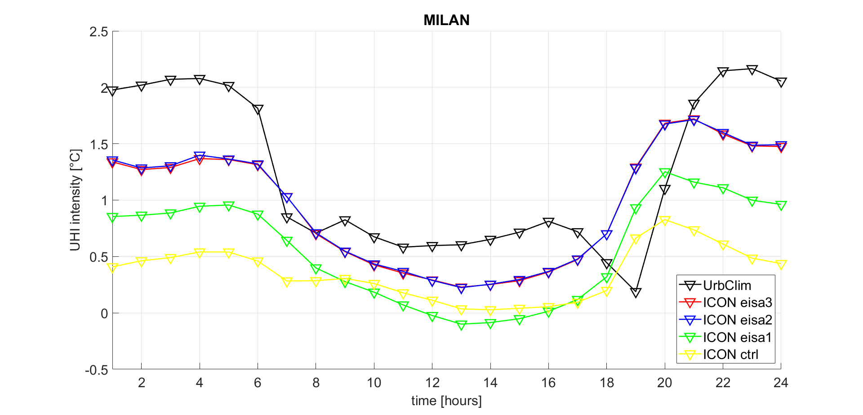
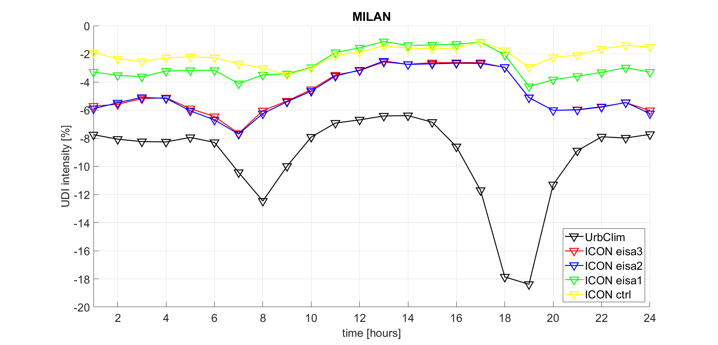
WG1: Porting of TERRA_URB in ICON
Resolution: 2km (0.018°) over Italy domain
Period: 01 August 2017 to 05 August 2017
Itype_eisa = 3 (eisa 3)
Itype_eisa = 2 (eisa 2)
Itype_eisa = 1 (eisa 1)
lterra_urb = off (ctrl)
ICON + TERRA-URB UHI vs UrbClim UHI and UDI:
Effect of urban hydrology over MILAN

Slide 11
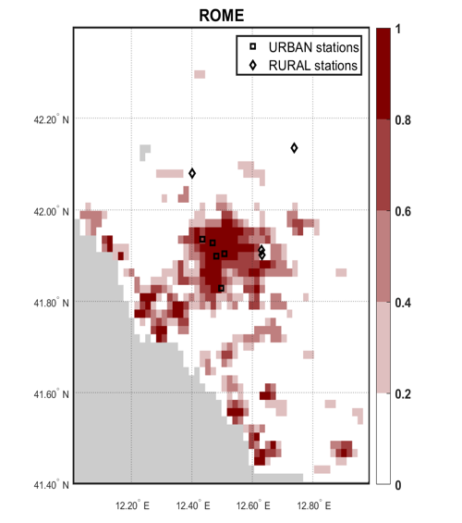
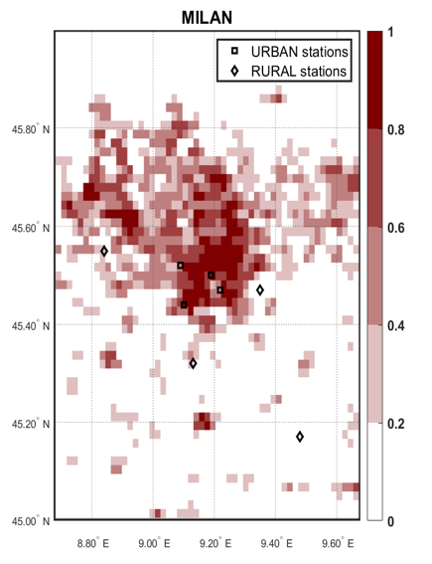
WG1: Porting of TERRA_URB in ICON
Validation with Point Stations
0.87 ≤ Fr_paved
URBAN stations
≤ 1( )
0 ≤ Fr_paved
RURAL stations
≤ 0.12 ( )
0.74 ≤ Fr_paved
URBAN stations
≤ 0.94 ( )
0.005 ≤ Fr_paved
RURAL stations
≤ 0.27 ( )

Slide 12
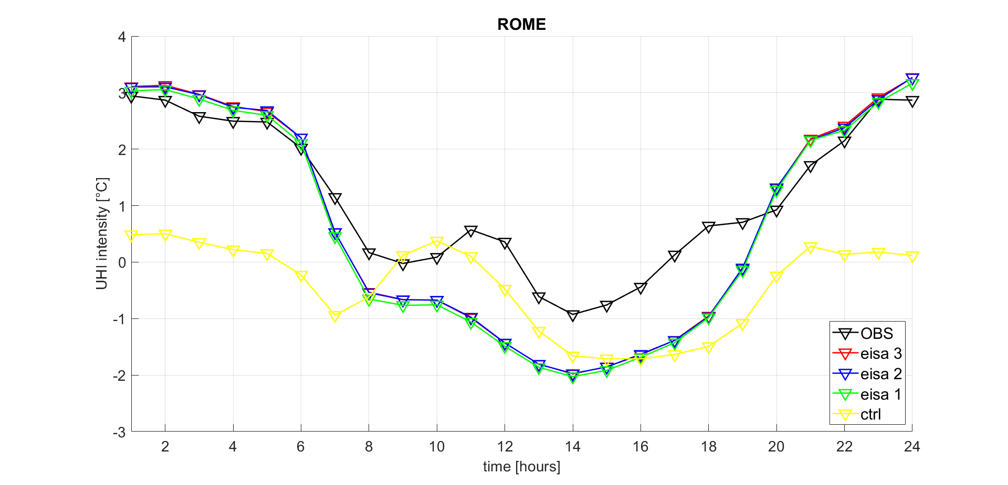
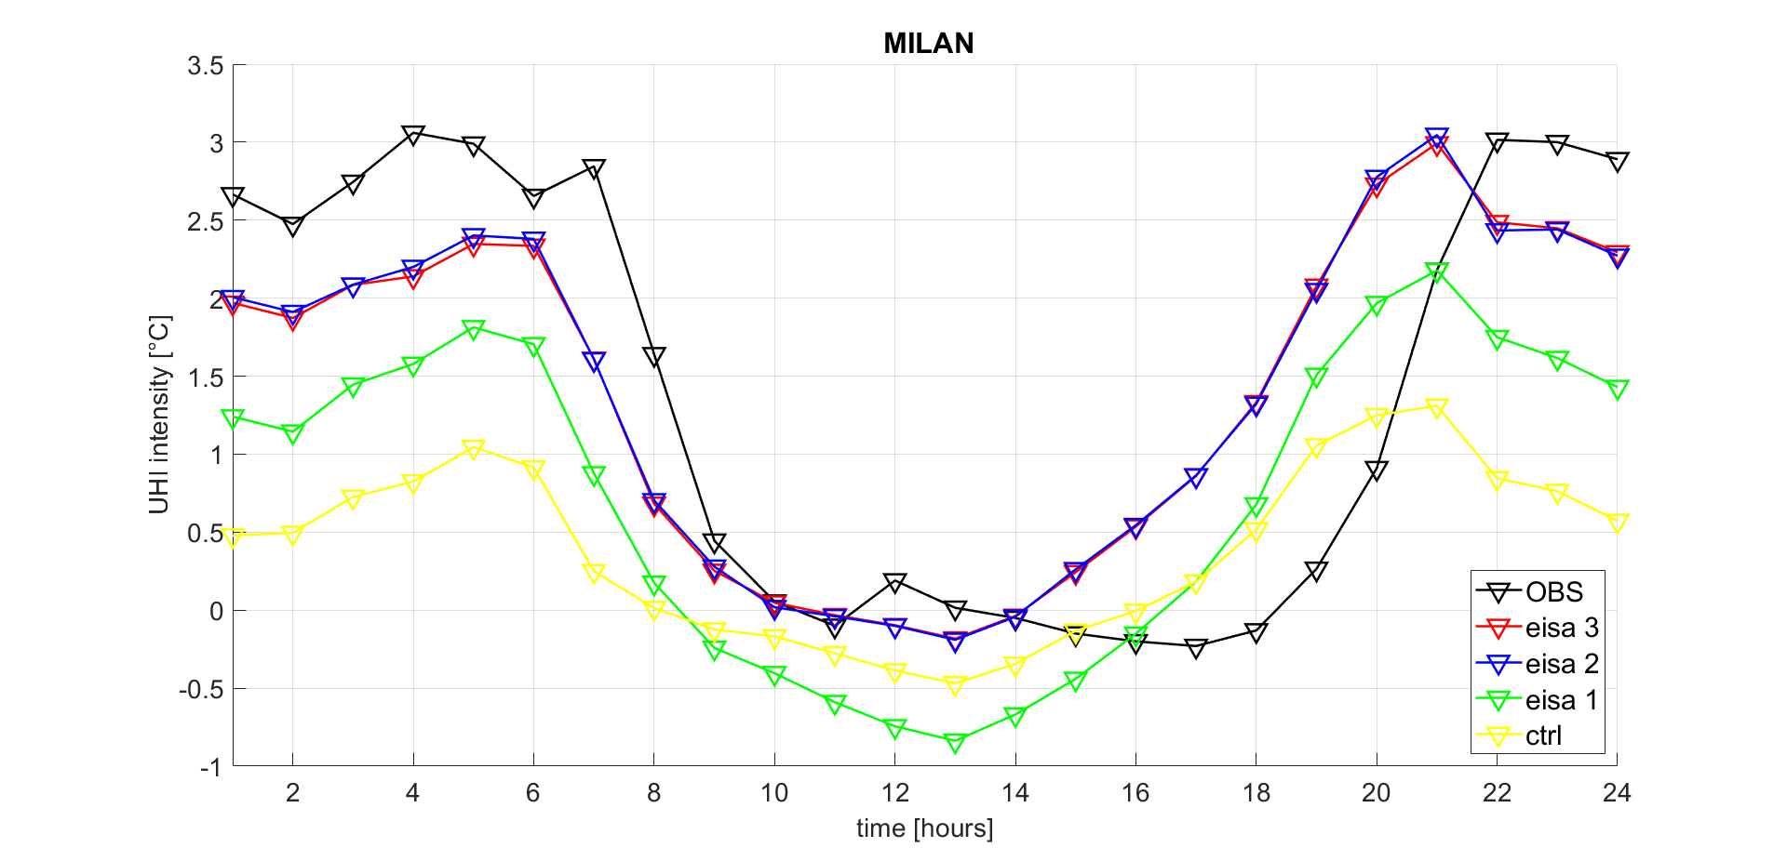
WG1: Porting of TERRA_URB in ICON
Resolution: 2km (0.018°) over Italy domain
Period: 01 August 2017 to 05 August 2017
Itype_eisa = 3 (eisa 3)
Itype_eisa = 2 (eisa 2)
Itype_eisa = 1 (eisa 1)
lterra_urb = off (ctrl)
ICON + TERRA-URB UHI vs OBS UHI:
Effect of urban hydrology over ROME and MILAN

Slide 13
WG1: Porting of TERRA_URB in ICON
Conlusions
Regarding itype_eisa=2, if the water is available under the ground, the bare soil evaporation over impervious areas is blocked and evapotranspiration effects are prevented (e.g strong effect over MILAN).
Regarding itype_eisa=3, the effects of water puddles seem to be negligible maybe due to low resolution. Do we need to go further with the resolution (e.g. < 500m) in order to capture puddles effects?
Up the now, the effects of TERRA_URB are already very satisfying and the model seems to be very able in distinguish between URBAN and RURAL signal!

Slide 14


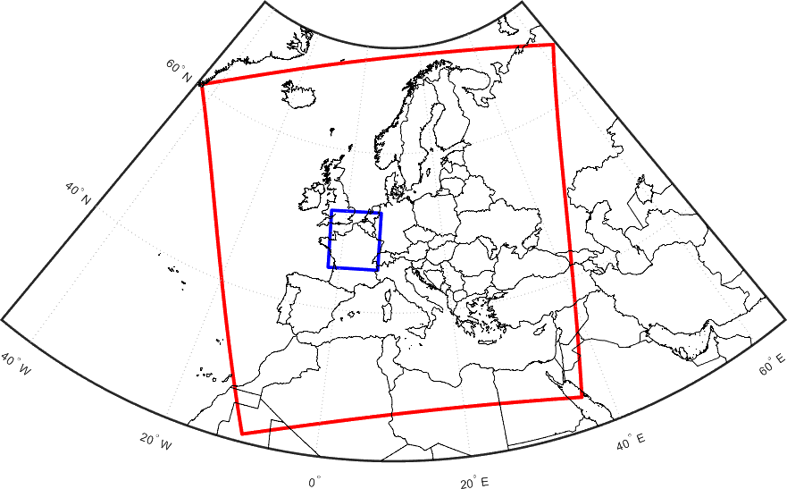
WG2: New EXTPAR for ICON
ECOCLIMAP-SG vs GLC: model setup
CCLM Protocol for CORDEX FPS URB-RCC stage0 (short experiment)
Version model:
cosmo v6.0 + TERRA-URB (bulk parametrization),
Double nesting downscaling:
1) EURO-CORDEX Experiment 0.11°(12,5 km),
run period from January 2019 to August 2020, configuration based on COPAT2 outcome (2019 as spin up period, 2020 as evaluation period) forced with ERA5 reanalysis at 6hr.
2) CP Experiment 0.0275° (3km),
run period from January 2020 to August 2020, Paris domain, based on Nukleus configuration.
Options:
CCLM group (KIT and CMCC) will run 2 experiments changing land-use dataset: Ecoclimap vs GlobCover

Slide 15
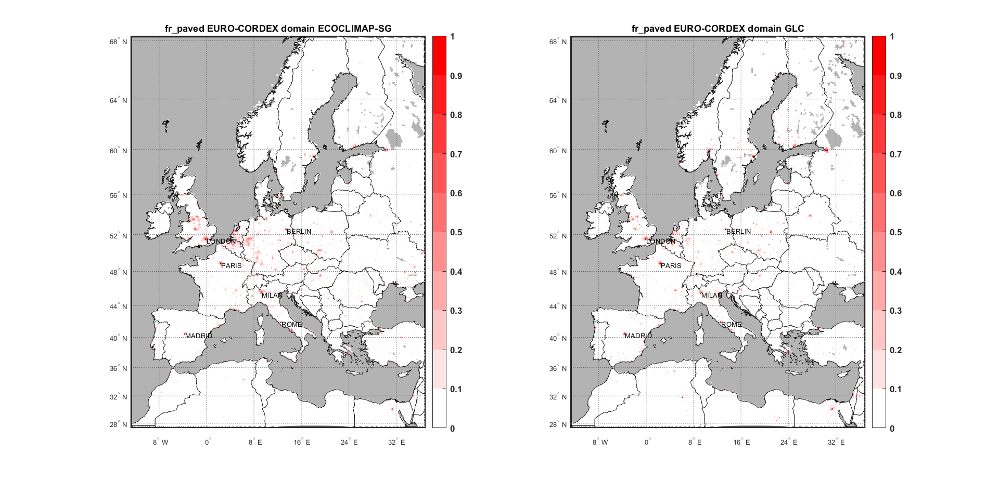
WG2: New EXTPAR for ICON
ECOCLIMAP-SG vs GLC: some preliminary results
Fr_paved maps: ECO.-SG vs GLC
vs

Slide 16
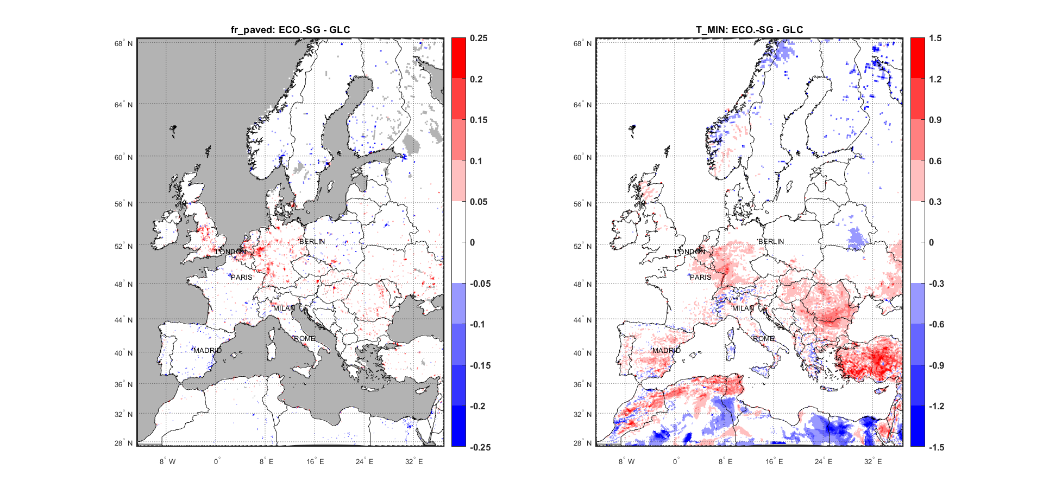
WG2: New EXTPAR for ICON
ECOCLIMAP-SG vs GLC: some preliminary results
Fr_paved and T_MIN. difference maps: ECO.-SG - GLC
vs

Slide 17
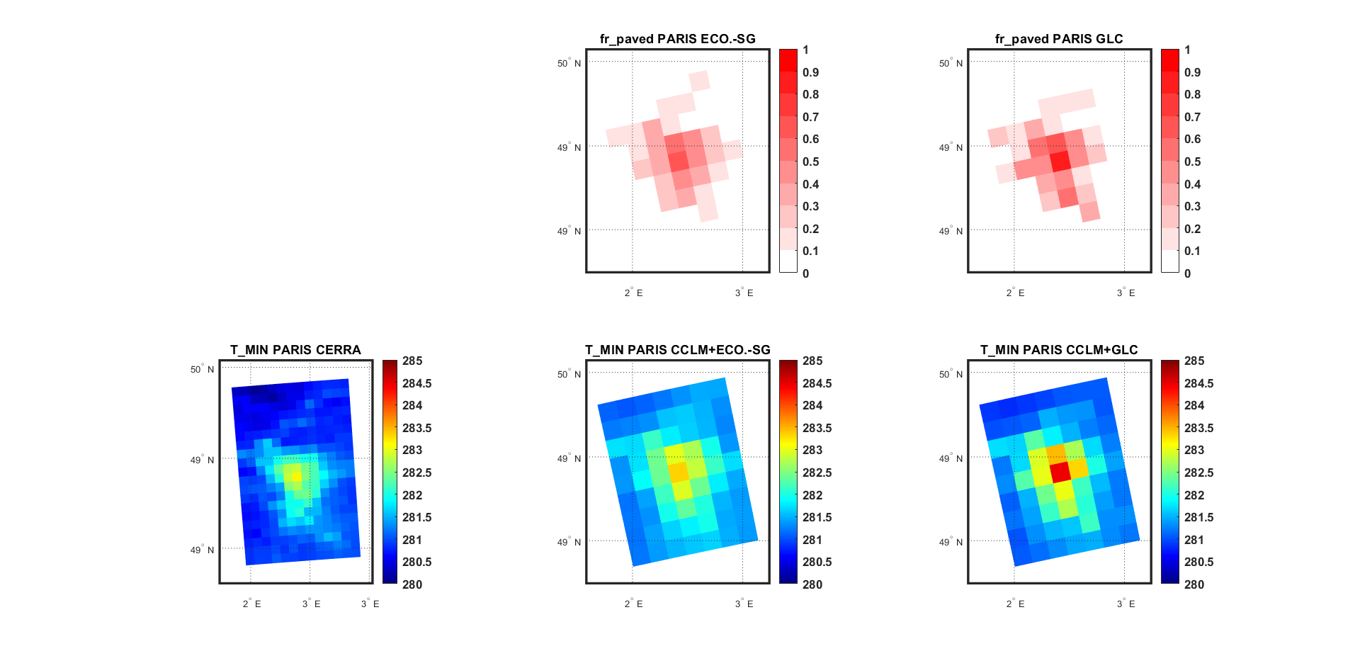
WG2: New EXTPAR for ICON
ECOCLIMAP-SG vs GLC: some preliminary results
T_MIN. difference maps over PARIS: ECO.-SG - GLC
The intensity of ECO-SG urban signal seems to be closer to CERRA (5.5km) reanalysis signal

Slide 18
WG2: New EXTPAR for ICON
Conclusions
Even at low resolution (12.5km) some urban patterns can be solved and the model (COSMO) seems to be very sensitive to the landuse dataset.
More accurate analysis with ICON and CP simulations will help us to understand how the dataset affect the model performance especially at urban scales.
The current results are already good, but they can be improved with:
Points for open discussion
ECOCLIMAP as landsoil cover dataset, What is the status of implementation of ECOCLIMAP in ICON?
BCs ICON instead of BCs IFS? Are the ICON BCs downlodable from DWD?
At this stage of the implementations the results are very satisfactory and with the last things left to do the results can only get better !

