Slide 1
Some important tools (WG3b / WG4: Status Report)
Jean-Marie Bettems¹, Juergen Helmert²
¹MeteoSwiss, Zurich, Switzerland
²DWD, Offenbach, Germany

Slide 2
EXTPAR (WG3b)
COSMO software, external parameters retrieval
SCA is Katie Osterried / ETHZ
Latest release 5.4 (29.05.2020)
https://github.com/C2SM-RCM/extpar
Notes:
More information…

Slide 3
EXTPAR - Background
Geospatial data are retrieved from high-resolution satellite information or land registers and are aggregated to the model’s global or limited-area grid.
In a final processing step all available data are cross-checked for consistency (e.g., to exclude vegetation on glaciers).
The required model parameters are very similar for NWP models, but the used data sources and the applied tools vary between different models – i.e. different mapping of geospatial information (Onvlee et al, 2014).
Bog - St-Daniel sector - Frontenac National Park (Québec, Canada) -Wikipedia

Slide 4
From COSMO to ICON model
Turbulence Scheme, TERRA, FLake, SeaIce are unified between COSMO and ICON. However, there are some targeted modifications in TERRA, differences in the coupling due to the tile approach, differences in the use of the external parameters, and the tunings of the models differ.
Targeted modifications
To better represent effects of partial snow cover and of snow under tree canopy
Reduction of roughness length over snow cover
Interception of rime
External parameters
Post-processing of processed raw data, like use of look-up tables to compute derived fields, computation of a yearly cycle, or topo smoothing, is done in …
… EXTPAR and INT2LM (COSMO)
… the ICON model itself (ICON)
Notes:
Some developments still in COSMO, but we are lucky because …

Slide 5
EXTPAR Status
Active development team (ETHZ, MPI-M and DWD).
One week hackathon organized yearly to accelerate development.
Code unification and major code consolidation performed these last 3 years.
Clean-up and unify raw data sets, now all available under Git-LFS repository (https://gitlab.dkrz.de/extpar-data/extpar-input-data/-/tree/master).
Comprehensive regression suite (different platforms, both COSMO and ICON models).
Up to date documentation (“User and Implementation manual”).
Raw data sets recently added
CAMEL Emissivity (NASA, global)
ESA CCI land cover (ESA, global)
Corine land cover (Copernicus, Europe)
Output fields recently added
Skin conductivity (SKC)

Slide 6
EXTPAR – From 2017 to 2020
Features | 2017 | 2020 | Results
Development requests | pers. communication, E-Mail | GitHub Issue List¹ | Better overview, avoid work duplication
Source code handling | $ADM/workbench @DWD GitHub (CLM) | Github handling, Jenkins, and merging of available modifications | robust and stable environment Parallelization: fast CDO with OMP support
Software Test Suite | Own tests @ DWD, CSCS, MPI | TestSuite with Jenkins including ICON @GitHub | Improved Quality management
Web-Interface: Evaluate existing versions, hosting a common interface | PAMORE (DWD), WebPEP (CLM) | PAMORE (DWD), WebPEP (CLM) | Actually PAMORE and WebPEP
General module for reading new data as demand | Own F90 module for new data | Easy implementation by simple CDO scripts | Faster implementation of new data
Compiler support | Intel, Cray | Intel, Cray, NAG, PGI | More robust and clean code
Integration of developments for SSO, glacier points, emissivity | Available only @DWD, or MPI, ETH | Available for all users @GitHub EXTPAR | Share ressources for new developments
¹ https://github.com/C2SM-RCM/extpar/issues

Slide 7
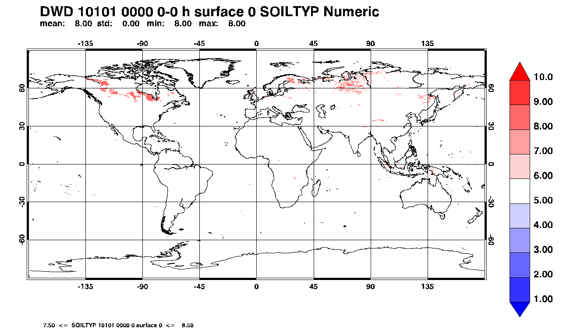
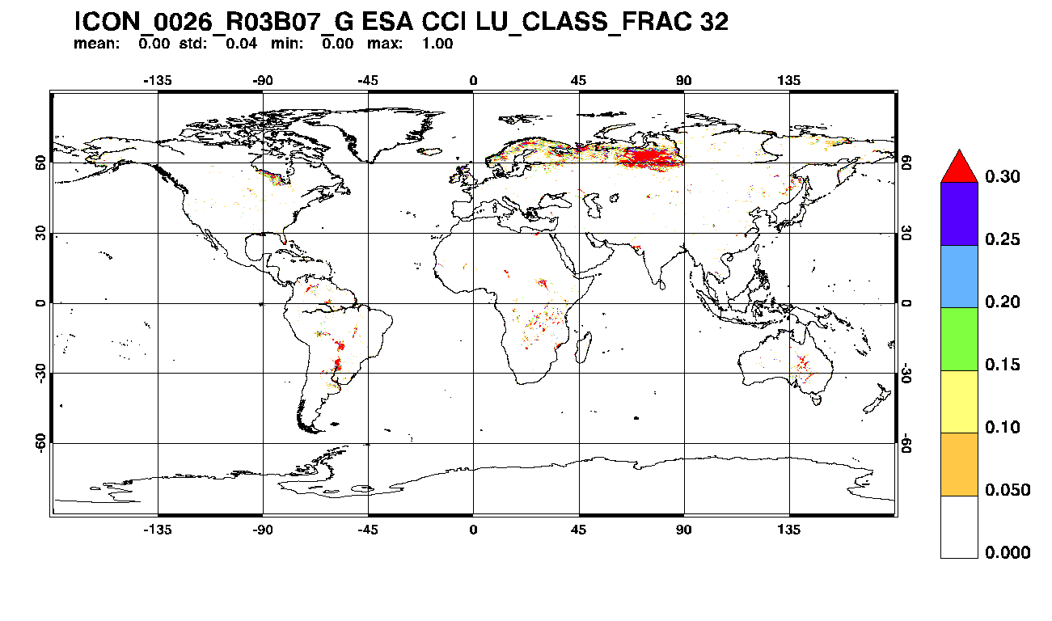
ESA CCI* Land-use data
*climate change initiative
Outcome from COSMO-D2 experiments with MIRE parameterization:
New land-use data (ESA CCI) can provide improved representation of active mires compared to FAO
Advantages of ESA CCI:
Higher resolution (compared to FAO soil)
Higher granularity compared to GlobCover2009 (38 vs. 23 land-use classes and full global coverage)
Periodic updates (advantage in reanalysis projects)

Slide 8
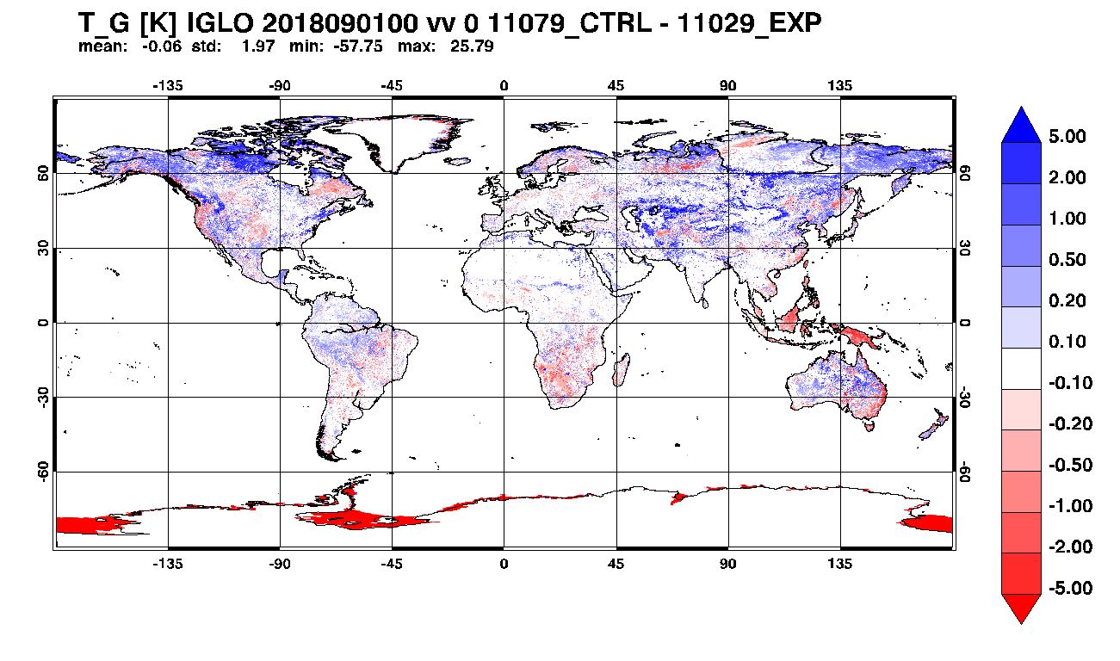
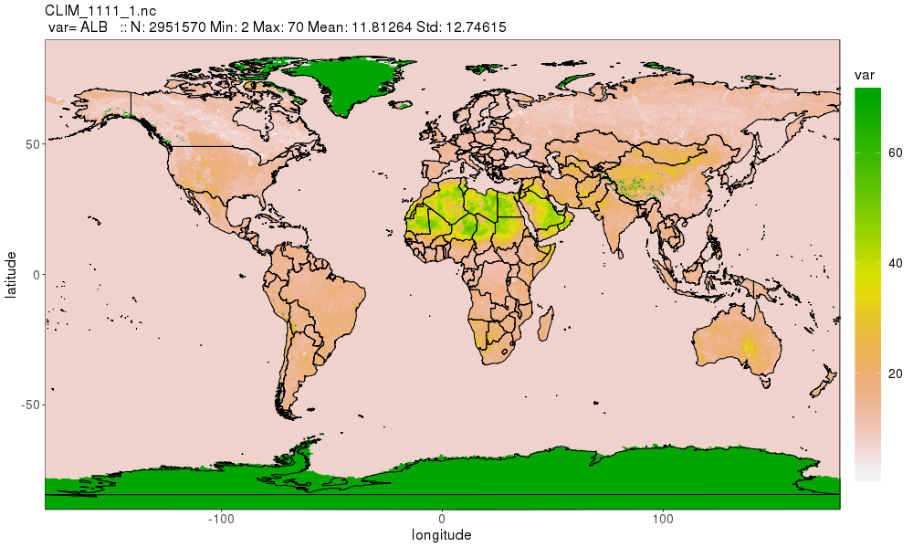
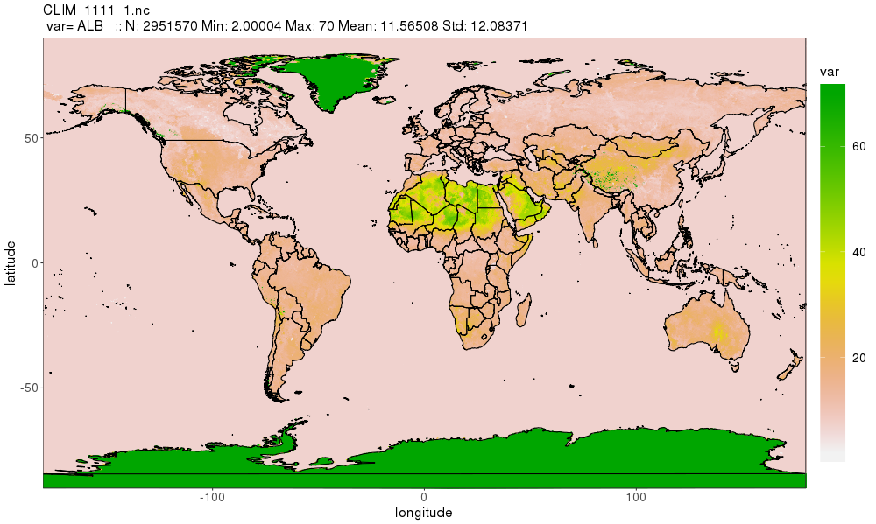
Some critical issues
Developing / adapting a new parameterization means more than developing / adapting a new parameterization…
Recent developments in WG3b have shown that the following tasks may consume a considerable amount of resources
Development of new / consolidated external parameters (high resolution, global)
Tuning (application specific, CALMO methodology)
Testing (global, multiple resolutions, multiple time scales)
Surface albedo EXTPAR GlobCover/GLCC → EXTPAR ESA CCI → degraded near surface T !
Notes:
Some lessons learnt …
Maybe evident for core model developers at DWD, but useful when planning developments outside of this core group…

Slide 9
EXTPAR – Outlook 2021
EXTPAR work packages
Code
Content
Infrastructure
A1 Disk cache approach
B1 ESA CCI LandCover
C1 raw data processing
A2 fast topo processing
B2 SoilGrids
C2 cmake environment
A3 register raw, buffer, grib
B3 Pollen
C3 Repository @DKRZ
A4 code replacement- cdo
B4 Global hires orography
C4 Input data maintenance
+ Urban parameters
C5 Unified web interface

Slide 10
TSA (WG3b)
Externalized version of TERRA
Not (yet) a COSMO software
Latest release on 13.07.2020
https://github.com/COSMO-ORG/terra-standalone
Notes:
More information…

Slide 11
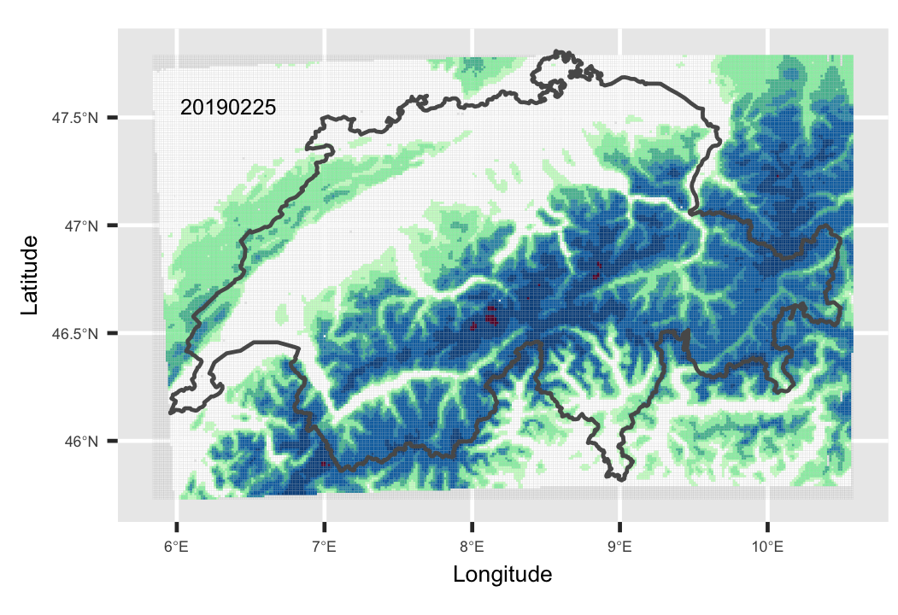
TSA Status
Very useful tool to efficiently develop new soil & surface parameterizations, to spin-up the model, to run climate scale simulations (e.g. high resolution re-analysis).
See e.g. the development workflow in SAINT (cheap high resolution full winter simulations, support comparison with satellite products)
A new version based on the latest COSMO v6.0, including also the new SAINT model, is being prepared and will be ready before year end (Dörte Liermann, Ulrich Schätler, Varun Sharma).
Because the included TERRA module is common to COSMO and ICON, this tool will be ICON capable (but currently without tiles functionality).
TERRA standalone will be proposed as an official COSMO (consortium) software.

Slide 12
TSA Outlook
Is the current code a good basis for providing the TSA functionality for the future decade (i.e. ICON)? Or are they any plan to directly include this functionality in the ICON framework?
Find resources for further development !
Possible next steps :
Include necessary infrastructure to also support the new urban model (“poor man” tiles, additional external parameters).
Include full support for ICON tiles.
Include full support for ICON internal processing of external parameters.

Slide 13
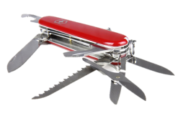
Fieldextra (WG4)
COSMO software, pre- and post-processing
SCA is Jean-Marie Bettems / MeteoSwiss
Latest release 13.2.0 (17.04.2020)
https://github.com/COSMO-ORG/fieldextra
Notes:
More information…

Slide 14
Fieldextra Status v13.0.0 (06.06.19), v13.1.0 (25.10.19), v13.2.0 (17.04.20), v13.3.0 (11.2020)
Most recent production release is v13.2.0
Massive performance improvements for some applications (parallel import and more)
Upscaling tool (used at MeteoSwiss to upscale KENDA-1 analysis onto COSMO-2E grid)
Robust and flexible NetCDF CF import (incl. compression, nc4 / nc3 / nc3 with 64bits offset)
New operator to compute balanced PP and QX fields (from INT2LM)
Extend lateral re-gridding (bi-linear, generalized distance, conditional, barycentric for ICON)
Support compacter namelist for complex operations
Comprehensive cookbook (more than 60 fully commented examples)
And much more … → https://github.com/COSMO-ORG/fieldextra-wiki/blob/master/History.md

Slide 15
Fieldextra Outlook
Release v13.3.0 almost ready (internal consolidations, support for SAINT, fx tools)
Plan for the next months: improved support for continuous integration and deployment (CI/CD) (CI/CD introduces ongoing automation and continuous monitoring throughout the lifecycle of apps, from integration and testing phases to delivery and deployment)
improved installation process (Spack integration, Cmake,...)
improved regression suite
Full support of ICON grid under consideration (currently only operations from ICON to regular grid are supported)

Slide 16
Thank you! Questions or Comments?

