Slide 1
Soil and surface activities (WG3b: Status Report)
Sascha Bellaire¹, Jean-Marie Bettems¹, Paola Mercogliano², Antigoni Voudouri³
¹MeteoSwiss, Zurich, Switzerland
²Centro euro-Mediterraneo sui Cambiamenti Climatici, Italy
³Hellenic National Meteorological Service, Greece

Slide 2
Soil & surface activities (WG3 a&b)
Reformulation of land surface processes – implicit solver, consistency [PT ConSAT, ▻ 2021Q1]
Revision of interception storage [PT ConSAT]
Revision of TERRA hydrology [DWD & MCH, ▻ COSMO v6.0]
Effect of vegetation canopy (skin layer, resistance formulation, semi-transparent layer) [DWD, PT ConSAT, ▻ skin layer available now]
Improved vegetation phenology and stomatal conductance [PT VAINT]
New urban model [PT AEVUS 2, ▻ COSMO v6.0] [PP Città]
Advanced snow model [PT SAINT, ▻ COSMO v6.0] [PT SAINT 2]
Common snow analysis [New PP, kick off 18.11.2020]
(Tool) Model calibration [PP CALMO-MAX, ▻ 2020Q4] [trCLIM@ETHZ, new PP]
(Tool) TERRA standalone (consolidate & extend) [DWD, PT SAINT, ▻ 2020Q4]
(COSMO software) EXTPAR (code, land use, topography, urban parameters, soil, pollen) [ETHZ, DWD, MPI-H, ▻ running task]
Notes:
Also WG3a
Hope I forgot nothing
Blue: more details coming later / Grey: proposal for new PT or PP in preparation / group of people involved, availability
See also WG3b parallel session repo for more information (e.g. VAINT)

Slide 3
From COSMO to ICON model
Turbulence Scheme, TERRA, FLake, SeaIce are unified between COSMO and ICON. However, there are some targeted modifications in TERRA, differences in the coupling due to the tile approach, differences in the use of the external parameters, and the tunings of the models differ.
Targeted modifications
To better represent effects of partial snow cover and of snow under tree canopy
Reduction of roughness length over snow cover
Interception of rime
External parameters
Post-processing of processed raw data, like use of look-up tables to compute derived fields, computation of a yearly cycle, or topo smoothing, is done in …
… EXTPAR and INT2LM (COSMO)
… the ICON model itself (ICON)
Notes:
Some developments still in COSMO, but we are lucky because …

Slide 4
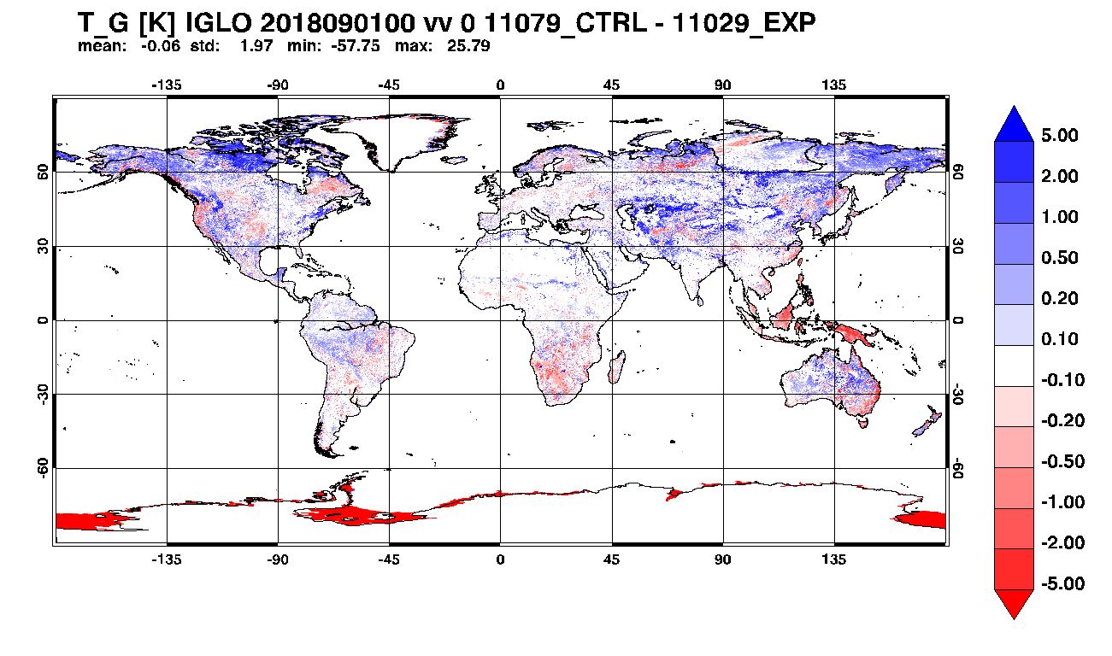
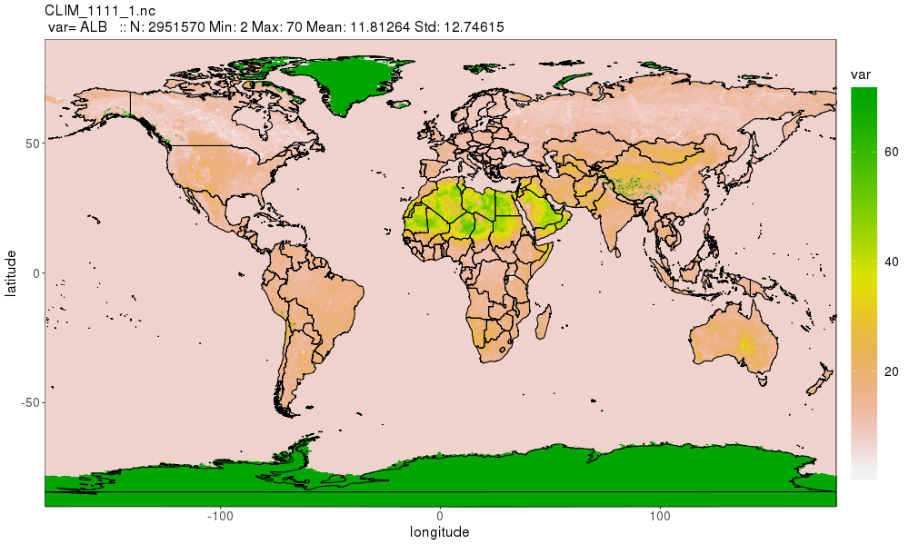
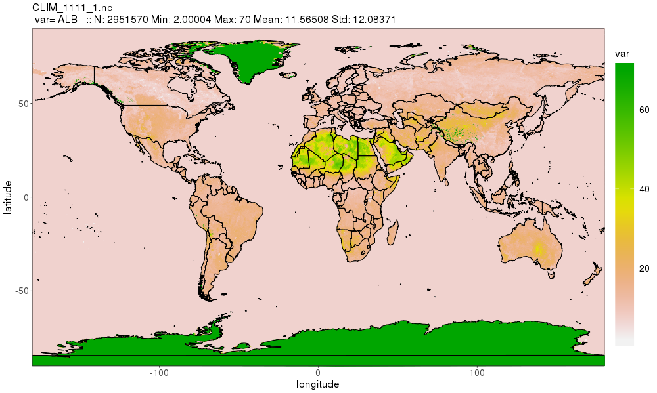
Some critical issues
Developing / adapting a new parameterization means more than developing / adapting a new parameterization…
Recent developments in WG3b have shown that the following tasks may consume a considerable amount of resources
Development of new / consolidated external parameters (high resolution, global)
Tuning (application specific, CALMO methodology)
Testing (global, multiple resolutions, multiple time scales)
Surface albedo EXTPAR GlobCover/GLCC → EXTPAR ESA CCI → degraded near surface T !
Notes:
Some lessons learnt …
Maybe evident for core model developers at DWD, but useful when planning developments outside of this core group…

Slide 5
Stay tuned …
More plenary session talks coming now …
WG3b parallel session talks http://www.cosmo-model.org/view/repository/GM-2020/WG3b
WG3b web page http://www.cosmo-model.org/content/tasks/workGroups/wg3b/default.htm
WG3b mailing list wg3b@cosmo-model.org
WG3b coordinator jean-marie.bettems@meteoswiss.ch
… and “WG3ab development guidelines for ICON” … coming soon!
Notes:
More information…

Slide 6
Next talk please (urban parameterization)…
Notes:
More information…

