Slide 1
CALibration of the COSMO MOdel CALMO -MAX
Project participants*
Antigoni Voudouri, Euripides Avgoustoglou, Yoav Levi, Izthak Carmona, Eduardo Bucchignani and Jean-Marie Bettems
*with the contribution of Pirmin Kaufmann, Silje Soerland (ETHZ) and Andreas Will (BTU)
22nd COSMO General Meeting, 1-11.09.2020

Slide 2
Status of the project
The project has been extended until December 2020 due to COVID-19
C-MAX workshop took place in Cottbus 3-5.02.2020
Calibration of COSMO-1 for 5 parameters (tkhmin, v0snow, uc1, rlam_heat, radfac) has been finalised and verification of the results is available.
Attempt to reduce the computational cost by modifying calculation of performance score and by performing minimum number of simulations to fit the MM
Simulations over the Mediterranean Sea for 5 parameters have been performed and calibration is pending
Collaboration with ETHZ on a new project trCLIM
Collaboration with the University of Cottbus on MM modifications to improve efficiency
Networking with other groups IRSN (currently suspended)
Documents and deliverables
Detailed description of the parameters convergence (used in optimization method)
Technical report No 42
Contribution to the 20th COSMO Newsletter
Meta model available at ECMWF and @ https://github.com/COSMO-ORG/CALMO-MM

Slide 3
Meta Model Status summary (IMS contribution)
A perturbed initial condition run was made to estimate the internal model variability. Screen out cases where internal model variability is larger that parameter dependency.
2m dew point temperature (from INCA) has been introduced in the performance score to reduce the risk of over fitting the temperature.
Calculate the skill score using spatial verification for precipitation FSS instead of ETS and weights given to fields included.
Minimize computational cost needed for MM by calculating optimum value for 365 days by:
objective cluster analysis (20 members-representative days)
reduce grid points used by the MM (full data records)
Modifications to MatLab code to increase efficiency - now the computation time is 10% less from original!
Translation of the MM from Matlab to Octave, to run at ECMWF machines

Slide 4
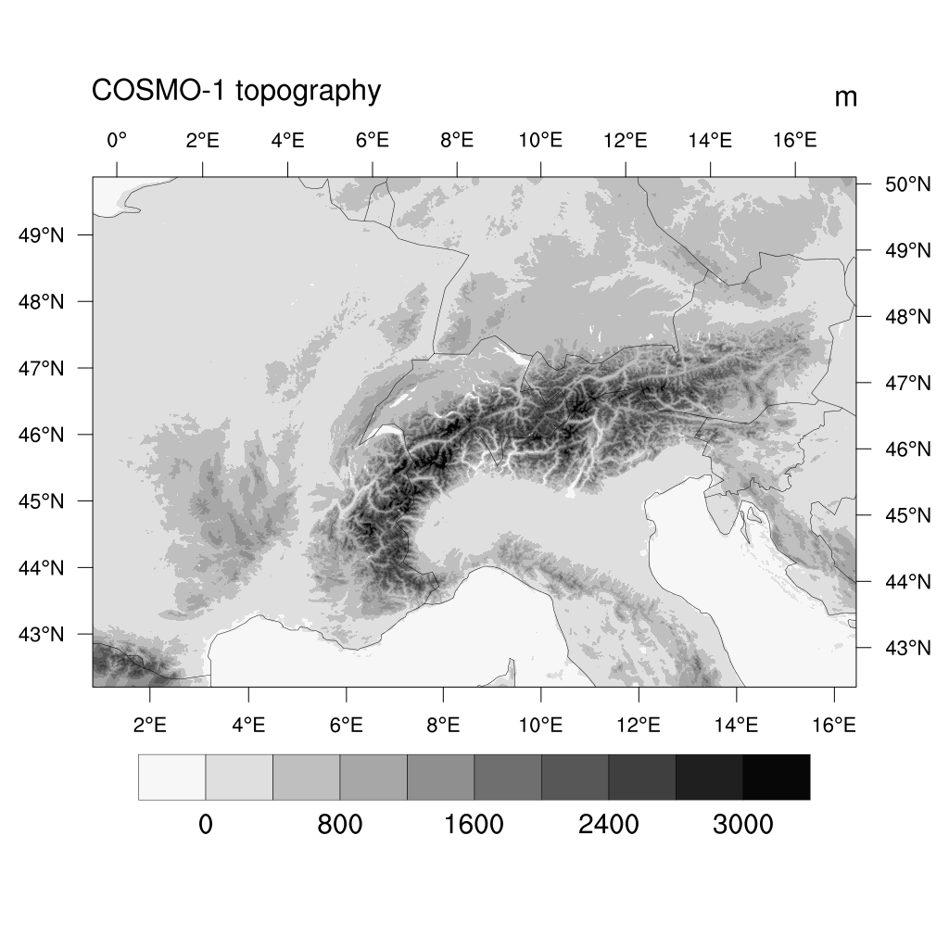
Calibration of COSMO-1
Acronym | Parameter | Parameter Range | Optimum value | ETHZ Value
Minimal diffusion coefficient for heat | tkhmin | [0. 1 ,0.4,1] | 0.279 | 1.37
Factor for laminar resistance for heat | rlam_heat | [0.1,1,2] | 0.9296 | 0.72
Parameter controlling the vertical variation of critical relative humidity for sub-grid cloud formation | uc1 | [0,0.8,1] | 0.7686 | 0.75
Factor for vertical velocity of snow | v0snow | [10,20,30] | 18.95 | 25.6
Fraction of cloud water and ice considered by the radiation scheme | radfac | [0.3,0.6,0.9] | 0.6775 | 0.59

Slide 5
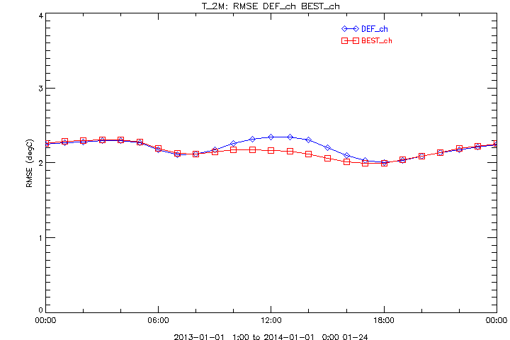
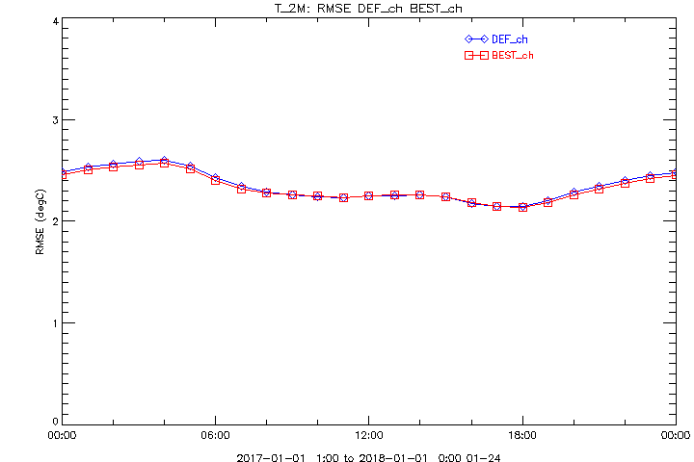
2m temperature for years 2013 and 2017
Year | 2013 |  | 2017
Measure T2m | DEF | BEST | DEF | BEST
ME | 0.043 | 0.128 | 0.236 | 0.143
RMSE | 2.2 | 2.1 | 2.35 | 2.33
MINMOD | -28.67 | -28.67 | -29.64 | -28.77
MINOBS | -28.7 |  | -29.5
MAXMOD | 38.43 | 37.41 | 40.0 | 40.0
MAXOBS | 37.1 | 37.1 | 36.9

Slide 6
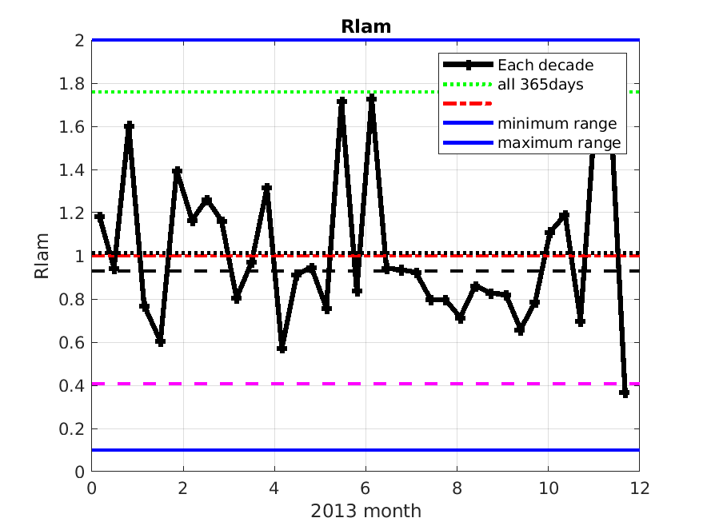
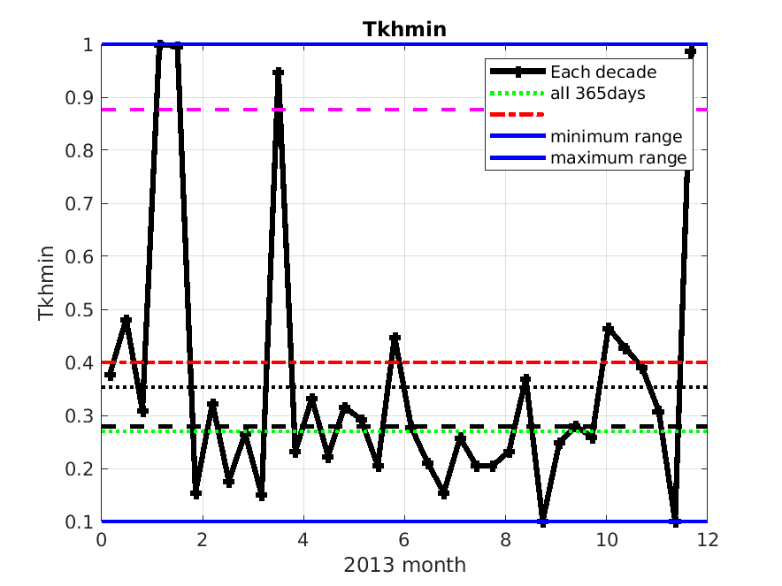
rlam_heat
For all 365 days in one run
default
20 clusters
Mean 36 decades (“decade”=10 days)
Median 36 decades

Slide 7
Calibration over the Mediterranean
Parameter | INTERPRETATION | range | Test values (default)
rat_sea | ratio of laminar scaling factors for heat over sea | 1-100 | 1, 10, 50
rlam_heat | scaling factor of the laminar boundary layer for heat | 0.1 – 10.0 | 0.1, 1.0, 2.0
tkhmin tkmmin | minimal value of diffusion coefficient for heat and momentum (kept equal) | 0.0-2.0 | 0.1, 0.40, 2.0
tur_len | asymptotic maximal turbulent length scale (m) | 10 – 10000 | 100, 150, 1000
c_soil | surface area index of evaporative soil surfaces ( dependent on surface area density of the roughness elements over land , c_lnd) | 0-c_lnd(2.0) | 0, 1, 2

Slide 8
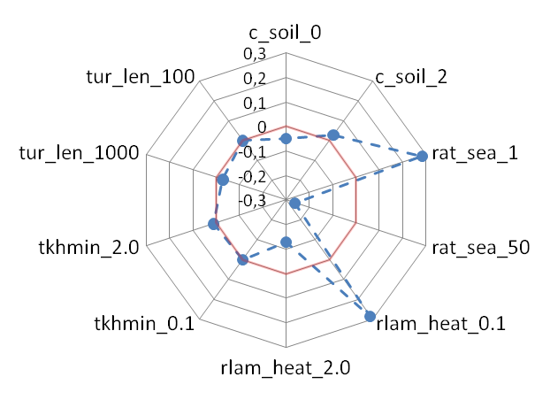
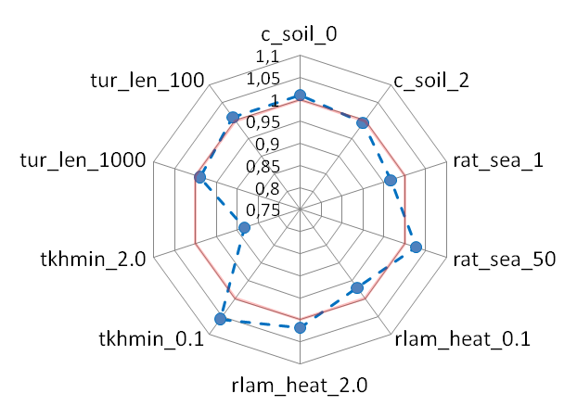
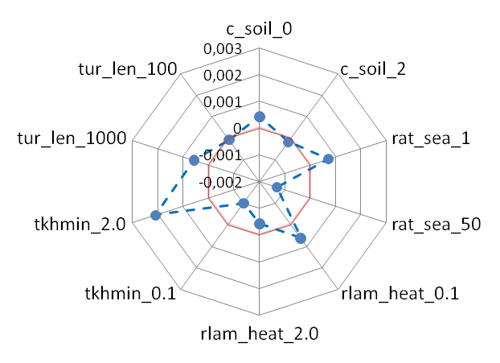
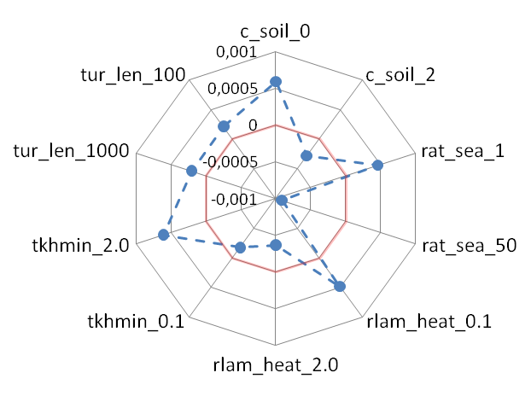
 | c_soil_0 | c_soil_2 | rat_sea_1 | rat_sea_50 | rlam_heat_0.1 | rlam_heat_2.0 | tkhmin_0.1 | tkhmin_2.0 | tur_len_1000 | tur_len_100
c_soil_0
c_soil_2
rat_sea_1 |  | 4B TMAX
rat_sea_50 | 4A TMAX
rlam_heat_0.1 |  | 5B TMAX |  | 1A TOT_PREC
rlam_heat_2.0 | 5A TMAX |  | 1B TOT_PREC
tkhmin_0.1 | 7B TMAX |  | 2B T_RANGE |  | 3B T_RANGE
tkhmin_2.0 |  | 7A TMAX |  | 2A T_RANGE |  | 3A T_RANGE
tur_len_1000 |  | 8A TMIN |  | 6A TMIN |  | 9A TMIN |  | 10A TMIN
tur_len_100 | 8B TMIN |  | 6B TMAX |  | 9B TMIN |  | 10B TMIN
(<TOT_PREC>TEST-<TOT_PREC>DEFAULT) / <TOT_PREC>DEFAULT
<TMAX_2M-TMIN_2M>TEST / <TMAX_2M-TMIN_2M>DEFAULT
(<TMIN_2M>TEST-<TMIN_2M>DEFAULT) / <TMIN_2M>DEFAULT
(<TMAX_2M>TEST-<TMAX_2M>DEFAULT) / <TMAX_2M>DEFAULT

Slide 9
Remarks
Strong dependency of parameters optimum on the time of the year
Significant optimum value differences, large intra-annual fluctuations
Variation of the optimum reflects dependency on the atmospheric flow or weather pattern (check with observed atmospheric fields)
Implicit dependency of some tuning parameters to model variables
Methodology is “model independent” and can be applied to any NWP or climate model.

Slide 10
Future work – CALMO based next PP
Schedule a web conference for a training with a full MM package
Final report
CALMO-Next……..
Cost reduction in terms of computational cost with respect to model performance improvement
Synchronize the COSMO and the ETHZ developments. Provide a unified, consolidated, portable (Octave or Python) and well documented (user guide) meta-model code for both RCM and NWP and an automatized procedure
Cottbus department of mathematics to: (a) propose a new approach on MM (b) perform calibration on the new dynamical core
Use calibration to check robustness of parameterization schemes e.g. do similar optimum parameter values define confidence interval of the parameterization scheme?
List of unconfined and ‘tuned’ parameters correlated to model variables is needed
antigoni.voudouri@hnms.gr
10

Slide 11
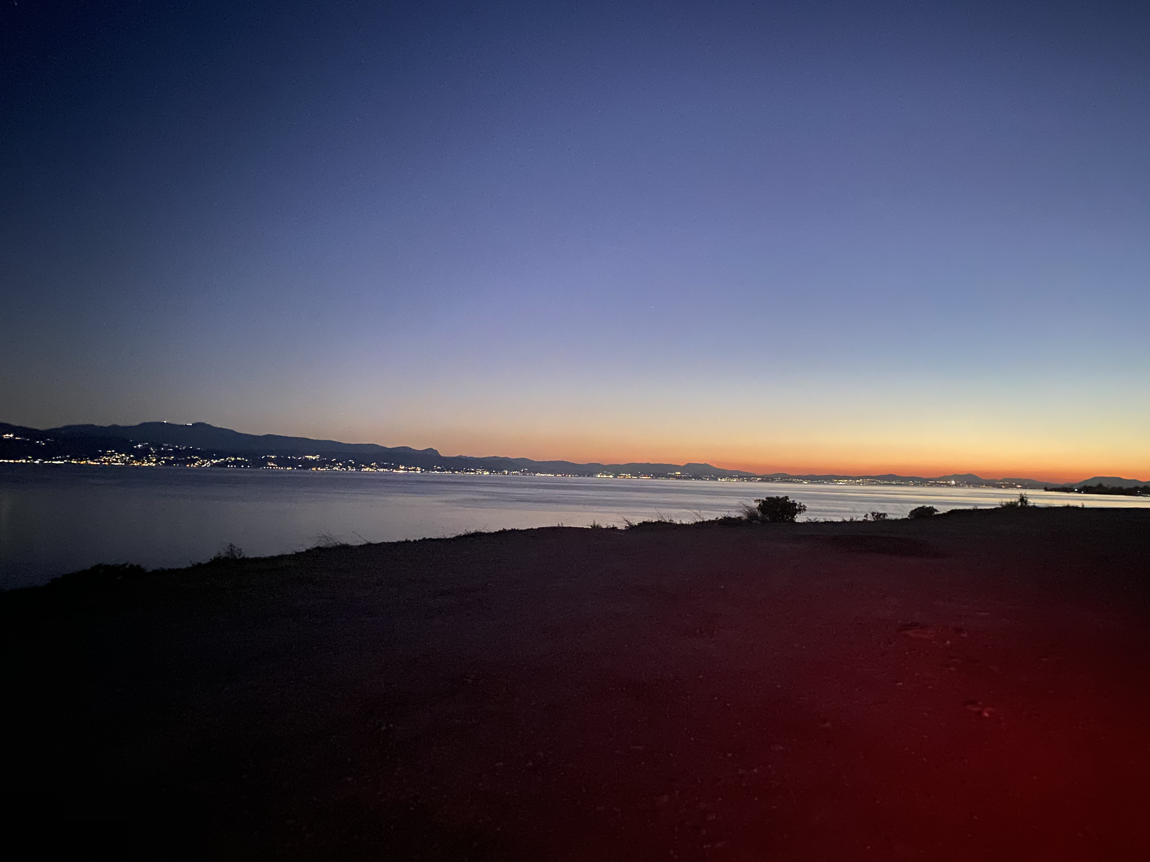
THANK YOU FOR YOUR ATTENTION

