Slide 1
Results of use of machine learning for probabilistic postprocessing of COSMO-E
Daniele Nerini, Mathieu Schaer, Regula Keller, Jean-Christophe Orain, Stephan Hemri, Yinghao Dai, Christoph Spirig, Jonas Bhend, Mark Liniger & Lionel Moret

Slide 2
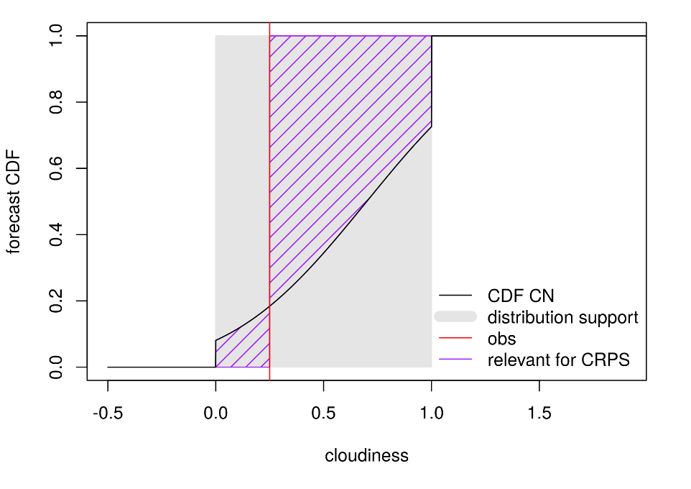
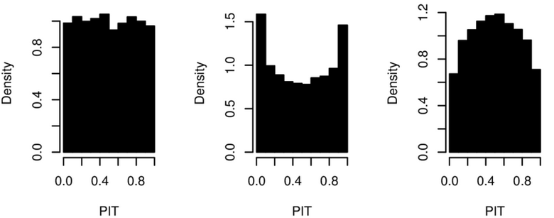
Goal
To provide subgrid-resolution (point), calibrated, probabilistic forecasts.
Temperatures, wind, cloudiness, precipitation
Quality criteria:
accuracy
Continuous ranked probability score (CRPS)
calibration
Probability integral transform (PIT) histograms
flat histogram: predictive distribution equals observed distribution
© R. Ranjan
better
well calibrated
underdispersive
overdispersive

Slide 3
Archive of NWP reforecasts
COSMO-ENS (COE)
2.2 km horiz. res.
21 members
2 runs day-1 (00UTC and 12 UTC)
5 day forecast horizon
June 2016 - October 2019
Surface parameters as well as some upper levels
© R. Keller

Slide 4
Wind

Slide 5
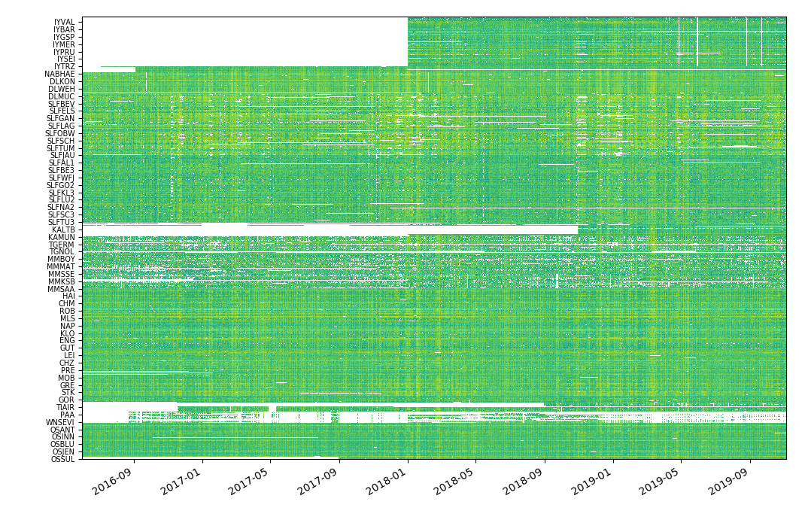
Reference observations
train 50%
val 25%
test 25%
test 20%
100 stations
0.8 years
MeteoSwiss and partner measurement networks (e.g. SLF, DWD, ZAMG, …)
hourly observations of wind speed, gust, and direction
ca. 500 surface stations
Sequential split in time (50-25-25).
Randomized split in space (60-20-20).
100 stations
0.8 years
val 20%
300 stations
1.6 years
log hourly wind speed
train 60%
MeteoSwiss
stations →
time →

Slide 6
Approach
Use neural networks to fit the parameters of the conditional probability distribution of the target variable.
Only predictors at the point of interest are considered.
Model selection and evaluation completely outside of the training data.
Fit a truly global model, fitting a single model for all locations and leadtimes.
Forecast(x,y,z,t,predictors)

Slide 7
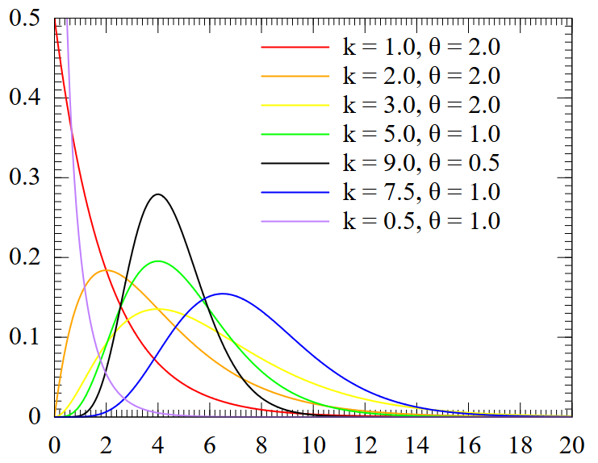
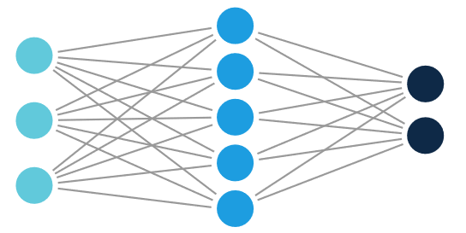
Probabilistic deep learning
Use a neural network to predict the parameters of the conditional probability distribution:
Select target variable (wind speed)
Select input features
Select parametric distribution (e.g., Gamma for wind speed and gust)
Select neural network architecture (the output nodes represent the parameters of the target distribution)
Select loss function (CRPS)
© wikipedia
Model selection based on the validation set.

Slide 8
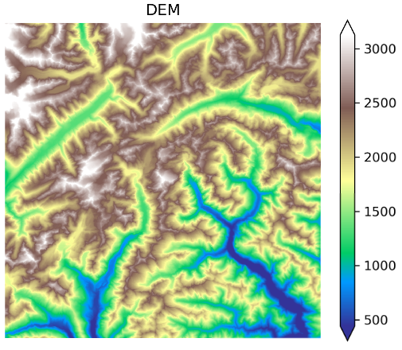
Topographical descriptors
Various topographic features are extracted from a 50 m DEM.
E.g., Topographic Position Index (TPI) provides the altitude difference w.r.t. to surrounding neighborhood.
Descriptors are computed at different spatial scales.
↔ 50 km
TPI
500m
TPI
2000m
aspect
1000m
Valley Index (Schaer 2019)
1000m
S-N derivative
1000m

Slide 9
coe+dem+hdiff
+tpi500
coe+dem+hdiff
+tpi500+tpi2000
coe
coe+dem
coe+dem+hdiff
MLPP max wind speed
[m/s]
MLPP - DMO
[m/s]
↔ 50 km

Slide 10
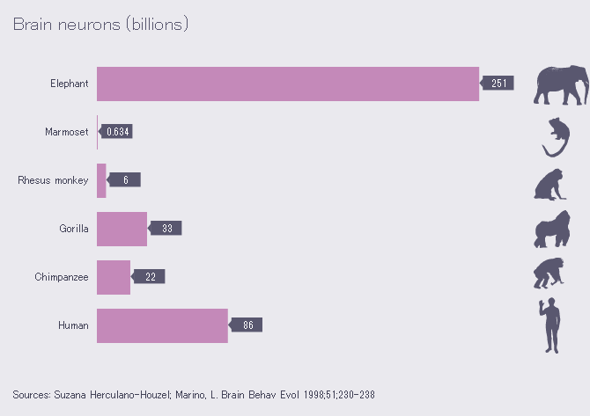
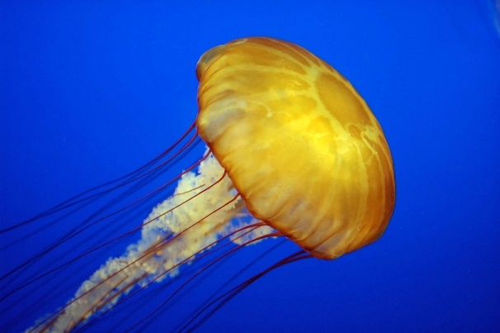
0.000001
Notes:
eine Quallen/ jellyfish

Slide 11
Model evaluation
Wind speed, gust, and direction
Test set (2019), unseen stations only
Compared to raw COE, skill score:
CRPSS = 1 – CRPS / CRPS_{COE}
Positively oriented (higher is better!)

Slide 12
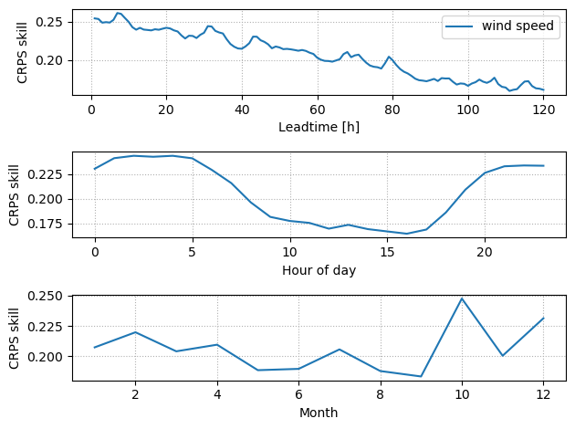
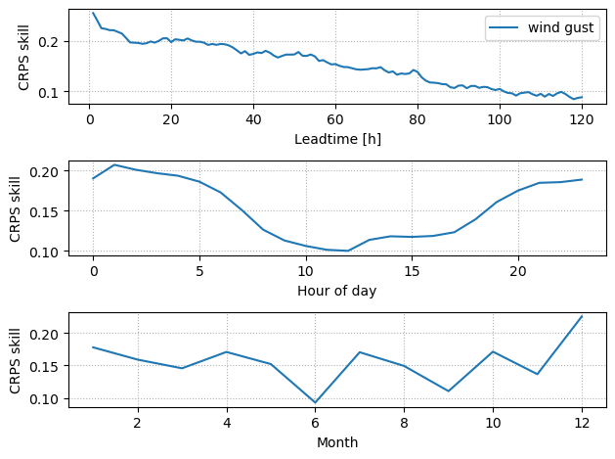
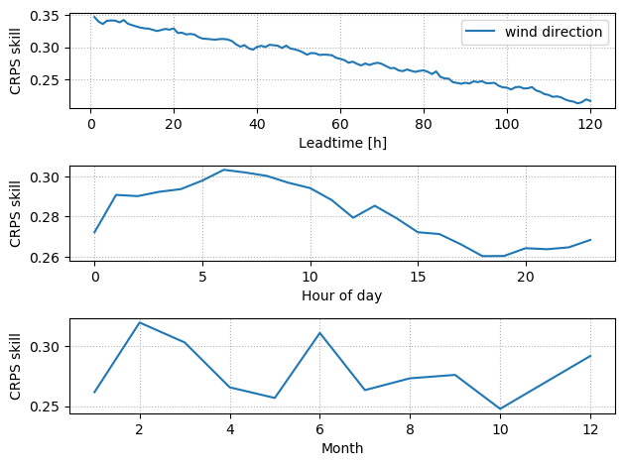
Accuracy improvement (CRPSS) in time
wind speed
wind gust
wind direction
better
$$CRPSS(ML)=1−\frac{CRPS(ML)}{CRPS(COSMO−E)}$$

Slide 13
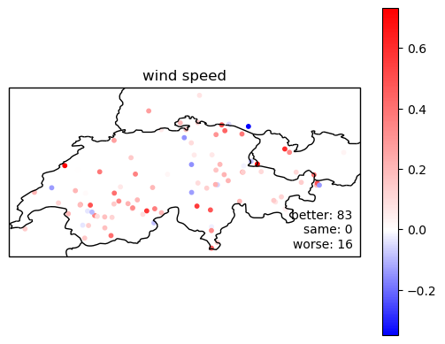
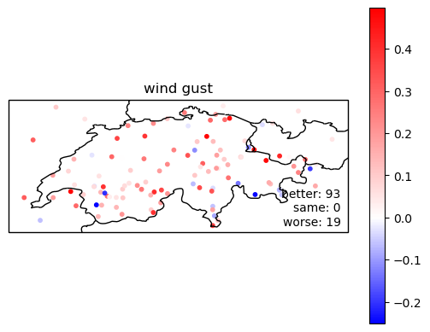
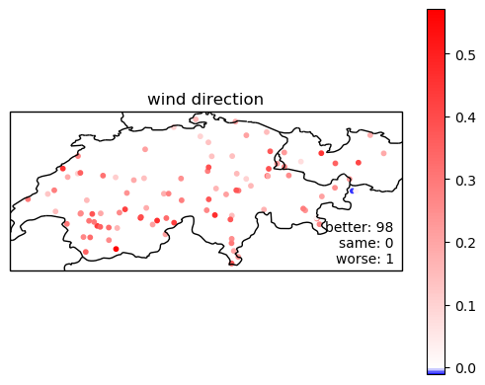
Accuracy improvement (CRPSS) in space
wind speed
wind gust
wind direction

Slide 14
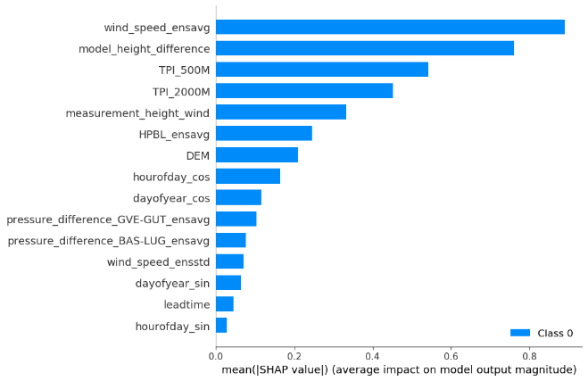
Feature importance for wind speed
SHAP (SHapley Additive exPlanations): https://github.com/slundberg/shap

Slide 15
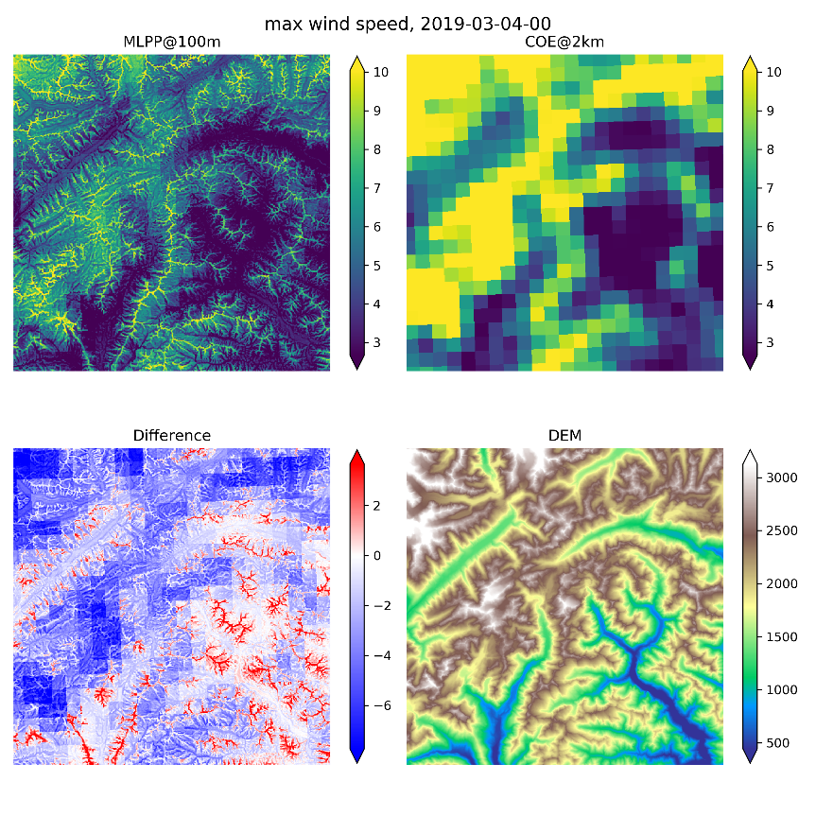
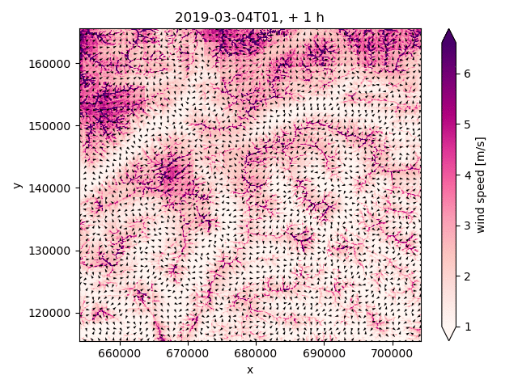
High-resolution wind maps
↔ 50 km

Slide 16
Cloud cover

Slide 17
Conditional GAN (cGAN)
G
D
61 206 094 parameters
1 316 951 parameters
CLCT_mean
CLCT_var CLCH_mean CLCL_mean TCC_mean TCC_var HCC_mean MCC_mean
LCC_mean
LCC_var HPBL_mean T_2M_mean
COSMO-E
embeddings
IFS
init_time
lead_time
hour_of_day month

Slide 18
Example forecasts (init time 2019.02.22 12:00, lead time 22)
observation
COSMO-E
cGAN
ob
cGAN
cGAN
cGAN

Slide 19
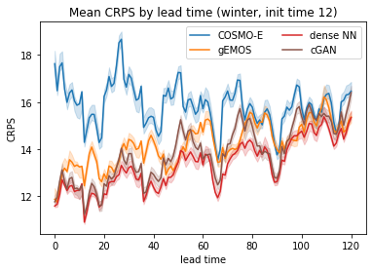
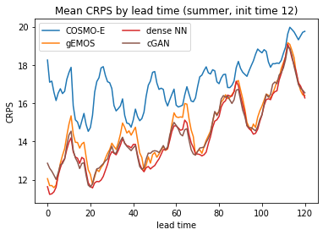
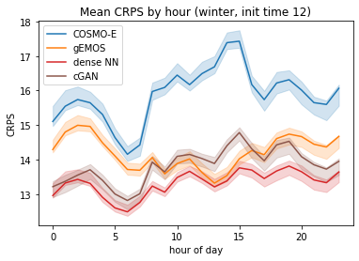
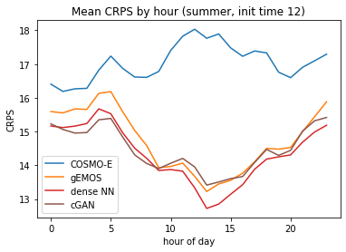
Performance by lead time
better

Slide 20
Performance by location
better

Slide 21
Temperature

Slide 22
Predictors
Observations
Temperature + stations information
Restricted Topo
+Pressure layers
+Wind
(RTAO-P-W)
Topographic predictors
Best one :
DEM
TPI 10000 m
TPI 4000 m
TPI 6000 m
COSMO-E
Temperature
MHDiff
HPBL
Soil Type
Pressure Layers
Wind

Slide 23
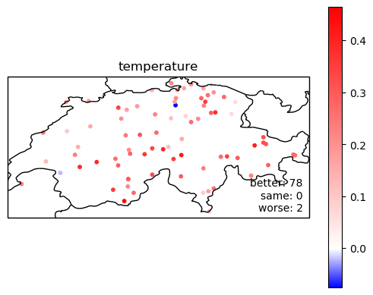
ML improvement : CRPSS vs COSMO-E altitude corrected

Slide 24
Conclusions
Postprocessing maps NWP forecasts to observable quantities.
Neural networks can provide a flexible estimator of nonlinear relationships between ensemble statistics, topography and the target conditional probability distribution.
The exact architecture is not very important, but epistemic uncertainty needs to be quantified; dropout is easily implemented and delivers good results.
Topography is an importance source of predictability for wind forecasting.
Visual inspection of predictions as important as average metrics for model selection.
Model explanation techniques such as SHAP are very useful to build trust in the model.

Slide 26
Temperature ML parameters
Monte Carlo dropout network
Target : hourly temperature from observations data (966 stations and more than 3 years of data)
Optimizer Adam
Validation loss = CRPS
Patience = 5
Number of output members = 50
Split reftimes (0,7; 0,1; 0,2)
Split stations (0,6; 0,1; 0,3)
Features : Mean and std of COSMO-E + Others

Slide 27
ML improvement : CRPSS vs gEMOS

Slide 28
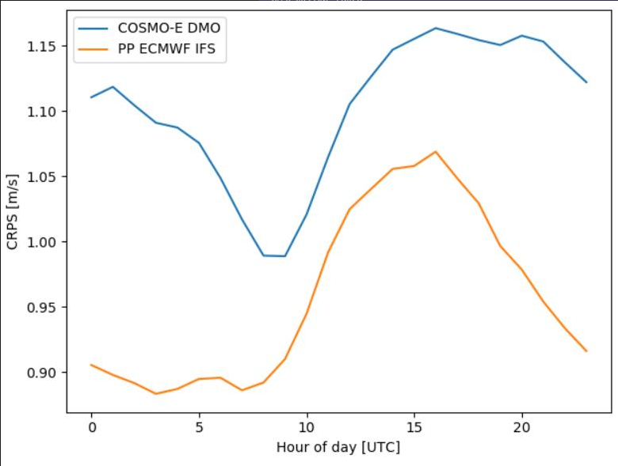
COSMO-E vs IFS + ML

Slide 29
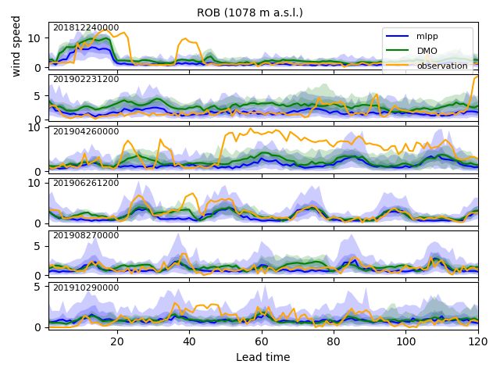
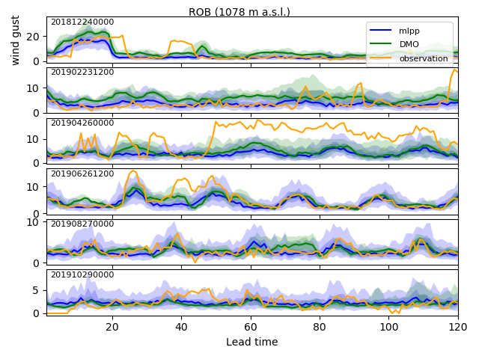
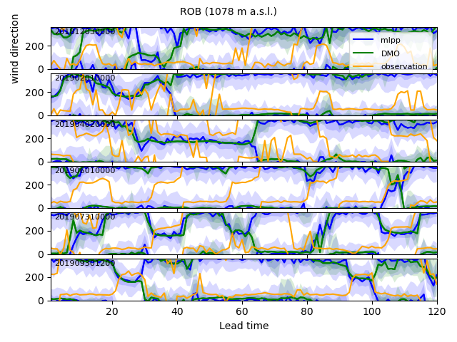
Meteograms
wind speed
wind gust
wind direction

Slide 30
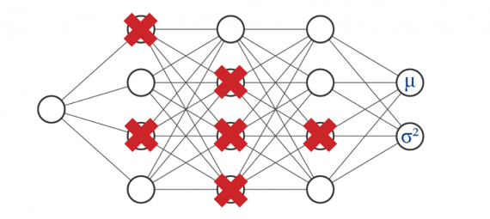
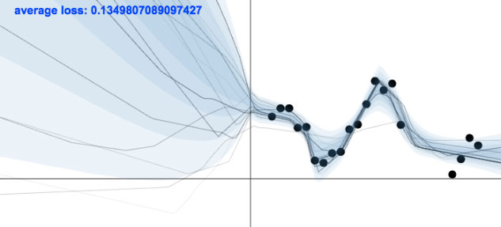
Neural Network Architecture
Bachstein 2019
Regular MLP with distribution parameters as outputs.
Describe uncertainty in the data.
Features cannot fully determine the target values.
Aleatoric uncertainty.
Gal 2015
epistemic uncertainty
aleatoric uncertainty

Slide 31
Neural Network Architecture
Bachstein 2019
Regular MLP with distribution parameters as outputs.
Describe uncertainty in the data.
Features cannot fully determine the target values.
Aleatoric uncertainty.
Dropout during inference to create an ensemble of models.
Describe uncertainty in the ML model.
Training data do not cover all possible situations (→ extrapolation)
Epistemic uncertainty.
Gal 2015
epistemic uncertainty
aleatoric uncertainty

Slide 32
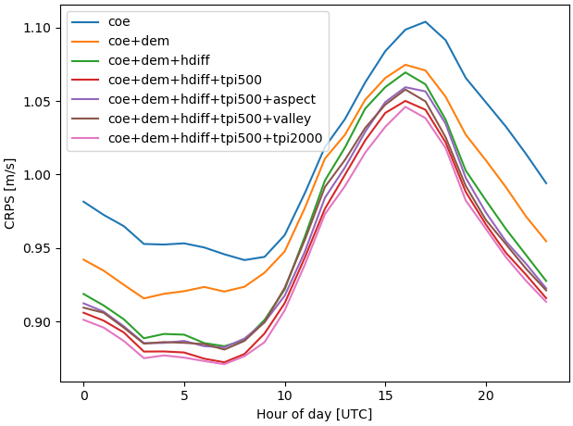
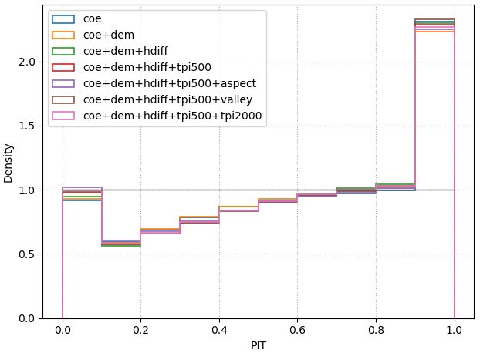
1. Topographical features
Experiment | CRPS [m/s]
coe (NWP only) | 1.004
dem | 0.976
dem+hdiff | 0.954
dem+hdiff+tpi500 | 0.940
dem+hdiff+tpi500+aspect | 0.948
dem+hdiff+tpi500+valley | 0.947
dem+hdiff+tpi500+tpi2000 | 0.936
HDIFF: «NWP altitude error»
DEM and HDIFF provide largest improvements in accuracy.
PIT histograms are all very similar.
→ Topographic predictors improve forecast accuracy rather than calibration.

Slide 33
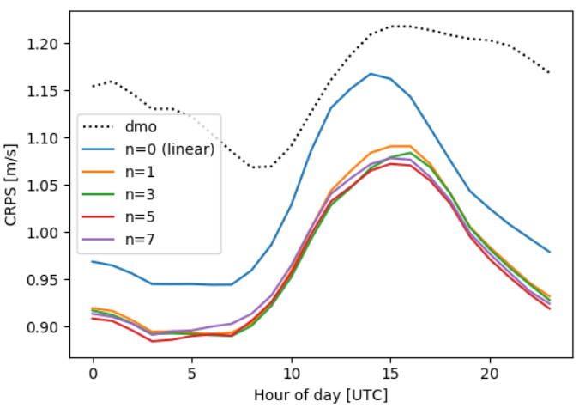
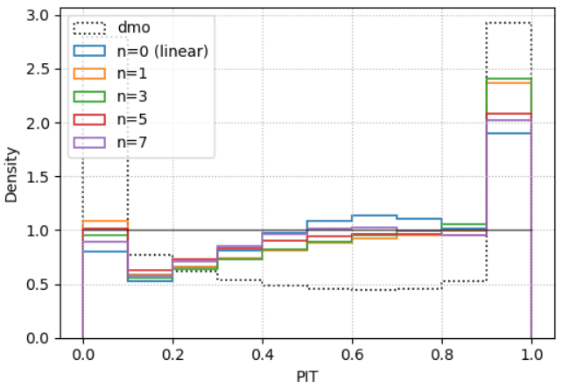
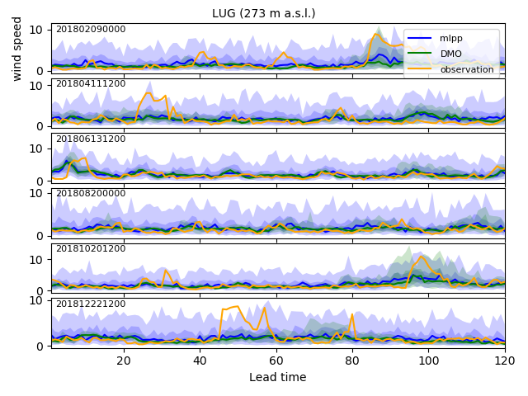
2. Model complexity
First hidden layer brings the most added value.
Deeper models can improve calibration but not necessarily accuracy.
Linear model mostly improves on accuracy by inflating the spread:
# hidden layers | # params | CRPS [m/s]
0 | 28 | 1.025
1 | 4,098 | 0.969
3 | 135,682 | 0.964
5 | 267,266 | 0.959
7 | 398,850 | 0.966

Slide 34
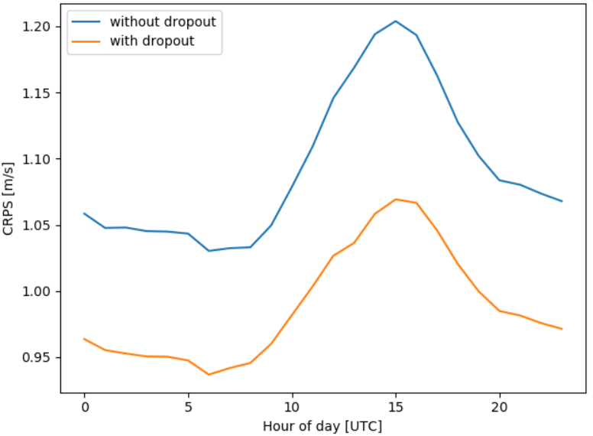
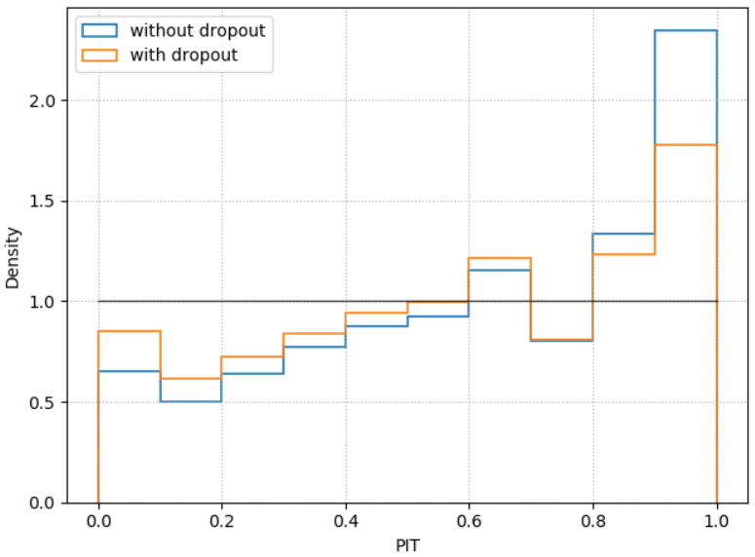
3. Dropout for predictions

Slide 35
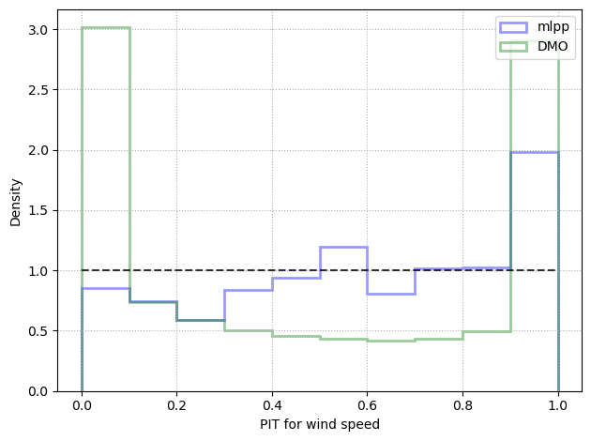
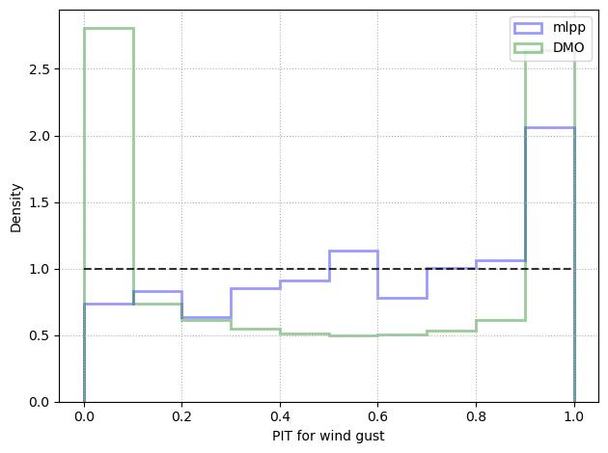
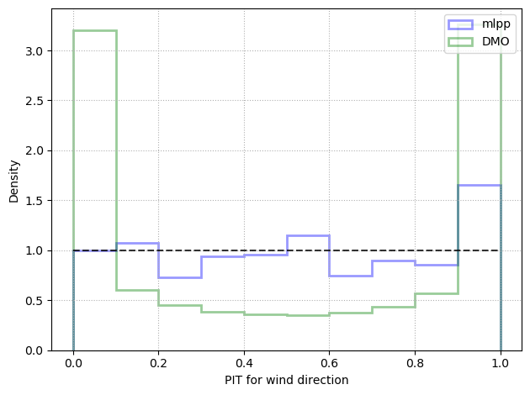
Calibration
wind speed
wind gust
wind direction

Slide 36
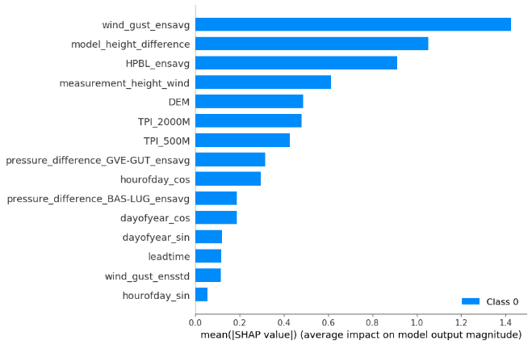
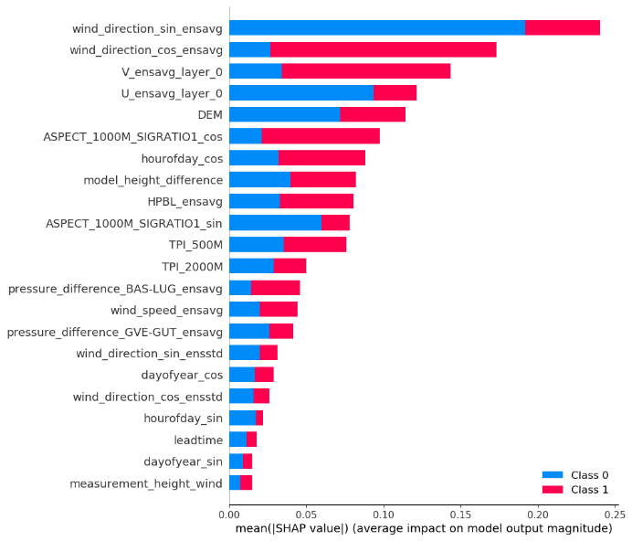
Feature importance
wind speed
wind gust
wind direction
SHAP (SHapley Additive exPlanations): https://github.com/slundberg/shap

Slide 37
Dense neural network
CLCX: COSMO-E XCC: IFS (+12)
Input
Output
CLCT_mean
CLCT_var CLCH_mean CLCL_mean TCC_mean TCC_var HCC_mean
HCC_var MCC_mean
MCC_var HPBL_mean T_2M_mean T_2M_var
init_time
lead_time lat_lon_pair
hour_of_day month
pred_ensemble0
pred_ensemble1
⋮
pred_ensemble20
embeddings
Dense neural network
Nonparametric
15 830 121 parameters

Slide 38
Example forecasts (init time 2019.02.22 12:00, lead time 22)
observation
COSMO-E
gEMOS (+ECC)
ob
dense NN (no ECC)
dense NN (+ECC)

Slide 39
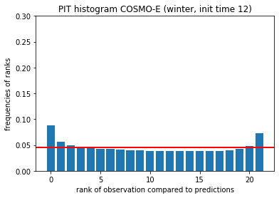
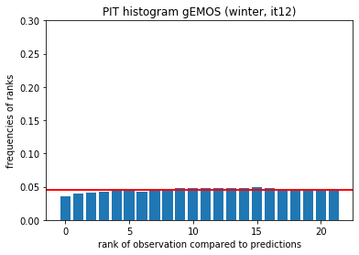
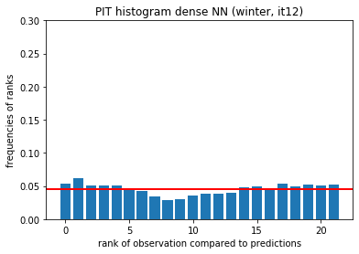
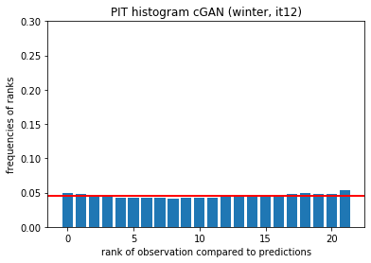
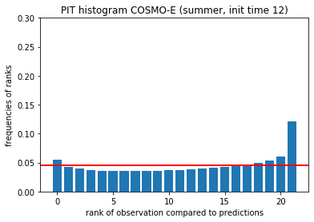
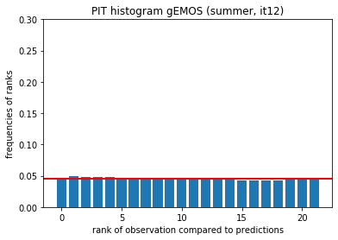
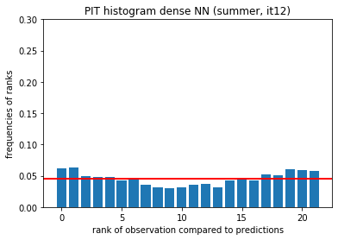
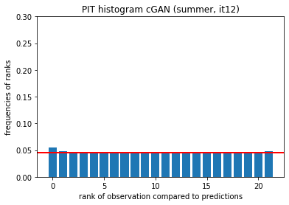
PIT histograms

