Slide 1
KENDA Activities at MeteoSwiss
Daniel Leuenberger, Claire Merker, Samuel Monhart and Marco Arpagaus
MeteoSwiss, Zürich
Maxime Hervo and Alexander Haefele
MeteoSwiss, Payerne

Slide 2
Content
KENDA-1: Setup and (pre-)operational results
Assimilation of Wind Lidar observations
Assimilation of Microwave Radiometer observations
Plans for next COSMO year

Slide 3
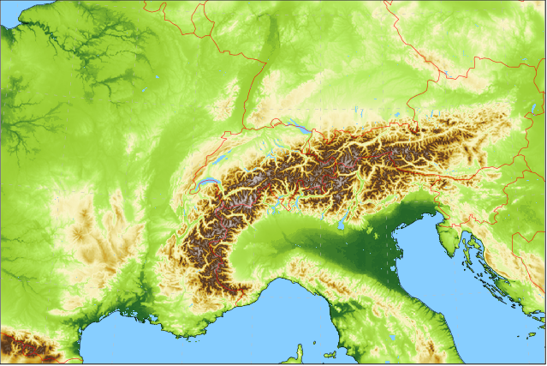
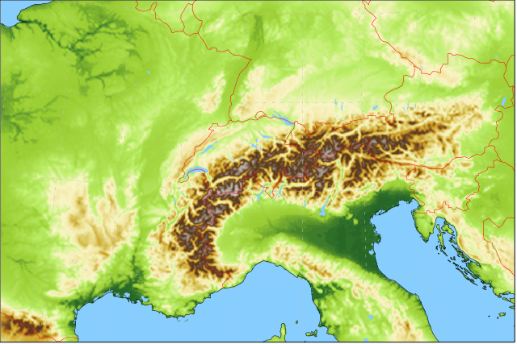
ModInterim: COSMO-1E & COSMO-2E
Lateral boundary conditions: IFS ENS & HRES 18km / 0.2° 4x per day
Lateral boundary conditions: IFS ENS 18km / 0.2° 4x per day
ensemble data assimilation: LETKF at 1.1km
COSMO-1E: 33 hour forecasts, 8x per day 1.1km grid size (convection permitting) 11 ensemble members
COSMO-2E: 5 day forecasts, 4x per day 2.2km grid size (convection permitting) 21 ensemble members

Slide 4
KENDA-1 Setup
Hourly cycles
40 ensemble members
LBC perturbations from 30-36h old ECMWF ENS perturbations centered around the latest ECMWF HRES forecast
Snow analysis on deterministic analysis, applied to all members, once a day
KENDA-1 analyses initialize
COSMO-1E forecasts (first 10 members)
COSMO-2E forecasts (first 20 members), upscaled to 2.2km grid

Slide 5
KENDA-1 Setup
Model Configuration
COSMO Version 5.07 in single precision and on GPU
New soil model settings according to Schulz and Vogel (2020)
1.1km grid
SPPT
LHN in every member
LETKF Configuration
Same as settings of KENDA on 2.2km grid:
Adaptive localization and multiplicative covariance inflation
Additive covariance inflation using global ICON B-Matrix
Relaxation to prior perturbations (RTPP)
New Observations
MODE-S

Slide 6
KENDA-1: (Pre-)Operational Results
Comparison of KENDA-1 vs KENDA deterministic analyses with independent SYNOP observations
Comparison of COSMO-1E CTRL (KENDA-1) vs COSMO-1 (Nudging) deterministic forecasts with independent SYNOP observations
Lead times 1-6h
Lead times 12-24h
Comparison of COSMO-1E (KENDA-1) vs COSMO-E (KENDA) ensemble analyses and forecasts with TEMP observations

Slide 7
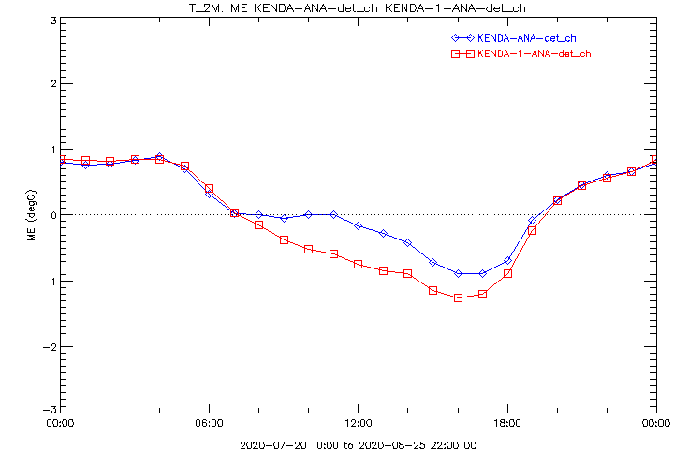
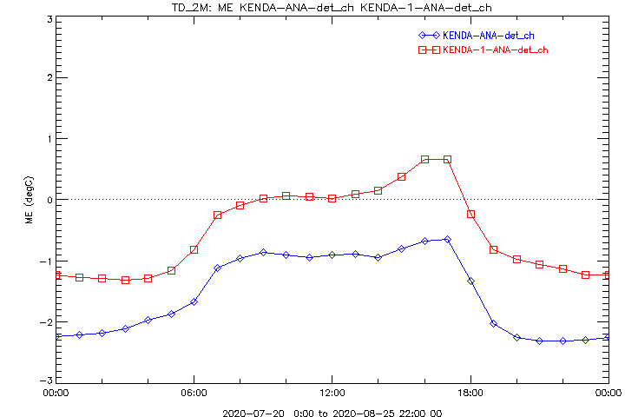
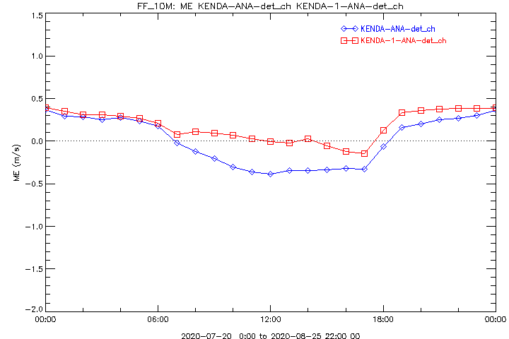
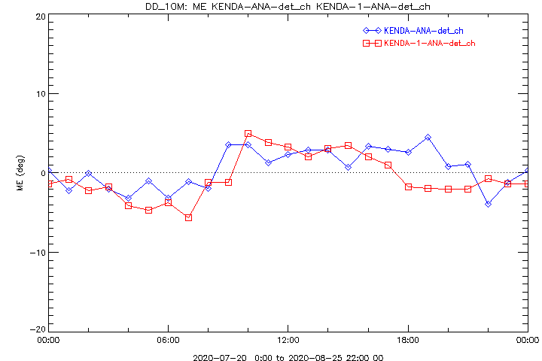
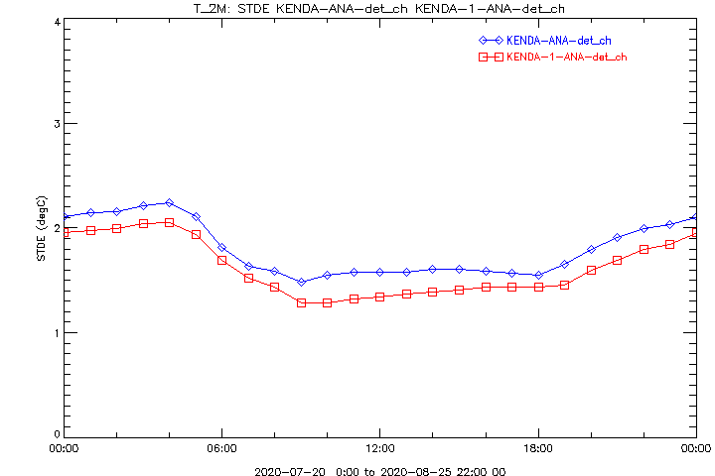
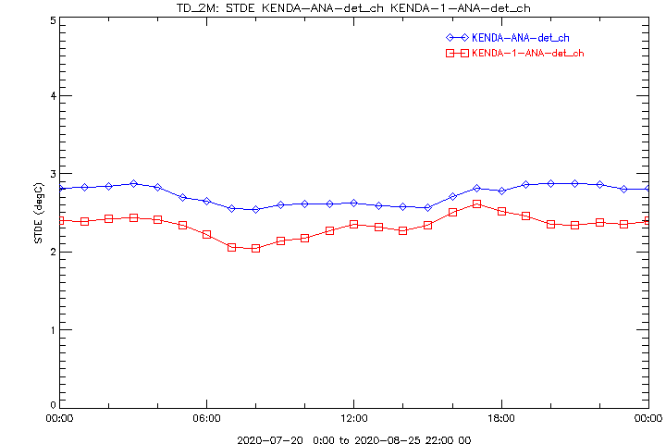
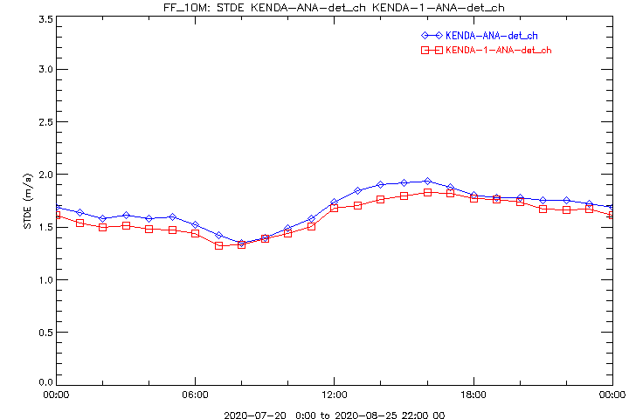
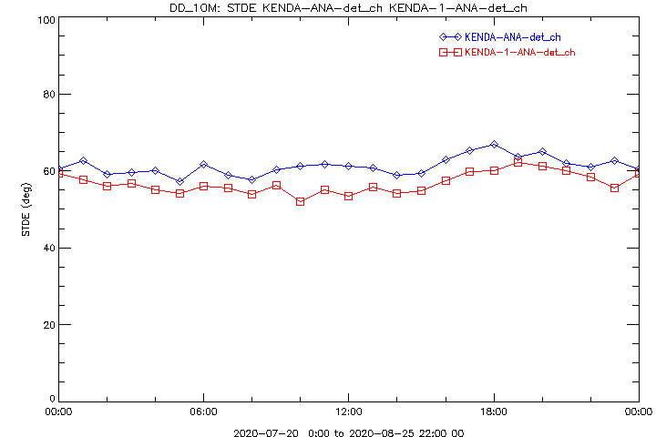
KENDA-1: (Pre-)Operational Results
Comparison of KENDA-1 and KENDA deterministic analyses
Verification with independent SYNOP Obs, 20.7. – 25.8.2020
T2m
Td2m
FF10m
DD10m
BIAS
SD
Similar results for First Guess
KENDA-1 KENDA

Slide 8
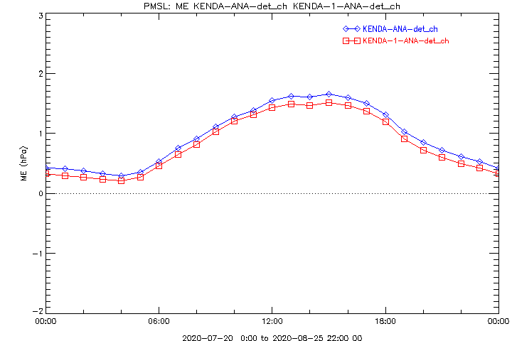
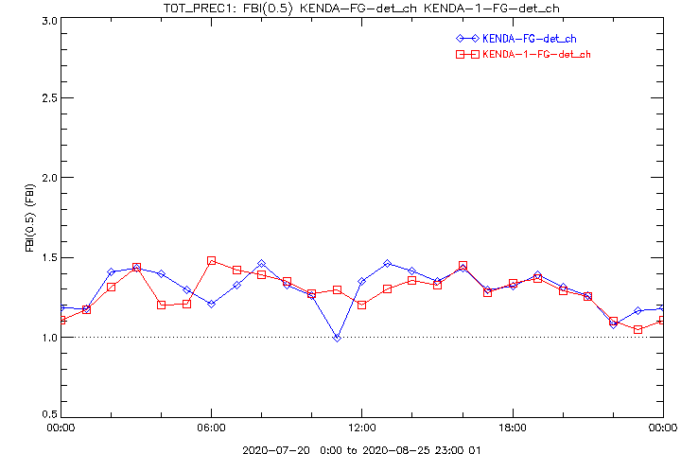
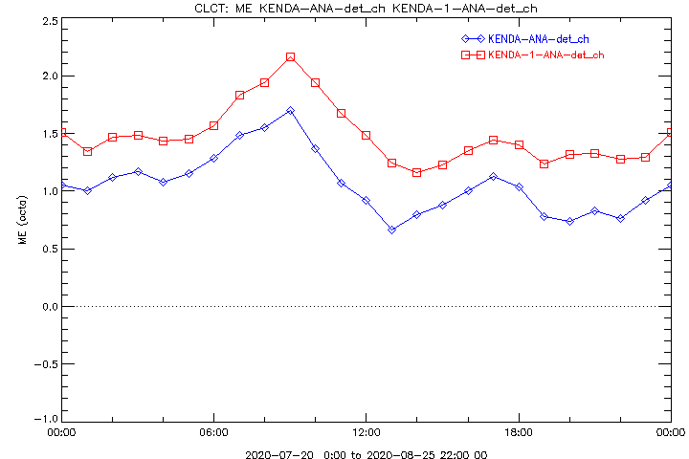
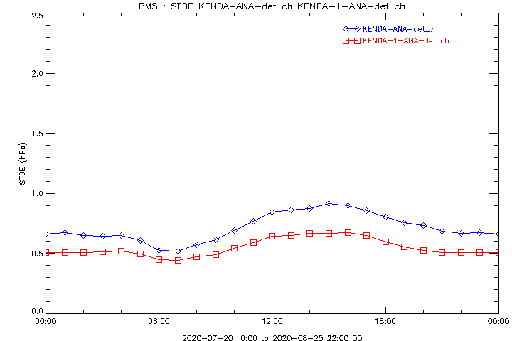
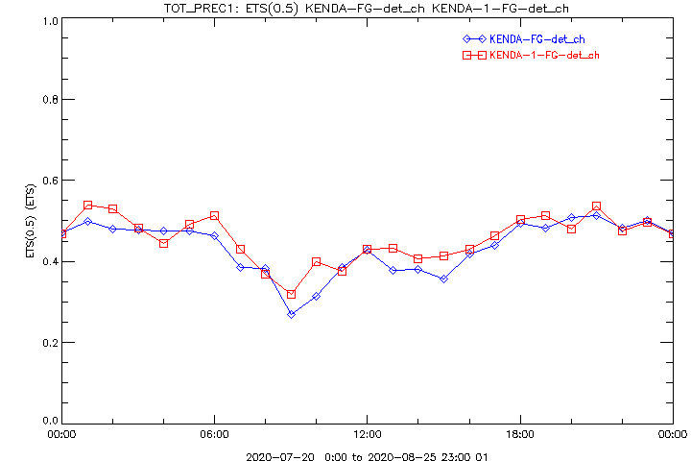
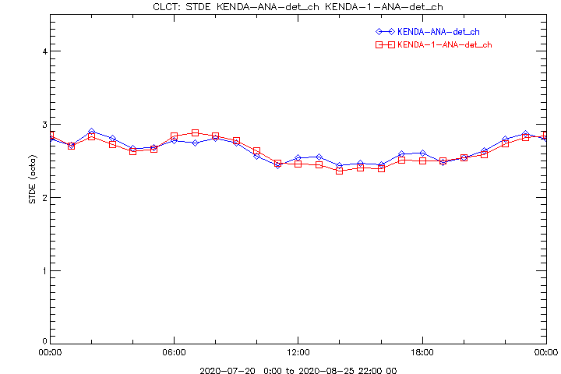
KENDA-1: (Pre-)Operational Results
Comparison of KENDA-1 and KENDA deterministic Analyses
Verification with independent SYNOP Obs, 20.7. – 25.8.2020
PMSL
TOT_PREC
CLCT
BIAS
BIAS
FBI
SD
ETS
SD
Similar results for First Guess
KENDA-1 KENDA

Slide 9
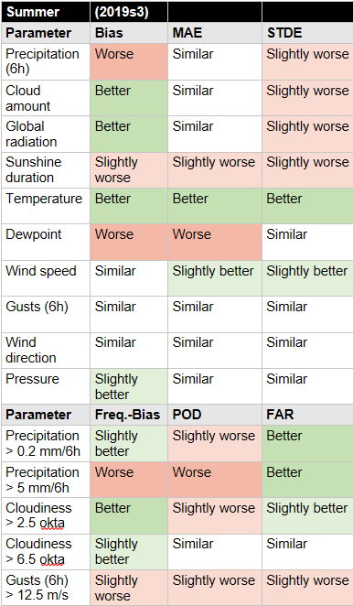
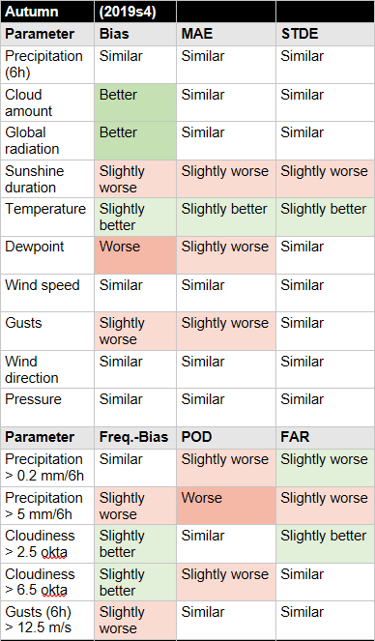
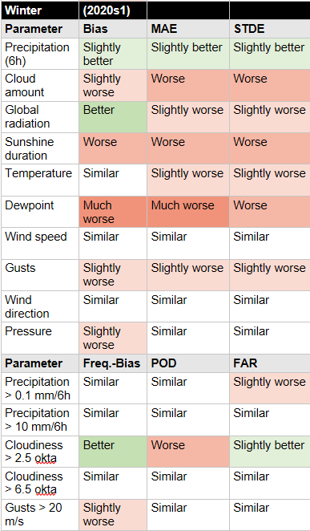
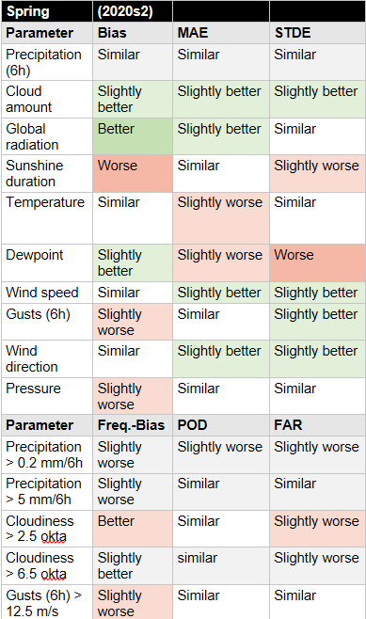
KENDA-1: (Pre-)Operational Results
Comparison of COSMO-1E CTRL (KENDA-1) and COSMO-1 (Nudging), LT 1-6h
Comparison against SYNOP Observations
Summer 2019
2 weeks
Autumn 2019
2 weeks
Winter 2019
2 weeks
Spring 2020
2 weeks
Mixed results, some better, some worse, overall about same quality, missing dewpoint assimilation

Slide 10
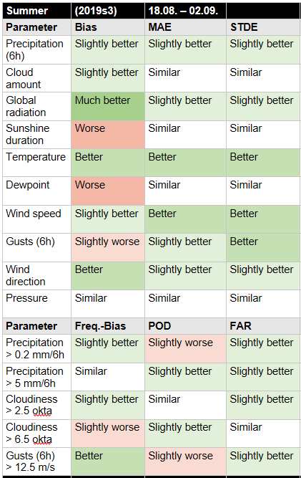
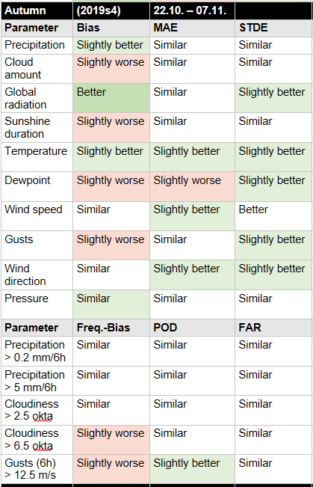
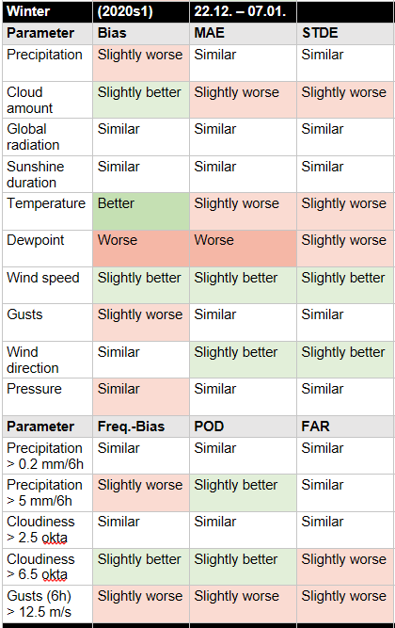
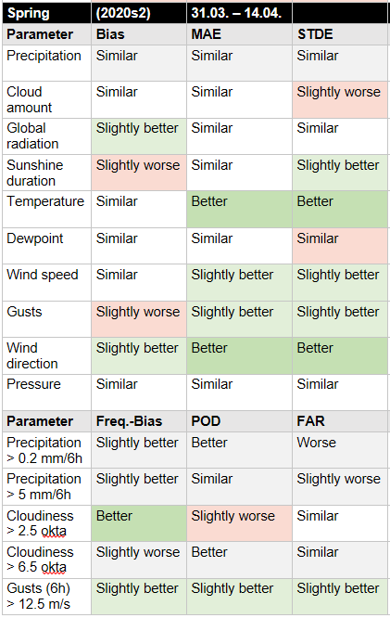
KENDA-1: (Pre-)Operational Results
Comparison of COSMO-1E CTRL (KENDA-1) and COSMO-1 (Nudging), LT 12-24h
Comparison against SYNOP Observations
Summer 2019
2 weeks
Autumn 2019
2 weeks
Winter 2019
2 weeks
Spring 2020
2 weeks
Temperature and global radiation better, especially in summer, missing dewpoint assimilation
Otherwise as good as COSMO-1

Slide 11
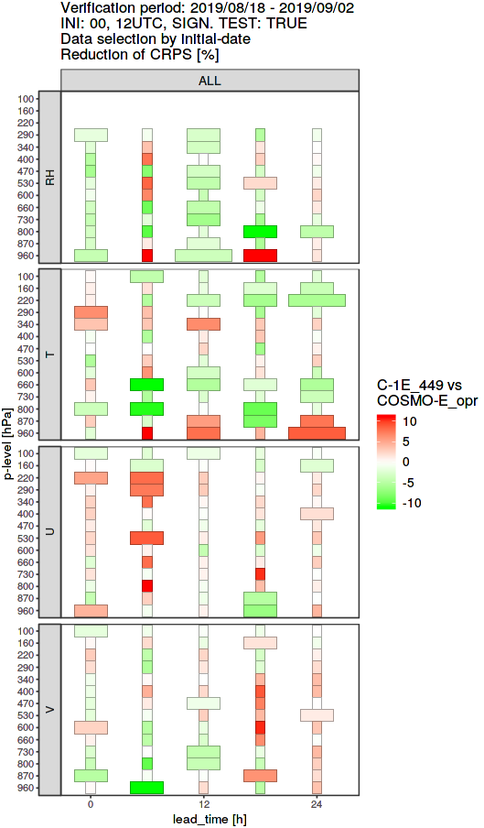
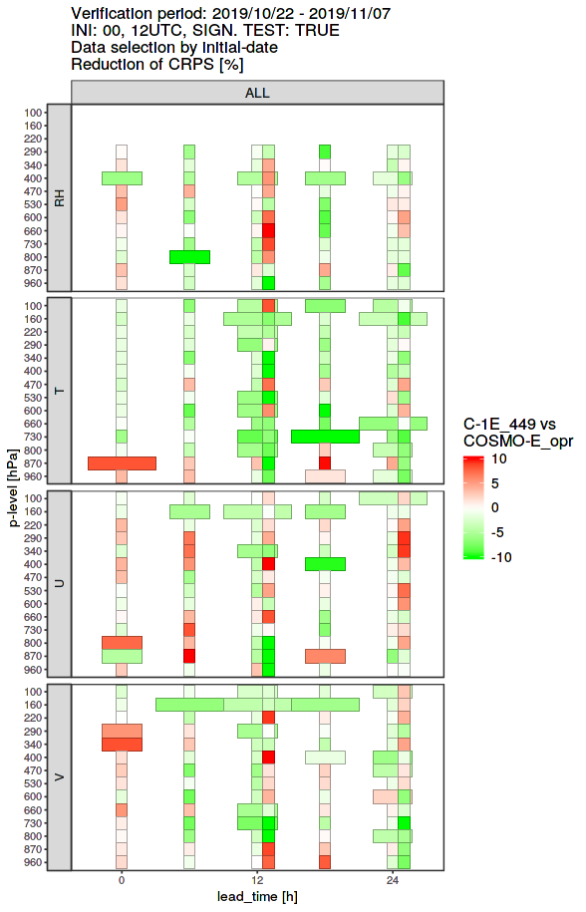
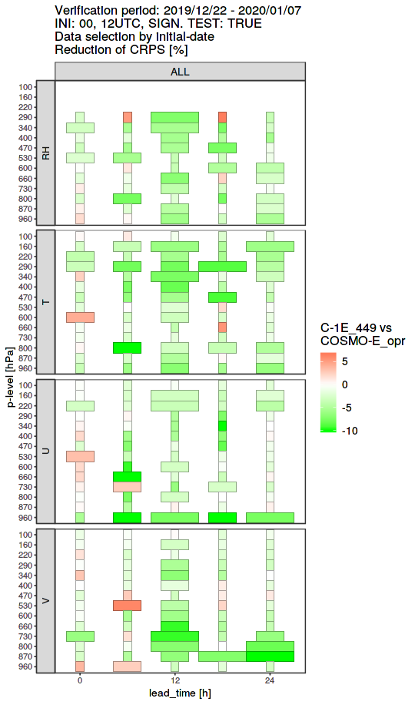
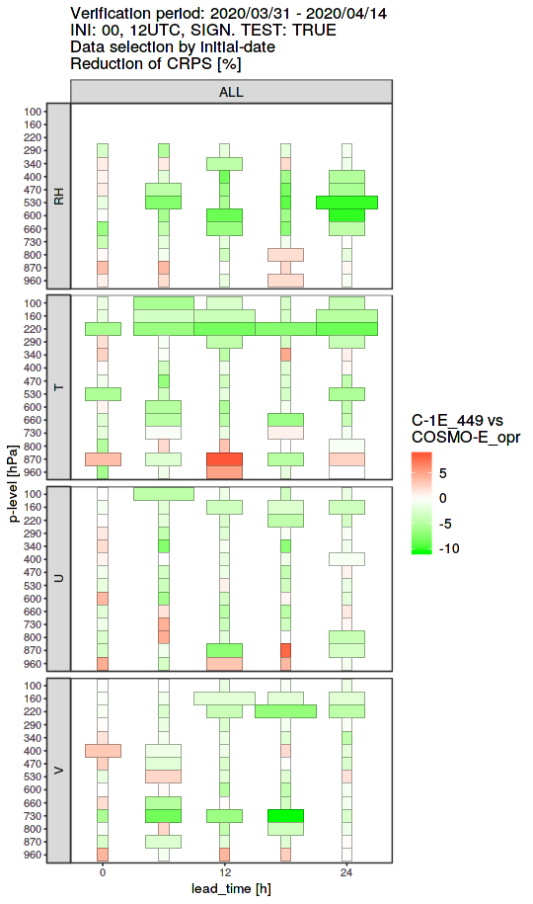
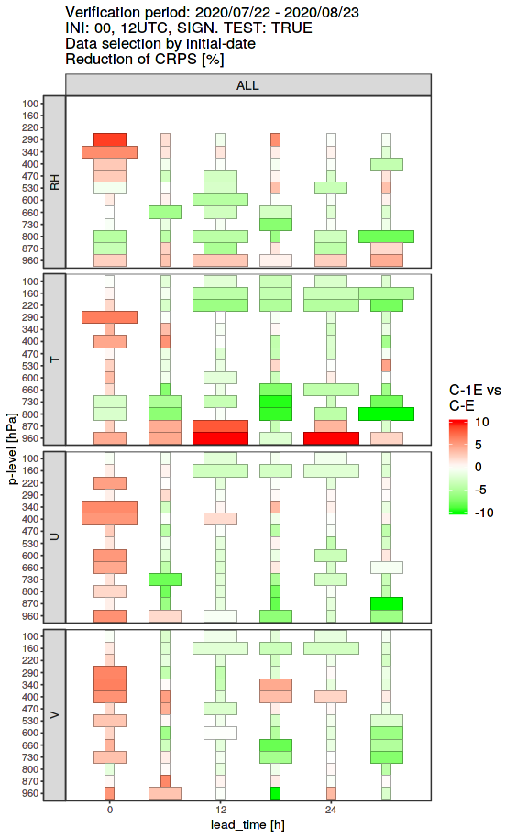
KENDA-1: (Pre-)Operational Results
Comparison of COSMO-1E (KENDA-1) and COSMO-E (KENDA) ensemble FCST
CRPS Reduction, comparison against Radiosondes
Summer 2019
2 weeks
Autumn 2019
2 weeks
Winter 2019
2 weeks
Spring 2020
2 weeks
Summer 2020
4 weeks

Slide 12
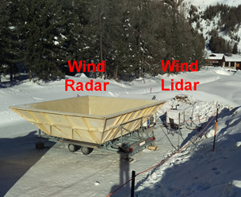
Assimilation of Wind Lidar Observations
See presentation by Samuel Monhart on Friday, 4.9.2020, 9:55 in VR3
Wind Lidar measures wind components (u,v) derived from Doppler information in backscattered laser beams
profile wind information in the boundary layer (0-2km) with high temporal resolution
wind components directly assimilated in KENDA-1

Slide 13
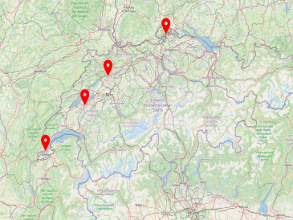
Wind Lidar Assimilation
SHA
GRE
KLO / KLO_LIDAR
PAY
Analysis
First Guess
w/o Lidar
with Lidar
Verification against independent Wind Radar wind profiles
GVE
Kloten
(KLO)
Schaffhausen
(SHA)
Grenchen
(GRE)
Payerne
(PAY)

Slide 14
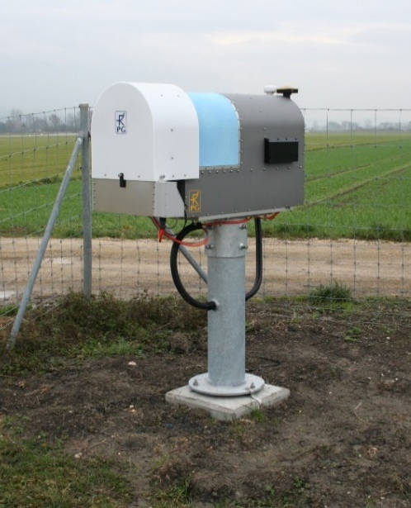
Assimilation of MW Radiometer Obs
See presentation by Claire Merker on Friday, 4.9.2020, 10:20 in VR3
Measures atmospheric radiation: brightness temperature
14 frequency bands (sensitive to humidity and/or temperature)
6 scanning elevation angles
3 stations in Switzerland
Provides temperature and humidity information in the boundary layer with high temporal resolution: potential for improving the representation of the boundary layer in the initial conditions
HATPRO (RPG)

Slide 15
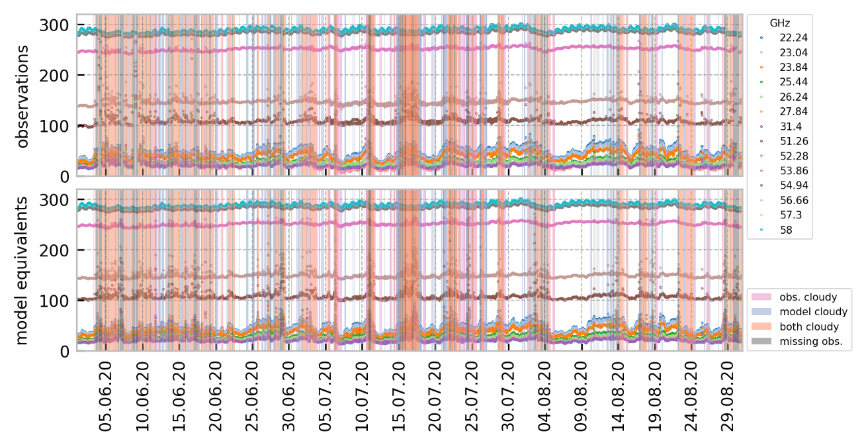
KENDA-1 O-B statistics of MWR BT
Brightness temperature (K)

Slide 16
Summary and Concluding Remarks
ModInterim operational since 6.8.2020
Successful introduction of KENDA-1, running on an 1.1km grid with 40 ensemble members. This is only possible on our machine when COSMO runs on GPU and with single precision. A major effort was needed to bring COSMO up to speed for KENDA-1!
Overall, the majority of performance differences are positive, showing improvements of COSMO-1E (initialized by KENDA-1) versus the old models
We miss the Td2m observations in the assimilation process and look forward to using them (and T2m) soon ☺
Assimilation of Wind Lidar observations straight forward, similar to Wind Radar observations, similar quality.
O-B statistics and a first single observation experiment with MWR observations look promising (“The future is brightness temperatures”)

Slide 17
Outlook for COSMO year 2020/2021
Assimilation of ground-based MWR observations (Claire Merker)
Assimilation of Wind Lidar observations
Samuel Monhart, until Q4/2020
follow-on project, impact of an additional station in Basel, Q3/2021 to Q3/2022
Assimilation of Raman Lidar T and qv profiles (Bas Crezee, start: 1.11.2020, 1.5y)
development of observation operator for T and qv profiles
Assimilation of T2m/RH2m observations (Daniel Leuenberger and Bas Crezee)
Assimilation of drones observations (Daniel Leuenberger)
development of dedicated aircraft code type for drones, tests
Start work with ICON-LAM (Daniel Leuenberger)

