Slide 1
Assimilation of Wind Lidar Observations with KENDA-1
Samuel Monhart, Daniel Leuenberger, Claire Merker, MeteoSwiss, Zürich
Maxime Hervo, Alexander Haefele, MeteoSwiss, Payerne

Slide 2
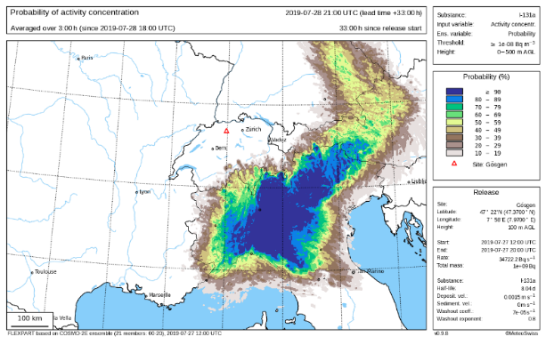
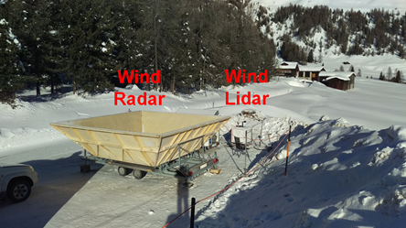
Motivation and Instruments
EMER-Met: Emergency Response Meteorology
Assimilation of microwave radiometer (Claire Merker)
Development of a dispersion ensemble
Installation of Doppler lidars
Assimilation of Doppler Wind Lidar data
Wind Lidar measurements
wind components (u,v) derived from Doppler information in backscattered laser beams
profile wind information in the boundary layer (0-2km) with high temporal resolution
wind components directly assimilated in KENDA-1
Timeline
Q4 2020: finished verification of Assimilation experiments
Q1 2021: Operationalization of Wind Lidar assimilation
Q3 2021 to Q3/2022: analysis for an addition station (Basel)
Visualization of ensemble dispersion modelling.
Stefan Rüdisühli (MeteoSwiss), Unpublished

Slide 3
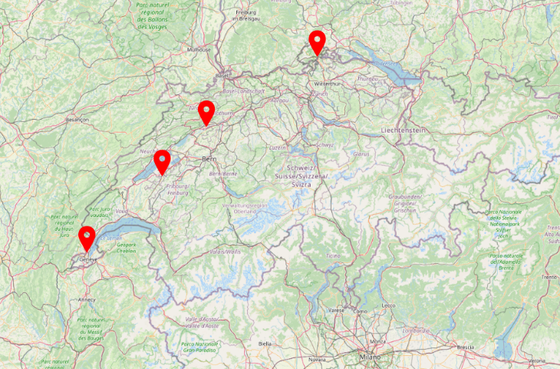
Methods
O-B-Statistics
Assessment of statistical properties between observation and model
Observation operator for Lidar observations
Verification
Rfdbk-Verification suite developed at DWD
Computation of statistical measures for Analysis, First Guess and Forecast
Only the ensemble mean is used at the moment
Wind Lidar sites
Kloten (KLO) and Geneva (GVE)
Wind Radar sites ( = wind profiler)
Kloten & Geneva: experimental sites
Schaffhausen (SHA), Grenchen (GRE), Payerne (PAY)
SHA
GRE
PAY
KLO
GVE
Wind Lidar and Wind Radar (experimental site)
Wind Radars (permanent sites)

Slide 4
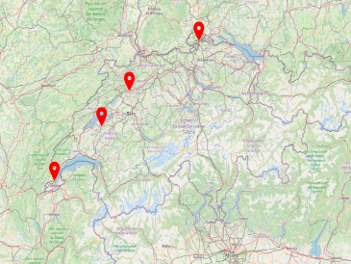
O-B-Statistics: KENDA First Guess
Wind direction (D)
Wind speed (F)
SHA
GRE
KLO / KLO_LIDAR
DJF 17/18
PAY
GVE
ME mean error
SD standard deviation
LEN number of data

Slide 5
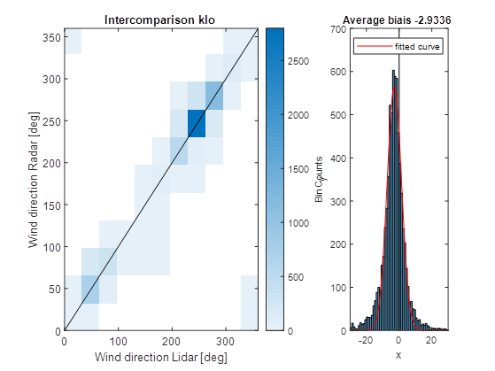
O-B-Statistics: KENDA First Guess
Wind direction (D)
Wind speed (F)
SHA
GRE
KLO / KLO_LIDAR
DJF 17/18
PAY
GVE
Mean error difference
diff_{LIDAR-WPROF}= ca. -3°
ME mean error
SD standard deviation
LEN number of data
Instrumental difference:
diff_{LIDAR-WPROF}= -3°

Slide 6
O-B-Statistics: KENDA First Guess
Wind direction D [°]
Wind speed F [m/s]
SHA
GRE
KLO / KLO_LIDAR
DJF 17/18
PAY
GVE
MAM 18
JJA18
ME mean error
SD standard deviation
LEN number of data
SON18

Slide 7
O-B-Statistics: KENDA First Guess
Wind component U [m/s]
Wind component V [m/s]
SHA
GRE
KLO / KLO_LIDAR
DJF 17/18
PAY
GVE
MAM 18
JJA18
ME mean error
SD standard deviation
LEN number of data
SON18

Slide 8
Assimilation experiment
SHA
GRE
KLO / KLO_LIDAR
General
Wind is a main driver for dispersion
Changing wind regimes: Timing, location, intensity and direction of wind is crucial
Representative wind regimes for Swiss Midlands
Specific characteristics
Strong vertical wind shear
Sudden changes in wind speed (& direction)
Wind direction W/SW and E/NE
Selected Periods
KLO: January 18, 7 days, Bisenlage
KLO: May/June 18, 11 days, synoptically driven convective period
Similar periods for GVE
➔Verification of the analysis and the 1-hour First Guess with independent Wind Radar observations
PAY
GVE
Notes:
Main challenge:
Well suitable periods often exhibit low data availability (fornts → rain → signal attenuation, same in fog cases)

Slide 9
Assimilation experiment
SHA
GRE
KLO / KLO_LIDAR
KENDA-1 First Guess (FG) and Analysis (ANA) against KLO Wind Lidar
PAY
GVE
Wind direction D [°]
Wind speed F [m/s]
Analysis
First Guess
w/o Lidar
with Lidar

Slide 10
Assimilation experiment
SHA
GRE
KLO / KLO_LIDAR
KENDA-1 First Guess (FG) and Analysis (ANA) against KLO Wind Lidar
PAY
Wind component U [m/s]
Wind component V [m/s]
GVE
Analysis
First Guess
w/o Lidar
with Lidar

Slide 11
Assimilation experiment
SHA
GRE
KLO / KLO_LIDAR
KENDA-1 First Guess (FG) and Analysis (ANA) against KLO Wind Radar
PAY
Wind direction D [°]
Wind speed F [m/s]
GVE
Analysis
First Guess
w/o Lidar
with Lidar

Slide 12
Assimilation experiment
SHA
GRE
KLO / KLO_LIDAR
KENDA-1 First Guess (FG) and Analysis (ANA) against KLO Wind Radar
PAY
Wind component U [m/s]
Wind component V [m/s]
GVE
Analysis
First Guess
w/o Lidar
with Lidar

Slide 13
Assimilation experiment
SHA
GRE
Analysis
First Guess
w/o Lidar
with Lidar
KENDA-1 First Guess (FG) and Analysis (ANA) against all Wind Radars
KLO / KLO_LIDAR
PAY
Schaffhausen
(SHA)
GVE
Kloten
(KLO)
Grenchen
(GRE)
Payerne
(PAY)

Slide 14
Assimilation experiment SUMMER
SHA
GRE
Analysis
First Guess
w/o Lidar
with Lidar
KENDA-1 First Guess (FG) and Analysis (ANA) against all Wind Radars
KLO / KLO_LIDAR
PAY
Schaffhausen
(SHA)
GVE
Kloten
(KLO)
Grenchen
(GRE)
Payerne
(PAY)

Slide 15
Operational COSMO-1E Wind Radar Schaffhausen (SHA) 22.07.2020 – 01.09.2020, All intitialization times (00, 03, 06, 09, 12, 15, 18, 21)
SHA
GRE
KLO / KLO_LIDAR
PAY
GVE

Slide 16
Operational COSMO-1E Wind Radar Payerne (PAY) 22.07.2020 – 01.09.2020, All intitialization times (00, 03, 06, 09, 12, 15, 18, 21)
SHA
GRE
KLO / KLO_LIDAR
PAY
GVE

Slide 17
Operational COSMO-1E Wind Radar Grenchen (GRE) 22.07.2020 – 01.09.2020, All intitialization times (00, 03, 06, 09, 12, 15, 18, 21)
SHA
GRE
KLO / KLO_LIDAR
PAY
GVE

Slide 18
Summary
O-B-Statistics
Instrumental differences of errors (Wind Lidar vs. Wind Radar)
Wind direction bias in Wind Lidar larger (more negative) than bias of the Wind Radar but within measurement uncertainty of 3°
No clear signal of difference in U and V
Spatial differences of errors (between Wind Radars)
Lowest bias and standard deviation for SHA depending →caused by instrument quality
Marginal seasonal differences of errors
Assimilation experiment
Positive effect of Wind Lidar assimilation
Analysis and one-hour First Guess: Reduction of mean error and standard deviation
Effect in wind direction strongest
Effect visible as well at distant stations
Operational COSMO-1E
Effect of Wind Lidar assimilation is expected to be lost within few hours

Slide 19
Outlook and Discussion Points
What, if any, is the impact on other variables? (Precip, Temperature,…)
Impact very short-lived! How to prolong impact of data assimilation into forecast?
How to combine Wind Radar and Wind Lidar observations at the same station?
Different code type (Wind Lidar: 187, Wind Radar: 132)
Observation error larger for wind Radar at low levels?

Slide 21
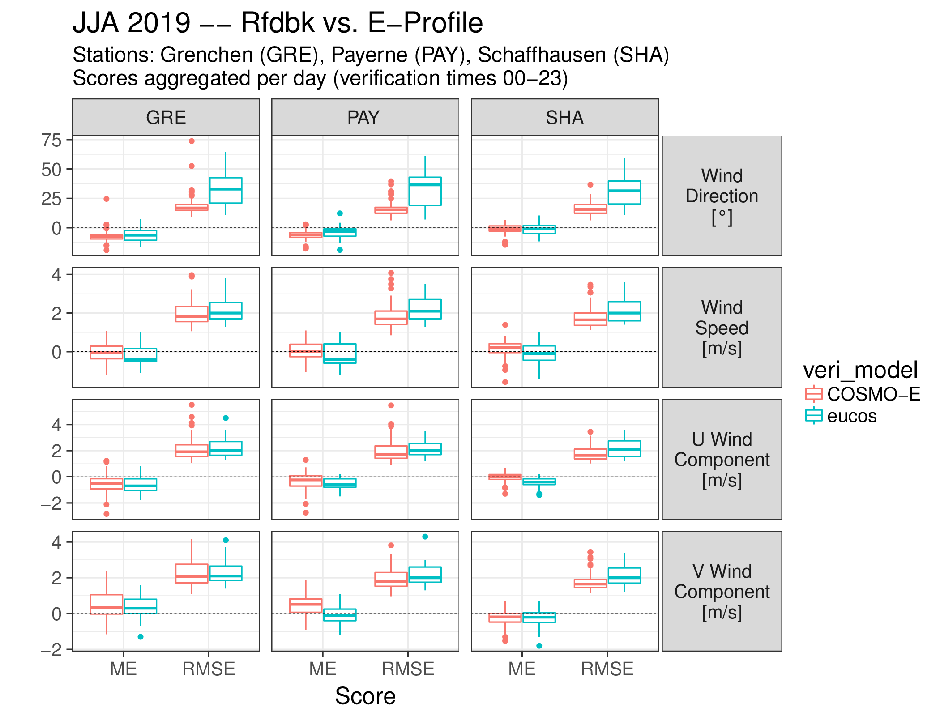
Wind radar
Rfdbk vs. Eucos
3 Stations
Wind direction, Wind speed, U & V
Daily integrated errors
Eucos available starting in 2019
Good agreement of errors
Rfdbk: COSMO-E First guess, 1 per hours
Eucos: ECMWF Model (details unknown)

