Slide 1
Github: status and future plans
Katie Osterried

Slide 2
Outline
Current status of Github usage
Available tools on Github and their usefulness
  Pull requests and testing with Jenkins
  Issues
  Wiki
Future plans

Slide 3
Current usage of Github by the COSMO consortium
C2SM-RCM organization (collection of private git repositories on Github)
  Used to distribute code to members of C2SM in Switzerland
  Used on a trial basis by the consortium to evaluate Github for the last 18 months or so
Git repositories include:
  Cosmo-prerelease
    Used to merge the developments from the POMPA priority project into the official cosmo version
  Fieldextra
  Extpar

Slide 4
Github tools: Pull Requests
Actively being used by the consortium developers for:
  code review
  testing before merging into official versions (including automated testing with Jenkins)
Allows for easy collaboration between developers located in different institutions
  Comment directly in code
  Attach pictures or links in comments
Opinion: definitely adding value for cosmo developers

Slide 5
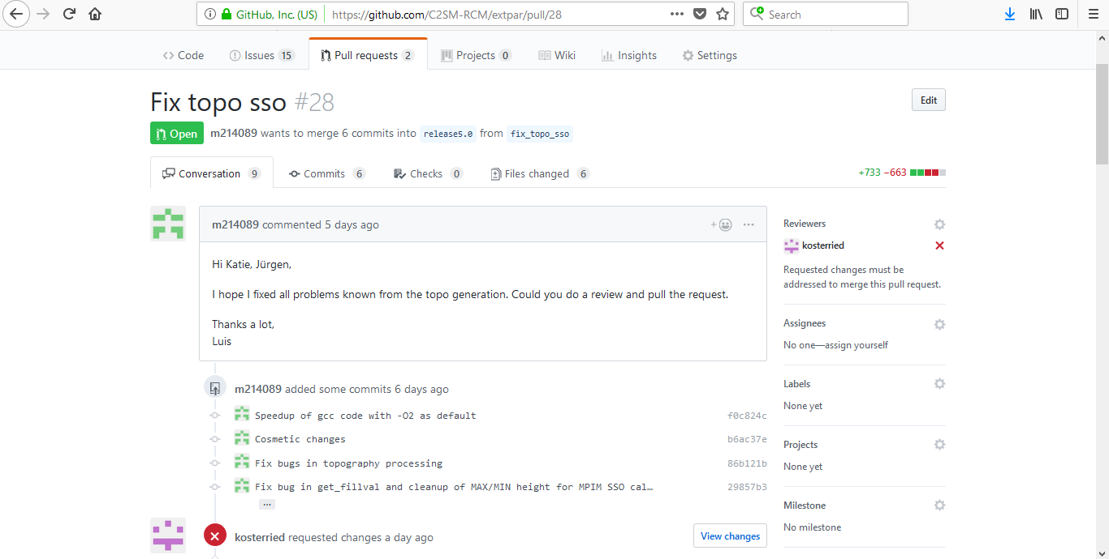
Extpar pull request

Slide 6
Github tools: Issues
Issues are being actively used in all of the consortium codes hosted on Github to:
  Report bugs and communicate workarounds/solutions
  Request new features
Useful features:
  Can assign issues to individuals
  Issues can be resolved and closed with a commit message
Opinion: definitely adding value for cosmo developers

Slide 7
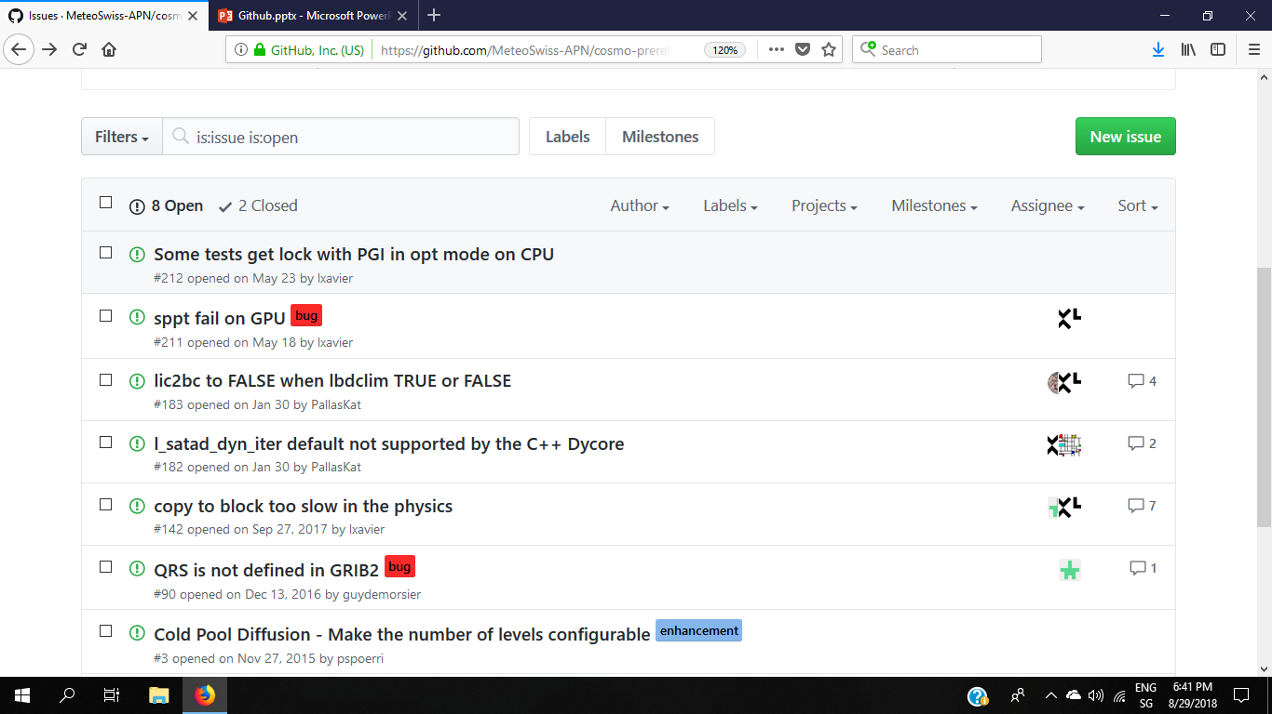
Cosmo-prerelease issues list

Slide 8
Github tools: wiki
Each repository on Github comes with a wiki
(itself a git repository)
Useful for documenting compilation information, dependencies, manuals, release notes, etc.
Used very actively by some cosmo developers (see Fieldextra wiki), but mostly not really used
Time-consuming to make wiki pages
Opinion: Not a clear benefit for cosmo developers (but definitely for users)

Slide 9
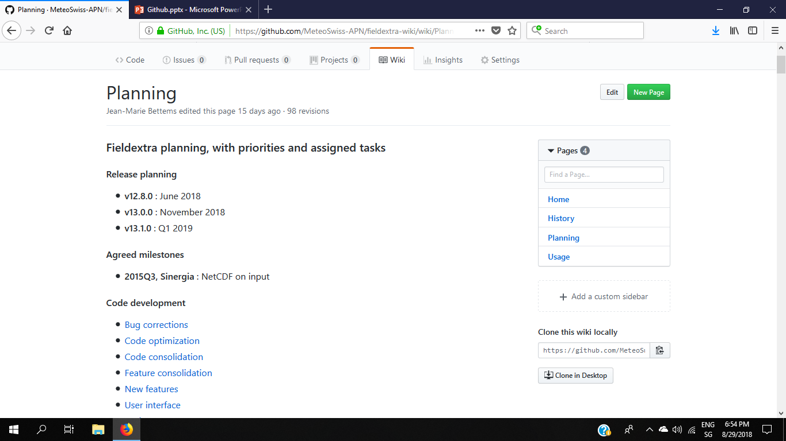
Fieldextra wiki page: Planning

Slide 10
Future plans with Github
Transition from trial basis (C2SM-RCM organization) to more permanent basis (COSMO-ORG organization)
github.com/COSMO-ORG
COSMO-ORG organization is administrated by Xavier Lapillonne from MeteoSwiss (Xavier.Lapillonne@meteoswiss.ch)
Already contains official version of Int2lm, CALMO-MM, and terra-standalone
Plans to move Fieldextra and Extpar after their next releases
Cosmo- TBD (Uli?)

Slide 11
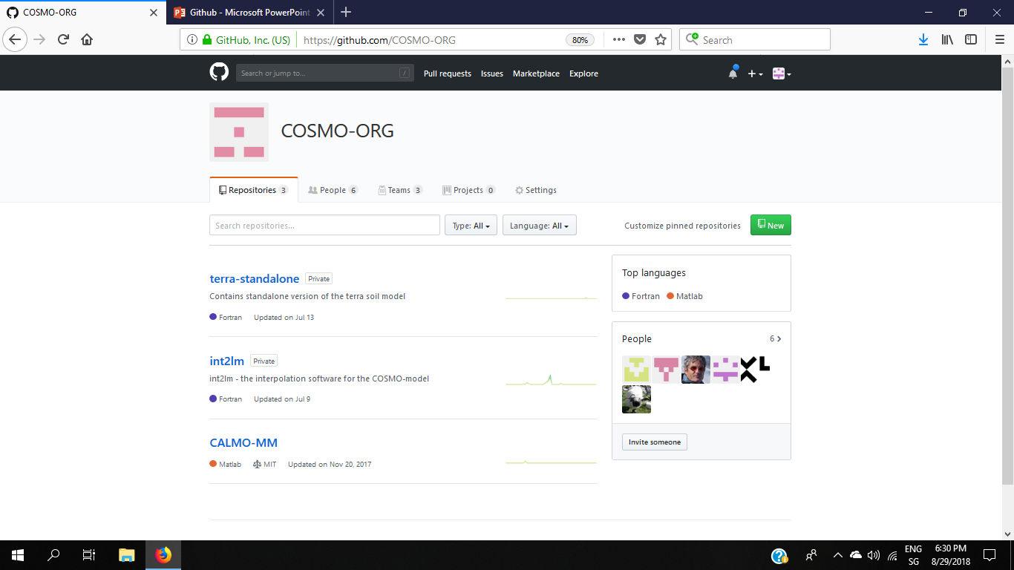
COSMO-ORG

