Slide 1

COSMO-LEPS updates
Andrea Montani
Arpae Emilia-Romagna Servizio IdroMeteoClima, Bologna, Italy
COSMO GM, St Petersburgh, 3-6 September 2018

Slide 2
Outline
Present status,
COSMO-LEPS products on the public web: what was done, what is missing, what could be done,
Performance of the system,
Tests @ 5 km,
Towards multi-physics (in CIAO PT),
Development of COSMO-LEPS based visualization products (in WG7).

Slide 3
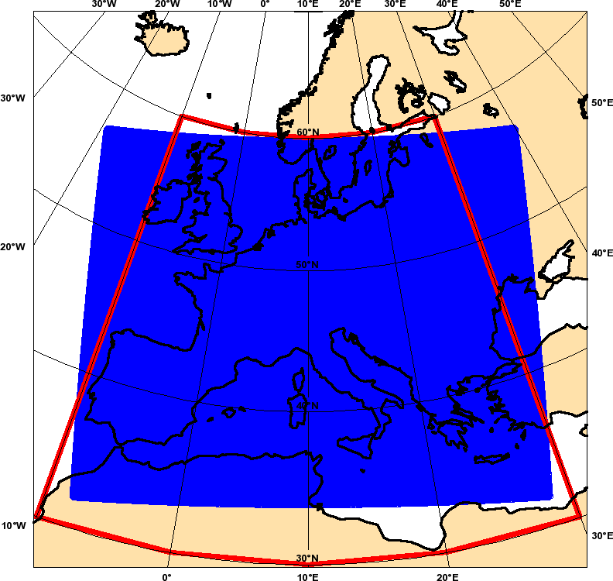

COSMO-LEPS suite @ ECMWF: configuration “oper” (operationally implemented on 5 November 2002 - the first in Europe)
20 Representative Members (RMs) drive the 20 COSMO integrations (each of them weighted according to the cluster populations)
+
using Tiedtke convection scheme
+
perturbations in turbulence scheme and in physical parameterisations (no SPPT)
+
soil initial conditions from
ICON-EU model (DWD)
4 variables
Z U V Q
3 levels
500 700 850 hPa
d-1
d
d+1
d+2
d+3
d+4
d+5
Cluster Analysis and RM identification
Cluster analysis and RM identification
older EPS
00
younger EPS
2 time steps
12
EuropeanArea
Complete Linkage
clustering interval
COSMO-LEPS integration
domain
The suite runs as a “time-critical application” managed by Arpae-SIMC;
The computer time (57 million BUs for 2018) provided by the COSMO partners which are ECMWF member states;
COSMO v5.03 since 1 February 2016,
Δx ~ 7 km; 40 ML; 2 runs per day (00 and 12UTC); fcst range: 132h;
single precision since 1/12/2016 (20 runs in SP are cheaper than 16 runs in DP).
COSMO-LEPS
clustering area

Slide 4
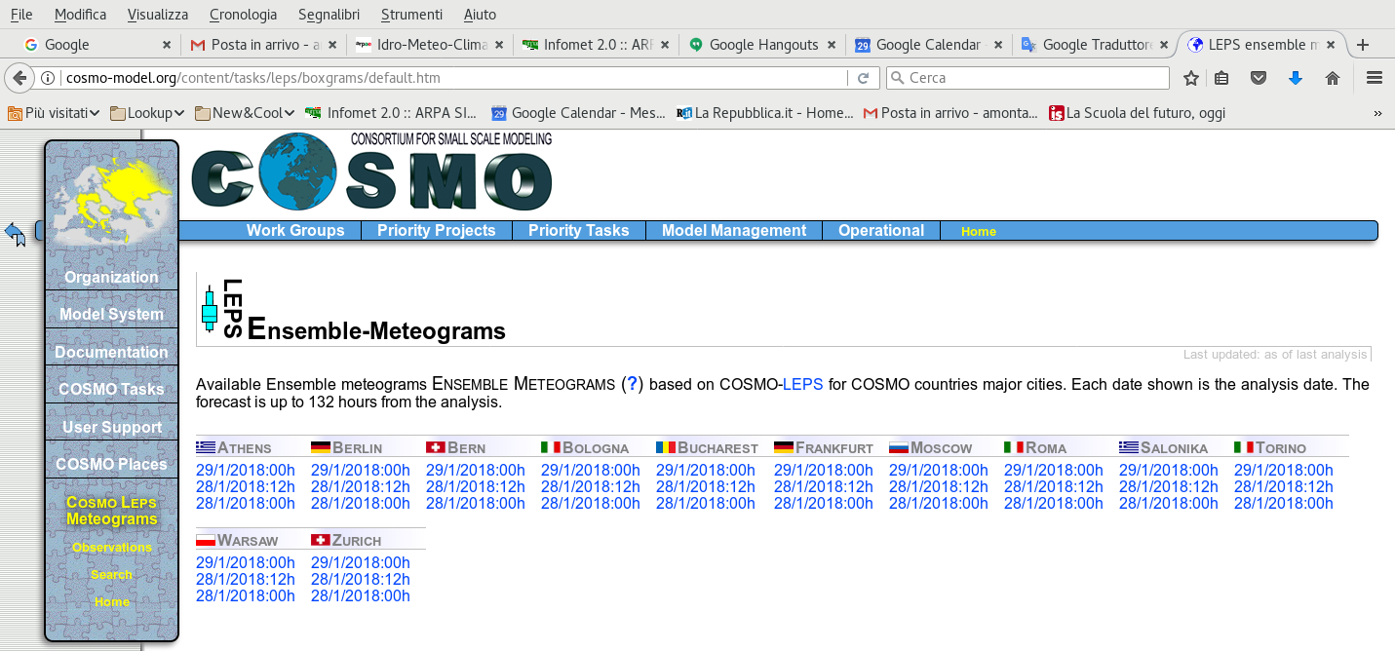
COSMO-LEPS on the public web
Disseminate a set of static maps (jpg/png files) including:
  meteograms over a list of locations,
  probability maps for total precipitation, snowfall, temperature, gust.
15/09/2017: document provided to SMC with the proposal (got +ve feedback);
29/09/2017: first prototype of meteograms prepared (assistance from ECMWF user support);
16/10/2017: operational implementation over 12 locations with products transferred from ECMWF to COSMO web-site at about 10UTC (22UTC) for the 00UTC (12UTC) run.
http://www.cosmo-model.org/content/tasks/leps/boxgrams/default.htm

Slide 5
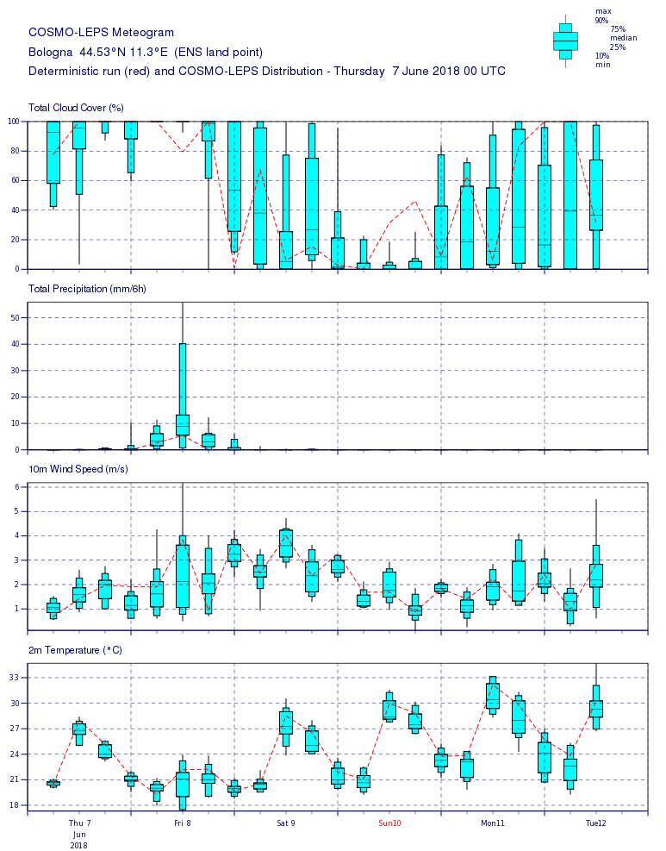
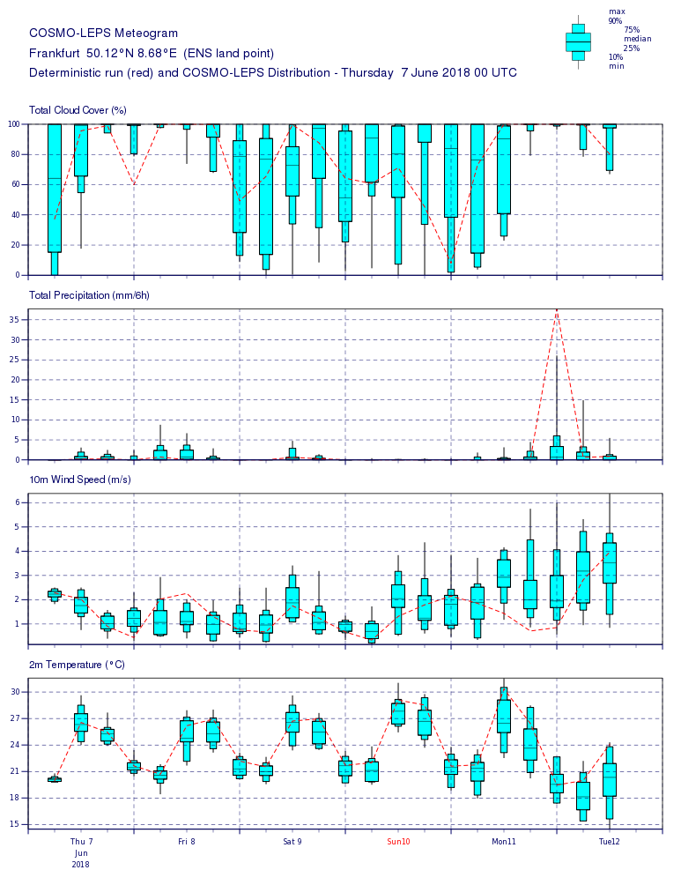
COSMO-LEPS and the web: meteograms over Bologna and Frankfurt

Slide 6
COSMO-LEPS on the public web: list-to-do things
Requests on meteogram locations:
Frankfurth → Offenbach,
Add Locarno and Geneva,
Add sites from Czech Republic (still need feedback from STC),
Add European capitals (are we sure?!?!!??).
...
  Probability maps for total precipitation, snowfall, temperature, gust.
  Work still to start (lack of resources)
  Agree on thresholds, accumulation times, .....

Slide 7
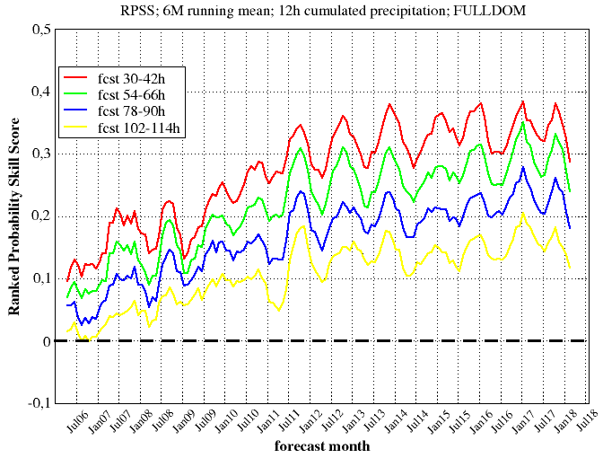
Trends in precipitation forecast scores: RPSS
Monthly verification performed over the full integration domain (~1400 synop; NGP)
Variable: 12h cumulated precipitation (thresholds: 1, 5, 10, 15, 25, 50 mm).
Score: Ranked Probability Skill Score (RPSS), updated to May 2018 ; 6-month running mean.
a good forecast system has RPSS > 0; the higher, the better.
Some recent decay.
Positive trend for all forecast ranges, especially the longer ones ( --- and --- ).

Slide 8
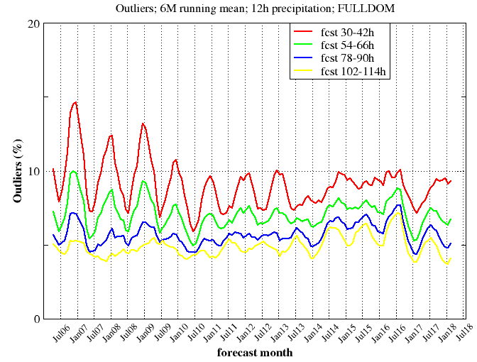
Trends in precipitation forecast scores: OUTLIERS
Monthly verification performed over the full integration domain (~1400 synop; NGP)
Variable: 12h cumulated precipitation .
Score: Percentage of outliers, updated to May 2018; 6-month running mean.
How often the analysis falls outside the forecast interval spanned by the ensemble members; … the lower the better, usually …
Statistically, a forecast system has Outliers ~ 2/N+1, N being the ensemble size.
Some recent increase in the short range.
Positive trend (e.g. decrease) for the other forecast ranges.

Slide 9
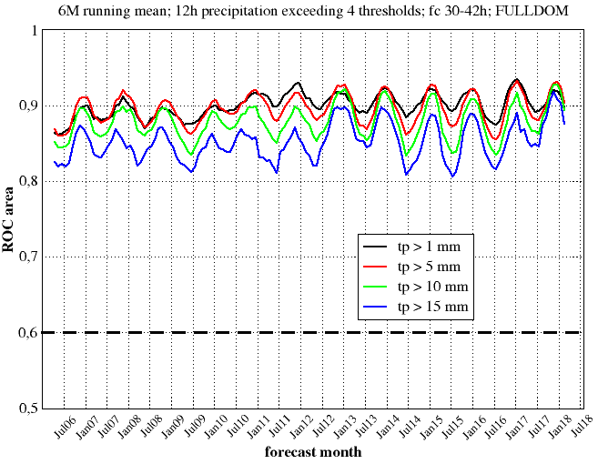
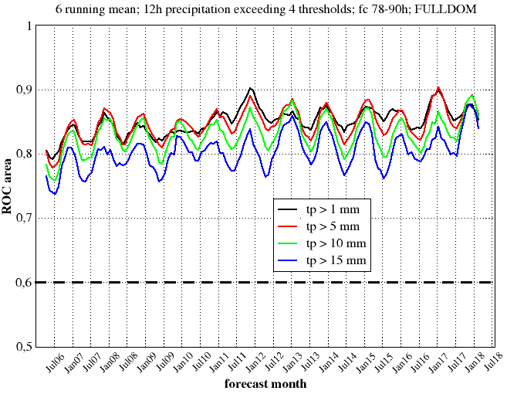
Trends in precipitation forecast scores: ROC area
Monthly verification performed over the full integration domain (~1400 synop; NGP)
Variable: 12h cumulated precipitation .
Score: area under the diagram HIT rate vs FAR, updated to May 2018; 6-month running mean.
A “good” forecast system should have ROC area > 0.6; the higher, the better.
Consider 4 events (12h precipitation above 1, 5, 10, 15 mm) and 2 forecast ranges (30-42h, 78-90h).
ROC area: fcst 30-42h
ROC area: fcst 78-90h
fc 30-42h
fc 78-90h
Positive trend of the score for both forecast ranges, more noticeable for the higher thresholds.

Slide 10
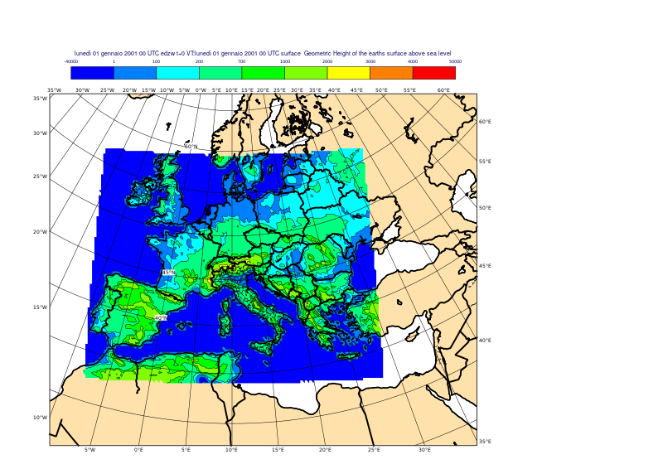
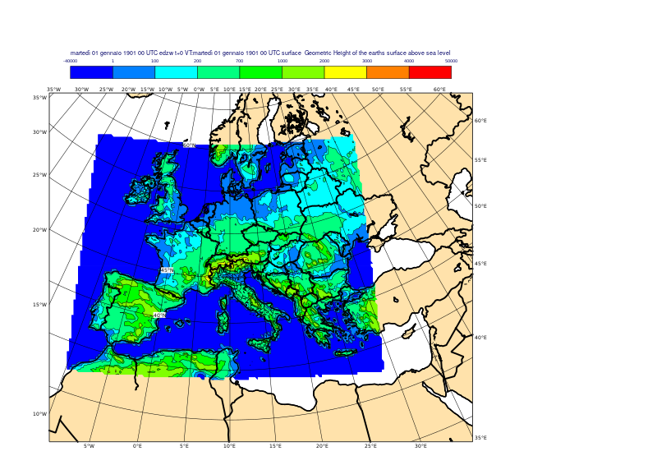
5-km upgrade (1)
In agreement with the Consortium strategies, we are assessing the sensitivity of COSMO-LEPS forecast skill to the use of different parameterisations of moist convection and to enhanced horizontal resolution.
From 24/11 to 31/12/2017 and from 1/5 to 31/5/2018, in addition to oper7 (COSMO-LEPS @ 7 km), we also ran a test configuration (only at 00UTC), denoted with test5.
oper7
test5

Slide 11
5-km upgrade (2)
 | oper7 | test5
model version | 5.03 | 5.05
convection scheme | Tiedtke | members 1-10 IFS-Bechtold members 11-20 Tiedtke
Perturbations to physical parameterisation | “random” | none
horizontal resolution | 7 km | 5 km
grid points | 511 x 415 x 40 = 8.482.600 | 739 x 599 x 40 = 17.706.440
time step (s) | 66 | 45
Billing Units for one single run (forecast length: 132h) | 1750 | 5378
elapsed time (s) | 542 (720 tasks) | 1235 (972 tasks)

Slide 12
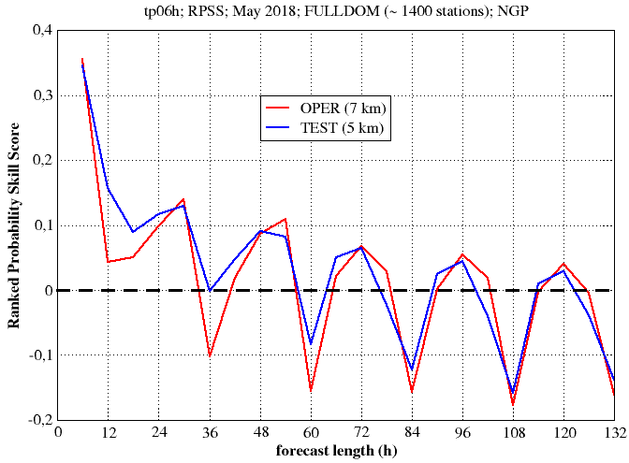
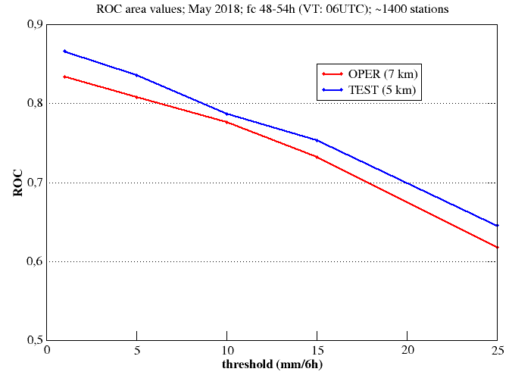
May 2018 experimentation: oper7 vs test5
Variable: 6h cumulated precipitation (thresholds: 1, 5, 10, 15, 25, 50 mm).
Scores: Ranked Probability Skill Score (RPSS), ROC area at fixed forecast range.
RPSS: tp06h
ROC: tp06h
RPSS: clear daily cycle in the performance of the model; higher skill of test5 in the short range for day-time precipitation; mixed results later on.
ROC area: slight positive impact of enhanced resolution for all thresholds.

Slide 13
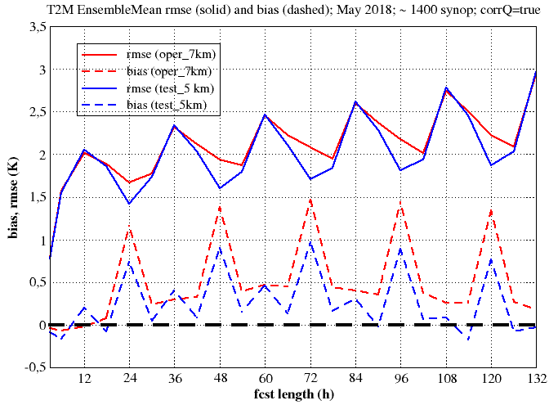
May 2018 experimentation: oper7 vs test5
Variables: 2-metre temperature
Scores: bias, and rmse of the ensemble mean (model forecast correct with station height difference)
t2m
Temperature: still positive bias at all forecast ranges (the model is too warm), but bias reduction, especially at night-time, in test5. Correspondingly, reduction of rmse.

Slide 14
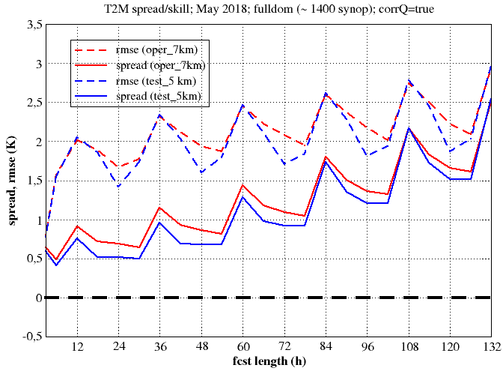
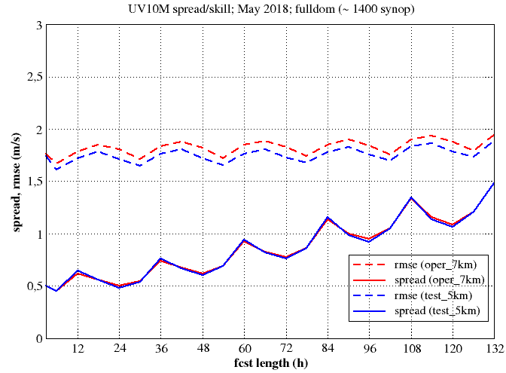
May 2018 experimentation: oper7 vs test5
Variables: 2-metre temperature and 10-metre wind speed
Scores: rmse of the ensemble mean, spread.
t2m
wspeed10m
T2M: some reduction of rmse at night-time for test5; larger spread for oper7 (effect of perturbed parameters, missing in test5?)
WSPEED10M: no impact on spread by enhanced resolution; slight systematic reduction of rmse of the ensemble mean.

Slide 15
Thanks for your attention!!!

Slide 16
Outline
Present status,
COSMO-LEPS products on the public web (what was done, what is missing, what could be done),
performance of the system,
tests @5 km,
towards multi-physics (CIAO PT),
development of COSMO-LEPS based visualization products.

Slide 17
SubTask4: COSMO-B and COSMO-T in ensemble mode
Implement cleps_20bt: (also referred to as TEST5 in the previous slides) where
  members 1-10 are run with Bechtold scheme (cleps_10b);
  members 11-20 are run with Tiedtke scheme (cleps_10t),
  cleps_20bt has the same initial and boundary conditions as operational COSMO-LEPS.
Compare cleps_20bt vs cleps_10b and cleps_10t in terms of surface variables (e.g. TP, T2M, TD2M).
Deliverables: Assessment of the skill of cleps_20bt and COSMO-LEPS….
variable: 6h/12h/24h cumulated precipitation;
period : 1-31 May 2018;
region: full integration domain;
method: nearest grid point; no-weighted fcst;
obs: synop reports (~ 1400 stations/day);
fcst ranges: 0-6h, 6-12h, …, 126-132h;
thresholds: 1, 5, 10, 15, 25, 50 mm/12h;
systems: cleps_20bt vs cleps_10b and cleps_10t;
scores: probabilistic and deterministic evaluation

Slide 18
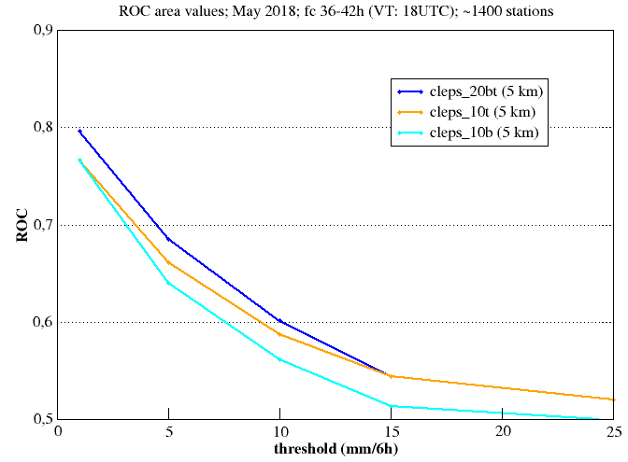
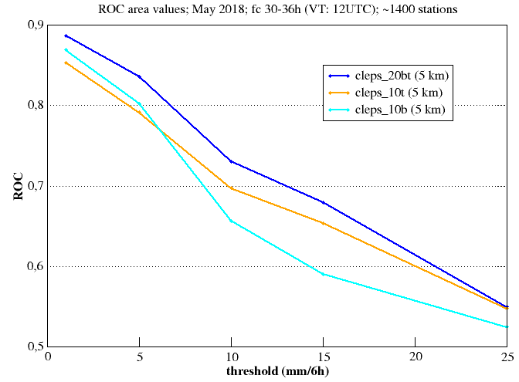
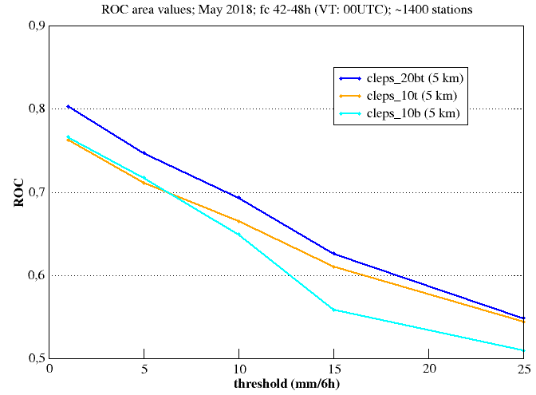
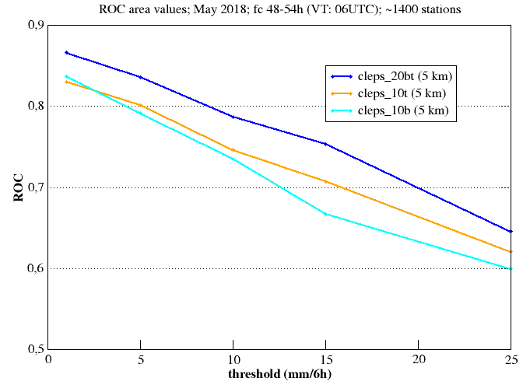
Sono qui
Very similar performance of cleps_10b and cleps_10t for low precipitation thresholds.
For light day-time precipitation, higher ROC area for cleps_10b
Otherwise, cleps_10t better
For high thresholds, few events and limited statistical solidity of the results

Slide 19
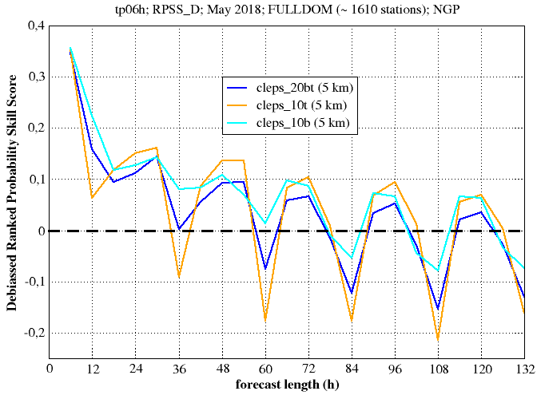
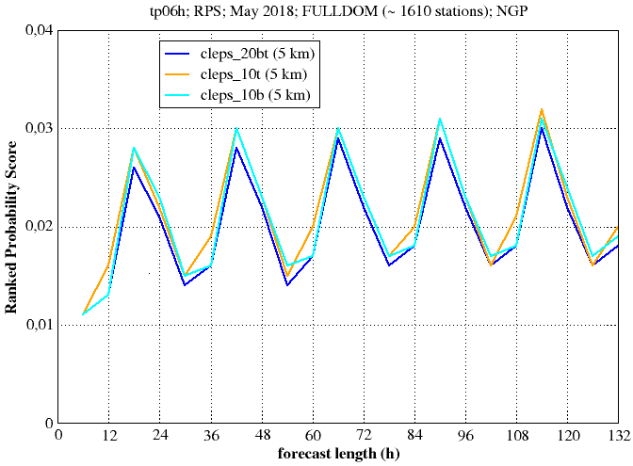
Bla bla
cleps_10b better than cleps_10t except for night time verification (18-24 and 42-48 fcst ranges)
For longer ranges, low skill for day-time verification by both systems.

Slide 20
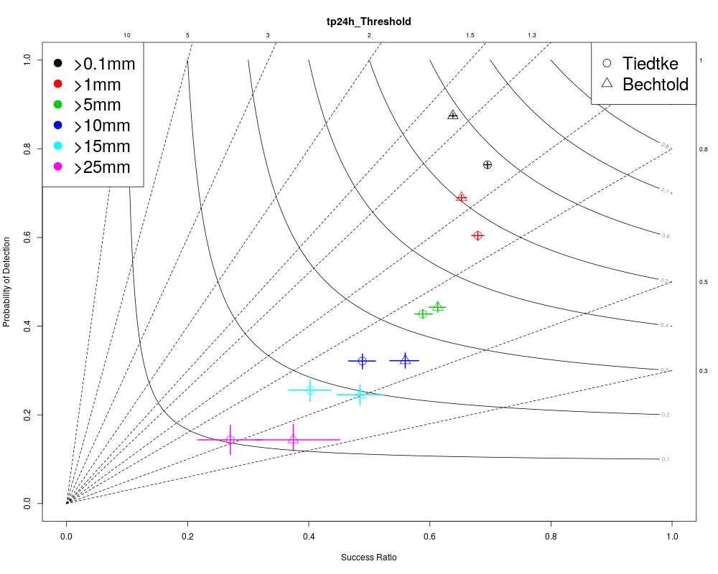
1-member Tiedtke vs 1-member Bechtold (day 1)
0-24h
COSMO-B (Δ):
overestimation of light precipitation events (drizzle problem),
higher skill for heavier precipitation cases.

Slide 21
201805:
Maps with spread/skill in 10m wind, t2m for cleps5 vs cleps7 FATTE
Maps with cleps5_20bt, cleps5_10b, cleps5_10t for tp06h FATTE
Maps for tp06h, tp12h and tp24h for deterministic Bechtold_vs_Tiedtke

Slide 22
Outline
Operational ensemble system COSMO-LEPS:
  main features (what is old, what is new),
  performance of the system,
  future upgrades (towards 5 km, towards multi-physics).
Development of COSMO-LEPS based visualization products:
  products on COSMO website,
  probabilistic wind roses,
  “chessboard” maps for Emilia-Romagna region,
  implementation of Italian “chessboard” for National Civil Protection.
Conclusions and plans

Slide 23
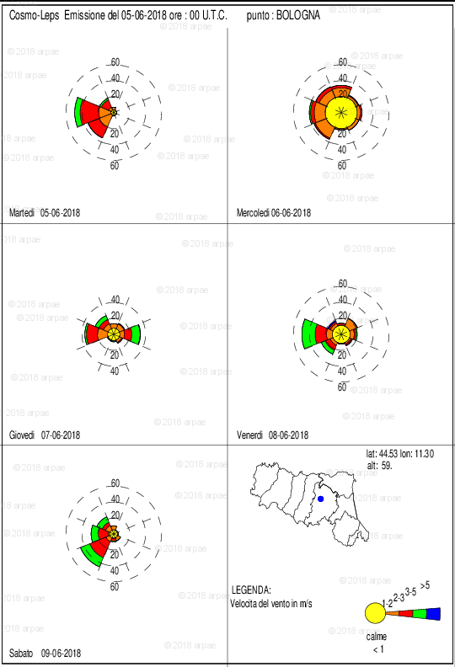
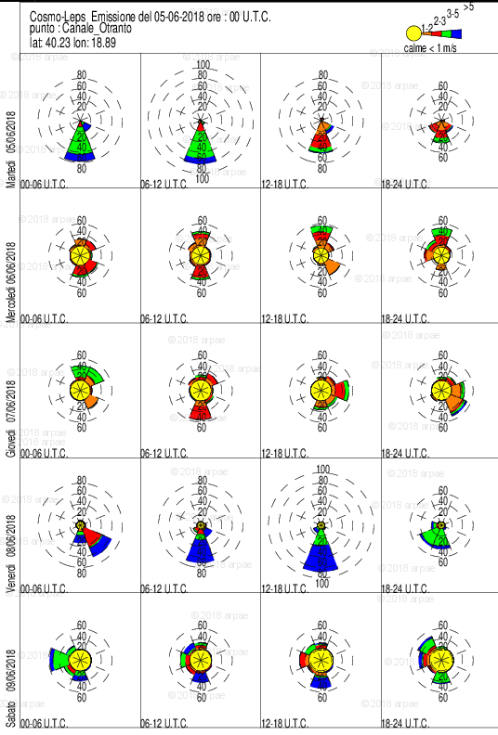
Probabilistic wind roses over fixed locations

Slide 24
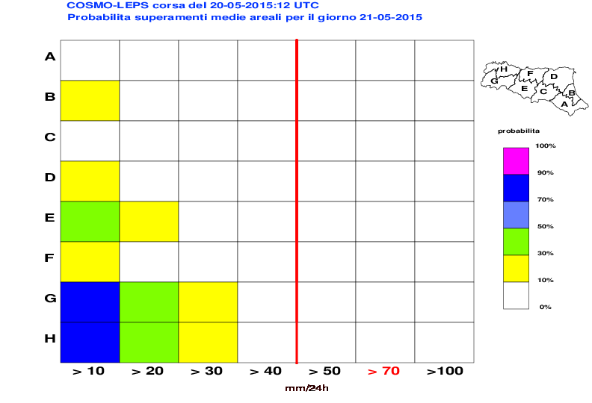
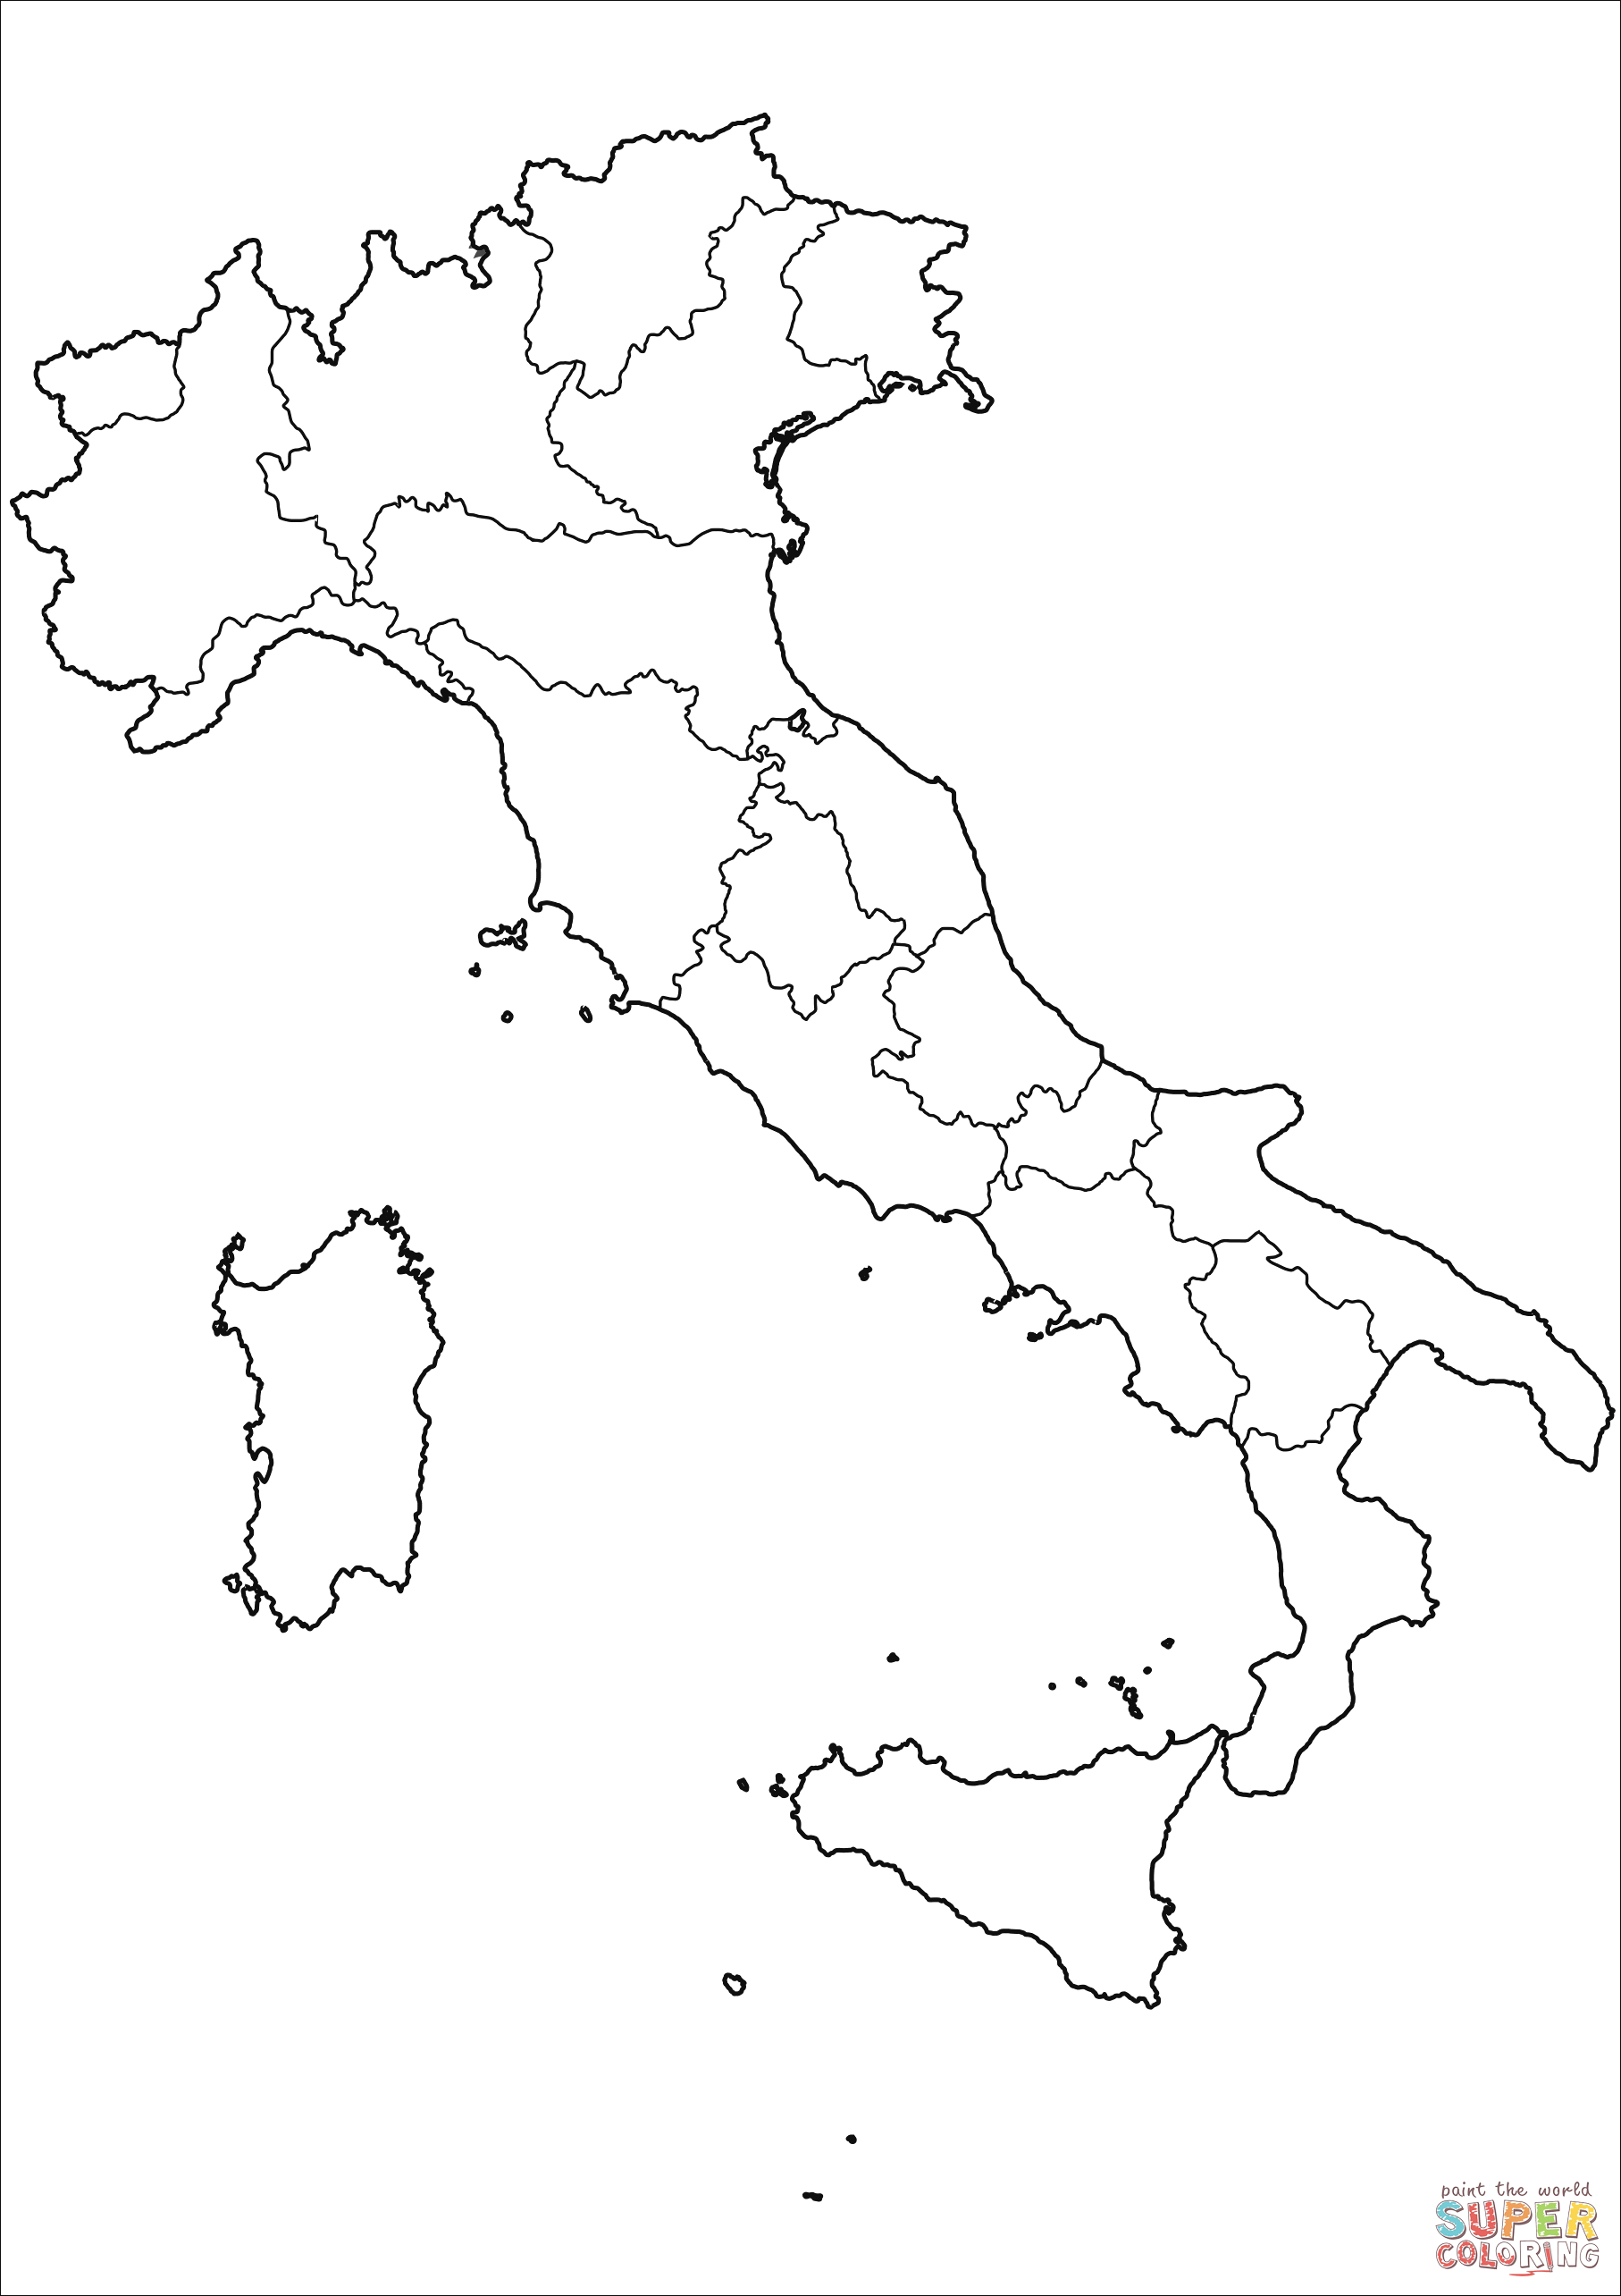
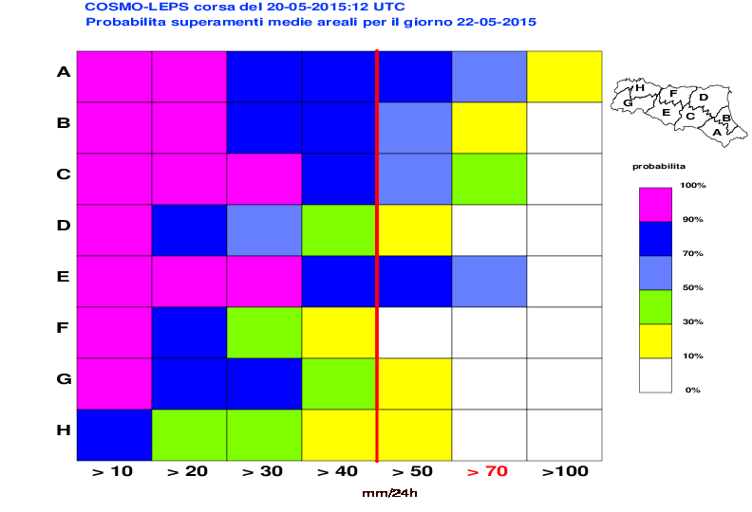
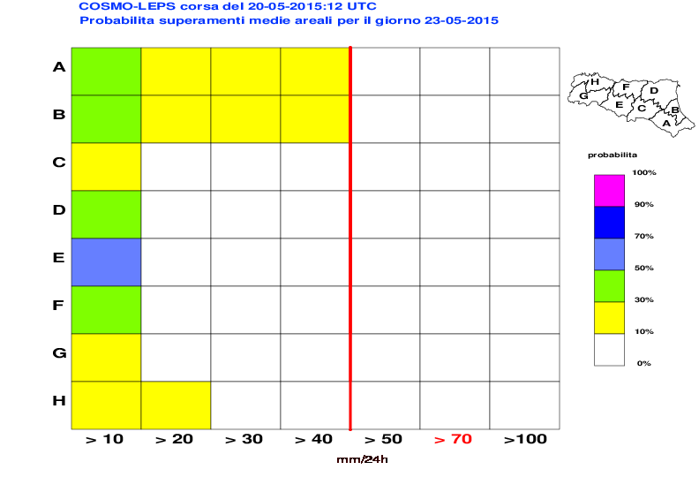
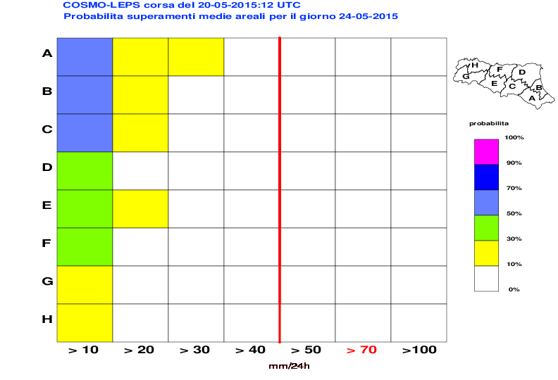
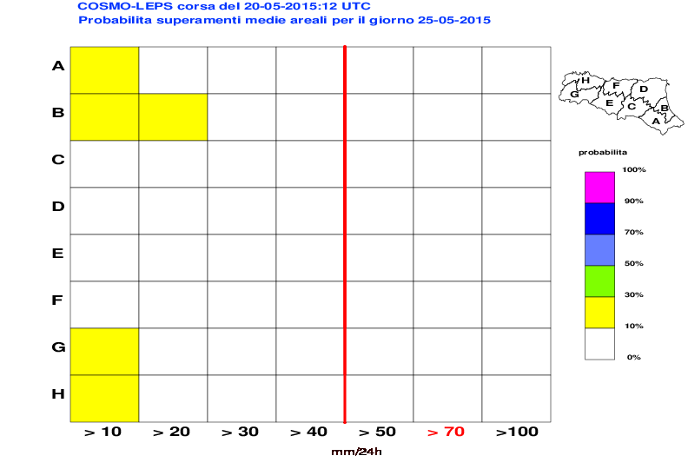
“Chessboard” over alert areas
Divide Emilia-Romagna into 8 “homogeneous” alert areas (average size ~3000 km², 60 grid points per area).
For each COSMO-LEPS member, consider the corresponding areal means of 24-hour precipitation.
Compute exceedance probabilities for pre-defined thresholds; colours “quantify” probabilities.
http://www.smr.arpa.emr.it/infomet2/

Slide 25
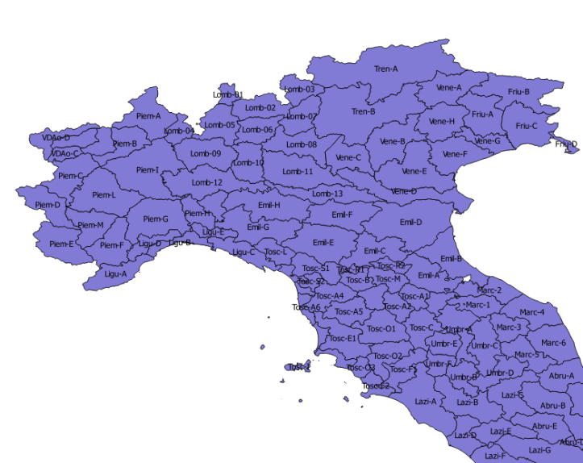
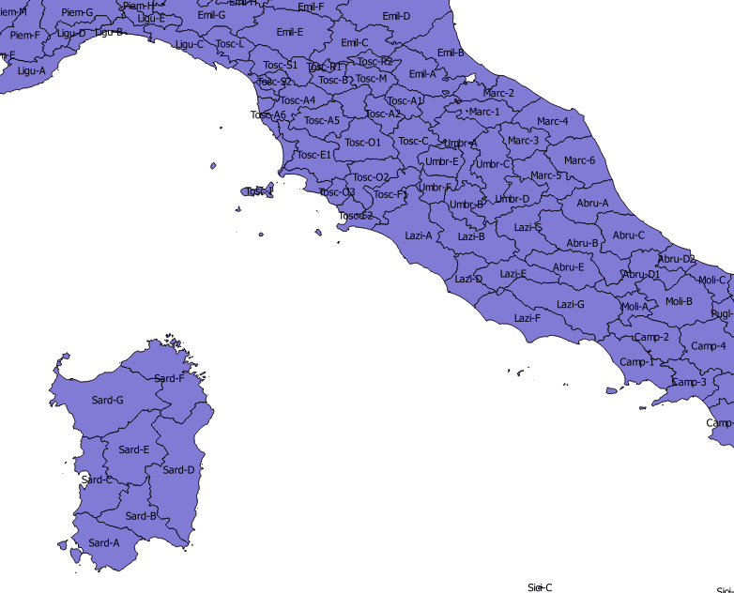
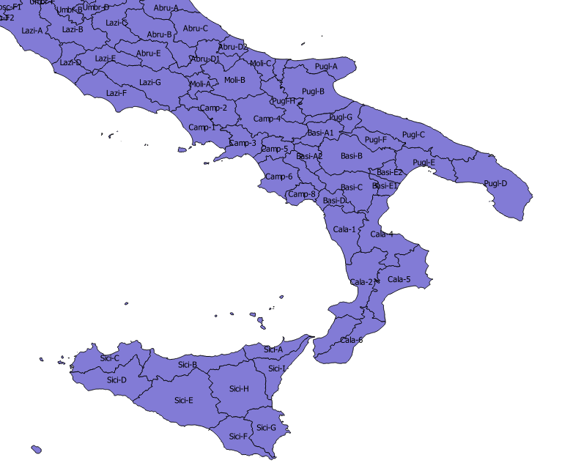
Towards an Italian chessboard:
In Italy: 20 regions......
but 156 alert areas, selected with different criteria by the different regions.
The smallest alert area: 193 km² (in Tuscany)
The largest alert area: 5670 km² (in Sicily)
http://www.smr.arpa.emr.it/infomet2/
https://simc.arpae.it/scacchieraitalia/

Slide 26
Conclusions
COSMO-LEPS: well established product complementing ECMWF-ENS where high-spatial detail is required.
Improved forecast skill of COSMO-LEPS throughout the years.
Promising results by the increase of horizontal resolution (7 → 5 km) and the use of different parameterisations of moist convection (“multi-physics” approach).
Probabilistic products are (at last!) considered and can support Civil Protection decisions.
Italian chessboard: “optimal” solution would be to blend COSMO-LEPS and ENS products, but this is probably not appropriate with the present choice of alert areas.
Keep on working with regional Civil Protection Agencies “to think ensemble” with them and develop customised products.

Slide 27
Thanks for your attention!!!

Slide 28
Extra slides

Slide 29
About COSMO-LEPS
What is it?
It is the Limited-area Ensemble Prediction System (LEPS), based on COSMO-model and implemented within COSMO (COnsortium for Small-scale Modelling, including Germany, Greece, Israel, Italy, Poland, Romania, Russia, Switzerland) implemented and maintained by Arpae-SIMC.
Why?
COSMO-LEPS was developed to combine the advantages of global-model ensembles with the high-resolution details gained by the LAMs, so as to identify the possible occurrence of high-impact and localised weather events (heavy rainfall, strong winds, temperature anomalies, snowfall, …).
generation of COSMO-LEPS to improve the forecast of high-impact weather in the short and early-medium range (up to d+5).

Slide 30
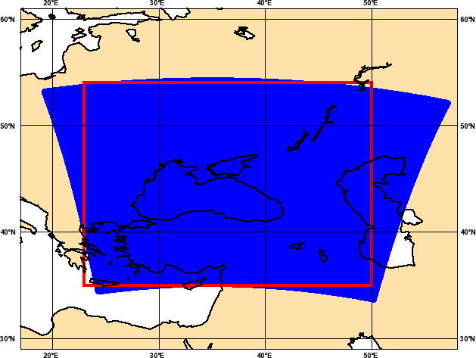
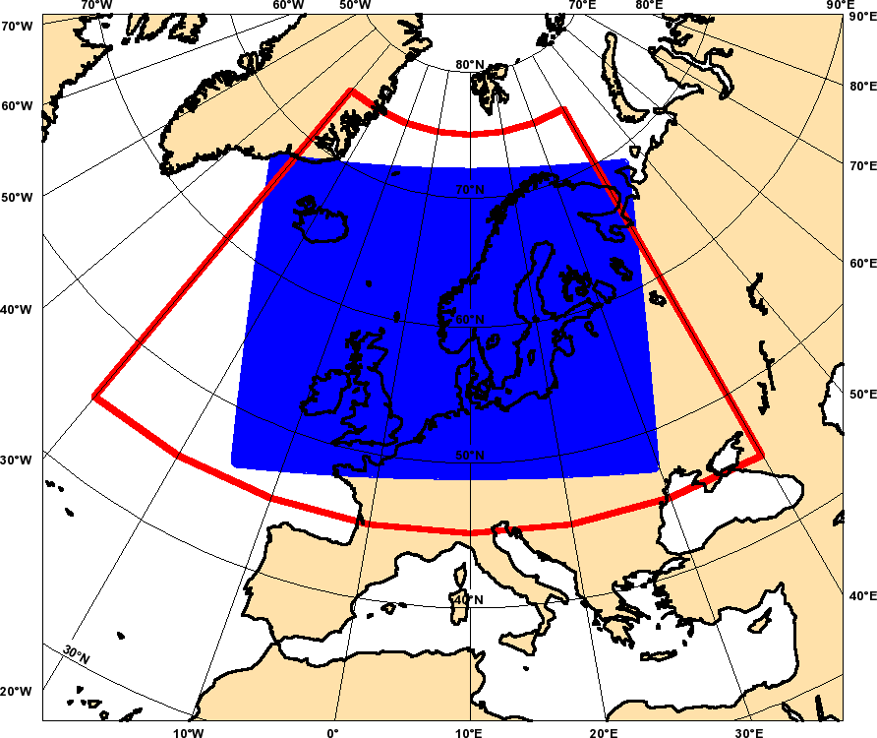
Operational set-up
20 perturbed COSMO-model runs (ICs and 3-hourly BCs from 20 selected ENS members) to generate, “via weights”, probabilistic output; start at 00 and 12UTC; Δt = 132h.
1 deterministic run (ICs and 3-hourly BCs from ECMWF HRES) to “join” deterministic and probabilistic approaches; start at 00 and 12 UTC; Δt = 132h.
Relocation
COSMO-LEPS was “cloned” e relocated over different regions in the framework of European Projects (FP6 Preview – WP Windstorms) and WMO Projects (FROST-2014 for the Winter Olympics in Sochi, Russia).

Slide 31
Dissemination
COSMO-LEPS products are operationally disseminated towards:
COSMO countries,
non-COSMO hydro-meteorological weather services,
ECMWF (TIGGE-LAM, EFAS),
private sector,
…..

Slide 32
Towards COSMO-LEPS @ 5 km?
In agreement with the Consortium strategies, we are undertaking an experimental phase to assess the forecast skill of COSMO-LEPS with enhanced horizontal resolution at 5 km.
From 24/11 to 31/12/2017 and from 1/5 to 31/5/2018, in addition to oper7 (COSMO-LEPS @ 7 km), an experimental suite, denoted with test5 (the same integration domain as oper7, but at 5 km) was implemented.
oper7
test5
511x 415 grid points 739x599 grid points

Slide 33
COSMO-LEPS suite @ ECMWF: configuration “5 km” (“multi-physics” approach: use of different parameterizations to represent “moist convection”)
20 Representative Members (RMs) drive the 20 COSMO integrations (each of them weighted according to the cluster populations)
+
using IFS-Bechtold (1-10) or Tiedtke (11-20) convection scheme
+
NO perturbations in turbulence scheme and in physical parameterisations
+
soil initial conditions from
ICON-EU model (DWD)
4 variables
Z U V Q
3 levels
500 700 850 hPa
d-1
d
d+1
d+2
d+3
d+4
d+5
Cluster Analysis and RM identification
Cluster analysis and RM identification
older EPS
00
younger EPS
2 time steps
12
EuropeanArea
Complete Linkage
clustering interval
COSMO-LEPS integration
domain
The suite runs as a “time-critical application” managed by Arpae-SIMC;
The computer time (57 million BUs for 2018) provided by the COSMO partners which are ECMWF member states.
Δx ~ 5 km; 40 ML; 1 run per day (00UTC); fcst range: 132h; single precision.
COSMO-LEPS
clustering area

Slide 34
COSMO-LEPS @ 5 km: some preliminary figures
nodes = 24
totalTasks = 864 (geometry: 27x32)
test for 1 COSMO-LEPS run
Configuration | Grid points | Delta t (s) | BU (1 run, fc+132h, 40 ML) | ElapsedTime (min) | Impact on ECMWF National allocations (CH+DE+GR+IT)
oper | 511x415x40 = 8.482.600 | 66 | 2044 | 9 | 2.4%
cleps5 | 739x599x40 = 17.706.440 (oper x 2.1) | 45 | 8632 | 29 | 10%
cleps5_XL | 919x719x40 = 26.430.440 (oper x 3.1) | 45 | 11772 | 50 | 14%
Try to optimise the configuration - more aggressive approach → use more nodes!

Slide 35
In Italia, 20 regioni
156 alert regions
The smallest: 193 km2 (Tuscany)
The largest 5670 km2 (Sicily)
http://www.smr.arpa.emr.it/infomet2/
https://simc.arpae.it/scacchieraitalia/

Slide 36
consider the 20 areal means of 24-hour total precipitation for COSMO-LEPS members within each alert area (consider the grid points falling in the alert area)
construct probabilities from the 20 areal means

Slide 37
cosmo-leps-MultiPhysics vs cosmo-leps-Operational
Verifition performed over Northern Italy (~1000 stations; NGP)
Variable: 6-hourly cumulated precipitation;
Period: April-May 2017 (~60 days)
Score: Ranked Probability Skill Score (a good forecast system has RPSS > 0; the higher, the better …
Matteo Vasconi (Univ. Bologna)
cosmo-leps-MultiPhysics provides better skill than cosmo-leps-Operational, more clearly for forecast ranges after day 2.

Slide 38
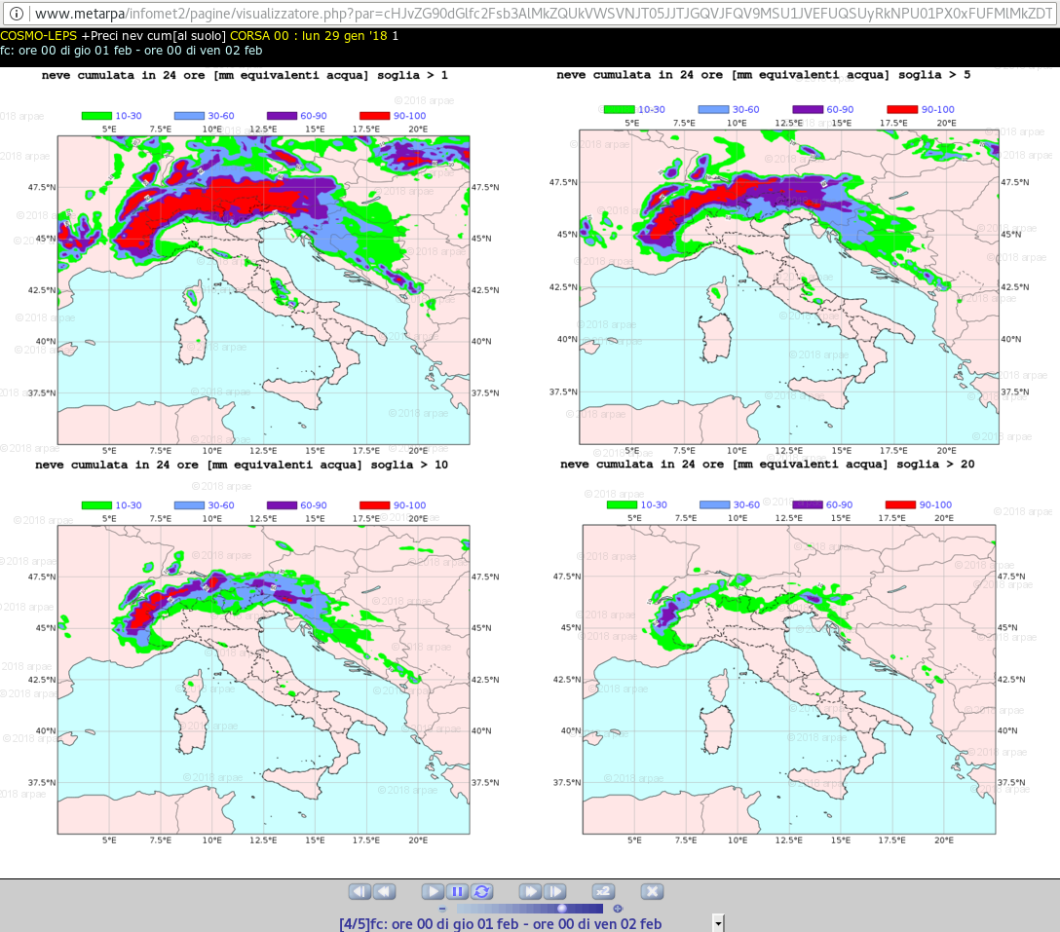
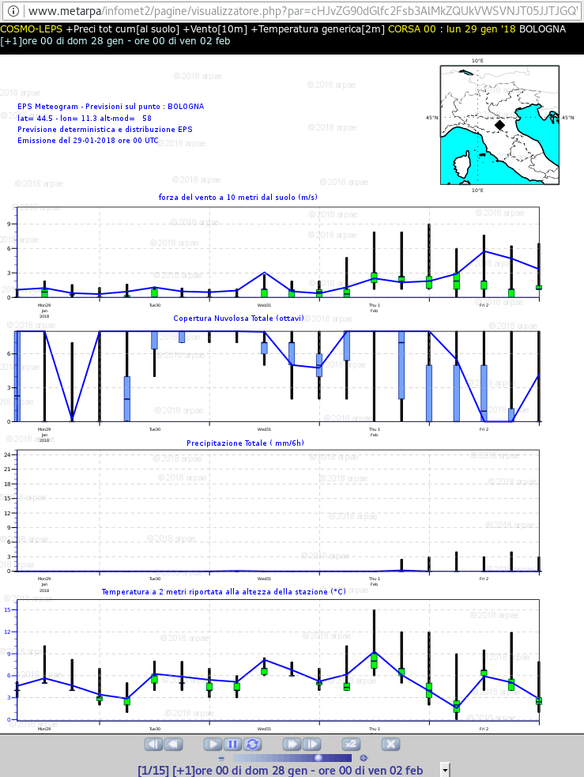
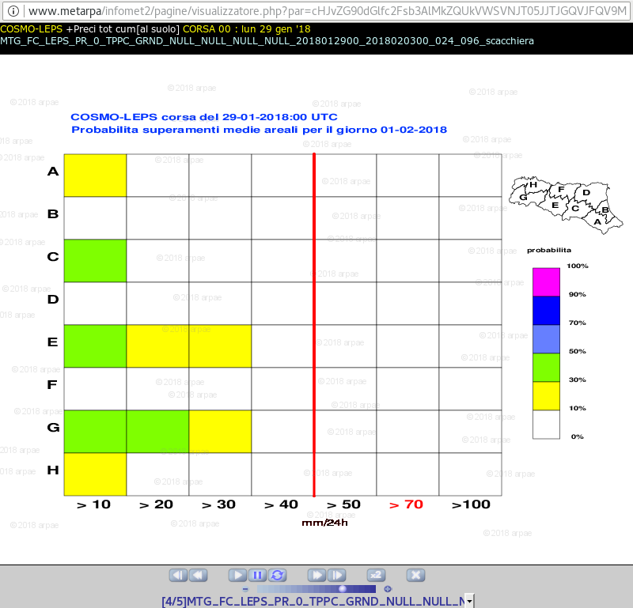
Products (different spatio-temporal details are covered)

Slide 39
COSMO-LEPS methodology
Dim 2
Possible evolution scenarios
ensemble size reduction
Cluster members chosen as representative members (RMs)
Initial conditions
Dim 1
LAM scenario
Dim 2
LAM scenario
LAM integrations driven by
RMs
LAM scenario
Initial conditions
Dim 1

Slide 40
Sviluppi futuri
COSMO-LEPS verso la multi-fisica
COSMO-LEPS verso i 5 km

Slide 41
Sviluppi futuri
COSMO-LEPS verso la multi-fisica
COSMO-LEPS su web pubblico
COSMO-LEPS verso i 5 km
Tigge-lam???
-cosmo-leps vs ecmwf?
Applicazioni x sochi?

Slide 42
State-of-the-art
COSMO-LEPS: 20 members, single precision, 7 km, 40 ML, fc+132h, twice a day.
The production of the 00UTC-based COSMO-LEPS starts at 8.10UTC and dissemination begins at about 8.45UTC (+12 hours for 12UTC products).
Products (grib files and/or png images) are operationally disseminated to the COSMO countries which made requests, plus to JRC for EFAS-related issues.
In other consortia, there is on-going activity on the upgrade of convection-parameterised ensemble systems (e.g. LAEF, 11 → 5 km).
Upgrade COSMO-LEPS (7 → 5 km) to stay abreast of the other systems?
Is it worth it?

Slide 43
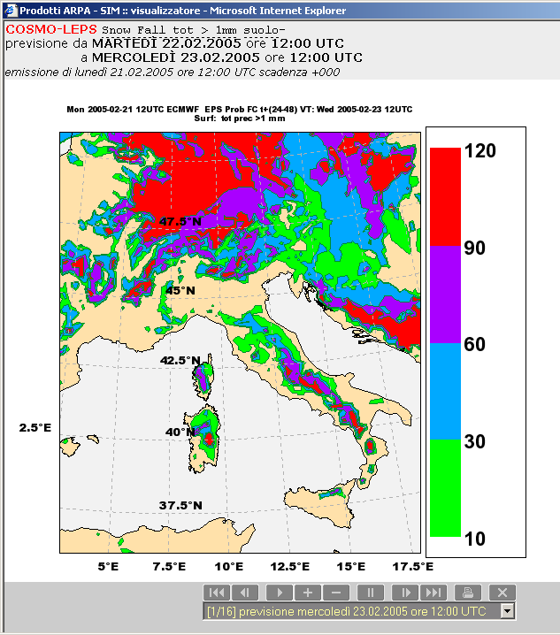
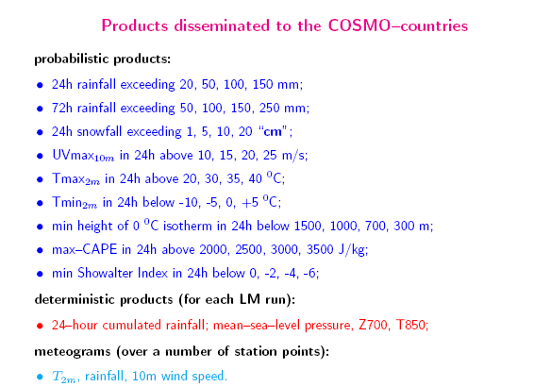
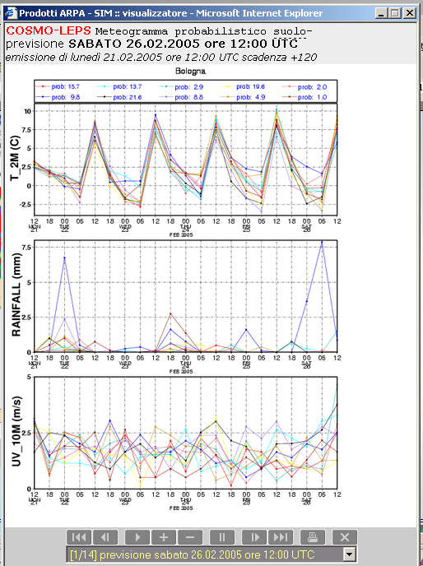
COSMO-LEPS
Real time products

Slide 44
Changes during the last COSMO year
5 October 2016: fieldextra upgrade.
  Migration to fieldextra 12.3.1 (and I’m still there….).
1 December 2016: suite upgrade.
  The ensemble size is increased from 16 to 20 members.
  COSMO integrations are performed in single-precision mode.
  The suite is about 30% cheaper than last year.
10 May 2017: dissemination to DWD.
  Test dissemination of COSMO-LEPS fields in GRIB2 format.
20 July 2017: implementation of visibility products.
  COSMO-LEPS provides forecasts of visibility using 3 different methods (modifications to fieldextra dictionary were needed).
  Clustering code migrated from GRIB_API to ecCodes.

Slide 45
Resolution upgrade: some numbers
As for 2017, COSMO-LEPS costs 59.000.000 (59 million) BUs, including both operations and some tests with the IFS-Bechtold convection scheme.
the computing availability for CH+DE+GR+IT amounts to 2.257.243.000 (2.2 billion) BUs.
COSMO-LEPS @ 7 km (cleps7) weights on the national allocations for about 2.6%.
7 km: one grid-box covers ~ 49 km².
5 km: one grid-box covers ~ 25 km².
Keeping the same integration domain, the reduction of grid spacing (Δx, 7 → 5 km; TSTEP, 66 → 48 sec) implies an increase of computing costs by approximately a factor of 3.
The impact of COSMO-LEPS @ 5 km (cleps5) on the national allocations would remain anyway limited (below 8%).
Proposed road-map:
perform 2-3 weeks of experimentation with “cleps5” to assess potential benefit and added value with respect to cleps7.

Slide 46
cleps @ 5 km: costs
nodes = 24; totalTasks = 864 (36 tasksPerNode; geometry: 27x32)
oper (delta t = 66s)
5 km(larger) 5 km(smaller) 7 km
919x719x40 739x599x40 511x415x40
26.430.440 17.706.440 8.482.600
---------------------------------------------------------------------
int2lm
1 node - total_tasks=36 (6x6)
115 BU 86 BU 45 BU
714 sec 534 sec 276 sec
~12m ~9m ~4.5m
---------------------------------------------------------------------
cosmo
24 nodes - totalTasks=864 (27x32)
delta_t=45s delta_t=45s delta_t=66s
11772 BU 8632 BU 2044 BU
3041 sec 1728 sec 528 sec
~50m ~29m ~8.8m
5 km(larger) 5 km(smaller) 7 km
919x719x40 739x599x40 511x415x40
26.430.440 17.706.440 8.482.600
---------------------------------------------------------------------
int2lm
1 node - total_tasks=36 (6x6)
115 BU 86 BU 45 BU
714 sec 534 sec 276 sec
~12m ~9m ~4.5m
---------------------------------------------------------------------
cosmo
24 nodes - totalTasks=864 (27x32)
delta_t=45s delta_t=45s delta_t=66s
11772 BU 8632 BU 2044 BU
3041 sec 1728 sec 528 sec
~50m ~29m ~8.8m

Slide 47
COSMO-LEPS @ 5 km: some figures
nodes = 24;
totalTasks = 864 (geometry: 27x32)
tasks PerNode = 36
test for 1 COSMO-LEPS run (fc +132h, 40 ML)
Config grid-points delta t BU Elapsed
(s) (min)
oper 511x415x40 = 8.482.600 66 2044 9
cleps5 739x599x40 = 17.706.440 (oper x 2.1) 45 8632 29 cleps5_XL 919x719x40 = 26.430.440 (oper x 3.1) 45 11772 50
Try to optimise the configuration - more aggressive approach → use more modes!

Slide 48
Mappe delle aree di allertamento

Slide 49


Slide 52
Per predisporre la scacchiera probabilistica si calcola dapprima la pioggia media prevista in 24 ore su ognuna delle singole macroaree in cui è suddiviso il territorio nazionale, utilizzando i 20 membri dell'esperimento COSMO-LEPS e verificando con quale frequenza sono superate delle soglie prefissate di pioggia cumulata.
La frequenza è calcolata normalizzando a 100 la popolazione dei 20 membri dell'ensemble, tramite l'utilizzo del peso statistico di ogni singolo mebro, variabile per ogni singola singola corsa, poiché essi non sono equiprobabili.

Slide 53
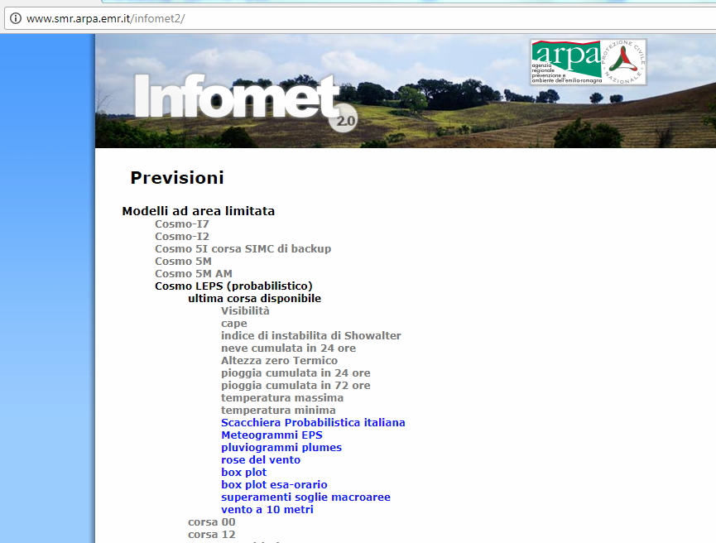
Il prodotto è disponibile sul portale Infomet 2.0

Slide 54
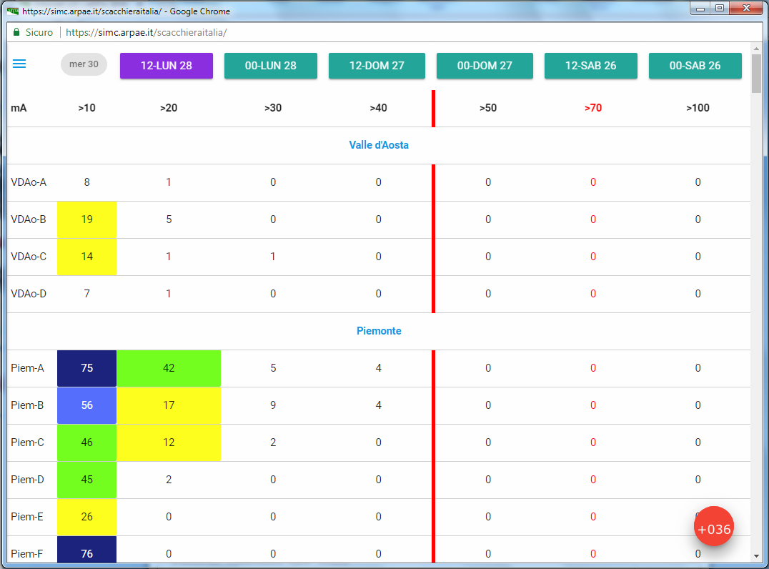
Sono disponibili le ultime 6 corse del
Modello, alle 0 e alle 12
UTC

Slide 55
Cliccando sul simbolo della lista si apre
una tendina a scorrimento che consente di
scorrere la pagina fino alla regione
desiderata, altrimenti si può
scorrere la pagina con la
slide-bar

Slide 56
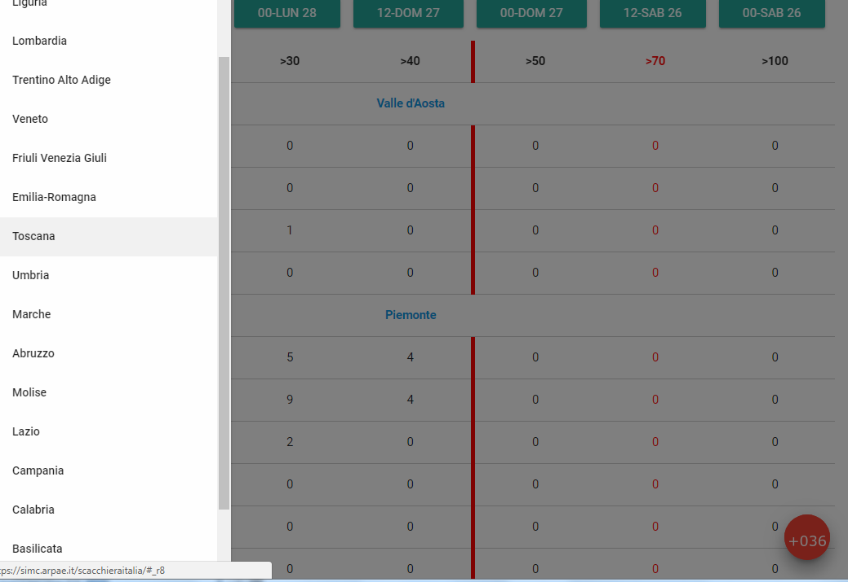
Cliccando con il tasto di
sinistra
del mouse e rilasciandolo
sulla regione desiderata
la pagina si posiziona
correttamente

Slide 57
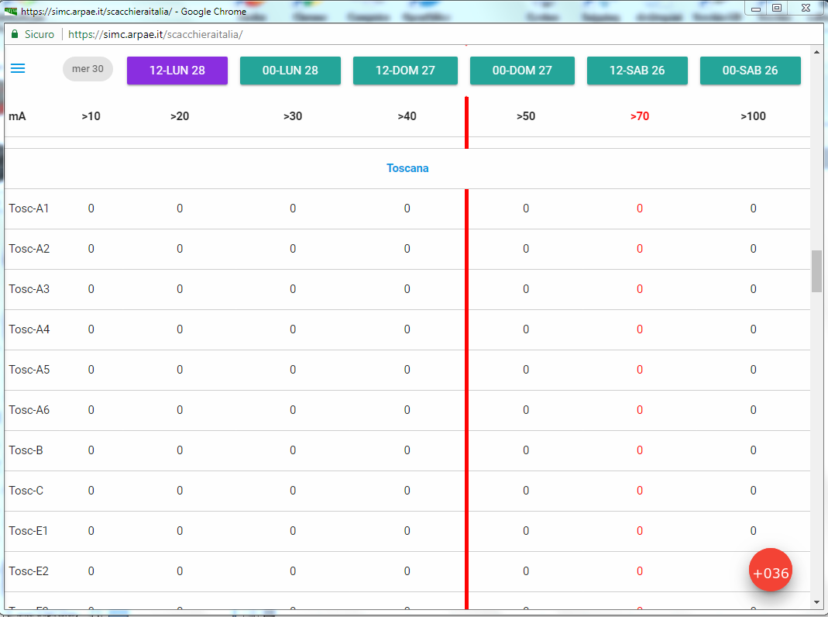
Il codice identificativo di ogni
macroarea è quello utilizzato
dal DPCN
In basso a destra è indicata la
scadenza estrema di
validazione della corsa, per la
corsa delle 12 la prima
scadenza è una +36 ore
Perché l'intervallo di
cumulazione è dalle 0 alle 24

Slide 58
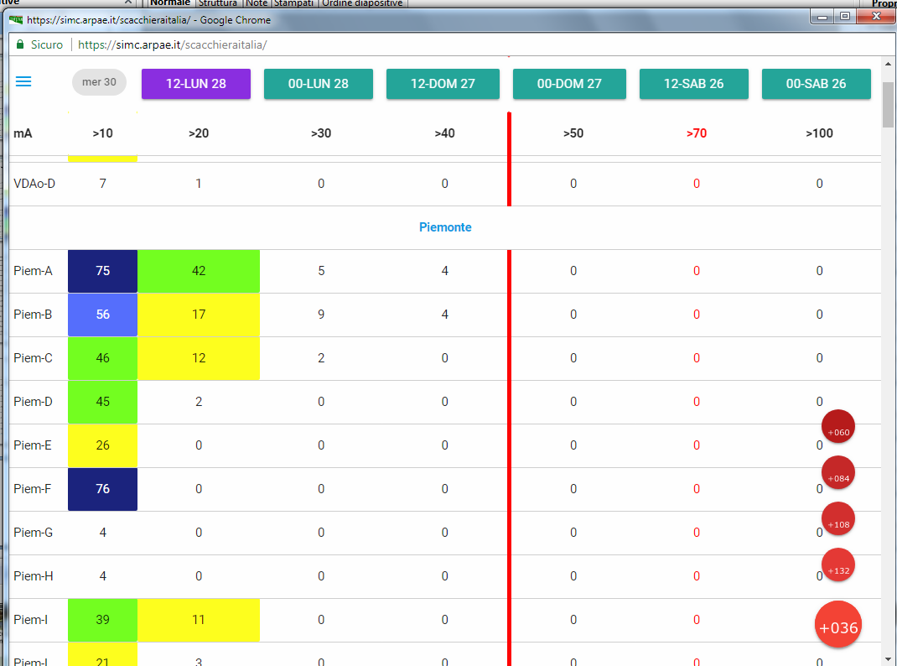
Portando il cursore del mouse
sul circoletto della scadenza
compaiono anche i circoletti
delle scadenze successive che
si selezionano portando
il cursore sulla scadenza desiderata
e confermando con un click
sul tasto di sinistra
del mouse

Slide 59
In questo caso il 42% dei membri
dell'ensemble superano la soglia
di 20 mm di pioggia media
cumulata in 24 ore sulla
macroarea Piem-A

Slide 60
Outline
Present status,
COSMO-LEPS products on the public web (what was done, what is missing, what could be done),
performance of the system,
tests @5 km,
towards multi-physics (CIAO PT),
development of COSMO-LEPS based visualization products.

