Slide 1
SCA Report for the COSMO-Model
Ulrich Schättler
Source Code Administrator

Slide 2
Contents
Versions implemented since September 2017
NWP Test Suite
POMPA Contributions
Documentations
GRIB 2
Plans for the next versions

Slide 3
Versions Implemented since September 2017

Slide 4
Version | Date | Contents (Highlights) | Results Changes
5.04f | 01.09.17 | additional modifications to COSMO-ICON physics (new namelists, bug fixes, GPU version of TERRA) Possibility to reproduce behaviour of old turbulence scheme (not TERRA!) changes in data assimilation new diagnostic output to highlight convective cell tracks (for ESSL testbed) changes in handling statistically processed fields (min, max, avg, sums) possibility to use RTTOV12 | yes yes eventually no no SynSat
Please read more about the changes in the Release Notes for the different versions.

Slide 5
Version | Date | Contents (Highlights) | Results Changes
5.04g | 13.11.17 | Reproducing behaviour of old physics Updated TERRA to latest ICON version GPU port for Tiedtke scheme Modified computation of HPBL Modifications to SPPT | yes yes no HPBL lsppt=.T.

Slide 6
Version | Date | Contents (Highlights) | Results Changes
5.04h | 15.12.17 | Data assimilation: processing of AMV Dynamics: halo treatment of tt_lheat Physics: lshallowconv_only for Tiedtke-Bechtold GPU port of Turbulence | if used yes no no

Slide 7
Version | Date | Contents (Highlights) | Results Changes
5.05 | 23.02.18 | Porting additional parts to GPU GCL communication library for GPU Optimization of global communication in latent heat nudging New option for targeted cold pool diffusion | no no no if used
02.08.18: Implemented a bug fix in turb_transfer.f90 in patch version 5.05_1

Slide 8
Results of NWP Test Suite: 5.03 vs 5.05
Following the analysis of the relative performance of the two model versions: 5.03 (operational version) and 5.05 (test version of a specific TURBDIFF configuration), the newer version of the model, on the whole, outperforms its predecessor, while in some cases performance is worsen. For parameters as precipitation and for all parameters on high atmospheric levels, no significant impact on performance was identified.
See detailed report of the NWP Test Suite Team
STC approved the new version in July
COSMO-Model 5.05_1 is the new Reference Version

Slide 9
Distribution of New INT2LM and COSMO
11.07.: Information on new version to the consortium
08.08.: Information on the patch version 5.05_1 to the consortium
08.08.: Information on new versions (INT2LM, COSMO) to all other partners
September: provision of ICON test data sets for all partners, because of changes in data delivery:
provision of additional data necessary for ICON-LAM (including HHL)
crop upper 20 levels also for W
activate setting of UUID for horizontal and vertical grid. INT2LM should then check this (lcheck_uuidOfHGrid=.TRUE., needs INT2LM 2.05)
October: Implement changes in operational data delivery: All licences should have installed INT2LM 2.05 by then!

Slide 10
Latest Developments
Version | Date | Contents (Highlights) | Results Changes
5.05a | 22.06.18 | Dynamics: 2nd order Bott scheme together with deformational correction method Porting additional parts to GPU: diagnostics, output Changes to prepare implementation of Radar Forward Operator | if used no no
21.07.18: Implemented the bug fix in turb_transfer.f90 in patch version 5.05a_1
DWD only, not yet distributed to COSMO

Slide 11
POMPA

Slide 12
Latest POMPA Contributions
5.05_1: The whole physics (but seaice) are able to run on GPUs
5.05a_1: Diagnostics, output and lmorg have been ported
next version: will contain port of assimilation (including LHN) and CLM extensions (IF (lbdclim) …)
see POMPA update tomorrow afternoon!

Slide 13
Documentation

Slide 14
Update of Documentation
Part I: Dynamics and Numerics: Update by Michael Baldauf
Part IV: Implemenation Documentation: No actions; still have plans to write: Implementation Specific Details of the COSMO-Model
Part V: Preprocessing: Update by Uli Blahak / Daniel Rieger
Part VI: Postprocessing: No actions; still have plans to write: Model Output and Data Formats for I/O
Part VII: User Guide: Update by COSMO SCA

Slide 15
GRIB 2

Slide 16
Start Your Migration to GRIB 2 NOW
DWD uses GRIB 2 for about 4 years now
All necessary actions have been taken to enable all COSMO partners to also migrate to GRIB 2
For information on how to go on, see:
http://www.cosmo-model.org/content/model/documentation/grib/default.htm
Additional information and documentation can be found within these pages (ok, some of them are not finished yet, but will be soon)

Slide 17
Plans for the Next Versions

Slide 18
Versions 5.06 and Beyond
Version 5.06 (February 2019)
POMPA: Port of Assimilation and LHN (already in 2018) 5.05b
Radar forward operator (EMVORADO) (hopefully, in 2018) 5.05c
still needs some technical clean up and documentation
tests at DWD are ongoing
Higher order horizontal discretizations (by end of 2018) 5.05d
already available; WG 2 coordinator still has to check
Version 6.0 (December 2019 at latest)
Urban module : tests in PT AEVUS are ongoing (see updated PT plan)
Mire parameterization (optional)
Unification with CLM Version (work in progress)

Slide 19
Further (Technical) Issues
Removal of coarse radiation grid (perhaps 5.06, work in progress)
Optimization of copy-in / copy-out (perhaps 5.06)
Use of CLAW directives to optimize physical parameterizations for GPU
What about EULAG?

Slide 20
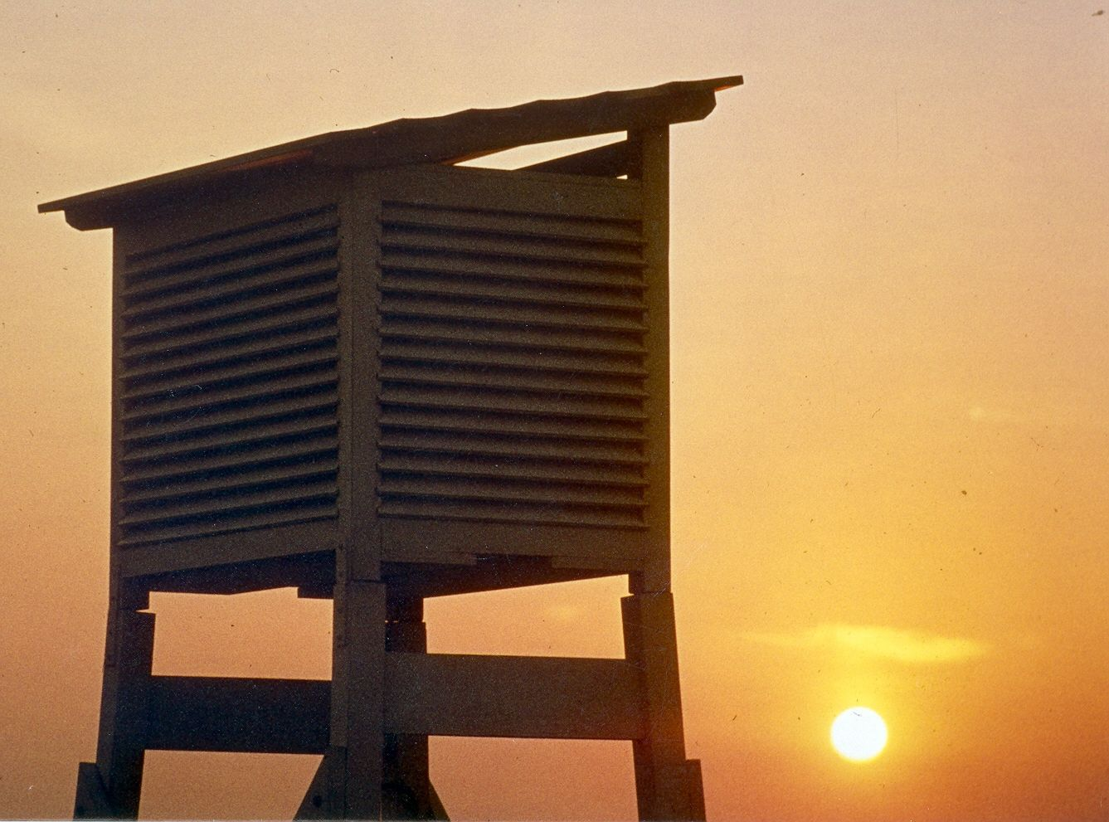
Thank you
very much
for your
attention

