Slide 1

COSMO Priority Project
C2I
Transition of COSMO to ICON-LAM
D. Rieger
…with contributions from many
COSMO and ICON colleagues
Daniel.Rieger@dwd.de

Slide 2
ICON-LAM – Goals
Unified modelling system for global and regional scale
Focus of national and international collaborations on this modelling system (e.g., COSMO, CLM, ART, universities)
Better efficiency in model development (content and software infrastructure)
Improvements in model physics (e.g., surface tiles)
Better forecast quality
Higher efficiency in terms of HPC resources

Slide 3
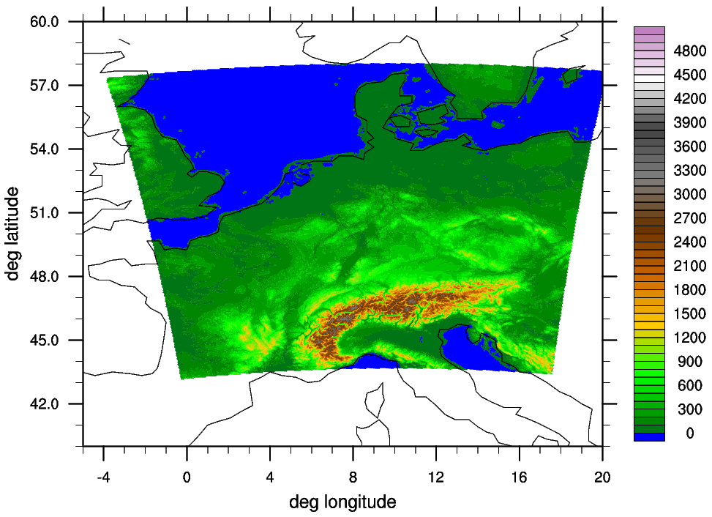
ICON-D2 – Setup
Grid: R19B7 (2.08 km), 65 layers with model top at 22 km
Grid covers an area similar to COSMO-D2

Slide 4
ICON-LAM: Time line at DWD
Optimization of model configuration and parameterizations
(permanent task)
Coupling of ICON-LAM with KENDA (Km-scale ENsemble-based Data Assimilation)
Goal: Consolidated version until end of 2018, afterwards further improvements
Further extension of the verification system
Parallel routine in summer 2019 (det. & ens.)
Operational in the second half of 2020

Slide 5
ICON-D2 Tests at DWD
Results for June 2018
COSMO-D2 forecasts (routine)
ICON-D2 started every 12h from interpolated analysis with BC from ICON-EU

Slide 6
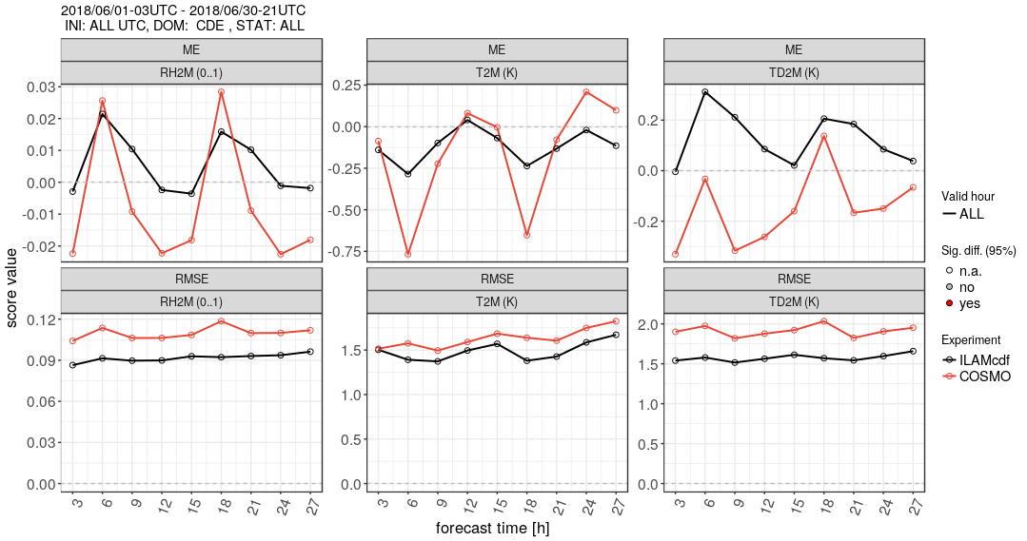
ICON-D2 Tests at DWD

Slide 7
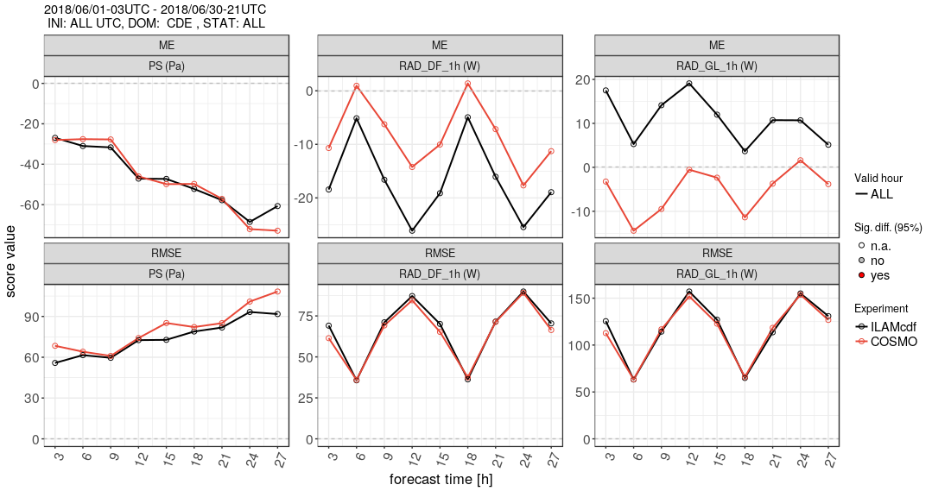
ICON-D2 Tests at DWD

Slide 8
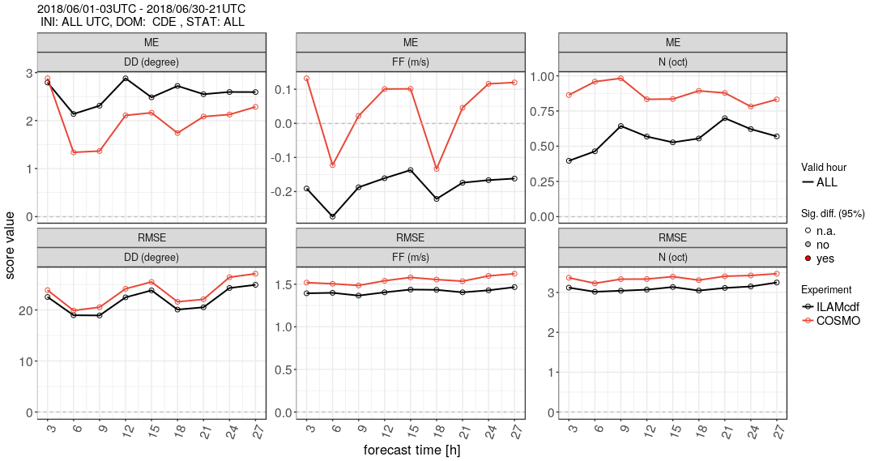
ICON-D2 Tests at DWD

Slide 9
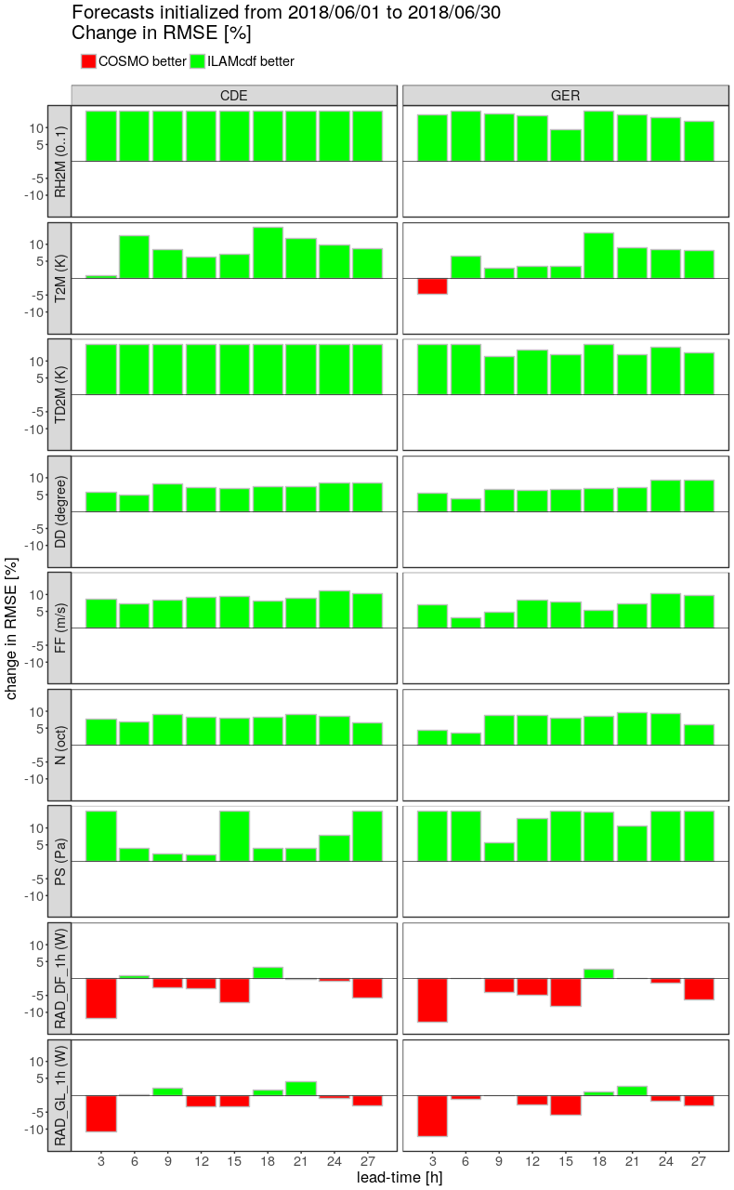
ICON-D2 Tests at DWD

Slide 10
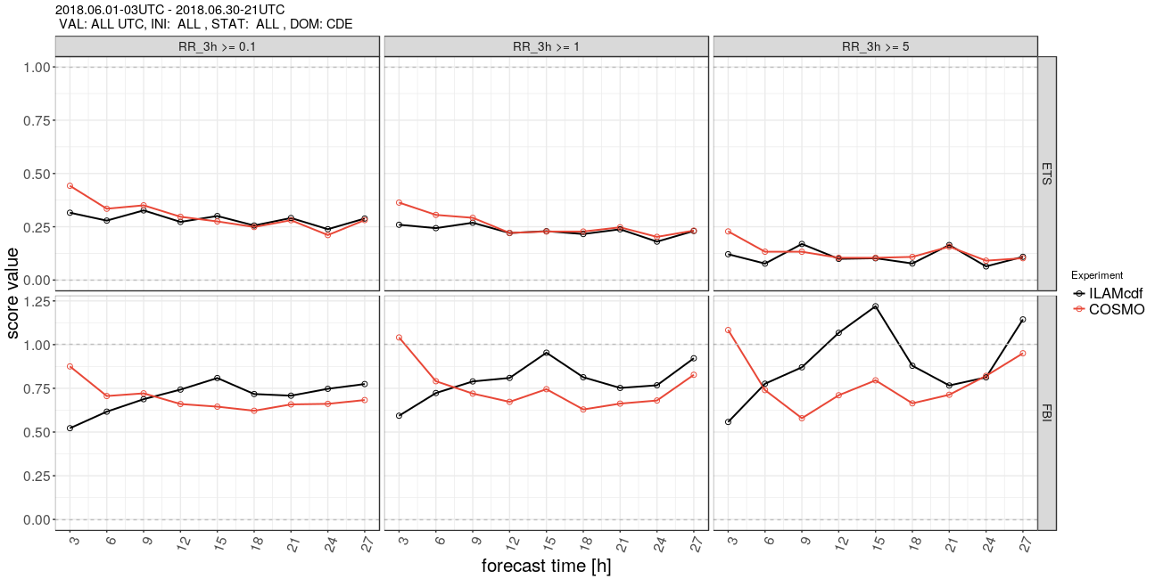
ICON-D2 Tests at DWD

Slide 11
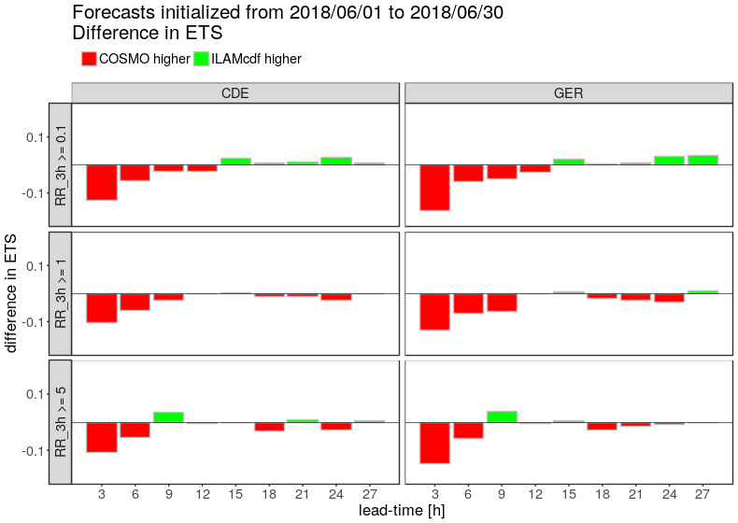
ICON-D2 Tests at DWD

Slide 12
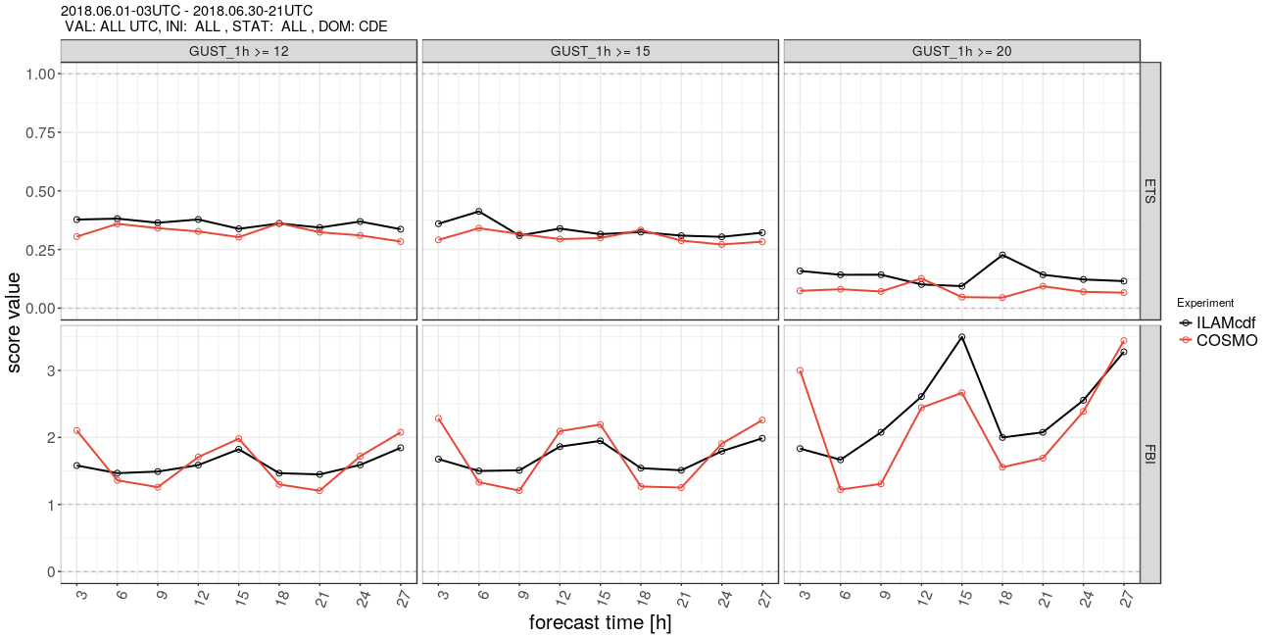
ICON-D2 Tests at DWD

Slide 13
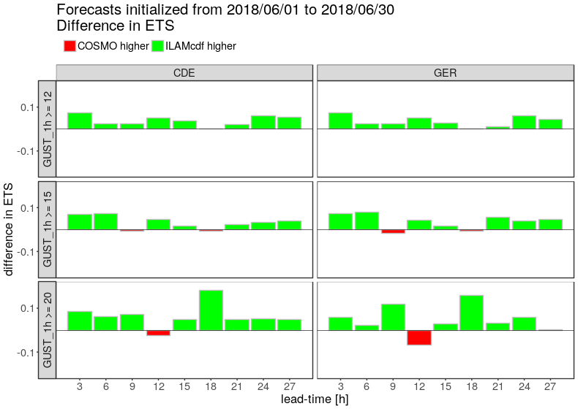
ICON-D2 Tests at DWD

Slide 14
Motivation COSMO Priority Project C2I
COSMO Priority Projects are specific research tasks over a period of 3 to 4 years
Focus of DWD developments on ICON instead of the COSMO model
COSMO strategy foresees a transition phase to ICON-LAM
PP C2I is restricted to deterministic modelling systems. Ensemble applications are covered by COSMO Priority Project APSU
Goal of the COSMO Priority Project C2I is to ensure a smooth transition from the COSMO model to ICON-LAM

Slide 15
Participating institutions
National meteorological services of the COSMO member states:
  MCH (Switzerland), COMET (Italy), HNMS (Greece), IMGW (Poland), NMA (Romania), RHM (Russia), IMS (Israel)
Other major COSMO members:
  ARPAE (Italy), ARPA Piemonte (Italy), CIRA (Italy)
Academic communities:
  CLM Community, ART
National meteorological services (licensees):
  INMET (Brasil)

Slide 16
PP C2I Timeline
Phase 1
Phase 2
Phase 3
ICON Training 2018
Installation
Setup
First experiments
Daily forecasts
Verification
Daily forecasts
Verification
Data assimilation
Forecasters’ feedback
Q2 2018 – Q4 2018
Q1 2019 – Q2 2020
Q3 2020 – Q4 2021

Slide 17
C2I Workshop on Setup & Experiments
15-19 October 2018, Langen, Germany
Financial support from COSMO license money is already approved for two participants per institution!
Preliminary agenda includes:
Remapping of initial and boundary data (from global ICON or IFS)
Conduction of ICON simulations for individually chosen limited-area domains
Visualization of the results
First, these tasks are performed on DWD’s HPC system. The next step is to perform those simulations on the individual participants’ HPC system (if remote access is possible)

Slide 18
Preliminary Agenda is Available!

Slide 19
Updates on Task 8: Technical Framework
Support mailing list is ready icon.support@dwd.de
Official start in October?
Externally accessible Git repository at DWD:
git.dwd.de
Currently, Terms of Reference are being prepared
The ToR include a specific development workflow

Slide 20
Development Workflow

Slide 21



Contributions in PP-C2I
Phase 1 - Preparation & Installation (4/18-12/18)
After the participation in the ICON Training Course 2018 (Valeria Garbero - ArpaP), the model has been installed at the CIRA supercomputer “TURING”, since ArpaP uses the CIRA hardware resource (joint installation).
TURING:
40 dual socket Xeon E5-2697 v4 @ 2.30GHz computational nodes (1440 core in total)
2 Xeon Phi (TM) CPU 7210 @ 1.30GHz computational nodes (128 core in total)
2 GPU Nvidia Pascal Tesla P100 @ 1.33GHz (128 core in total)
256 GB RAM per node
Operating System: RedHat Enterprise Linux 7.3
Fortran compiler: Intel Fortran v18.0.2
MPI: Intel MPI Library for Linux* OS, Version 2018 Update 2
TEAM
E. Bucchignani, P. Mercogliano (CIRA)
M. Milelli V. Garbero (ArpaP)
COSMO GM 2018, St. Petersburg
Notes:
21

Slide 22
Compilation «hot» topics
Due to the Fortran compiler version (v. 18), the option –assume realloc—lhs has been used
The INTEL MPI works properly, even if non included in the suggested list.
GRIB-API-1.22 (the same used in COSMO); the last release 1.27 has been downloaded and compiled, but not still tested.
netcdf-4.4.1.1, netcdf-fortran-4.4.4
Further libraries required (and installed locally): XML2, HDF5, ZLIB, SZIP
The autoconf configuration has been performed with:
./configure --with-fortran=intel --with- grib_api=/usr/local/apps/grib_api-1.22.0/
Afterwards, some adjustments in the Makefile were required, in order to address some issues that arose in the compilation:
CC: from gcc to icc
ln LDFLAGS definition, we added: -lxml2 -lz -lm -ldl –llzma
In MPI_LIB definition, some parentheses were missing
Compilation successful !!! !
COSMO GM 2018, St. Petersburg
Notes:
22

Slide 23
Plans for 2019 (Phase 2)
ICON training for key personnel of CIRA (through training course and self study)
Definition of model set up
Selection of few case studies (severe events)
Comparison with corresponding COSMO forecast (in terms of numerical performances)
Verification of results using all kind of observations available
Results published in the COSMO Newsletter 2019
COSMO GM 2018, St. Petersburg
Notes:
23

Slide 24
COSMO Priority Project C2I
Status at NMA
Instalation of ICON Model at NMA
Model version – used at ICON-LAM training course in April 2018
IBM platform
Compiler – gnu-5.4.0
openmpi-2.0.1
Libraries
-libxml2-2.7.2
-zlib-1.2.11
-szip-2.1.1
-hdf5-1.10.2
-netcdf-4.2.1
-grib_api-1.26.1
Configuration options
./configure --with-fortran=gcc --with-mpi=/opt/tools/libraries/openmpi/2.0.1-gcc-5.4.0/ --with netcdf=/export/home/ncit/external/rodica.dumitrache/LIBRARII/netcdf-4.2.1_install --with-grib_api=/export/home/ncit/external/rodica.dumitrache/LIBRARII/grib_api-1.26.1_install –includedir=/export/home/ncit/external/rodica.dumitrache/ICON_2018/icon_tutorial/icon-training-2018/support
To test the model, we run the idealized test cases proposed in the documentation.

Slide 25
Plans at NMA for ICON forecast setup
Until the end of December 2018 – set-up and run the ICON-LAM for Romanian territory at 7 km resolution on the same domain as the operational COSMO 7 km
Test cases for ICON-LAM
- running the ICON-LAM for a few severe weather situations
- comparing the results with COSMO operational run
Implementation in pre-operational activity – depending on the computing resources available

Slide 26
ICON installation & setup at the IMS
PP C2I
COSMO GM 2018
St. Petersburg

Slide 27
ICON installation at IMS
On IMS domestic cluster:
  ICON code was compiled (with ifort) but crashes at runtime
  IT support work on making it possible to run (The main problem is old compilers)
On a set of workstations at IMS:
  Compiled (with GNU) but can not run due to insufficient RAM
On a cloud environment (both Azure and AWS were tested):
  Several benchmark runs were performed using the provided “real data” case of global forecast simulation
  The major goal of those runs was to test the system performance and find the optimal setup for parallel MPI parallelization
icontools did not compile properly yet

Slide 28
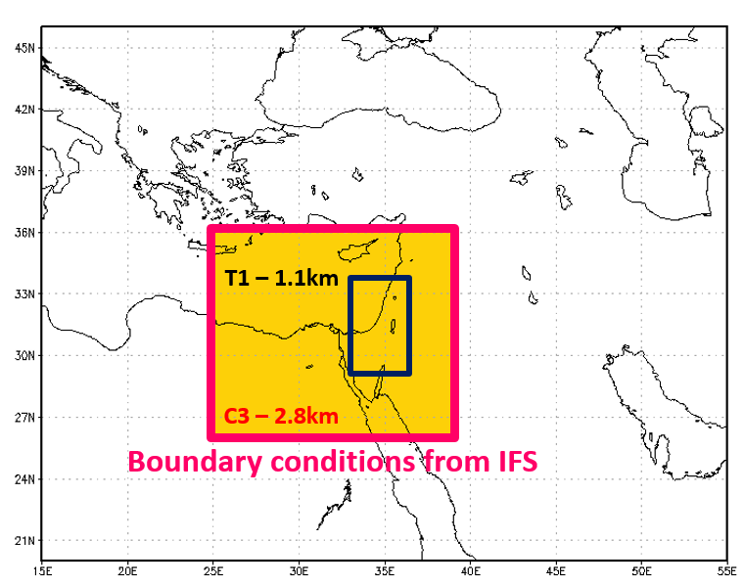
Plans for ICON forecast setup at IMS
In order to compare ICON-LAM performance with COSMO – similar as possible domains and namelist setup will be defined.
Current COSMO domains setup:

Slide 29
First experiments (with IMS setup?)
So far, only the global test case was run to test and tune the system performance
ICON-LAM tests haven’t been performed yet

Slide 30
RHM: Installation of the Icon Model Package on CRAY-XC40
compiler | Mpi library | Result of compiling/tests
Cray Fortran 8.6.3 | CRAY MPICH2 7.6.3 | Compilation: success (+) Case1: (+) Case2: (-)
Intel 17.0.4 |  | Compilation: success (+) Case1: (+) Case2: (-)
gcc 7.2.0 |  | Compilation: - Problem with configuration: configure: WARNING: fcntl.h: present but cannot be compiled configure: WARNING: fcntl.h: check for missing prerequisite headers? configure: WARNING: fcntl.h: see the Autoconf documentation configure: WARNING: fcntl.h: section "Present But Cannot Be Compiled" configure: WARNING: fcntl.h: proceeding with the preprocessor's result configure: WARNING: fcntl.h: in the future, the compiler will take precedence configure: WARNING: ## ------------------------------------------- ## configure: WARNING: ## Report this to luis.kornblueh@mpimet.mpg.de ## configure: WARNING: ## ------------------------------------------- ##
Comments for package IconTutorial2018
Required xml2 library
Generated file build_command don’t have command “make”

Slide 31
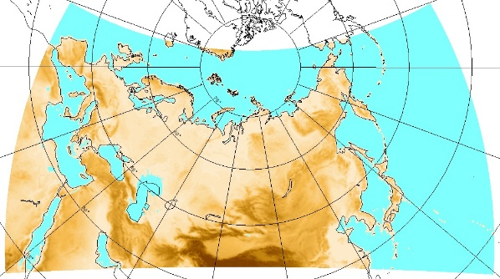
RHM: Plan for Icon-LAM forecast setup
To decrease grid step for COSMO-Ru13ENA from 13.2 to 6.6 km for the same domain.
  Operative routine at autumn 2018.
Test runs ICON-LAM for the same domain ENA (Europe North Asia) with resolution 13 (R03B07) and 6.6 km (R03B08).
  Start after adding necessary fields in output ICON forecasts from DWD
Adaptation of output ICON-LAM for customers: setting of output, visualization, verification, delivery etc.
Operative routine ICON-LAM6.6 after positive verification
COSMO-Ru13 (ENA)
at 2018-08-25
Domain: 13200 km x 6100 km
Grid size: 13.2 km
Time step: 120 s
Forecast: 120 h

Slide 32
RHM: results of first experiments
ICON-Tutorial 2018
At this moment ICON from package ICON-tutorial2018 runs only for case1.
Idealized case (case1) run well.
Global run failed (technical reasons?):
FATAL ERROR in mo_input_request_list:InputRequestList_fetchRequiredTiledSurface: data read for variable "t_g" is incomplete
FINISH called from PE: 22

Slide 33
RHM: Timings ICON-global (ideal case) and COSMO-Ru13

Slide 34
ICON-CLM (Climate Limited Area Mode)
Development Status
Trang Van Pham, Christian Steger
Climate and Environment Service
Deutscher Wetterdienst
C2I Meeting, COSMO GM
2018

Slide 35
ICON implementation
Installation of ICON-CLM done on Cray (DWD) and Mistral.
ICON-CLM first version based on ICON-LAM:
  Ability to perform long simulation
  More flexible output intervals for some variables and flexible input read-in (in case input data are not provided by GCM)
  Time independent SST/CI
  Time independent GHG
  Available common technical infrastructure for Cray and Mistral (set ups for other machines could be included)
  Evaluation tool E_TOOLS
  Test suite for climatological application
  Git-Server for ICON-CLM source code and ICON-CLM script packages
In progress:
  Upper boundary nudging from GCM data
  Converting GCM data to remapicon format
Next plan:
  Optimal setup for ICON-CLM

Slide 36
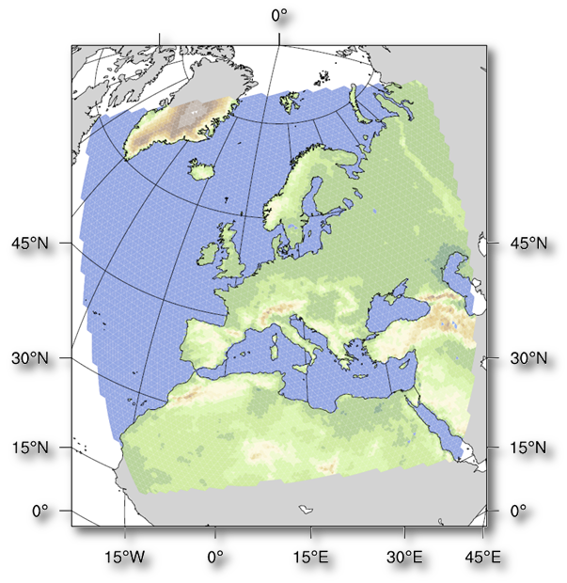
ICON-CLM experiment setups
First test simulation
EU-CORDEX domain
Reanalysis run
EU-CORDEX domain
RCP run
EU-CORDEX domain
R02B06 (~40km)
ERA-Interim as intial, lateral and lower boundary data
Period: 1979-1991
R02B08 (~10km)
ERA-Interim as intial, lateral and lower boundary data
Period: ERA-Interim period 1979-2016
R02B06 (~40km)
MPI-ESM as intial, lateral and lower boundary data
Period:

Slide 37
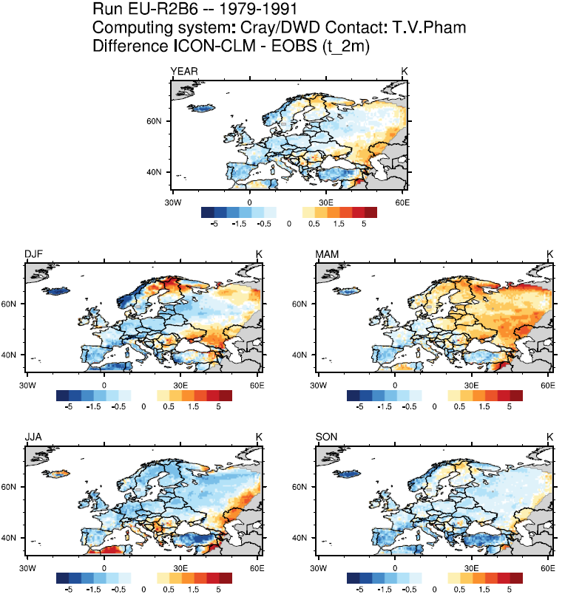
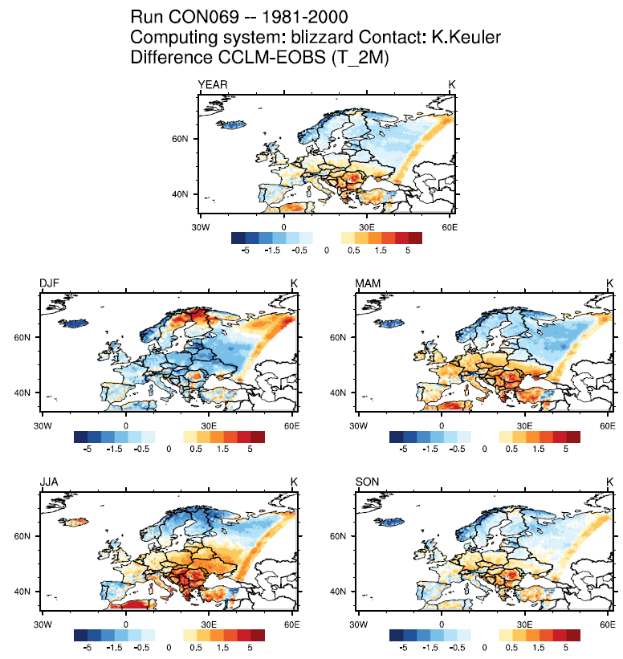
ICON-CLM first test results
ICON-CLM
COSMO-CLM

Slide 38
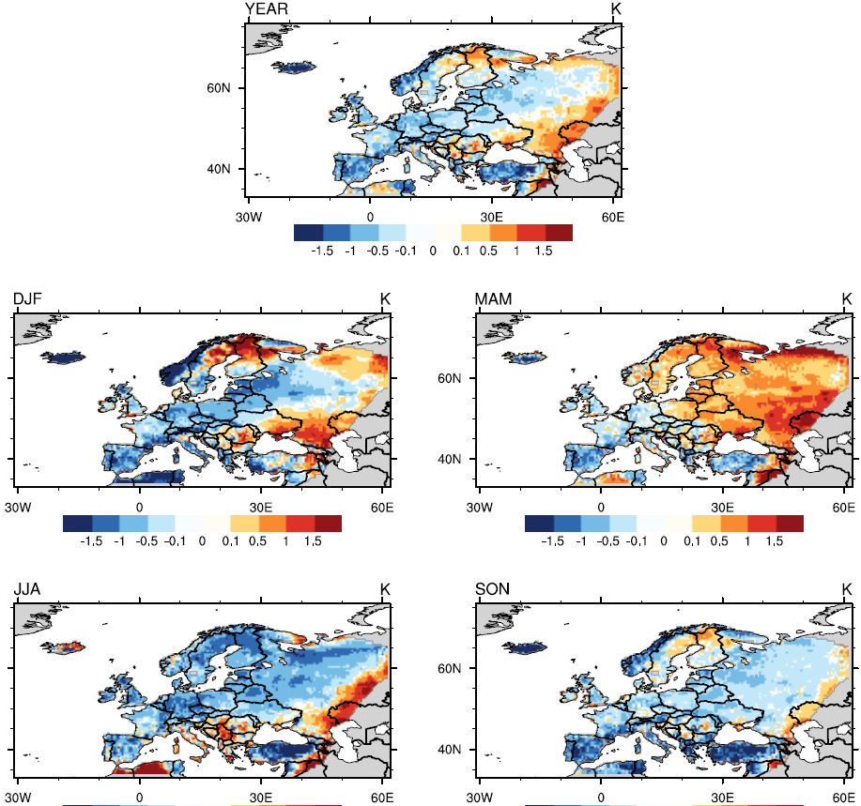
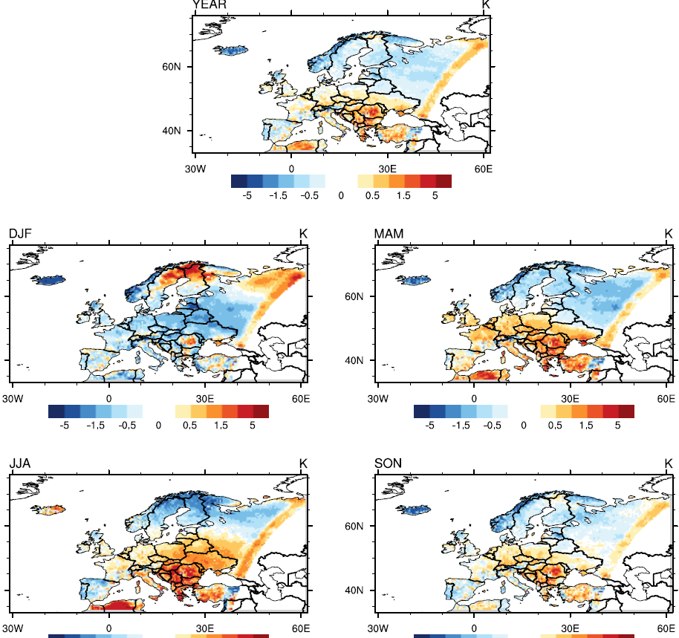
ICON-CLM first test results
ICON-CLM
COSMO-CLM

Slide 39
ICON-CLM first test results
ICON-CLM
COSMO-CLM
The scales are quite different!

Slide 40

Instituto Nacional de Meteorologia - Brasil
ICON and ICONTOOLS compiled with versions of gcc (6.2.1) and openmpi (2.0.2).
All exercises done successfully (case_idealized, case_lam and case_realdata).
Gilberto Bonatti

Slide 41
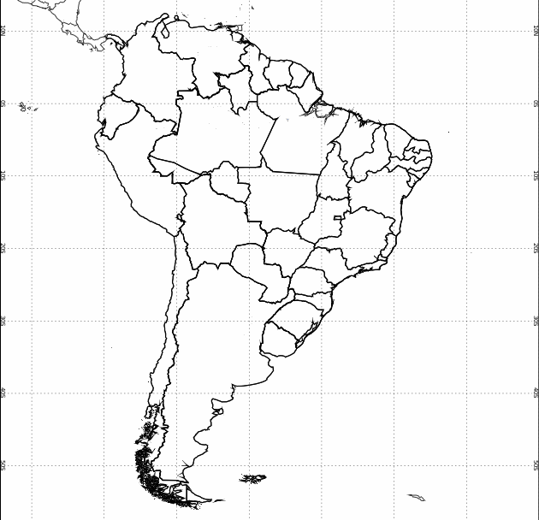
Instituto Nacional de Meteorologia - Brasil
Run the ICON model for South America with 7km of horizontal resolution.
Run the ICON model for 3 regions of Brazil (South, Southeast and Northeast) with 2.8km of horizontal resolution.
Gilberto Bonatti

Slide 42
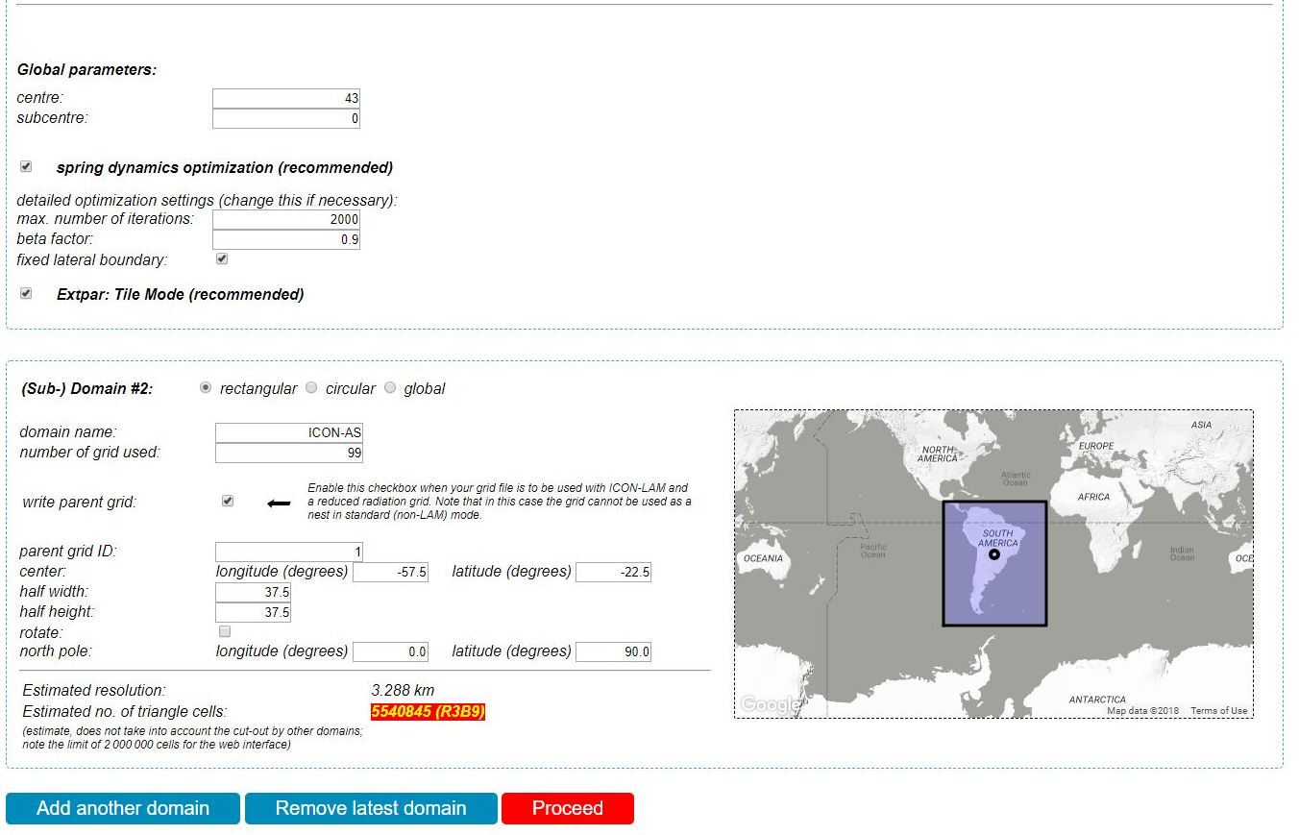
Instituto Nacional de Meteorologia - Brasil
Waiting for data and training to run ICON - Brazil
Gilberto Bonatti

Slide 43
COSMO Priority Project C2I
Status at NMA
Instalation of ICON Model at NMA
Model version – used at ICON-LAM training course in April 2018
IBM platform
Compiler – gnu-5.4.0
openmpi-2.0.1
Libraries
-libxml2-2.7.2
-zlib-1.2.11
-szip-2.1.1
-hdf5-1.10.2
-netcdf-4.2.1
-grib_api-1.26.1
Configuration options
./configure --with-fortran=gcc --with-mpi=/opt/tools/libraries/openmpi/2.0.1-gcc-5.4.0/ --with netcdf=/export/home/ncit/external/rodica.dumitrache/LIBRARII/netcdf-4.2.1_install --with-grib_api=/export/home/ncit/external/rodica.dumitrache/LIBRARII/grib_api-1.26.1_install –includedir=/export/home/ncit/external/rodica.dumitrache/ICON_2018/icon_tutorial/icon-training-2018/support
To test the model, we run the idealized test cases proposed in the documentation.

Slide 44
Plans at NMA for ICON forecast setup
Until the end of December 2018 – set-up and run the ICON-LAM for Romanian territory at 7 km resolution on the same domain as the operational COSMO 7 km
Test cases for ICON-LAM
- running the ICON-LAM for a few severe weather situations
- comparing the results with COSMO operational run
Implementation in pre-operational activity – depending on the computing resources available

