Slide 1

NWP Test Suite: some updates
Andrea Montani
Arpae Emilia-Romagna Servizio IdroMeteoClima, Bologna, Italy
COSMO GM 2018
St Petersburg, 3-6 September 2018

Slide 2
Outline
COSMO NWP test suite:
  how it is now (forecast mode, free_soil)
  how it is becoming (hindcast mode, free_soil)
  some open issues

Slide 3
Goals of NWP test suite
Build up a software environment to perform carefully-controlled and rigorous testing with calculation of verification statistics for any COSMO model test - version
Offer necessary information on the model forecasting performance
Provide the COSMO community with standards against which the impacts of new developments in the model should be evaluated.
Benchmark to monitor the progress of mesoscale forecast improvement (periodic testing as COSMO evolves).

Slide 4
How it is now (ForecastMode - FreeSoil)
We tested the old version of COSMO (e.g v5.03) and the new one (e.g. v5.05) for 2 months (January 2017 and July 2017) at both 7 km (40 ML, fc+72h) and 2.8 km (50 ML, fc+48h), always starting at 00UTC.
As for 7km, COSMO_v5.05 was tested in both DoublePrecision and SinglePrecision (only DP @2.8 km).
Initial conditions and 3-hourly lateral boundary conditions are provided by ECMWF HRES analysis and forecast fields (no nudging, only straight interpolation):
HRES ➔ COSMO@7p0 ➔ COSMO@2p8
COSMO@7p0: as for the first day of integration (1 January and 1 July) the soil is interpolated from ICON-EU. For the other days, the soil fields are 24h forecasts of the previous run, properly merged with SST from ECMWF analysis.
COSMO@2p8: as for the first day of integration (1 January and 1 July) the soil is interpolated from COSMO@7p0. For the other days, the soil fields are 24h forecasts of the previous run, properly merged with SST from ECMWF analysis.
Observations: synop reports from Europe and the Middle East (about 3600 stations x day).
Output fields are stored on ECMWF ecfs and provided to Versus and Rfdbk (both installed at ECMWF) for the comparison of the 2 model versions at both resolutions and for the intercomparison of the verification tools.

Slide 5
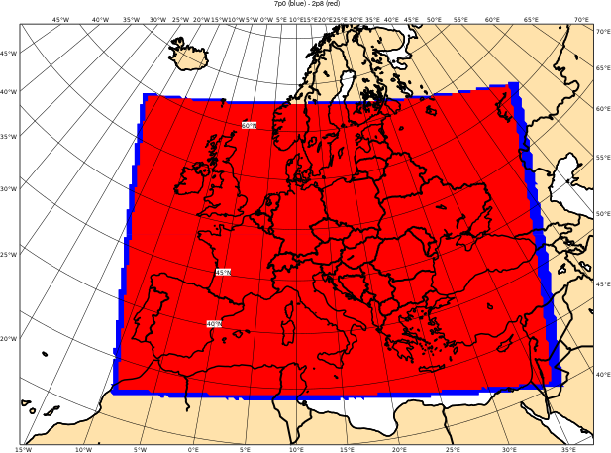
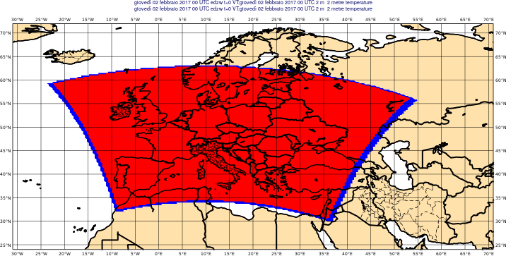
Present integration domains
    7p0 (661x471x40 = 12.453.240 grid points)
    2p8 (1587x1147x50 = 91.014.450 grid points)

Slide 6
NWP Test Suite: HindcastMode – FreeSoil
We will test the future versions for 2 months (January 2017 and July 2017) at both 7 km (40 ML) and 2.8 km (50 ML), always starting at 00UTC.
As for 7km, COSMO will be tested in both DoublePrecision and SinglePrecision (only DP @2.8 km).
6-hourly analyses from ECMWF HRES will provide ICs/BCs for 24h runs at both resolutions.
HRES ➔ COSMO@7p0
HRES ➔ COSMO@2p8
was preferred (simpler and faster) to
HRES ➔ COSMO@7p0 ➔ COSMO@2p8

Slide 7
NWP Test Suite: how it is being implemented
COSMO@7p0:
as for the first day of integration (1 January and 1 July) the soil is interpolated from ICON-EU and the initial/boundary conditions come from HRES;
for the other days, the soil fields are 24h forecasts of the previous run, properly merged with SST from ECMWF analysis and the ICs are taken from the previous integration day (numerically, this is equivalent to a unique one-month run, but no restart needed and no risk of running into troubles with extremely long jobs on ECMWF super-computers).
COSMO@2p8:
the same.
Observations:
synop reports from Europe and the Middle East (about 3600 stations x day).
Storage:
output fields are stored on ECMWF ecfs and provided only to Rfdbk (???) for the comparison of the model versions at both resolutions/precision modes.

Slide 8
Open issues
Still to quantify properly the costs (anyway HindcastMode cheaper than ForecastMode).
What to do with Versus?
Move to grib2 production?
Transition from COSMO to ICON-LAM: NWP Test Suite still needed? Coordinate with C2I project.
HRES provides 6-hourly analyses (~ 10 km), while ERA5 provides 1-hourly analyses (~ 30 km). Think about this?
Let the ForecastMode - FreeSoil and HindcastMode - FreeSoil coexist for some model cycles?
Thanks for your attention

Slide 9
Extra slides

Slide 10
How it was (ForecastMode - IFS soil)
Test the present version of COSMO (e.g v5.01) and the experimental one (e.g. v5.03) for 2 months (January 2013 and July 2013) at both 7 km (40 ML, fc+72h) and 2.8 km (50 ML, fc+48h), always starting at 00UTC.
Initial conditions, lower boundary conditions and 3-hourly lateral boundary conditions are provided by ECMWF HRES analysis and forecast fields (no nudging, only straight interpolation ) as follows:
HRES ➔ COSMO@7p0
HRES ➔ COSMO@2p8
Observations: synop reports from a domain covering most of Europe and the Middle East (about 3600 stations x day).
Output fields are stored on ECMWF ecfs and provided to Versus (also installed at ECMWF) for the comparison of the 2 model versions at both resolutions.

Slide 11
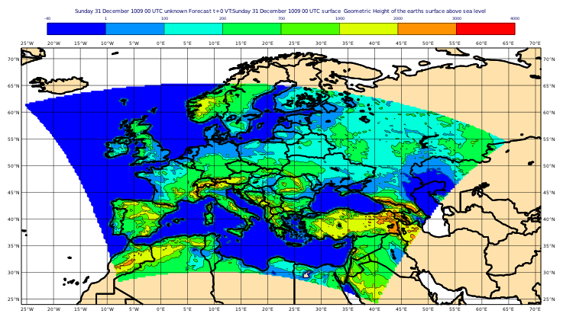
Old domains: NWP METEOROLOGICAL TEST SUITE: integration domain (for both 7 and 2.8 km)
ECMWF HRES: ec_nx = 801; ec_ny = 401; 137 ML; ec_dlon = ec_dlat = 0.125 (14 km); fc+72h
COSMO@7p0: ie_tot = 745 ; je_tot = 569; 40 ML; dlon = dlat = 0.625 (7 km); fc+72h
COSMO@2p8: ie_tot = 1799 ; je_tot = 1369; 50 ML; dlon = dlat = 0.025 (2.8 km); fc+48h

