Slide 1
Some Verification Highlights and Issues in Precipitation Verification
Saint Petersburg, 3 September 2018
Pirmin Kaufmann, MeteoSwiss

Slide 2
A few remarkable results from Summer 2017 and Winter 2017/18

Slide 3
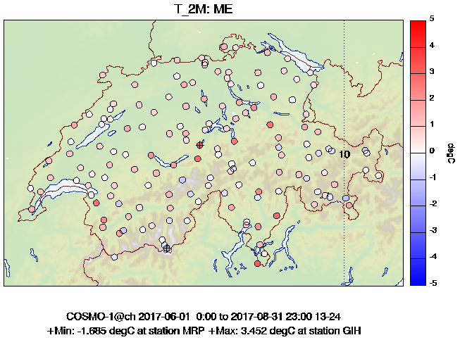
2m Temperature Bias COSMO-1
Summer 2017
Station Bias up to 3.5 °C
perfect score

Slide 4
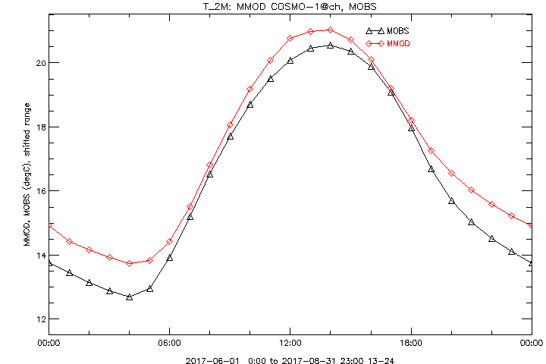
T2m Bias: Strongest During the Night
Summer 2017
daytime

Slide 5
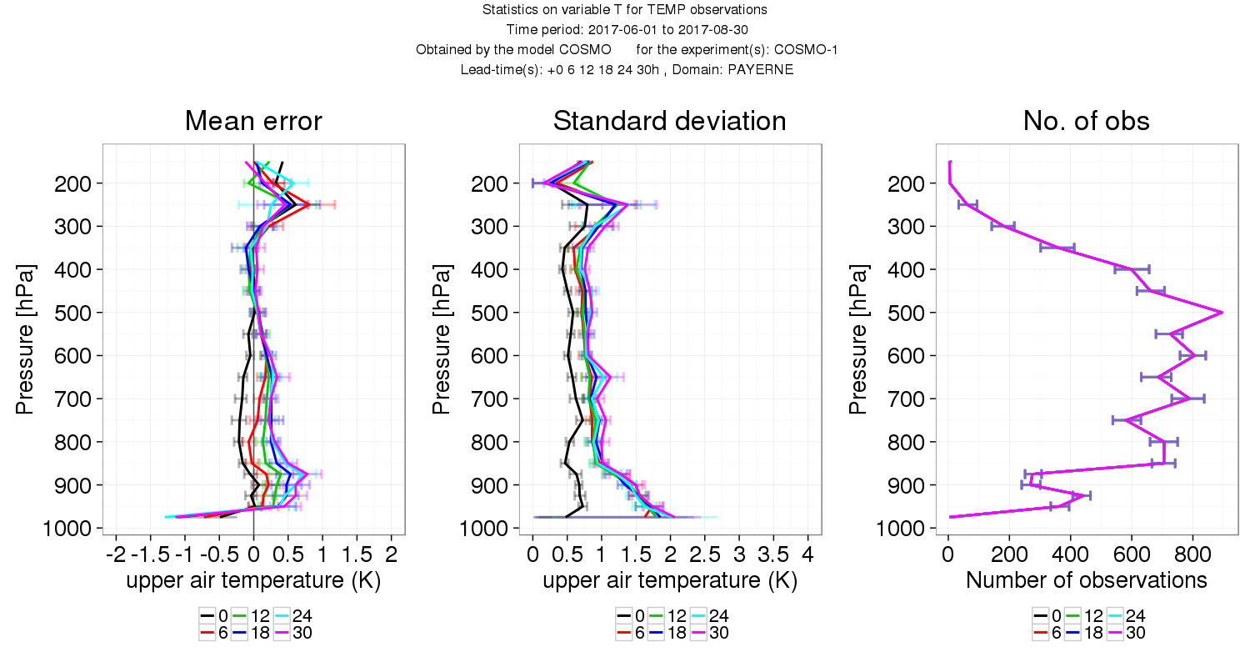
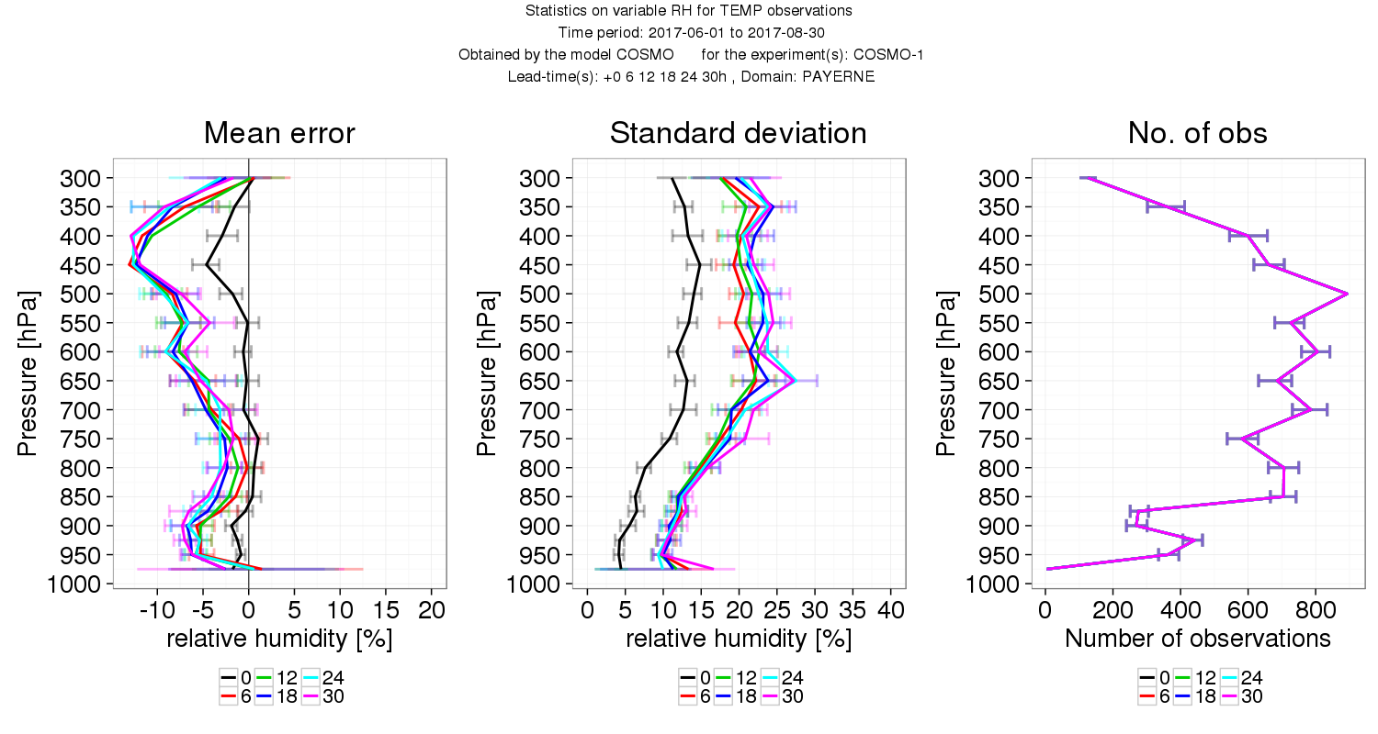
Upper-Air Verification Summer
COSMO-1
Summer 2017
Payerne
Temp.
BL too warm
Rel. Hum.
BL too dry

Slide 6
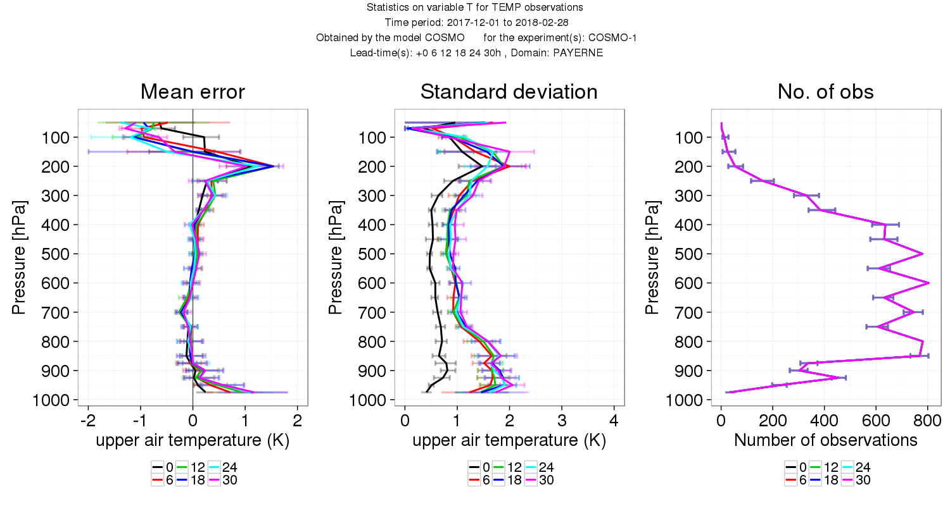
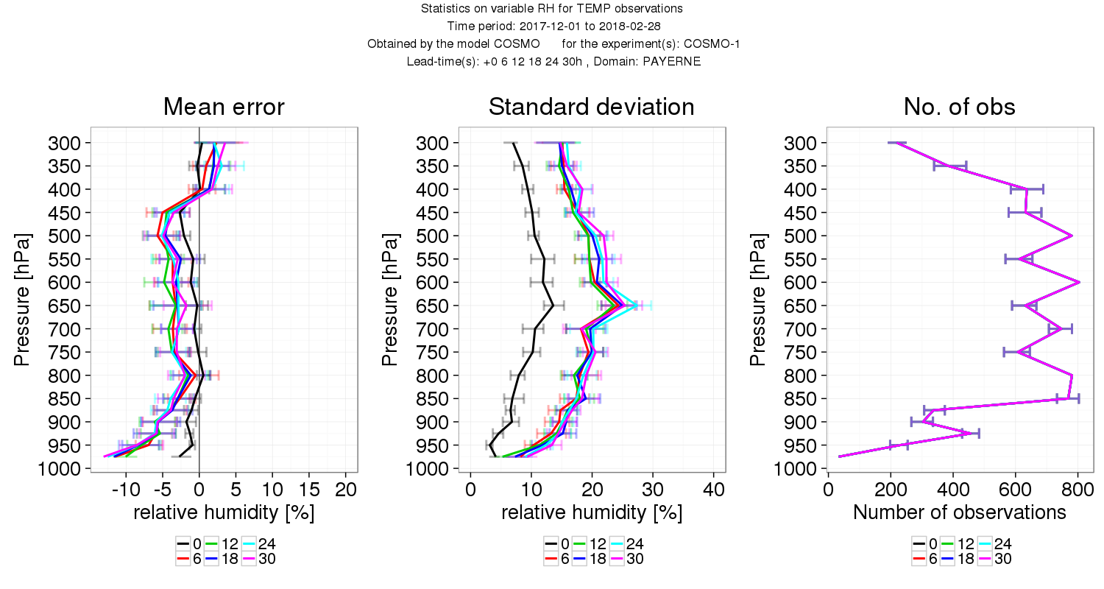
Upper-Air Verification Winter
COSMO-1
Winter 17/18
Payerne
Temp.
BL too warm
Rel. Hum.
BL too dry

Slide 7
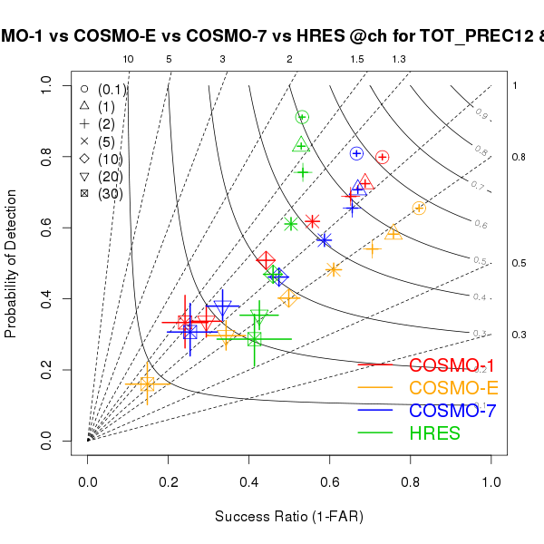
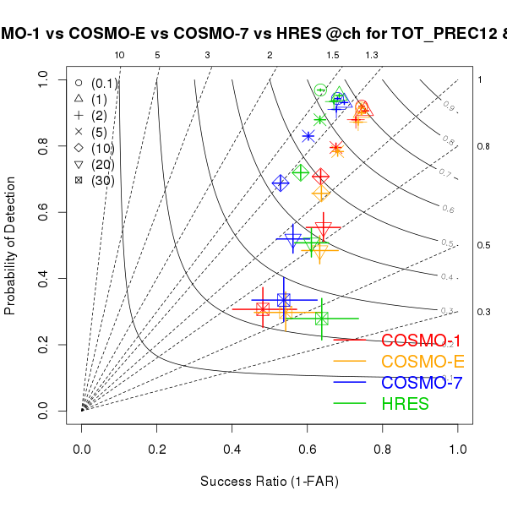
Precipitation Comparison Oper. Models
COSMO-1 best model in summer (12h-sum +12 to +24)
COSMO-1 and -E together best in winter
Summer 2017
Winter 2017/18
perfect score

Slide 8
Precipitation
Freq. Bias
Threshold 0.5 mm/h
Strong fluctuation in frequency bias of COSMO-1 at shortest lead times
ETS, MAE, STD, .. indicate considerable higher quality at first three hours (01-03)
Most likely benefit of latent heat nudging
perfect score
Summer 2017
perfect score
Eq. threat score
Threshold 0.5 mm/h
Summer 2017

Slide 9
Wind Gusts
-□- COSMO-1
-x- COSMO-E Control
-Δ- COSMO-E Median
-◊- COSMO-7
-+- HRES
perfect score
Summer 2017
ETS for thresh.12.5 ms⁻¹ (25 kn, 45 km/h)
Summer 2017
Wind gust performance: COSMO-1 clearly the best model

Slide 10
Deterministic Value from Ensemble Prediction: Median for Precipitation

Slide 11
The two flavours of the precipitation median
For meteorologists, the “intuitive” way is to first de-accumulate the precipitation and then calculate the median → “meteorological” median of 1h/3h/6h/12h-sums.
For hydrologists, the cumulative precipitation is much more important that the rate. Thus the median is calculated from the accumulated precipitation since model initialization as in the model output and de-accumulated only after determining the median values → “hydrological” median of sum since start of model

Slide 12
Spring 2017, 1h-Precip
Mean Obs, Mean Model over Switzerland
Dry bias of “meteorological” median, increases strongly with lead time
Similar results for 12h-precip
Observation
Control run
“Hydrological” median
“Meteorological” median
perfect value

Slide 13
Spring 2017, 1h-Precip
Frequency Bias 0.1 mm/h (precipitation yes/no)
Dry bias of “meteorological” median increases with lead time
Wet bias of “hydrological” median increases with lead time
“Hydrological” median
Control run
perfect score
“Meteorological” median

Slide 14
Spring 2017, 12h-Precip 10 mm/12h
Freq. Bias 10 mm/12h (strong precipitation)
Dry bias of both median variants, increases strongly with lead time
perfect score
Control run
“Hydrological” median
“Meteorological” median

Slide 15
Conclusions
Neither way of building the median leads to satisfying results
For skewed distributions as precipitation, either variant of building the median leads to a large bias
Median is strongly smoothing and cuts away extreme end of distribution
Occurrence of extremes is considerably underestimated, especially at long lead times!
Never use median to judge potential for extremes!

Slide 16
Spatial averaging of precipitation

Slide 17
Spatial Averaging of Precipitation
Reason for averaging: Models cannot predict precipitation with grid point accuracy, especially in convective situations
COSMO standard: “Average of grid points within 15 km radius” was defined in 2008 for 7 km models
Still best choice for performance of km-scale models 10 years later?

Slide 18
COSMO-1 Summer 2016 (Switzerland) 1h Precip
-◊- 15 km disk-average -□- 3x3 GP average
-+- 1 GP optimized
-x- 1 GP nearest neighbor
FBI
perfect score
0.1 mm/h
0.5 mm/h
2 mm/h
perfect score
ETS

Slide 19
Summary COSMO-1 (Summer)
Frequency bias for all thresholds best for 3x3 GP
1 GP associations almost as good
Disk-average15 km has a strong positive frequency bias for small and medium thresholds
Equitable threat score best for disk-average 15 km, but only with a very small difference
Winter 2017 results are all clearly in favor of single GP associations
➔ 3x3 GP averaging seems to be good compromise

Slide 20
HRES Grid with11 km resolution
Frequency bias for all thresholds best for single GP
3x3 GP strong positive frequency bias for smallest two thresholds
Equitable threat score similar for all methods, for lowest threshold slight disadvantage for 3x3 GP, highest threshold slight advantage for 3x3 GP
Winter 2017 results clearly in favor of single GP associations
➔ For coarser models, grid point averaging does not seem to be a good idea, as it increases the frequency bias of weak precipitation

Slide 21
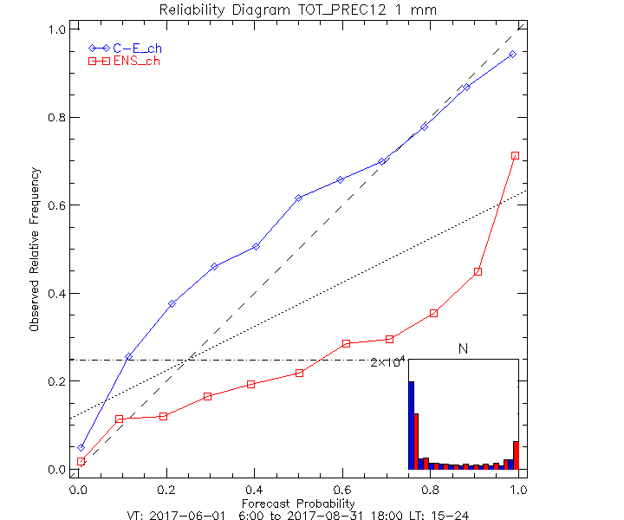
Reliability of forecast probabilities
-◊- COSMO-E (3x3 GP)
-□- ENS (single GP)
Summer 2017
Thresh. 1 mm/12h
Switzerland
perfect score

