Slide 1

Using climate statistical properties to generate realistic interpolated precipitation fields
Flora Gofa
20TH COSMO General Meeting , 3-6 Sept 2018, St. Petersburg, WG5 Session

Slide 2
Motivation
  Accurate knowledge οf precipitation patterns in terms of quantity and spatial structure is required for many applications, including verification purposes that require very high resolution datasets
  Lack of available precipitation data, not only in time intervals that enable the evolution of a weather event to be well represented, but mainly with adequate spatial coverage.
  For rain gauges, data are continuous in time, but the density of networks is insufficient. Particularly acute in mountainous regions like Greece, where physical access is limited, and further exacerbated by the strong influence of topography
  Precipitation estimates based on radar and satellite gridded data have a high degree of uncertainty associated with them and therefore should only be used in combination with surface measurements.
  Goals
  Extend the method of the creation of precipitation atlas for Greece in the creation of daily precipitation observation analysis to be used for verification purposes that require very high resolution datasets
  Analyze the reliability of the methodology based on a certain convective case

Slide 3
Interpolation Methods
Deterministic
Probabilistic
Other
Use only geometric characteristics of point observations
Nearest neighborhood
Fixed Radius
Inverse distance weighting (IDW)
Based on probabilistic theory and use the concept of randomness
Kriging methods
Developed only for meteorological purposes (using deterministic and probabilistic approach)
AURELHY (1987)
PRISM (1994)
MISH (2007)
20TH COSMO General Meeting , 3-6 Sept 2018, St. Petersburg, WG5 Session

Slide 4
MISH
(Meteorological Interpolation based on Surface Homogenized Data)
(Szentimrey & Bihari, 2014)
The main advantages of MISH method:
requires homogenized data series
gets information from a long term data series (often geostatistical methods use a single realization in time for modeling but meteorological data are spatio-temporal!)
calculates the optimum interpolation parameters which are certain known functions of the climate statistical parameters
interpolation formula depends on climate elements
20TH COSMO General Meeting , 3-6 Sept 2018, St. Petersburg, WG5 Session

Slide 5
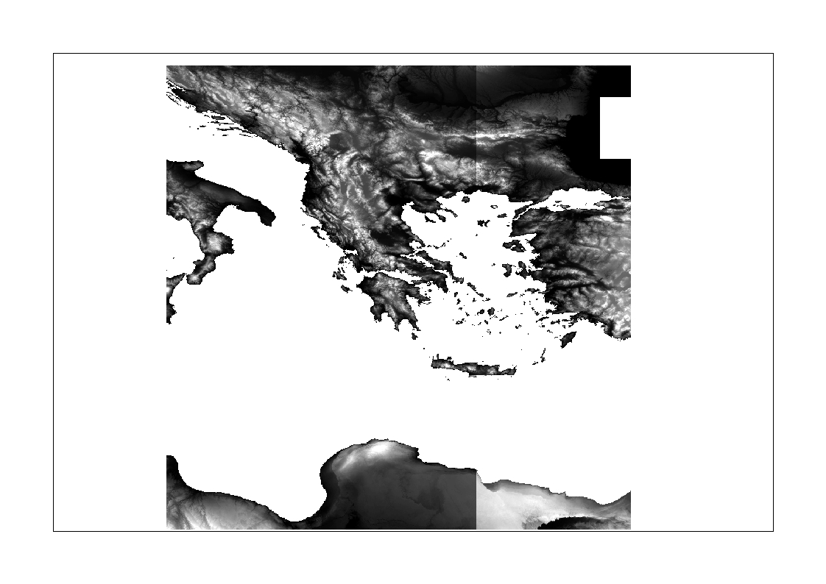
Spatial analysis approach
The data series of mean monthly values are correlated with geophysical parameters (elevation height, slope, orientation, % sea-land, distance from coast line, etc.) that correspond to the latititude-longitude position of each station
Shuttle Radar Topography Mission
The analysis procedure is performed in two stages:
Α : Calculation of geophysical parameters from the digital surface model DEM originating from NASA (http://srtm.csi.cgiar.org)
Β: Application of a multiple linear regression analysis to correlate the mean monthly values to the geophysical parameters.
20TH COSMO General Meeting , 3-6 Sept 2018, St. Petersburg, WG5 Session

Slide 6
Additional Geophysical Parameters
Besides first 14 AURELHY principal components proposed
by the AURELHY interpolation method (Analyse Utilisant le Relief
pour les besoins del‘ Hydrométéorologie) the following predictors
were used:
Elevation (m)
Euclidian distance to coastline (Km)
Land to sea percentage coverage (%) within a 10 km radius
Latitude φ (decimal degrees)
Solar irradiance on the Earth surface (W.m⁻²) (calculated via libRadtran (Mayer and Kylling, 2005))
20TH COSMO General Meeting , 3-6 Sept 2018, St. Petersburg, WG5 Session

Slide 7
Spatial Analysis – MISH (Model)
Input
Data series of mean monthly precipitation values for 157 stations (for precipitation
Geophysical parameters in gridded format
Output
Geophysical parameters that have high correlation with the precipitation values for each month
Correlation coefficients
Degree of correlation
20TH COSMO General Meeting , 3-6 Sept 2018, St. Petersburg, WG5 Session

Slide 8
Spatial Interpolation – MISH (Interpol)
(used to interpolate any observational field)
Input
Correlation with main geophysical parameters relevant to climate data
Spatial analysis of precipitation tendencies
Point observations to be interpolated
Background gridded field (e.g. derived from remote sensing)
Output
Interpolated precipitation values in a grid of resolution 30΄΄ (750mx750m)
20TH COSMO General Meeting , 3-6 Sept 2018, St. Petersburg, WG5 Session

Slide 9
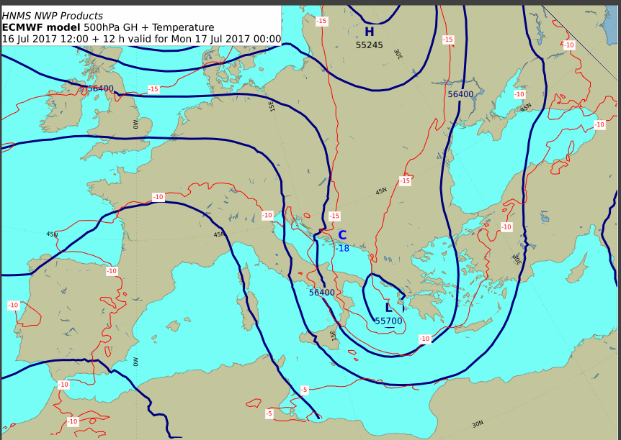
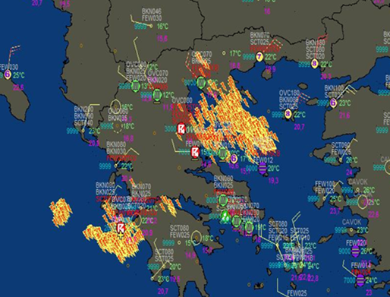
Test case: 16-17 July 2017
A mesoscale convective system that affected Greece during the period 16-17/07/2017. Cut off low system passed over the country followed by a cold front combined with strong convective activity.
Observations from 200 surface stations were available as 24h accumulations
The point observations was attempted to be interpolated spatially using MISH method on a ~1km grid.
g
The interpolation is based on the correlations with the geophysical parameters that resulted from the spatial analysis of the climatological data for February (model part of MISH simulation)

Slide 10
Steps that were followed……
The first step in the use of the precipitation correlation coefficients produced by the modelling procedure with the MISH software for month of July.
Although the modeling system is based on monthly data, daily or even smaller time interval means can also be interpolated with the correlations resulting from the modeling procedure for the month the event took place.
It is important to note that the correlation coefficient (R) for the precipitation for the month of July with the geophysical parameters was 0.781
Interpolation using MISH of the point observations with and without background filed (H-SAF)
20TH COSMO General Meeting , 3-6 Sept 2018, St. Petersburg, WG5 Session

Slide 11
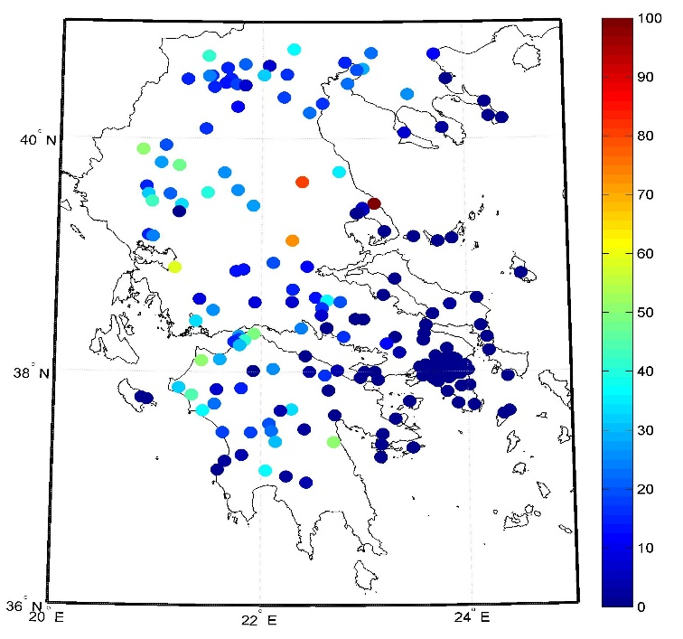
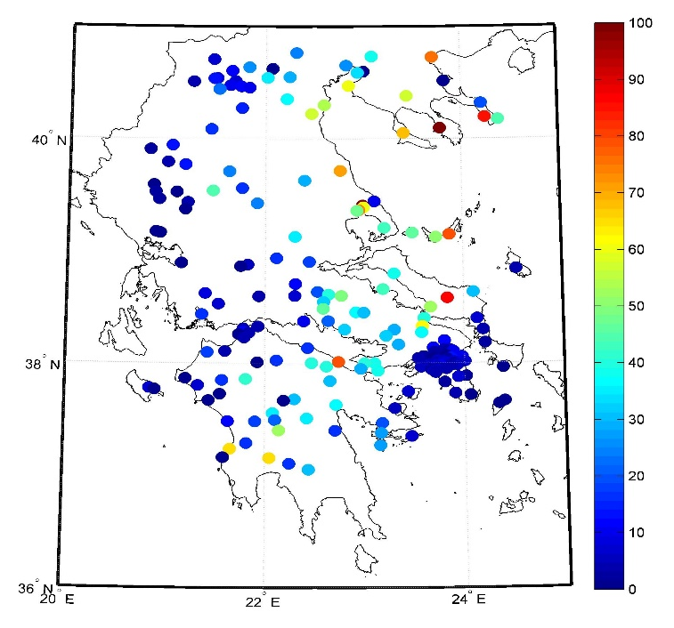
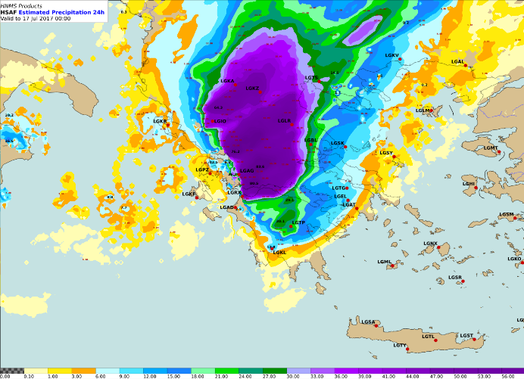
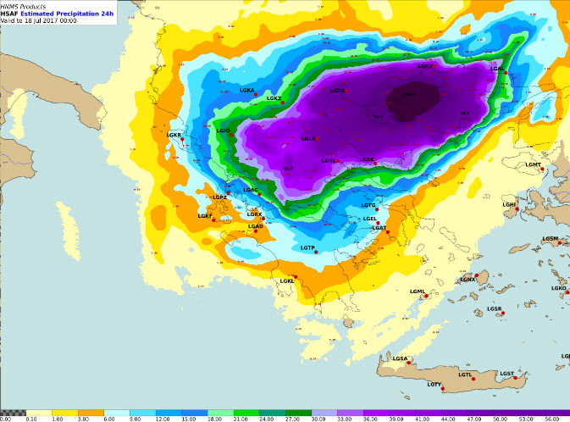
Test case: 16-17 July 2017
Location and precipitation amount of observations
Left: 16.07.17, Right:17.07.17
Interpolated values from H-SAF product H05.
20TH COSMO General Meeting , 3-6 Sept 2018, St. Petersburg, WG5 Session

Slide 12
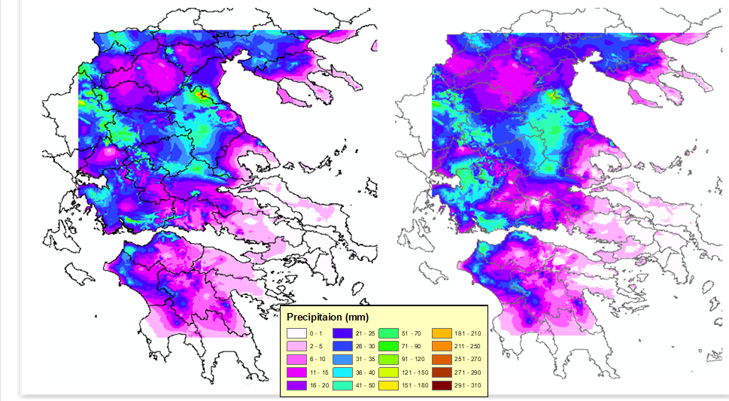
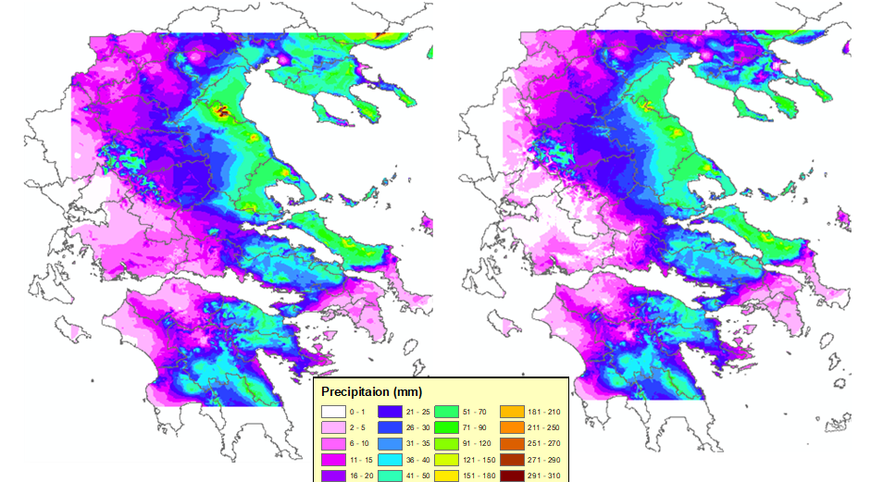
Interpolated values from 24h precipitation values
Left: surface stations and background field
Right: only surface stations
16.07.17
Remarks
Use of background field does
not alter the structure of precipitation
Amount of precipitation is
increased in areas where no surface station was present.
the weight that the software
Is given to the background info is less compared to that of the observations
17.07.17
20TH COSMO General Meeting , 3-6 Sept 2018, St. Petersburg, WG5 Session

Slide 13
Method evaluation approach
To obtain insight into the error associated with the application, a statistical evaluation procedure was performed.
Code was developed that allowed the application of the Leave-One-Out Cross Validation (LOOCV) technique where the interpolation software is trained N separate times on all data except for one point (one surface station) and a prediction is made for that point.
LOOCV is essentially an estimate of the generalized performance of model trained on n-1 samples of data.
20TH COSMO General Meeting , 3-6 Sept 2018, St. Petersburg, WG5 Session

Slide 14
Mean statistical indices derived from the application of LOOCV
MISH interpolation approach has a tendency to underestimate precipitation amounts in all cases (negative ME), while the use of background information slightly improved the predicted precipitation values, mainly for 17.07.17, while the RMSE was on the order of 14.7-17.4mm/24h.
20TH COSMO General Meeting , 3-6 Sept 2018, St. Petersburg, WG5 Session

Slide 15
Next steps……
Apply the MISH interpolation method on different precipitation regimes, not only on convective events
If method is proved to work satisfactory for this purpose, will be also applied on forecast data, in order to have a more realistic interpolation of data (not purely mathematical thansformation as it is usually the case) on finer resolution grids
Connect the use of MISH for high resolution obs and fct datasets for spatial verification applications
20TH COSMO General Meeting , 3-6 Sept 2018, St. Petersburg, WG5 Session

Slide 16

Ευχαριστώ πολύ – Ερωτήσεις?
20TH COSMO General Meeting , 3-6 Sept 2018, St. Petersburg, WG5 Session

Slide 17
Additional slides
WG5 parallel session, COSMO General Meeting, Jerusalem 2017

Slide 18
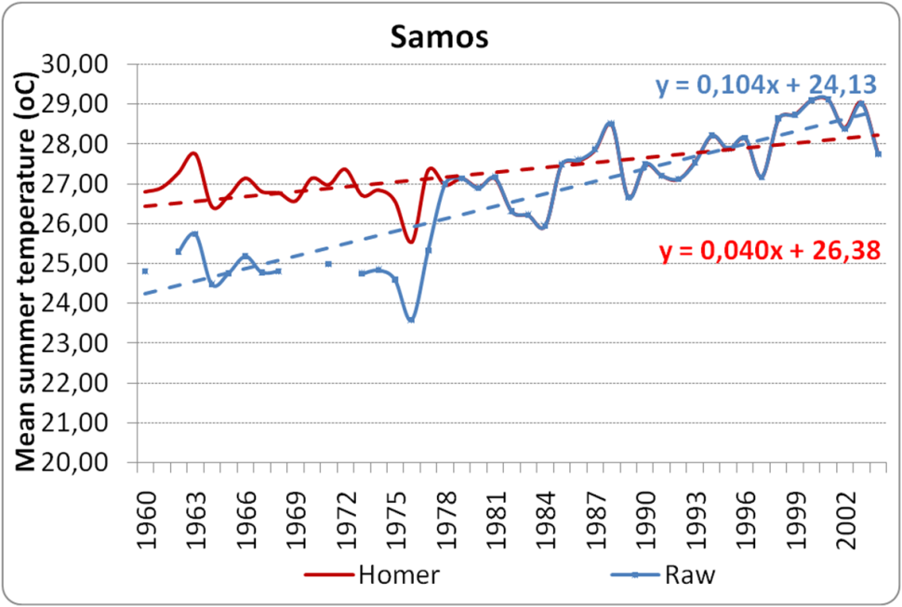
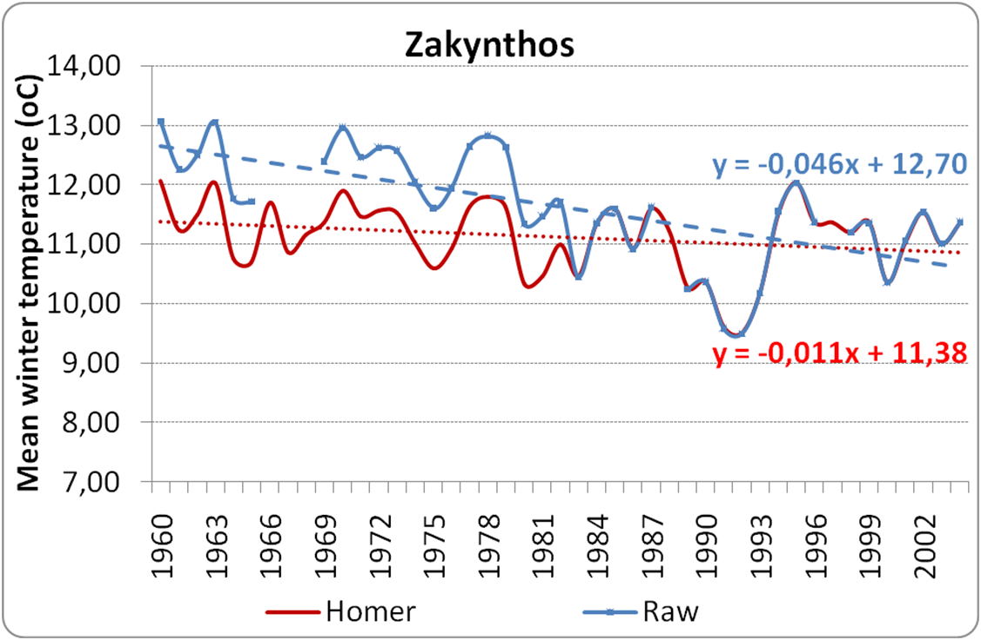
Impact of homogenization procedure corrections
Example of Mean Temperature data series correction
Σημείο ρήξης : Απρίλιος 1978
Σημείο ρήξης : Μάιος 1982
WG5 parallel session, COSMO General Meeting, Jerusalem 2017

Slide 19
Methodology
Elevation data come from the DEM originating from NASA (SRTM) 90 x 90m (http://srtm.csi.cgiar.org)
Interpolation method: MISH (Meteorological Interpolation based on Surface Homogenized Data), developed for meteorological purposes (Szentimrey & Bihari, 2014)
First 15 principal components proposed by the AURELHY interpolation method (Analyse Utilisant le Relief pour les besoins del‘ Hydrométéorologie) were used as geophysical variables
WG5 parallel session, COSMO General Meeting, Jerusalem 2017

Slide 20
Using the methodology followed for the production
of a climate atlas…….
  Α. Homogenization of climate data
  Β. Spatial analysis of data series
  C. Spatial Interpolation
  D. Mapping
20TH COSMO General Meeting , 3-6 Sept 2018, St. Petersburg, WG5 Session

Slide 21
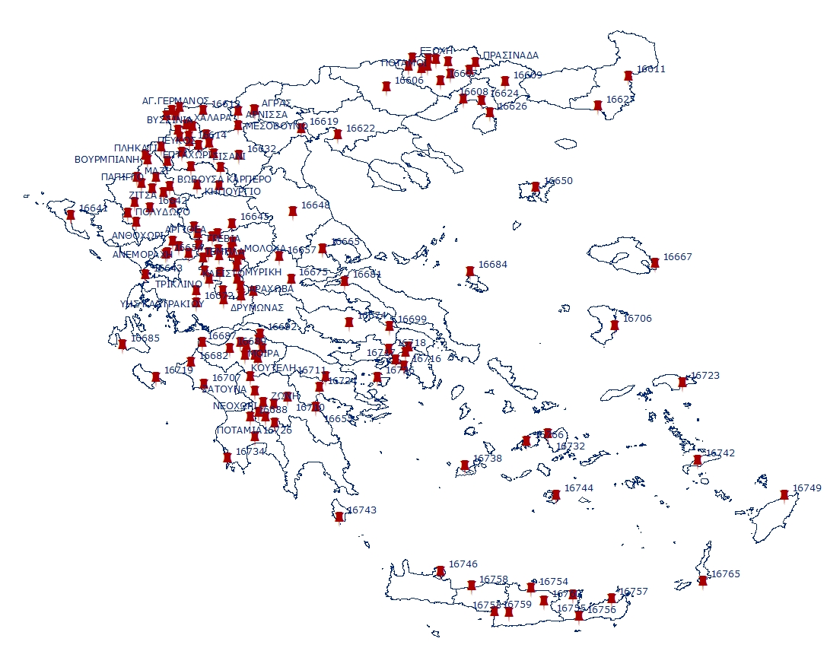
Location of Stations and Data
Climatological data for precipitation from 157 surface stations for the period 1970 -2004 (35 years)
Homogenization method HOMER (COST ES0601)
20TH COSMO General Meeting , 3-6 Sept 2018, St. Petersburg, WG5 Session

Slide 22
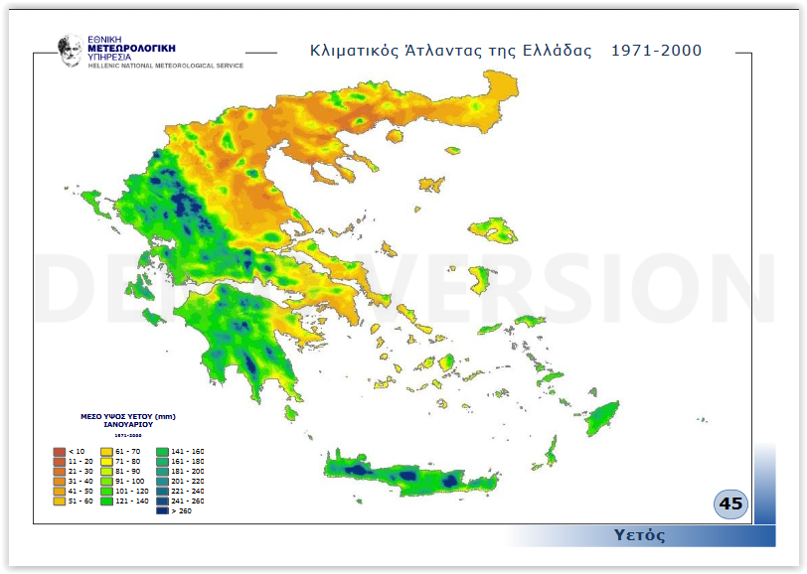
January- mean precipitation
WG5 parallel session, COSMO General Meeting, Jerusalem 2017

Slide 23
Monthly correlation coefficient for various parameters
20TH COSMO General Meeting , 3-6 Sept 2018, St. Petersburg, WG5 Session

Slide 24
Β. Χωρική Ανάλυση – Υπολογισμός Γεωφυσικών Παραμέτρων
Οι γεωφυσικές παράμετροι που χρησιμοποιήθηκαν είναι:
Γεωγραφικό πλάτος
Γεωγραφικό μήκος
Μέσο υψόμετρο εντός κυκλικής περιοχής ακτίνας 800 μέτρων
Ποσοστό ξηράς θάλασσας εντός κυκλικής περιοχής ακτίνας 800 μέτρων
Απόσταση από την ακτογραμμή
Ηλιακή ακτινοβολία
Μέση κλίση εντός κυκλικής περιοχής ακτίνας 800 μέτρων
Μέσος προσανατολισμός εντός κυκλικής περιοχής ακτίνας 800 μέτρων στην διεύθυνση βορράς – νότος
Μέσος προσανατολισμός εντός κυκλικής περιοχής ακτίνας 800 μέτρων στην διεύθυνση ανατολή δύση
Μέση κυρτότητα εντός κυκλικής περιοχής ακτίνας 800 μέτρων
Μεγαλύτερο υψόμετρο εντός τεταρτοκυκλίου ακτίνας 10χλμ.στην κατεύθυνση ΒΑ
Μεγαλύτερο υψόμετρο εντός τεταρτοκυκλίου ακτίνας 10χλμ.στην κατεύθυνση ΝΑ
Μεγαλύτερο υψόμετρο εντός τεταρτοκυκλίου ακτίνας 10χλμ.στην κατεύθυνση ΝΔ
Μεγαλύτερο υψόμετρο εντός τεταρτοκυκλίου ακτίνας 10χλμ.στην κατεύθυνση ΒΔ
20TH COSMO General Meeting , 3-6 Sept 2018, St. Petersburg, WG5 Session

