Slide 1

Paraskavedekatriaphobia vs. Bernoulli and Gauss – an attempt to verify elements of superstition by statistical investigations
Ulrich Damrath
DWD – till 2015
Background from: Thomas Ford Memorial Library and mars.wiwi.hu-berlin,de

Slide 2
Paraskavedekatriaphobia
(Paraskevi-Ke-Deka-treis-phobia
Friday - & - 13 - fear)^{*)}
*) Thanks to Flora
13:
  Dozen of the devil or of the baker
  (give 13 portions instead of 12 to avoid fraud surely)
  13th Fairy in a fairytale
  Quatorzième‘s
  13 in Tarot – the death
  13 is 13 times on 1 $
  Calender calculation for years with 13 lunar months were more complicated than those with 12 months.
13th
  Friday, 13th: Began 1907 with popular novel „Friday, the Thirteenth“ by Th. W. Lawson – then in other novels and news
  Then further in novels, newspapers …
  Tuesday, 13th in Greek and and Hispanic culture – fall of Constantinople (during 4th crusade) 13th of April 1204 and 29th May 1453 -Tritikadeketreisphobia
  Tuesday 17th in Italy, from shuffling the digits of the roman number XVII to VIXI (I have lived) - Paraskevikedekaeptaphobia
Notes:
Quatorziemes were people who come to diners where currently 13 persons were guests to avoid a bad luck number. In England around 1860 lived a man who had two or three meals per day and earned around 20000 pounds sterling which would be mor than a million today!!!

Slide 3
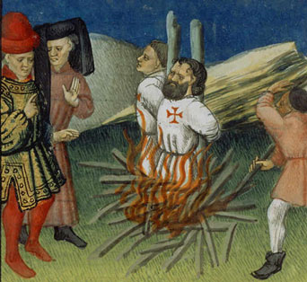
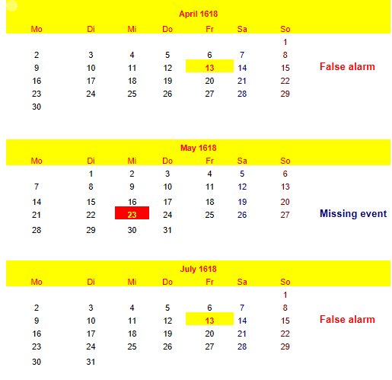
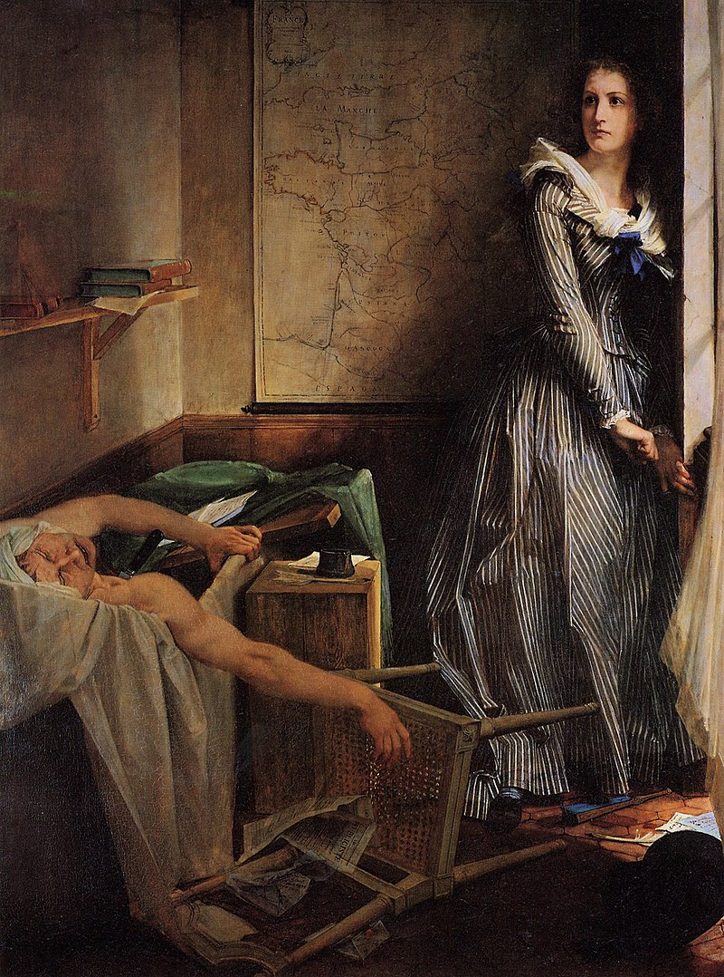
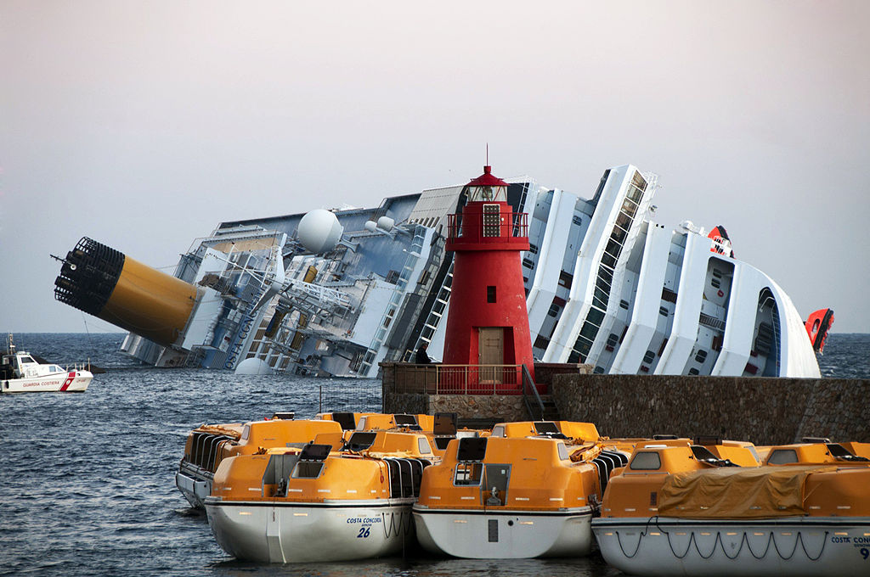
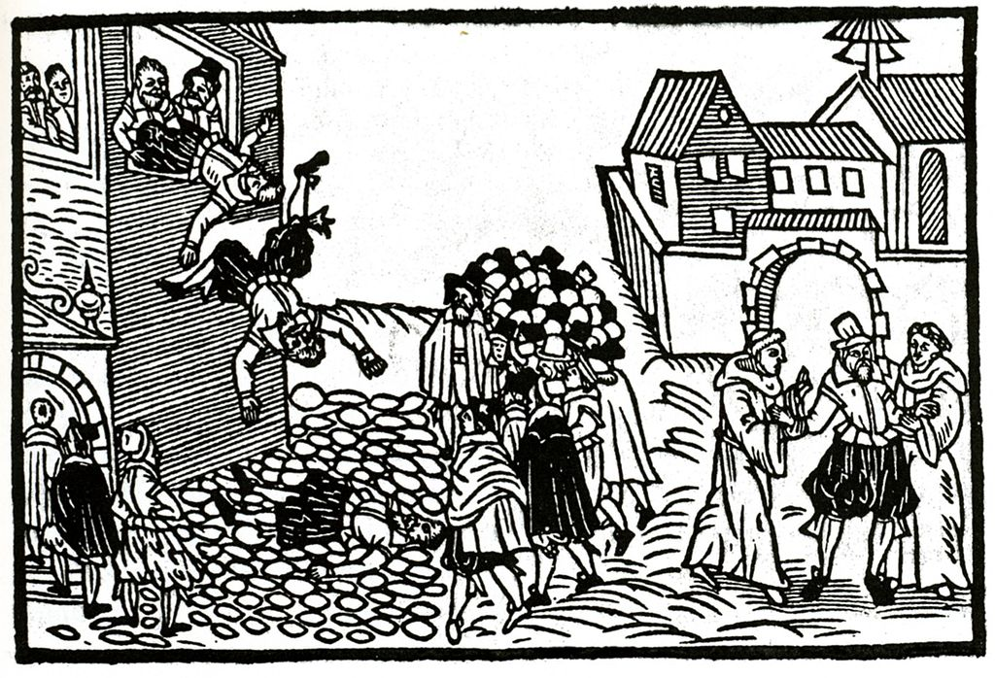
The Myth – its origin and what happens in reality
Pyre for Jacques de Molay
Templar Grand Master
caused by an decret
from Friday 13.10.1307
Hits
http://www.templerlexikon.uni-hamburg.de,
PD-alt-100, https://de.wikipedia.org/w/index.php?curid=2654658
Friday 13.1.2012
Costa Concordia
Von Rvongher / Wikimedia Commons –
Eigenes Werk, CC BY-SA 3.0,
https://commons.wikimedia.org/w/index.php
?curid=18045701
13.7.1793 (Sat.: But nearby)
J.P. Marat killed by Ch. Corday
Notes:
Some extremely historical events like burning of the Grand Master of Templars th havary of the Costa Concordia are strongly related to Friday13th. On the other hand during 1618 two cases of Friday13^{th occured} without any important historical event but on Wednesday 23rd of May Defenestration in Prague lead to the Thirty Years' War. So we have whithin one year are missing event and two false alarms. Also occured: March 8 – Johannes Kepler discovers the third law of planetary motion

Slide 4
Statistical evaluation
Basic questions:
  Do accidents occur generally on days with bad luck or
  if accidents occur, are days of bad luck preferred?
  Popular belief gives no clear answer.
Data base: Selection of accidents/events following lists from Wikipedia
Investigation of accidents at special dates/weekdays of well known bad luck (I,GR,D{EU}) with frequency of accidents at other date/weekday constellation (birth dates of the grandchildren) – Test of frequencies of occurences of events at one day using Gaussian and Bernoulli formulas as well as traditional verification techniques for contingency tables (hits, false alarms, missing events)
Investigation of accidents at special days in the year („wasted days“, dies atri: may have their origin for example by defeats of Roman army in historical battles near river Allia and other events at the day after the ides)

Slide 5
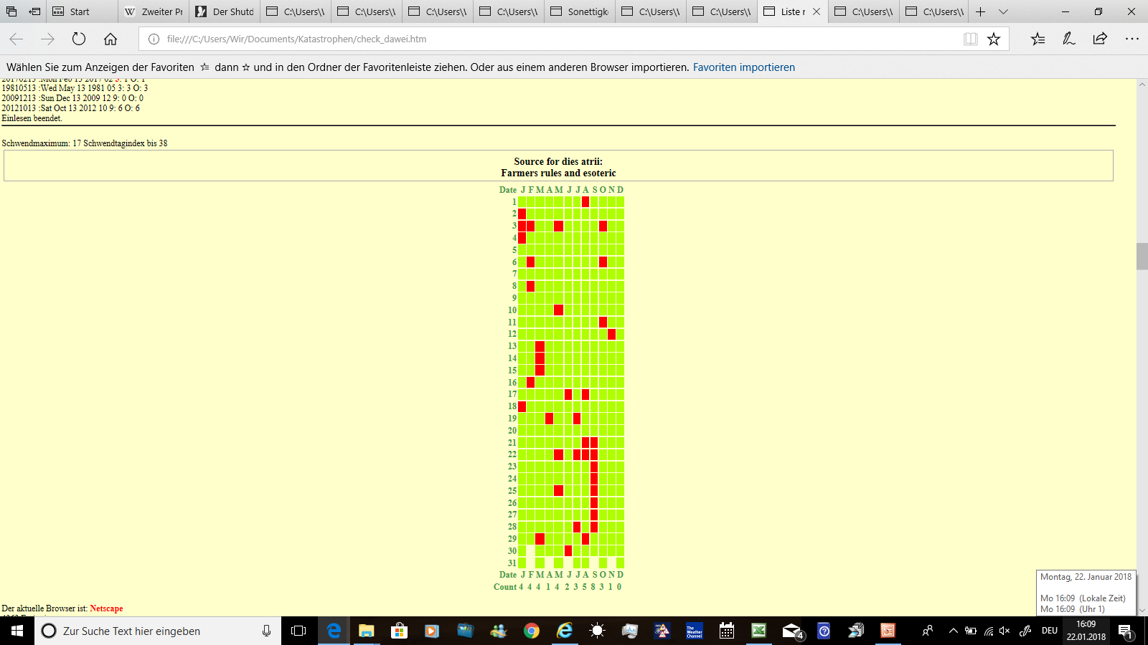
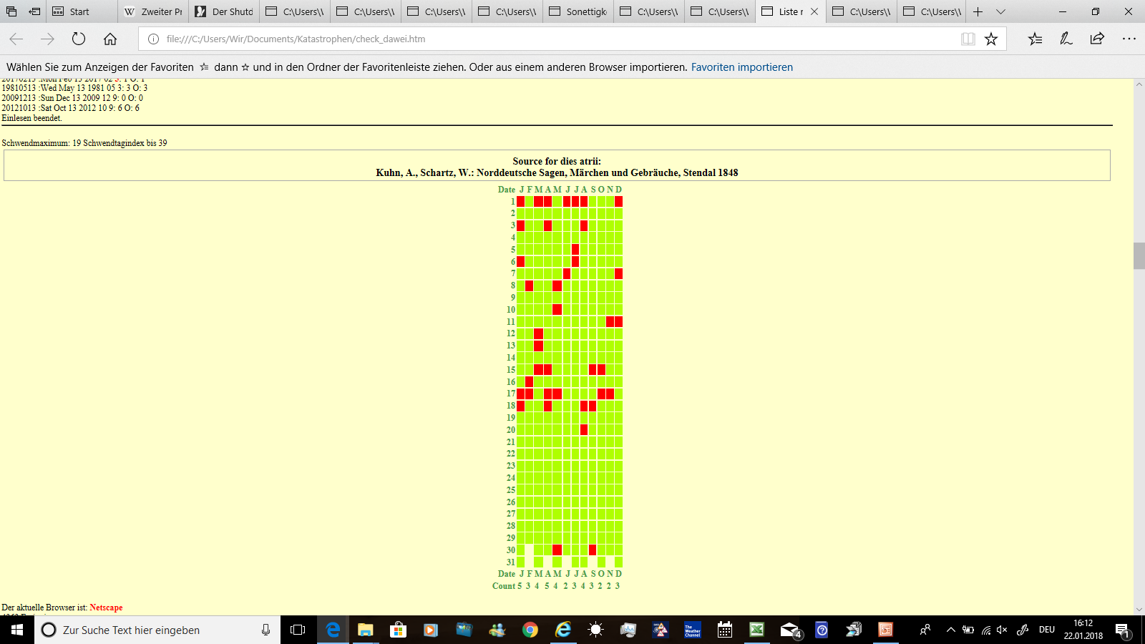
39 cases
Wi: 8 Sp: 9 Su: 10 Aut: 12
40 cases
Wi: 11 Sp: 13 Su: 9 Au: 7
9 common dates
Source for dies atri:
Kuhn, A., Schartz, W.: Norddeutsche Sagen,
Märchen und Gebräuche, Stendal 1848
Source for dies atri:
Farmers rules and esoteric
Notes:
Is there any consensus between these two types of wasted days?

Slide 6
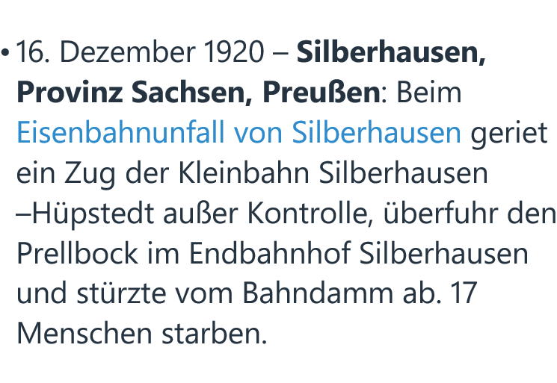
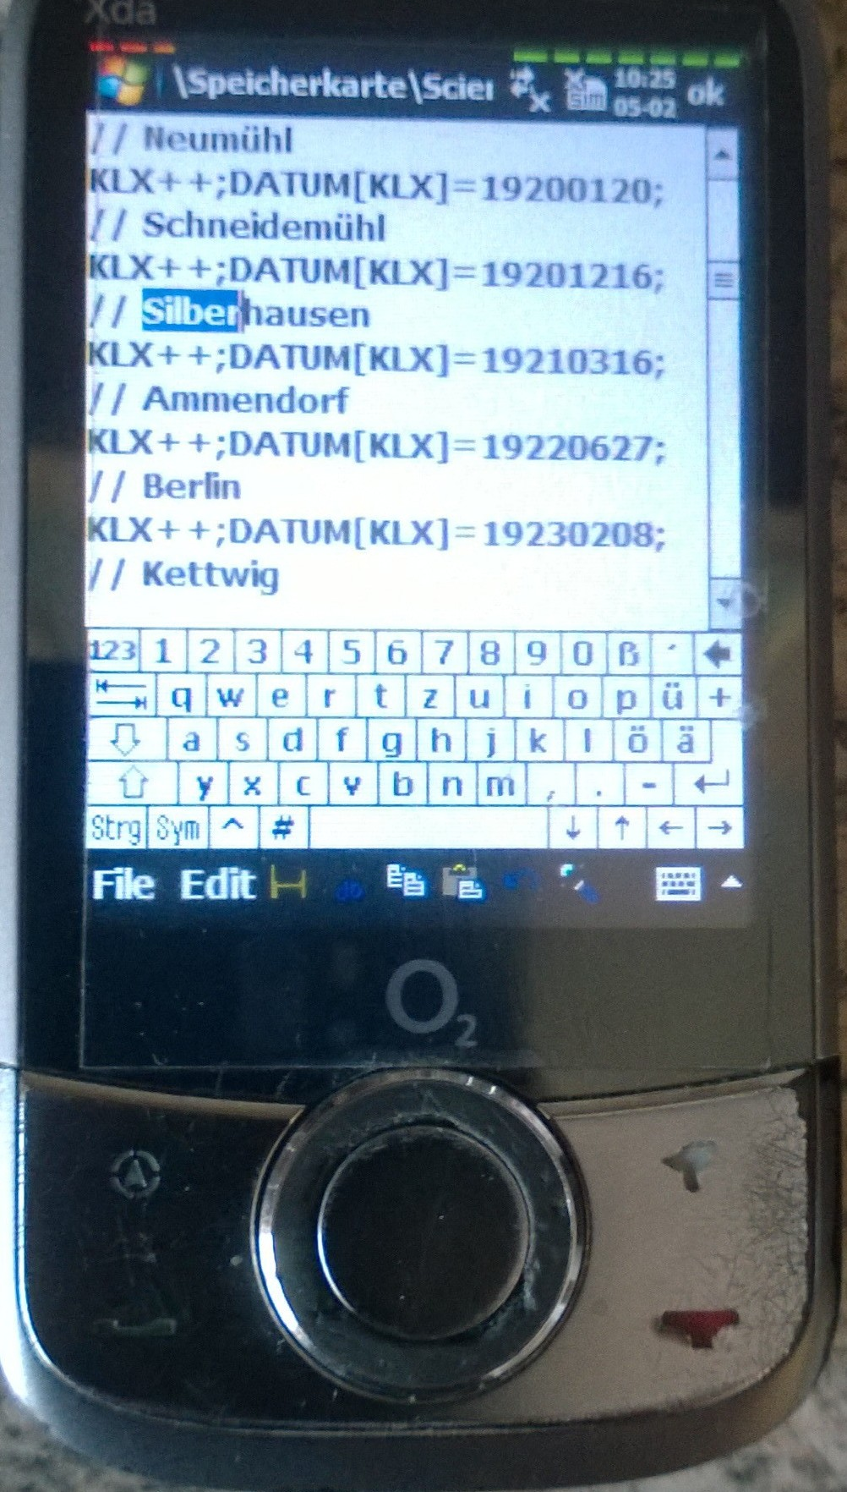
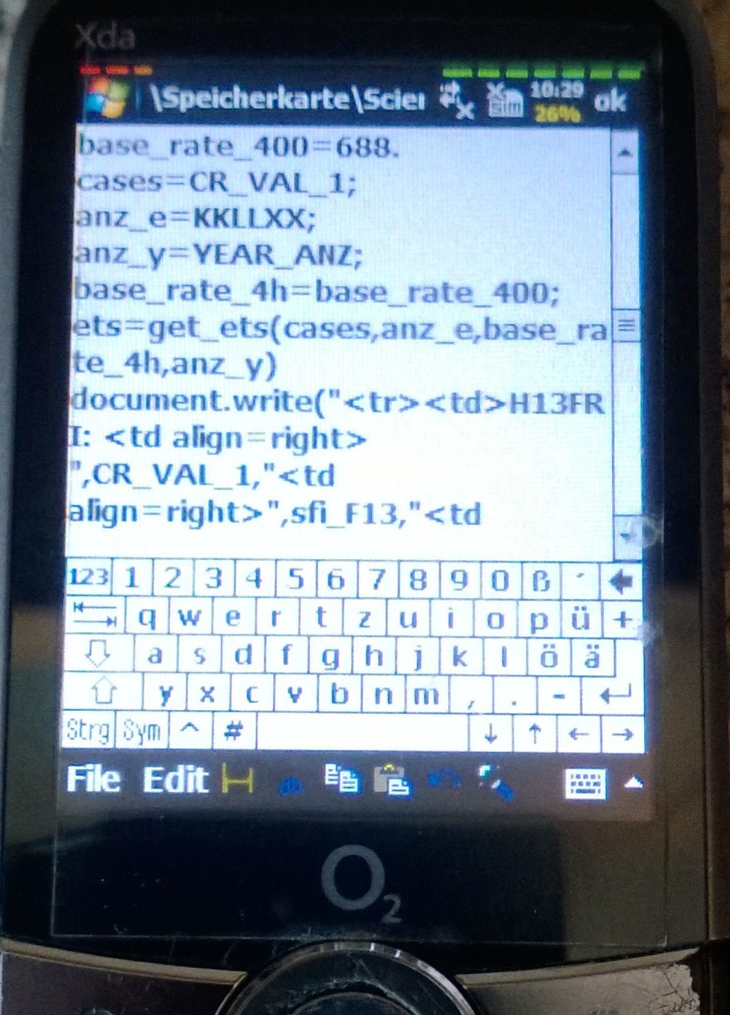
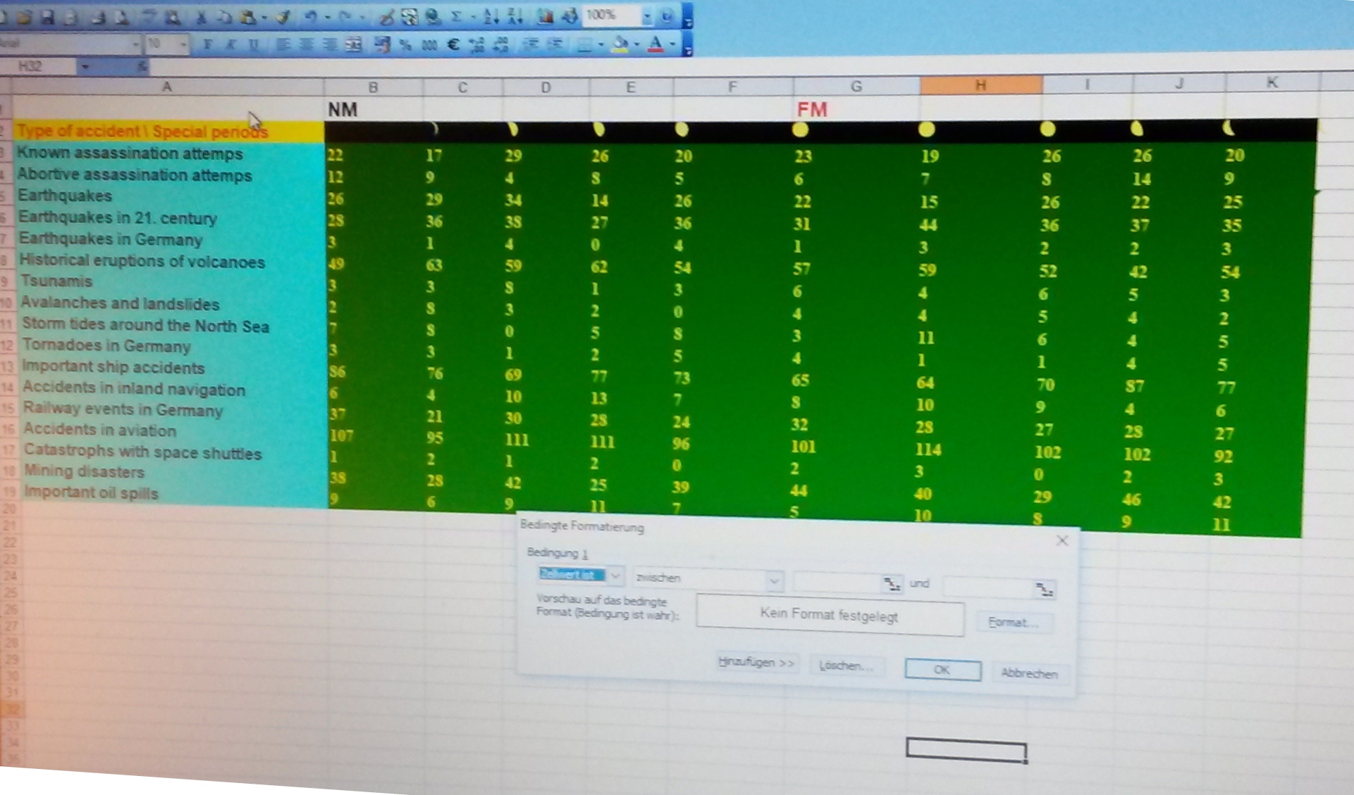
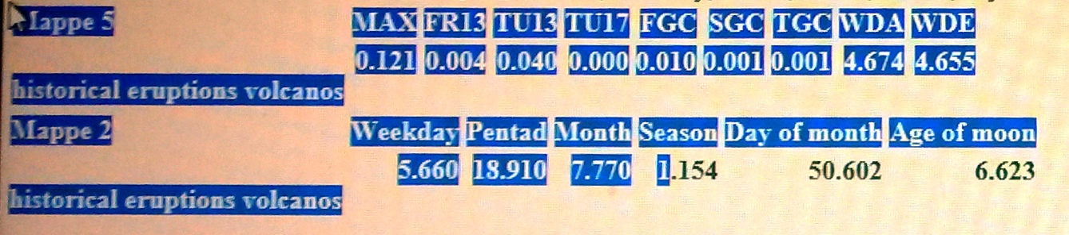

Data collection and data flow – from Wikipedia over some JavaScript files, mouse storage to excel and ppt
Notes:
Left chair arm: Mobile phone with Wikipedia articles, Right chair arm: Editor to create and modify a JavaScript data file, Later programming in JavaScript for all planned date and accident combinations with data control to avoid or at least minimize mistyping (Is D=YYYYMMDD a real date?, Is Julday (D(K-1)) < Julday (D(K))? ), transfer of all files to an PC and then copy the results via mouse storage to excel …

Slide 7
Type of accident and number of cases
Type of accident \ Number of cases | Cases
Known assassination attempts | 228
Abortive assassination attempts | 82
Earthquakes | 264
Earthquakes in 21. century | 348
Earthquakes in Germany | 27
Historical eruptions of volcanoes | 571
Tsunamis | 42
Avalanches and landslides | 36
Storm tides around the North Sea | 105
Tornadoes in Germany | 30
Accidents in nature | 1423
Important ship accidents | 748
Accidents in inland navigation | 94
Railway events in Germany | 282
Accidents in aviation | 1031
Catastrophs with space shuttles | 16
Traffic | 2171
Mining disasters | 374
Important oil spills | 85
Industry | 459
Whole number of accidents 4363
Notes:
All accidents that were available from German files in Wikipedia. Known assassination attempts mean all assassinations were planned victims are killed. Abortive attempts mean that planned victims survived and assassins were captured and/or killed - later.
The number of observed earthquakes overall and during 21th century demonstrate one problem while data collection

Slide 8
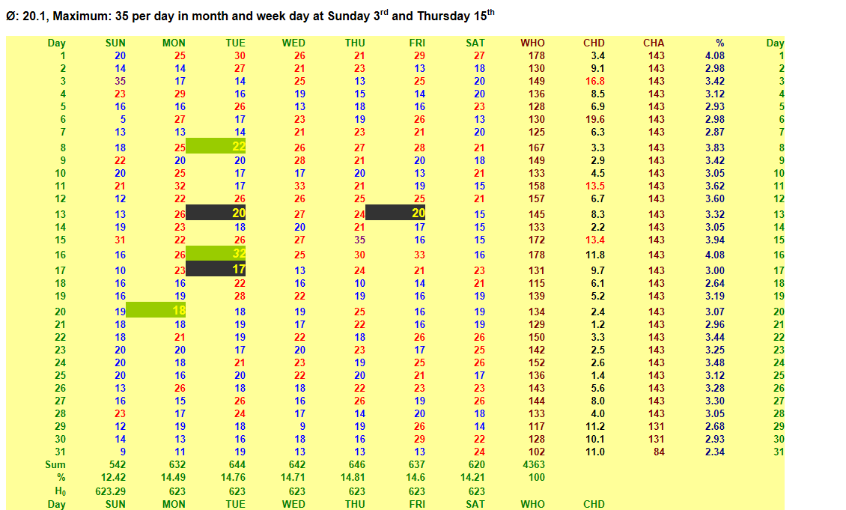
General information: All 4363 catastrophic events
B
i
r
t
h
d
a
t
e
s
o
f
t
h
e
g
r
a
n
d
c
h
i
l
d
r
e
n
WHO: sum over all weekdays at a given date
CHD: χ2 value for each date (red significant)
CHA: value of chance for each date
Sum: sum over each weekday
H₀: value of chance for each
weekday
Notes:
All information concerning date and weekday, magenta: maximal value, blue values below average, red: values above average, statistical aggregation for days, dates

Slide 9
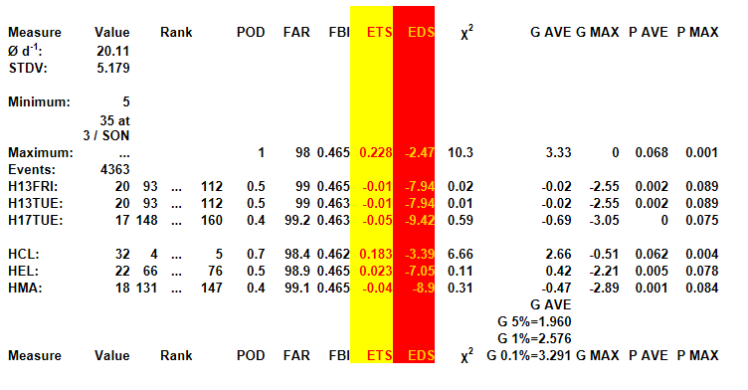
Statistical basic information concerning frequencies of accidents for one date/weekday
G (AVE,MAX): Significance test related to Gaussian distribution
P (AVE,MAX): Significance test related to Bernoullis distribution
with average or maximum as zero hypothesis
Notes:
Values and rank for different date/weekday combinations, values resulting from the contingency table (HITS: accidents at the given day, FALSE ALARMS: given day without accident, MISSING EVENTS: accidents other date, CORRECT REJECTIONS: remaining cases,) Comparison of frequency ov event with maximal and average value

Slide 10
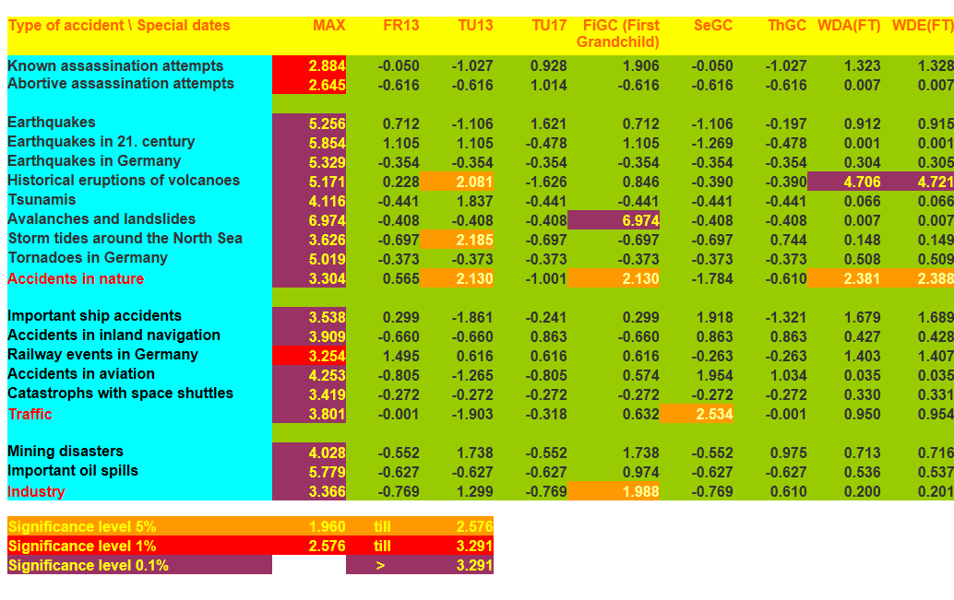
Significance levels for occurences of cases at single days and wasted days concerning Northern German tales
Significance tests for single days related to Gaussian distribution

Slide 11
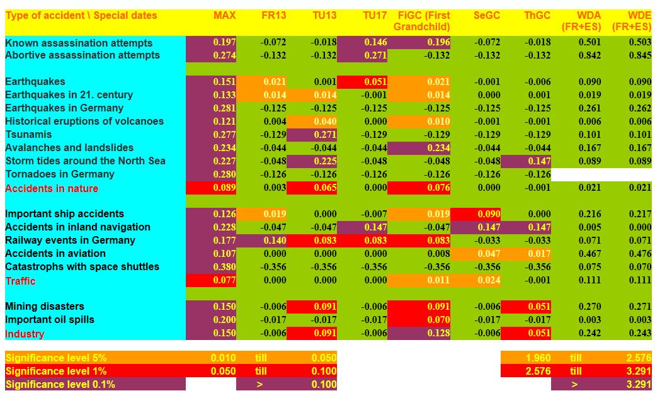
Significance levels for occurences of cases at single days and wasted days concerning farmers rules and esoteric
Significance tests for single days related to Bernoullis distribution
Notes:
Our first grandchild seems to have a real bad date-weekday-constellation compared with all known dates/days with bad luck.

Slide 12
On the interpretation of a contingency table
What do you see while looking at this carefully chosen case with randomly best results – the only case with a significant χ2 test score?
Hit rate for days with bad luck on wasted days is 77 (13.5%) compared to 494 (86.5%) on days without bad luck.
On wasted days days without bad luck occur in 9637 of 89058 cases (10.7%).
Breaking News: DwithBL on WD occur 1.3 times often than DwithoutBL!
Serious:
  Hit rates of around 0.8% for days with bad luck concerning all wasted days cannot be described as a success – especially if it is accompanied by a false alarm ratio in the order of 99% .
  Only in around 50% of all years between begin and end of the period with volcanic eruptions under consideration (1510 – 2011) were accidents observed. Wasted days occured in all the years.
  See cost-loss-analysis in the following hidden slides
 | Wasted days | Other days | All days
Days with bad luck | 77 13.5% 0.79% | 494 86.5% 0,61% | 571 100% 0.63%
Days without bad luck | 9637 10.7% 99.21% | 80680 89.3% 99.39% | 89058 100% 99.37%
All days for years with accidents Days for all years with or without an accident | 9711 19578 | 81174 163652 | 90885 183230
Notes:
This is an example which explains the problem in general. The number of false alarms and missing events is in general higher than the number of hits - for all events and wasted days and days with bad luck.

Slide 13
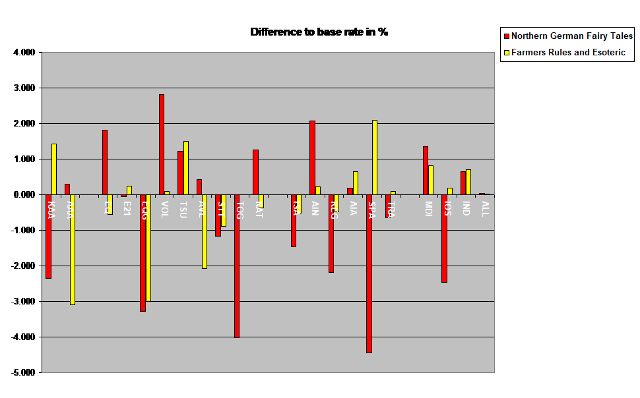
Deviations of frequencies with accidents from basic frequencies of wasted days in % (same order of categories as in slides before)
X
Category | Positive deviation from base rate | Negative deviation from base rate
Farmers rules and esoteric | 7 | 9
Northern German Fairy Tales | 9 | 8
Common cases of deviations | 3 | 5
Notes:
No systematic dependencies on days with accidents of different types exist for the two types of wasted days.

Slide 15
Relation between costs if forecast is used
to the costs in cases that prevention is never made
Relation between costs if forecast is used
to the costs in cases that prevention is ever made
Notes:
An idea from around 1995 with an extension from 2018 (yellow background). The costs for the case that a forecast (a believe on a day with bad luck) is used are compared to the costs if protection measures are ever or never taken.
The cost function reaches 1 for the values given in the formulas with yellow background. See the table at slide 18 for examples of these values.

Slide 16
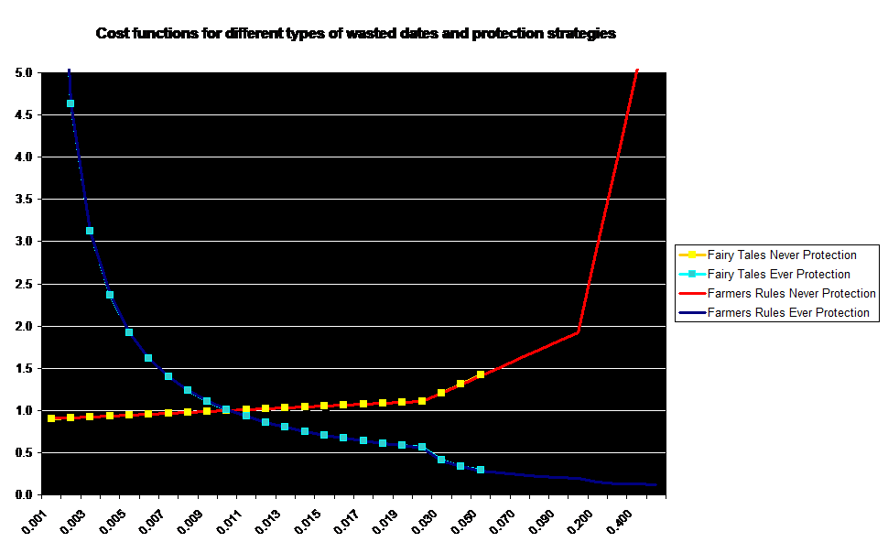
Cost function (vertically) for different types of wasted days and different protection strategies depending on cost-loss-ratio (horizontally)

Slide 17
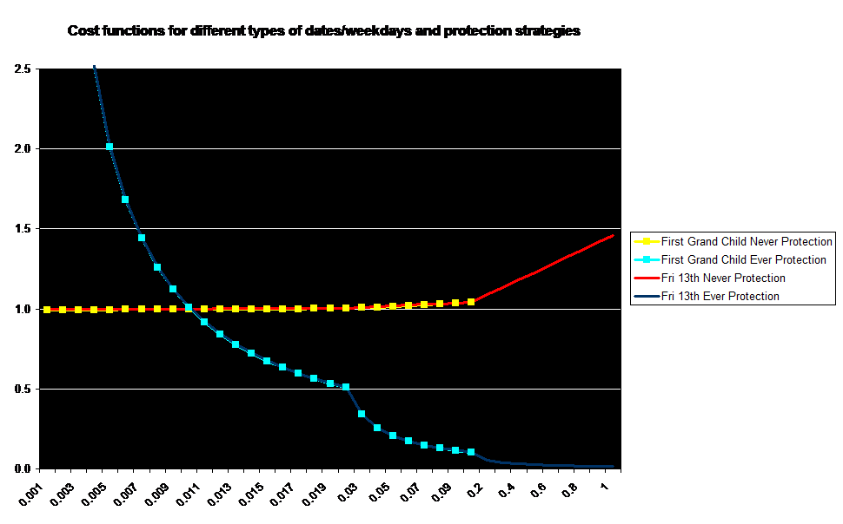
Cost function (vertically) for different types of date/weekday combinations and different protection strategies depending on cost-loss-ratio (horizontally)

Slide 18
Cost function with value 1 for as a function of different protection rules for different wasted days and date/weekday combination
Bad luck type | Critical CLR for strategy ever protection (values below cause higher costs than use) | Critical CLR for strategy never protection (values above causes higher costs than use)
Maximum | 0.01009 | 0.01724
FR 13 | 0.01012 | 0.00985
TU 13 | 0.01012 | 0.00990
TU 17 | 0.01013 | 0.00841
FGC | 0.01010 | 0.01586
SGC | 0.01012 | 0.01086
TGC | 0.01013 | 0.00888
WD NGFT | 0.01017 | 0.01013
WD FR | 0.01015 | 0.01013
Notes:
Mo differences can be seen by eye ball inspection between the cost functions for different types of wasted days and protection strategies on pages 16 and 17. The values of cost-loss-ratio where cost function crosses 1 are extremely small and sign that the strategy "Never protection" is probably the favourite compared to the alternate strategy.

Slide 19
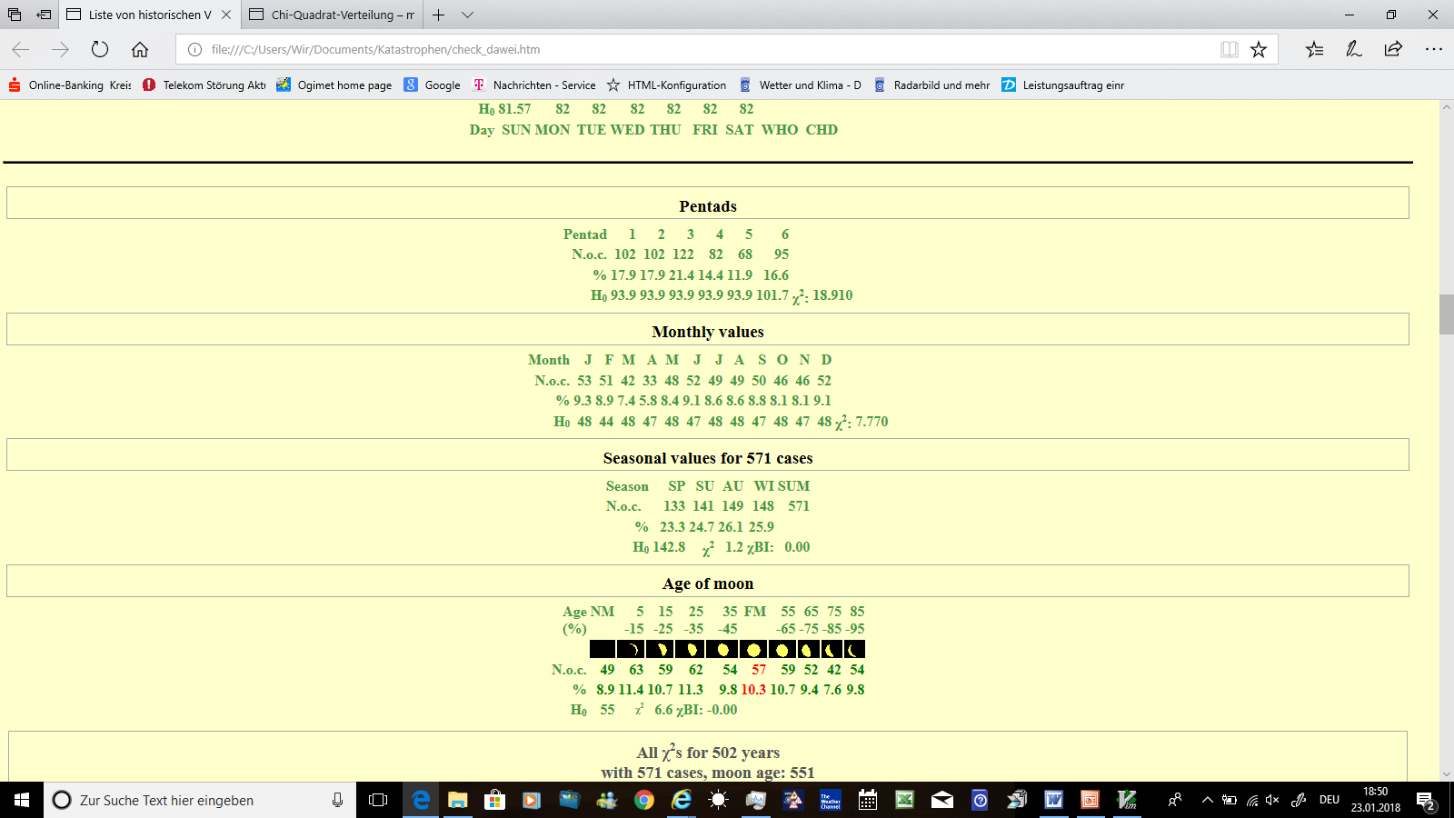
Evaluation for different periods: Example volcanic eruptions
Notes:
Surprise: Why a minimal frequency of volcanic eruptions aoocur between 20th an 25th of a month? Data quality: 10 times a storm tide at the North Sea at All Saint‘s day

Slide 20
Evaluation for different periods: Example volcanic eruptions
Notes:
χ-BI: Control value for calculation of χ2, has to be Zero

Slide 21
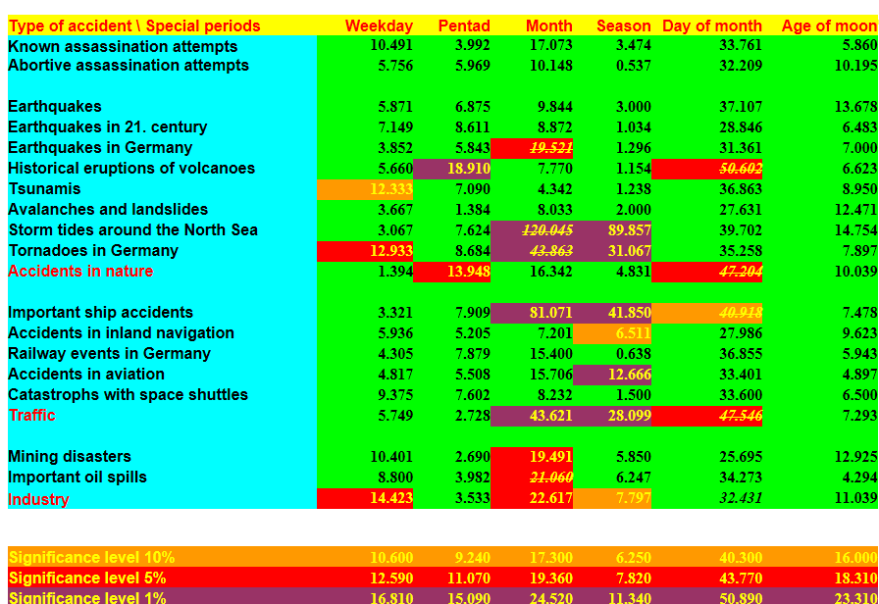
Significance levels for occurences of cases during special types of periods

Slide 22
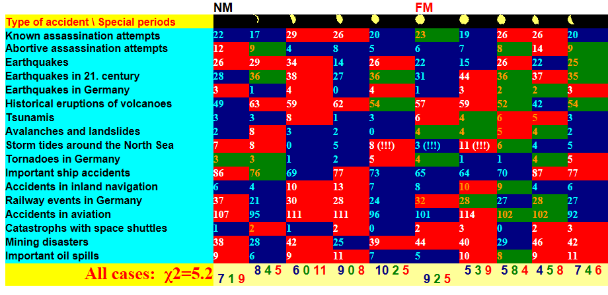
Number of accidents during different moon ages: below average, around average, above average

Slide 23
Summary and conclusions
A first attempt was made to prove the nonsense of some elements of superstition.
This attempt seemed to be successful with some problematical results.
Accidents seem to be related more to special periods like months and seasons with specific human activities than to special days.
Statistics has to be refined in order to be more serious (Homogeneity of observation material, learning module - verifying module, comparison 1600-1615 with 2000-2015 because of same weekday/date constellations …).
While believing in occurence of accidents at special days – keep in mind also the false alarms and missing events.
Point 5. will probably have no sense in popular belief. Paraskavedekatriaphobia and self-fulfilling prophecies are mighty weapons.
If there are any questions please contact:
u2.damrath@t-online.de
Notes:
The described results should not judged as serious statistical results. It is a first attempt to reproduce the origin of popular belief. Serious statistics may follow.

