Slide 1


Common Plot Reports
2018-2019

Slide 2

Last year…….
Common Plot Reports 2017-2018
Guidelines prepared and sent in Oct (WG5 web repository)
Keep the coarser resolution comparison (~5-7km) for one year (trend since 2011)
Add high res model comparison on two “semi-common” areas: different climatology
Keep 12UTC run for coarser resolution comparisons
Extremal dependence scores – EDI for 6h and 24h precipitation
Add LCC on top of TCC, also categorical scores with thresholds – NOT POSSIBLE
Add wind gust categorical scores
Add wind performance rose diagrams for selected stations – Maria Stefania presentation

Slide 3
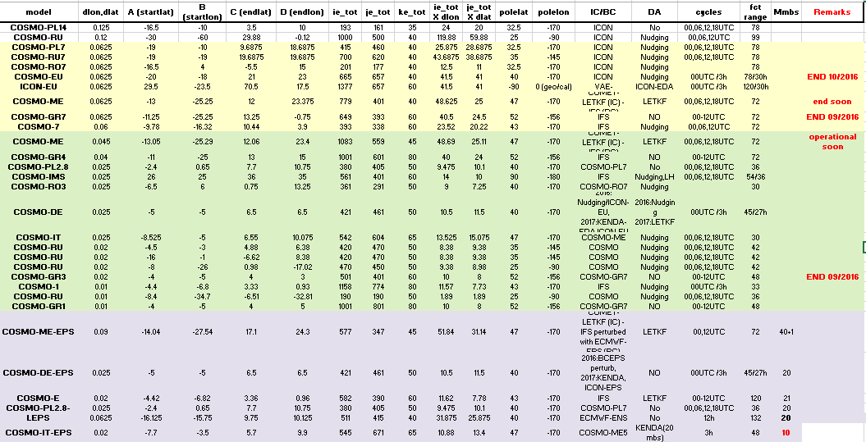
_{Feedback from questionnaire}
_{~7km}
_{~1-4km}
_{EPS}

Slide 4



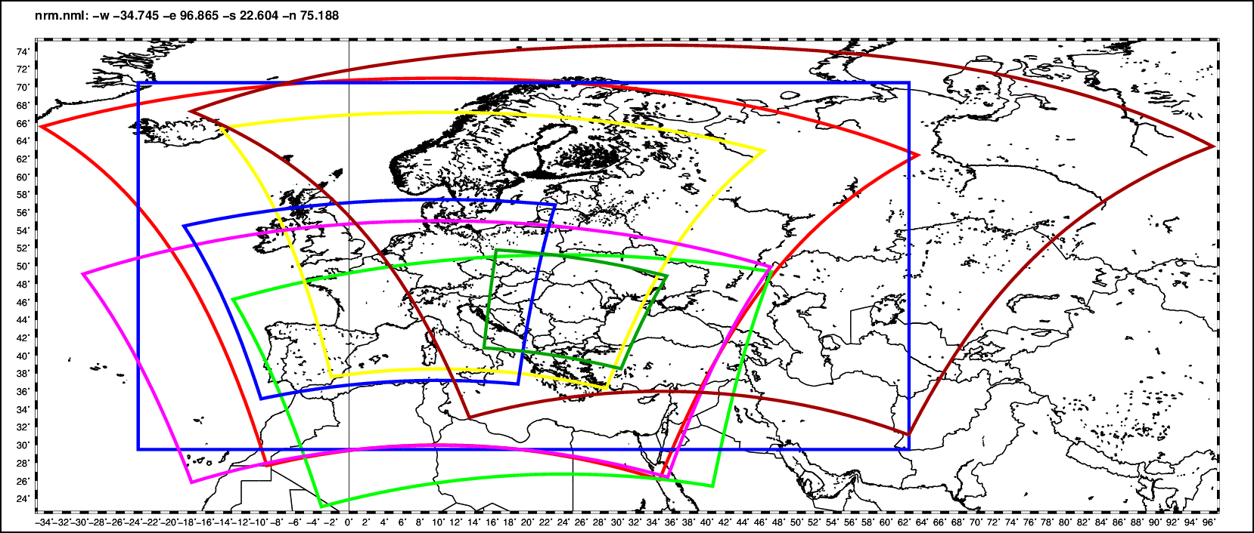
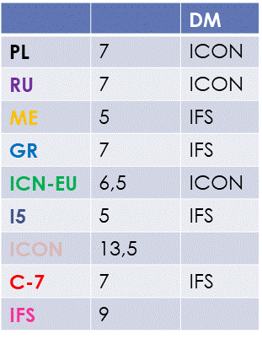
Common Area 1: coarse resolution
DWD (ICON-EU)
IMGW
RHM
DWD (ICON-EU)
MCH
COMET
NMA
HNMS

Slide 5
Common Area 1: coarse resol
ICON-EU (DWD), COSMO-7 (MCH), COSMO-ME4 (COMET), COSMO-GR4 (HNMS), COSMO-PL7 (IMGW), COSMO-RU7 (RHM), COSMO-5M (ARPAE) and the two driving models ECMWF-IFS, ICON.
Standard Verification (seasonal):
Continuous parameters - T2m, MSLP, Td 2m, WSpeed, TCC. Scores: ME, RMSE
Dichotomic parameters – Precipitation. Scores: Contingency table, FBI, ETS. Cumulating: 6h and 24h
Thresholds: 0.2, 0.4, 0.6, 0.8, 1, 2, 3, 4, 5, 6, 7, 8, 9, 10, 12, 14, 16, 18, 20 mm/6h and mm/24h
Dichotomic parameters – TCC (30km radius method). Scores: Contingency table, FBI, ETS, CSI.
Intervals: [0,25], (25, 75), [75,100]
Dichotomic parameters – Windgust (3D method height optimized): Obs: WMO Code 11233, Fcs:VMAX_10M (187,201). Scores: Contingency table, FBI, ETS, CSI.
Thresholds: 12.5, 15, 20 m/sec.
EDI (Extremal Dependency Index)
Type: Standard, Period: Seasonal, Parameter: Precipitation, Method: 15 km radius method, Index: EDI (Dichotomic). Thresholds: 1, 5, 10, 15, 20, 25, 30 mm/6h and mm/24h.

Slide 6
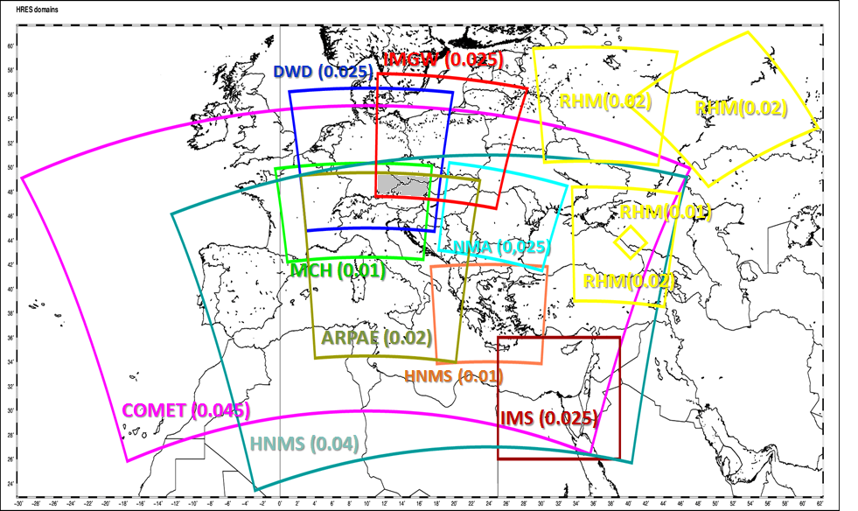
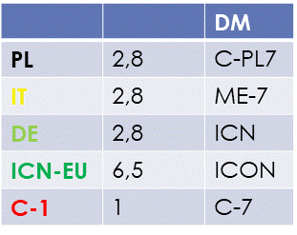
Common Area 2

Slide 7
Common Area 2
COSMO-DE (DWD:0.025), COSMO-1 (MCH:0.01), COSMO-PL2.5 (IMGW:0.025), COSMO-IT (CoMET:0.025), COSMO-I2 (ArpaE:0.025) and the two driving models ECMWF-IFS, ICON-EU.
_{Standard Verification:}
Continuous parameters- T2m ,Td, Wspeed, TCC. Scores: ME, RMSE. Forecast Step: every 3 hours
Dichotomic parameters – Precipitation (8 km radius method). Scores: FBI, ETS. Cumulating: 6h and 24h
Dichotomic parameters – Windgust (3D method height optimized): Obs:WMO Code 11041, Fcs:VMAX_10M (187,201). Scores: Contingency table, FBI, ETS, CSI.
Thresholds: 12.5, 15, 20 m/sec.
Cycle: Only 00UTC cycle will be verified for continuous and dichotomic parameters.
_{Extremal Dependence Index}
Type: Standard, Period: Seasonal, Parameter: Precipitation, Method: 8 km radius method, Index: EDI (Dichotomic). Thresholds: 1, 5, 10, 15, 20, 25, 30 mm/6h and mm/24h.

Slide 8
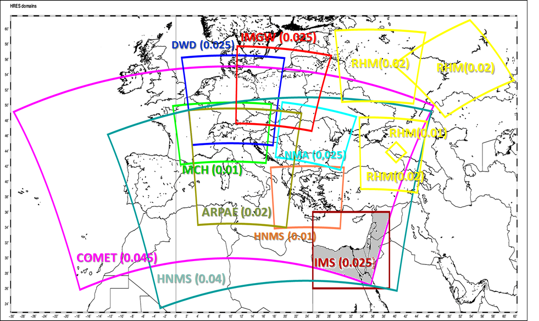
Common Area 3
Scenario 5
model | resolution
COSMO-IMS | 0.025
COSMO-ME5 | 0.045
COSMO-GR4 | 0.04

Slide 9
Common Area 3
COSMO-ME5 (COMET), COSMO-GR4 (HNMS). COSMO-IL(IMS)
_{Standard Verification:}
Continuous parameters- T2m ,Td, Wspeed, TCC. Scores: ME, RMSE. Forecast Step: every 3 hours
Dichotomic parameters – Precipitation (8 km radius method). Scores: FBI, ETS. Cumulating: 6h and 24h
Dichotomic parameters – Windgust (3D method height optimized): Obs:WMO Code 11041, Fcs:VMAX_10M (187,201). Scores: Contingency table, FBI, ETS, CSI.
Thresholds: 12.5, 15, 20 m/sec.
Cycle: Only 00UTC cycle will be verified for continuous and dichotomic parameters.
_{Extremal Dependence Index}
Type: Standard, Period: Seasonal, Parameter: Precipitation, Method: 8 km radius method, Index: EDI (Dichotomic). Thresholds: 1, 5, 10, 15, 20, 25, 30 mm/6h and mm/24h.

Slide 10
Common Plots activity for 2018-2019
Keep the standard parameter scores for CM1 and CM2 Ito maintain long term trends
Additional wait to dedicated verification analysis: model performance of various weather reimes/climate (CM3), performance rose for wind sp/dir (M.S.Tesini)
Include FSS for CA2 aggregated over cases that warnings were issued (by Arpa-PT possibly if obs in gridded format become available
Abort VERSUS as mandatory for Common Plots production when is necessary. Delivery of txt files with statistical results following the guidelines in the any possible degree

Slide 11
Common Plots suggestions for 2018-2019 Neighborhood methods
New possibilities of Verification for this year would be application of VAST software for the application of Neighborhood methods (with space/time windows)
Necessary to have OPERA gridded observations for Common Area 1 in grib format – Available?
Naima Vela could take over the activity if obs are available. Files have to be however for the same area (?) and format as the ones E.Oberto is collecting for the Long term trends
This may not be possible for a whole season but for specific days of each season, maybe after selecting days where weather warnings for intense precipitation were issued over the area of interest.

