Slide 1


WG5
WG5: Common Plot Reports
Dimitra Boucouvala & WG5
Notes:
This year, I was assigned the task of the Common Verification, which included comparison of model results over a Common Area

Slide 2

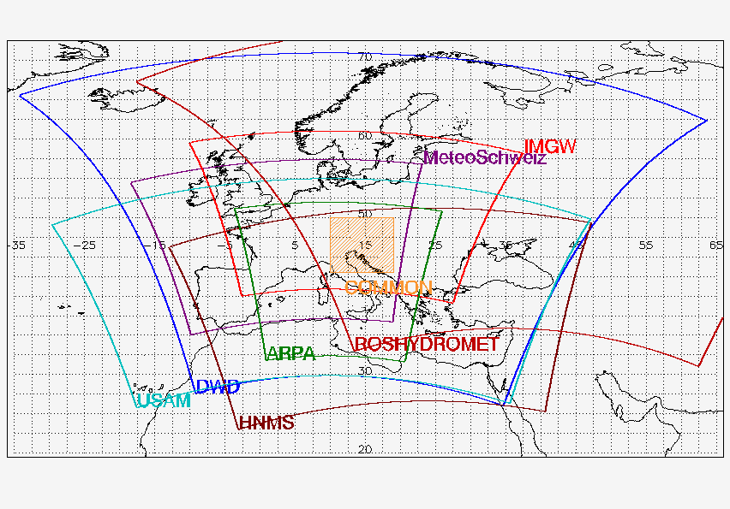
Standard Verification on Common Area 1- COSMO models and IFS/ECMWF- ICON for 00 and 12UTC Runs
Notes:
The Common Area in respect to each country’s domain

Slide 3
Standard Verification on Common Area
Period: JJA 2017- MAM 2018
Continuous parameters - T2m, Td2m, Mslp, Wspeed, (3 D method height optimized) TCC (30km radius method)
  Scores : ME, RMSE
  Forecasts Step: every 3 hours for 72 hours
Dichotomous parameters – Precipitation (15km radius method):
  Scores: FBI-POD-FAR-TS with Performance Diagram
  Cumulating: 6h and 24h
  Main Thresholds: 0.2, 1, 2, 5, 10, 20 mm/6h and mm/24h
Notes:
So this year we introduced HR test for the Various domaina

Slide 4
Additional Verification on Common Area
1 & 2 based on last GM
Dichotomic cloud verification 0-25, 25-75,75-100:
FBI, ETS, CSI
Wind Gust Verification for CM1 (only few countries provided)
Not done : Low and High Cloud cover verification
  Extremal Dependency Index (EDI ) 6h and 24h cumulating Preci (00 Run): Thresholds: 1, 5, 10, 15, 20, 25, 30

Slide 5
COSMO models used for Common Area
Resolution and Driving Model
 | JJA17 | SON17 | DJF18 | MAM18 | DM
PL | 7 | 7 | 7 | 7 | ICON
RU | 7 | 7 | 7 | 7 | ICON
ME | 5 | 5 | 5 | 5 | IFS
GR | 7 | 4 | 4 | 4 | IFS
ICN-EU | 6,5 | 6,5 | 6,5 | 6,5 | ICON
I5 | 5 | 5 | 5 | 5 | IFS
ICON | 13,5 | 13,5 | 13,5 | 13,5
C-7 | 7 | 7 | 7 | - | IFS
IFS | 9 | 9 | 9 | 9
No Data for C-7 in MAM, no TCC for C-RU7
Notes:
The model characteristics

Slide 6
Weather elements for ComA
JJA : above average warm – extremely in June- some days of precipitation
SON: Relatively cool some rain and snow
DJF : Genarally Mild winter
MAM: Warm spring (especially April and May) with little precipitation

Slide 7
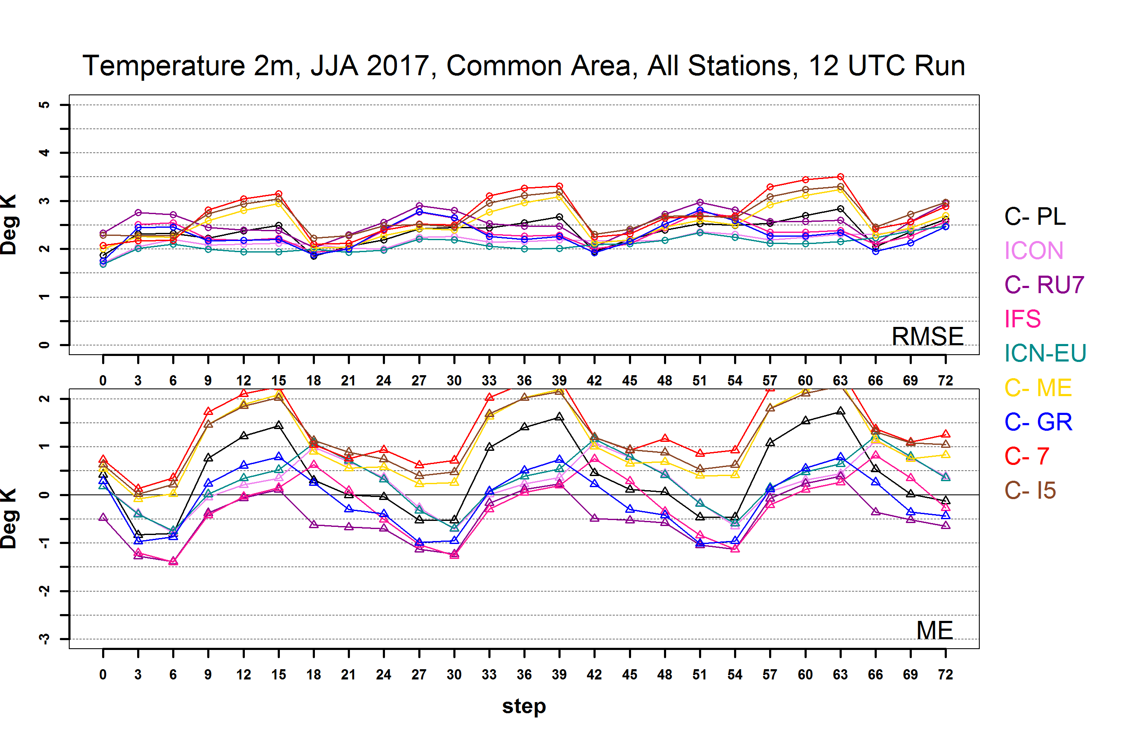
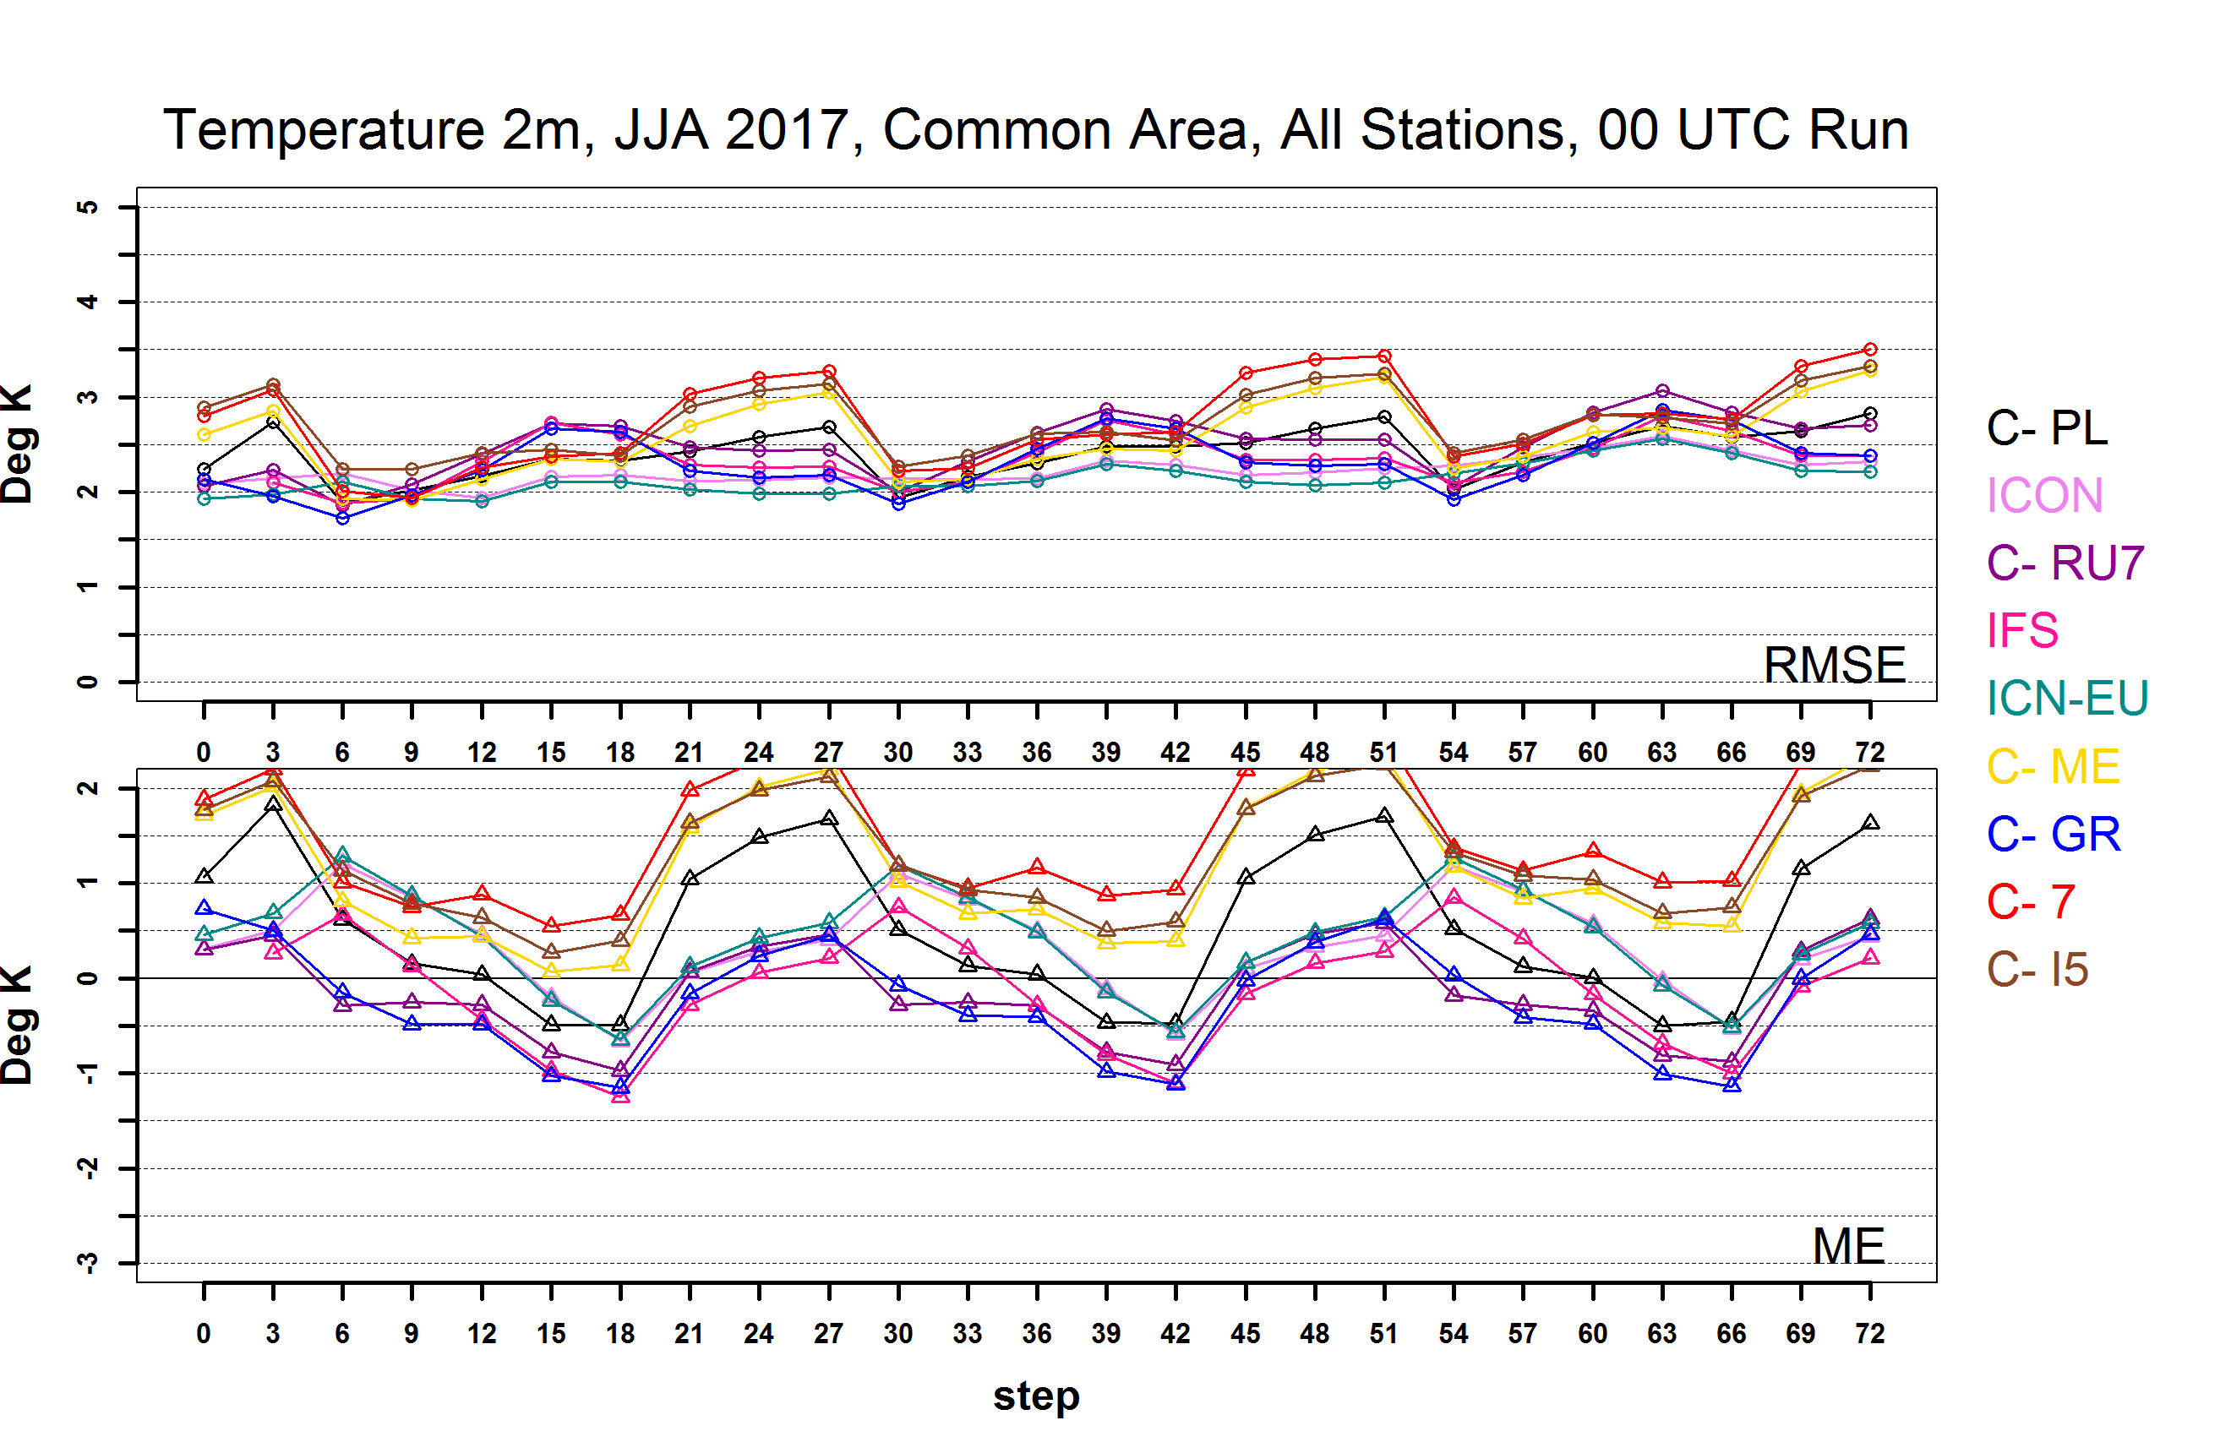
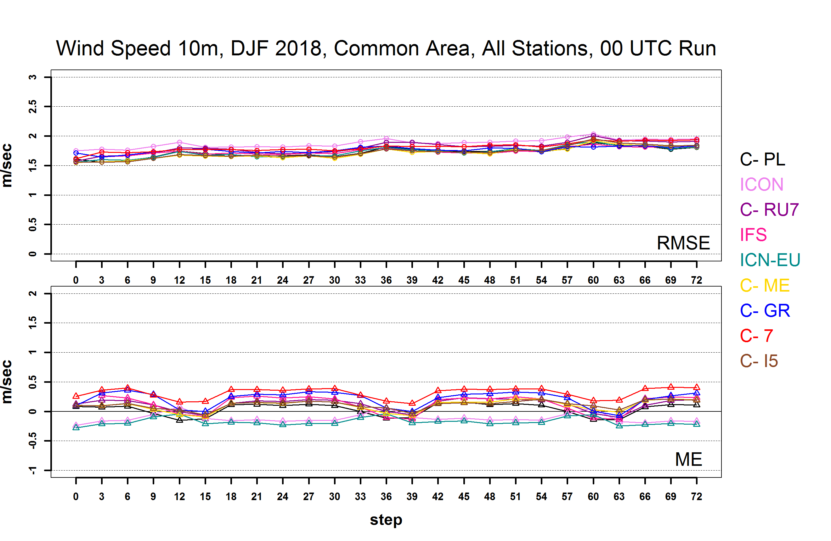
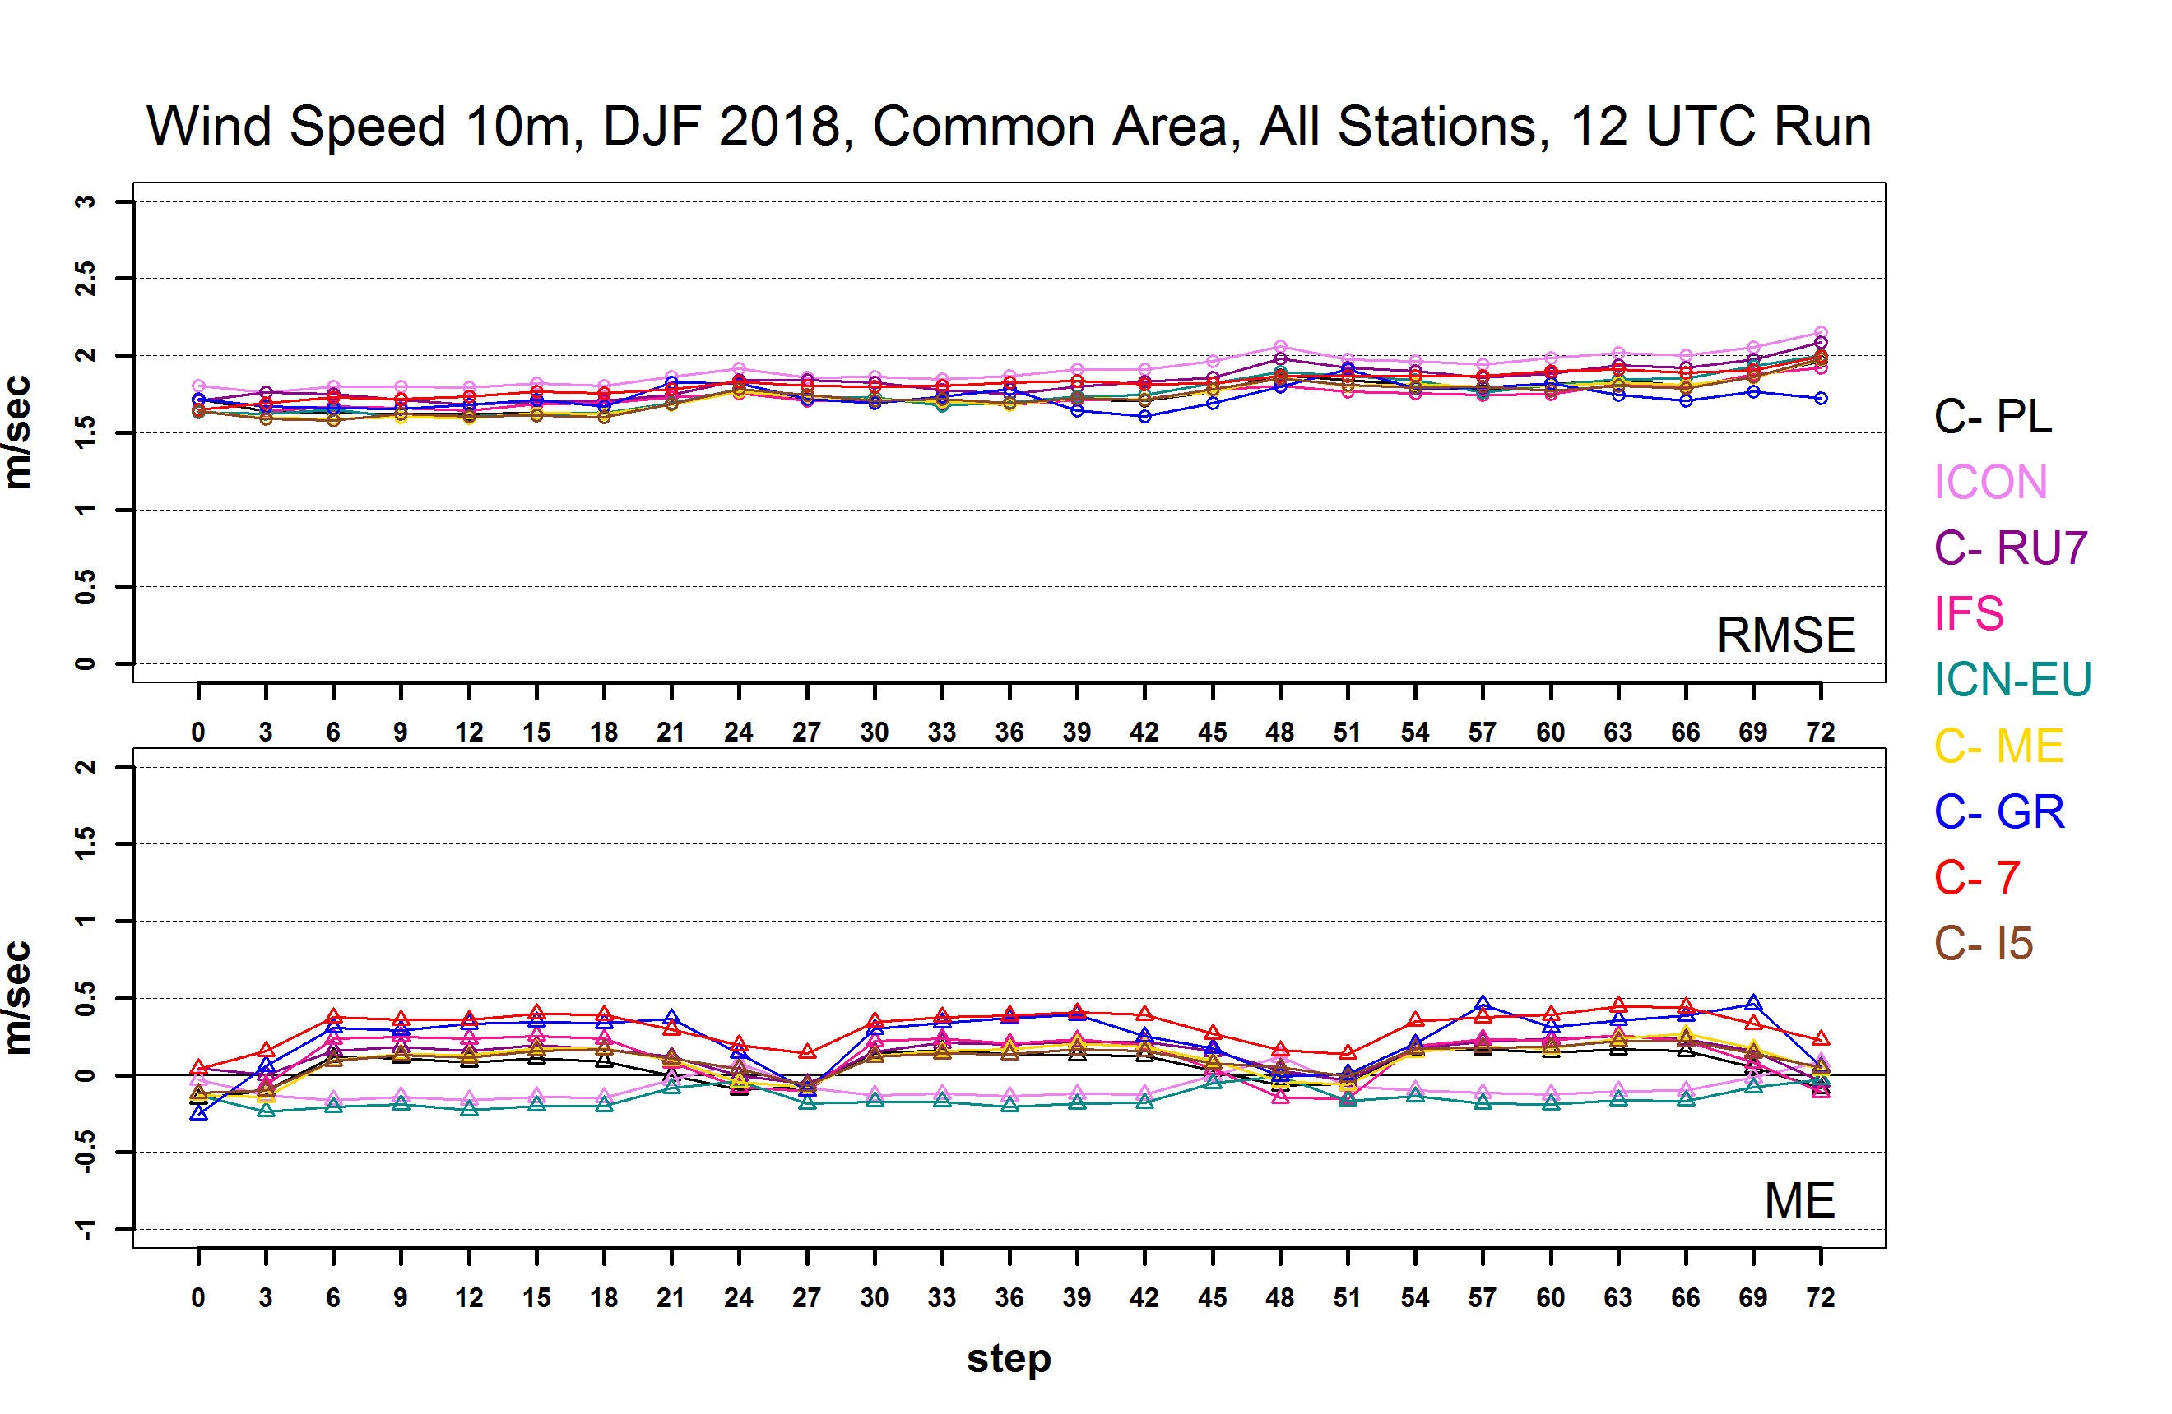
_{T2M}
00 UTC
Run
00 UTC Run and 12 UTC Run score difference is not significant
12 UTC
Run
_{WS}
Notes:
00 UTC Run and 12 UTS Run score difference is not significant, except some scores of 2m Dew Point Temperature.

Slide 8
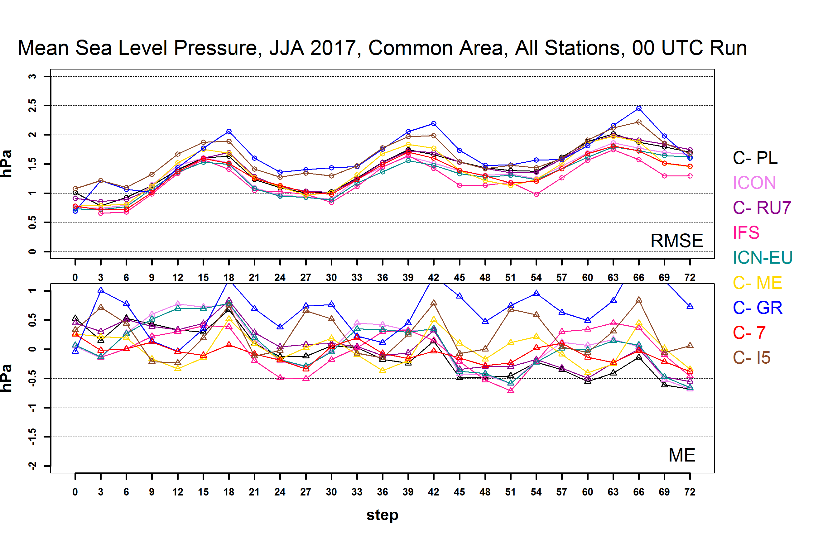

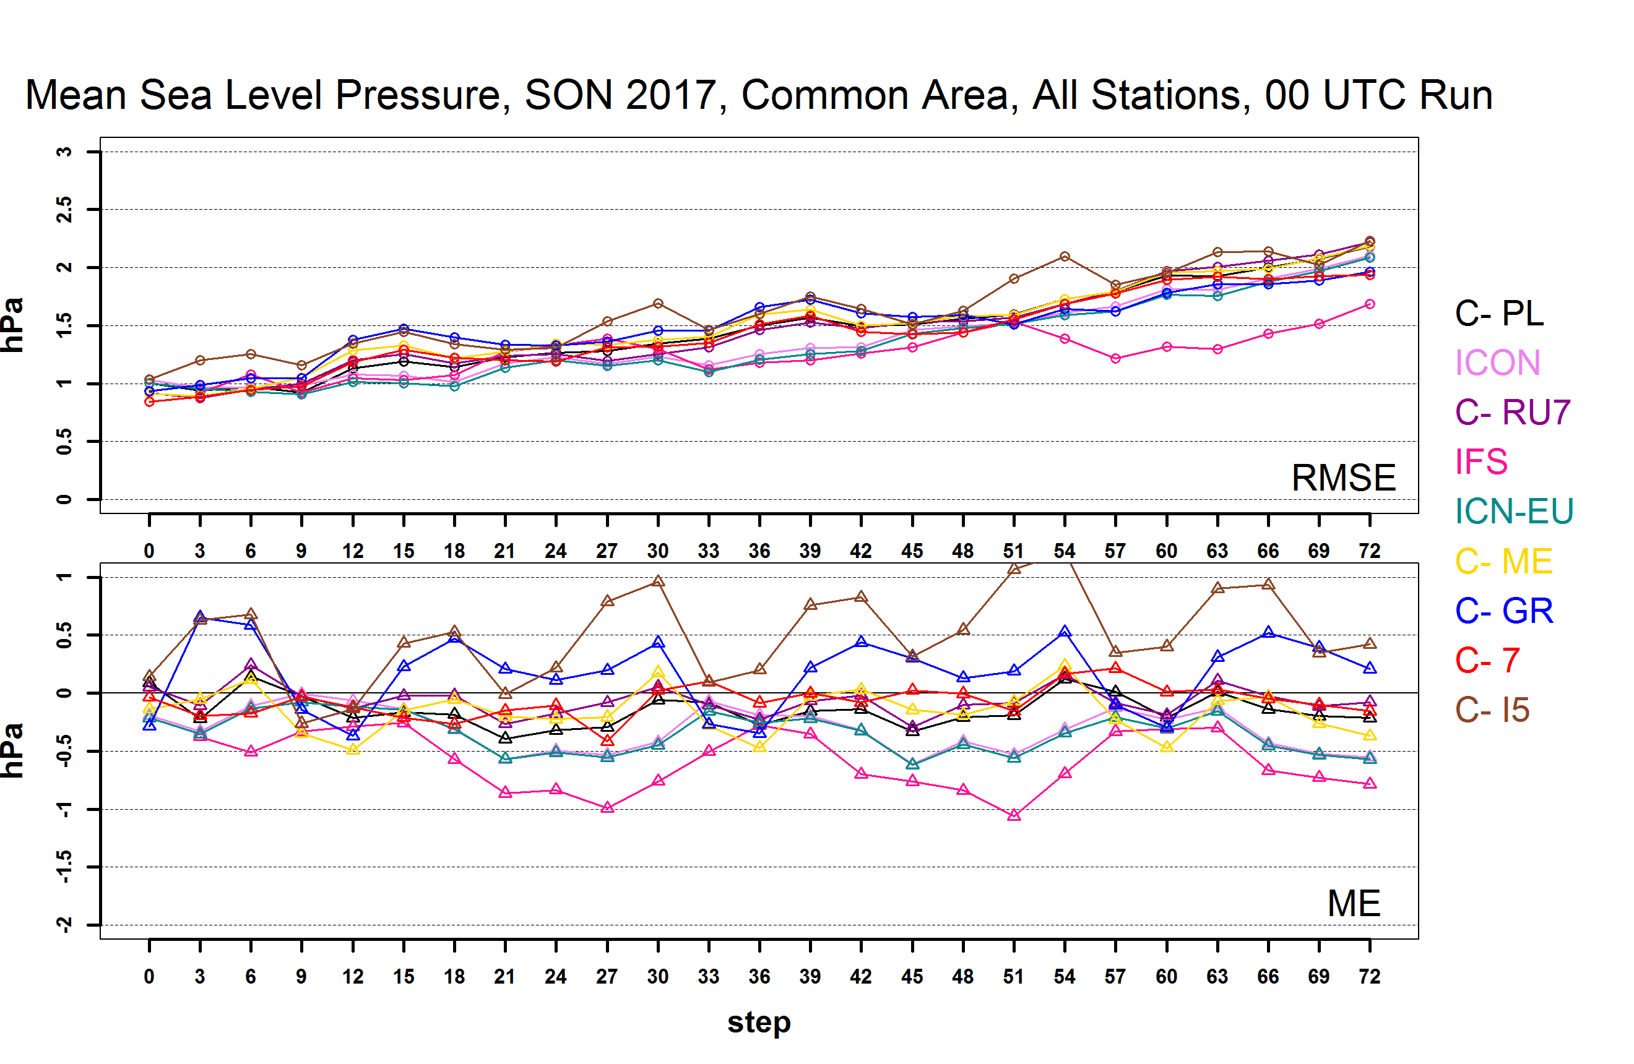

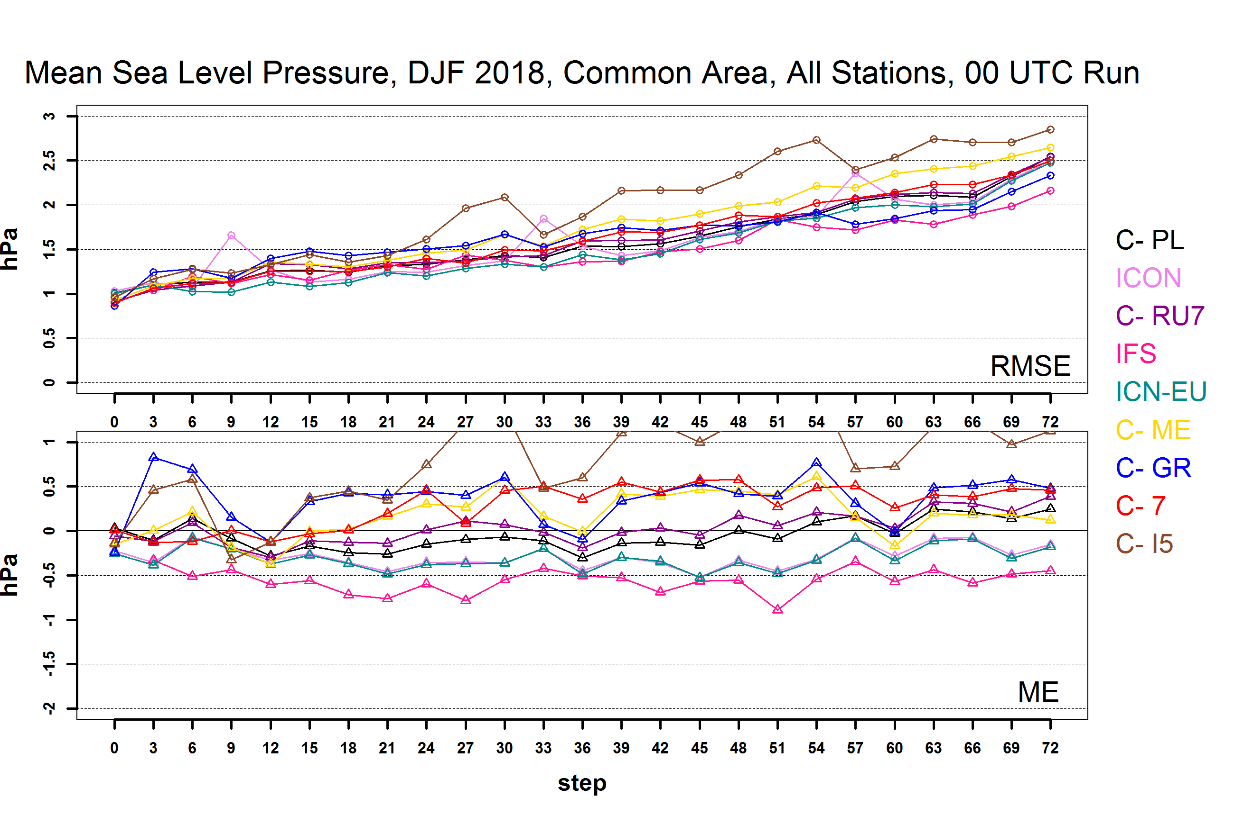
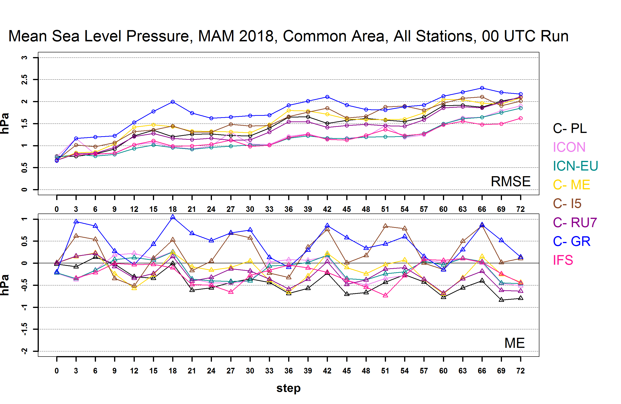


MSLP 00 UTC Run
JJA RMSE diurnal cycle. ME oscillating around zero. RMSE increasing with time faster in DJF
Notes:
First lets have a look at the summertime where the error tendency is different from the other seasons I left COSMO-EU

Slide 9
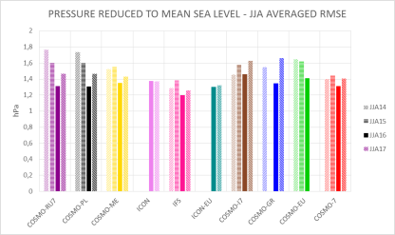
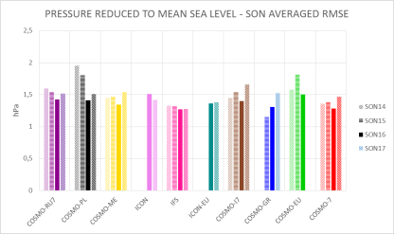
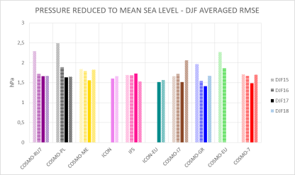
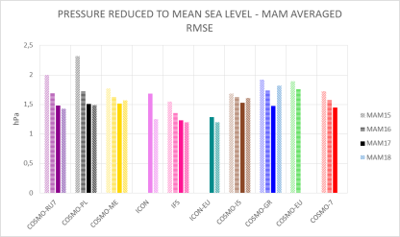

MSLP RMSE Tendency
$$RMSEseasonal=\sqrt{\frac{1}{n}\sum_{k=1}^{n}{(RMSE)k2}}$$
JJA SON DJF slight increase since last year. MAM decrease

Slide 10
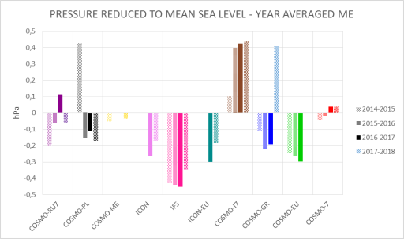
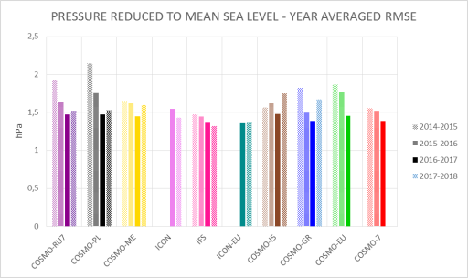
MSLP Annual Tendency Scores
All global models and ICON-EU
ME negative tendency and
decrease of ME
RMSE increase for all COSMO
models but slight decrease for
IFS ICON

Slide 11
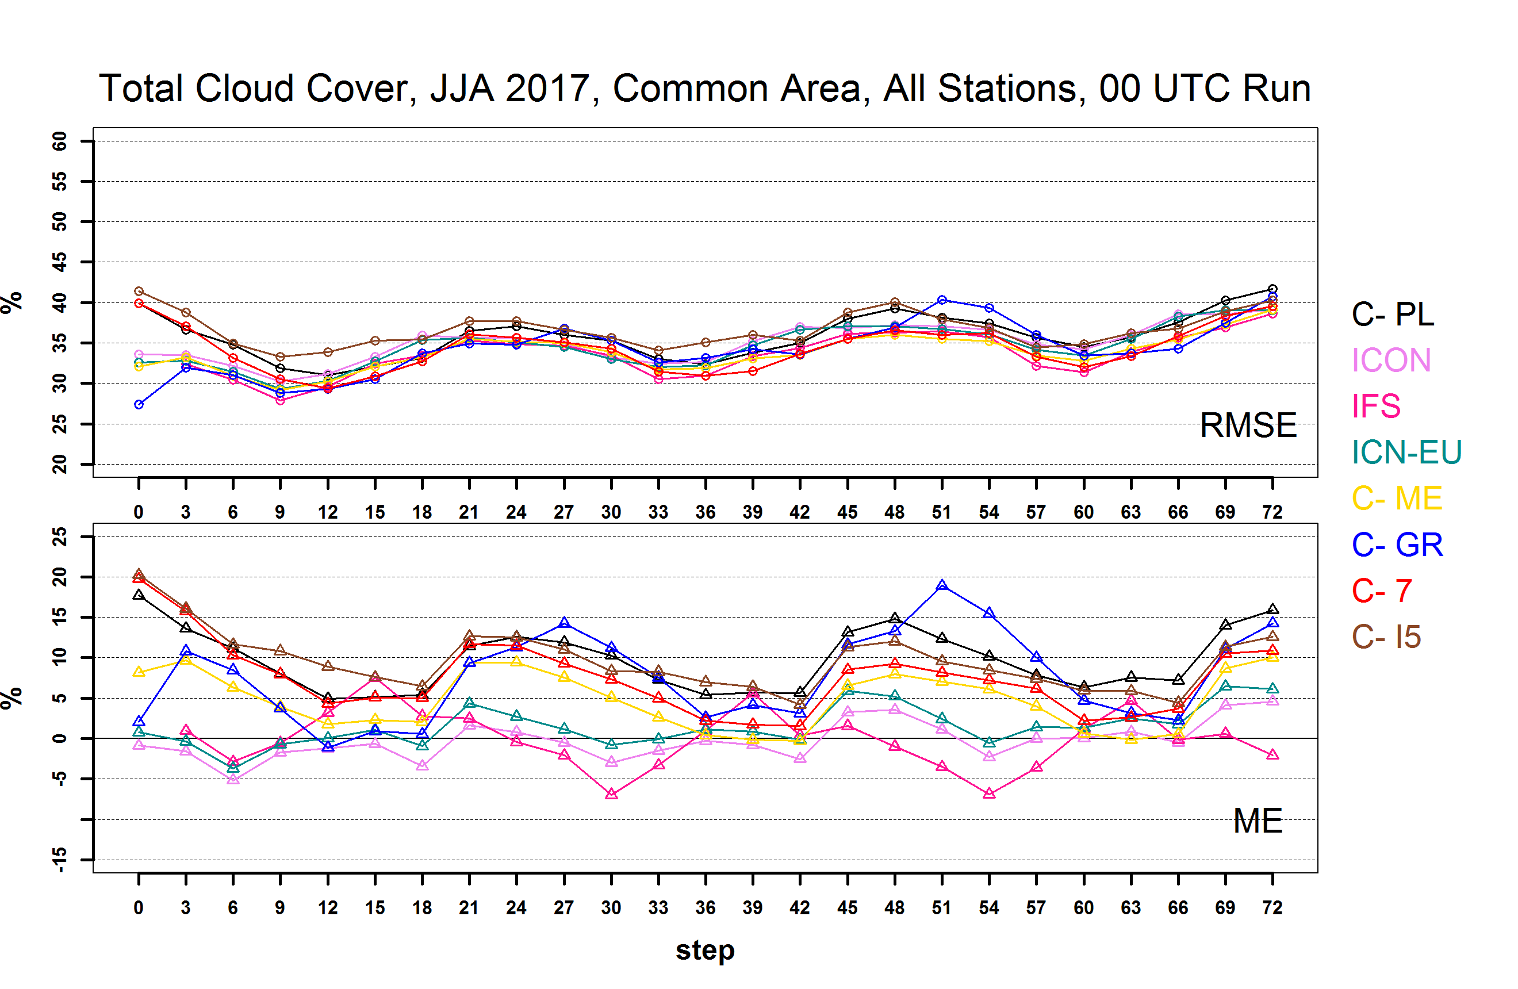
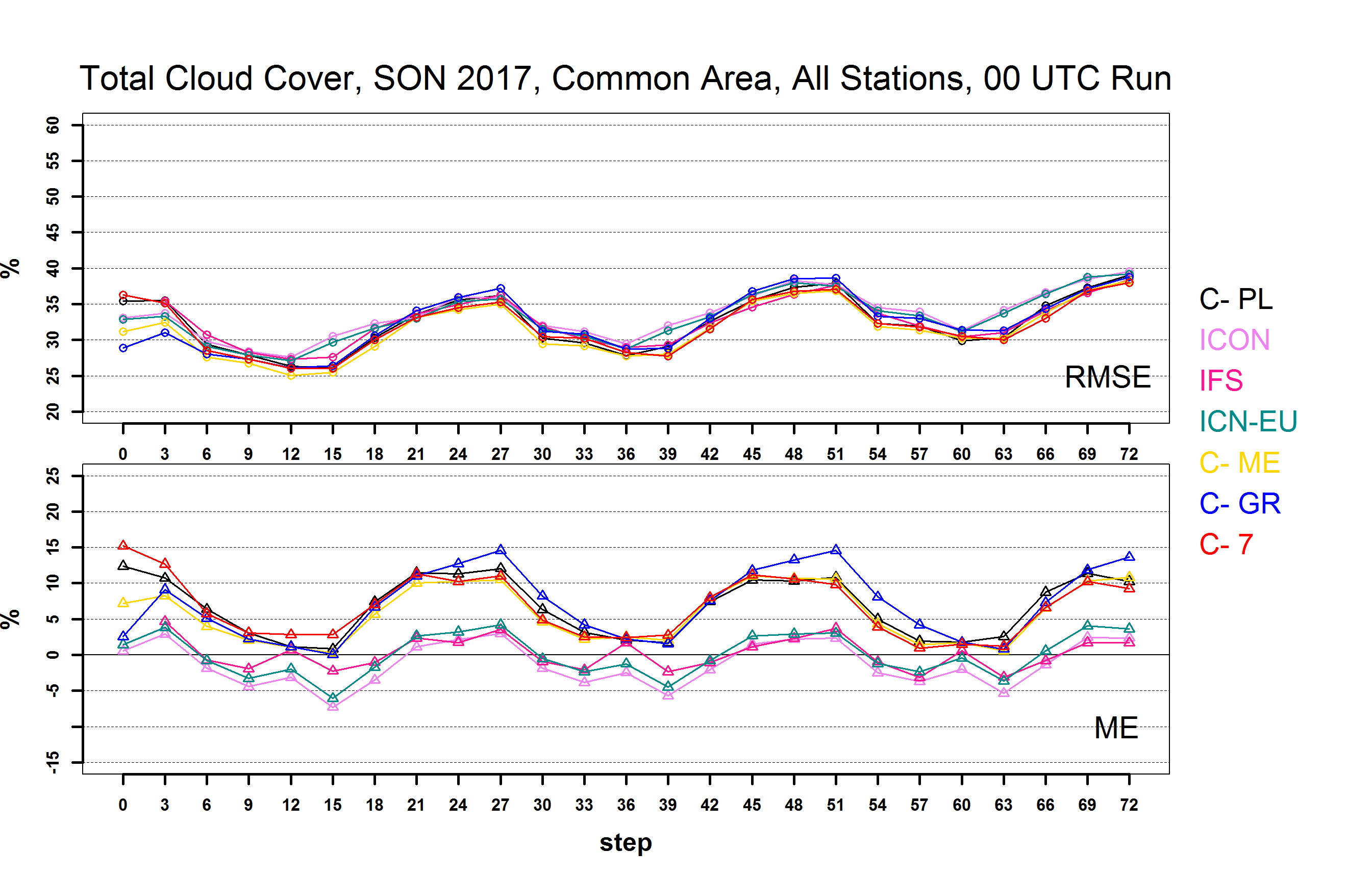
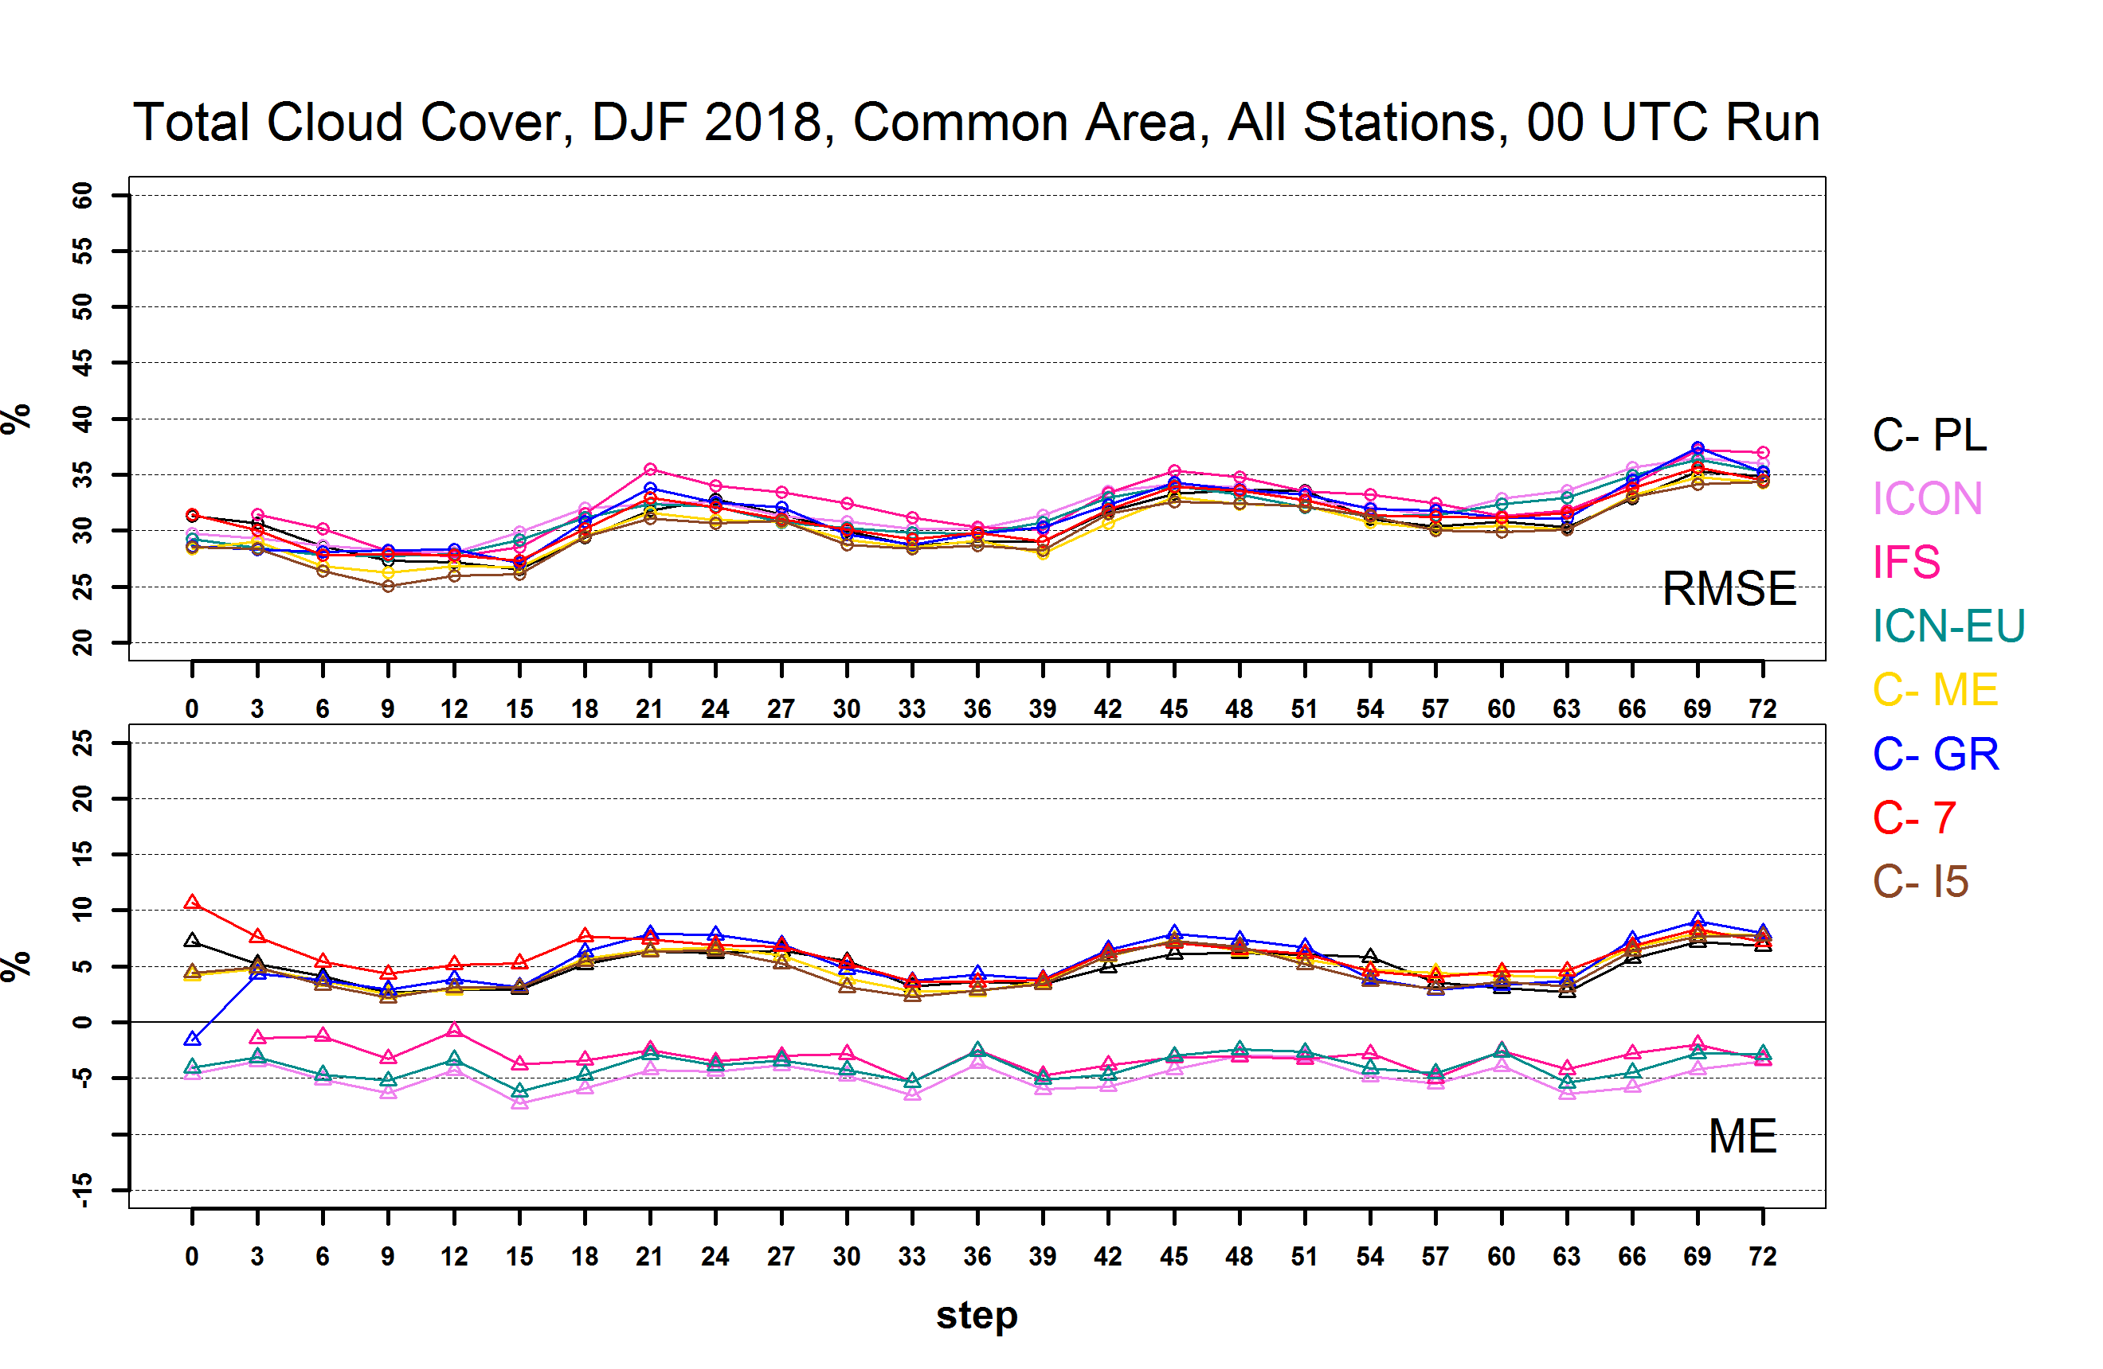
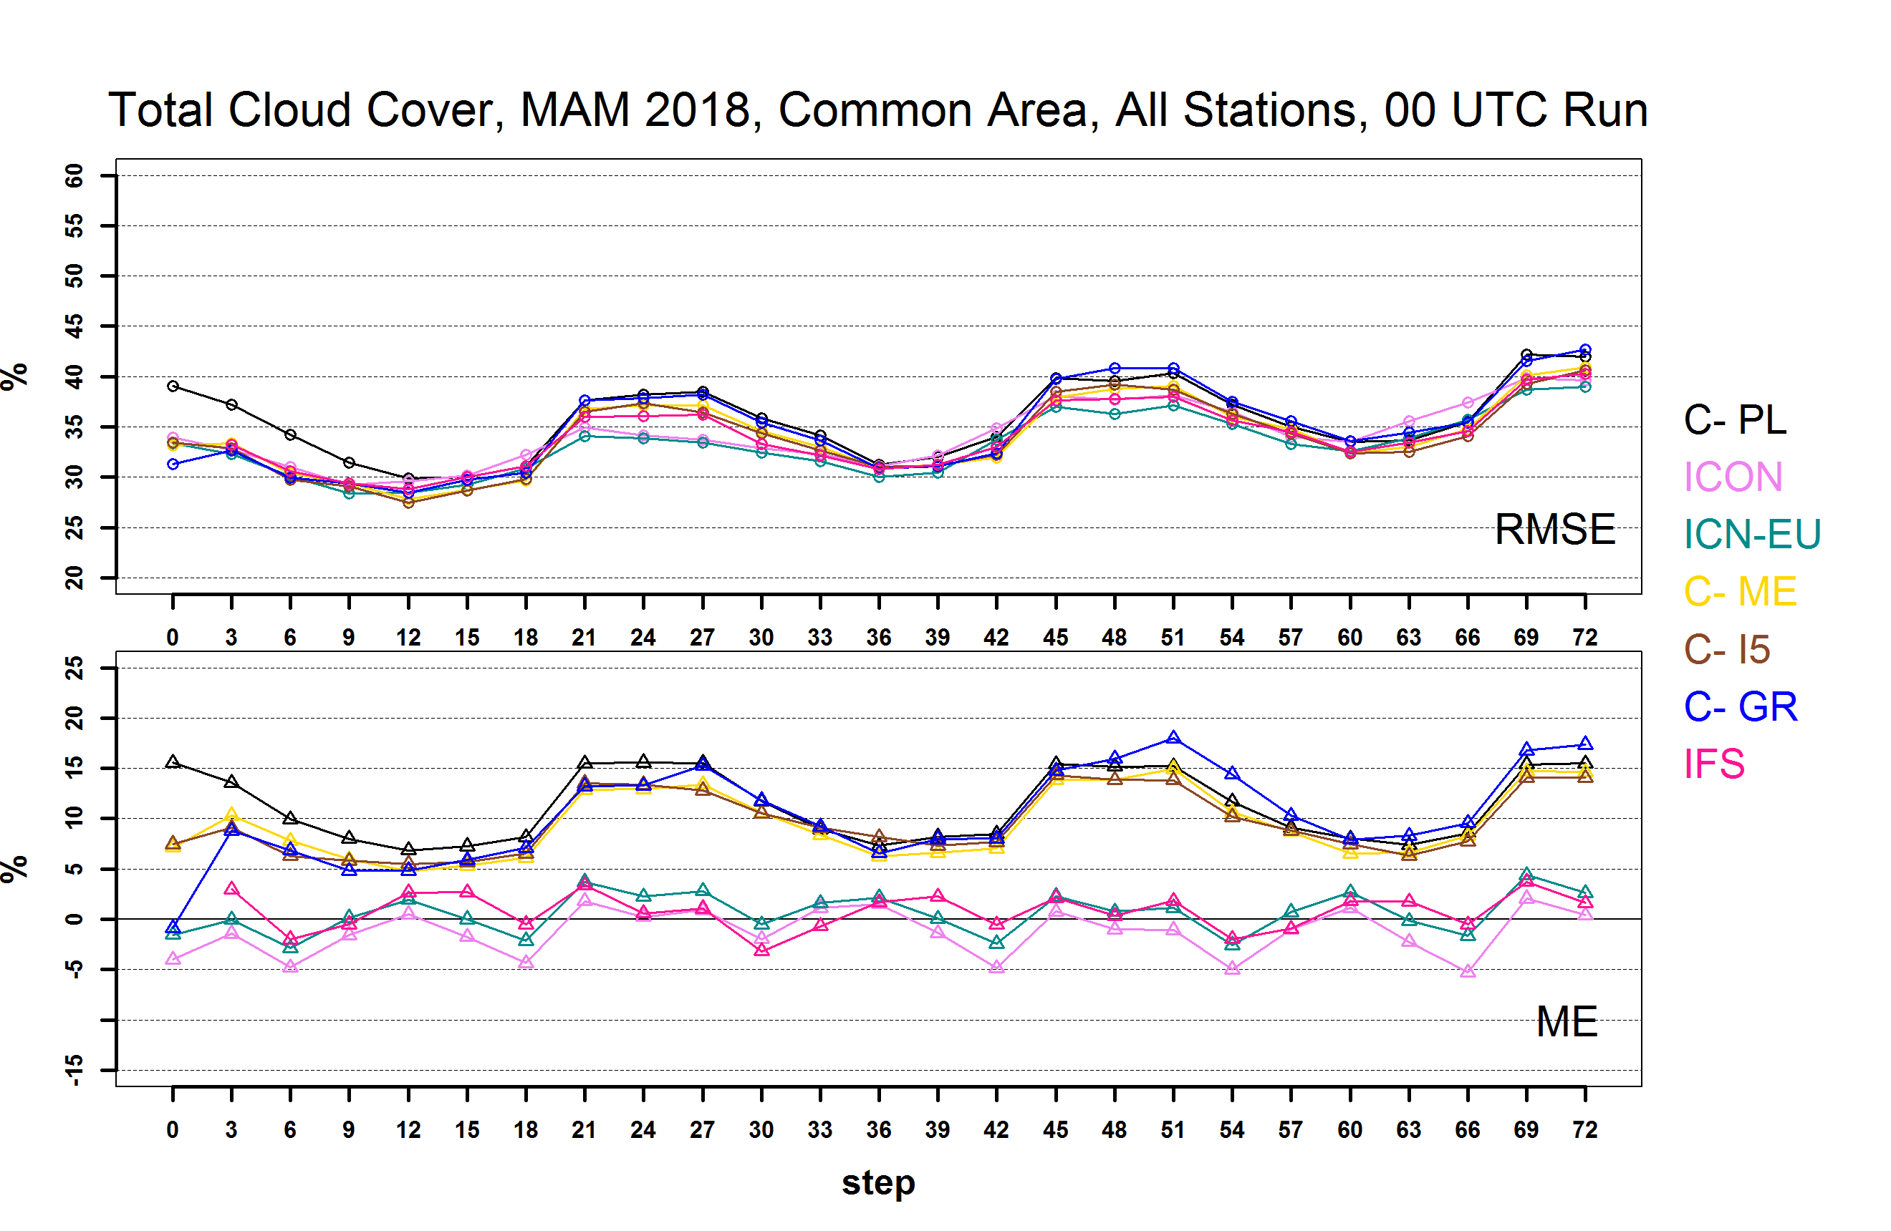
Total Cloud Cover 00 UTC Run
COSMO models follow similar cycle. Overestimation especially night . Smoother cycle in DJF with IFS ICON ICON-EU almost constant slight underestimation

Slide 12
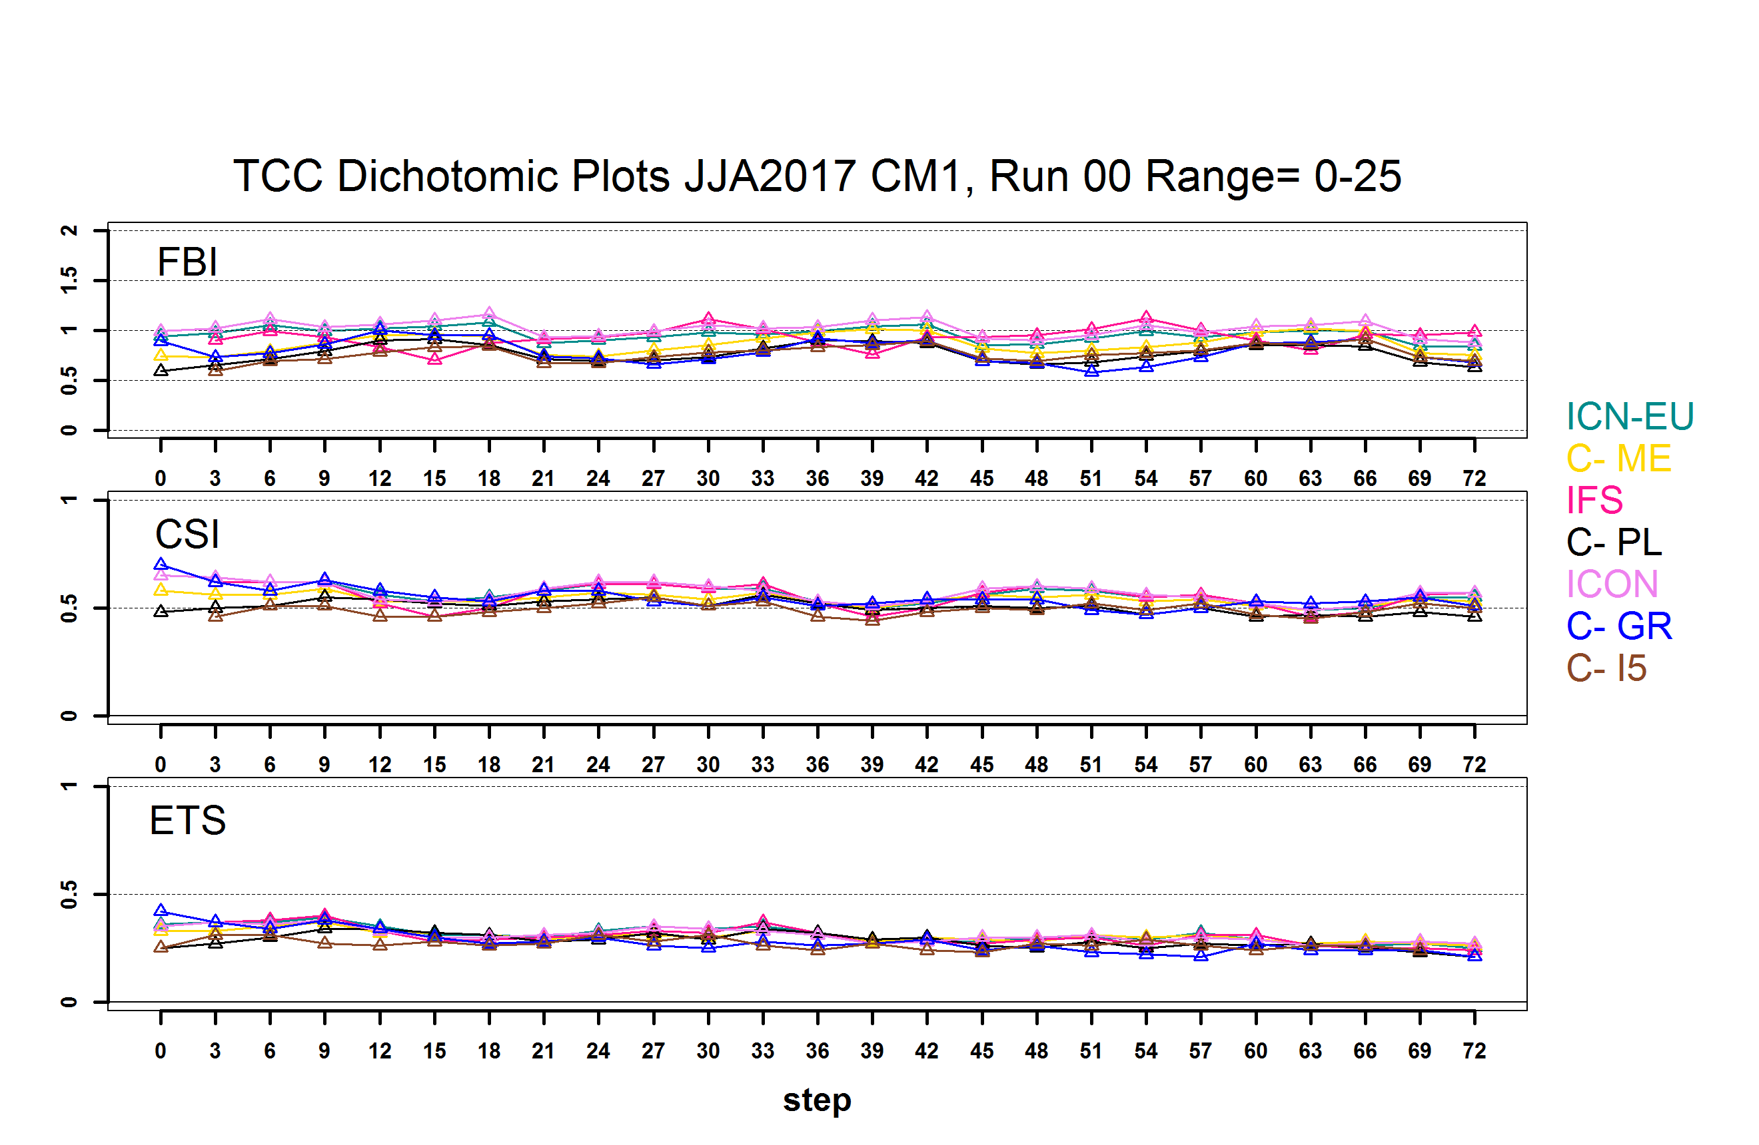
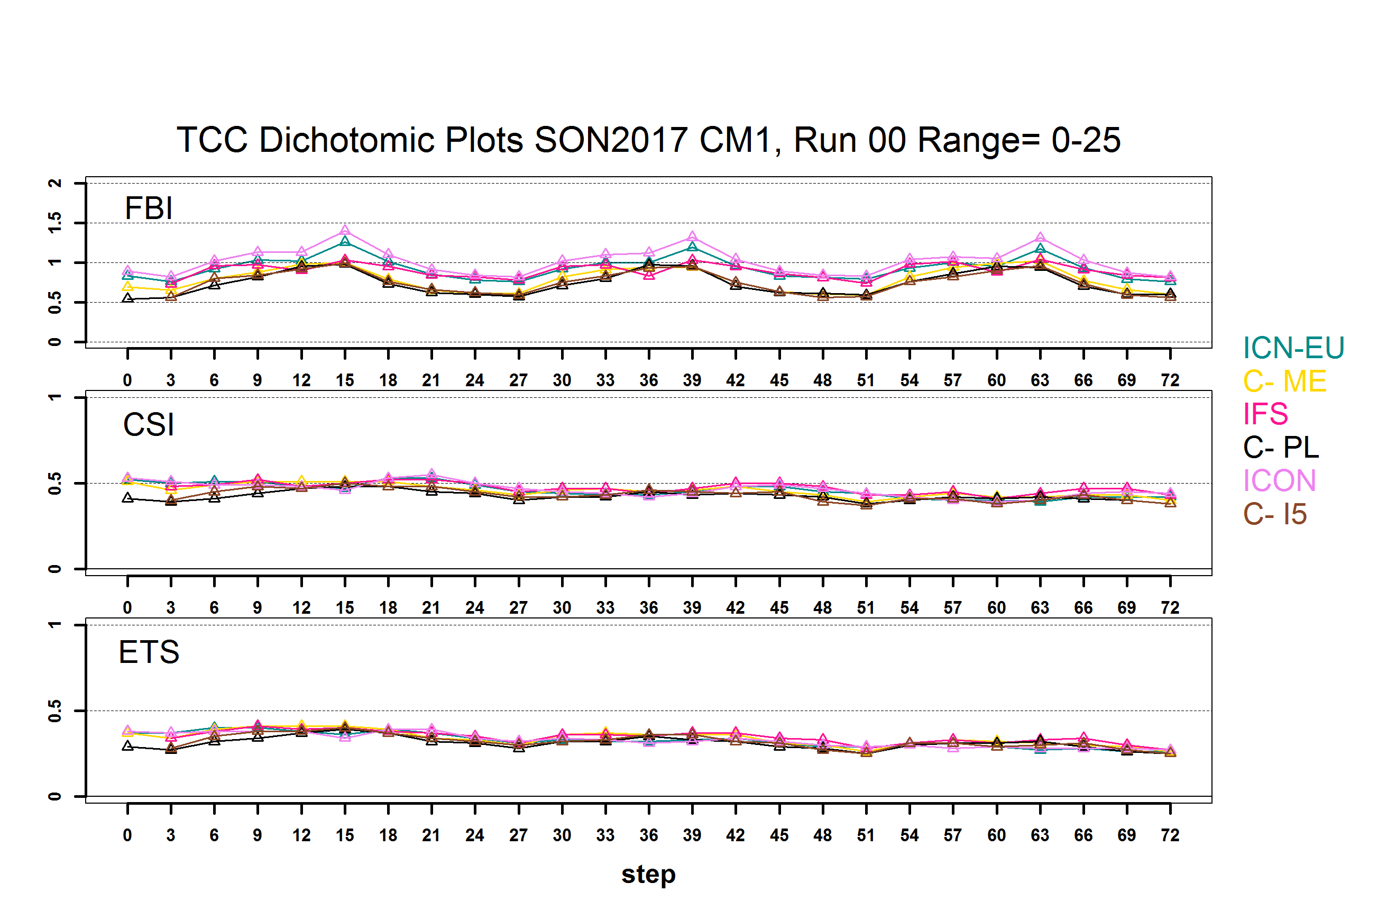
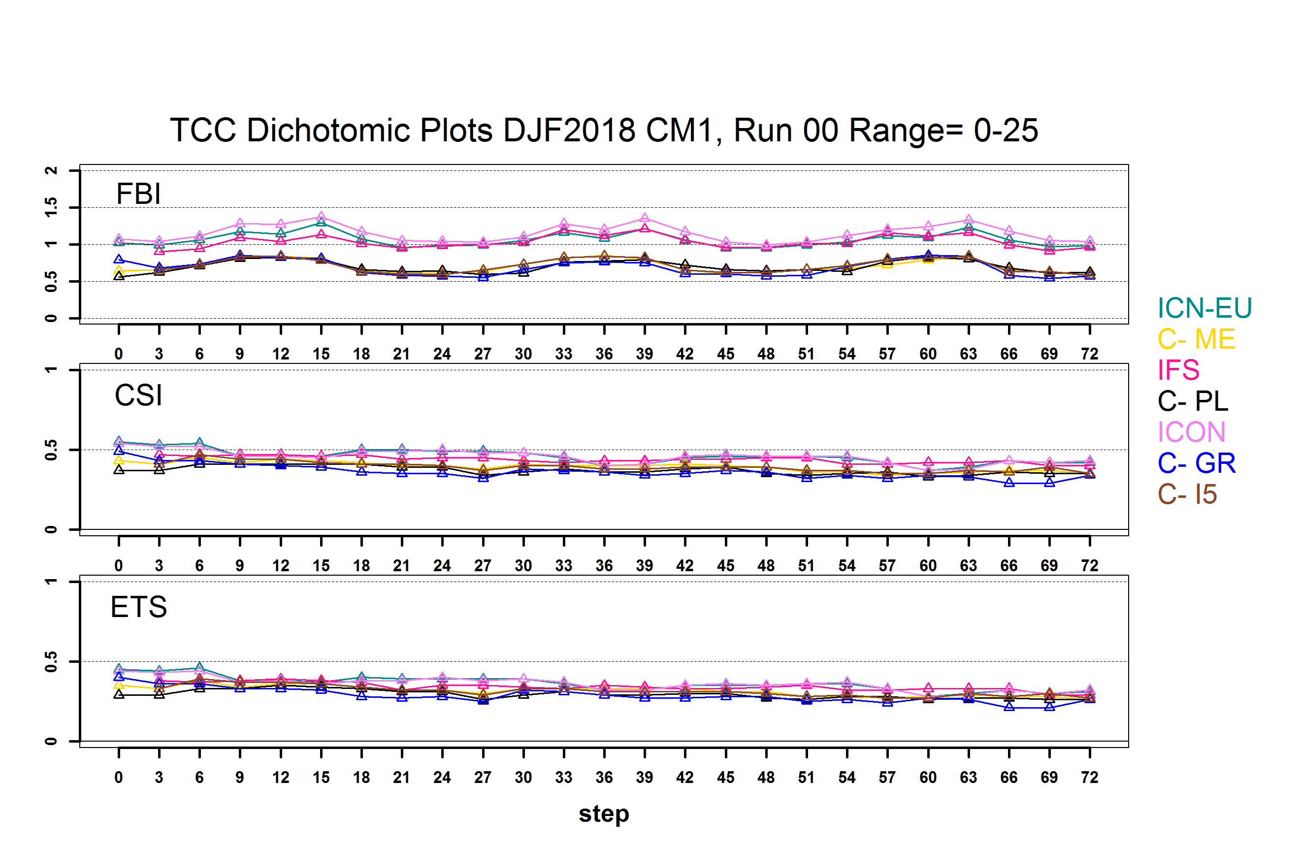
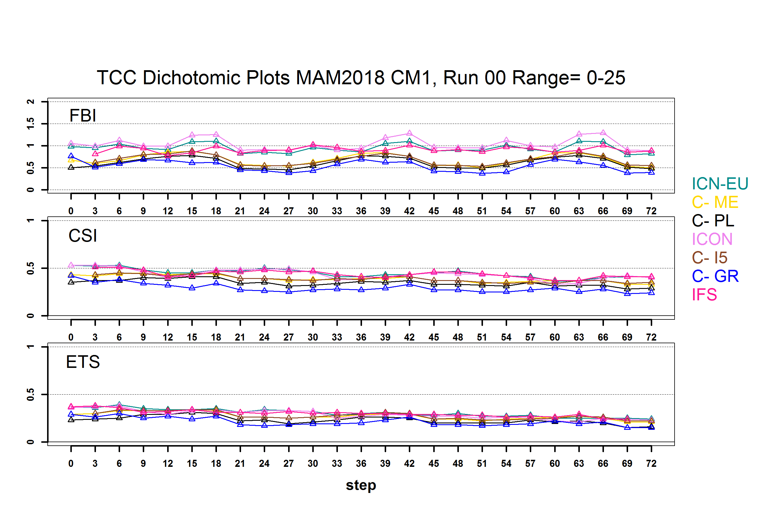
Total Cloud Cover Dichotomic 00 UTC Run 0-25
COSMO models follow similar cycle. IFS ICON ICON-EU slight overestimation of cases especially DJF MAM for this low threshold, This can be a reason for underestimation of TCC

Slide 13
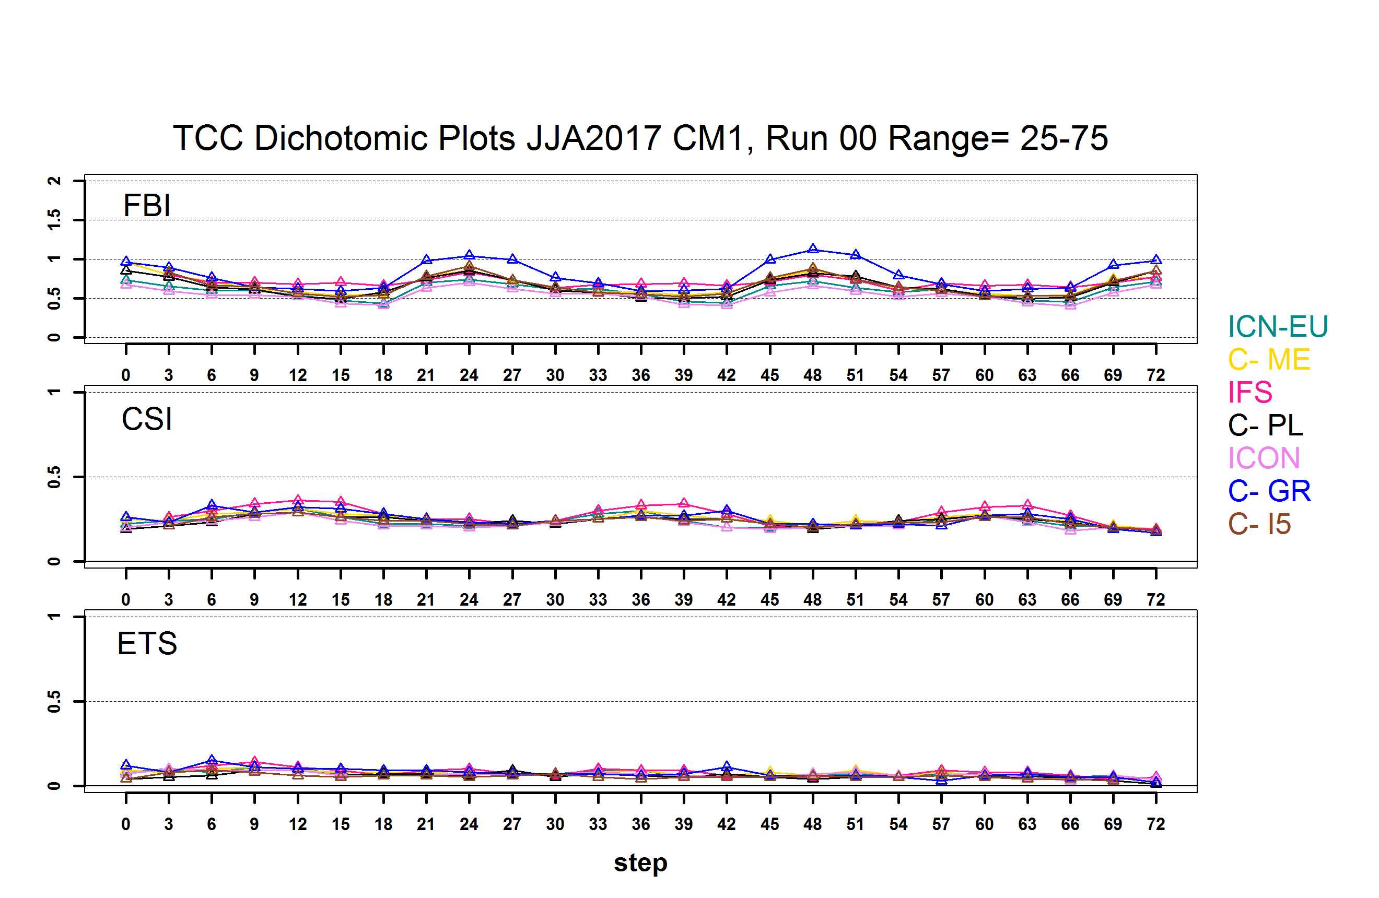
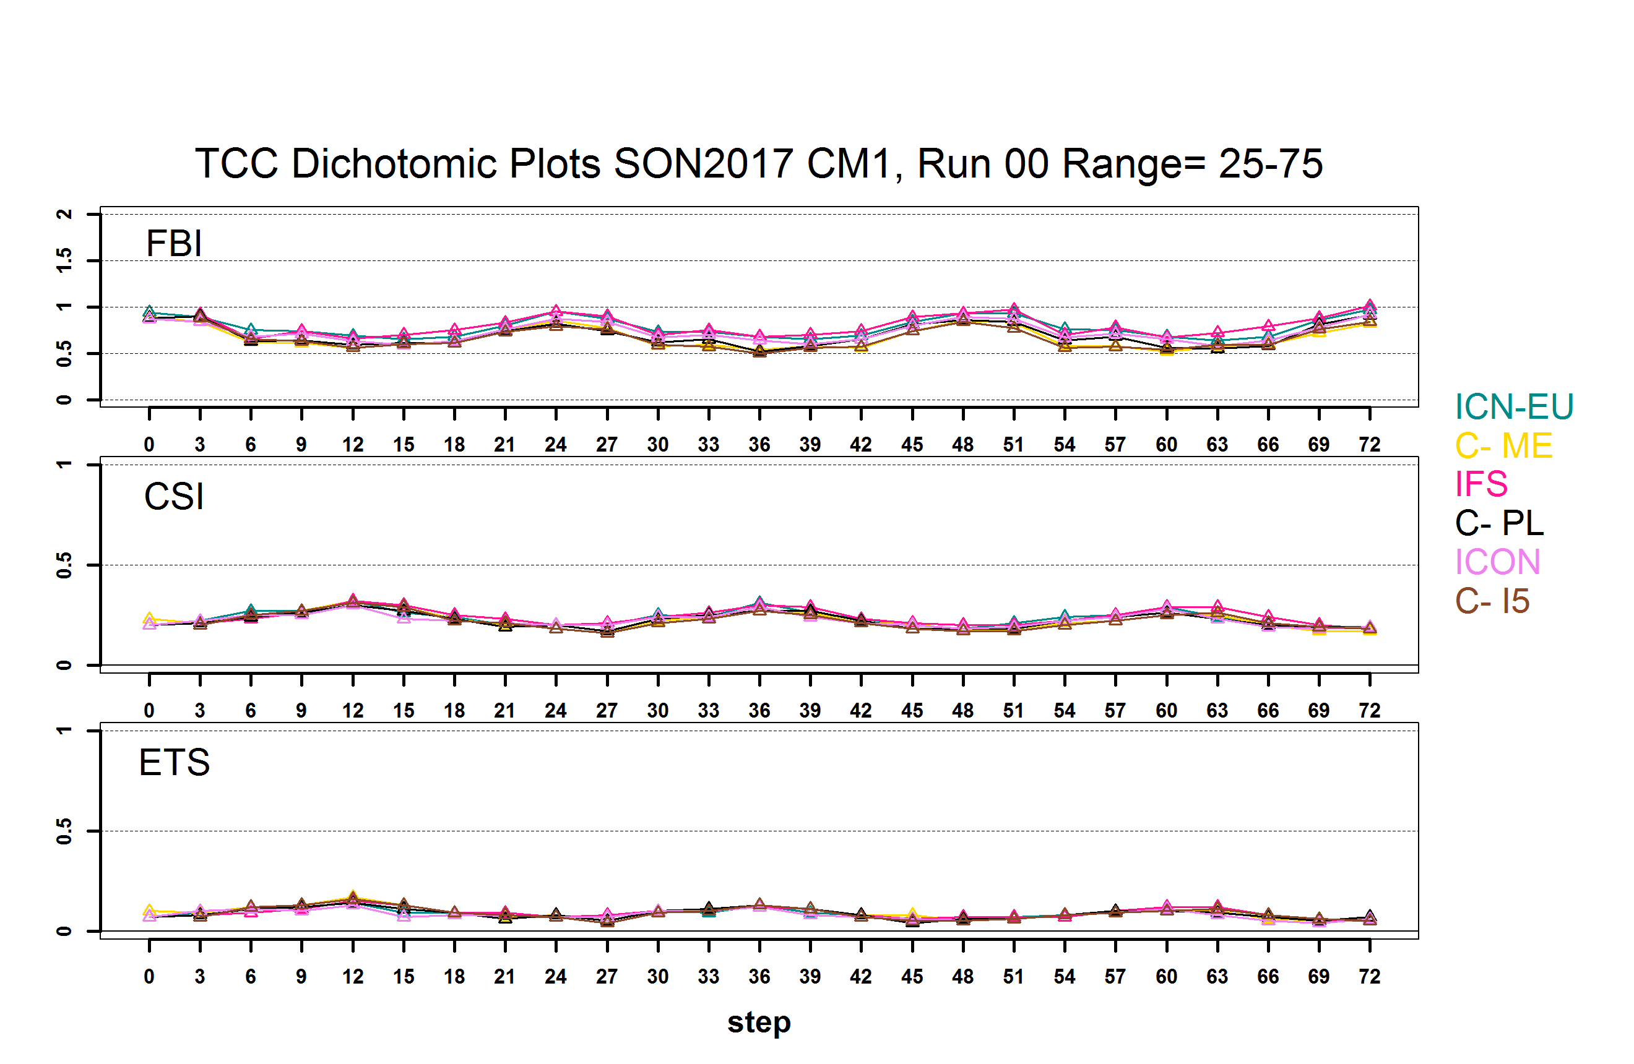
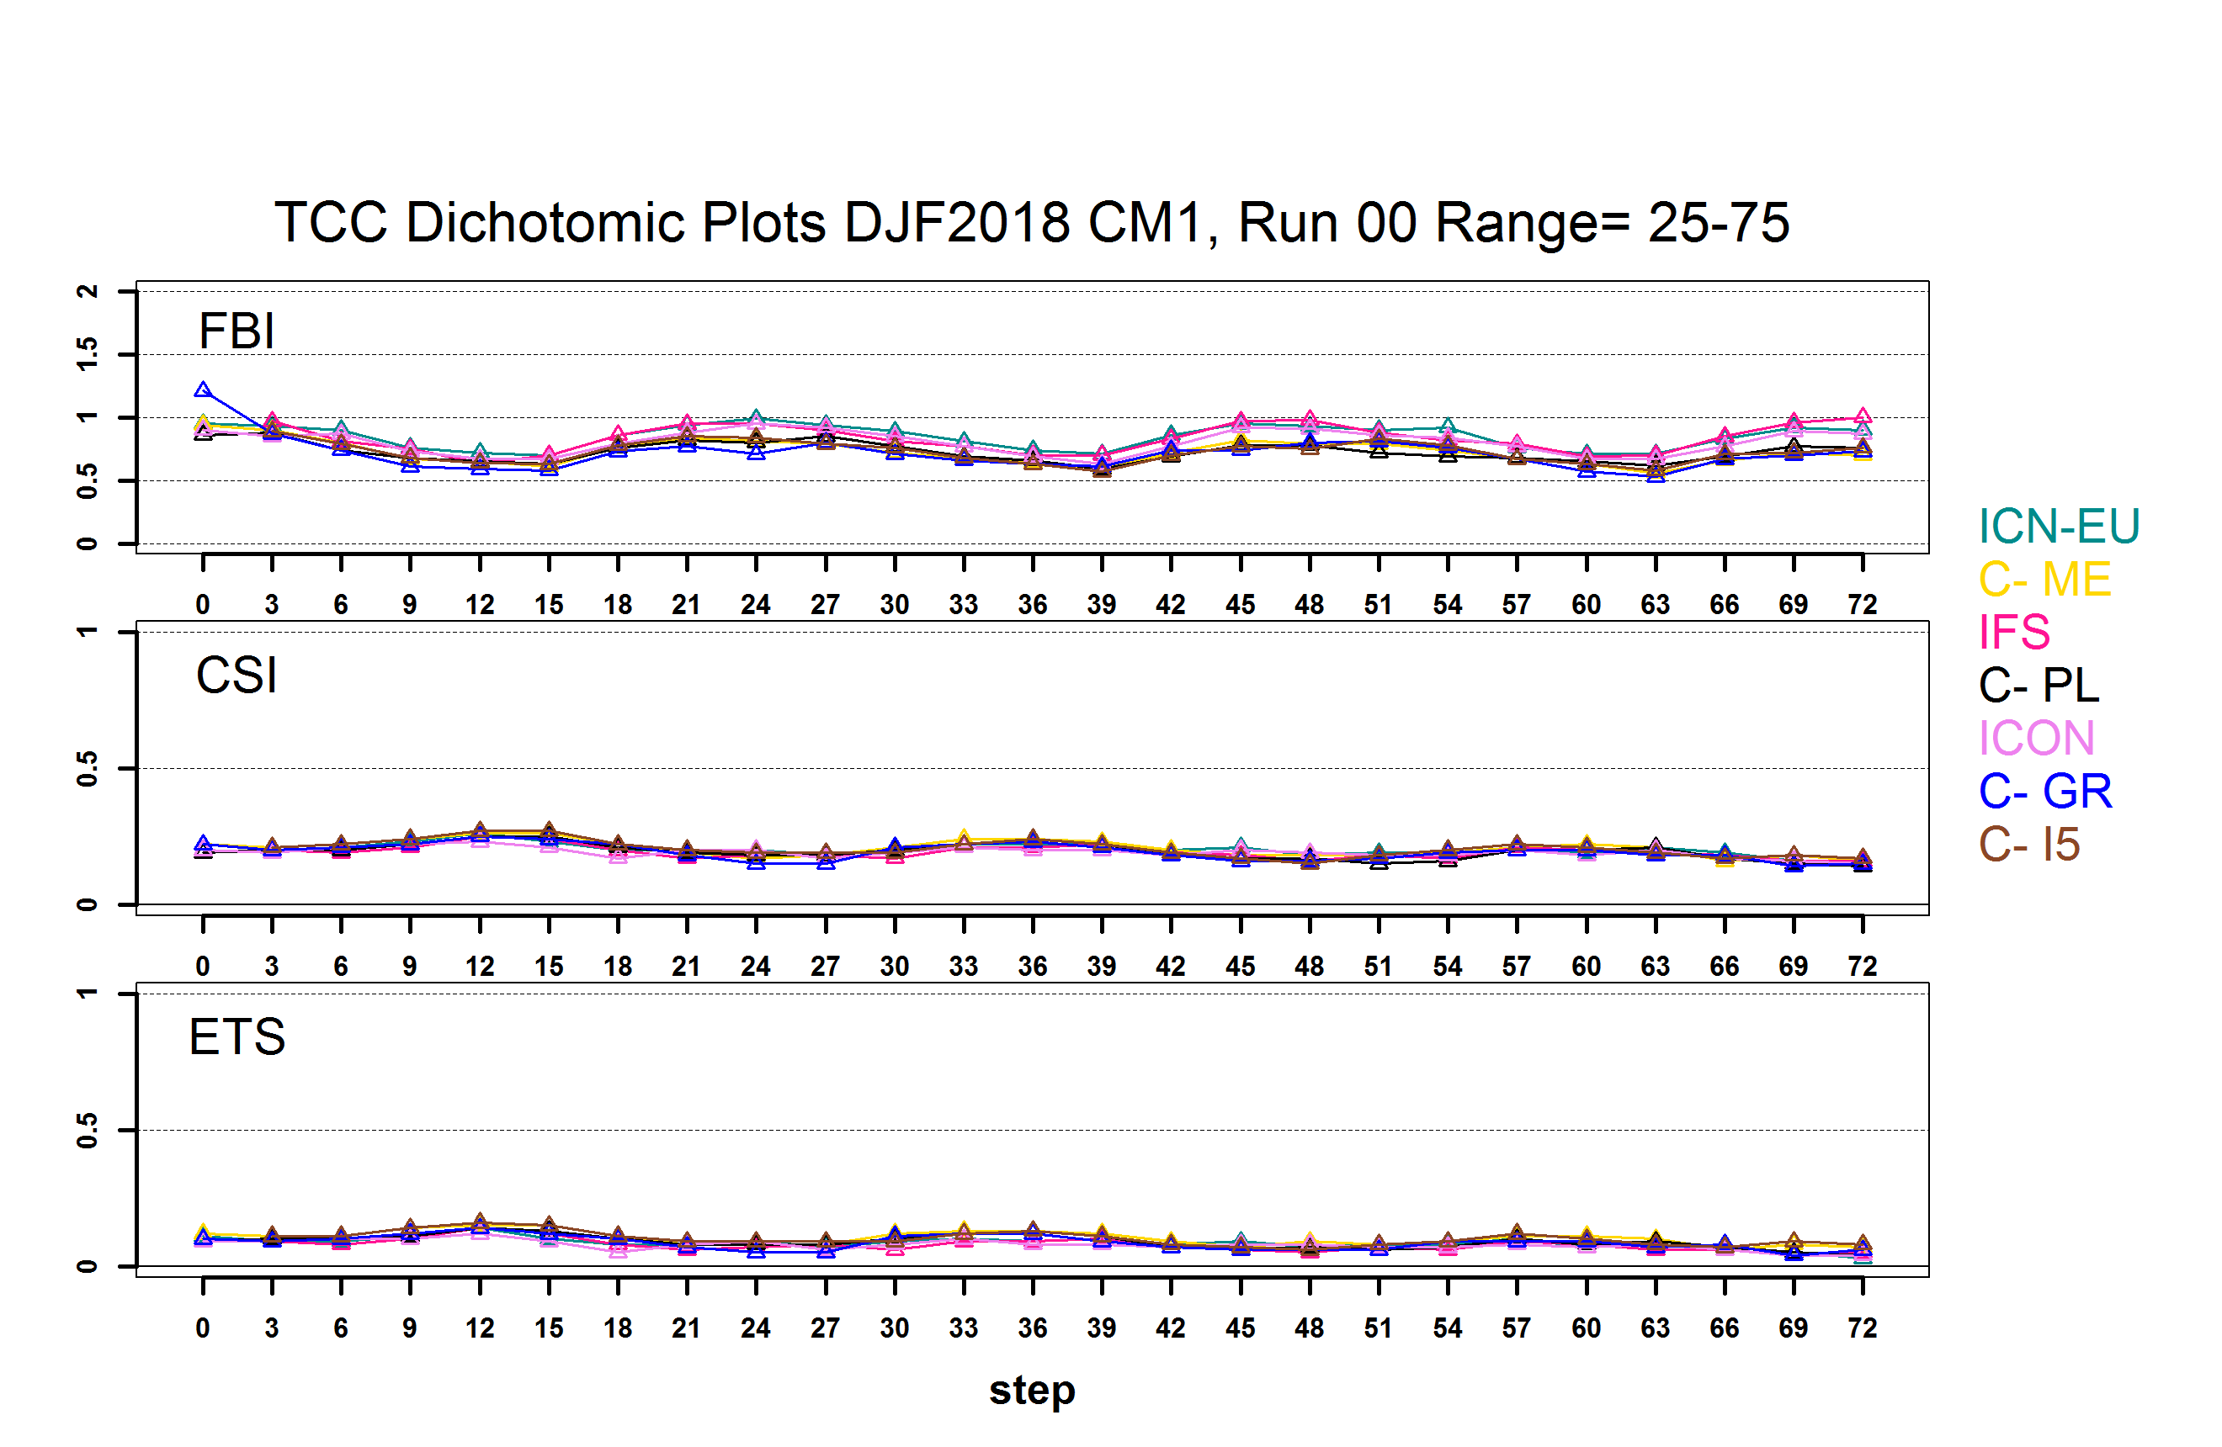
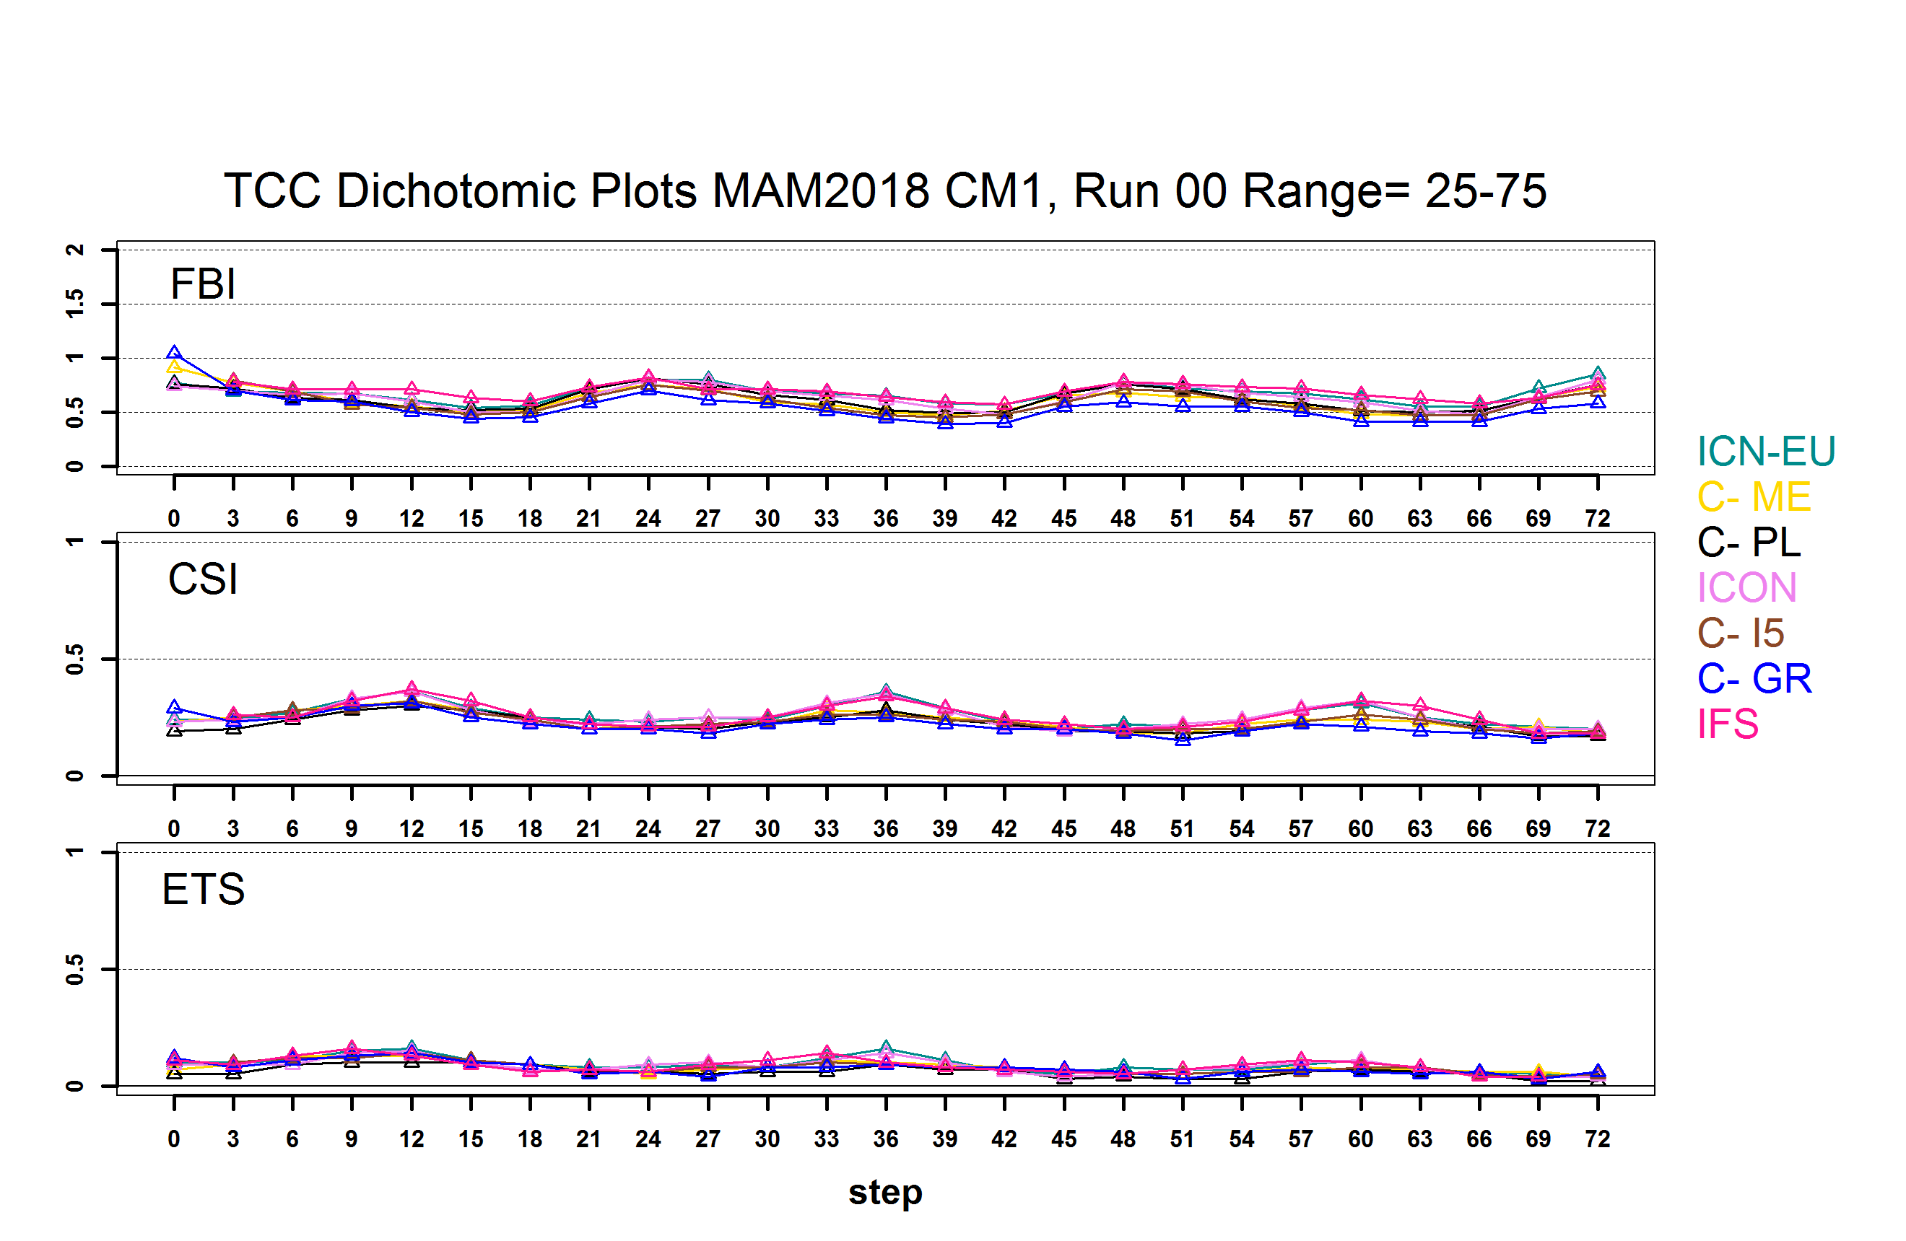
Total Cloud Cover Dichotomic 00 UTC Run 25-75
ETS CSI close to zero for this threshold It is the worst values

Slide 14
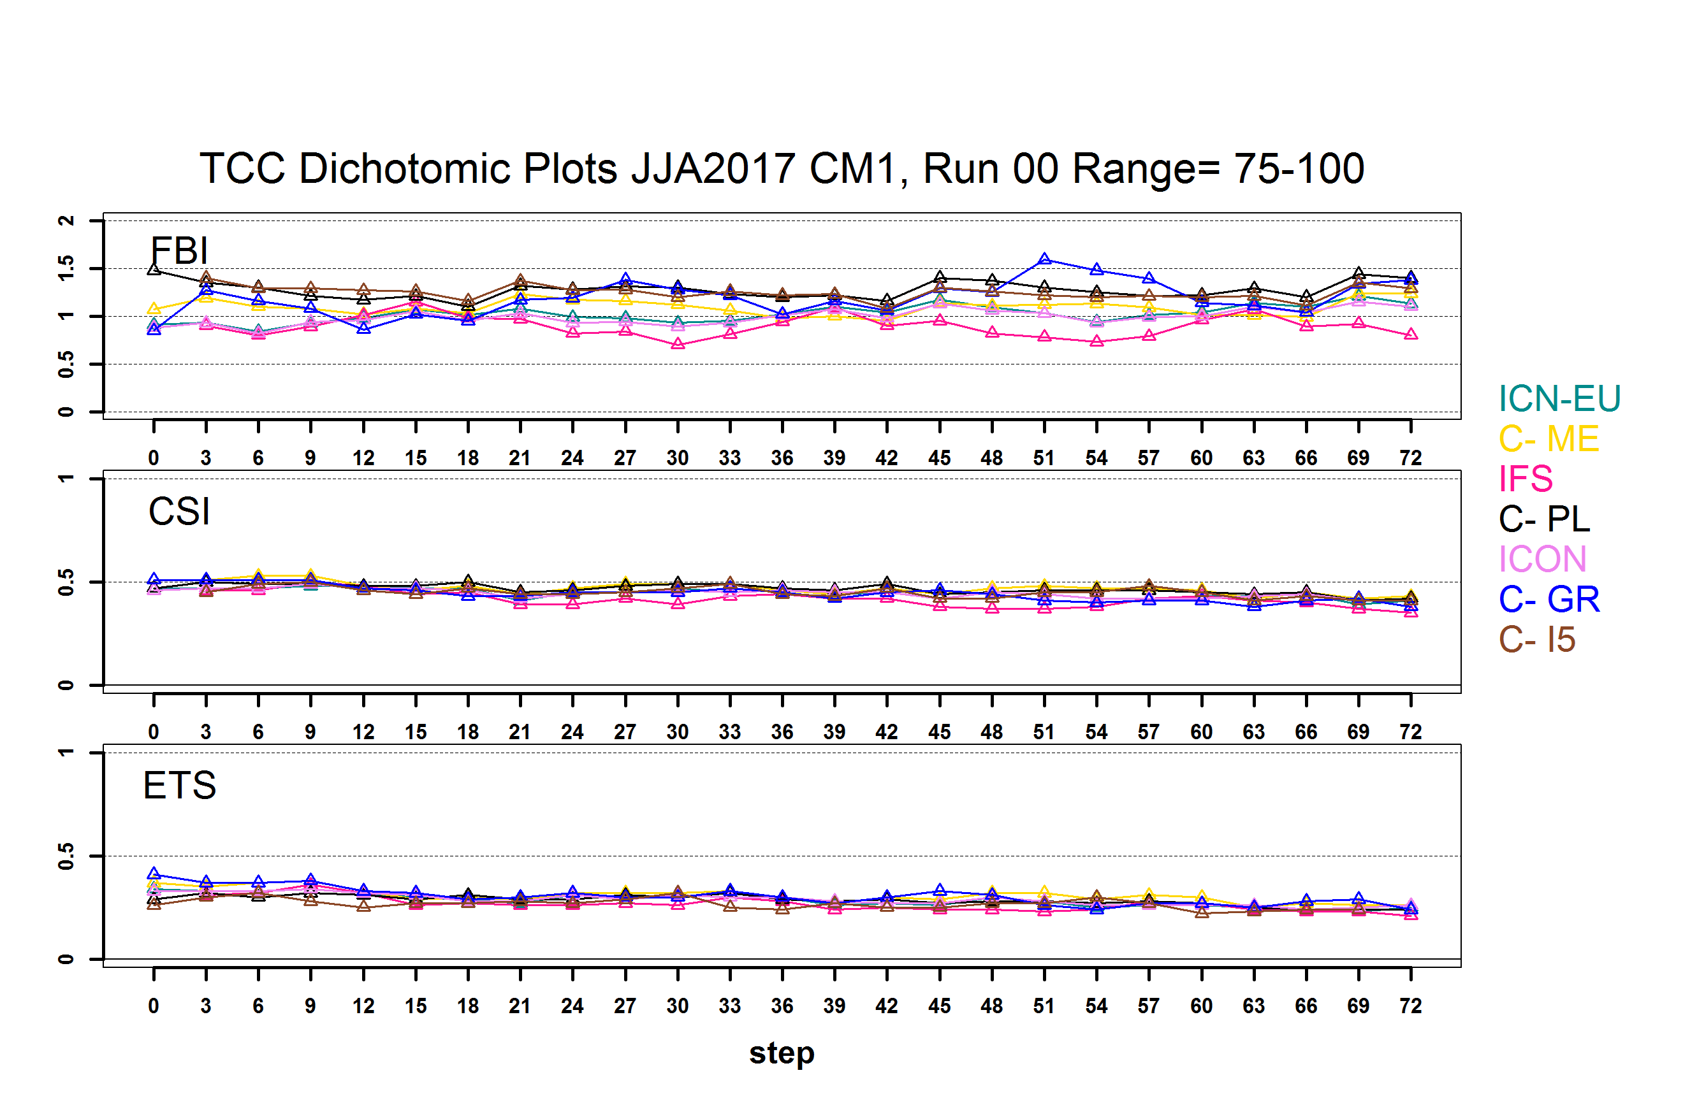
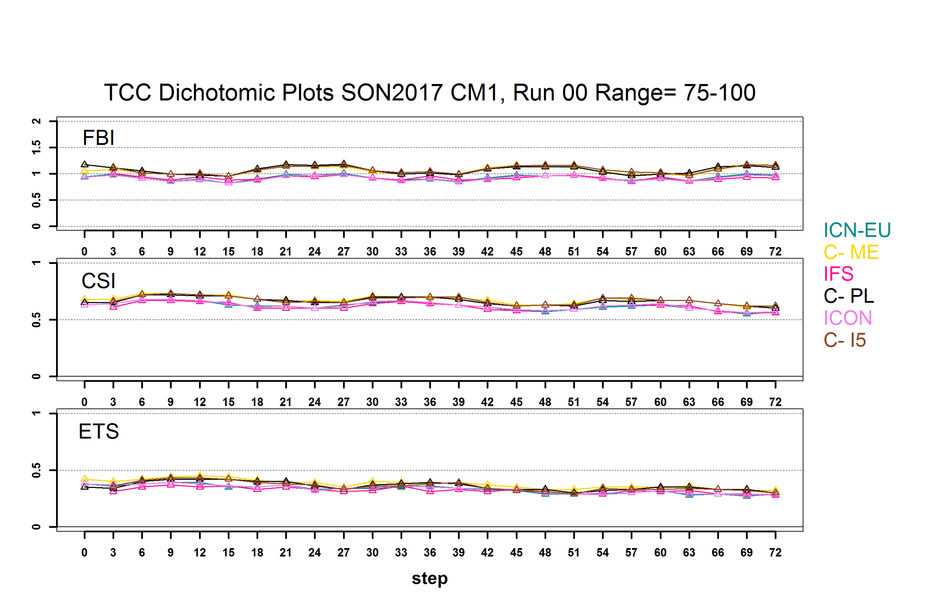
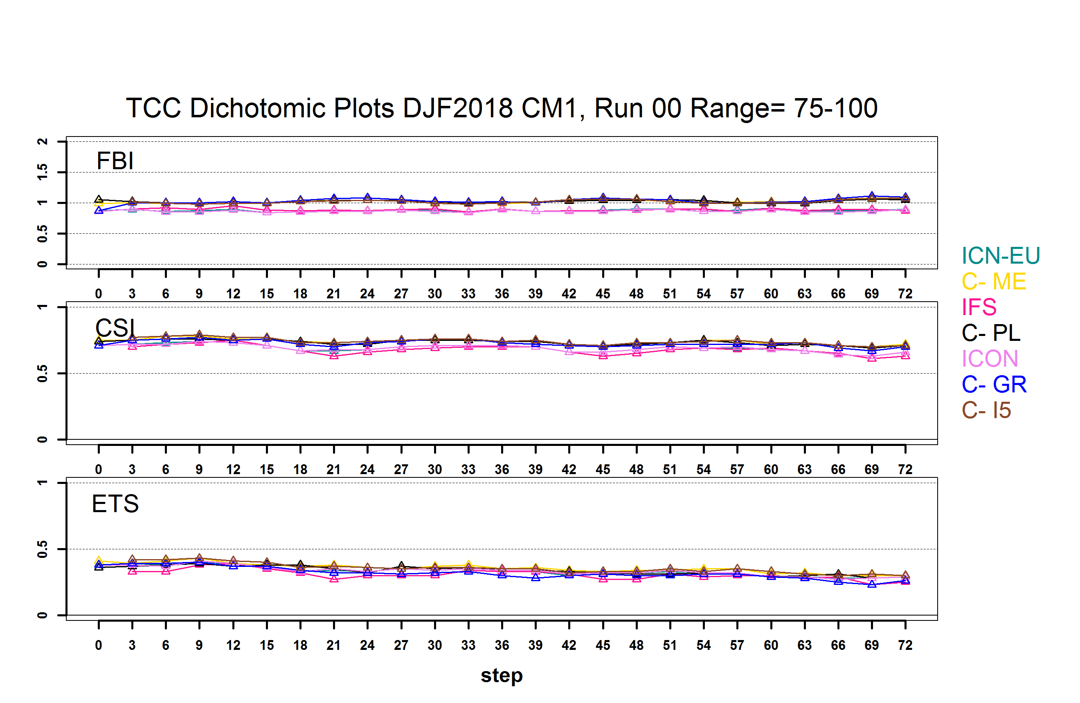
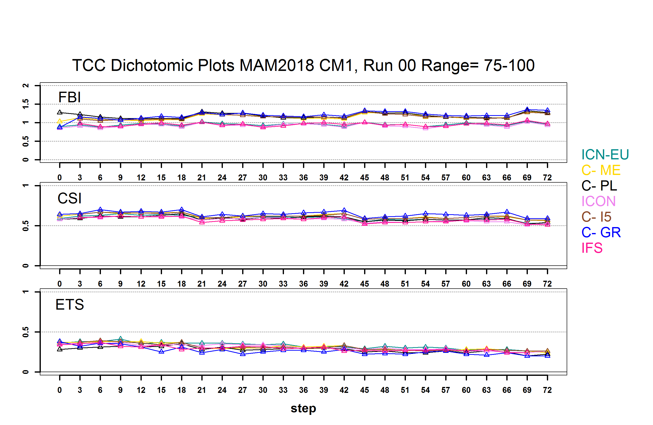

Total Cloud Cover Dichotomic 00 UTC Run 75-100
Slight diurnal cycle. ETS better than 25-75. Models grouped together

Slide 15
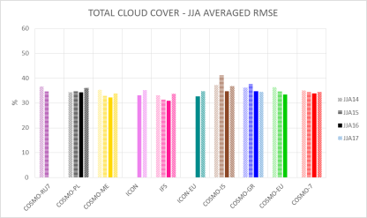
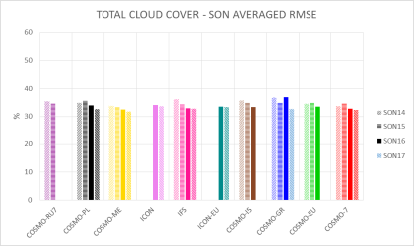
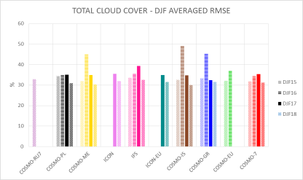
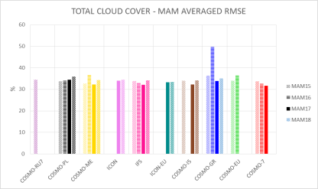
TCC RMSE Tendency since last year
Slight increase for JJA MAM, Drop for SON, DJF.

Slide 16
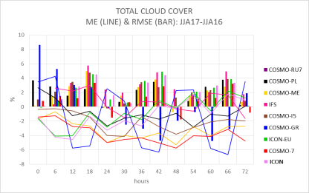
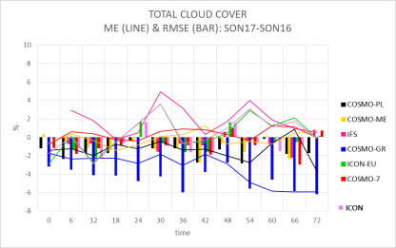
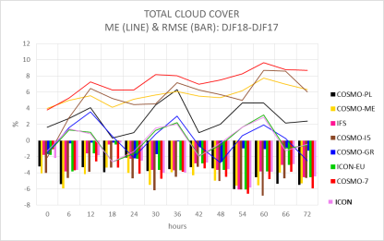
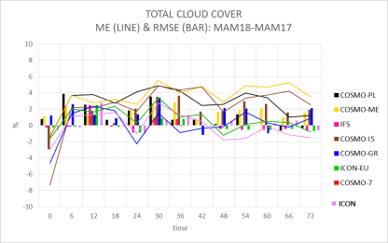
Daily cycle ME and RMSE TCC Tendency
RMSE JJA increase mainly daytime- Drop DJF all day

Slide 17
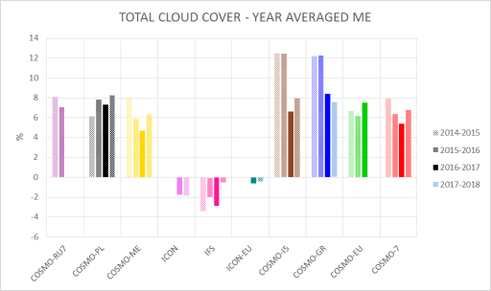
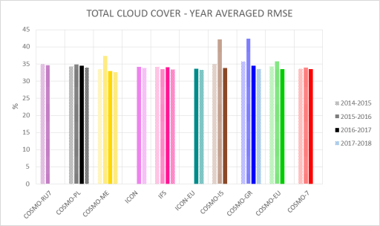
TCC Annual Tendency Scores
ME slightly negative for
ICON IFS ICON-EU, some models increase from last year
RMSE Slight decrease
from last year

Slide 18
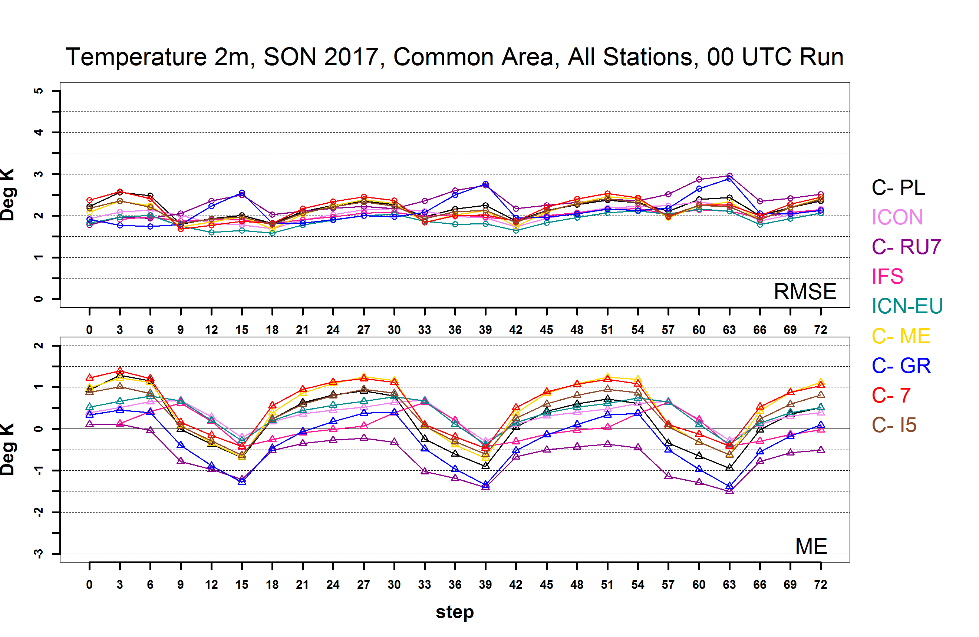
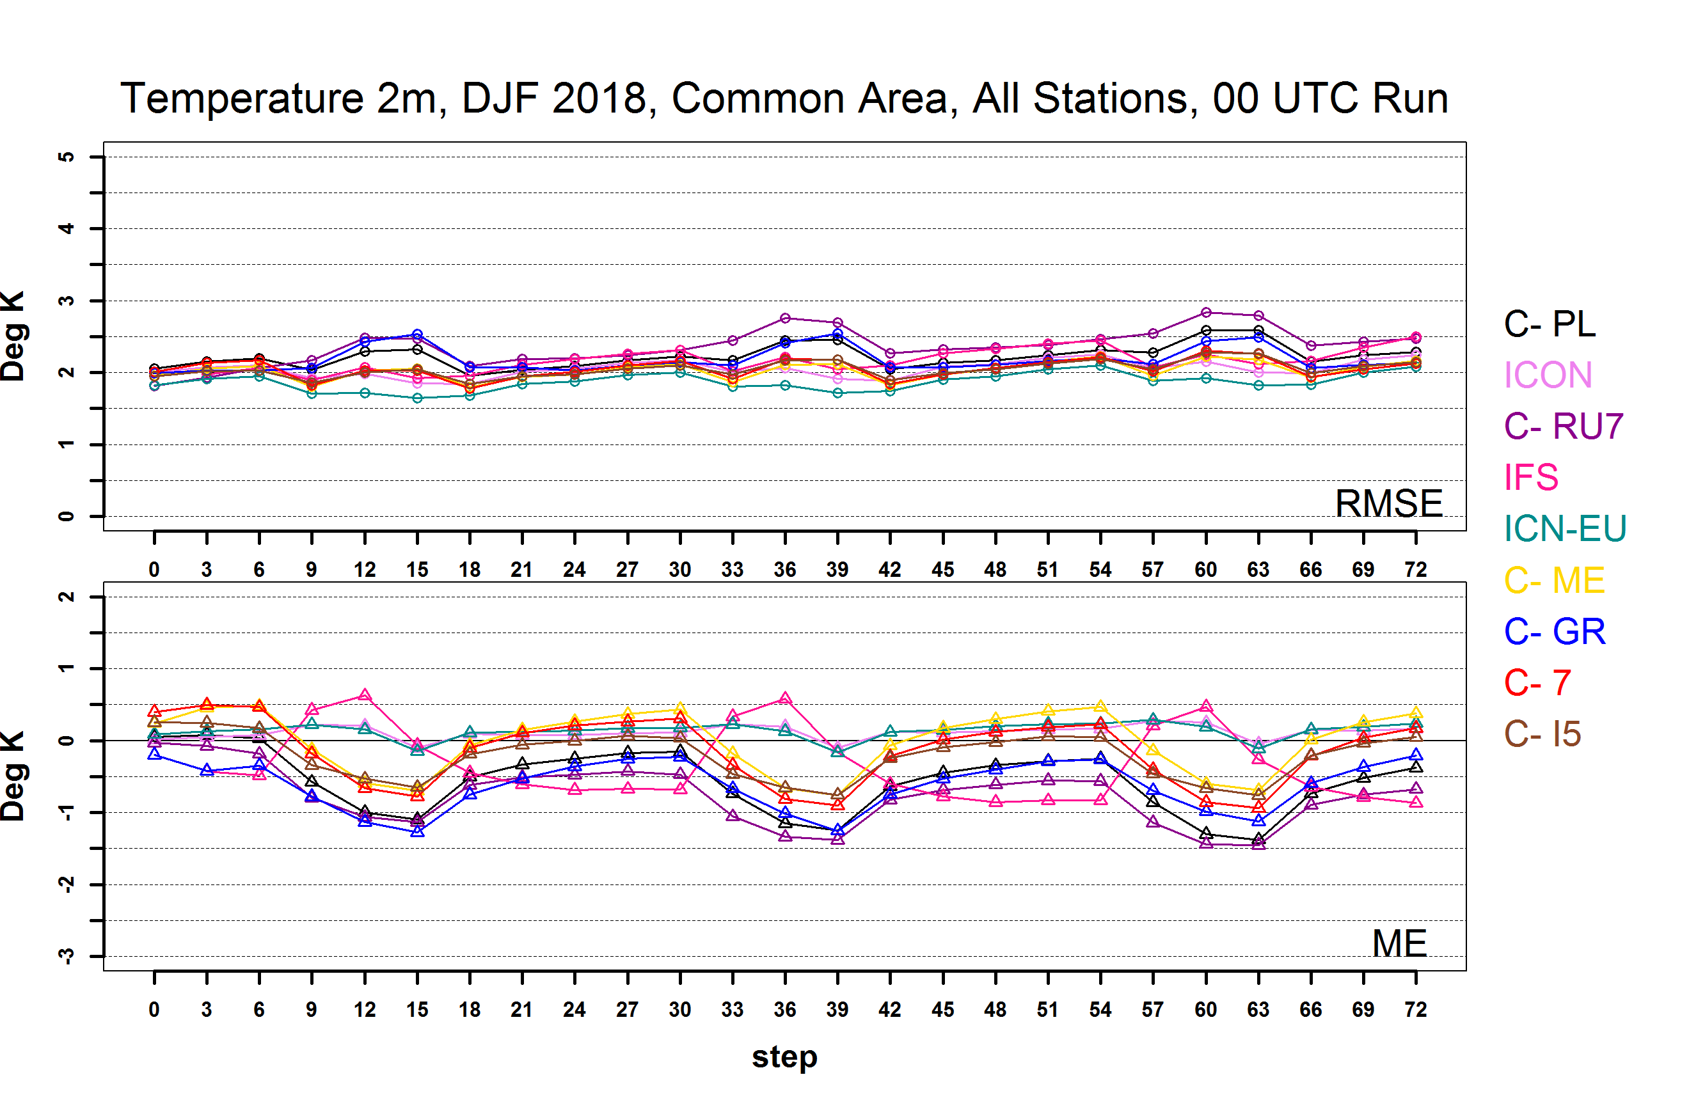
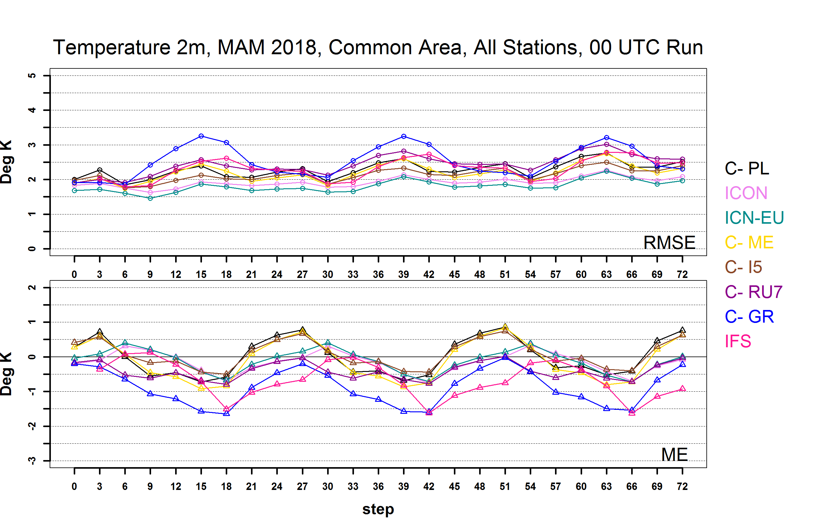
Temperature 2m 00 UTC Run
Clear diurnal ME cycle with positive tendency at night and negative in the day .JJA more divergence with 3 models overestimating in the day. All COSMO models underestimate T in the winter, some even at night. IFS DJF different cycle

Slide 19

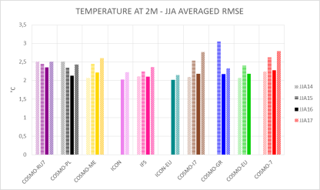
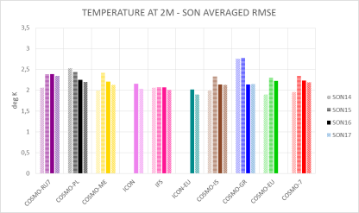
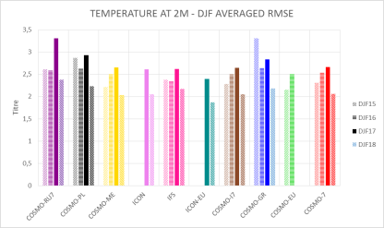
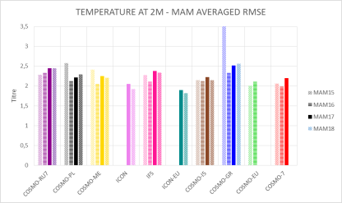

Temp RMSE Tendency
Slight increase for JJA, Drop for SON, DJF no significant change MAM

Slide 20
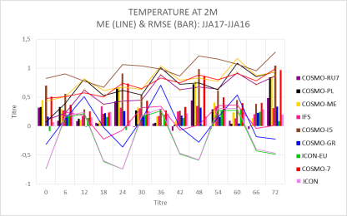
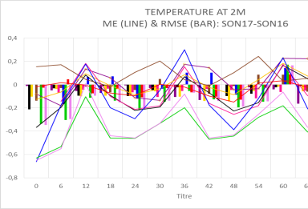


Daily cycle ME and RMSE Temp Tendency
RMSE JJA increase mainly daytime- Drop DJF all day

Slide 21


Temp Annual Tendency Scores
ME Variable
RMSE Slight decrease
from last year

Slide 22




T DEW 2m 00 UTC Run
ME RMSE diurnal cycle JJA MAM Higher values in the afternoon . C-7 again constant underestimation in JJA .
Notes:
What is different here is the diurnal cycle observed in JJA and MAM with overestimation in the afternoon

Slide 23




Tdew RMSE Tendency
Slight increase for JJA, Drop for DJF SON, MAM

Slide 24



WIND SPEED 10m 00 UTC Run
Similar RMSE diurnal cycle for all models. ICON-EU slightly negative ME

Slide 25




WS RMSE Tendency
Slight increase for JJA, SON, DJF slight decrease for MAM

Slide 26




Daily cycle ME and RMSE WS Tendency
RMSE increase JJA DJF mainly daytime- Drop MAM all day

Slide 27


WS Yearly Scores
Generally LESS overestimation
since last year
BUT RMSE- Slight increase
from last year

Slide 28



WIND GUST 10m 00 UTC Run DJF
12.5
15
20
Worst scores for Range 0-20 - > Underestimation of cases with higher values of Wind Gust

Slide 29



WIND GUST 10m 00 UTC Run MAM
12.5
15
20
Worst scores for Range 0-20 - > Underestimation of cases with higher values of Wind Gust
–more diurnal variability

Slide 30




JJA and DJF different : JJA clear FBI diurnal cycle with overestimation especially 12h, slight underestimation at 24h especially IFS, ICON . DJF models grouped together with FBI >1 for all times with better ETS.
6h > 0.2mm
Notes:
Threat score

Slide 31




6h > 5 mm
For higher thresholds FBI smaller diurnal cycle Models grouped together-ETS worse with time

Slide 32




Extremal Dependency Index 00 UTC Run
5mm
5mm
Better Values for DJF. Diurnal Cycle for higher thresholds. with higher values in the daytime.
10mm
10mm

Slide 33

Standard Verification on Common Area 2- High Resolution, COSMO-DE2, COSMO-1, COSMO-IT, COSMO-PL, and ICON-EU, ICO IFS for 00 UTC Run

Slide 34
COSMO HR Common Area 2 models
 | JJA17 | SON17 | DJF18 | MAM18 | DM
PL | 2,8 | 2,8 | 2,8 | 2,8 | C-PL7
IT | 2,8 | 2,8 | 2,8 | 2,8 | ME-7
DE | 2,8 | 2,8 | 2,8 | 2,8 | ICN
ICN-EU | 6,5 | 6,5 | 6,5 | 6,5 | ICON
C-1 | 1 | 1 | 1 | - | C-7
Notes:
Forecast range is very short up to 24 h

Slide 35


COMMON AREA 2 HR TEMP
Similar behavior for CM1 and CM2. JJA ME JJA better for CM2

Slide 36


COMMON AREA 2 HR TDEW
JJA better C-1 better than C7

Slide 37


COMMON AREA 2 HR WS
RMSE higher for C-IT, C-DE, ICON-EU

Slide 38

6h > 0.2mm
CM2 HR Models
CM1 Models
Better results for CM2, Higher ETS and FBI closer to 1

Slide 39

Standard Verification on Common Area 3- Dry Area COSMO-IL(2.8km), COSMO-GR (4km) , COSMO-ME(5km) for 00 UTC Run

Slide 40




COMMON AREA 3 TEMP
CM1
CM1
CM1
Mostly underestimation No diurnal RMSE cycle
CM1

Slide 41




COMMON AREA 3 TDEW
TD Underestimation. RMSE increase with time. Higher values than CM1
CM1
CM1
CM1

Slide 42




COMMON AREA 3 TCC
Significant Diurnal cycle and overestimation DJF. RMSE higher than CM1 with diurnal variation
CM1
CM1

Slide 43




COMMON AREA 3 WS
CM1
CM1
WS RMSE higher than CM1
CM1
CM1

Slide 44


COMMON AREA 3 PRECI
6h > 0.2mm
Only DJF reasonable results
6h > 0.2mm

Slide 45
Conclusions I
We investigated the errors of COSMO models over common datasets from JJA 2017 to MAM 2018. HR tests over a smaller common Area CM2 were performed. Also a dry climate Area CM3 was tested
The results showed that the general models behaviour did not significantly change from the previous years.
The summertime JJA17 most RMSE scores increased compared to last year, possibly due to the extremely warm and dry summer.
On the other side, winter DJF17-18 RMSE scores were generally better.
On annual basis, T, T2m, Tdew, TCC RMSE scores improved
Global Models slightly underestimate TCC and ME is lower than COSMO. TCCD showed overestimation of lower thresholds cases for these models.

Slide 46
Conclusions II
The precipitation FBI scores show diurnal variability in JJA (as in previous years) with drizzle overestimation of global models especially IFS
The HR models scores for CM2 are slightly better than CM1
CM3 Dry Area scores for all 3 models were higher than CM1 for TCC, Tdew and Wind Speed. Temperature was mostly underestimated.

Slide 47
Thank you for your attention !
Ideas? Questions ?
WG5

Slide 48




Daily cycle ME and RMSE MSLP Tendency
Mostly RMSE increase in SON, MAM. Not so significant daily variability of RMSE

Slide 49




Daily cycle ME and RMSE Tdew Tendency
RMSE increase JJA all day- Drop DJF all day

Slide 50

Precipitation 6h and 24h-Performance Diagram
In the graph is exploited the geometric relationship between four measures of dichotomous forecast performance:
  probability of detection (POD)
  success ratio(SR, defined as 1-FAR)
  bias score (FBI)
  threat score (TS, also known as the Critical Success Index).
For good forecasts, POD, SR, bias and TS approach unity, such that a perfect forecast lies in the upper right of the diagram.
The cross-hairs about the verification point represent the influence of the sampling variability.
  They are estimated data (from the contingency table).
  The bars represents the 95th percentile range for SR and POD.

Slide 51




COMMON AREA 2 HR TCC
ME again negative for IFS, ICON; ICON-EU

Slide 52



COMMON AREA 2 HR TCC DICHOTOMIC
FBI higher for IFS ICON ICON-EU mainly for 0-25. ETS, CSI lower for 25-75

Slide 53




COMMON AREA 2 HR MSLP
Tendency of ME > 0 and diurnal cycle for JJA

Slide 54




COMMON AREA 3 MSLP
Mostly underestimation and less RMSE increase with time

