Slide 1
IMGW-PIB experiences and results
of operational forecasts
of fog (VR)/thunderstorms(FR)
Andrzej Mazur
Institute of Meteorology and Water Management – National Research Institute
Instytut Meteorologii i Gospodarki Wodnej – Państwowy Instytut Badawczy

Slide 2
Contents
Introduction
Flashrate/thunderstoms (FR) – definition
Applications, customers
Examples, verification
Visibility Range (VR) – definition
Applications, customers
Examples, verification
Indices – ”Added Value Approach”?
Conclusions

Slide 3
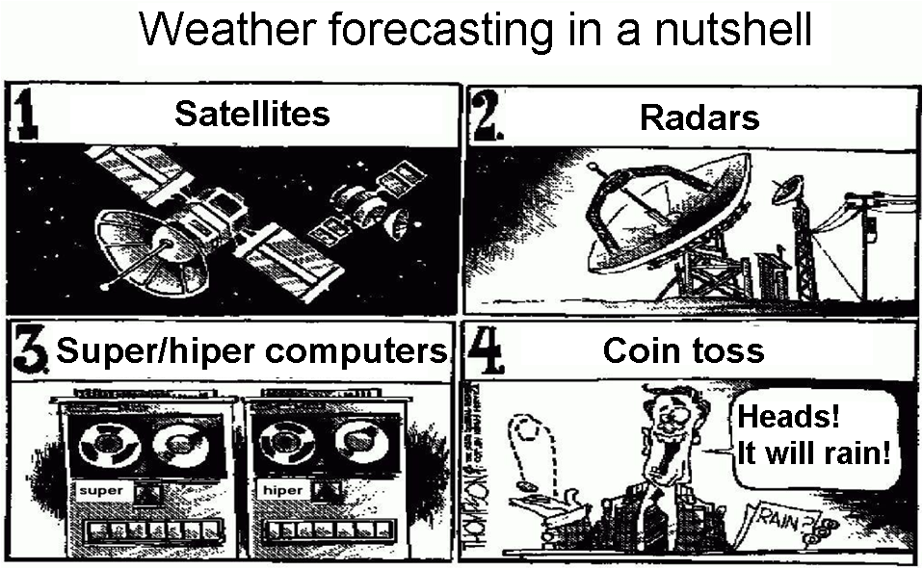
Introduction

Slide 4
Flashrate – definition
Assumption – relationship between CAPE (→ updraft velocity W), cloud-top/cloud-base temperatures (CTT/CBT, respectively) and frequency of lightnings (FR, #/minutes). Additional filters can be applied.
Wong et al., 2013: Evaluating a lightning parameterization based on cloud-top height for mesoscale numerical model simulations. Geosci. Model Dev., 6. See also Lopez, 2016: A Lightning Parameterization for the ECMWF Integrated Forecasting System. Mon.Wea. Rev. 144
Forecasts verified against measurements at Polish lightning detection network

Slide 5
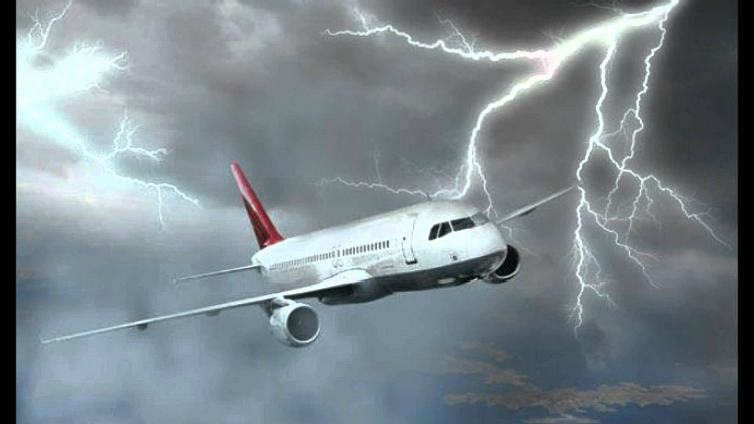
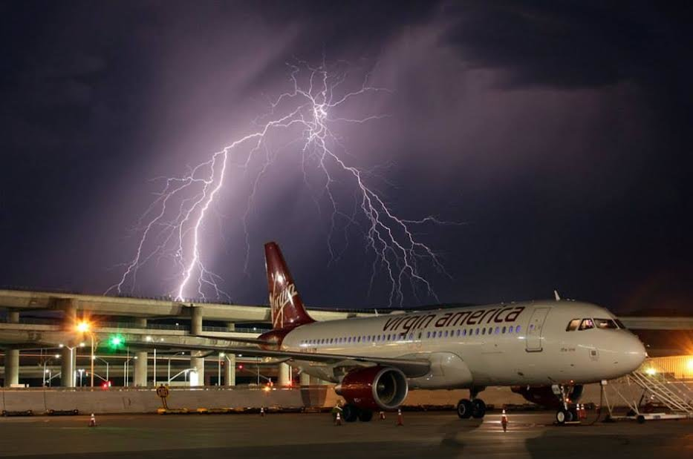
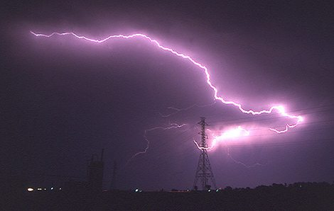
FR – applications, customers
Three main groups of customers: aviation services, energy production sector, crisis management centers
The most obvious impact of severe weather on electric utility operations – power outages. Improvements in forecasts of major events (thunderstorms) – an aid for managers in resource scheduling and management.
Although spectacular, lightings (and thunders) themselves are not (very) dangerous for airplanes as much as for ground operations at the airport. Yet, thunderstorms detection and forecast is vital for aviation.

Slide 6
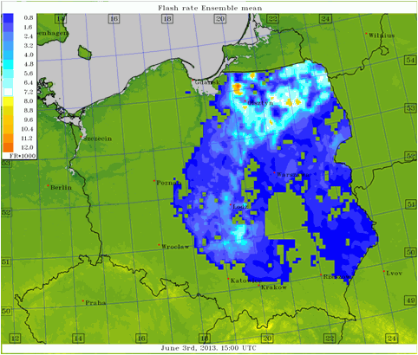
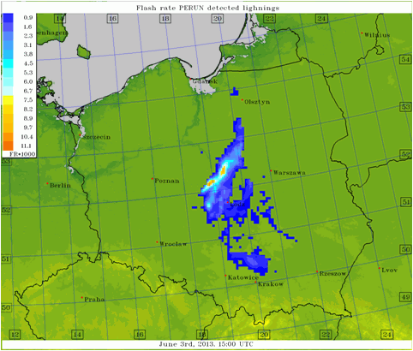
Examples – thunderstorms (FR)
”Raw” CAPE/updraft algorithm overestimates lightning rates…

Slide 7
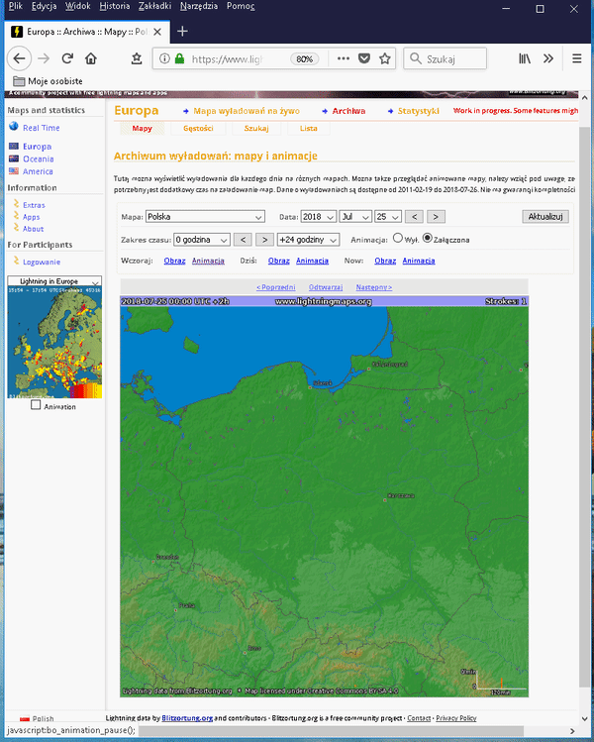
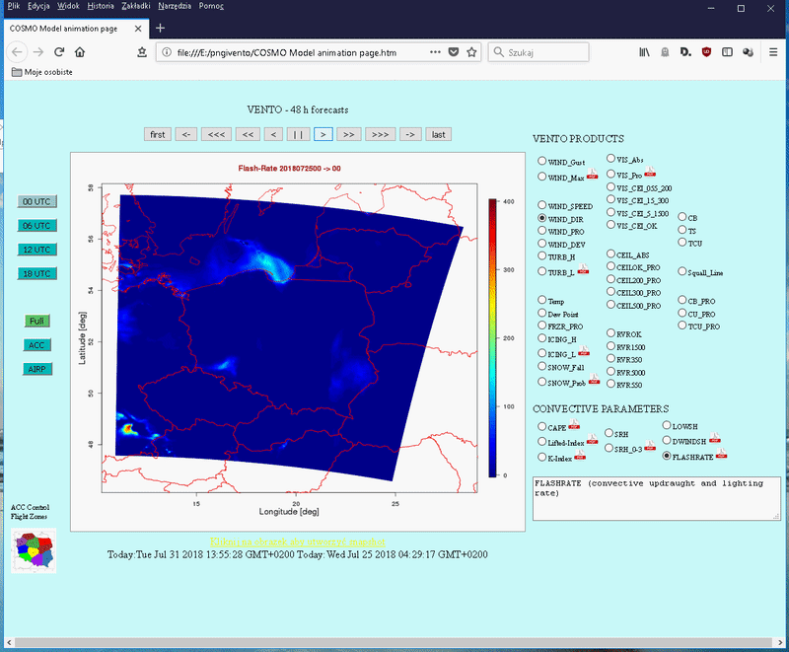
Examples – thunderstorms (FR)

Slide 8
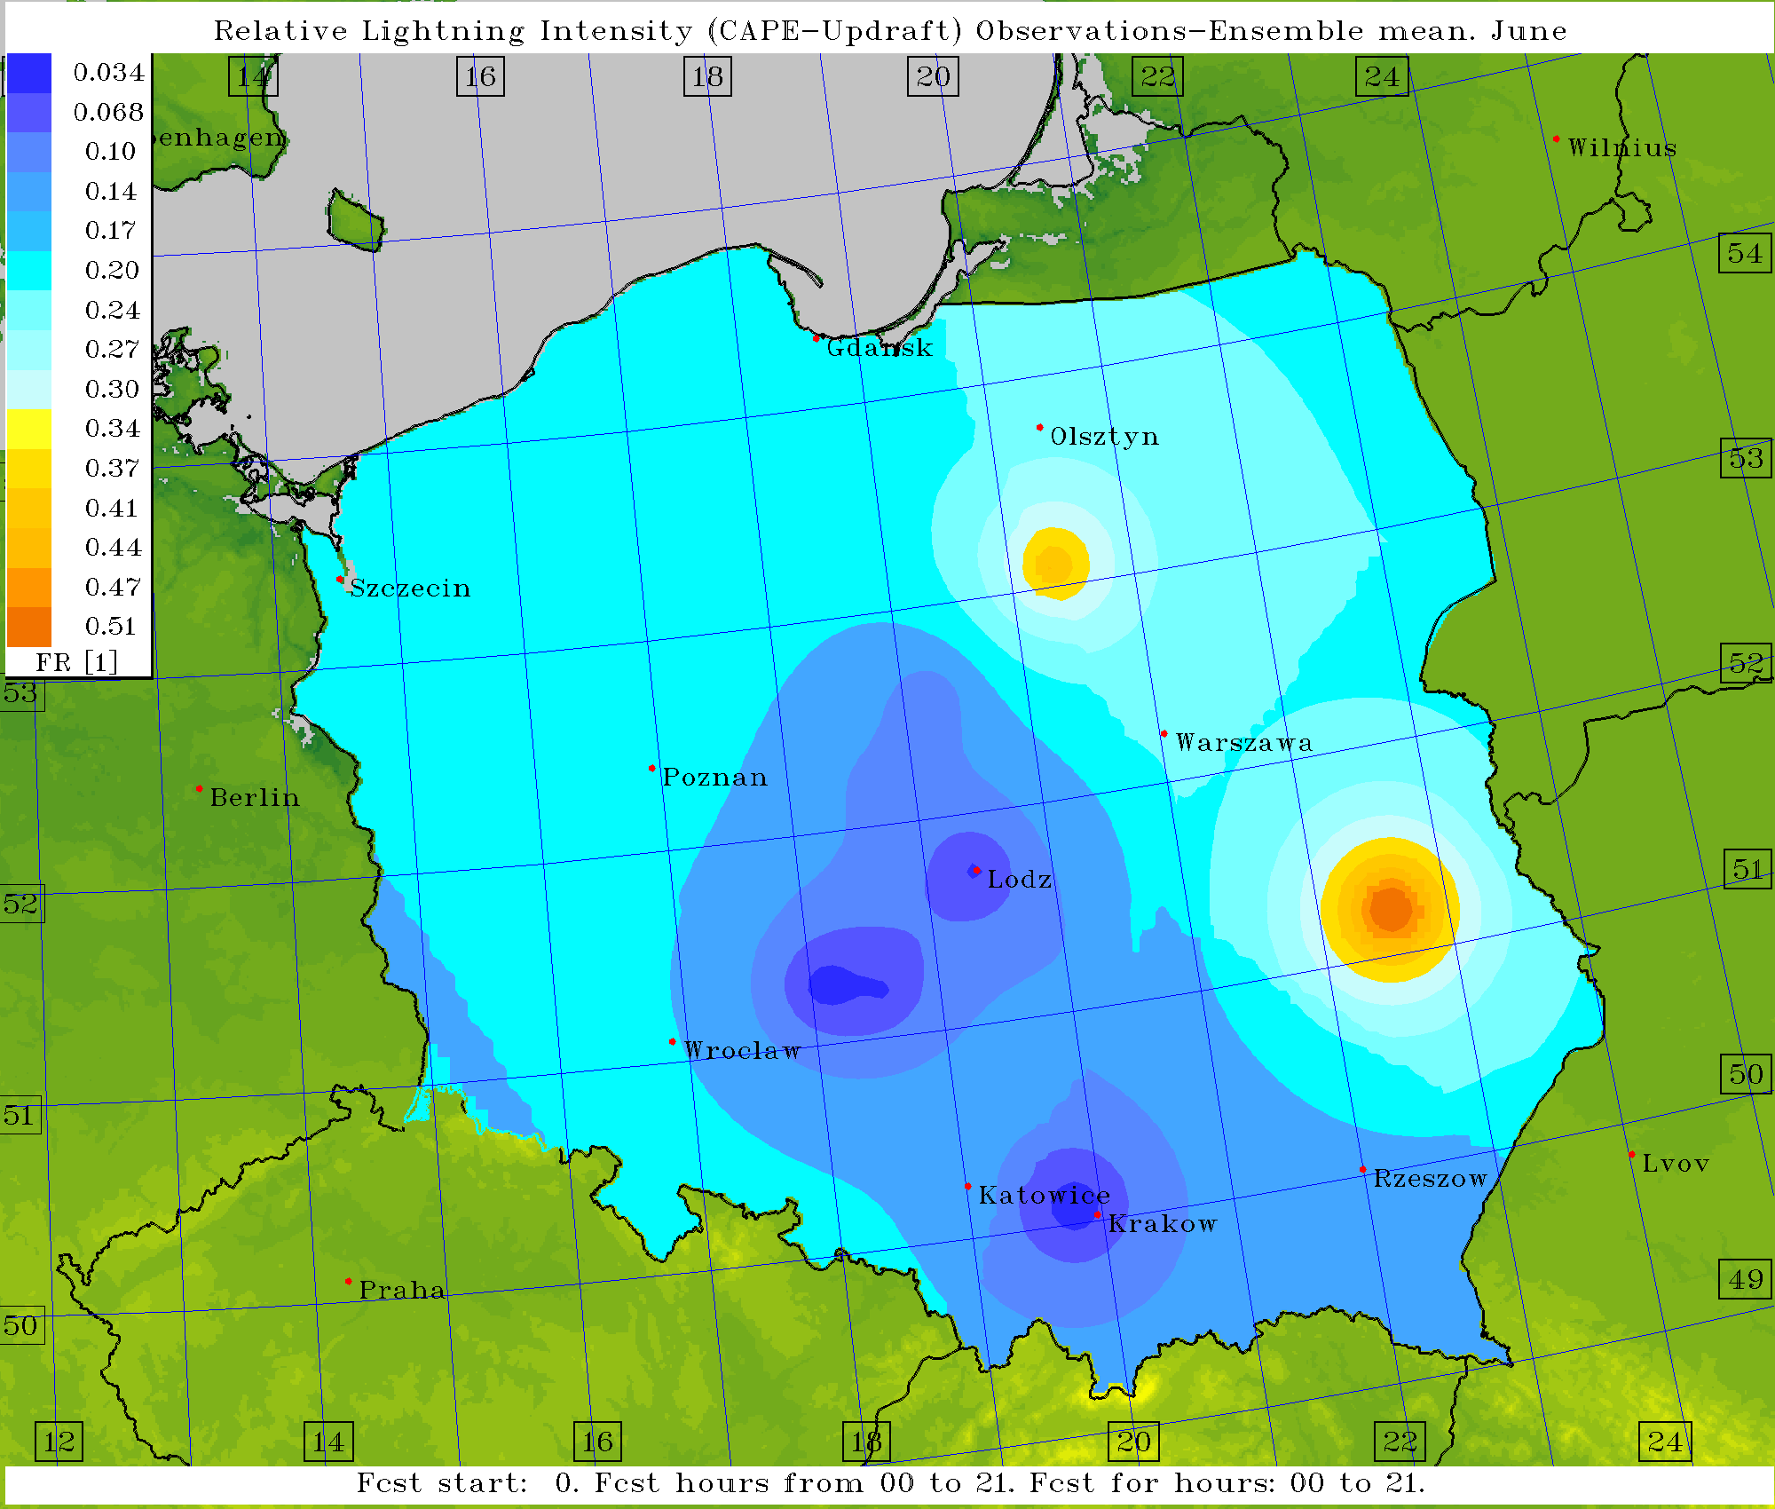
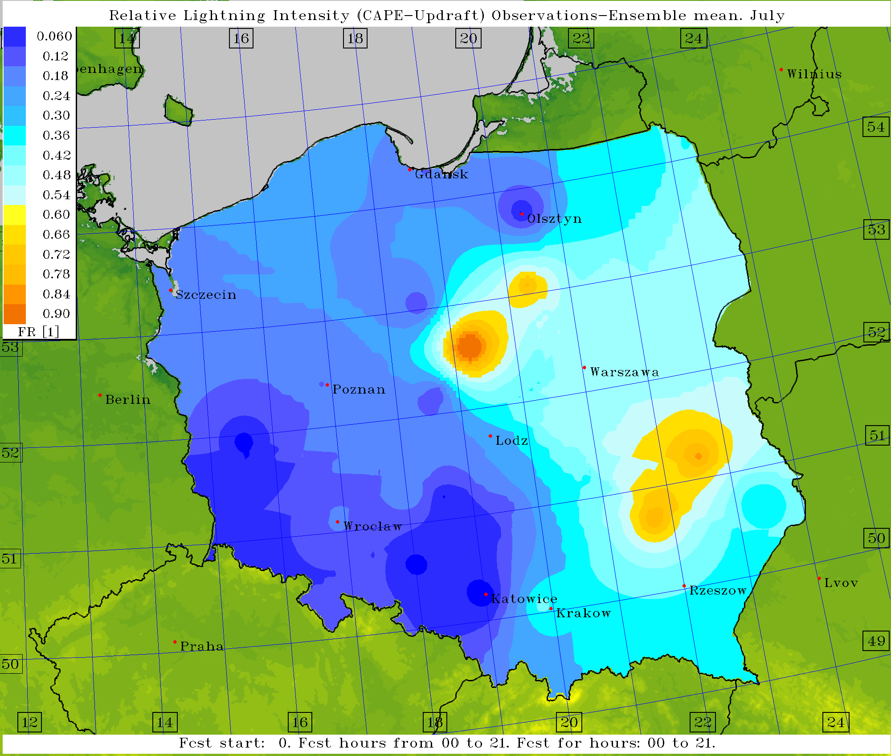
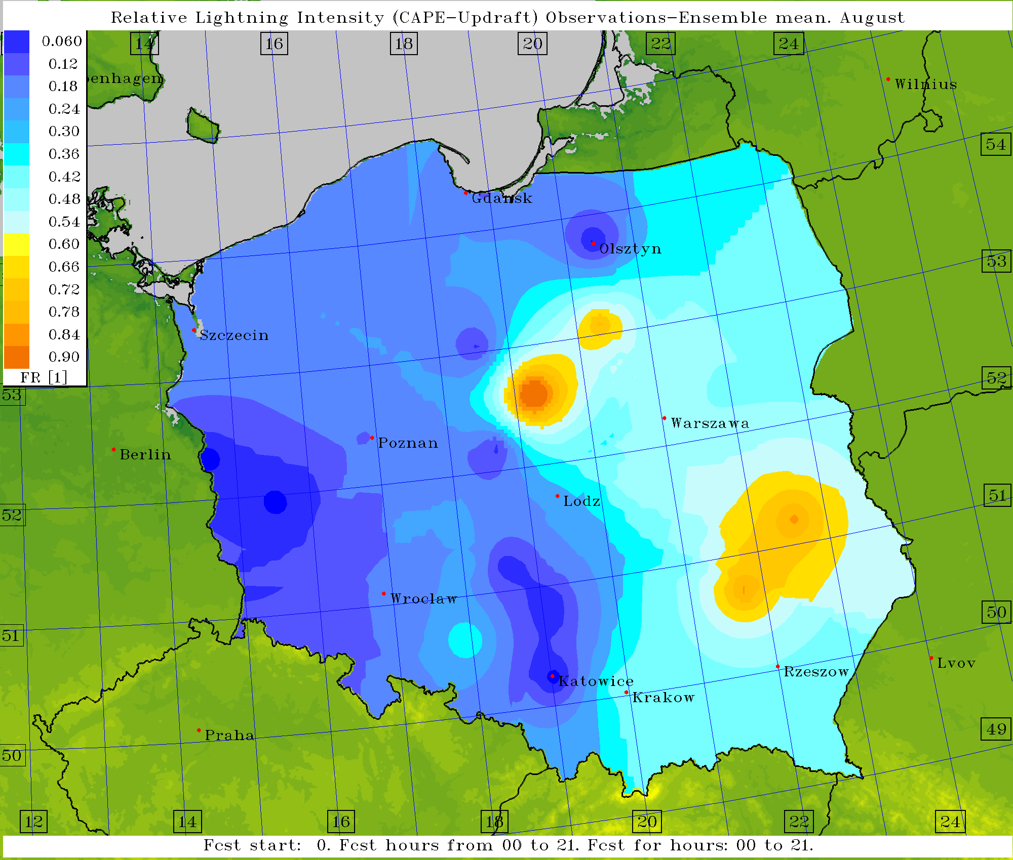
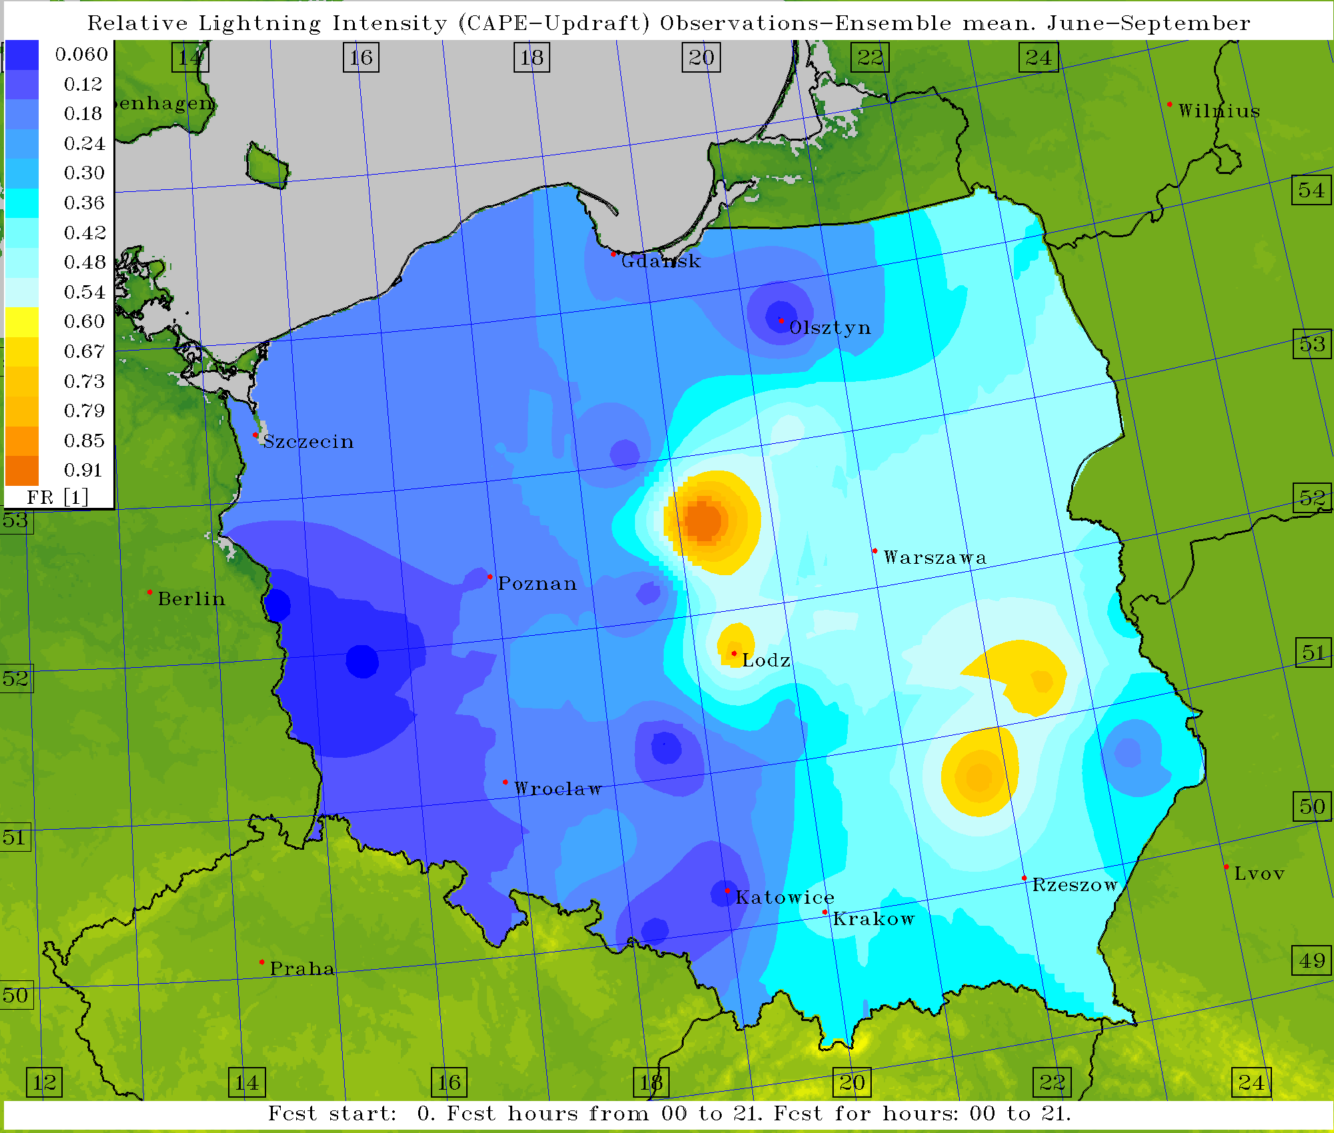
Verification – Flashrate
Mean Absolute Error, averaged for warm period of 2013

Slide 9
Visibility Range – definition
Forecasts of visibility range – from DMO; algorithm based on forecast of extinction coefficient ß_{ext} (a function of water/ice amount in the air):
(Boudala et al., 2012: Parameterization of Runway Visual Range as a Function of Visibility: Implications for Numerical Weather Prediction Models. Journal of Atmospheric and Oceanic Technology, (2) vol. 29.
See also Kunkel, 1984: Parametrization of Droplet Terminal Velocity and Extinction Coefficient in Fog Models. Journal of Climate and Applied Meteorology, vol. 23)
Forecasts verified against observations at Polish SYNOP stations

Slide 10
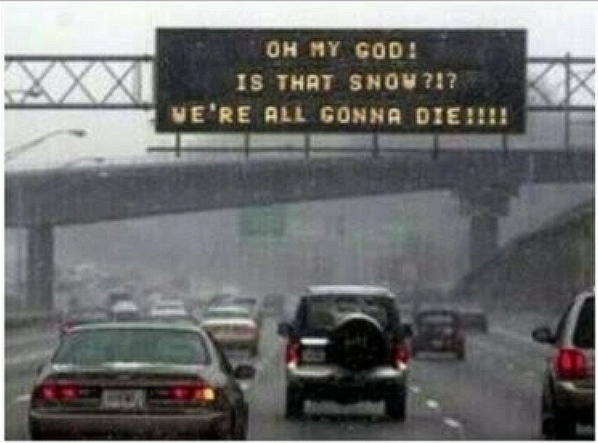
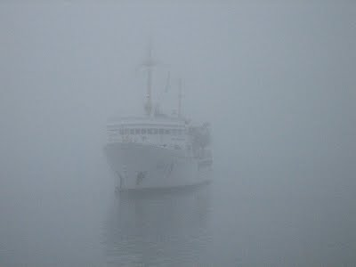
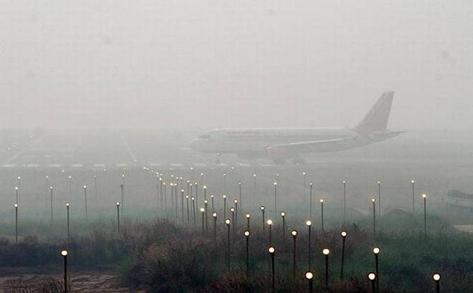
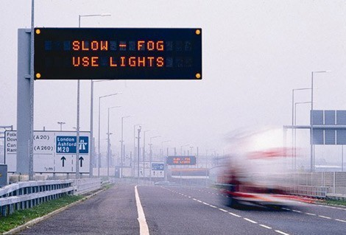
VR – applications, customers
VIS/fog
RVR
Transport nad maintenance services appear to be a main customer for VR. Especially aviation (in-flight and ground), road and sea transportation:
VMS
Courtesy of Jeremy Clarkson, Top Gear (2012)

Slide 11
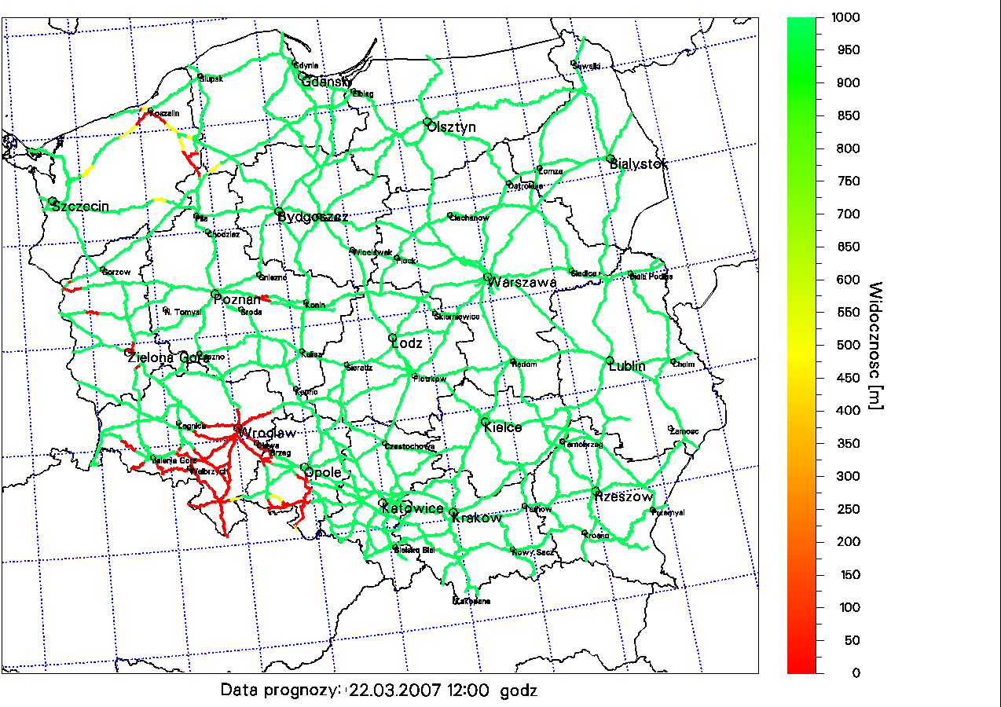
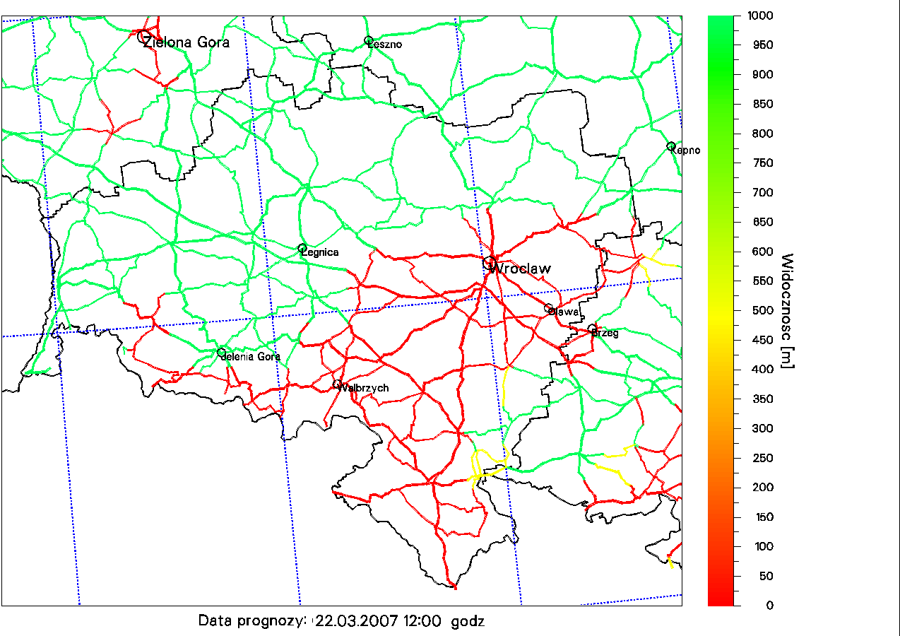
Examples – Visibility Range

Slide 12
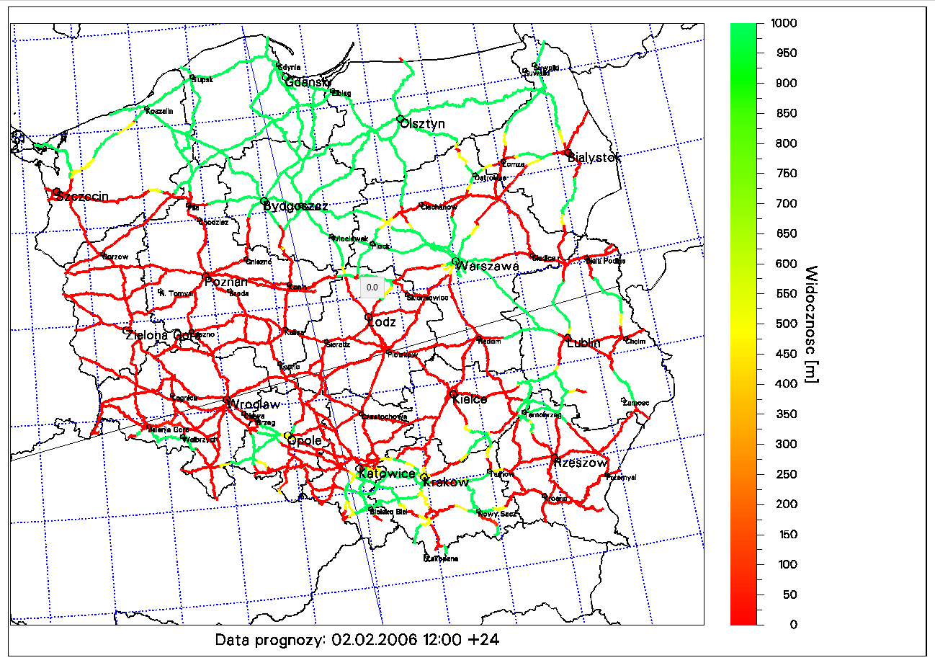

Examples – Visibility Range

Slide 13
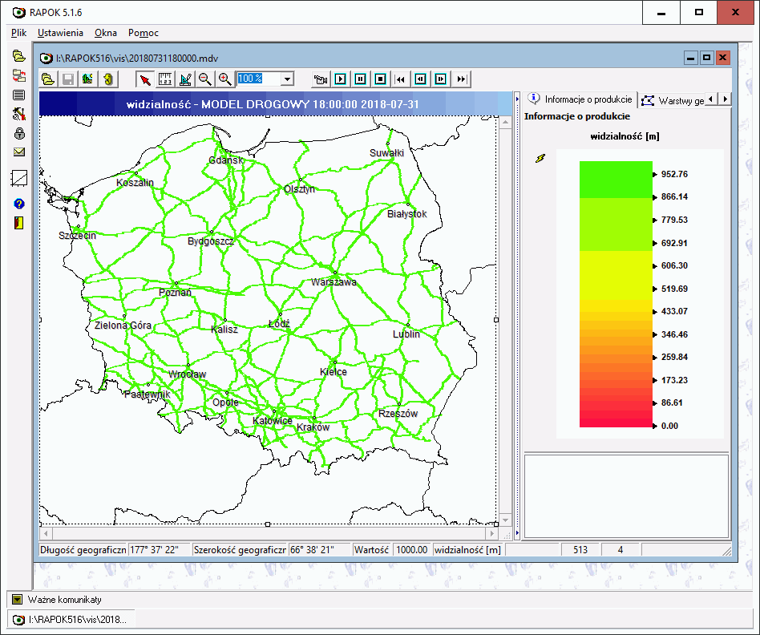
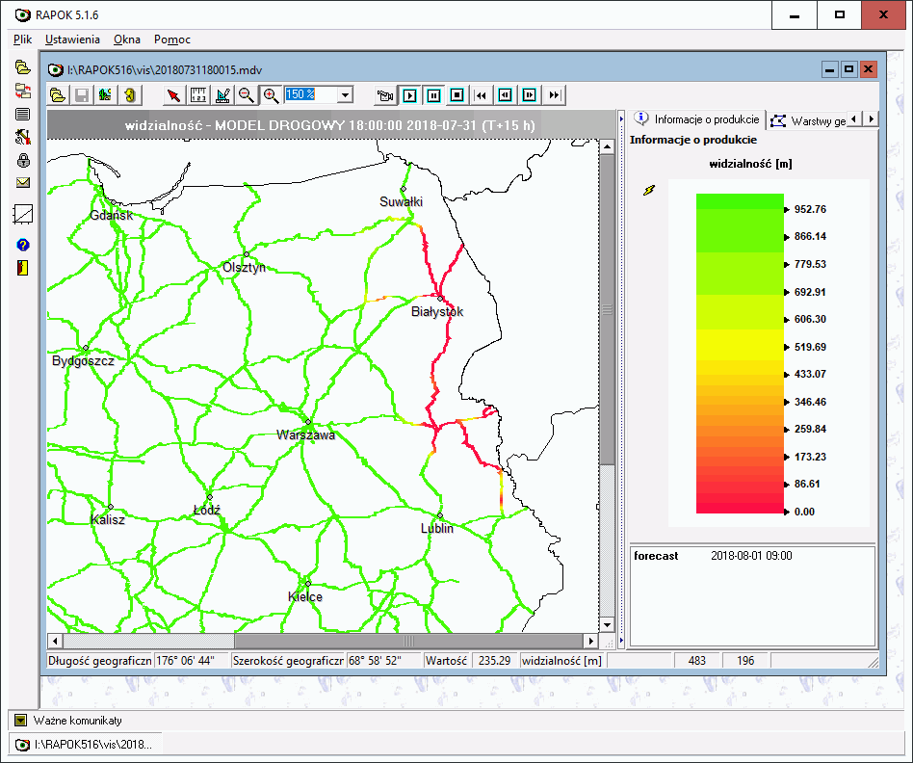
Examples – Visibility Range

Slide 14
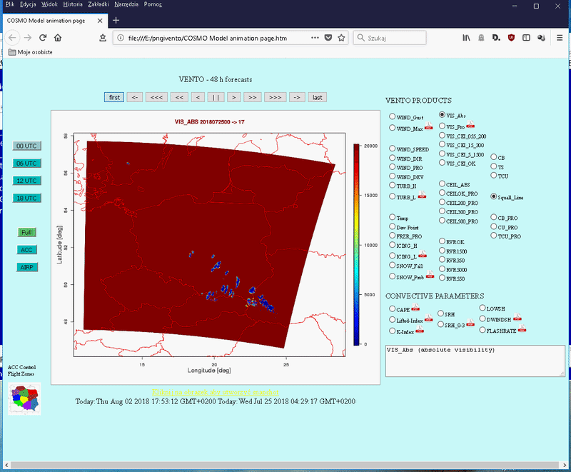
Examples – Visibility Range

Slide 15

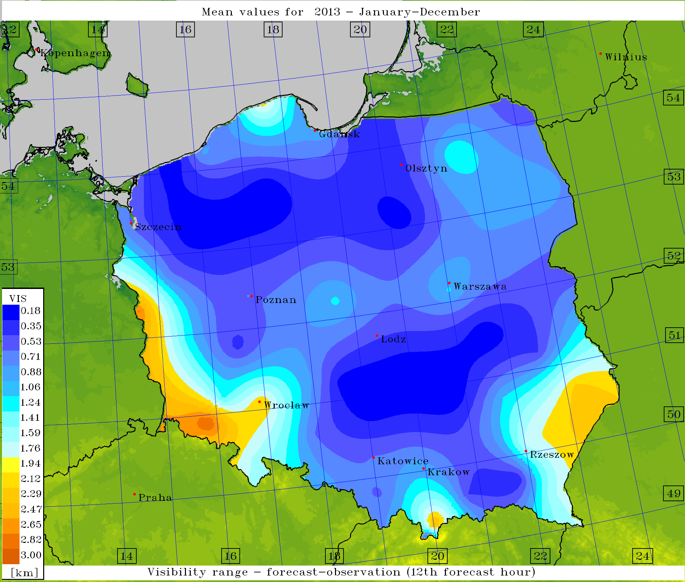
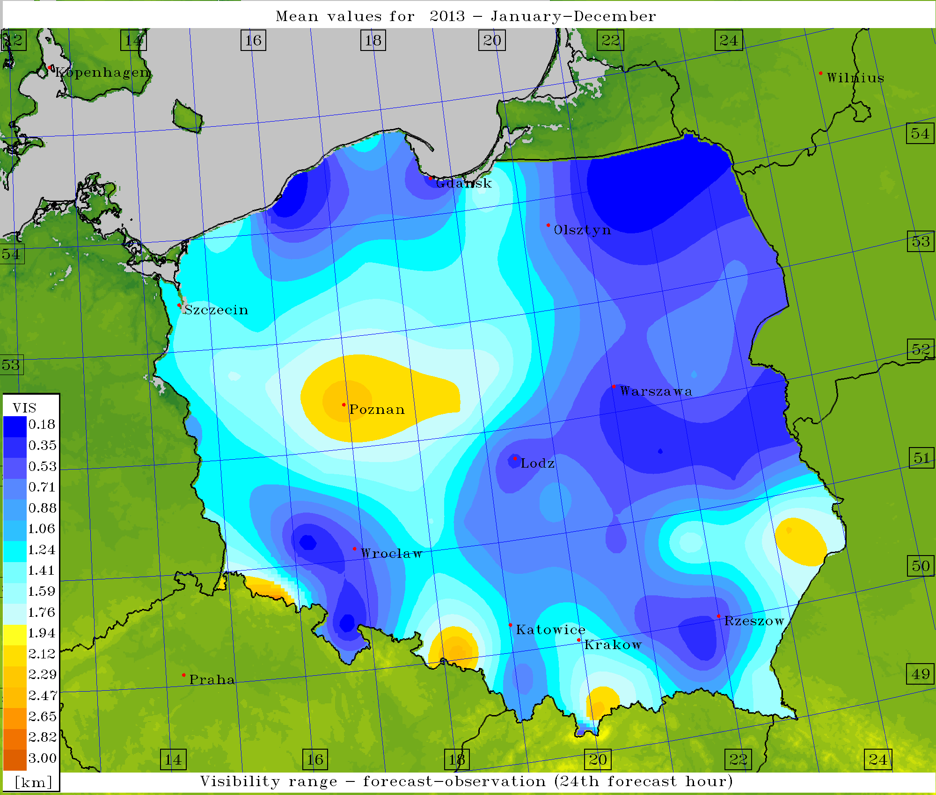
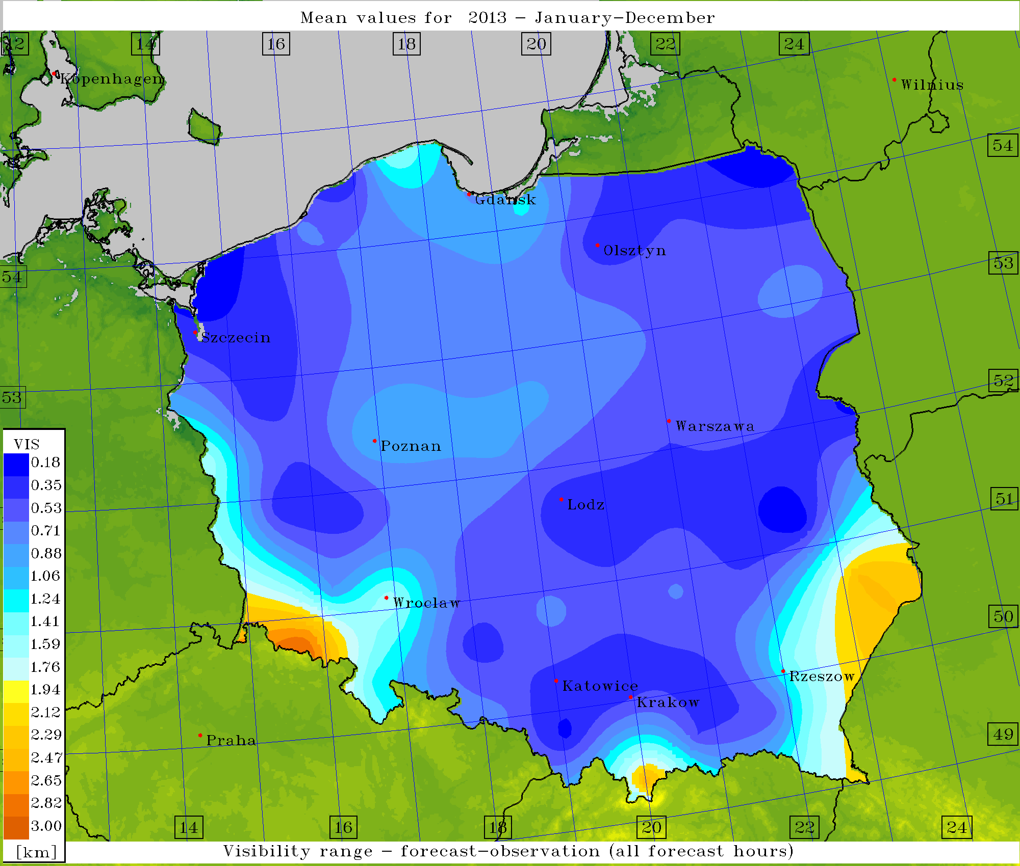
Verification – Visibility Range
Mean Absolute Error, averaged for warm period of 2013

Slide 16
Indices – ”Added Value Approach”?
Alternative – Fog Stability Index (FSI)
Forecasts of FSI – from DMO; algorithm based on forecast of condensation, vertical temperature gradient and advection:
condensation vertical temp. gradient advection
Where T, Td – temperature and dew point at 2m (K), T850 – temperature at 850 hPa (K), V850 – wind speed at 850 hPa (knots).
See e.g. Song, Yunyoung and Yum, Seong Soo: Development and Verification of the Fog Stability Index for Incheon International Airport based on the Measured Fog Characteristics, Atmosphere, Vol. 23, 4, 2013, pp.443-452
Probability of fog occurence increases when FSI drops down
Forecasts verified against observations at Polish SYNOP stations

Slide 17
Indices – ”Added Value Approach”?
Sensitivity analysis
Assuming that for chosen value of FSI fog appearance is certain, compute scores from the contingency table (POD, FC, SR, TS), then calculate the product – a new ”OVERALL” score:
OVRALL = POD x FC x SR x TS
POD = a / (a + c)
FC = (a + d) / (a + b + c + d)
SR = 1 – FAR = a / (a + b)
TS = a / (a + b +c)
Where a – hits, b – misses, c – false alarms, d – correct negatives

Slide 18
Indices – ”Added Value Approach”?
Best value of OVRALL (~0.008) – for FSI = 21

Slide 19
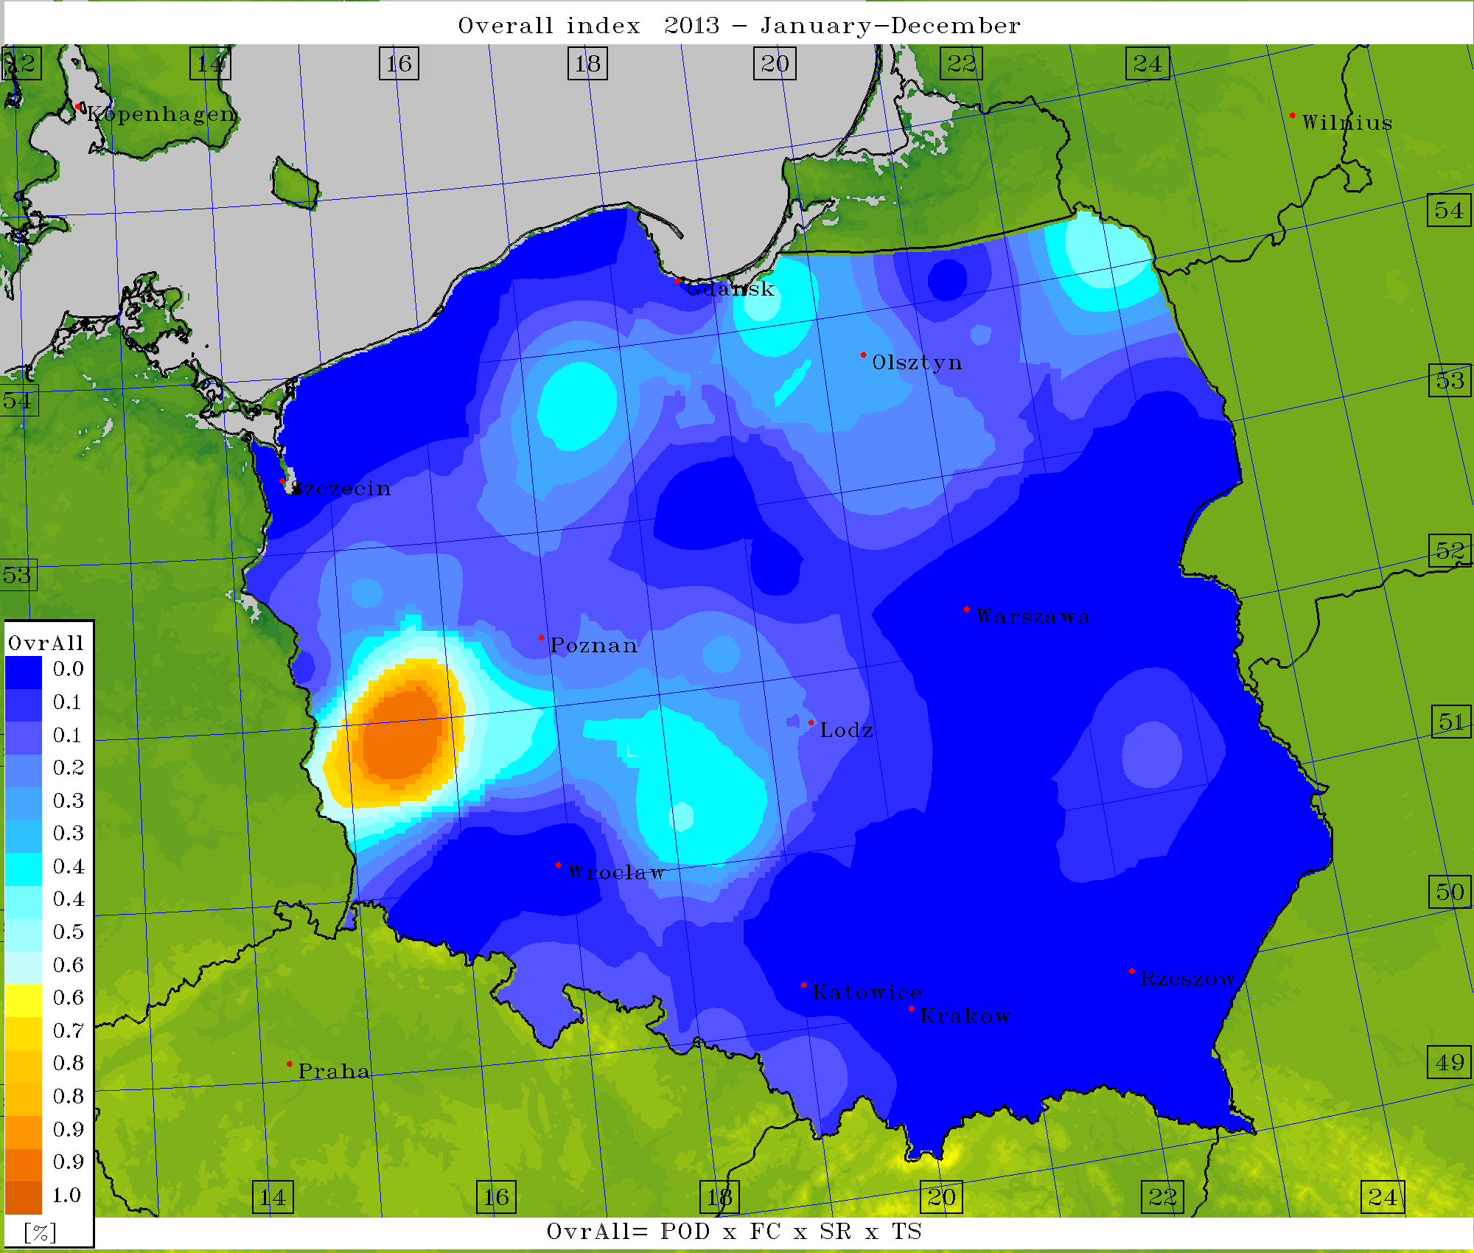
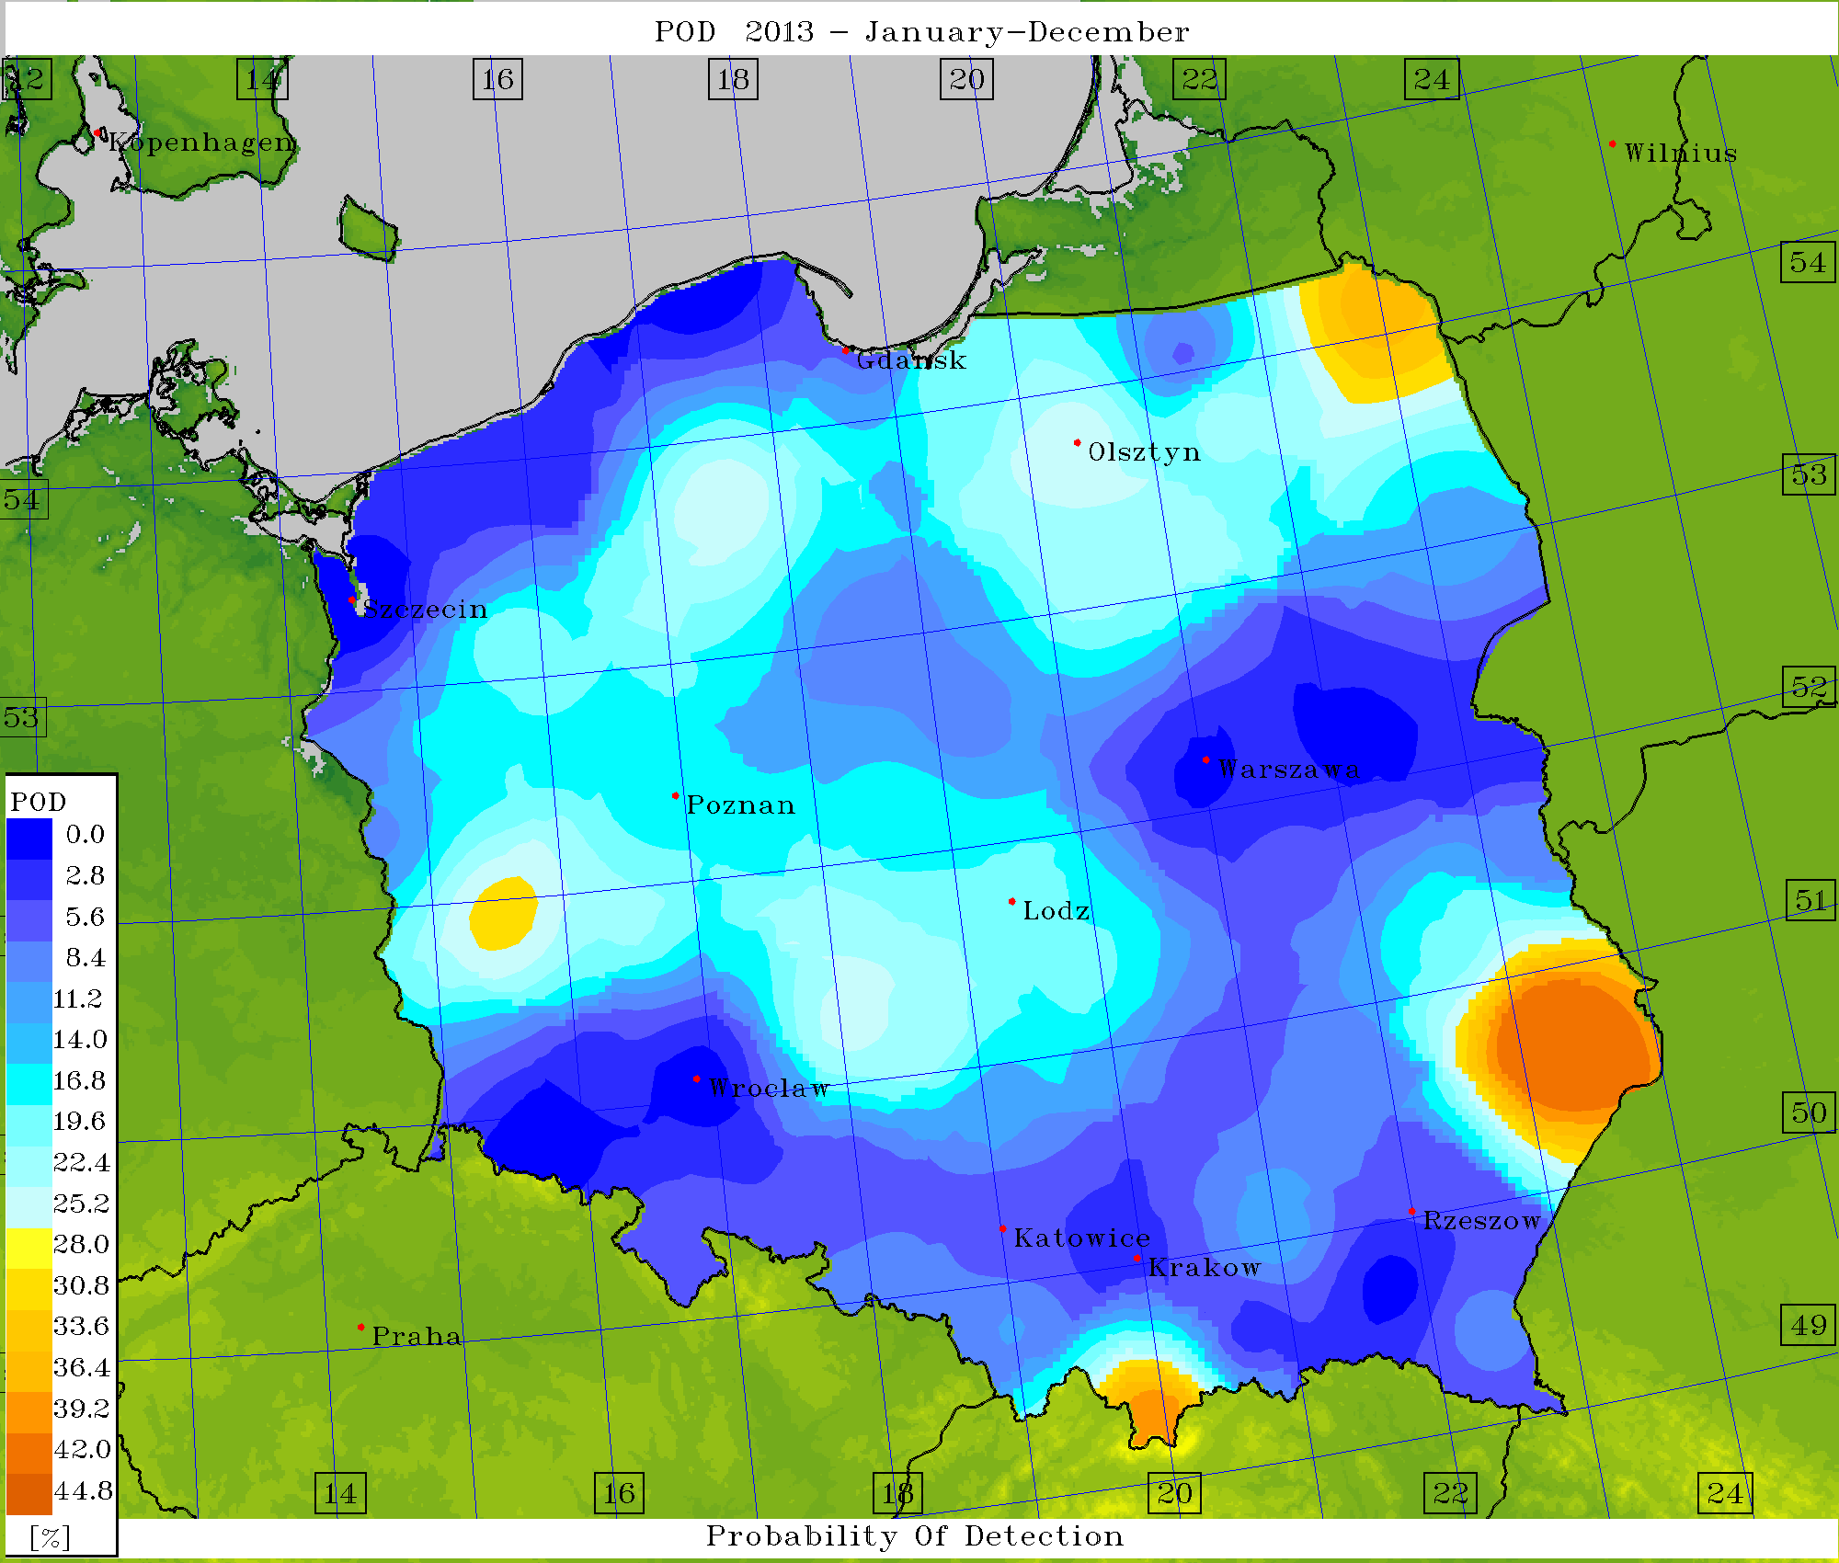
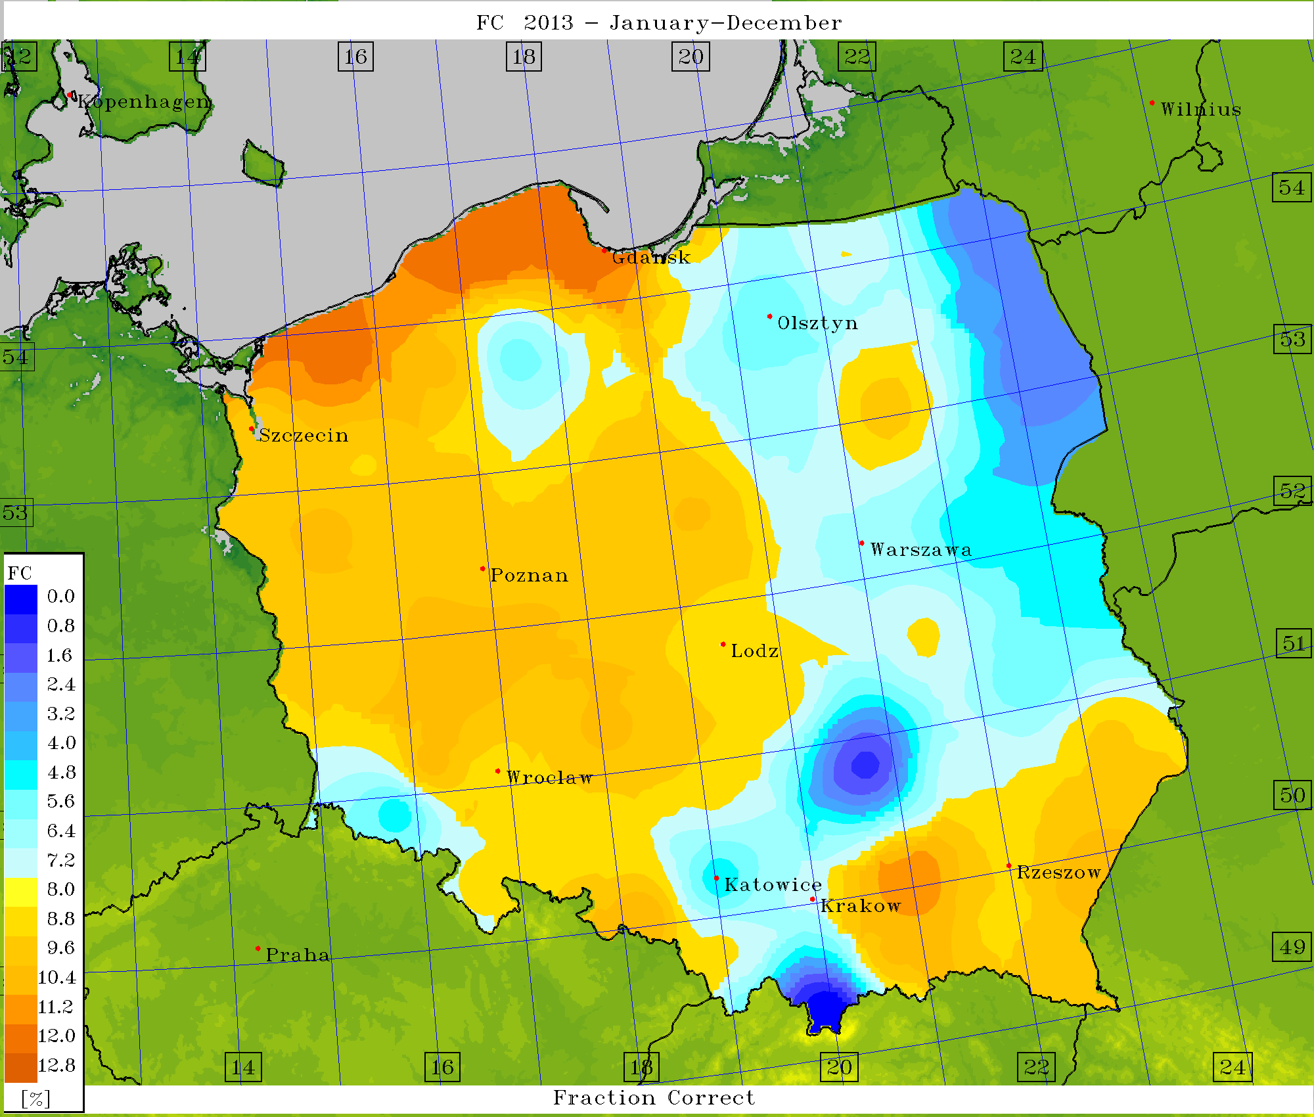
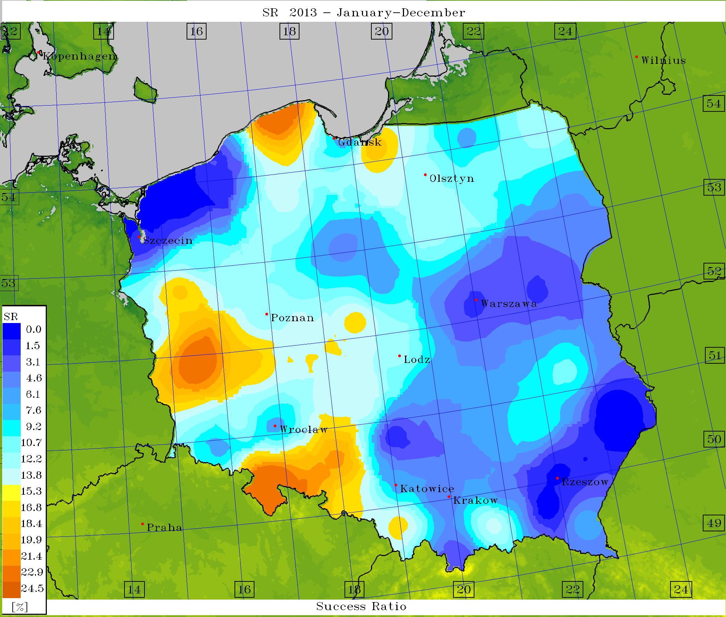
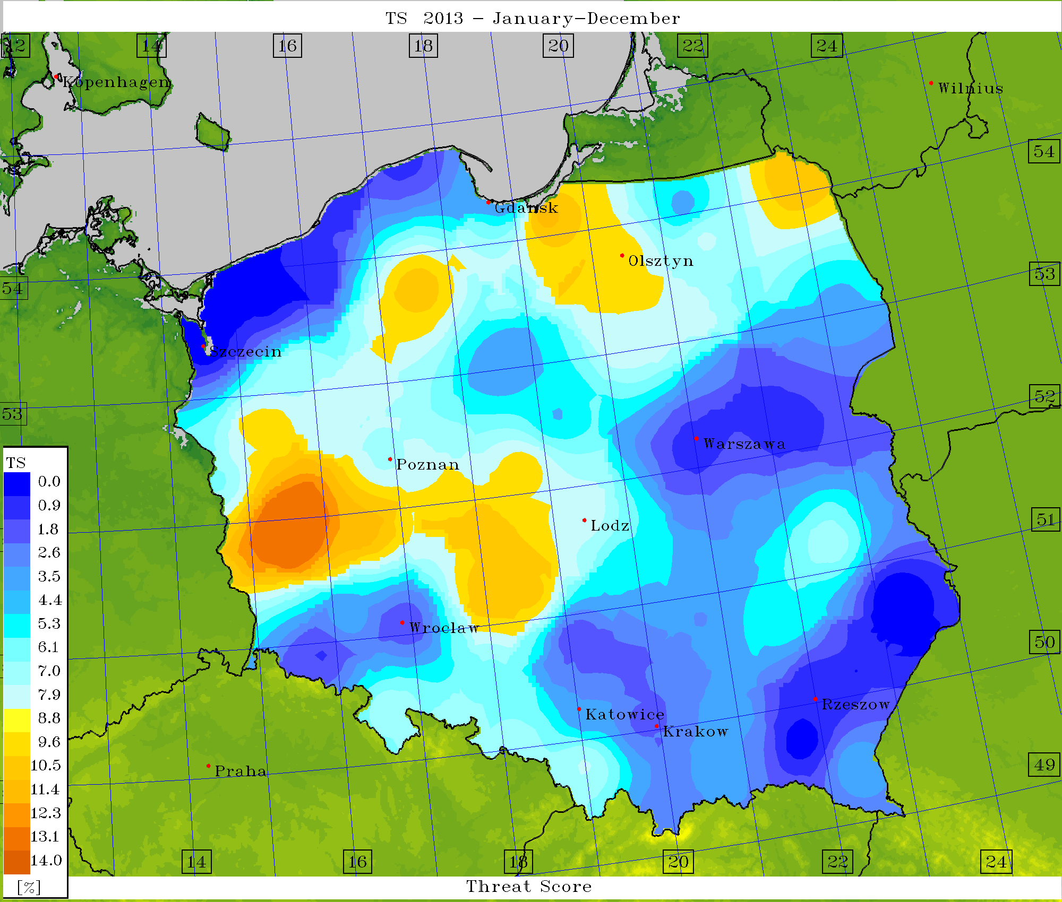
Verification – scores for FSI = 21

Slide 20
Indices – ”Added Value Approach”?
Alternative – thunderstorms via indices
Stability indices:
K-Index (def.): KI = (T₈₅₀ – T₅₀₀) + D₈₅₀ – (T₇₀₀ – D₇₀₀)
As this index increases from a value of ~20, the likelihood of showers/thunderstorms is expected to increase. Occurrence of thunderstorm(s) is virtually certain for K greater than 40.
Total Totals (def.): TT = (T₈₅₀ – T₅₀₀) + (D₈₅₀ – T₅₀₀)
Showers/thunderstorms become increasingly likely from TT values~30, and severe thunderstorms are considered probable for values >50.
Lifted index (LI) Showers and thunderstorms become increasingly likely from LI values of about 0, and severe thunderstorms are considered likely for values of < –3.

Slide 21
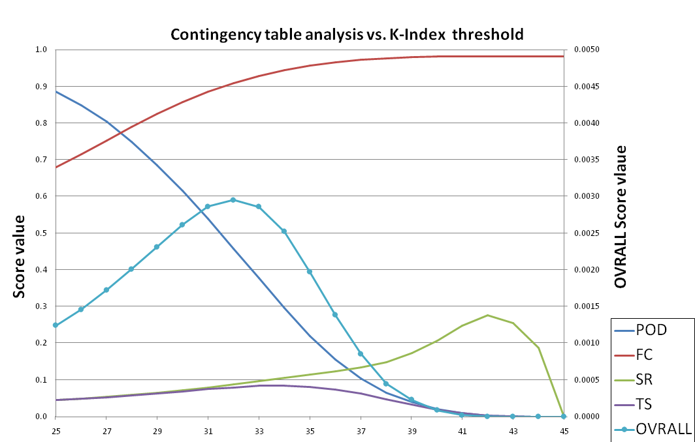
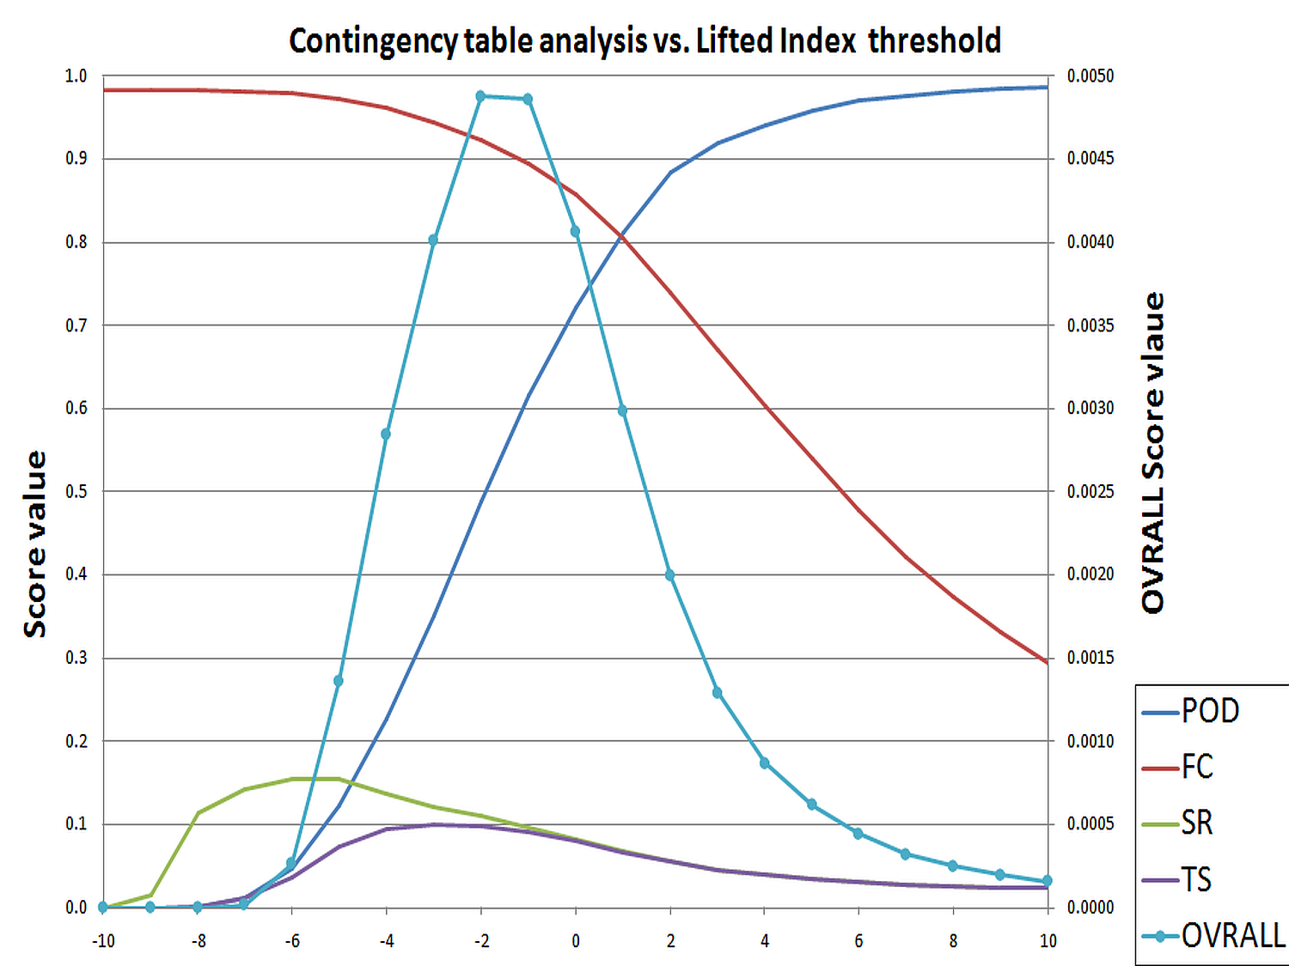
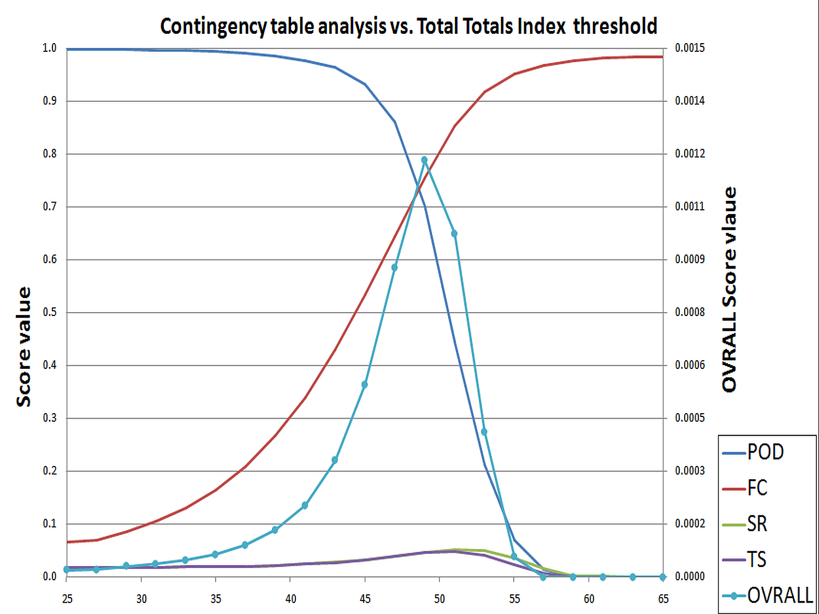
Indices – ”Added Value Approach”?
Best value of OVRALL (~0.0046) – for Lifted Index = -2
Best value of OVRALL (~0.0012) – for Total Totals Index= 49
Best value of OVRALL (~0.003) – for K-Index = 32

Slide 22
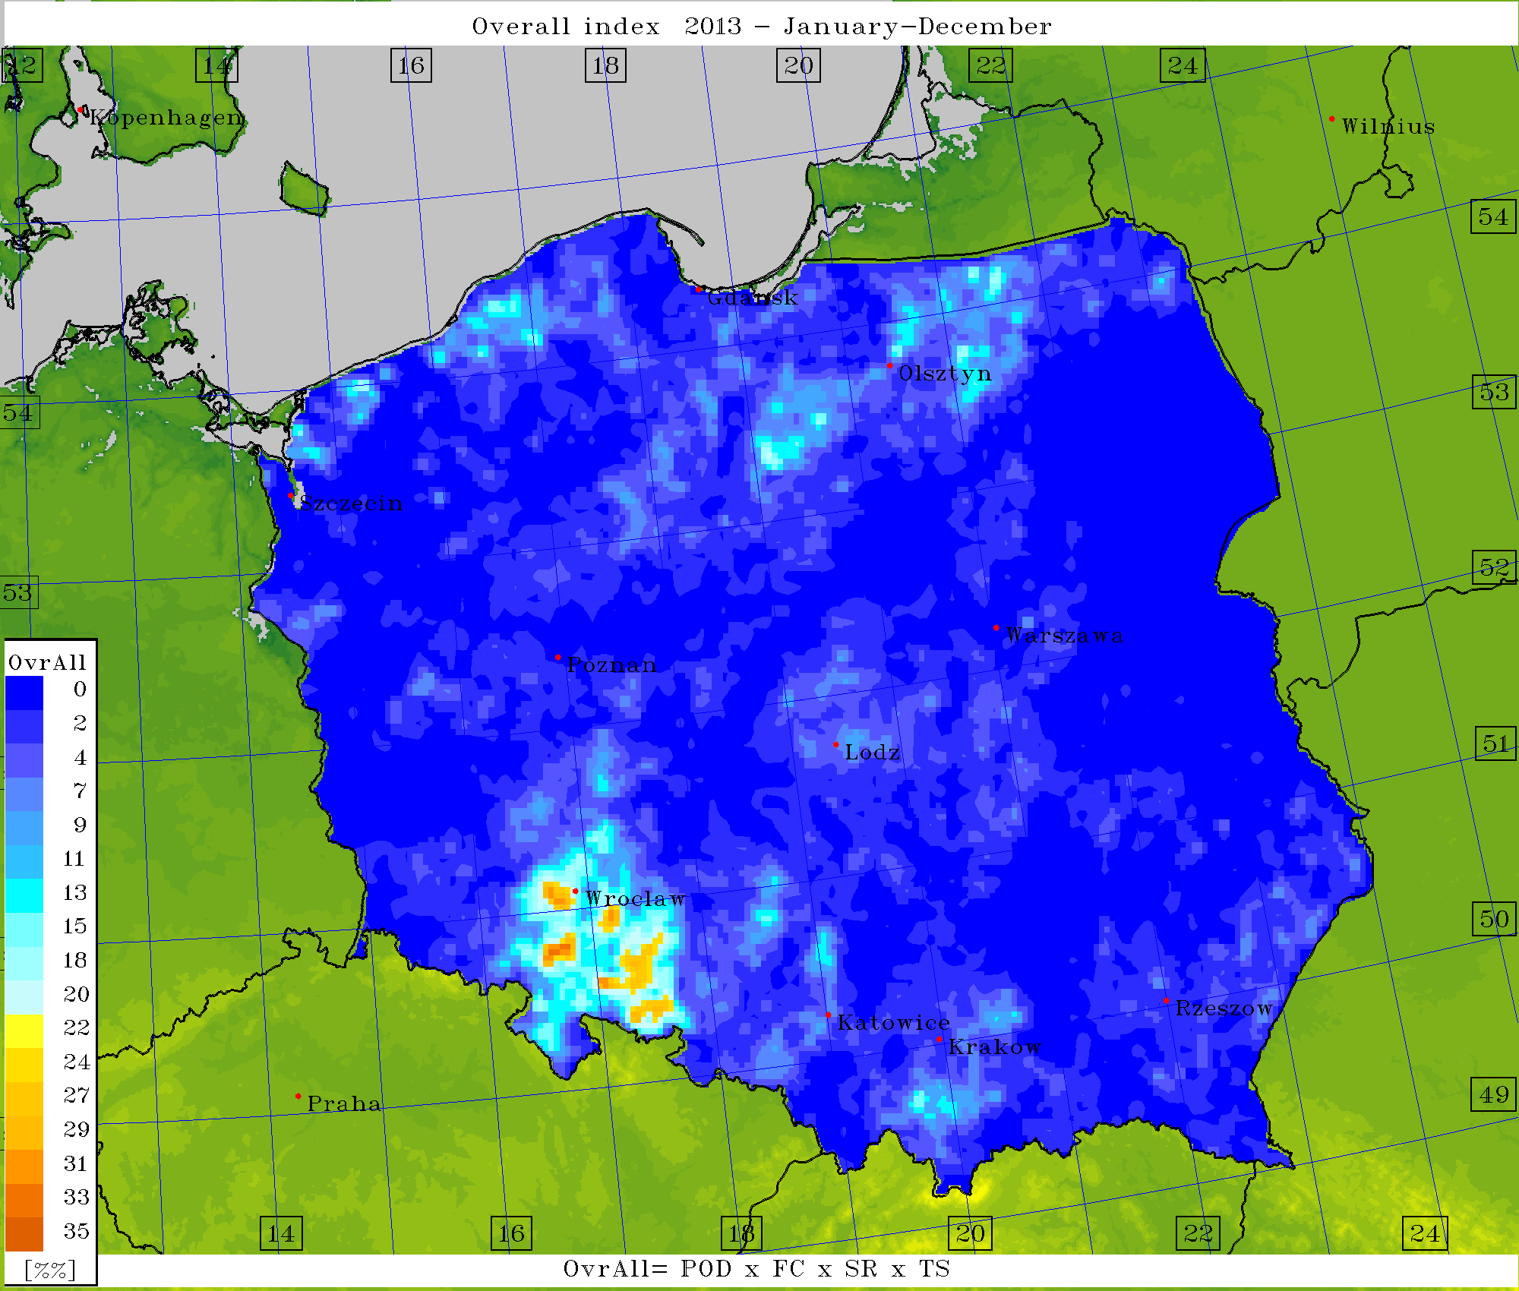
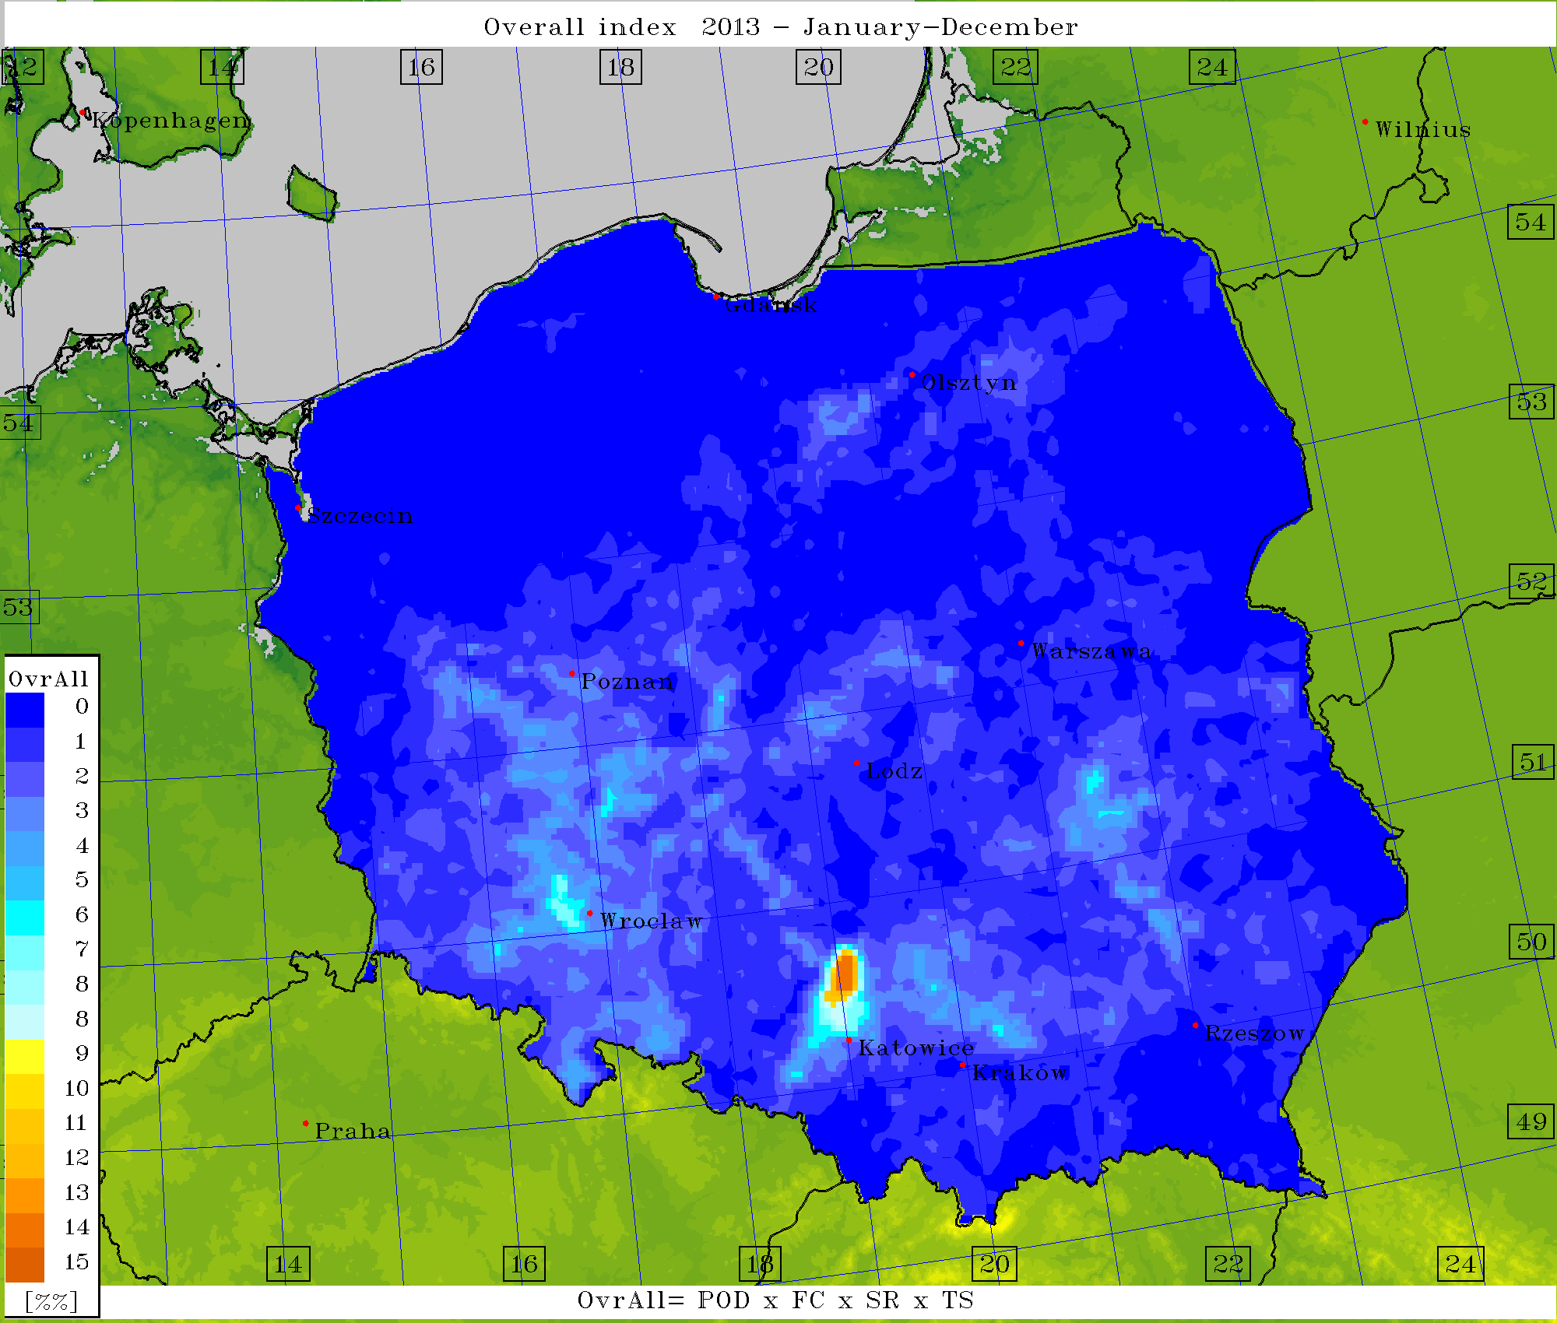
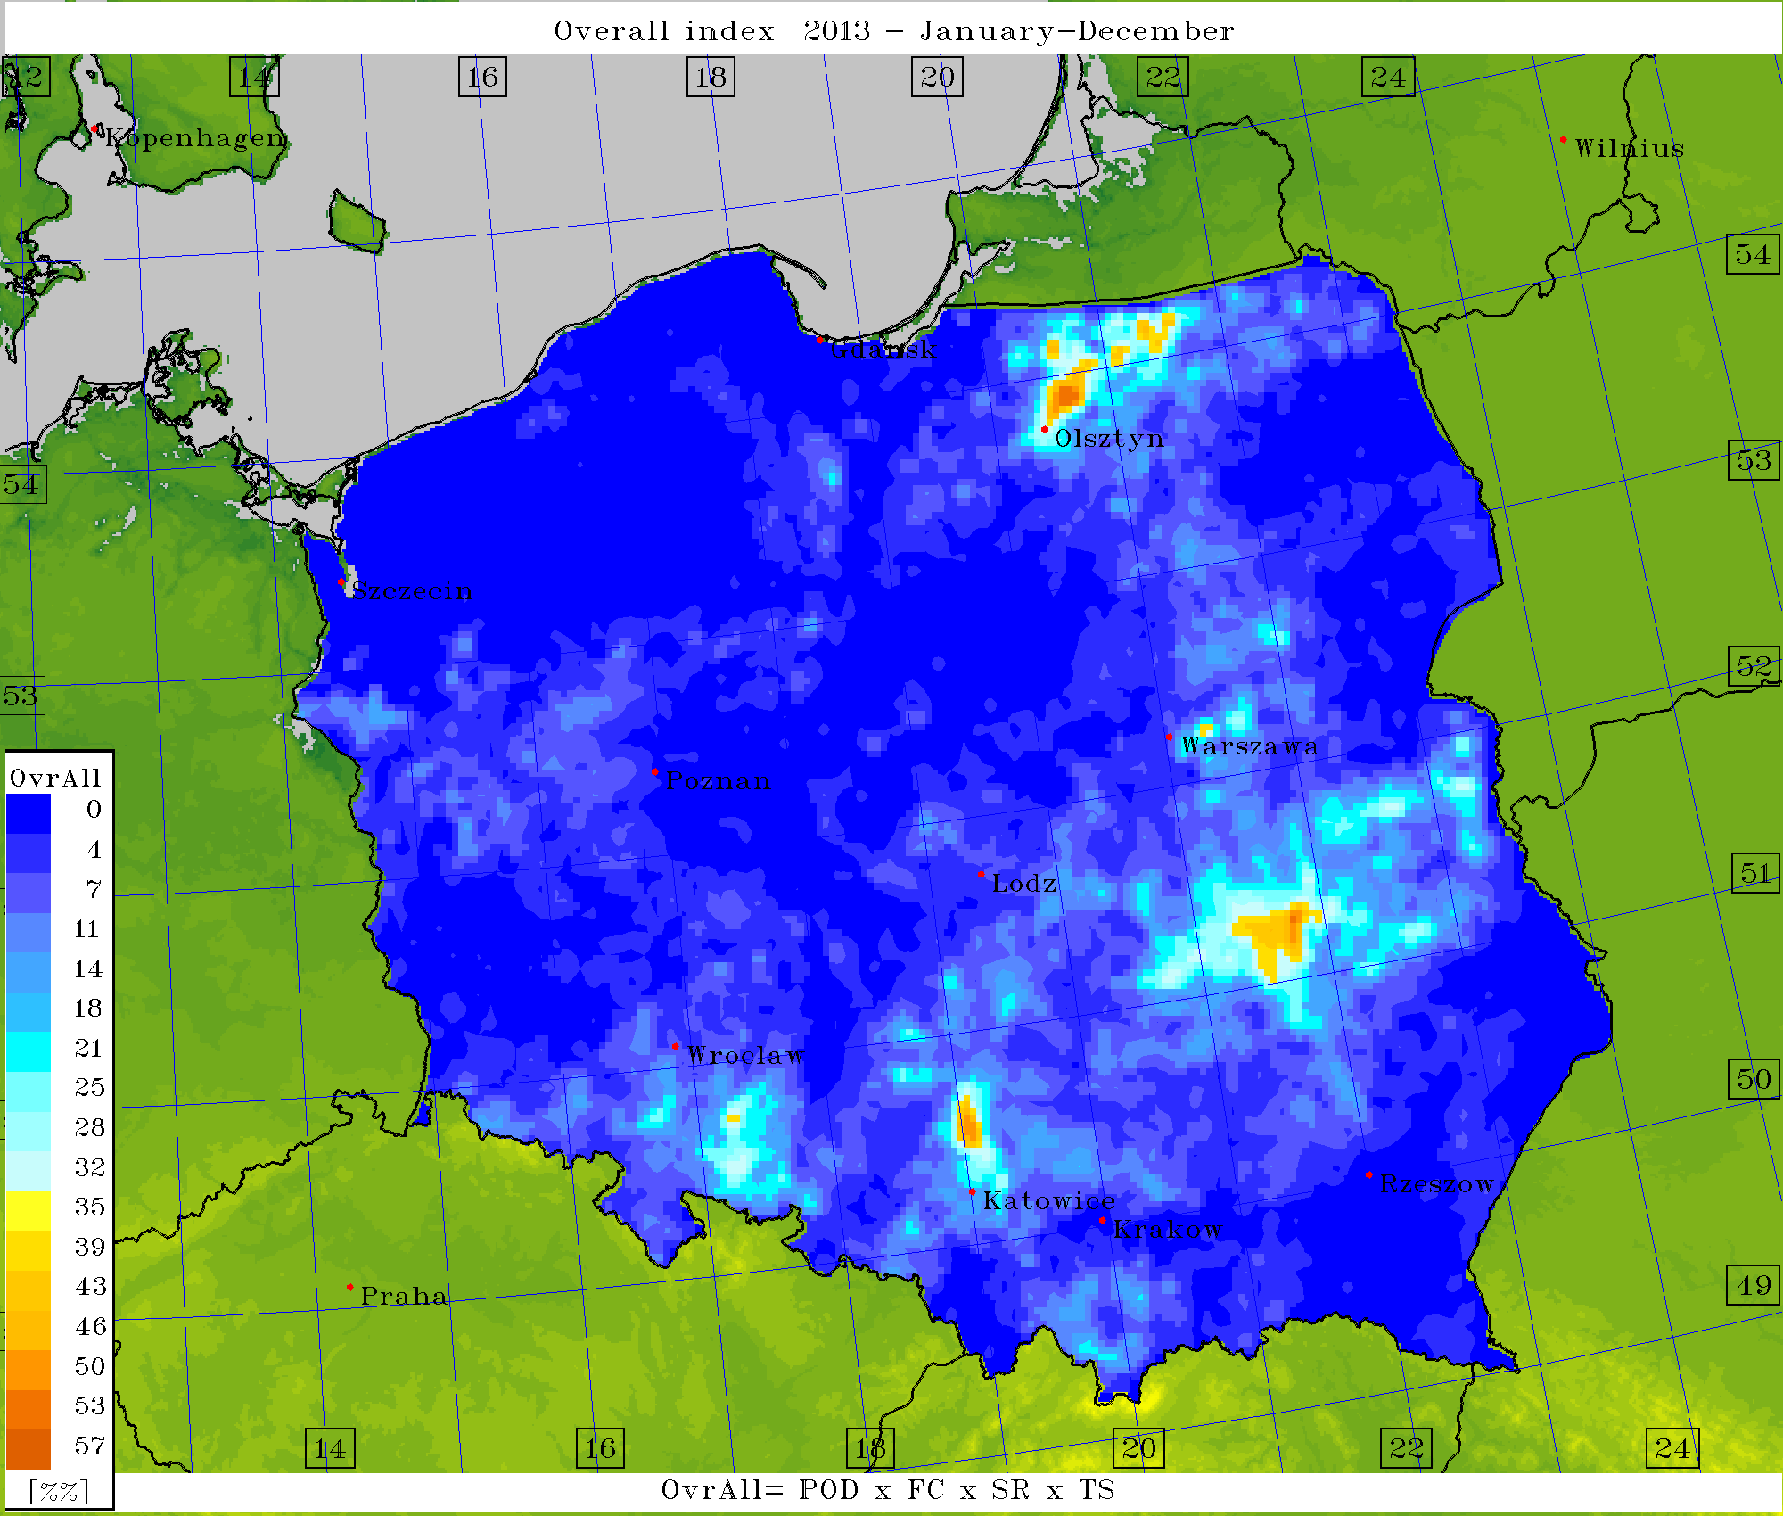
K-Index; thresh=21
Worst results
Total Totals; thresh=49
Lifted Index; thresh=-2
Best results

Slide 23
No ”Thank you!”, no ”Questions?”!
Motivation!
Conclusions – VIS forecasts and customers
Customers – transportation and appropriate services (maintenance)
In general forecasts (skill) are better for lowlands.
MAE is increasing with forecast’s hour
Conclusions – FR forecasts and customers
Customers – aviation and its appropriate services (air, ground); power production and supply services
CAPE-based forecasts of FR produce nice skill in central and north-western Poland, with spread bigger in central and western Poland. This algo overestimates FR, even with some precipitation filter applied. Another filter (cloud ice/snow/water contents) tends to (slightly) underestimate FR, however.
From our experience, FR forecasts were generally better in dry months with the (huge amount of ) occurrence of convective phenomena .
FSI / Lifted (et al.) index contingency table analysis approach –
maybe an alternative for over- or underestimating VIS/FR???

Slide 24


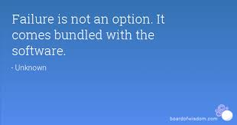

Motivating sentence(s):
Optimistic
Pessimistic
TV-show: Mythbusters
Realistic

