Slide 1
Fieldextra Lifecycle
Petra Baumann
WG4 Parallel Session, COSMO GM 2018, 04.09.2018

Slide 2
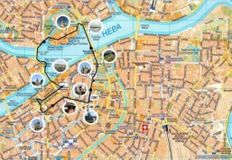
Purpose
Encourage the COSMO partners to contribute to the definition of the lifecycle of fieldextra!
Plan for today:
Short overview of
  releases since COSMO GM 2017
  developments for the next releases v12.8.0 and v13.0.0
Discussion
  «What should happen after v13.0.0?«.

Slide 3
Where are we now?
  History and planning on GitHub:
  https://github.com/MeteoSwiss-APN/fieldextra-wiki/wiki
  Releases since COSMO GM 2017:
  v12.7.0, released on 02.02.2018, published on COSMO web site
  v12.7.1, released on 09.05.2018, only on GitHub
  v12.7.2-4, released on 23.05.-23.07.2018, only on GitHub
Notes:
Interesting in
v12.7.0:
Possibility to write frame output
Possibility to produce cross sections along arbitrary paths
Support of ART products
New point operator ‘stretch’
Improved OpenMP performances (parallel execution of toper, poper, voper)
v12.7.1:
Consolidated and extended cookbook
New fxdestagger
Recognize ICON-EPS

Slide 4
Where are we now?
  v12.8.0, by end of 2018
    NetCDF input
    Extended lateral re-gridding (conditional source points, generalized distance)
    Cookbook with more than 50 fully commented examples
  v13.0.0, Q1 of 2019
    Migration from GRIB API to ecCodes
    Streamline installation procedure using CMake
    Consolidate regression suite
    Improve namelist structure
Notes:
v12.8.0:
- History available in devlopment branch on GitHub
v13.0.0:
Consolidate regression suite:
In particular for operationalization tests:
Compare min, max, mean, std, #missing
Disregard large differences for non-significative values
Strict testing of meta information (in particular for GRIB2)
Improve namelist structure:
Support writing more compact namelists
Facilitate writing complex namelists

Slide 5
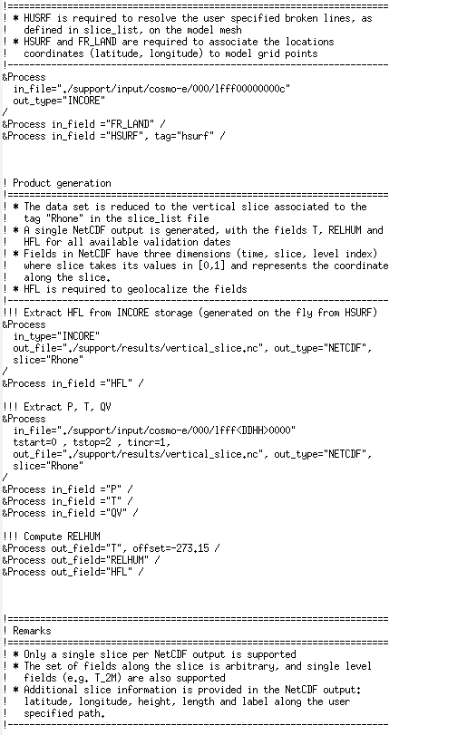
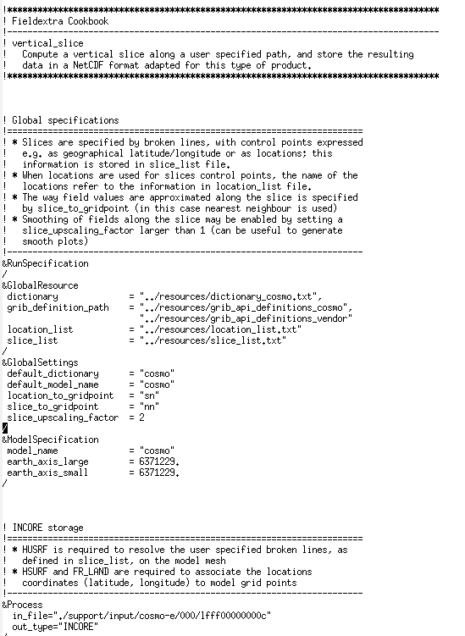
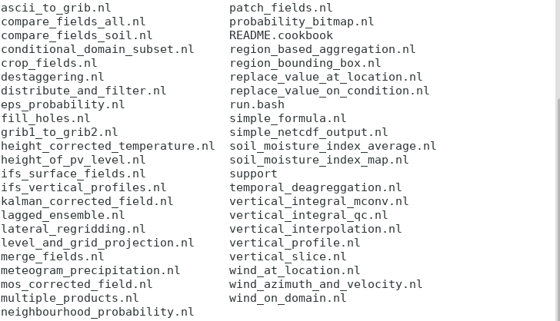
Extensive Cookbook
Notes:
Table of contents in README.cookbook!

Slide 6
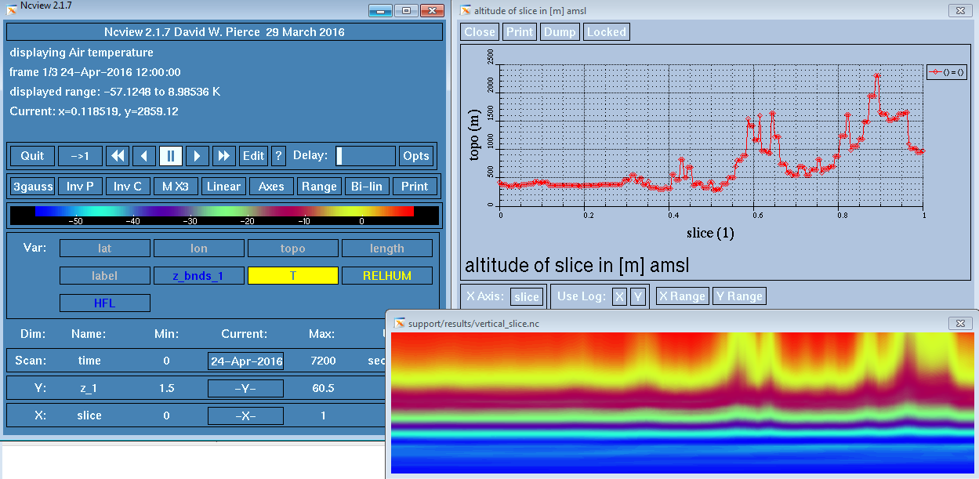
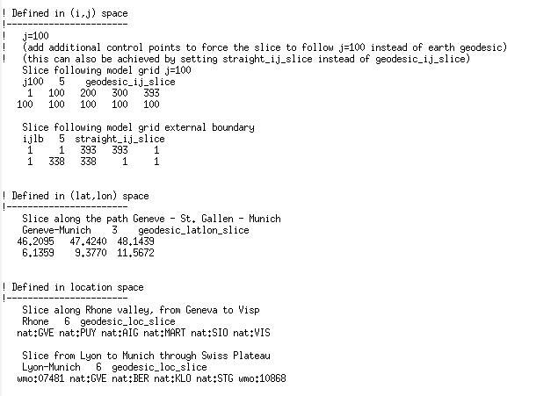
Some Nice New Features
    Vertical cross sections along arbitrary path, e.g. along the Rhône valley from Geneva to Visp
Notes:
Vertical profiles can be created in a very simple way using «grins –i –j»

Slide 7
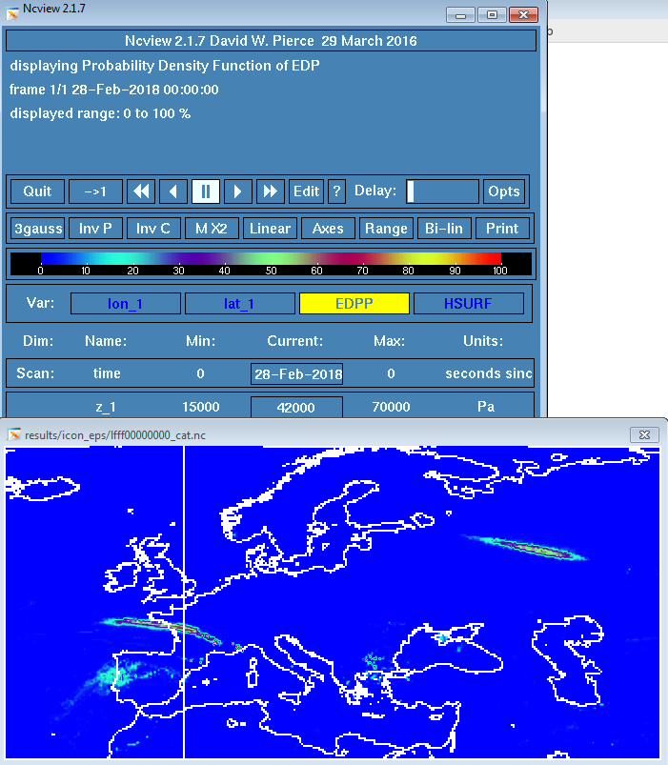
Some Nice New Features
      CAT probabilities based on ICON-EPS (developed by Axel Barleben, DWD)
      ICON-EPS input on native grid
      Eddy dissipation parameter on pressure levels, using voper=«intpl_k2p,nearest»
      Fitting, using a composition of poper=«logarithm_e», poper=«polynomial», and poper=«exponential»
      Probability of exceedance
      GRIB2 output on geographical lat/lon grid
Notes:
ICON-EPS support since v12.7.1!

Slide 8
Some Nice New Features
  MeteoSwiss project ModInterim:
  RUC of 1.1 km ensemble for short range forecast, prolonged 2-4 times per day on 2.2 km grid to medium range
  Upscaling from 1.1 to 2.2 km geometry for seamless products, e.g.
  Soil and surface fields (e.g. T_SO, W_SO):
    conditional next neighbour interpolation, considering points of same surface type, and weighing horizontal distance by a factor of 200 as compared to vertical distance

Slide 9
Some Nice New Features
  U and V
    de-stagger
    lateral interpolation by picking next neighbour
    vertical profile on coarse geometry
      linear interpolation in height above top of surface layer (assumed at 20m above ground)
      extrapolation using constant value below top of surface layer
    re-stagger

Slide 10
Some Nice New Features
  QV (following INCA algorithm)
    lateral interpolation by averaging 9 neighbours
    linear interpolation in pressure above top of surface layer (assumed at 20m above ground)
    extrapolation using constant vertical gradient below top of surface layer (computing representative vertical gradient in PBL)
    Clip to QVsat to avoid super-saturation

Slide 11
Where should we go?
ICON: full support of ICON grid, …
Optimization: parallel input, MPI support, memory management, …
Internal consolidation: handling of undefined values, …
New features: GeoTIFF support, …
«Fieldextra as a (micro-)service»: functionalities as library, single-task-services as, e.g., provided by fx tools, …
Replacement by another tool
Somewhere off the beaten track?
Notes:
See also planning in the WiKi on GitHub: https://github.com/MeteoSwiss-APN/fieldextra-wiki/wiki/Planning
ICON:
Native grid supported on input, output on lat/lon grid
GeoTIFF support:
A Fortran library for GeoTIFF is already available from Davide Cesari
Fieldextra as a service:

Slide 12
Feedback
DWD (collected by Hermann Asensio):
  Full support of ICON grid would be a great focus, as ICON-D2/ICON-LAM will start at the end of 2019 in a test phase
  As data size will increase, also optimization should be prioritized
  GeoTIFF output would be very nice

Slide 13
Feedback

