Slide 1

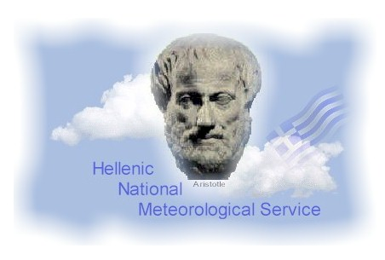
A Method for the Hierarchy of CALMO_MAX Tests
Euripides Avgoustoglou
Hellenic National Meteorological Service
20th COSMO General Meeting, St. Petersburg
September 3rd, 2018
1

Slide 2
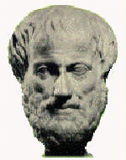
MOTIVATION
Towards the effort of model opimization and upon gauging the model sensitivity, when the number n of considered model parameters increases, the number of their pair combinations regarding their min and max values vastly increases [O(2n)²].
In CALMO_MAX project , considering an extensive period of COSMO Model testing of order 1 year over a horizontal grid of ~1km, the number of tests becomes of O[10²(2n)²] and upon the accounting of intermediate parameter values regarding the use of a metamodel, the number of tests rises to O[10³(2n)²] or the equivalent of runs for 3 centuries for n=5 !!
An efficient methodology to constrain the number of tests should be to indicate their impact according to some quantitative criteria and decide upon the resulting priority.
The methodology is expected to be of practical value if two goals could be accomplished:
The tests get a priority order and are performed according to it.
If the number of tests becomes too extensive, the method should be flexible enough to be terminated at the priority that suits the available computational resources. The recommended truncation, however, needs to be supported by some valid scientific arguments regarding the relative importance of the tests that will be included against those that will be omitted.
Euripides Avgoustoglou HNMS, 20th COSMO General Meeting, September 3rd 2018
2

Slide 3
The proposed methodology will be presented in STEPS and in reference to the web presentation in the 17th COSMO General Meeting in Wrocław:
“Design and Evaluation of Sensitivity Tests for CALMO Project”
available at:
http://www.cosmo-model.org/content/consortium/generalMeetings/general2015/parallel.htm
and referred as EA_COSMO_GM_2015 herein.
Euripides Avgoustoglou HNMS, 20th COSMO General Meeting, September 3rd 2018
3

Slide 4
STEPS OF THE METHOD
Euripides Avgoustoglou HNMS, 20th COSMO General Meeting, September 3rd 2018
4

Slide 5
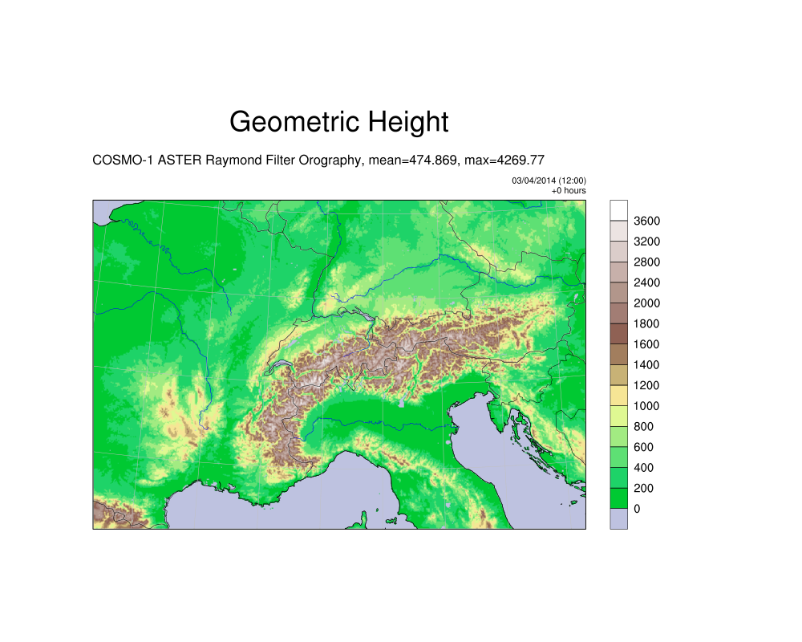
STEP 1
Decide the domain where the metamodel will be used for optimization.
In the application of the method, a domain that includes Switzerland and Northern Italy areas over a horizontal grid of ~1Km is chosen , i.e.
Euripides Avgoustoglou HNMS, 20th COSMO General Meeting, September 3rd 2018
5

Slide 6
STEP 2
Choose the parameters that will be optimized by the meta model.
Parameter | INTERPRETATION | range | Test values (default)
uc1 | Parameter controlling the vertical variation of critical relative humidity for sub-grid cloud formation | 0.0-1.0 | 0.0, 0.3, 1.0
radfac | Fraction of cloud water and ice considered by the radiation scheme | 0.3-0.9 | 0.3, 0.6, 0.9
rlam_heat | Scaling factor of the laminar boundary layer for heat | 0.1 – 2.0 | 0.1, 1.0, 2.0
tkhmin tkmmin | minimal value of diffusion coefficient for heat and momentum (kept equal) | 0.1-1.0 | 0.1, 0.4, 1.0
v0snow | factor in the terminal velocity for snow | 10.0 – 30.0 | 10.0, 20.0, 30.0
Euripides Avgoustoglou HNMS, 20th COSMO General Meeting, September 3rd 2018
6

Slide 7
But how the priority order is going to be given?
This is presented in the following steps …
Euripides Avgoustoglou HNMS, 20th COSMO General Meeting, September 3rd 2018
7

Slide 8
STEP 3:
Decide on the model variables that will be used and tabulate them according to their importance denoted as ranking .
At this stage of the work, this step is subjective but in my opinion, it can be done on meteorological arguments based on the internal knowledge of the model. The variables that are recommended below are as given in EA_COSMO_GM_2015 but with some rearrangement according to their subjectively estimated importance.
The subjective criteria on making this choice are not of importance for the presentation of the method and can be discussed at a later stage.
< TOT_PREC>: 0-24 hr period accummulated precipitation (kg m⁻²).
< TMIN_2M>: Minimum 2m temperature 0-24 hr periods (every hr).
< TMAX_2M>: Maximum 2m temperature for 0-24 hr periods (every hr)
< T_2M >: 2m temperature for 0-24 hr periods.
< TD_2M >: Dew point temperature for 0-24 hr periods.
< SNOW_GSP >: 0-24 hr periods accumulated grid-scale snow (kg m⁻²)
< CLCM >: Medium cloud cover (%) average of 1hr time steps 03-24 hs.
< CLCL >: Low cloud cover (%) average of 1hr time steps 03-24 hs.
< CLCH > : High cloud cover (%) average of 1hr time steps 03-24 hs.
Euripides Avgoustoglou HNMS, 20th COSMO General Meeting, September 3rd 2018
8

Slide 9
STEP 4:
Define the sensitivities (S) of these parameters. This is also a matter of choice. I follow the choice made in EA_COSMO_GM_2015.
Euripides Avgoustoglou HNMS, 20th COSMO General Meeting, September 3rd 2018
9

Slide 10
STEP 5:
Perform all the model runs for the dates chosen for all the default values of the parameters chosen and produce at least all the considered variables mentioned before.
Perform all the model runs for the dates chosen for all the max values of the parameters chosen and produce at least all the considered variables mentioned before.
Perform all the model runs for the dates chosen for all the min values of all the parameters chosen and produce at least all the considered variables mentioned before.
In what follows, the results from CALMO_MAX are used for the whole 2013.
Euripides Avgoustoglou HNMS, 20th COSMO General Meeting, September 3rd 2018
10

Slide 11
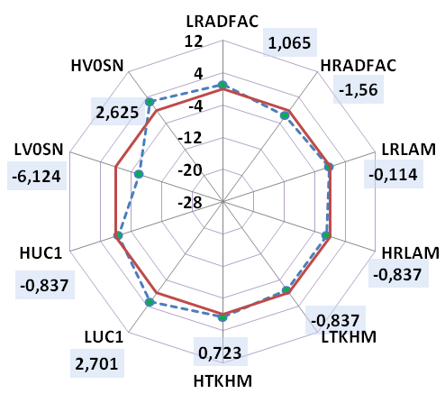
STEP 6:
Present the sensitivity of the variable of the highest ranking in a spider-type graph, i.e TOT_PREC.
TOT_PREC (%)
Euripides Avgoustoglou HNMS, 20th COSMO General Meeting, September 3rd 2018
11

Slide 12
Analysis of STEP 6
The red polygon refers to the zero sensitivity “axis”.
The sensitivities are depicted with green bullets .
The dashed polygon line that connects the dots, although not neccessary in the present form of the method, denotes optically the overall sensitivity for the considered meteorological variable especially to the degree that it is convex/concave and mainly in reference to the zero sensitivity red polygon.
Euripides Avgoustoglou HNMS, 20th COSMO General Meeting, September 3rd 2018
12

Slide 13
STEP 7:
Evaluate the absolute values of the pair differences for all different parameter sensitivities given in the spider-type graphs.
Sort these values and place them next to their corresponding spider graph «priority list».
A value of «+1» or «-1» is also addressed to these differences depending whether the substracted sensitivities have the same or different signs (i.e., they are at the same or opposite side of the sensitivity axis.
The differences with the highest absolute value and sensitivities with different signs refer to the first group of combination of parameters with the highest priority.
The differences with the highest absolute value and sensitivities with the same sign refer to the second group of combination of parameters with the highest priority.
The same process is followed for all the considered meteorological fieds according to their estimated importance.
Euripides Avgoustoglou HNMS, 20th COSMO General Meeting, September 3rd 2018
13

Slide 14
EXAMPLE OF STEP 7
TOT_PREC (%)
Euripides Avgoustoglou HNMS, 20th COSMO General Meeting, September 3rd 2018
14

Slide 15
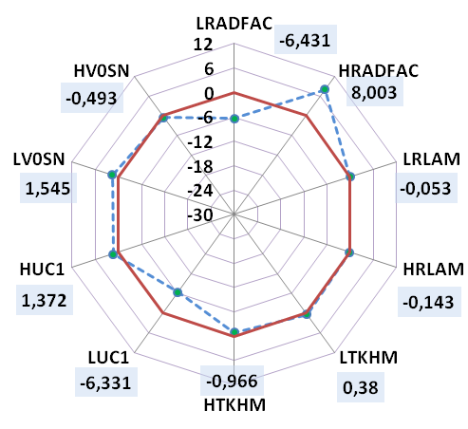
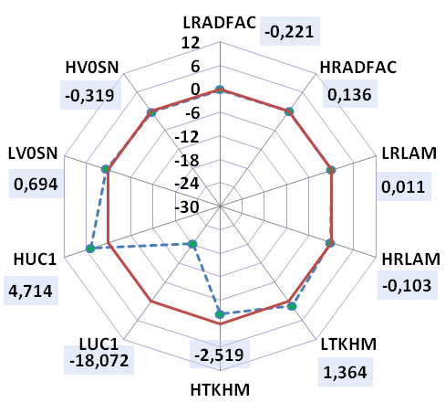
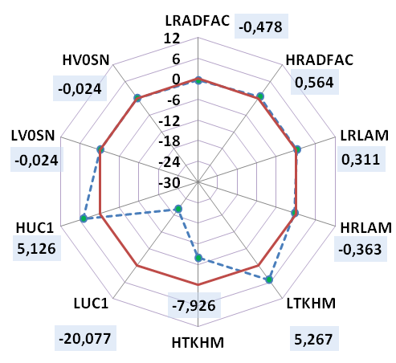
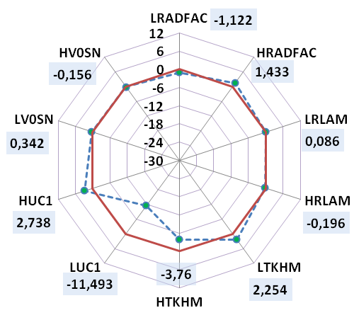
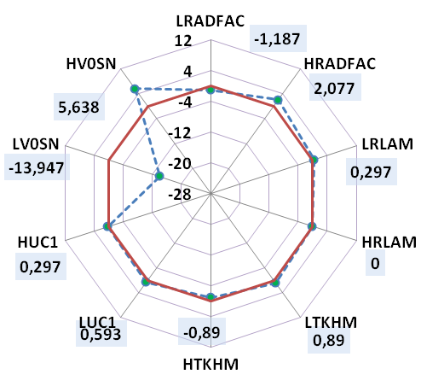
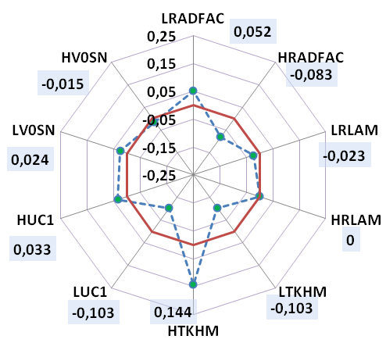
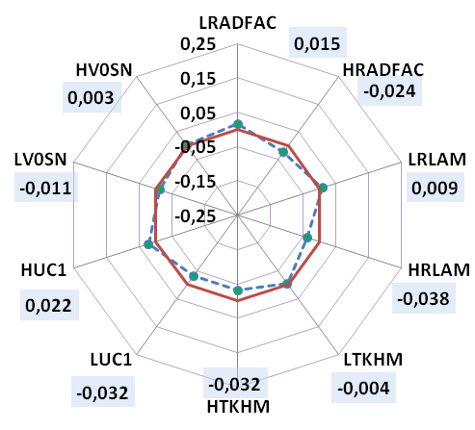
Nevertheless ,the spider-graphs provide a fair indication of the most sensitive parameters.
However, it is higly recommended to put special care on the axis scaling.
PANORAMA OF SENSITIVITIES OVER THE WHOLE 2013
CLCH
CLCM
CLCL
CLCT
SNOW_GSP
TOT_PREC
T2m
Td
Euripides Avgoustoglou HNMS, 20th COSMO General Meeting, September 3rd 2018
15

Slide 16
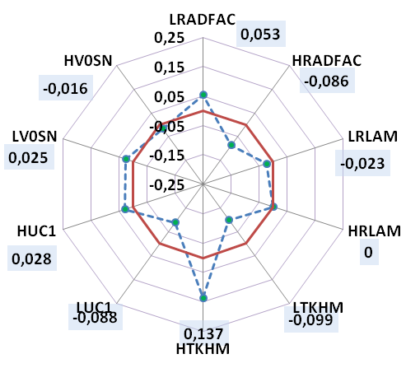
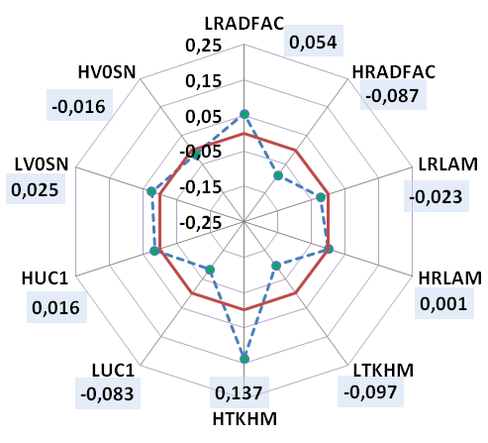
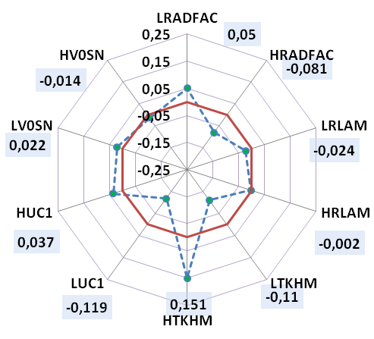
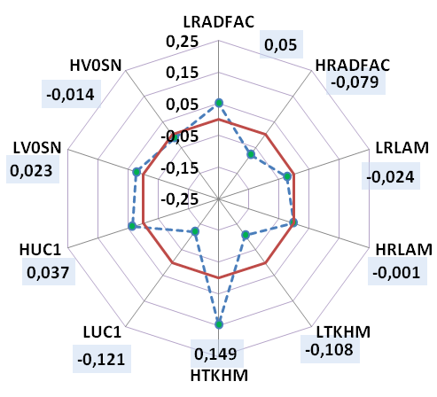
PANORAMA OF SENSITIVITIES OVER THE WHOLE 2013
T2m
Tmax_2m
T2m_18UTC
Td
Tmin_2m
T2m_06UTC
In the present analysis, T2m, Tmax_2m, Tmin_2m, T2m_18UTC, T2m_06UTC display essentially the same sensitivity.
Euripides Avgoustoglou HNMS, 20th COSMO General Meeting, September 3rd 2018
16

Slide 17
Practically, the most sensitive parameter combinations can be directly addressed from the spider-graphs !
CLCH
CLCM
CLCL
CLCT
SNOW_GSP
TOT_PREC
T2m
Td
Euripides Avgoustoglou HNMS, 20th COSMO General Meeting, September 3rd 2018
17

Slide 18
Under the previous analysis, the resulting priority board depicts all sensitivities and further testing strategies can be developed.
PRIORITY BOARD FOR THE WHOLE 2013
Euripides Avgoustoglou HNMS, 20th COSMO General Meeting, September 3rd 2018
18

Slide 19
EXTENSION OF THE METHODOLOGY:
The above analysis can be readily used to get important insight to seasonal or monthly sensitivity through modified spider graphs.
Euripides Avgoustoglou HNMS, 20th COSMO General Meeting, September 3rd 2018
19

Slide 20
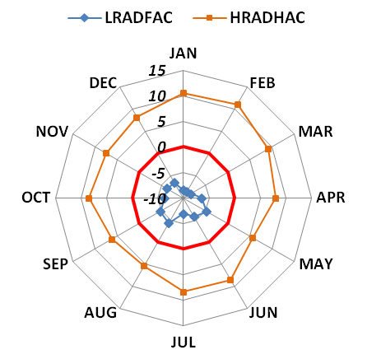
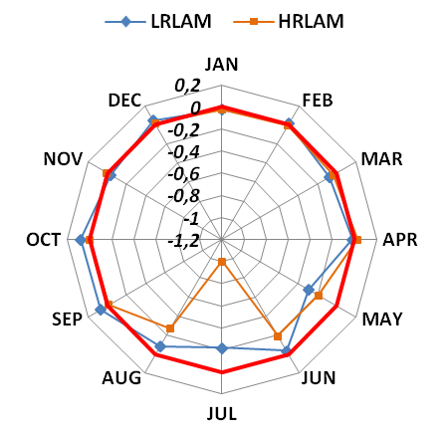
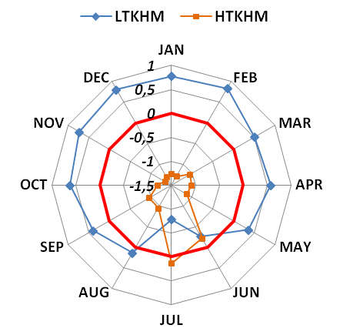
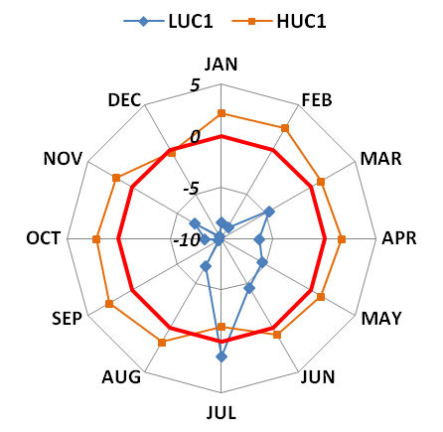
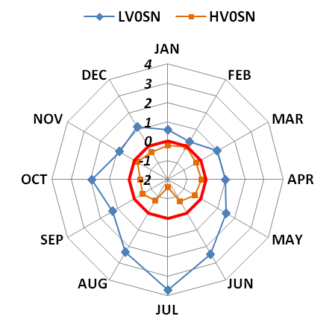
CLCH
Monthly Sensitivities
! Different scales. The graph with the largest scale range denotes the most sensitive parameter!
Euripides Avgoustoglou HNMS, 20th COSMO General Meeting, September 3rd 2018
20

Slide 21
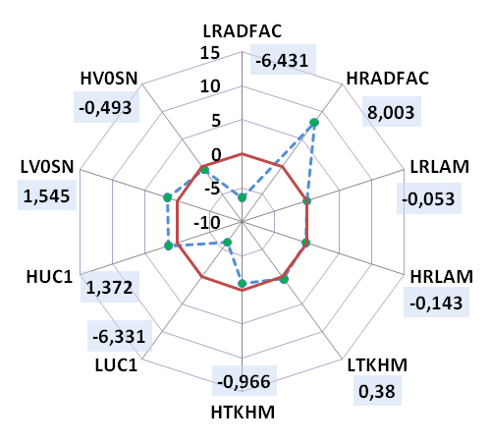
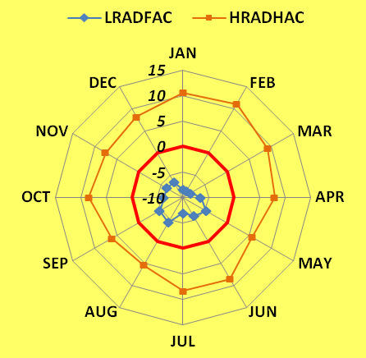
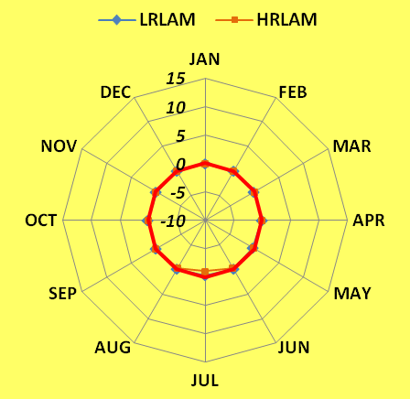
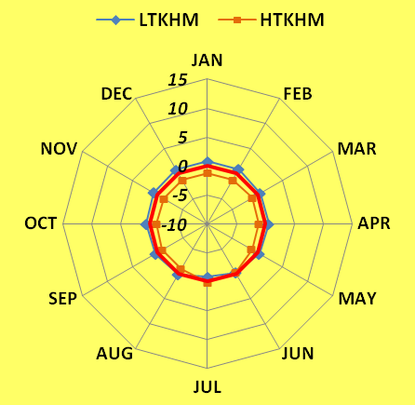
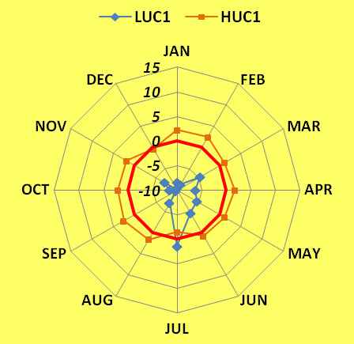
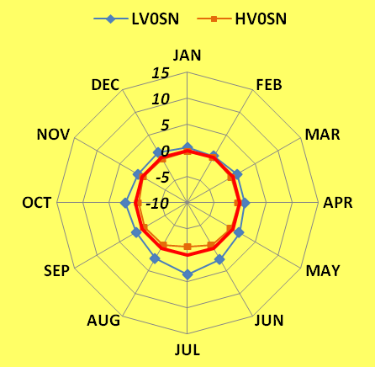
CLCH (Yearly vs Monthly Sensitivities)
! Same scales
Euripides Avgoustoglou HNMS, 20th COSMO General Meeting, September 3rd 2018
21

Slide 22
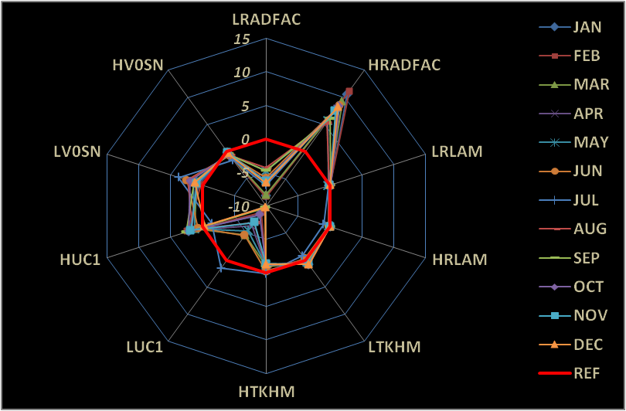
Monthly Sensitivities combined
CLCH
Euripides Avgoustoglou HNMS, 20th COSMO General Meeting, September 3rd 2018
22

Slide 23
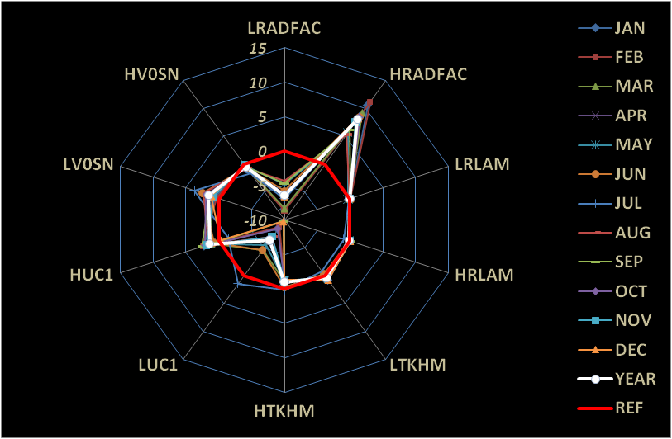
Yearly and Monthly Sensitivities combined
CLCH
Euripides Avgoustoglou HNMS, 20th COSMO General Meeting, September 3rd 2018
23

Slide 24
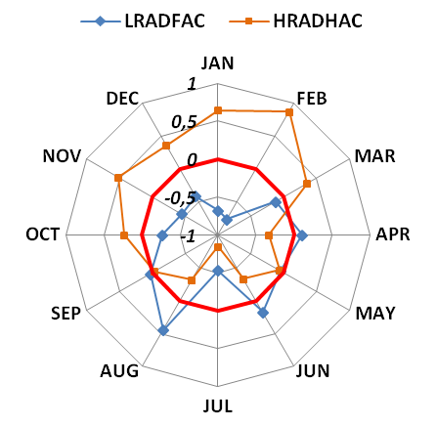
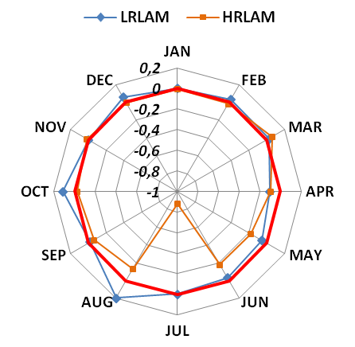
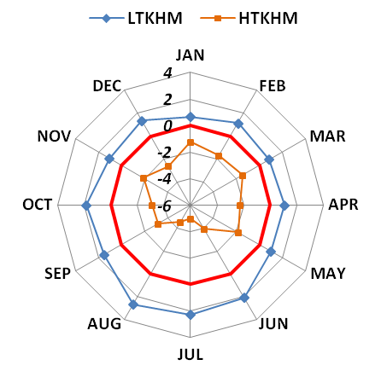
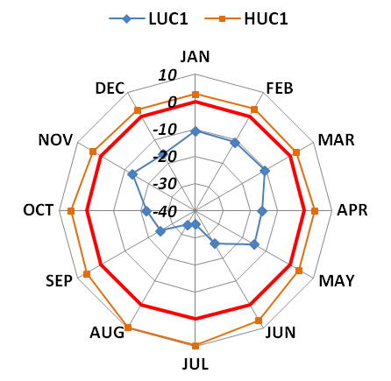
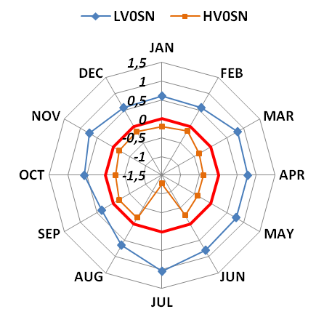
CLCM
Monthly Sensitivities
Euripides Avgoustoglou HNMS, 20th COSMO General Meeting, September 3rd 2018
24

Slide 25
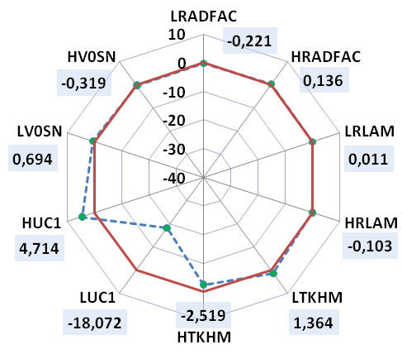
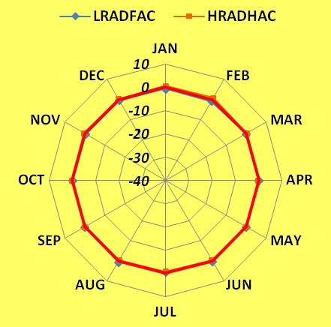
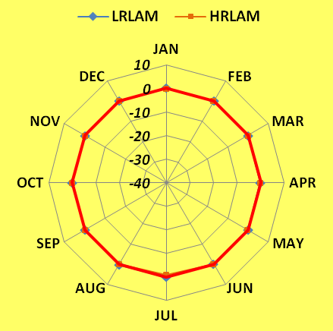
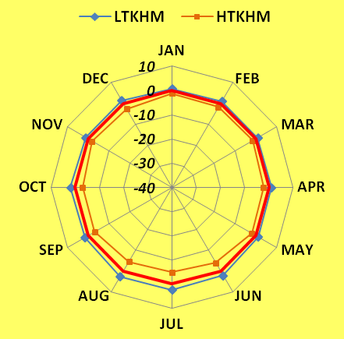
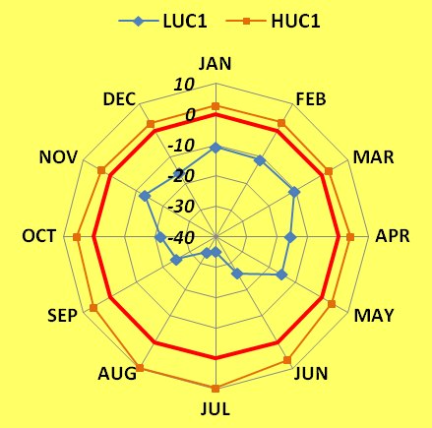
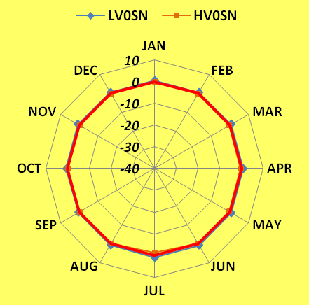
CLCM (Yearly vs Monthly Sensitivities)
Euripides Avgoustoglou HNMS, 20th COSMO General Meeting, September 3rd 2018
25

Slide 26
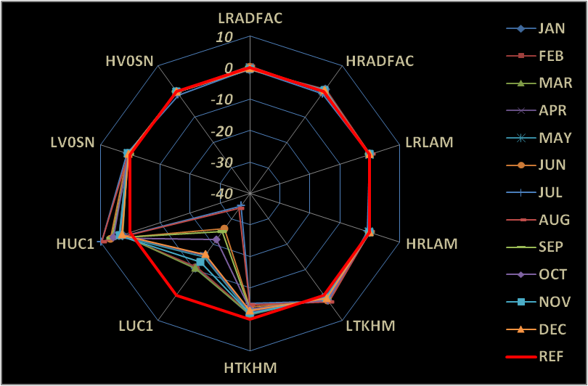
Monthly Sensitivities combined
CLCM
Euripides Avgoustoglou HNMS, 20th COSMO General Meeting, September 3rd 2018
26

Slide 27
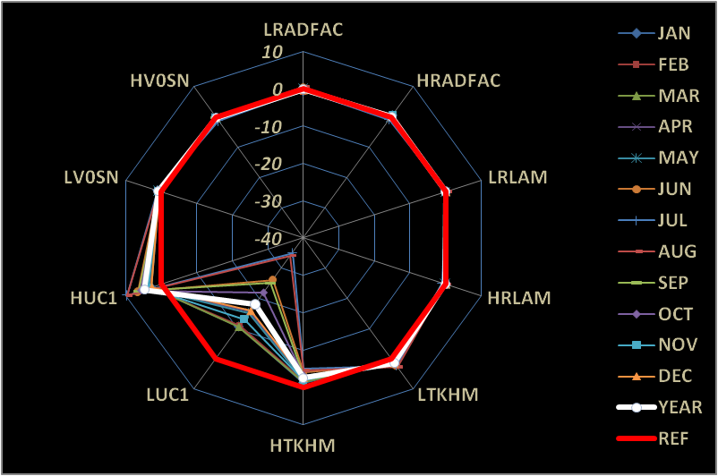
Yearly and Monthly Sensitivities combined
CLCM
Euripides Avgoustoglou HNMS, 20th COSMO General Meeting, September 3rd 2018
27

Slide 28
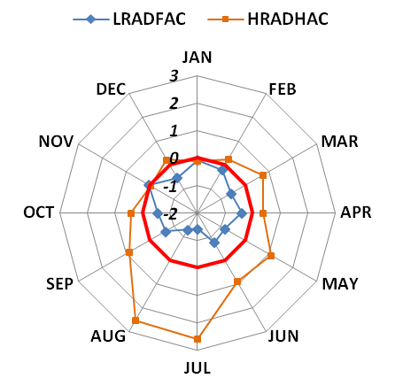
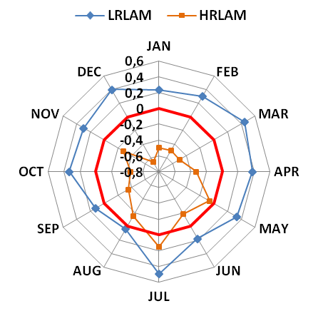
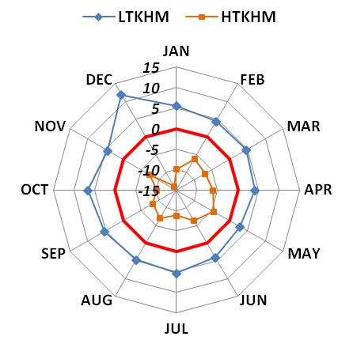
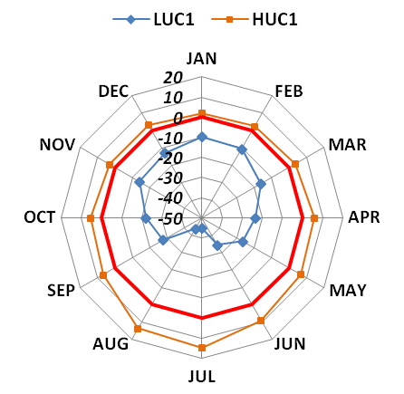
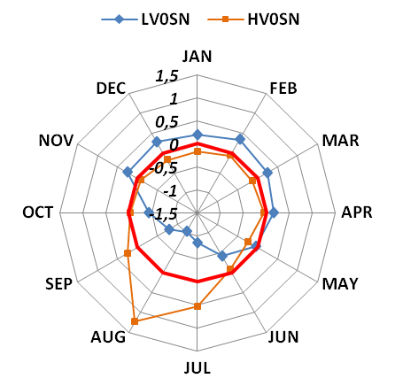
CLCL
Monthly Sensitivities
Euripides Avgoustoglou HNMS, 20th COSMO General Meeting, September 3rd 2018
28

Slide 29
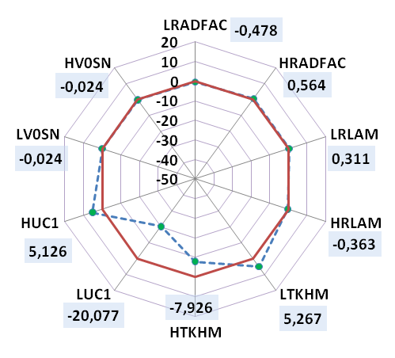
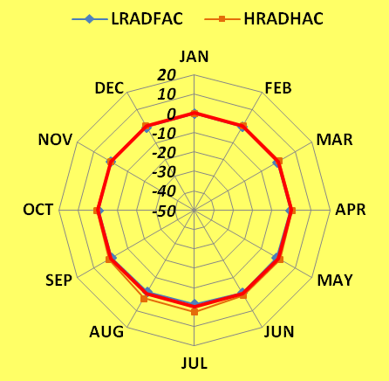
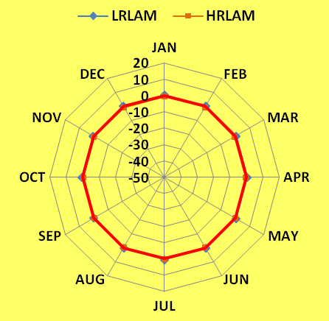
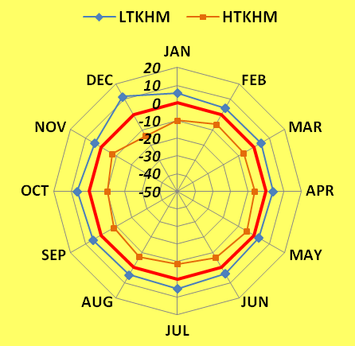


CLCL (Yearly vs Monthly Sensitivities)
Euripides Avgoustoglou HNMS, 20th COSMO General Meeting, September 3rd 2018
29

Slide 30

Monthly Sensitivities combined
CLCL
Euripides Avgoustoglou HNMS, 20th COSMO General Meeting, September 3rd 2018
30

Slide 31

Yearly and Monthly Sensitivities combined
CLCL
Euripides Avgoustoglou HNMS, 20th COSMO General Meeting, September 3rd 2018
31

Slide 32





CLCT
Monthly Sensitivities
Euripides Avgoustoglou HNMS, 20th COSMO General Meeting, September 3rd 2018
32

Slide 33






CLCT (Yearly vs Monthly Sensitivities)
Euripides Avgoustoglou HNMS, 20th COSMO General Meeting, September 3rd 2018
33

Slide 34

Monthly Sensitivities combined
CLCT
Euripides Avgoustoglou HNMS, 20th COSMO General Meeting, September 3rd 2018
34

Slide 35

Yearly and Monthly Sensitivities combined
CLCT
Euripides Avgoustoglou HNMS, 20th COSMO General Meeting, September 3rd 2018
35

Slide 36





SNOW_GSP
Monthly Sensitivities
Euripides Avgoustoglou HNMS, 20th COSMO General Meeting, September 3rd 2018
36

Slide 37






SNOW_GSP (Yearly vs Monthly Sensitivities)
Euripides Avgoustoglou HNMS, 20th COSMO General Meeting, September 3rd 2018
37

Slide 38

Monthly Sensitivities combined
SNOW_GSP
Euripides Avgoustoglou HNMS, 20th COSMO General Meeting, September 3rd 2018
38

Slide 39

Yearly and Monthly Sensitivities combined
SNOW_GSP
Euripides Avgoustoglou HNMS, 20th COSMO General Meeting, September 3rd 2018
39

Slide 40





TOT_PREC
Monthly Sensitivities
Euripides Avgoustoglou HNMS, 20th COSMO General Meeting, September 3rd 2018
40

Slide 41






TOT_PREC (Yearly vs Monthly Sensitivities)
Euripides Avgoustoglou HNMS, 20th COSMO General Meeting, September 3rd 2018
41

Slide 42

Monthly Sensitivities combined
TOT_PREC
Euripides Avgoustoglou HNMS, 20th COSMO General Meeting, September 3rd 2018
42

Slide 43

Yearly and Monthly Sensitivities combined
TOT_PREC
Euripides Avgoustoglou HNMS, 20th COSMO General Meeting, September 3rd 2018
43

Slide 44





T2m
Monthly Sensitivities
Euripides Avgoustoglou HNMS, 20th COSMO General Meeting, September 3rd 2018
44

Slide 45






T2m (Yearly vs Monthly Sensitivities)
T2m
Euripides Avgoustoglou HNMS, 20th COSMO General Meeting, September 3rd 2018
45

Slide 46

Monthly Sensitivities combined
T2m
Euripides Avgoustoglou HNMS, 20th COSMO General Meeting, September 3rd 2018
46

Slide 47

Yearly and Monthly Sensitivities combined
T2m
Euripides Avgoustoglou HNMS, 20th COSMO General Meeting, September 3rd 2018
47

Slide 48





Tmin2m
Monthly Sensitivities
Euripides Avgoustoglou HNMS, 20th COSMO General Meeting, September 3rd 2018
48

Slide 49






Tmin2m (Yearly vs Monthly Sensitivities)
Euripides Avgoustoglou HNMS, 20th COSMO General Meeting, September 3rd 2018
49

Slide 50

Monthly Sensitivities combined
Tmin2m
Euripides Avgoustoglou HNMS, 20th COSMO General Meeting, September 3rd 2018
50

Slide 51

Yearly and Monthly Sensitivities combined
Tmin2m
Euripides Avgoustoglou HNMS, 20th COSMO General Meeting, September 3rd 2018
51

Slide 52





T2m06UTC
Monthly Sensitivities
Euripides Avgoustoglou HNMS, 20th COSMO General Meeting, September 3rd 2018
52

Slide 53






T2m06UTC (Yearly vs Monthly Sensitivities)
Euripides Avgoustoglou HNMS, 20th COSMO General Meeting, September 3rd 2018
53

Slide 54

Monthly Sensitivities combined
T2m06UTC
Euripides Avgoustoglou HNMS, 20th COSMO General Meeting, September 3rd 2018
54

Slide 55

Yearly and Monthly Sensitivities combined
T2m06UTC
Euripides Avgoustoglou HNMS, 20th COSMO General Meeting, September 3rd 2018
55

Slide 56





Tmax2m
Monthly Sensitivities
Euripides Avgoustoglou HNMS, 20th COSMO General Meeting, September 3rd 2018
56

Slide 57






Tmax2m (Yearly vs Monthly Sensitivities)
Euripides Avgoustoglou HNMS, 20th COSMO General Meeting, September 3rd 2018
57

Slide 58

Monthly Sensitivities combined
Tmax2m
Euripides Avgoustoglou HNMS, 20th COSMO General Meeting, September 3rd 2018
58

Slide 59

Yearly and Monthly Sensitivities combined
Tmax2m
Euripides Avgoustoglou HNMS, 20th COSMO General Meeting, September 3rd 2018
59

Slide 60





T2m18UTC
Monthly Sensitivities
Euripides Avgoustoglou HNMS, 20th COSMO General Meeting, September 3rd 2018
60

Slide 61






T2m18UTC (Yearly vs Monthly Sensitivities)
Euripides Avgoustoglou HNMS, 20th COSMO General Meeting, September 3rd 2018
61

Slide 62

Monthly Sensitivities combined
T2m18UTC
Euripides Avgoustoglou HNMS, 20th COSMO General Meeting, September 3rd 2018
62

Slide 63

Yearly and Monthly Sensitivities combined
T2m18UTC
Euripides Avgoustoglou HNMS, 20th COSMO General Meeting, September 3rd 2018
63

Slide 64





Td
Monthly Sensitivities
Euripides Avgoustoglou HNMS, 20th COSMO General Meeting, September 3rd 2018
64

Slide 65






Td (Yearly vs Monthly Sensitivities)
Euripides Avgoustoglou HNMS, 20th COSMO General Meeting, September 3rd 2018
65

Slide 66

Monthly Sensitivities combined
Td
Euripides Avgoustoglou HNMS, 20th COSMO General Meeting, September 3rd 2018
66

Slide 67

Yearly and Monthly Sensitivities combined
Td
Euripides Avgoustoglou HNMS, 20th COSMO General Meeting, September 3rd 2018
67

Slide 68








PANORAMA OF MONTHLY SENSITIVITIES FOR 2013
JANUARY
CLCH
CLCM
CLCL
CLCT
SNOW_GSP
TOT_PREC
T2m
Td
Euripides Avgoustoglou HNMS, 20th COSMO General Meeting, September 3rd 2018
68

Slide 69








FEBRUARY
CLCH
CLCM
CLCL
CLCT
SNOW_GSP
TOT_PREC
T2m
Td
Euripides Avgoustoglou HNMS, 20th COSMO General Meeting, September 3rd 2018
69

Slide 70








MARCH
CLCH
CLCM
CLCL
CLCT
SNOW_GSP
TOT_PREC
T2m
Td
Euripides Avgoustoglou HNMS, 20th COSMO General Meeting, September 3rd 2018
70

Slide 71








APRIL
CLCH
CLCM
CLCL
CLCT
SNOW_GSP
TOT_PREC
T2m
Td
Euripides Avgoustoglou HNMS, 20th COSMO General Meeting, September 3rd 2018
71

Slide 72








MAY
CLCH
CLCM
CLCL
CLCT
SNOW_GSP
TOT_PREC
T2m
Td
Euripides Avgoustoglou HNMS, 20th COSMO General Meeting, September 3rd 2018
72

Slide 73








JUNE
CLCH
CLCM
CLCL
CLCT
SNOW_GSP
TOT_PREC
T2m
Td
Euripides Avgoustoglou HNMS, 20th COSMO General Meeting, September 3rd 2018
73

Slide 74








JULY
CLCH
CLCM
CLCL
CLCT
SNOW_GSP
TOT_PREC
T2m
Td
Euripides Avgoustoglou HNMS, 20th COSMO General Meeting, September 3rd 2018
74

Slide 75








AUGUST
CLCH
CLCM
CLCL
CLCT
SNOW_GSP
TOT_PREC
T2m
Td
Euripides Avgoustoglou HNMS, 20th COSMO General Meeting, September 3rd 2018
75

Slide 76








SEPTEMBER
CLCH
CLCM
CLCL
CLCT
SNOW_GSP
TOT_PREC
T2m
Td
Euripides Avgoustoglou HNMS, 20th COSMO General Meeting, September 3rd 2018
76

Slide 77








OCTOBER
CLCH
CLCM
CLCL
CLCT
SNOW_GSP
TOT_PREC
T2m
Td
Euripides Avgoustoglou HNMS, 20th COSMO General Meeting, September 3rd 2018
77

Slide 78








NOVEMBER
CLCH
CLCM
CLCL
CLCT
SNOW_GSP
TOT_PREC
T2m
Td
Euripides Avgoustoglou HNMS, 20th COSMO General Meeting, September 3rd 2018
78

Slide 79








DECEMBER
CLCH
CLCM
CLCL
CLCT
SNOW_GSP
TOT_PREC
T2m
Td
Euripides Avgoustoglou HNMS, 20th COSMO General Meeting, September 3rd 2018
79

Slide 80
CONCLUSIONS
The spider graphs with the largest parameter range can potentially denote the most sensitive parameter for a particular field.
The relative sensitivity ot the other considered parameters can be estimated by employing the scale with the largest parameter range for the remaining spider-graphs.
Yearly versus monthly spider graphs can provide a relatively transparent seasonal dependence of the parameters chosen.
In principle, the use of spider graphs can be used to select objectively the model parameters needed to be optimized.
Overall, a relatively systematic, consistent, objective and robust methodology regarding the evaluation of model parameters priority for testing purposes has been presented that can facilitate the formidable task of the model optimization proccess.
Euripides Avgoustoglou HNMS, 20th COSMO General Meeting, September 3rd 2018
80

