Slide 1
Introductory activities in PP APSU at IMWM
and results of ANN post-processing of EPS forecasts
Andrzej Mazur, Grzegorz Duniec, Witek Interewicz
Institute of Meteorology and Water Management – National Research Institute
Instytut meteorologii i Gospodarki Wodnej – Państwowy Instytut Badawczy

Slide 2
Contents
Introduction
Operational configuration/Setup
Initial activities in PP APSU at IMWM
Setup
Results
ANN post-processing of EPS forecasts
Setup
Results
Conclusions

Slide 3
Introduction – Operational configuration
Operational since January, 2016
4 runs/day, 36 hours forecasts, 20 members/4 groups
ICs/BCs from previous det. runs of 7km model (Lagged EPS)
Forecasts of T2M, TD2M, PS, U10M, TOT_PREC…
Other forecasts also available (specific, dedicated)
Immediate post-processing (probabilities, charts, plots…)
Results stored for research (skill-spread relation)

Slide 4
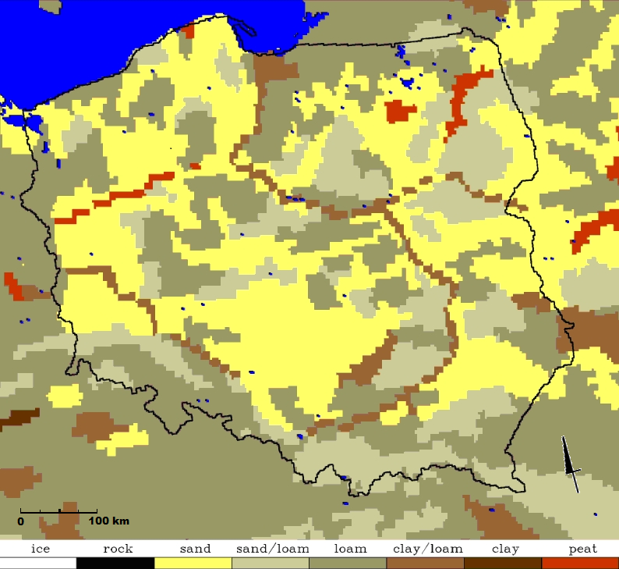
Initial activities in PP APSU – Setup
Generation of members – with (new) RNG
c_soil perturbation (further: c_soil)
perturbation of soil surface temperature (from analysis file – laf_pert). Additional constraints applied – an average perturbation over the entire domain is set to zero via normalization of perturbation values.
perturbation of collection efficiency coefficient E_{c} (eff-coeff, the efficiency with which a drop intercepts and unites with the smaller drops it overtakes; determined by the relative airflow around the falling drop; assumed constant and equal to 0.8 in deterministic model; effective only for non-zero precipitation)
For the first two points the amplitude of perturbation depended on the soil type (clay, sand, peat etc.)

Slide 5
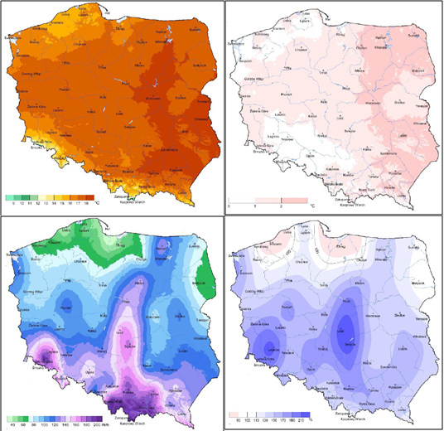
Upper left: T, upper right: ∆T;
lower left: P, lower right: ∆P
Initial activities in PP APSU – Setup
Following cases were considered:
c_soil, laf_pert, eff-coeff – generation schemes applied separately;
Combination of two out of three schemes (laf-eff, eff-c_soil etc.);
Combination of all perturbation schemes (eps_all).
Warm season 2013 (June to September; presented for June only).
Analyzed: average values of spread of TD2M, TE2M, U10M and average value of skills for same fields.
Average spread/skill values were compared with monthly mean/deviation of monthly mean TE2M (1971–2000) – T and ∆T, and respectively with monthly sum/deviation of monthly sum of precipitation P and ∆P, respectively

Slide 6
Initial activities in PP APSU – Results
Relation | Spread | Skill
TD2M | T⁻¹, ∆T⁻¹, all schemes | T⁻¹, ∆T⁻¹, all schemes, western Poland T⁻¹, ∆T, all schemes, northeastern Poland T, ∆T, all schemes, southeastern Poland
 | P⁻¹, ∆P⁻¹, all schemes, western Poland P, ∆P, all schemes, eastern Poland | P⁻¹, ∆P⁻¹, all schemes
TE2M | T⁻¹, ∆T⁻¹, all schemes | T⁻¹, ∆T⁻¹, all schemes
 | P⁻¹, ∆P⁻¹, all schemes, western Poland P, ∆P, all schemes, eastern Poland | P, ∆P, all schemes, eastern Poland P⁻¹, ∆P⁻¹, all schemes, central Poland
U10M | T⁻¹, ∆T⁻¹, all schemes, except laf-c_soil T, ∆T, laf-c_soil | T, ∆T, all schemes
 | Hard to establish uniquely | P, ∆P, all schemes

Slide 7
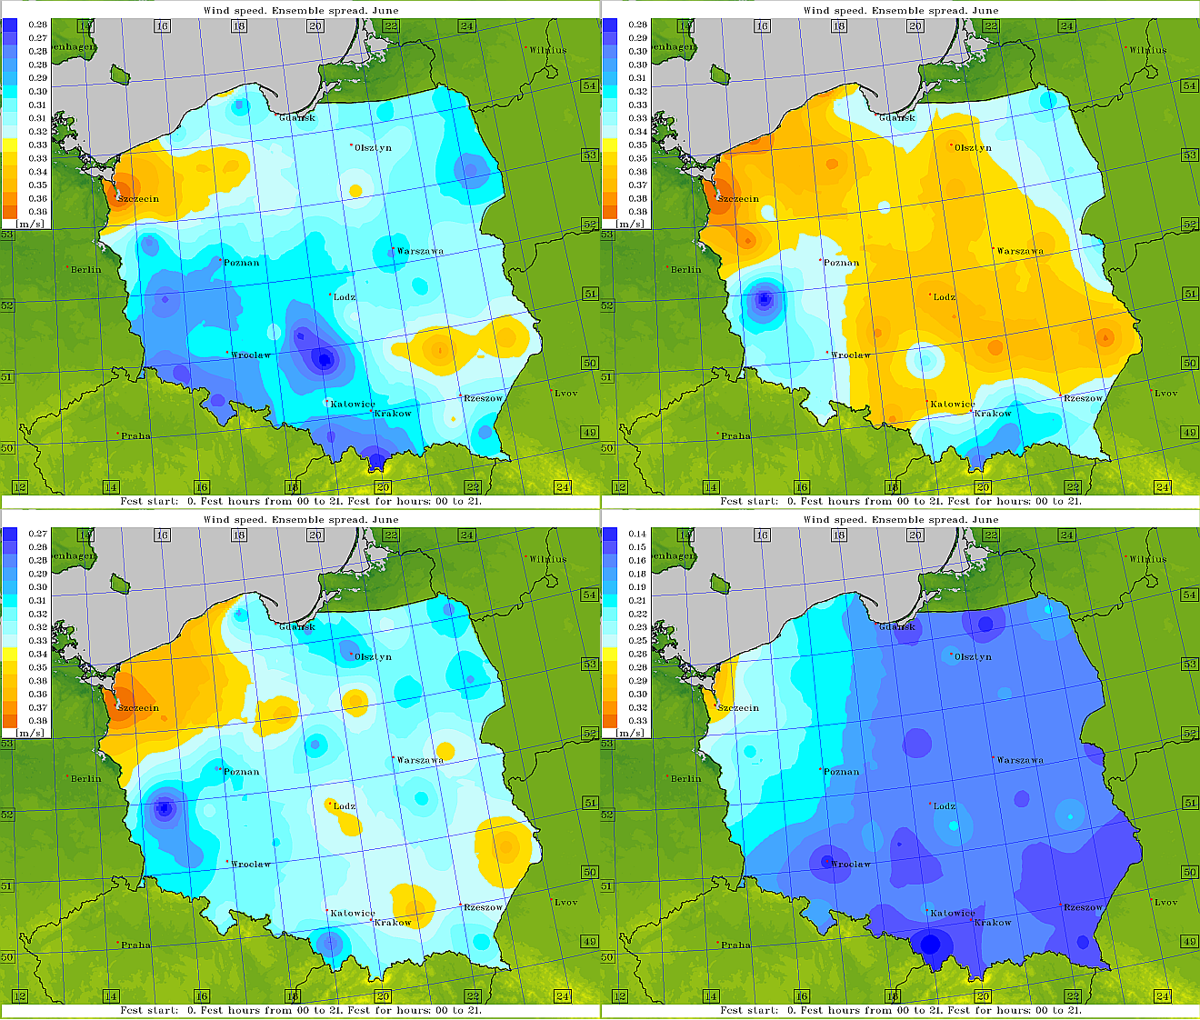
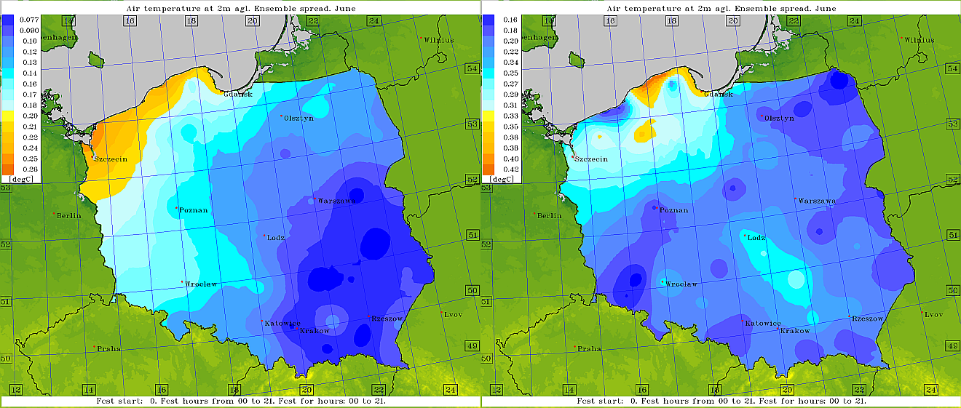
Initial activities in PP APSU – Results
Results of average values of spread/skill can be classified into the following groups:
TD2M spread/skill | laf-pert, eff-coef, laf-eff eps-all c_soil, laf-c_soil, eff-c_soil
TE2M spread/skill | laf-pert, eff-coef, laf-eff c_soil, laf-c_soil, eff-c_soil, eps-all
U10M spread/skill | c_soil laf-c_soil eff-c_soil, eps-all laf-pert, eff-coef, laf-eff

Slide 8
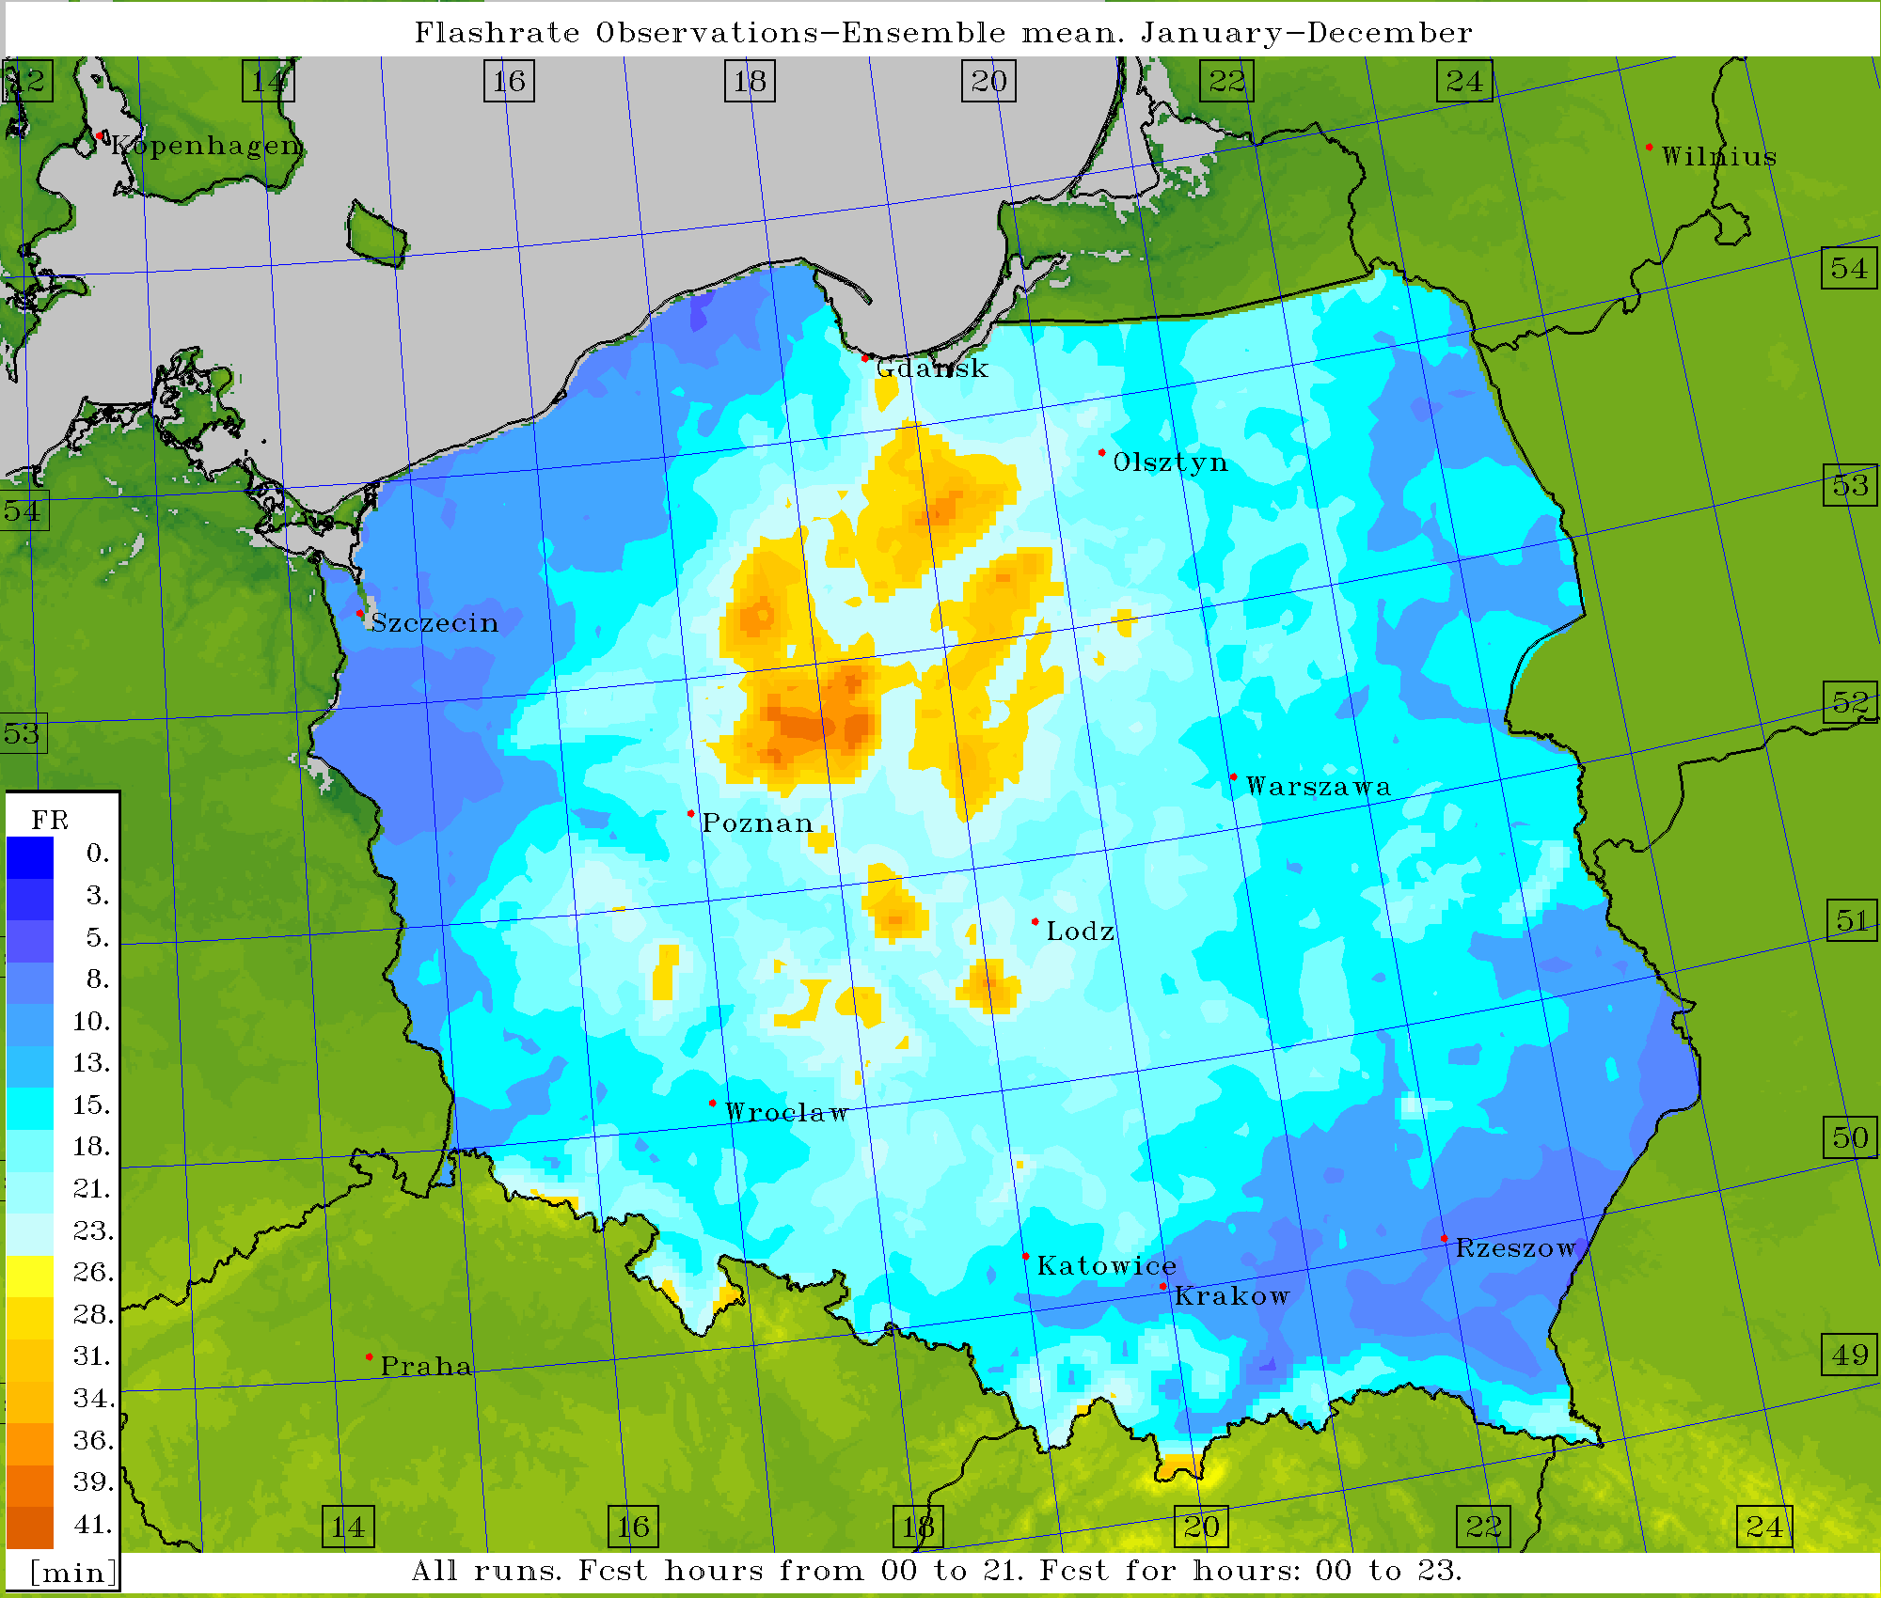
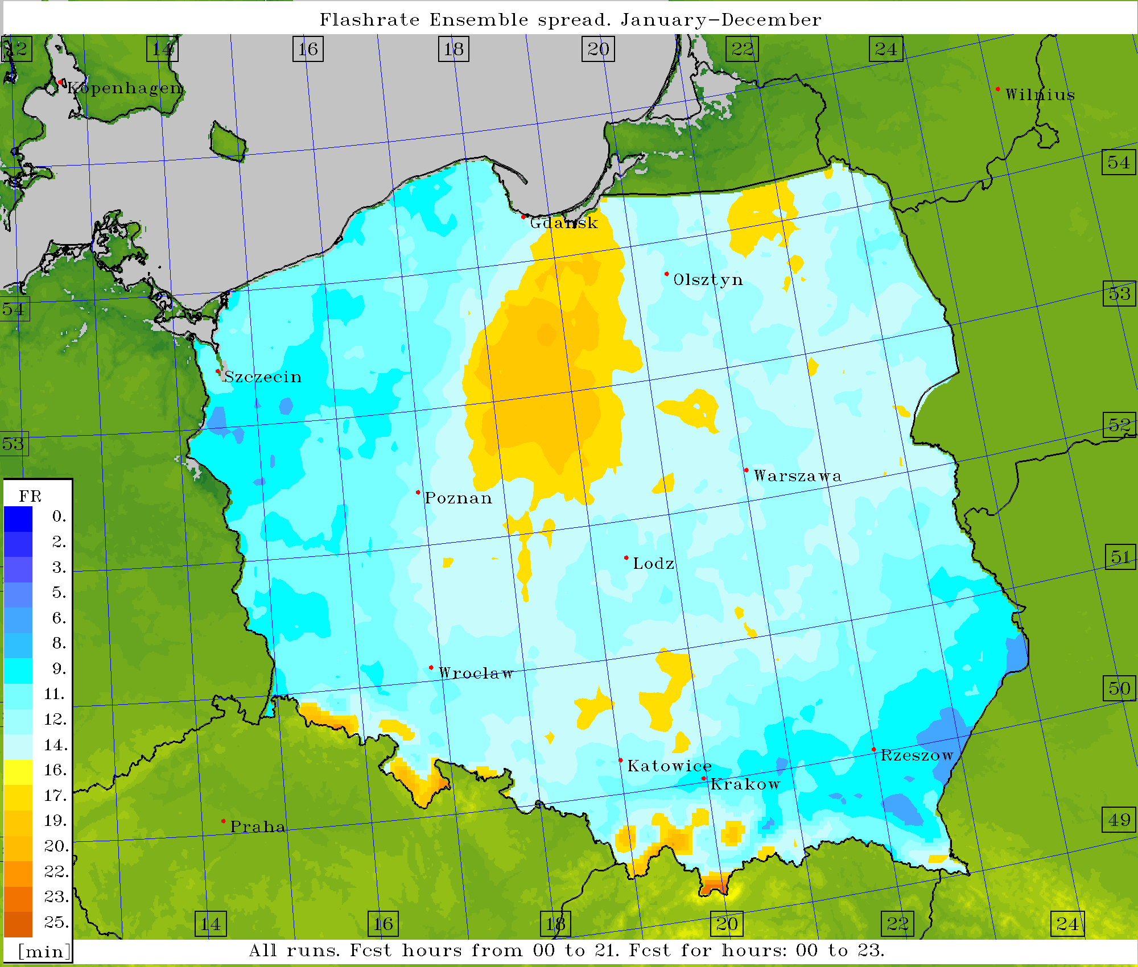
Initial activities in PP APSU – Results
Mean skill (left) and spread (right) of flashrate, c_soil (operational) perturbation, 2013

Slide 9
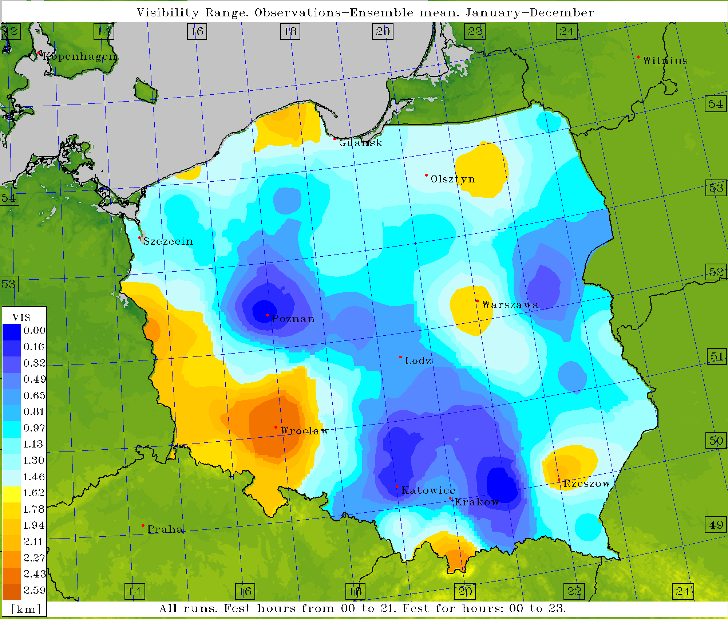
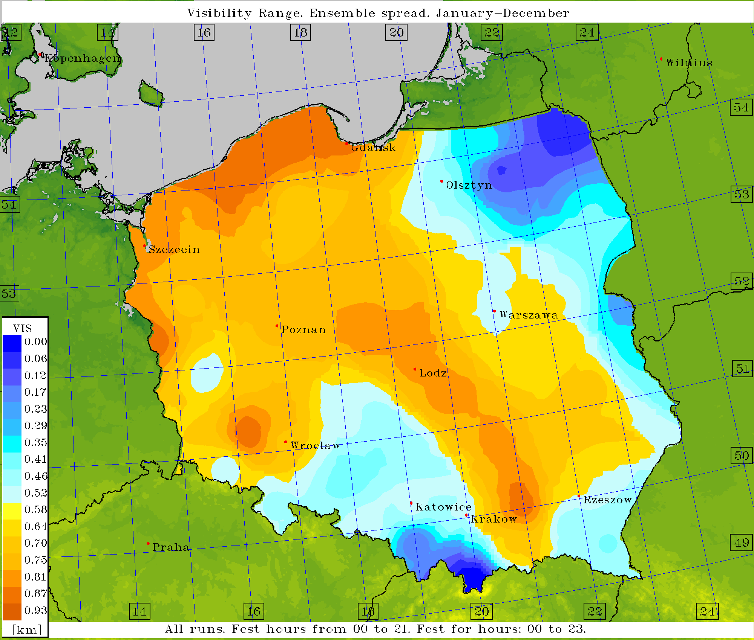
Initial activities in PP APSU – Results
Mean skill (left) and spread (right) of VIS, c_soil (operational) perturbation, 2013

Slide 10
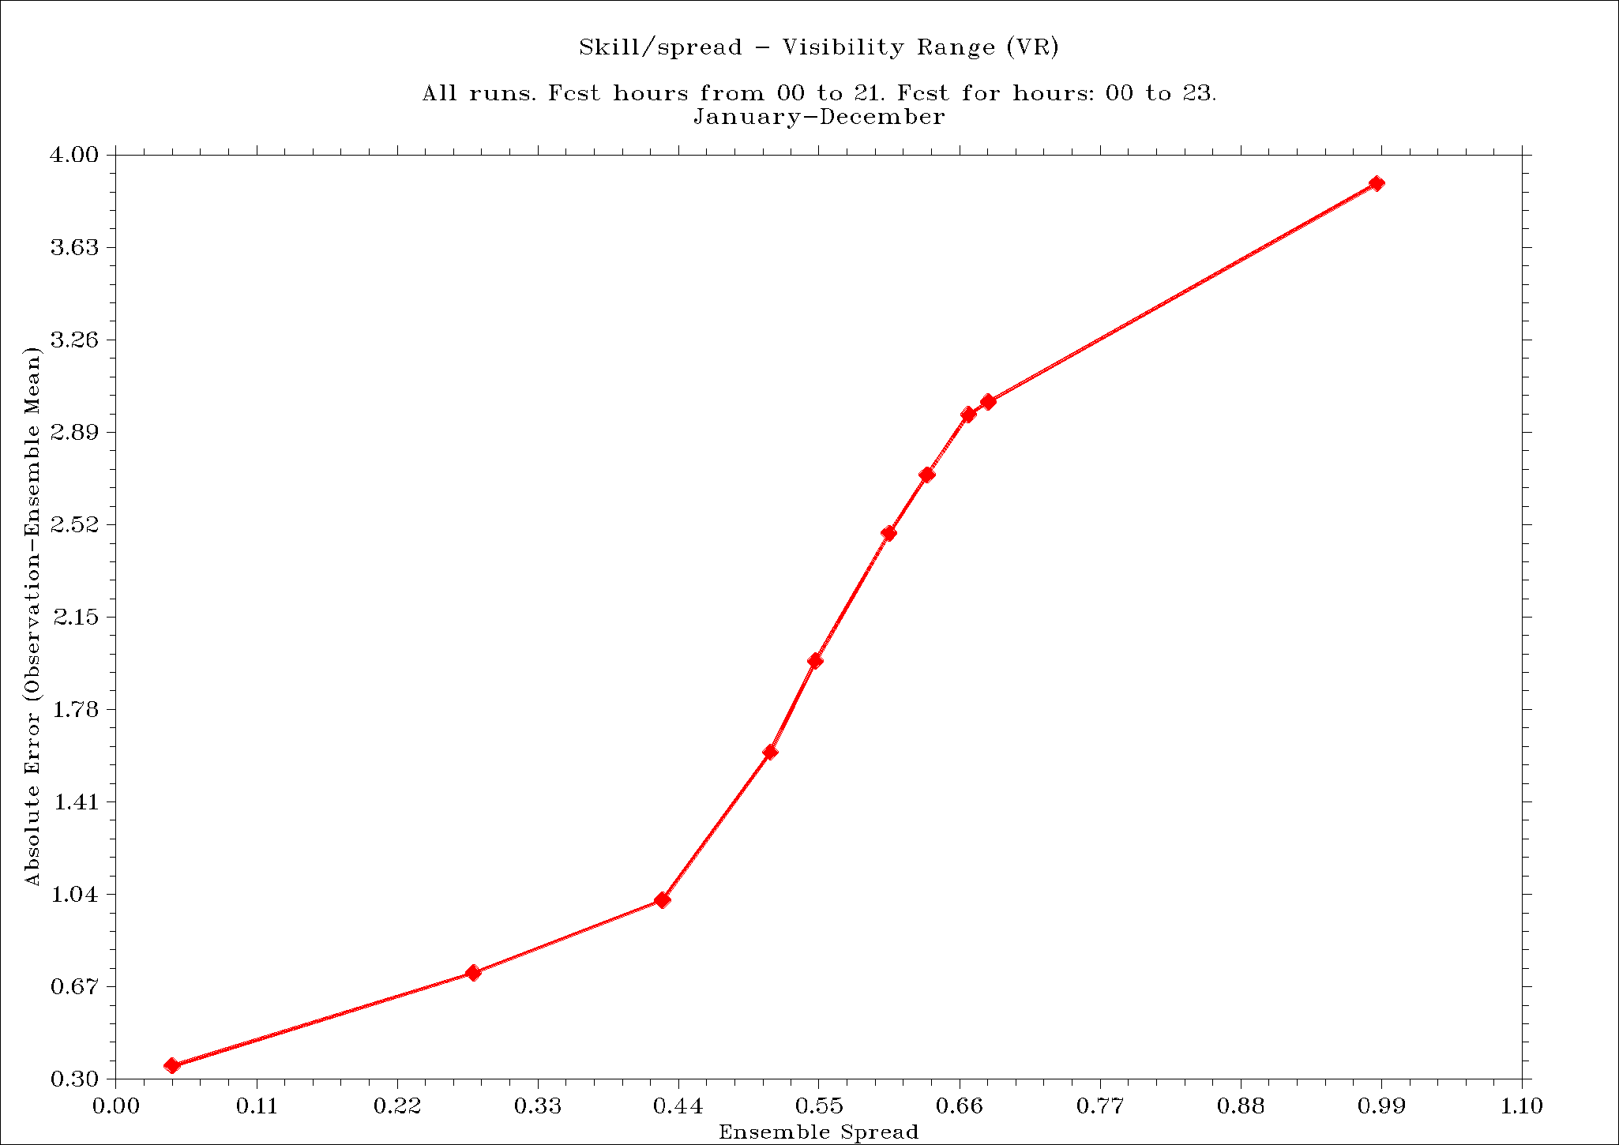
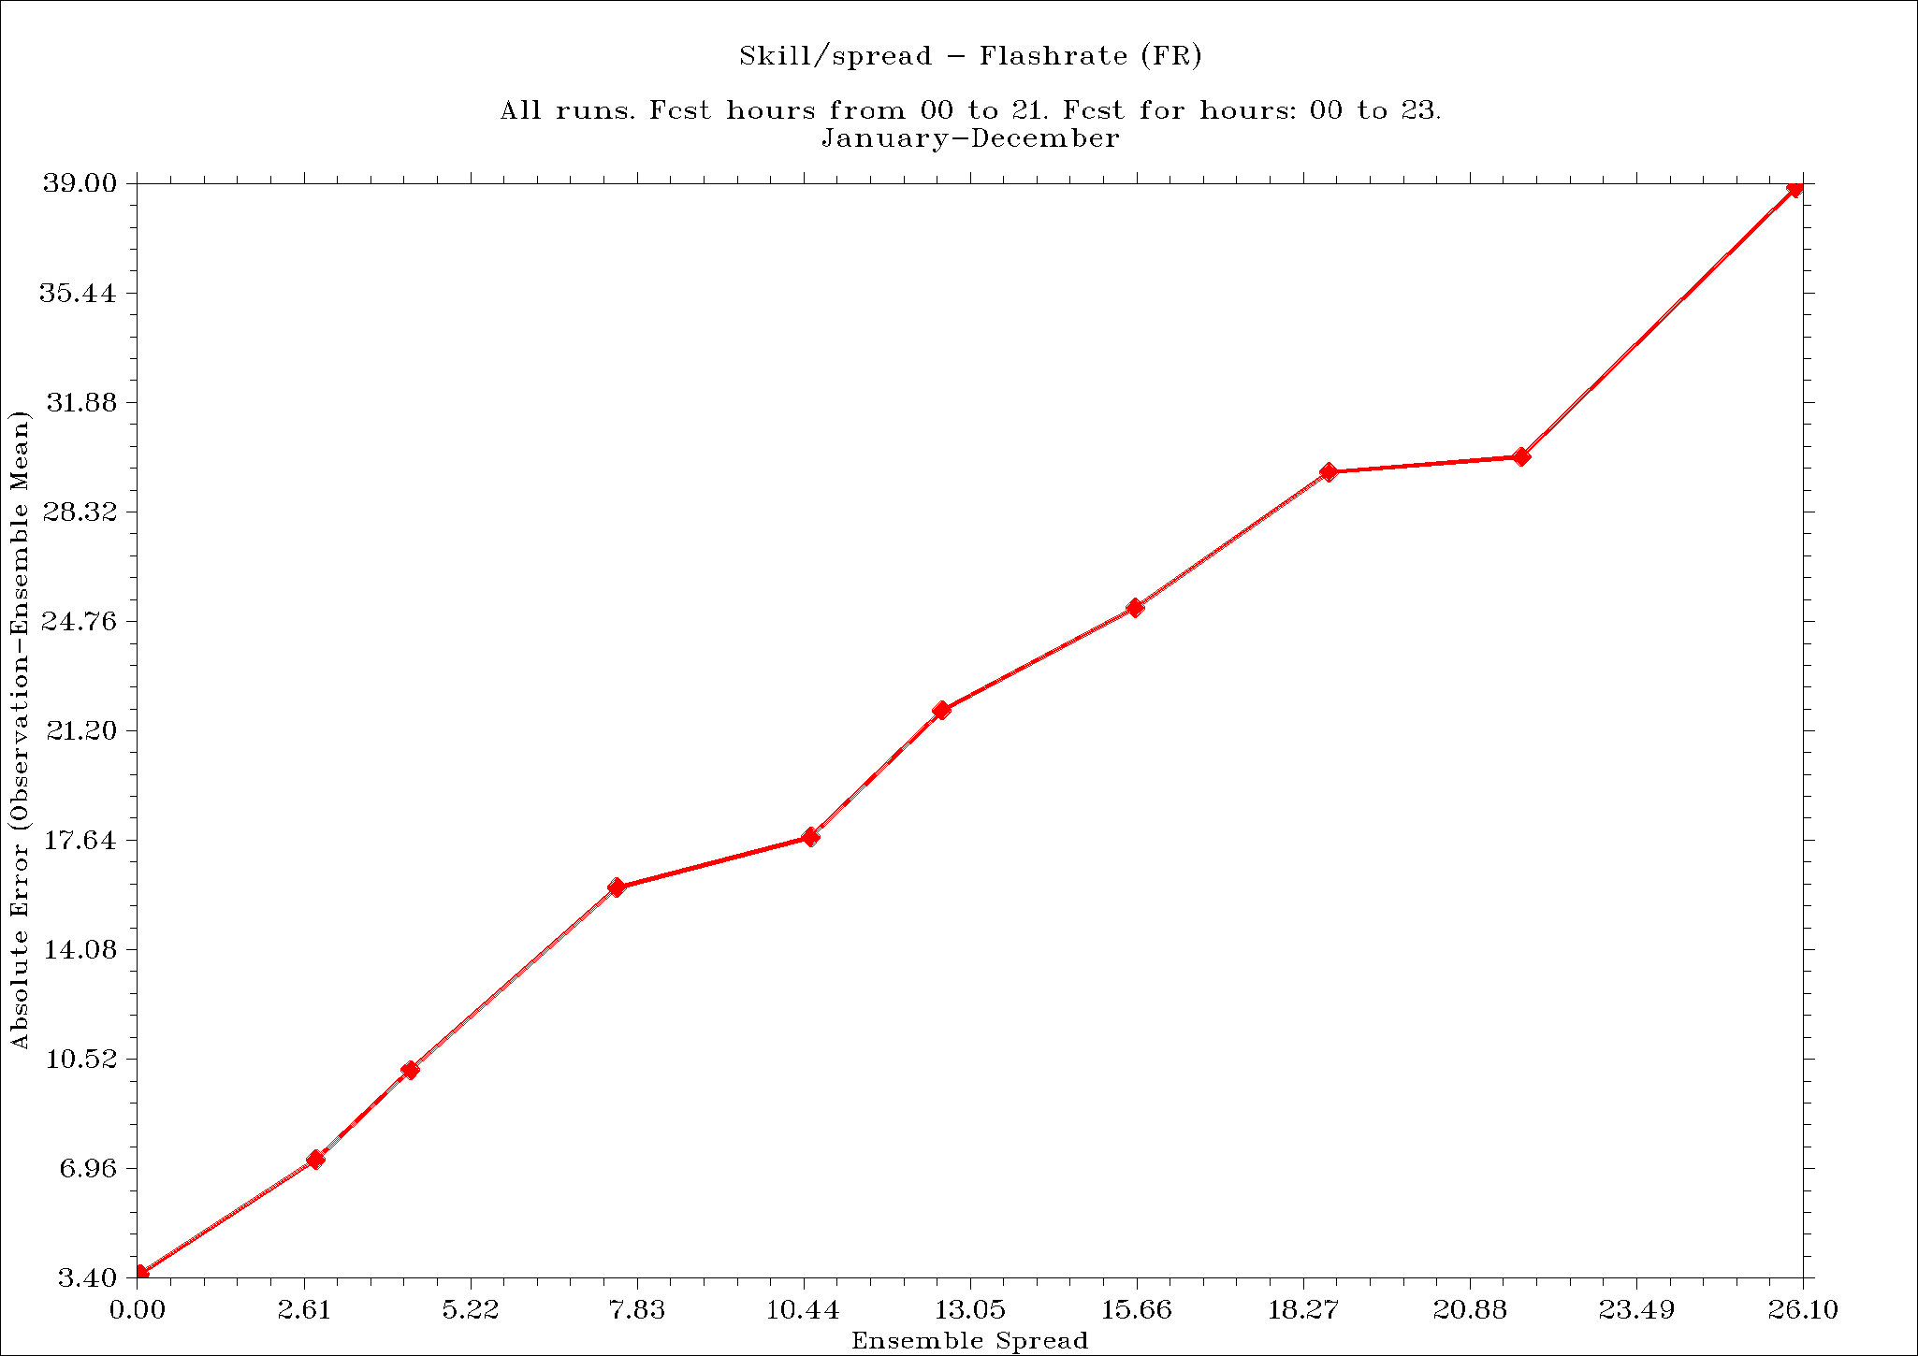
Initial activities in PP APSU – Results
Skill/spread for VIS(left) and FR (right), c_soil (operational) perturbation, 2013

Slide 11
Alternative – Fog Stability Index (FSI)
Forecasts of FSI – from DMO; algorithm based on forecast of advection, condensation and vertical temperature gradient :
Where T, Td – temperature and dew point at 2m (K), T850 – temperature at 850 hPa (K), V850 – wind speed at 850 hPa (knots).
See e.g. Song, Yunyoung and Yum, Seong Soo: Development and Verification of the Fog Stability Index for Incheon International Airport based on the Measured Fog Characteristics, Atmosphere, Vol. 23, 4, 2013, pp.443-452
Probability of fog occurence increases when FSI drops down
Forecasts verified against observations at Polish SYNOP stations

Slide 12
Sensitivity analysis
Assuming that for preselected value of FSI fog appearance is certain, compute scores from the contingency table (POD, FC, SR, TS), then calculate the product – a new ”OVERALL” score:
OVRALL = POD x FC x SR x TS
POD = a / (a + c)
FC = (a + d) / (a + b + c + d)
SR = 1 – FAR = a / (a + b)
TS = a / (a + b +c)
Where a – hits, b – misses, c – false alarms, d – correct negatives

Slide 13
Overall score (def.) – a product of POD, FC, SR and TS
Best value of OVRALL (~0.008) – for FSI = 21

Slide 14
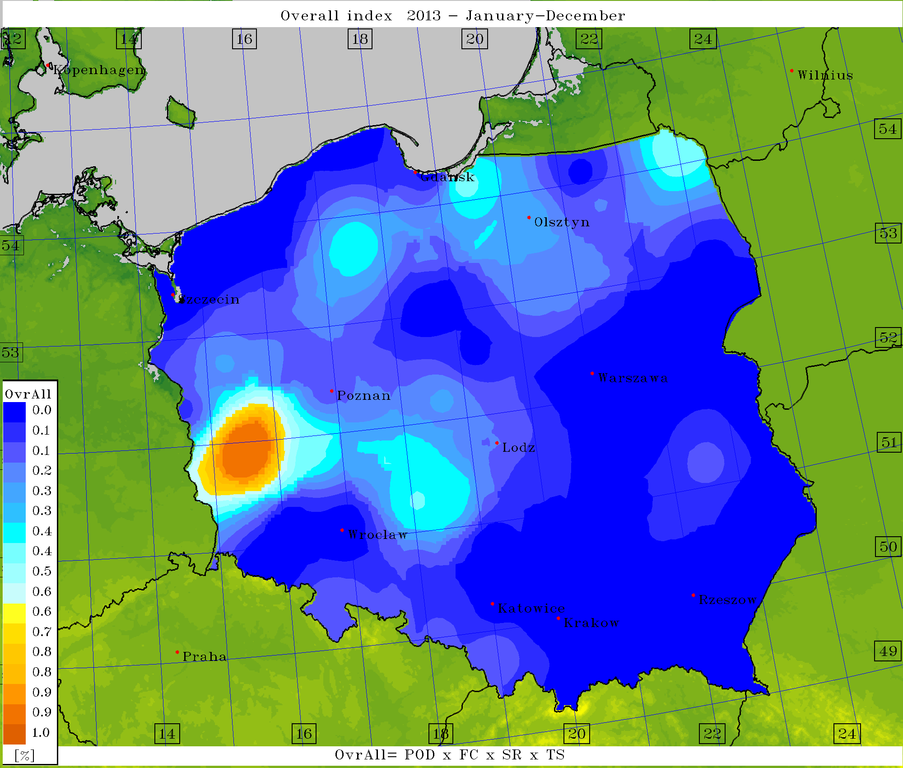
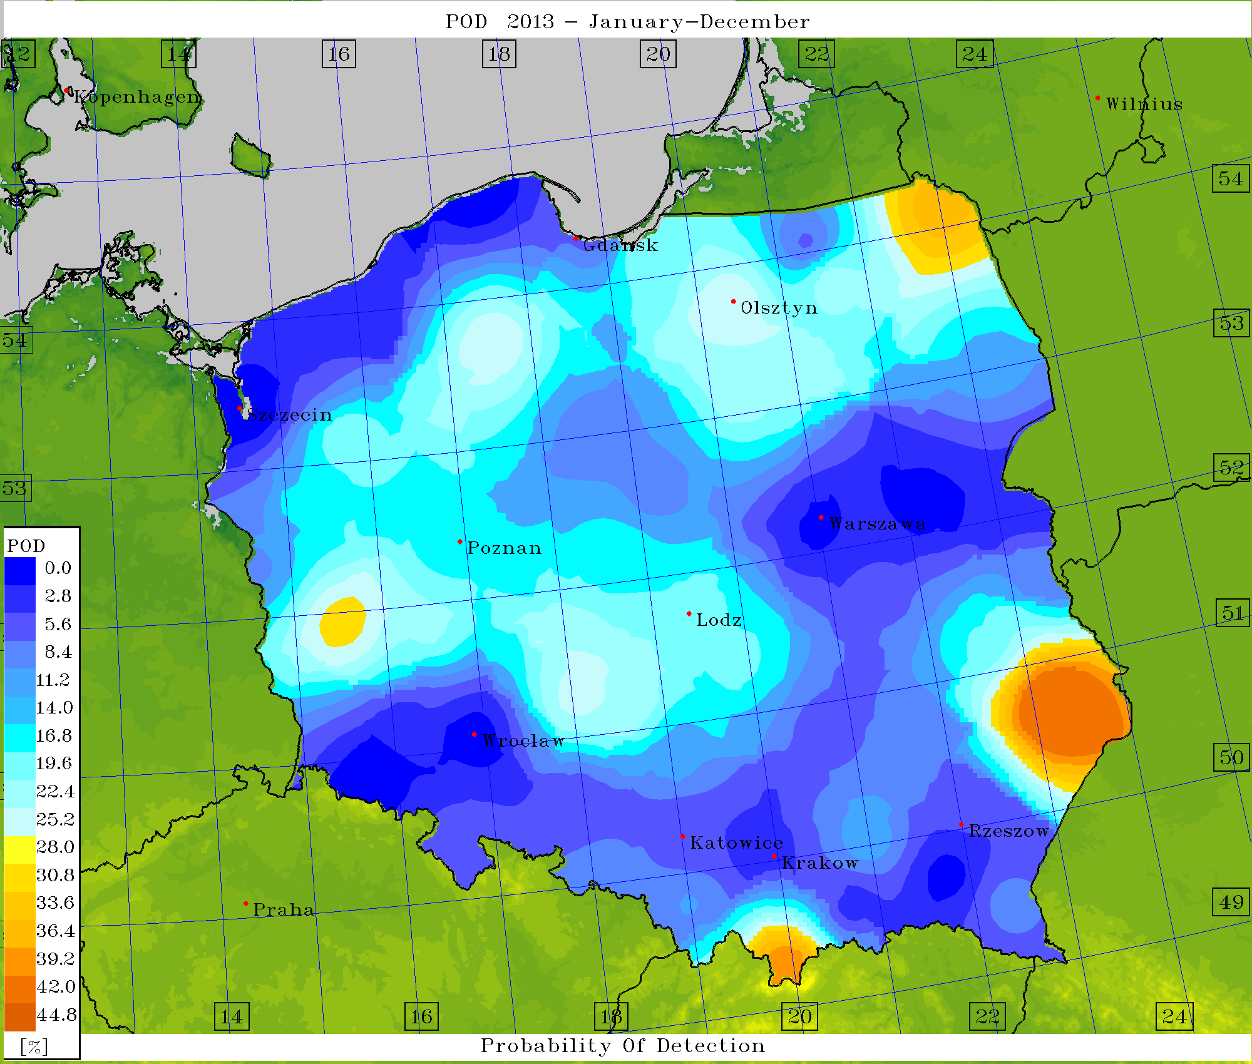
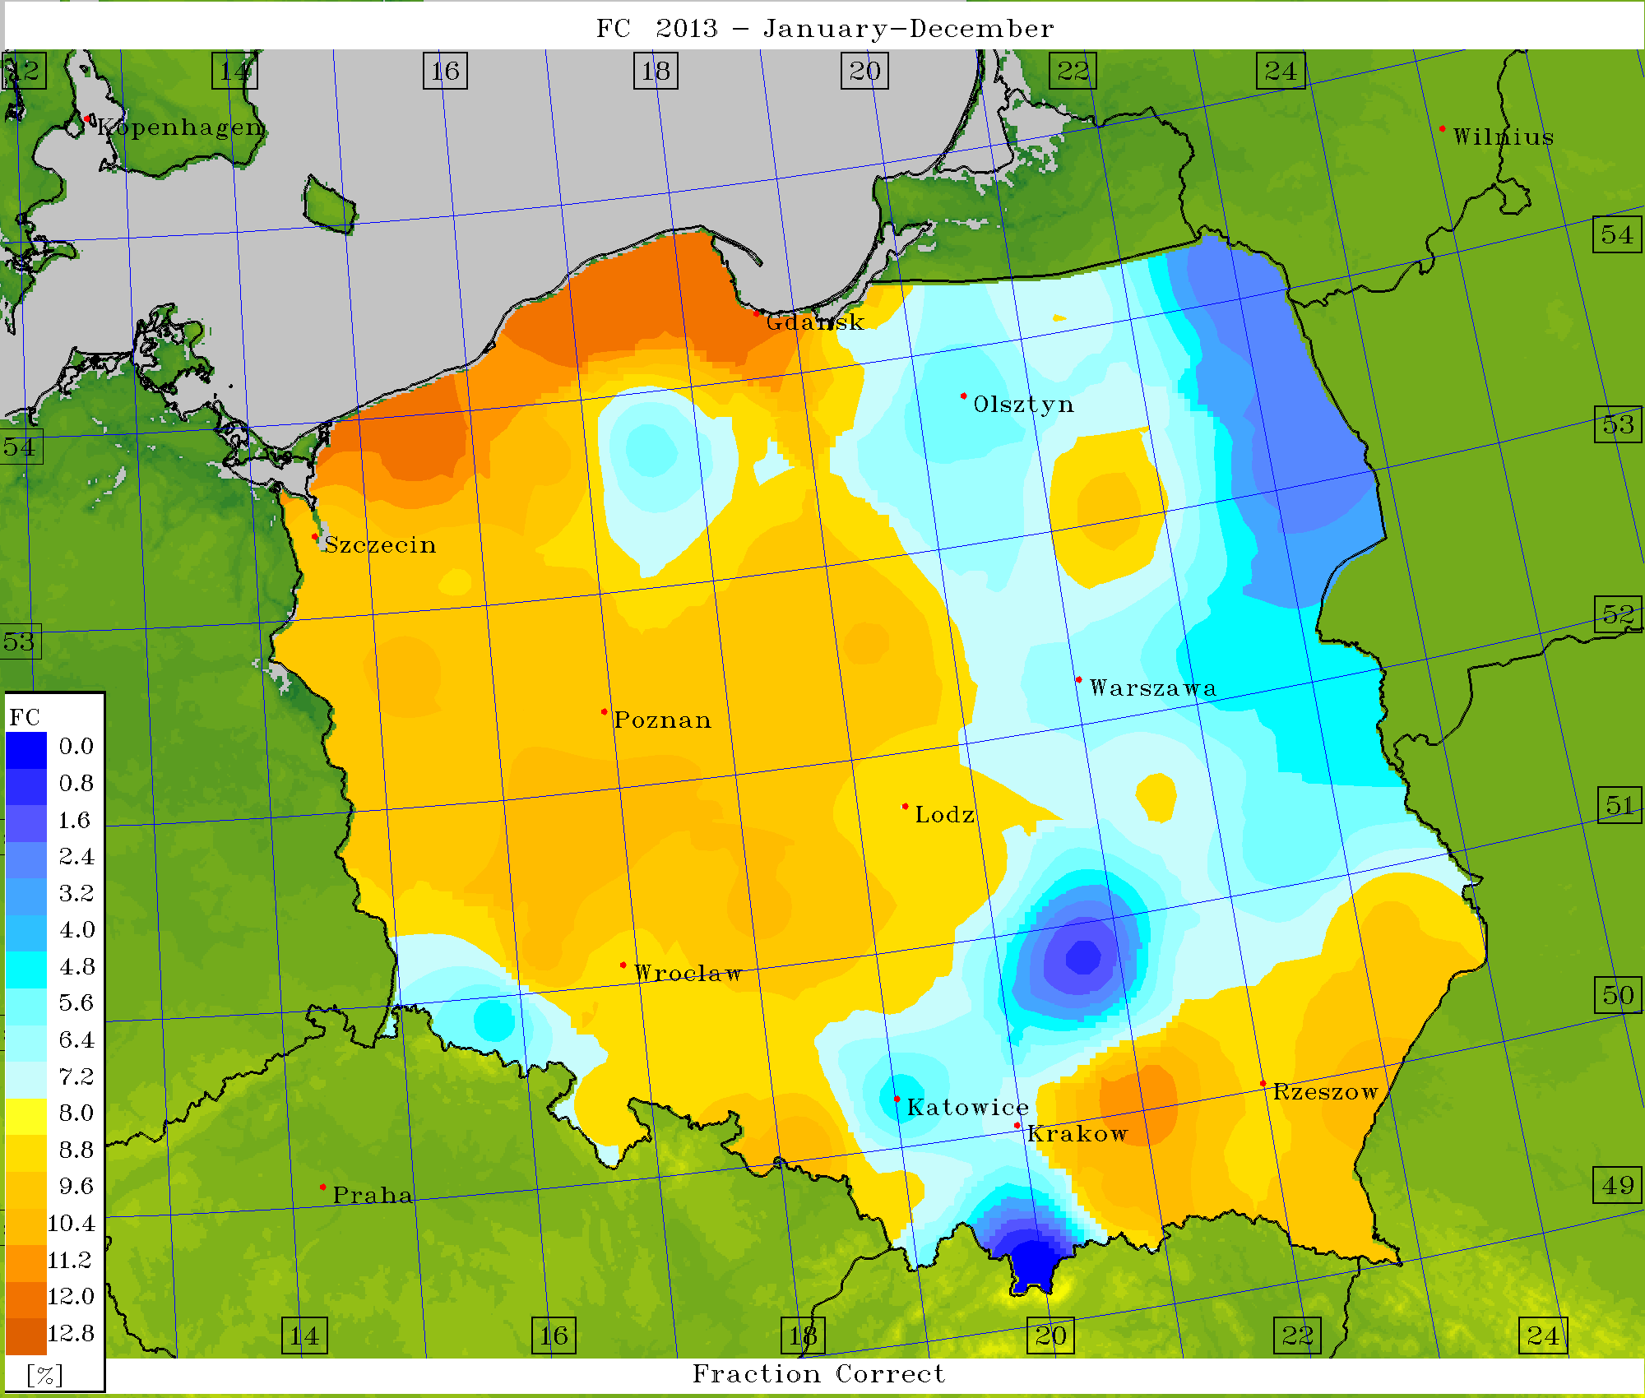
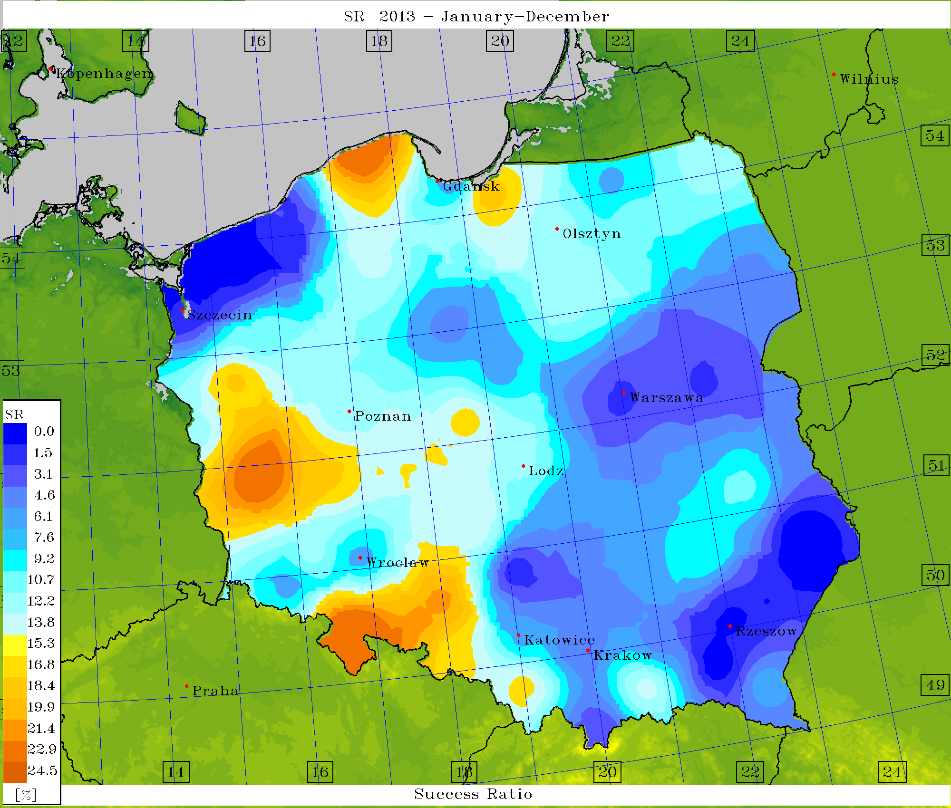
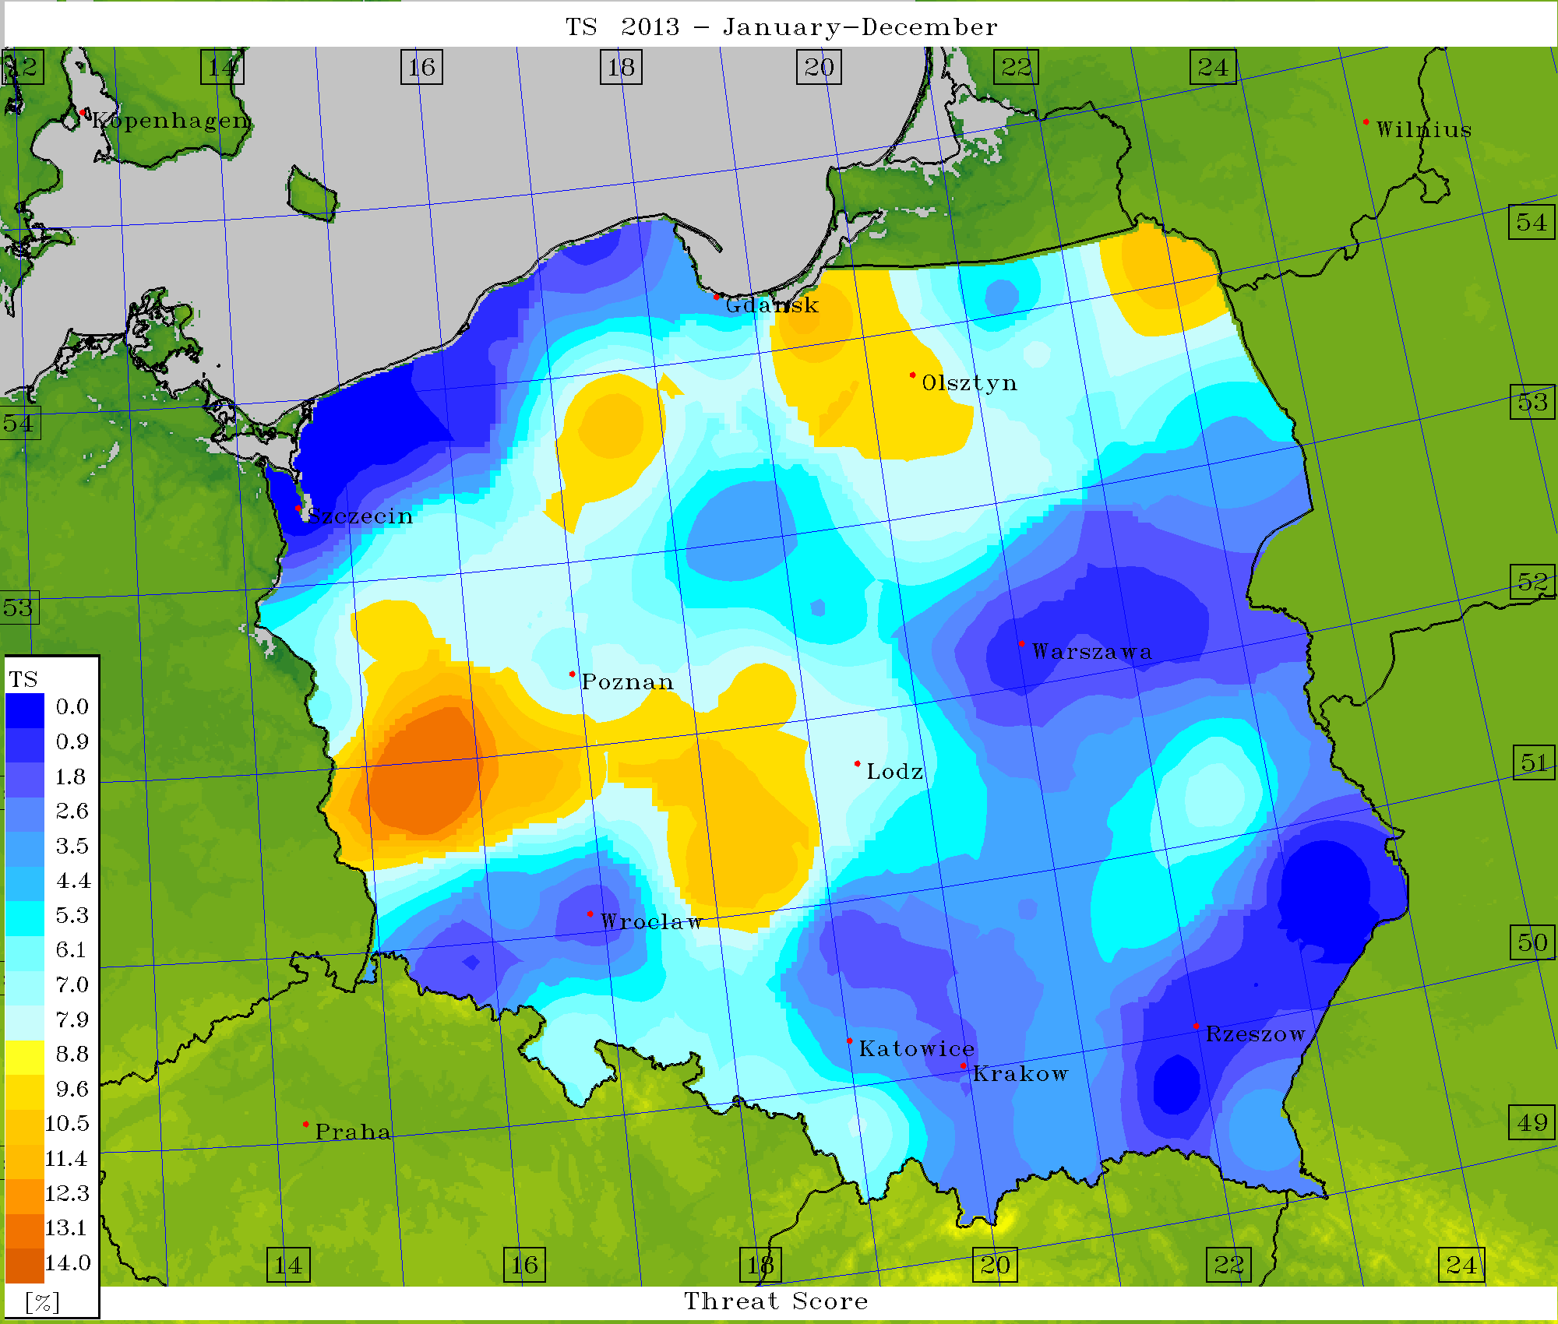
Verification – scores (determ.) for FSI = 21

Slide 15
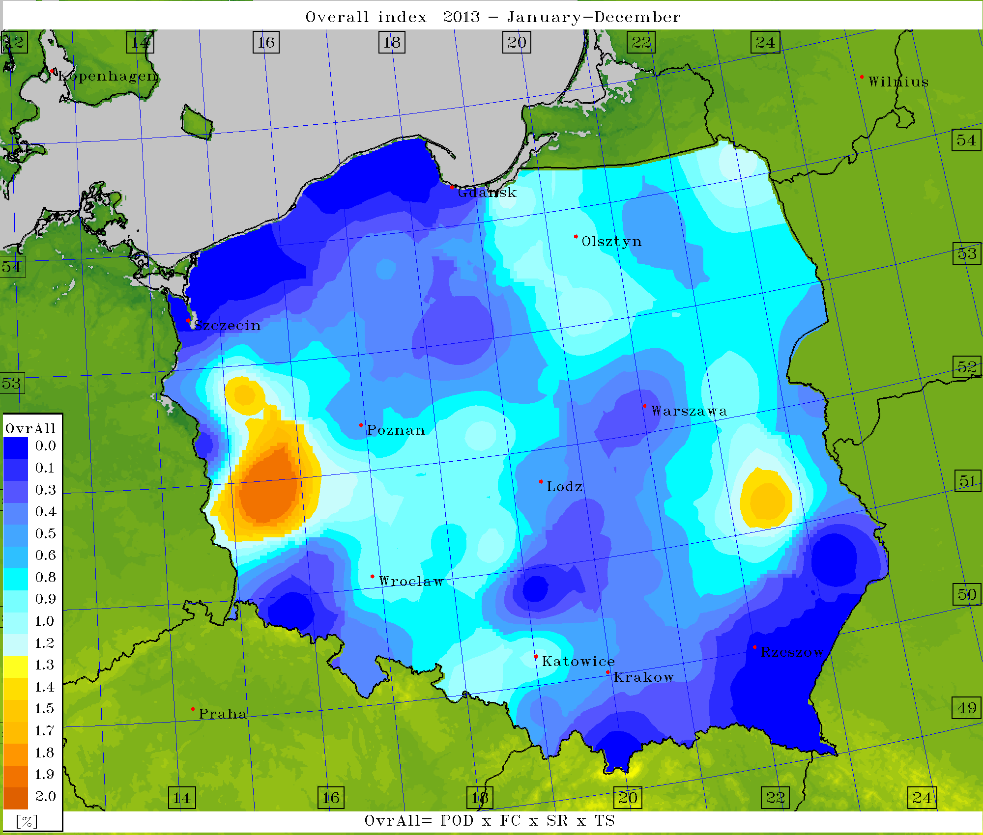
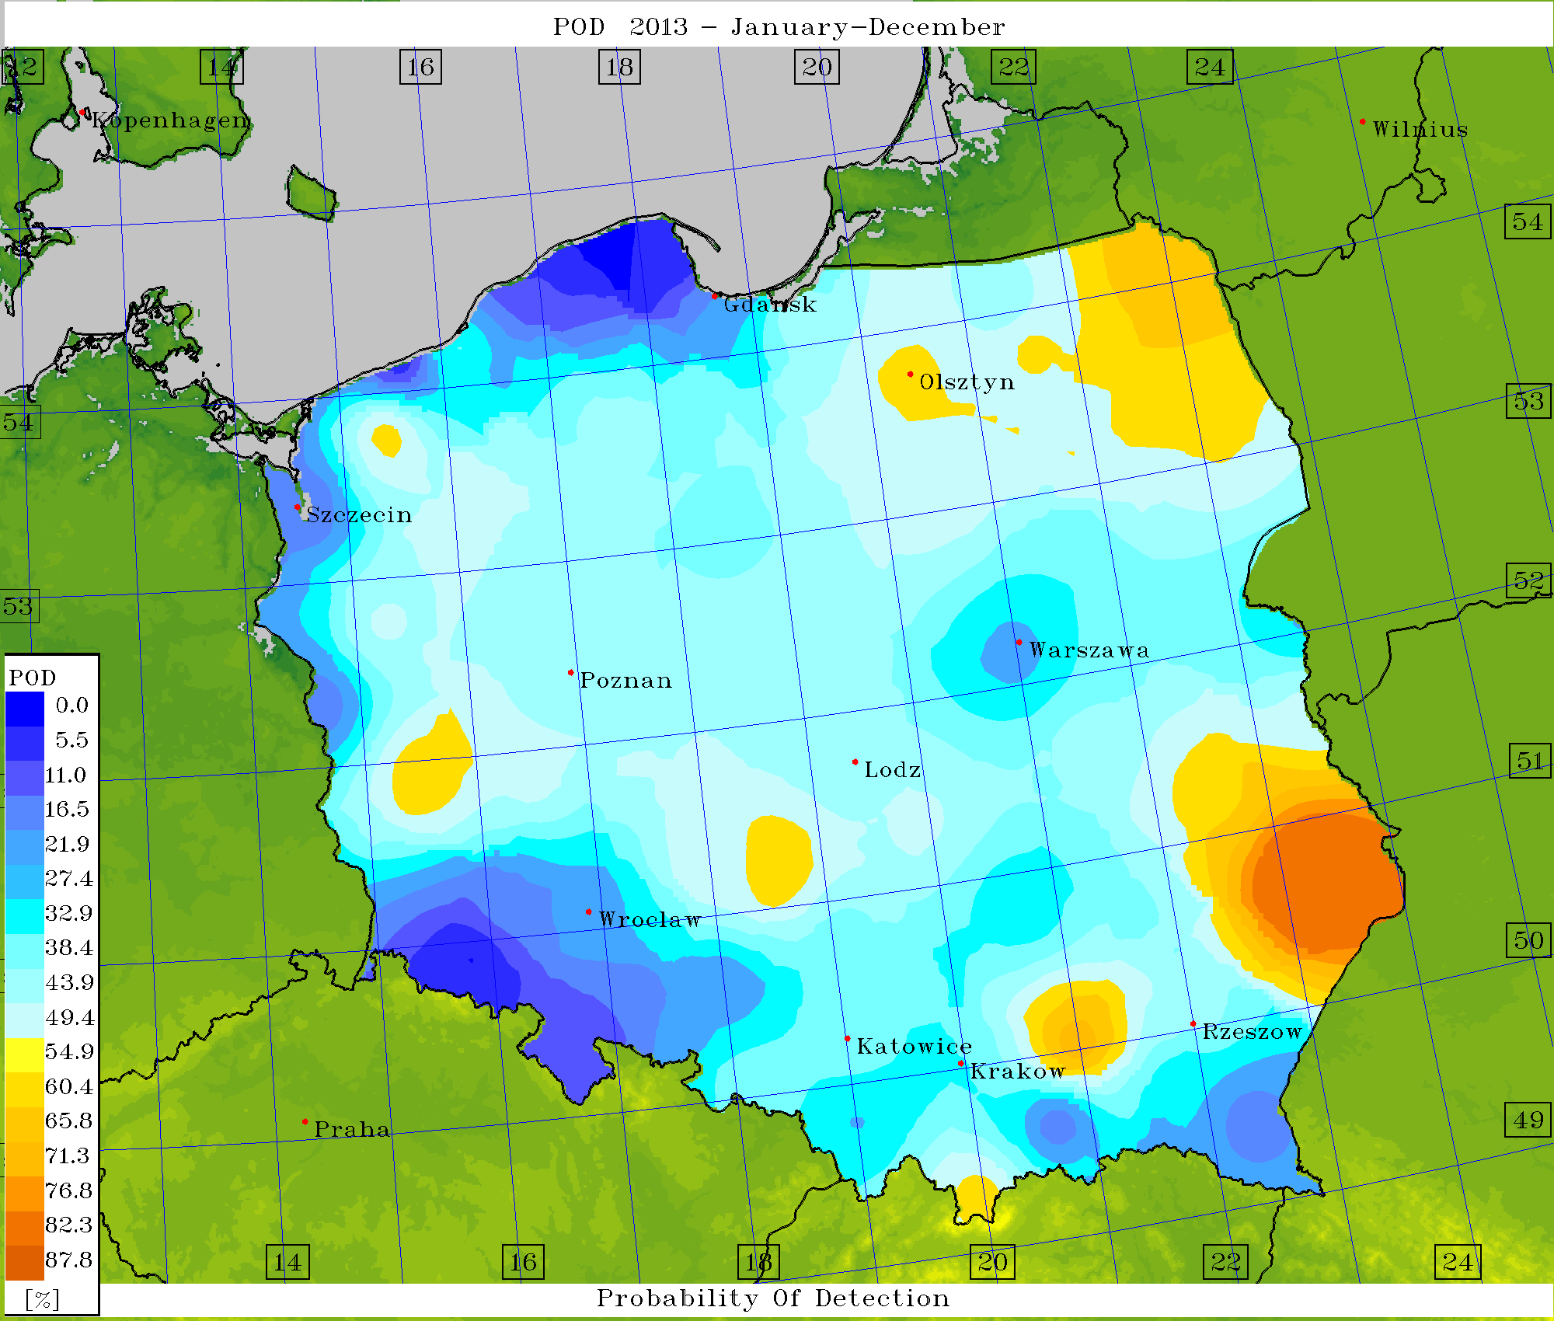
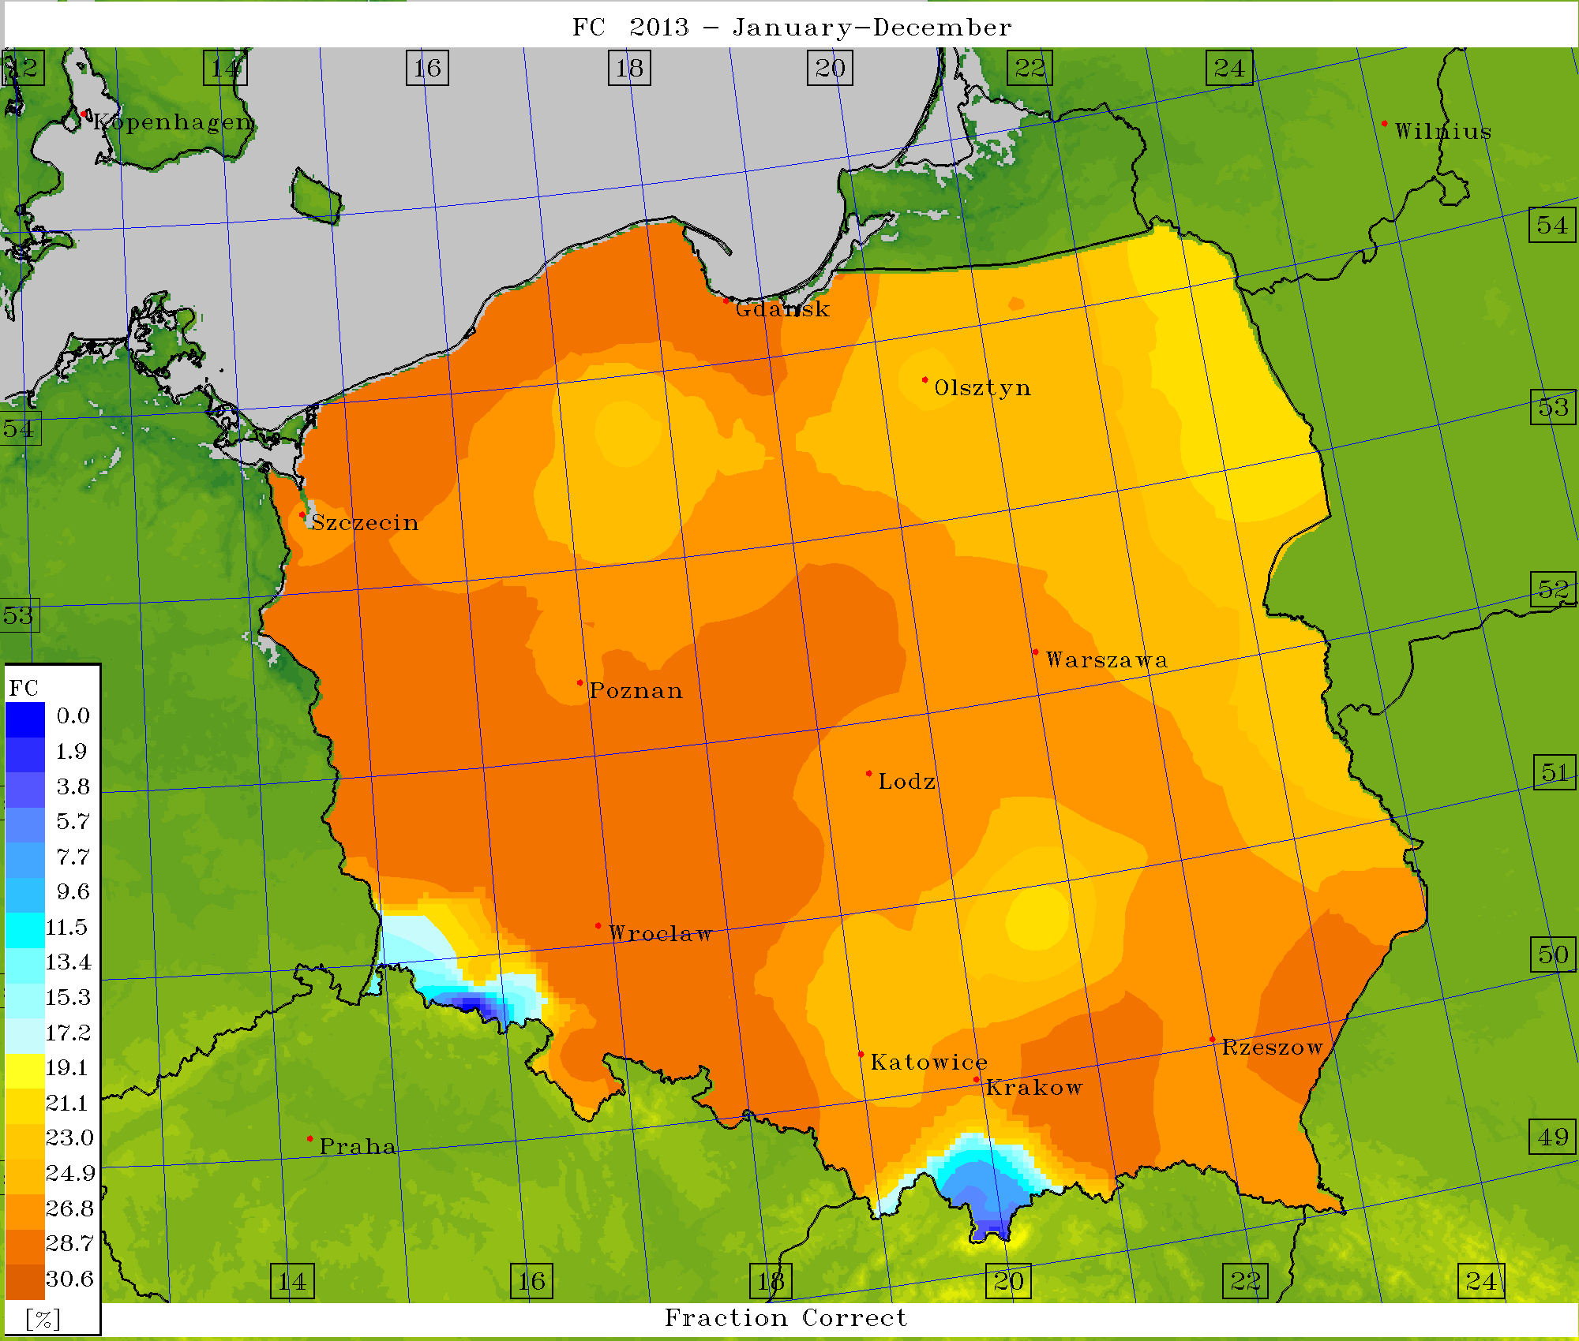
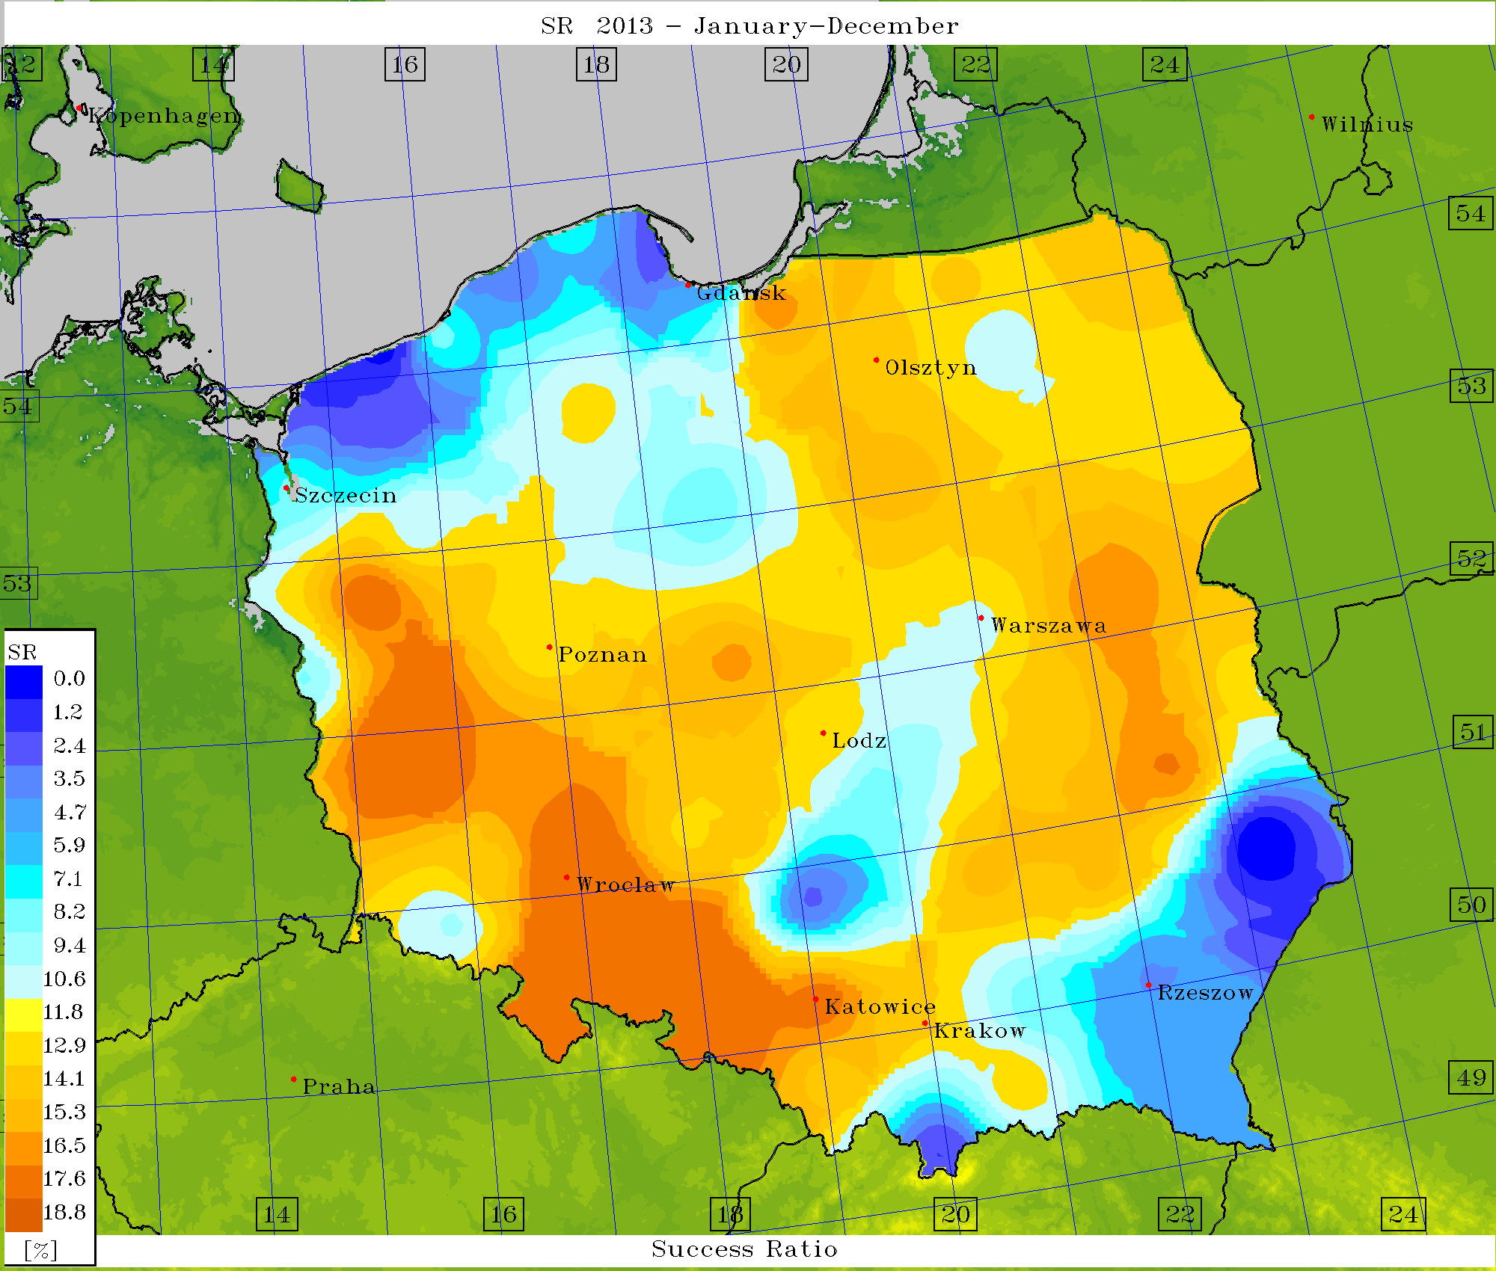
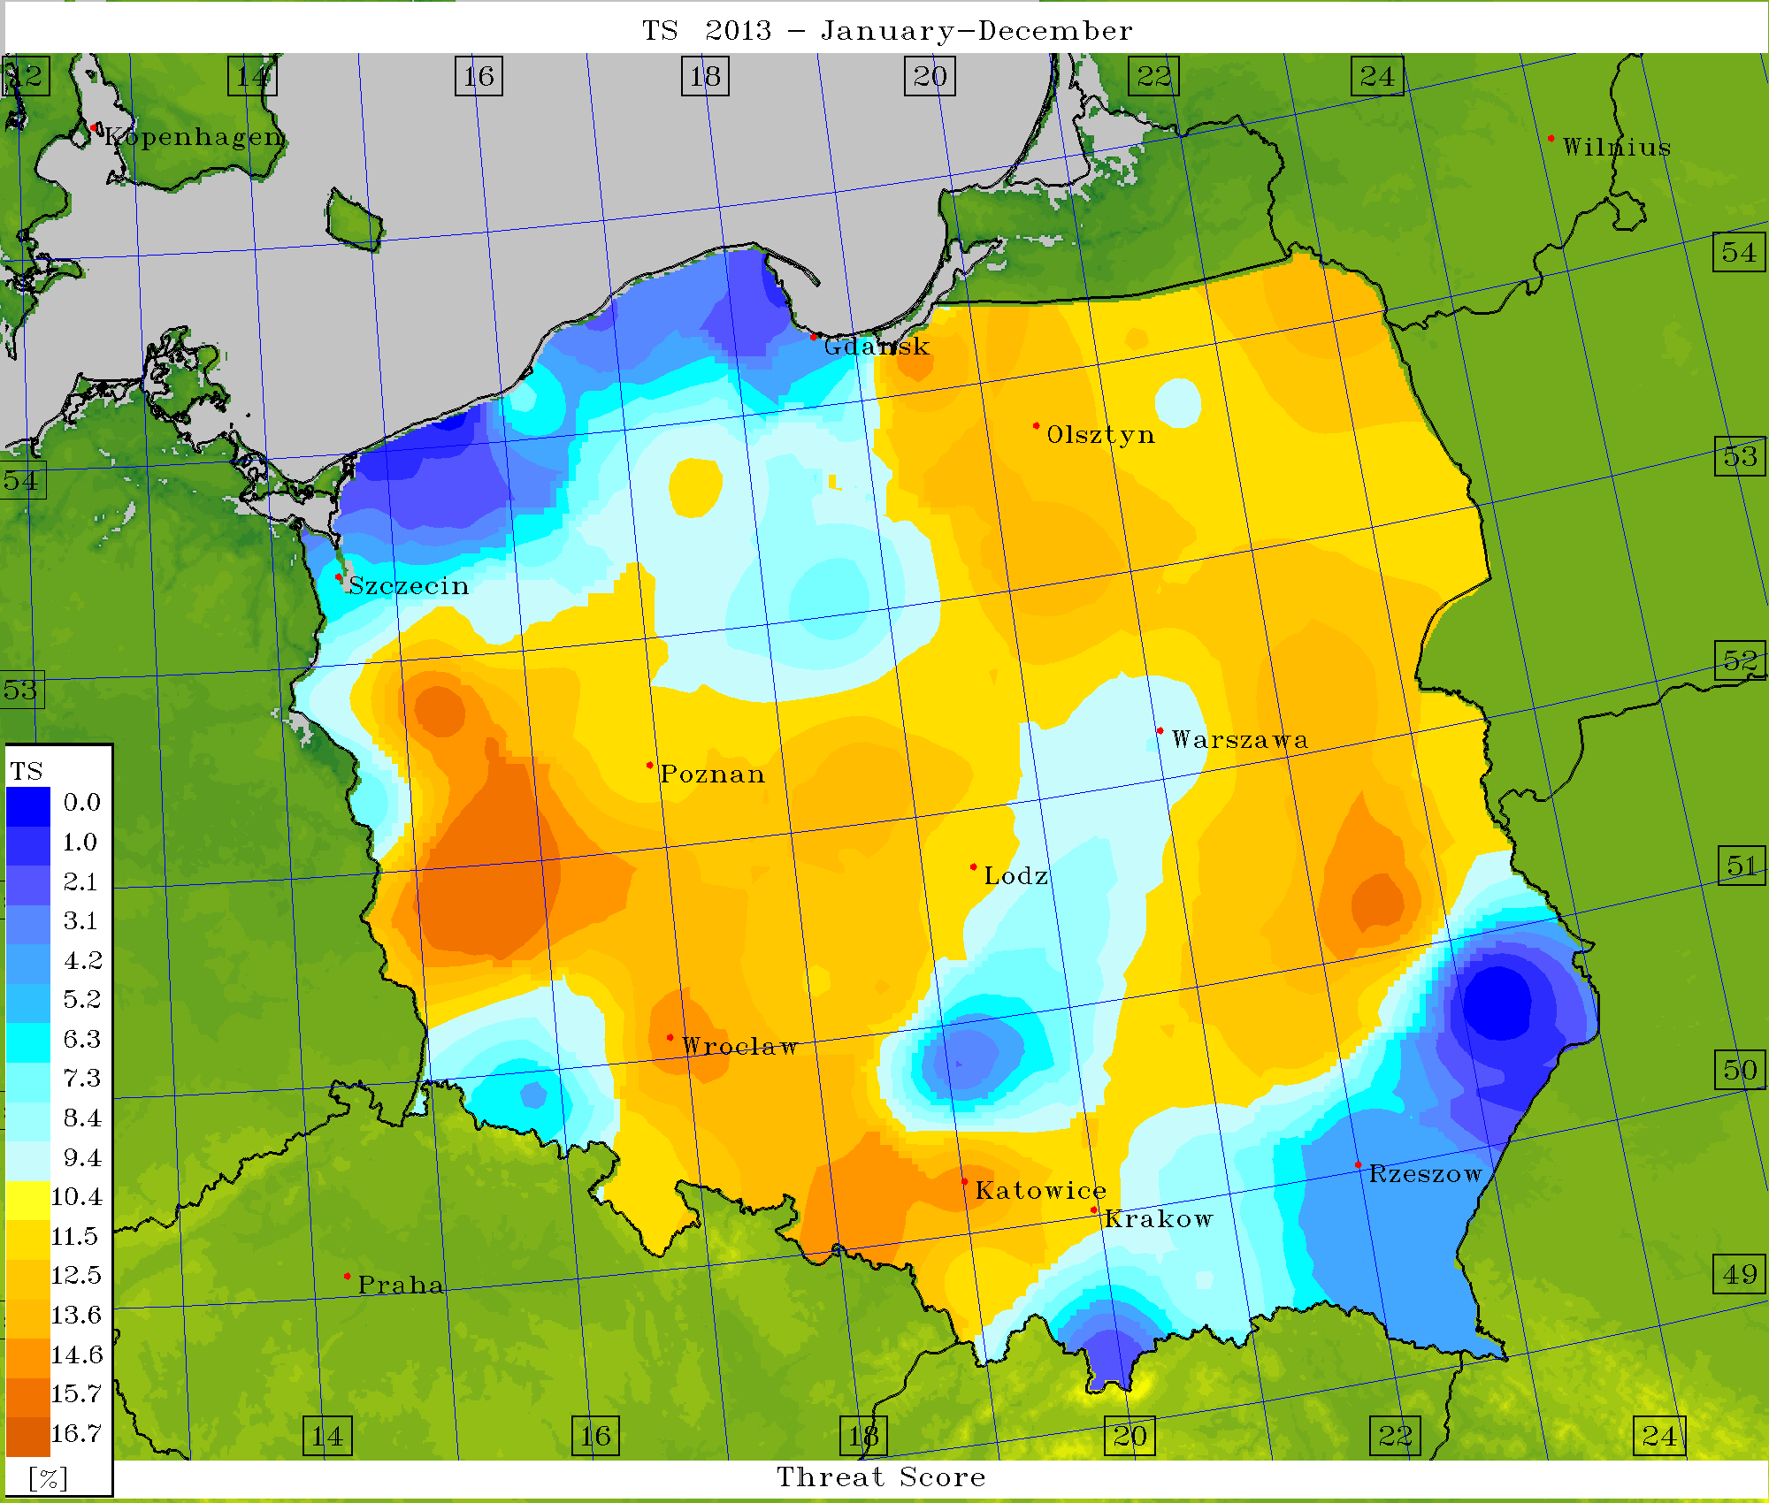
Verification – scores (EPS) for FSI=21

Slide 16
Alternative – thunderstorms via indices
Stability indices:
K-Index (def.): KI = (T₈₅₀ – T₅₀₀) + D₈₅₀ – (T₇₀₀ – D₇₀₀)
As this index increases from a value of ~20, the likelihood of showers/thunderstorms is expected to increase. Occurence of thunderstorm(s) is virtually certain for K greater than 40.
Total Totals (def.): TT = (T₈₅₀ – T₅₀₀) + (D₈₅₀ – T₅₀₀)
Showers/thunderstorms become increasingly likely from TT values~30, and severe thunderstorms are considered probable for values >50.
Lifted index (LI) Showers and thunderstorms become increasingly likely from LI values of about 0, and severe thunderstorms are considered likely for values of < –3.

Slide 17
Best value of OVRALL (~0.003) – for K-Index = 32

Slide 18
Best value of OVRALL (~0.0046) – for Lifted Index = -2

Slide 19
Best value of OVRALL (~0.0012) – for Total Totals Index= 49

Slide 20
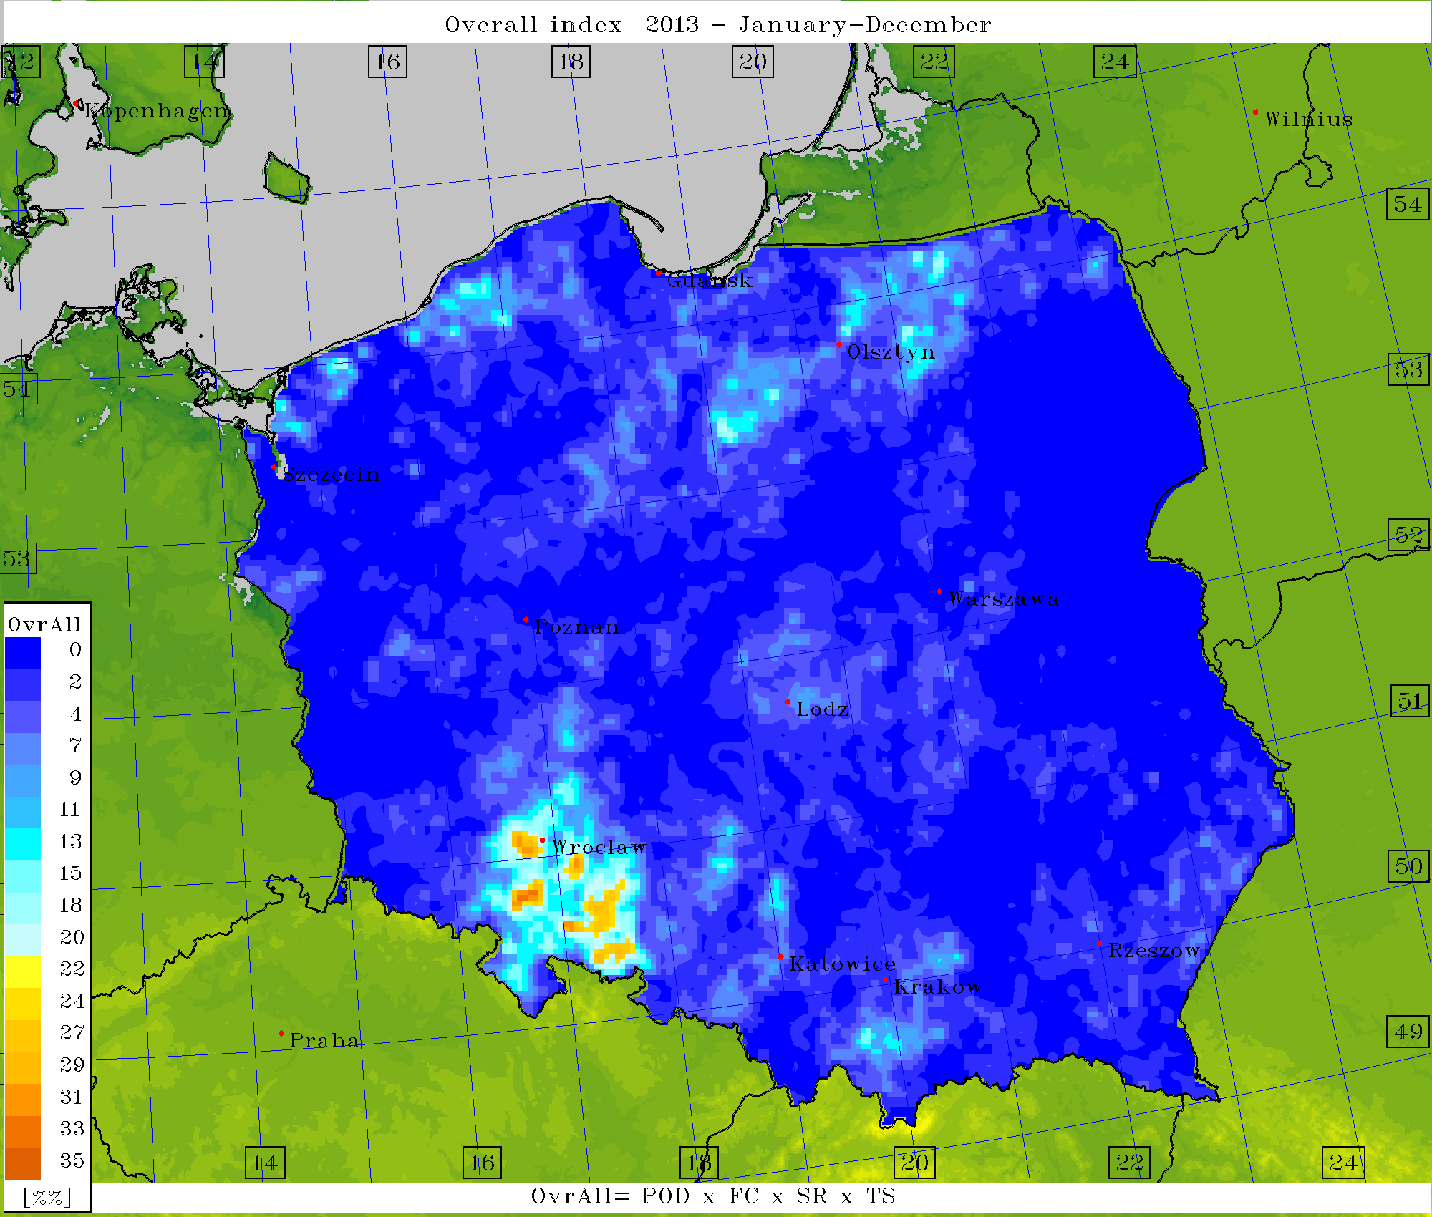
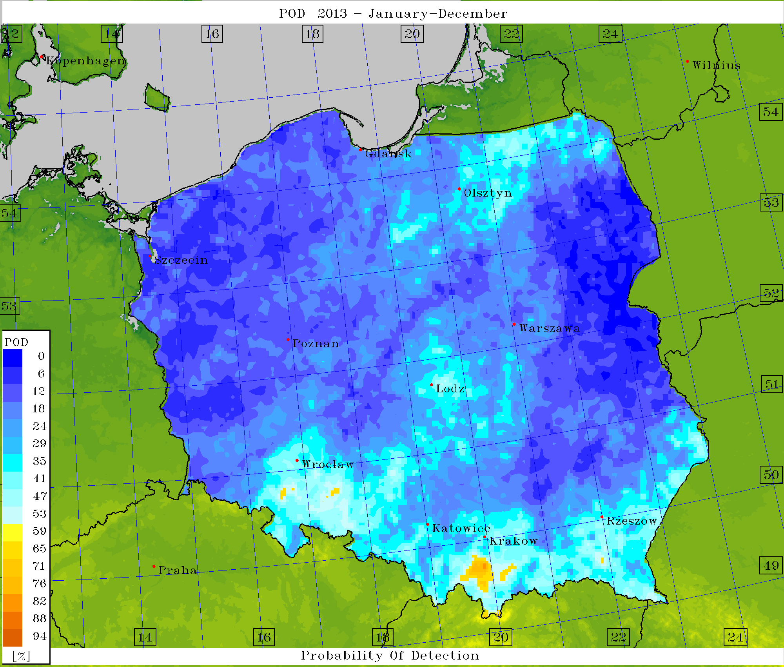
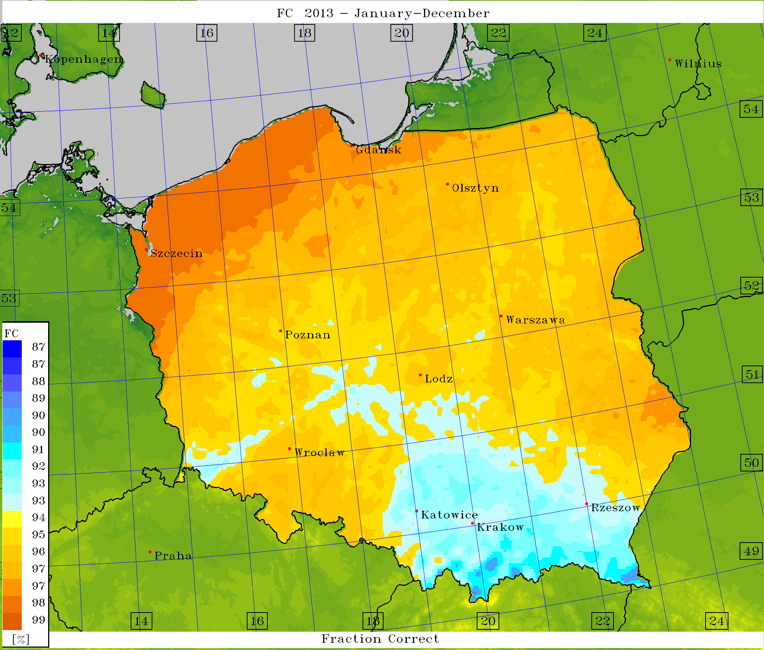
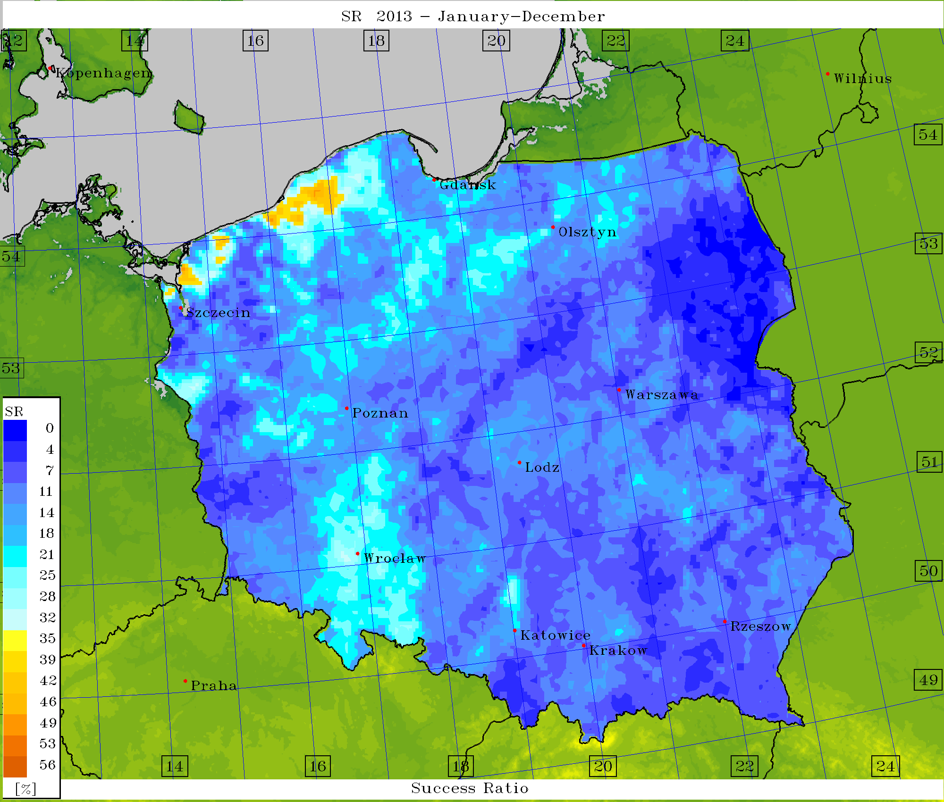
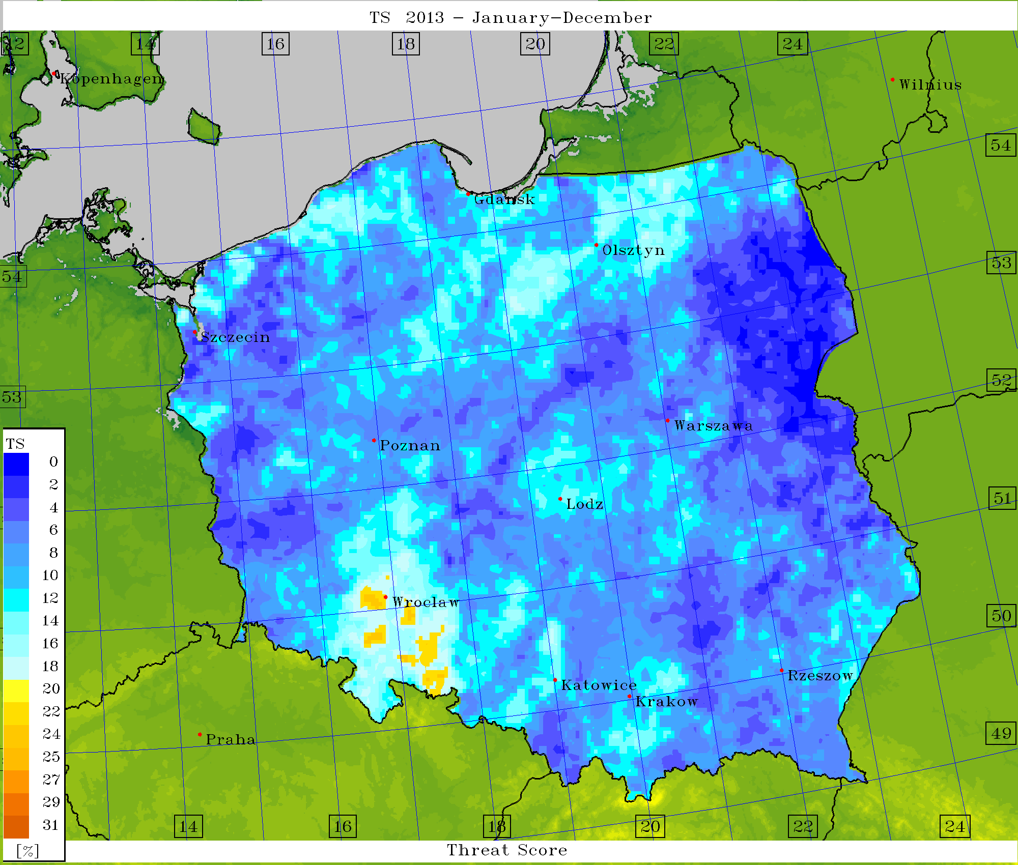
Verification – scores (det.) for K-index = 32

Slide 21
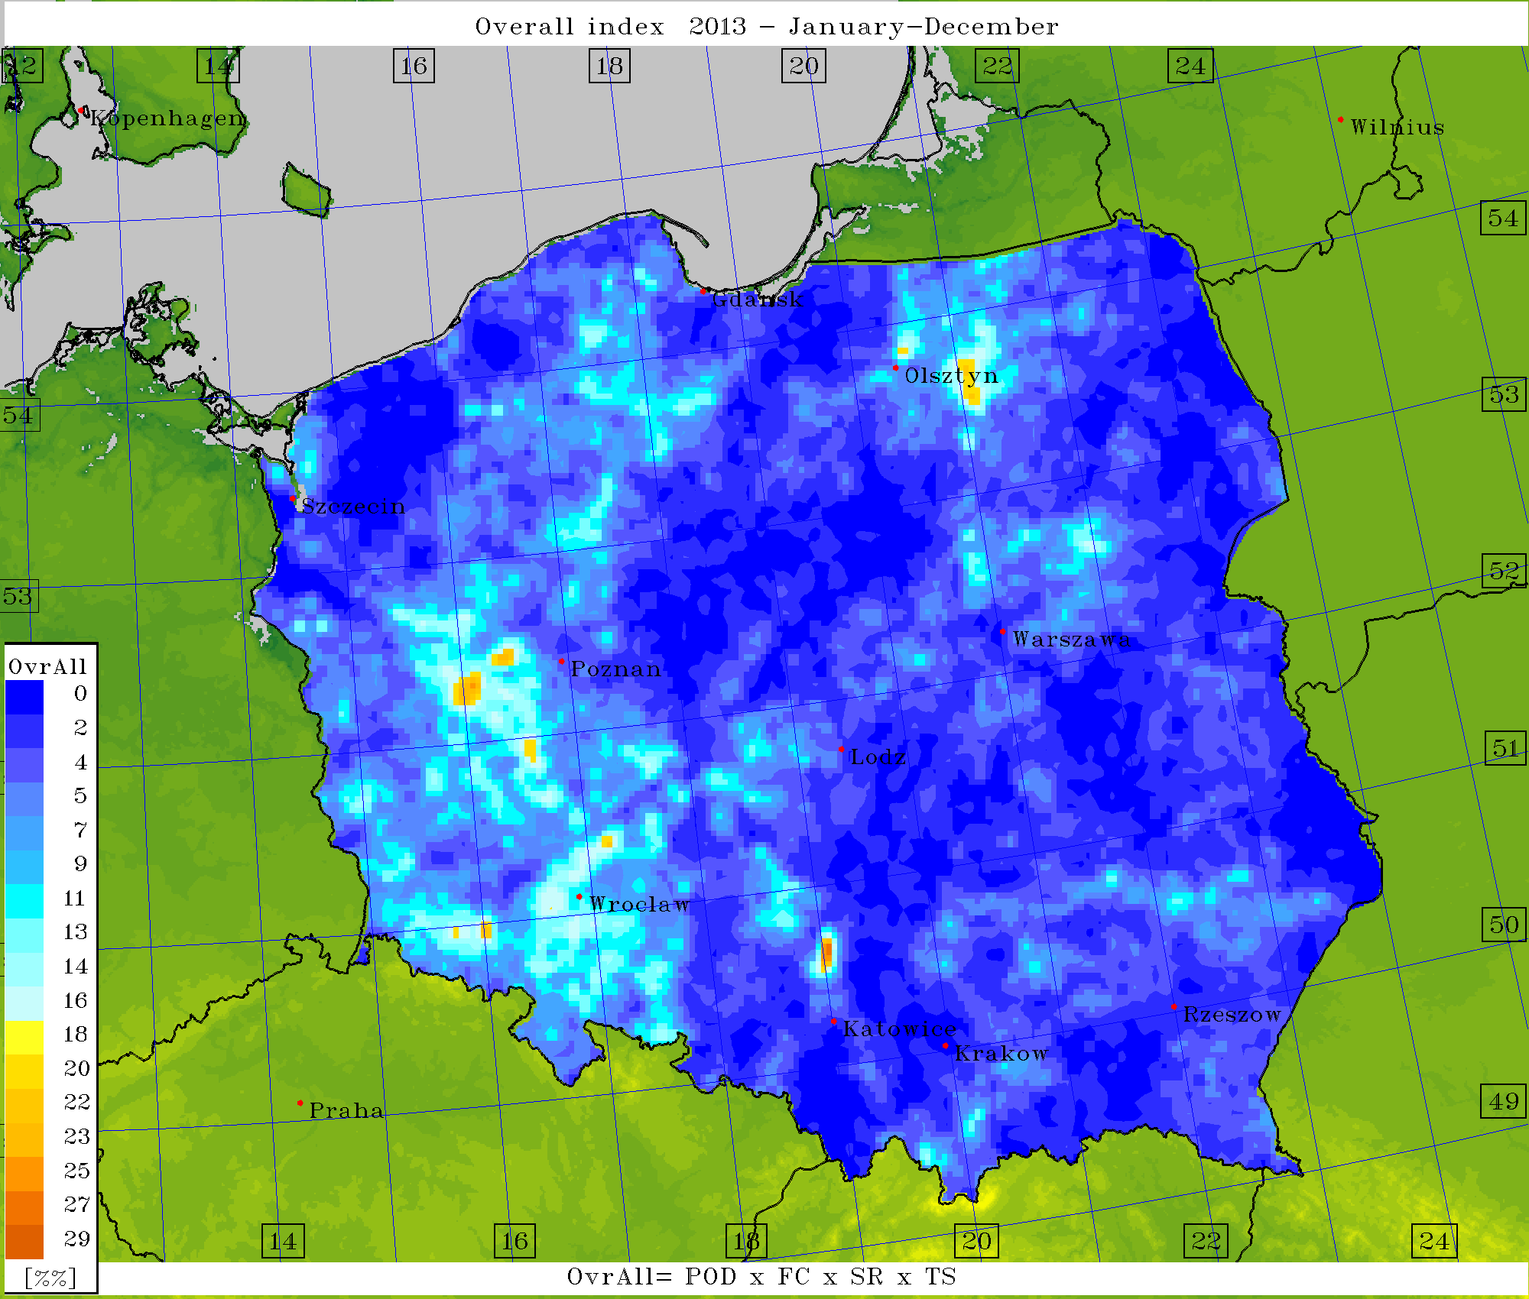
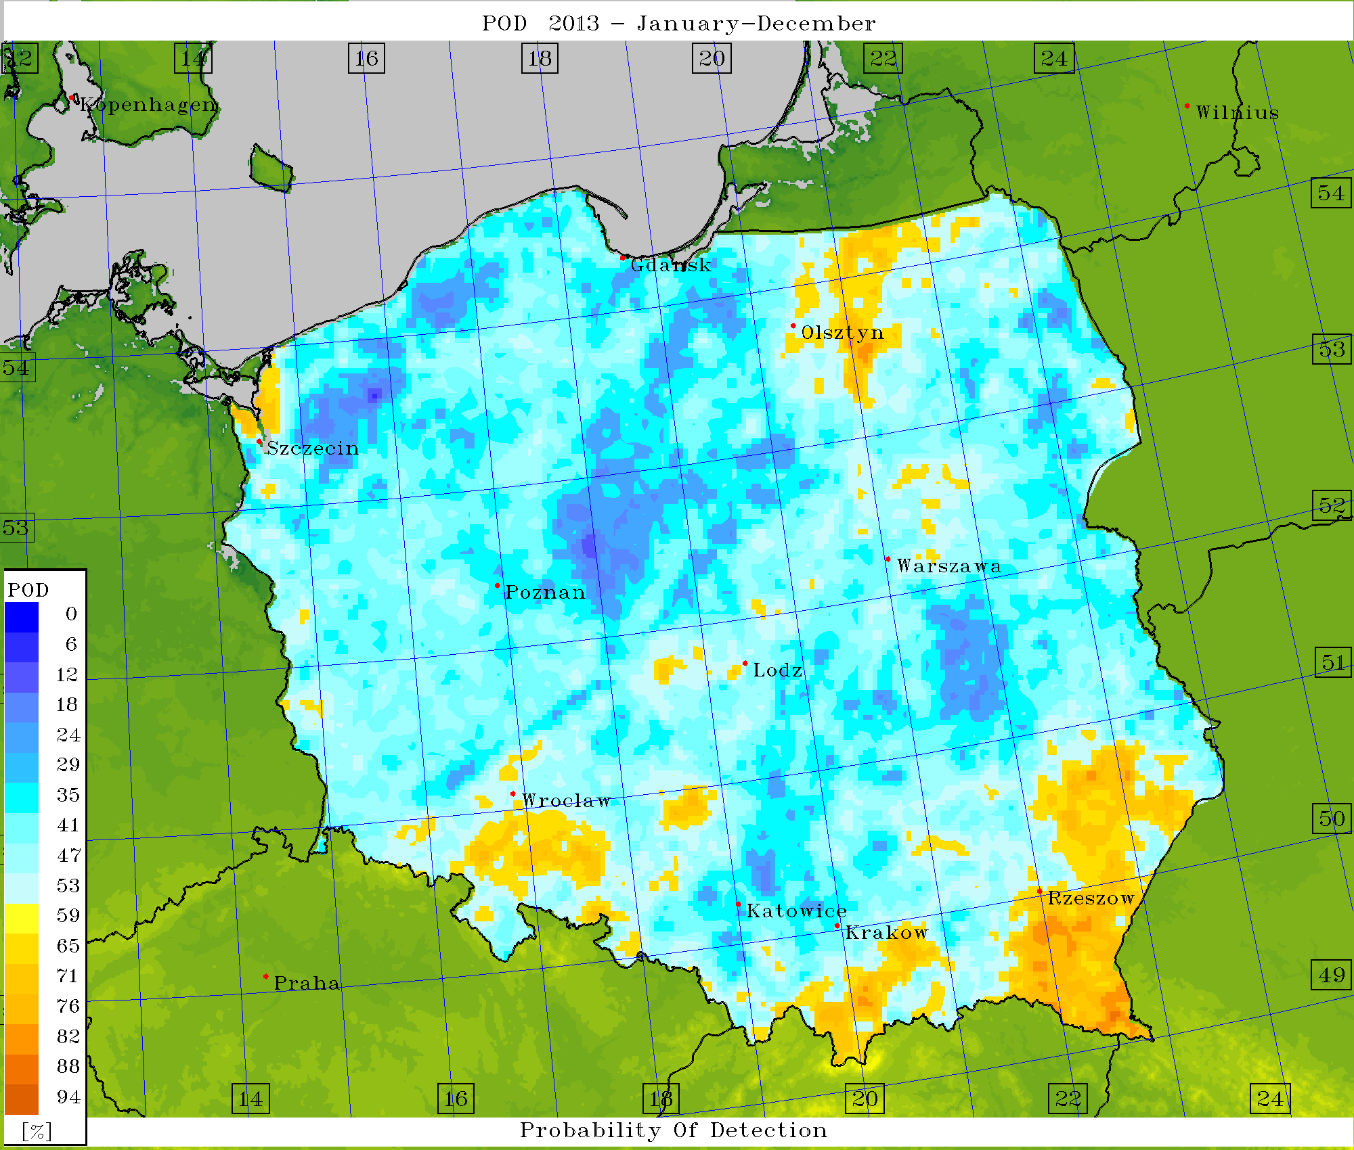
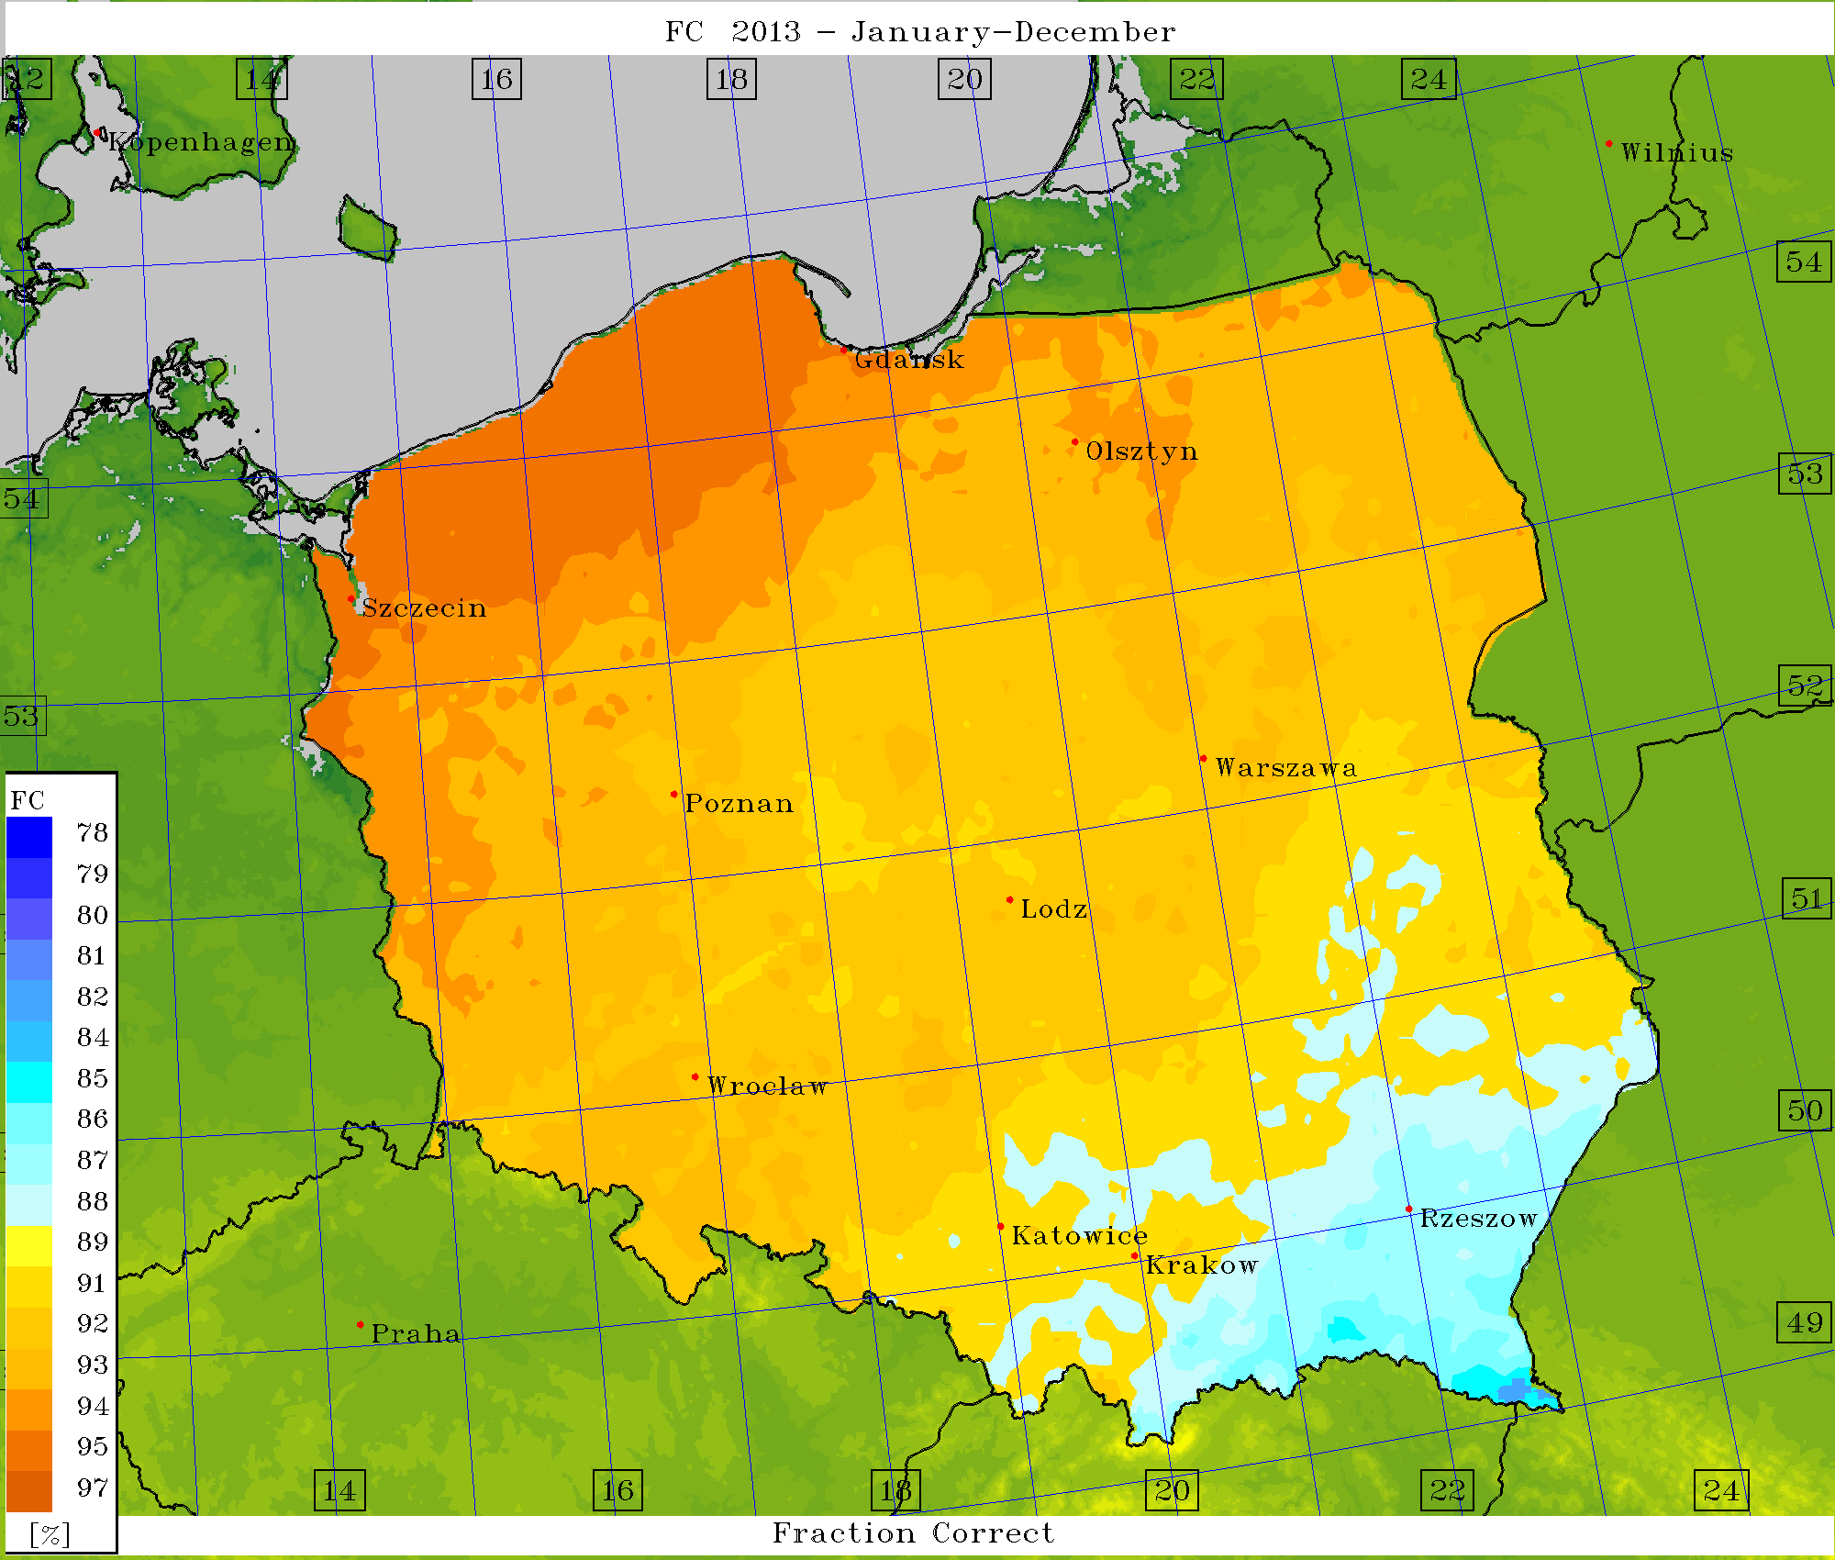
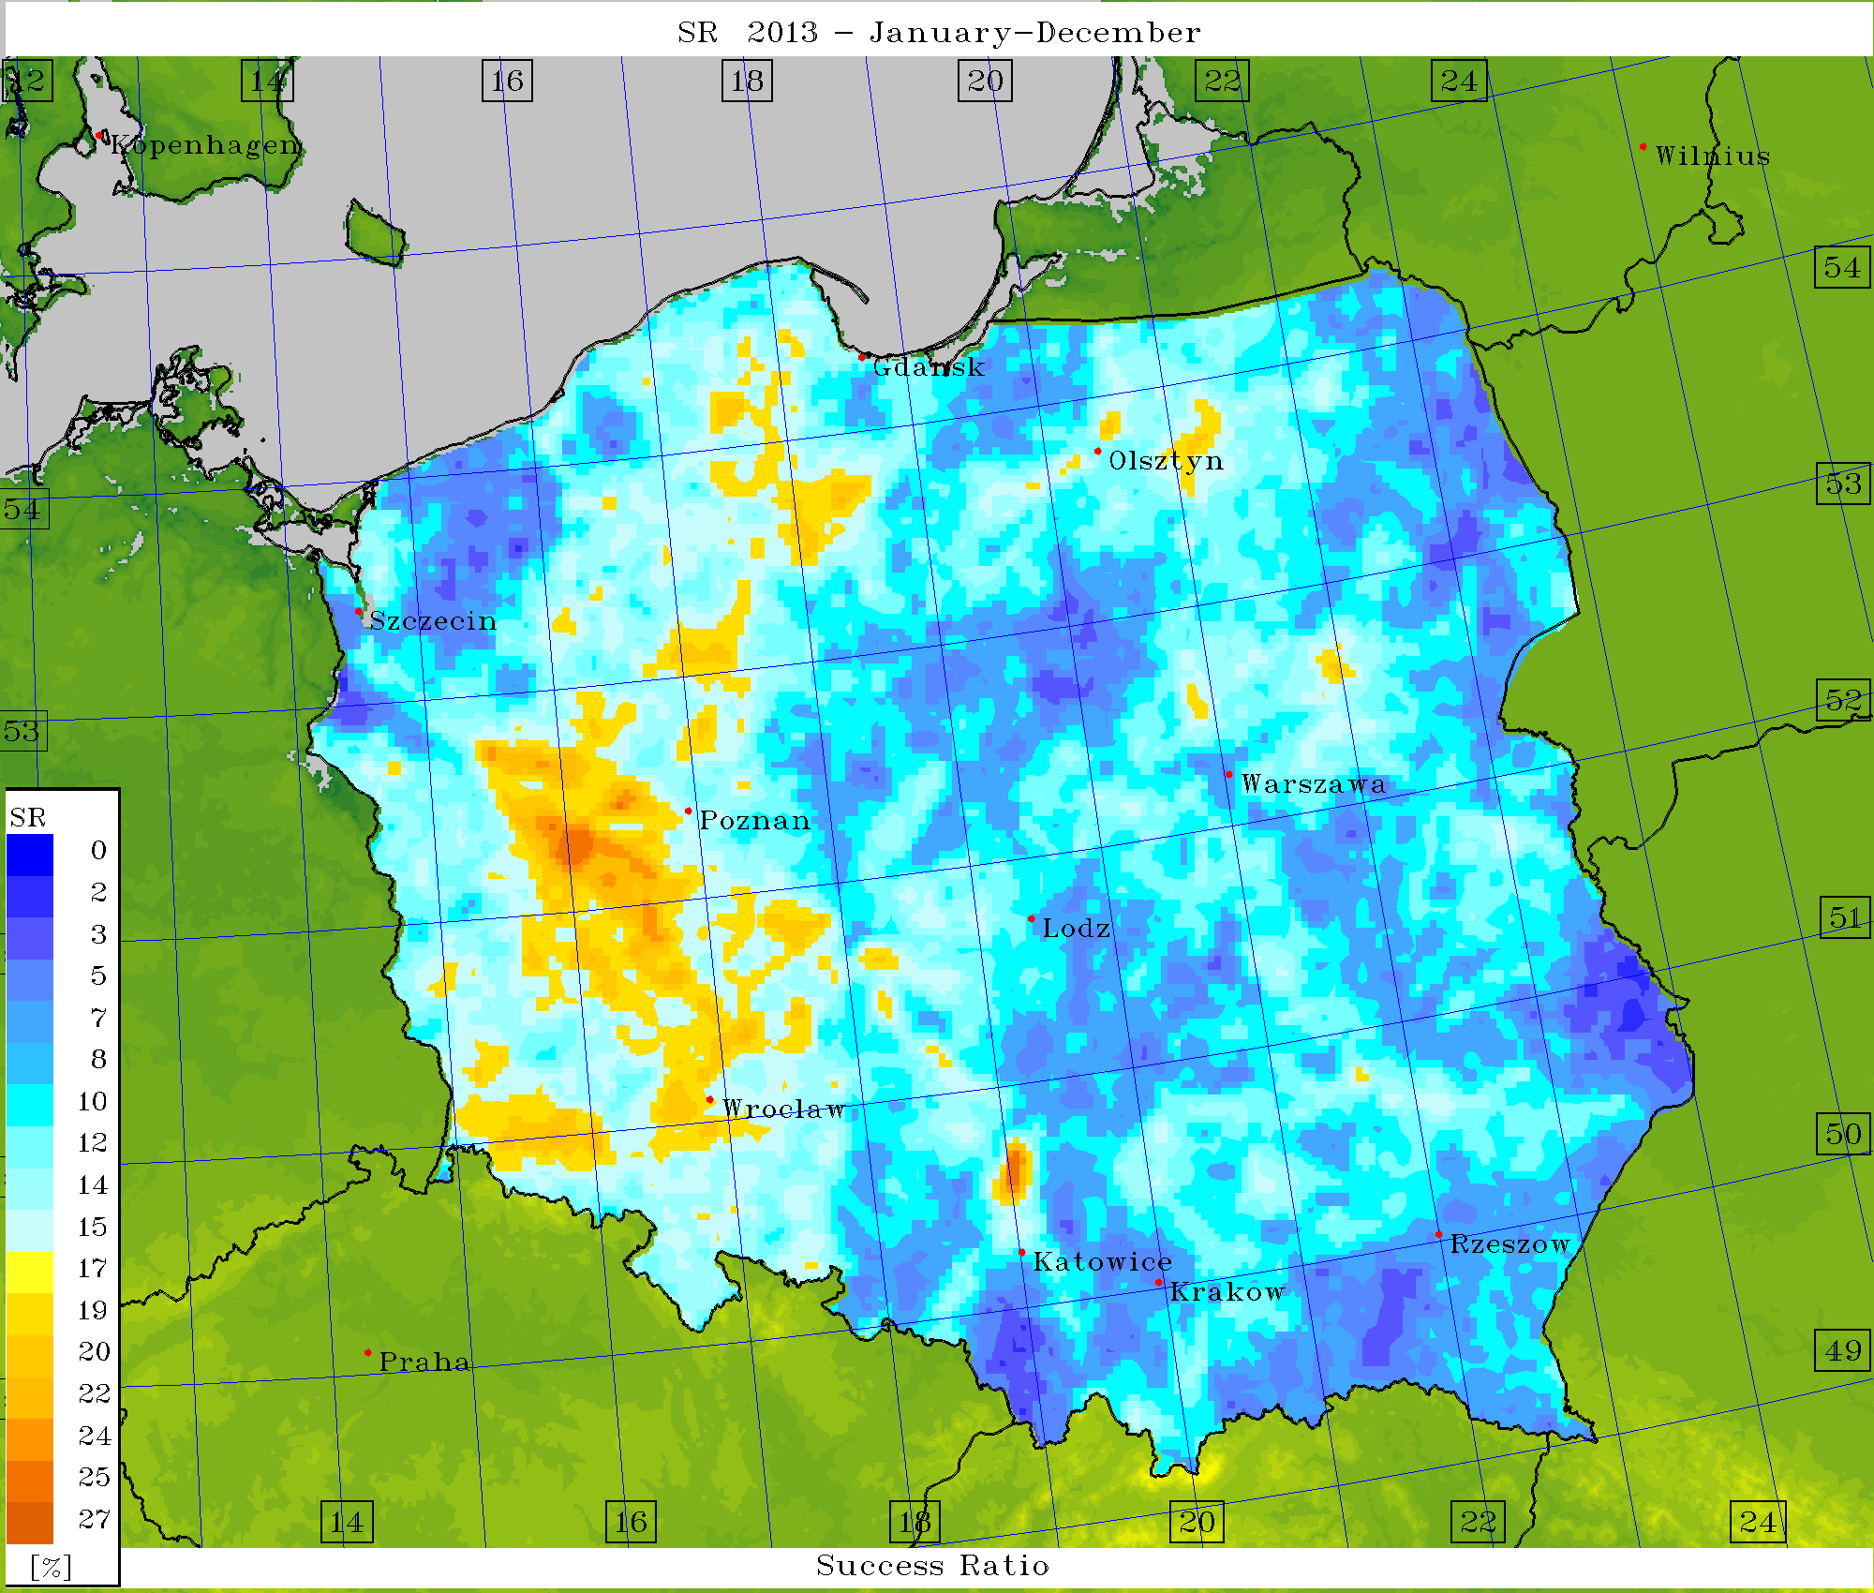
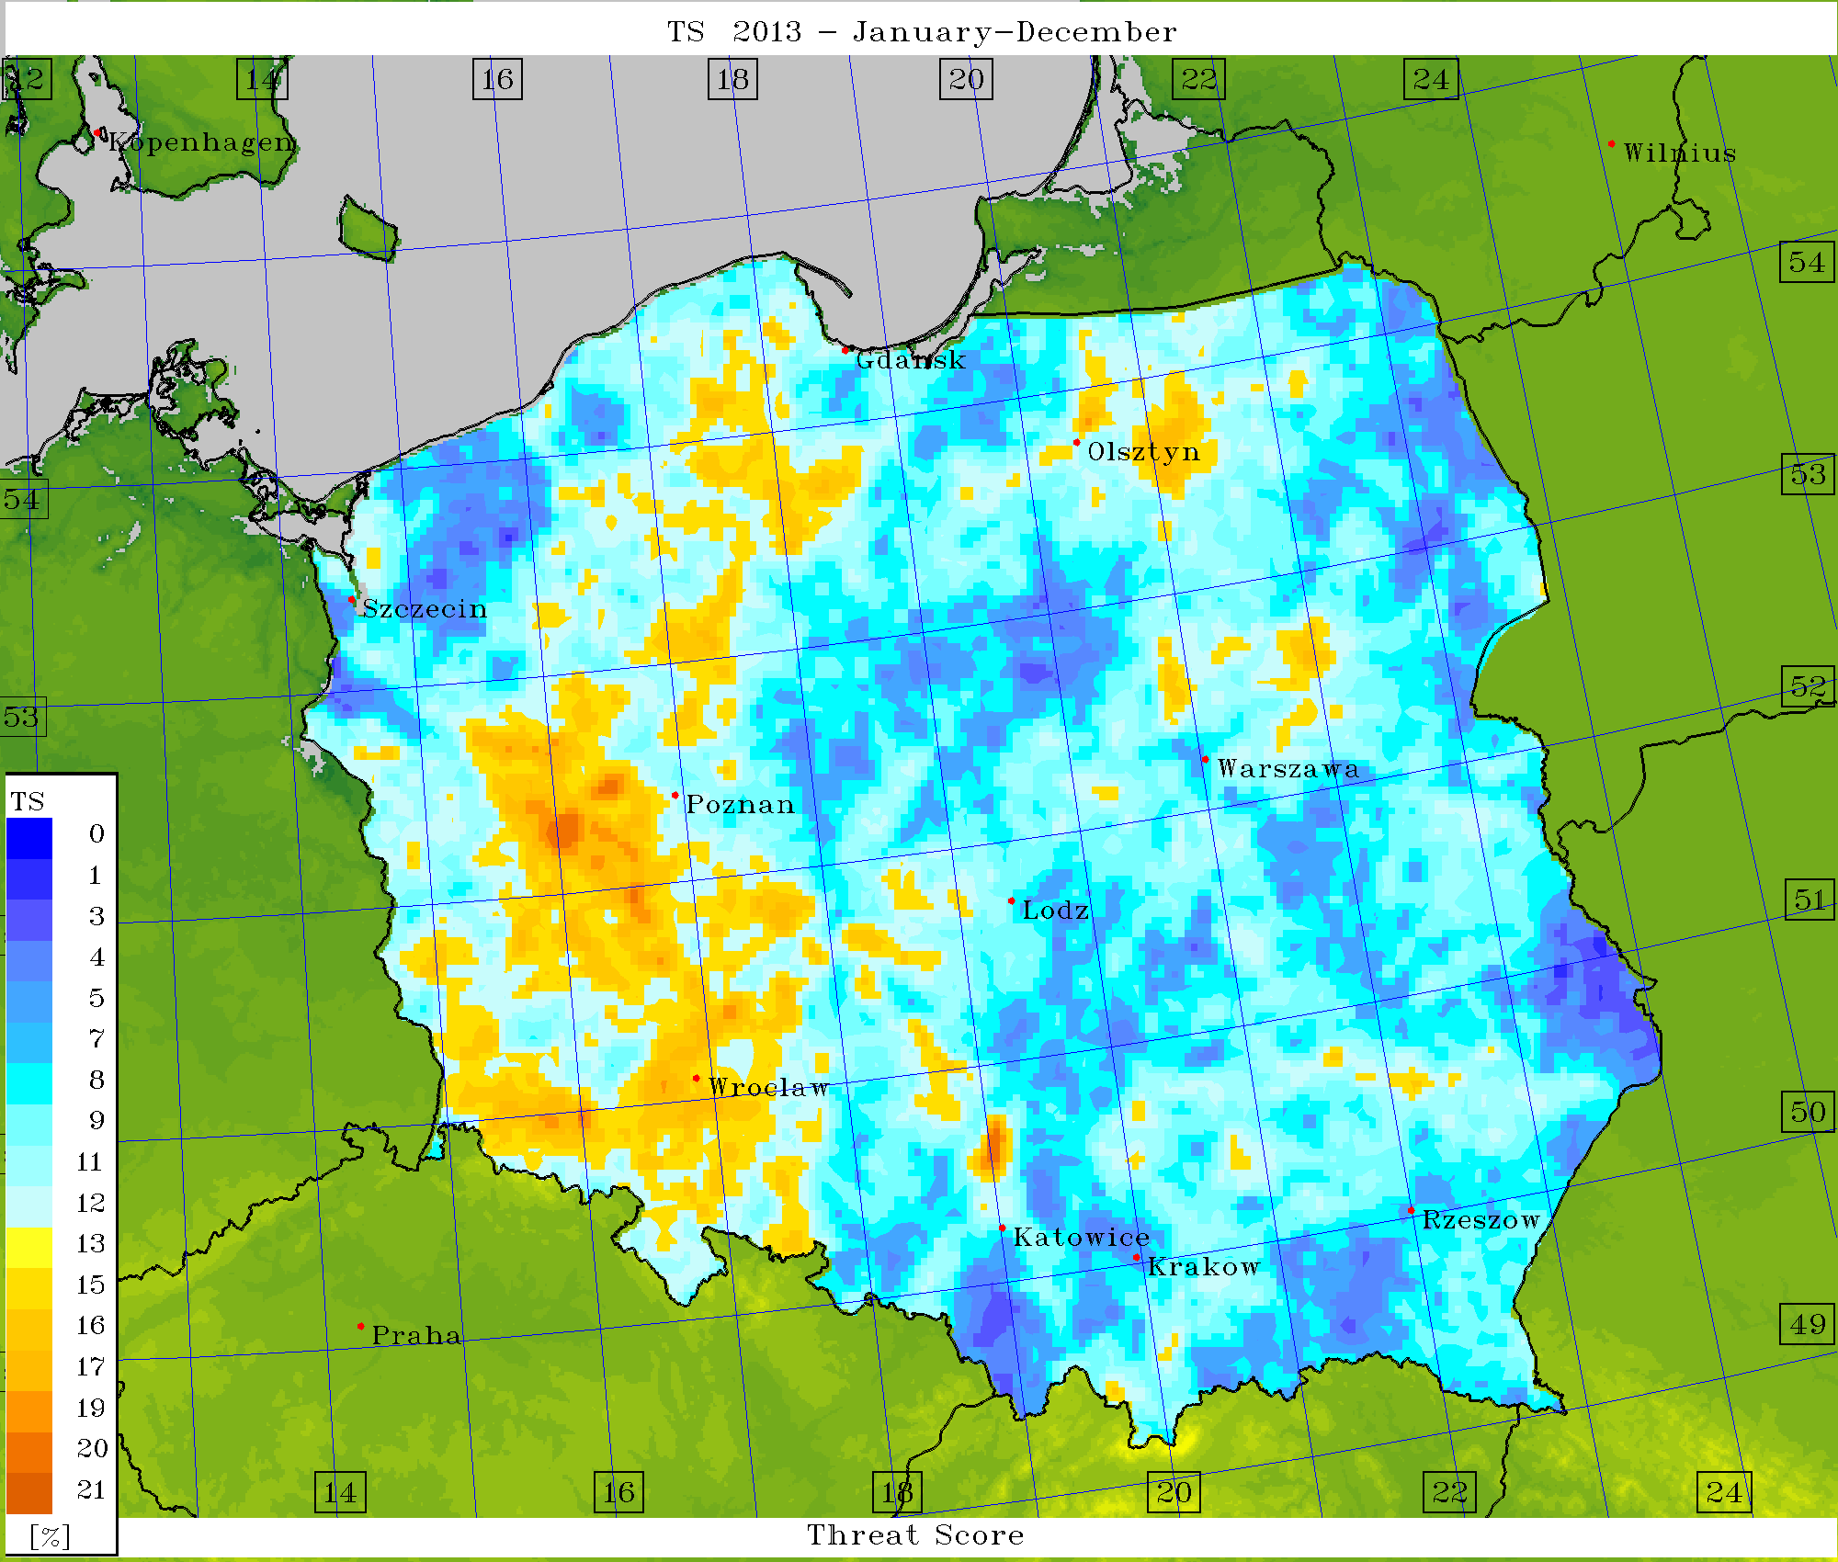
Verification – scores (EPS) for K-index = 32

Slide 22
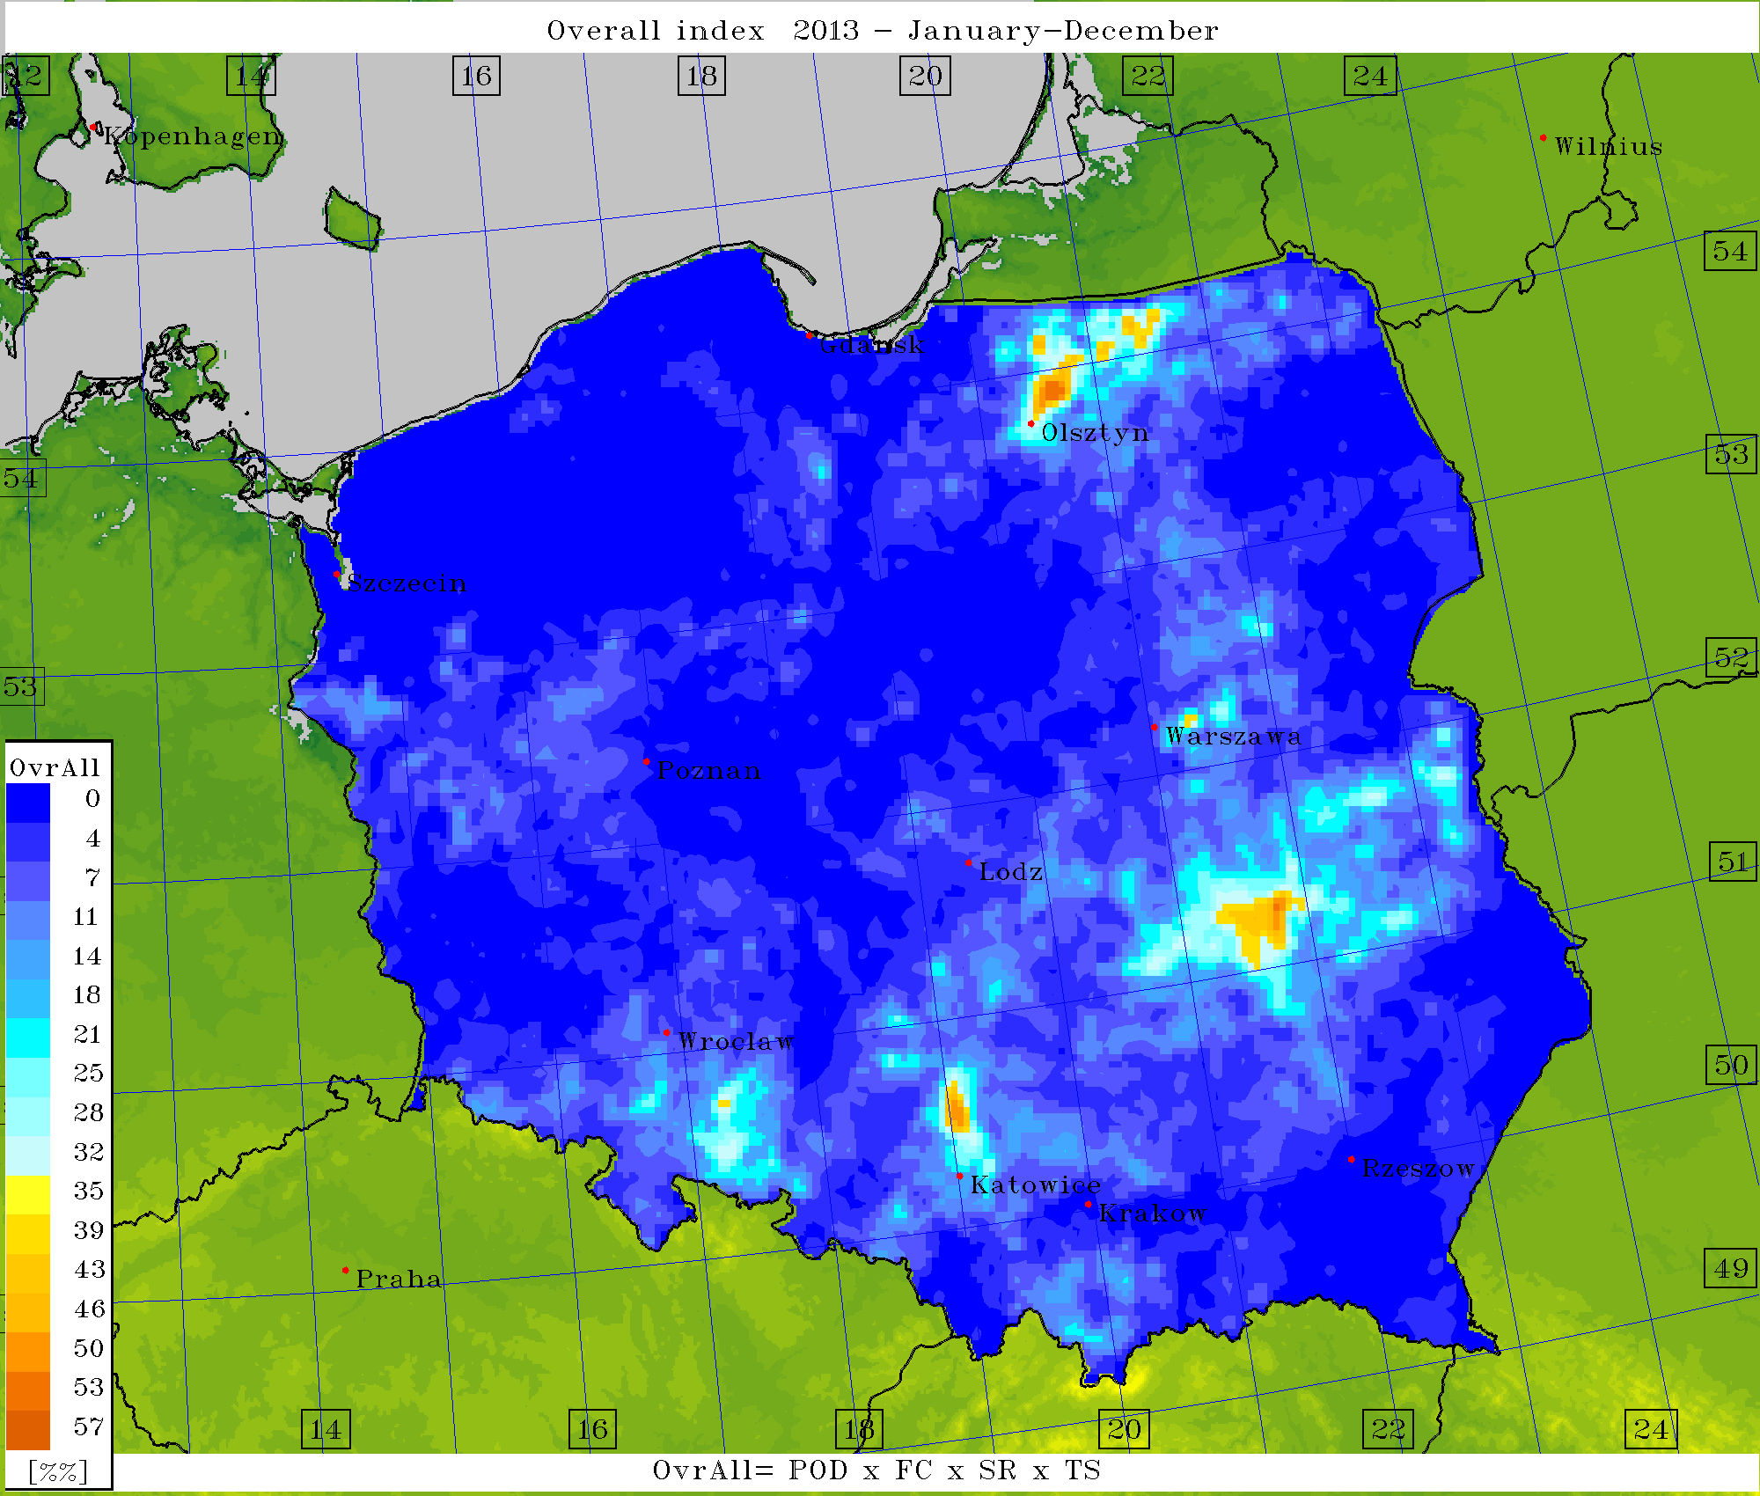
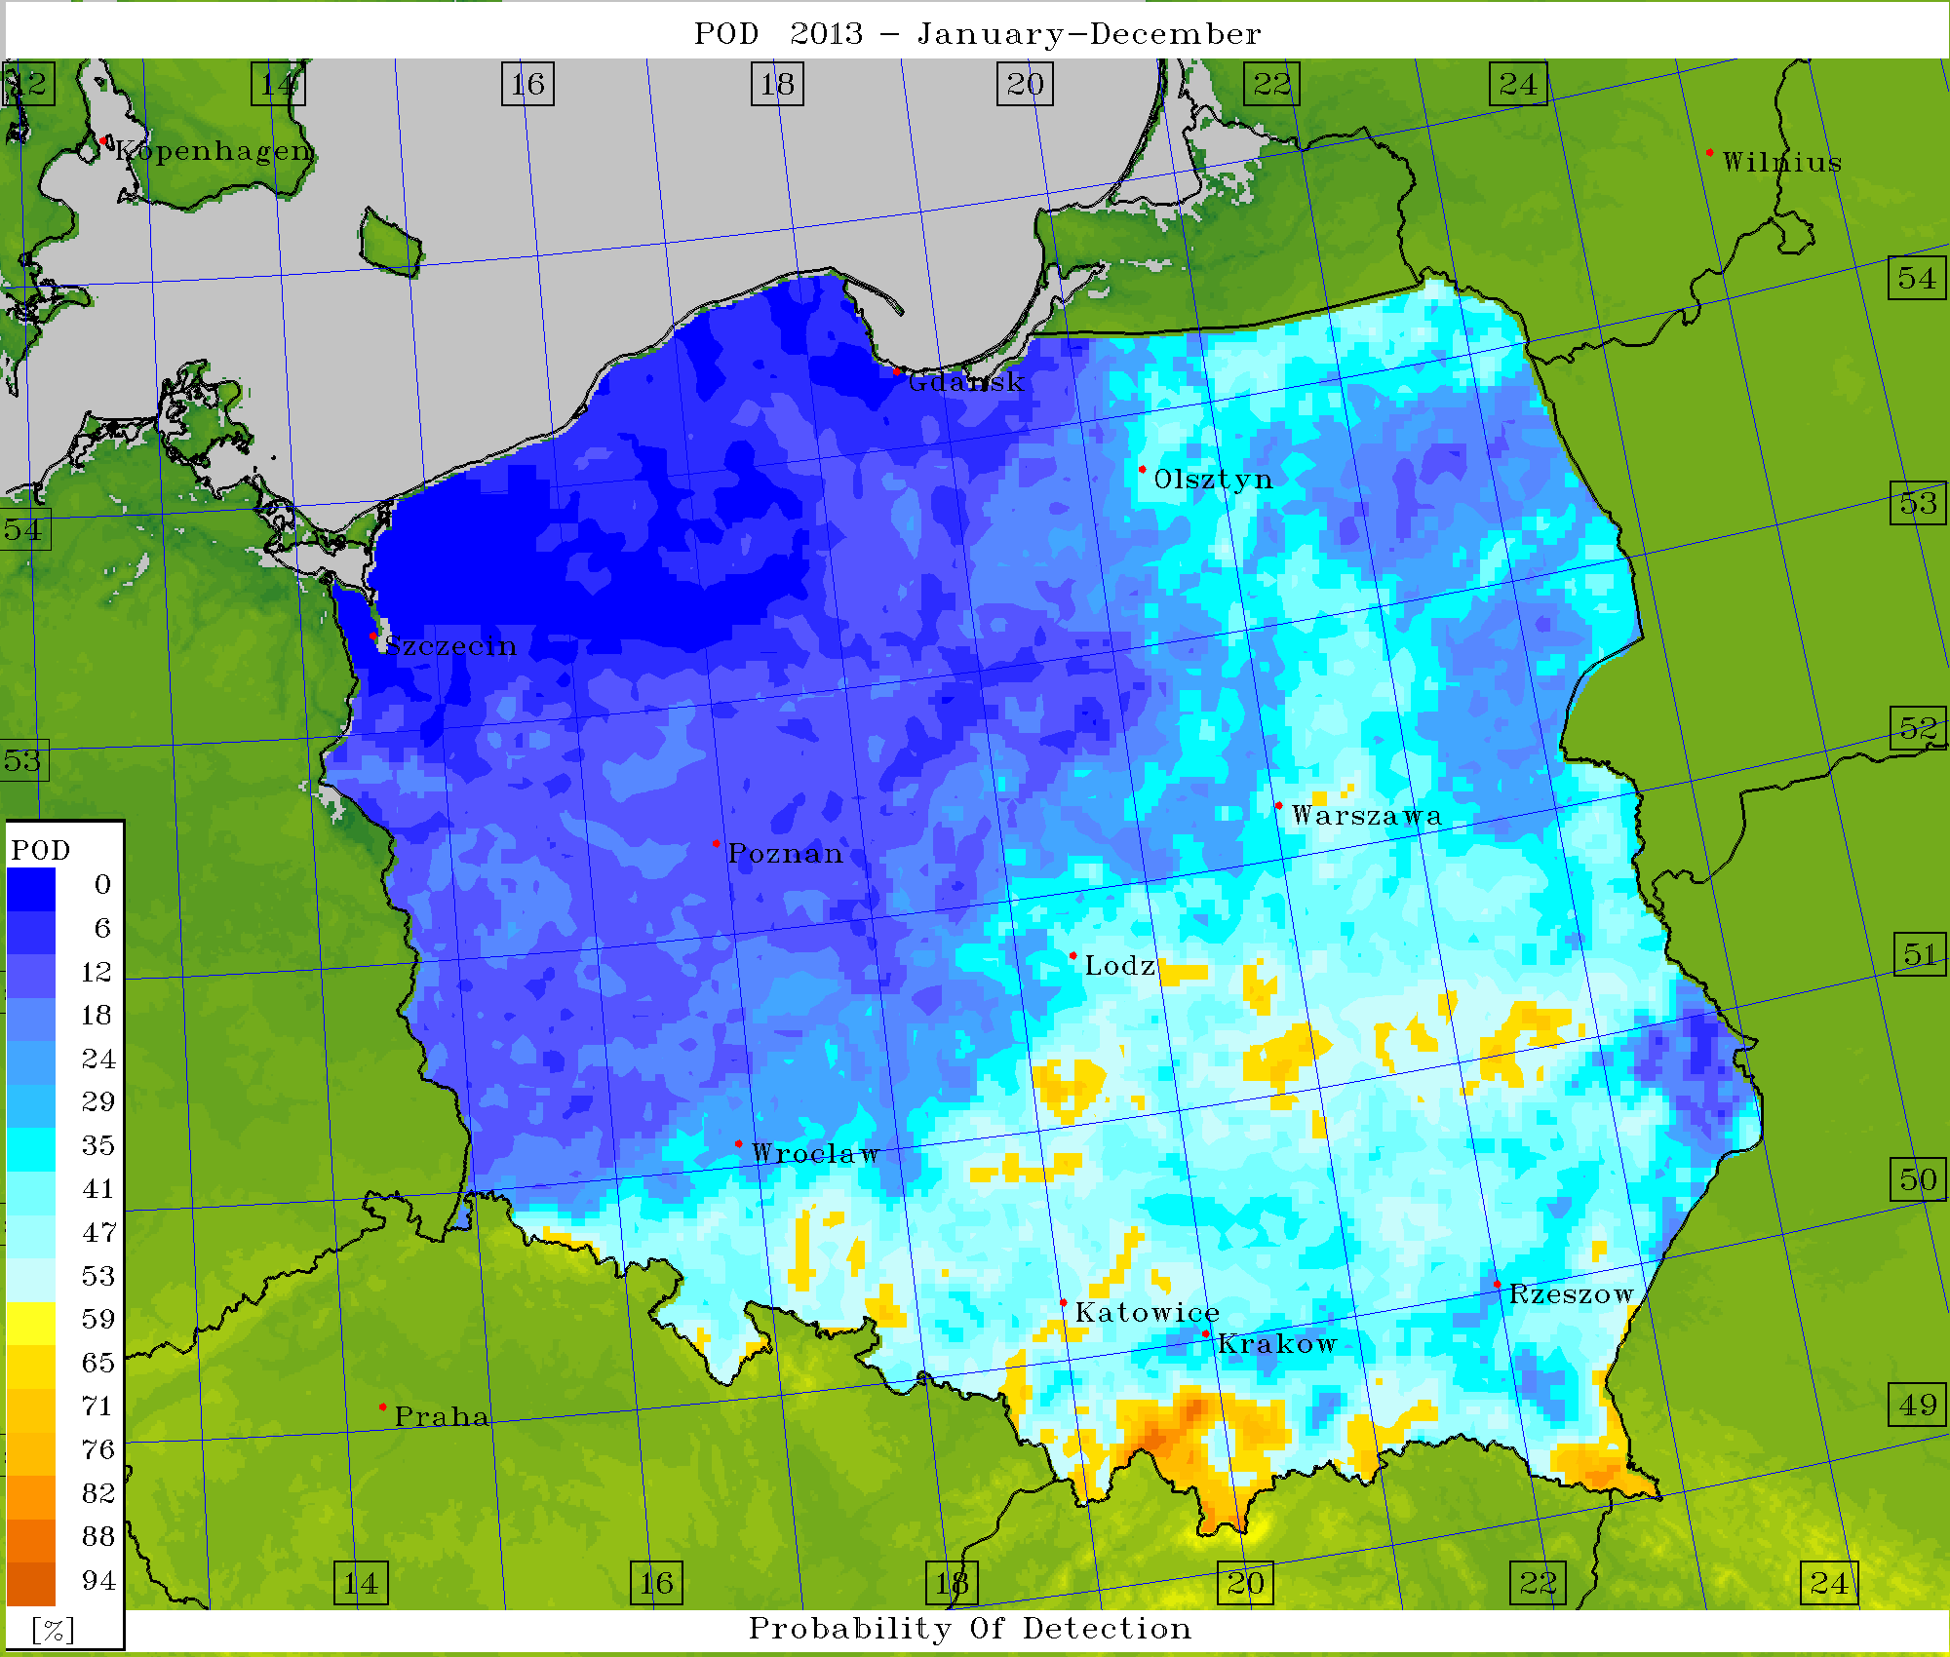
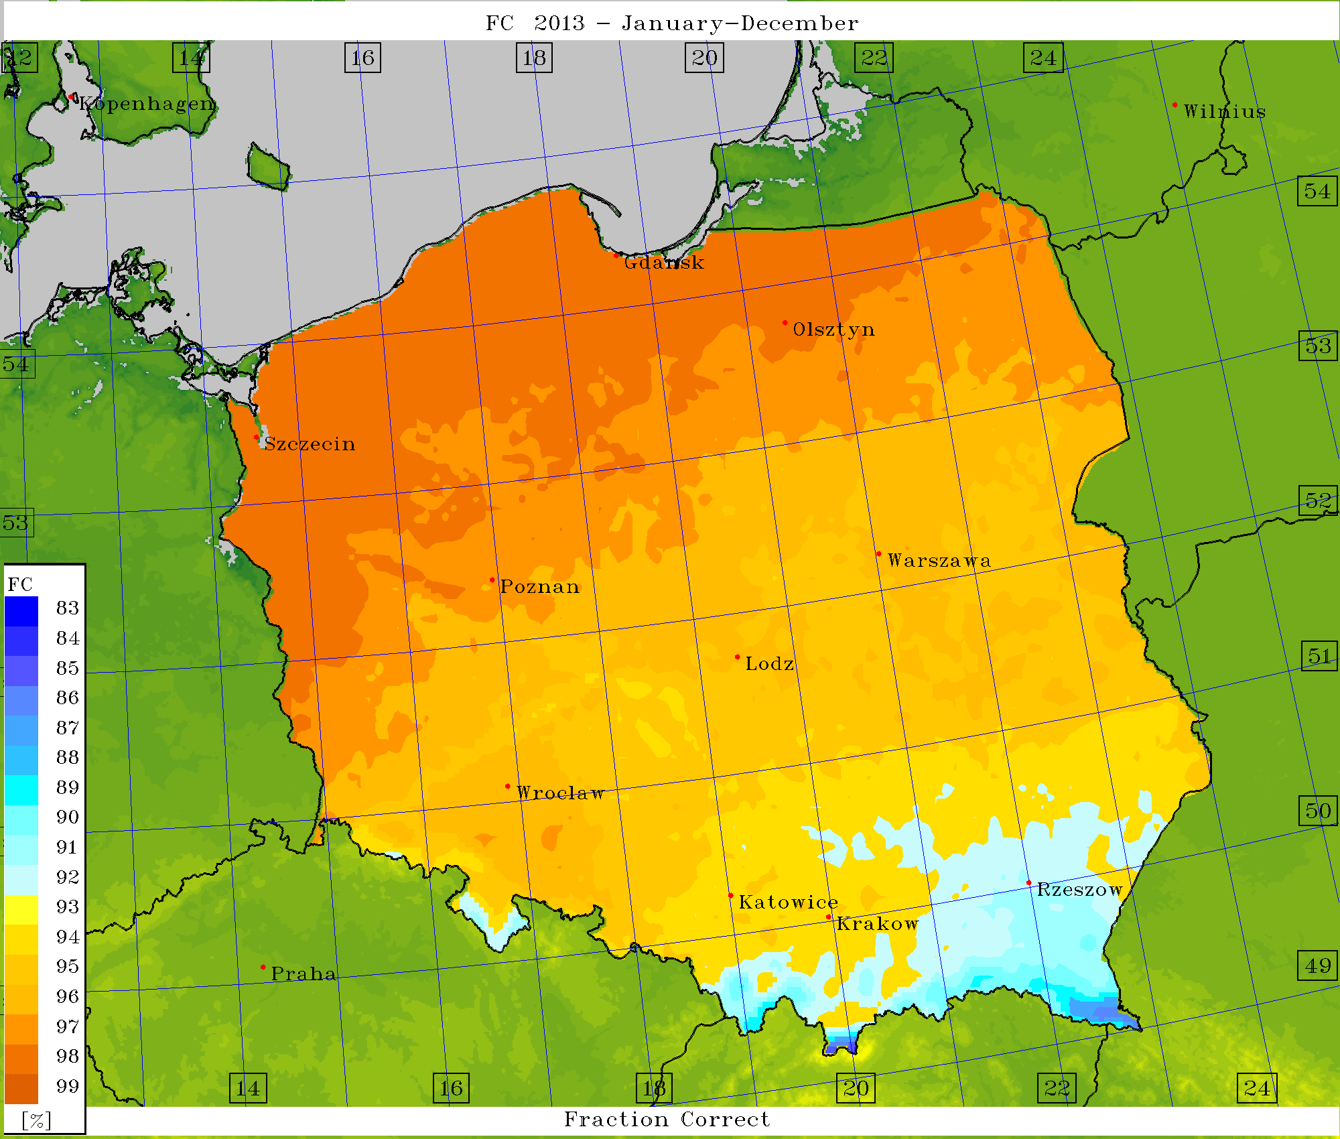
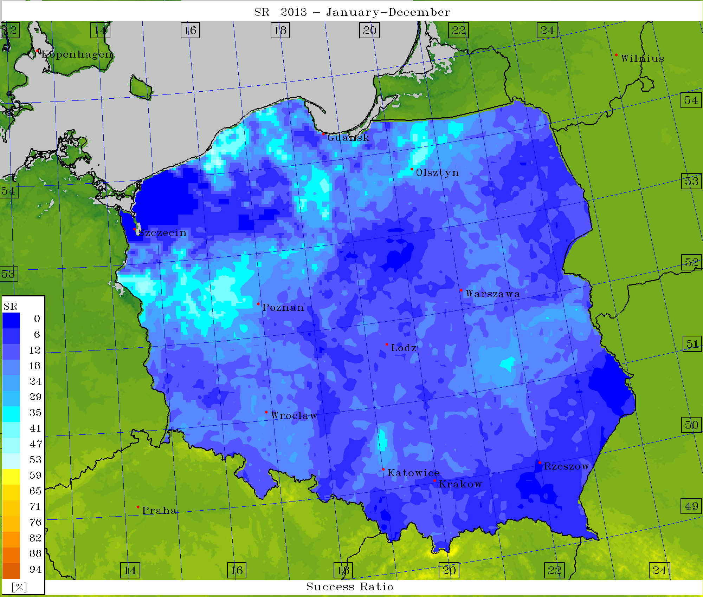
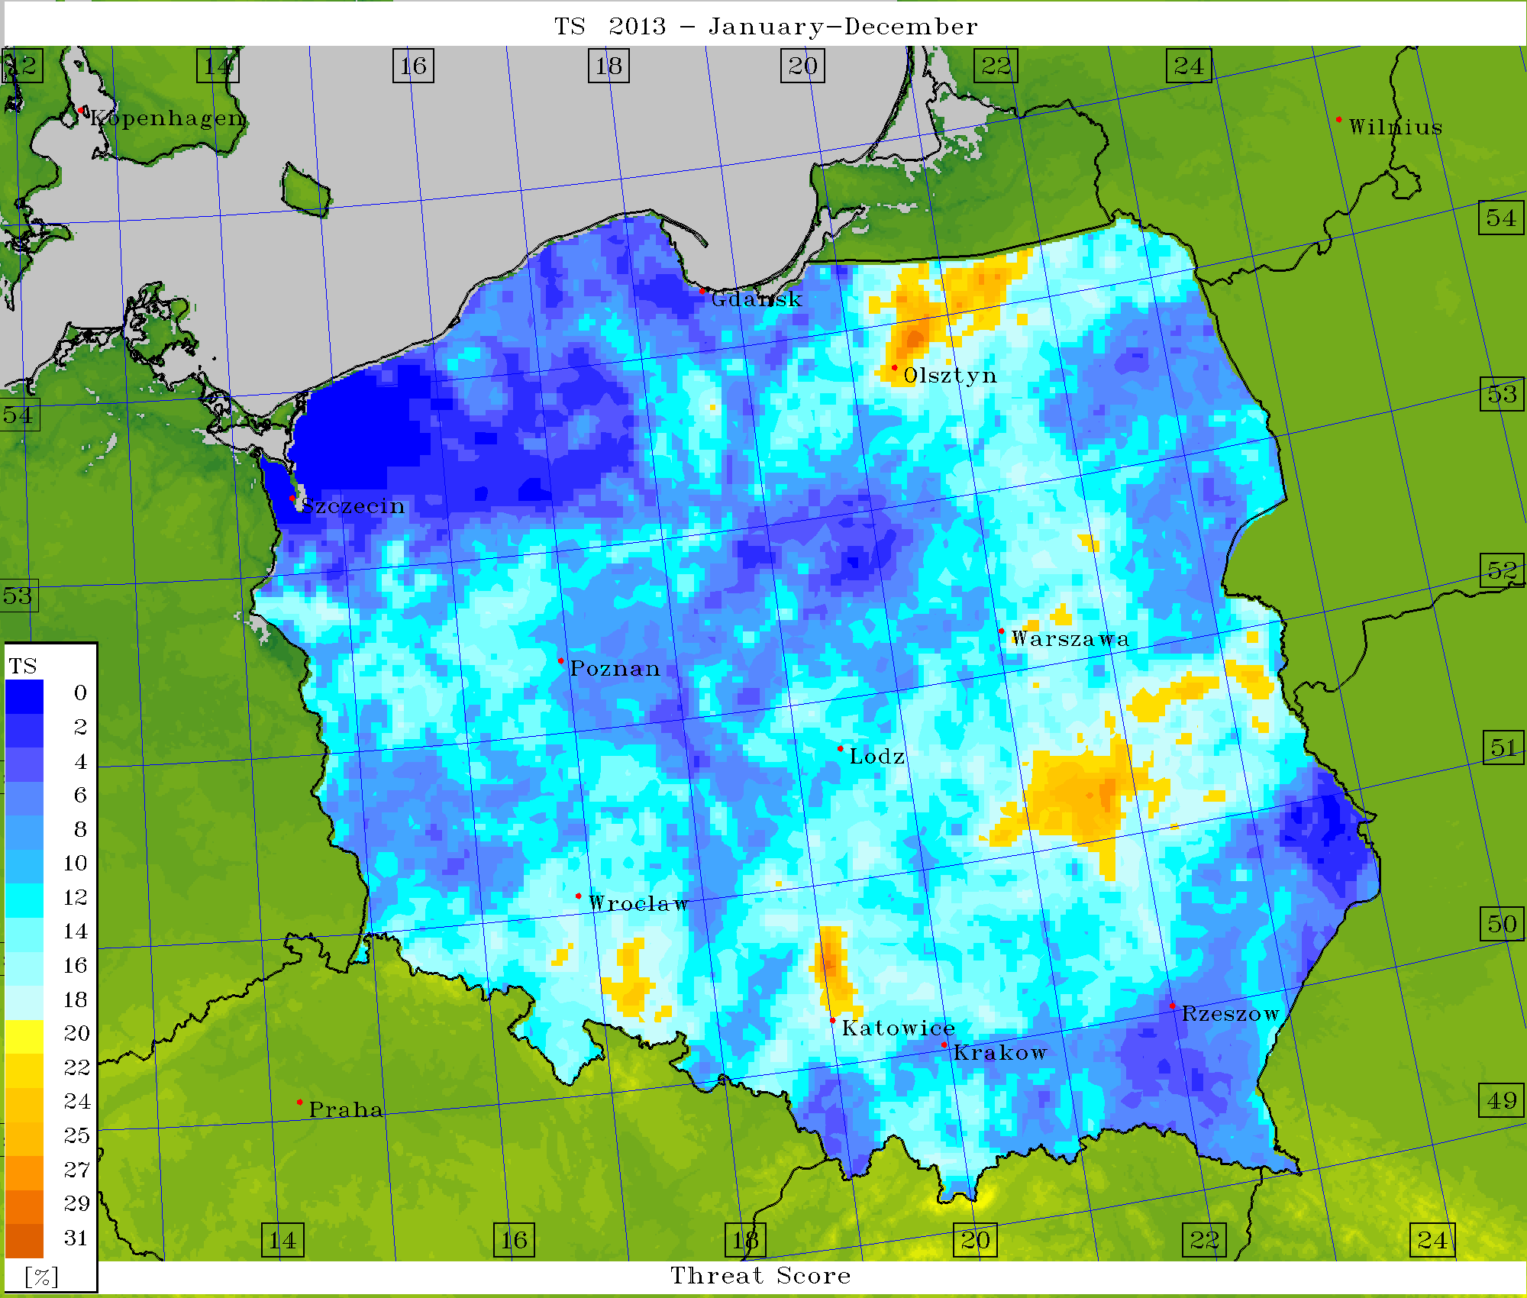
Verification – scores (det.) for Lifted Index = -2

Slide 23
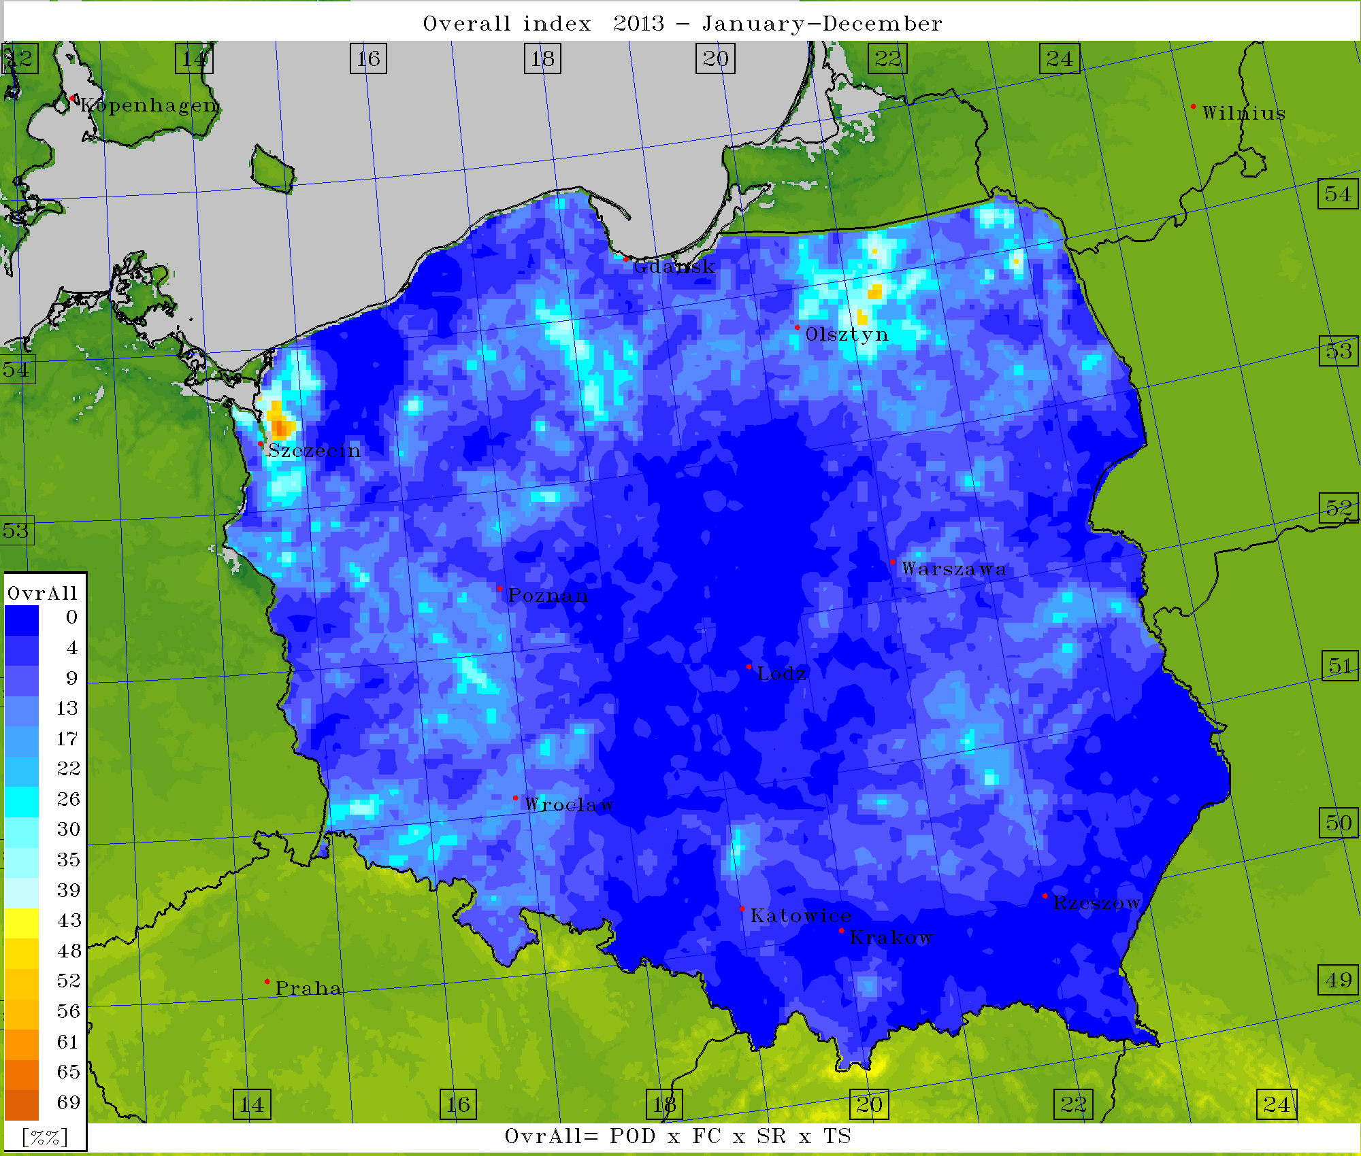
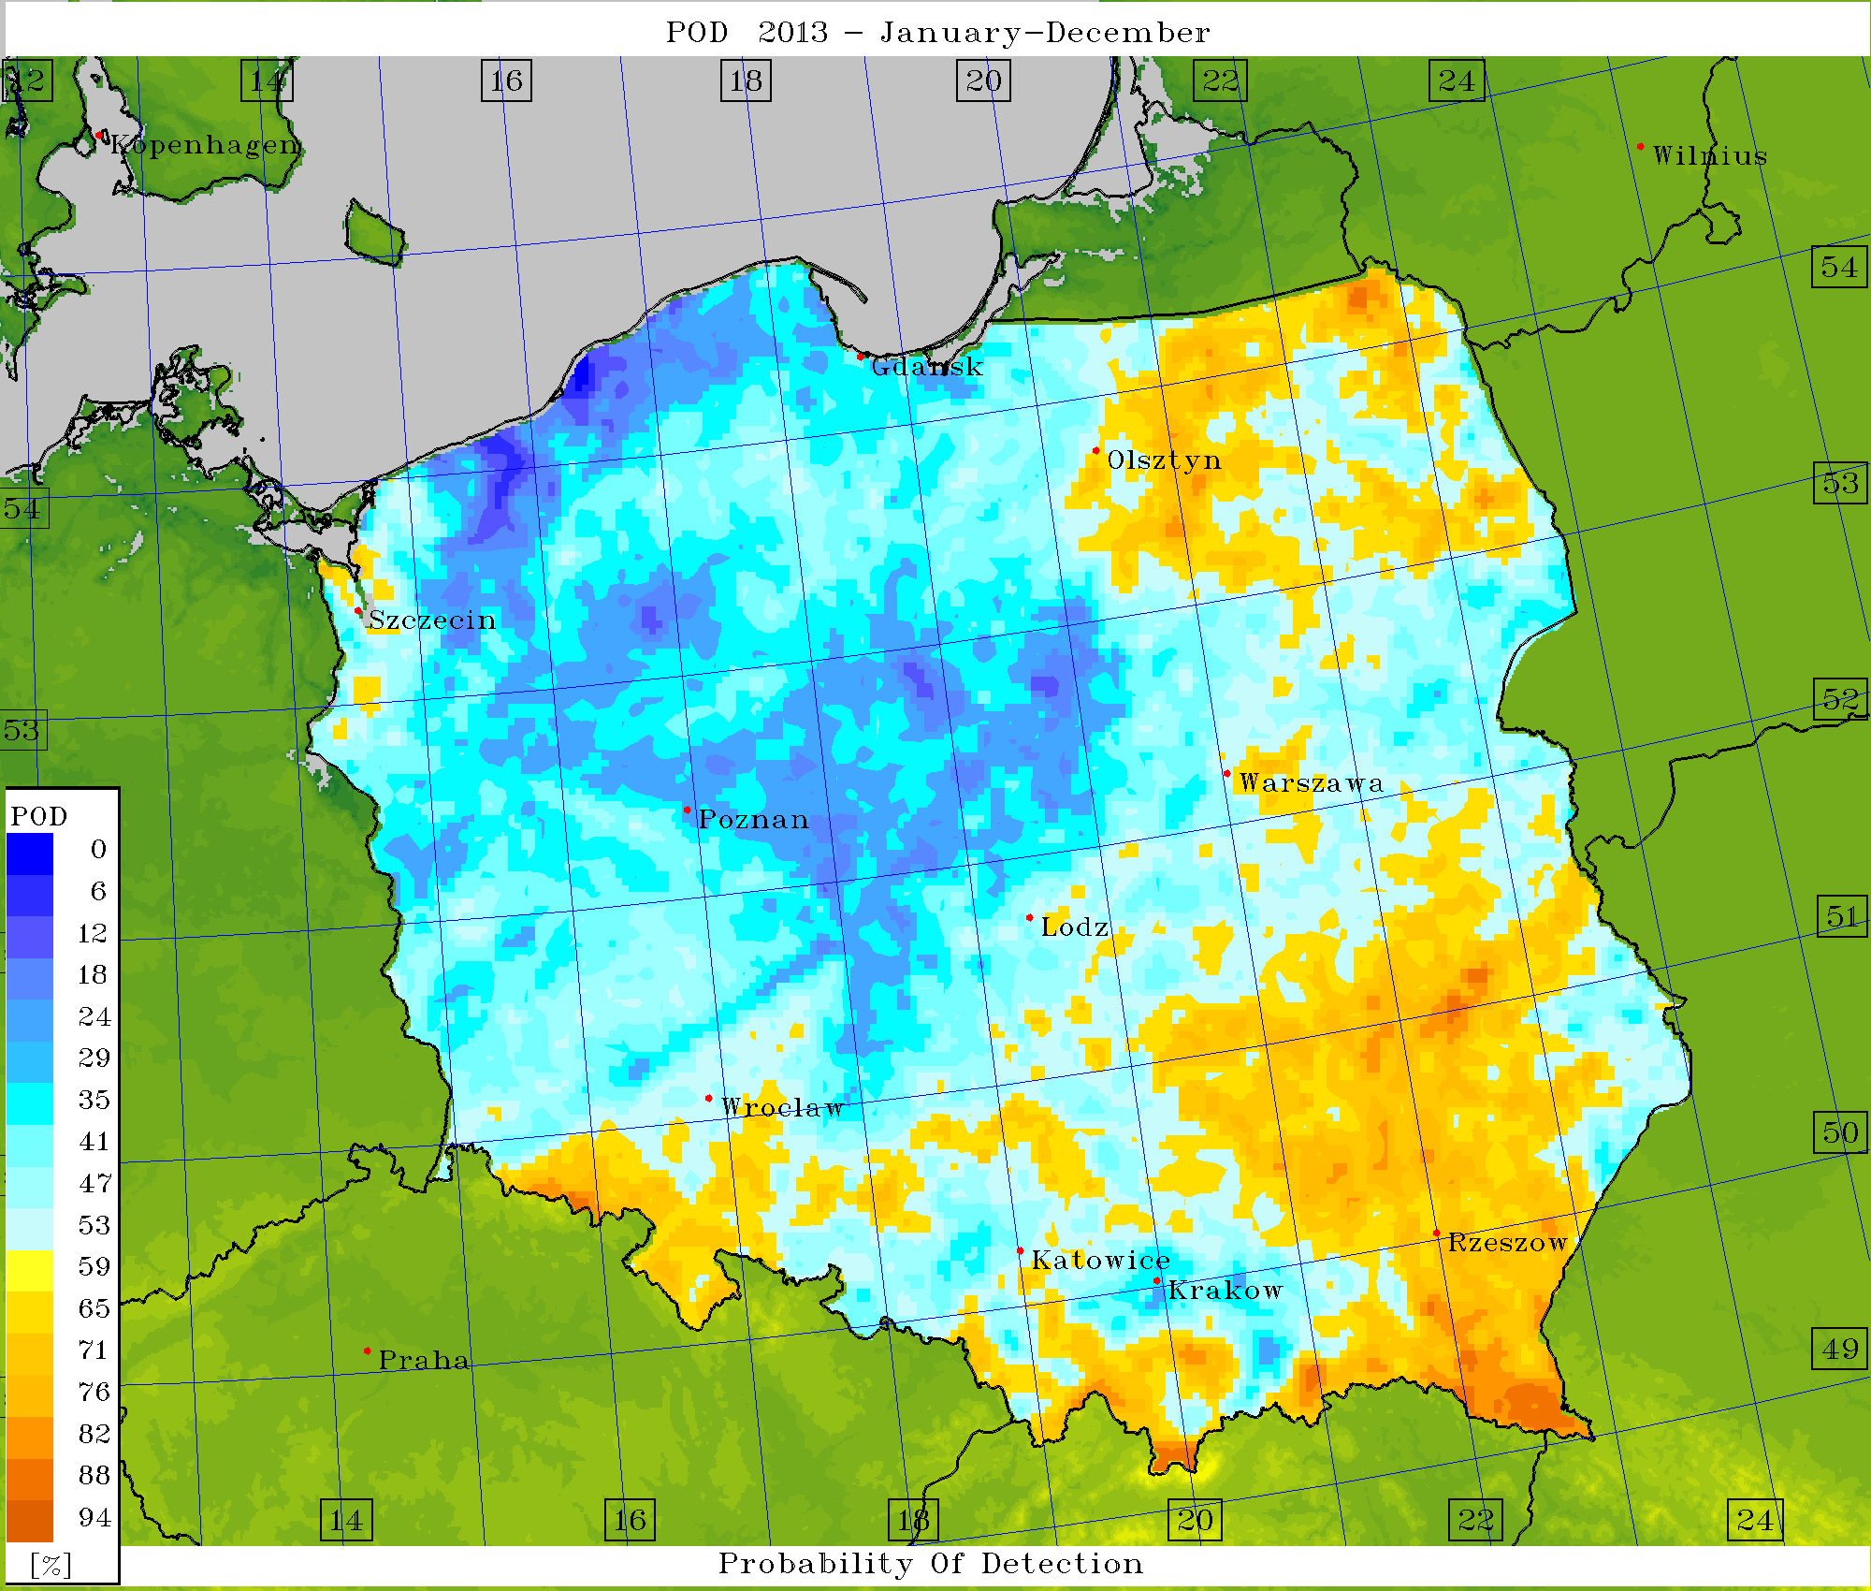
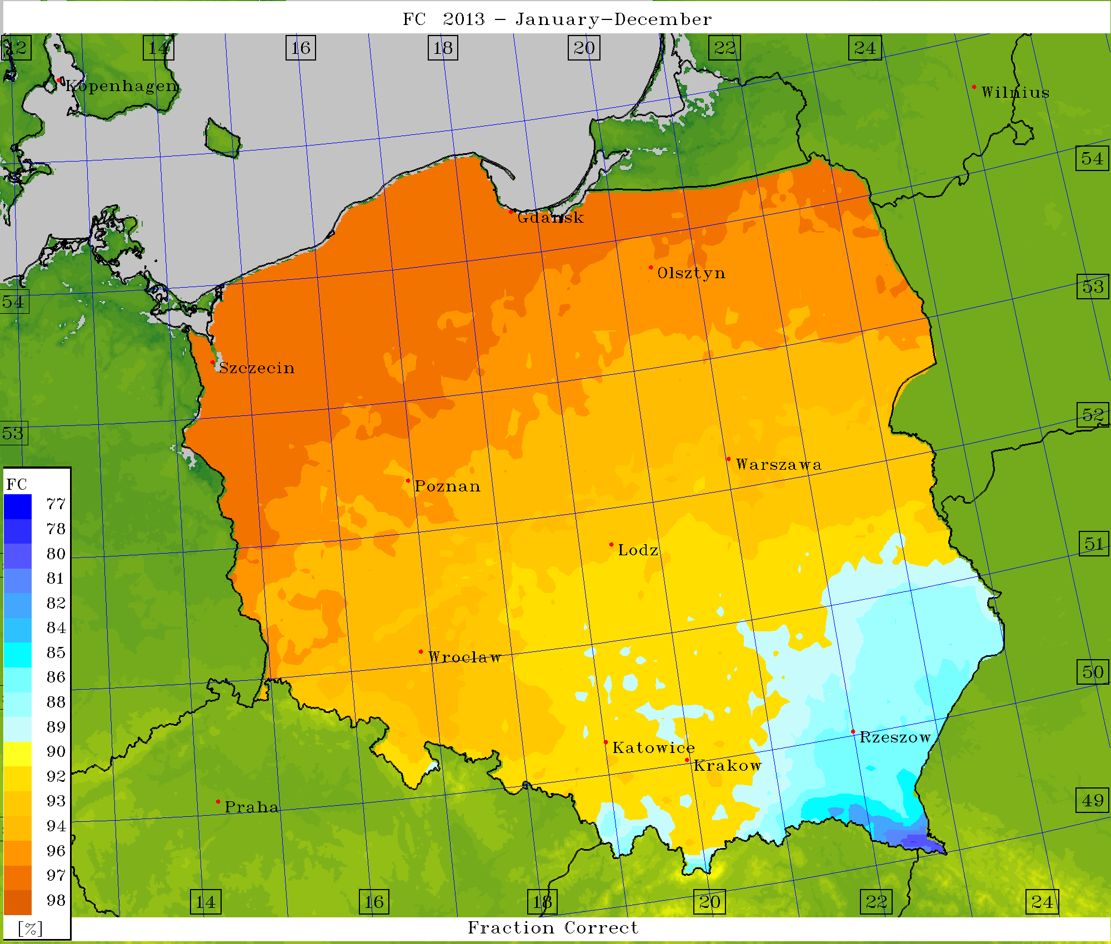
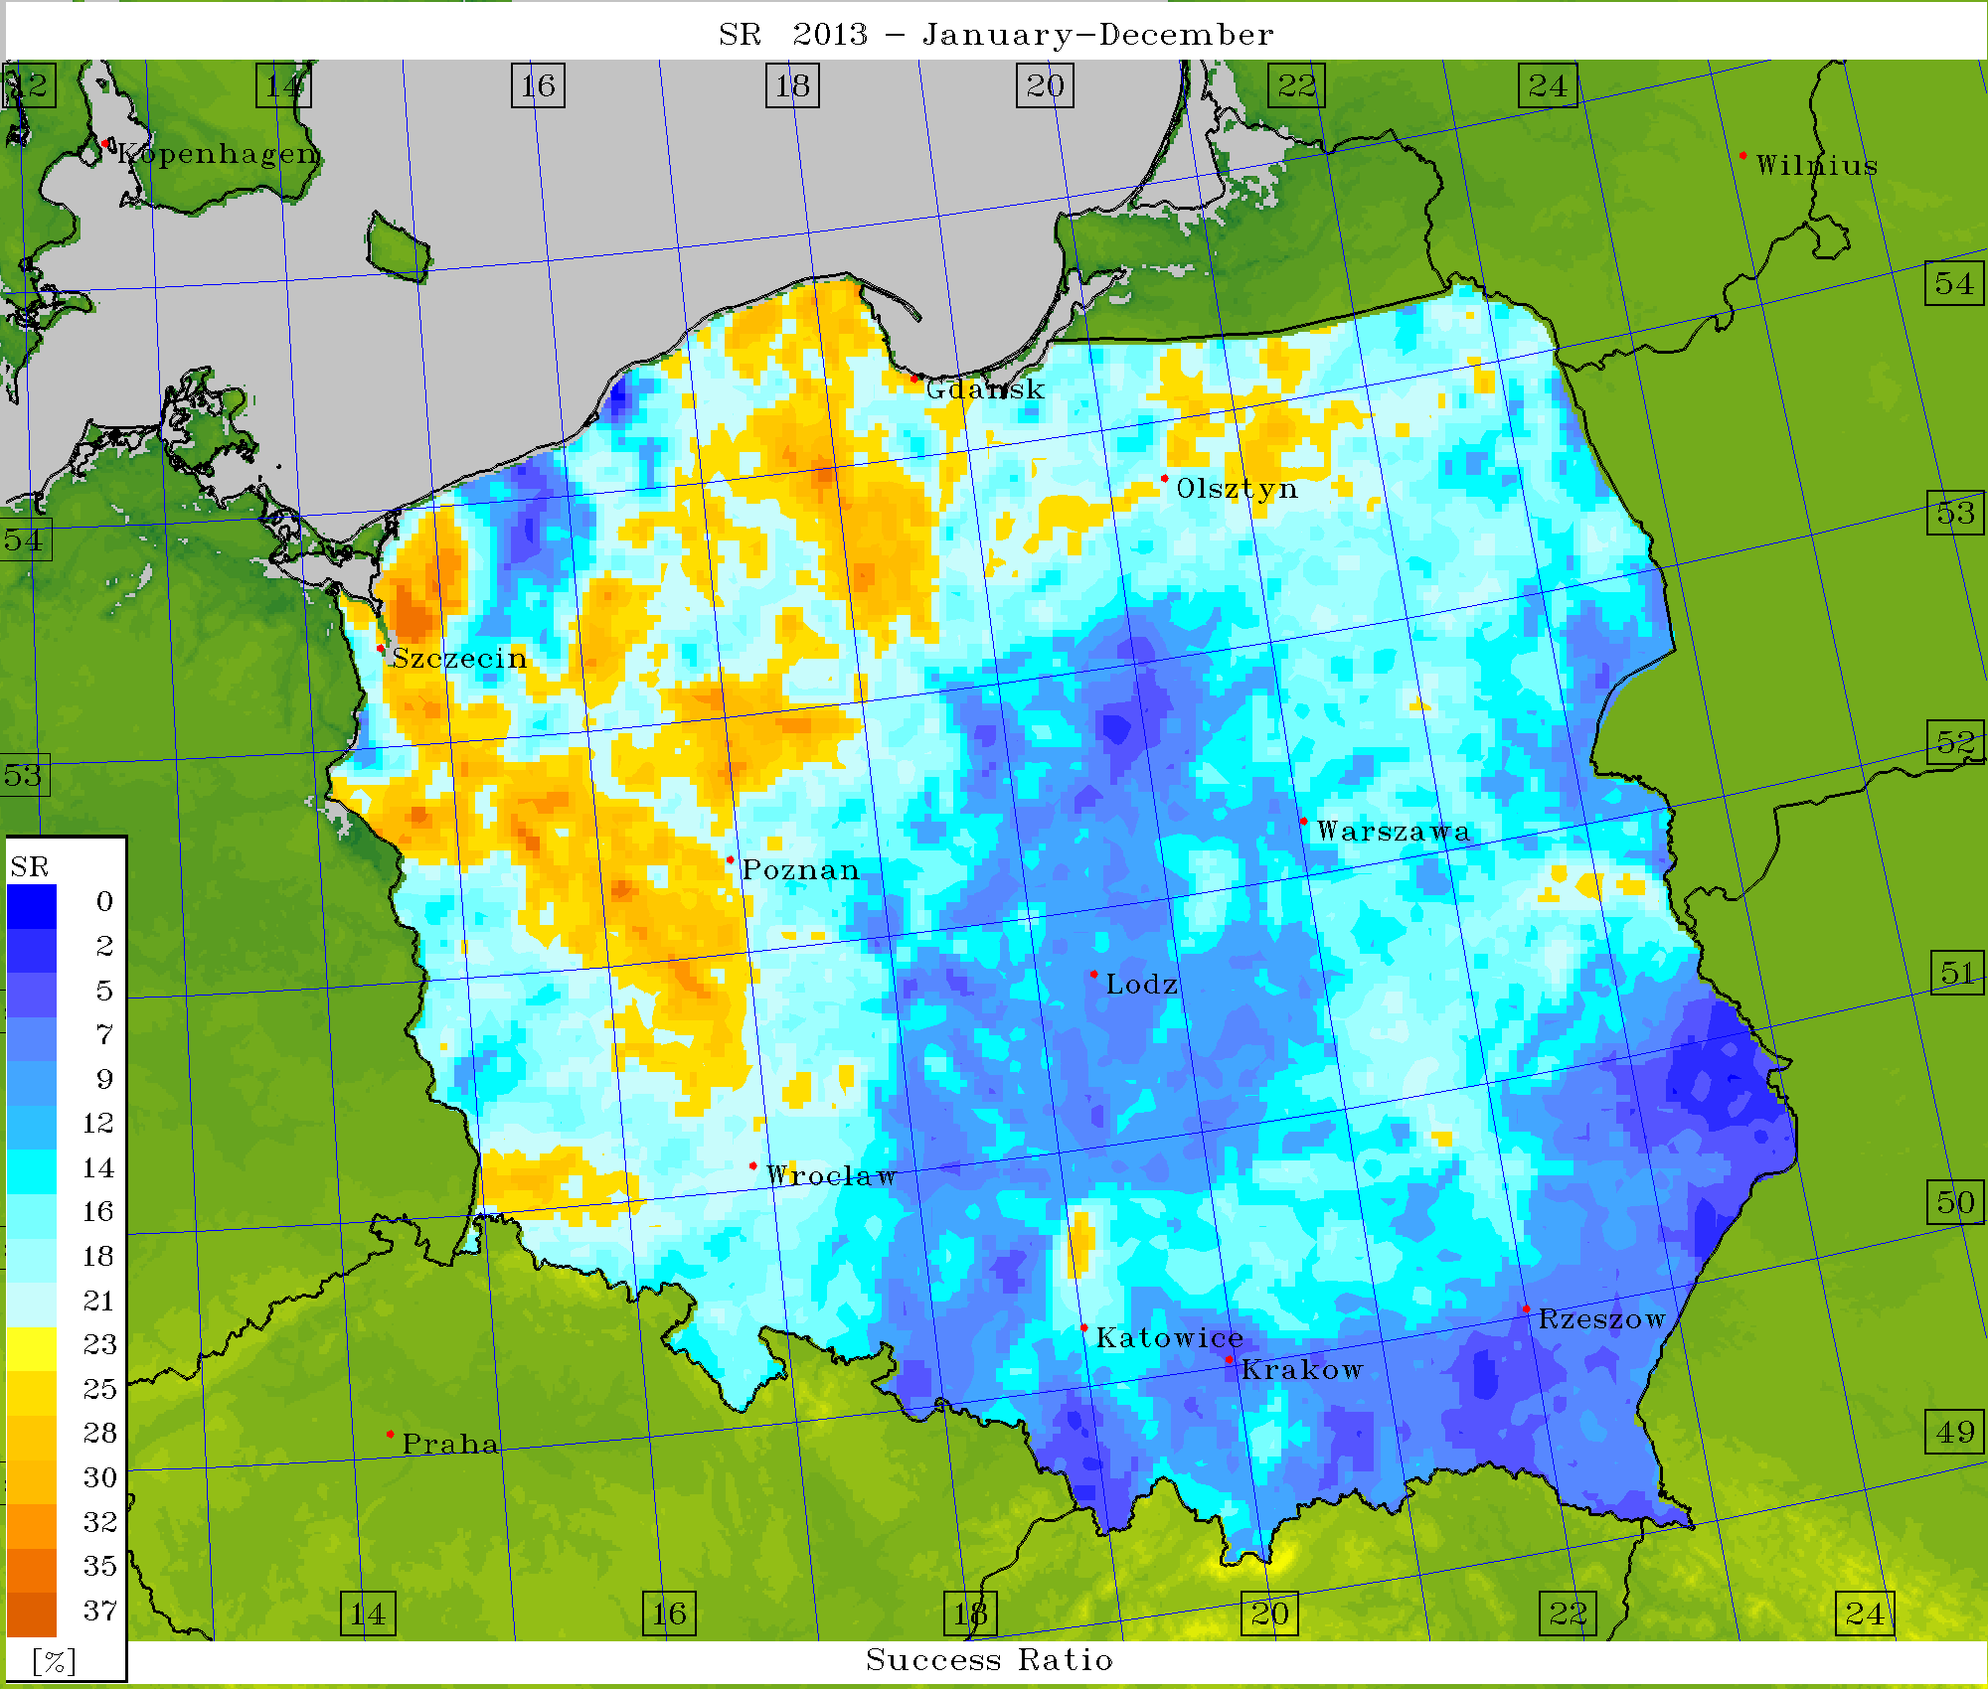
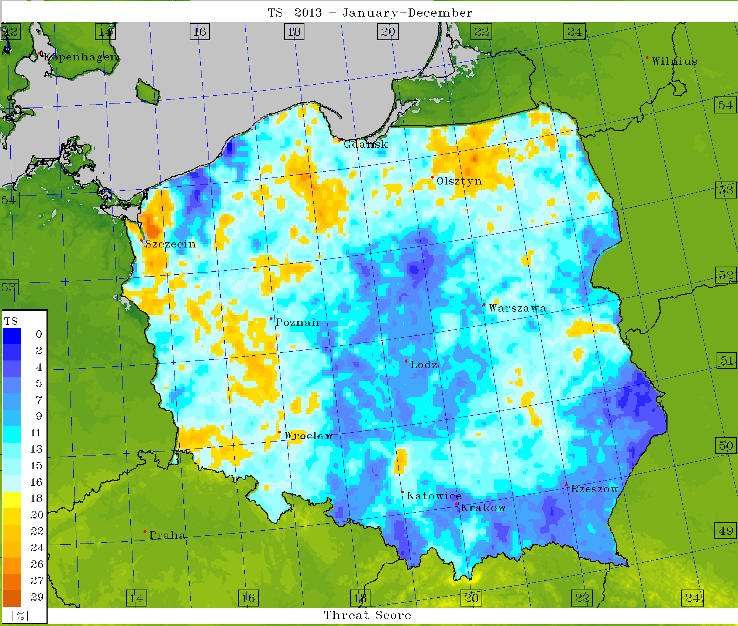
Verification – scores (EPS) for Lifted Index = -2

Slide 24
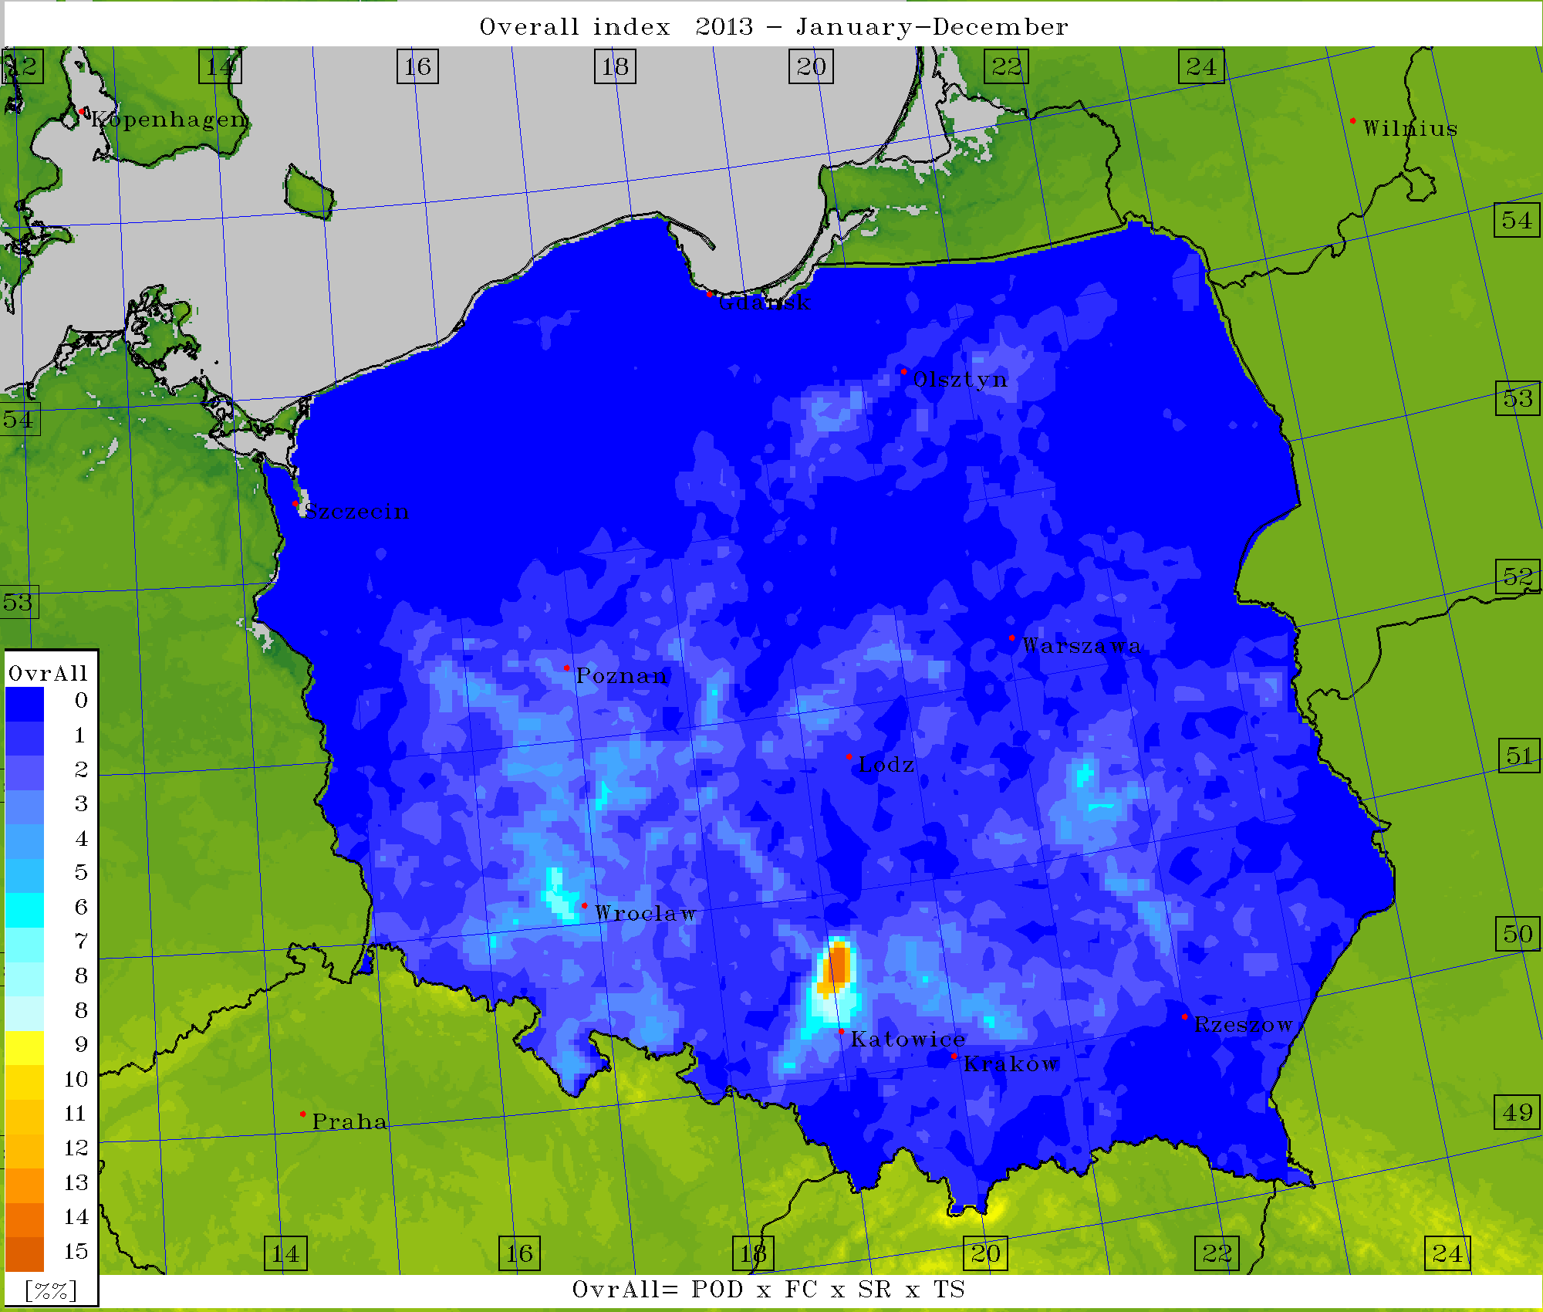
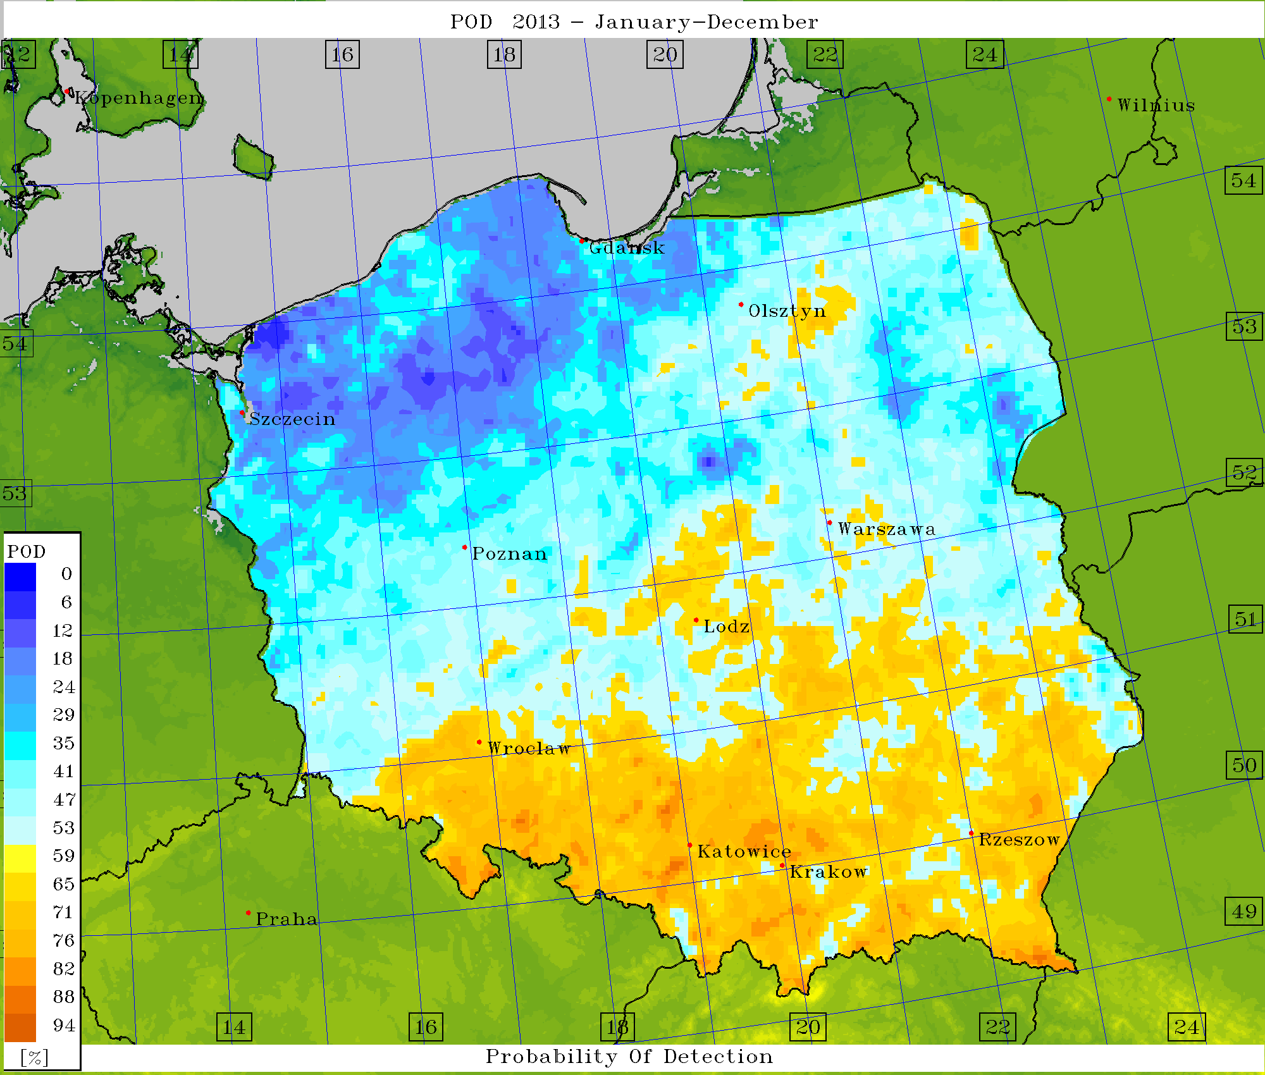
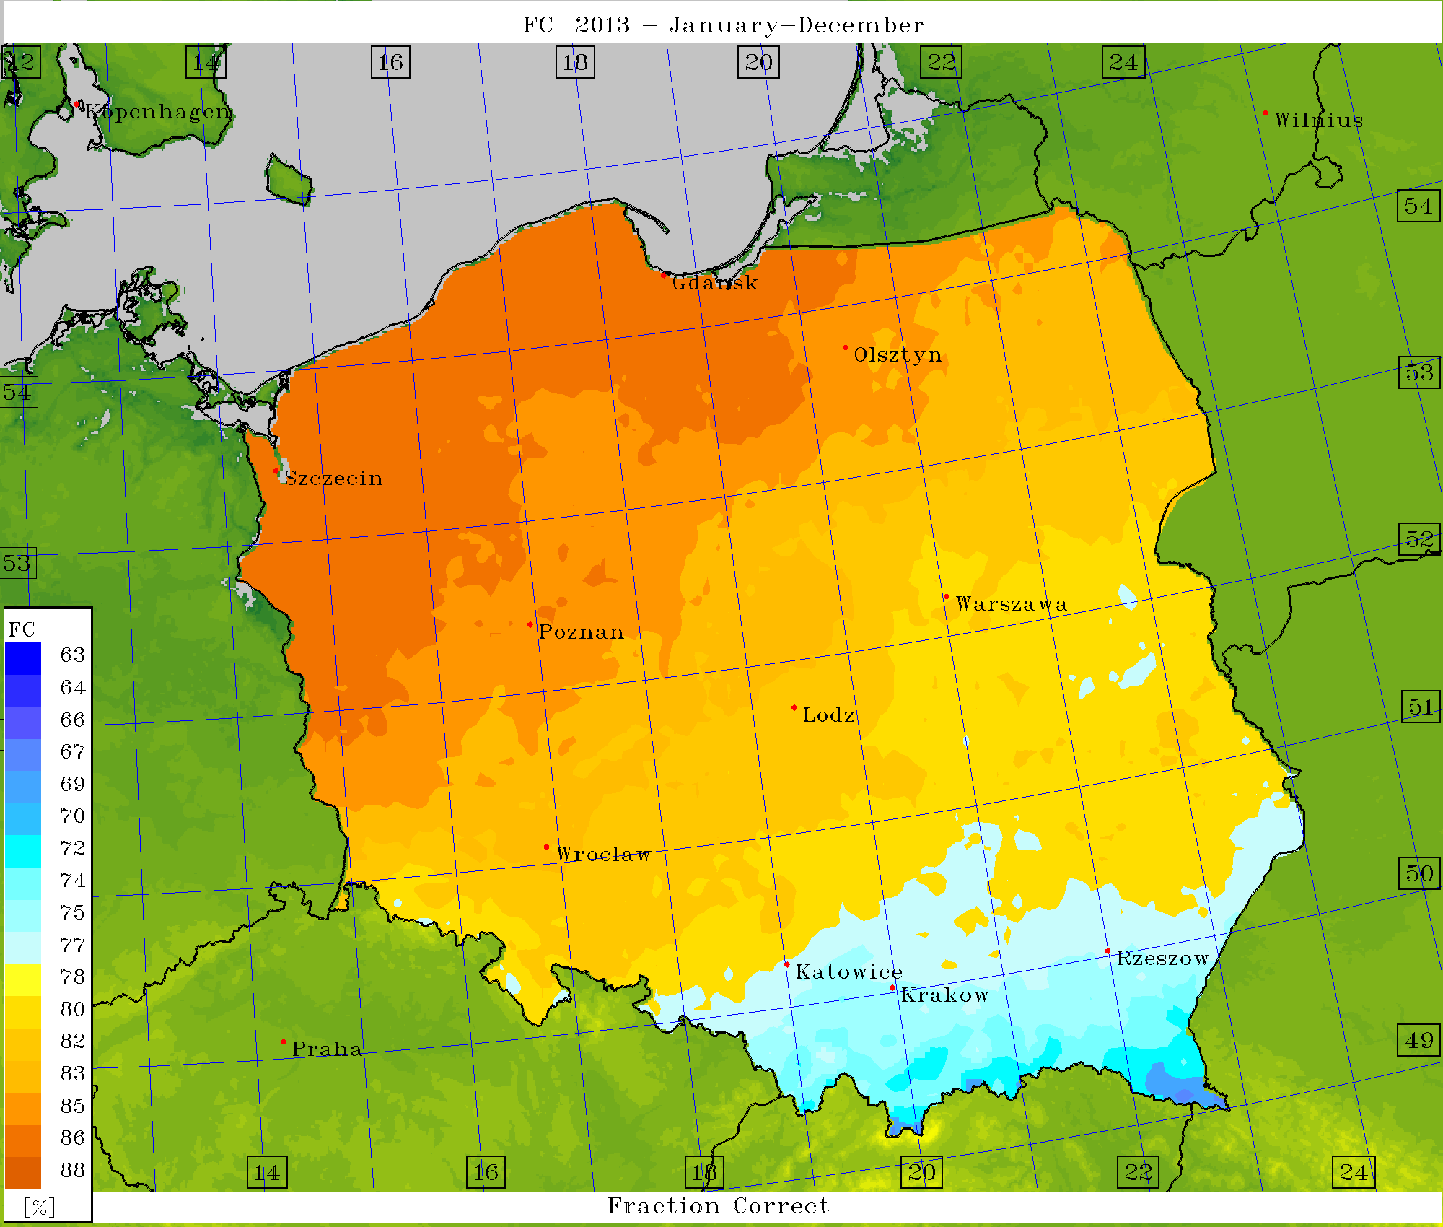
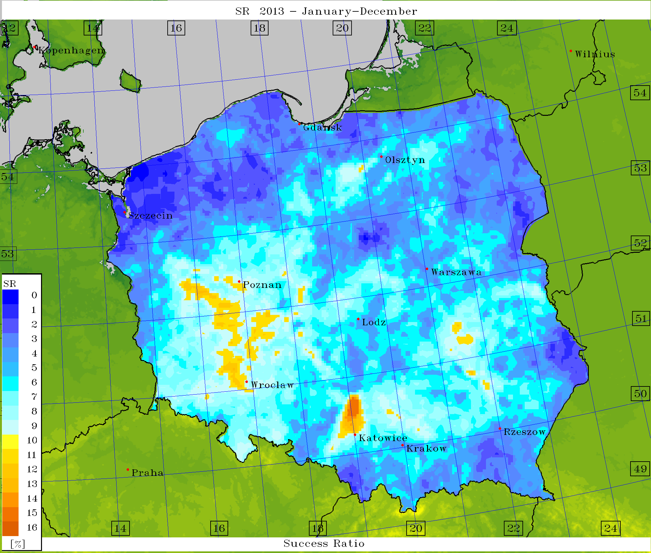
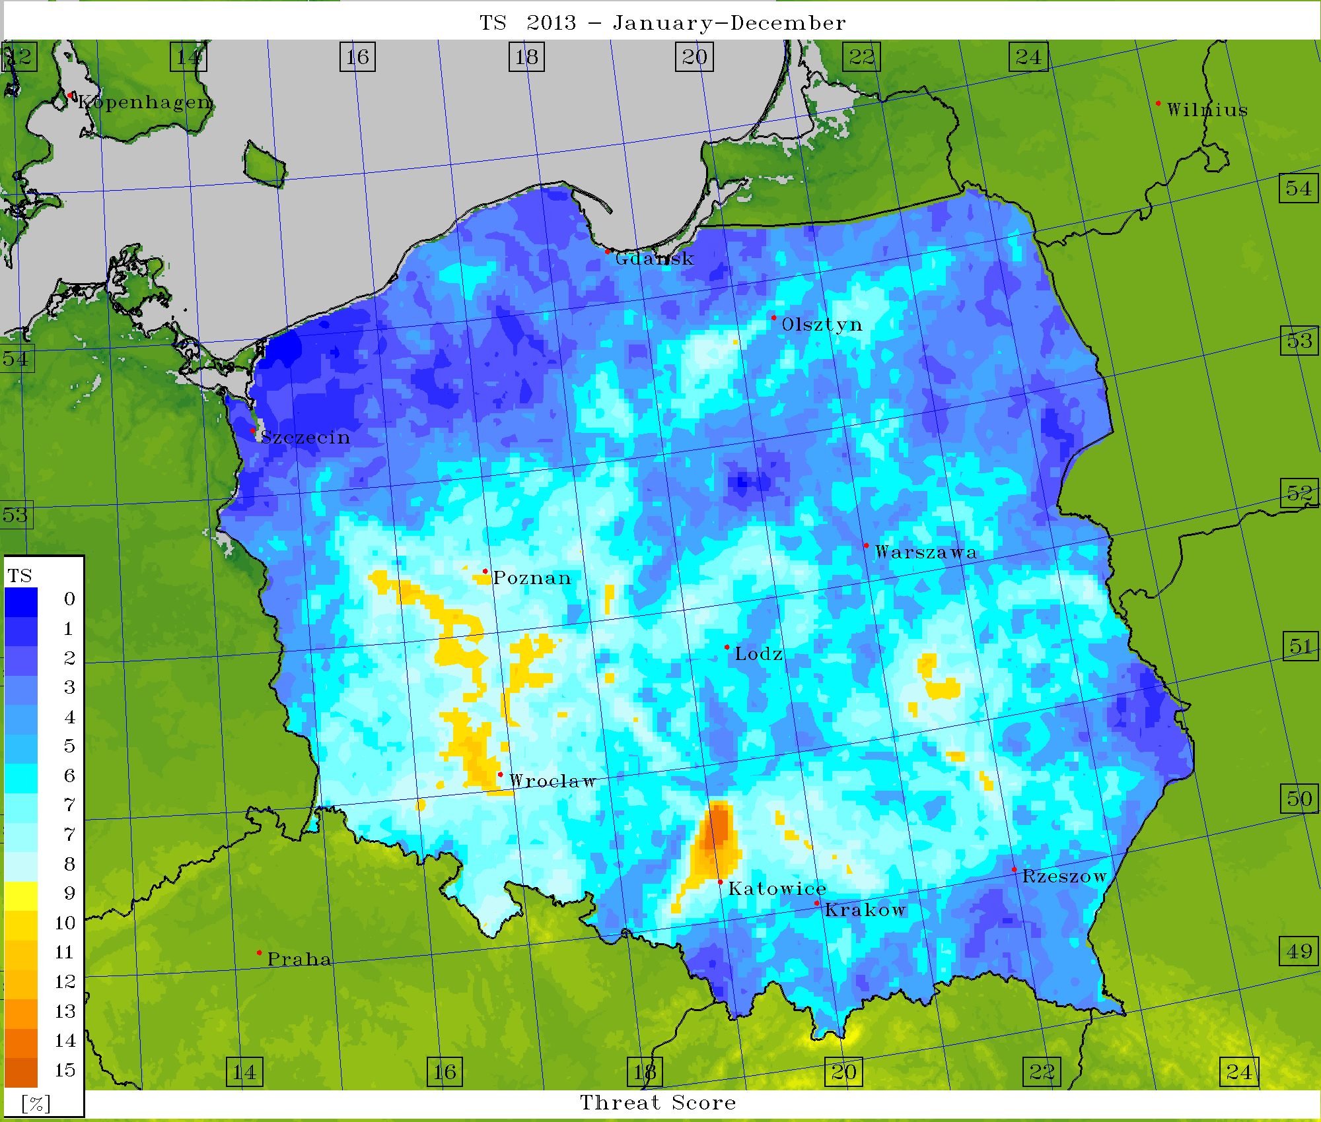
Verification – scores (det.) for TT Index = 49

Slide 25
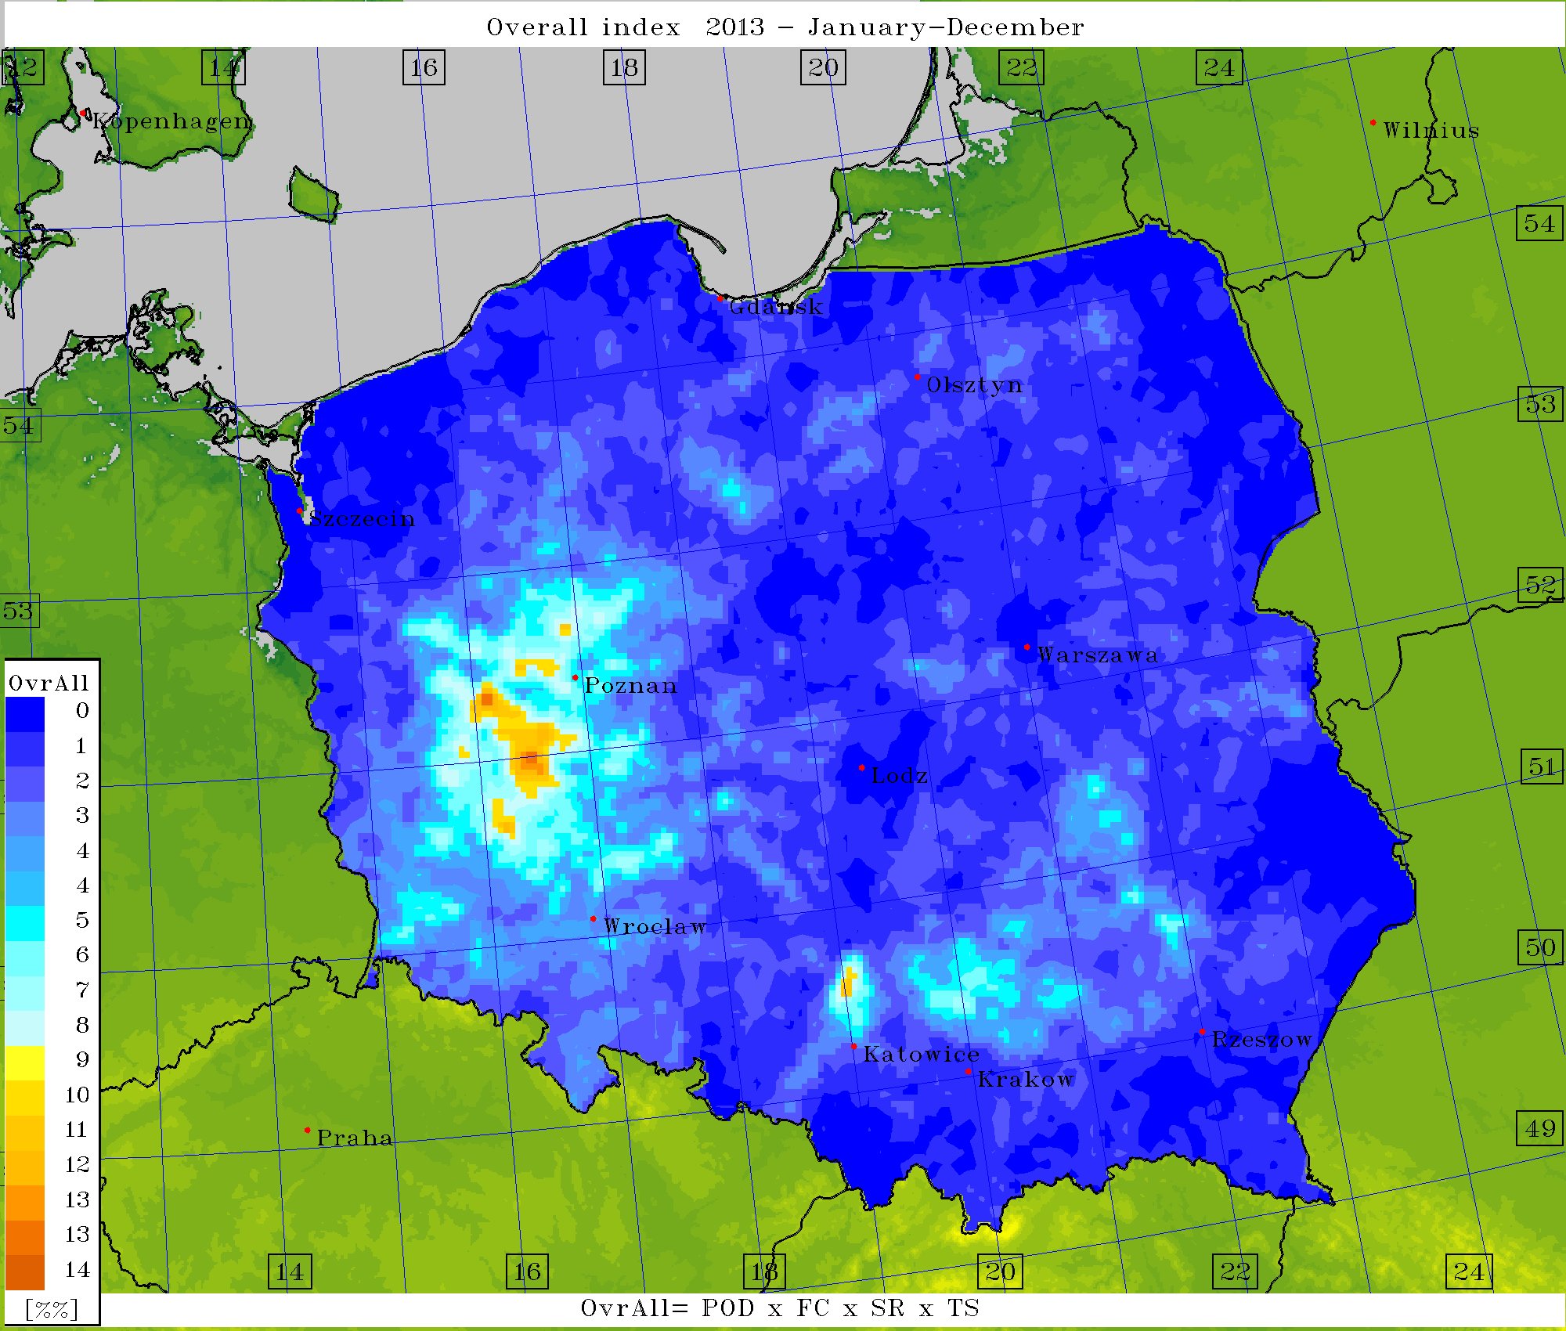
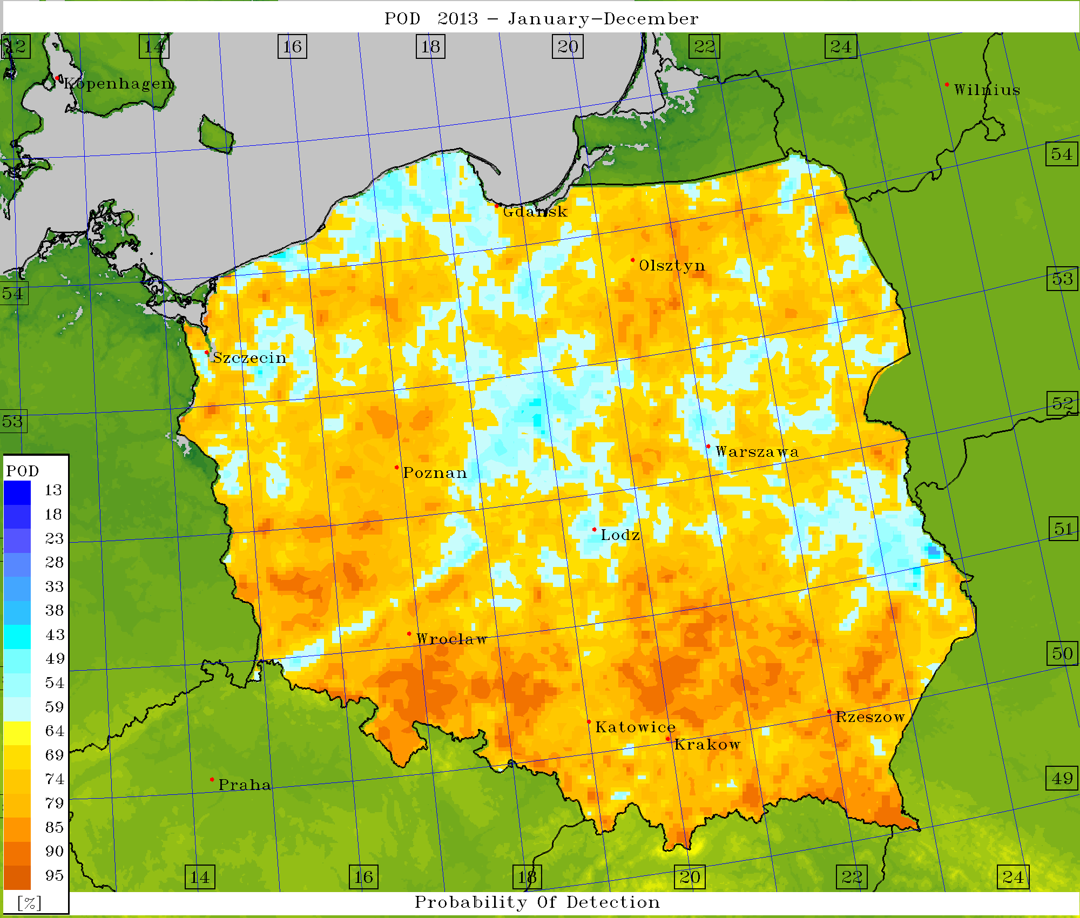
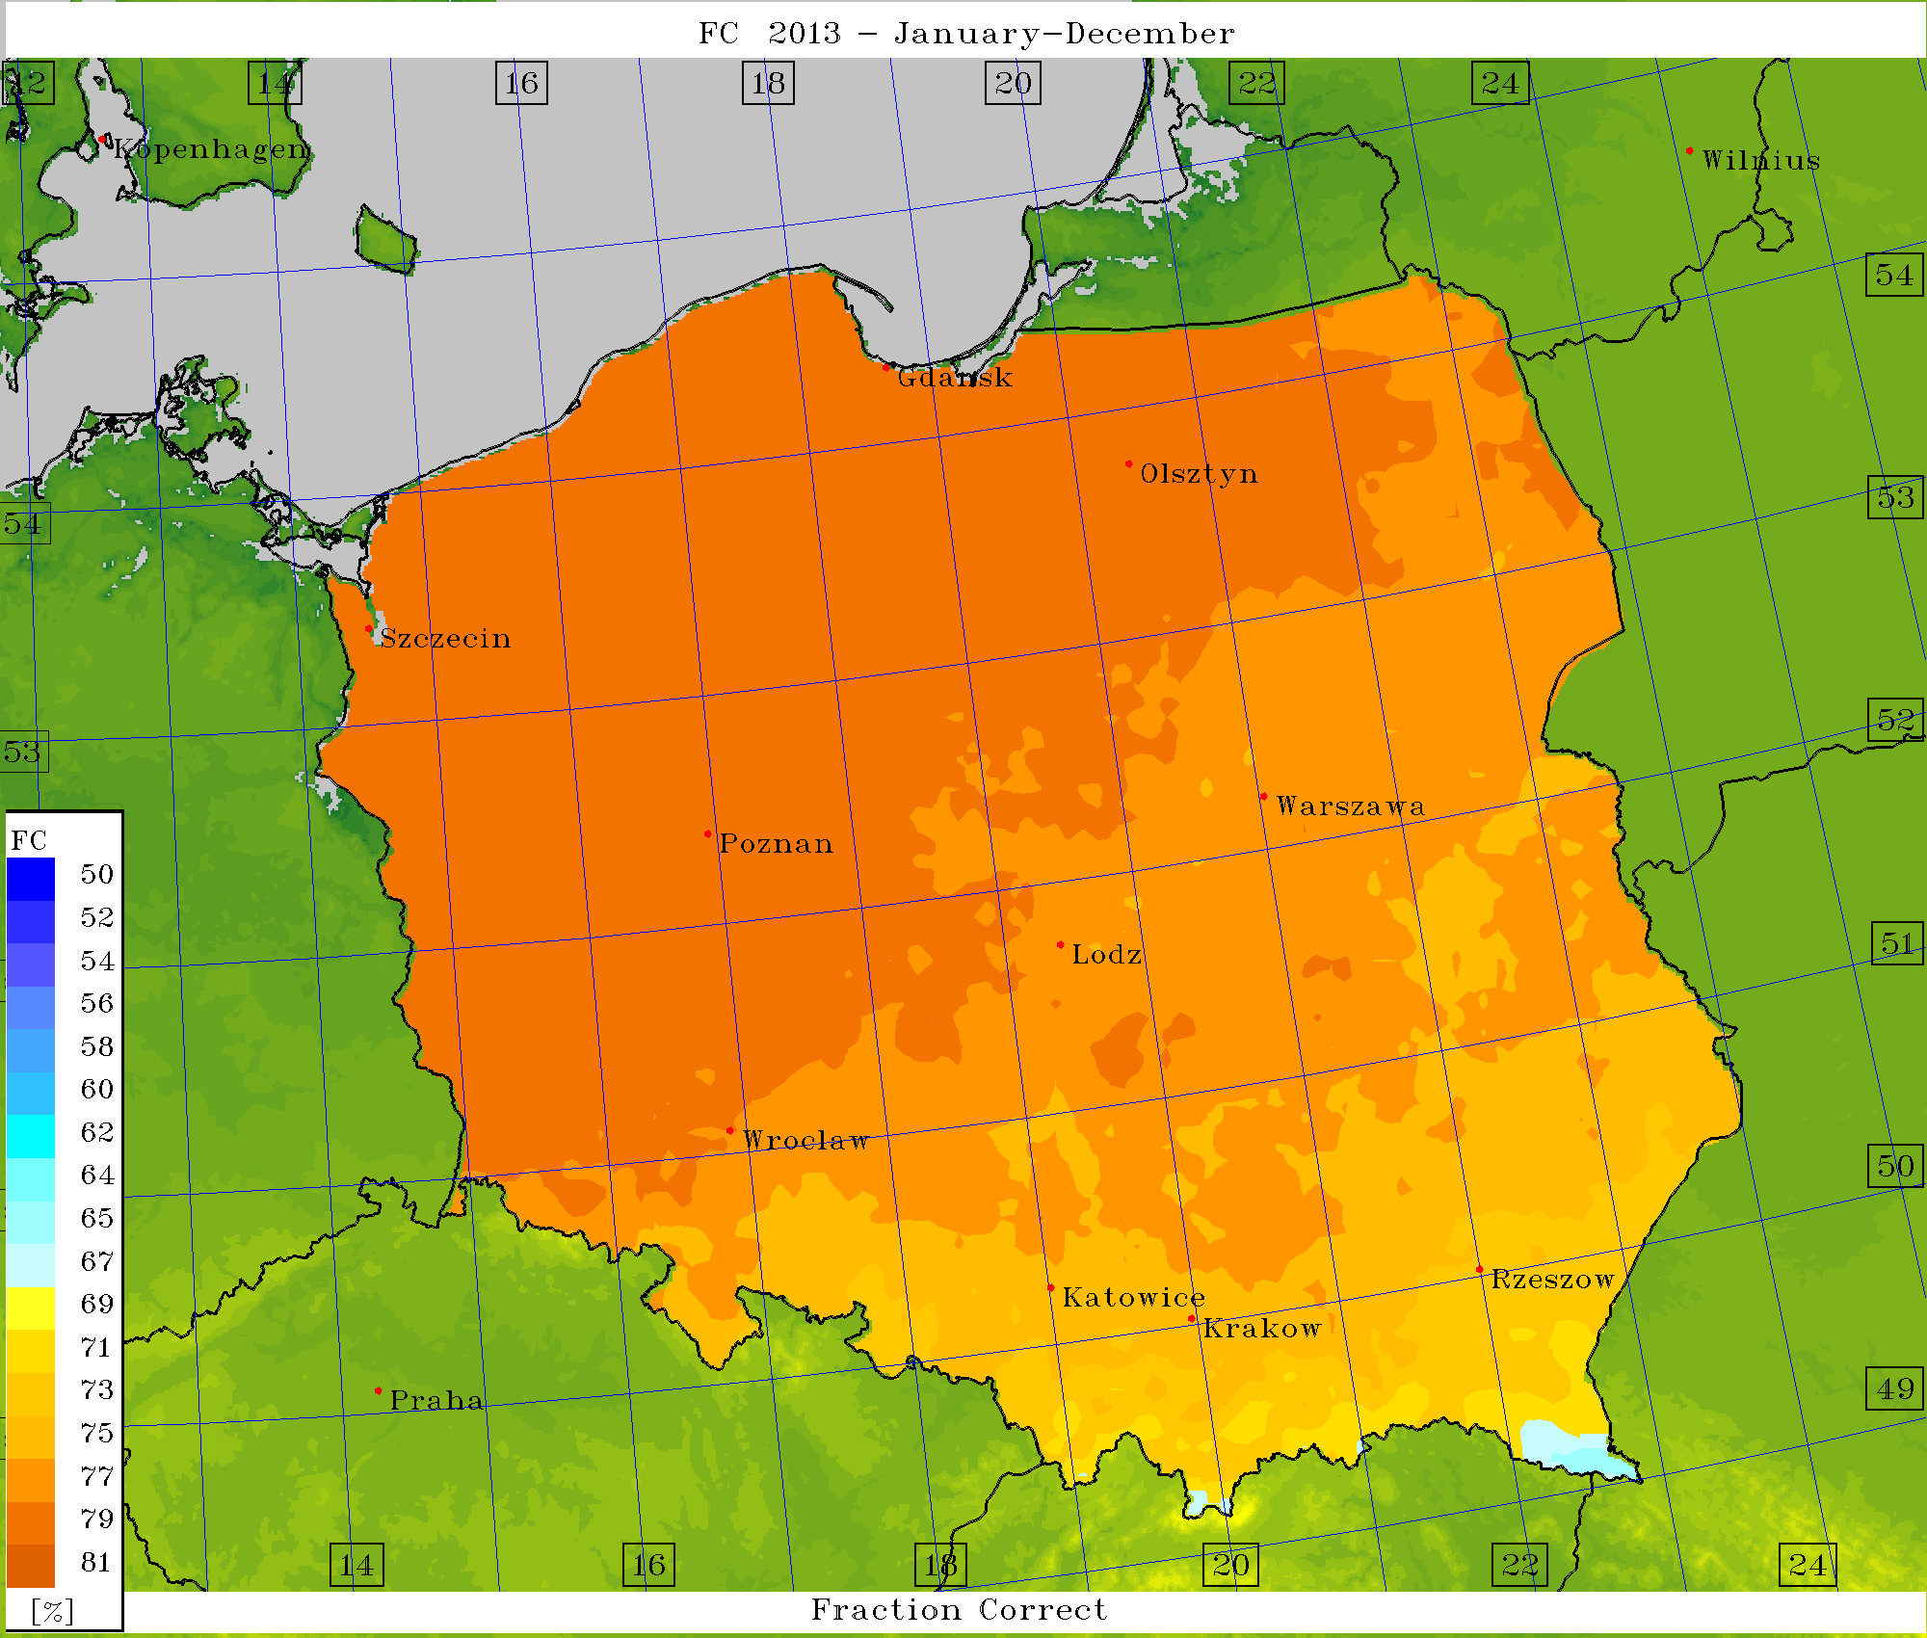
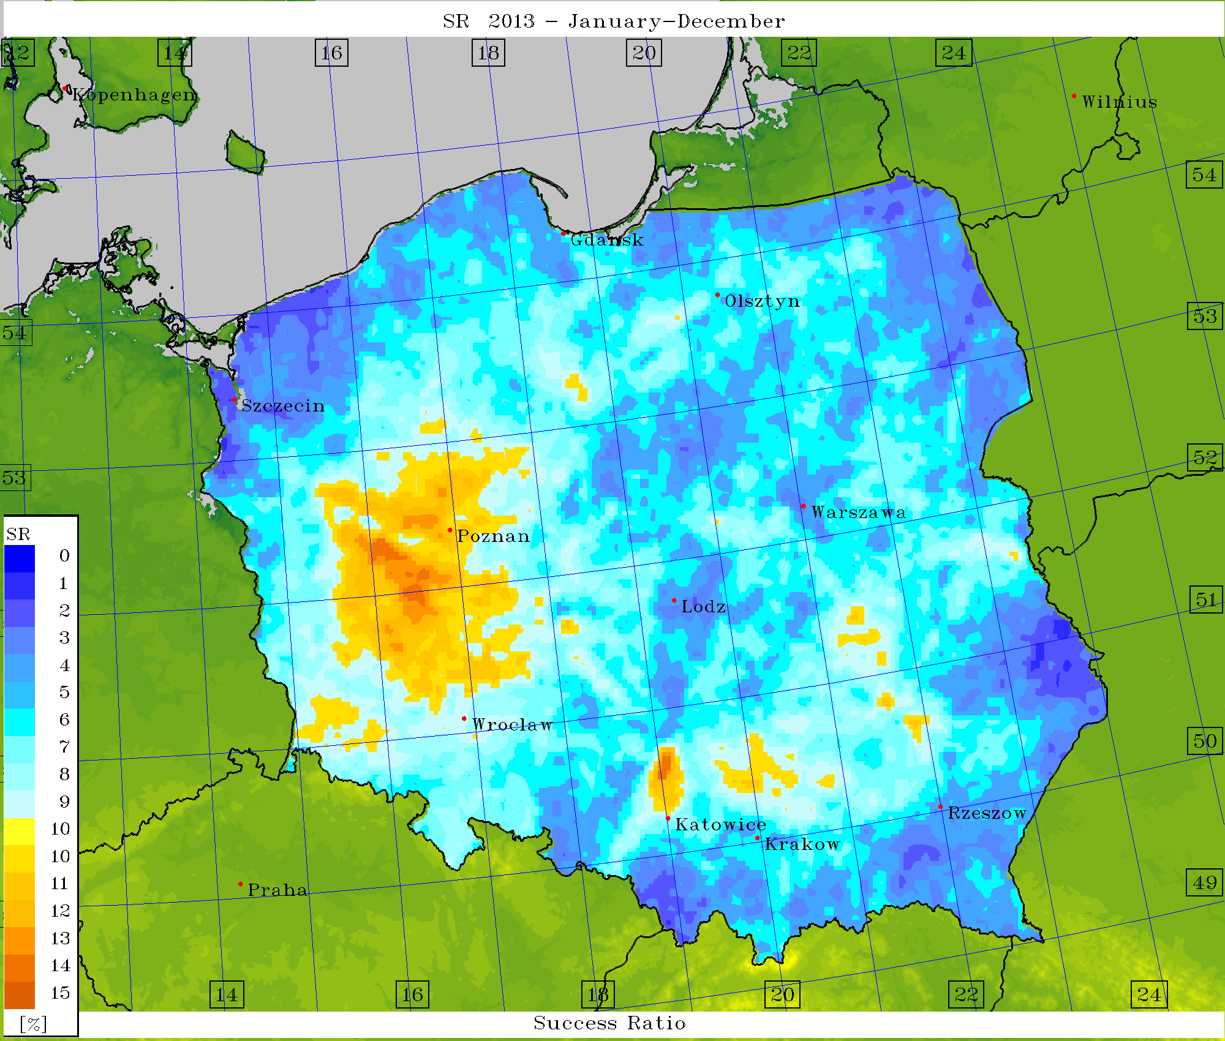
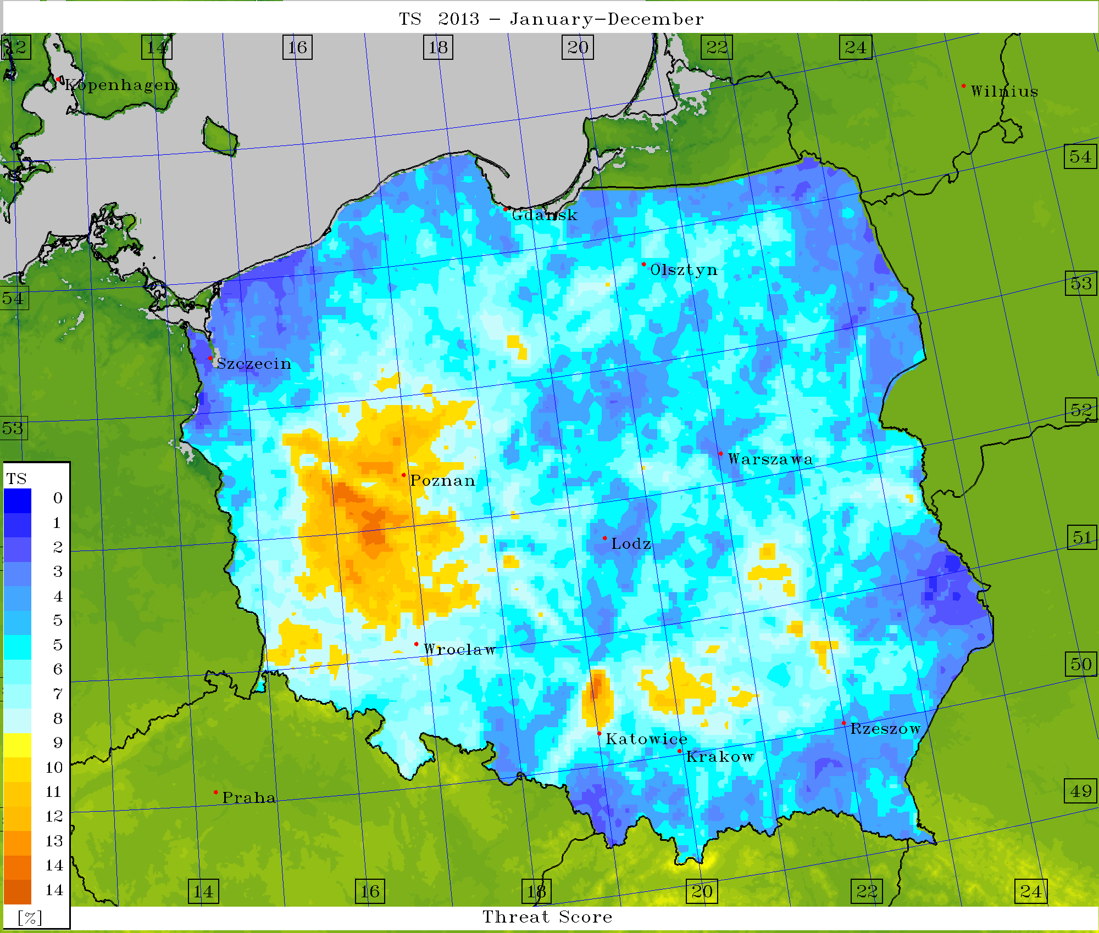
Verification – scores (EPS) for TT Index = 49

Slide 26
Worst results
K-index Lifted Index Total Totals
Best results
Overall score (upper – deterministic, lower – EPS)

Slide 27
Conclusions
Values of spread/skill are in general independent on kind of soil.
Average values of the spread of TD2M/T2M/U10M are inversely proportional to monthly mean air temperature and to deviation of the monthly mean air temperature (T and ∆T), calculated for the period of 1971-2000.
Long-term monthly sum of precipitation (P) is above a climatological average →average values of spread of TD2M, T2M and U10M are ~low.
The correlations between the values of skill of TD2M, T2M, U10M and T, ∆T, P, and ∆P are similar to the ones between spread of TD2M, T2M, U10M and T, ∆T, P, and ∆P. Average value of skill is ~independent on disturbed field/parameter.
The distribution of skill average values is ~similar to each other.
FSI / Lifted (et al.) index contingency table analysis approach –
maybe an alternative for over- or underestimating VIS/FR???

Slide 28
ANN post-processing of EPS forecasts – Setup
Simple EPS mean – arithmetic average
x – input forecast values,
y – ensemble mean,
m – # members

Slide 29
ANN post-processing of EPS forecasts – Setup
(Multi)linear regression approach – compute weights for different ensemble members.
y – new (corrected) ensemble mean
X – input forecast values/parameters –
T2M, TD2M, U10M, PS,
λ,φ (geo. coords), h – elevation,
t_{s}, t_{c} (start/current hour of fcst.),
β = f(λ,φ,h,t_{s},t_{c} ,X_{old}[m]) – weights,
calculated from old forecasts (MLR)
vs. observations
m – members, n = m+p (#other parms)

Slide 30
ANN post-processing of EPS forecasts – Setup

Slide 31
ANN post-processing of EPS forecasts – Setup
25 input neurons (20 members + λ,φ,h,t_{s},t_{c})
5 neurons in a single hidden layer (referring to 4 blocks of TL-ICs/BCs and spatial/temporal coordinates – blocked).
Every forecast (temperature, wind speed, pressure, etc.) treated independently.
Activation function: hyperbolic tangent (symmetric with respect to 0,0).
Training method: backward propagation of errors (back-prop).
Optimization: gradient descent.

Slide 32
ANN post-processing of EPS forecasts – Results
Basic statistics for April, 2018
Means | ME | MAE | RMSE | MinE | MaxE
Dew point
Simple EPS | 0.253 | 2.009 | 2.812 | -12.4 | 15.1
MLR | -0.310 | 1.989 | 2.755 | -12.3 | 14.8
ANN | -0.244 | 1.981 | 2.750 | -11.2 | 14.8
Air temp.
Simple EPS | 0.771 | 2.369 | 3.443 | -14.600 | 18.100
MLR | 0.475 | 2.252 | 3.206 | -14.500 | 16.600
ANN | 0.066 | 2.214 | 3.135 | -13.600 | 15.500
Windspeed
Simple EPS | -0.618 | 1.737 | 2.297 | -13.6 | 13.6
MLR | 0.113 | 1.488 | 1.978 | -7.8 | 13.2
ANN | -0.200 | 1.436 | 1.814 | -6.1 | 13.2

Slide 33
ANN post-processing of EPS forecasts – Results
Air temp. 2m. Simple mean
Air temp. 2m. MLR mean
Air temp. 2m. ANN mean

Slide 34
ANN post-processing of EPS forecasts – Results
Air temp. 2m. Simple mean
Air temp. 2m. MLR mean
ANN post-processing of EPS forecasts – Results
Air temp. 2m. ANN mean

Slide 35
No ”Thank you!”, no ”Questions?”!
Motivation!
Conclusions
ANN Cons:
Complicated pre- and post-processing
Answer – Once done, works automatically
Need for big data sets (archives), and for relatively huge computational resources
Answer – … business as usual
Long computational time for training
Answer – Learning is performed monthly with the acceptable quality.
ANN Pros:
Ready-to-use dedicated software with source codes (FORTRAN).
Sophisticated yet elegant and intuitive concept.
Improvement in preliminary case study observed,
Forecasts are getting better and better with the extension of learning period – key reason!

Slide 36
Motivating sentence:
Motivating sentence:
As master Yoda says:
Do – or do not. There is no ”try”.

