Slide 1
POMPA Contributions to the official COSMO-Model
Ulrich Schättler
Source Code Administrator

Slide 2
Highlights from the History of GPU Implementation
5.01 (11.2014): Implemented organizational framework for COSMO-ICON physics (e.g. src_block_fields.f90, etc.)
5.03 (11.2015):
The radiation was the first parameterization of the official code that could be run on a GPU. But also other code already contained ACC-statements.
The interface to the C++ dynamical core and serialization has been implemented
5.04e (03.2017): GPU version of SSO scheme
5.04f (09.2017): GPU version of TERRA
5.04g (11.2017): GPU version of Tiedtke convection
5.04h (12.2017): GPU version of Turbulence
Then I stopped to test the GPU version on DWD machines (Sorry)

Slide 3
Highlights from the History of GPU Implementation II
5.05 (02.2018):
Microphysics, FLake, Terra-init and organize_physics
src_lbc
Nudging
GCL communication library for GPU communication
5.05a (06.2018)
Diagnostics
Output
Treatment of utility routines (which are called from CPU and from GPU regions)

Slide 4
And the Ongoing Developments (5.05b)
Latent Heat Nudging
Climate part (IF (lbdclim) …)
…and all the "little things" to get if fully going

Slide 5
For Version 5.06
COSMO-Model 5.06 should be able to run fully on GPU
What is still missing for that?
What about missing Features from POMPA_supported_features.xlsx?
Documentation
Is the documentation for installing and running GPU version complete?
Can we give sufficient support?

Slide 6
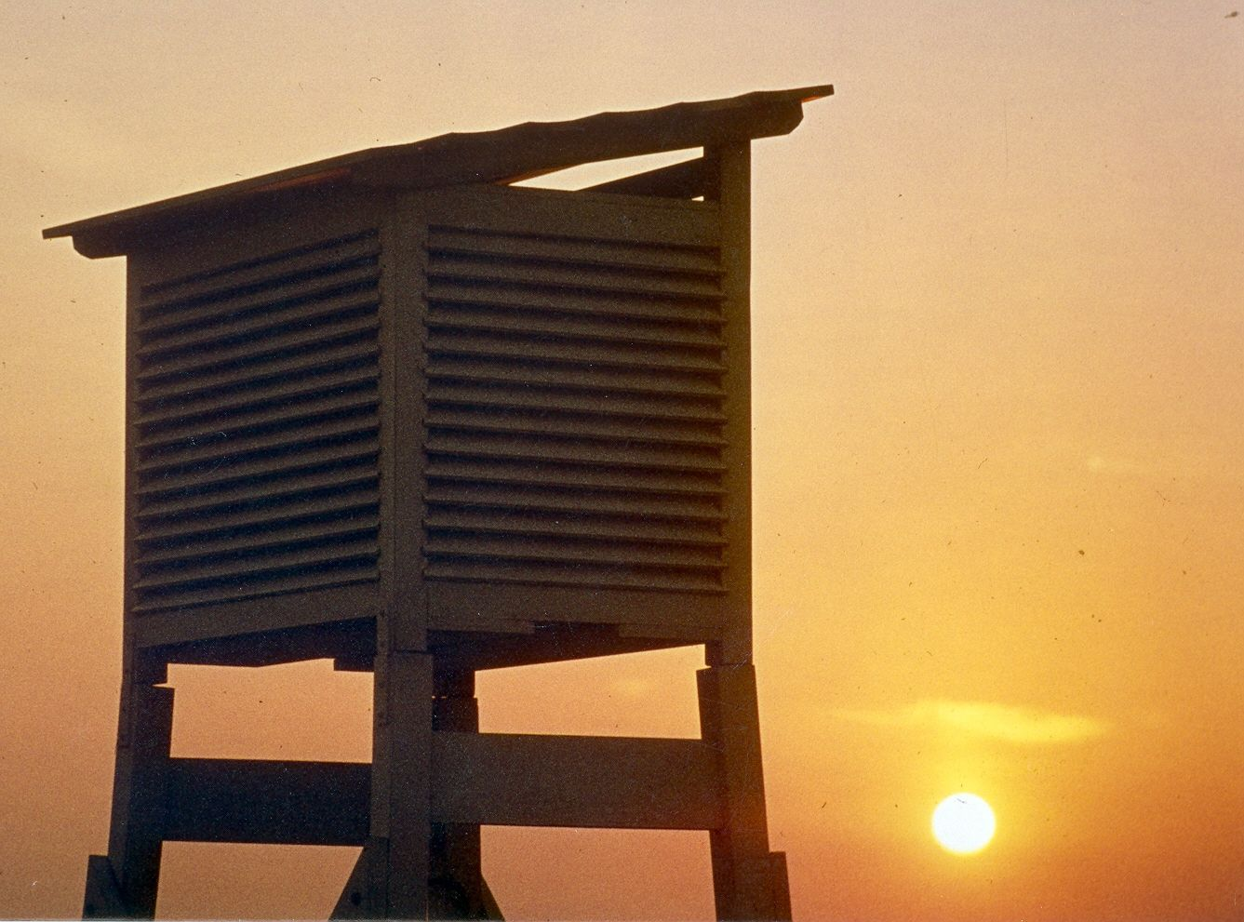
Thank you
very much
for your
attention

