Slide 1
COSMO PP IMPACT
ICON on Massively Parallel ArChiTecture
X. Lapillonne, C. Osuna MeteoSwiss
V. Clement³, O. Fuhrer^{1,}, C. Osuna¹, K. Osterried³, H. Vogt² , A. Walser¹ , C. Charpilloz¹, P. Spoerri³ , T. Wicky
¹MeteoSwiss, ²CSCS, ³C2SM ETH

Slide 2
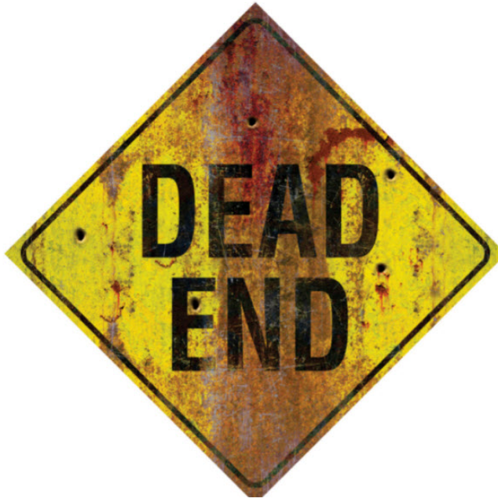
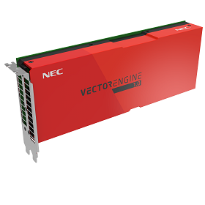
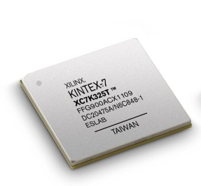
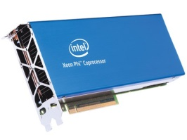
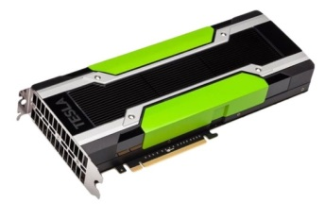
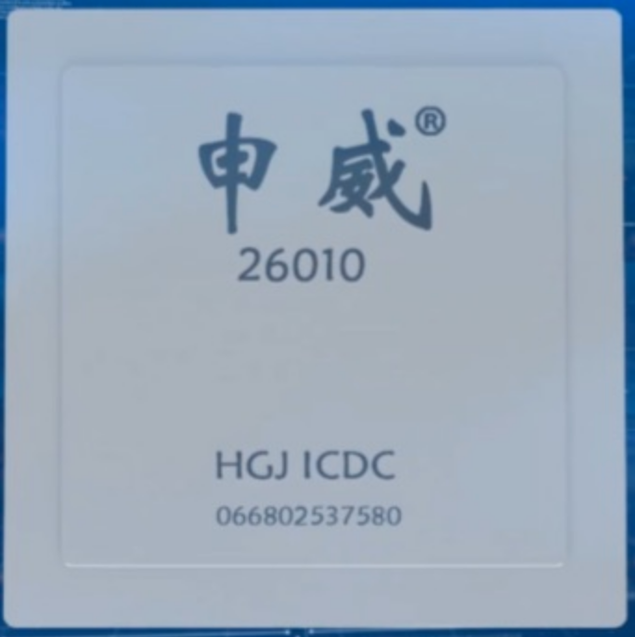
Why investing a new HPC project ?
Physical limits , Moore’s law is over
  2004 end of frequency scaling → multi-core
  2012 end of rapid cost decline → constant $/transistor
  2019 heat dissipation constraints → massively parallel architecture
  2021 end of reduction in feature size → ?
K. Flamm 2017, IEEE Computing in Science & Engineering
Specialized hardware, large diversity
increased on chip parallelism
GPUs
FPGAs
Vector
Many-core
processors
AI Accelerators
(e.g. Google Tensor Flow,
Intel Nervana)
??
Unknown

Slide 3
New HPC project
Build on know-how from POMPA project
Future HPC will show ever more parallelism than actual GPU & CPU:
    further adapt our models and programming tools
    Investigate tasks parallelism
Focus on ICON model

Slide 4
COSMO PP IMPACT (submitted)
ICON on Massively Parallel ArChiTecture
First implementation of a baseline OpenACC version of ICON for NWP :
  Initial version of the dycore is available
  Physical parametrizations require a full port
Investigate OpenMP 4.5 for accelerator (currently not mature enough in all compilers)
Improve modularity of the model structure
Need to invest in software engineering beyond OpenACC in order to make support of different platforms maintainable in the long term:
  Implement ICON Dycore based on DSL (Domain Specific Language)
  evaluate use of CLAW-DSL abstractions for the physical parameterisation
  Investigate task parallelism
Low risk, known technologies
High risk
High potential Future proof

Slide 5
Performance portability, why do we need abstraction ?
Directives : portable but not optimal code with single source
  different optimization for different target architecture
  in the dynamics difficult to achieve opt. performance
x1.3
x1.8
Possible solutions : Domain specific Language (Gridtools), abstraction, CLAW

Slide 6
CLAW Fortran manipulation tool
https://github.com/claw-project
CLAW FORTRAN Compiler
  OpenSource project, developped by MeteoSwiss/ETH.
  Based on the OMNI Compiler (developed by Riken)
Two modes
CLAW-directives
  Transformation in exisiting CPU optimize code with pre-existing OpenACC directives
CLAW-DSL (single column abstraction for the physics)
  Code written has single column (abstract horizontal direction)
  OpenACC/OpenMP directives are automatically added depending on the target (abstraction)

Slide 7
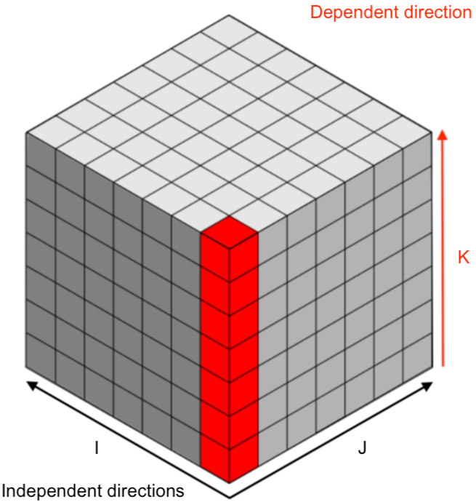
CLAW-DSL Single column abstraction approach : performance portability in the Fortran physics
Separation of concerns
  Domain scientists focus on their problem (1 column, 1 box)
  CLAW compiler produce code for each target and directive languages

Slide 8
Claw one column example
!$claw parallelize forward
DO icol = 1, ncol
CALL lw_solver(ngpt, nlay, tau(icol,:,:))
END DO
Loop over horizontal direction generated by claw at compile time
CALL lw_solver(ngpt, nlay, tau)
SUBROUTINE lw_solver(ngpt, nlay, tau, …)
  !$claw define dimension icol(1:ncol) &
  !$claw parallelize
  DO igpt = 1, ngpt
  DO ilev = 1, nlay
tau_loc(ilev) = max(tau(ilev,igpt) …

Slide 9
High level DSL for weather and climate
Increase abstraction : no explicit data structure, loops, HW-dependent details
More optimizations, task parallelism
Higher productivity and code safety
Language still to be defined, developer input required
Collaboration with ECMWF as part of ESCAPE project
Example gtclang
(working implementation of the COSMO dycore)
gtclang language prototype :
Generates efficient code for x86 multi-core,NVIDIA GPUs, Intel Xeon Phi
4x – 6x reduction in LOC

Slide 10
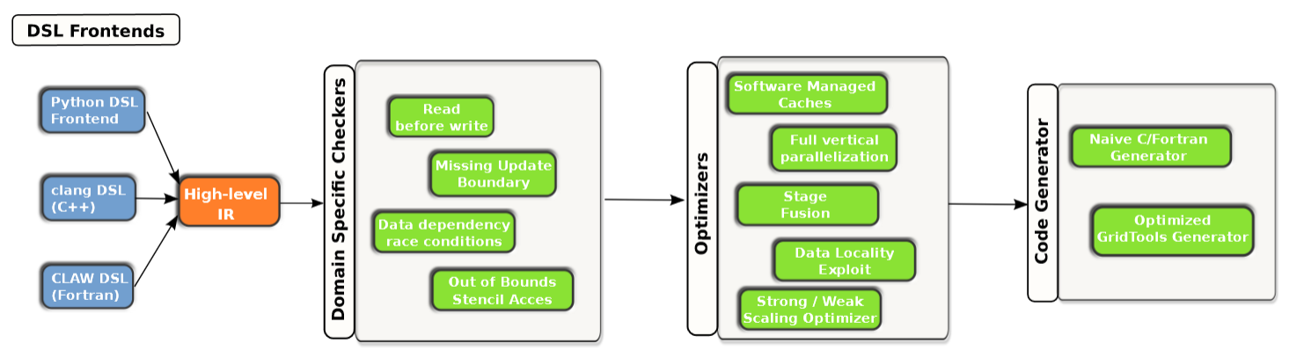
High level Intermediate Representation (HIR)
Multiple high level DSL (different communities)
Single HIR and optimization tool chain - currently based on GridTools Framework, Joint development between CSCS / MeteoSwiss / C2SM
CLAW-DSL : Fortran DSL for the physical parameterizations

Slide 11
Thanks you

Slide 12
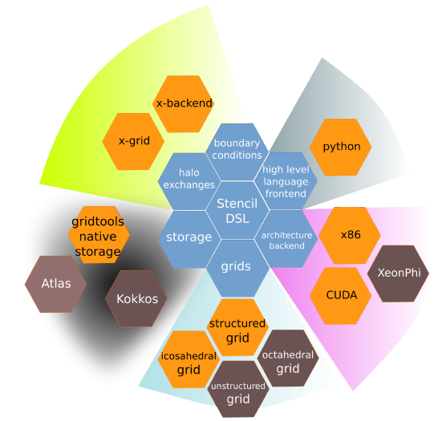
GridTools Framework
“SDK for weather and climate
science”
Joint development between
CSCS / MeteoSwiss / C2SM
Domain-specific for Earth
system model components
Regional (production) and
global grids (prototype)
Multiple APIs (C++, Python,
gtclang)

Slide 13
Claw one column example
!$claw parallelize forward
DO icol = 1, ncol
CALL lw_solver(ngpt, nlay, tau(icol,:,:))
END DO
Loop over horizontal direction generated by claw at compile time
CALL lw_solver(ngpt, nlay, tau)
SUBROUTINE lw_solver(ngpt, nlay, tau, …)
  !$claw define dimension icol(1:ncol) &
  !$claw parallelize
  DO igpt = 1, ngpt
  DO ilev = 1, nlay
tau_loc(ilev) = max(tau(ilev,igpt) …

Slide 14
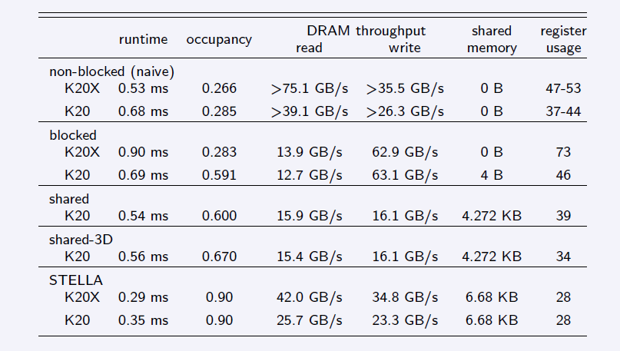
Efficiency myth
Heavily optimized code is faster than Fortran + OpenACC
(Example: 1.5x for horizontal diffusion operator)

Slide 15
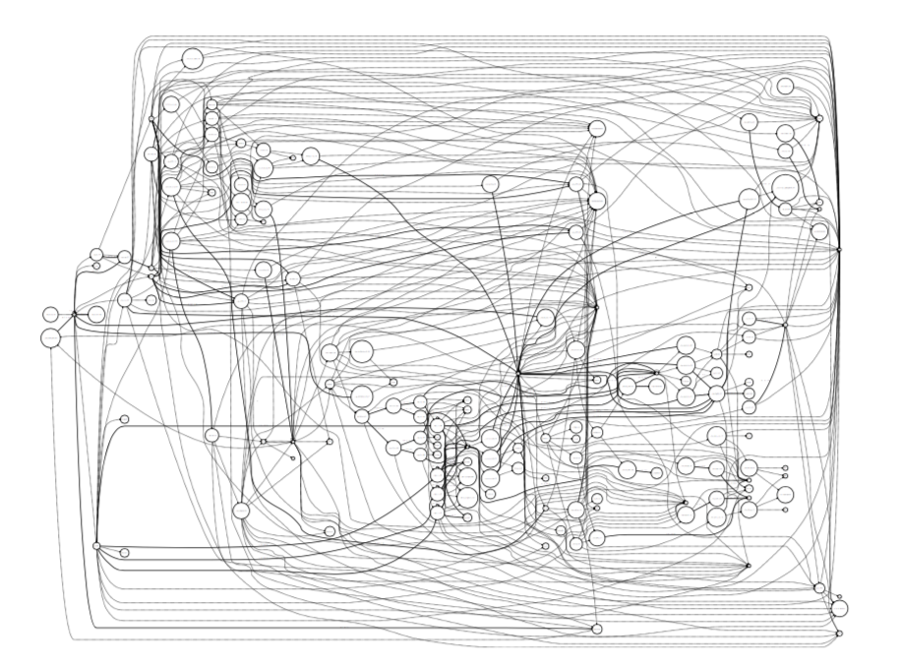
Software (Automatic optimization)
Compilers will not solve the problem!
DSL-based code can be automatically optimized for a specific hardware target
E.g. “Design of a Compiler Framework for Domain Specific Languages for Geophysical Fluid Dynamics Models” (Fabian Thüring, MSc thesis)
Example: Fast-waves solver
Graph representation of code
Rearrange for data-locality
Run independent computations in parallel

Slide 16
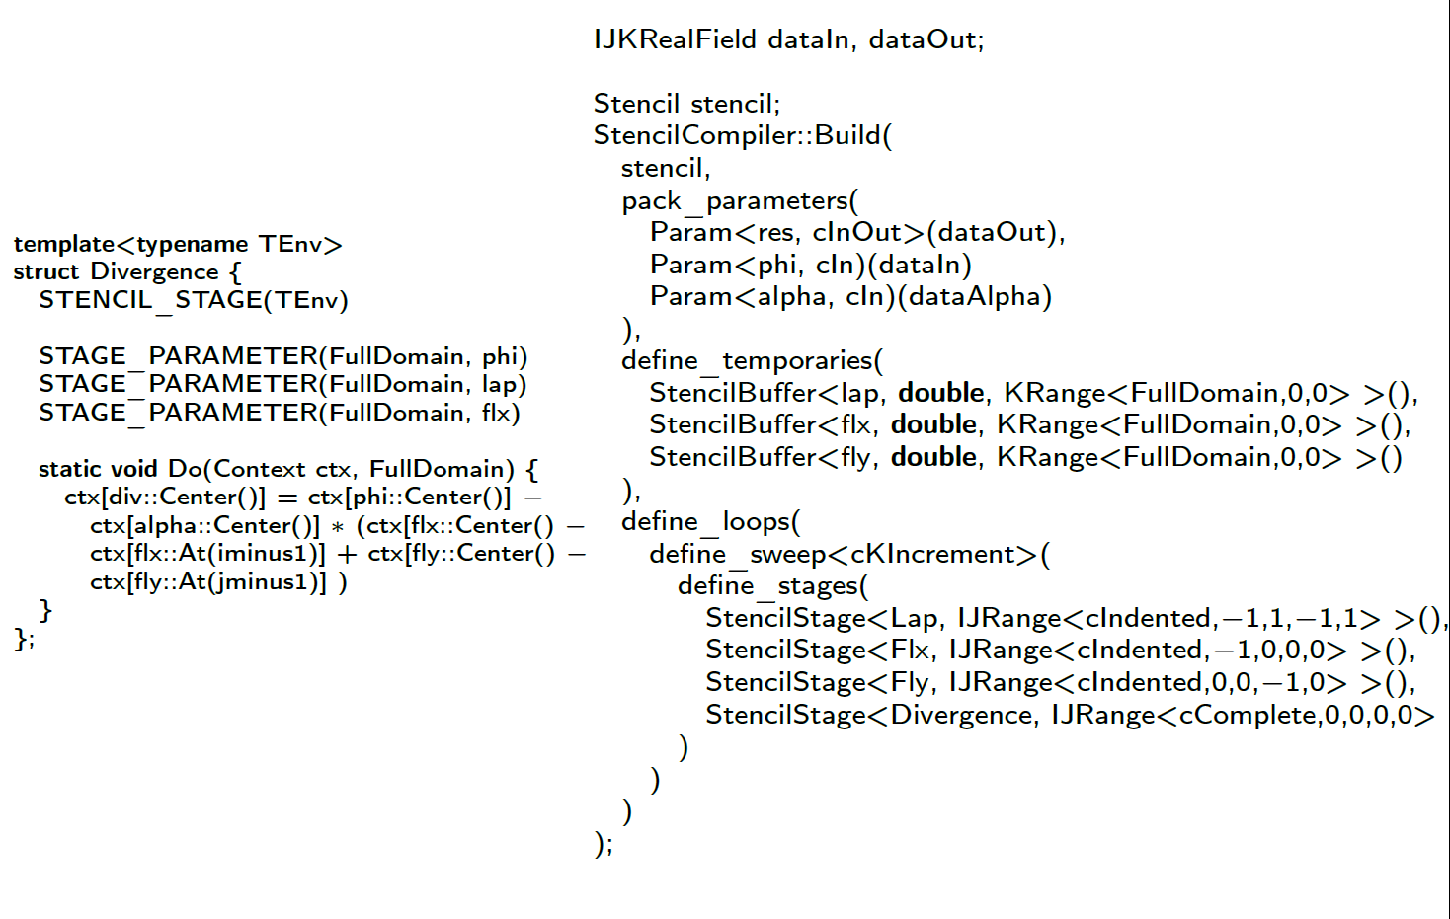
STELLA SYNTAX
Only specify neighbourhood relations and domain of application
Code for specific architecture is generated at compile time

Slide 17
COSMO quasi-global
Source: Vogt, 2017
Δx | # nodes | SYPD | MWh / SY
0.93 km | 4,888 | 0.043 | 596
1.9 km | 4,888 | 0.23 | 97.8
3.7 km | 4,888 | 0.97 | 20.8
What would it take to do a 36 year AMIP simulation?
 | Δx = 0.93 km | Δx = 1.9 km
Time to solution | 840 days | 156 days
Energy to solution | 22 GWh (0.9 M$) | 3.5 GWh (0.150 M$)
CO2eq to solution | 3’800 tons | 640 tons
$ to solution (2go.cscs.ch) | 97 M node hours → 68 M$ | 18 M node hours → 12 M$

Slide 18
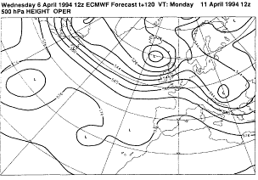
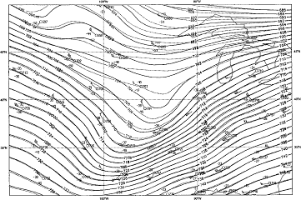
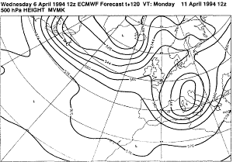
Ensemble prediction
The atmospheric system is a chaotic system:
i.e. high sensitivity to initial condition
Initial conditions (dotted lines)
Operational 120 h forecast
Initial conditions (full lines)
Modified forecast

Slide 19
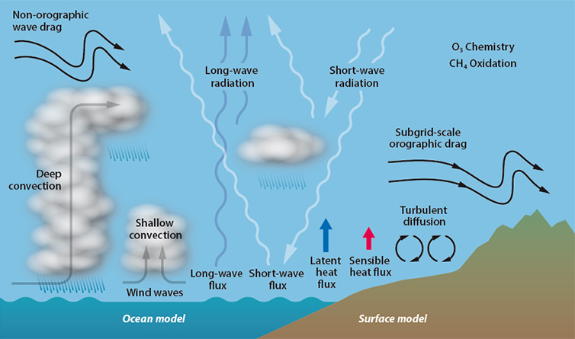
Modeling the Earth system
(source https://www.ecmwf.int/sites/default/files/medialibrary/2017-09/atmospheric-physics-754px.jpg)
Notes:
Earth system is a multi-scale, multi-physics problem.
Many different procceses act together that have to be represented in one form or another in a weather and climate model.
Formation and dissipation of different types of clouds.
Interaction of the radiation impinging from the sun, and the longwave radiation emmanating form the warm Earth.
Surface-vegation-atmosphere-transfer determining the latent, sensible fluxes of heat.
But also the effect of topogrphy on the atmosphere that acts on the momentum budget.
So let’s take for example a deep cumulus cloud…

