Slide 1
Changes in int2lm towards V2.05
Ulrich Blahak
Deutscher Wetterdienst, Offenbach
COSMO General Meeting, Jerusalem, 11.9.2017

Slide 2
Version naming
Last official version: 2.02
2.03 (Feb. 2017): (handed out for further beta-testing)
  Contains all changes which have been presented at last years GM
  Further major changes for non-hydrostatic input models (ICON, COSMO, UM)
  Important bug fix in case of ICON input
  Some smaller bug fixes
Shortly thereafter: Re-labeling to 2.04 (2.04a 1 bugfix) to be consistent with DWD-internal version control (otherwise, no changes of the content)
Soon 2.04b = candidate for 2.05 (Sep. 2017):
  Smaller bugfixes
  Option to only process the COSMO external parameters
  Kinne aerosol climatology (from T2RC2)
  Processing of operational ECMWF aerosol fields (CAMS) (from T2RC2)

Slide 3
Modifications with considerable influence on results
Concerning non-hydrostatic input models (COSMO, ICON, UM, CM(?)):
  New methods of adapting vertical profiles to new orography (deeper valleys, higher mountains in COSMO orography) --- all 3D variables except pressure
  Profiles of W blended to „terrain following“ values (according to U and V) near the surface
  Computation of (hydrostatically balanced) pressure: pressure no longer interpolated but computed analytically from interpolated profiles of T and QV – this is a bugfix rather than a change!
Concerning soil temperature:
  Bugfix for ICON input only:
    Surface temperature T_SO (initial data) should be adapted to the new orography by way of conservation of differences to near-surface atm. T.
    But for ICON input, this was done wrong so that effectively T_SO was not adapted but only horizontally interpolated!
  For ICON/COSMO/IFS input: difference-based adaption of T_SO only near the soil surface. At deeper layers blending to a climatological height correction (-0.7 K / 100 m)

Slide 4
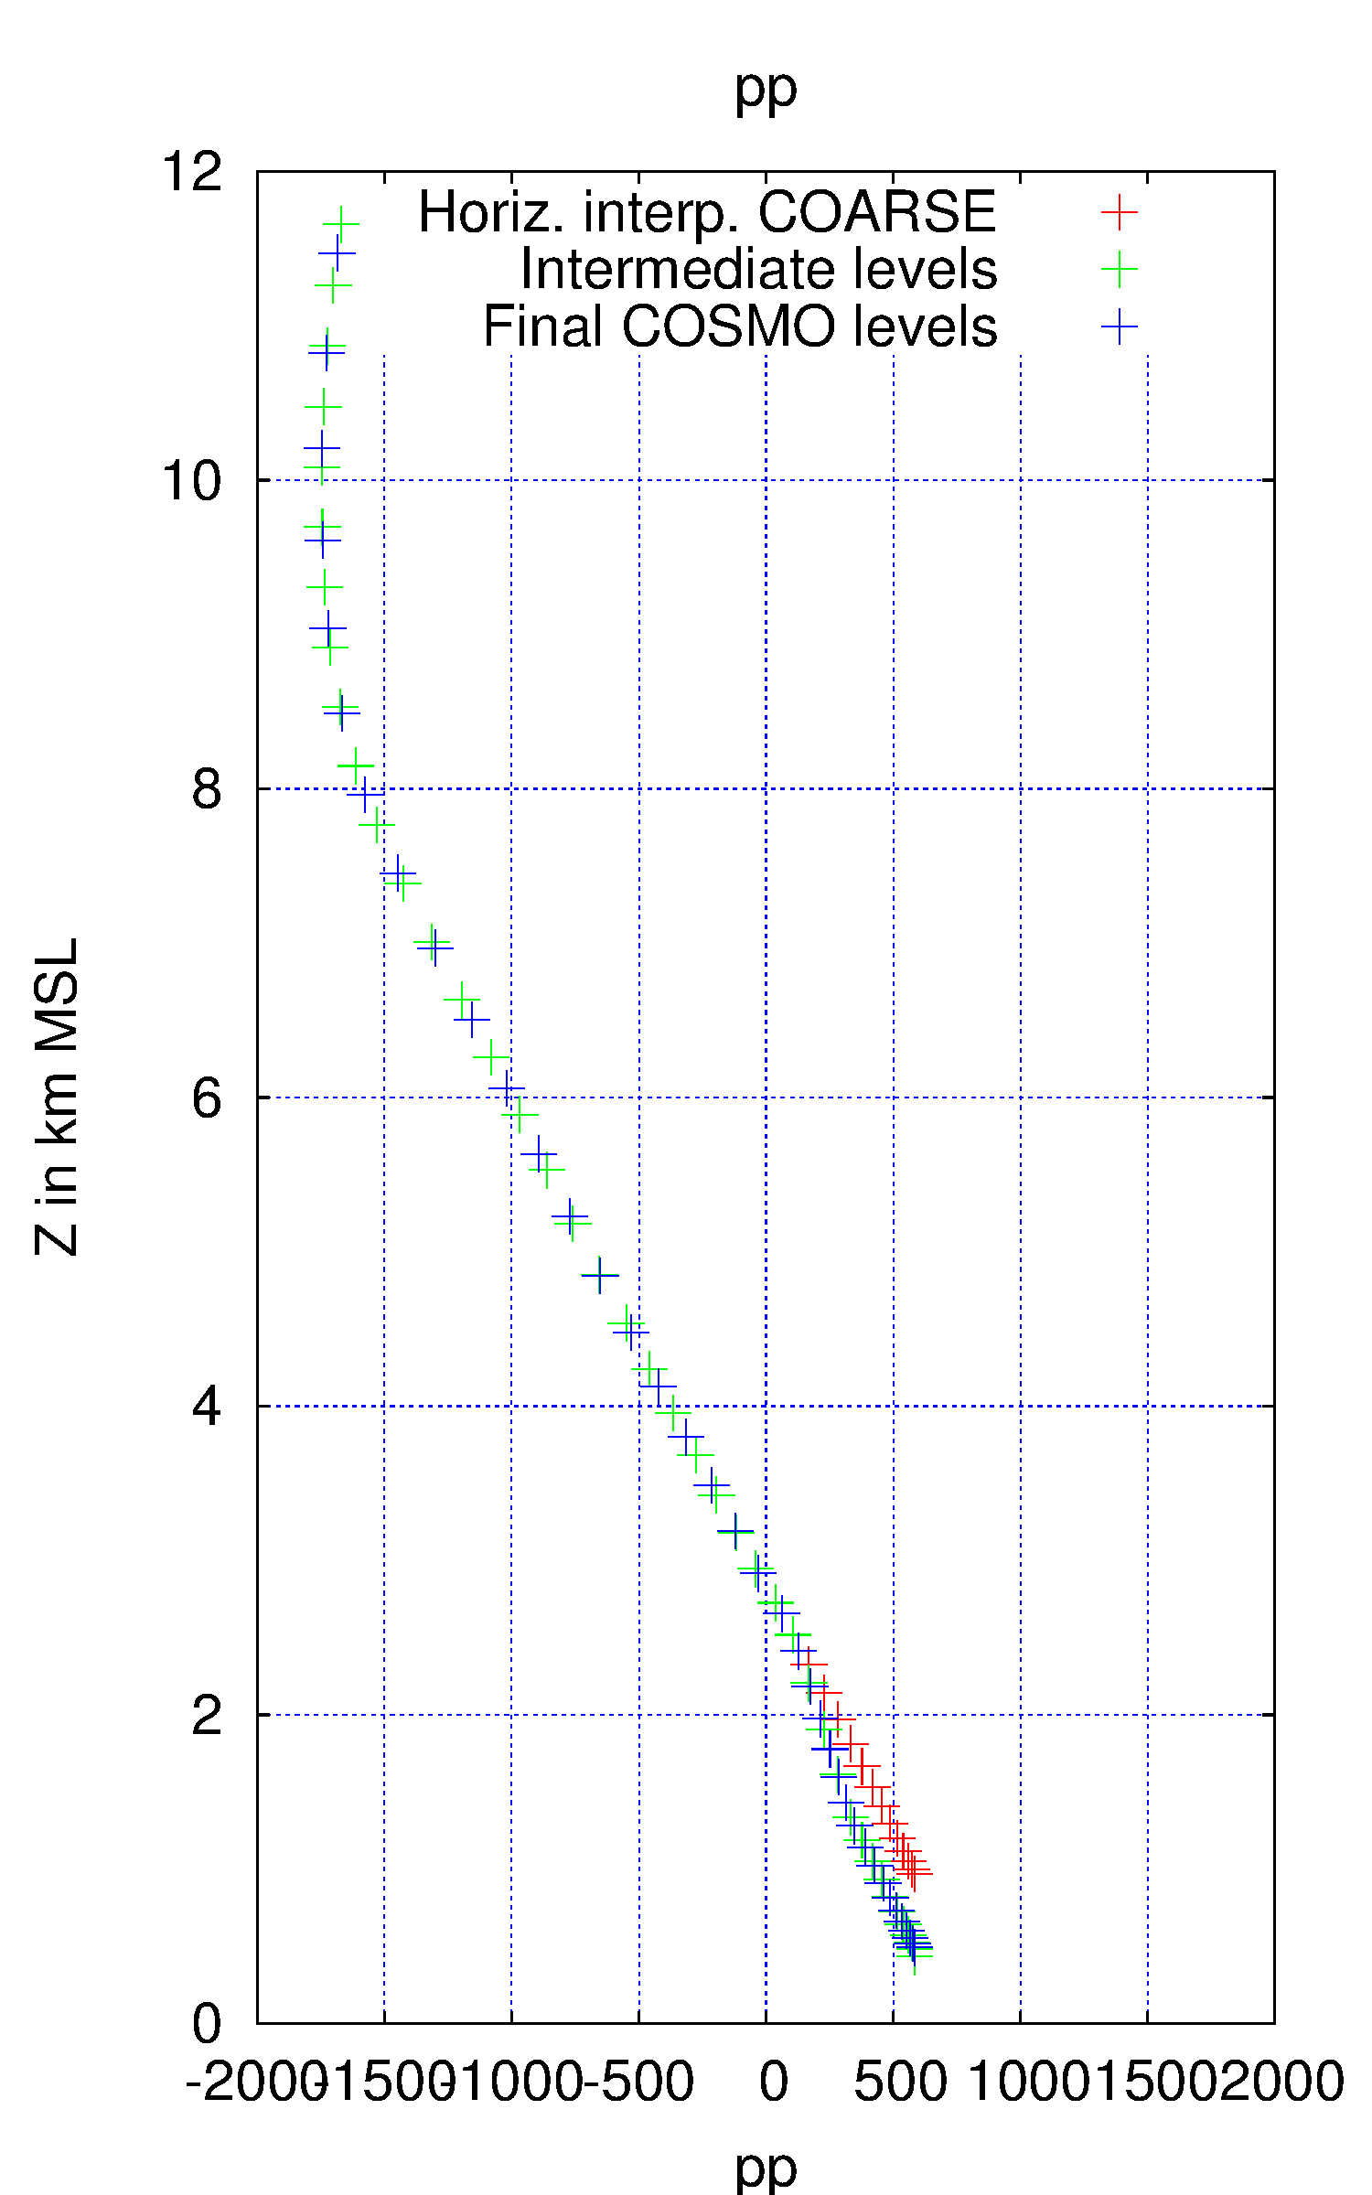
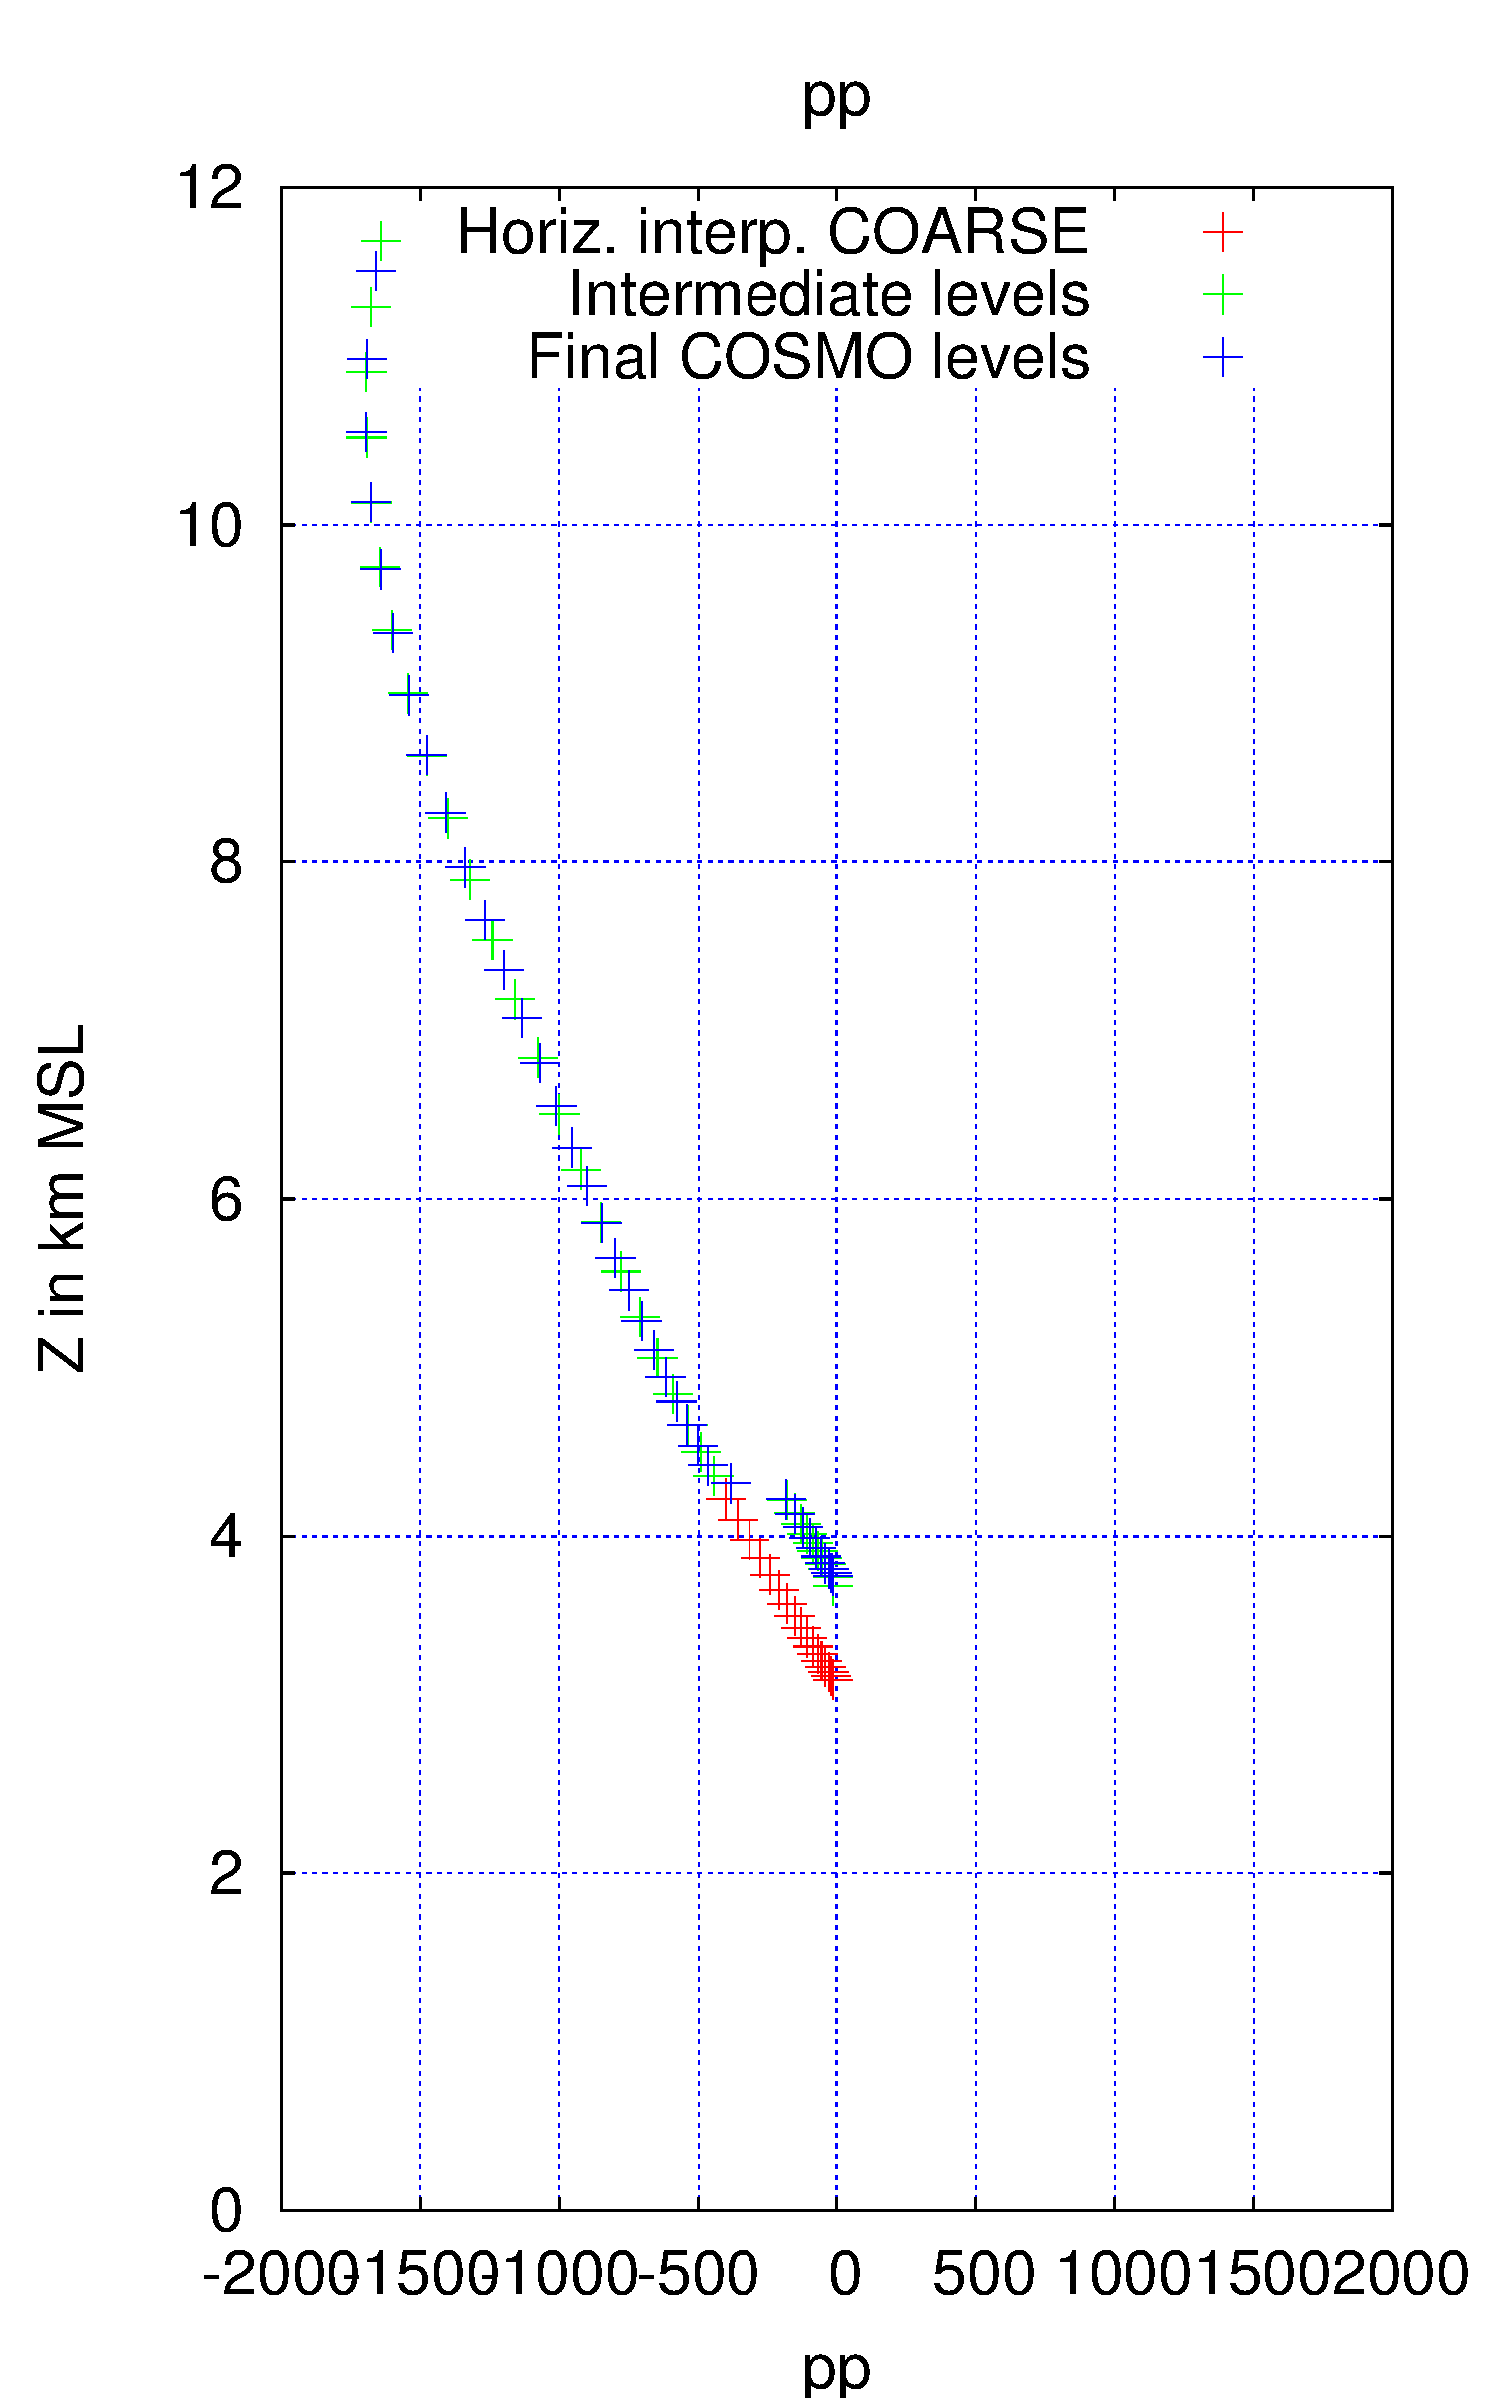
Pressure computation
OLD inter-polation
of PP
deeper valley
higher mountain
problematic!
inaccurate!

Slide 5
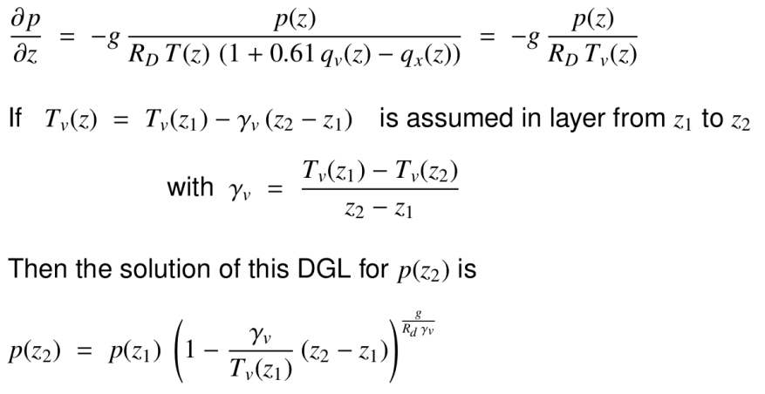
Pressure computation
New: PP is no longer interpolated, but analytically computed (integrated) from hydrostatic equation, based on the before interpolated T- and QV profiles:

Slide 6
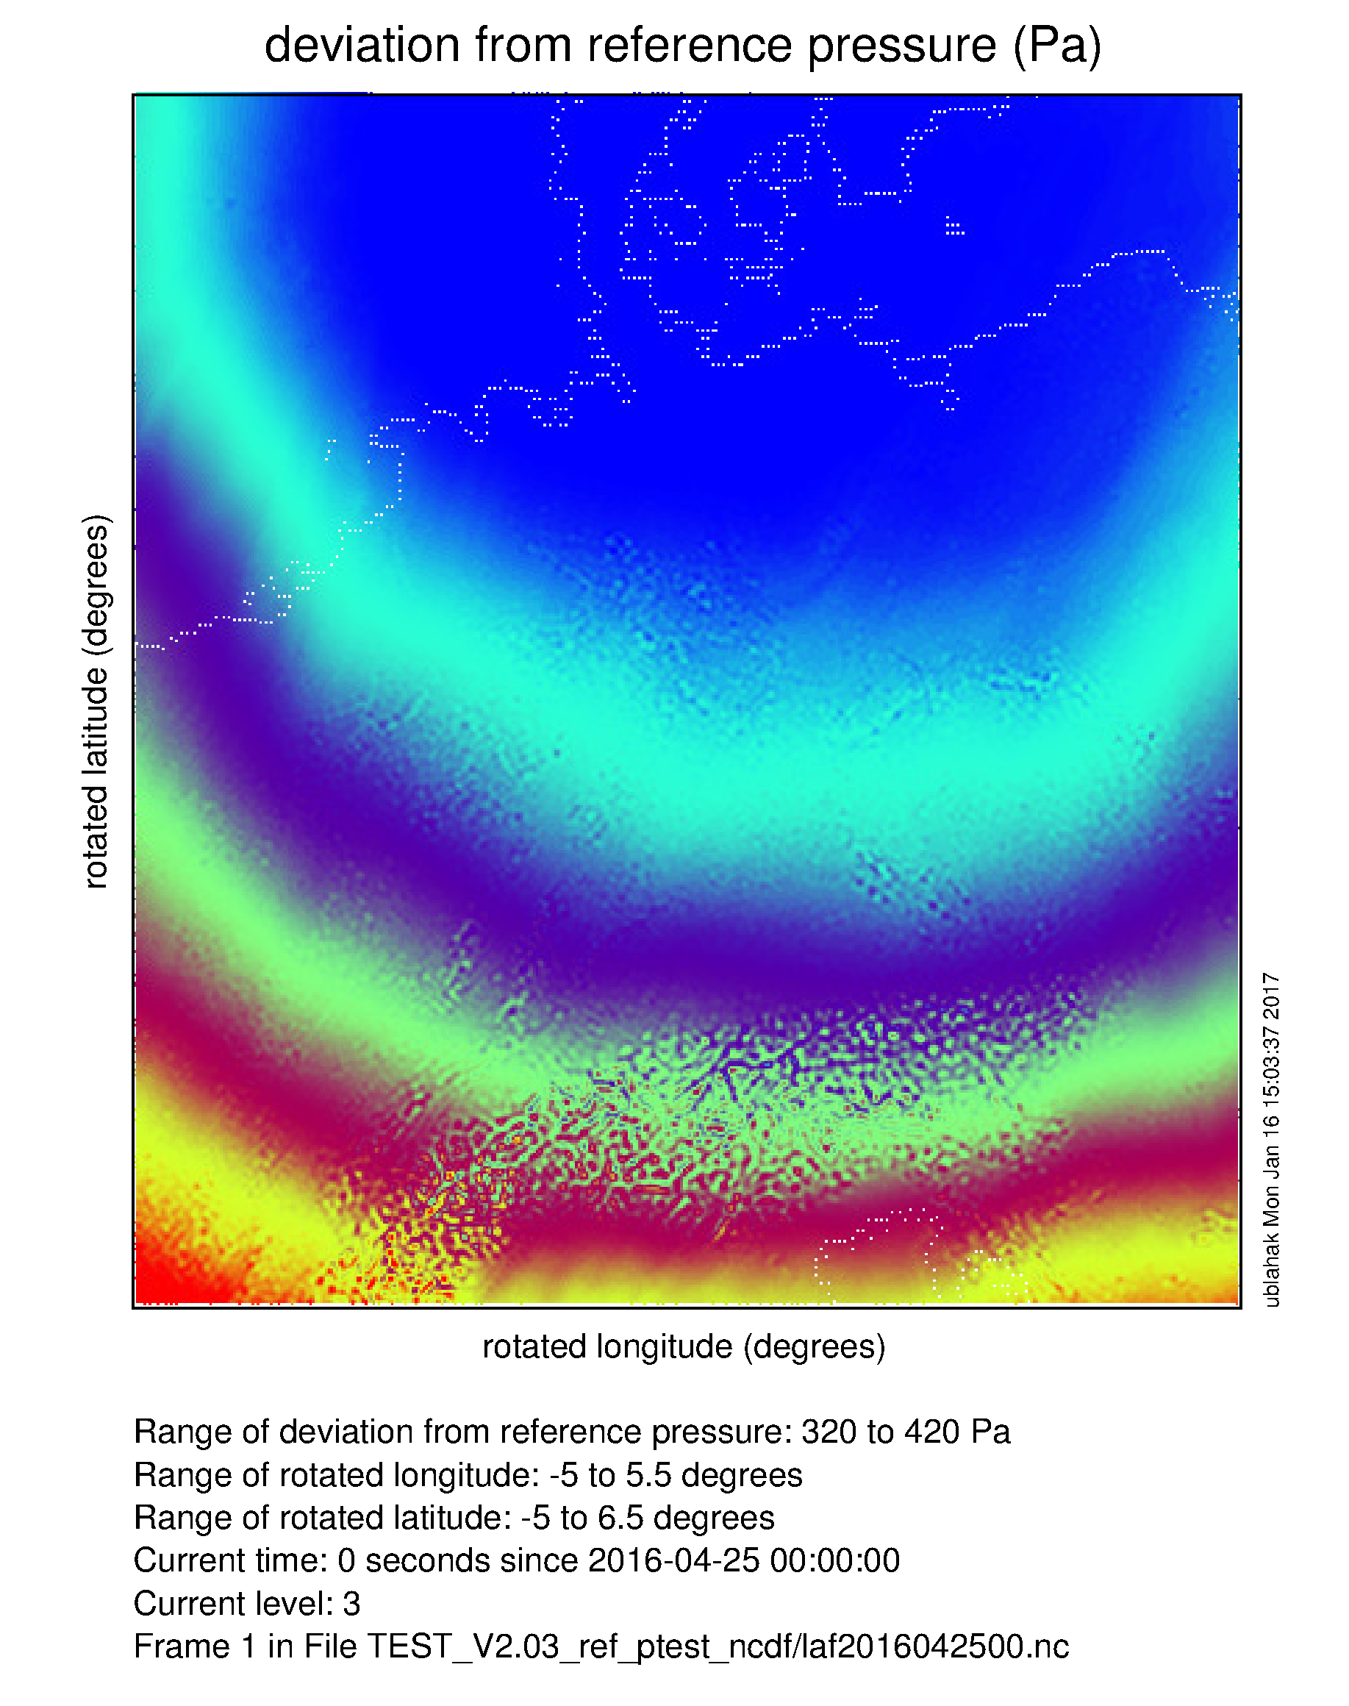
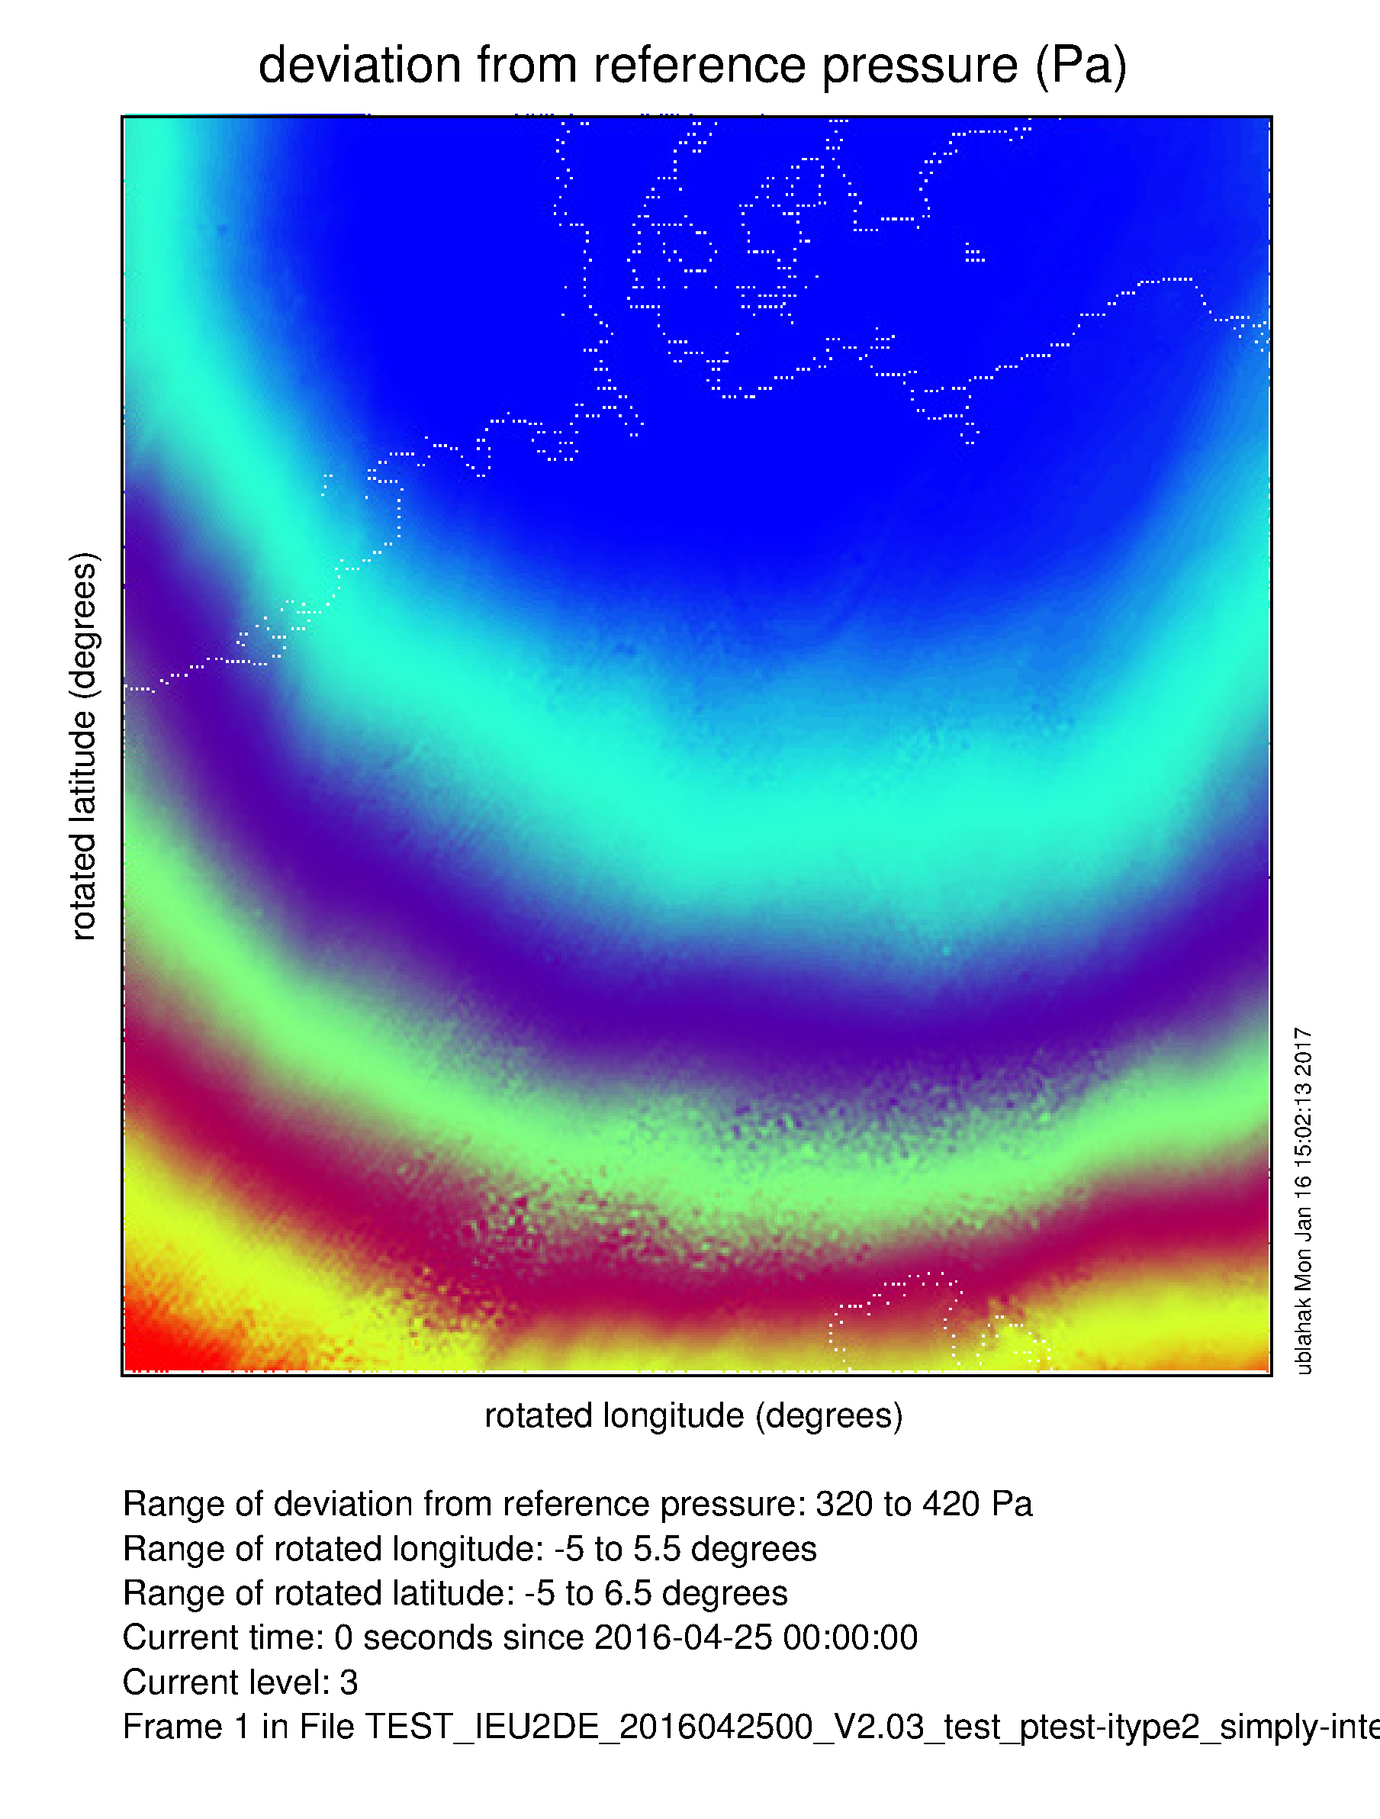
Pressure computation
OLD
NEW
level 4: height ~ 18 km
flat surface

Slide 7
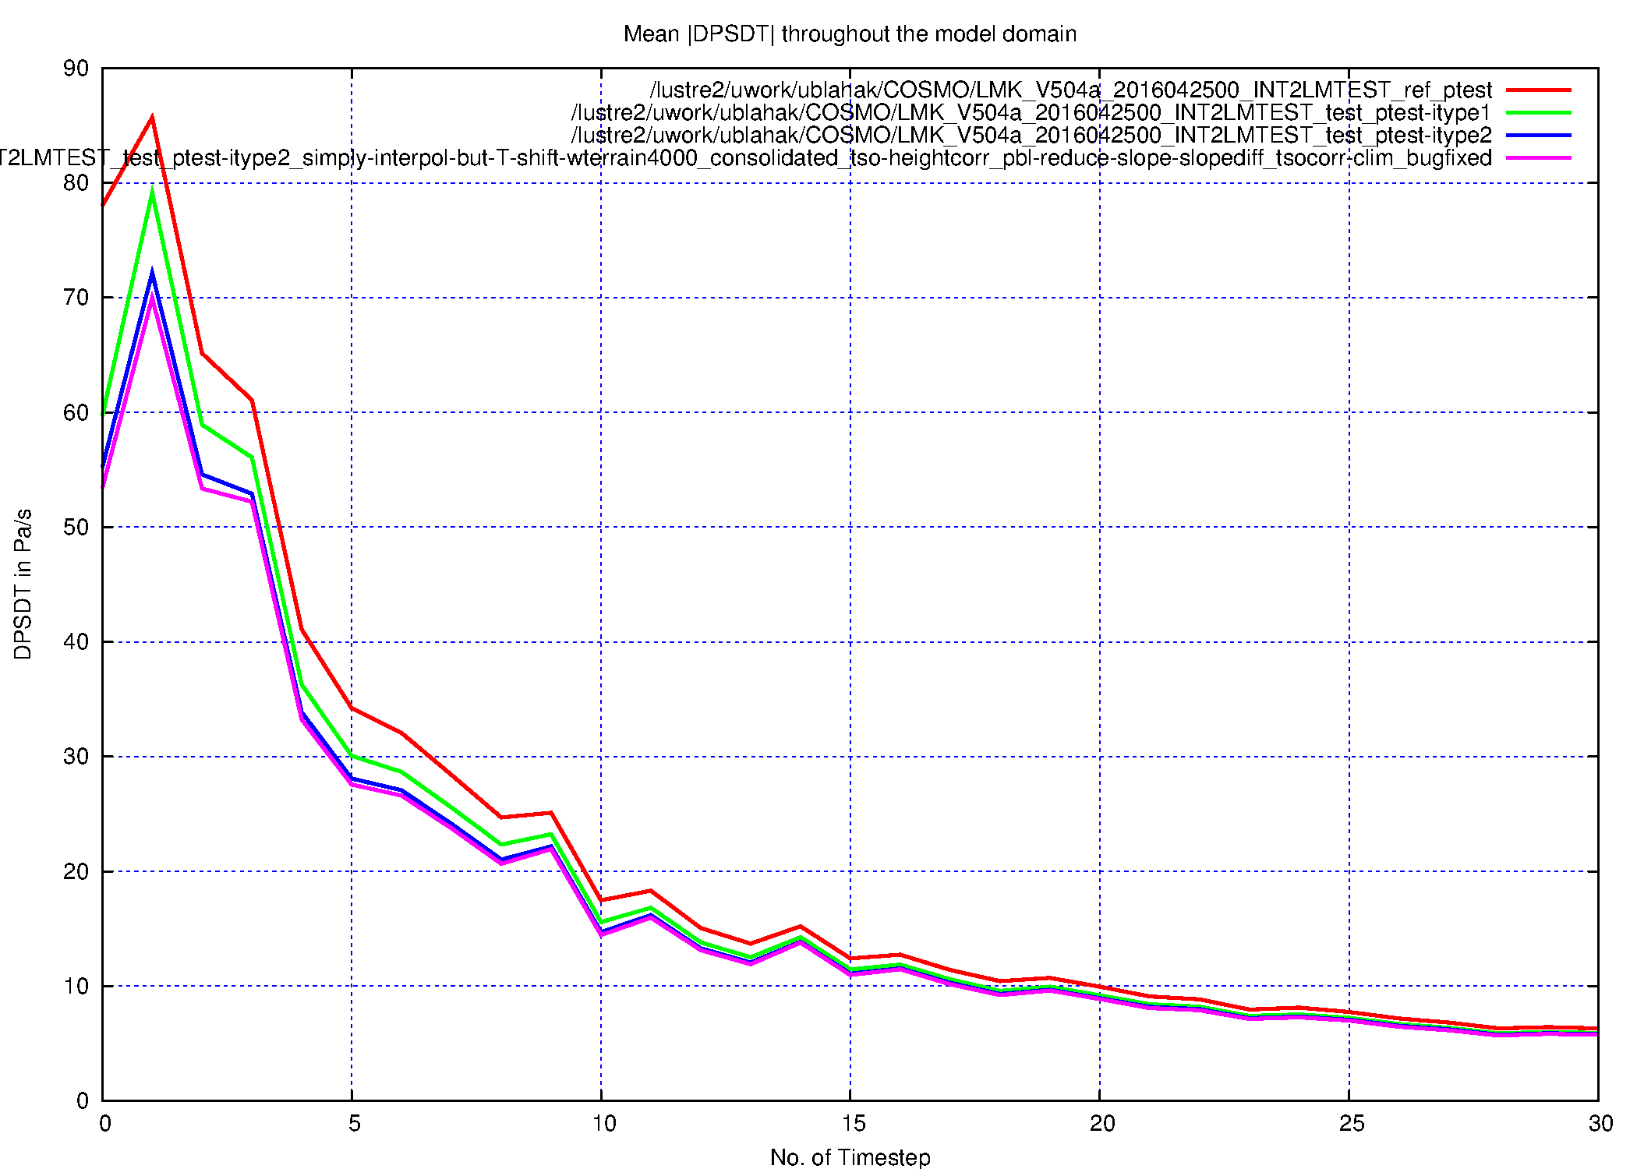
Resulting noise in COSMO-DE
OLD PP
NEW PP
NEW PP +
NEW PROFILE METHODS (see following slides)
DPSDT

Slide 8
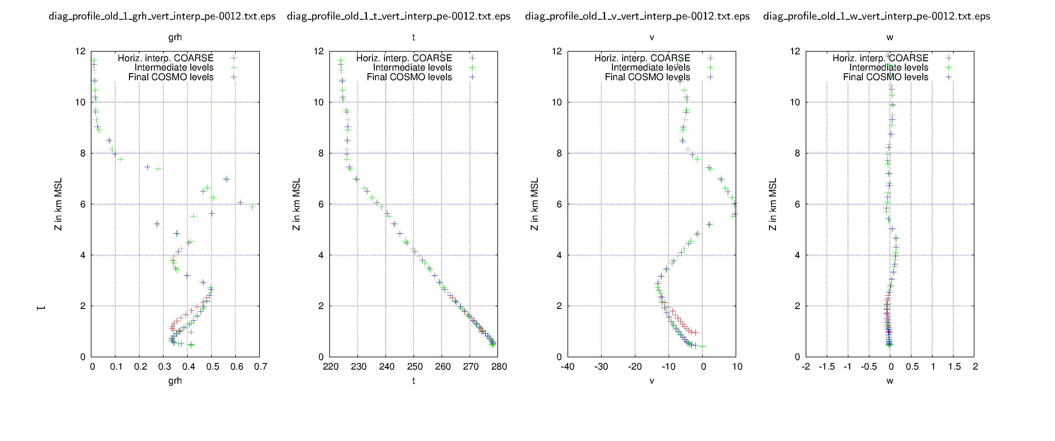
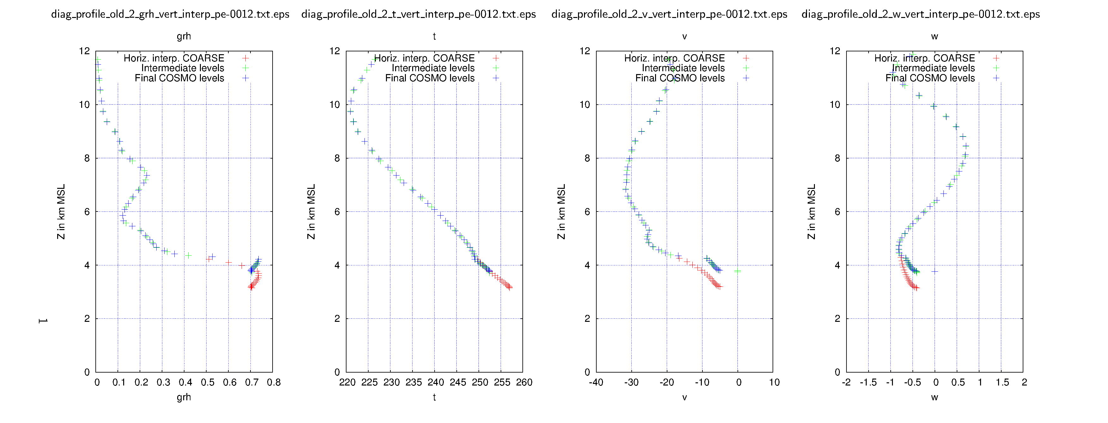
OLD profile methods for other vars
OLD
deeper valley
higher mountain

Slide 9
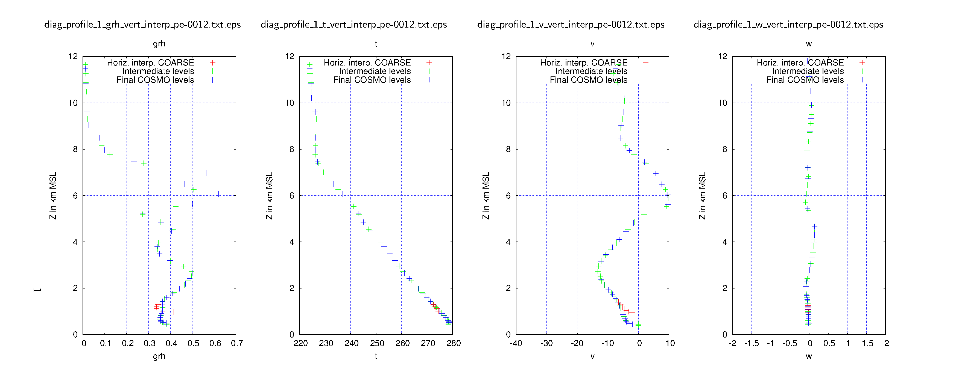
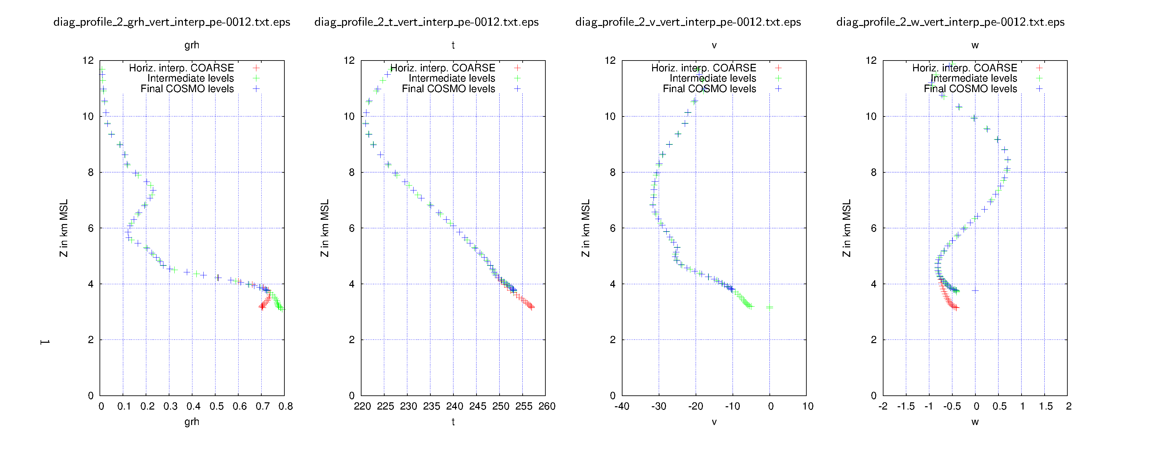
New profile methods for other vars
NEW
„gradient extrapol. + linear transition“
„gradient extrapol. + linear transition“
deeper valley
„gradient extrapol. + linear transition
+ terrain following“
Tracers:
„gradient extrapol.
+ linear transition“
„gradient extrapol.“
higher mountain
Tracers:
„linear transition“
„linear transition
+ terrain following“
„simple interpol.“
„simple shift“
„simple interpol.“

Slide 10
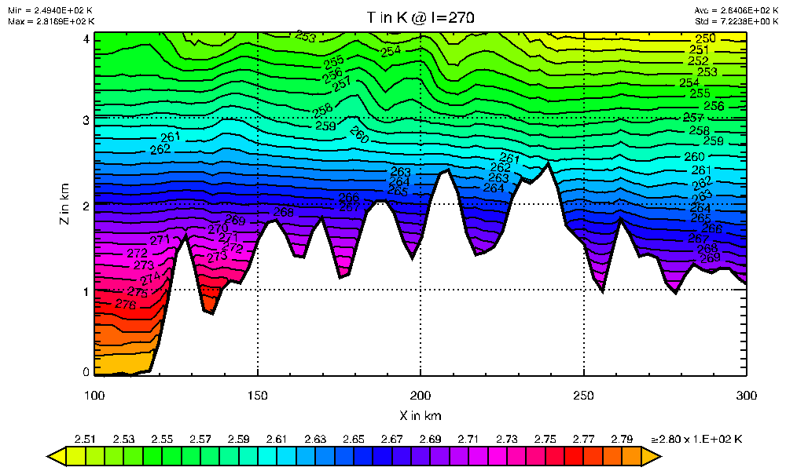
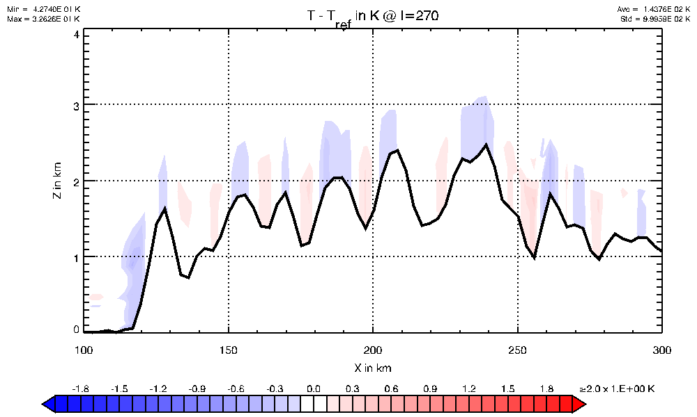
New profile methods: example for T
Difference to old method

Slide 11
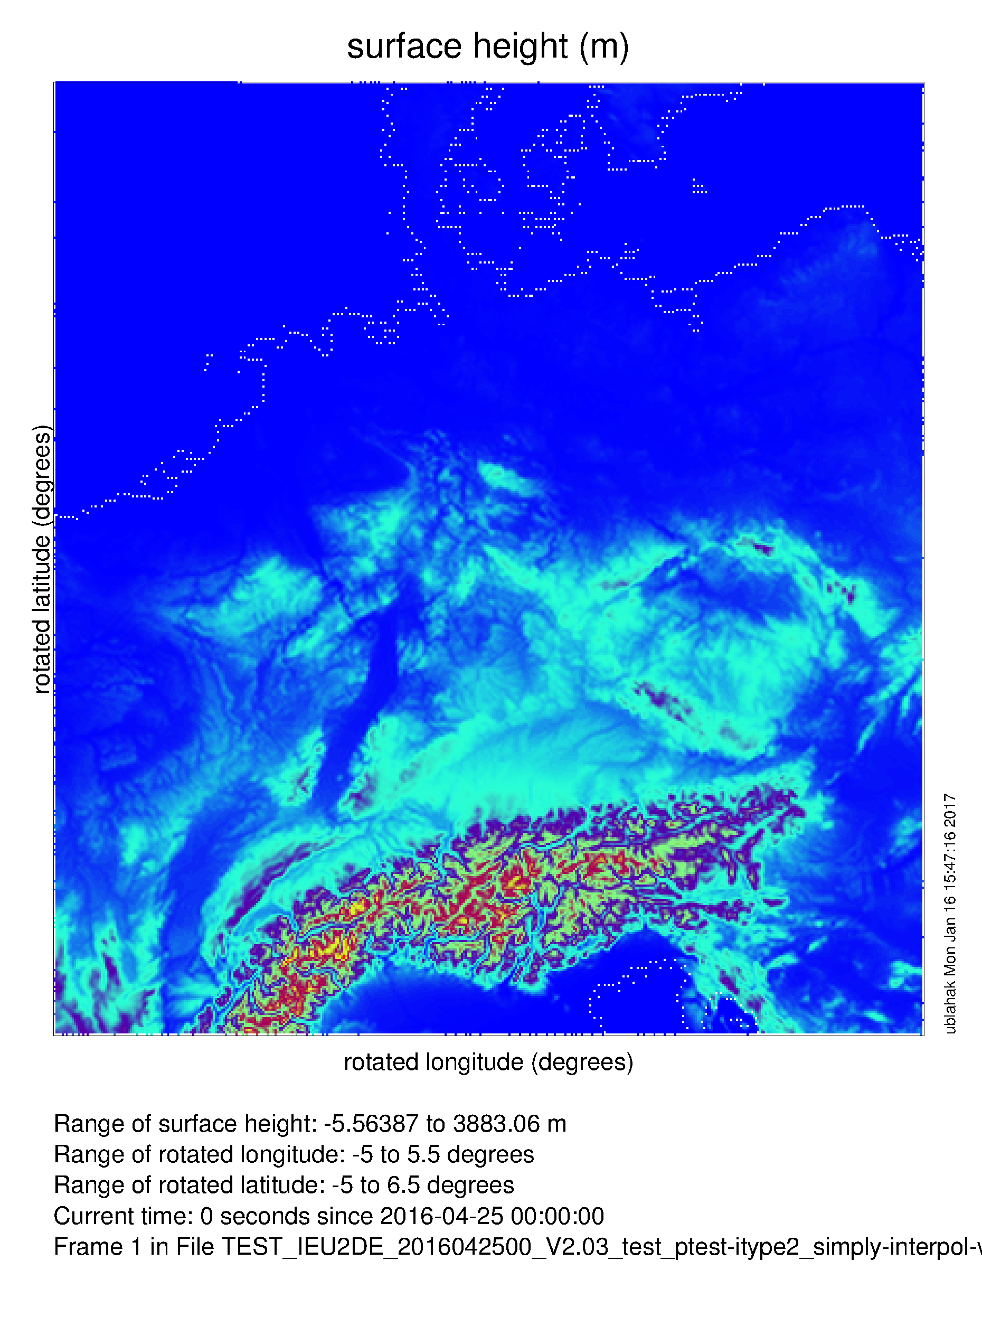
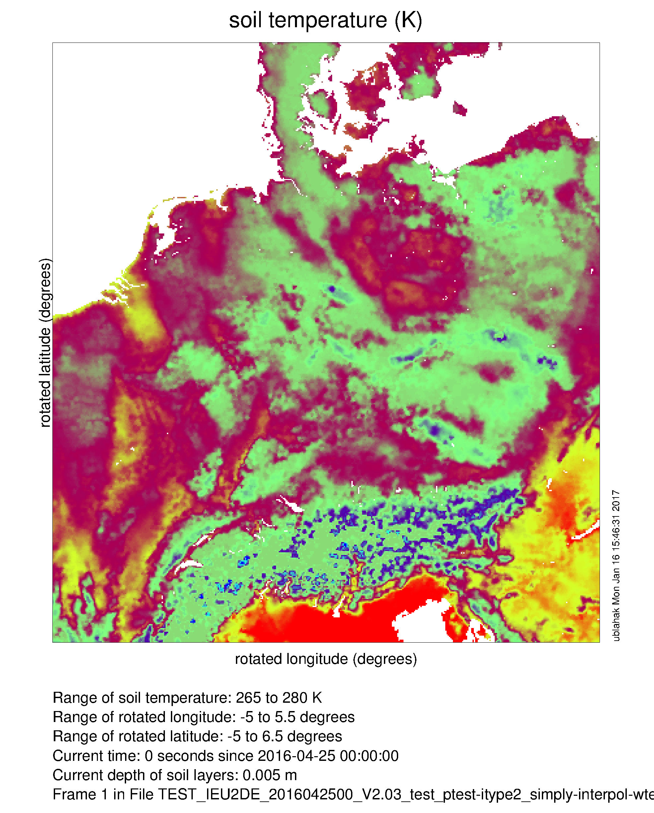
Soil temperature bug
(First layer)
COSMO oro
??? rather smooth!

Slide 12
Soil temperature bug
(First layer)
COSMO oro

Slide 13
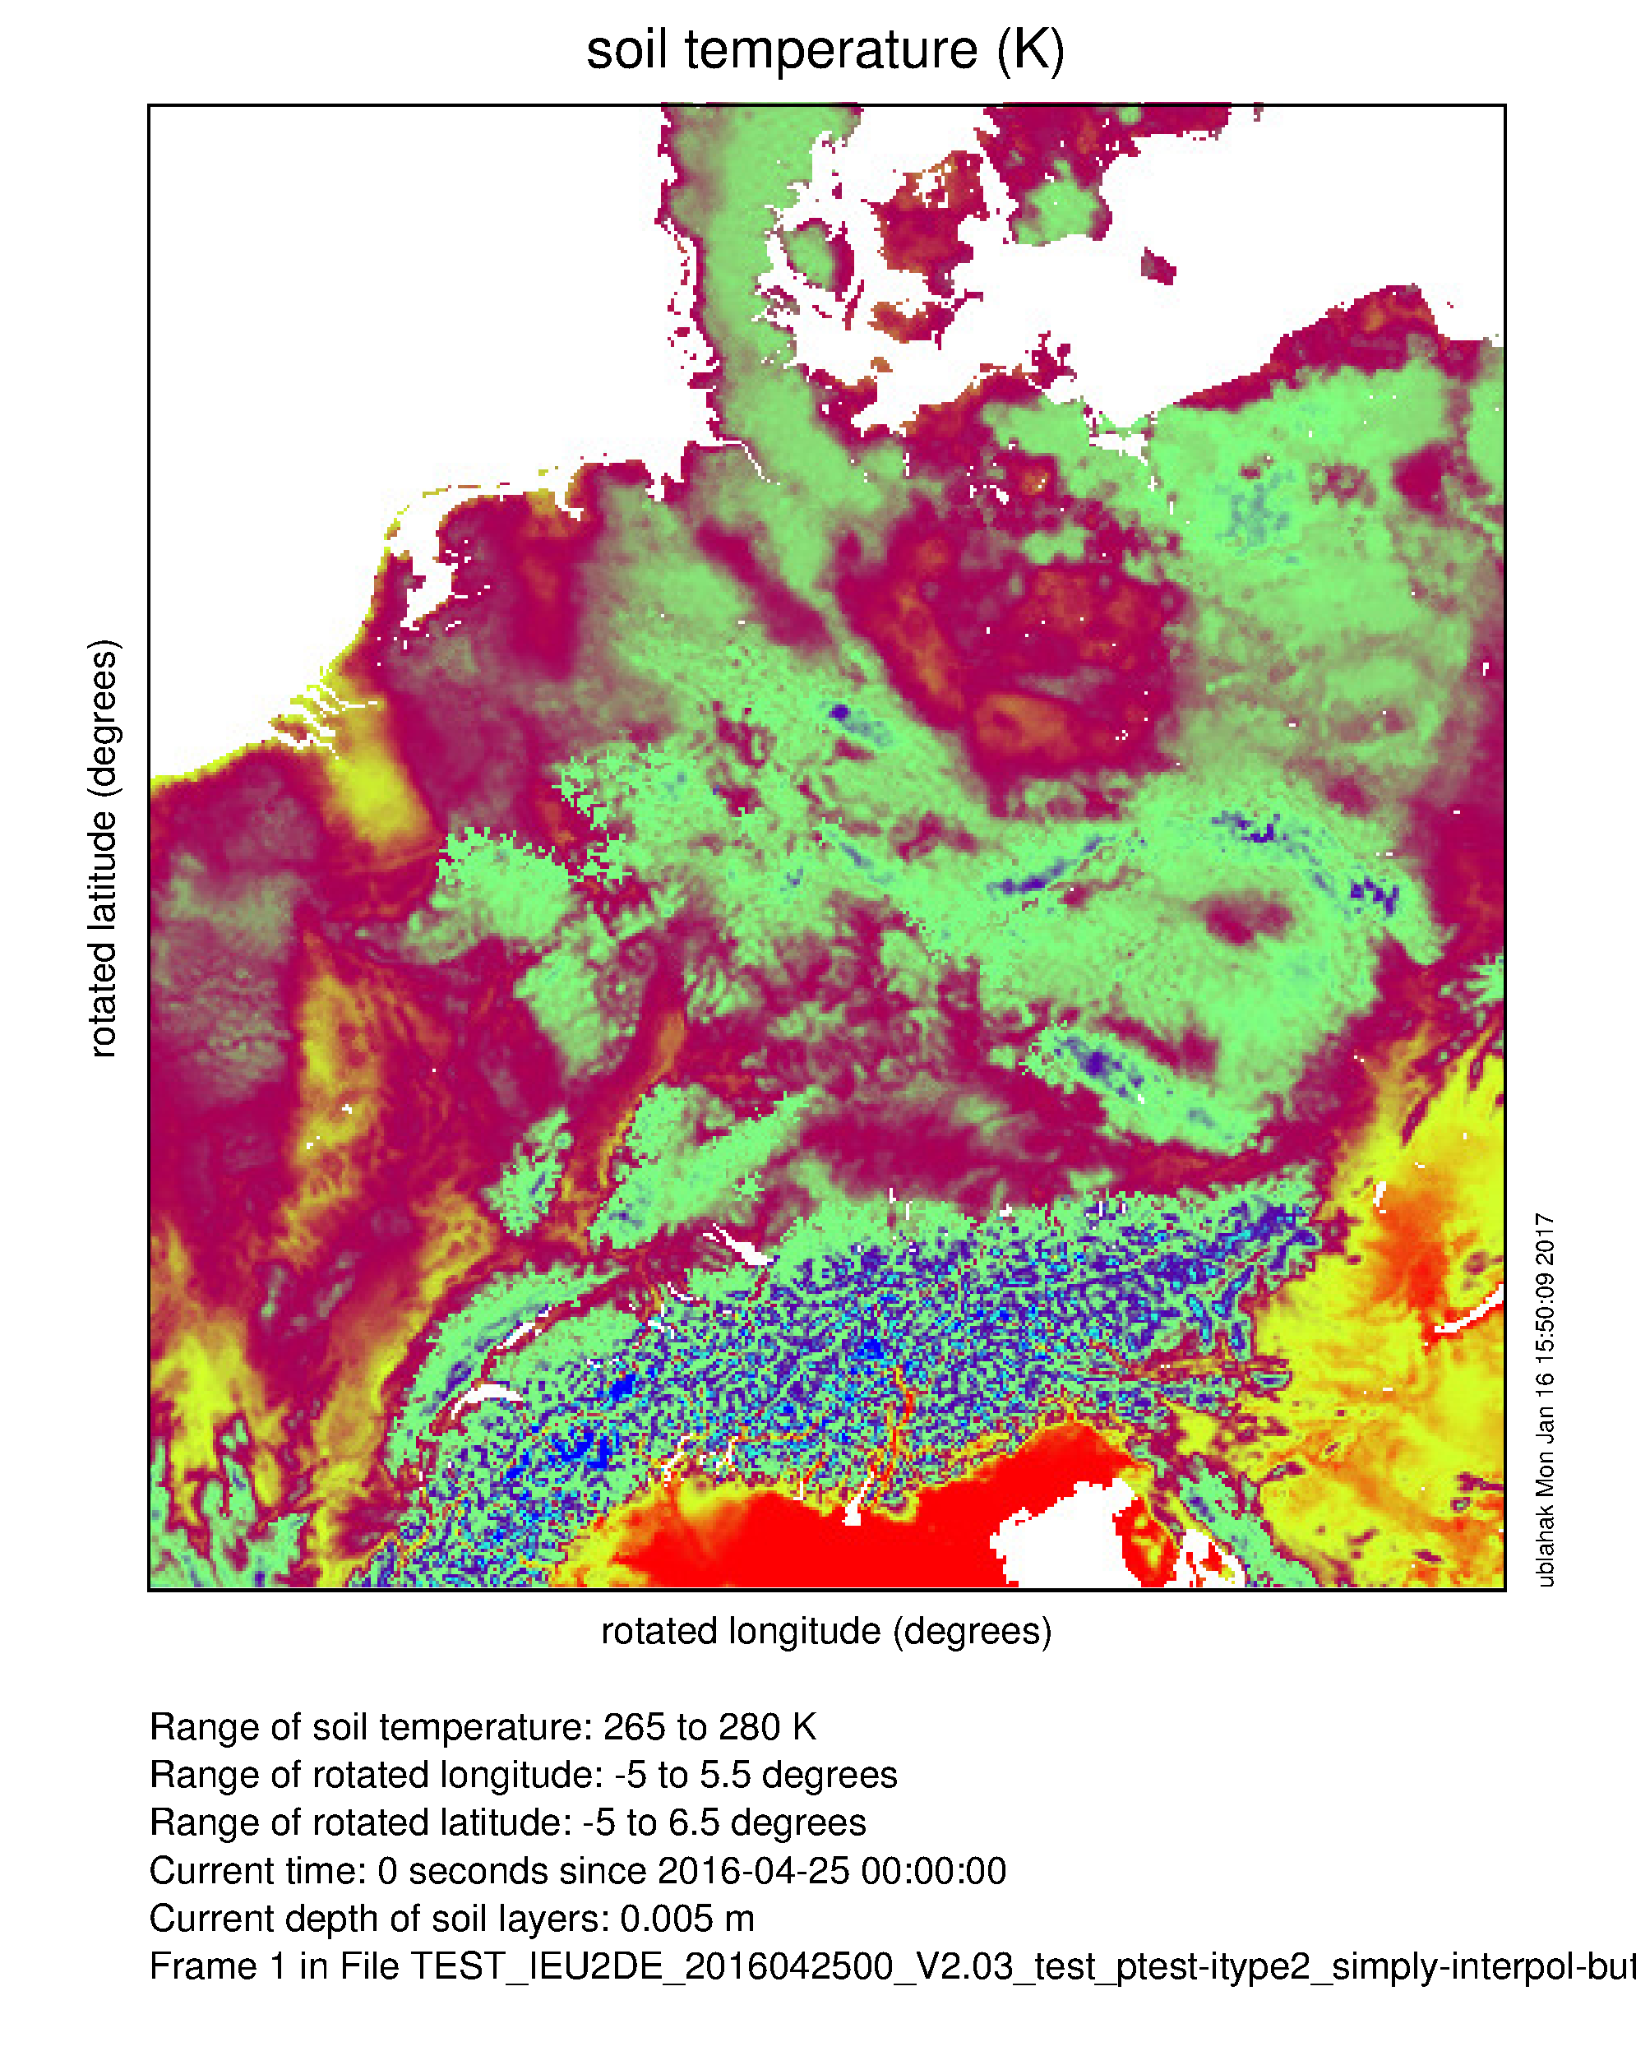
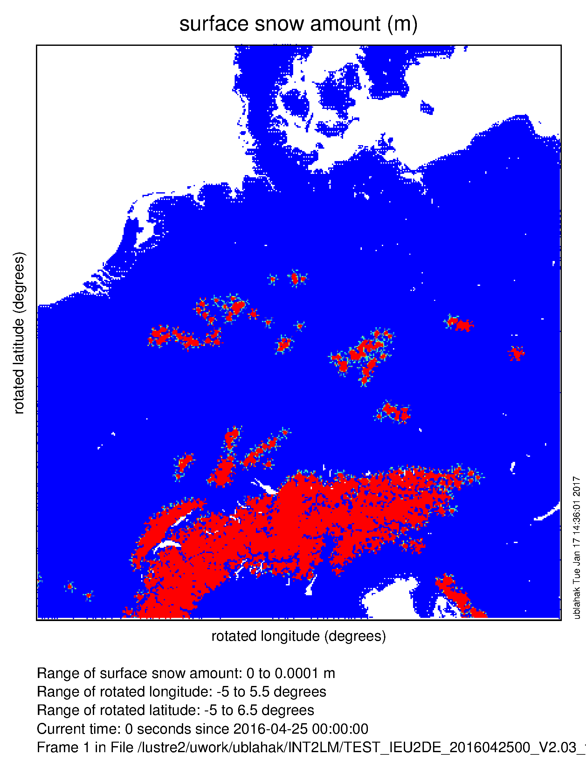
Soil temperature bug fixed
(First layer)
COSMO oro
„Crow‘s-feet“ stem from small snow amounts in ICONEU-input (partial snow cover). In this case, int2lm clips T_S to -0.8°C at, and because this is not the case in the ICON input data, the clipping is inherited to the soil levels by conservation of the vertical differences!

Slide 14
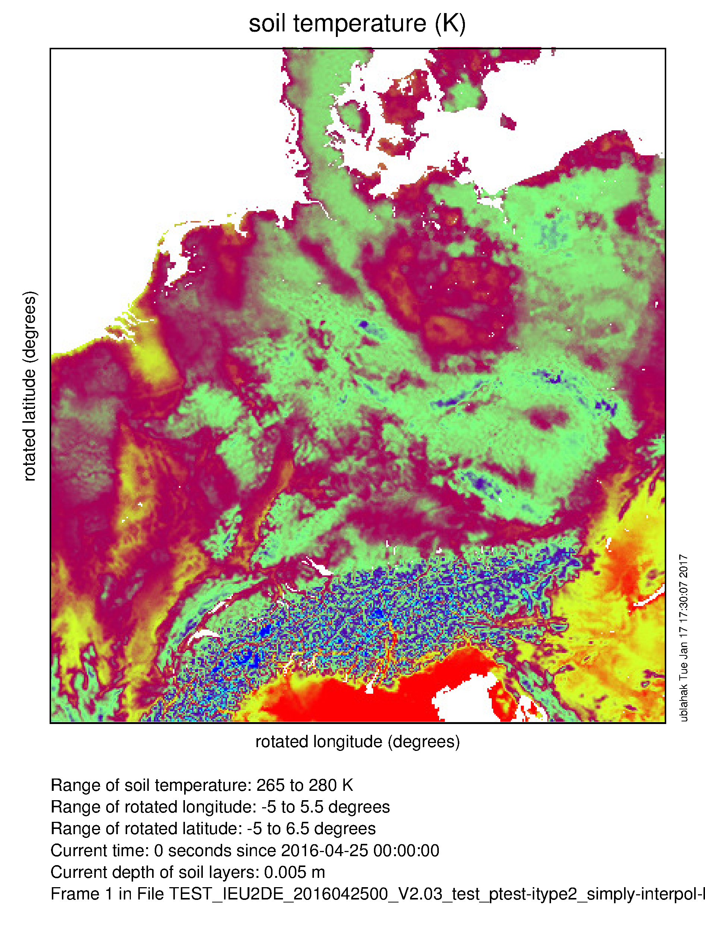
Clipping of T_S to -0.8°C removed
(First layer)
COSMO oro
Also effects in the Alps!

Slide 15
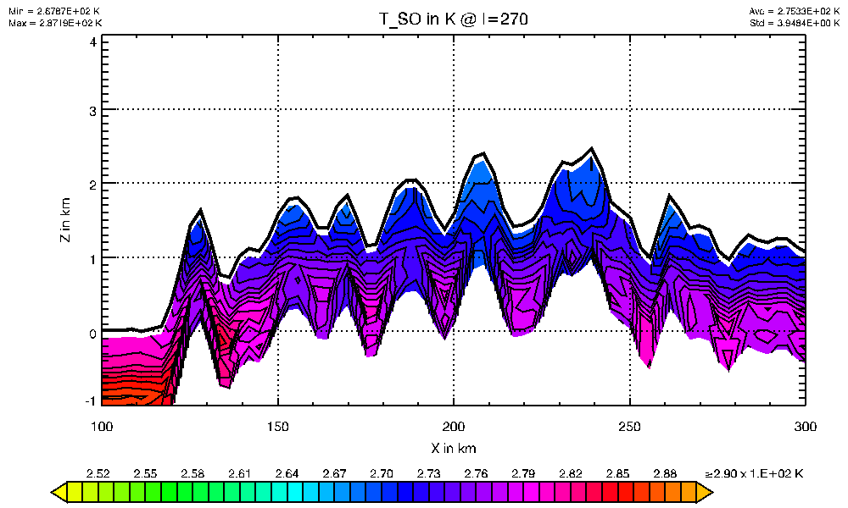
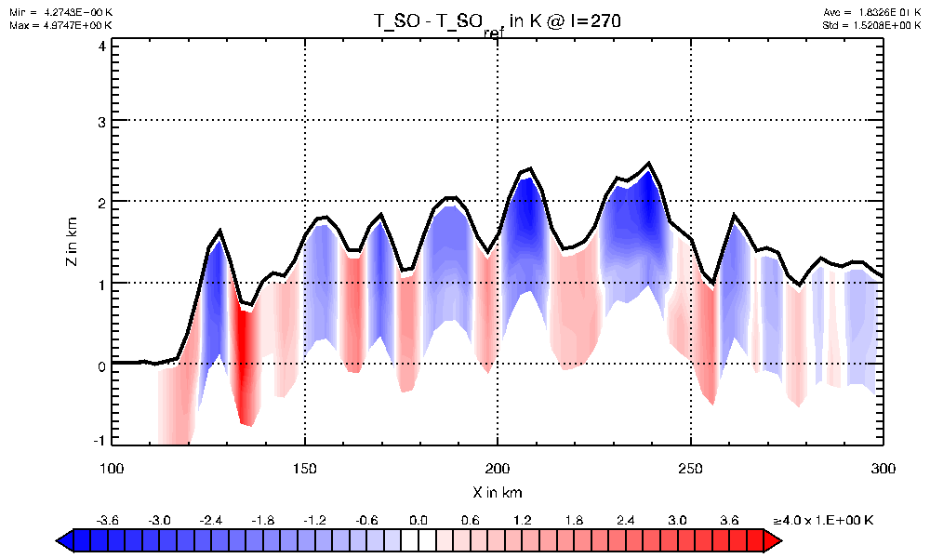
Soil temperature bugfixed and blending to climatological height correction
COSMO oro
Bugfixed and clipping removed + blending towards climatological height correction for deeper layers
Difference to old method

Slide 16
Effect of changes on standard verification at IMS
See following slide from Pavel Khain …

Slide 17
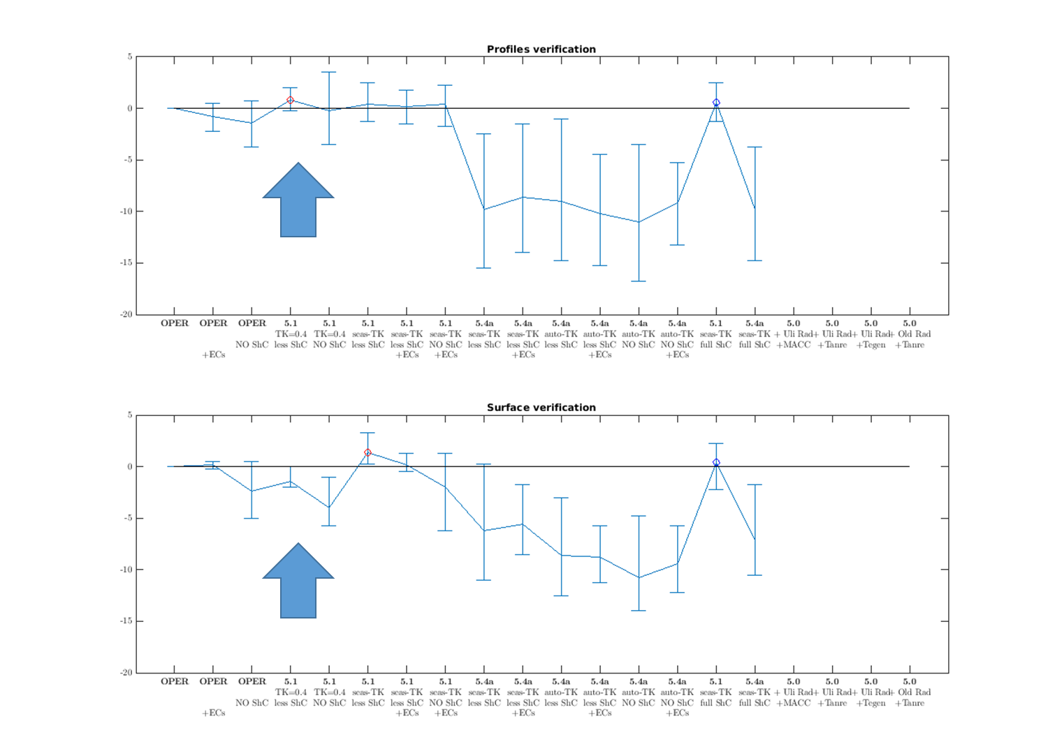
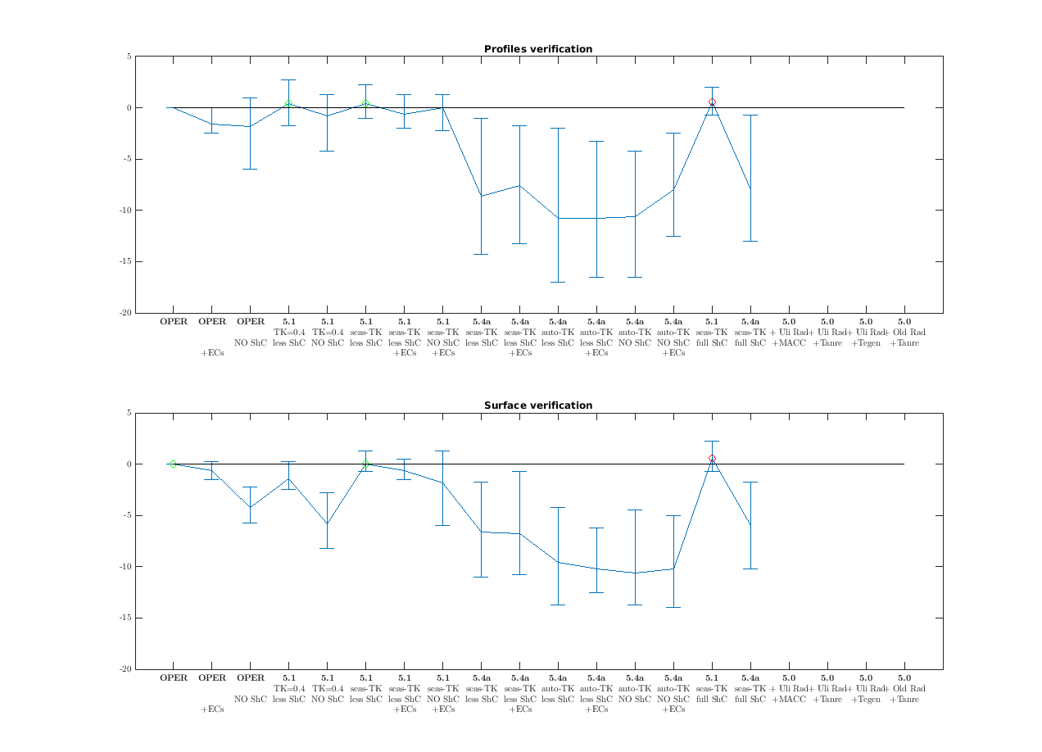
Overall „IMS-score“ for 7 summertime cases and different model configurations
Old INT2LM
New INT2LM
Oper.
(still old INT2LM) Oper.
Overall averaged IMS-Score over T, Wind, RH, over all cases and 3 fcst hours 24, 36, 48 h

Slide 18
Summary of these changes
Non-hydrostatic input models: (new options activated by default!)
  Pressure now spatially much more smooth over mountains
    less initial noise if COSMO starts from interpolated analysis
    less noise at the boundaries
  New methods for vertical interpolation of the other 3D fields also lead to a reduction of the initial noise
  Blending to terrain-following W near the surface also reduces noise
ICON input:
  Now soil temperature T_SO in initial data is truly adapted to the COSMO orography and near-surface T (bugfix)
  Option to blend T_SO from pure T_{ke} –difference conservation near the surface to a pure climatological height correction at larger depth
  (new option activated by default!)
These changes lead to considerable forecast improvements at IMS

Slide 19
Further changes
Processing of fields for the newest Kinne-climatology (from T2(RC)2 )
  Work of Marina Shatunova, Natalia Chubarova, … (T2RC2)
  Monthly mean optical properties for the 8 Ritter-Geleyn wavelenghts (+ the 550 nm wavelength)
  Only total aerosol (original climatology is for fine- and coarse-mode)
  shortNames of fields in EXTPAR: AOT12, SSA12, ASY12 (dim: ie:je:12:9)
  Currently only supported for NetCDF extpar files! Something special would have to be made for grib1/2, first in extpar and then in int2lm!
  itype_aerosol = 3 (in prep. also for COSMO)
Processing of CAMS aerosols from operational IFS (from T2(RC)2 )
  itype_aerosol = 4

Slide 20
Further changes
Possibility to process only the external parameters at initial time:
  Some external parameters are time dependent (climatologies, plant cover, LAI, …)
  For some applications it is necessary to update these from time to time.
  Up to now, this was technically only possible in climate mode and/or if all atmospheric fields were also available for the respective time from a driving „coarse“ model.
  Now this can be done stand-alone (lextpar_lm_only=.true.). No data from a „coarse“ model necessary. Data will be written to a laf-file.
  Applications:
    Just getting the external parameters for a certain time
    Producing boundary data from a coarse model with shifted initial time, but at the same time updating the external parameters, without needing the full fields in the coarse analysis file

Slide 21
Further bug fixes
Fix of index bound violation in computing PP for non-hydrostatic input models (no change of results, apart from possible crash)
Fixed problems with T_S at coastal points for IFS data, when the coarse grid is much coarser than the COSMO grid. There has been a previous extra treatment of such situations, but this treatment could lead to crashes in desert regions, because for very dry soil T_S = 0.0 was produced (no change of results, apart from possible crash)
Fix from Guy de Morsier in an index bound when computing domain decomposition (no change of results, apart from possible crash)

Slide 22
New namelist parameters ( /CNTRL/ )
PARAMETER | DEFAULT | TYPE | MEANING
itype_profiles_vert_interp | 2 | INT | 1 = old method 2 = new method
itype_balance_pp | 2 | INT | 1 = old method (for Leapfrog) 2 = new method (for RK-core)
itype_fast_waves_lm | 2 | INT | If itype_balance_pp = 2: 1 = „old“ RK fast waves solver 2 = „new“ RK fast waves solver (SC-form)
lmultlay_deepsoil_clim_hcorr | .TRUE. | L | Whether or not to blend the T_SO height adaption from conservation of vertical differences to the T_{ke} near the surface towards a climatological height correction (-0.007 K/m) at deeper layers.
itype_aerosol = 3 / 4 | 1 | INT | New option „3“ for Kinne (2015) aerosol climatology (MACv2); „4“ for CAMS aerosols
lextpar_lm_only | .FALSE. | L | Option to only process external parameters of COSMO (see one of the next slides)
Eliminated: lbalance_pp (because this has to be done always!)

Slide 23
Way forward
Release of 2.05 together with COSMO 5.05
In future, using git at CSCS to host int2lm developments would be beneficial

Slide 24
Todo
User guide
Release planning page
HTML-documentation
misc.global

Slide 25
New profile methods for other vars
Starting from MAX[HSURF_{cosmo} , HSURF_{coarse}] + 500 m (not from klv850)
„simple interp.“ (higher mountains): linear interpolation from intermediate profile
„simple shift“ (higher mountains): remove levels below 500 m AGL as neede and shift PBL profile upwards so that values at 500 m from both sides match
„gradient extrapol.“ (deeper valleys): linear extrapolation down from 500 m AGL with the gradient between 1000 and 500 m AGL to fill gap, shifting of original PBL-values to continuously match at 500 m AGL.
„linear transition“ (both for deeper valleys and higher mountains): linear transition from 500 m AGL towards the surface so that surface values are conserved

Slide 26
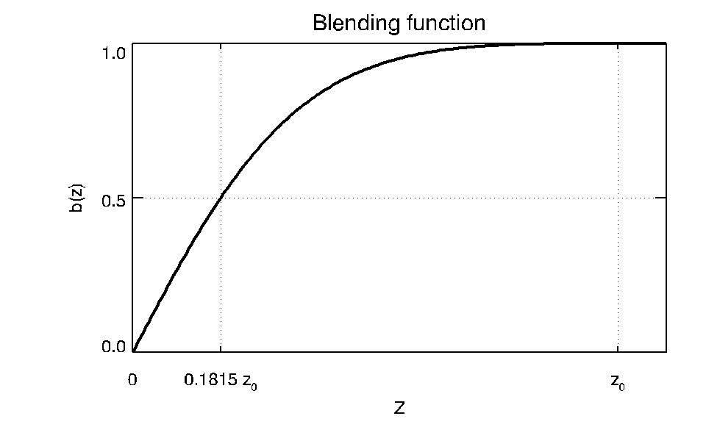
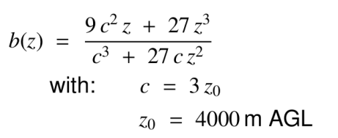
New profile methods for other vars
„terrain-following w“:
Slope-dependent PBL reduction for U, V, T, RH:
  For heights below 500 m AGL, slope- and ΔHSURF-dependent blending to „no-PBL-profile (= extrapolated linear profile using the gradient 1000 m – 500 m AGL). Slope-dependent blending starts at 10 % slope and ends at 20 %, but is reduced if coarse and COSMO-slopes are similar (|Δ| < 5 %).

Slide 27
Soil temperature bug
Intended method of adapting T_SO to new orography based on conserved differences to lowest atm. T (no vertical interp. for ICON/COSMO input!)
T(ke)
…
TS
TSO(1)
TSO(2)
…
T_{gl}(ke)
TS_{gl}
TSO_{gl}(1)
TSO_{gl}(2)
T_{LM}(ke_lm)
ΔTS
ΔTSO(1)
ΔTSO(2)
ΔTSO(3)
TS_{LM}
TSO_{LM}(1)
TSO_{LM}(2)
…
Vertical adapt.
+
-
-
=
+
-
-
=
Horizontal interpolation
+
-
-
=
+
-
-
=
Coarse grid horizontal COSMO grid

Slide 28
Soil temperature bug
Buggy method:

Slide 29
Soil temperature bug
Buggy method: so far correct …
T(ke)
…
TS
TSO(1)
TSO(2)
…
T_{gl}(ke)
TS_{gl}
TSO_{gl}(1)
TSO_{gl}(2)
T_{LM}(ke_lm)
ΔTS
ΔTSO(1)
ΔTSO(2)
ΔTSO(3)
TS_{LM}
TSO_{LM}(2)
TSO_{LM}(3)
…
Vertical adapt.
+
-
-
=
+
-
-
=
Horizontal interpolation
+
-
-
=
+
-
-
=
Coarse grid horizontal COSMO grid

Slide 30
Soil temperature bug
Buggy method:
T(ke)
…
TS
TSO(1)
TSO(2)
…
T_{gl}(ke)
TS_{gl}
TSO_{gl}(1)
TSO_{gl}(2)
T_{LM}(ke_lm)
ΔTS
ΔTSO(1)
ΔTSO(2)
ΔTSO(3)
TS_{LM}
TSO_{LM}(2)
TSO_{LM}(3)
…
Vertical adapt.
+
-
-
=
+
-
-
=
Now comes the error: differencing based on TS_{LM}, not TS_{gl} …
Horizontal interpolation
+
-
-
=
+
-
-
=
Coarse grid horizontal COSMO grid

Slide 31
Soil temperature bug
Buggy method:
T(ke)
…
TS
TSO(1)
TSO(2)
…
T_{gl}(ke)
TS_{LM}
TSO_{gl}(1)
TSO_{gl}(2)
T_{LM}(ke_lm)
ΔTS
ΔTSO(1)
ΔTSO(2)
ΔTSO(3)
TS_{LM}
TSO_{gl}(2)
TSO_{gl}(3)
…
Vertical adapt.
+
-
-
=
+
-
-
=
Therefore, TS_{gl} is exactly recovered, which is the original field from input, interpolated in the horizontal!
Horizontal interpolation
+
-
-
=
+
-
-
=
Coarse grid horizontal COSMO grid

Slide 32
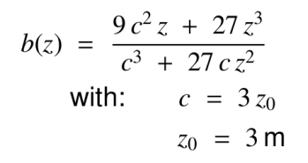
Soil temperature bugfixed and blending to climatological height correction
COSMO oro
Bugfixed and clipping removed + blending towards climatological height correction for deeper layers
Difference to old method

Slide 33
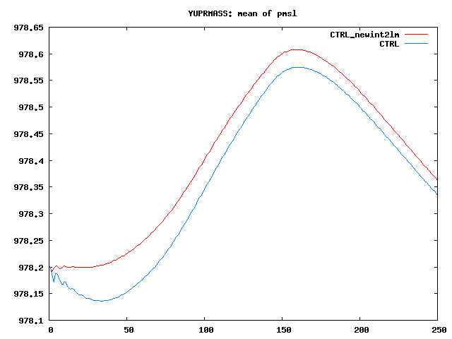
Effect of changes on PMSL in KENDA BACY experiment of Klaus Stephan (~para)
25.5.2016 0 UTC + 2 h
Note: changes only effective at the boundaries
Domain mean PMSL
No. of timestep

