Slide 1
The new operational set-up of
COSMO-DE-EPS
C. Gebhardt, H. Reich, C. Schraff, M. Denhard, R. Kohlhepp, S. Theis, M. Buchhold developers of KENDA, ICON-EPS, ICON-EDA, verification

Slide 2
Outline
former operational set-up
new operational set-up (since 21st March 2017)
verification results („new vs. old“)
verification results (general characteristics in 2017)
future plans

Slide 3
COSMO-DE-EPS - the former set-up
2.8km horizontal resolution
50 vertical levels
20 members
27h forecast range
4 global models
BC-EPS as boundary and initial perturbations
Fixed physics perturbations
Soil moisture perturbation
changes
BC-EPS

Slide 4
Why and how did we change the member generation?
General:
overcome underdispersion of forecasts and improve forecast skill (spread, skill scores, reliability, resolution) by an improved representation of atmospheric variability
use methods being more consistent with the underlying dynamics and statistics

Slide 5
Why and how did we change the member generation?
specific changes:
improved quantification of initial state uncertainty by a “Local ensemble transform Kalman filter” as a statistical-dynamical sound method (“KENDA”) (including stochastic, scale-dependent perturbation of soil moisture, soil temperature, and SST)
ICON-EPS provides boundary conditions for COSMO-DE-EPS based on a state-of-the-art model with high quality. Use of ICON-EPS is technically more feasible (data transfer, robustness)
new randomized selection of physics perturbations improves forecast quality and is more flexible (e.g. perturb more parameters)

Slide 6
Improvements in COSMO-DE-EPS
RP
KENDA as EPS initial conditions 1-20 of 40 members
Soil moisture perturbation as part of KENDA
ICON-EPS members 1-20 of 40 used as boundary conditions
Randomised selection of physics parameter perturbations (RP)
COSMO-DE-EPS
KENDA
ICON-EPS
Soil moisture
perturbation
Folie: T. Tröndle

Slide 7
KENDA & COSMO-DE-EPS (initial conditions)
4D-LETKF (Local Ensemble Transform Kalman Filter)
Observations:
SYNOP, TEMP, aircraft, wind profiler
radar derived precipitation rate via Latent Heat Nudging (LHN)
“deterministic analysis”: Initial Conditions for COSMO-DE
“analysis ensemble”:
observation uncertainties & error inflation
variations in soil moisture, soil temperature and SST
first 20 (of 40) analysis members as initial conditions for COSMO-DE-EPS
ICON-EPS provides boundary conditions for COSMO-DE-EPS based on a state-of-the-art model with high quality Use of ICON-EPS is technically more feasible (data transfer, robustness)
new randomized selection of physics perturbations improves forecast quality and is more flexible (i.e. perturb more parameters)

Slide 8
ICON-EPS & COSMO-DE-EPS (boundary conditions)
COSMO-DE-EPS: 2.8 km
ICON-EU-EPS Nest: 20 km
ICON-EPS: 40 km
Pre-operational ensemble prediction system
Currently operational:
ICON Ensemble Data Assimilation
Boundary conditions for COSMO-DE-EPS

Slide 9
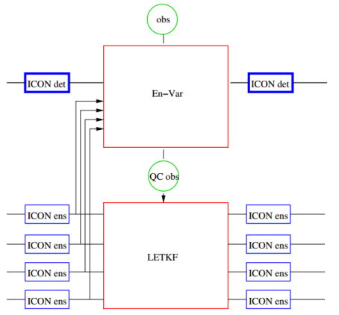
ICON Ensemble Data Assimilation
Global
ensemble data assimilation
ICON-EDA
40 members
40 / 20 km
EnVar
Global ensemble
prediction
ICON-EPS
40 members
40 / 20 km (Europe)
LETKF
LETKF (Localized Ensemble Transform Kalman Filter)
Covariance Inflation
adaptive multiplicative factor
additive Inflation + 0,25B_{3dVar} (NMC Method)
„relaxation to the prior“
SST 1K random perturbations with spatial correlations of 100km/1000km and correlations in time of 1 day
En-Var using flow dependent background error covariance from the LETKF ( -> 13 km)
Andreas Rhodin, Harald Anlauf, Ana Fernandez del Rio, Alexander Cress, Roland Potthast

Slide 10
Randomized physics perturbations in COSMO-DE-EPS
2-3 different values for each of 12 parameters
each parameter is perturbed in 50% of the members of each ensemble run
random selection of members with perturbed parameter at each forecast start (done for each parameter seperately)
parameter values stay fixed over the forecast range
New perturbations (easier to implement with the RP)
a_stab | c_diff | radqi_fact | radqc_ Fact | thick_sc | rlam_heat | entr_sc | q_crit | tur_len | tkhmin | tkmmin | lhn_coef
0 | 0.2 | 0.5 | 0.5 | 25000 | 1 | 0.0003 | 1.6 | 150 | 0.4 | 0.4 | 1
1 | 0.1 | 0.9 | 0.9 | 10000 | 10 | 0.002 | 4 | 500 | 0.7 | 0.7 | 0.5
 | 10 |  |  | 30000 | 0.1 |  |  |  | 0.2 | 0.2

Slide 11
Verification results („new vs. old“)
26th July – 25th August 2016
00 and 12 UTC (not shown) runs with 27 hours forecast range
hourly precipitation vs radar (rain gauge adjusted )
1 and 3-hourly 10m gusts vs SYNOP
2m temperature vs SYNOP

Slide 12
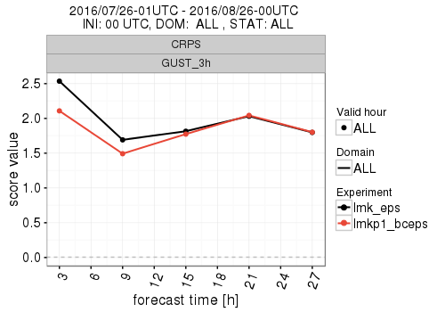
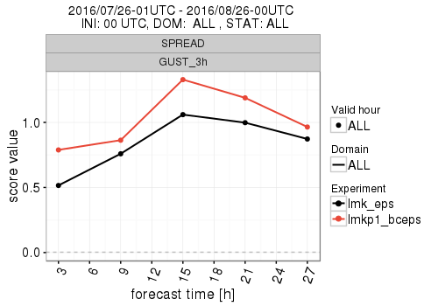
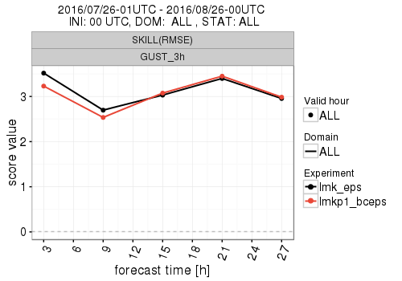
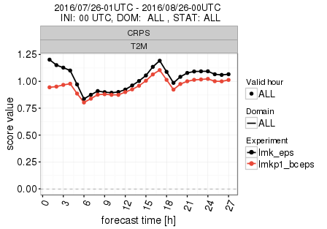
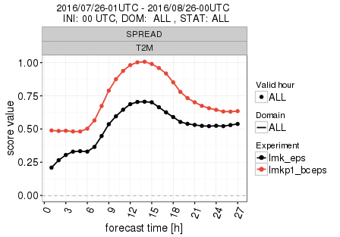
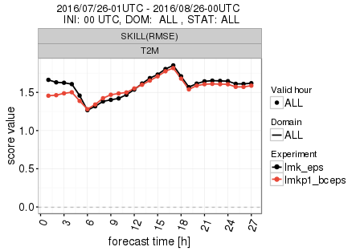
Results CRPS Spread and Skill
WGUST_3h
T2M
routine
kenda+bceps
Time [h]

Slide 13
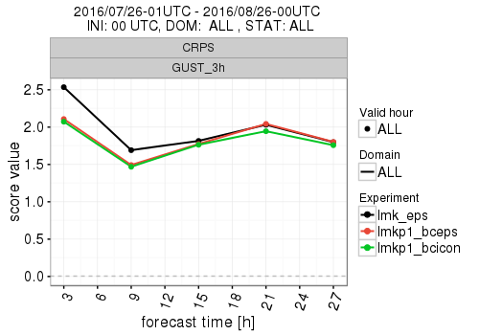
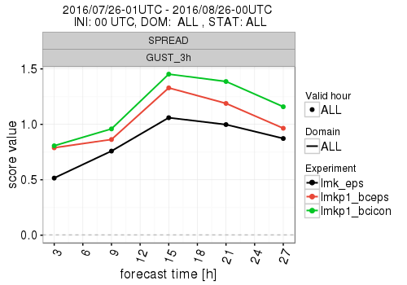
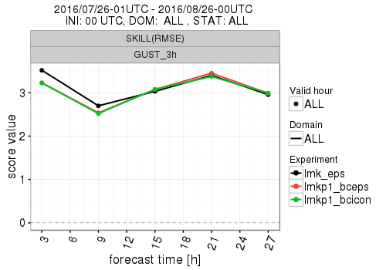
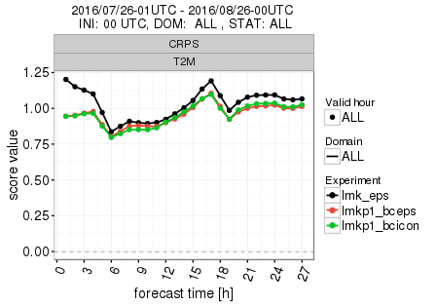
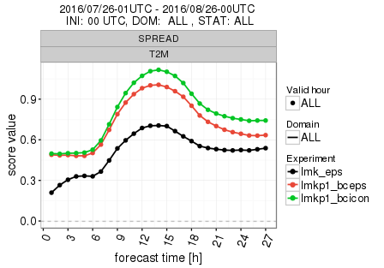
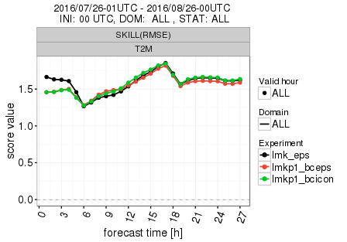
Results CRPS Spread and Skill
WGUST_3h
T2M
routine
kenda+bceps
kenda+icon
Time [h]

Slide 14
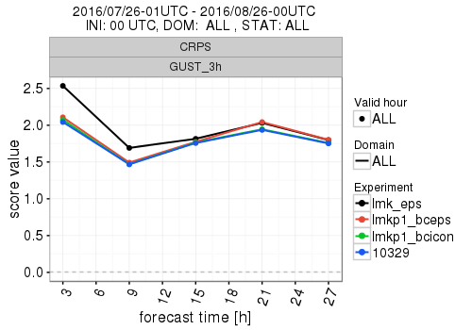
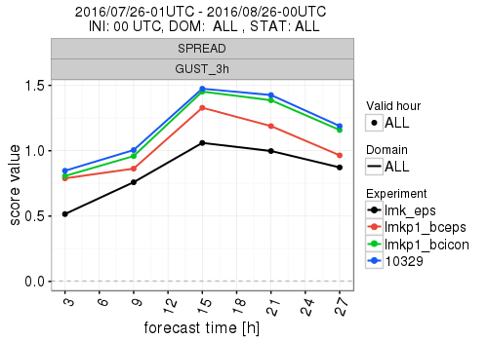
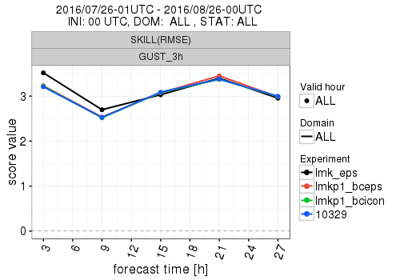
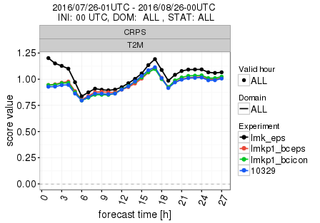
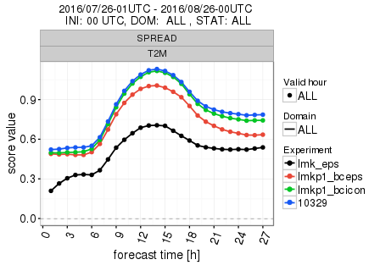
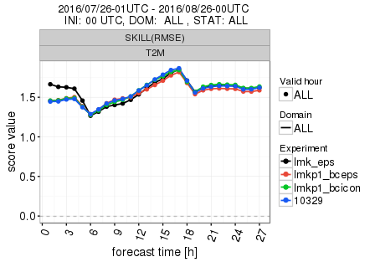
Results CRPS Spread and Skill
WGUST_3h
T2M
routine
kenda+bceps
kenda+icon
kenda+icon+rp

Slide 15
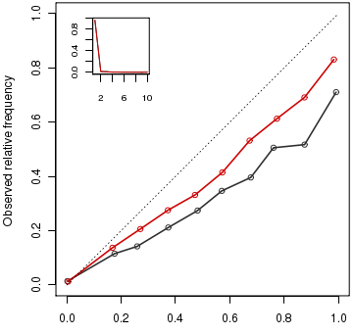
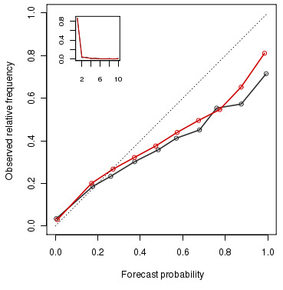
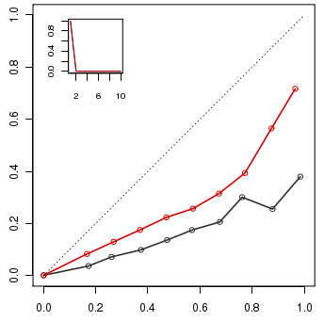
Results – Reliability diagram
Threshold 1mm/h
Threshold 0.1mm/h
Threshold 5mm/h
PREC routine (black) and kenda+icon+rp (red) from 26.07.-25.08.2016
as 00 UTC run for the threshold values 0.1, 1 and 5mm/h

Slide 16
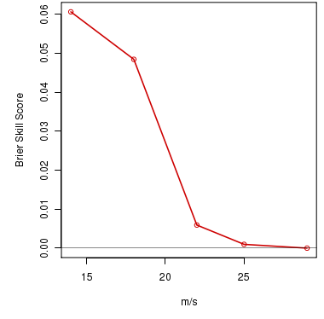
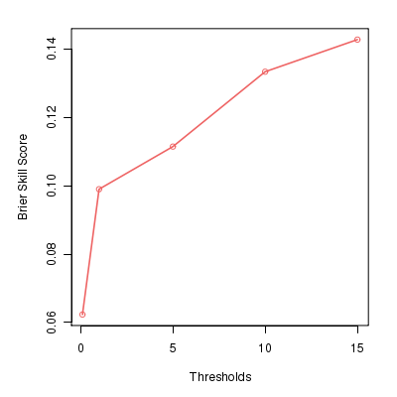
Results – Brier skill score
small data sample size
improving BSS with higher precipitation rates
1h-WGUST kenda+icon+rp vs. routine from 26.07.-25.08.2016 as 00 UTC run
PREC kenda+icon+rp vs. routine from 26.07.-25.08.2016 as 00 UTC run

Slide 17
Verification results (general characteristics in 2017)
June 2017
00 and 12 UTC (not shown) runs with 27 hours forecast range
hourly precipitation vs radar (rain gauge adjusted )
hourly 10m gusts vs SYNOP
no 2m temperature shown

Slide 18
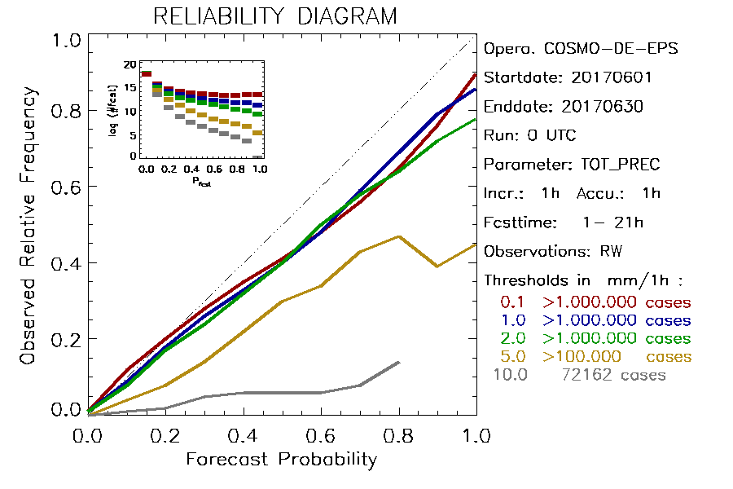
slide by S. Theis
Reliability Diagram precipitation

Slide 19
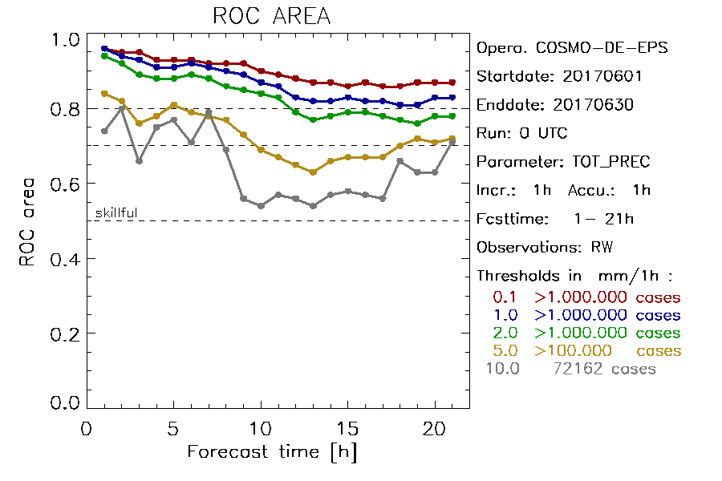
slide by S. Theis
„ROC area“ precipitation

Slide 20
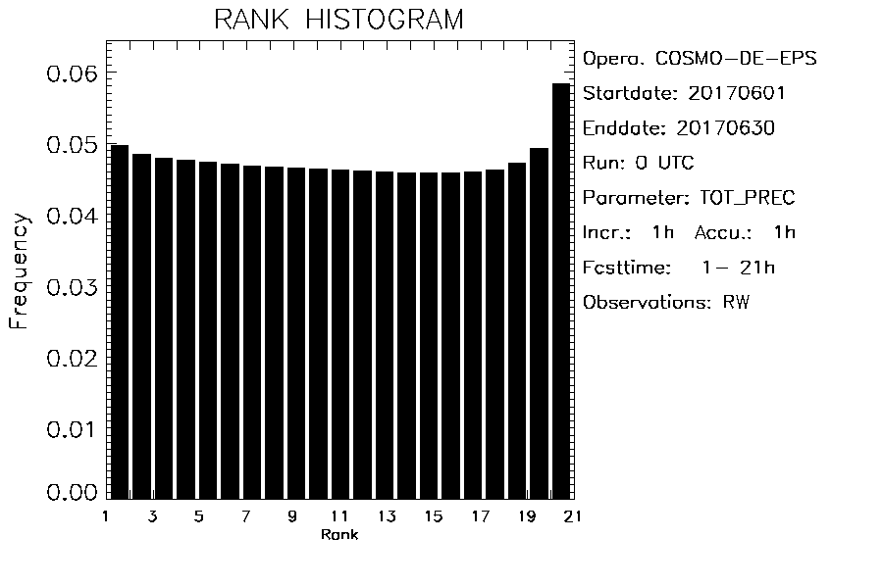
slide by S. Theis
Rank histogram precipitation

Slide 21
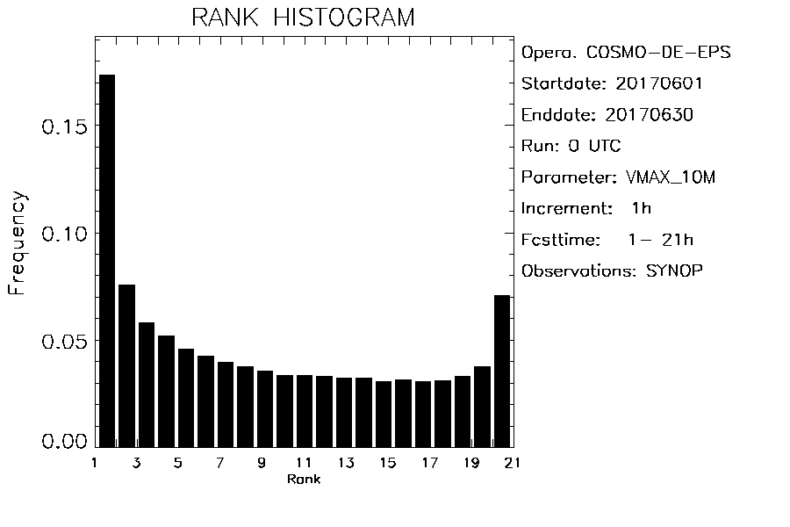
slide by S. Theis
Rank histogram wind gusts

Slide 22
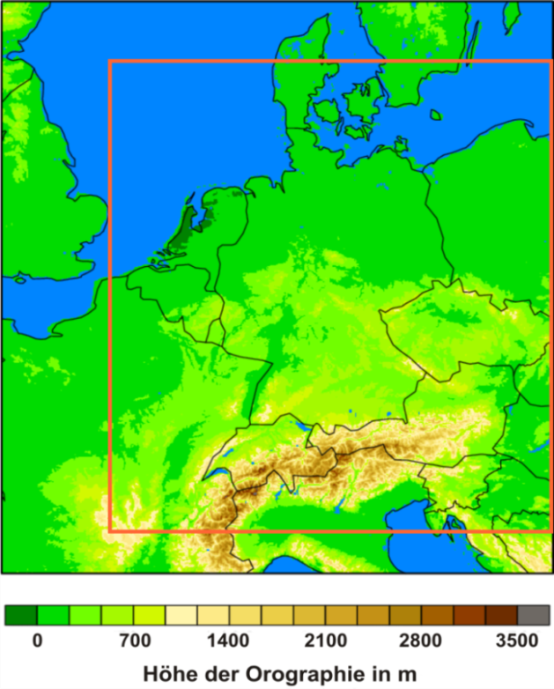
future plans
COSMO-D2(-EPS)
2.2 km
65 vertical levels
651 x 716 grid points
larger domain
stochastic “model for the model error” (E. Machulskaya)
SYNFONY Seamless Integrated Forecasting System for Nowcasting and very short range forecasts
ICON-LAM(-EPS)…..

Slide 23
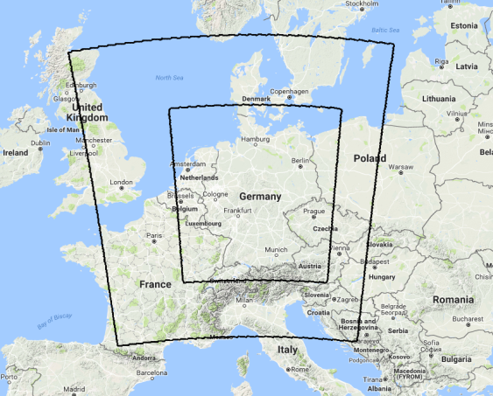
slide by D. Majewski
SINFONY RUC: hourly 12h ensemble forecasts based on very short data cut-off (< 20 min); assimilation of esp. 3D-radar data, satellite (SEVIRI), Mode-S; 40 members for ensemble data assimilation and 40 members for EPS.
ICON-LAM-EPS: every 3 hours ensemble forecasts up to 48h; 40 members for ensemble data assimilation and 30 members for EPS.
Model domain of SINFONY RUC / ICON-LAM:
538.000 grid points / layer with a grid
spacing of 2.08 km for the full domain and
a 2-way nest with 707.000 grid points / layer
and a grid spacing of 1.04 km for Germany.
65 layers.
Δ~ 1.04 km
Δ~ 2.08 km

Slide 24
slide by S. Theis
Outlook: Novel Product Types (not operational yet)
members themselves
(one color per member, > 40 dBZ)
12.Mai 2015
Source:
European Severe Storm Laboratory
Testbed 2015

Slide 25
Thank you for your attention!!

