Slide 1


Current activities in the
CLM-Community
Barbara Früh & CLM WG coordinators
COSMO – General Meeting
September 13, 2017
Jerusalem, Israel

Slide 2
Content
Ongoing activities (selected)
CLM-Community efforts:
  Evaluation of Convection Permitting Climate
  simulations (CECPC5.0)
  CORDEX CORE
Time step dependency of COSMO-CLM simulation results
COSMO-COSMO-CLM reunification
CLM-Community issues

Slide 3
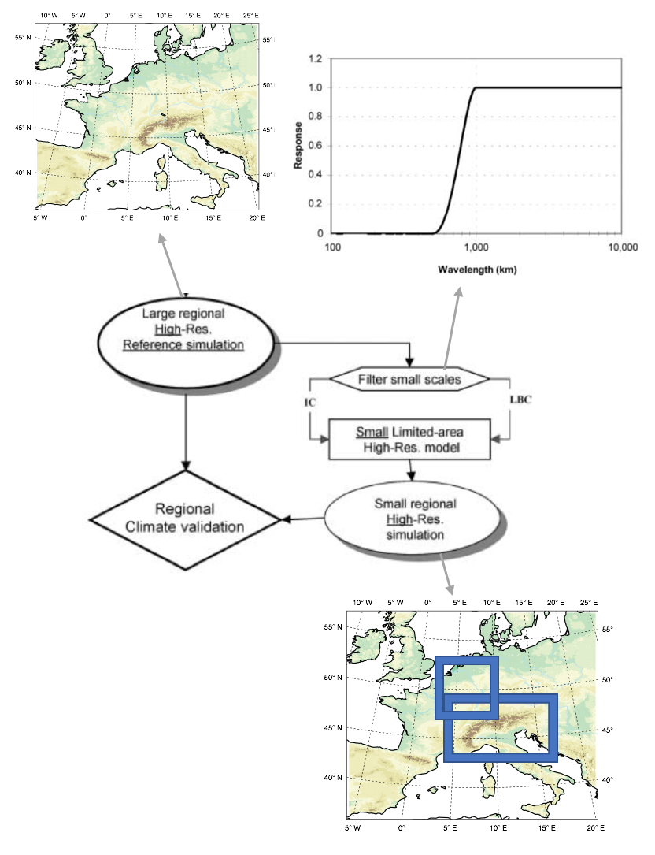
CRCS working group
Big Brother experiment - Method:
Produce large simulations (Big brother) at convection-permitting scale.
Use Big Brother output as input for a simulation with a smaller domain (Little brother).
Compare the little and big brother. Ideally they should match perfectly.
Big Brother experiment - Result:
First results: difficulty in filtering graupel in a physically consistent way.
Both 6-hourly and 1-hourly update frequencies of the LBC lead to inconsistencies
Slide: courtesy of Erwan Brisson

Slide 4

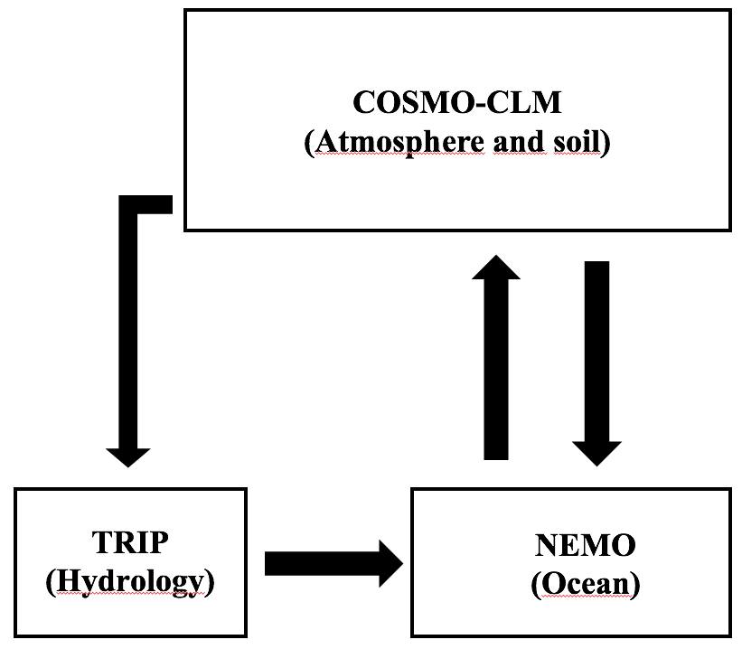
WG AIO: Coupling of the Mediterranean Sea,
North- and Baltic Sea to COSMO-CLM
COUPLED – UNCOUPLED SST (ERA-Interim)
Slide: courtesy of Erwan Brisson

Slide 5
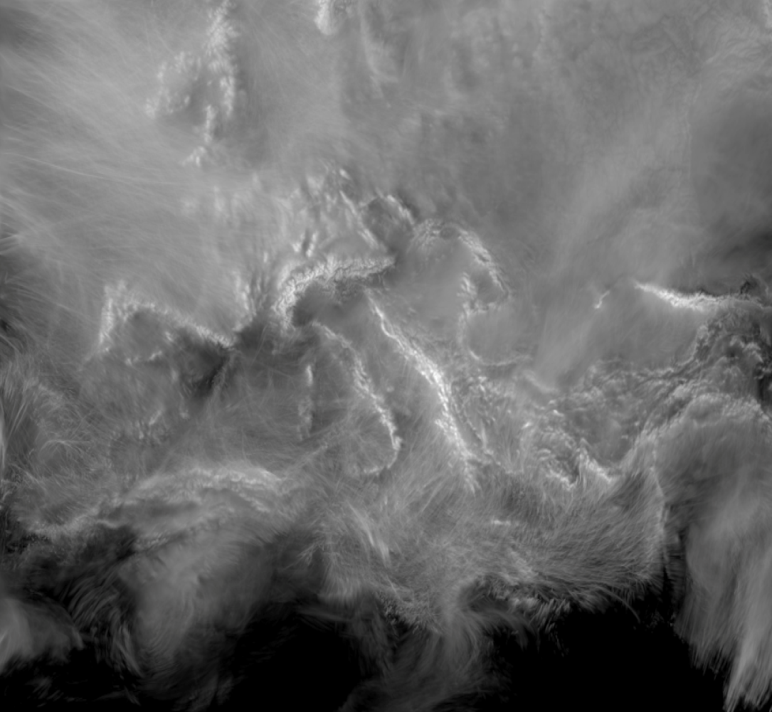
WG AIO & CRCS: Convection-permitting simulations over the MED-Cordex domain
Simulation at convection permitting scales over the Med-CORDEX domain.
COSMO-CLM
Lightning potential index (U. Blahak)
Cloud optical thickness (COT) and cloud top pressure (CTP) (M. Keller)
Example: Precipitation for December 1999
Three large storms hit Europe:
  Coastal lines and orography appear
Small convective events over warm seas:
  Finer structures Coastal processes:
  Most lines over the coast of Med. Sea are perpendicular to the coast lines
Slide: courtesy of Erwan Brisson

Slide 6
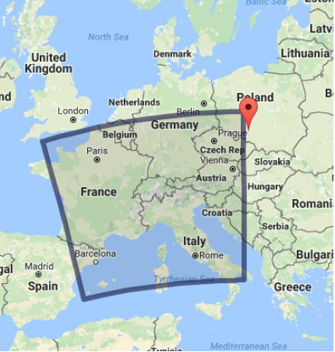
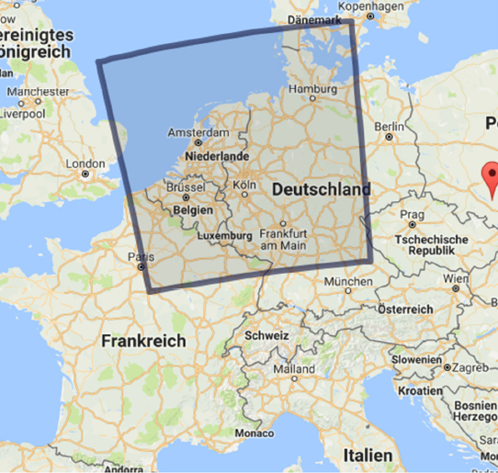
Coordinated Evaluation of Convection Permitting Climate
simulations with COSMO-CLM5.0 (CECPC5.0)
Goal
coordinated parameter testing (COSMO5.0-CLM) at 0.0275°
Alpine
2008
Experimental protocol
2 domains, close to CORDEX FPS on convection
  Alpine: adapted Meteo-Swiss configuration
  cosmo-SW2_20150421_5.0
  Low-land: adapted COSMO-DE
  cosmo-DE_20140424_5.0
1 year simulations (+1.5 years of spin-up)
Driving data: COSMO-EU analysis (DWD)
  no intermediate nesting step
  hourly update frequency
Expected outcomes
benchmark of COSMO-CLM at CP resolution in Europe
identification of the most sensitive model configurations
recommended model configuration for other domains
Low-land
2007

Slide 7
Progress and future plans
Sensitivity experiments
10-year evaluation run with optimum setup
Preparation phase
Evaluation process
Development of ETOOL-HR
Preparation phase
Definition of domains and time periods
List of relevant configurations to be tested
Choice of forcing data (COSMO-EU) and
default settings
Tests phase for INT2LM
Preparation of the driving data with INT2LM
Spin-up run for soil initialisation (15 months)
Reference simulations (current status)
Development of ETOOL-HR
Retrieve and share a set of high-resolution gridded observational reference datasets
Implementation of new datasets and diagnostics (ongoing)

Slide 8
CORDEX Coordinated Output for Regional Evaluations (CORE)
simulation framework (Giorgi et al, August 2017) is in support of IPCC AR6 proposed by CORDEX Scientific Advisory Team (SAT).
simulation framework for the CORDEX-CORE program
Main goal: provide core set of comprehensive and homogeneous projections for most CORDEX domains.
Further goal: have a succinct set of simulations
Slide: courtesy of Silje Lund Sørland

Slide 9
Simulation framework
domains
grid spacing
simulation period
driving GCMs and scenarios
archive
downscaling procedures
Slide: courtesy of Silje Lund Sørland

Slide 10
CLM-Community
# | Domain | Collaboration
1 | Africa | JRC
2 | South Asia | Goethe University Frankfurt
3 | Central America
4 | Southeast Asia | J. Liebig University Giessen
5 | South America
6 | Middle East – North Africa | CMCC, IMS
7 | East Asia
8 | Arctic
9 | Europe | ETH through PRINCIPLES
10 | North America
11 | Australia
12 | Central Asia
Slide: courtesy of Silje Lund Sørland

Slide 11
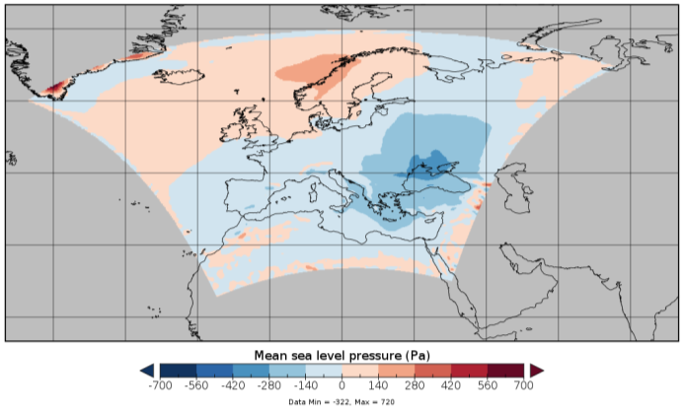
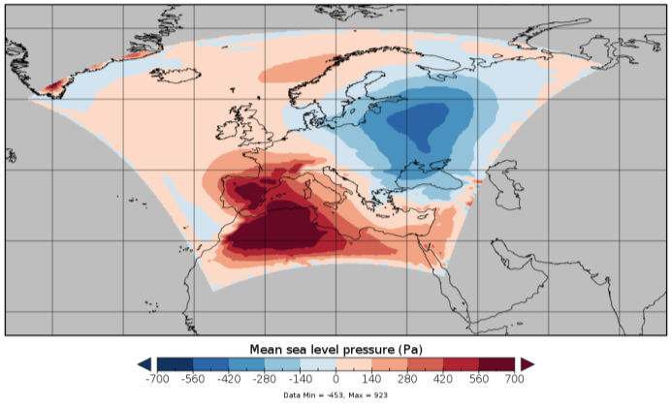
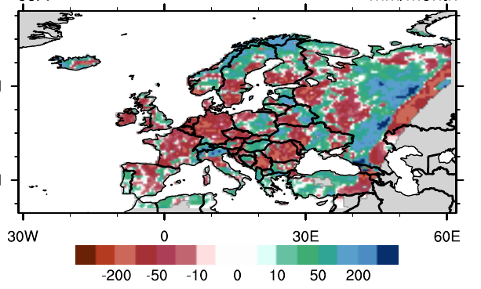
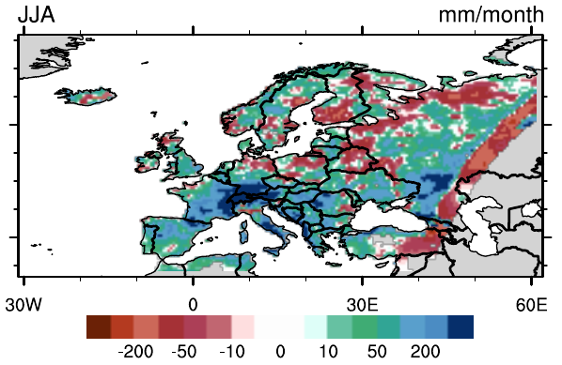
Time step dependency in recommended version cclm_5.0_clm9
Slide: courtesy of Andy Dobler
Changing time step dt =150s (recommendation) to dt = 120s:
dt = 150 s
dt = 120 s
→ large pressure bias in the South-West
PMSL bias
(vs ERAinterim July 1979)
in Pa
→ large precipitation bias over the Alps.
JJA prec. bias
(vs EOBS)
in mm/month

Slide 12
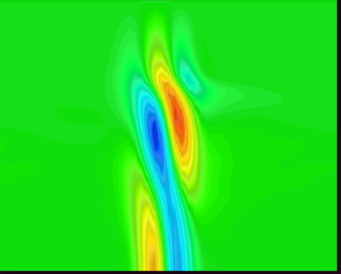
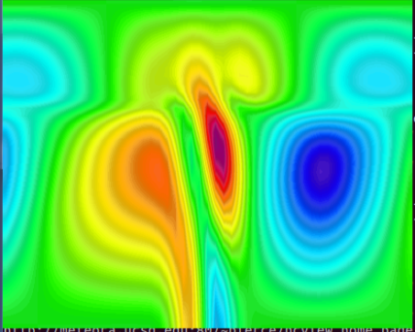
Tests have shown that:
Slide: courtesy of Andy Dobler
increase of model height to 30 km, rlwidth to 1,000,000 or nrdtau to 15 (recommended: nrdtau=5) solves the problem
problem also appears with other spatial resolutions (e.g., dlon=0.22 or 0.44)
problem does not appear with dt=90, 144, 150, 180, 200 or 240
itype_spubc = 2 or 3 solves problem partly - but create other problems
→ Hypothesis: the problem lies in the Rayleigh damping.
dt = 150 s
dt = 120 s
Note: A similar behaviour appears in the vertical velocities in an idealized test case (2D ideal Gaussian hill, dx=0.44) when applying stronger Rayleigh damping (lower nrdtau).
Vertical velocities after 4 days with dt=150 (left) and dt=120 (right), using nrdtau=2 (for dt=120 there are large up and down-draft areas, dt=150 looks OK.)
Notes:
rlwidth (REAL) If lexpl_lbc = .TRUE., this parameter specifies the width of the relaxation layer in meters. It should be 10 to 15 times the grid mesh size in meters, but should not exceed 0.25 times the full domain size. DEFAULT: 85000.0
nrdtau (INT) nrdtau*dt is the e-folding time for damping at the model top. Larger values of nrdtau result in weaker damping. DEFAULT: 5
itype_spubc (INT) To choose the type of Rayleigh damping in the upper levels.
1: chooses the damping against boundary fields;
2: chooses the damping against filtered forecast fields (can be chosen, if the boundary data is only available on frames.
3: New sponge layer near upper model boundary (according to Klemp et al.)
DEFAULT: 1

Slide 13
COSMO – COSMO-CLM reunification
COSMO-CLM SCA in CLM-Community: Burkhardt Rockel
Reunification starts with the release of COSMO5.5
Reunification to be realized with COSMO6
intended to be finished in September 2018.
COPAT (Coordinated parameter testing) like evaluation to be performed
intended to receive a recommended model version in September 2019
COSMO6.0-CLM will be the version to which
ICON-LAM climatological evaluation run will be compared
intended to be finished in September 2020
ICON-LAM SCA in CLM-Community: not designated yet

Slide 14
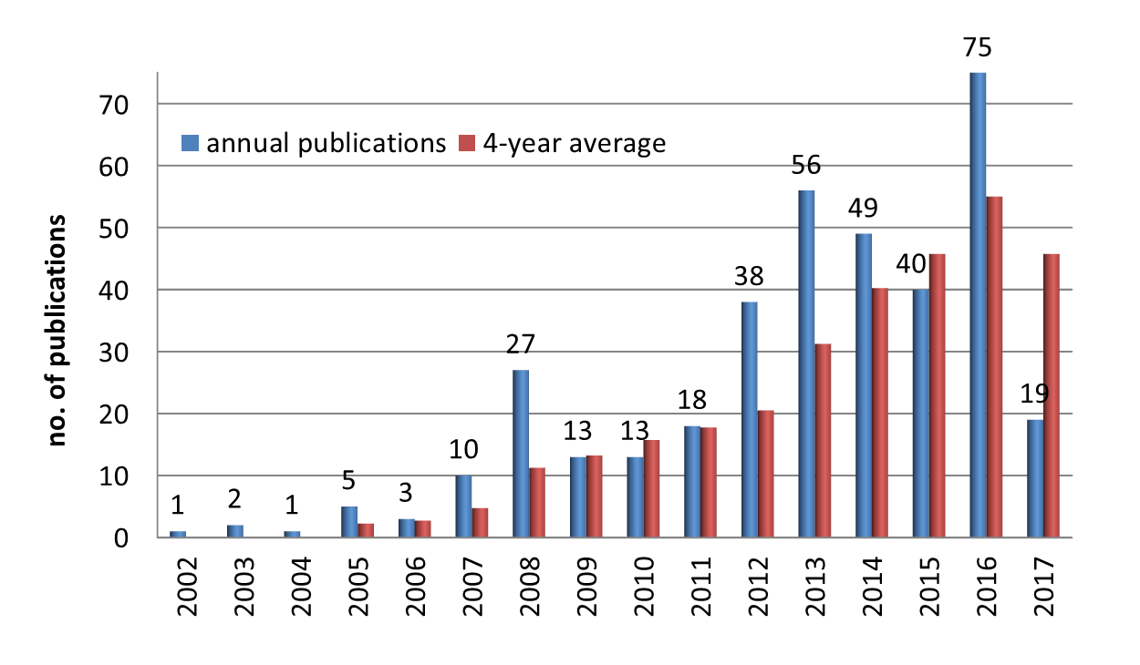
CLM-Community development of publications
Good news w.r.t. the visibility of COSMO-CLM & CLM-Community

Slide 15


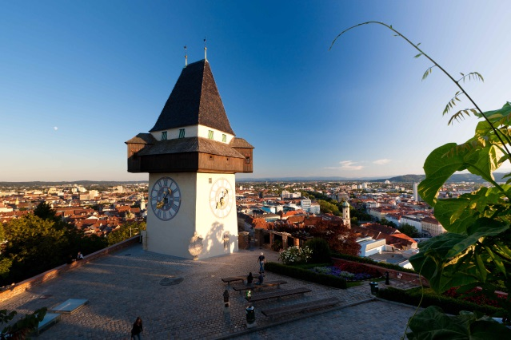
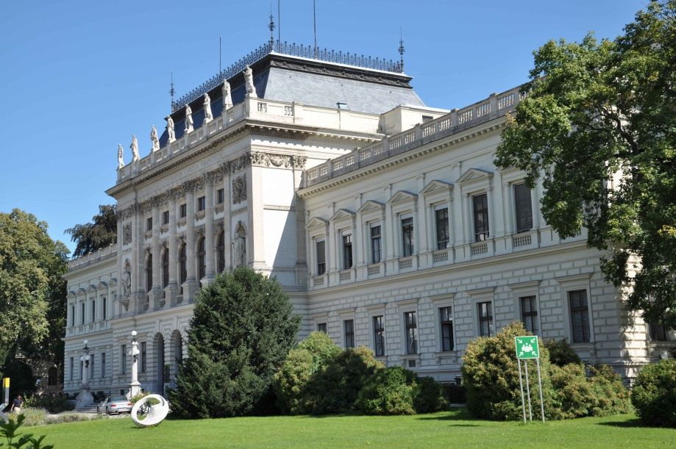
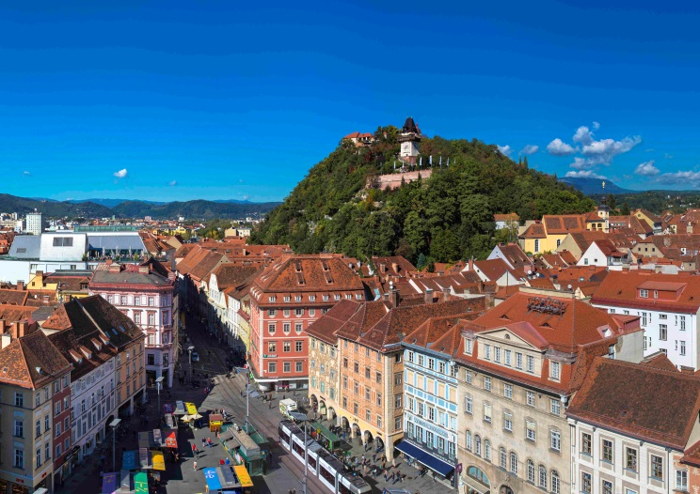
CLM-Community Assembly 2017
September 19 - 22, 2017
Karl-Franzens-Universität Graz / University of Graz
Wegener Center for Climate and Global Change
Austria
http://wegcenter.uni-graz.at/de/wegener-center/

Slide 16
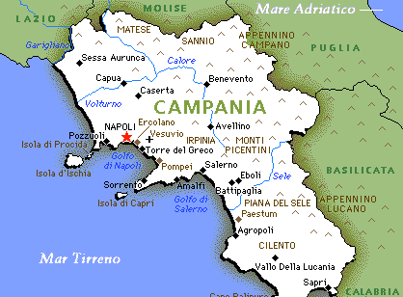
CLM-Community Assembly 2018 & 2019
September 18 - 21, 2018
Karlsruhe Institute of Technology
Germany
2019
CMCC - Centro Euro-Mediterraneo sui Cambiamenti Climatici
CIRA – Italian Aerospace Research Center
Somewhere close to Naples, Italy

Slide 17
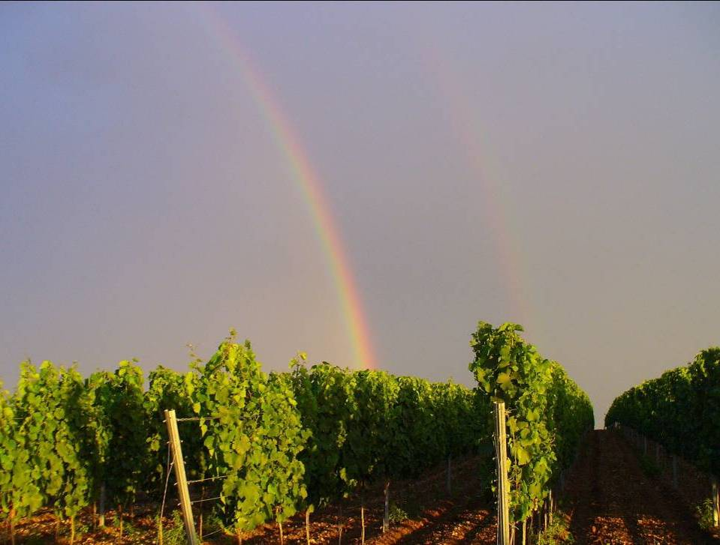
Thank you very much for your attention!!!
Barbara Früh
Notes:
17

Slide 18

Experiments for Low-land; reference configuration: cosmo-DE_20140424_5.0
Parameter | Namelist | Default value | Tested value | Comment
itype_fast_waves | COSMO | 2 | 1 | Treatment of fast waves; old scheme, might lower the numerical stability.
ivctype | INT2LM | 2 | 4 | Use the SLEVE vertical coordinate system (def:hybrid Gal-Chen)
lconv | COSMO | TRUE | FALSE | Turn off the shallow convection scheme
lradtopo | COSMO, INT2LM | FALSE | TRUE | topographic corrections of radiation (e.g. mountains North/South faces)
itype_aerosol | COSMO | 1 | 2 | Tegen climatology for aerosols (def:Tanre)
itype_evsl | COSMO | 2 | 4? | parameterization for evaporation of bare soil
itype_turb | COSMO | 3 | 1; 2 | Parametrization for vertical turbulent diffusion (def:prognostic TKE-based scheme)
itype_root | COSMO | 1 | 2 | Decreasing root density with depth (def:uniform root distribution)
itype_heatcond | COSMO | 1 | 2 | The soil heat conductivity accounts for soil moisture/soil ice (def:soil moisture only)
itype_albedo | COSMO | 1 | 2 | The surface albedo is function a dry and saturated soil (def:function of soil type)
lsso | COSMO | FALSE | TRUE
lfilter_oro |  | TRUE with INT2LM | TRUE with EXTPAR | Testing of the influence of the filtering method
y_scalar_advect | COSMO | BOTT2_STRANG | BOTT2 | horizontal advection type for the Runge-Kutta dynamical core
iadv_order | COSMO | 5 | 3 | Save resources by increasing the time step
hd_corr_trcr_bd | COSMO | 0.0 | 1.0 | Reduction factor for the horizontal diffusion flux for tracers in the sponge zone

