Slide 1
COSMO-Model New Versions and Plans
Ulrich Schättler
Source Code Administrator

Slide 2
Contents
Versions implemented since September 2016
Status of Version 5.05
A Remark to the Common COSMO-ICON Physics
Plans for the next versions

Slide 3
Versions Implemented since September 2016

Slide 4
Version | Date | Contents (Highlights) | Results Changes
5.04c | 06.10.16 | additional tuning factors for physics perturbation in radiation and convection minor adaptations for COSMO-ICON physics and GPU code C++ dynamical core integration Set values of T_SO layers to reasonable values and bitsPerValue to 24 | no no no only T_SO
The modifications for T_SO lead to a higher GRIB precision for T_SO values
and can lead to significant changes in a data assimilation cycle. DWD observed
melting of soil ice and a reduced cold bias during the day.

Slide 5
Version | Date | Contents (Highlights) | Results Changes
5.04d | 12.12.16 | several changes and additional features in data assimilation changes to blocked turbulence scheme | numerical not yet operational
5.04e | 23.03.17 | activated blocked turbulence scheme implemented blocked surface schemes from ICON (TERRA, FLake, SeaICE) blocked version of SSO scheme eliminated non-blocked parameterization | yes yes no
5.04d is the last version with non-blocked turbulence and surface schemes.
5.04e runs all parameterizations in the blocked format with modified turbulence and surface schemes. A new configuration is necessary (TUNING, PHYCTL)

Slide 6
Version | Date | Contents (Highlights) | Results Changes
5.04f | 01.09.17 | additional modifications to COSMO-ICON physics (new namelists, bug fixes, GPU version of TERRA) Possibility to reproduce behaviour of old turbulence scheme (not TERRA!) changes in data assimilation new diagnostic output to highlight convective cell tracks (for ESSL testbed) changes in handling statistically processed fields (min, max, avg, sums) possibility to use RTTOV12 | yes yes eventually no no SynSat
It is possible to reproduce the behaviour of the „old“ physics „rather“ closely
(but you do it on your own risk).
Please read more about the changes in the Release Notes for the different versions.

Slide 7
Status of COSMO-Model 5.05

Slide 8
Testing new COSMO-ICON Physics
From Version 5.04e on, all parameterizations are in blocked format.
COSMO and ICON are using the same packages for
First NUMEX experiment in winter 2016/17 indicated some problems with the new interface for TERRA: had to fix some technical details
Microphysics | since 5.01 (already validated)
SSO | bit-identical: there were no changes in ICON
Turbulence | modifications in ICON: Tests by M. Raschendorfer showed comparable results to former COSMO version
Surface schemes | modifications in ICON: no tests to compare only these modifications to former COSMO version

Slide 9
NWP Test Suite at ECMWF based on IFS Data
NWP Test Suite performed with a beta-version of 5.04e from 16.12.16 (had some billing units left at ECMWF for 2016) did not show an improvement over 5.03
Problem could be that the new COSMO-ICON physics performs even worse with IFS soil data.
Simulation period shown: January 2013
ME and RMSE for 7 km test (January 2013) with IFS

Slide 10
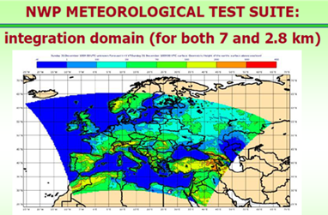
NWP Test Suite at ECMWF based on GME Data
But runs with GME soil data did not improve this situation significantly.
ME and RMSE for 7 km test (January 2013) with GME

Slide 11
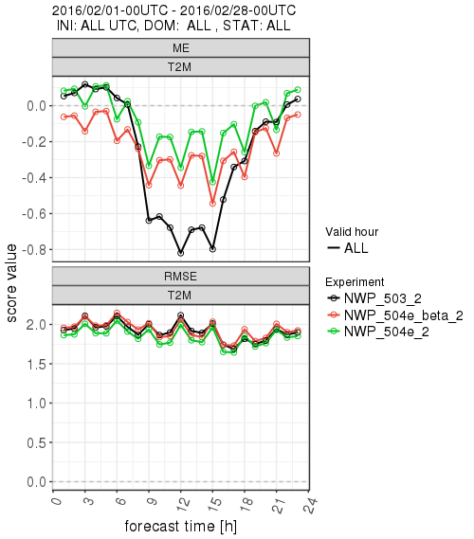
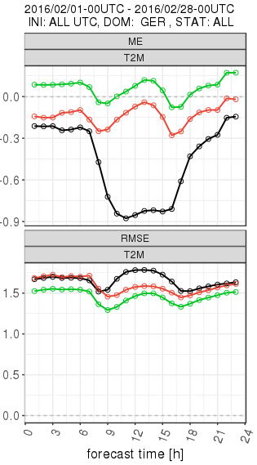
Hindcasts at DWD
A one month simulation starting from interpolated ICON data and driven by ICON analysis for February 2016 using the same integration domain as the NWP Test Suite.
Results show an improvement for the 2m temperature.

Slide 12
Numex Experiment with KENDA
Compared to a KENDA Experiment with operational version for May/June 2016
Tests with the new physics and different configurations show a sensitivity in forecast results
Problem: initial condition for the soil is taken from the "old" COSMO-DE analysis, which seems not to fit to new COSMO-ICON physics
Experiment:
old COSMO with KENDA (Exp. 10416)
old COSMO with Nudging (Routine 2016)
new COSMO with KENDA (Exp. 10441)

Slide 13
First Conclusions
???????????
Perform different hindcasts for 3 (4) months (March-June 2016; in climate mode) to compare the soil properties. All tests start with the operational COSMO-DE soil values on 1st March 2016.
Binary | Namelist
V5.4 | OPER_NOW
March | April | May
June
V5.5R | TEST_OLD (as OPER)
March | April | May
Evaluation
BACY
with DA
V5.5 | TEST_REF (10441)
V5.4 | ROUTI
March | April | May
V5.5 | TEST_NEW (as ICON)
March | April | May
June

Slide 14
W_SO in the Hindcasts

Slide 15
Lessons Learned
Different configurations of hindcasts lead to different soil moisture contents
Dry out of soil with soil moisture close to plant wilting point can occur, which can produce a negative feedback cycle: low soil moisture →low evaporation → low clouds and low precip → low soil moisture
In ICON(-EU) a soil moisture analysis prevents the soil from drying out
Results of the 2 BACY experiments (which are started from the soil condition of the corresponding hindcast) show good results for the COSMO-ICON physics in regions, where the soil did not dry out.
Need to prevent unrealistic dry out of soil in summer.
But at the moment the results from Version 5.05 are not acceptable.

Slide 16
A Remark to the Common COSMO-ICON Physics

Slide 17
Scheme | COSMO | ICON
Microphysics | prognostic water vapour, cloud water, ice, rain, snow, graupel (Doms, 2004; Seifert, 2010)
Radiation | Ritter-Geleyn δ two-stream | RRTM
Cloud Cover | ?? | Köhler
Subgrid scale orography | Lott and Miller (1997)
Turbulence | prognostic TKE scheme (Raschendorfer)
Surface Schemes | TERRA (Heise and Schrodin, 2002) FLake (Mironov) SeaIce (Mironov)
Convection | Tiedtke or shallow | Tiedtke-Bechtold
 | Tiedtke-Bechtold (optional)
Technically modified COSMO code will be brougth back to ICON (Q4/2017)

Slide 18
Unified Physics?
For most parameterizations we use the same packages
BUT: There are significant differences!
External Parameters:
ICON reads "raw data", e.g. landuse class fractions. It does not use the SSO contribution to z0.
COSMO reads "end products" like plant cover fraction, stomata resistance, roughness lengths incl. SSO contribution etc. via INT2LM
The latter precludes implementing a tile approach similar to ICON; moreover, there are several parameterization components in ICON that make direct use of landuse classes, e.g. snow albedo, snow-cover fraction, table for stomata resistances: these cannot be transferred to the COSMO-Model!

Slide 19
Plans for the Next Versions

Slide 20
Version 5.06: From the Working Groups
WG 1:
Radar forward operator ✓
WG 2:
Improvement for Bott Advection depending on results
Higher order horizontal discretizations ✓ (available June 2017)
WG 3a:
2-moment microphysics ✓
SPPT (bug fixes) ✓
WG 3b:
Urban module (good results assumed; work in progress)
Mire parameterization (optional) ✓
POMPA: see Xavier‘s presentation afterwards

Slide 21
„If you have knowledge, share it to the world“
Dotan, Member of Kibbutz Ramat Rachel
„Write the documentation“
Dmitrii Mironov, Scientific Programme Manager of COSMO

Slide 22
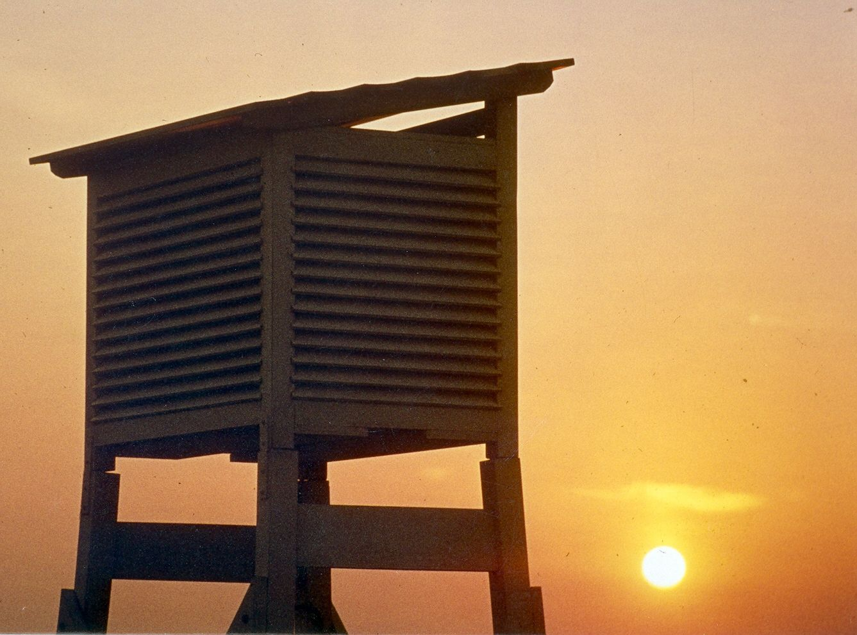
Thank you
very much
for your
attention

