Slide 1





Testing & Tuning of Revised Cloud Radiation Coupling T²(RC)² PP Status Report
בס"ד
Harel Muskatel (IMS), Pavel Khain (IMS), Alon Shtivelman (IMS)
Ulrich Blahak (DWD), Matthias Raschendorfer (DWD)
Martin Kohler (DWD), Daniel Rieger (DWD)
Oliver Fuhrer (MCH), Xavier Lapillonne (MCH)
Gdaly Rivin (RHM), Natalia Chubarova (RHM)
Marina Shatunova (RHM), Alexey Poliukhov (RHM)
Alexander Kirsanov (RHM), Simon Gruber (KIT)
19th COSMO General Meeting, Israel September 12, 2017

Slide 2
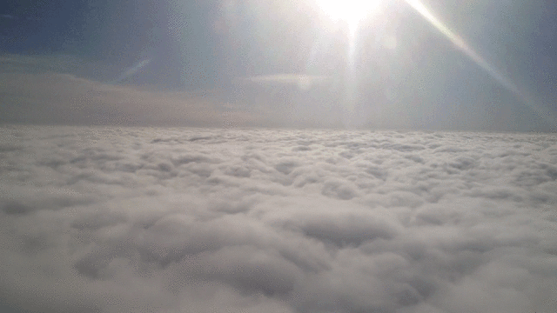
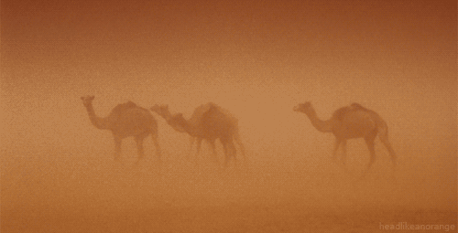
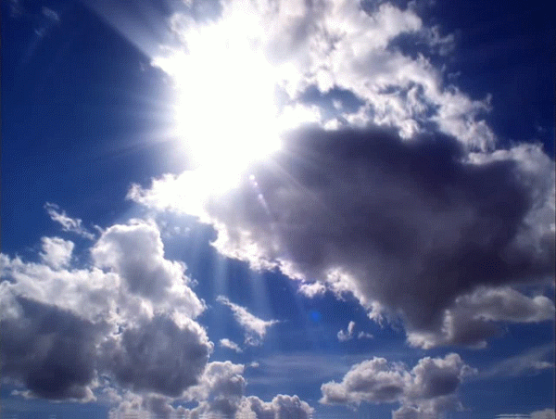

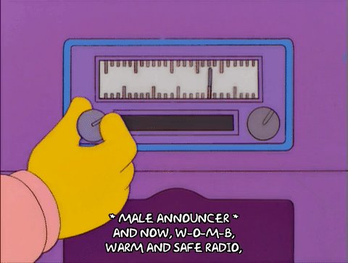
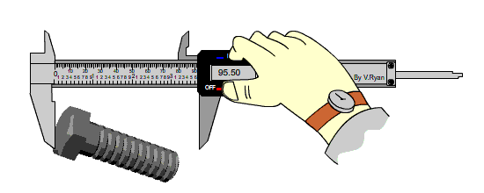


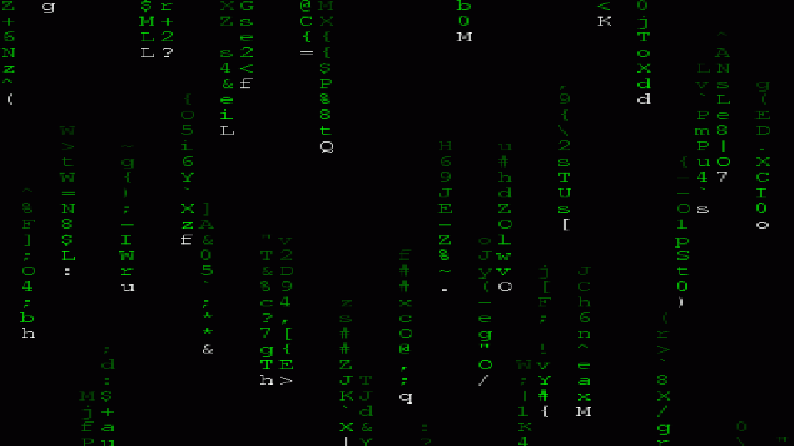
Outline
Revised
Cloud/aerosols
Radiation
Coupling
Cloud Radiation Coupling
Aerosols
Sub Grid
Scale Clouds
CALMO
Testing &
Tuning
Calibration
Testing
Temporal Resolution
MCSI
DP to SP
Run Time
Optimization

Slide 3
Cloud Radiation Coupling

Slide 4
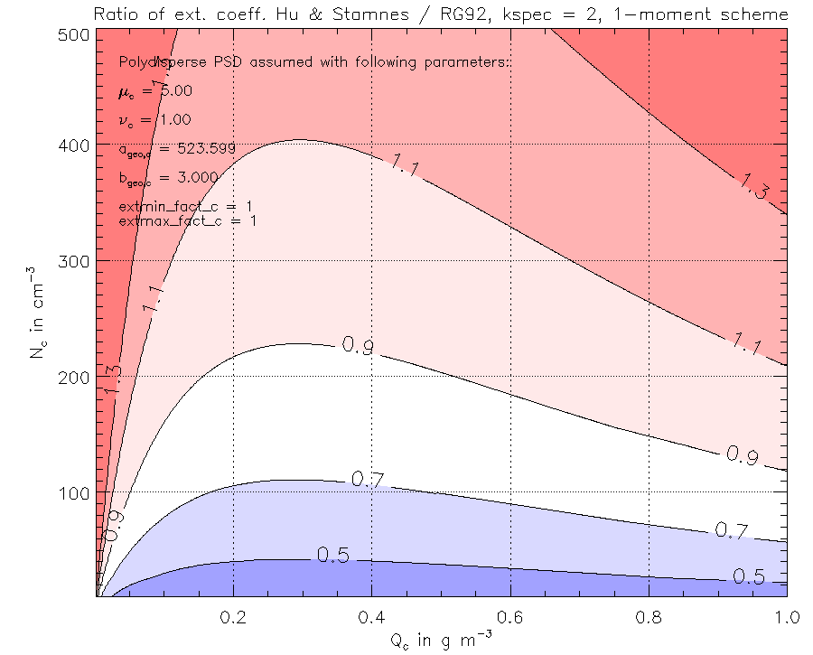
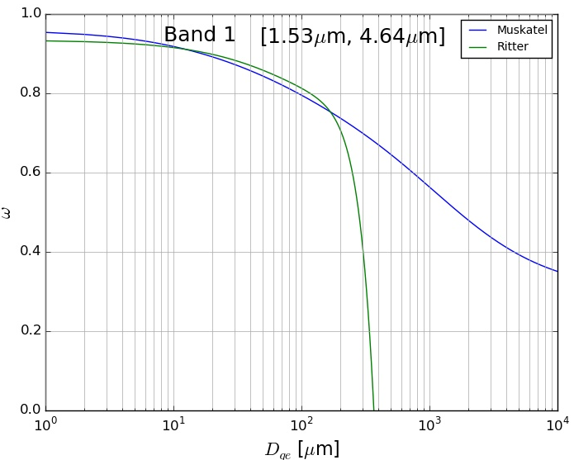
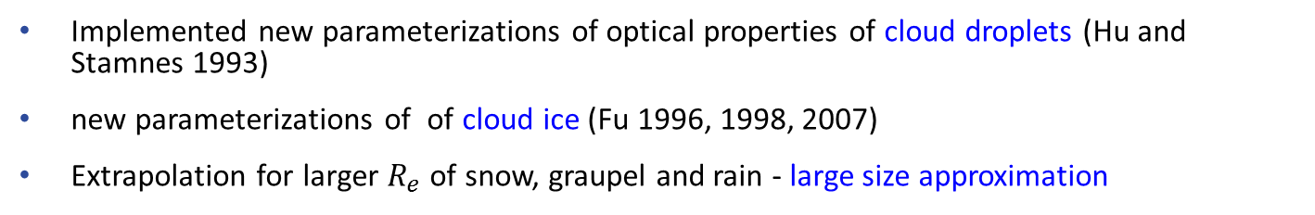
New Cloud Radiation Coupling
Implemented new parameterizations of optical properties of cloud droplets (Hu and Stamnes 1993)
new parameterizations of of cloud ice (Fu 1996, 1998, 2007)
Extrapolation for larger $R_{e}$of snow, graupel and rain - large size approximation
Same in ICON RRTM - Task 7 – phase 2

Slide 5
Aerosols

Slide 6
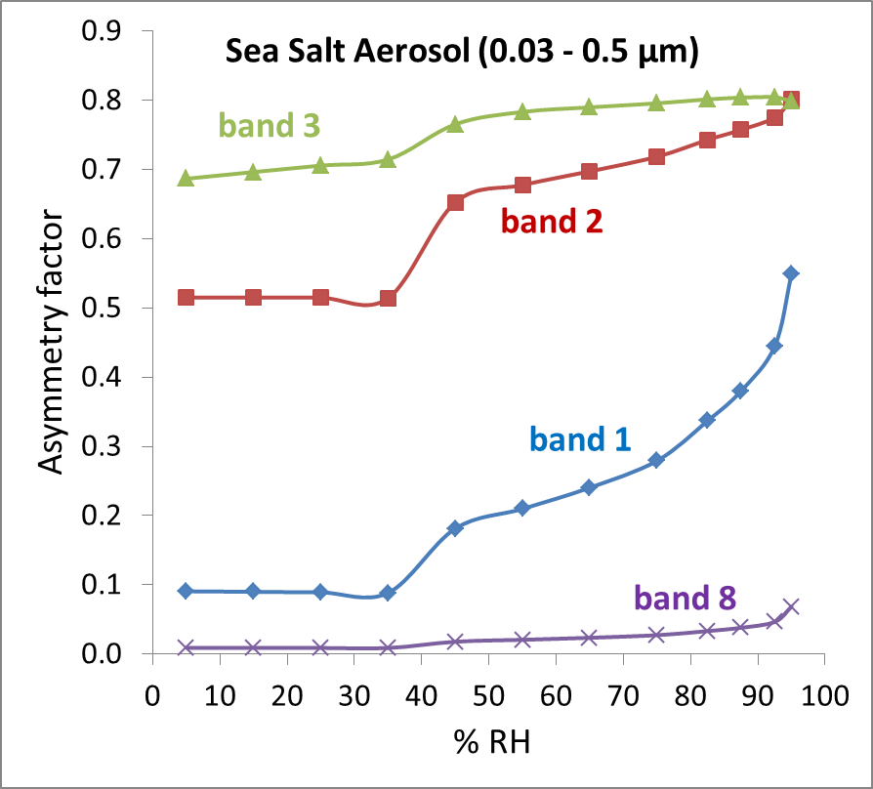
New Aerosols input for Radiation
Implementation of CAMS-ECMWF aerosols in the radiation scheme.
Sea Salt Aerosol (0.03 - 0.5 µm)
Sea Salt Aerosol (0.5 - 5 µm)
Sea Salt Aerosol (5 - 20 µm)
Dust Aerosol (0.03 - 0.55 µm)
Dust Aerosol (0.55 - 0.9 µm)
Dust Aerosol (0.9 - 20 µm)
Hydrophobic Organic Matter Aerosol
Hydrophilic Organic Matter Aerosol
Hydrophobic Black Carbon Aerosol
Hydrophilic Black Carbon Aerosol
Sulphate
Adaptation of CAMS optical properties to COSMO wavelength bands.
Succesfully tested against observations (Global radiation, T2m, rain) for 30 test cases over 10 stations in Israel. Results compared to Tanre and Tegen climatologies.
Test version running twice a day in IMS since June2017 – so far so good!
Implementation of MAC-v1 Kinne (2013) Monthly aerosol climatology with global coverage at a spatial resolution of 1° in the radiation scheme. Not yet tested – will be done as part of phase 2.

Slide 7
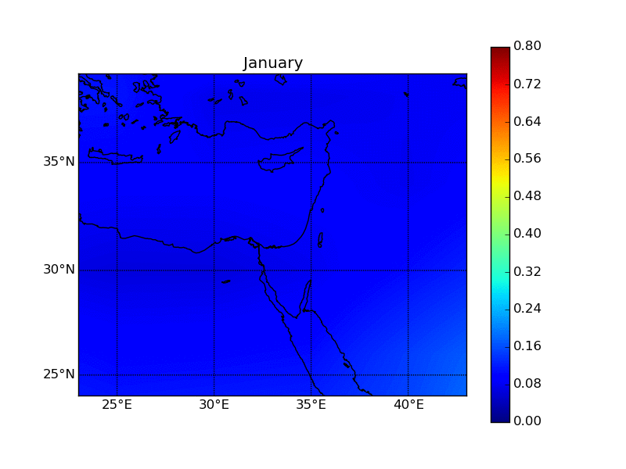
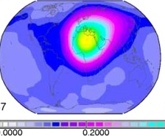
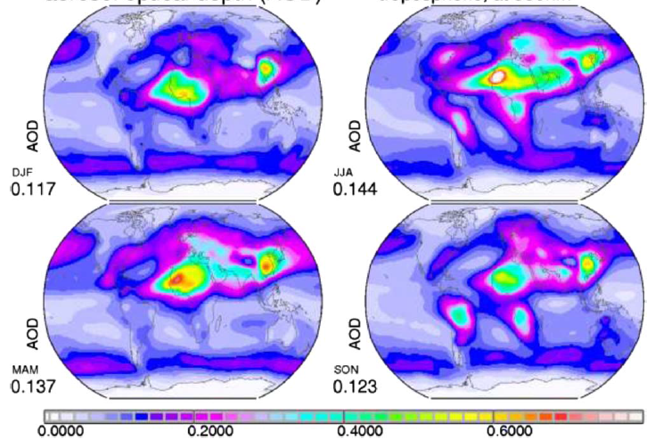
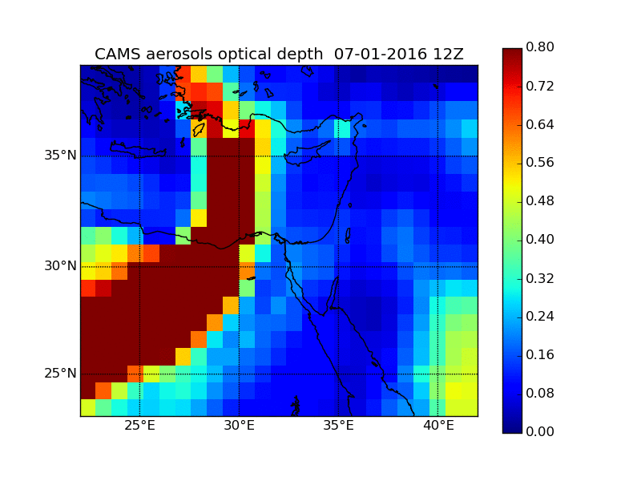
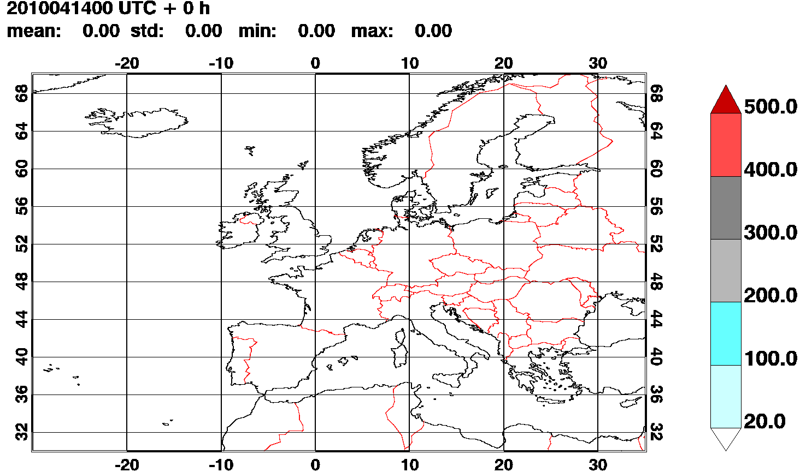
Aerosols Input for COSMO Radiation
Tanre (1983)
Tegen (1997)
Kinne (2013)
itype_aerosol = 1
itype_aerosol = 2
itype_aerosol = 3
Task 6.1 - done
CAMS-ECMWF
ICON-ART
itype_aerosol = 4
itype_aerosol = 5 ?
Task 3.1 - done
Task 8 – phase 2

Slide 8
New Aerosols Input for Microphysics
Aerosols act as cloud condensation nuclei CCN – large effect on cloud formation, dynamics and precipitation
Large concentration of aerosols was reported as both decrease and increae of rainfall
Pristine tropical clouds with low CCN concentration can rain out to quickly to mature to long lived clouds
Polluted clouds with very high CCN concentrations may evaporate before rain can occur
Rosenfeld et al., Science, 321 , 2008

Slide 9
New Aerosols Input for Microphysics

Slide 10
New Aerosols Input for Microphysics
Use climatological value, i.e. Tegen climatology, as an input for cloud droplet activation formula described by Segal and Khain which defines the droplet number concentration based on aerosols concentration, vertical velocity at cloud base and effective updraft speed (done by UB)
Implementation of CAMS-ECMWF aerosols in the mycrophysical scheme.
The current nucleation schemes, both for water droplets and for ice, use fixed aerosols number concentration
Using CAMS prognostic aerosols as input for the Segal & Khain scheme is now a possibility
Using CAMS aerosols concentration in Philips and Meyers ice heterogeneous nucleation schemes.
Testing against MODIS, CloudNet, radar observational datasets
Task 9 – phase 2

Slide 11
Sub Grid
Scale Clouds

Slide 12
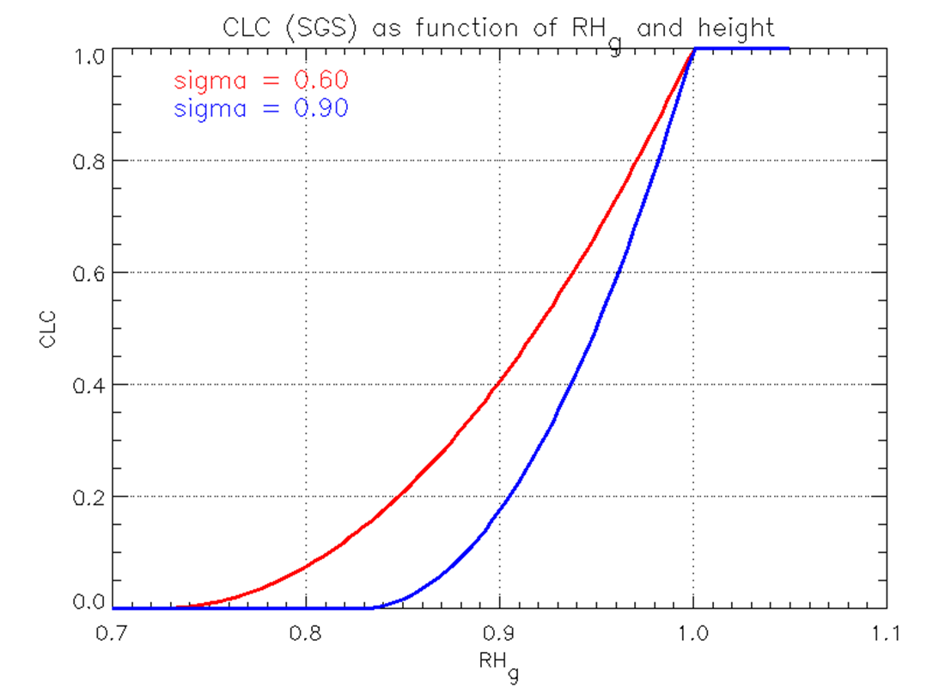
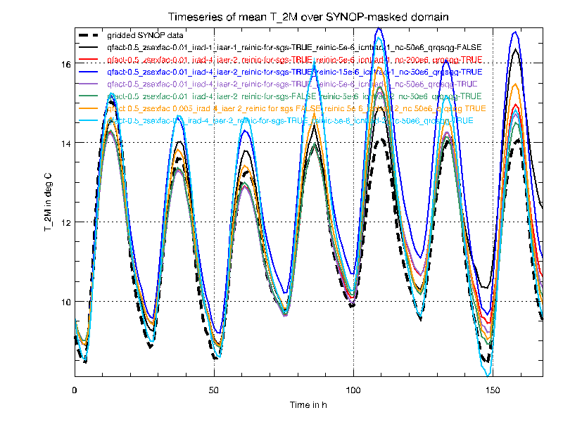
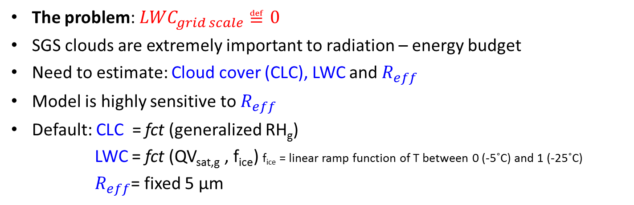

Sub-Grid Scale Clouds
The problem: ${LWC}_{grid scale}≝0$
SGS clouds are extremely important to radiation – energy budget
Need to estimate: Cloud cover (CLC), LWC and $R_{eff}$
Model is highly sensitive to $R_{eff}$
Default: CLC = fct (generalized RH_{g})
LWC = fct (QV_{sat,g} , f_{ice}) f_{ice} = linear ramp function of T between 0 (-5˚C) and 1 (-25˚C)
$R_{eff}$= fixed 5 µm
COSMO-DE results for different $R_{eff}$ schemes

Slide 13
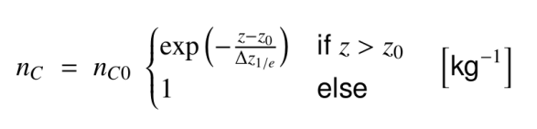

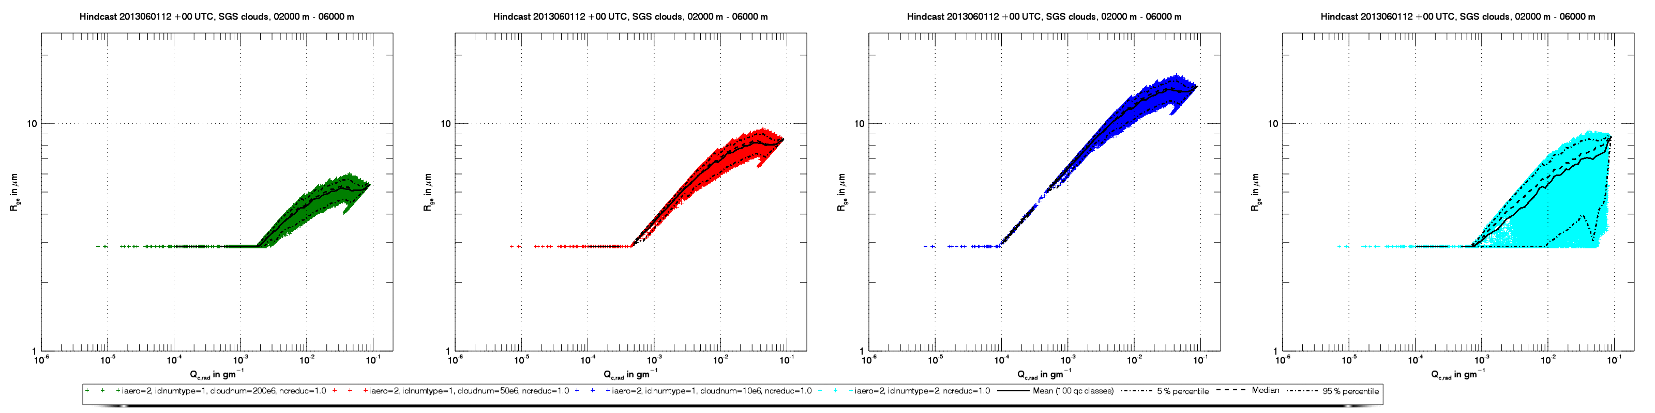
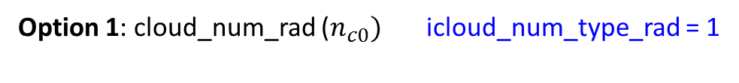
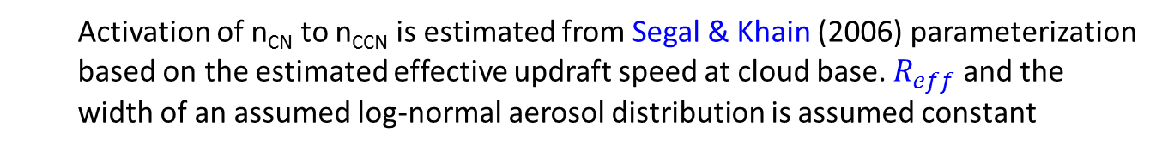

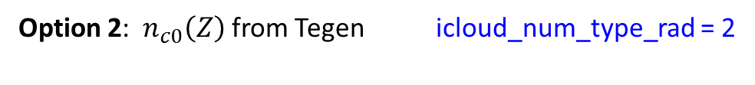
New parametrizations of $R_{eff}$ in SGS Clouds
Option 1: cloud_num_rad ($n_{c0})$ icloud_num_type_rad = 1
Option 2: $n_{c0}\left(Z\right)$ from Tegen icloud_num_type_rad = 2
Task 2.1 - done
Activation of n_{CN} to n_{CCN} is estimated from Segal & Khain (2006) parameterization based on the estimated effective updraft speed at cloud base. $R_{eff}$ and the width of an assumed log-normal aerosol distribution is assumed constant

Slide 14

New parametrizations of $R_{eff}$ in SGS Clouds
Option 3 to solve the problem → LES simulations with detailed spectral bin microphysics: Hebrew University cloud model - HUCM & System Atmospheric Modeling with spectral bin microphysics - SAM-SBM

Slide 15
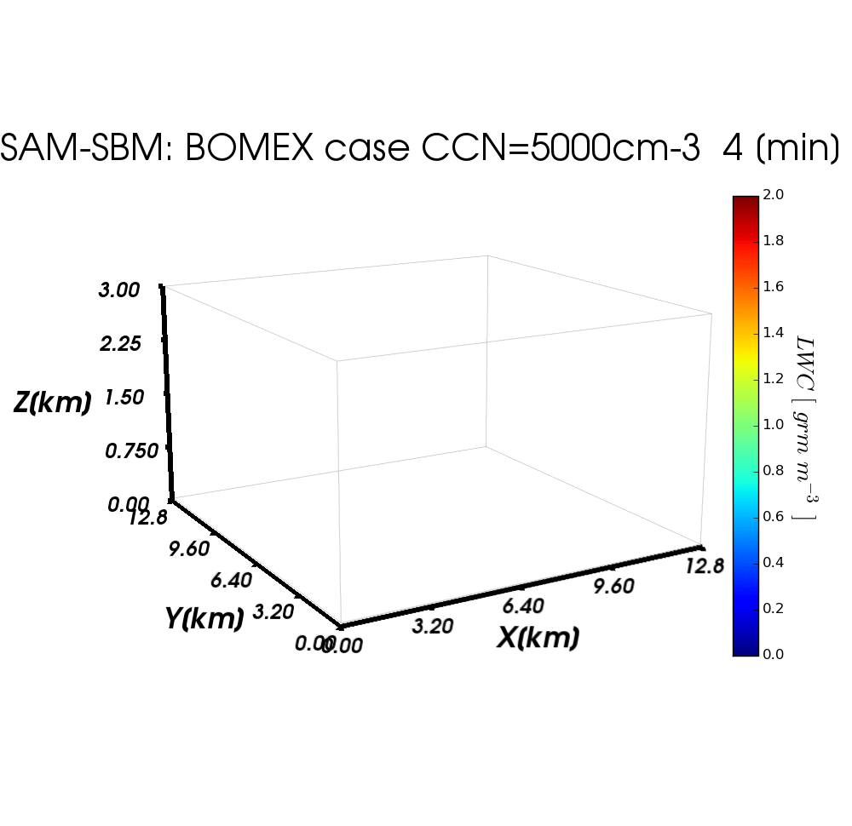
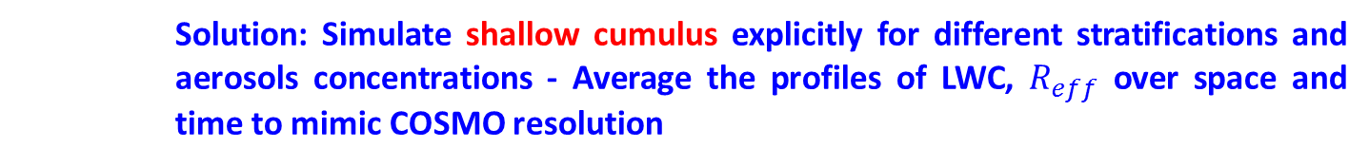

New parametrizations of $R_{eff}$ in SGS Clouds
Solution: Simulate shallow cumulus explicitly for different stratifications and aerosols concentrations - Average the profiles of LWC, $R_{eff}$ over space and time to mimic COSMO resolution
Benchmark test case: Barbados Oceanographic and Meteorological Experiment (BOMEX)
Resolution: horiz. 100m, vertical 40m, time step: 1s, runtime: 8h. Domain: 12.8 X 12.8 X 5.1km

Slide 16
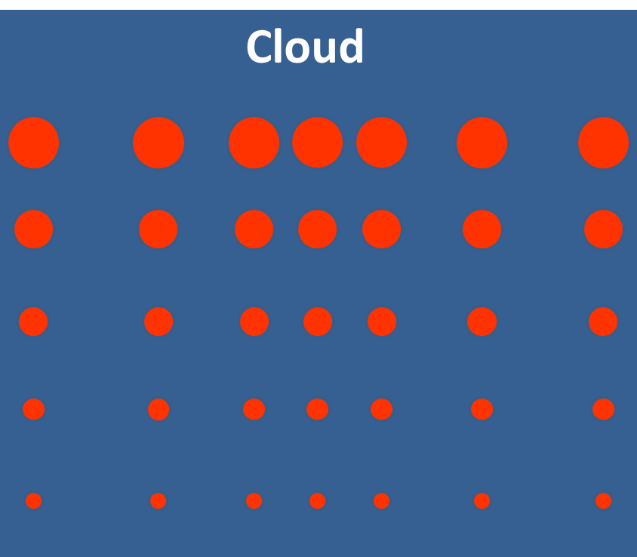
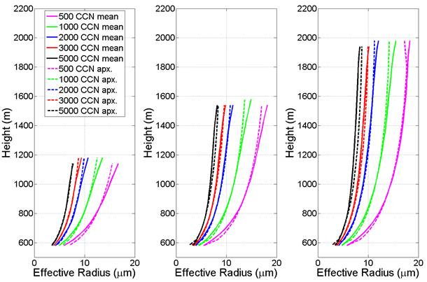
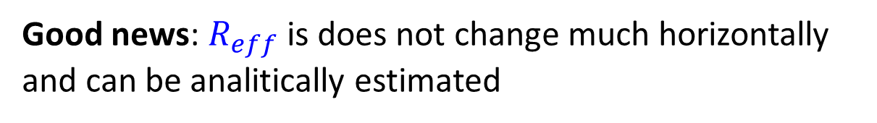

$R_{eff}$ in Sub-Grid Scale Clouds
Good news: $R_{eff}$ is does not change much horizontally and can be analitically estimated
$$\overline{R_{eff}}=fct({CCN}_{cloud base},H_{above c. base},T)$$

Slide 17
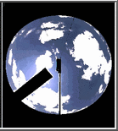
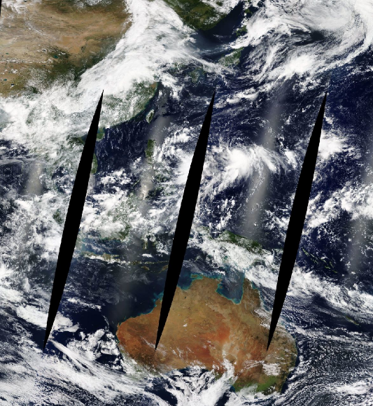
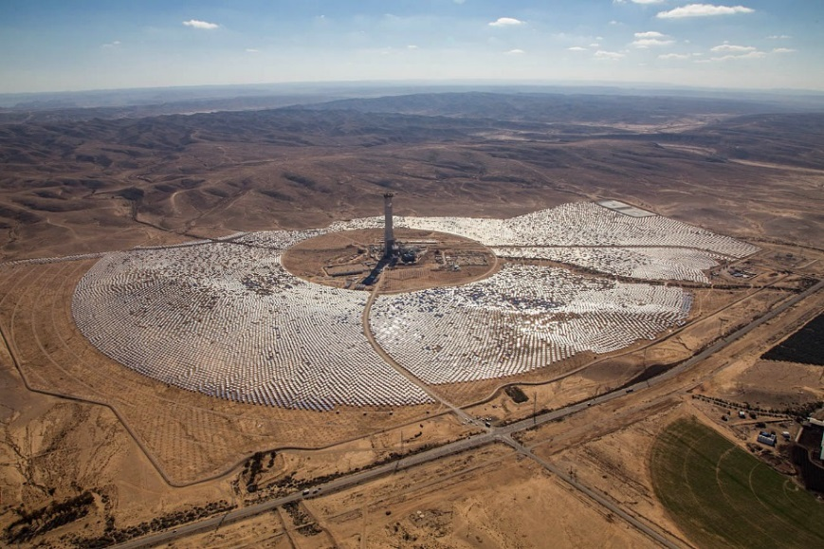

Sub-Grid Scale Clouds – phase 2
Oper. SGS CLC scheme
SAM LES benchmark simulations
Boeing SGS CLC scheme
Observations
SAM LES parametrization for SGS CLC

Slide 18
Clibration

Slide 19
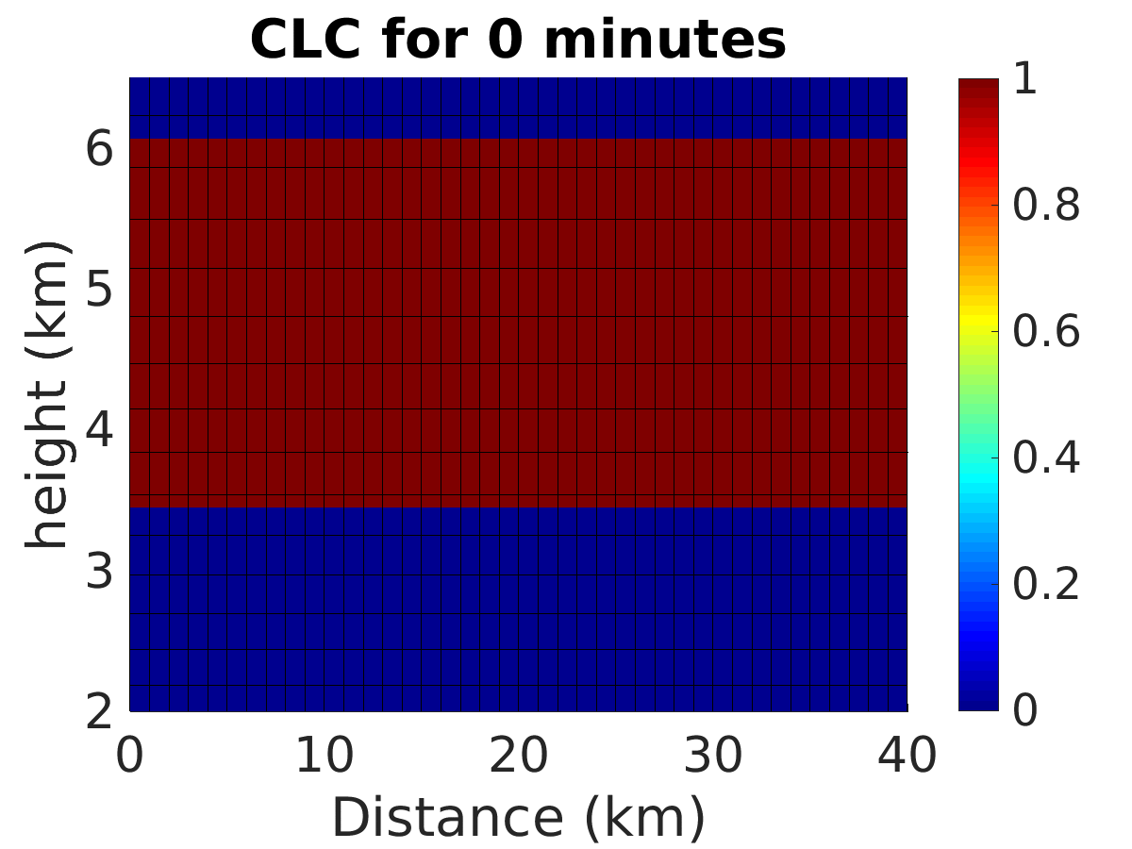
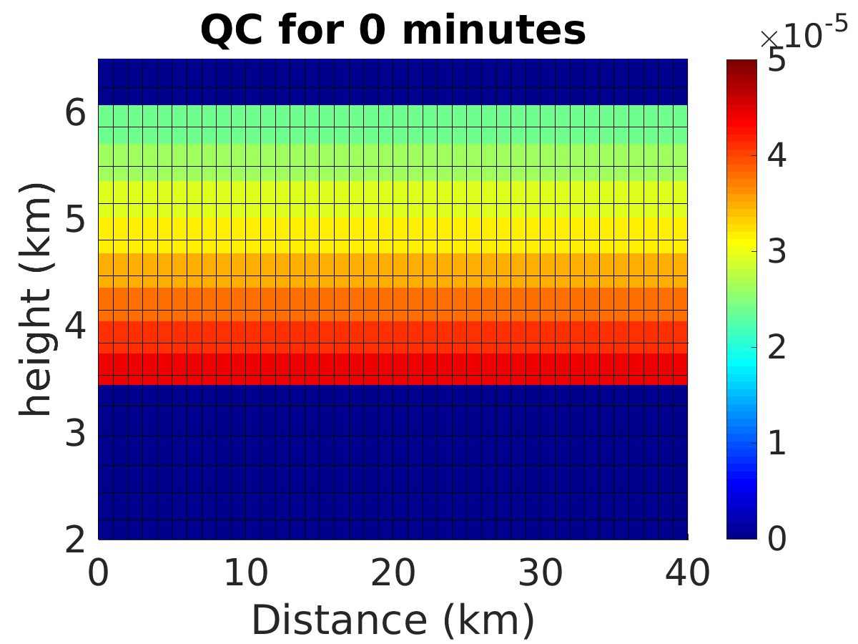
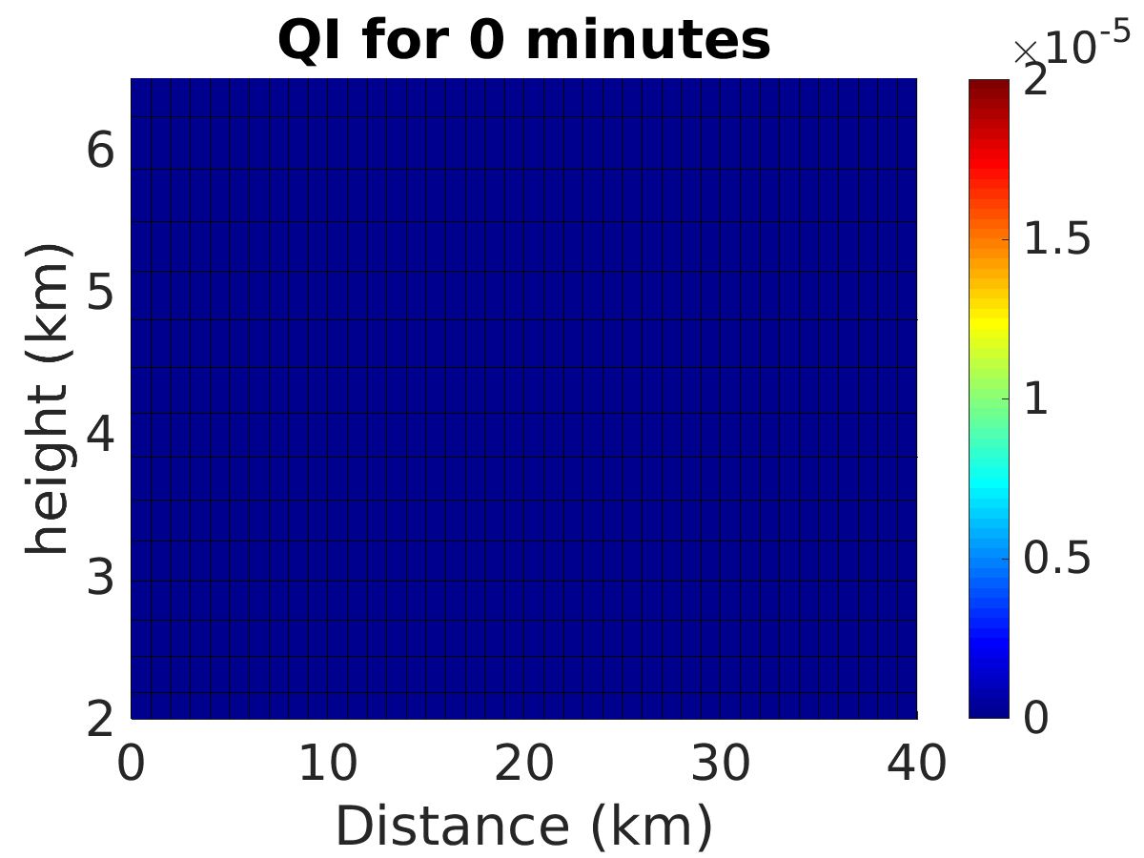

Choosing Parameters for Fine Tuning
32 new tuning parameters
Use idealized COSMO framework to create different cloud types
Decide which parameters are the most important for each cloud type
True/False switches & continuous parameters
Anvil of CB | Fair weather Cu | Mixed phase | Warm Stratus | Cirrus
p1,p2,p3,p6,p7,p9,p10,p11,p14, p16,p23,p24,p25,p29,p30, p31,p32 | p2,p6,p7,p8,p15,p17,p18,p19,p32 | p1,p2,p3,p6,p7,p8,p9,p10,p11,p14,p15,p16,p17,p18,p19,p23,p24,p25,p26,p27,p28,p29,p30,p31,p32 | p1,p2,p6, p8,p15,p17, p18,p19,p26,p27, p28,p32 | p1,p2,p3,p6,p7,p9,p10,p11,p14,p16,p23,p24,p25,p29,p30,p31,p32
Mixed phase cloud

Slide 20
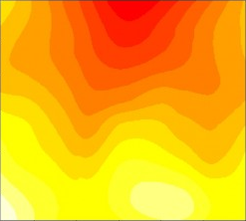



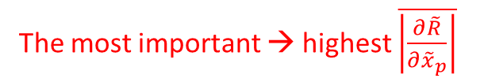

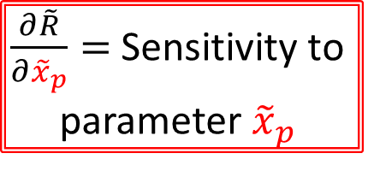


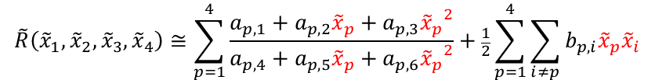
Sensitivity Analysis in Continuous Parameters Space
STEP 1: Perform several idealized simulations to “fill the parameters space”
STEP 2: Read the global radiation reduction at each point
STEP 3: Perform fit of the global radiation reduction in parameters space
$$\tilde{R}\left({\tilde{x}}_{1},{\tilde{x}}_{2},{\tilde{x}}_{3},{\tilde{x}}_{4}\right)≅\sum_{p=1}^{4}{\frac{a_{p,1}+a_{p,2}{\tilde{x}}_{p}+a_{p,3}{{\tilde{x}}_{p}}^{2}}{a_{p,4}+a_{p,5}{\tilde{x}}_{p}+a_{p,6}{{\tilde{x}}_{p}}^{2}}}+\frac{1}{2}\sum_{p=1}^{4}{\sum_{i≠p}{b_{p,i}{\tilde{x}}_{p}{\tilde{x}}_{i}}}$$
$${\tilde{x}}_{1}$$
$$MAX\left\{{\tilde{x}}_{1}\right\}$$
$\frac{∂\tilde{R}}{∂{\tilde{x}}_{p}}=$ Sensitivity to parameter ${\tilde{x}}_{p}$
$${\tilde{x}}_{2}$$
$$MIN\left\{{\tilde{x}}_{2}\right\}$$
$$MAX\left\{{\tilde{x}}_{2}\right\}$$
The most important → highest $\overline{\left|\frac{∂\tilde{R}}{∂{\tilde{x}}_{p}}\right|}$
$$MIN\left\{{\tilde{x}}_{1}\right\}$$

Slide 21
A List of 8 most important parameters
lrad_incl_qrqsqg
iradpar_cloud
lrad_use_largesizeapprox
lrad_ice_smooth_surfaces
lrad_ice_fd_is_gsquared
itype_aerosol
icloud_num_type_rad
radqcfact
radqifact
rad_arearat_ls_i
rad_arearat_ls_s
rad_arearat_ls_g
rad_arearat_ls_h
rhobulk_ls_ini_i
reff_ini_c
reff_ini_i
cloud_num_rad
zref_cloud_num_rad
dz_oe_cloud_num_rad
tqc_thresh_rad
tqi_thresh_rad
tqs_thresh_rad
rhos_n0shigh_rad
rhos_n0slow_rad
n0s_low_rad
rhoc_nchigh_rad
rhoc_nclow_rad
ncfact_low_rad
rhoi_nihigh_rad
rhoi_nilow_rad
nifact_low_rad
qvsatfact_sgscl_rad
true / false
switches
(2) Operational / new scheme
(1) Include rain, snow & graupel
(7,17) Number concentration of cloud droplets
(15,32) Sub-grid water clouds properties
(8,9) Sub-grid scale variability
Task 1.1 - done
continuous parameters
Tasks 1.2,1.3 - Automatic parameter tuning performed on ECMWF computers (30M DWD BU) → transferred to phase 2

Slide 22
Testing

Slide 23
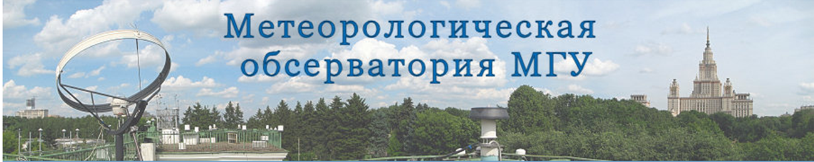
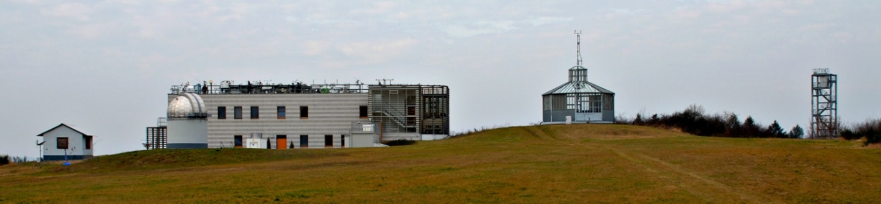
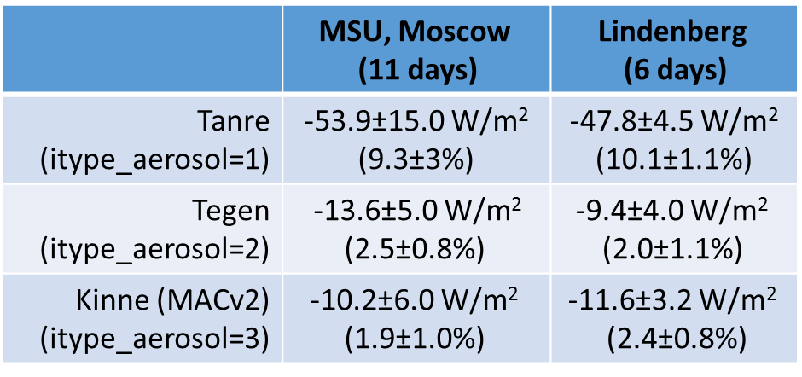
COSMO Radiation Scheme Testing Against Observational Data in Clear Skies Conditions
Task 6.2 - done

Slide 24
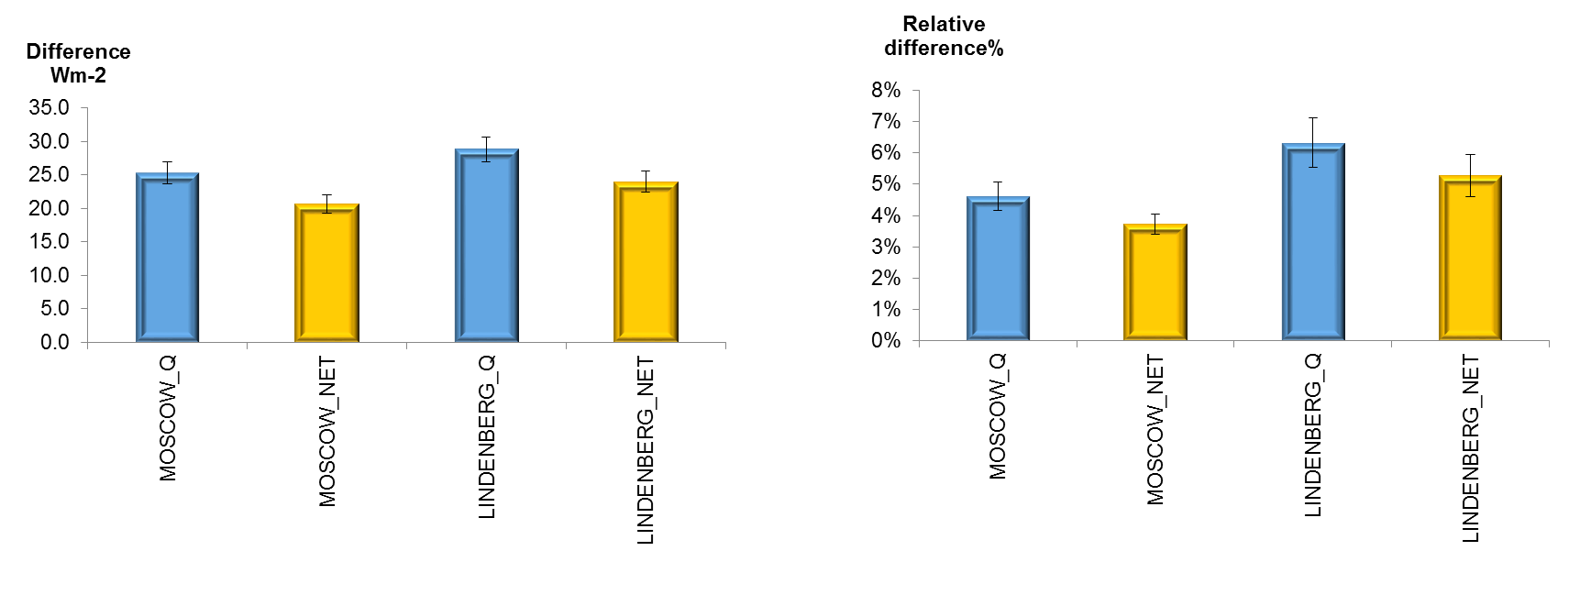
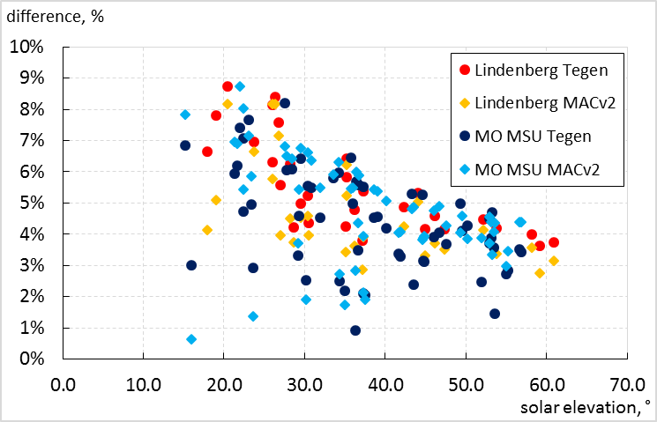
COSMO Radiation Scheme Testing Against Observational Data in Clear Skies Conditions
Inter—comparisons of COSMO simulations with the accurate off-line model simulations (RT CLIRAD(FC05)-SW model and benchmark Monte-Carlo model)
hsun>15°
Task 6.3 - done
More Testing – phase 2
Difference=Q(Net)_{COSMO} – Q(NET)_{CLIRAD}
Relative Difference=Q(Net)_{COSMO} / Q(NET)_{CLIRAD},%

Slide 25
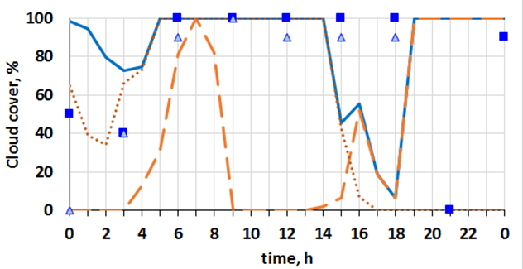
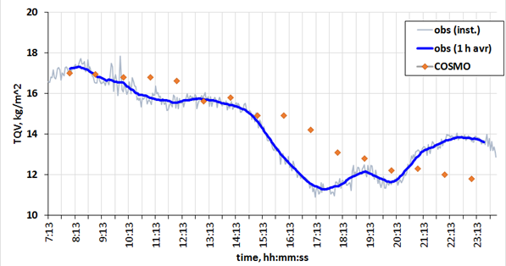
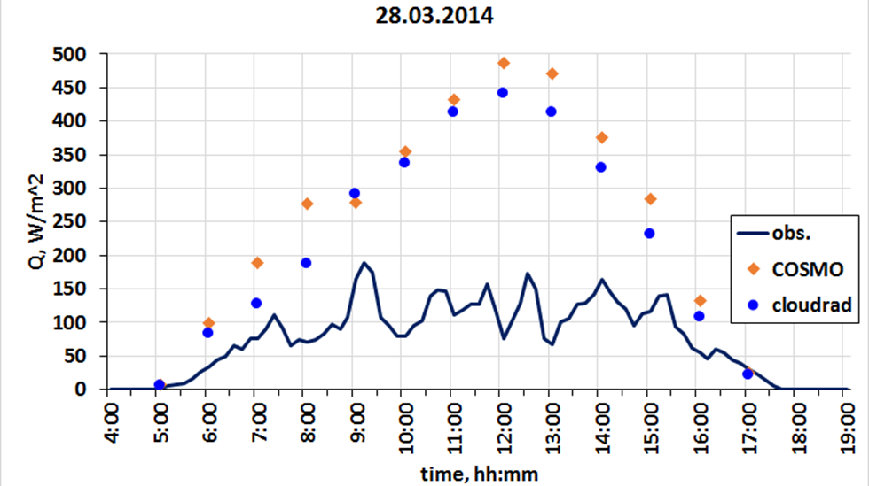
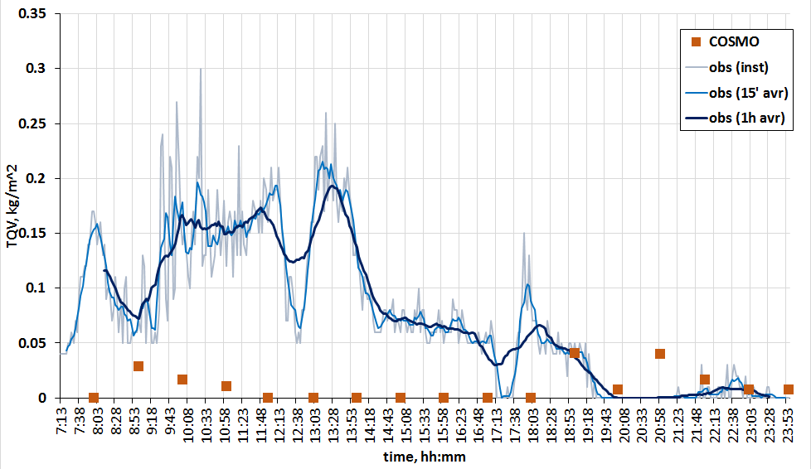
COSMO Radiation Scheme Testing Against Observational Data in Cloudy Skies Conditions
TCC, MCC, LCC
An inter-comparisons of different aerosol COSMO simulations with the accurate observations in cloudy conditions - Lindenberg
Task 6.4 - done
TQV
Q
More Testing – phase 2
TQC

Slide 26
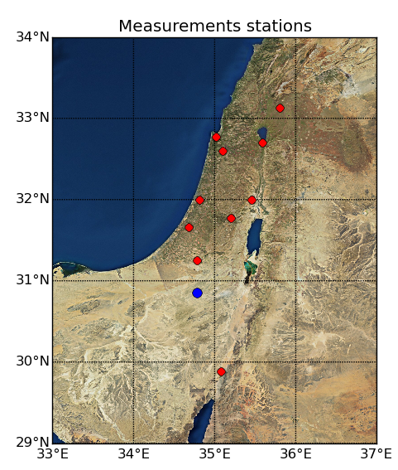

Testing the New COSMO Radiation Scheme with CAMS Prognostic Aerosols
29 test cases in different weather situations
lead time of 30h/42h
10 measurement stations (T2m, GR)
1 AEORNET station in Sede-Boker (AOD)
Rain verifications using radar data (10 cases)
4 models: COSMO 2.8km 5.0 (driving model IFS):
Oper. rad. scheme + Tanre
New rad. Scheme + Tanre
New rad. scheme + Tegen
New rad. Scheme + CAMS
CAMS data taken from previous day (-24h but -12h is also available)

Slide 27
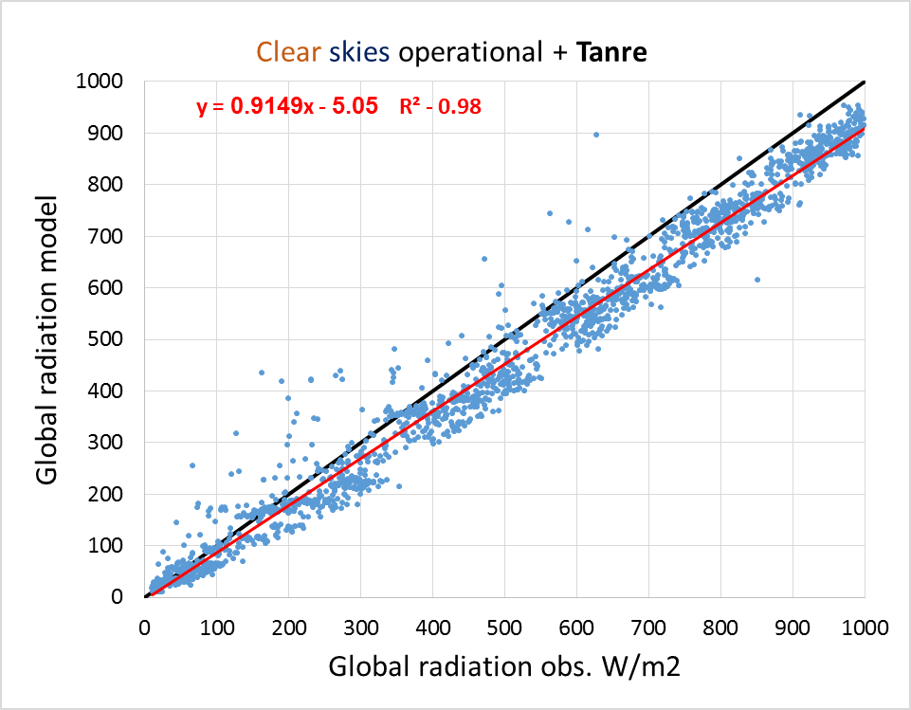
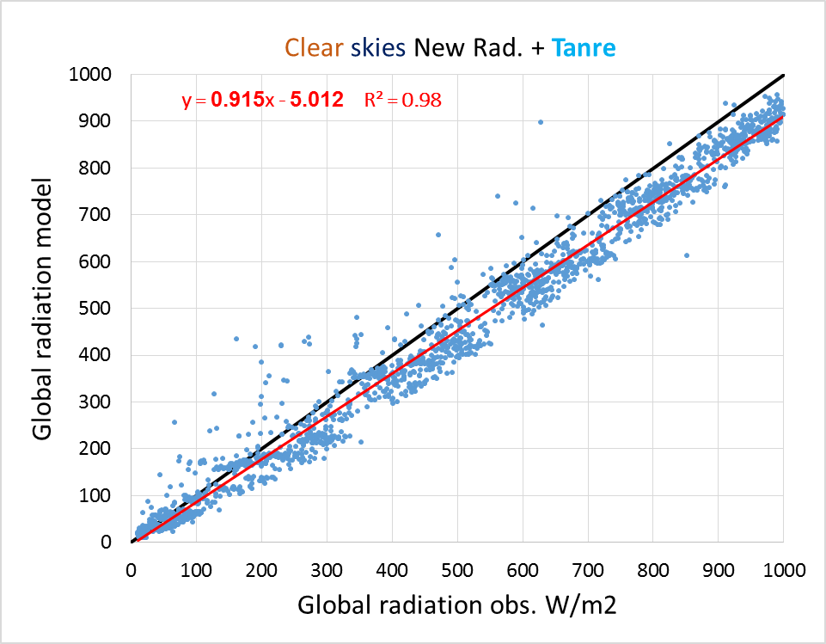






Testing the New COSMO Radiation Scheme with CAMS Prognostic Aerosols
TanreOP
Tanre
-55.9 $W/m^{2}$
-56.2 $W/m^{2}$
Tegen
CAMS
15.6 $W/m^{2}$
11.4 $W/m^{2}$

Slide 28



New COSMO-IL-CAMS Test Version
Running twice a-day since Jun2017
AOD bias:
Tanre 0.24
CAMS 0.04
Task 3.2 - done
GR bias:
TanreOP -55.0 W/m²
CAMS 1.3 W/m²

Slide 29
Temporal Resolution

Slide 30

Radiation Temporal Resolution
Radiation scheme current operational call time
COSMO 7 km
COSMO 2.8 km
1 hour
15 minutes

Slide 31



Radiation Temporal Resolution
COSMO-7km / 2.8km
23-25/04/2015 test case
Partial cloudiness + High wind speeds
${ ∆t}_{rad}=15 min$
${ ∆t}_{rad}=5 min$

Slide 32









Radiation Temporal Resolution- COSMO 2.8 km
${ ∆t}_{rad}=60 min$
${ ∆t}_{rad}=15 min$
${ ∆t}_{rad}=5 min$

Slide 33


Radiation Temporal Resolution
Cloudy
Cloudy
Task 5.1 - done
Clear
Clear
15 min
60 min
15 min
60 min

Slide 34
MCSI

Slide 35





Monte-Carlo Spectral Integration
Based on Bodo Ritter’s work (Pincus & Stevens 2009 method)
Valid for radiation models based on the k-distribution method
Gases absorption spectra for each band is transformed from wavelength to cumulative probability space
$$k(CP)$$
$$g_{3}$$
$$g_{2}$$
$$g_{1}$$
$$k(ν)$$
Fu & Liou 1992

Slide 36


Monte-Carlo Spectral Integration
Transmission for a spectral band:
Exponential Sum Fitting Technique (ESFT) (RG1992)
Very expensive computationally
Fluxes:
Task 5.2 - done
Calculate one g in every time step for each gas and band
MCSI
FESFT (RG1992)
Task 5.3 Testing – phase 2
~ 3 times faster (RG1992)

Slide 37
DP to SP

Slide 38

Towards a SP Version of the Radiation Scheme
In PP POMPA most parts of COSMO were re-written to enable SP/DP. Currently only radiation scheme is run on DP regardless of the WP
Radiation standalone scheme was used for one time step runs:
A. Double precision, unperturbed
B. Double precision, with the some input fields randomly perturbed to 1e⁻⁷
C. Single precision, unperturbed
D. Single precision, with the input fields randomly perturbed to 1e⁻⁷
80X60X60 grid points
0.02 ˚ resolution
Date: 16/6/2014 18UTC

Slide 39
Towards a SP Version of the Radiation Scheme
Radiation
Radiation
Radiation
Radiation
Radiation
fesft
fesft
fesft
SP
DP

Slide 40

All in SP/DP

Slide 41






Towards a SP Version of the Radiation Scheme - Summery
Task 4 - done
SP
DP

Slide 42
Summery
Project duration: September 2015 - August 2019 FTEs (plan/used): 2.60/2.51 in COSMO year 2015-2016 2.70/2.33 in COSMO year 2016-2017 2.30/0.00 in COSMO year 2017-2018 2.35/0.00 in COSMO year 2018-2019 Total FTEs planned: 9.95 Total FTEs used: 4.84
15 participant from DWD, IMS, RHM, MCH, KIT
Including:
Cloud-radiation coupling
Aerosols-radiation coupling
Run-time optimization
Model calibration
Testing and Tuning
Microphysical issues
Towards ICON model development

Slide 43


