Slide 1


WG7 and SPRED PP
Chiara Marsigli
Arpae SIMC, Bologna, Italy

Slide 2
Outline
WG7 activities
  ensemble development:
    COSMO-DE-EPS
    COSMO-E
    TLE-MVE
    COSMO-IT-EPS
    COSMO-LEPS
    COSMO-ME-EPS
SPRED PP
  Improving the spread/skill relation
  Physics perturbation
  Soil/surface perturbation
  Calibration and products
  ICs for the ensembles

Slide 3
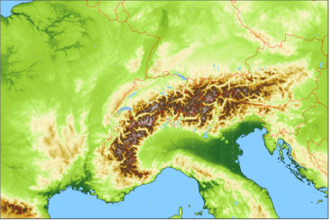
COSMO-E operational setup
21 members (control and 20 perturbed runs)
2.2 km horizontal mesh-size, 60 vertical levels
two forecasts per day (00 and 12 UTC) up to +120h
initial condition (perturbations): KENDA assimilation cycle
  KENDA ensemble mean for control
  KENDA members 1-20 (out of 40)
lateral boundary condition (perturbations): ECMWF IFS-ENS (18 & 06 UTC, i.e., 6h older LBCs)
  ENS control for control
  ENS members 1-20 (out of 50)
model uncertainty: SPPT
COSMO version 5.0+/GPU, single precision
-> Performance: 97 min for +120h forecast

Slide 4
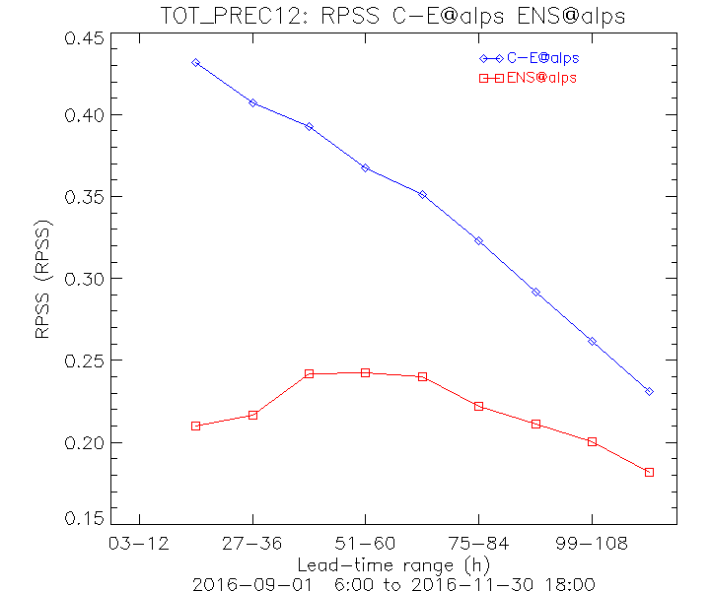
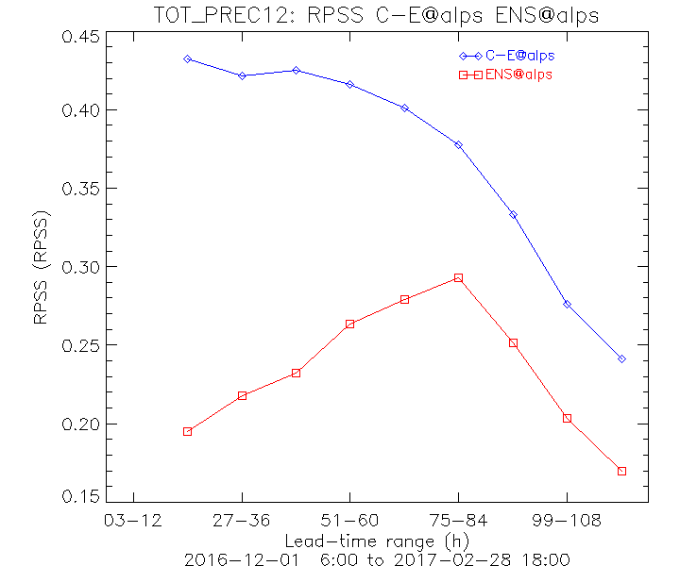
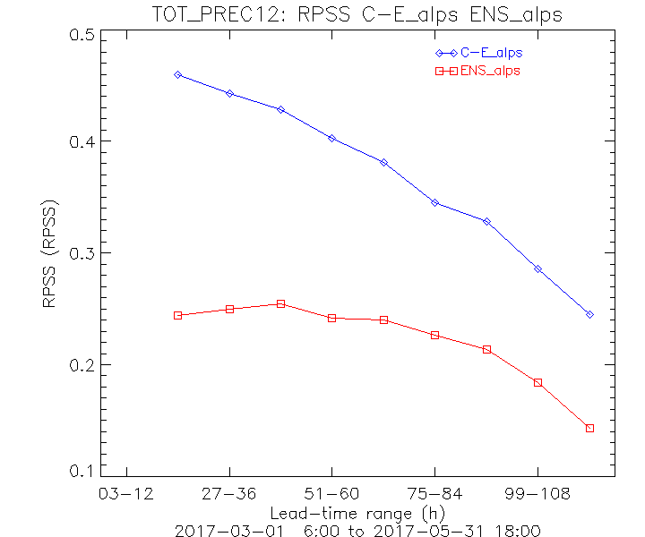
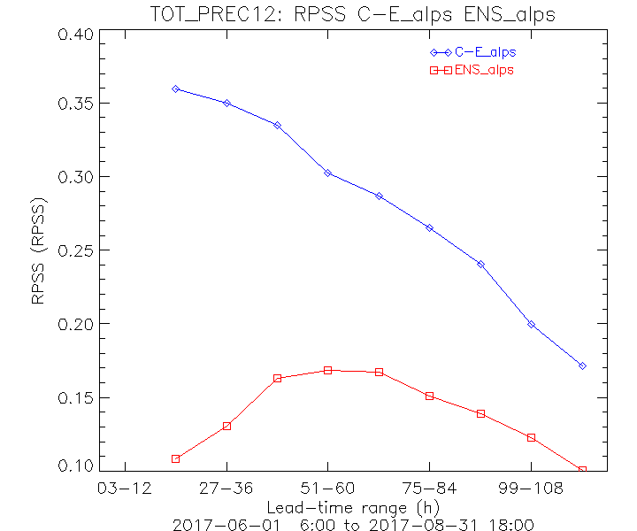
COSMO-E
Verification – comparison with ECMWF ENS
tp 12h
SON
DJF
COSMO-E
ENS
RPSS
MAM
JJA
Thresholds: 0.1, 0.2, 0.5, 1, 2, 5, 10, 20, 30, 50 mm/12h

Slide 5
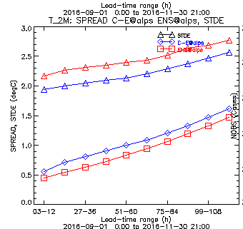
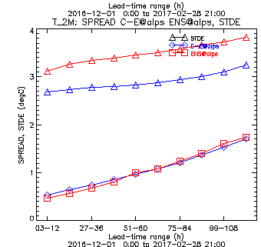
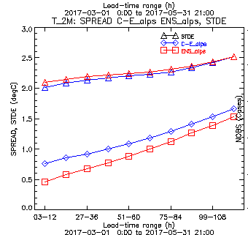
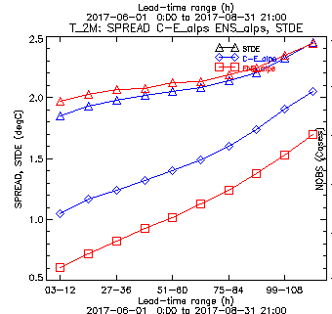
COSMO-E
Verification – comparison with ECMWF ENS
T 2m
SON
DJF
spread & skill (STDE)
COSMO-E
ENS
MAM
JJA

Slide 6
TLE-MVE – operational setup and status
Operational since January, 2016
4 runs per day, 36 hours forecasts, 20 members in 4 groups
Time-lagged, c_soil perturbation
6

Slide 7
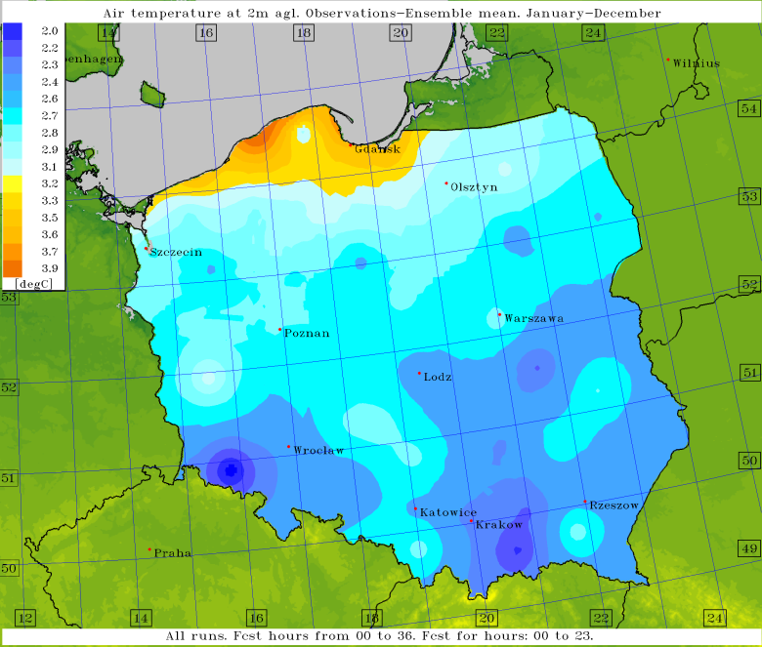
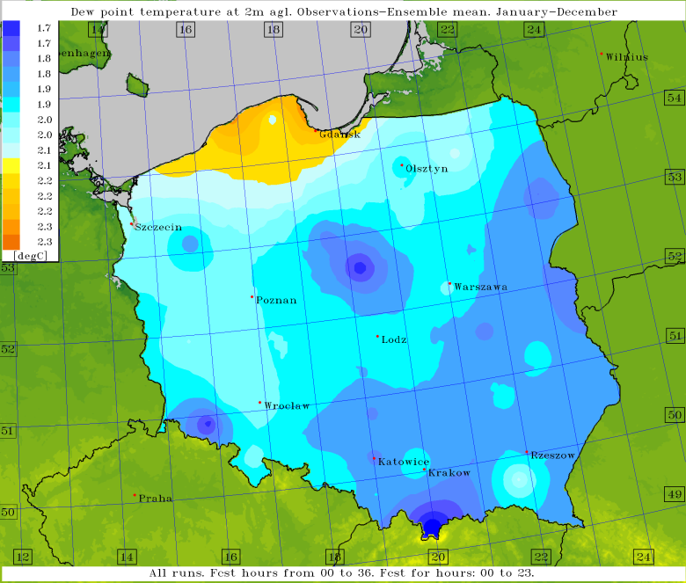
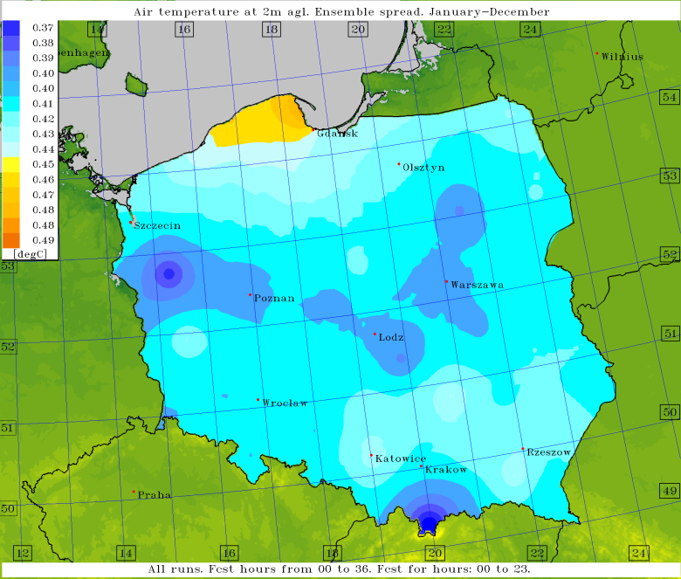
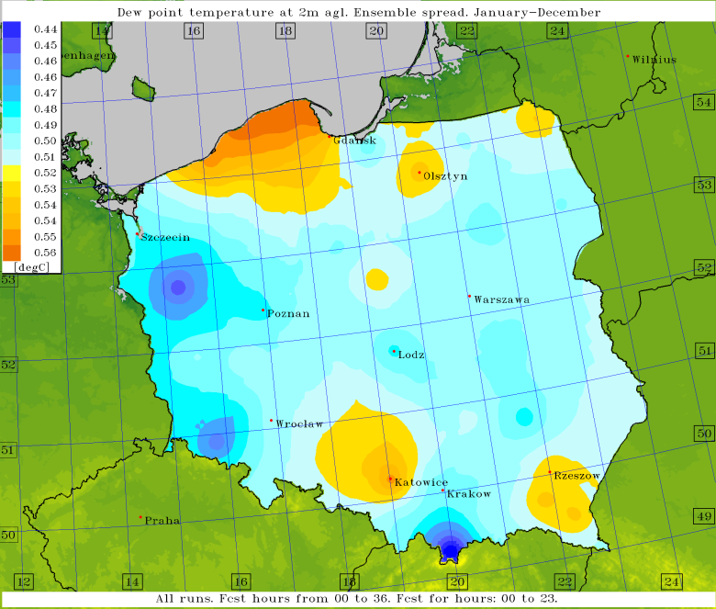
TLE-MVE – Study of the spread/skill relation
Skill-Spread spatial distribution
(a)
(b)
(c)
(d)
7
Avg. skill (up)/spread (down); T2M, TD2M (all runs, all fcst hours, Jan-Dec)
Notes:
7
Instytut Meteorologii i Gospodarki Wodnej - Państwowy Instytut Badawczy

Slide 8
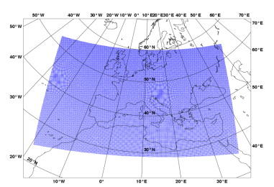
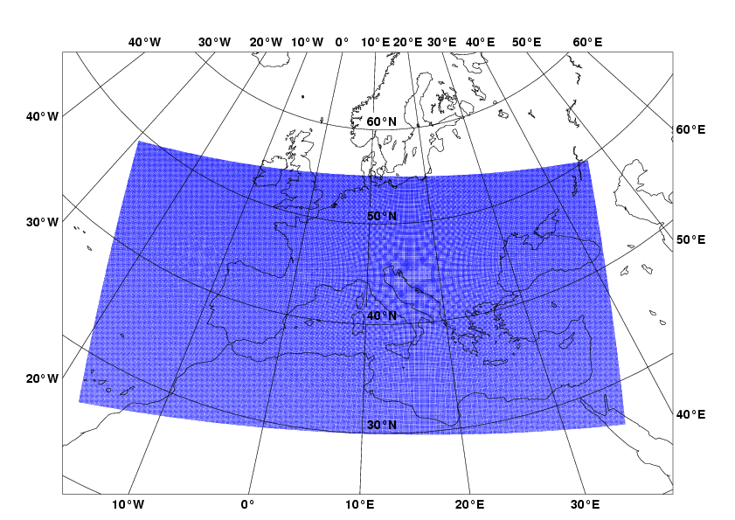
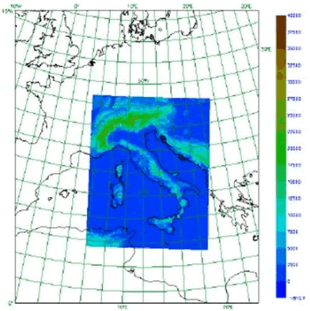


COSMO-IT-EPS: pre-operational set-up
LETKF (COMET)
COSMO-ME-EPS (COMET)
10 km
going to 7 soon KENDA
2.2 km
explicit convection
COSMO-IT-EPS (Arpae)
10 km (going to 7)

Slide 9
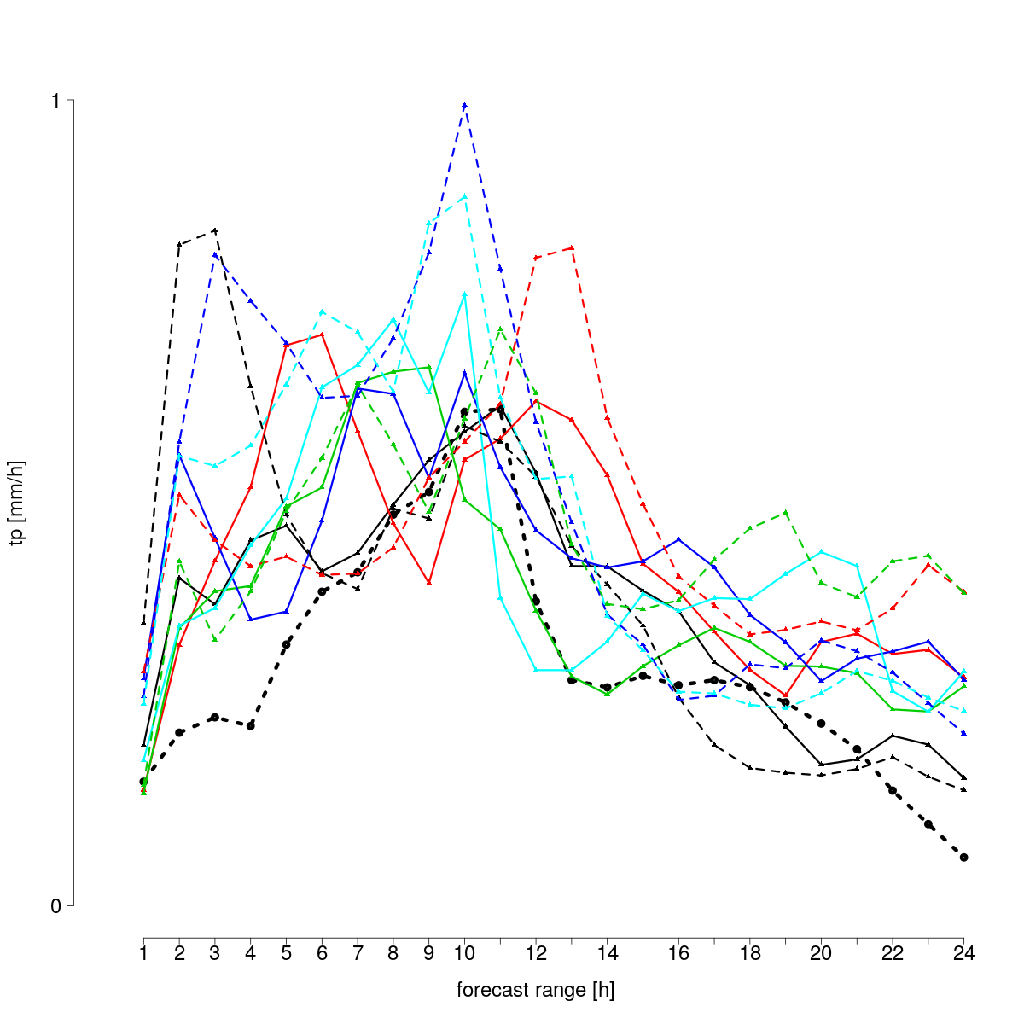
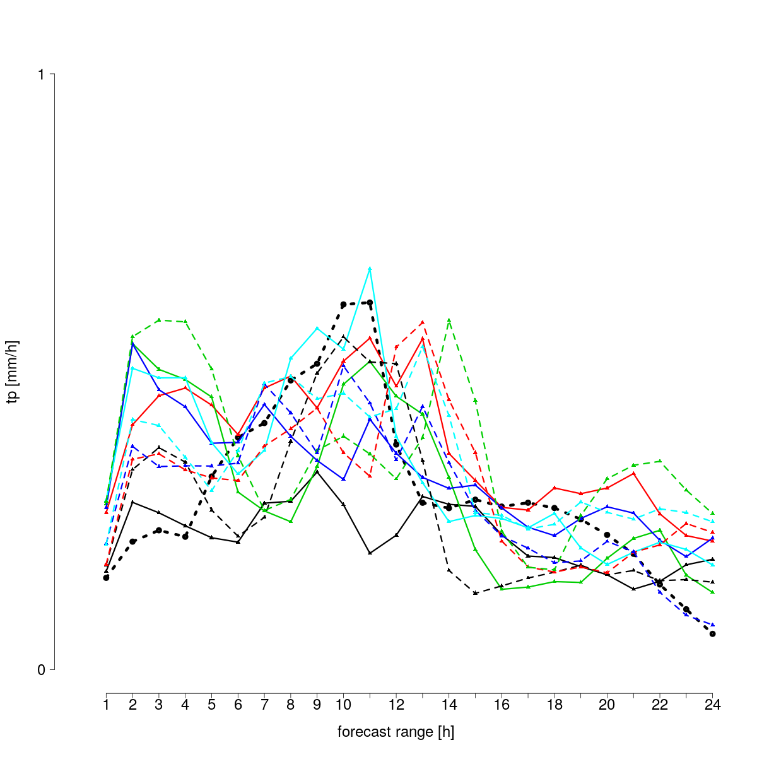
KENDA Initial Conditions
CTRL
CTRL + IC from LETKF
ensemble members
CASE STUDY: 10/10/2015
radar estimate
Hourly precipitation, area average (land only)

Slide 10
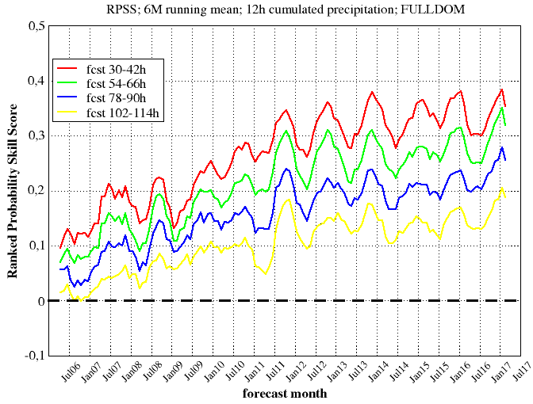
COSMO-LEPS
Trends in forecast scores
RPSS
Positive trend for all forecast ranges in the last years, especially for the longer ones ( --- and --- ).
Monthly-based verification performed over the full integration domain (~1400 synop reports; NGP)

Slide 11


COSMO-LEPS to web
Little visibility of COSMO-LEPS on COSMO web-site (no maps, not updated configuration, not updated namelists, ...)
Increase the visibility and the use of ensemble-based products both inside and outside the Consortium and attract more users for COSMO model
Disseminate from ECMWF to COSMO web-site some static maps with very few “basic” products:
  meteograms of COSMO-LEPS over some fixed locations,
  ensemble mean of mean-sea-level-pressure overlapped with probability of total precipitation to exceed some threshold

Slide 12
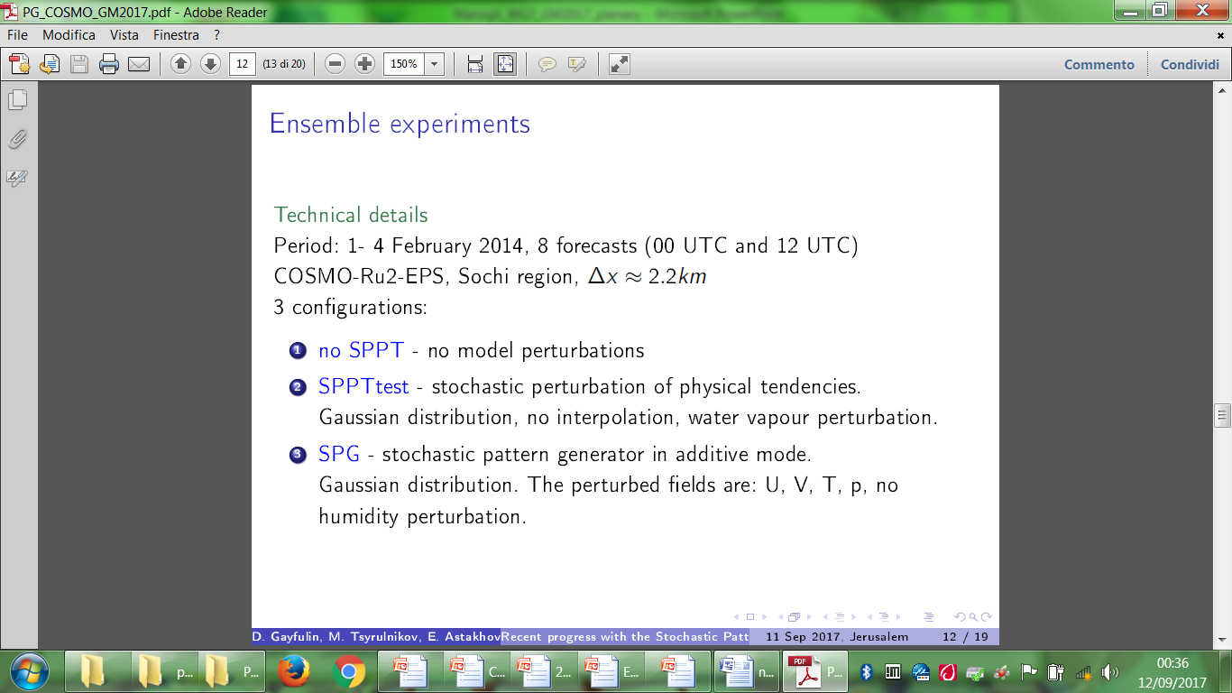
COSMO-Ru2-EPS

Slide 13
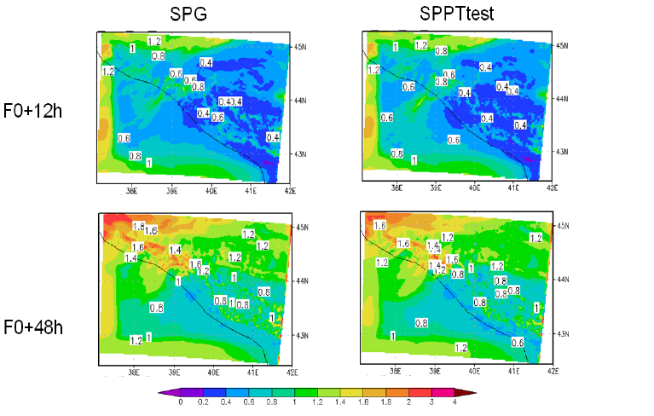
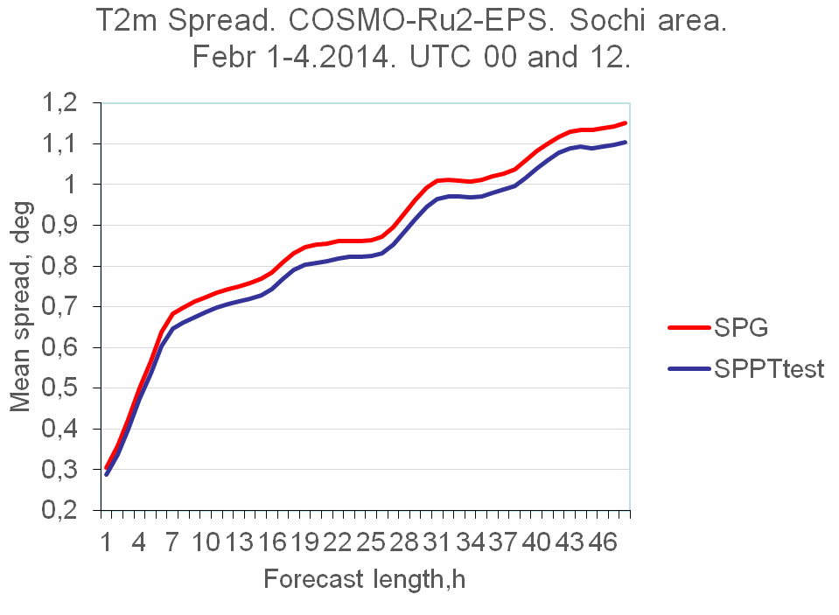
COSMO-Ru2-EPS – SPG test

Slide 14
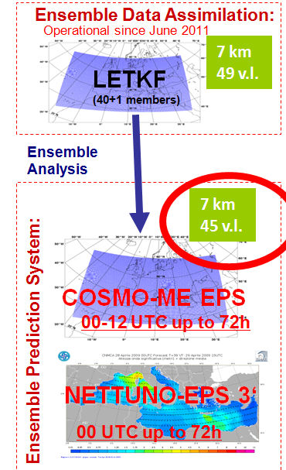
Operational products (Fieldextra)
COSMO-ME EPS
2 x standard deviation 2m temperature
2 x standard deviation 10m wind
6h integrated total precipitation > 0.2 mm
6h integrated total precipitation > 10 mm
6h integrated total precipitation > 20 mm
6h integrated total precipitation > 30 mm
6h integrated total precipitation > 40 mm
24h integrated total precipitation > 100 mm
24h integrated total precipitation > 20 mm
24h integrated total precipitation > 40 mm
6h integrated total snow precipitation > 0.2 cm
6h integrated total snow precipitation > 10 cm
6h integrated total snow precipitation > 20 cm
6h integrated total snow precipitation > 5 cm
24h integrated total snow precipitation > 10 cm
24h integrated total snow precipitation > 20 cm
24h integrated total snow precipitation > 40 cm
Max 2m temperature > 32°C
Max 2m temperature > 35°C
Max 2m temperature > 38°C
Min 2m temperature < 5°C
Min 2m temperature < 0°C
Min 2m temperature < -5°C
Min 2m temperature < -10°C
Wind gust > 21 kt
Wind gust > 33 kt
Wind gust > 55 kt
Sea wave height prob > 2.5 m
Sea wave height prob > 4 m
Sea wave height prob > 5 m

Slide 15


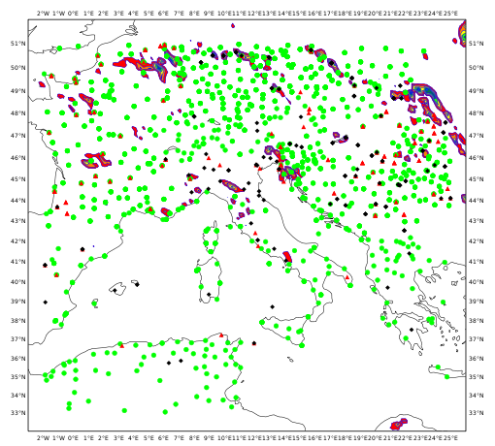
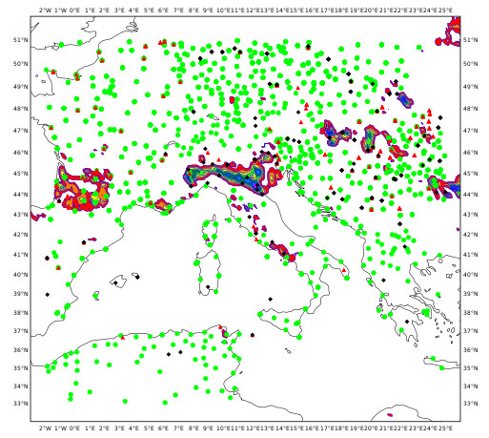
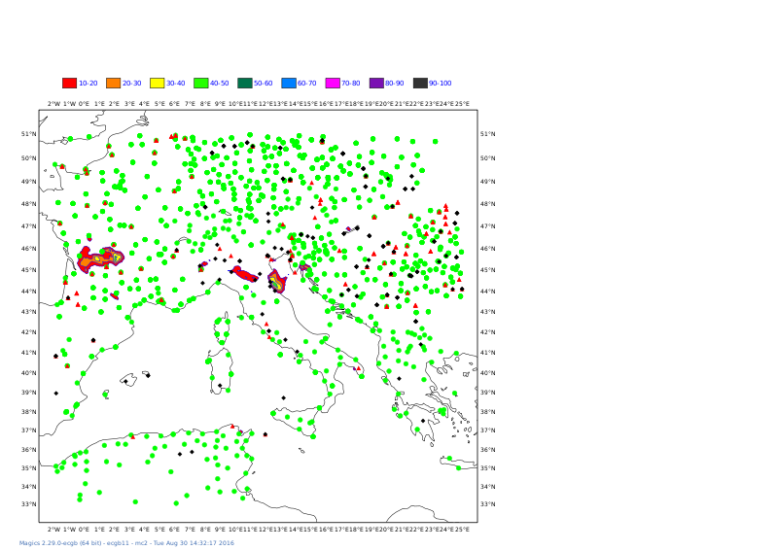
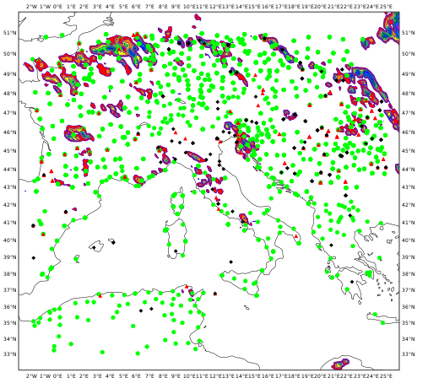
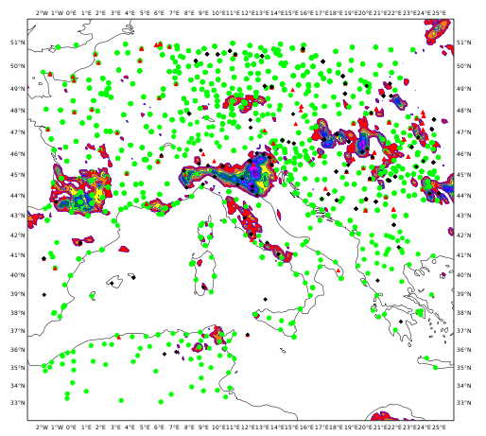
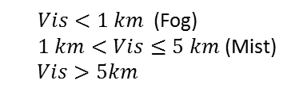


COSMO-ME EPS
Visibility from asymptotic approach
Probability of fog
Probability of mist
Probability (%):
$$RH≥95 \%$$
Observations:
$$Vis<1 km \text{ (}\text{Fog}\text{)}$$
$$1 km<Vis≤5 km \text{(}\text{Mist}\text{)}$$
$$Vis>5km$$
$$RH≥93 \%$$

Slide 16
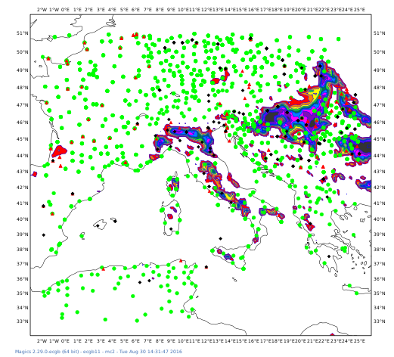
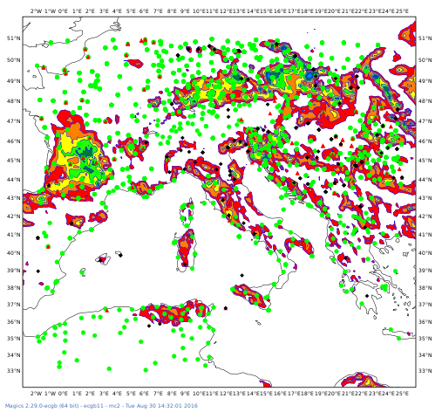
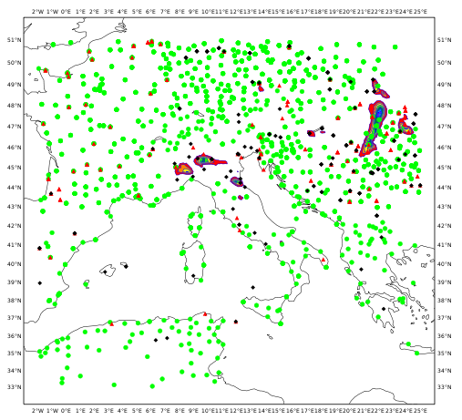
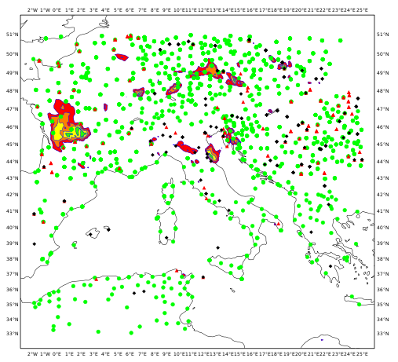
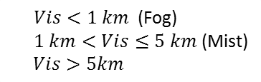


COSMO-ME EPS
Visibility from UPS approach
Probability of fog
Probability of mist
Probability (%):
Without
$MRI$ control
Observations:
$$Vis<1 km \text{ (}\text{Fog}\text{)}$$
$$1 km<Vis≤5 km \text{(}\text{Mist}\text{)}$$
$$Vis>5km$$
With
$MRI$ control

Slide 17
Future plans
The PP SPRED was due to end in August 2017
It is now extended to February 2018
  Task 1: writing a report on the spread/skill relation
  Task 2: test new model perturbation methods
  Task 3: complete soil perturbation method
  Task 4: calibration and products
The proposal for a new PP is in preparation (3 year project)
Main topics:
  test new methods for model perturbation and review the parameter perturbation,
  lower boundary perturbation: SPG, combination of pert.
  calibration and new products

