Slide 1
Numerical effects of a reformulated SAT
with an implicit treatment of surface-temperature in the heat budget
for a snow-free skin layer including a possible snow cover
The connecting ConSAT task: TURBTRAN <-> TERRA
Feedback between transfer-velocity and surface temperature
Influence of snow-treatment
Matthias Raschendorfer
Matthias Raschendorfer
COSMO-GM Jerusalem 2017

Slide 2
What is the reason of this activity?
Huge impact of surface-heat budget on near surface variables
steers the partition of radiation fluxes into SHF, LHF and GHF
First implementation step into ICON-TERRA of the last year development:
heat budget of a rough surface (cover-layer being a an extended skin-layer):
with a test-implementation into COSMO-TERRA:
with a heat storage → infinite thin soil skin
loosely coupled to the rigid soil → part of the soil
Semi-transparent for radiation → no transmission
only for the snow free part of the grid-cell surface
Necessary adaptation to long time steps with ICON: 6 min and more
time-step oscillations of T_sx = T_sf | T_sn (and the related surface fluxes)
amplitudes up to more than 80K !!
some model-crashes for ensemble-members !!
even the active artificial flux-limiter of TERRA can not prevent from crashes!!
time-bombe also for COSMO-applications

Slide 3
Method:
Identification of grid-points with large time-step increments in T_sx
Producing time-step series for the selected grid-points with individual settings of special parameters (quasi-SC-simulations)
Implementing new features, which
may cure the problem
can be reduced to almost the previous situation by parameter settings
Performing diagnostics in order to visualize the problem and the effect of implemented measures
Aim:
A new formulation running stable for any situation without the artificial flux-reduction in TERRA

Slide 4
Result of first diagnostic:
Problem is mainly related to grid-points with one or more of the following properties:
strong radiation forcing (tropics)
a thin (developing or vanishing) snow-cover
frozen precipitation at warm surface | liquid precipitation at frozen surface
disappearing interception-water or snow-water
fractional snow cover (particularly with dynamical sf and sn sub-tiles)
freezing or melting of soil water
Hypothesis:
Initial disturbance
Not smoothed out (ore even amplified) due to missing implicitness in some fundamental formulations
Implication:
I: Implementing the missing implicitness
II: Removing unphysical disturbances

Slide 5
Ad I: Linear-implicitly coupled budget equations at the surface:
mean cover-temp.
(of lin. vert. prof.).
mean snow-temp. (of lin. vert. prof.)
substantial, loosely coupled, semi-transparent C-layer
idealized, infinite-thin
S-layer
so far substituted by
so far only explicit and resistance of soil-half-layer not considered
singularity for vanishing snow-depth
so far only explicit contribution considered
so far no budget equation for in favour of setting

Slide 6
Ad I: Resulting matrix of the extended linear system:
altered
All 2 + k_soil budgets are always present (even for f_sn=0 or f_sn=1)
They are linearly coupled in the temperatures:
created
sn | sf | b1 | b2 | b3 | …
isc
fes
ifb
Can easily be tri-diagonalized by matrix-operations and solved by the standard solver
Partly reducible by parameters:
isc:
degree of corrected implicit coupling of T_sn to the soil- and atm. temperatures
fes:
degree of considered flux-equilibrium in diagnostics of T_sf
ifb:
degree of implicitness for effective surface fluxes used in the heat budgets
Default for test: isc=1; fes=1; ifb=1 (full implicit solution active) - modified for diagnostic points

Slide 7
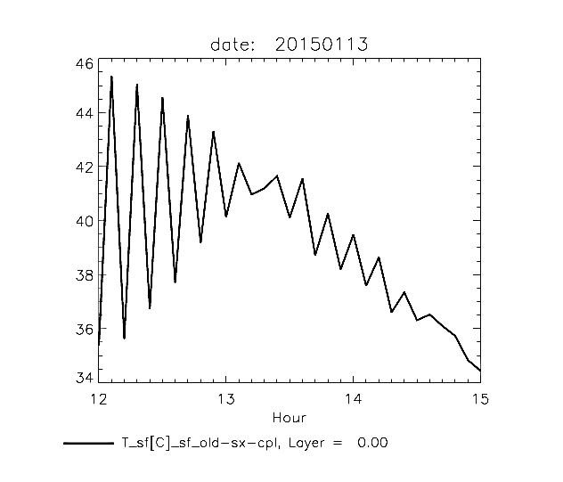
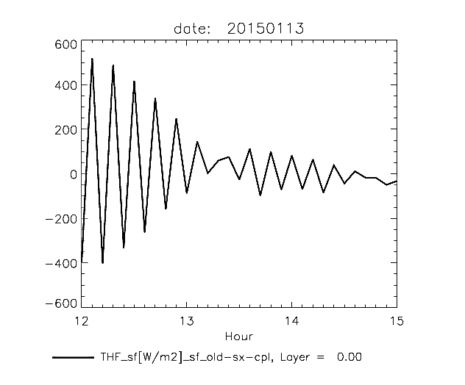
Ad I: Test-grid-point Kenia (+33.71_+7.89) :
After-noon situation; tropical hot with strong radiation forcing
3 hour ICON-global test-run (R2B6) with defaults of the new SAT/TERRA-scheme (dt=6 min)
Emulation of so far operational surface coupling only for a special grid-pointC
T_sf
THF_sf
old-sx-coupling: isc=0; fes=0; ifb=0
Strong 2*dt- oscillations with old coupling around noon with strong radiative forcing!

Slide 8
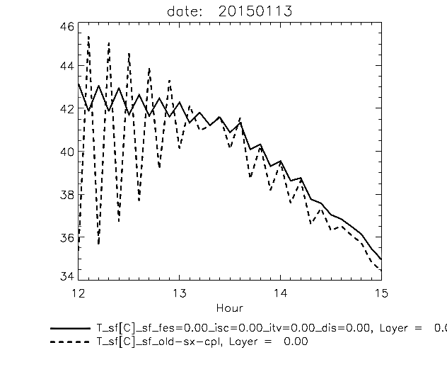
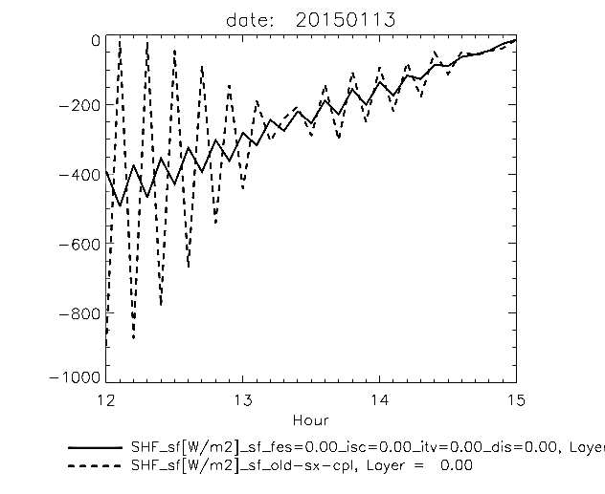
Ad I: Test-grid-point Kenia (+33.71_+7.89) :
After-noon situation; tropical hot with strong radiation forcing
3 hour ICON-global test-run (R2B6) with defaults of the new SAT/TERRA-scheme (dt=6 min)
Emulation of so far operational surface coupling only for the special grid-point:
T_sf
SHF_sf
old-sx-cpl + ifb=1
old-sx-cpl + ifb=1
Oscillations strongly reduced by ifb=1 (implicit flux increments active for soil forcing)

Slide 9
Ad I: Implicit increments of atmospheric transfer velocities:
Remaining oscillations may be due to implicit T_sx-dependency on transfer velocity for heat ,
which is the main variable part in the linear coefficients SHF_sx and LHF_sx:
The implicit heat budgets for sf and sn become quadratic in :
From solutions of the decoupled versions of these quadratic equations:
This updated transfer velocity is used in the subsequent linear system:
The factor of the linear T_sx-dependency of the transfer-velocity is estimated by registration:

Slide 10
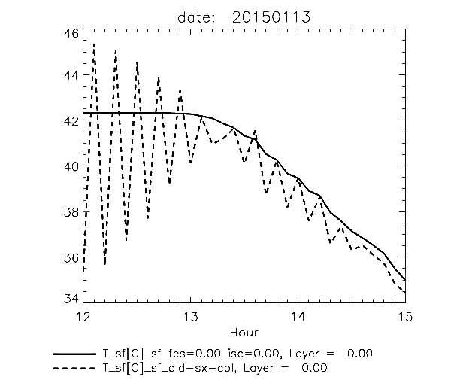
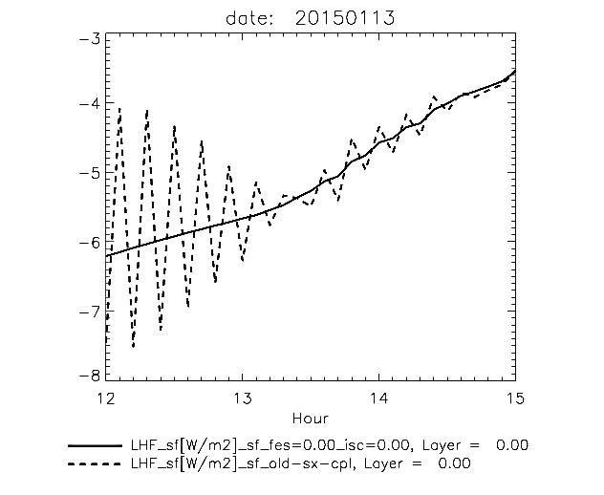
Ad I: Test-grid-point Kenia (+33.71_+7.89) :
After-noon situation; tropical hot with strong radiation forcing
3 hour ICON-global test-run (R2B6) with defaults of the new SAT/TERRA-scheme (dt=6 min)
Non-default settings only for the special grid-point:
T_sf
LHF_sf
old-sx-cpl + Ifb=1 + itv=1
old-sx-cpl + Ifb=1 + itv=1
Oscillations almost completely eliminated by ifb=1 + itv=1
Similar result but a bit larger daily amplitudes ifb=1 + itv=1 + fes=1 (not shown)
itv=1: full consideration of implicit T_sx-dependency in atmospheric transfer velocity
fes=1: full consideration of flux-equilibrium at the sf surface

Slide 11
Ad I +II: Scheme for snow-covered fraction and snow-depth :
Snow is not equally distributed along the grid-cell surface, due to various sources of inhomogeneity:
Snow-covered fraction
increases monotonically with mean snow-water level of a grid cell
until a critical mean snow-water level is reached.
Specific snow-water-level is prop. to specific snow-depth
ssp
ssp
New control-parameter : ssp: spreading efficiency
ssp=0: so far operational version; not steady; it is always !!
ssp=1: full snow-spreading; always full snow-cover!!

Slide 12
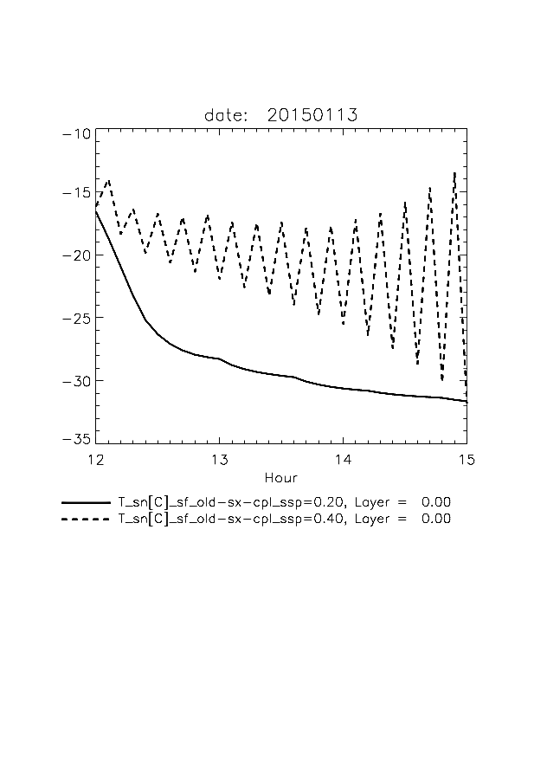
Ad I: Noth-India (+85.51_+28.33) :
Evening situation; frozen soil; snow-fall with a thin snow cover yet
3 hour ICON-global test-run (R2B6) with defaults of the new SAT/TERRA-scheme (dt=6 min)
Non-default settings only for the special grid-point:
T_sn [C]
T_sn [C]
old-sx-cpl + isc=0.0 + ssp=0,2
old-sx-cpl + isc=0.0 + ssp=0,4
h_sn [mm]
full-impl-cpl + isc=0.0 + ssp=0,4
full-impl-cpl + isc=1.0 + ssp=0,4

Slide 13
Ad II: Removing various unphysical disturbances:
Various artificial limits (mainly due to the explicit formulation itself) are sources (or at least the trigger) of oscillations or are not in accordance with the implicit solution
Some of them have been removed:
Implicit and positive definite treatment of surface water reduction (interception water or snow) by evaporation
Quadratic equation for w_sf or w_sn
Reduction of evaporating surface
Various security limitations of w_sf | w_sn, of h_sn | f_sn, as well as for T_sf | T_sn
Water phase conversions of precipitation specific for sf and sn surface
Consideration of all the conversion heat in the thermal budgets
Adaptions in the aggregation of variables for dynamic sn and sf sub-tiles
adapted linear T_sx-coefficients of LHF
Others are still active:
explicit treatment of snow-melting separated form the implicit heat budget
explicit treatment of soil water freezing and -melting separated form the implicit heat budgets
general neglect of SHF related to precipitation and infiltration!!

Slide 14
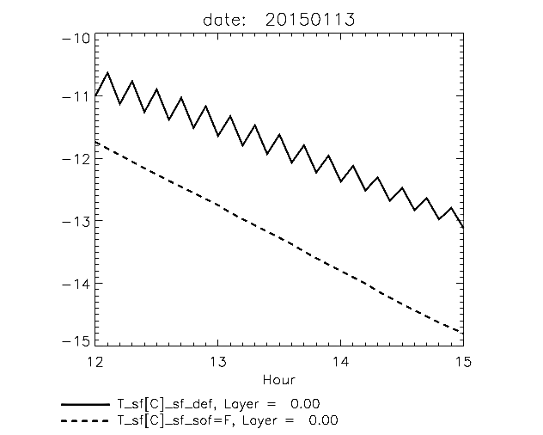
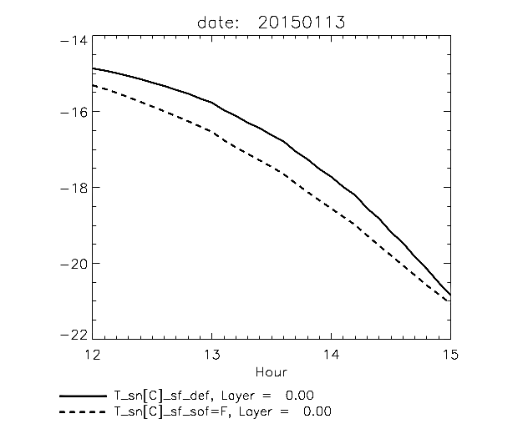
Ad II: Siberia (+102.83_+43.42) :
Nocturnal cooling; partly frozen soil with fractional snow-cover
with full implicit coupling:
sf-surface
sn-surface
T_sf [C]
still some oscillations!!
T_sn [C]
vanishing for deactivated soil-freezing!!
new-def-cpl
new-def-cpl
new-def-cpl + sof=F
new-def-cpl + sof=F
sof=F: explicit soil-freezing and –melting is deactivated
Oscillating T_sf is due to instability in explicit formulation of soil-freezing or -melting
Snow-cover is not affected

Slide 15
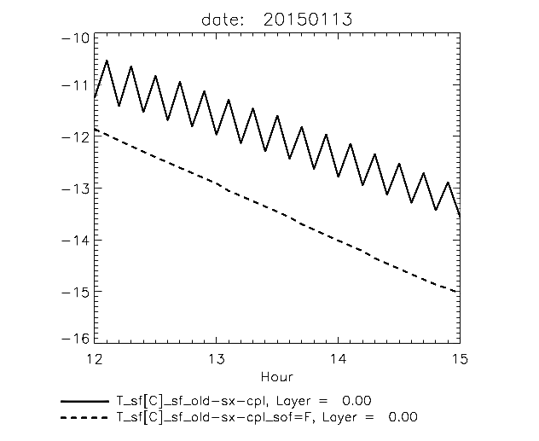
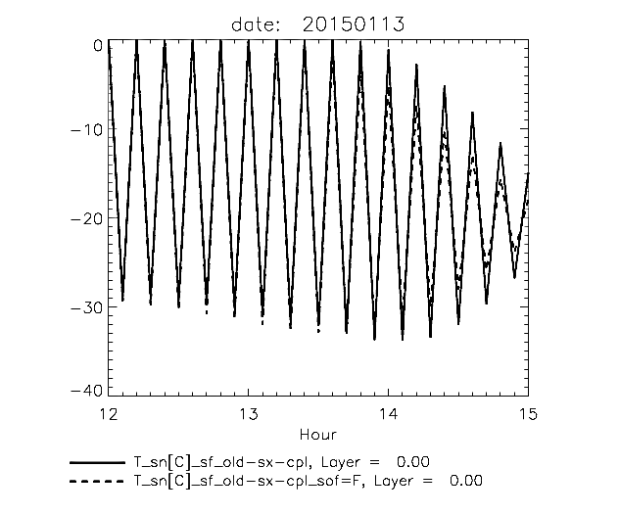
Ad II: Siberia (+102.83_+43.42) :
Nocturnal cooling; partly frozen soil with fractional snow-cover
with old explicit coupling:
sf-surface
sn-surface
sof=F: explicit soil-freezing and –melting is deactivated
Oscillating T_sf due to instability in explicit formulation of soil-freezing or -melting
T_sn is oscillating regardless if soil-freezing and –melting is switched on or off

Slide 16
Resume:
If you don’t look a time-step ahead, disturbances in your relations may cause amplifying feed-back reactions!

Slide 17
Outlook:
Including melting of snow and freezing/melting of soil-ice into the implicit heat budgets
Extending the coupled heat-budget of the snow-free skin-layer by the extended one for the roughness cover
Consideration of sensible heat related to water fluxes

Slide 19
Main new features implemented:
Reformulation of the heat budget equations in TERRA for the:
roughness-cover of the snow free-part (sf) | single-layer snow-cover at the snow-cov. part (sn)
uppermost soil layer (b1)
Implicitly coupled by temperatures: T_sf T_sn and T_b1, T_b2, …
Linearizing the dependency on T_sx = T_sf | T_sn for all contributing surface fluxes
Additional implicitness by considering the T_sx-dependency of atmospheric transfer velocity
Implicit increment transfer velocity is quadratic in T_sx
Snow heat budget reduces -> skin-layer flux-equilibrium in the limit h_sn -> 0
New steady and more realistic parameterization of snow-fraction as a function of snow-water
Describing phase change of falling precipitation more consistently
Implicit treatment of surface water levels (w_sf | w_sn) with respect to evaporation

Slide 20
WG3a-Activities and PT ConSAT:
Review of verification with common blocked TURBDIFF and old TERRA in COSMO-DE
Verification of the EDP-forecast derived from TURBDIFF within the ICON model
Towards a new diagnostic of equilibrium surface temperature in combination with SAT and the soil model
Feedback between transfer-velocity and surface temperature
Applicability of a tile approach in cases with stable stratification
Matthias Raschendorfer
Matthias Raschendorfer
COSMO-GM Jerusalem 2017

