Slide 1


Verification Overview
(based on CP activity: JJA2016-MAM2017)
Alexander Kirsanov & WG5

Slide 2
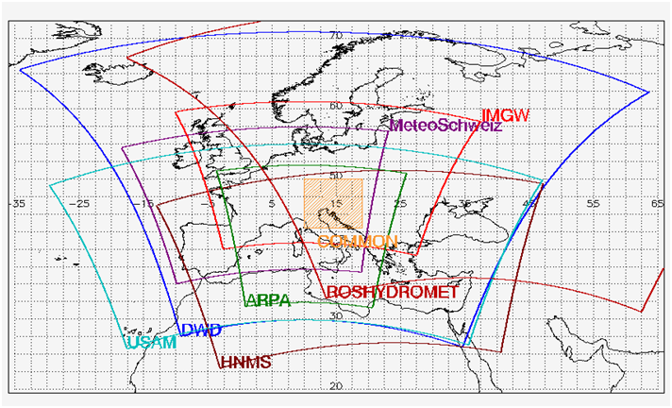
VERIFICATION OVER THE COMMON AREA
COSMO-7, COSMO-EU, COSMO-GR, COSMO-I7, ICON-EU, IFS, ICON,
COSMO-ME, COSMO-PL, COSMO-RU7
Annual reports and Seasonal analytics are located at the website:
http://cosmo-model.org/content/tasks/verification.priv/

Slide 3
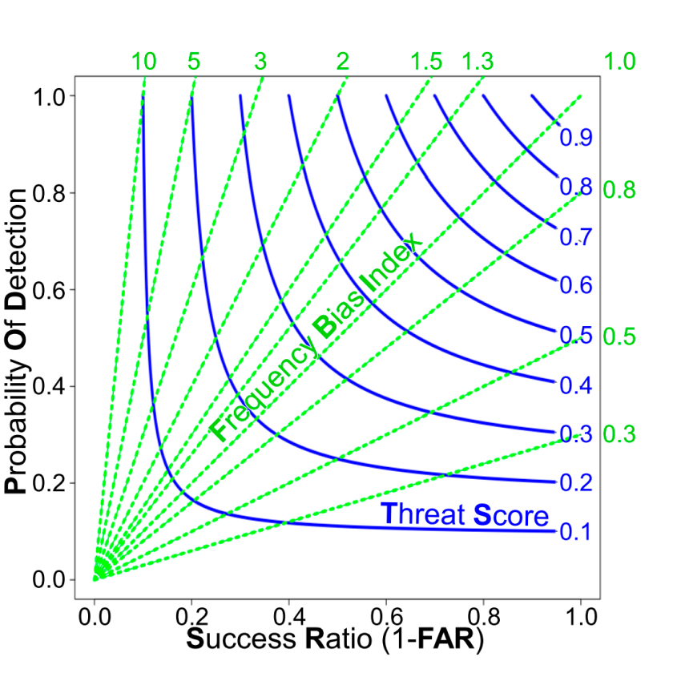
General Information on Scores
Continuous parameters
Performance Diagram
Temperature at 2 m
Dew point temperature at 2 m
Pressure reduced to Mean Sea Level
Wind speed at 10 m
Total cloud cover
Dichotomic parameters
Total Precipitation in 6 hours
Total Precipitation in 24 hours
Extremal Dependence Indices

Slide 4
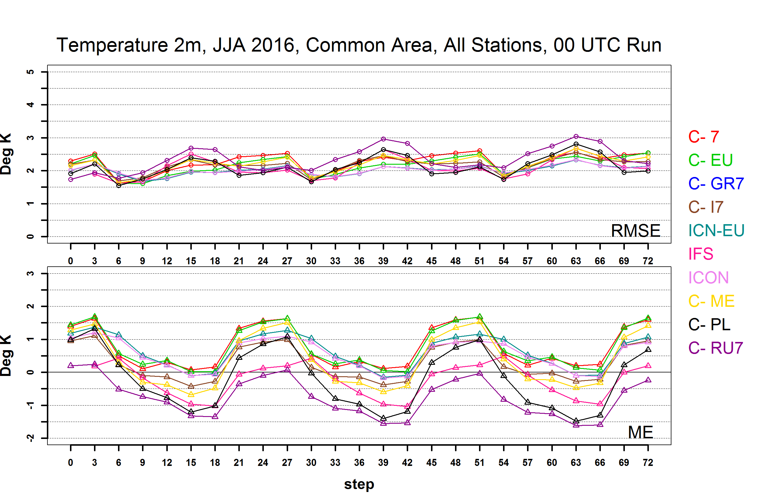
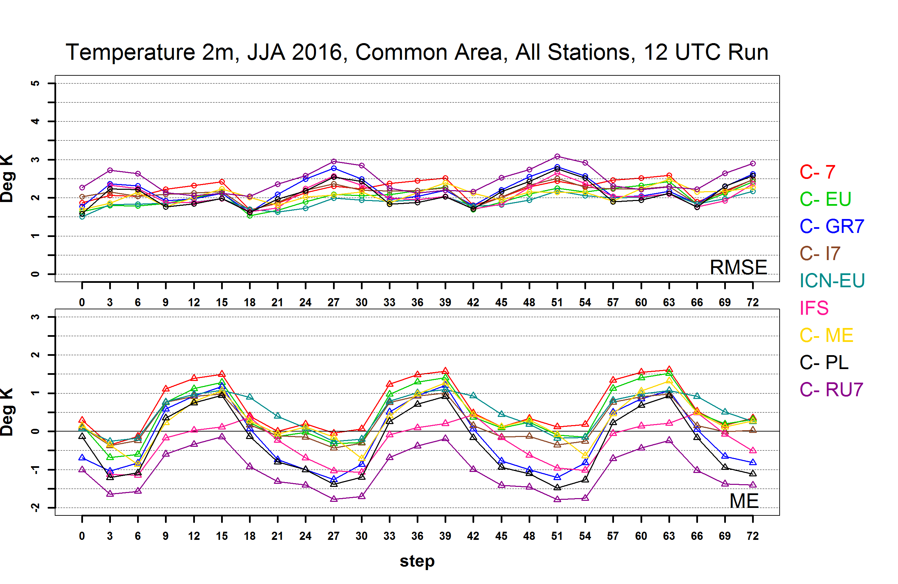
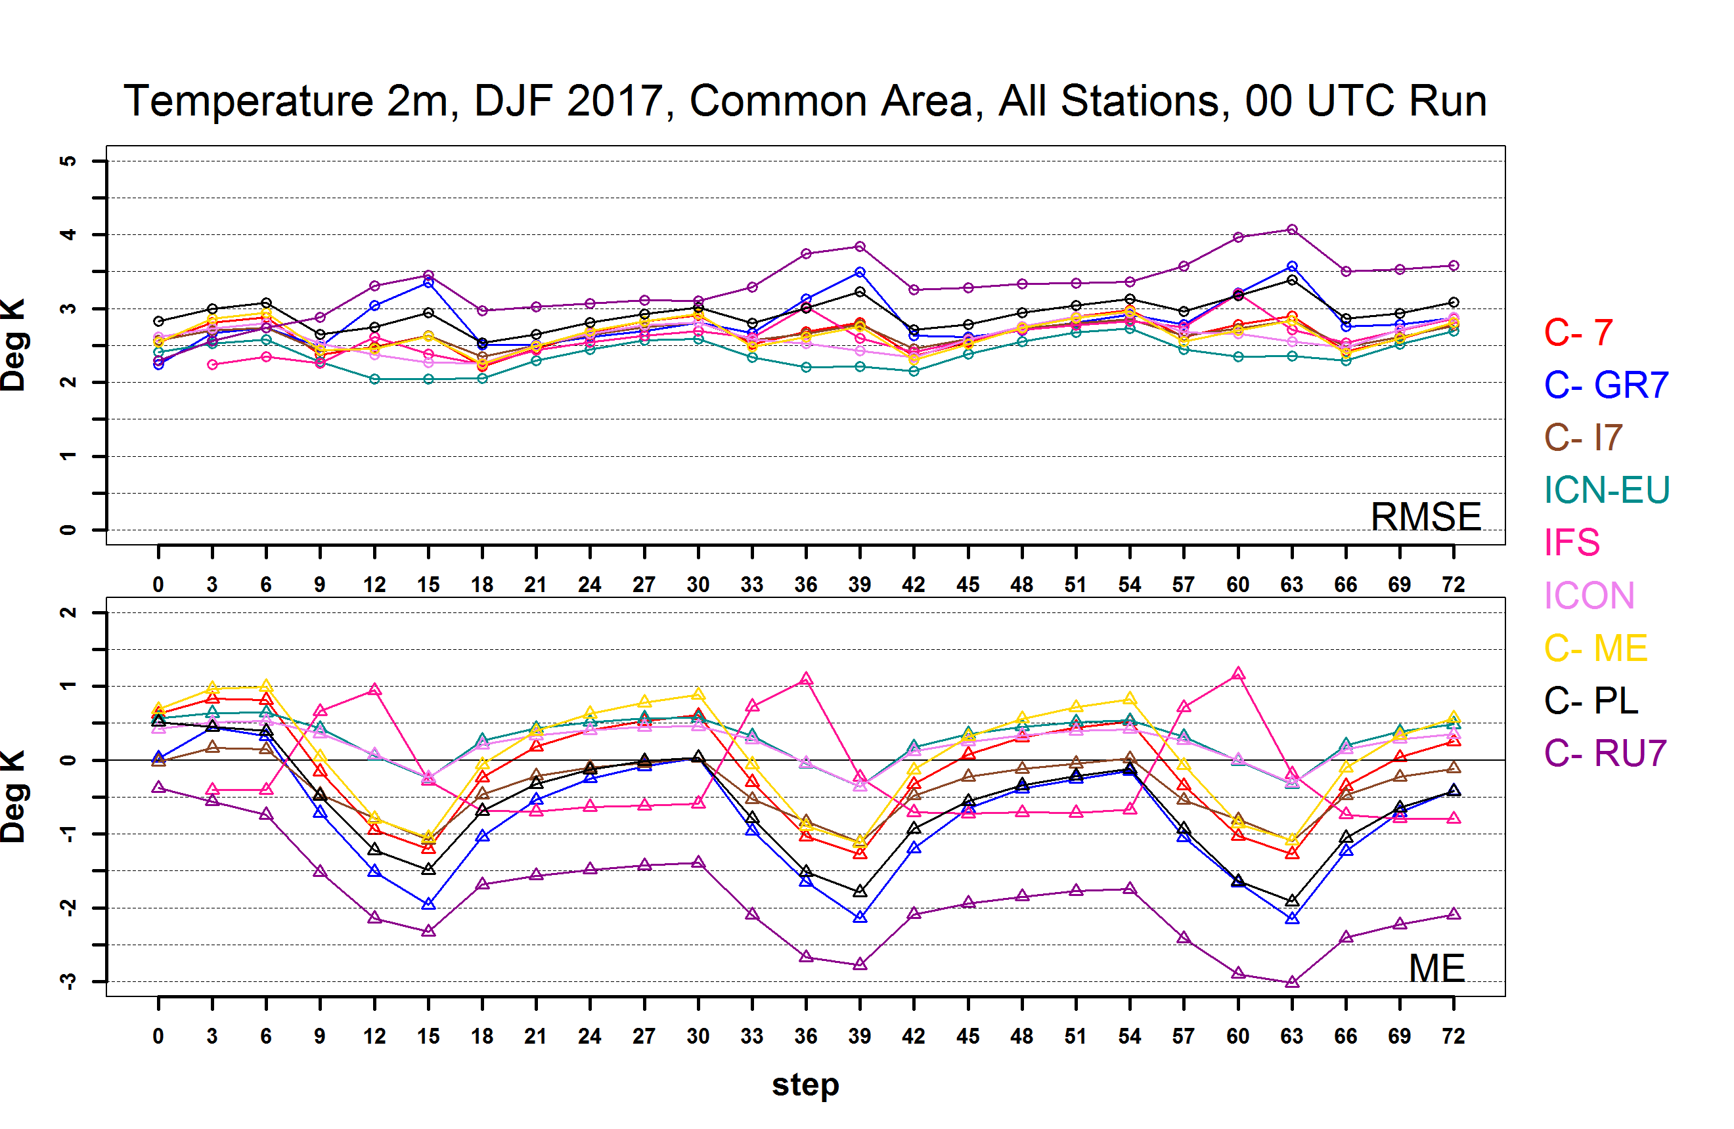
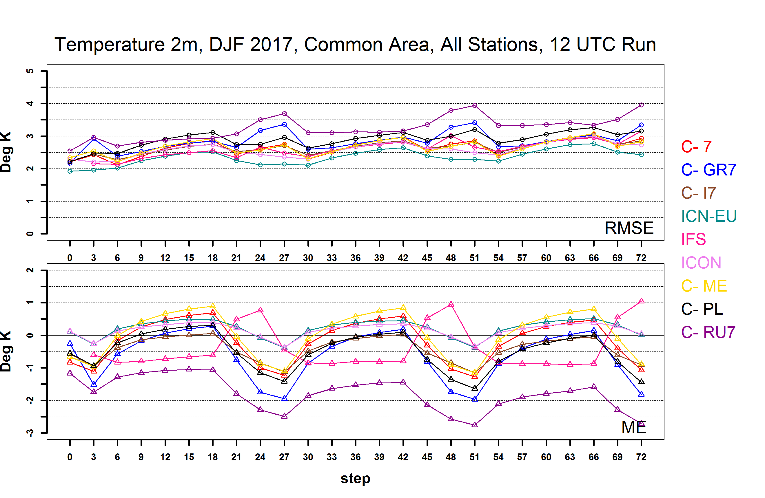
00 UTC
Run
00 UTC Run and 12 UTC Run score difference is not significant
12 UTC
Run
Notes:
00 UTC Run and 12 UTC Run score difference is not significant, except some scores of 2m Dew Point Temperature and a few precipitation scores.

Slide 5
TEMPERATURE AT 2M From: 2016-06-01 To: 2017-05-31
ME
Diurnal variability underestimation:
negative ME during day, positive ME during night
RMSE
ICON-EU/ICON:
the lowest RMSE and diurnal score variations
Last year tendency: JJA RMSE ↓ SON RMSE ↓ DJF RMSE ↑ MAM RMSE ↑

Slide 6
DEW POINT TEMPERATURE AT 2M From: 2016-06-01 To: 2017-05-31
ME
ICON-EU/ICON
positive ME is decreasing with lead time:
Spinup effect?
RMSE
ME and RMSE maximum is during the late daytime
Last year tendency: JJA RMSE ↓ DJF RMSE ↑ MAM RMSE ↑
Notes:
ICON (and ICON-EU) ME is decreasing with lead time especially during JJA and SON, 00 UTC Run

Slide 7
TOTAL CLOUD COVER From: 2016-06-01 To: 2017-05-31
ME
COSMO → ME>0
ICON-EU/ICON → ME~0
IFS → ME<0
RMSE
ME and RMSE maximum during nighttime
Last year tendency: ME and RMSE decrease for most COSMO models

Slide 8
WIND SPEED AT 10 M From: 2016-06-01 To: 2017-05-31
ME
ICON-EU/ICON has closest to zero ME, less notable diurnal ME variation
Last year tendency: SON RMSE ↓ ME is decreasing

Slide 9
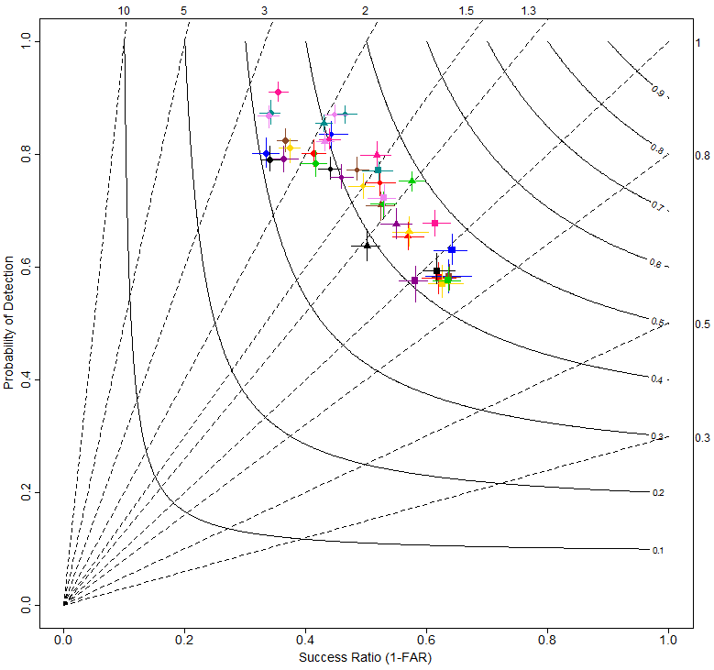
Precipitation in 6h 0.2 mm threshold From: 2016-06-01 To: 2016-08-31
The most significant diurnal variation and the lowest (worst) Threat Score compared to other seasons
ICON, ICON-EU, and IFS overestimate low precipitation more than COSMO models:
Presumably, The IFS/ICON cumulus convection scheme is responsible?
Notes:
Low precipitation overestimated, strongest overestimation during daytime

Slide 10
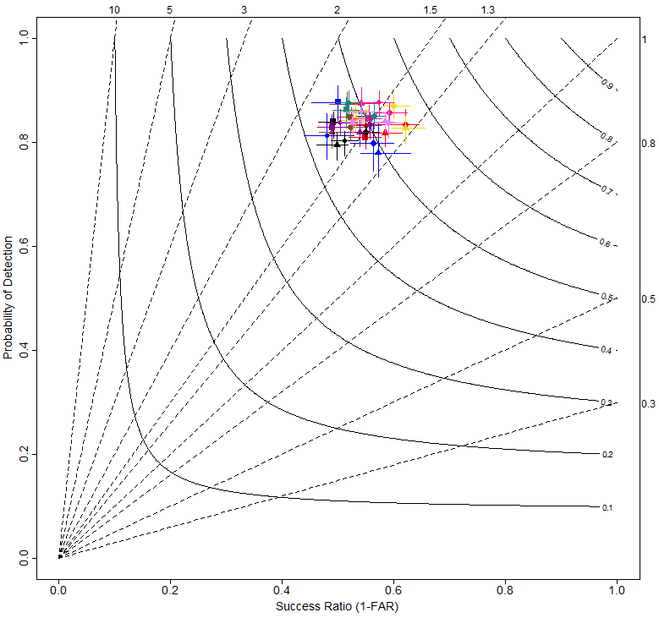
Precipitation in 6h 0.2 mm threshold From: 2016-12-01 To: 2016-02-28
Low precipitation overestimated
Threat Score is
better than during summer
Less than during other seasons diurnal variation and differences between models
Scores can be divided into warm season (JJA and MAM) and cold season (DJF and SON) groups with similar patterns

Slide 11
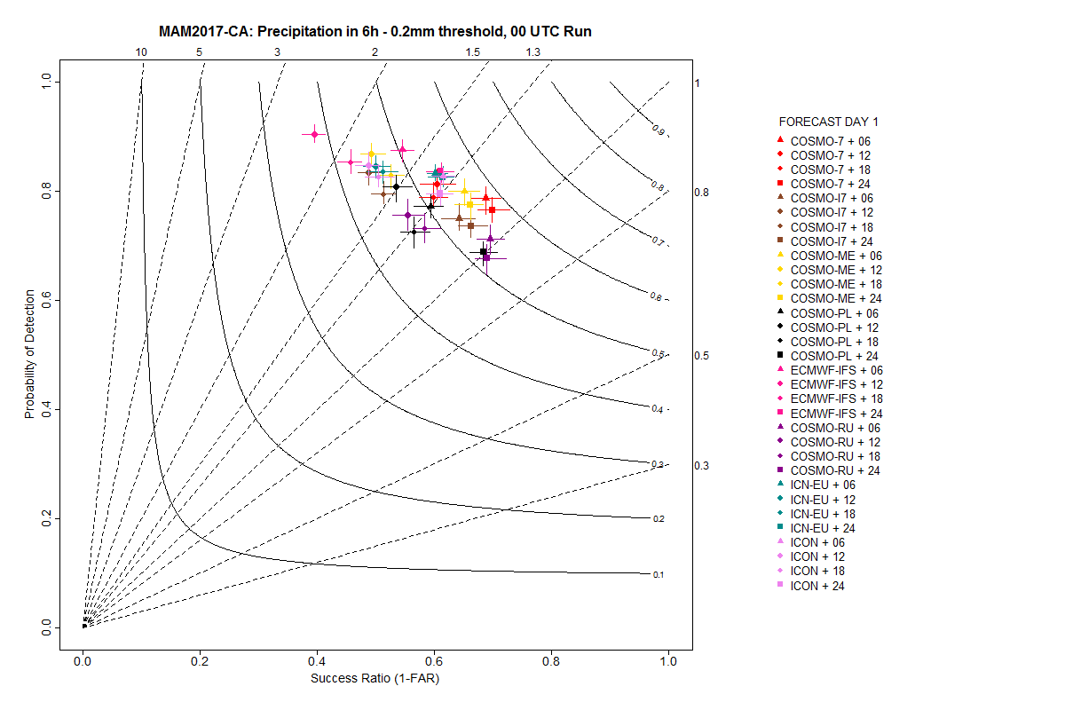
Precipitation in 6h 0.2 mm threshold From: 2017-03-01 To: 2017-05-31
IFS overestimates low precipitation more than
ICON-EU/ICON during MAM-2017 and SON-2016
Notes:
IFS overestimates low precipitation more than ICON during MAM and SON yet the Threat Score is higher for IFS in case of SON (not shown)

Slide 12
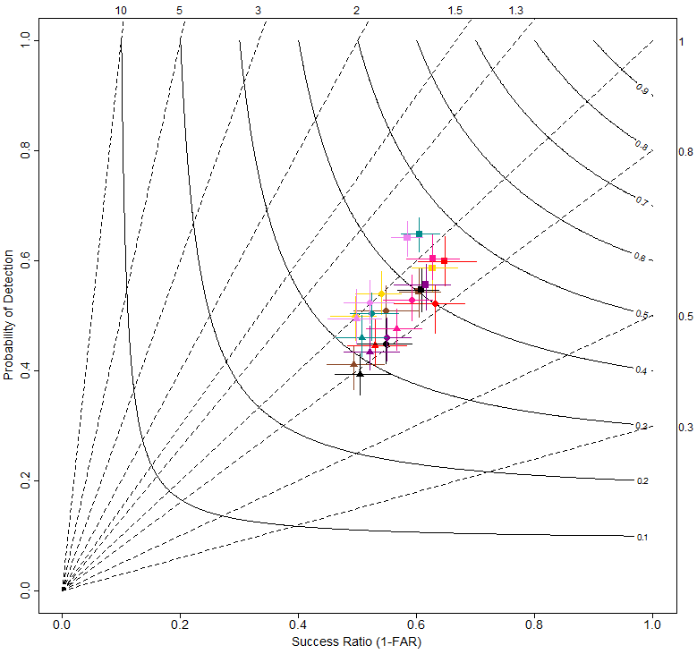
Precipitation in 24h 10 mm threshold From: 2017-03-01 To: 2017-05-31
High precipitation events are underestimated
ICON-EU/ICON underestimate high precipitation events the least

Slide 13
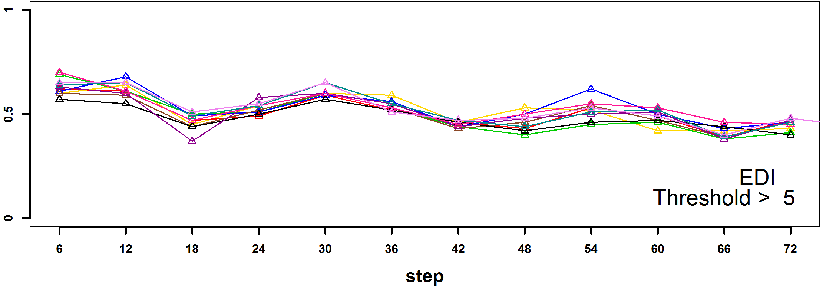
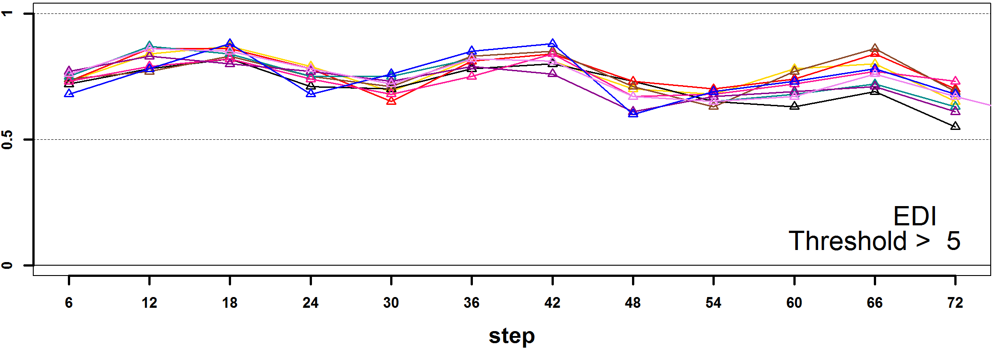
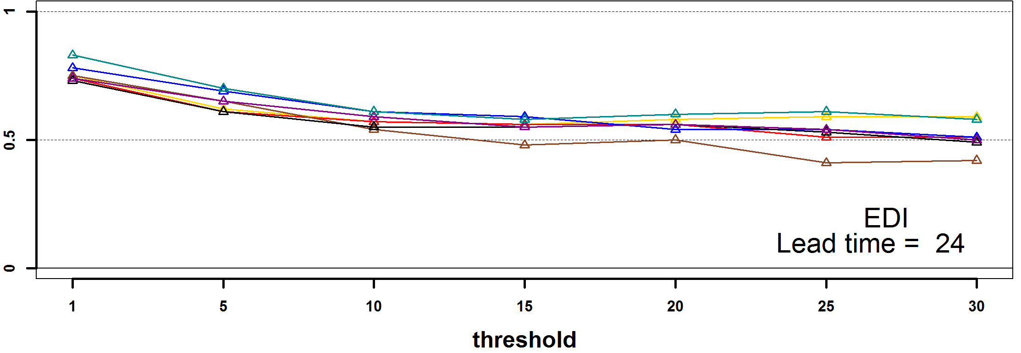
Precipitation in 6h JJA-2016: EDI
EDI&SEDI show diurnal variability with minimum values during 12-18 UTC for JJA and MAM, during 18-24 UTC for DJF and SON
Precipitation in 6h DJF-2017: EDI
EDI&SEDI values are decreasing for higher precipitation events, decreasing with the lead time
Precipitation in 24h JJA-2016: EDI

Slide 14
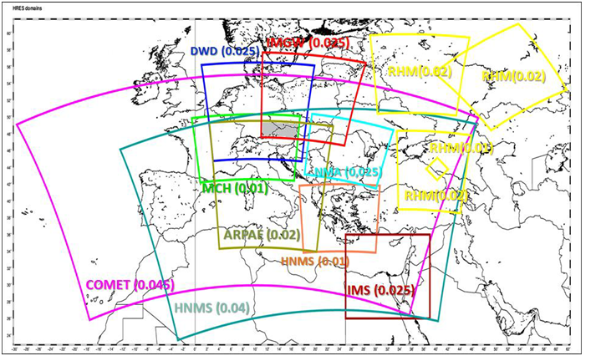
VERIFICATION OVER THE COMMON AREA 2:
FINE RESOLUTION
COSMO-1, COSMO-DE, IFS, ICON, COSMO-IT, COSMO-PL

Slide 15
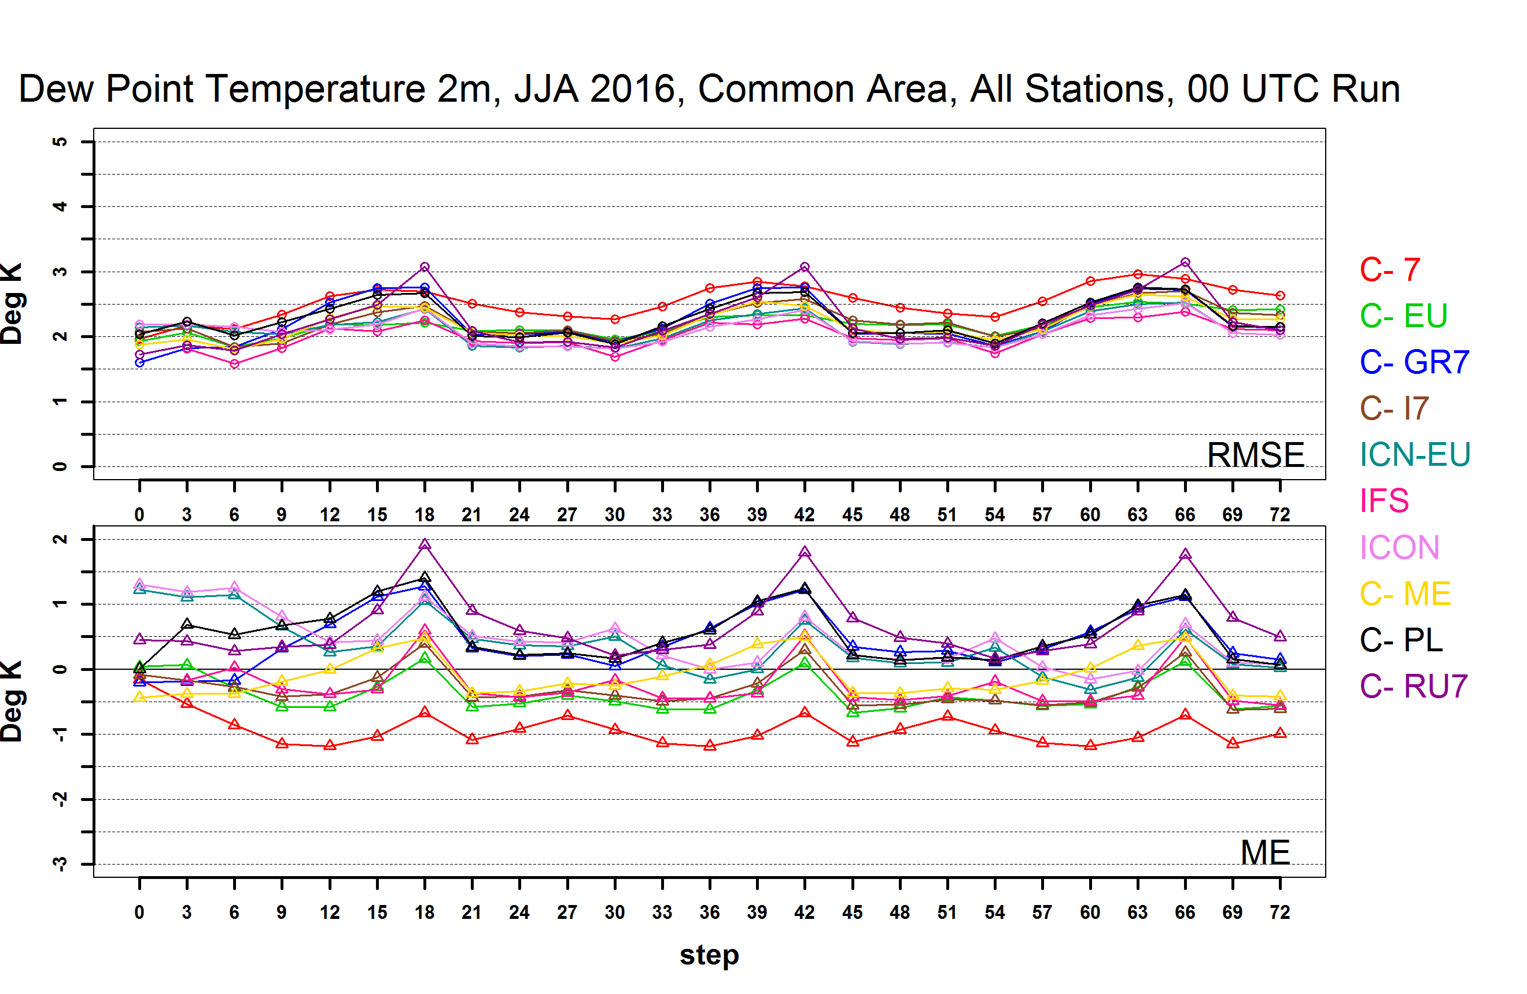
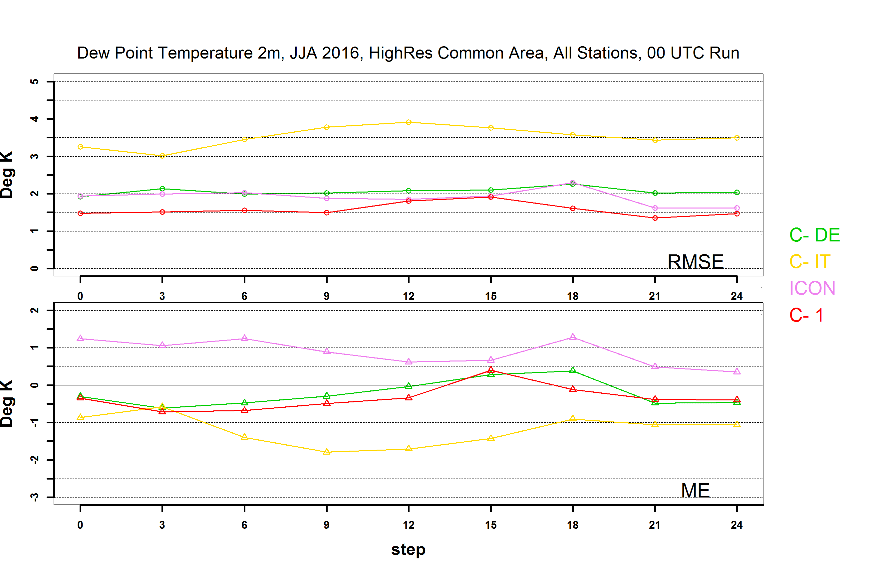
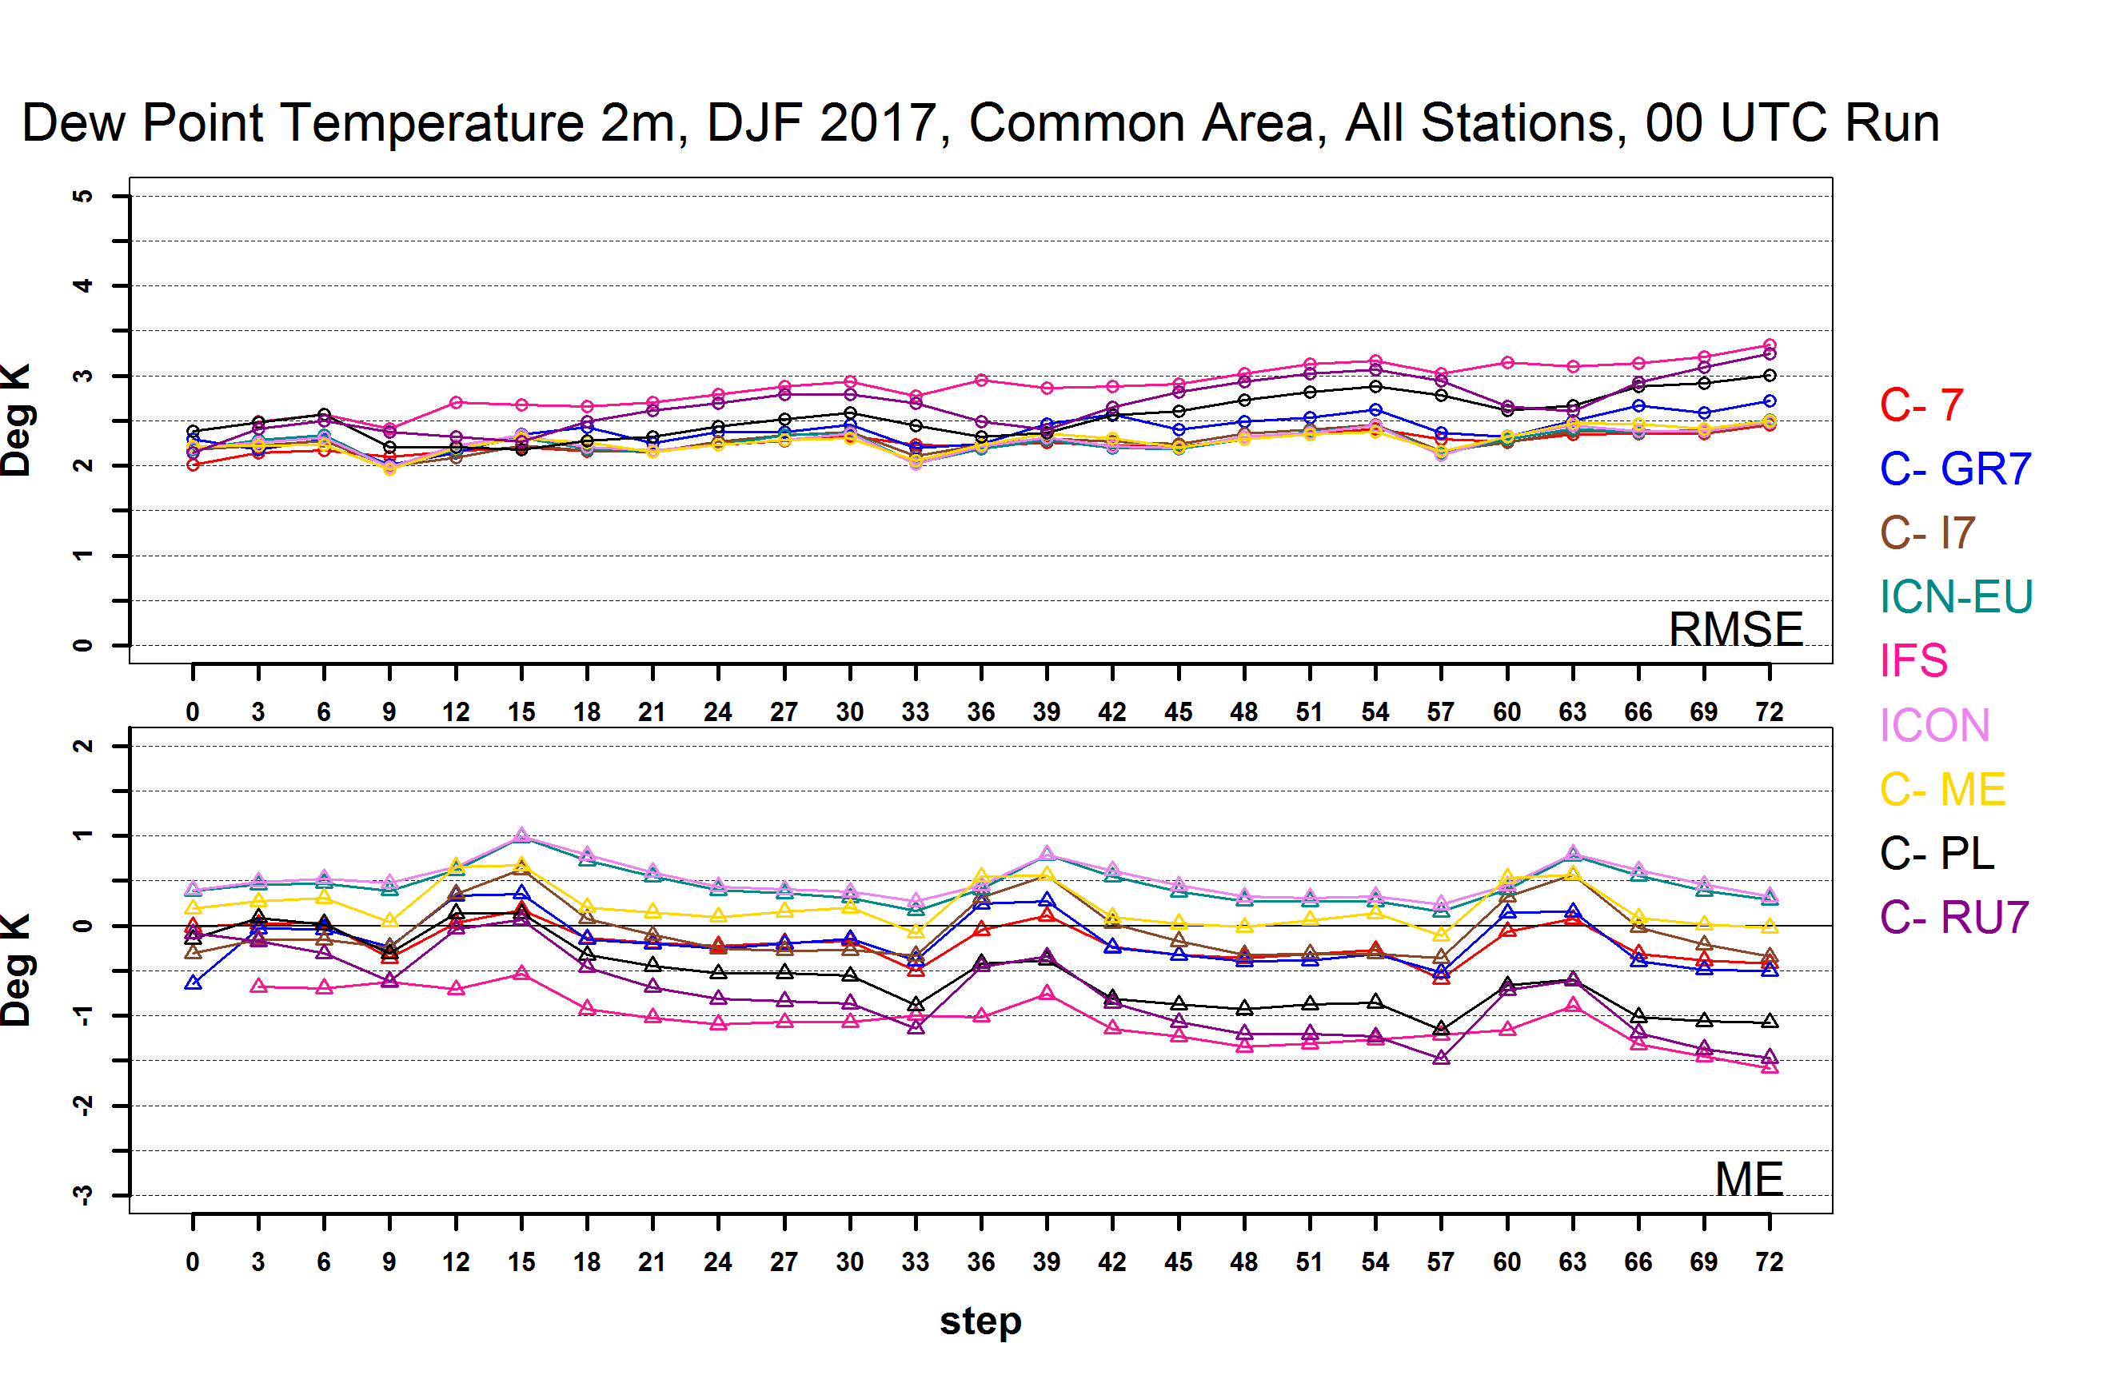
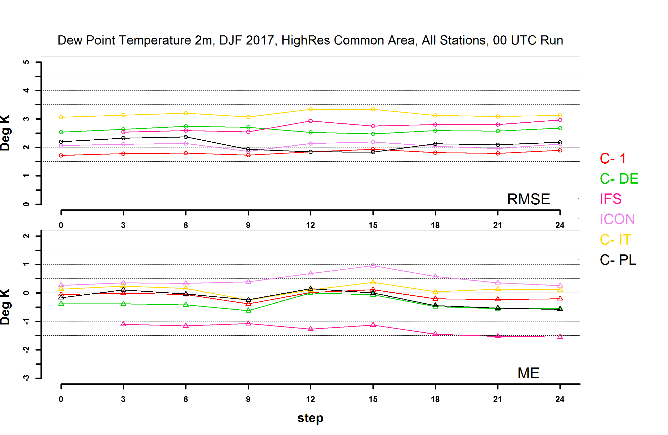
Coarse
Res.
Dew point temperature at 2 m scores are slightly better for High resolution models, compared to coarse resolution models, especially for COSMO-1 and COSMO-PL
High
Res.
Notes:
T2M, PMSL, TCC , WSPD Fine Resolution Domain scores are not significantly better than the scores of Coarse resolution models

Slide 16
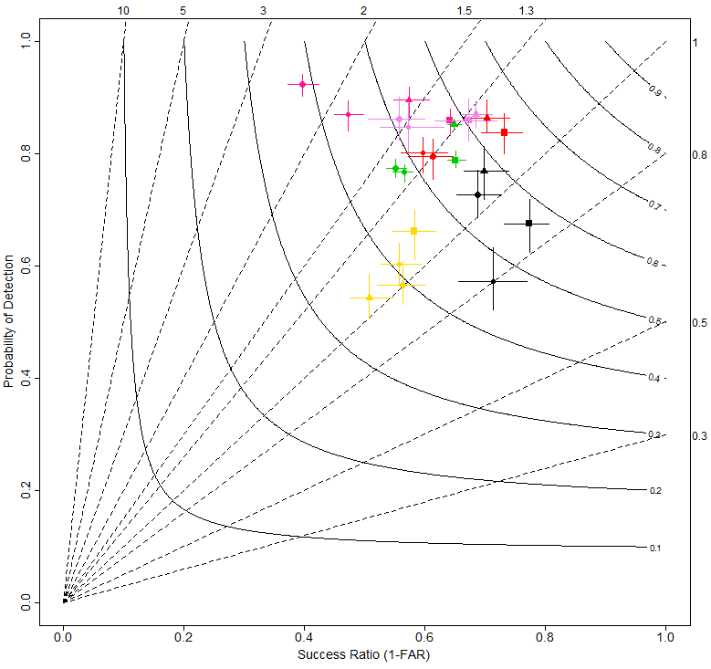
Precipitation in 6h 0.2 mm threshold From: 2017-03-01 To: 2017-05-31
Common Area 2:
Fine Resolution
Common Area:
Coarse Resolution
Added value of high resolution: COSMO-1 shows the best scores
Generally, there are better scores for High Resolution models (than for Coarse Resolution models) for low precipitation events…

Slide 17
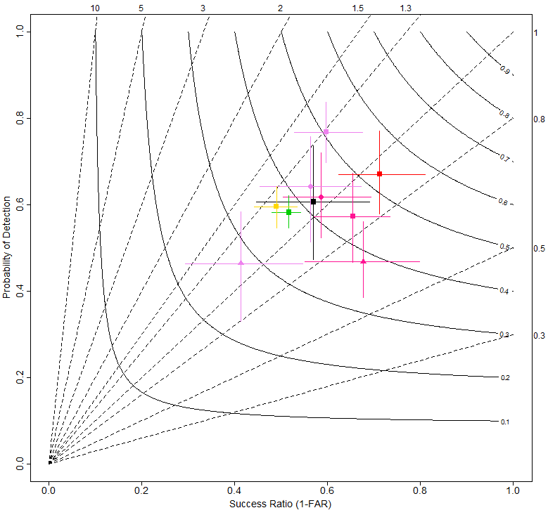
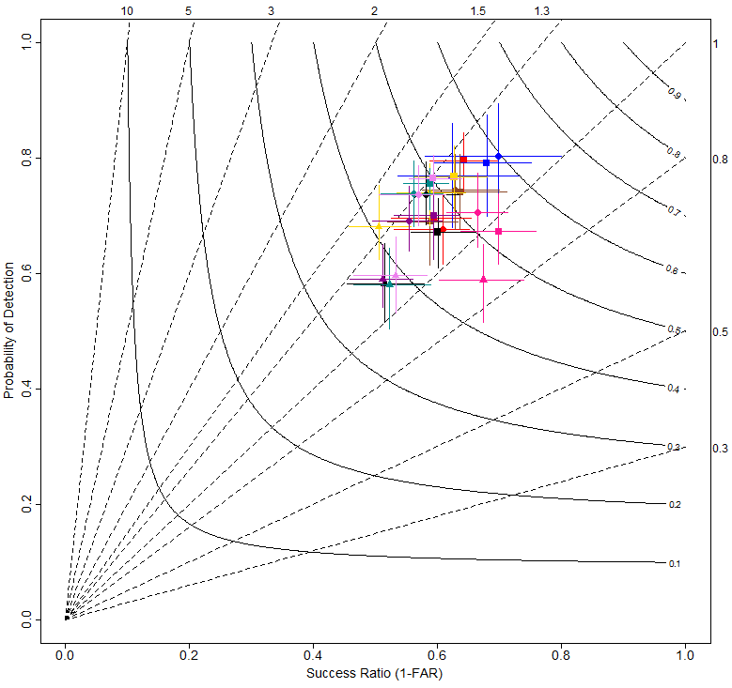
Precipitation in 24h 10 mm threshold From: 2016-12-01 To: 2017-02-28
Common Area 2:
Fine Resolution
Common Area:
Coarse Resolution
…but for high precipitation events and longer accumulation period High Resolution models are not significantly better

Slide 18
CONCLUSIONS
00 UTC Run and 12 UTS Run score difference is not significant (good news!)
ICON scores are close to IFS scores and are notably better for T2m, Td2m, and for a number of precipitation scores (!!!)
ICON, ICON-EU, and IFS overestimate low precipitation more than COSMO models: presumably, The IFS/ICON cumulus convection scheme is responsible?
COSMO show less overestimation of low precipitation events compared to IFS, ICON, and ICON-EU, the most significant in this regard is added value of High Resolution COSMO versions
ICON, ICON-EU and IFS have the mean error around zero or negative, while the COSMO versions mainly overestimate total clouds
Overestimation of 10 m wind speed decreased for most models during the last three years, and the RMSE improved

Slide 19
Thank you for your attention

Slide 20
PRESSURE REDUCED TO MEAN SEA LEVEL From: 2016-06-01 To: 2017-05-31
ME
RMSE
RMSE minimum during nighttime for warm seasons JJA and MAM
Last year tendency: JJA RMSE ↓ SON RMSE ↓ DJF RMSE ↓ MAM RMSE ↓

Slide 21
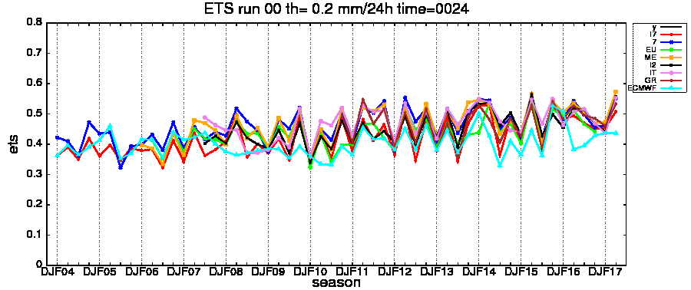
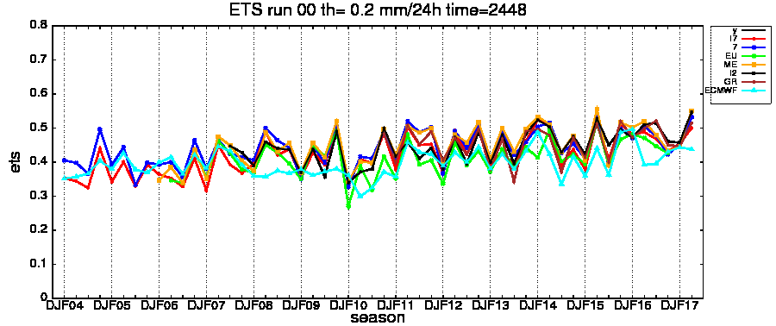
LOW THRESHOLDS
LONG TREND PRECIPITATION with high resolution stations
Very slightly positive/steady trend
seasonal oscillation
LAM perform better than ECMWF (low thres.)
Long-term trends of COSMO models performance over Italian catchment areas, Elena Oberto, Naima Vela, Flora Gofa
Notes:
ETS for run00 for each model
Seasonal trend starting from djf04 till mam17
First and second day
Very low threshold 2 mm in 24 h
Comments:
Slightly positive trend
General better performance for LAM

Slide 22
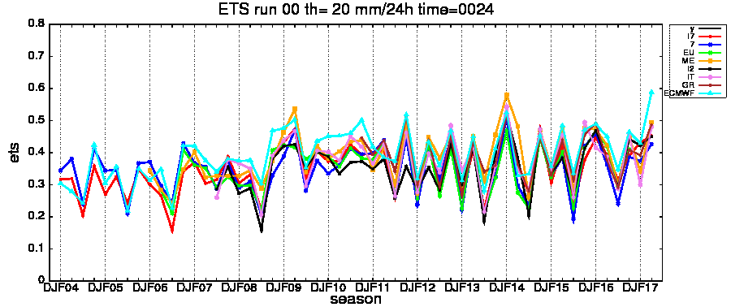
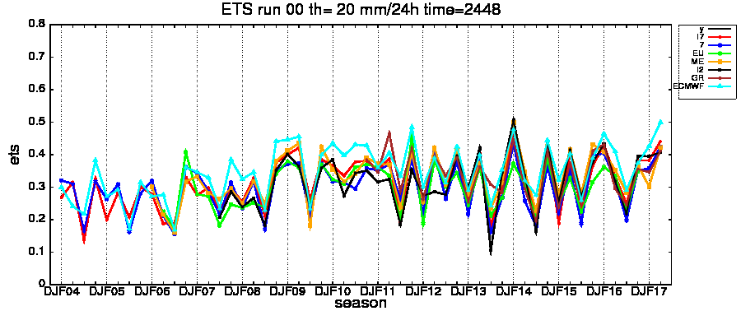
HIGH THRESHOLDS
LONG TREND PRECIPITATION with high resolution stations
Very slightly positive trend
Big seasonal oscillation
ECMWF often performs better than LAM (medium-high thres.)
Long-term trends of COSMO models performance over Italian catchment areas, Elena Oberto, Naima Vela, Flora Gofa
Notes:
ETS for run00 for each model
Seasonal trend starting from djf04 till mam17
First and second day
High threshold 20 mm in 24 h
Comments:
Slightly positive trend
Light better performance for IFS with respect LAM

Slide 23
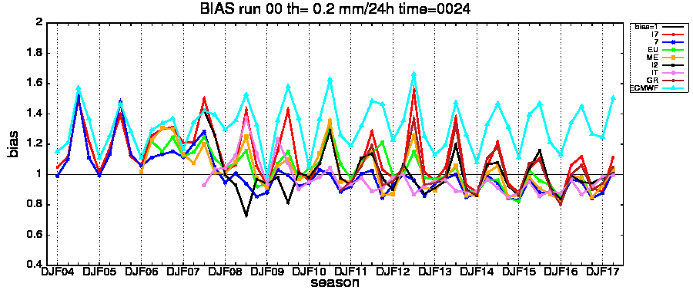
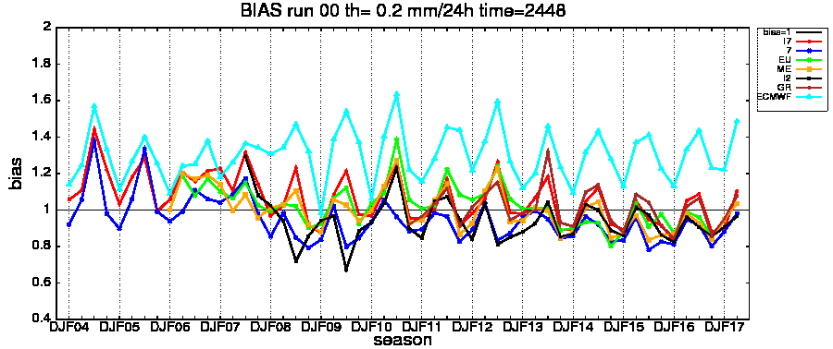
LOW THRESHOLDS
LONG TREND PRECIPITATION with high resolution stations
Ecmwf overestimation
Summer overestimation
Reduction of the overestimation for LAM
Long-term trends of COSMO models performance over Italian catchment areas, Elena Oberto, Naima Vela, Flora Gofa
Notes:
BIAS for run00 for each model
Seasonal trend starting from djf04 till mam17
First and second day
Very low threshold 2 mm in 24 h
Comments:
Systematic overestimation for IFS
General summer overstimation
General bias reduction for LAMs during last year

Slide 24
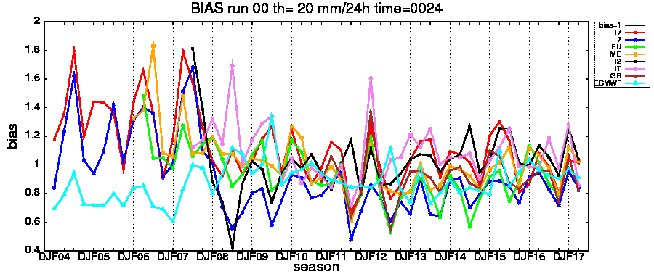
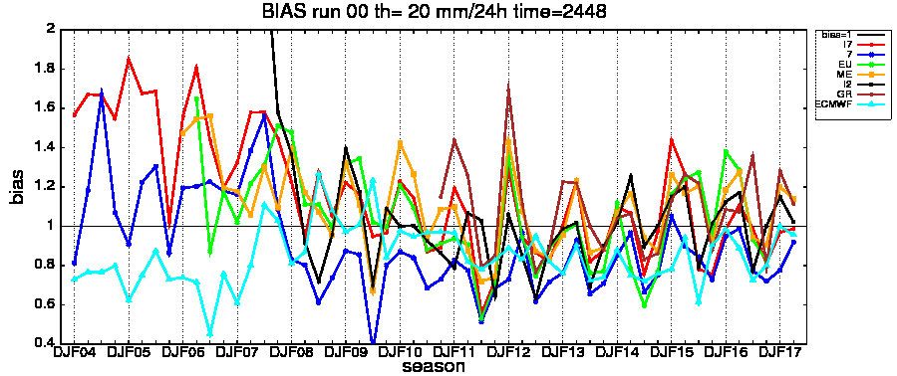
HIGH THRESHOLDS
LONG TREND PRECIPITATION with high resolution stations
General underestimation, especially 7, IFS
Seasonal cycle
Worse the second day
Long-term trends of COSMO models performance over Italian catchment areas, Elena Oberto, Naima Vela, Flora Gofa
Notes:
BIAS for run00 for each model
Seasonal trend starting from djf04 till mam17
First and second day
High threshold 20 mm in 24 h
Comments:
Pronounced seasonal error cycle
General underestimation for IFS, 7 ecc..
General bias increasing during the second day

