Slide 1
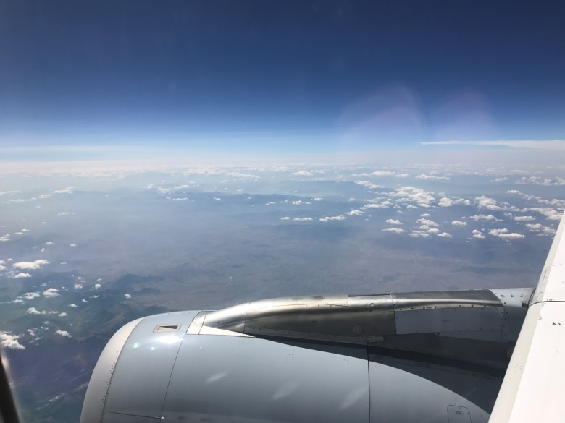
COSMO-ART and ICON-ART
Status - Development – Application
Bernhard Vogel + COSMO-ART + ICON-ART developers

Slide 2
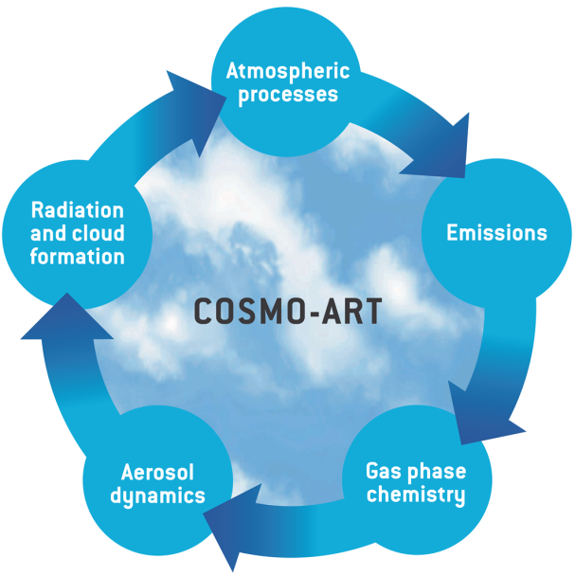

Slide 3
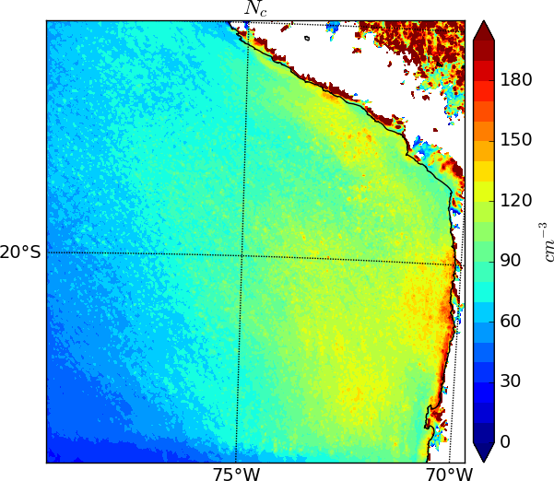
Simulated cloud droplet concentration

Slide 4



Clouds and radiation (old)
r_{e}= 5 µm,
LWC(RH),
f_{c}
r_{e}, LWC
Δ x
Δ x
Notes:
10.10.16
Subgridscale /humidity based clouds:
See Ulis slides

Slide 5
Clouds and radiation (new)
r_{e}= (CCN,LWC(Rh))
f_{c}
r_{e}, LWC
Δ x
Δ x
Notes:
10.10.16
Subgridscale /humidity based clouds:
See Ulis slides

Slide 6
Effect on climate engineering net radiation
Aerosol effect on subgrid scale clouds results in:
+ 18% (7 km)
+ 13% (2.8 km)

Slide 7



Publications
Athanasopoulou et al.: Changes in domestic heating fuel use in Greece: effects on atmospheric chemistry and radiation, ACP, 2017.
Revokatova et al.: Short-term forecast of carbon monoxide concentration over Moscow region by COSMO-ART, PAAG, submitted 2017.
Glassmeier et al.: A comparison of two chemistry and aerosol schemes on the regional scale and the resulting impact on radiative properties and liquid- and ice-phase aerosol–cloud interactions, ACP, 2017
Gruber et al.: Contrails and Their Impact on Shortwave Radiation and Photovoltaic Power Production - A Regional Model Study, submitted to ACP
Dissertations:
Tobias Schad: Albedo enhancement via brightening stratocumulus clouds as climate engineering method.
Konrad Deetz: Assessing the Aerosol Impact on Southern West African Clouds and Atmospheric Dynamics

Slide 8
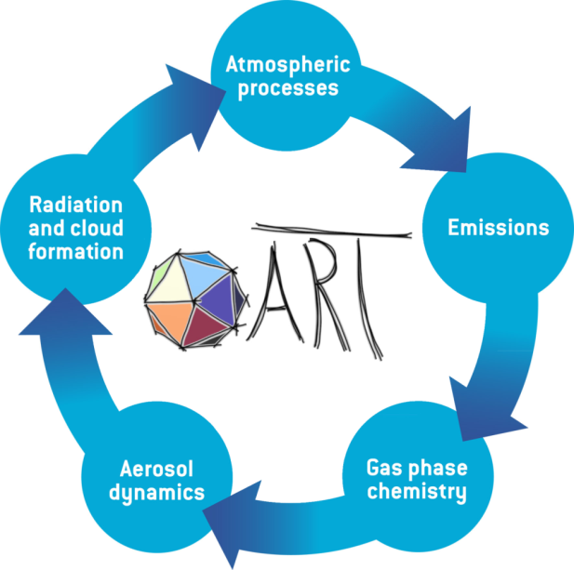

Slide 9



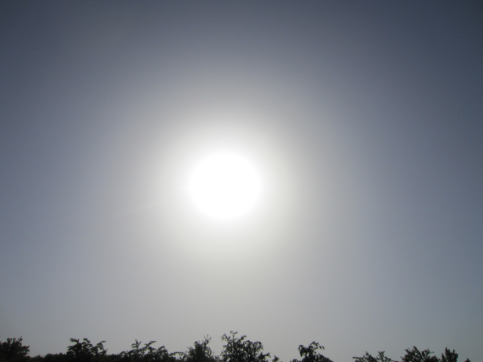


Photovoltaikertragsreduktion durch Saharastaub
2016-2020

Slide 10
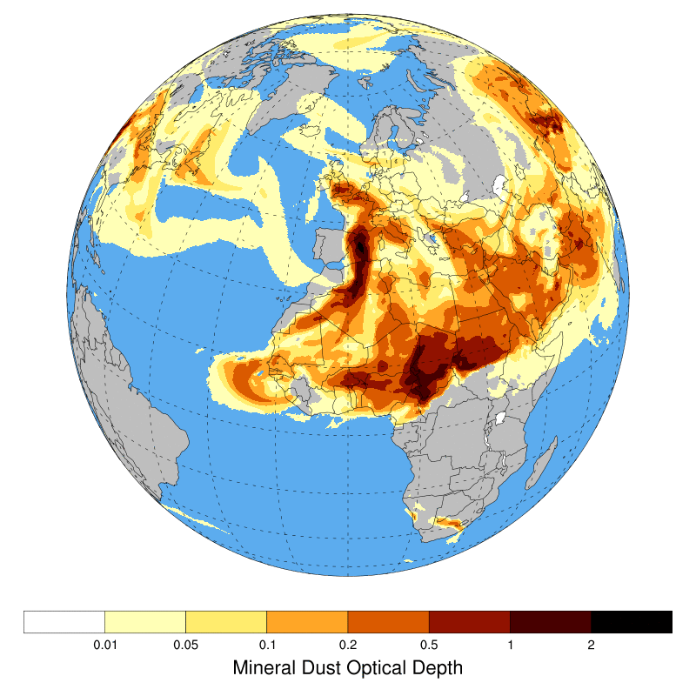
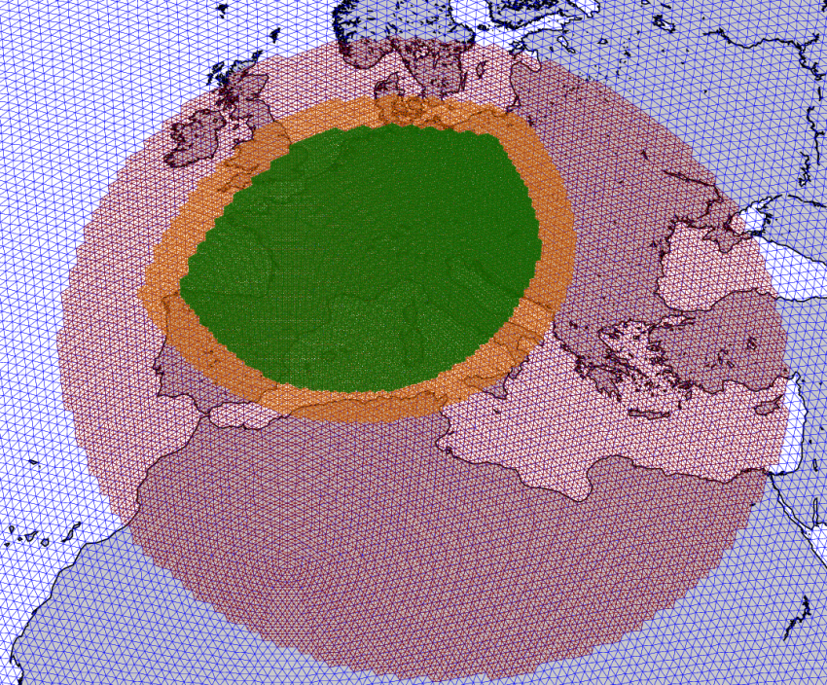
Dust episode April 2014

Slide 11
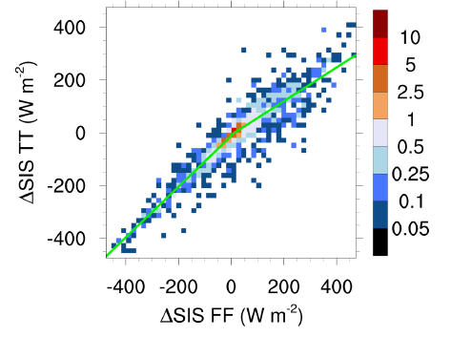
Difference in surface radiation, 4 April 2014
with dust interaction
no dust interaction
Rieger et al., 2017

Slide 12
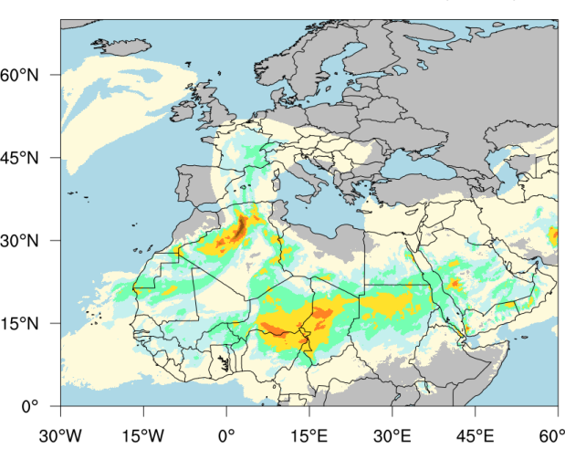
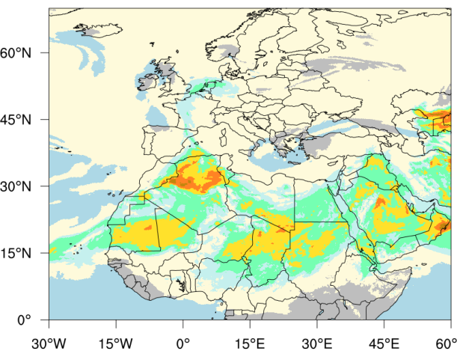
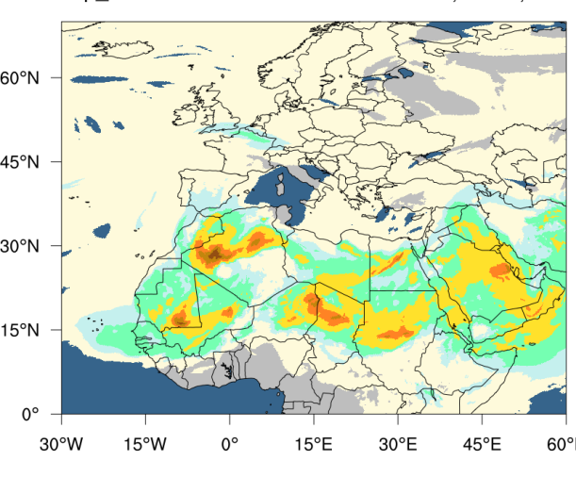
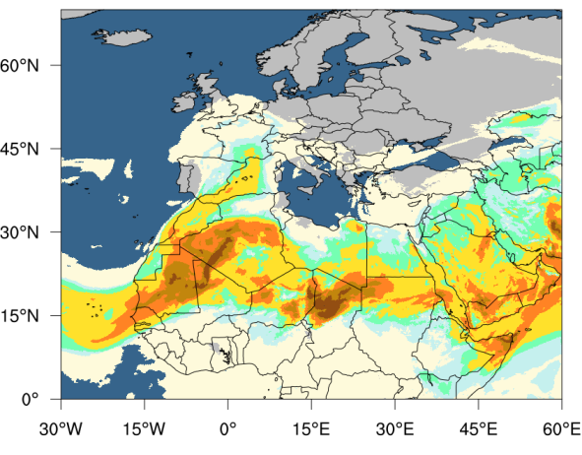
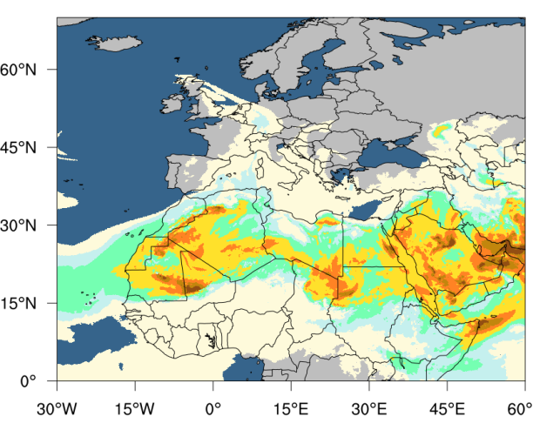
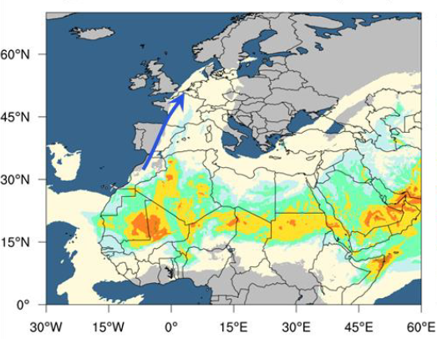
Saharan Dust over Europe in 2017
24.03.2017
29.05.2017
14.06.2017
06.07.2017
19.07.2017
30.08.2017

Slide 13
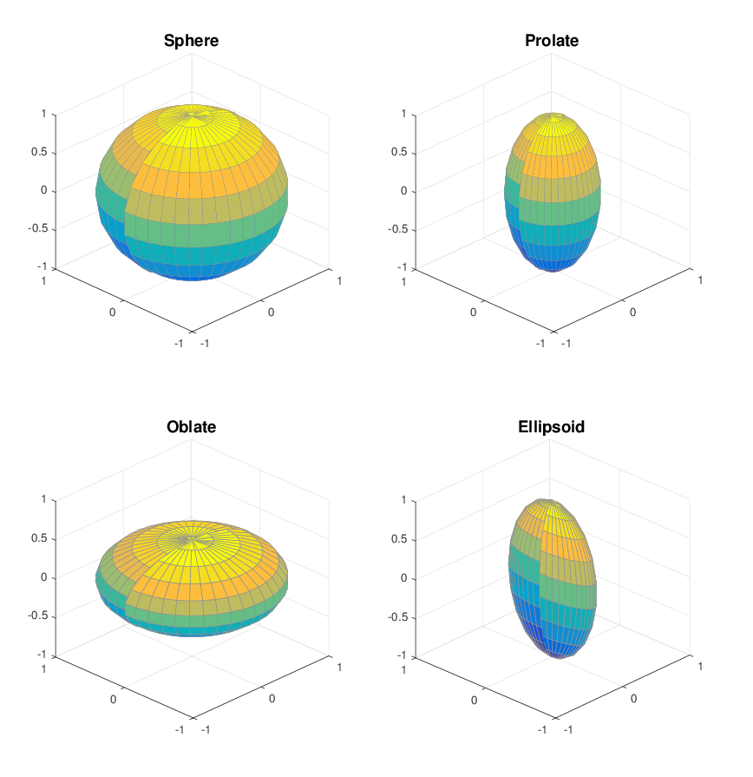
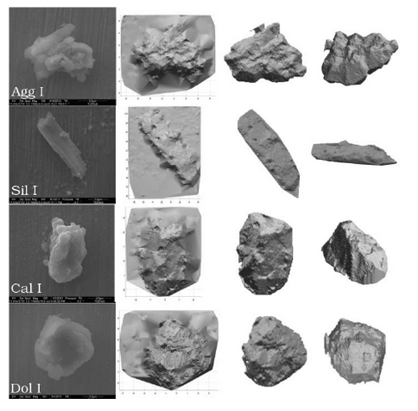
Particle shapes
Lindqvist et al., 2014
Meng et al (2010)
Notes:
For clarification, imagine that both cross-sections of ellipsoid are ellipses while in prolate and oblate there is always one circular cross-section

Slide 14
Mass-Specific Extinction Coefficient
Mode A
Mode B
Mode C

Slide 15
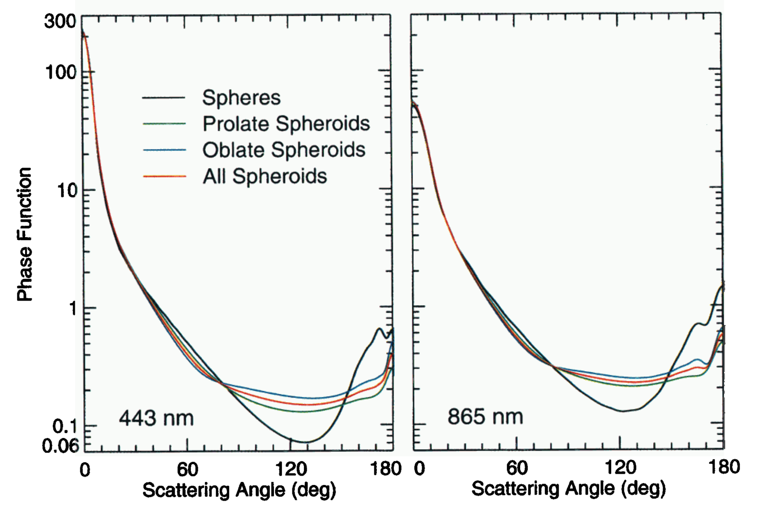

Phase function
Mishchenko et al., 1997

Slide 16
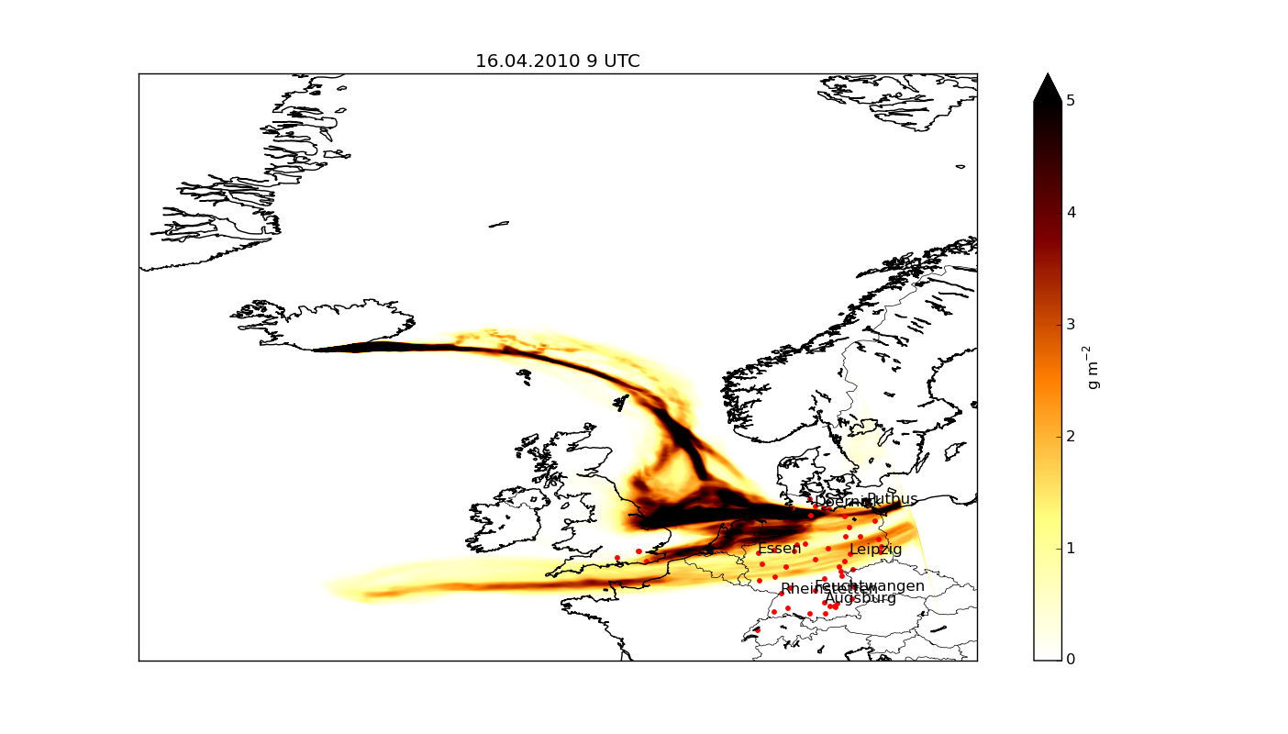
Vertical integrated mass

Slide 17
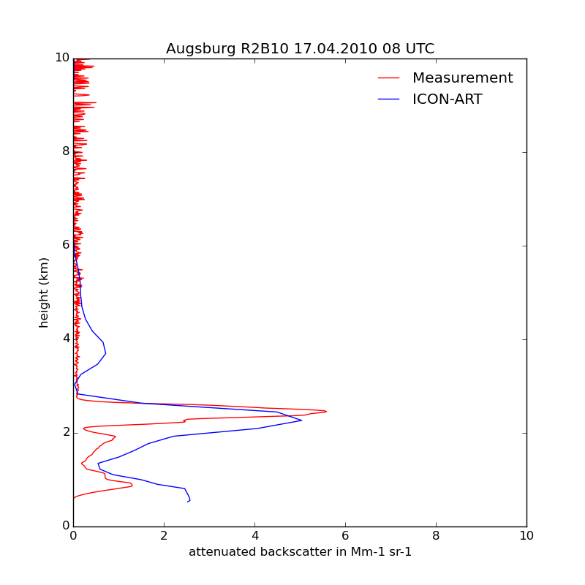
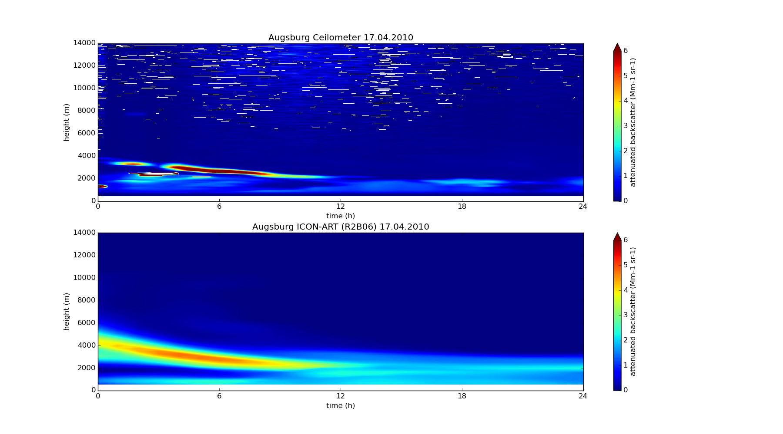
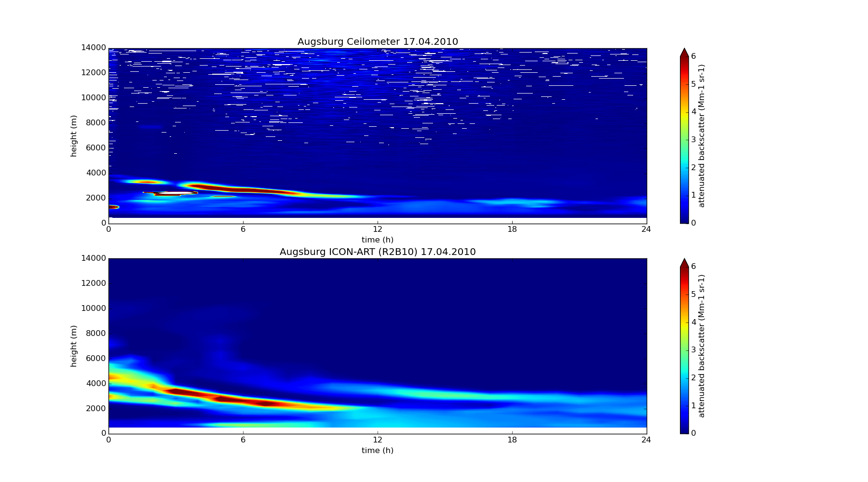
Vertical profiles of attenuated backscatter
Ceilometer, Augsburg, 17.04.10
ICON-ART

Slide 18
Data assimilation
The profiles of the attenuated backscatter are a first example of a forward operator for aerosol particles.
In addition to the simulated AODs this opens the road to data assimilation.
You can expect first results at the next GM.

Slide 19

Milestones
Monodisperse
Tracer
Polydisperse
Tracer/ Modal Aerosol
Photolysis
Cloud
Feedback
Radiation Feedback
First Order
Chem. React.
Trace Gas Emissions
Gas Phase
Chemistry (KPP)
ICON-ART DEVELOPMENT
Radionuclides
Mineral Dust
Aerosol
Internally Mixed Aerosol
Volcanic
Ash
Sea Salt Aerosol
Atmospheric
Trace Gases

Slide 20
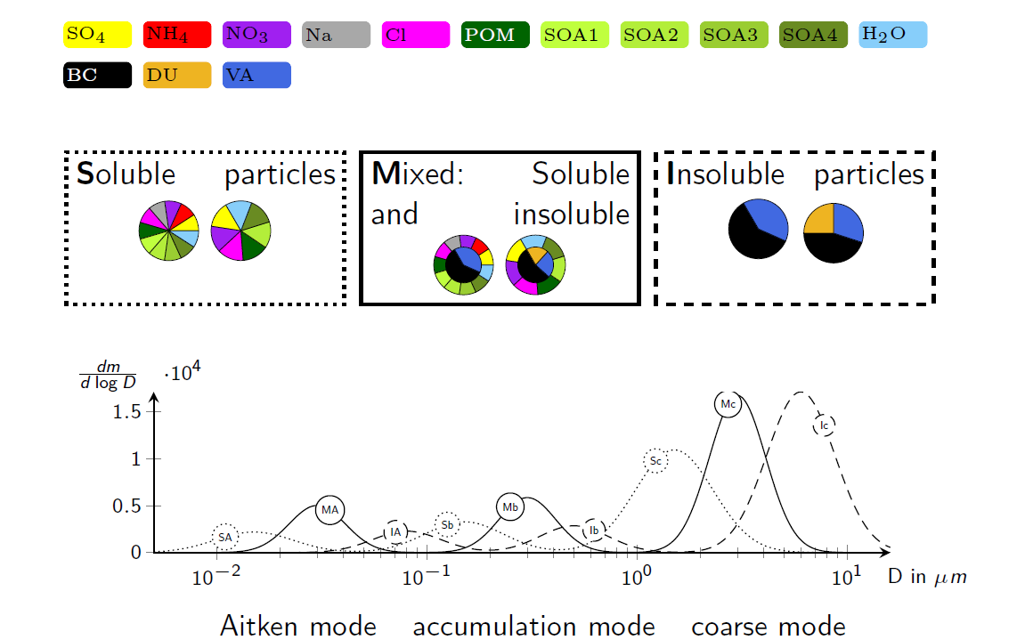
New aerosol model

Slide 21
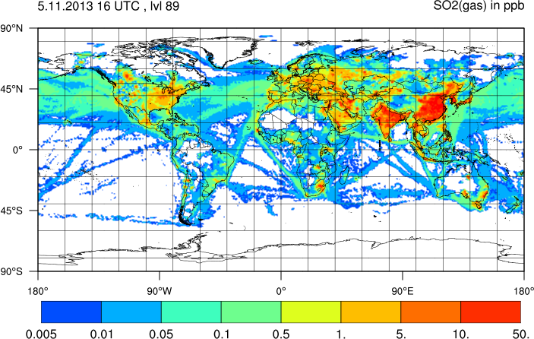
Simulated SO₂ concentration

Slide 22
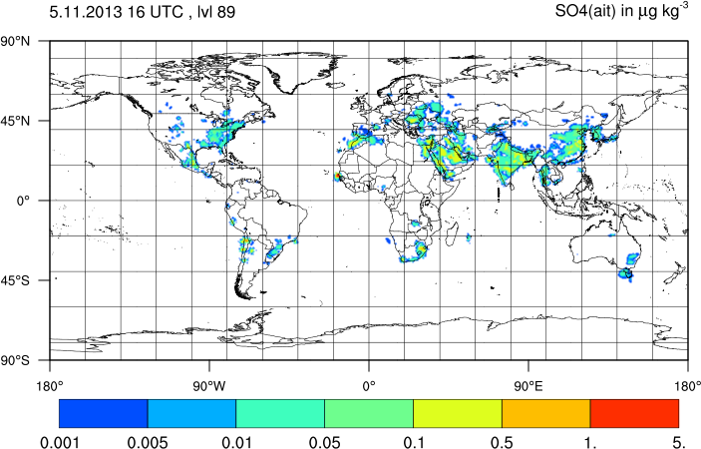
Sulfate concentration (Aitken mode)

Slide 23
Publications
Rieger et al.: Impact of the 4 April 2014 Saharan dust outbreak on the photovoltaic power generation in Germany, ACPD, 2017.
Gasch et al.: An analysis of the September 2015 severe dust event in the Eastern Mediterranean, ACPD, 2017
Weimer et al.: M., An emission module for ICON-ART 2.0: implementation and simulations of acetone, Geosci. Model Dev., 2017
Donner et al.: Are atmospheric updrafts a key to unlocking climate forcing and sensitivity?, Atmos. Chem. Phys., 2016.
Rieger et al.: ICON-ART 1.0 - a new online-coupled model system from the global to regional scale, Geosci. Model Dev., 2017.

Slide 24
Aerosols in operational forecasts
Pollen grains: health issues
Volcanic ash: aviation
Mineral dust: visibility
Vegetation fires: health, aviation
Sea salt, mineral dust: cloud formation
Primary and secondary aerosols:
visibility, fog, icing, flooding, …
2013
2018

