Slide 1
PP POMPA status
Xavier Lapillonne

Slide 2
Performance On Massively Parallel Architectures
Main outcomes :
Performance portable version of the Dycore -> STELLA DSL
GPU capable version of the COSMO model
Possibility to run the model in single precision

Slide 3
Main task in 2017: Merge all developments into official version
5.X
5.0+ POMPA
4.19

Slide 4
C++/STELLA Dynamical core
Integrated: works in GPU/CPU mode – will be distributed with 5.05
Full developer documentation distributed to SCA

Slide 5
Integration Status (OpenACC+comm.)
Components | Status
radiation, surface, shallow conv., sso | merged
turbulence, microphysics | on going
Tiedke conv. , flake | To do
Sea-ice, Bechtold | Not considered
Assimilation | on going
Organize code | To do
Comminication (GLC) | To do
Release of the GPU version Q1 2018 ?

Slide 6
Integrating GPU enabled Code (SCA view)
Is in principle no problem: OpenACC statements are (as directives) ignored by a non-GPU compiler
Readability of the code is not influenced (at least you get accustomed to it).
Problematic are the parts, where code has to be modified (ifdef or different implementation)
The C++ DyCore
Need to gain experience, currently installed on workstation by P. Spoerri

Slide 7
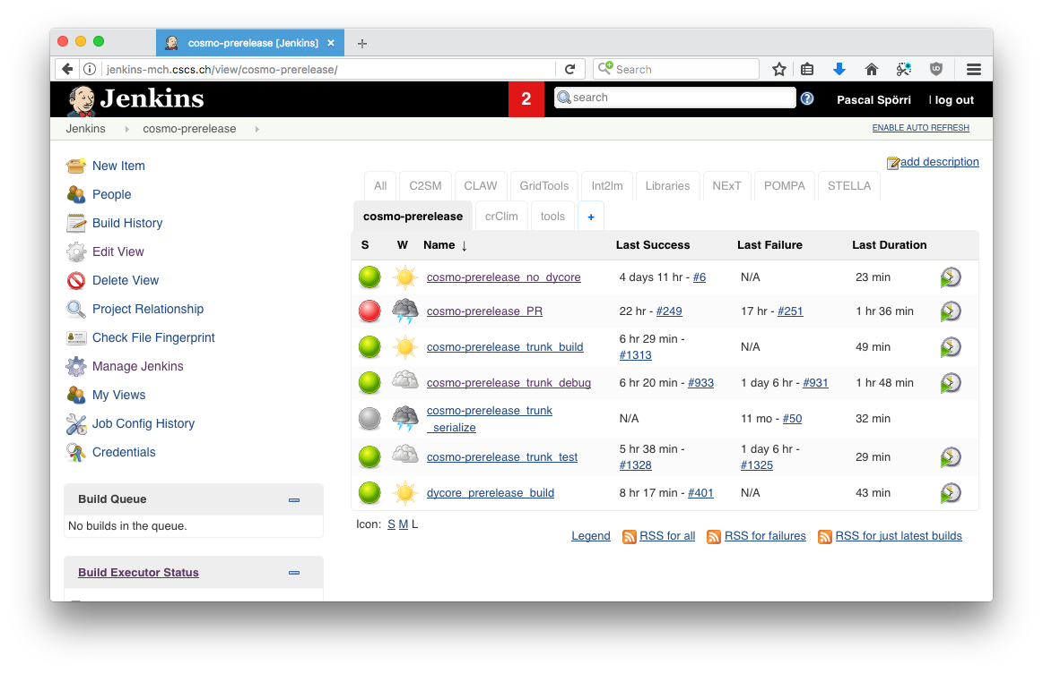
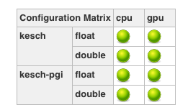
Testing
3 ways
On linux work station
On Cray Test Cluster at DWD
On CSCS machines using github/jenkins and the automated test suite
Github Pull Request
(ok if red)

Slide 8
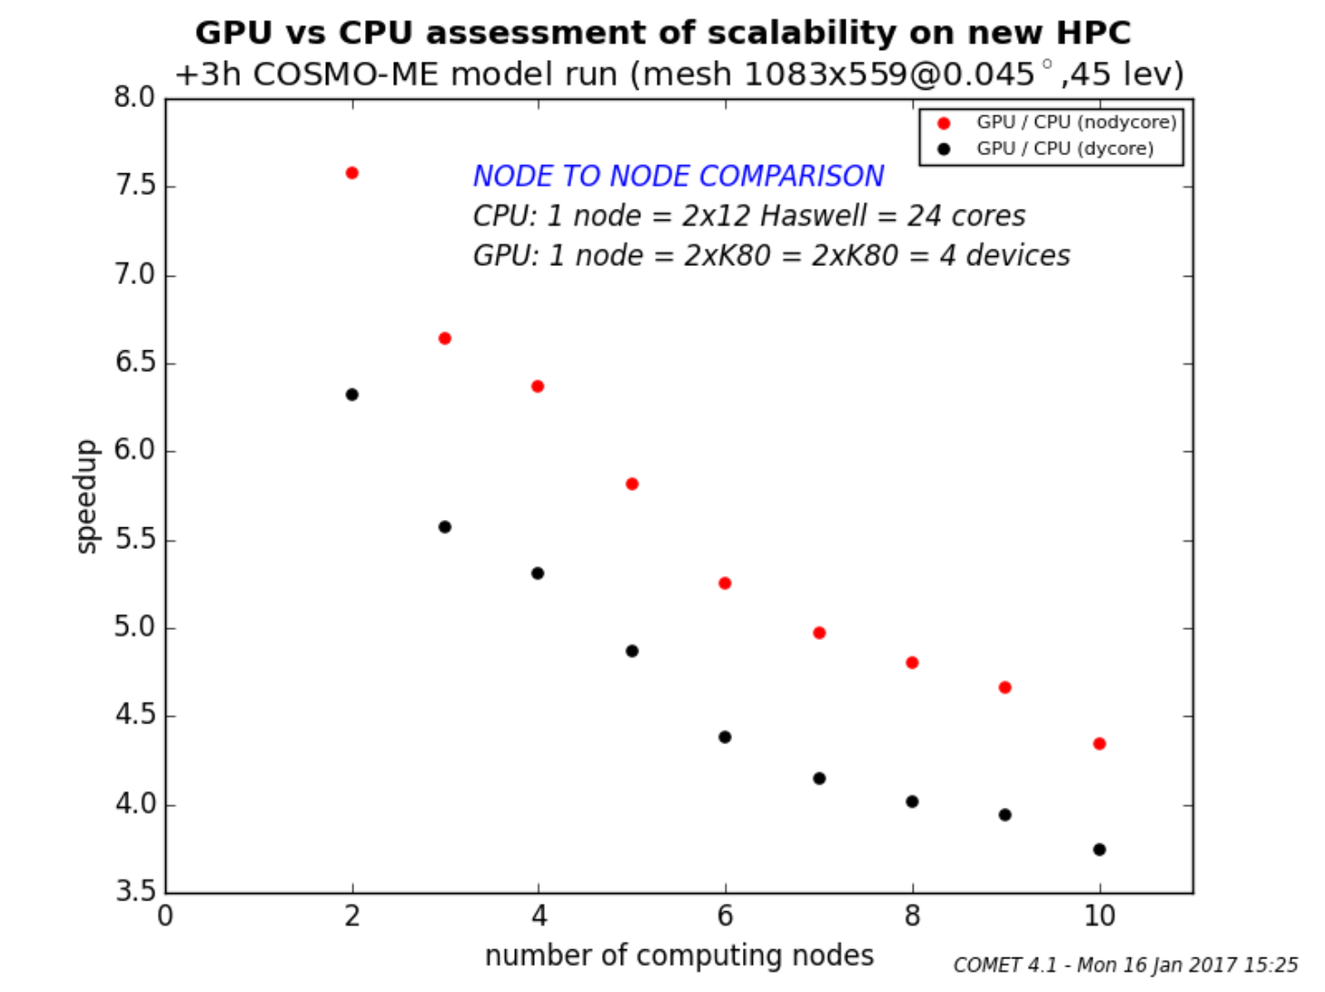
COMET experience with GPU
Large GPU system – 112 K80 GPUs
Experience with COSMO-ME (ensemble), shows significant speedup

Slide 9
What does 3x speed up mean
GPU system
CPU system

Slide 10
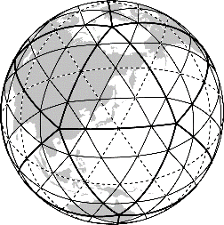
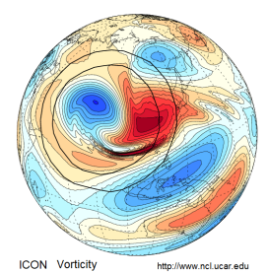
Related projects
ENIAC
3 years, funded by PASC initiative (3 Post-Docs), PI U. Lohmann
Collaboration : ETH, CSCS, MPI-M, MetetoSwiss, DWD
Adapt the ICON model to run on GPU and many-core architecture (XeonPhi)
Achieving a high degree of performance portability by:
using source-to-source translation tool : CLAW
Explore alternative approaches such as the GridTools domain-specific lan- guage (DSL)
Prepare the ICON model for actual use-cases in weather and climate on emerging HPC systems

Slide 11
Related projects
PASCHA
3 years, funded by PASC initiative (2 Post-Docs), PI T. Hoefler
Focus on the COSMO model
Replace the STELLA library with the GridTools library
Port to Xeon-Phi (GridTool backend and code adaptation)
Improve strong scalability of COSMO by introducing functional parallelism
Acceptance of DSL low : explore new approach =>

Slide 12
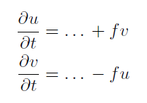
Prototype high-level DSL
Example: gtclang
Coriolis force
No loops
No data structures
No halo-updates
function avg {
offset off;
storage in;
avg = 0.5 * ( in(off) + in() ) ;
} ;
function coriolis_force {
storage fc, in;
coriolis_force = fc() * in();
};
operator coriolis {
storage u_tend, u, v_tend, v, fc;
vertical_region ( k_start , k_end ) {
u_tend += avg(j-1, coriolis_force(fc, avg(i+1, v));
v_tend -= avg(i-1, coriolis_force(fc, avg(j+1, u));
};
};
};

Slide 13
High-level DSLs
Acceptance of STELLA / GridTools is low (C++, boiler plate, code safety, manual optimization, …)
High-level DSL can leverage the power of GridTools but provide a more acceptable and safe frontend

Slide 14
IMGW : port of Eulag dycore to GridTools
Hardwork, not enough example/documentation available
Difficult to debug, lack of user friendly tools. Difficult to diagnose the actual state of computation
But
It is worth the effort if we can get performance portable code
It could pay off from an economical point of view (cheaper machine at the end)

Slide 15
HPC Priority project for COSMO consortium
POMPA project will finish end of 2017
Possible content:
Achieve performance portability: x86 multi-core CPU, NVIDIA GPU, Intel Xeon Phi
Increase strong scalability through task parallelism (e.g. different components run in parallel)
Apply and evaluate different programming models: DSLs, directives, source-to-source compilers
More intensive use of library
Address low precision (single precision)
Questions
Only consider ICON (what about COSMO)
How to achieve a broader engagement within COSMO as compared to the POMPA priority project?

Slide 16
Thanks for your attention

