Slide 1
SCA Report for the COSMO-Model
Ulrich Schättler
Source Code Administrator

Slide 2
Contents
Versions implemented since September 2016
Status of Version 5.05
A Remark to the Common COSMO-ICON Physics
Plans for the next versions

Slide 3
Versions Implemented since September 2016

Slide 4
Version | Date | Contents (Highlights) | Results Changes
5.04c | 06.10.16 | additional tuning factors for physics perturbation in radiation and convection minor adaptations for COSMO-ICON physics and GPU code C++ dynamical core integration Set values of T_SO layers to reasonable values and bitsPerValue to 24 | no no no only T_SO
The modifications for T_SO lead to a higher GRIB precision for T_SO values
and can lead to significant changes in a data assimilation cycle. DWD observed
melting of soil ice and a reduced cold bias during the day.

Slide 5
Version | Date | Contents (Highlights) | Results Changes
5.04d | 12.12.16 | several changes and additional features in data assimilation changes to blocked turbulence scheme | numerical not yet operational
5.04e | 23.03.17 | activated blocked turbulence scheme implemented blocked surface schemes from ICON (TERRA, FLake, SeaICE) blocked version of SSO scheme eliminated non-blocked parameterization | yes yes no
5.04d is the last version with non-blocked turbulence and surface schemes.
5.04e runs all parameterizations in the blocked format with modified turbulence and surface schemes. A new configuration is recommended (TUNING, PHYCTL)

Slide 6
Version | Date | Contents (Highlights) | Results Changes
5.04f | 01.09.17 | additional modifications to COSMO-ICON physics (new namelists, bug fixes, GPU version of TERRA) Possibility to reproduce behaviour of old turbulence scheme (not TERRA!) changes in data assimilation new diagnostic output to highlight convective cell tracks (for ESSL testbed) changes in handling statistically processed fields (min, max, avg, sums) possibility to use RTTOV12 | yes yes eventually no no SynSat
Please read more about the changes in the Release Notes for the different versions.

Slide 7
Update of Documentation
Part VII: User Guide has been updated
Part VI: Postprocessing
has never been written
now in preparation: Model Output and Data Formats for I/O
Data Formats for I/O (from UG, Chapter 5: GRIB 1/2, NetCDF)
Mandatory input fields
Analysis fields
Model output fields (from UG, Chapter 8)
Statistically processed fields
ASCII output

Slide 8
Update of Documentation
Part IV: Implementation Documentation
has never been written
now in planning: Implementation Specific Details of the COSMO-Model
should be a collection of technical descriptions, e.g:
Blocked data structure; copy-in/copy-out
Tracer Structure
Boundary Condition Module
Incremental Analysis Update
???

Slide 9
Status of COSMO-Model 5.05

Slide 10
Testing new COSMO-ICON Physics
From Version 5.04e on, all parameterizations are in blocked format.
COSMO and ICON are using the same packages for
First NUMEX experiment in winter 2016/17 indicated some problems with the new interface for TERRA: had to fix some technical details
Microphysics | since 5.01 (already validated)
SSO | bit-identical: there were no changes in ICON
Turbulence | modifications in ICON: Tests by M. Raschendorfer showed comparable results to former COSMO version
Surface schemes | modifications in ICON: no tests to compare only these modifications to former COSMO version

Slide 11
NWP Test Suite at ECMWF based on IFS Data
NWP Test Suite performed with a beta-version of 5.04e from 16.12.16 (had some billing units left at ECMWF for 2016) did not show an improvement over 5.03
Problem could be that the new COSMO-ICON physics performs even worse with IFS soil data.
Simulation period shown: January 2013
ME and RMSE for 7 km test (January 2013) with IFS

Slide 12
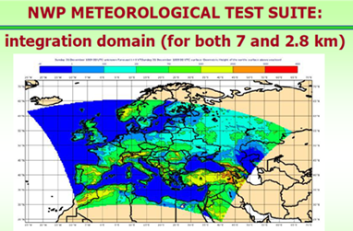
NWP Test Suite at ECMWF based on GME Data
But runs with GME soil data did not improve this situation significantly.
ME and RMSE for 7 km test (January 2013) with GME

Slide 13
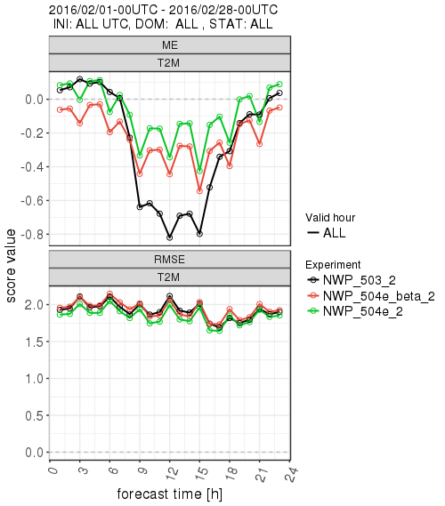
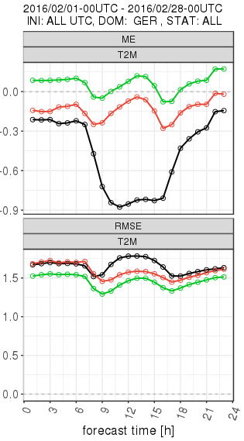
Hindcasts at DWD
A one month simulation starting from interpolated ICON data and driven by ICON analysis for February 2016 using the same integration domain as the NWP Test Suite.
Results show an improvement for the 2m temperature.

Slide 14
Numex Experiment with KENDA
Compared to a KENDA Experiment with operational version for May/June 2016
Tests with the new physics and different configurations show a sensitivity in forecast results
Problem: initial condition for the soil is taken from the "old" COSMO-DE analysis, which seems not to fit to new COSMO-ICON physics
Experiment:
old COSMO with KENDA (Exp. 10416)
old COSMO with Nudging (Routine 2016)
new COSMO with KENDA (Exp. 10441)

Slide 15
First Conclusions
???????????
Perform different hindcasts for 3 (4) months (March-June 2016; in climate mode) to compare the soil properties. All tests start with the operational COSMO-DE soil values on 1st March 2016.
Binary | Namelist
V5.4 | OPER_NOW
March | April | May
June
V5.5R | TEST_OLD (as OPER)
March | April | May
Evaluation
BACY
with DA
V5.5 | TEST_REF (10441)
V5.4 | ROUTI
March | April | May
V5.5 | TEST_NEW (as ICON)
March | April | May
June

Slide 16
W_SO

Slide 17
Hindcasts: Lessons Learned
Different configurations of hindcasts lead to different soil moisture contents
Dry out of soil with soil moisture close to plant wilting point can occur, which can produce a negative feedback cycle: low soil moisture -> low evaporation -> low clouds and low precip -> low soil moisture
In ICON(-EU) a soil moisture analysis prevents the soil from drying out
Significant amount of water in relation to the precipitation is put into the soil for June 2016 by ICON-EU SMA

Slide 18
BACY Experiments with KENDA
Performed 2 BACY experiments (OPER_NOW, TEST_NEW) for May / June, starting with soil conditions from corresponding hindcasts.
Verification in non-dry regions show good results for COSMO-ICON physics
Need to prevent unrealistic dry out of soil in summer
Experiments with adapted minimal stomata resistance map (from ICON) in hindcast mode

Slide 19
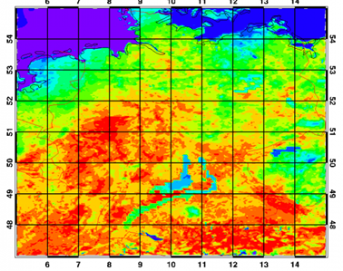
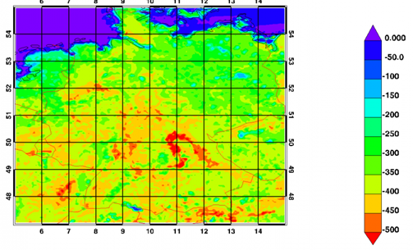
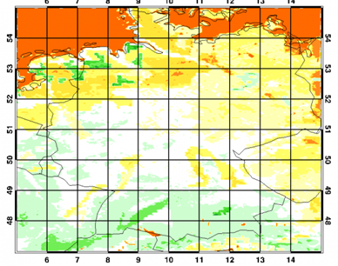
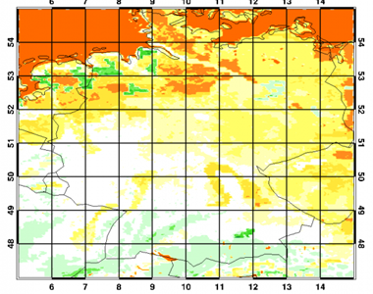
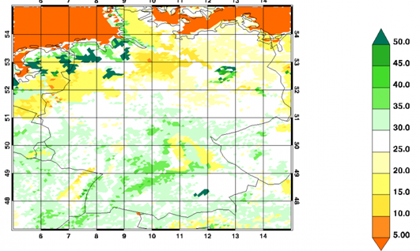
Case Study 2016, June 23, 12 UTC
OPER_NOW TEST_NEW ICON_EU
Latent Heat Flux (above) Soil Moisture Lev. 5 (below)
Low Evap

Slide 20
Further Technical Issues: Timings
12 hour | DE: 10x24+0 5.04d4 | DE:10x24+0 5.04f | DE: 17x28+4 5.04d4 | DE: 17x28+4 5.04f
Total | 637.15 | 638.54 | 343.54 | 348.77
Dynamics | 349.85 | 341.32 | 175.54 | 170.83
Physics | 67.75 | 110.04 | 29.55 | 54.90
Precipitation | 23.97 | 23.32 | 7.23 | 7.16
Radiation | 5.36 | 5.14 | 3.79 | 3.56
Turbulence | 29.74 | 19.17 | 14.40 | 10.10
Convection | 1.16 | 1.20 | 0.59 | 0.58
Soil Model | 3.57 | 3.06 | 1.54 | 1.39
Vertical Diffusion | - | 10.03 | - | 5.54
Copying | 8.51 | 32.94+10.40 | 5.29 | 17.81+5.98
Additionals | 115.06 | 53.14 | 59.70 | 29.52

Slide 21
Further Technical Issues
With the full blocked physics now available, much data has to be copied to / from the blocked structure. This increases the timings for the physics.
If using RTTOV10/12, the additional time can be compensated by a cheaper vertical interpolation to the RTTOV pressure levels.
Work to reduce the time for copying is ongoing.
The coarse radiation grid causes some inconsistencies for radiation fields:
ASOB_S = ASWDIR_S +ASWDIFD_S - ASWDIFU_S
is not fullfilled when using coarse radiation grid.
Considering the timings for the radiation, do we still need the coarse radiation grid?

Slide 22
A Remark to the Common COSMO-ICON Physics

Slide 23
Scheme | COSMO | ICON
Microphysics | prognostic water vapour, cloud water, ice, rain, snow, graupel (Doms, 2004; Seifert, 2010)
Radiation | Ritter-Geleyn δ two-stream | RRTM
Cloud Cover | ?? | Köhler
Subgrid scale orography | Lott and Miller (1997)
Turbulence | prognostic TKE scheme (Raschendorfer)
Surface Schemes | TERRA (Heise and Schrodin, 2002) FLake (Mironov) SeaIce (Mironov)
Convection | Tiedtke or shallow | Tiedtke-Bechtold
 | Tiedtke-Bechtold (optional)
To do: bring technical changes in COSMO back to ICON

Slide 24
Unified Physics?
For most parameterizations we use the same packages
BUT: There are significant differences!
External Parameters:
ICON reads "raw data", e.g. landuse class fractions. It does not use the SSO contribution to z0.
COSMO reads "end products" like plant cover fraction, stomata resistance, roughness lengths incl. SSO contribution etc. via INT2LM
The latter precludes implementing a tile approach similar to ICON; moreover, there are several parameterization components in ICON that make direct use of landuse classes, e.g. snow albedo, snow-cover fraction, table for stomata resistances: these cannot be transferred to the COSMO-Model!

Slide 25
Plans for the Next Versions

Slide 26
Version 5.06: From the Working Groups
WG 1:
Radar forward operator ✓
WG 2:
Improvement for Bott Advection depending on results
Higher order horizontal discretizations ✓ (available June 2017)
WG 3a:
2-moment microphysics ✓
SPPT (bug fixes) ✓
WG 3b:
Urban module (good results assumed; work in progress)
Mire parameterization (optional) ✓

Slide 27
Ongoing POMPA Developments
C++ Dycore
Shift towards making C++ dycore standalone
Implement missing Features from POMPA_supported_features.xlsx
Extending dycore documentation
Physics to GPU:
Turbulence, Surface schemes, SSO, Microphysics, Tiedtke convection
Other
Nudging / LHN / Output to GPU
Assimilation in SP
New communication interfaces (call to GCL)
Optional static memory allocation (working arrays)

Slide 28
How to Proceed?
Implement subversions (5.05a, 5.05b, etc.) for testing. What is included, depends on what is ready.
Checklist:
Are the results bit identical? If not, do we have test / verification results?
Is documentation available, where necessary?
In the next time we have to document a lot (blocking structure, incremental analysis update, etc.): Provide enough time for this!

Slide 29
First Plans for COSMO-Model 5.07
From ICON developments
Prognostic sea-ice albedo parameterization
interception procedure (TERRA)
Coupling between soil and atmosphere (vegetation shading)

Slide 30
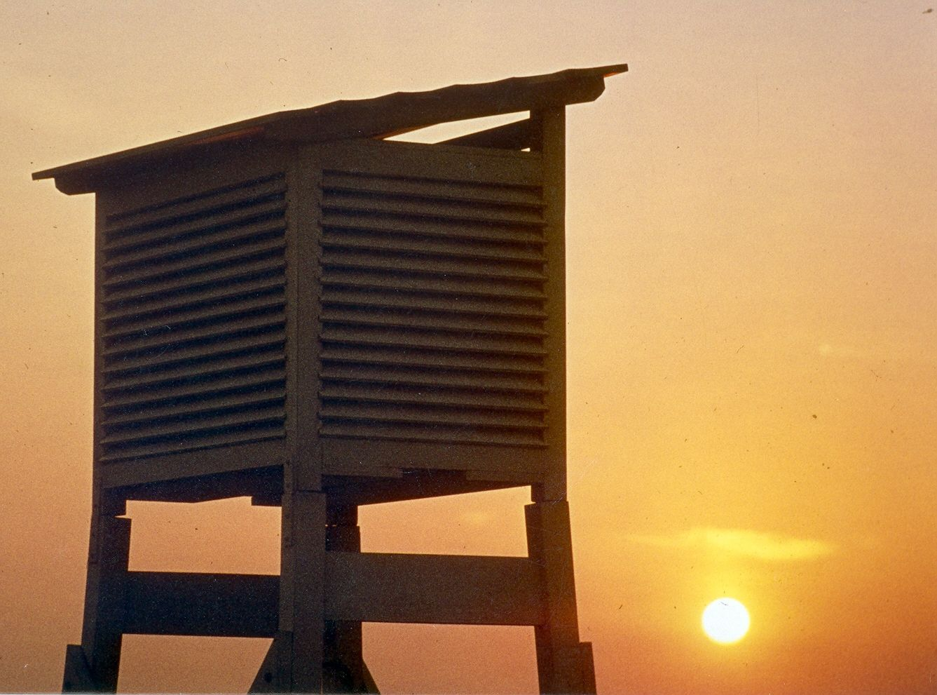
Thank you
very much
for your
attention

