Slide 1
Experience with Maintaining the GPU Enabled Version of COSMO
Ulrich Schättler
Source Code Administrator

Slide 2
Contents
GPU enabled Parts of COSMO
Experiences from the Source Code Administrator
Experiences from the Developer

Slide 3
GPU enabled Parts of COSMO

Slide 4
GPU enabled Parts in COSMO-Model 5.04f
Physical Parameterizations (with OpenACC)
Radiation, if not working on the coarse radiation grid
SSO scheme
TERRA
shallow convection
Dynamics
only, if using the C++ dycore: lcpp_dycore = .TRUE.
Everything else: work in progress

Slide 5
Performance of the GPU enabled Version
The copying of data between host (CPU) and device (GPU) is very expensive, therefore we cannot expect a good performance
Right now this has to be done for every physical package
Only if all packages are running on GPUs, we can update the device once before the physics and update the host once after the physics
And the final goal is, to run the full model on the GPU (with the exception of some parts of the assimilation)

Slide 6
Some Timings (do not take too seriously)
Linux workstation (81x81x50 grid points), 2 hour run-time,
GPU Device: NVS 315
32 cores; 1 GByte of memory
nproma=1024: need several blocks
Cray Test Cluster: 101x109x40 grid points, 1 hour run-time
GPU Device: Tesla P100-PCIE-12GB
3584 Cuda cores; 12 GByte
nproma=-1: only have one block
Package | GPU | CPU 1x1 | CPU 2x2
Physics | 318.29 | 147.94 | 41.44
Radiation | 147.24 | 10.80 | 3.39
SSO | 11.67 | 2.66 | 0.70
TERRA | 25.20 | 6.49 | 1.75
Convection | 6.30 | 1.86 | 0.49
Package | GPU | CPU 1x1 | CPU 2x2
Physics | 62.51 | 60.57 | 14.83
Radiation | 14.64 | 13.00 | 2.91
SSO | 0.27 | 1.22 | 0.31
TERRA | 4.69 | 4.07 | 1.00
Convection | 5.18 | 4.26 | 1.02

Slide 7
Experiences from the Source Code Administrator

Slide 8
Integrating GPU enabled Code
Is in principle no problem: OpenACC statements are (as directives) ignored by a non-GPU compiler
Readability of the code is not influenced (at least you get accustomed to it).
There are some longer passages at the beginning of subroutines (!$acc present / create, etc.), and the directives for the loops.
With colored highlighting, OpenACC directives are treated as comments
The directives around the loops are a "nice" encapsulation
Problematic are the parts, where code has to be modified:
Radiation: 2 different implementations for GPU / CPU for subroutines coe_th and coe_so (solved with ifdef _OPENACC)
Microphysics: Use of index list for better vectorization still under discussion

Slide 9
Testing GPU Code (I have 3 ways of doing it)
On my Linux workstation
had problems with extra CUDA Driver (need 7.5 instead of standard 7.0)
since OS update and usage of CUDA 8.0: no more problems
use PGI compiler (that I can update whenever I want: local installation)
"low profile" GPU with 32 cores and 1 GByte of memory
On Cray Test Cluster at DWD
System installed a year ago with KNLs; GPUs added in December
DWD-IT and Cray-Support are still learning how to administrate this system
(Nearly) everytime I use it, there are problems. The latest ones:
sfc_terra with OpenACC not compiled by cce: Insufficient memory
PGI 16.10 gives a linker error
On CSCS machines using jenkins and the automated test suite

Slide 10
The C++ DyCore
I have to admit: I never installed it on my own
During the COSMO Training in March, Pascal installed it on my workstation
it did not work at once, but Pascal solved it in a rather short time
I have to do it on my own now, to gather experiences

Slide 11
Experiences from the Developer

Slide 12
Learning OpenACC and Working on GPUs
Learning basic OpenACC constructs and understanding the basic method, how to put work to the GPUs, is not too difficult
host memory ↔ device memory
building kernels for the device
Which does not mean that I do everything correct now: my thinking is not fully "GPU aware":
lately modified interface for TERRA by adding 2 new local variables
jenkins tests on GPU failed, because I only allocated them on the host, not on the device
The big problem is to understand the concept of parallelization on the GPUs, and how to apply the OpenACC statements (gang, worker, vector): Here I still feel quite unsecure (and just do not have enough time to learn about it)

Slide 13
Conclusions

Slide 14
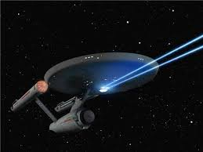
Some (very) Personal Thoughts
With the GPU version we are entering new galaxies
Be aware that Star Trek did not find paved highways, where they were going to
At least we are at the front line of development for meteorological codes
Having a GPU enabled code is not everything: you also need a computer to run it (in operations!) and you need staff to run, administrate and maintain that computer!
My feeling is, that in the next 3-5 years COSMO is the only meteorological code, which is operationally used and maintained

Slide 15
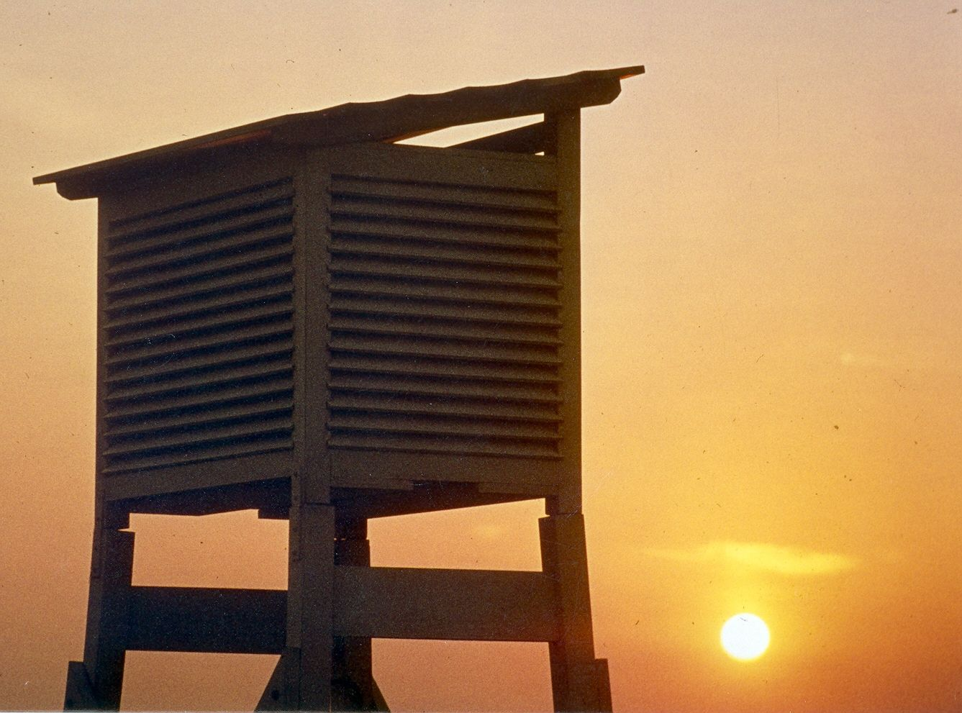
Thank you
very much
for your
attention

