Slide 1
GRIB2 and ecCodes in the COSMO-Model
Ulrich Schättler
Source Code Administrator

Slide 2
Contents
GRIB2 at DWD
How other COSMO Partners can use it
First tests with ecCodes

Slide 3
GRIB2 at DWD

Slide 4
Implementation at DWD
DWD uses grib_api and GRIB2 for more than 3 years now
Implementation consolidated since COSMO 5.02, INT2LM 2.02
Implementation in COSMO and INT2LM uses a DWD-special set of definition files: definition.edzw
  for shortNames
  for local use section
  also special samples are used
If other partners run COSMO / INT2LM with center ≠ 78 / edzw, they need similar definition files.
Solution: When using the DWD definition files, every center can create links to the necessary files where their own center specific specification appears in the link name.
A "link_cosmo_script" is provided to create all necessary links

Slide 5
Listing of definitions.edzw/grib2
grib2LocalSectionNumber.215.table -> grib2LocalSectionNumber.78.table MeteoSwiss
grib2LocalSectionNumber.220.table -> grib2LocalSectionNumber.78.table Poland
grib2LocalSectionNumber.242.table -> grib2LocalSectionNumber.78.table Romania
grib2LocalSectionNumber.250.table -> grib2LocalSectionNumber.78.table COSMO
grib2LocalSectionNumber.78.table Offenbach
grib2LocalSectionNumber.80.table -> grib2LocalSectionNumber.78.table Rome
local
local.215.def -> local.78.def
local.220.def -> local.78.def
local.242.def -> local.78.def
local.250.def -> local.78.def
etc.

Slide 6
Where to get the grib_api Environment
MCH maintains a repository on github: libgrib-api-cosmo-resources
  https://github.com/C2SM-RCM/libgrib-api-cosmo-resources: you need an account on github.com to log in and access the repository
  contains the COSMO specific definition and sample files for GRIB2 (according to COSMO GRIB2 policy)
  has been tested with COSMO, INT2LM and fieldextra 12.6.0
  currently available: 1.13.1, 1.20.0
tar-files for the INT2LM also contain these environments (together with corresponding ECMWF definitions)
In addition you need the corresponding version of grib_api (available from ECMWF or the DWD ftp-server)

Slide 7
How to use GRIB2
Install a grib_api version according to the installation instructions of ECMWF (at the moment DWD uses 1.20.0)
Install COSMO-Model (5.02 or higher) and INT2LM (2.02 or higher) with the compilation pragma –DGRIBAPI and
  for include files: -I /your/path/to/grib_api-x.y.z/include
  for libraries: -L /your/path/to/grib_api-x.y.z/lib
  -l grib_api_f90.a -l grib_api
Set necessary namelist variables to 'apix' for reading and 'api2' for writing GRIB2 with grib_api:
 | INT2LM | COSMO
Reading | ylmext_form_read yinext_form_read yin_form_read | yform_read
Writing | ylm_form_write | yform_write

Slide 8
How to use GRIB2 (cont.)
If you set ncenter≠78, be sure to have the necessary links in your grib_api environment
Set the environment variables
  GRIB_DEFINITION_PATH=/path/to/x.y.z/definitions.edzw:/perhaps/path2/to/x.y.z/definitions
  GRIB_SAMPLES_PATH=/path/to/1.20.0/samples
    /path/to/definitions.edzw: DWD definitions have to be first!
    /perhaps/path2/to/definitions: then you need the ECMWF definitions
Then run the programs

Slide 9
Caveats
DWD definition files are only maintained for GRIB2! If you want to read / write GRIB1 files you still have to use the DWD GRIB1 library and set 'grb1' instead of 'apix', 'api2'.
Be sure to have your GRIB_DEFINITION_PATH set correctly.

Slide 10
ecCodes

Slide 11
"New" Development at ECMWF
ECMWF integrated the grib_api library into ecCodes lately. ecCodes also contains a BUFR-library.
At ECMWF ecCodes is already operational.
Users are strongly encouraged to move from grib_api to ecCodes soon.
How much effort will it take to migrate? What are the differences?
  some functions have been removed: but COSMO was not using them
  Fortran 77 library has been removed: also not used in COSMO
  for more information see the ECMWF migration page
  instead of grib_info you have to use codes_info

Slide 12
First Tests with the COSMO-Model
Installed eccodes-2.3.0 and the environment (including "link_cosmo_script"): similar to grib_api
Compilation of COSMO (still) with –DGRIBAPI and include-/library-directories pointing to ecCodes installation: works!
  no adaptations necessary in the code
set GRIB_DEFINITION_PATH and GRIB_SAMPLES_PATH and run the binaries without problems.
New functionality in eccodes: packing type grid_ccsds: gives a loss-less compression for GRIB files of about 50% !!!
Could only test reading such files with COSMO (not yet prepared for writing other packing types than grid_simple).
A first test showed a slight improvement for reading data packed with ccsds (but statistically not significant). At least is seems not to be worse.

Slide 13
Really Nothing To Do?
Implement possibility to set the packing type.
Anything else?

Slide 14
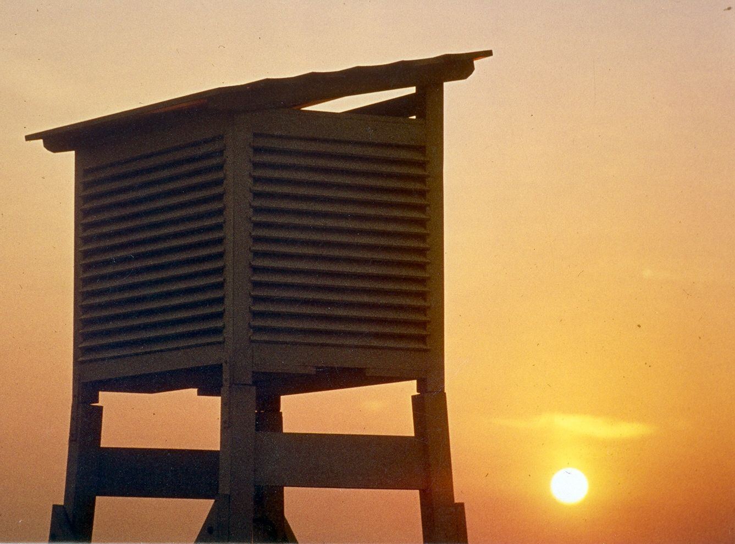
Thank you
very much
for your
attention

