Slide 1
PASC PASCHA Project
The next HPC step for the COSMO model
Carlos Osuna and Oliver Fuhrer, MeteoSwiss
COSMO General Meeting 2017, Jerusalem

Slide 2
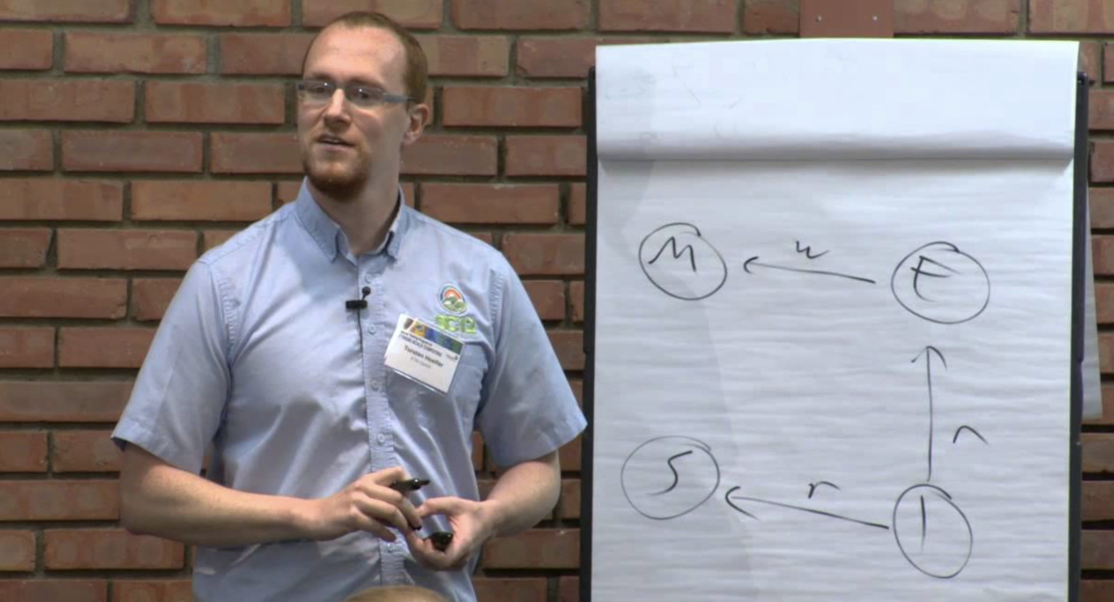
Overview (1/2)
Platform for Advanced Scientific Computing (PASC)
See http://www.pasc-ch.org/
Principle Investigator
Prof. Torsten Höfler
https://spcl.inf.ethz.ch/
Proposal
Handed in 11.2016
Written by Carlos Osuna and Oliver Fuhrer
Partners: Prof. Christoph Schär, Christina Schnadt

Slide 3
Overview (2/2)
Funding
494’300 CHF
Two positions for two years
Project duration
1.7.2017 – 30.6.2020 (3 years)
Project manager
Carlos Osuna (MeteoSchweiz)

Slide 4
Background
Architectural diversity
Xeon Phi
NVIDIA Tesla
x86
Vector
PASCHA
HP2C
2012
2013
2014
2015
2016
2017
2018
2019
Time

Slide 5
WP-A: Strong scalability
Improve strong scalability of COSMO by introducing functional parallelism, optimizing computation/communication overlap and optimizing the existing fine-grain parallelism (SIMD and SIMT) in order to improve the usability of the model for the main weather and climate use-cases.

Slide 6
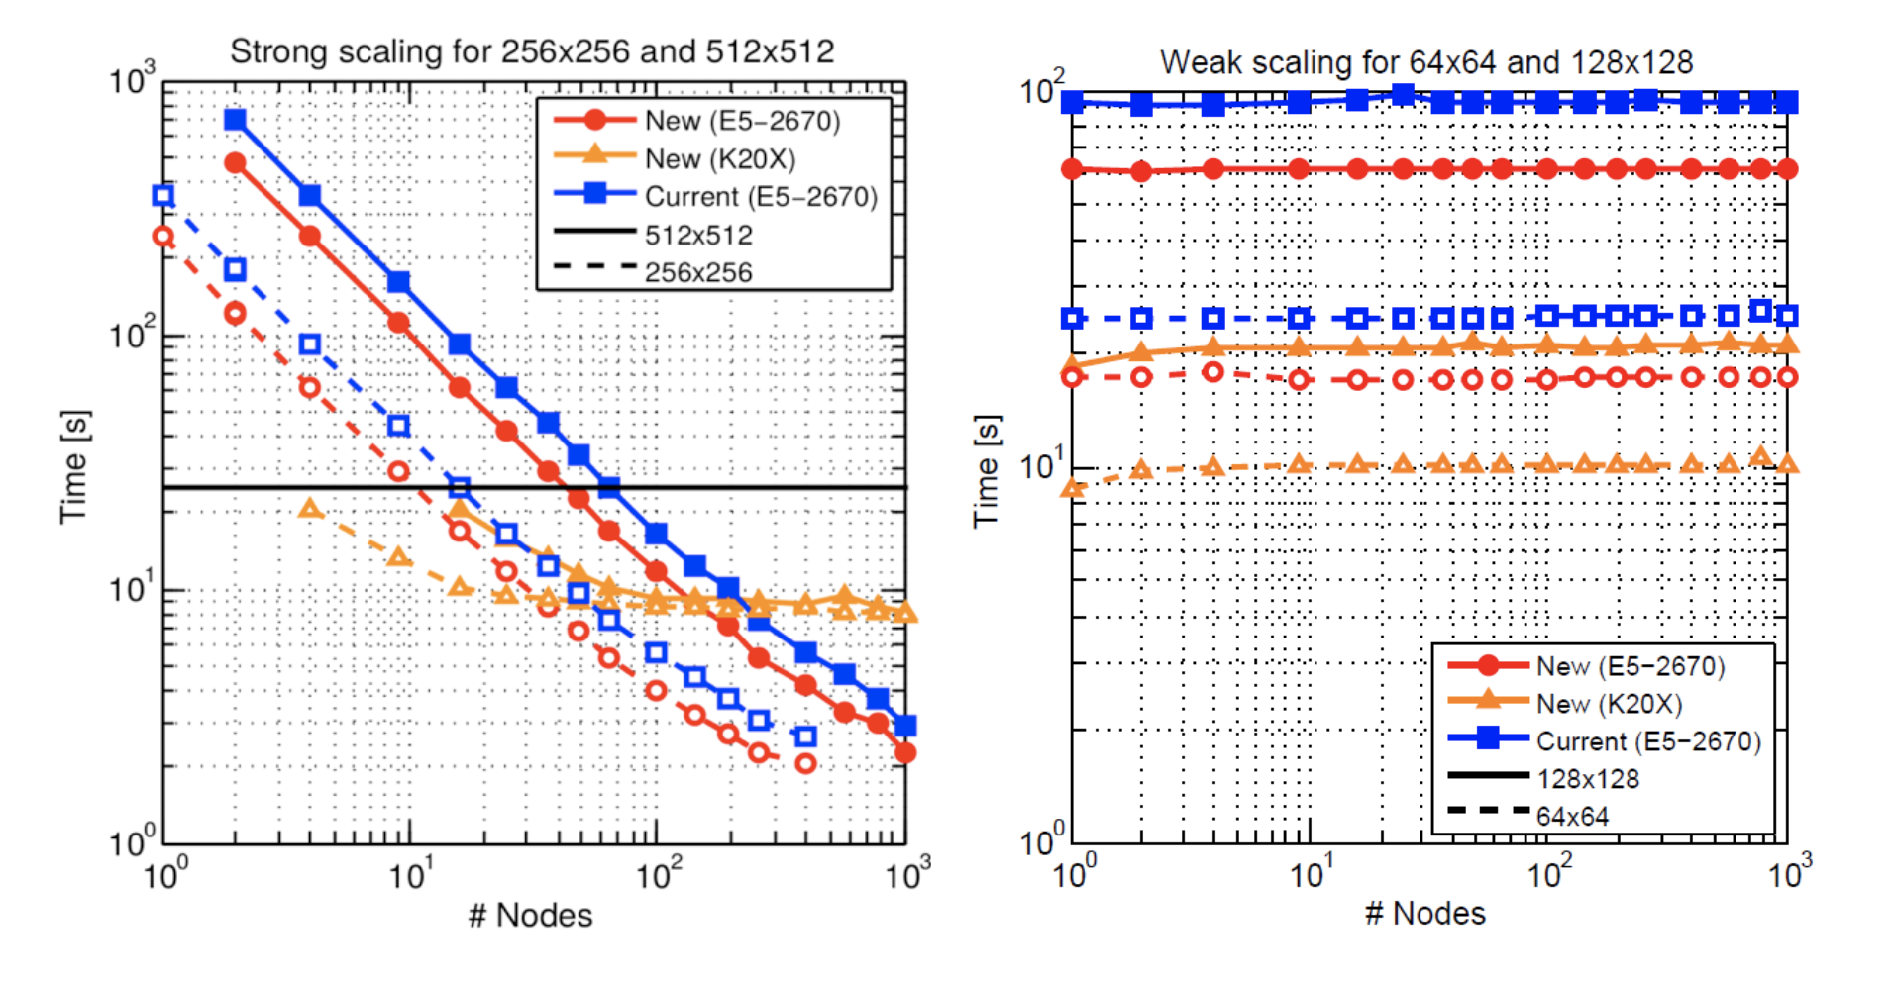
Scalability

Slide 7
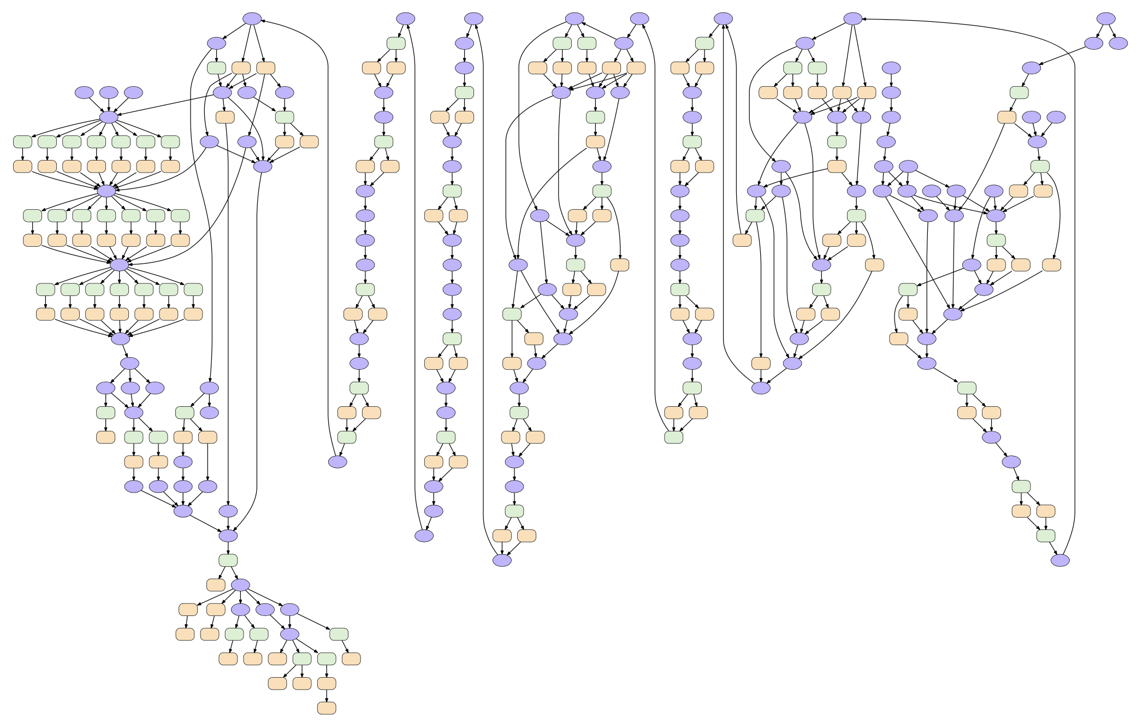
Functional parallelism
In dynamical core (execute independent stencils in parallel)
Coarse grained (e.g. execute radiation in parallel)

Slide 8
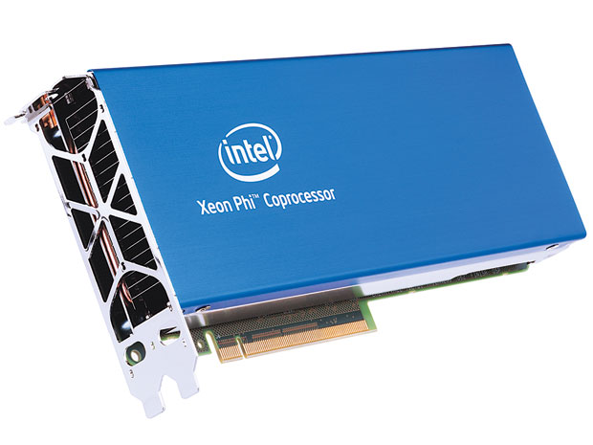
WP-B: Xeon Phi portability
Develop a Xeon Phi backend for the GridTools library and port the full COSMO model to Xeon Phi in order to improve the portability and performance portability of the source code and avoid vendor lock-in.

Slide 9
WP-C: DSLs for performance portability
Replace the STELLA library with the GridTools library in order to reduce software maintenance costs.
Develop a GridTools intermediate representation to enable high-level DSLs and to leverage external efforts interoperability with other DSL efforts in the community.

Slide 10
High-level DSLs
Acceptance of STELLA / GridTools is low (C++, boiler plate, code safety, manual optimization, …)
High-level DSL can leverage the power of GridTools but provide a more acceptable and safe frontend

Slide 11
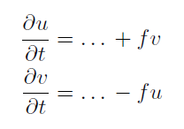
Prototype high-level DSL
Example: gtclang
Coriolis force
No loops
No data structures
No halo-updates
function avg {
offset off;
storage in;
avg = 0.5 * ( in(off) + in() ) ;
} ;
function coriolis_force {
storage fc, in;
coriolis_force = fc() * in();
};
operator coriolis {
storage u_tend, u, v_tend, v, fc;
vertical_region ( k_start , k_end ) {
u_tend += avg(j-1, coriolis_force(fc, avg(i+1, v));
v_tend -= avg(i-1, coriolis_force(fc, avg(j+1, u));
};
};
};

Slide 12
WP-D: Performance model driven optimization
Use performance model driven optimization of dynamical core in order to improve the single-socket performance.

Slide 13
Optimization options
Individual operations
flx(lap)
out
in
lap(in)
fly(lap)
update(flx,fly)
Fuse for data locality
flx(lap)
out
in
lap(in)
fly(lap)
update(flx,fly)
Fuse more aggresively
flx(lap)
out
in
lap(in)
fly(lap)
update(flx,fly)

Slide 14
Conclusions
Project ranging from simple porting (e.g. Xeon Phi) to more exploratory research (e.g. task parallelism, high-level DSLs)
Interdisciplinary team with domain scientists, computational scientists and computer scientists.
Focus on applications of COSMO model in weather and climate production.
Work has just started. Stay tuned for first results!

