Slide 1
ENIAC
ENabling the Icon model on heterogeneous ArChitecture
Xavier Lapillonne

Slide 2
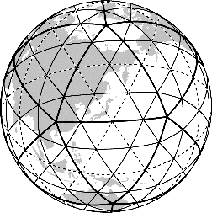
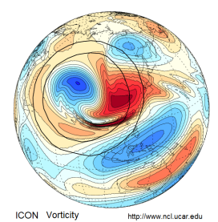
Main goal
Adapt the ICON model to run on GPU and many-core architecture (XeonPhi)
Achieving a high degree of performance portability by:
  using source-to-source translation tool : CLAW
  using alternative approaches such as the GridTools domain-specific lan- guage
Prepare the ICON model for actual use-cases in weather and climate on emerging HPC systems
Notes:
Stop short presentation at this slide

Slide 3






The ENIAC project
Funding: PASC initiative (Swiss HPC project), 3 post docs positions
Duration: 3 years, 07.2017-06.2020
The team
  ETH Zurich: Ulrike Lohmann (PI), S. Ferrachat, V. Clement, P Marti, C. Schnadt Poberaj
  MPI-M: M. Giorgetta, B. Stevens, G. Hime
  MeteoSwiss: X. Lapillonne (PM), O. Fuhrer
  CSCS: W. Sawyer
  DWD: G. Zängl

Slide 4
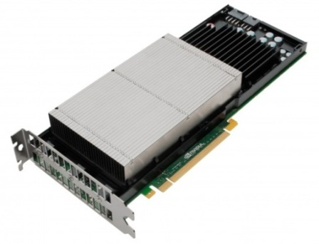
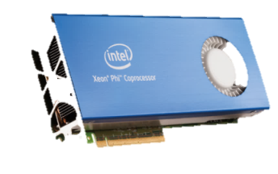

First steps: base line
Get a base line with existing programming models
  GPU with OpenACC
  XeonPhi optimize current OpenMP implementation

Slide 5
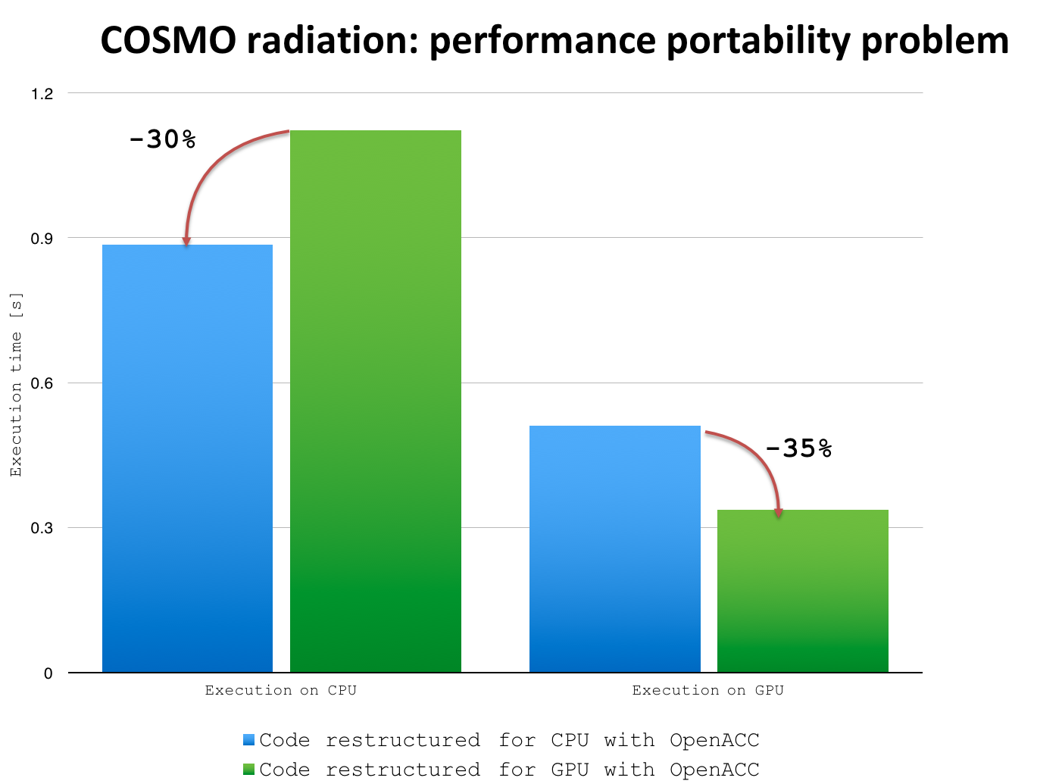
Step 2: Achieve performance portability
Currently using #ifdef to achieve best perf on CPU and GPU
Source-to-source translation tool : CLAW
Explore alternative approaches such as the GridTools domain-specific language and re-write

Slide 6
Having multiple source codes? Code Maintenance Problem
#ifndef _OPENACC
DO k=1,nz
CALL fct()
DO j=1,nproma
! 1st loop body
END DO
DO j=1,nproma
! 2nd loop body
END DO
DO j=1,nproma
! 3rd loop body
END DO
END DO
#else
!$acc parallel loop
DO j=1,nproma
!$acc loop
DO k=1,nz
CALL fct()
! 1st loop body
! 2nd loop body
! 3rd loop body
END DO
END DO
!$acc end parallel
#endif
CPU
Multiple code paths
Hard maintenance
Error prone
Domain scientists have to know well each target architectures
GPU

Slide 7
CLAW low-level directive transformations
!$acc parallel loop
!$claw loop-interchange
DO k=1,nz
!$claw loop-extract fusion
CALL fct()
!$claw loop-fusion group(j)
!$acc loop
DO j=1,nproma
! 1st loop body
END DO
!$claw loop-fusion group(j)
!$acc loop
DO j=1,nproma
! 2nd loop body
END DO
!$claw loop-fusion group(j)
!$acc loop
DO j=1,nproma
! 3rd loop body
END DO
END DO
!$acc end parallel
!$acc parallel loop
DO j=1,nproma
!$acc loop
DO k=1,nz
CALL fct()
! 1st loop body
! 2nd loop body
! 3rd loop body
END DO
END DO
!$acc end parallel
clawfc
CPU to GPU

Slide 8
CLAW low-level transformations
Single source code, match optimal performance of handwritten version

Slide 9
Too many directives? Too complicated?
!$acc parallel loop
!$claw loop-interchange
DO k=1,nz
!$claw loop-extract fusion
CALL fct()
!$claw loop-fusion
!$acc loop
!$omp parallel do
DO j=1,nproma
! 1st loop body
END DO
!$omp end parallel do
!$claw loop-fusion
!$acc loop
!$omp parallel do
DO j=1,nproma
! 2nd loop body
END DO
!$omp end parallel do
!$claw loop-fusion group(j)
!$acc loop
!$omp parallel do
DO j=1,nproma
! 3rd loop body
END DO
!$omp end parallel do
END DO
!$acc end parallel
Typical code could includes the following compiler directives:
OpenMP
OpenACC
CLAW
…
Still targeted for performance aware developer.
Doesn’t help the domain scientist.
Can we do it in a simpler way?

Slide 10
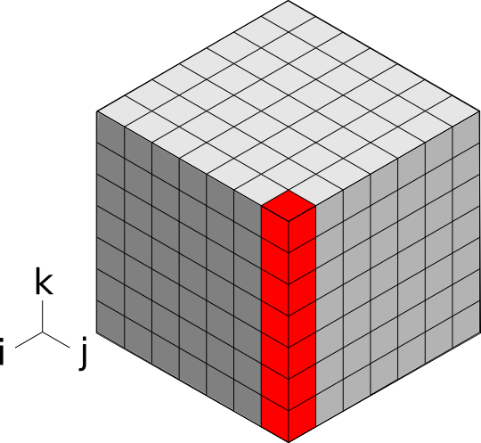
CLAW One column abstraction
Separation of concerns
  Domain scientists focus on their problem (1 column, 1 box)
  CLAW compiler produce code for each target and directive languages

Slide 11
Claw one column example
!$claw parallelize forward
DO icol = 1, ncol
CALL lw_solver(ngpt, nlay, tau(icol,:,:))
END DO
Loop over horizontal direction generated by claw at compile time
CALL lw_solver(ngpt, nlay, tau)
SUBROUTINE lw_solver(ngpt, nlay, tau, …)
  !$claw define dimension icol(1:ncol) &
  !$claw parallelize
  DO igpt = 1, ngpt
  DO ilev = 1, nlay
tau_loc(ilev) = max(tau(ilev,igpt) …

Slide 12

CLAW FORTRAN Compiler overview
Based on the OMNI Compiler (Developed at Rikken Inst., Japan)
Source-to-source translator
Open source under the BSD license
Available on GitHub with the specifications
.f90
.f90
CLAWFC
FPP
F_Front
CX2X
F_Back

Slide 13
Climate cases
Target applications will be defined by ETH/MPI, a specific set of physical parameterizations will be consider first in order to get the code ready
  Chemistry
  High-resolution climate runs

Slide 14
Thank you

Slide 15
CLAW low-level directive transformations
Loop transformations
  loop fusion (!$claw loop-fusion)
  loop reordering (!$claw loop-interchange)
  loop hoisting (!$claw loop-hoist)
  loop extraction (!$claw loop-extract)
Specific transformation
  kcaching (!$claw kcache)
  on-the-fly computation (!$claw call)
Utility transformation
  vector notation to do statements
    (!$claw array-transform)
  code removal (!$claw remove)
  ignore section (!$claw ignore)
  conditional primitive directive / code (!$claw acc/omp)

Slide 16
RRTMGP Example - original code
SUBROUTINE lw_solver(ngpt, nlay, tau, …)
  DO igpt = 1, ngpt
  DO ilev = 1, nlay
  DO icol = 1, ncol
tau_loc(icol,ilev) = max(tau(icol,ilev,igpt) …
trans(icol,ilev) = exp(-tau_loc(icol,ilev))
END DO
END DO
DO ilev = nlay, 1, -1
DO icol = 1, ncol
radn_dn(icol,ilev,igpt) = trans(icol,ilev) *
radn_dn(icol,ilev+1,igpt) …
END DO
END DO
DO ilev = 2, nlay + 1
DO icol = 1, ncol
radn_up(icol,ilev,igpt) = trans(icol,ilev-1) *
radn_up(icol,ilev-1,igpt)
END DO
END DO
END DO
radn_up(:,:,:) = 2._wp * pi * quad_wt * radn_up(:,:,:)
radn_dn(:,:,:) = 2._wp * pi * quad_wt * radn_dn(:,:,:)
END SUBROUTINE lw_solver

Slide 17
RRTMGP Example - one column only
SUBROUTINE lw_solver(ngpt, nlay, tau, …)
  DO igpt = 1, ngpt
  DO ilev = 1, nlay
tau_loc(ilev) = max(tau(ilev,igpt) …
trans(ilev) = exp(-tau_loc(ilev))
END DO
DO ilev = nlay, 1, -1
radn_dn(ilev,igpt) = trans(ilev) *
radn_dn(ilev+1,igpt) …
END DO
DO ilev = 2, nlay + 1
radn_up(ilev,igpt) = trans(ilev-1) *
radn_up(ilev-1,igpt)
END DO
END DO
radn_up(:,:) = 2._wp * pi * quad_wt * radn_up(:,:)
radn_dn(:,:) = 2._wp * pi * quad_wt * radn_dn(:,:)
END SUBROUTINE lw_solver

Slide 18
RRTMGP Example - kernel code
SUBROUTINE lw_solver(ngpt, nlay, tau, …)
  !$claw define dimension icol(1:ncol) &
  !$claw parallelize
  DO igpt = 1, ngpt
  DO ilev = 1, nlay
tau_loc(ilev) = max(tau(ilev,igpt) …
trans(ilev) = exp(-tau_loc(ilev))
END DO
DO ilev = nlay, 1, -1
radn_dn(ilev,igpt) = trans(ilev) *
radn_dn(ilev+1,igpt) …
END DO
DO ilev = 2, nlay + 1
radn_up(ilev,igpt) = trans(ilev-1) *
radn_up(ilev-1,igpt)
END DO
END DO
radn_up(:,:) = 2._wp * pi * quad_wt * radn_up(:,:)
radn_dn(:,:) = 2._wp * pi * quad_wt * radn_dn(:,:)
END SUBROUTINE lw_solver
Algorithm for one column only
Dependency on the vertical dimension only

