Slide 1
First experiments with KENDA for providing ICs to COSMO-It-EPS
Chiara Marsigli
Tiziana Paccagnella
Andrea Montani
ARPA Emilia-Romagna, SIMC

Slide 2
Set-up for the experiments
DA cycle:
3-hourly cycles, 36 hours
10 members
BCs from COSMO-LEPS (also ICs for cold start)
no model perturbations
observations: TEMP SYNOP ACARS AMDAR
Forecast:
10 members
36h forecast range
Parameter perturbations
BCs from COSMO-LEPS

Slide 3
Test cases (Hymex SOP)
I.T. ensemble run | Area of the main meteorological phenomenon | KENDA cycle
2012092512 | Alps | 2012092400 2012092512
2012092612 | Liguria Tuscany | 2012092500 2012092612
2012101100 | Corse Central Italy | 2012101000 2012101100
2012101112 | Corse Central Italy | 2012101000 2012101112
2012102512 | Northern Italy (IOP16) | 2012102400 2012102512

Slide 4
Issues under investigation
A remark: preliminary tests with a “basic” KENDA set-up
Analysis cycle:
Capability of KENDA to add perturbations at the small scale (spectra)
Differences between KENDA-derived analyses and downscaled analyses (spectra, spread, maps)
Quality of the analyses with respect to observations (area average)
Forecast:
Quality of the ensemble forecast with respect to observations, compared with downscaling ensemble (area average, maps of precipitation)

Slide 5
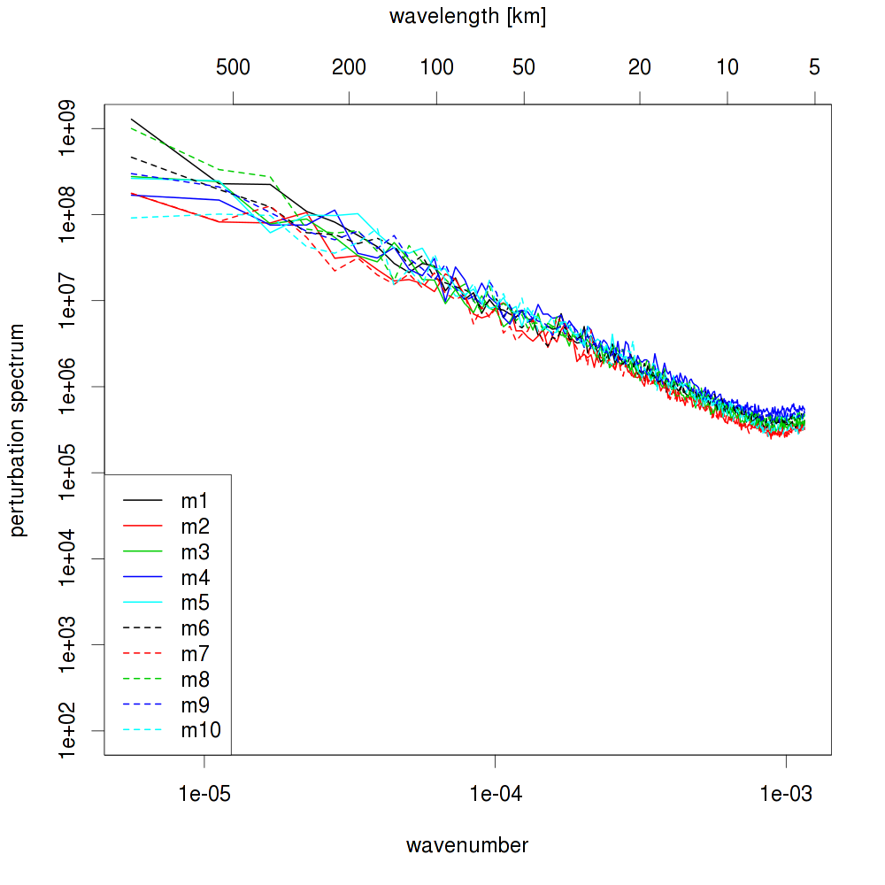
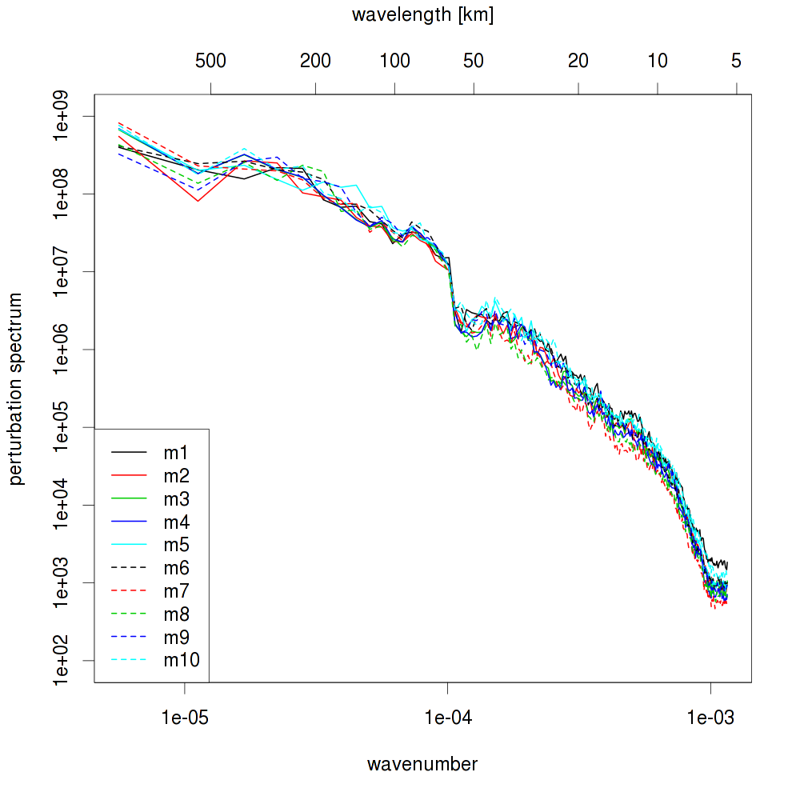
2012102512 - T level 50
kenda
int2lm

Slide 6
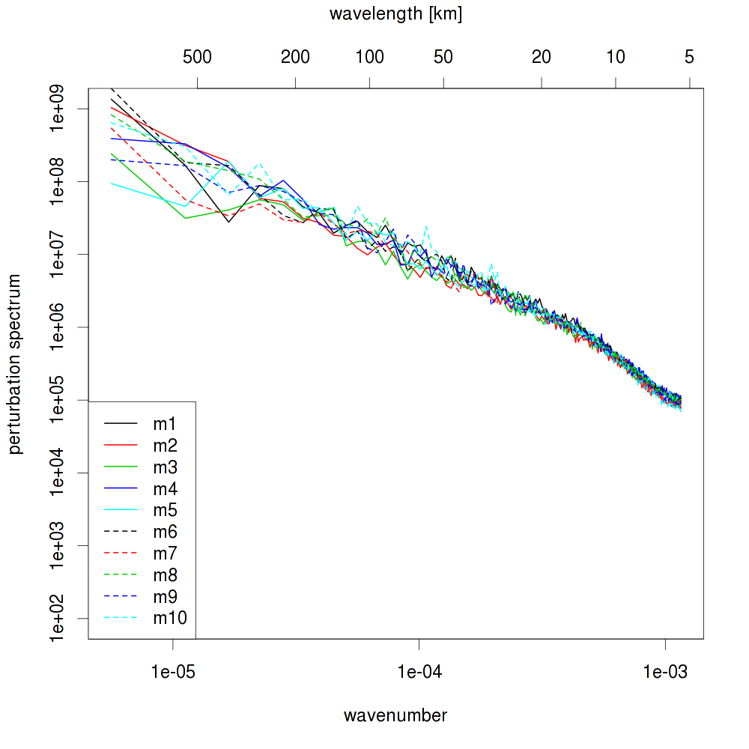
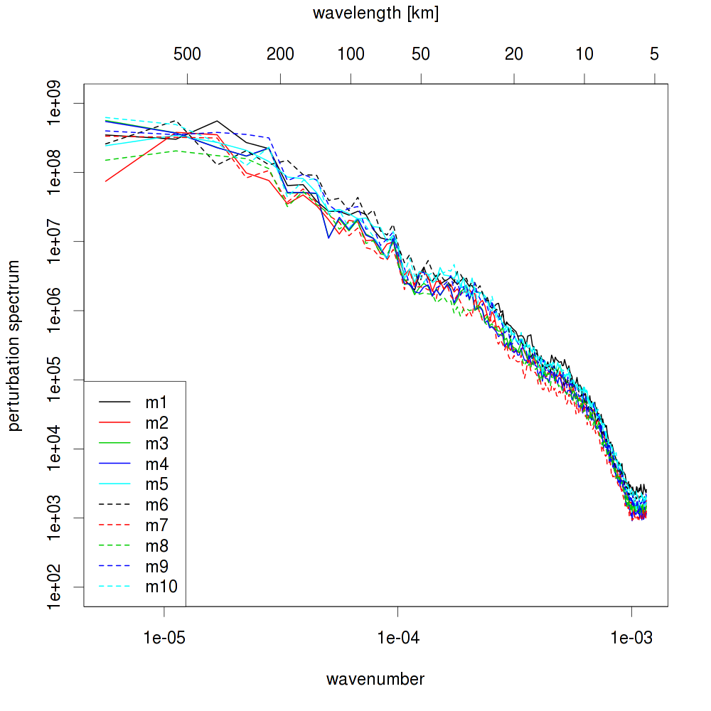
2012102512 - T level 40
kenda
int2lm

Slide 7
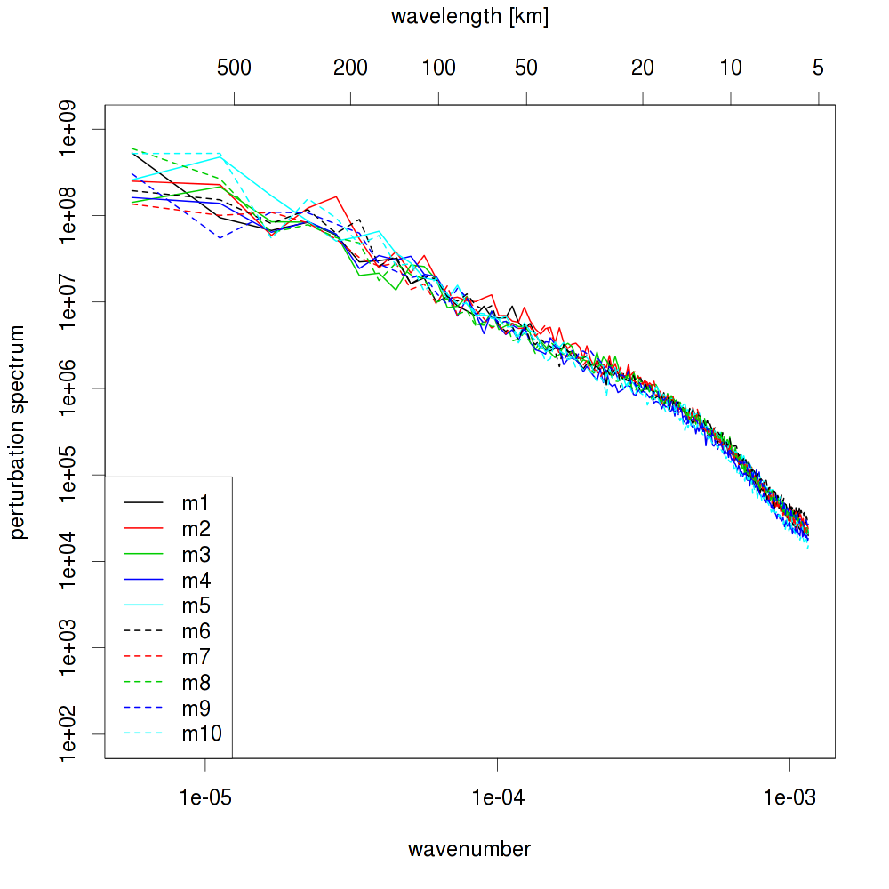
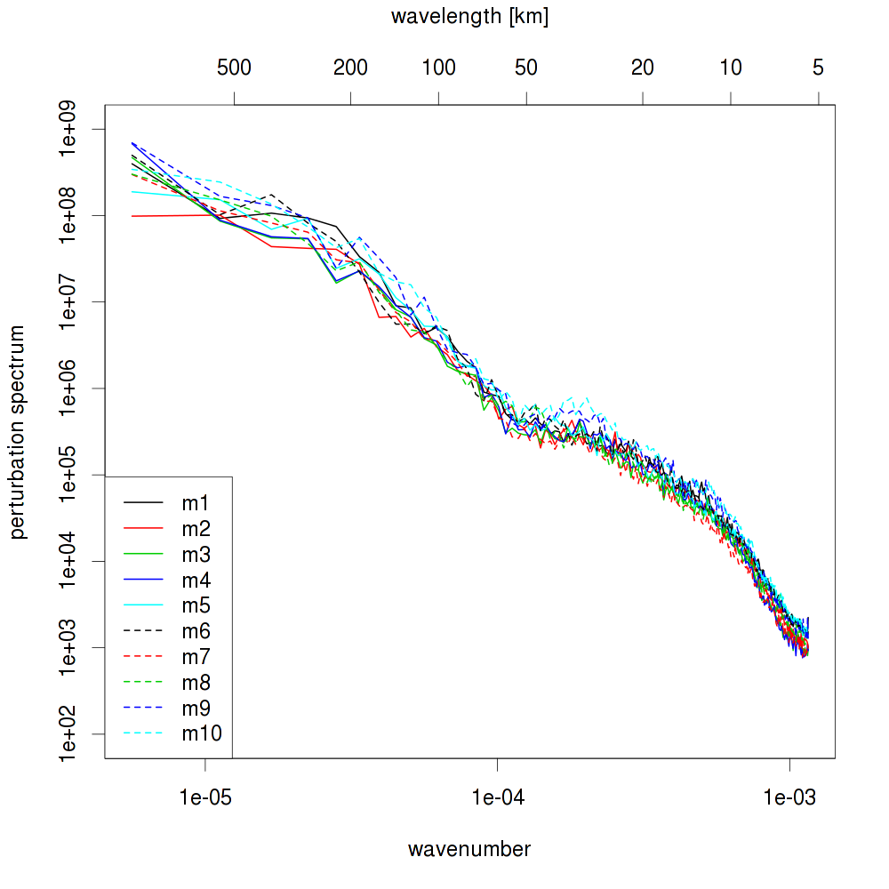
2012102512 - T level 30
kenda
int2lm

Slide 8
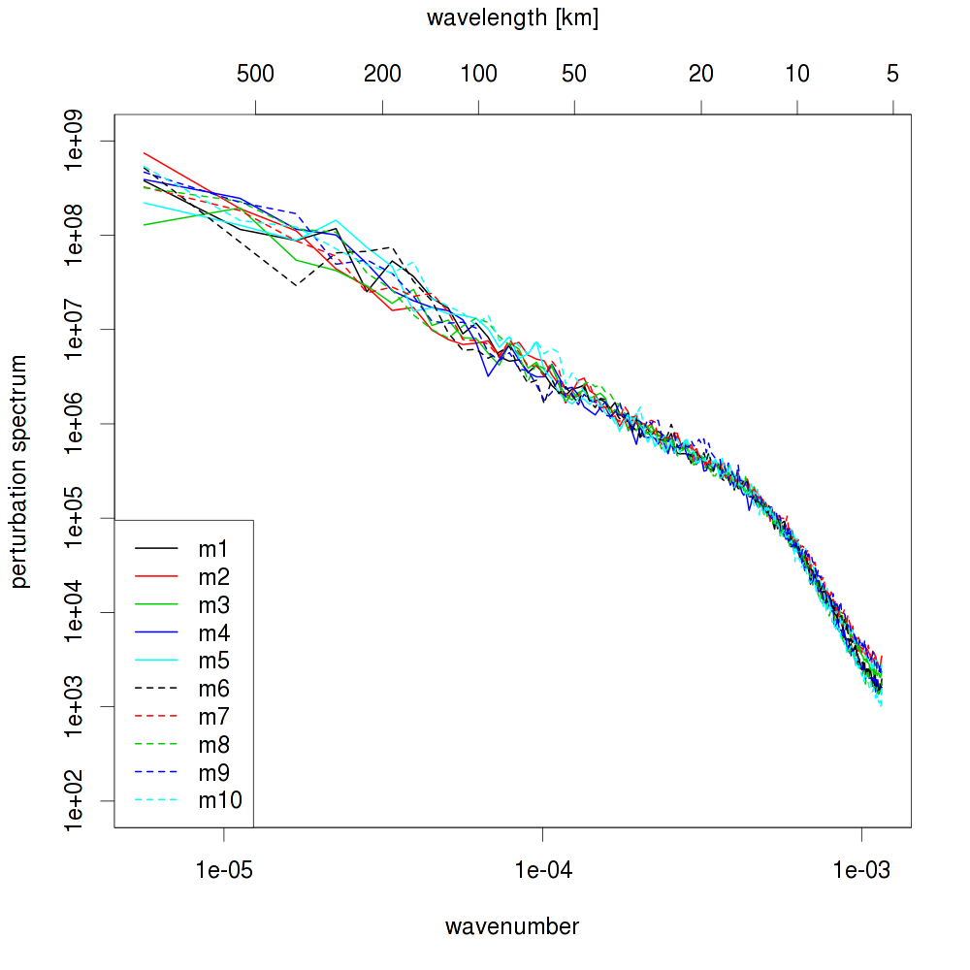
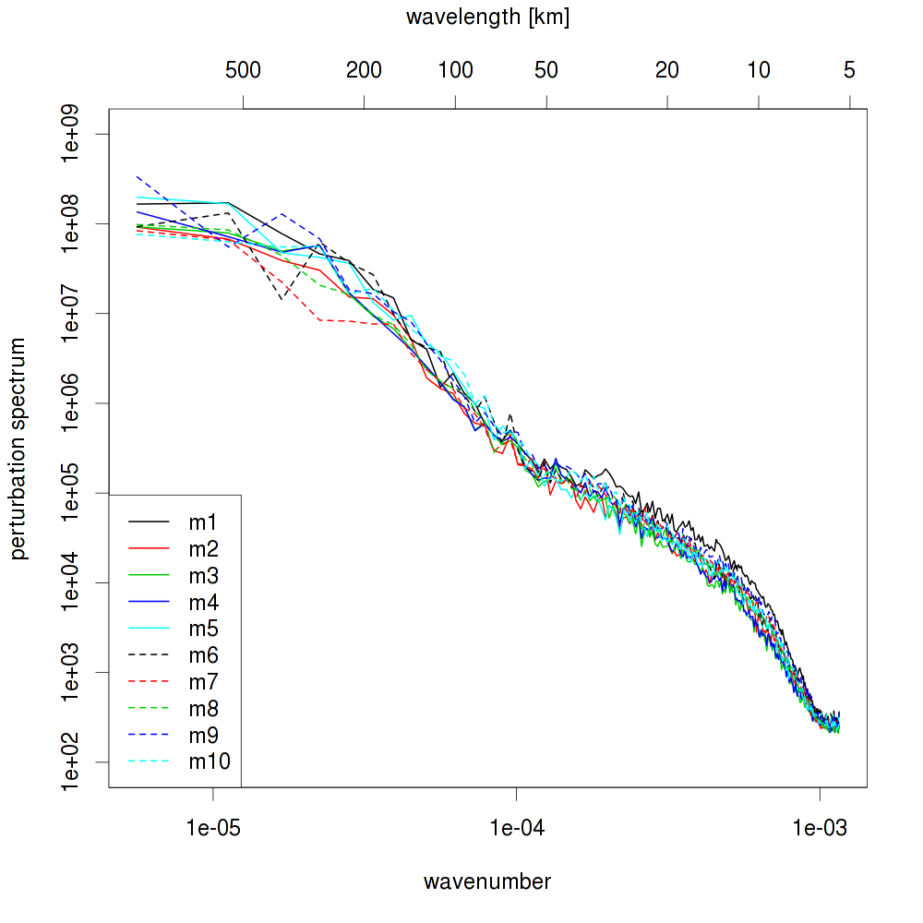
2012102512 - T level 20
kenda
int2lm

Slide 9
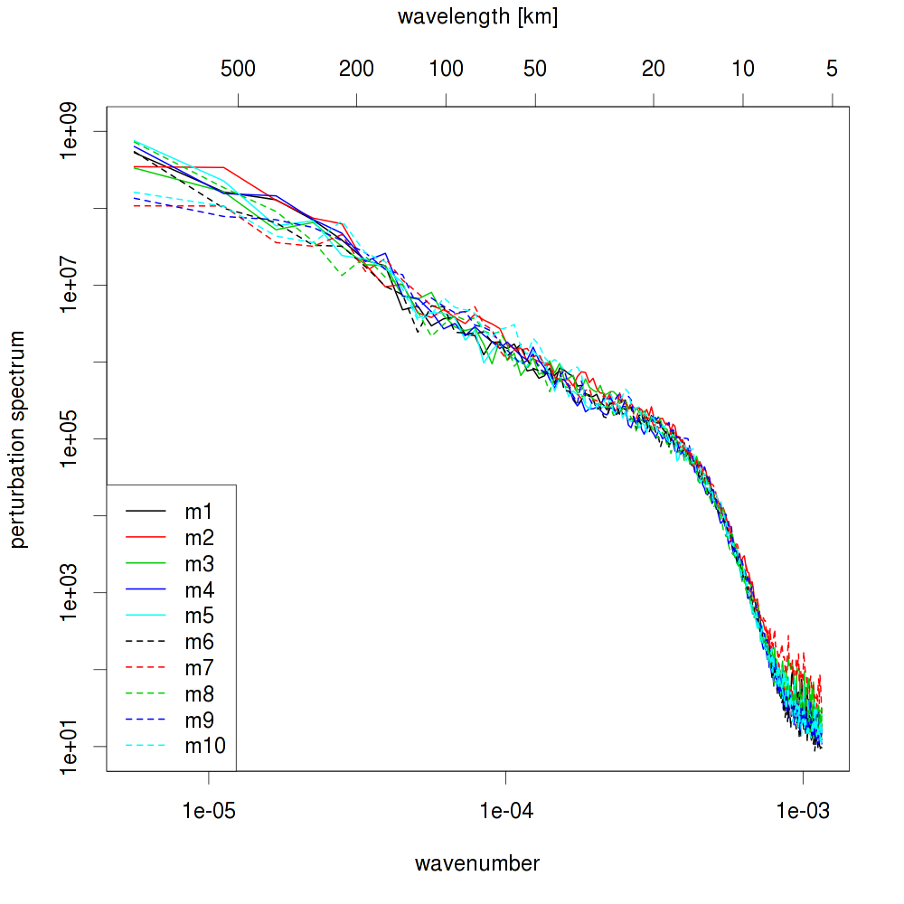
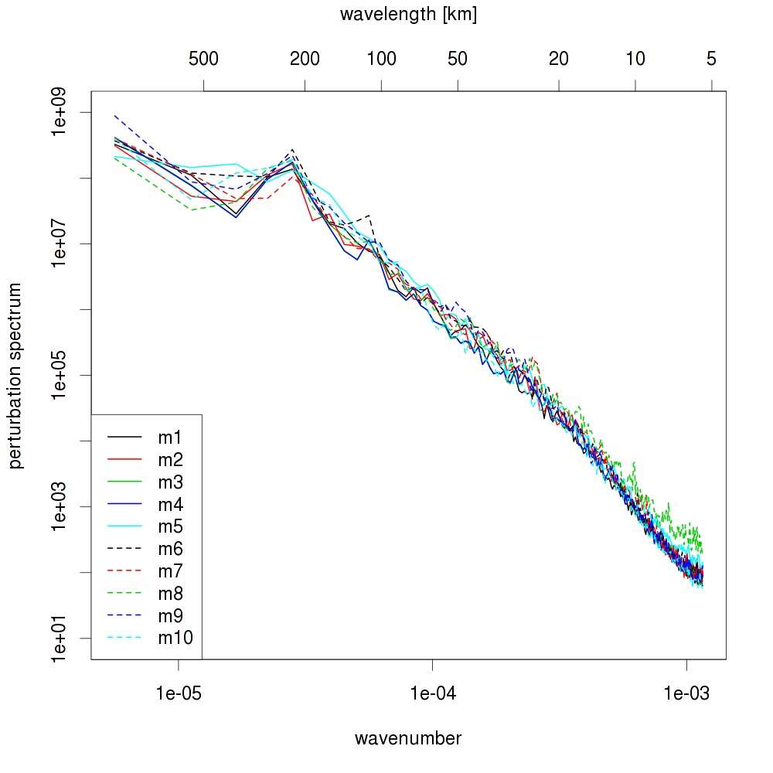
2012102512 - T level 10
kenda
int2lm

Slide 10
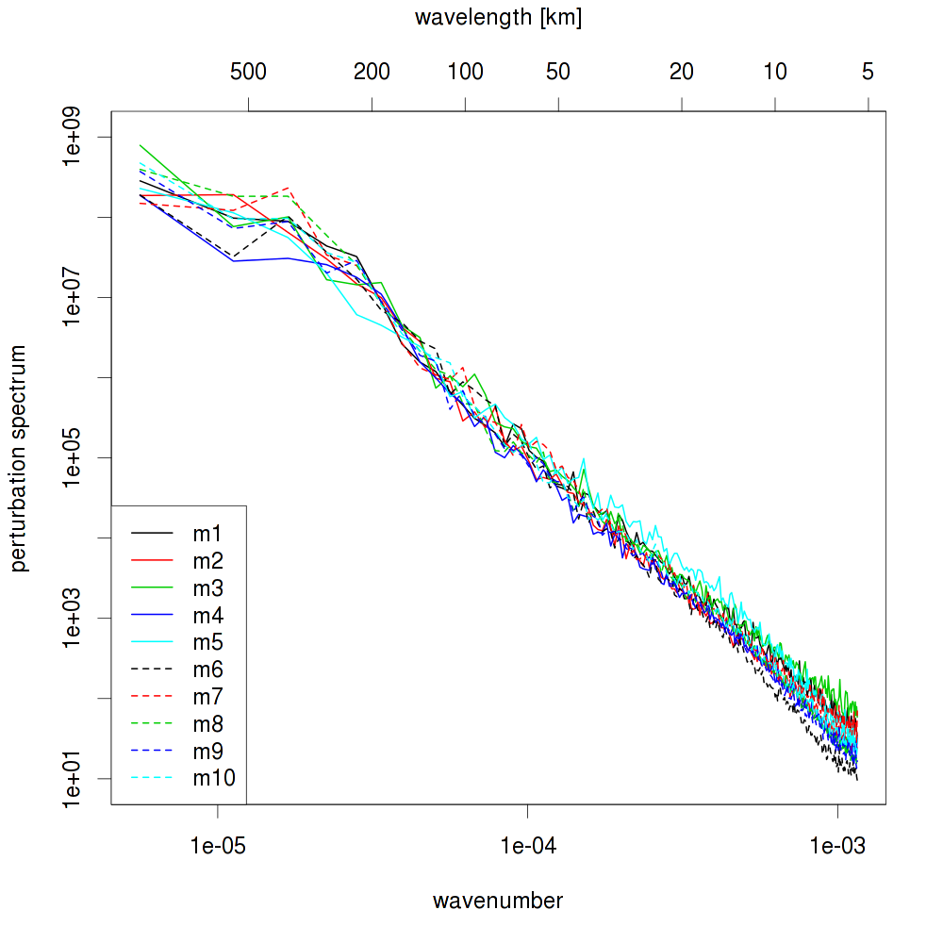
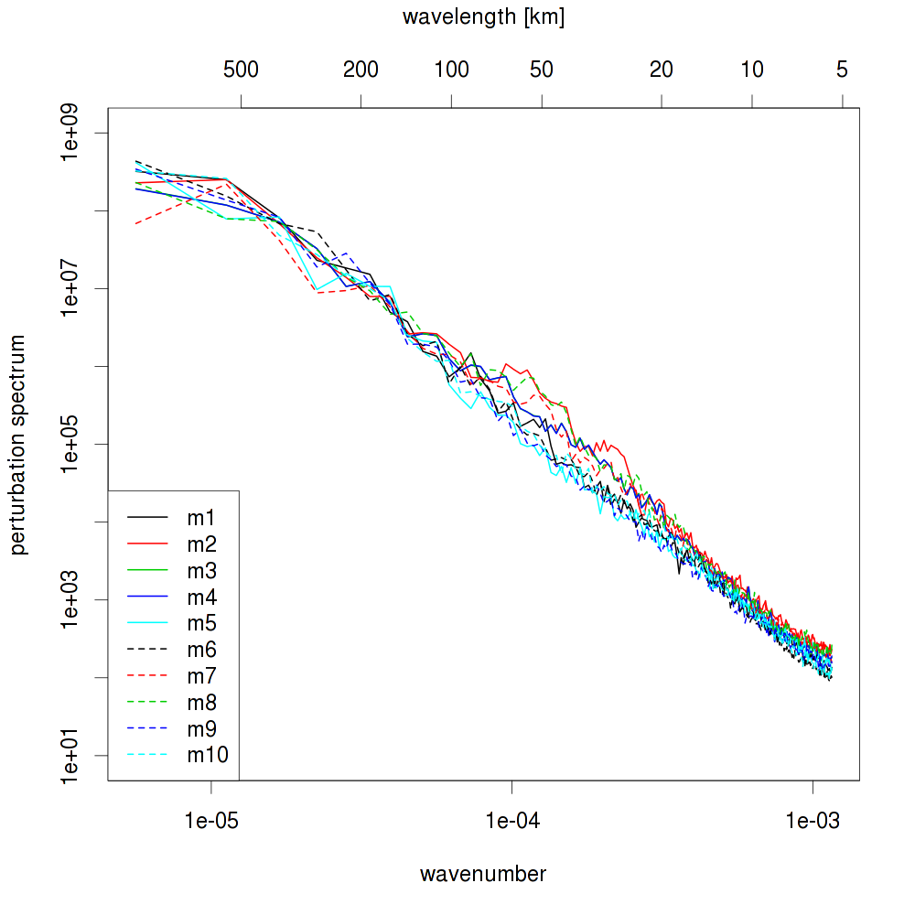
2012102512 - T level 1
kenda
int2lm

Slide 11
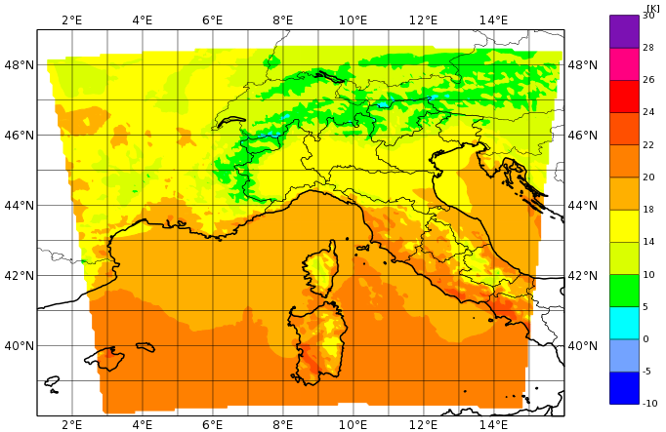
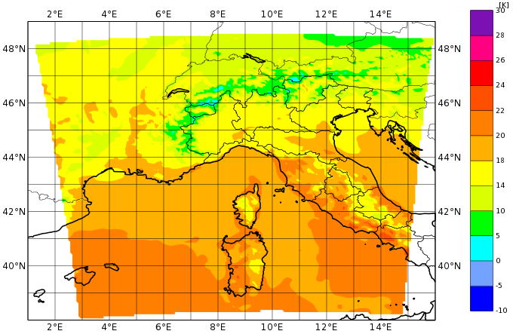
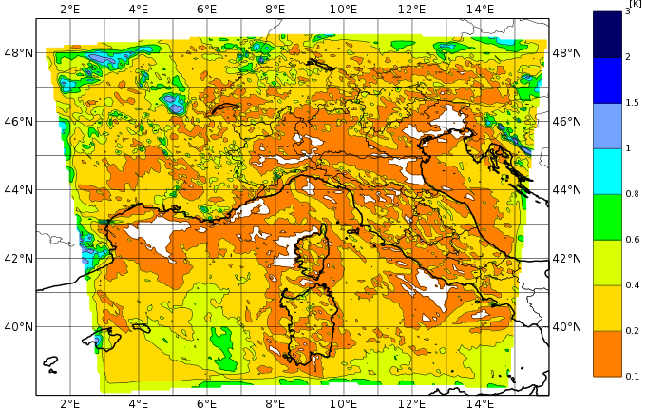
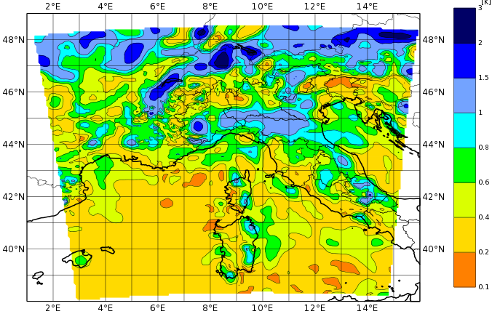
2012102512 – analysis T level 50
kenda
int2lm
mean
spread

Slide 12
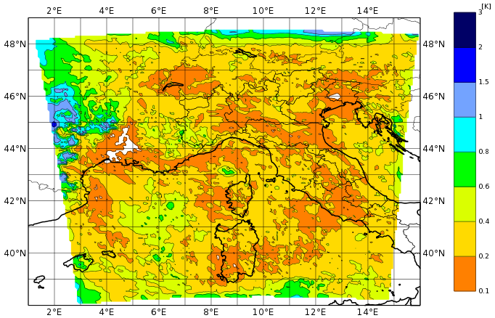
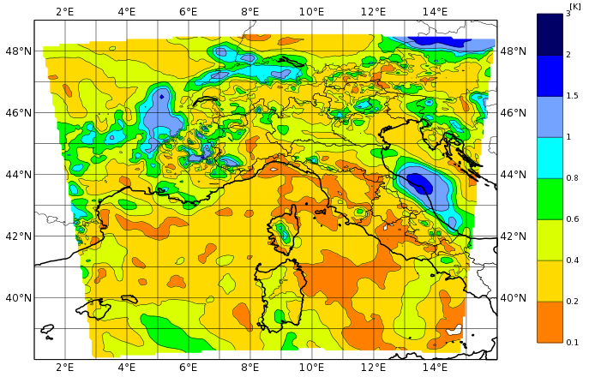
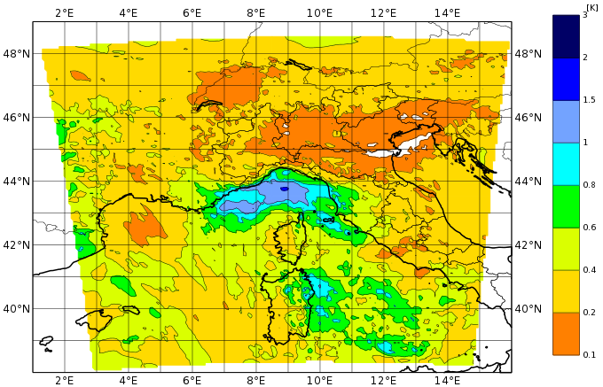
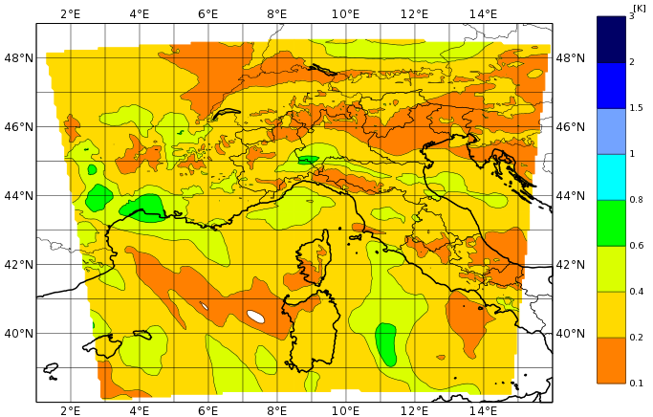
2012102512 – analysis spread
kenda
downscaling
T level 40
T level 30

Slide 13
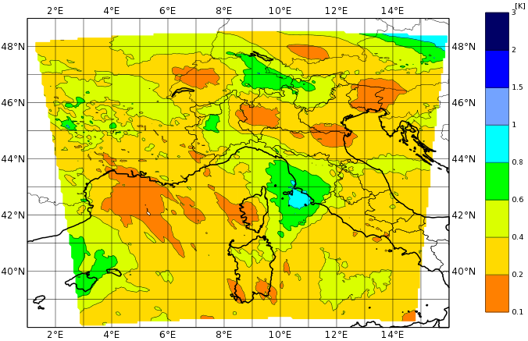
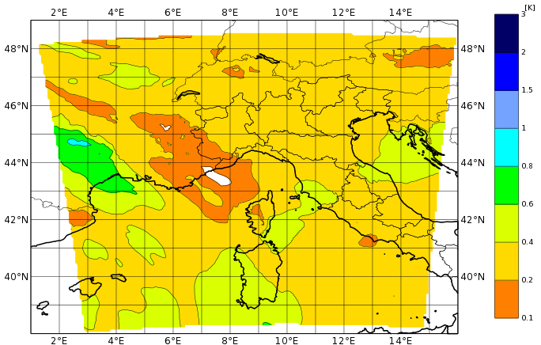
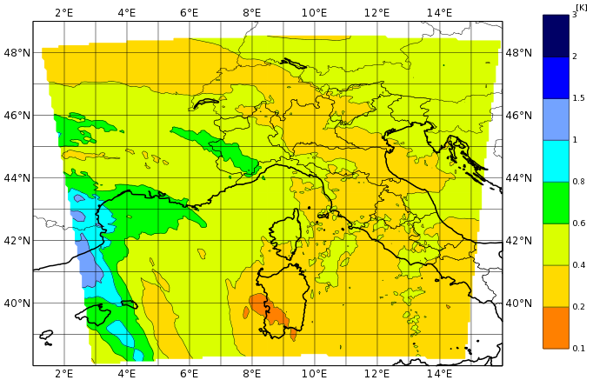
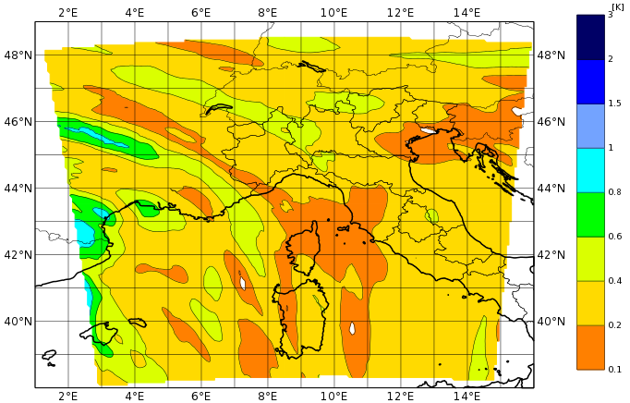
2012102512 – analysis spread
kenda
downscaling
T level 20
T level 10

Slide 14
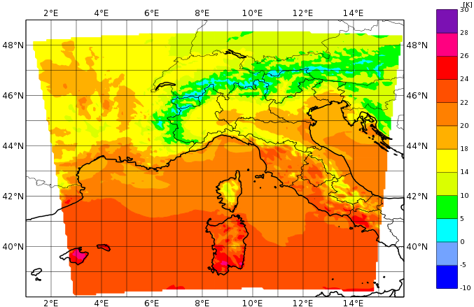
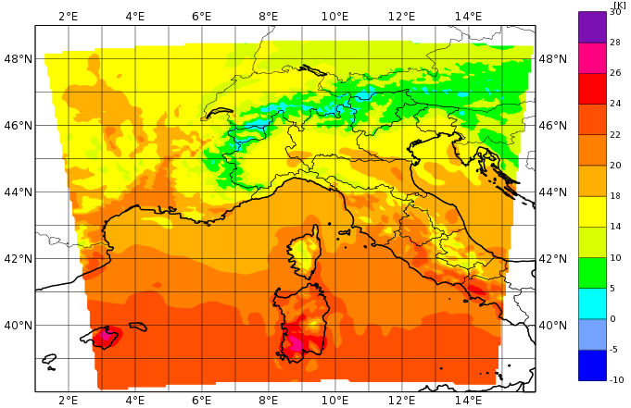
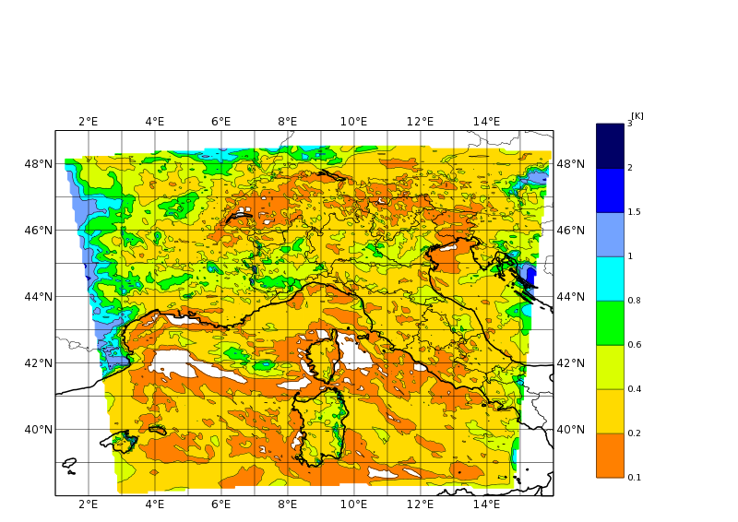
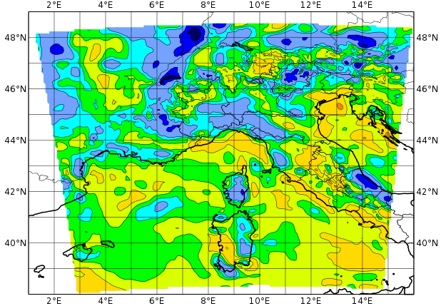
2012101112 – analysis T level 50
kenda
int2lm
mean
spread

Slide 15
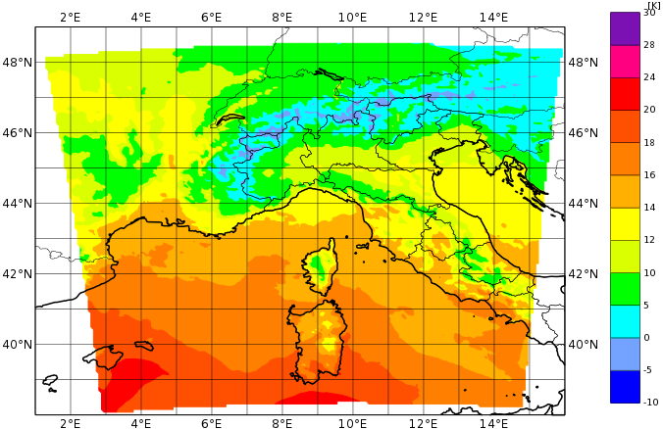
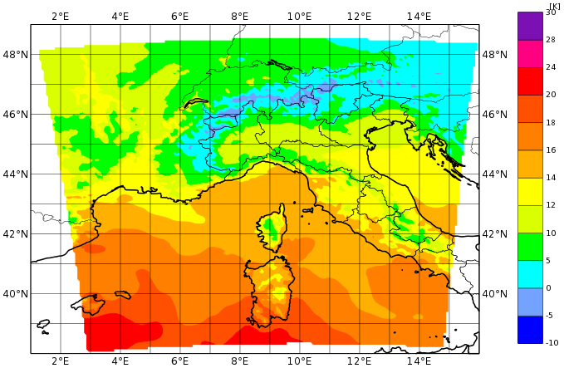
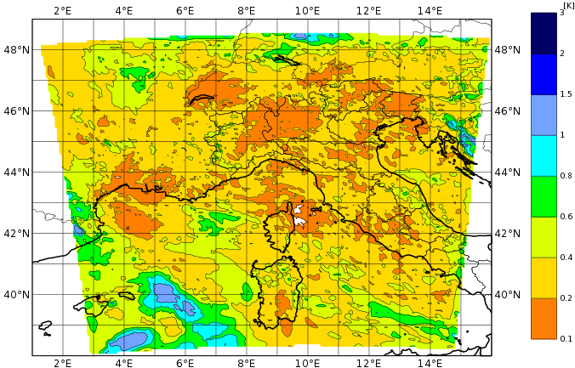
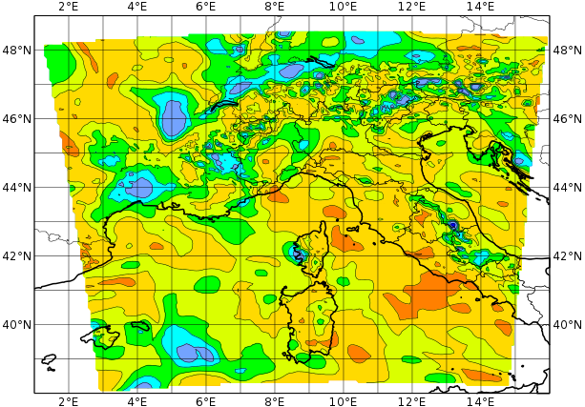
2012101112 – analysis T level 40
kenda
int2lm
mean
spread

Slide 16
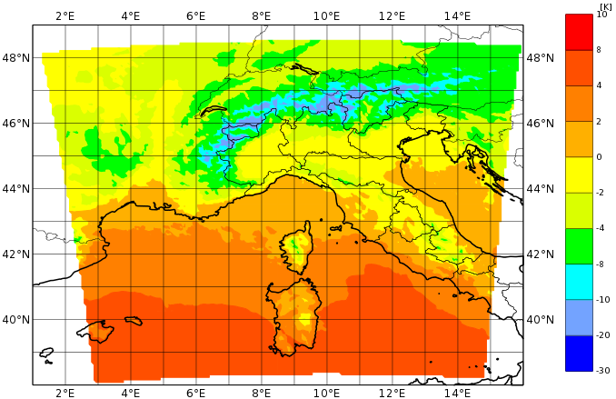
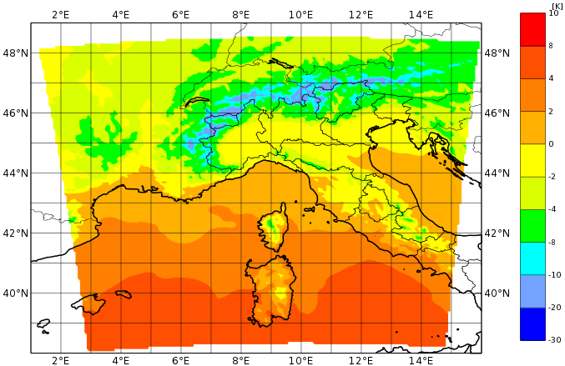
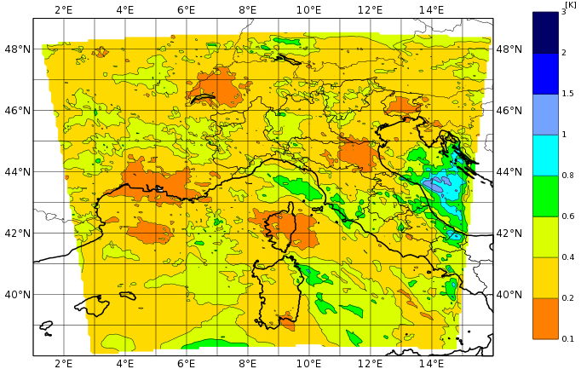
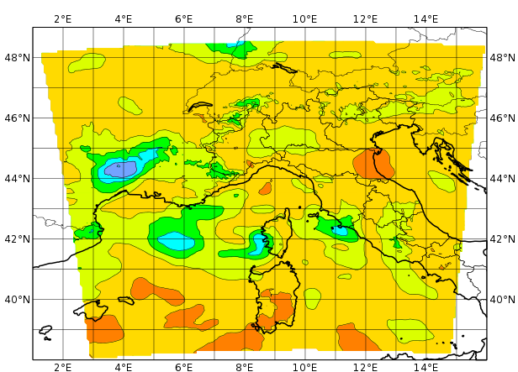
2012101112 – analysis T level 30
kenda
int2lm
mean
spread

Slide 17
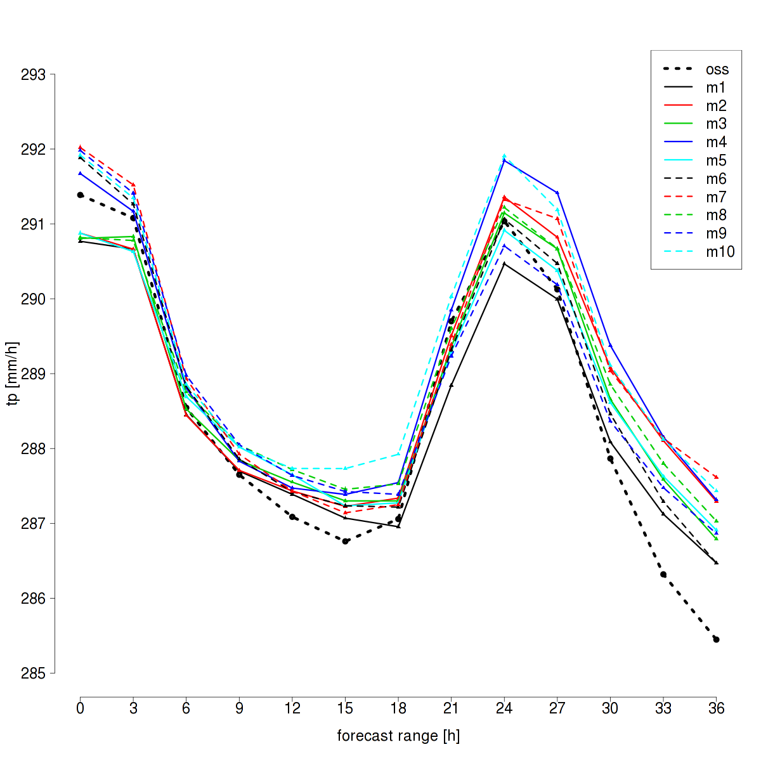
2012092512 - T2m areaTOT - downscaling

Slide 18
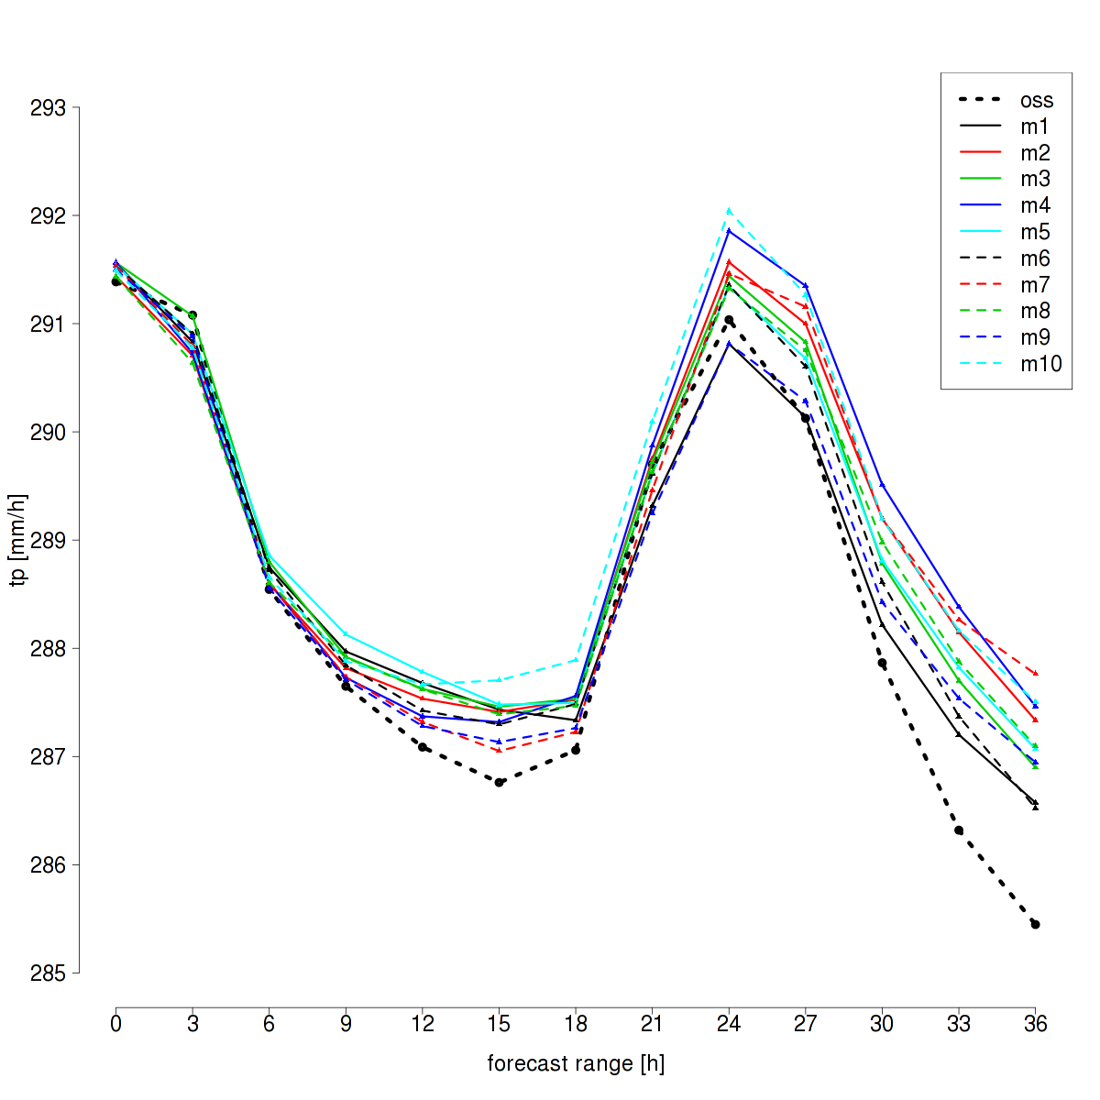
2012092512 - T2m areaTOT - kendaICs

Slide 19
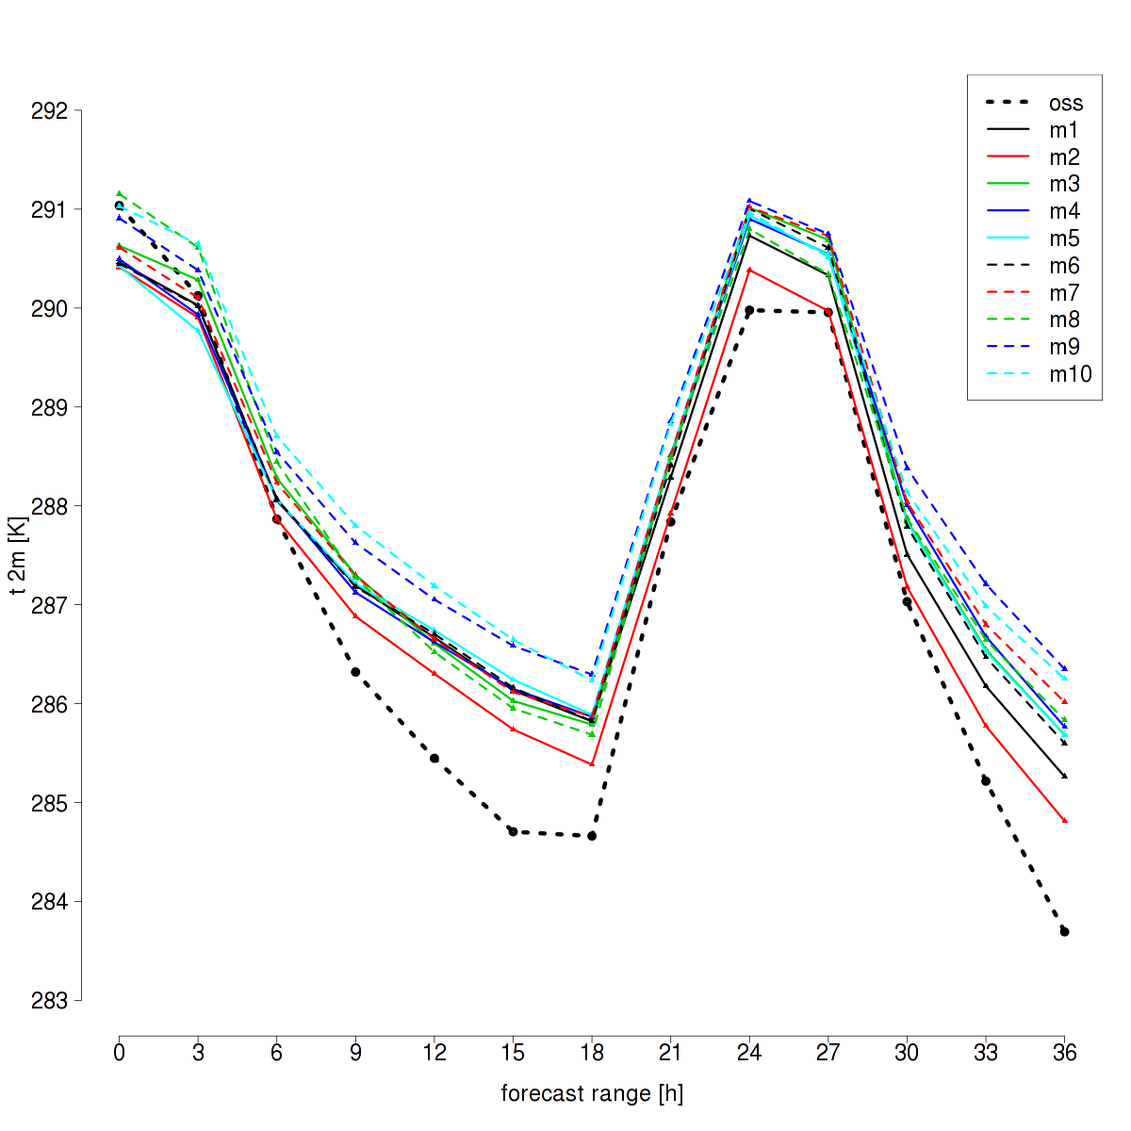
2012092612 - T2m areaTOT - downscaling

Slide 20
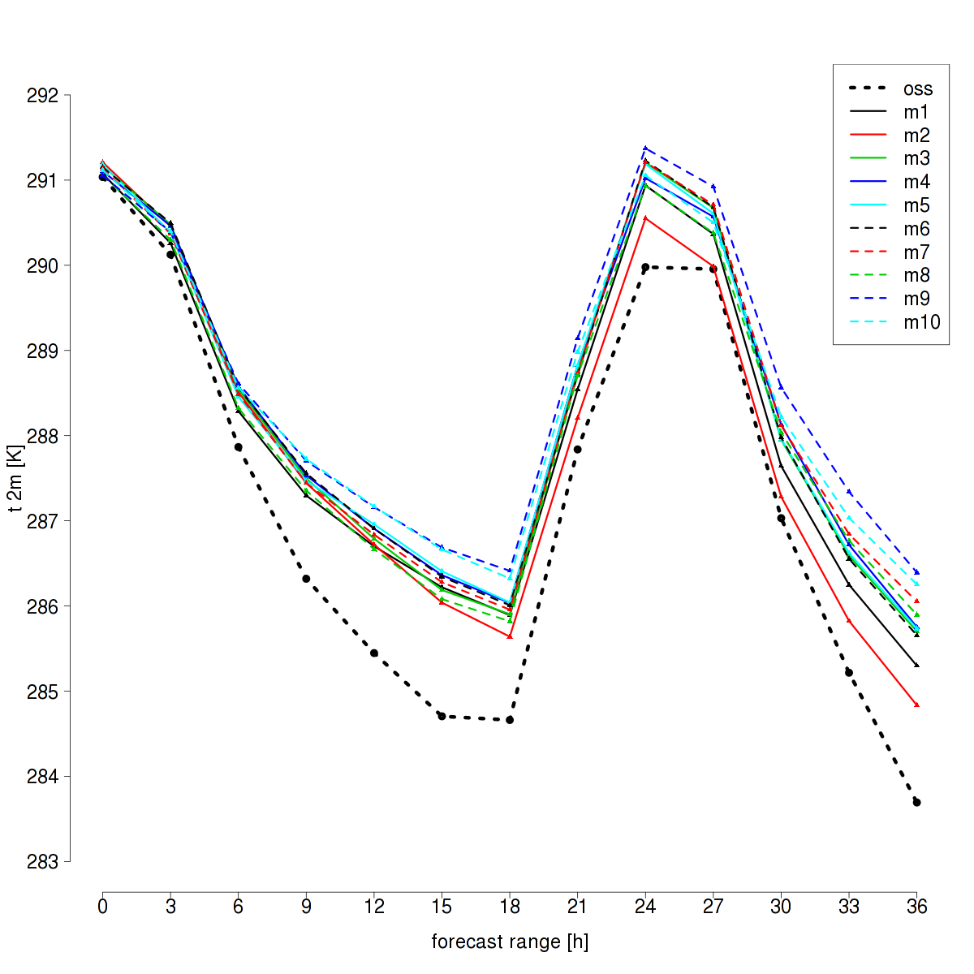
2012092612 - T2m areaTOT - kendaICs

Slide 21
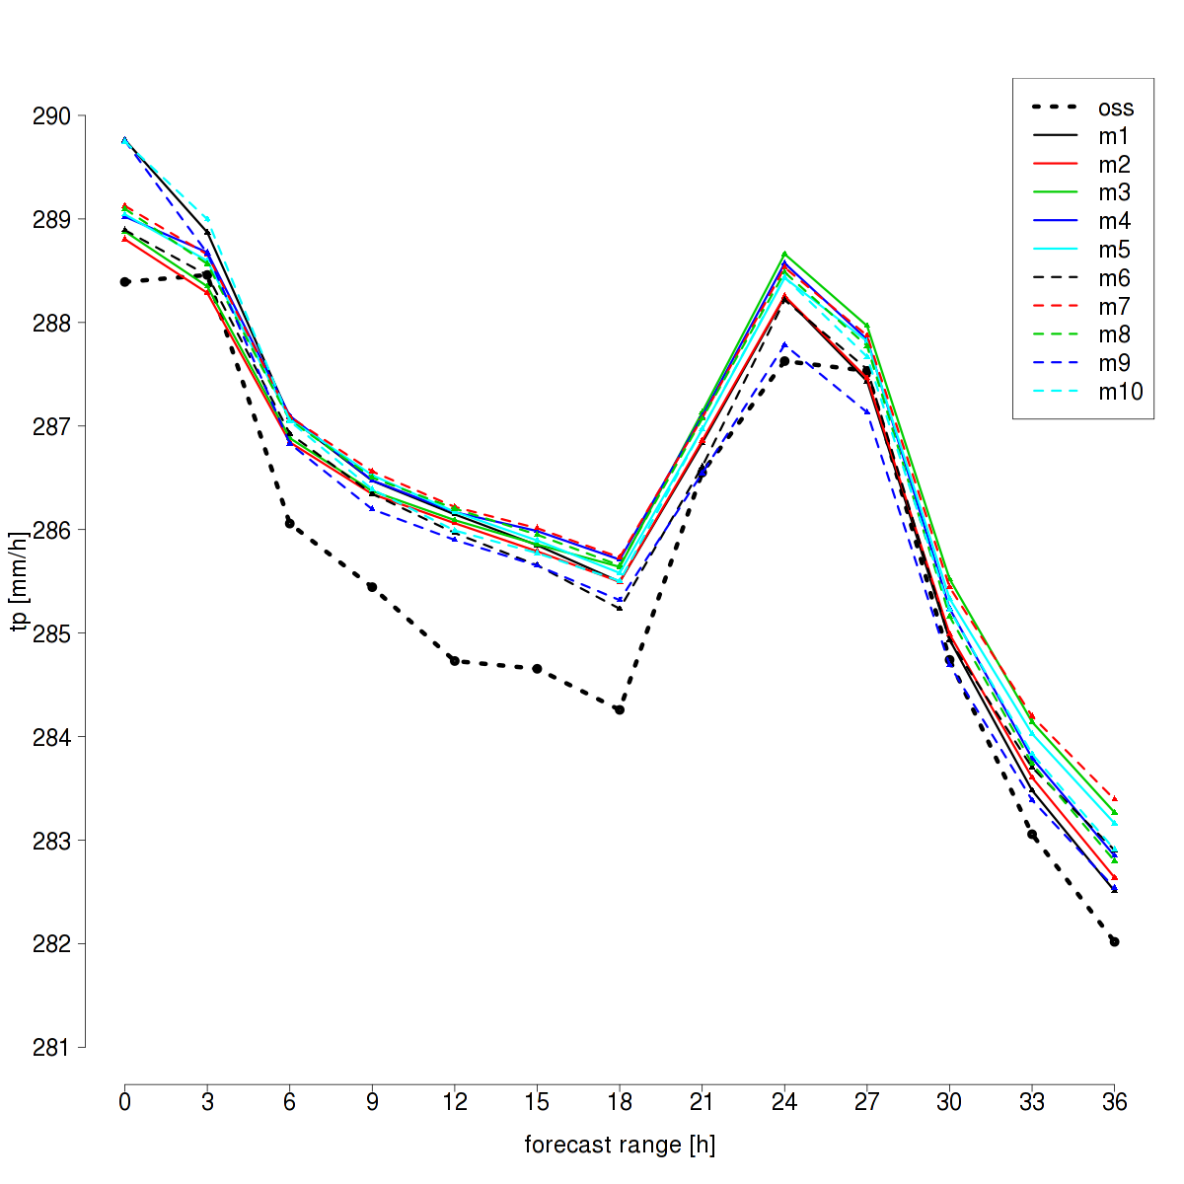
2012101112 - T2m areaTOT - downscaling

Slide 22
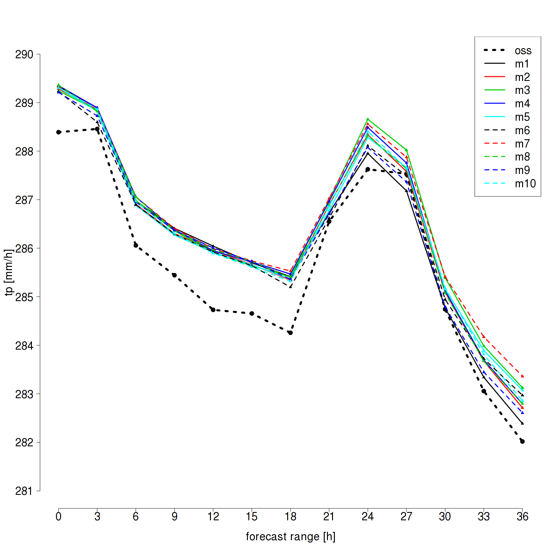
2012101112 - T2m areaTOT - kendaICs

Slide 23
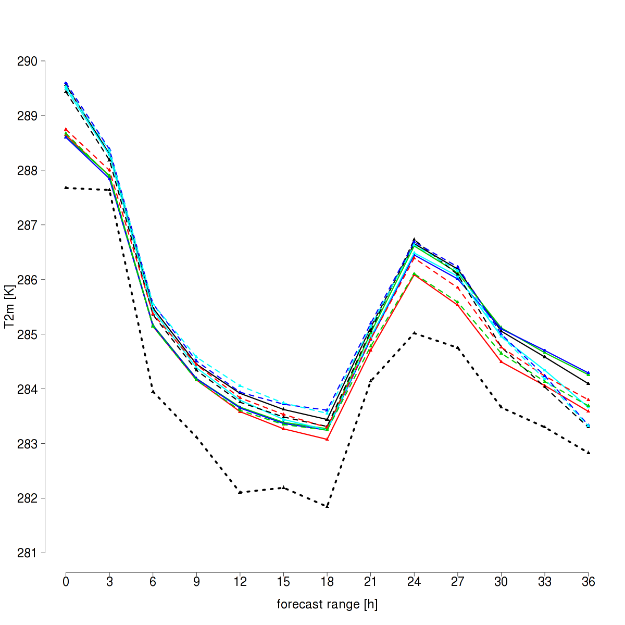
2012102512 - T2m areaTOT - downscaling

Slide 24
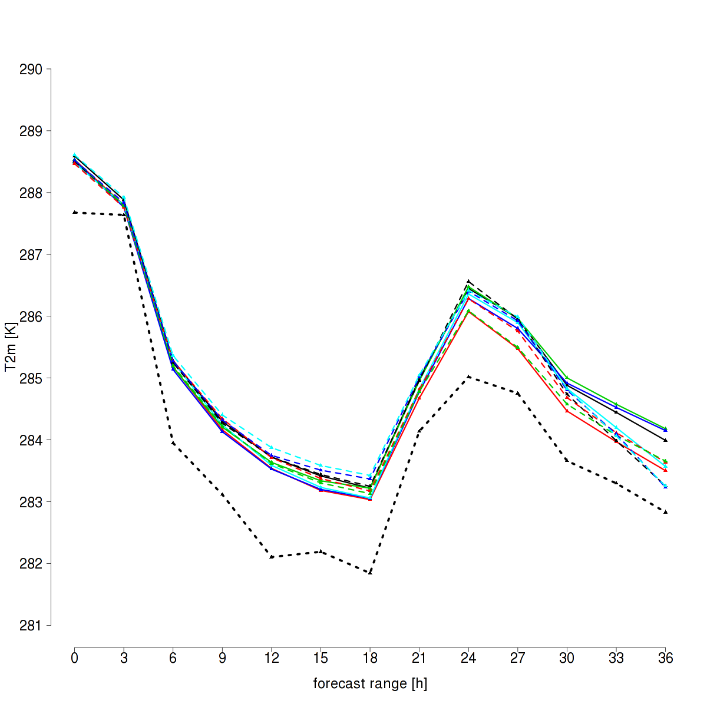
2012102512 - T2m areaTOT - kendaICs

Slide 25
One “bad” case

Slide 26
20121011 16-17 UTC
downscaling ICs
kenda ICs

Slide 27
One “good” case

Slide 28
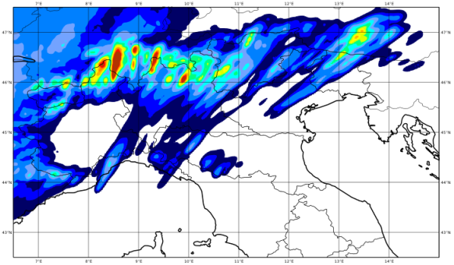
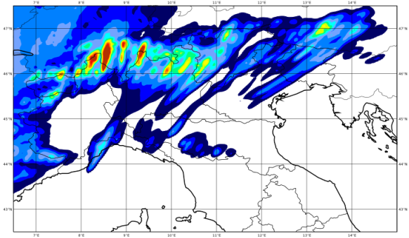
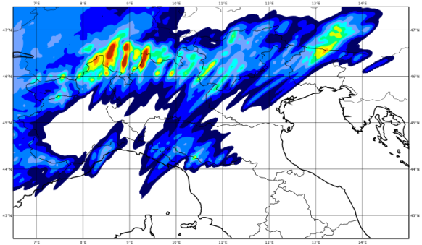
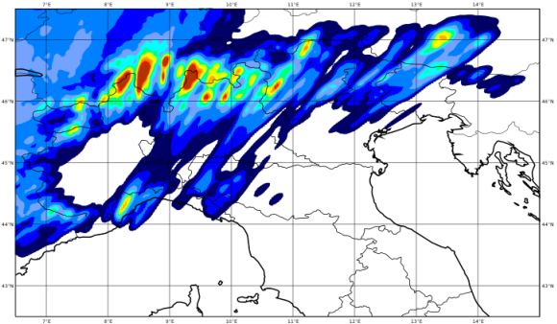
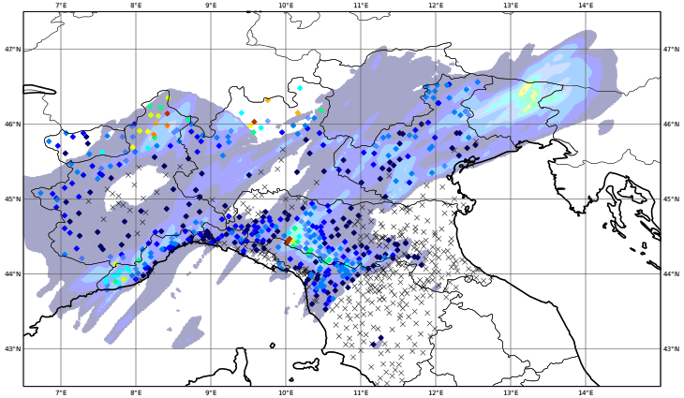
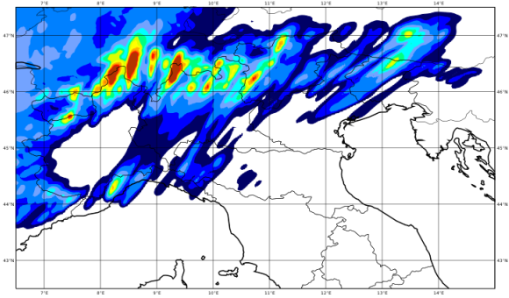
20120926 12-24 UTC
downscaling ICs
fc + 12 h
by V. Poli

Slide 29
20120926 12-24 UTC
kenda ICs
fc + 12 h
by V. Poli

Slide 30
CH2EPS – tp1h – areaLT

Slide 31
kendaIC – tp1h – areaLT

Slide 32
Concluding remarks
Analysis cycle:
KENDA is able to introduce small scale perturbations
KENDA analyses have less spread that downscaled analyses, especially at low levels
KENDA analyses not always closer to observation than downscaled analyses
Forecast:
Good performance for one case
Bad performance for one case -> explore the impact of:
Adding model perturbations in the analysis cycle
Run more ensemble members in the DA cycle
Tune KENDA parameters
Importance of assimilate precipitation ?

Slide 33
KENDA suite

Slide 34
Model perturbations in the forecast ensemble
Member | tur_len | rlam_heat | cloud_num | entr_sc | pat_len | crsmin
1 | 150 | 0.1 | 5.00e+08 | 0.0003 | 500 | 150
2 | 150 | 1 | 5.00e+07 | 0.0003 | 500 | 150
3 | 150 | 1 | 5.00e+08 | 0.0003 | 500 | 200
4 | 150 | 1 | 5.00e+08 | 0.002 | 500 | 150
5 | 500 | 1 | 5.00e+08 | 0.0003 | 500 | 150
6 | 150 | 1 | 5.00e+08 | 0.0003 | 500 | 150
7 | 150 | 1 | 5.00e+08 | 0.0003 | 1000 | 150
8 | 150 | 1 | 5.00e+07 | 0.002 | 500 | 150
9 | 500 | 0.1 | 5.00e+08 | 0.0003 | 500 | 150
10 | 150 | 1 | 5.00e+07 | 0.0003 | 500 | 150

Slide 35
Heght of the levels
Level | Height (m) | Pressure (hPa)
50 | 10 | 1000
40 | 800 | 900
30 | 3000 | 670
20 | 7000 | 400
10 | 13500 | 150
1 | 21500 | 35

Slide 36
Model perturbations experiment in the KENDA suite
Member | tur_len | rlam_heat | cloud_num | entr_sc | pat_len | crsmin
1 | 150 | 1 | 5.00e+08 | 0.0003 | 500 | 150
2 | 150 | 1 | 5.00e+07 | 0.0003 | 500 | 150
3 | 150 | 1 | 5.00e+08 | 0.0003 | 500 | 200
4 | 150 | 1 | 5.00e+08 | 0.002 | 500 | 150
5 | 500 | 1 | 5.00e+08 | 0.0003 | 500 | 150
6 | 150 | 0.1 | 5.00e+08 | 0.0003 | 500 | 150
7 | 150 | 1 | 5.00e+08 | 0.0003 | 1000 | 150
8 | 150 | 1 | 5.00e+07 | 0.002 | 500 | 150
9 | 500 | 0.1 | 5.00e+08 | 0.0003 | 500 | 150
10 | 150 | 1 | 5.00e+07 | 0.0003 | 500 | 150

