Slide 1
First COSMO-E experiments with SPPT
André Walser, Daliah Maurer, Marco Arpagaus
COSMO General Meeting
2 September 2013, Sibiu

Slide 2
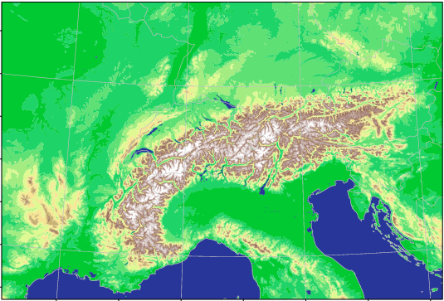

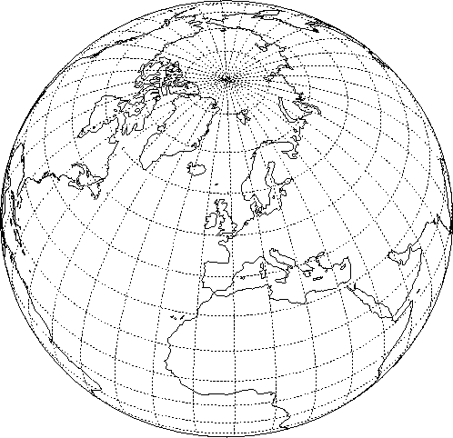
Project COSMO-NExT
Boundary conditions: IFS
10km
4x daily
Boundary conditions: VarEPS
20km
2x daily
ensemble data assimilation: LETKF
COSMO-1: 8x daily O(24 hour) forecasts
1.1km grid size (convection permitting)
COSMO-E: 2x daily 5 day forecasts
2.2km grid size (convection permitting)
O(21) ensemble members

Slide 3
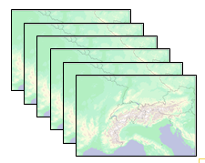
COSMO-E setup
Ensemble forecasts with convection-permitting resolution
(2.2 km mesh-size)
21 members
Twice a day up to +120h for Alpine area
(15% larger than COSMO-2 domain)
Range of possible scenarios and “best estimate”
COSMO version 4.26
Single precision, reduction of elapsed time to 60% with same forecast quality!
→ talk in POMPA session Tue afternoon

Slide 4
COSMO-NExT (and related) talks
Mon 09:10 (WG1/WG7): First COSMO-E experiments with SPPT
Mon 10:20 (WG4): Status of COSMO-1 development at MeteoSwiss
Mon 11:00 (WG5): Verification of the experimental version of COSMO-1: Winter-Spring 2013
Mon 11:30 (WG3a): Turb-i-Sim: Evaluation and improvement of COSMO turbulence over Alpine topography
Mon 12:00 (WG1): First Experience with KENDA at MeteoSwiss
Tue 14:55: EXTPAR developments towards version 2.0

Slide 5
Outline
COSMO-E physics perturbations:
  Validation of stochastic perturbation of physics tendencies (SPPT) scheme
  Impact of SPPT settings based on case studies
  Results from a 2 weeks test suite
COSMO-E LBCs
  First results from BC-EPS experiments
Outlook

Slide 6
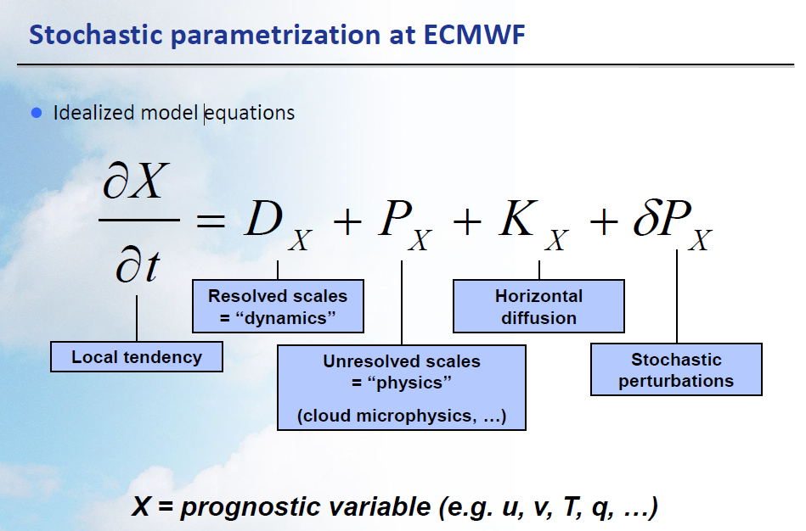
G. J. Shutts, ECMWF

Slide 7
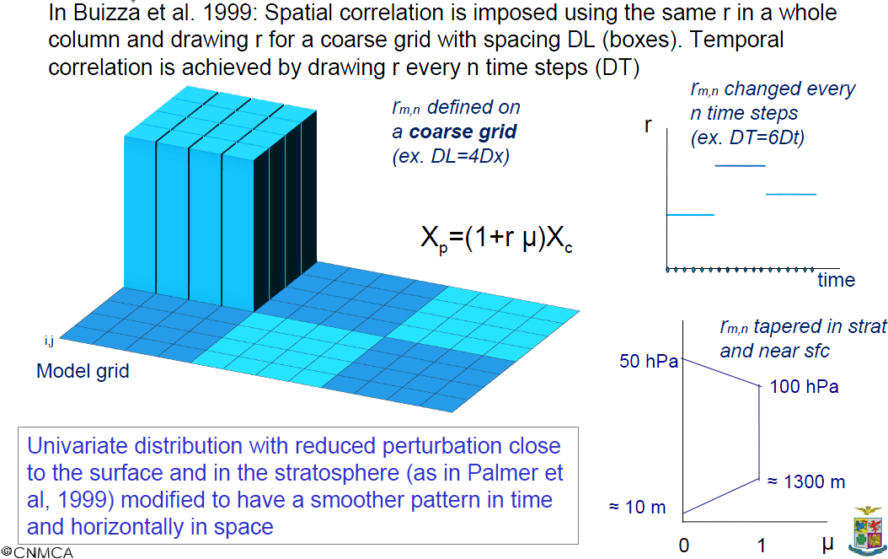
Implementation into COSMO
by L. Torrisi (CNMCA)

Slide 8
Validation of SPPT
SPPT must not degrade quality of members → show-stopper
deterministic runs for different SPPT setups:
  for all: lgauss_rn = lhorint_rn = ltimeint_rn = .true.
  ex0: no SPPT
  ex1: SPPT, recommended settings by Lucio
  (sigma = 0.25 & random number within [-0.75, 0.75])
  ex2: lqv_pertlim = .true.
  ex3: sigma = 0.5 & random number within [-1.0, 1.0]
  ex4: length-scale = 0.5 deg., time-scale = 30 min
  (default: 5 deg., 6 hrs)
  ex5: no tapering in lower troposphere / PBL
  (default: tapering below approx. 850 hPa)

Slide 9
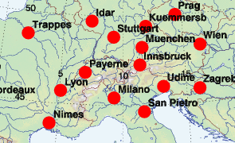
Upper-air verification
all stations:
Payerne, Milano, München, Udine, Stuttgart, Kümmersbruck, Wien, Praha, Zagreb, Nimes, San Pietro
temperature, rel. humidity, wind speed and direction, geopotential
+72h lead time

Slide 10
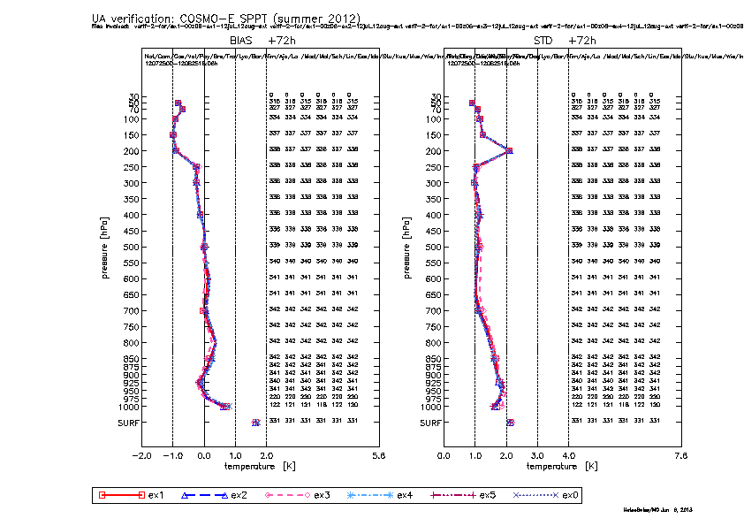
Upper-air: temperature
+72h, all stations, 25.07-25.08.2012

Slide 11
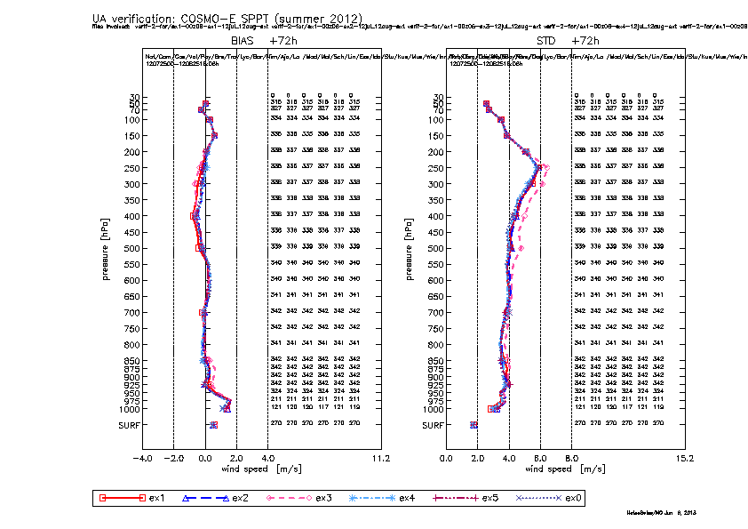
Upper-air: wind speed
+72h, all stations, 25.07-25.08.2012

Slide 12
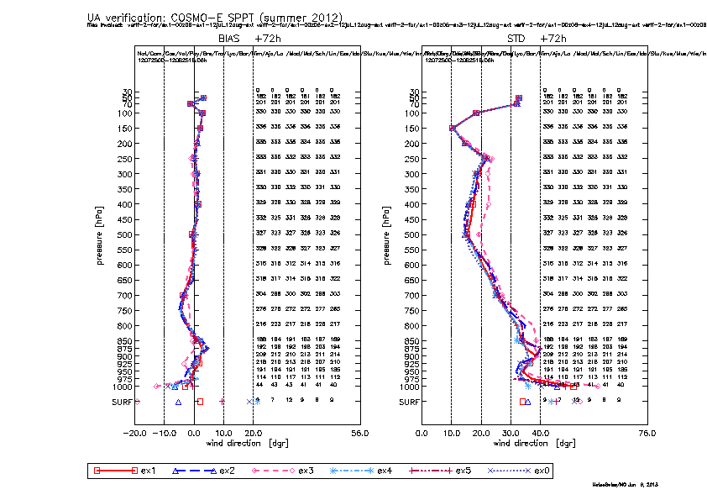
Upper-air: wind direction
+72h, all stations, 25.07-25.08.2012

Slide 13
Upper-air verification: conclusions
largest differences found for wind speed and direction in summer:
  ex3 shows larger STDE
  minor negative impact for ex1
  minor positive impact for ex4
marginal differences between all experiments for T, Z, and RH → no drying observed!

Slide 14
Surface verification
scores vs lead-time
~ 500 stations
following slides show the largest differences between experiments

Slide 15
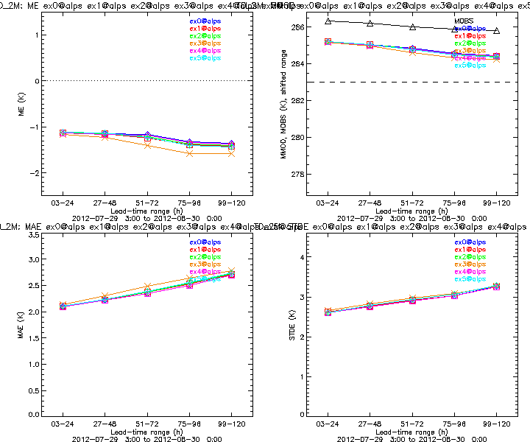
Surface: dew-point temperature all stations, 25.07-25.08.2012
bias
standard deviation
drying in ex3

Slide 16
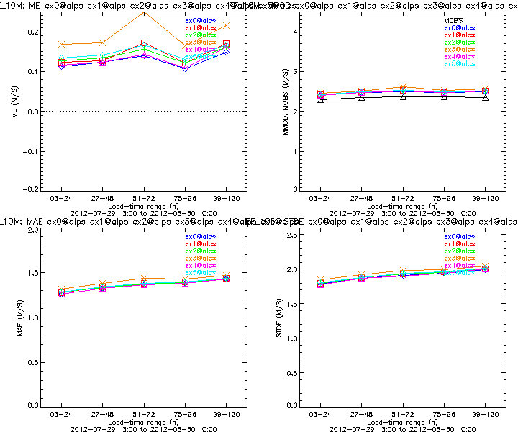
Surface: wind speed all stations, 25.07-25.08.2012
bias
standard deviation
ex3 shows largest bias and standard deviation

Slide 17
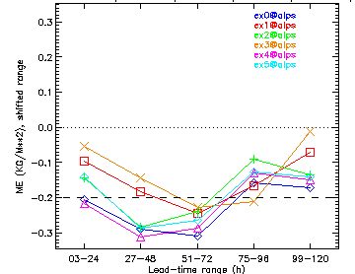
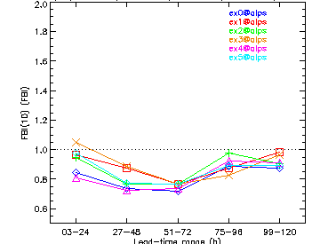
Surface: precipitation, 12h sum all stations, 25.07-25.08.2012
bias
frequency bias (10mm)
For summer precipitation ex3 belongs to the best experiments…

Slide 18
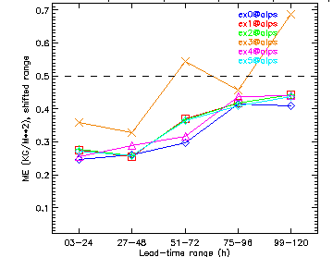
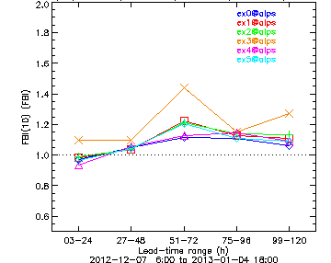
Surface: precipitation, 12h sum all stations, 03.12-31.12.2012
bias
frequency bias (10mm)
…but for winter precipitation ex3 it is the worst one

Slide 19
Surface verification: conclusions
small differences between all experiments, except for ex3 which shows
  larger STDE for some parameters
  drying in summer (Td_2m)
  higher precipitation amounts (worse in winter, better in summer)
No significant quality degradation seen with SPPT except for ex3 (largest random numbers together with large correlation-lengths)

Slide 20
COSMO-E SPPT case studies
Experiments for 2 summer and 2 autum cases investigated
SPPT perturbations only (no IC and BC pert.)
COSMO-2 domain (instead of new COSMO-E domain)
ICs: COSMO-2 analysis
LBCs: IFS-ENS control

Slide 21
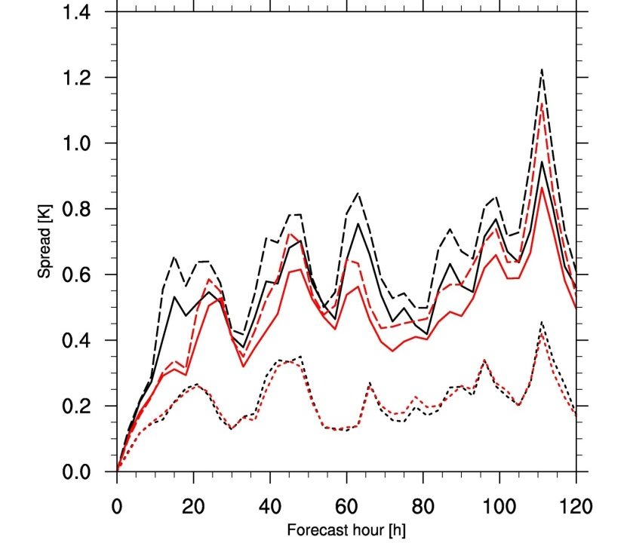
No tapering in lower troposphere
Main motivation to taper SPPT in PBL are stability issues
SPPT validation runs did not show any
Turn it off has significant impact on spread in PBL
Temperature spread over Swiss domain
-- off
-- on
250m above ground
700m above ground
tropopause

Slide 22
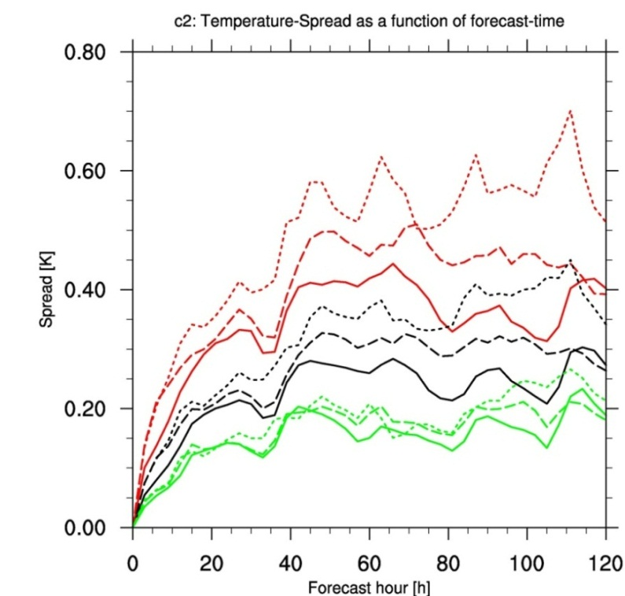
Impact of SPPT settings on spread
Case 2012-08-01: T spread COSMO-E domain
@ 500 (solid lines), 700 (dashed),
850 (dotted) hPa
large stdv_rn=0.5, range_rn=1 (ex3)
stdv_rn=0.25, range_rn=0.75 (ex1)
stdv_rn=0.25, range_rn=0.75, dlat_rn=dlon_rn=0.5°, ninc_rn=90 (ex4)
spread largest at 850 hPa, lowest at 500 hPa
spread saturation is reached at all height levels at about same lead-time
larger random numbers produce larger spread and faster spread growth
smaller correlation-lengths in space and time lead to smaller spread

Slide 23
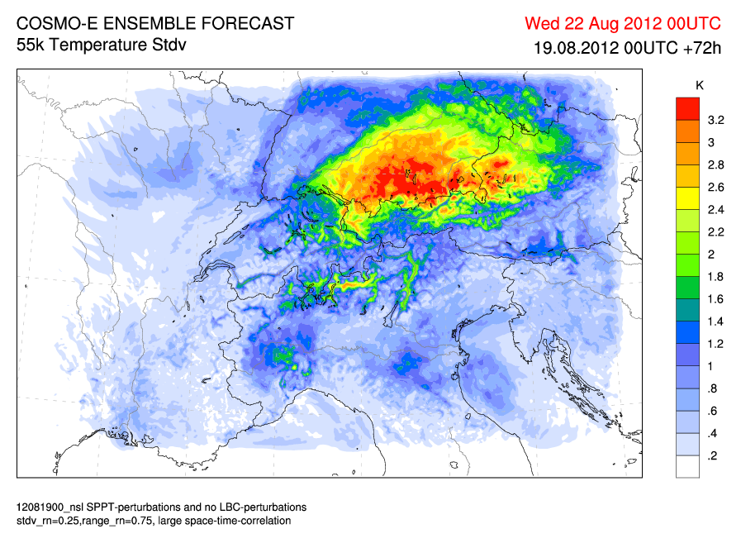
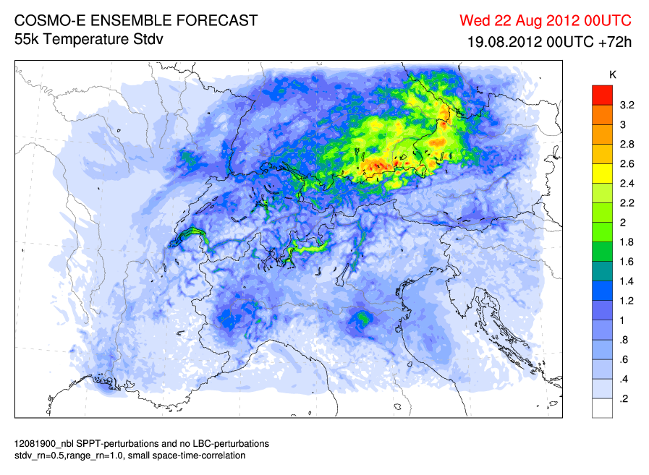
Impact of SPPT settings on spread
Case 2012-08-19: T spread ~250 m above ground +72h
small sigma/range
large space/time correlation
large sigma/range
small space/time correlation

Slide 24
First COSMO-E test suite
2 weeks period (2012-07-25 – 2012-08-07)
00 UTC forecast only
Experiments with 3 setups:
  LBC + SPPT:
    lqv_pertlim=.false. (default=.true.)
    dlat_rn=dlon_rn=0.5 (5.0)
    ninc_rn=180 (1080)
    stdv_rn=0.5 (0.5)
    range_rn=1.0 (1.0)
    no tapering near surface (code change)
    setup validated as well (not show before)
  LBC + COSMO-DE-EPS parameter perturbation (PP)
  LBC only
scale of convective systems

Slide 25
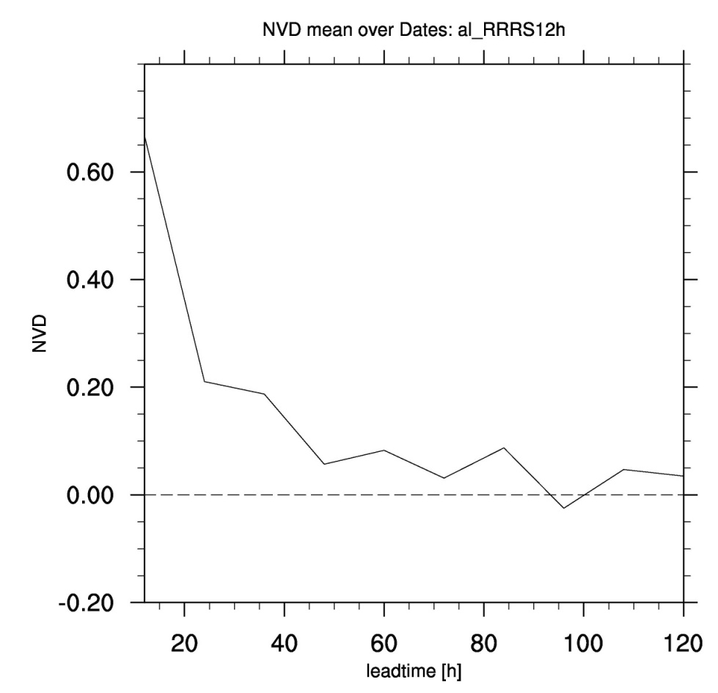
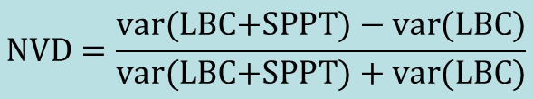
Comparison of ensemble dispersion
LBC+SPPT vs. LBC, precipitation > 1mm/12h
Normalized Variance Difference (NVD, Clark et al. 2009)
$$NVD=\frac{\text{var}\text{(}\text{LBC}\text{+}\text{SPPT}\text{) − }\text{var}\text{(}\text{LBC}\text{)}}{\text{var}\text{(}\text{LBC}\text{+}\text{SPPT}\text{) + }\text{var}\text{(}\text{LB}\text{C}\text{)}}$$
Range = [-1,+1]
LBC+SPPT show larger ensemble dispersion
but difference decreases with increasing lead-time

Slide 26
Verification COSMO-E test suite
focus on lead-times beyond 24 hours due to lack of IC perturbations
unfortunately VERSUS not yet ready at MCH for EPS
first step: against COSMO-2 analysis (ad-hoc)

Slide 27
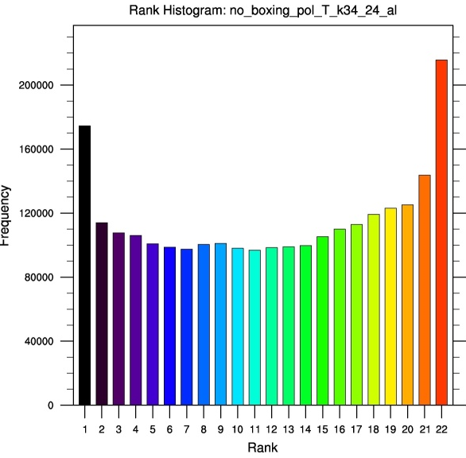
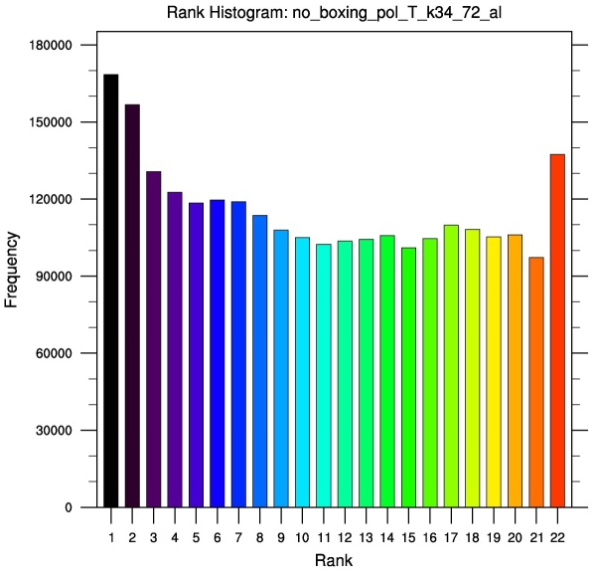
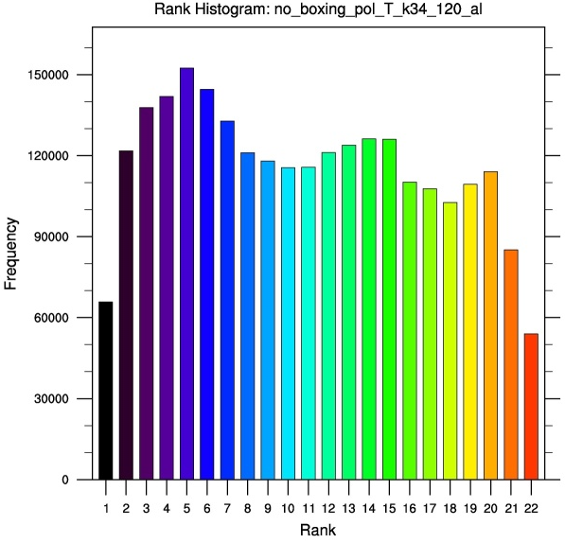
Rank histogram LBC+SPPT
temperature ~5500m above ground
+24h
+72h
+120h
too small spread up to +72h
but too large spread for end of forecast range

Slide 28
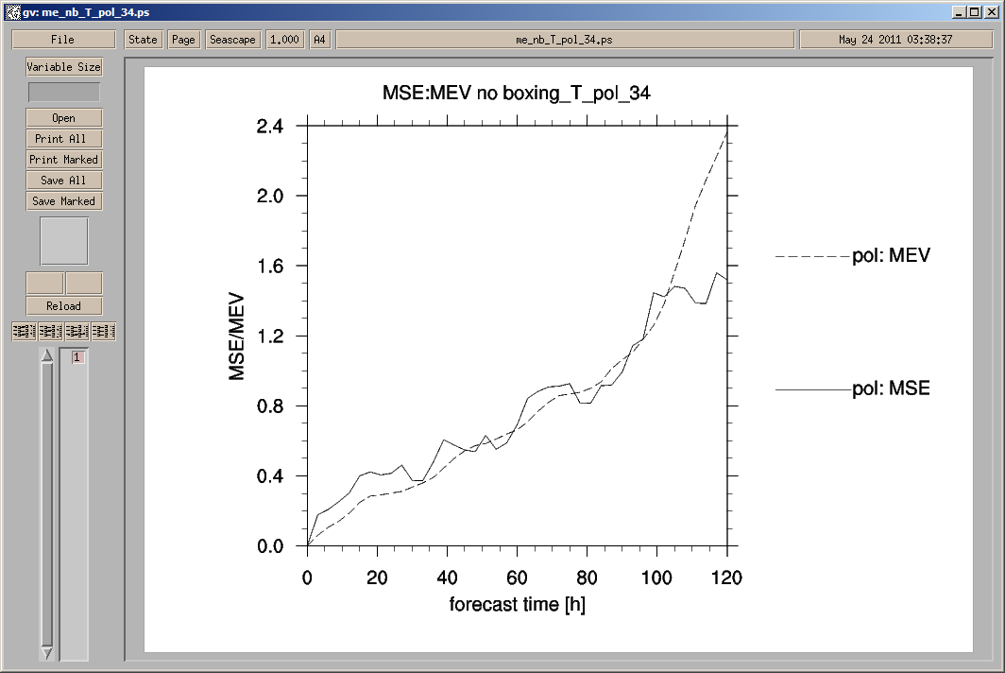
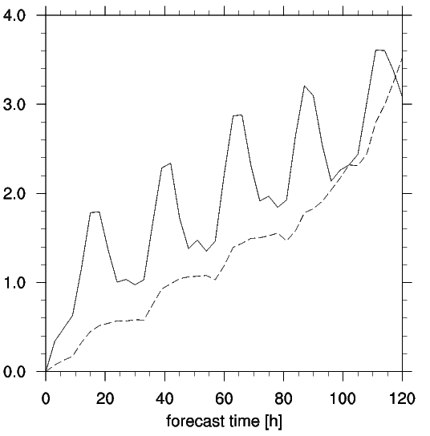
Spread & error temperature
mean squared error
mean ensemble variance
~5500m
~700m
LBC+SPPT
LBC+SPPT
too large spread for end of forecast range
too small spread in boundary layer

Slide 29
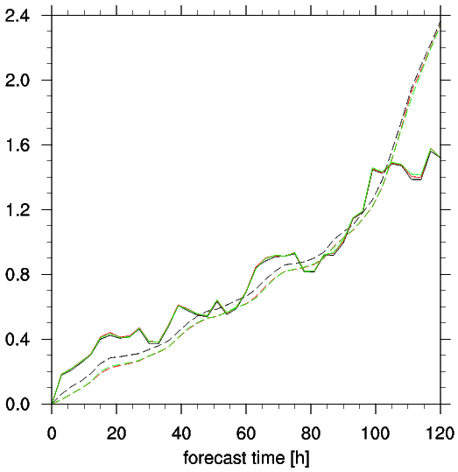
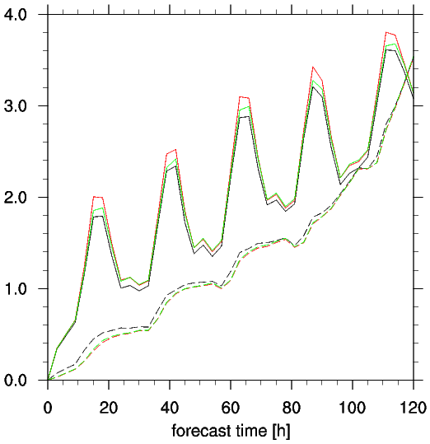
Spread & error temperature
mean squared error
mean ensemble variance
~5500m
~700m
LBC+SPPT
LBC+PP
LBC
LBC+SPPT
LBC+PP
LBC
LBC+PP and LBC slightly smaller spread
LBC show largest error
LBC+SPPT best, but differences small

Slide 30
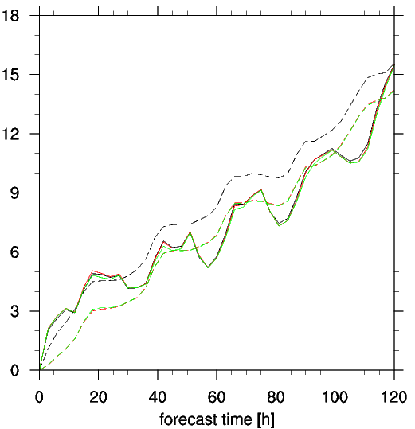
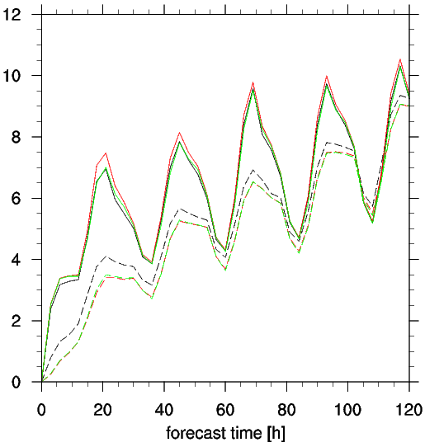
Spread & error wind speed
mean squared error
mean ensemble variance
~5500m
~700m
LBC+SPPT
LBC+PP
LBC
LBC+SPPT
LBC+PP
LBC
Too small spread in PBL for wind speed as well
LBC+SPPT rather too large spread in upper troposphere

Slide 31
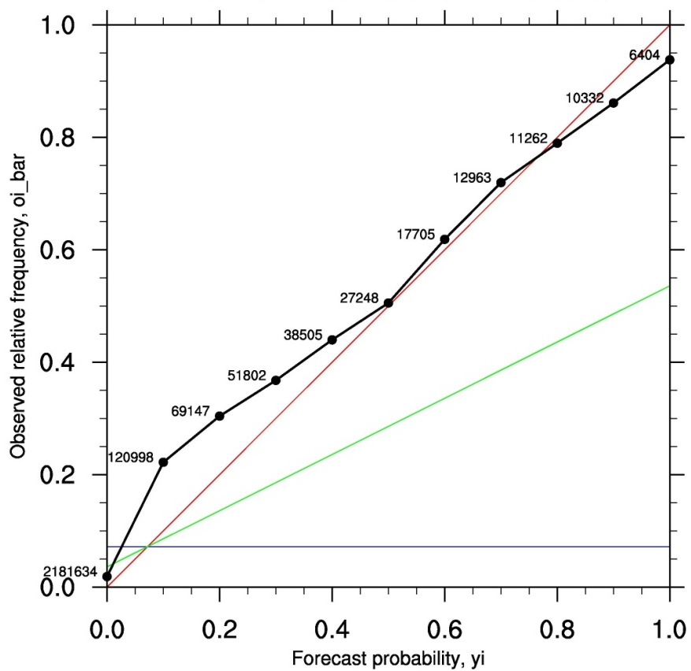
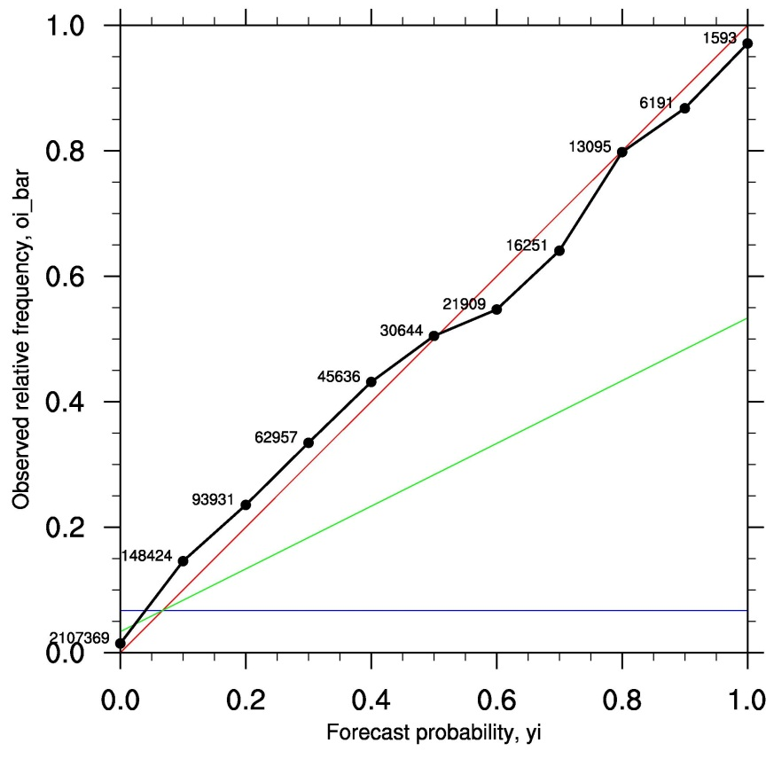
Reliability diagram LBC-SPPT
precipitation > 5mm/12h
+48h
+96h
+48h
high reliability in particular for longer lead-times
good resolution even for longer lead-times

Slide 32
Verification COSMO-E test suite
focus on lead-times beyond 24 hours due to lack of IC perturbations
unfortunately VERSUS not yet ready at MCH for EPS
first step: against COSMO-2 analysis (ad-hoc)
second step: against SYNOP observations (movero)

Slide 33
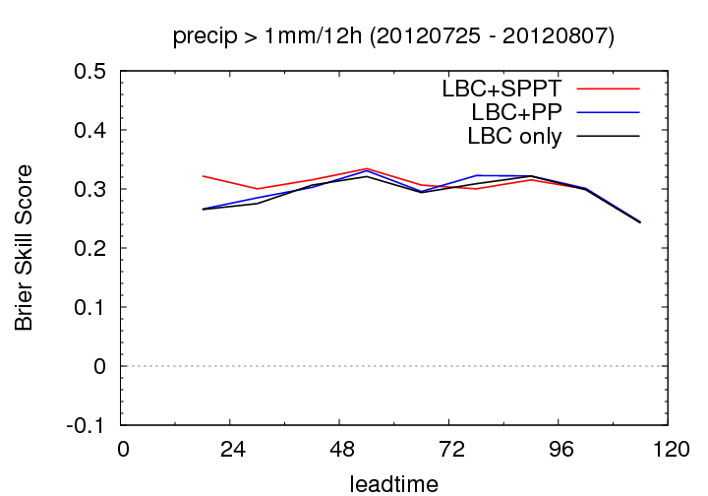
Brier Skill Score (ref=climatology)
better
worse than clim. forecast
Reference: forecast based on station climatology 2001-2010 (300 stations)
all experiments clearly better than clim. forecast for all lead-times
LBC+SPPT best until +72h, but differences very small

Slide 34
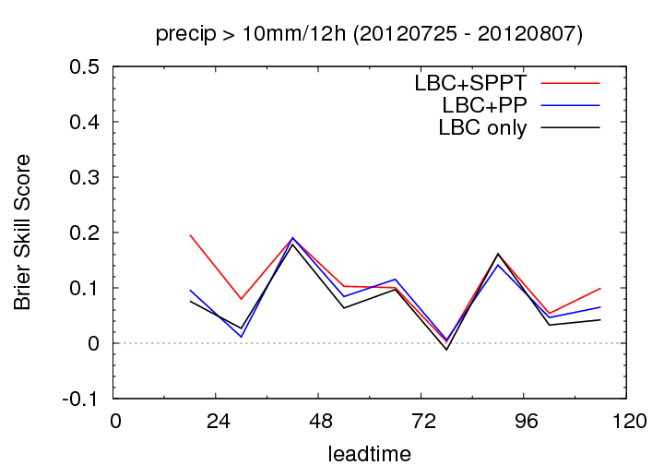
Brier Skill Score (ref=climatology)
better
worse than clim. forecast
Reference: Forecast based on station climatology 2001-2010 (300 stations)
daytime precip. only slightly better than clim. forecast
LBC+SPPT best experiment

Slide 35
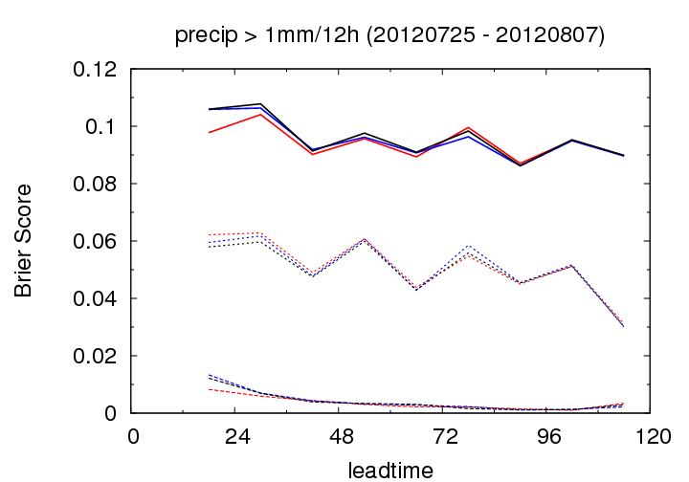
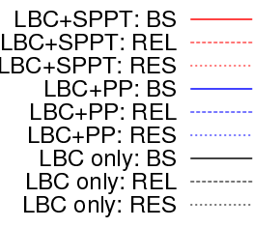
Brier Score decomposition
BS (the lower the better)
resolution (the higher the better)
reliability (the lower the better)
based on 500 stations
All experiments very similar:
very good reliability
resolution only slightly decreasing with increasing lead-times

Slide 36
Conclusions COSMO-E experiments
Surprisingly large reduction in spread with smaller correlation lengths for random numbers
SPPT produces only small additional spread for runs with LBC perturbations
3 setups LBC+SPPT, LBC+PP and LBC show similar results but impact of SPPT larger than of PP
spread in PBL clearly too small in PBL…
…but rather too large in upper-air with LBC+SPPT
only slightly better scores with SPPT so far
experiments shows surprisingly high reliability for precipitation probabilities (enough statistics?)

Slide 37
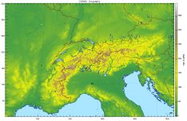
Representing uncertainty
Implementation of perturbations
initial conditions
boundary conditions
model physics
KENDA

Slide 38
BC-EPS experiments
ECMWF provide 2 BC-EPS data sets for 3 periods:
  current resolution T_{L}639 (~32 km) → BCR
  high resolution T_{L}1279 (~16 km) → BCH
winter storm period 2011-12-26 – 2012-01-08 run with COSMO-E (without SPPT)
first results show slightly better scores with BCH in surface verification (500 stations)

Slide 39
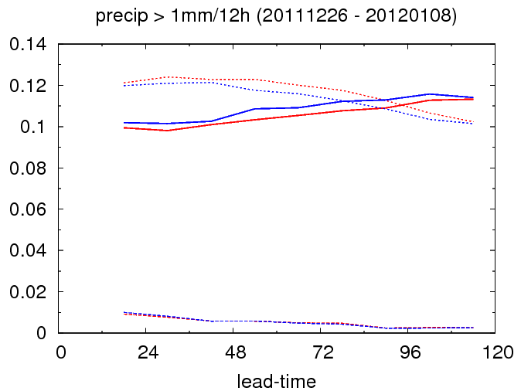
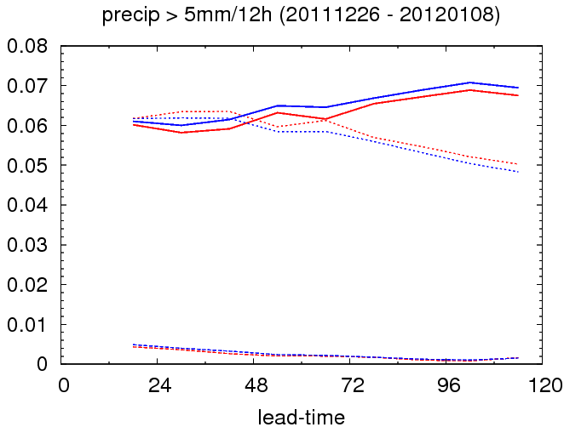
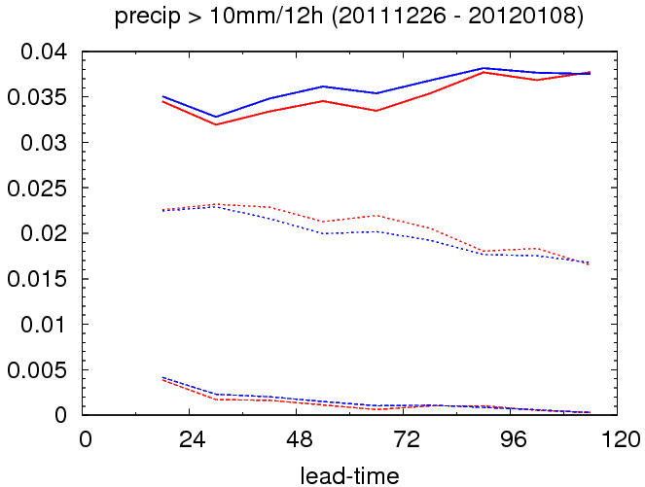
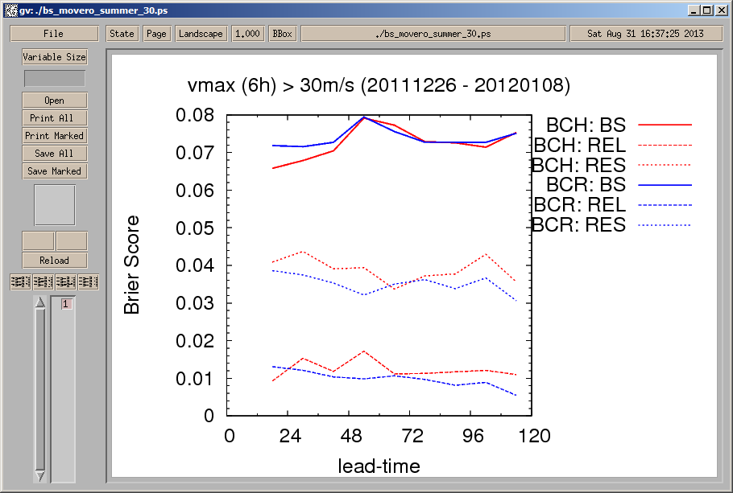
Brier score 12h sum of precipitation
BCH shows better scores
mainly thanks to better resolution

Slide 40
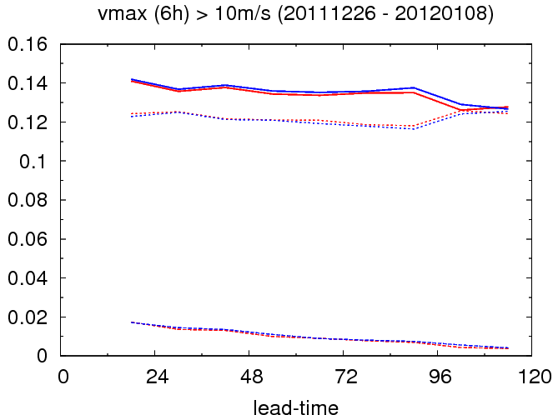

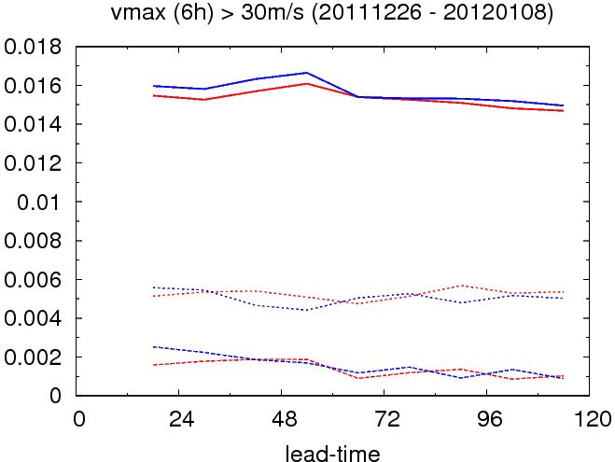
Brier Score 10m wind gusts
BCH slightly better
strangely, brier score gets better with increasing lead-time…

Slide 41
Outlook
continue work with SPPT (internship of Daliah Maurer)
  extend test suite (more statistics)
  analyse characteristics of SPPT term in model equations
  try to generate more spread near-surface without increasing upper-air spread
including IC perturbation from KENDA
implementation of SKEB in COSMO with Judith Berner (COSMO activity proposal)
detailed analysis of BC-EPS experiments and perform runs for other 2 periods

