Slide 1
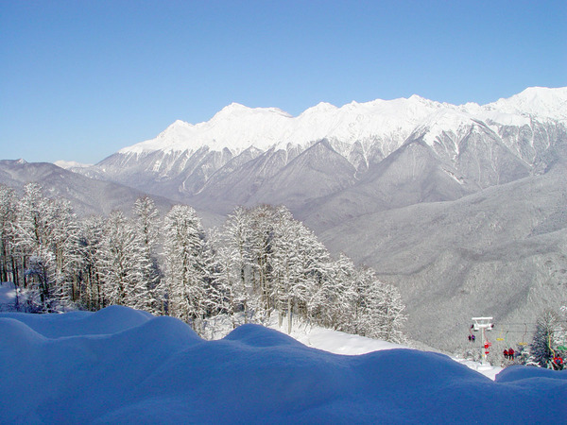
COSMO-Ru1:
current status
Marina Shatunova, Gdaliy Rivin, Denis Blinov
Hydrometeorological Research Center of Russia
Thanks our colleagues from MeteoSwiss

Slide 2
COSMO-Ru1: current status
CONTENT
COSMO-Ru1 overview
First results and verification
T2m
precipitation (case study of heavy precipitation event)
Influence of the IC & BC (first results)
domains
start of the forecasts
Near future work

Slide 3
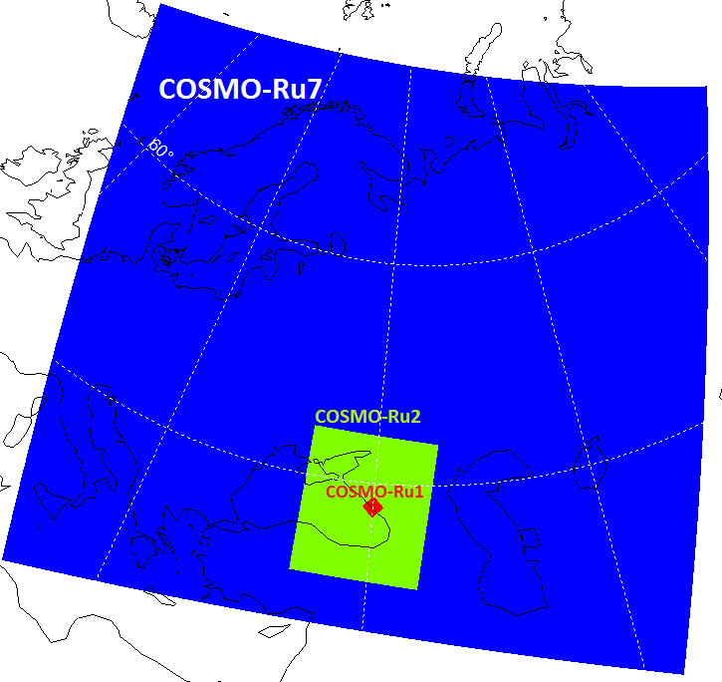
COSMO-Ru model’s areas
COSMO-Ru7
COSMO-Ru2
COSMO-Ru1
Domain: 4900 km x 4340 km
Grid: 700 x 620 x 40
Space step: 7 km
Time step: 40 s
Forecast: 78 h
Domain: 900 km x 1000 km
Grid: 420 x 470 x 50
Space step: 2.2 km
Time step: 20 s
Forecast: 48 h
Domain: 110 km x 110 km
Grid: 100 x 100 x 50
Space step: 1.1 km
Time step: 10 s
Forecast: 24 h

Slide 4
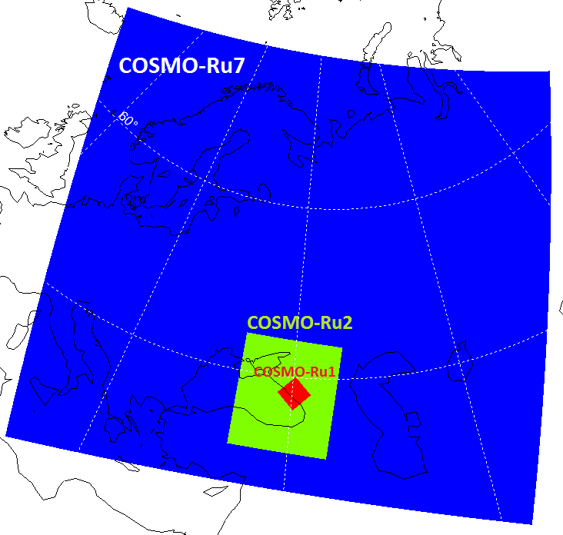
COSMO-Ru model’s areas
COSMO-Ru7
COSMO-Ru2
COSMO-Ru1
Domain: 4900 km x 4340 km
Grid: 700 x 620 x 40
Space step: 7 km
Time step: 40 s
Forecast: 78 h
Domain: 900 km x 1000 km
Grid: 420 x 470 x 50
Space step: 2.2 km
Time step: 20 s
Forecast: 48 h
Domain: 110 km x 110 km
Grid: 100 x 100 x 50
Space step: 1.1 km
Time step: 10 s
Forecast: 24 h
Domain: 220 km x 220 km
Grid: 200 x 200 x 50
Space step: 1.1 km
Time step: 10 s
Forecast: 24 h

Slide 5
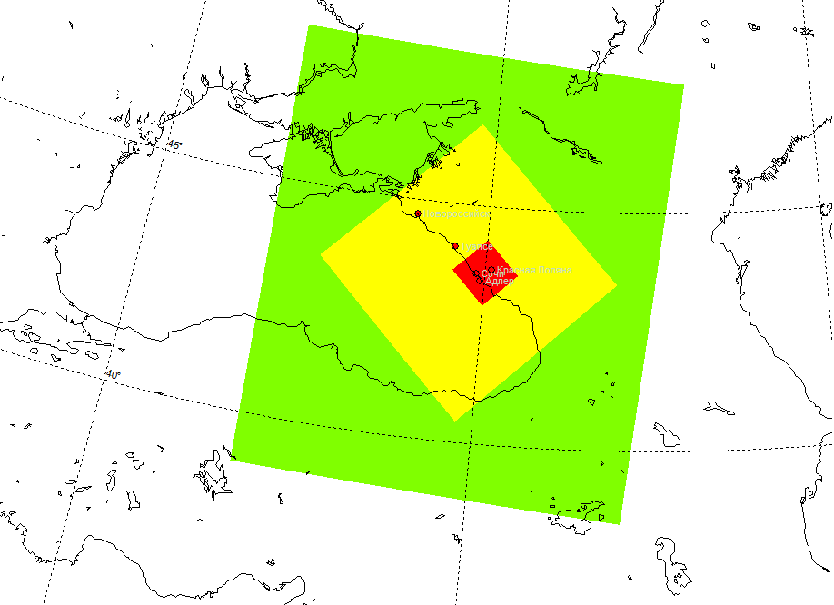
COSMO-Ru model’s areas
COSMO-Ru7
COSMO-Ru2
COSMO-Ru1
Domain: 4900 km x 4340 km
Grid: 700 x 620 x 40
Space step: 7 km
Time step: 40 s
Forecast: 78 h
Domain: 900 km x 1000 km
Grid: 420 x 470 x 50
Space step: 2.2 km
Time step: 20 s
Forecast: 48 h
Domain: 110 km x 110 km
Grid: 100 x 100 x 50
Space step: 1.1 km
Time step: 10 s
Forecast: 24 h
COSMO-Ru2
Domain: 220 km x 220 km
Grid: 200 x 200 x 50
Space step: 1.1 km
Time step: 10 s
Forecast: 24 h
COSMO-Ru1 (200x200)
Domain: 495 km x 495 km
Grid: 450 x 450 x 50
Space step: 1.1 km
Time step: 10 s
Forecast: 24 h
COSMO-Ru1 (450x450)
Cluster-based architecture Tornado, peak performance 35 TFLOPS
Cores: 288 (from 1536)
Runtime: 15.5 min (for 200x200) , 54 min (for 450x450)

Slide 6
The first results & verification
In order to assess the impact of the boundaries verifications were made for 3 simulation domain of the COSMO-Ru1:
450 x 450
200 x 200
100 x 100
For the verification the following sources of the observation data were used:
Roshydromet meteorological stations (maximum - 13, usually - 11) (observations are made every 3 hours, 12-hours precipitation sum);
AMS (maximum - 41 , usually - 12) (observations are made on average every ten minutes, but not all parameters)
Verifications were made for several winter days when severe weather conditions took place.

Slide 7
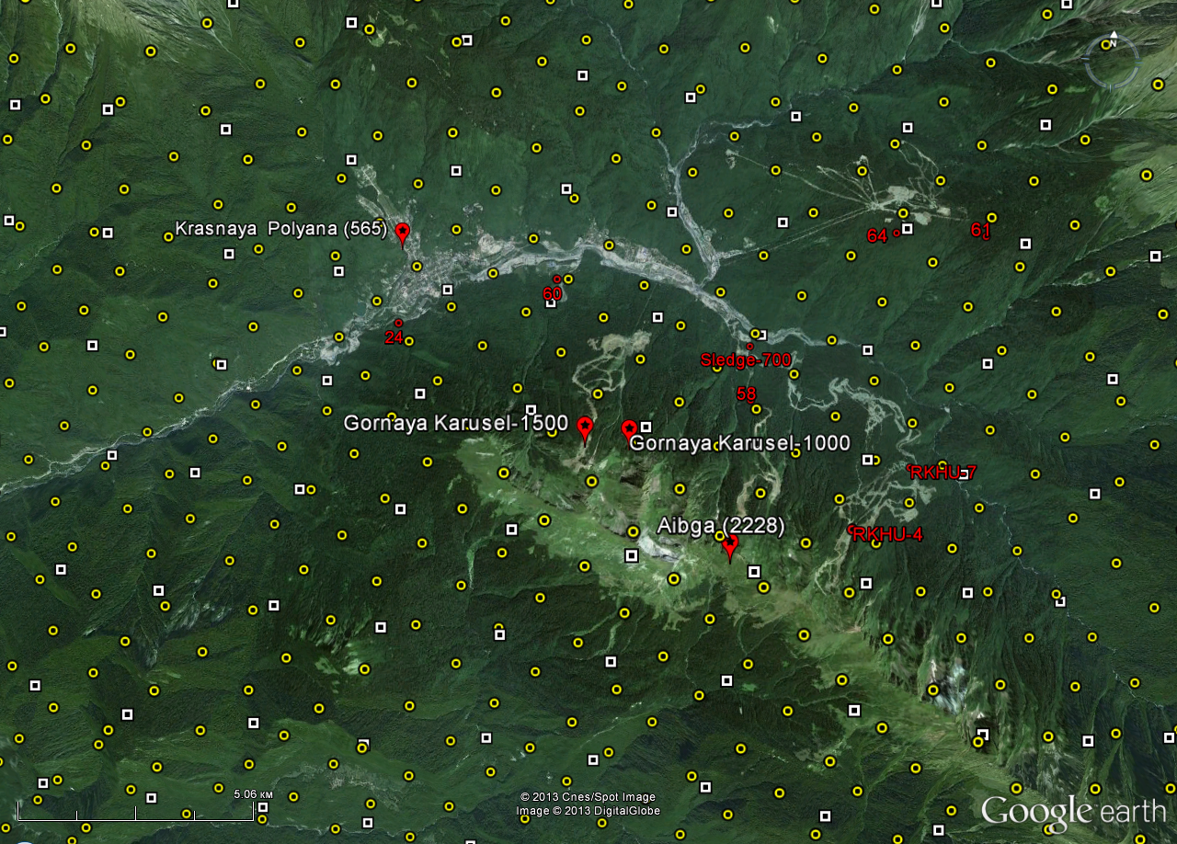
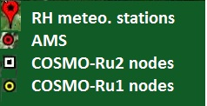
The first results & verification
Location of the observation points and model grid nodes

Slide 8
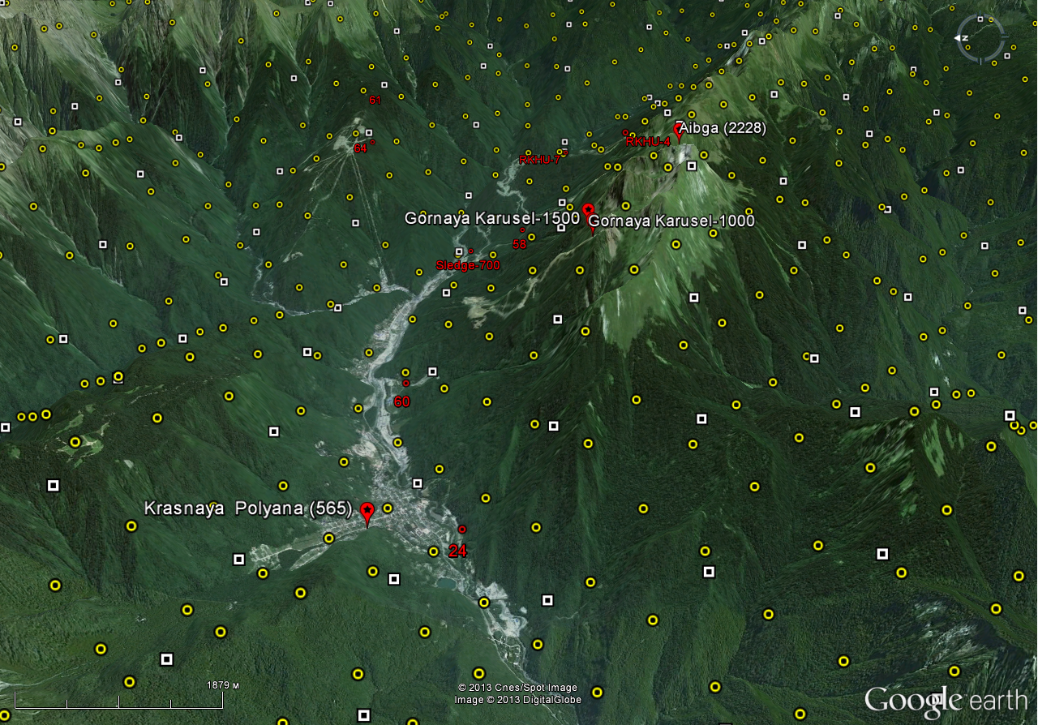
The first results & verification
Location of the observation points and model grid nodes (angle view)

Slide 9
The first results verification
COSMO-Ru1 grid and ASTER GDEM2 relief
Grid 1310 m
ASTER 1164 m
Δ 146 m
Grid 1702 m
ASTER 1403 m
Δ 299 m
Grid 1552 m
ASTER 1052 m
Δ 500 m
Grid 1107 m
ASTER 1436 m
Δ -329 m
Grid 1840 m
ASTER 2293 m
Δ -453 m

Slide 10
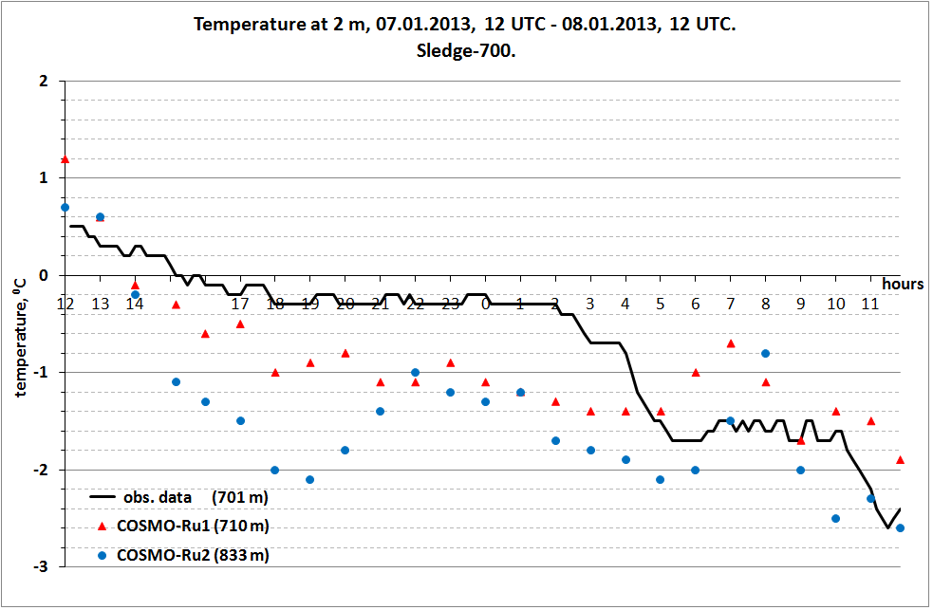
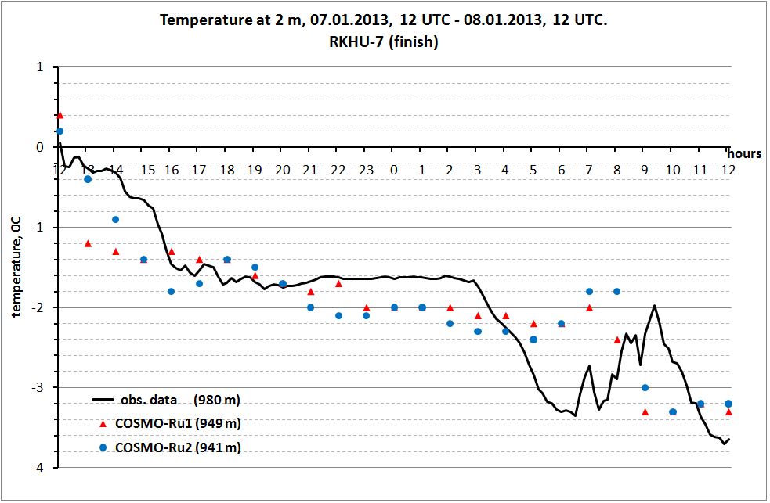
The first results & verification
Sledge-700
T2m forecast for 24 hours from 07.01.2013, 12 UTC
RKHU-7

Slide 11
The first results verification
AMS RKHU-4 location &
nodes of COSMO models (Ru1, Ru2, Ru7) for which meteograms are produced
&
ASTER GDEM2 relief

Slide 12
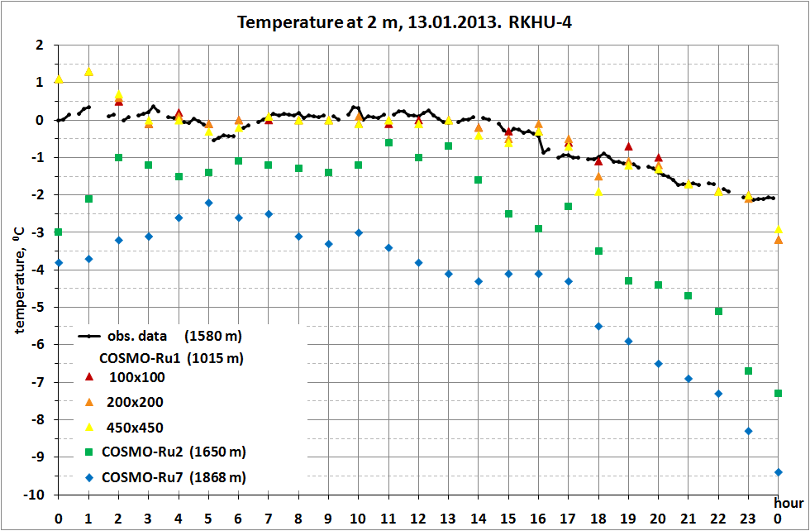
The first results verification

Slide 13
The first results verification
Station: Krasnaya Poliana Parameter: Temperature at 2m Data: 13.01.2013, 00UTC
Source | H, m | hours
 |  | 00 | 03 | 06 | 09 | 12 | 15 | 18 | 21 | 24
Obs.data | 564 | 0.7 | 0.9 | 0.3 | 0.5 | 0.5 | 0.3 | 0.1 | 0.5 | 0.3
COSMO-Ru1 (100) | 812 | 2.5 | 0.7 | 0.3 | 1.0 | 0.3 | 1.2 | -0.3 | -0.6 | -1.8
COSMO-Ru1 (200) |  | 2.5 | 0.6 | 0.4 | 1.5 | 0.7 | 0.9 | -0.8 | -0.5 | -1.6
COSMO-Ru1 (450) |  | 2.5 | 0.8 | 0.9 | 1.0 | 0.7 | 1.0 | 0.1 | -0.4 | -1.6
COSMO-Ru2 | 734 | 2.8 | 1.7 | 1.6 | 2.1 | 2.2 | 2.3 | 0.2 | 0.0 | -1.0
COSMO-Ru7 | 1048 | 1.6 | 1.3 | -0.1 | -0.2 | -0.1 | 0.1 | -0.7 | -1.7 | -4.2
ASTER GDEM2 data for the location of the node Ru1:
549 m (-263 m)

Slide 14
The first results verification
Station: Aibga Parameter: Temperature at 2m Data: 13.01.2013, 00 UTC
Source | H, m | hours
 |  | 00 | 03 | 06 | 09 | 12 | 15 | 18 | 21 | 24
Obs.data | 2225 | -5.6 | -5.4 | -5.0 | -4.8 | -5.2 | -5.5 | -8.4 | -10.2 | -10.4
COSMO-Ru1 (100) | 1542.4 | -2.2 | -1.6 | -2.4 | -1.4 | -1.4 | -1.9 | -2.1 | -4.0 | -6.5
COSMO-Ru1 (200) |  | -2.2 | -1.5 | -2.1 | -1.0 | -1.3 | -1.9 | -2.0 | -4.0 | -6.3
COSMO-Ru1 (450) |  | -2.2 | -1.4 | -2.1 | -1.4 | -1.5 | -2.1 | -2.6 | -4.0 | -6.1
COSMO-Ru2 | 1868.2 | -3.8 | -3.1 | -2.6 | -3.3 | -3.8 | -4.1 | -5.5 | -6.9 | -9.4
COSMO-Ru7 | 1179.1 | 0.1 | 1.3 | 1.1 | 0.5 | -0.1 | -0.3 | -0.7 | -2.4 | -4.8
ASTER GDEM2 data for the location of the node Ru1:
2014 m (+472 m)

Slide 15
The first results verification
Station: M.Karusel-1000 Parameter: Temperature at 2m Data: 13.01.2013, 00UTC
Source | H, m | hours
 |  | 00 | 03 | 06 | 09 | 12 | 15 | 18 | 21 | 24
Obs.data | 978 | 0.0 | n.d. | 0.0 | 0.1 | 0.0 | -0.1 | -1.4 | -1.9 | -2.2
COSMO-Ru1 (100) | 688.1 | 2.7 | 0.7 | 0.3 | 0.2 | 0.4 | 0.4 | 0.0 | 0.5 | -0.7
COSMO-Ru1 (200) |  | 2.7 | 0.9 | 0.4 | 0.2 | 0.3 | 0.3 | -0.3 | 0.2 | -0.6
COSMO-Ru1 (450) |  | 2.7 | 0.9 | 0.1 | 0.1 | 0.3 | 0.2 | -0.4 | 0.5 | -0.6
COSMO-Ru2 | 798.2 | 2.1 | 1.3 | 1.0 | 0.5 | 1.4 | 3.5 | 1.8 | 0.7 | -1.2
COSMO-Ru7 | 1179.1 | 0.1 | 1.3 | 1.1 | 0.5 | -0.1 | -0.3 | -0.7 | -2.4 | -4.8
ASTER GDEM2 data for the location of the node Ru1:
984 m (+296 m)

Slide 16
The first results verification
Station: Solokh-Aul Parameter: Temperature at 2m Data: 13.01.2013, 00UTC
Source | H, m | hours
 |  | 00 | 03 | 06 | 09 | 12 | 15 | 18 | 21 | 24
Obs.data | 443 | 3.9 | 4.5 | 4.1 | 3.7 | 4.0 | 3.0 | 1.8 | 1.1 | 0.2
COSMO-Ru1 (100) | 291.5 | 8.5 | 6.3 | 6.5 | 7.2 | 6.8 | 6.4 | 4.5 | 3.2 | 1.5
COSMO-Ru1 (200) |  | 8.5 | 6.3 | 6.6 | 6.7 | 6.8 | 6.1 | 4.3 | 3.4 | 1.4
COSMO-Ru1 (450) |  | 8.5 | 6.1 | 6.6 | 6.9 | 6.7 | 6.0 | 4.7 | 3.1 | 1.3
COSMO-Ru2 | 346.4 | 8.3 | 6.1 | 6.1 | 6.5 | 5.8 | 5.8 | 4.0 | 2.8 | 1.2
COSMO-Ru7 | 583.6 | 6.4 | 3.7 | 4.2 | 3.2 | 1.7 | 2.5 | 1.9 | 0.3 | -0.9
ASTER GDEM2 data for the location of the node Ru1:
310 m (+18.5 m)

Slide 17
First conclusion on T2m verification
COSMO-Ru1 provides a realistic temperature and its diurnal variations;
the greatest differences are in the initial moment;
some discrepancies with the observed values ​​may be due to prescribed altitude of the model grid nodes;
no any significant changes were found in the transition from one domain to another.

Slide 18
Case study: Heavy precipitation on 13.01.2013
12 hours precipitation sum (mm)
Station | Observed data | COSMO-Ru1 |  |  | COSMO-Ru2 | COSMO-Ru7
 |  | (100x100) | (200x200) | (450x450)
Krasnaya Poliana* | 33.0 | 37.8 | 37.8 | 35.1 | 21.8 | 55.9
Aibga* | 3.0 | 39.2 | 43.1 | 37.8 | 24.4 | 46.7
Sochi-Agro* | 21.0 | 20.8 | 20.5 | 17.4 | 19.0 | 30.3
M.Karusel-1500** | 0.9 | 23.6 | 26.0 | 21.8 | 18.9 | 38.2
M.Karusel-1000** | 37.0 | 24.0 | 27.3 | 22.9 | 19.8 | 38.2
Solokh-Aul** | 42.0 | 41.8 | 44.7 | 52.0 | 34.7 | 50.2
* - precipitation sum for the period 03-15 UTC
** - precipitation sum for the period 06-18 UTC

Slide 19
Case study: Heavy precipitation on 13.01.2013
12 hours precipitation sum (mm)
Station | Observed data | COSMO-Ru1 |  |  | COSMO-Ru2 | COSMO-Ru7
 |  | (100x100) | (200x200) | (450x450)
Krasnaya Poliana* | 33.0 | 37.8 | 37.8 | 35.1 | 21.8 | 55.9
Aibga* | 3.0 (?!) | 39.2 | 43.1 | 37.8 | 24.4 | 46.7
Sochi-Agro* | 21.0 | 20.8 | 20.5 | 17.4 | 19.0 | 30.3
M.Karusel-1500** | 0.9 (?!) | 23.6 | 26.0 | 21.8 | 18.9 | 38.2
M.Karusel-1000** | 37.0 | 24.0 | 27.3 | 22.9 | 19.8 | 38.2
Solokh-Aul** | 42.0 | 41.8 | 44.7 | 52.0 | 34.7 | 50.2
* - precipitation sum for the period 03-15 UTC
** - precipitation sum for the period 06-18 UTC

Slide 20
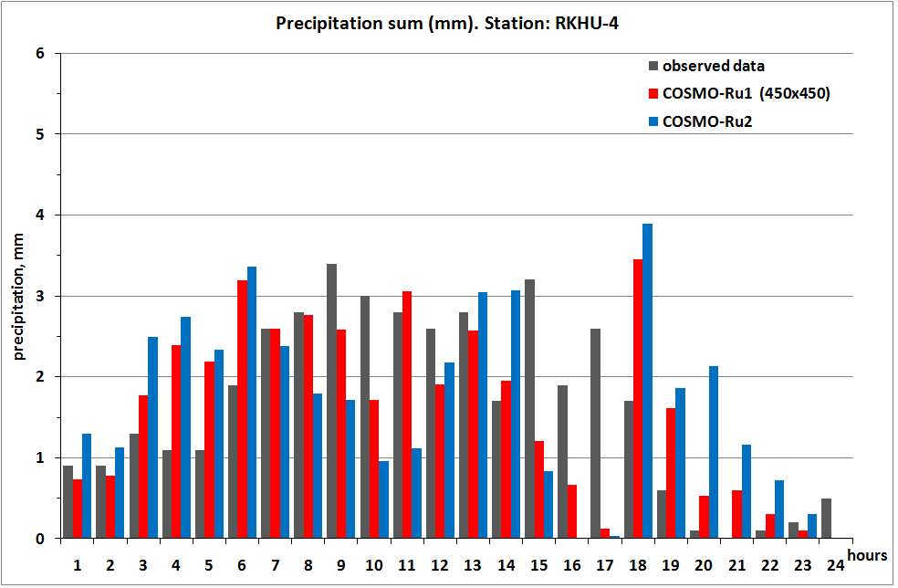
Case study: Heavy precipitation on 13.01.2013

Slide 21
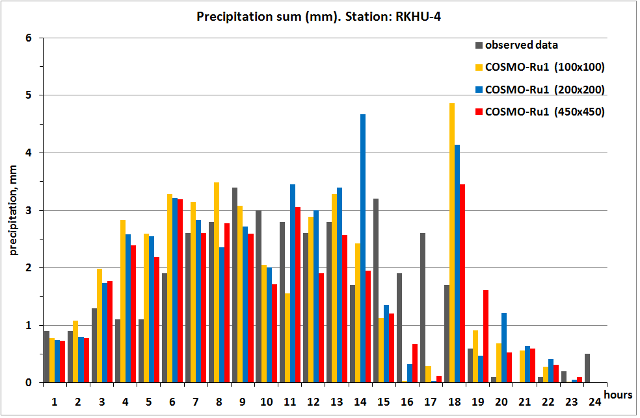
Case study: Heavy precipitation on 13.01.2013
24 h precipitation sum (mm)
Obs.data | 39.8
COSMO-Ru1 (100x100) | 43.2
COSMO-Ru1 (200x200) | 44.7
COSMO-Ru1 (450x450) | 38.8
COSMO-Ru2 | 40.6
COSMO-Ru7 | 40.7

Slide 22
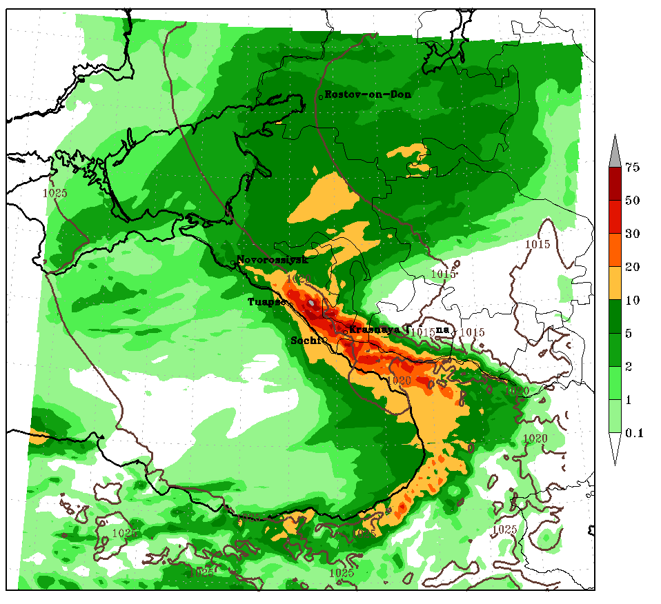
Case study: Heavy precipitation on 13.01.2013
Forecast of the 12hour precipitation sum (mm). COSMO-Ru2.

Slide 23
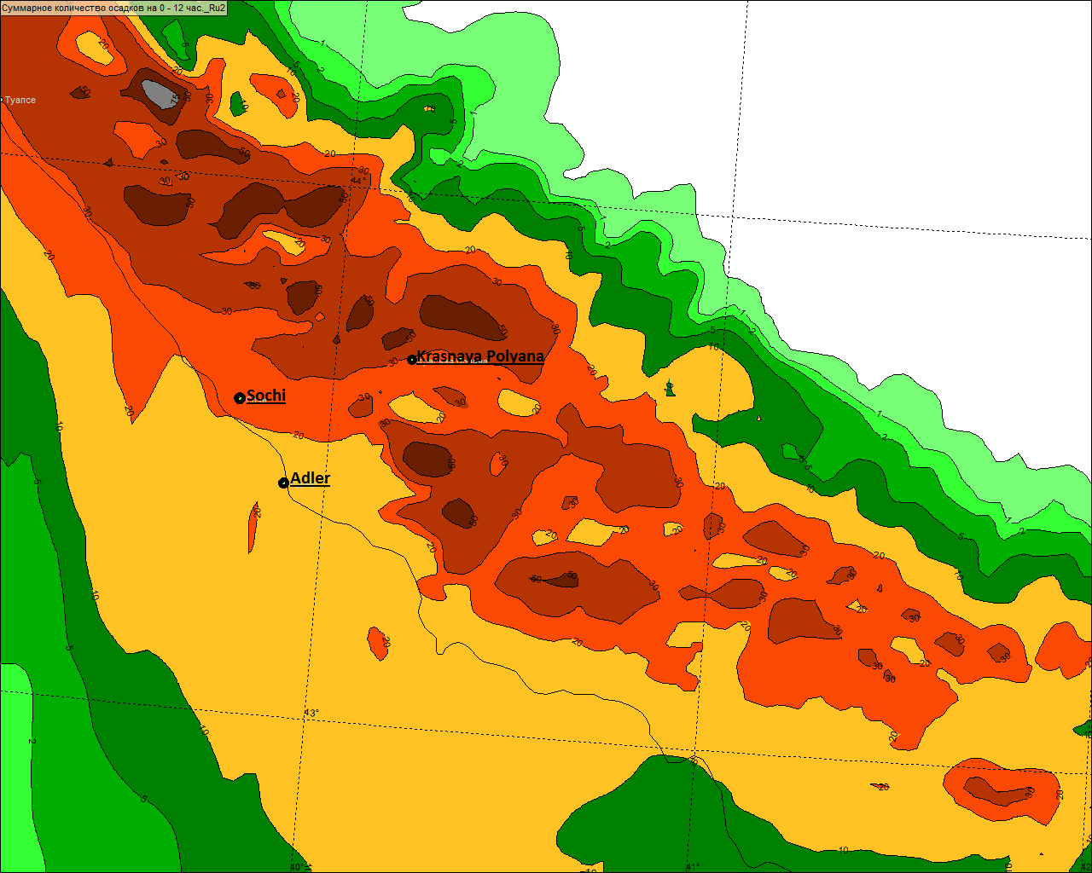
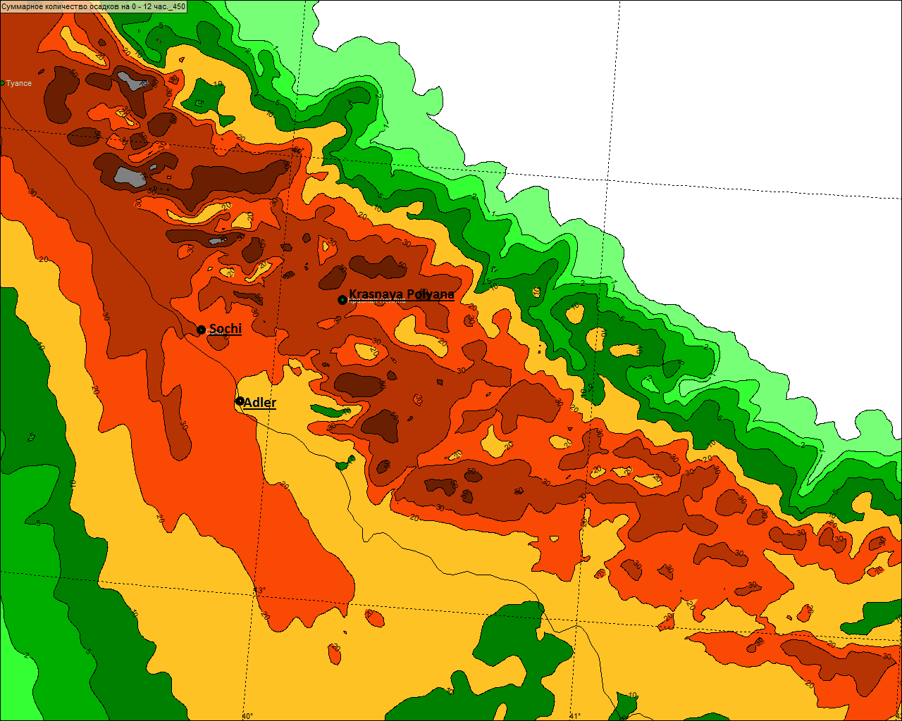
Case study: Heavy precipitation on 13.01.2013
Forecast of the 12 hour precipitation sum (mm) from 13.01.2013, 00 UTC.
COSMO-Ru2
COSMO-Ru1 (450 x 450)
Notes:
Case study:

Slide 24
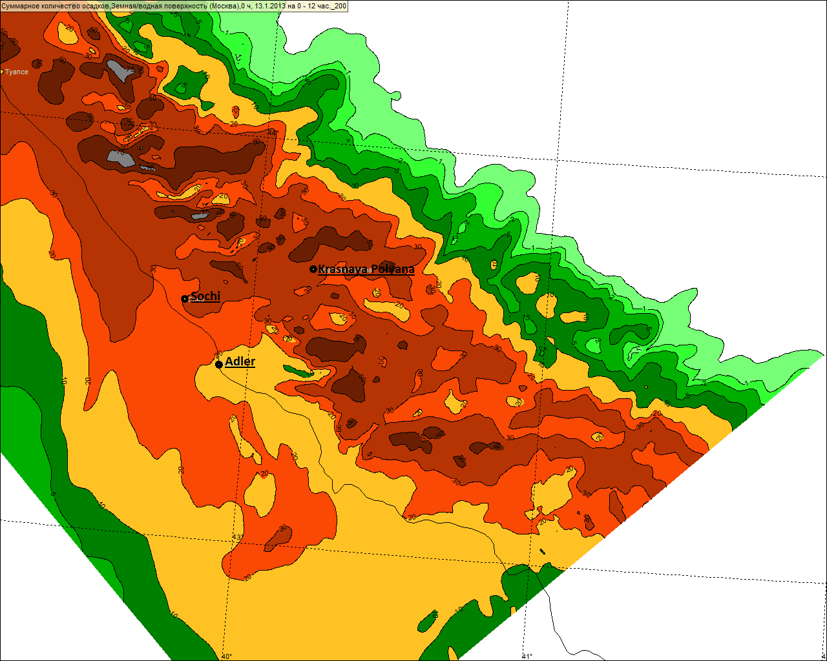
Case study: Heavy precipitation on 13.01.2013
Forecast of the 12 hour precipitation sum (mm) from 13.01.2013, 00 UTC.
COSMO-Ru1 (200 x 200)
COSMO-Ru1 (450 x 450)
Notes:
Case study:

Slide 25
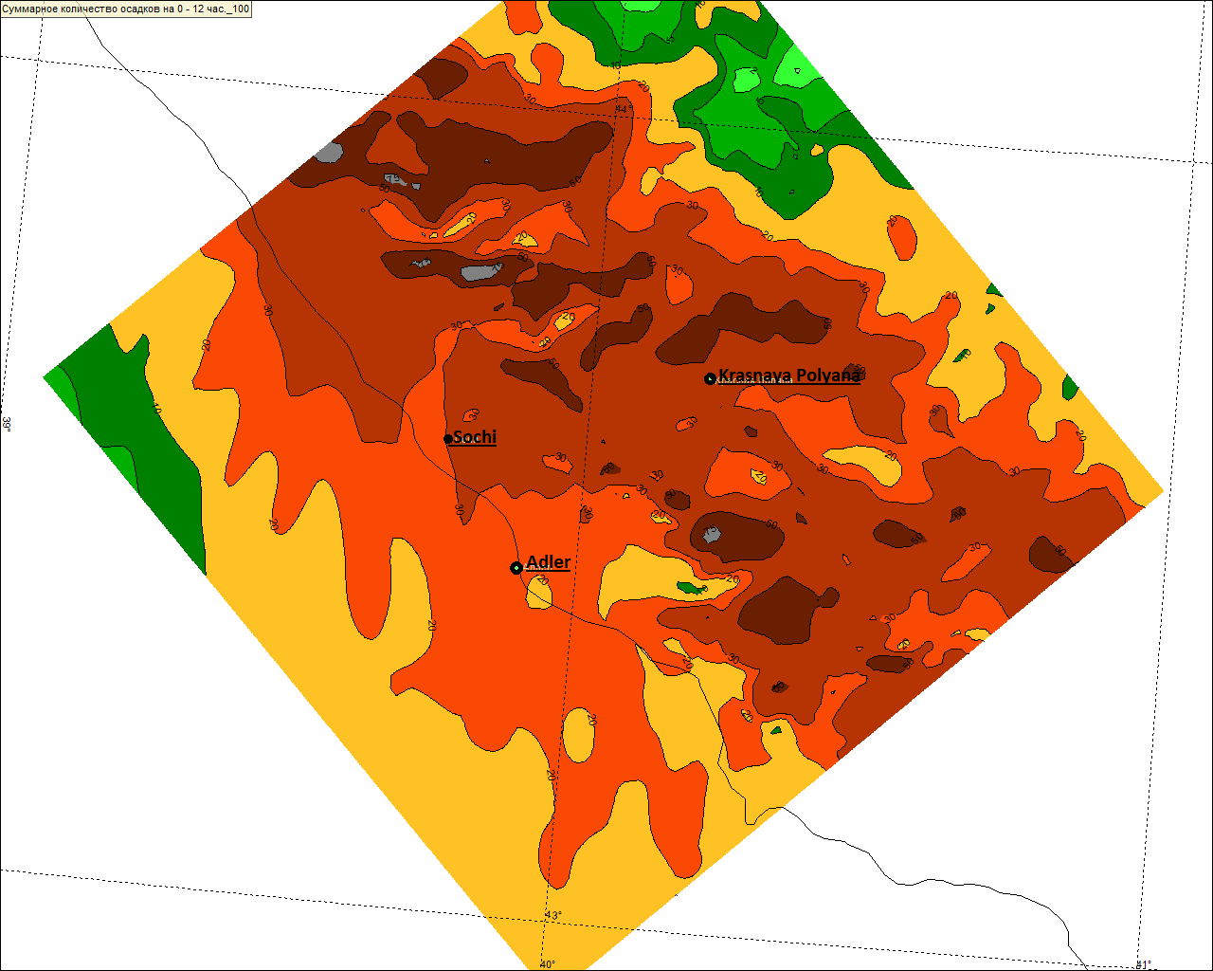
Case study: Heavy precipitation on 13.01.2013
Forecast of the 12 hour precipitation sum (mm) from 13.01.2013, 00 UTC.
COSMO-Ru1 (100 x 100)
COSMO-Ru1 (450 x 450)
Notes:
Case study:

Slide 26
Conclusion on precipitation verification
the spatial distribution of precipitation is reproduced in more detail;
COSMO-Ru1 provides a more accurate precipitation amount compared with the COSMO-Ru2;
there is rather good agreement in the temporal distribution of precipitation;
some changes in precipitation sum were detected with an expansion of the simulated domain.

Slide 27
Run with different IC&BC
How to improve T2m initial values?
How to obtain forecast earlier?
Insufficient data for assimilation during model run!
To start from the previous COSMO-Ru2 forecast
IC & BC from COSMO-Ru2:
start from 00 h;
start from -06 h;
start from -12 h.

Slide 28
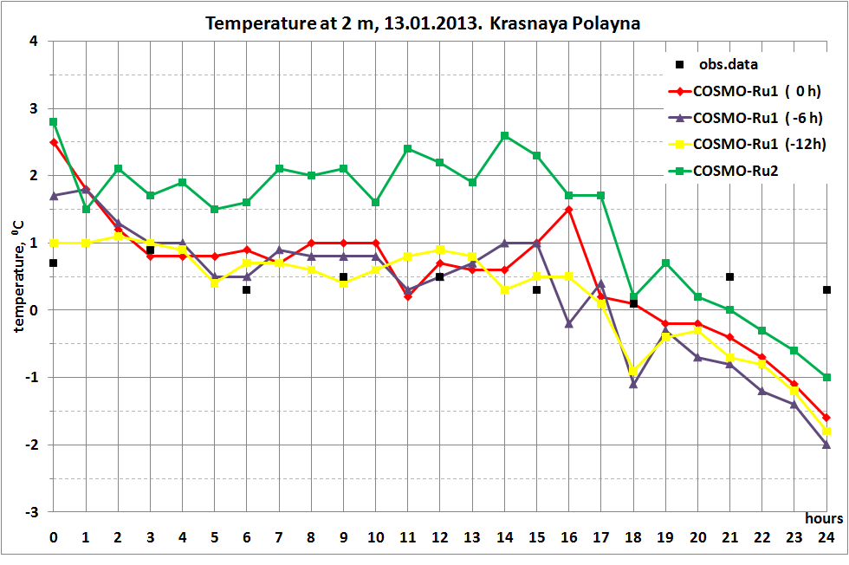
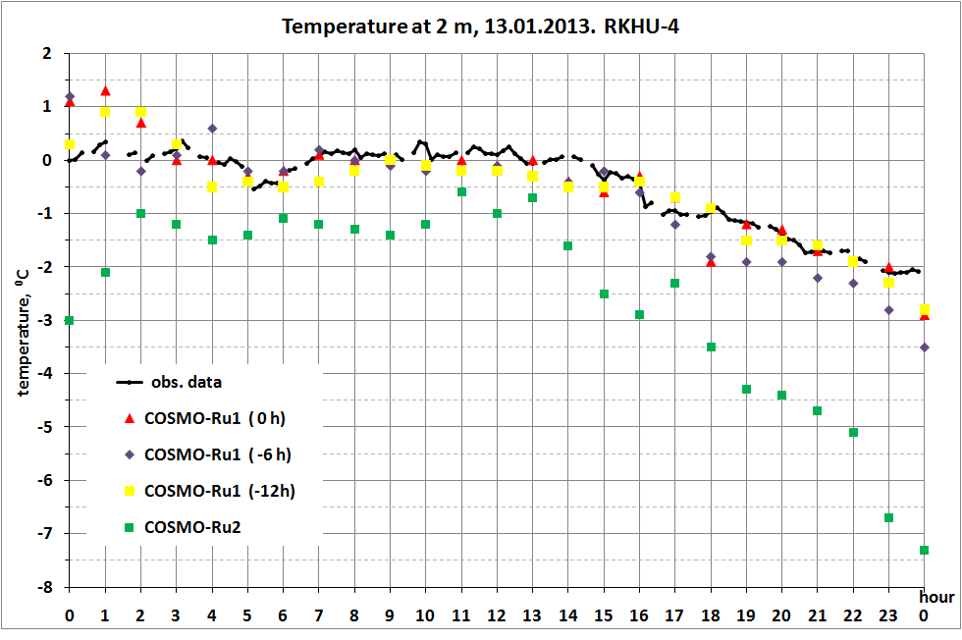
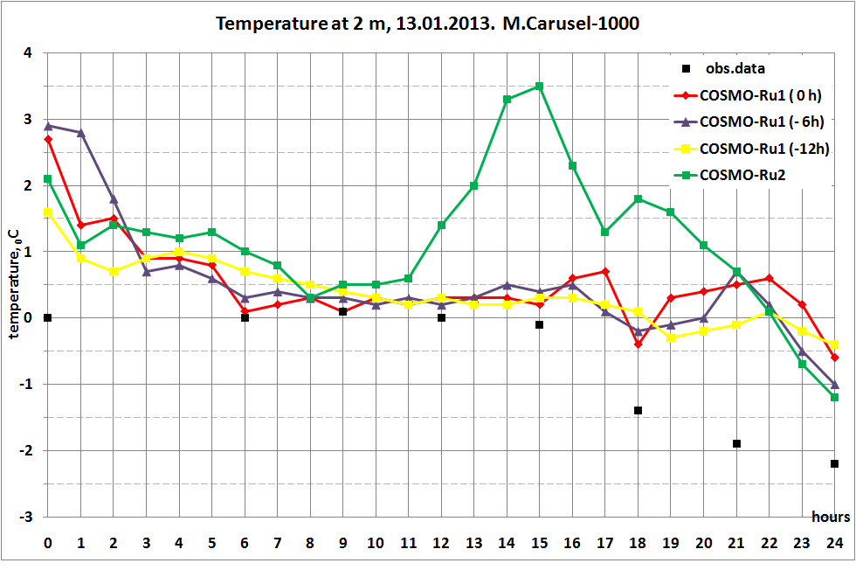
Run with different IC&BC
Krasnaya Polyana
COSMO-Ru1 T2m forecast with IC & BC from COSMO-Ru2:
start from 00 h;
start from -06 h;
start from -12 h.
RKHU-4
M.Carusel-1000

Slide 29
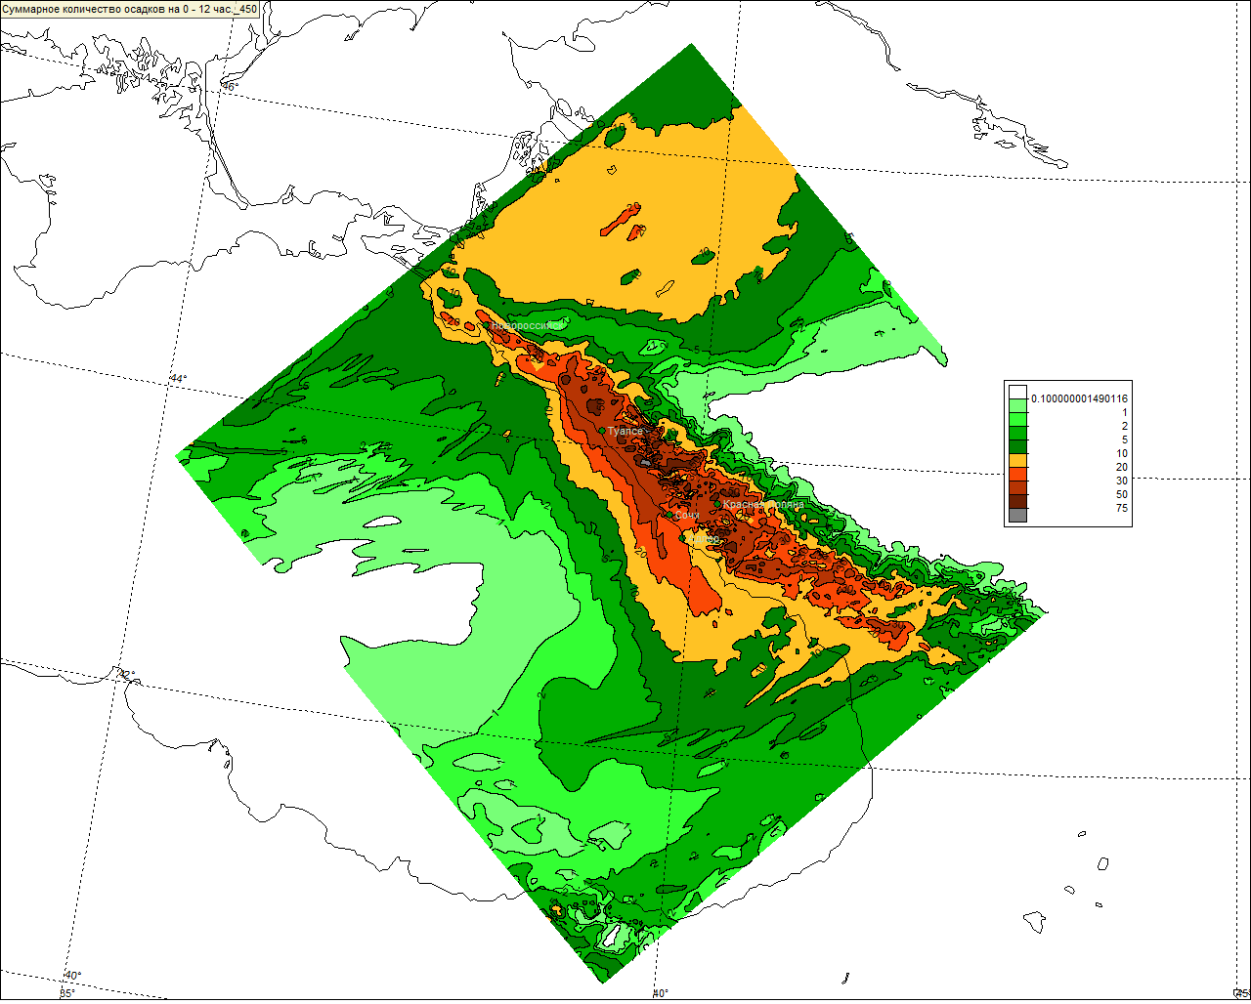
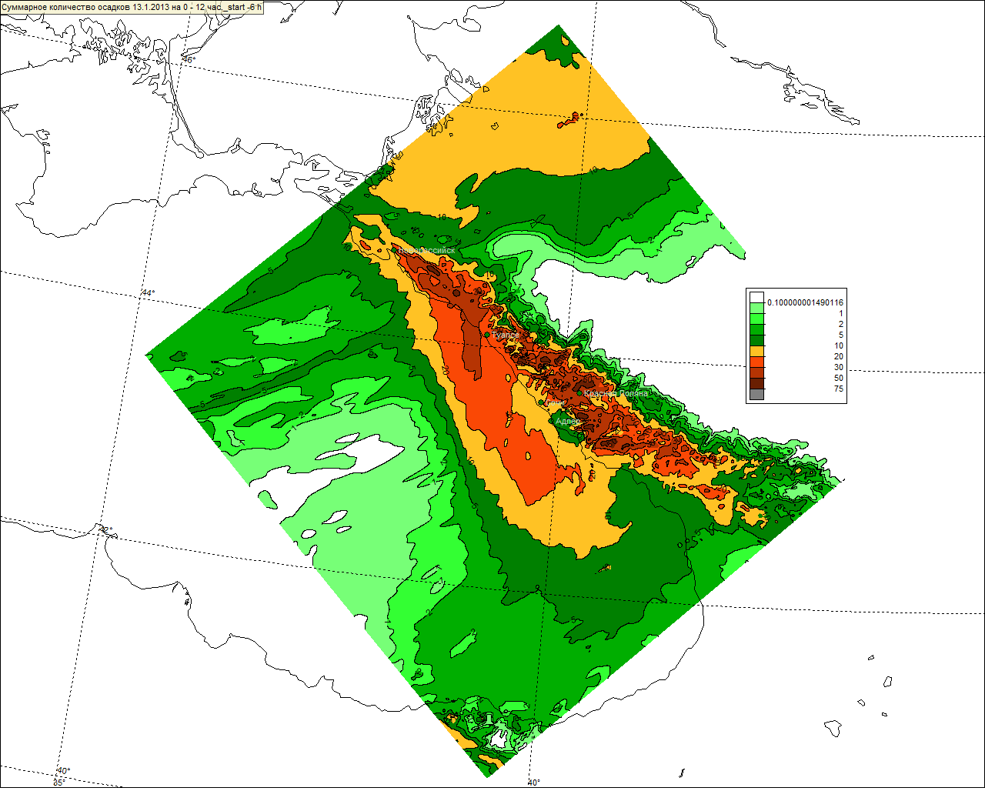
Run with different IC&BC
COSMO-Ru1 12h precipitation sum forecast with IC & BC from COSMO-Ru2
start from 00 h
start from -06 h

Slide 30
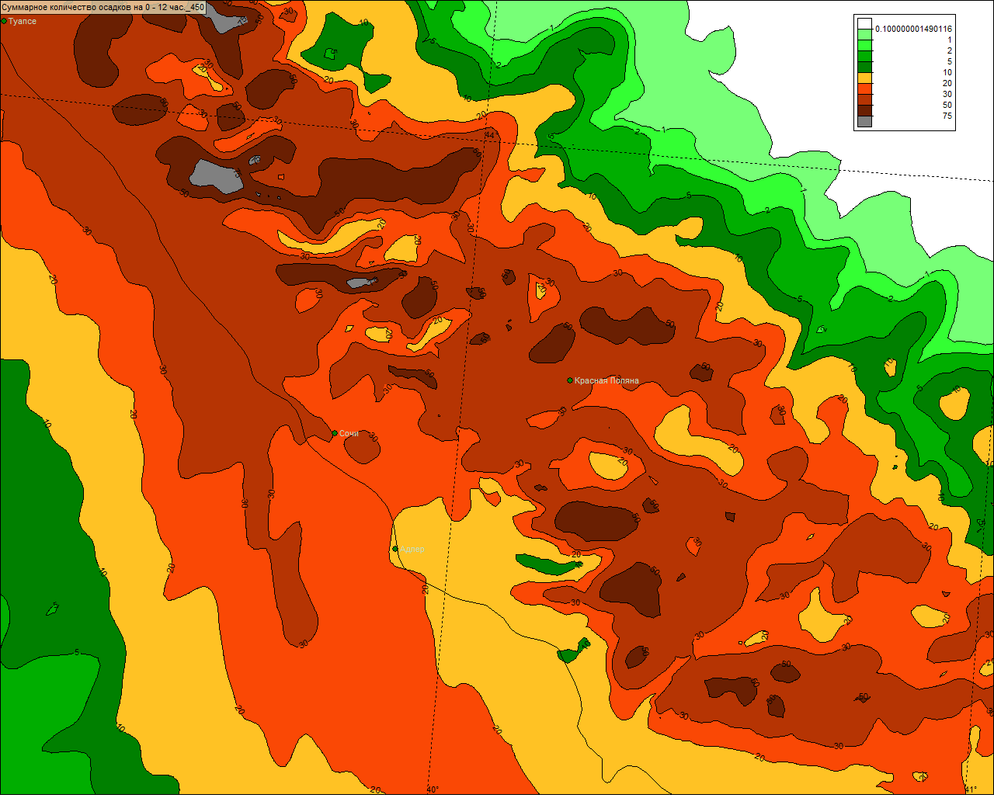
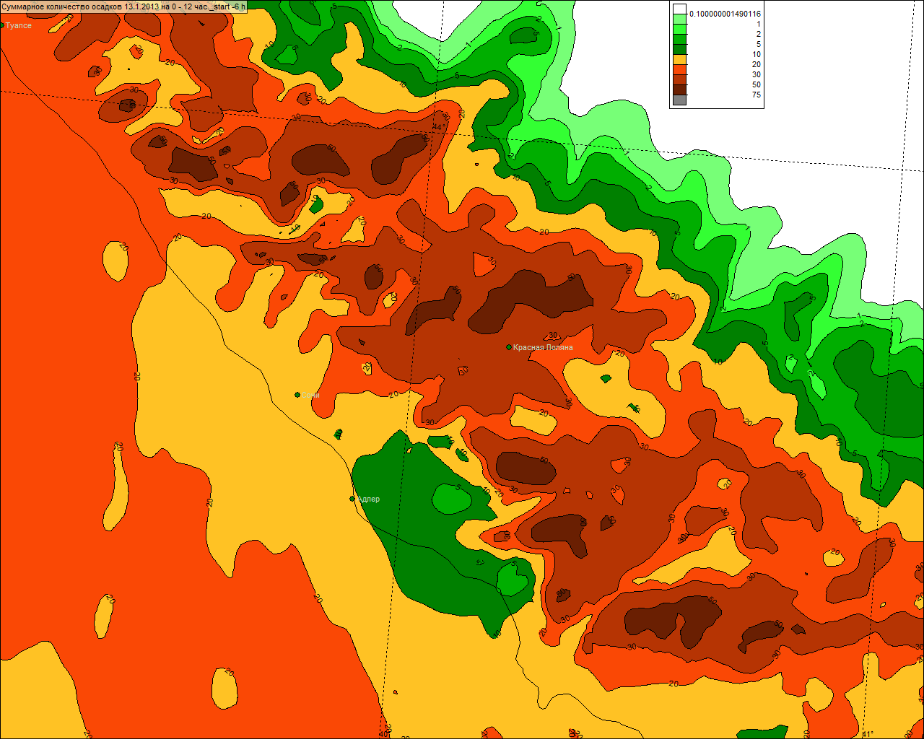
Run with different IC&BC
COSMO-Ru1 12h precipitation sum forecast with IC & BC from COSMO-Ru2
start from 00 h
start from -06 h
.Kr.Polyana
.Kr.Polyana
. Sochi
. Sochi

Slide 31
Conclusion and near future plan
COSMO-Ru1 is installed and works
The verification of the first results shows good agreement with observed data
It is possible to run COSMO-Ru1 with IC&BC from the previous COSMO-Ru2 forecast, but additional evaluations should be made beforehand
Use new orography and topography – with hope on new EXTPAR!
Verification by means of VERSUS
Run with implicit convection simulation
Thank you for your attention!

